Slide 1


Activities and plans of the USTC HGTD group
Yanwen Liu
University of Science and Technology of China

Slide 2
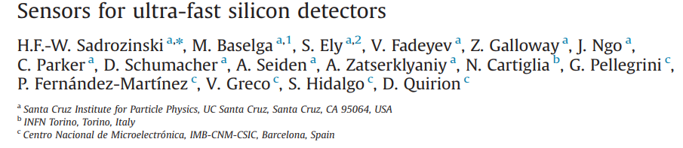
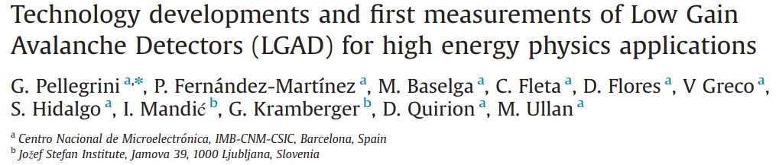
Introduction to LGAD/UFSD
RD 50 found indications of charge amplification in highly irradiated diodes and strip detectors
Utilize the amplification effect in a controlled way (H.F.-W. Sadrozinski presentation at 20th RD50 workshop in 2012)
NIM A765(2014)7-11
NIM A765(2014)12-16

Slide 3
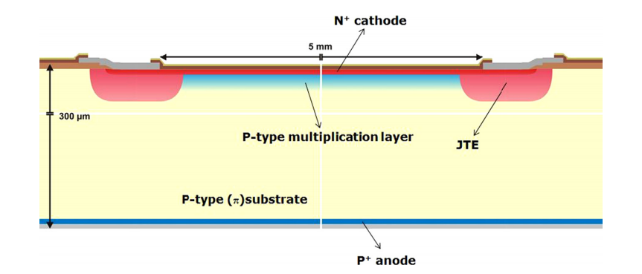
UFSD / LGAD
Drift velocity in silicon saturates at about 10⁷ cm/s
Charge collection for 300 um thick silicon ~ 3 ns
Fast silicon detector needs to be thin.
Need amplification layer to achieve high S/N
In early days …

Slide 4
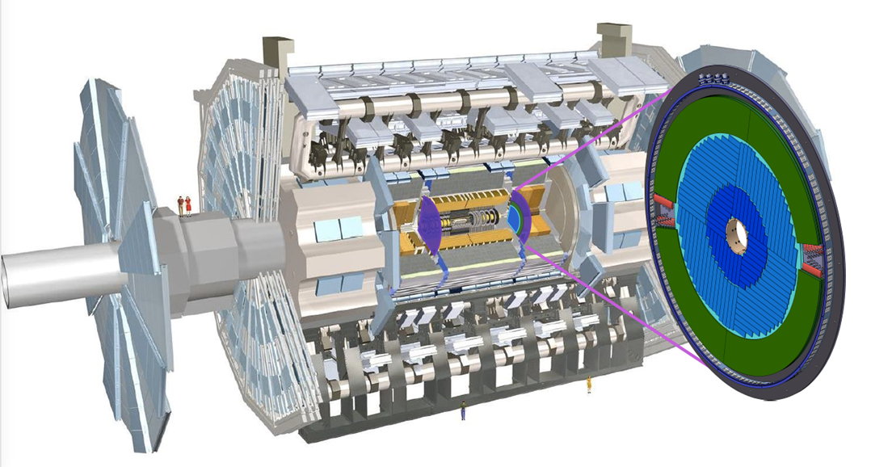
ATLAS HGTD project
Two double-sided disks at each endcap
At 3435 mm < |z| < 3485 mm
Coverage: 2.4 < |η| < 4.0
110 mm < R < 1000 mm
Pixel size: 1.3 x 1.3 mm²
Number of channels : 3.54 M
Active area: 6.3 m²
Time resolution per track: 30 ps

Slide 5
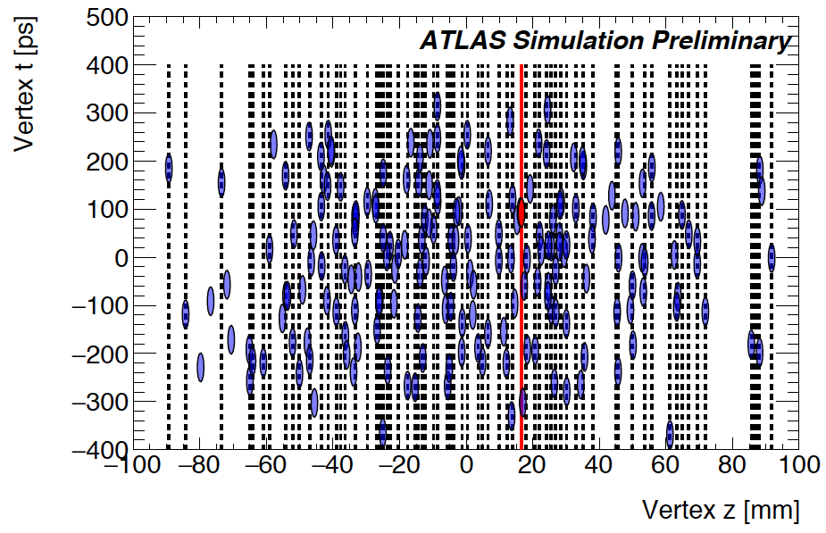
An event of 200 interactions

Slide 6
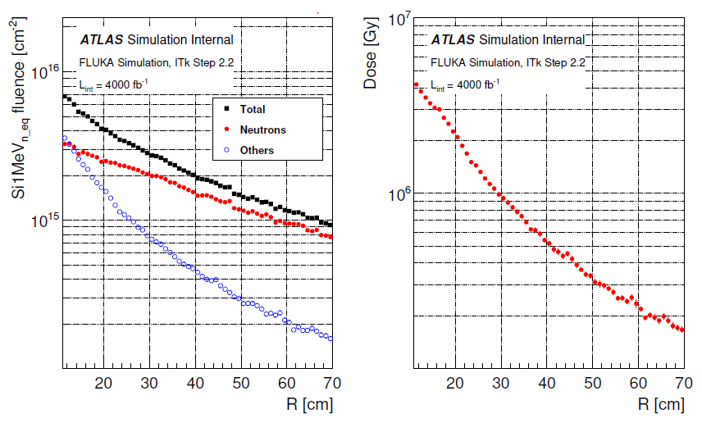
Radiation tolerance (TDR draft 2019 no SF)
At R = 12 cm, NIEL = 6.8x10¹⁵ n_{eq} / cm² , TID = 2.4 MGy

Slide 7
USTC HGTD team
Faculty: Hao Liang, Yanwen Liu, Yongjie Sun, Yusheng Wu, Lei Zhao, Zhengguo Zhao (6)
Postdoc: Quanyin Li (1)
Students: Han Chen, Jiajin Ge, Chihao Li, Zhengwei Xue, Tao Wang, Xiao Yang (6)
Blue = Sensor
Red = Electronics
Students 0.8 FTE, Postdoc and faculty members 0.5 FTE on HGTD
Joined the ATLAS HGTD project in January 2019

Slide 8
USTC HGTD activities
Sensor design and test
Electronics ALTIROC tests
Assembly study (mechanical dummy module, bump-bonding)
Test beam analysis

Slide 9
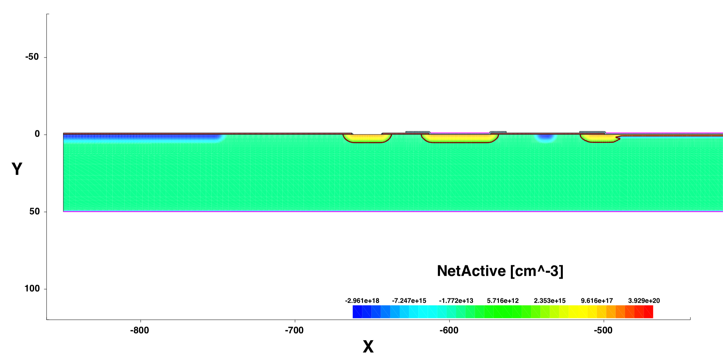
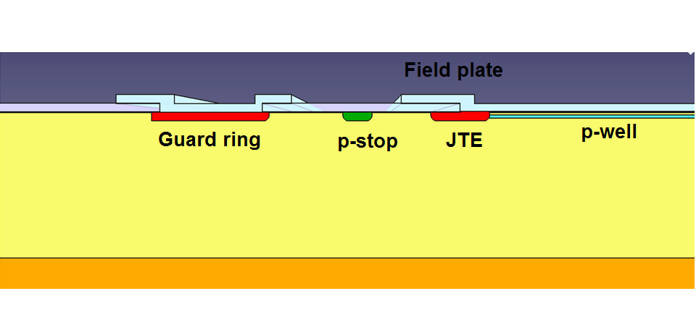
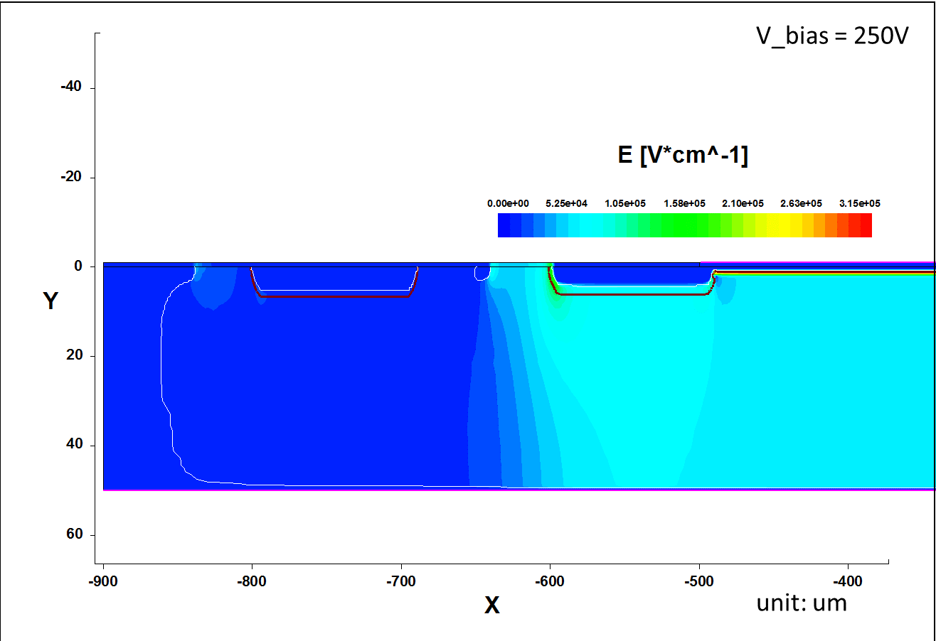
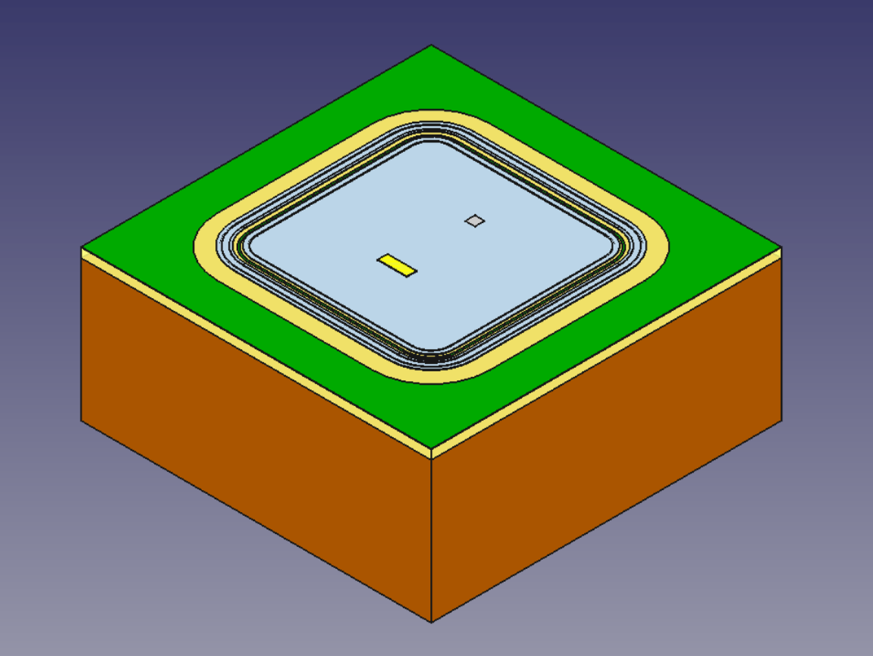
Sensor structure
C-stop
Float GuardRing
GuardRing
P-stop
JTE
N-Electrode
~70 μm
P-well
~50 μm
Field Plate
Field Plate
P-Electrode
VBD: 590 V (after 1x10¹⁵ n_{eq} /cm², Vmax: 630 V
Leakage current: 1.5x10⁻⁸ A

Slide 10
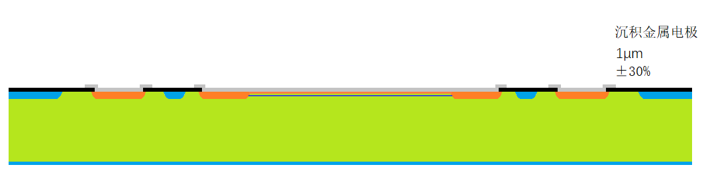


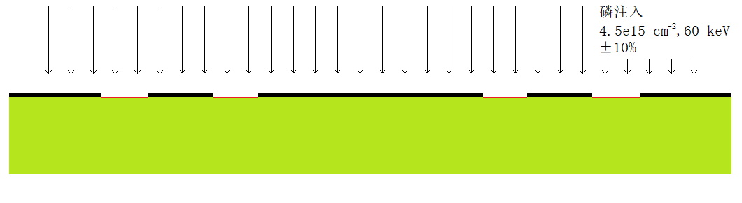

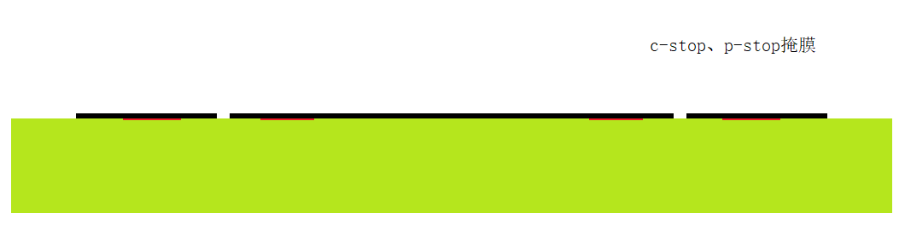
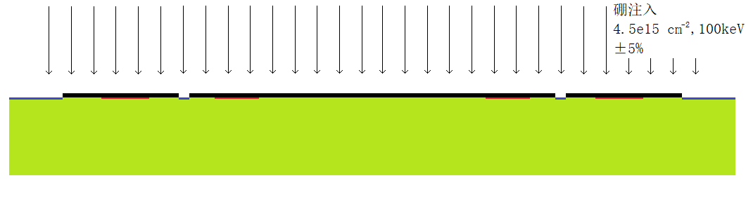

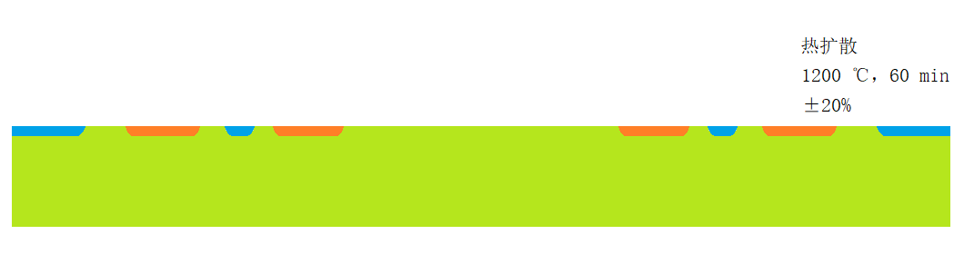

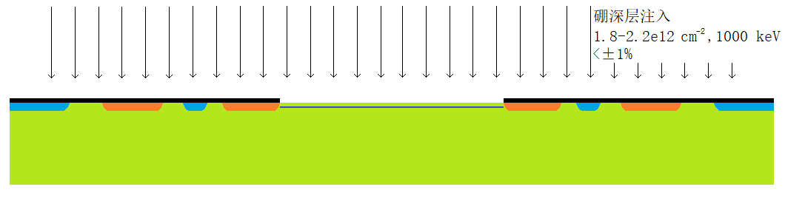
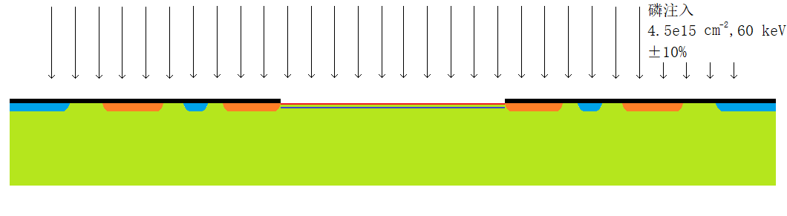

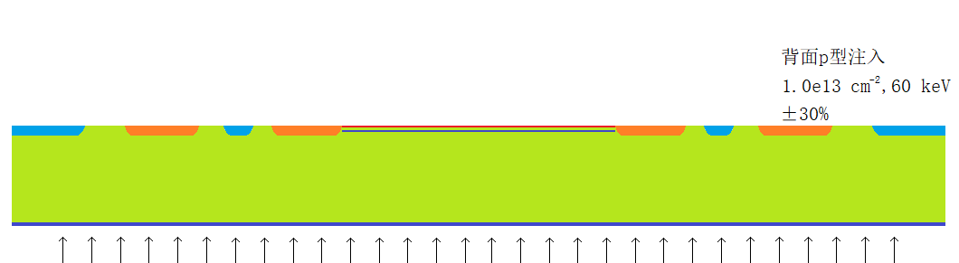
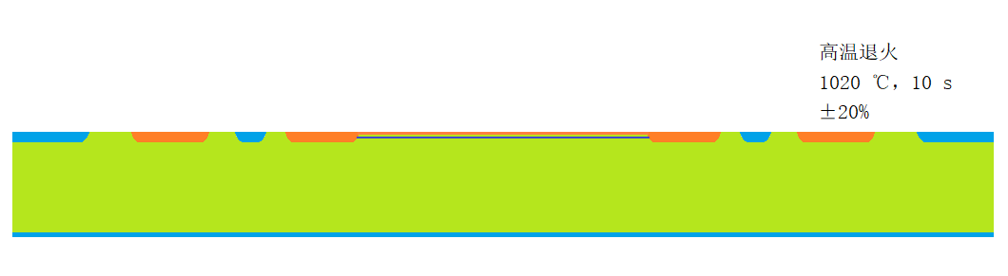
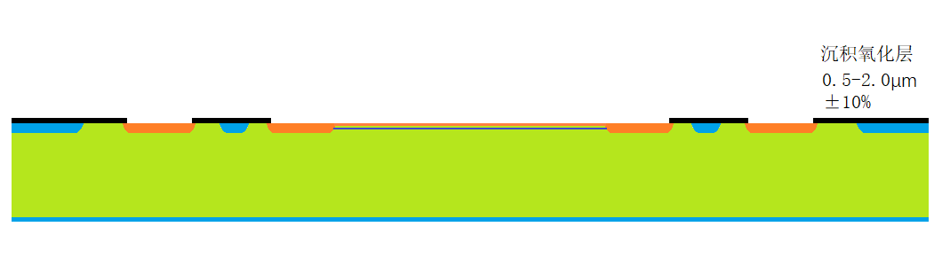
LGAD fabrication process
MASK: JTE, Guard ring
Phosphorus implant
MASK: c-stop, p-stop
Boron implant
Diffusion
MASK: n+ electrode, gain layer
Boron deep implant
Phosphorus implant
9. Backside Boron implant
10. Anneal
11. Deposit oxide
12. Deposit metal electrode

Slide 11
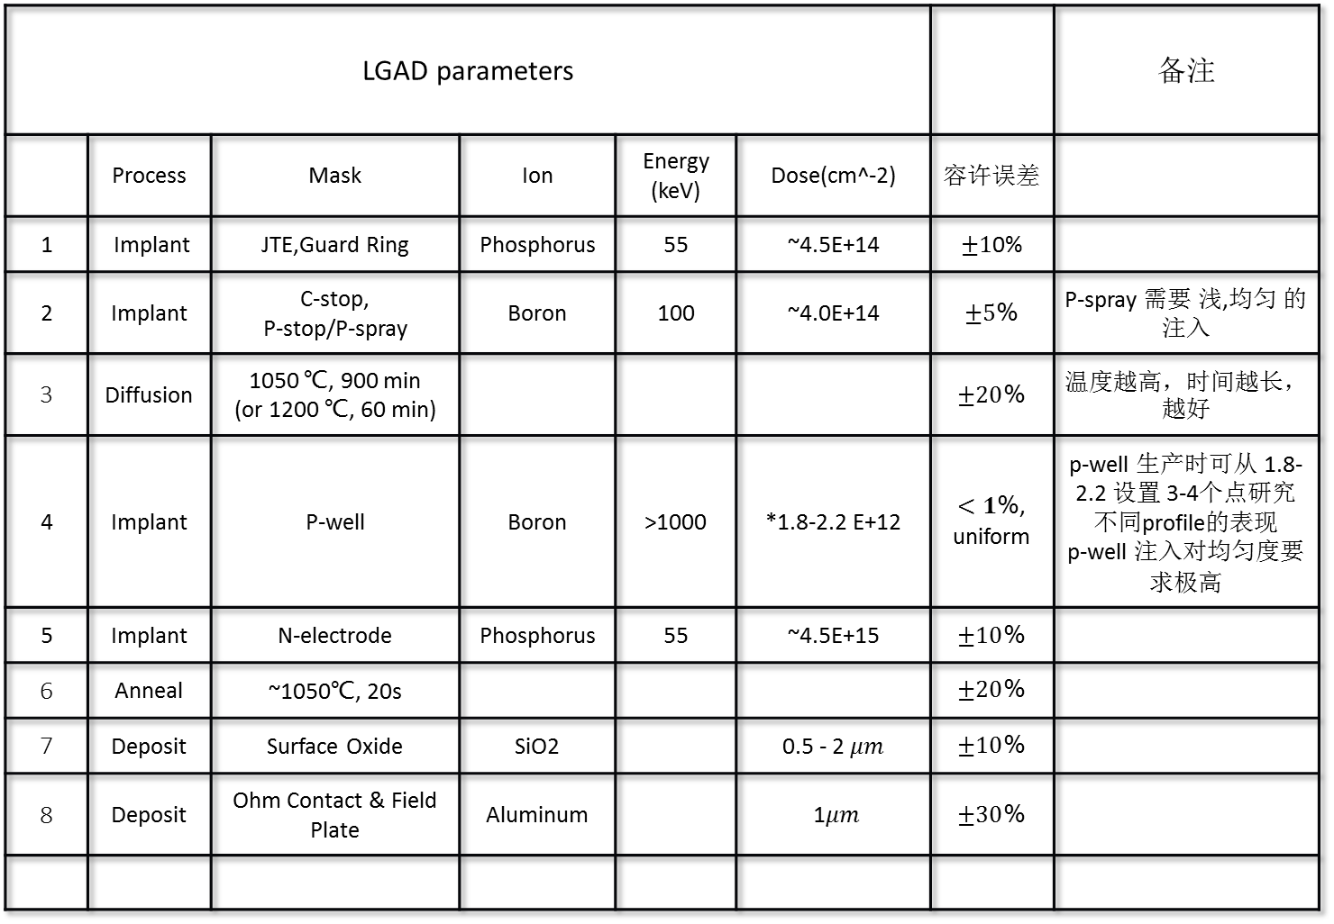
LGAD parameters |  |  |  |  |  |  | 备注
 | Process | Mask | Ion | Energy (keV) | Dose(cm^-2) | 容许误差
1 | Implant | JTE,Guard Ring | Phosphorus | 55 | ~4.5E+14 | $±1$0%
2 | Implant | C-stop, P-stop/P-spray | Boron | 100 | ~4.0E+14 | $±5$% | P-spray 需要 浅,均匀 的注入
3 | Diffusion | 1050 ℃, 900 min (or 1200 ℃, 60 min) |  |  |  | $±20$% | 温度越高，时间越长，越好
4 | Implant | P-well | Boron | >1000 | *1.8-2.2 E+12 | $<1$%, uniform | p-well 生产时可从 1.8-2.2 设置 3-4个点研究不同profile的表现 p-well 注入对均匀度要求极高
5 | Implant | N-electrode | Phosphorus | 55 | ~4.5E+15 | $±10$%
6 | Anneal | ~1050℃, 20s |  |  |  | $±20$%
7 | Deposit | Surface Oxide | SiO2 |  | 0.5 - 2$μm$ | $±10$%
8 | Deposit | Ohm Contact & Field Plate | Aluminum |  | 1$μm$ | $±30$%

Slide 12
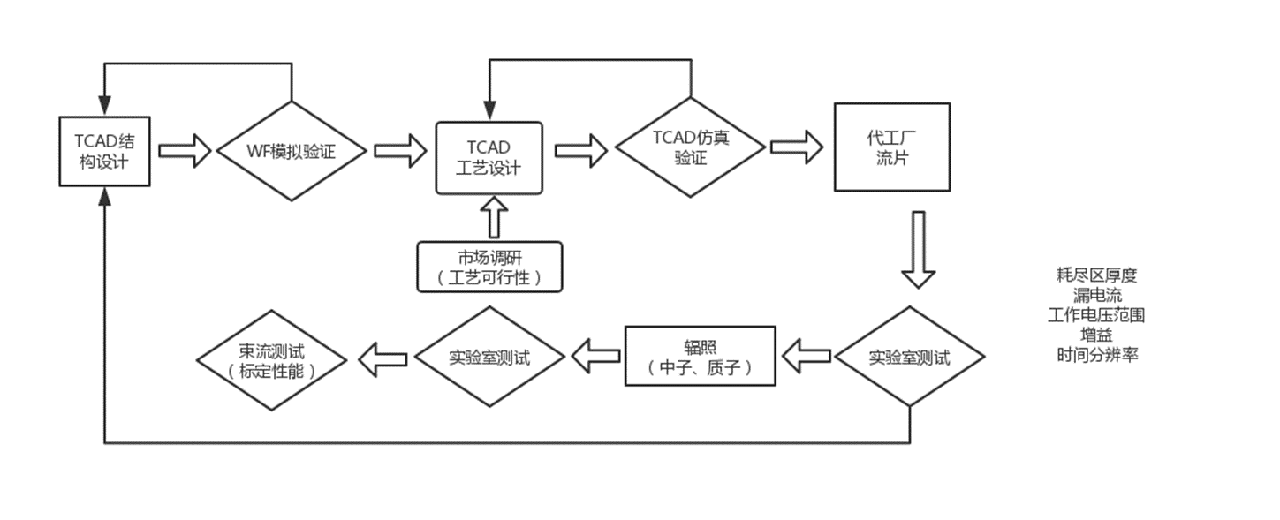
Sensor R&D
Failed test/verification
Passed test/verification

Slide 13
Sensor test
Unirradiated, HPK Type 1-1, 1-2, 2 & 3-2
Envelope Label | Contents |  |  | Total number
Single SET | LG1-SE3 x2 | LG1-SE5 NM | LG1-SE5 x4 | 11
 | PIN1-SE5 | PIN1-SE5 NM | LG1-SE2 x2
2x2 SET | LG 2x2-SE3-IP9 | LG 2x2-SE5-IP9 NM | LG 2x2-SE5-IP9 x4 | 14
 | PIN 2x2-SE5-IP9 | LG 2x2-SE2-IP9 | LG 2x2-SE5-IP7
 | LG 2x2-SE5-IP5 | LG 2x2-SE5-IP3 | LG 2x2-SE3-IP7
 | LG 2x2-SE3-IP5 | LG 2x2-SE5-IP5-IP9 UBM
LG 5x5-SE5-IP9 | LG 5x5-SE5-IP9 UBM |  |  | 1
4 types
104 sensors in total
Single & 2×2 in each type are measured
USTC is one of the test sites of LGAD sensors

Slide 14
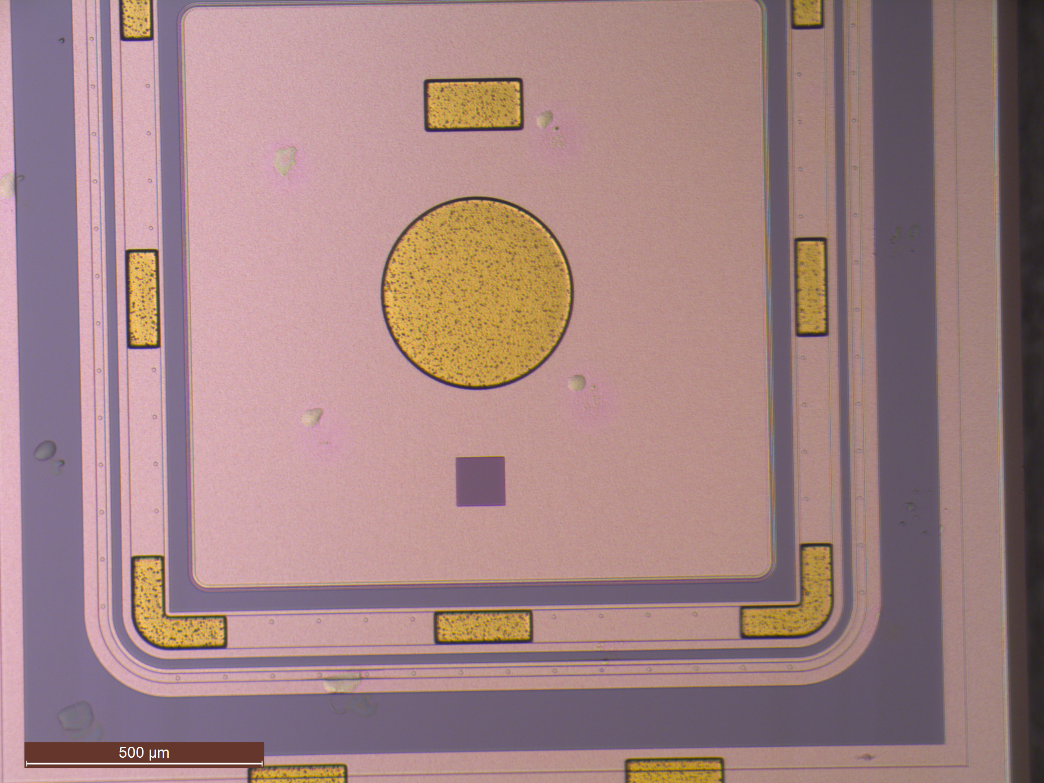
Inspection with microscope
Inspected all sensors with microscope.
Found glue on the surface of some sensors.
Glue can become very corrosive after irradiation. Feedback to HPK.

Slide 15
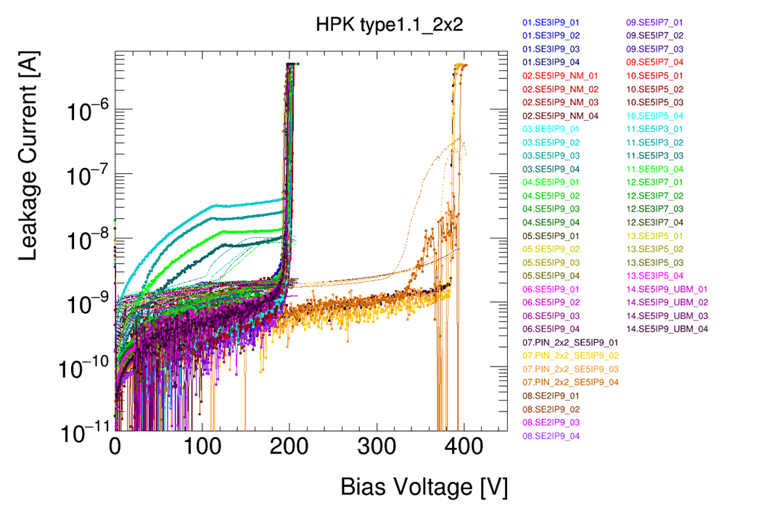
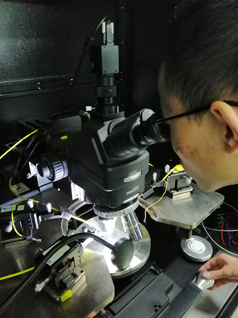
Tests at probe station (I-V)
Sensor | Type 1-1 |  | Type 1-2 |  | Type 2 |  | Type 3-2
 | Single | 2×2 | Single | 2×2 | Single | 2×2 | Single | 2×2
VBD/V | 216.2 | 201.1 | 272.3 | 277.9 | 255.9 | 245.0 | 130.3 | 126.8
Leakage current/nA | 0.45 | 0.69 | 1.18 | 1.11 | 1.41 | 2.41 | 0.79 | 1.27

Slide 16
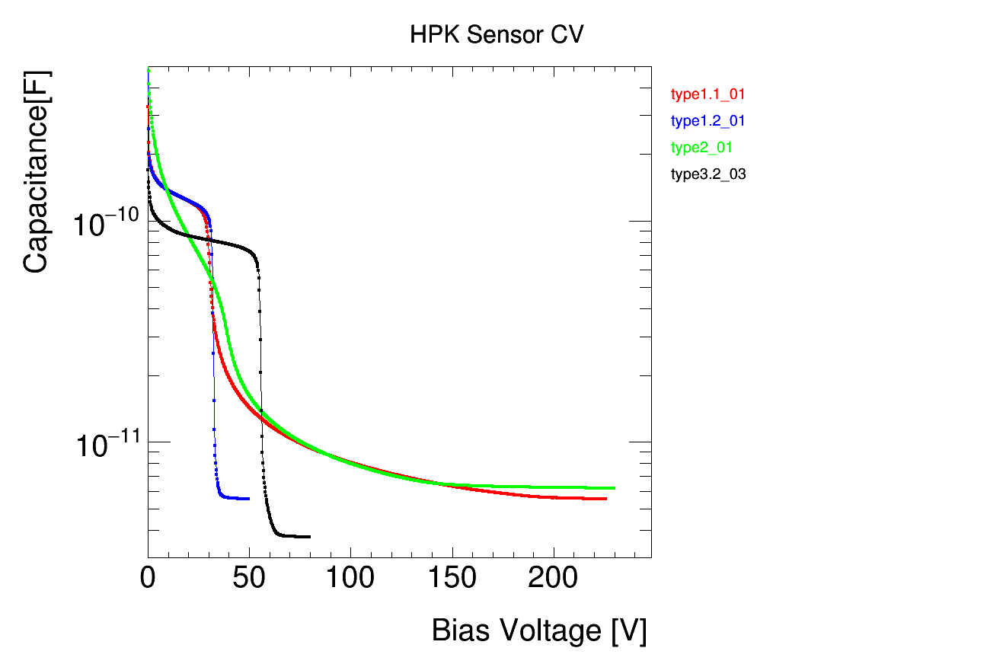
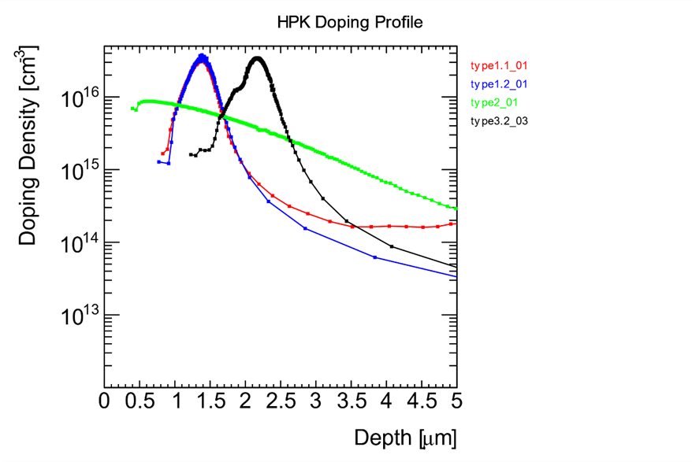
C-V and doping profiles
Type | 1-1 | 1-2 | 2 | 3-2
VGL/V | 23.7 | 31.7 | 32.2 | 54.8
VFD/V | 183.3 | 35.4 | 141.2 | 62.9
A large number of results reported in June 2019 HGTD mini week

Slide 17
Plan for sensor tests
Setup laser TCT and beta source test to determine
  time resolution
  gain
  efficiency
  uniformity
Test of irradiated sensors

Slide 18
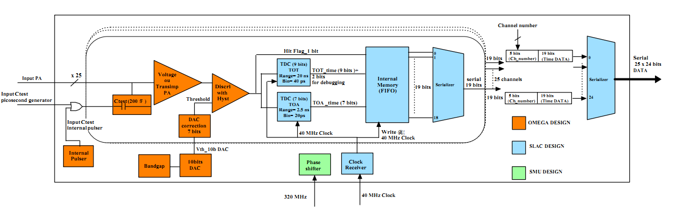
Electronics (testing ALTIROC chip)
Altiroc consists of PA(pre-amplifier), descriminator, TDC and digital parts.
scan test on descriminator threshold, injected charge(Qinj) and input signal delay, to evaluate the performance and mismatch among different ASIC chips. Also, the test results will be a reference for the next version ASIC.
Some new issues are found during the test: such as cross talk form digital controller to analog input, oscillation in analog front-end in some of channels, inconsistency among ASICs.
TDC
AMP
DISC

Slide 19
Threshold and charge scan
Descriminator Threshold Scan:
Test efficiency with different threshold and figure out the pedestal and max value of pre-amplifier output. Issues of cross talk and oscillation are found.
To research trends of TOA (Time of Arrival) and its std-dev due to the variation of injected charge.
Also, the minimum of acceptable charge can be found.

Slide 20
Testing of TDC (delay scan)
Delay Scan:
To evaluate comprehensive performance of TOA TDC: linear dynamic range, DNL & INL.
On going：
Irradiation test.
Difference of parameters and performance among channels and their distribution.
Notes:
Delay scan: Change the delay of ‘Start’signal with fixed ‘Stop’, i.e. change the input time interval

Slide 21
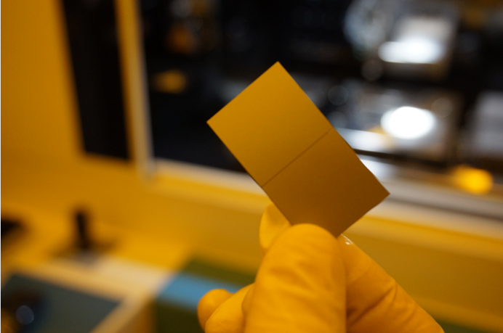
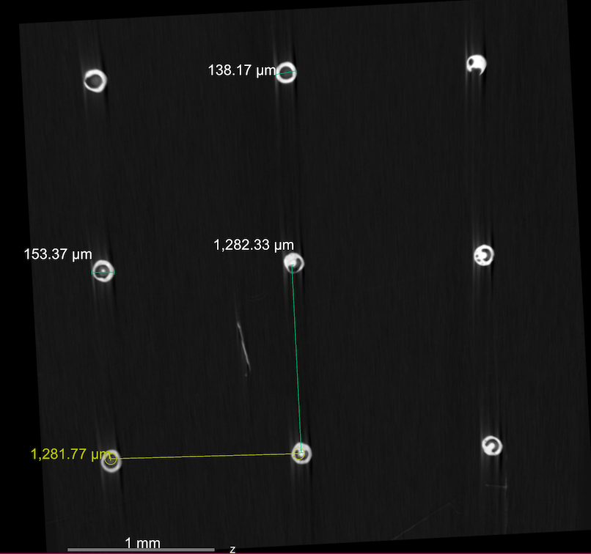
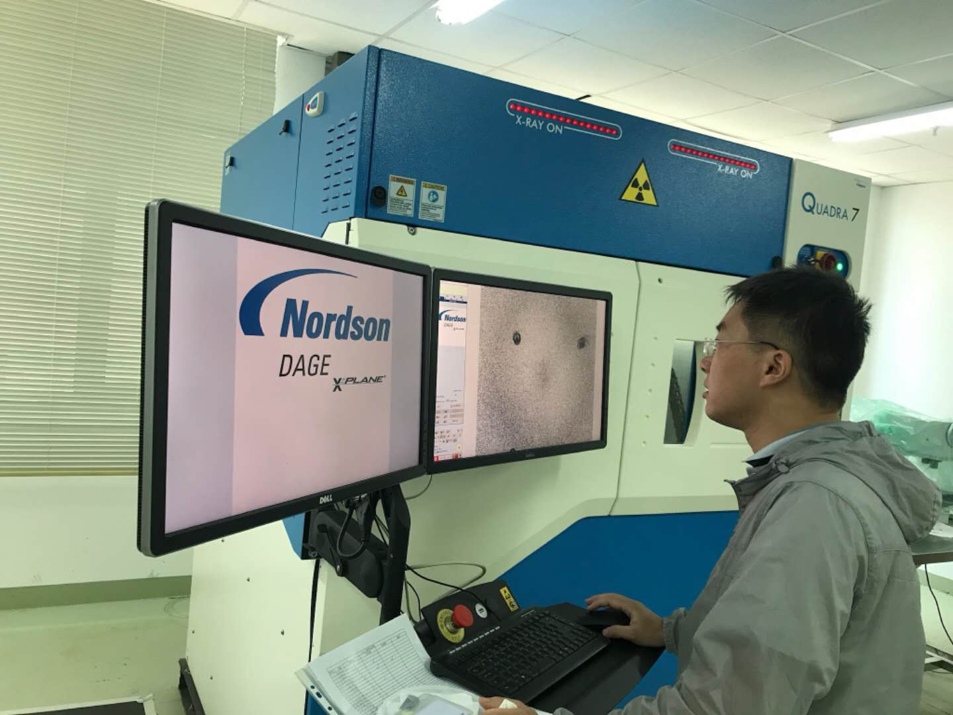
Assembly studies
Dummy sensors by SINANO
Bump-bonding
Shear test：> 1kg
X-ray CT at USTC
More details in the talk at May 29 Assembly meeting

Slide 22
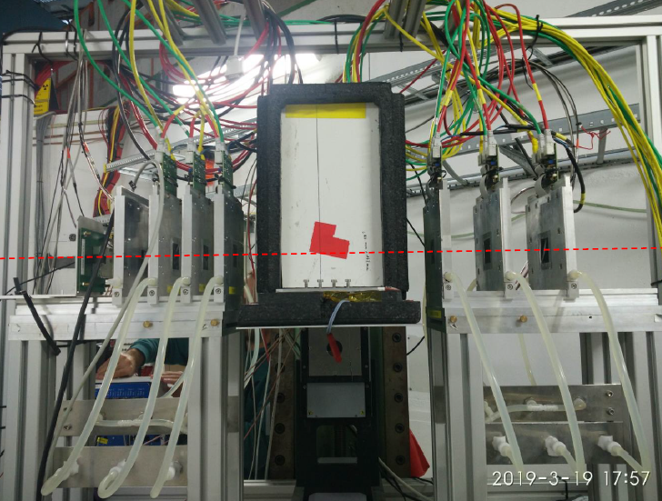
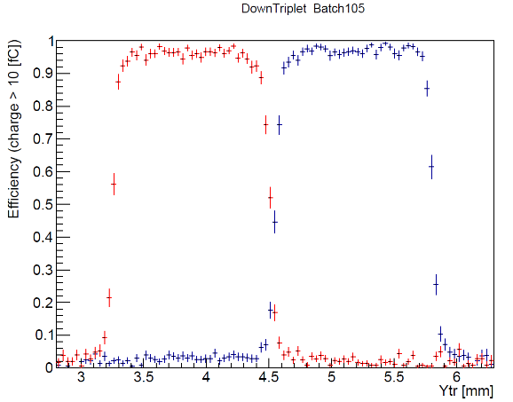
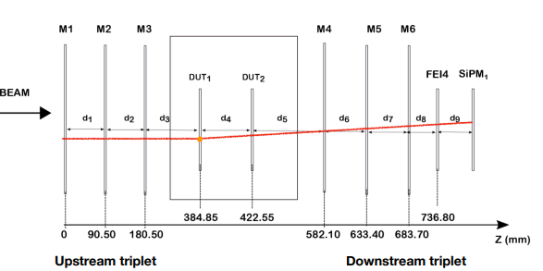
Test beam analysis
March 2019 at DESY, 6 GeV electron beam
Proposed tracking algorithm based on straight line segments
See our presentation in test beam meeting on May 9.

Slide 23
HGTD Digitization Software
The realistic HGTD digitization (simulation the signal propagation and electronics) is located in LAr software packages
TDR relies on tracking software (in Athena Release 20.20) to produce coherently the extended tracks to HGTD as well as the associated timing information, for physics and performance studies
Currently, the tracking software (PixelDigitization) uses a dummy model (Gaussian smearing) to mimic digitization effects.
To enjoy the realistic digitization in TDR studies, one needs to migrate the actual digitation codes from LAr software to PixelDigitization.
USTC group joined the efforts in late May, in close collaboration with HGTD software and performance group, as well as tracking CP group
  Tao Wang (1st year graduate) and Yusheng Wu
  Already be able to run both LAr and Pixel simulation and reconstruction software
  Currently study the HGTD digitization code in LAr packages and plan to migrate that to PixelDigitization soon, to be followed by performance and validation checks
  After the first project, plan to contribute to other areas of work, including timing information as well as object performance etc.
  In fact, we already participate in a physics study for HGTD earlier this year, may continue once the sufficient progress will be made on the low-level software work

Slide 24
Conclusion and outlook
USTC joined HGTD in Jan 2019 and has ramped up very efficiently Thanks to the very supportive community
Now actively working on
  Sensor design and tests
  ASIC RD
  assembly studies
  digitization software
Plans
  Continue to expand the test facility to include laser TCT, beta scope, and to handle irradiated sensors
  Continue to develop the sensor design
  Will participate in the detector and object performance studies as well as physics studies

Slide 25
BACK-UP

Slide 26
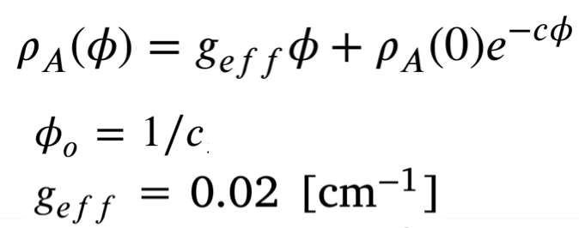
Acceptor removal
Reference: doi.org/10.1016/j.nima.2018.11.121

