Slide 1
Strong and radiative decays of X(3872) as a hadronic molecule with a negative parity
Yong-Liang Ma
In collaboration with M. Harada
Department of Physics, Nagoya University, Nagoya, Japan.

Slide 2
Outline
Introduction
Hadronic Molecular Structure of X(3872) with J^{PC} = 2⁻⁺
Numerical Results and Discussions
Conclusions

Slide 3
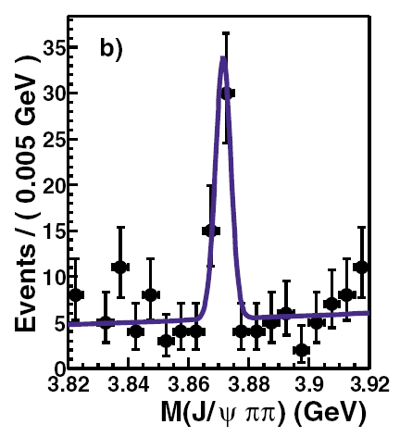
I. Introduction
X(3872) was first observed by Belle Collaboration:
S. K. Choi et al. [Belle Collaboration], Phys. Rev. Lett.91, 262001 (2003) [arXiv: hep-ex/0309032].
Confirmed by the CDF, theD0 and the BaBar Collaborations.
For more experimental discussion, the following talk from Belle Collabortion.

Slide 4
Quantum numbers of X(3872):
B. Aubert et al. [BABAR Collaboration],Phys. Rev. D 74, 071101 (2006) .
K. Abe et al. [Belle Collaboration], arXiv:hep-ex/0505037.
C = +
B.Aubert et al. [BABAR Collaboration], Phys. Rev. Lett.102, 132001 (2009).
Analyze the invariant π⁺ π – mass distribution and the total angular distribution of the J/ψ π⁺ π –decay mode.
Possible spin-parity J^{P} =1⁺ , 2⁻
A.Abulencia et al. [CDF Collaboration], Phys. Rev. Lett. 96, 102002 (2006).
A.Abulencia et al. [CDF Collaboration], Phys.Rev. Lett. 98, 132002 (2007) .
Quantum numbers of X(3872): J^{P} =1⁺⁺ , 2 ⁻ ⁺

Slide 5
Possible structures for X(3872)
Charmonium ?
S.Dubynskiy and M.B.Voloshin, Phys. Rev. D 77, 014013 (2008).
Y.Jia, W.L.Sang and J.Xu, arXiv:1007.4541 [hep-ph].
Hybrid state
F.E.Close and S.Godfrey, Phys.Lett. B 574, 210 (2003) ;B.A.Li, Phys.Lett. B 605, 306 (2005)
Tetraquark state
J.Vijande, F.Fernandez and A.Valcarce, Int. J. Mod. Phys. A 20, 702 (2005)
Chrmonium-molecule mixing state
E.Braaten and M.Kusunoki, Phys. Rev. D 72, 054022 (2005)
Y.b.Dong, A.Faessler, T.Gutsche and V.E.Lyubovitskij, Phys. Rev. D 77, 094013 (2008)
S.Takeuchi,Prog.Theor.Phys.Suppl.168, 107 (2007).
Molecular state
N.A.Tornqvist , Y.b.Dong, M.B.Voloshin, E.S.Swanson, Yong-Liang Ma, ……
The talk by Vijande this morning and Oset in the following section.
Here we regard X(3872) with J^{PC} =2⁻⁺ as DD* molecule.

Slide 6
Quantities used in the parameter fitting

Slide 7
II. Hadronic Molecular Structure of X(3872) with J^{PC} = 2⁻⁺
In isospin eigenstate

Slide 9
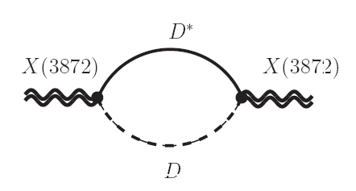
Compositeness condition : Z_{X} = 0
For other interaction, we use the phenomenological Lagrangian

Slide 10
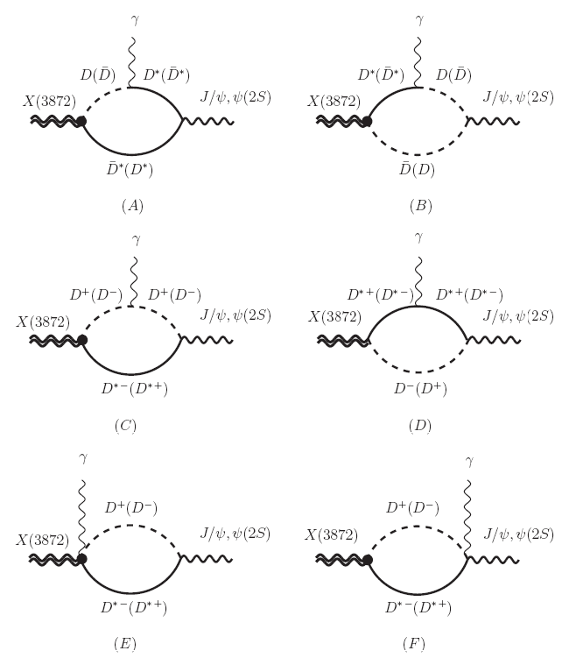

Slide 11
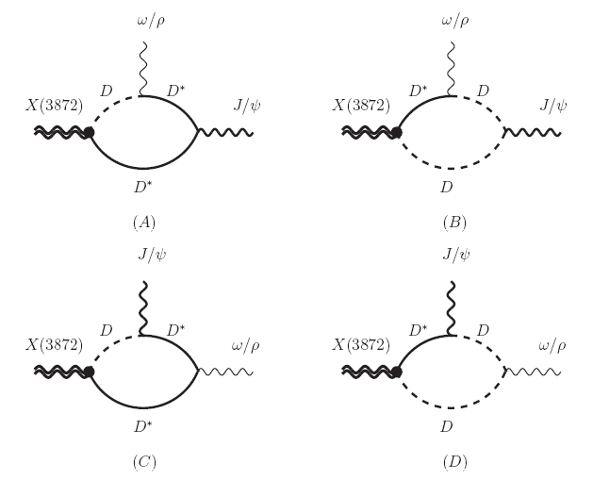

Slide 13
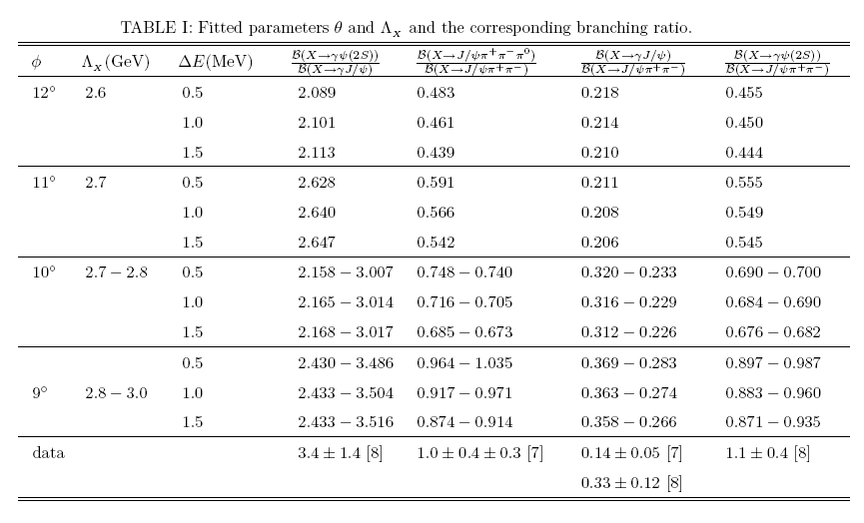
III. Numerical Results and Discussions

Slide 14
Y.Dong, et al. , Phys. Rev. D79, 094013 (2009).
Our results for the coupling constants are bigger than the corresponding ones in axial vector case.
Interpretation: In our case, X(3872) has quantum numbers J^{PC} =2 ⁻ ⁺ so the coupling between X(3872) and its constituents DD* is in P-wave. Compared with the case that X(3872) has quantum numbers J^{PC} =1⁺⁺ , it needs stronger attractive interaction to compensate the repulsive interaction induced by angular momentum.

Slide 15
Our result of the small mixing angle implies that the isospin singlet component is dominant.
Wave function:
≈ 1.0
Consistent with data!

Slide 16
From this we see the partial widths are of order of KeV.
These partial widths have been computed in the case that X(3872) has positive parity.
For the strong decays, it was found that the decay widths are around 50KeV which are both about one order larger than our present results.
But for radiative decays, the results depend on model closely.
X(3872) as a bound state of mesons, the radiative decay widths are of order KeV, at the same order as our present results.
X(3872) is a mixing state of molecule (without the charged DD* components) and charmonium component, the decay width is found to be of 100-200KeV, much larger than that computed from the hadronic molecule assumption.
admixture model of molecule with the charged DD* components and the charmonium components, the similar results as ours were yield.

Slide 17
The inclusion of other components as was done in the case that X(3872) has quantum numbers J^{PC} =1⁺⁺ may change our results.
Include J/ψω and J/ψρ in the wave function. This may increase the magnitudes of the strong decay widths and the results depend on the probability of J/ψω and J/ψρ in X(3872) even in the case that only the long distance effect is considered. In this sense, if the strong decay widths for tensor X(3872) are observed bigger than our present results, one may conclude that the tensor X(3872) cannot be a pure DD*molecule and other component should be included.
Regard X(3872) as a mixing state of charmonium and DD*. One may borrow the lesson from the X(3872) with1⁺⁺ case to naively expect that this change of the wave function of X(3872) may increase the magnitude of radiative decay width of X(3872).
In case other constituent is included, the probabilities of the relevant components should be fitted from data again so the magnitudes of the partial widths should be studied in detail.
The precise measurement of the strong decay widths can provide some clues on the structure of X(3872).

Slide 19
Similarly, the introduction of other components may change our numerical results.
In case of the charmonium component is included, the magnitudes for the partial widths might be changed but the ratio for the partial widths must be kept since the charmonium component is a definitely isospin singlet so it does not contribute to the isospin violating decays .
The same conclusion can bedrown if J/ψω are constituents of X(3872).
However complication arises if X(3872) has a J/ψρ component as was done . This is because the component J/ψρ gives a contribution to the isospin violating decays.

Slide 20
IV. Conclusion
By regarding the hidden charm state X(3872) as a DD* bound state, we studied its radiative and strong decays in the effective Lagrangian approach.

Slide 23
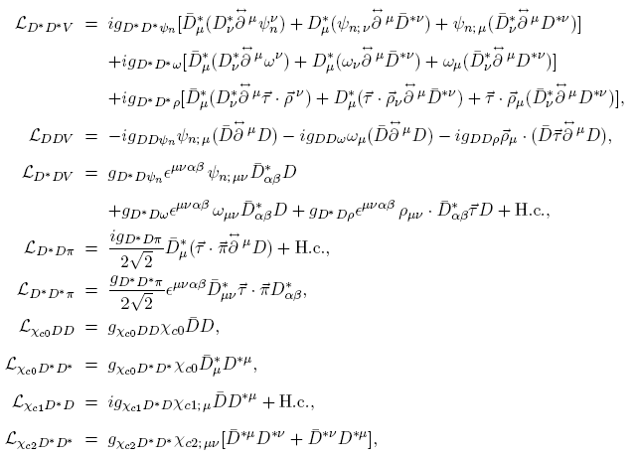

Slide 24
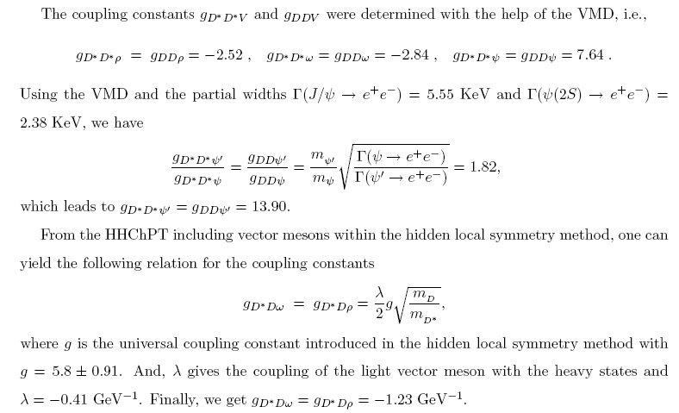

Slide 25
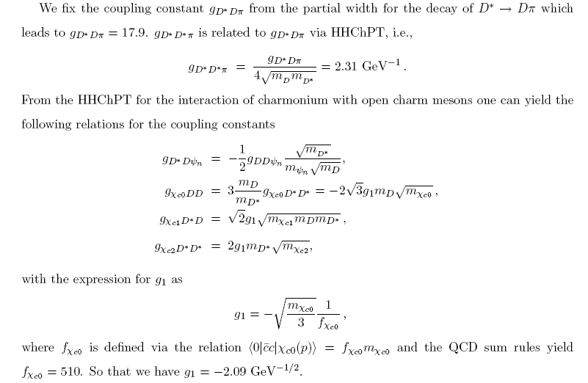

Slide 29
