Slide 1
SVD DAQ
25 Jan 2011 Belle2 DAQ meeting @Beijing
T. Tsuboyama (KEK)

Slide 2
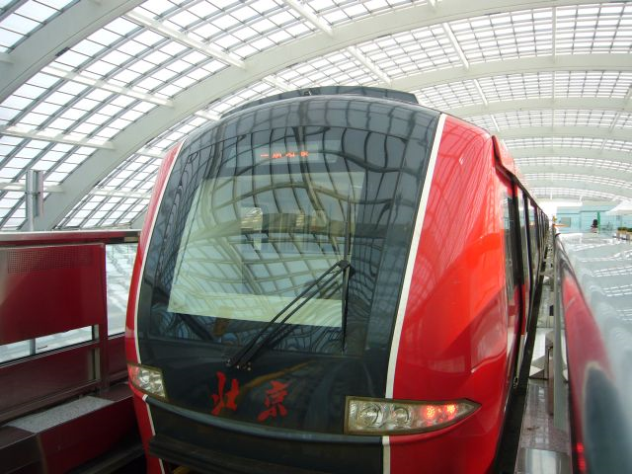
Outline
Outline
FADC
FTB and Timing distribution
Schedule
This talk is based on slides shown in Krakow meeting in Dec. 2010 and B2GM in Nov. 2010, especially by M. Friedl and W. Ostrowicz.

Slide 3
System Overview
The SVDDAQ consists of Frontend, Junction box, FADC, FTB. The timing and trigger control, nor the link to PXD, is not shown in this slide.
Finesse Transmitter Board (FTB)
FADC+PROC
1902
~2m
Junction
~10m
Unified optical
APV25
copper
box
Thicker
copper
data link (>20m)
chips
cable
cable
R
E
P
P
O
C
Front-end hybrids
Rad-hard
Analog level translation,
Unified Belle II
voltage
data sparsification and
DAQ system
regulators
hit time reconstruction

Slide 4
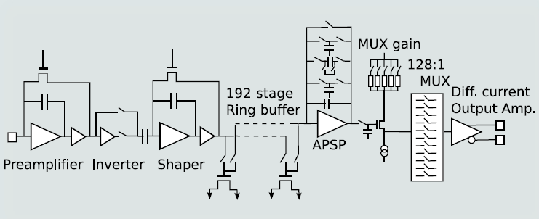
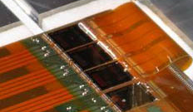
Front end --- APV25
The APV25 chips are designed for CMS at LHC
  Intrinsically radiation hard, short-shaping and pipe-lined.
  Suitable for Belle2 SVD.
The analog information can be used for wave form fit and hit time reconstruction for further background reduction.

Slide 5
More on APV25
APV25 has a 192-cell pipe line in each channel.
32 bit queue for readout.
In order to accommodate the 5 μsec trigger latency, APV25 will be operated with 32 MH clock sacrifying 20% slower readout time.
Dead time at front end.
  With a trigger rush, the readout queue may be filled up. Then further triggers can not be treated correctly, which causes dead time. We should send “busy” to CDAQ in a such case.
  For the recognition of “queue full” in APV25, an APV25 queue emulator will be implemented in the FADC timing controller.

Slide 6
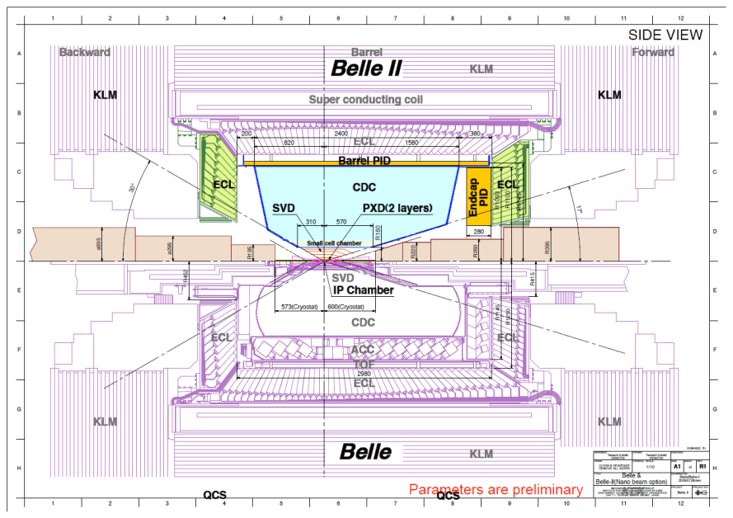
The Belle detector upgrade

Slide 7
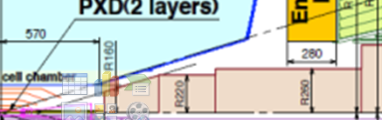
Junction Box
Just connectors and rad-hard voltage regulators (possibly with remote sensing to hybrids)
APV25 --- Operation voltage 2.5V
Absolute maximum voltage 2.7V
Only 20 / 50 pins of hybrid cable are signals → merge 2 front-end cables into one (same) signal cable to FADC
PXD may need a similar box.
Junction box
?

Slide 8
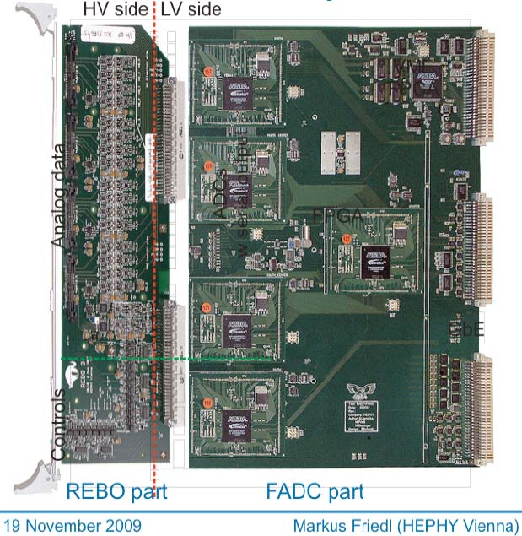
FADC
We proved that APV25 can drive 100 Ω twisted line for > 10 m.
  Repeaters are not necessary.
Analog Signal receivers can be very simple.
24 channels/board. (80 boards necessary.)
Integrating repeater (level translation) into FADC boards
24 inputs per board (6 x 4 or 4 x 6 APVs x hybrids)
→ 80+ VME boards in total
Needs to become more compact to fit onto a single board

Slide 9
FADC Scheme: Baseline
Level Translation at front-end interface
Majority of board operates at ground (earth) levels
Follows existing scheme

Slide 10
FADC Scheme: Alternative
Level Translation at module rear
Generally I do not consider this scheme very practical
Probably the only kind of advantage is that all translations become digital

Slide 11
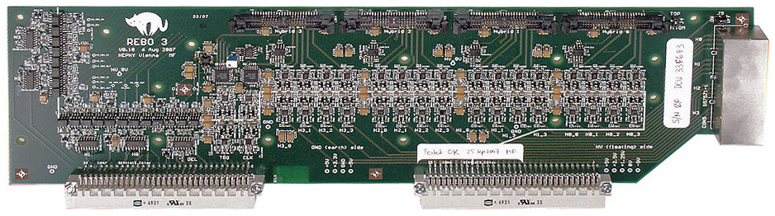
Existing REBO
Voltage Level Translation
Optocouplers (slow controls)
  REBO3 uses single optocouplers for digital
  slow controls
Amplifiers (signals & CLK/TRG)
  REBO3 uses two amplifiers per channel, one on each HV and LV sides

Slide 12
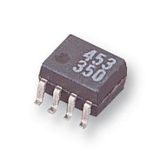
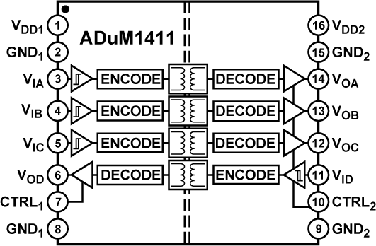
Level Translation – Digital
Existing REBO3
  HCPL0701 (1 optocoupler per SO8 package)
  used for digital slow controls (I2C and reset)
Alternative 1
  HCPL0731 has 2 couplers in the same package
Alternative 2
  Use digital isolators such as ADuM1411
  4 couplers in SO16 package (~2 x SO8)
  Faster versions would even allow
  translation of CLK and TRG
  Need to evaluate noise performance and operation frequency.

Slide 13
Level Translation – Analog
Existing REBO3
  first amp is actually attenuator and thus unnecessary
Future circuit
  AD8132 to be replaced by simple resistor (or divider)
  EL5173 could be replaced by EL5373 (3 channels), but ~3x bigger

Slide 14
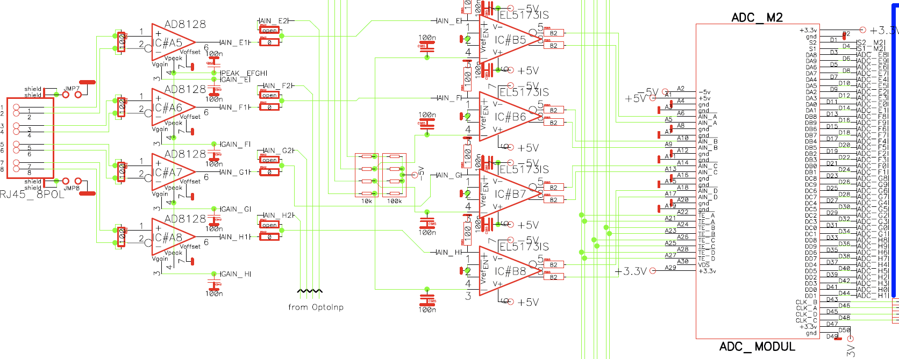
ADC Input
Existing FADC
  AD8128 equalizer to compensate frequency-dependent cable loss
  EL5173 to convert AD8128 output back to differential
  Even more amplifiers on ADC daughter board
  Parallel ADC data output
SVD DAQ Toru Tsuboyama (KEK)

Slide 15
FADC Improvements
No need to drive CAT7 cable anymore
→ reduce overall number of amplifiers in readout chain
Frequency response in the cable will be corrected by a digital FIR filter inside FPGA (feasibility study will be made in soon) in order to retain fully differential signal path.
Dual-ADC (AD9218) with 10 bit parallel outputs
→ 8-channel ADC (AD9212) with serial outputs
(has ~same size as the dual ADC)
5 old (but cheap) FPGAs (Altera Stratix 1 – EP1S20) → single powerful FPGA (Altera Stratix 4GX – EP4SGX180KF40C4N
Communication between VME FPGA and other FPGAs was done by parallel busses → serial communication between VME and central FPGA

Slide 16
Summary
APV25
  Sufficient thinned & non-thinned devices exist
  V_{DD} voltage must be kept ≤ 2.7V
Junction box scheme established
  Connectors and rad-hard voltage regulators
Several improvements suggested for FADC
  Simplification of voltage level translation
  ADC inputs (FIR filter)
  Serial links instead of parallel busses
Location for FADC racks
  On top of yellow rail beams
  Possibly with power supplies

Slide 17
FTB (Finesse transmitter Board)
1. FTB design:
a. SVD Electronics - general view
b. Two boards - one set
c. Results of meeting with Zhen’an Liu,
Hao Xu and Mikihiko Nakao.
2. Prototype design:
a. Prototype – double functionality
b. Prototype - tests setup

Slide 18
SVD Electronics - general view
F E E l e c t r o n i c s
PIXEL
Giessen Box
SVD tracker
opt
#1
opt
#40
COPPER#40
DAQ
opt
FRB
SVD electronics
…
opt
COPPER#2
FADC#80
FRB
opt
COPPER#1
FRB
opt
FADC#2
FTB#80
RJ45
FADC#1
RJ45
opt
TTD
opt
RJ45
#80
FTB#1
FTB#2
RJ45
…
SVD-CONTROLLER (SVDctlr)
RJ45
FCRB
RJ45
#2
RJ45
RJ45
RJ45
#1
RJ45
#81
RJ45

Slide 19
Two boards - one set
From/to FADC (2k)
FPGA
RJ45
DATA (2k)
FTB#(2k)
FTB fmw
Unified core 1
OpTr
To PXD (k)
DATA (2k-1) + (2k)
1. The same PCB
2. The same module
3. The same firmware
Unified core 2
RJ45
From/to TTD (2k)
DATA (2k-1)
From/to FADC (2k-1)
FPGA
RJ45
FTB#(2k-1)
FTB fmw
Unified core 1
HSD Link (k)
OpTr
DATA (2k) + (2k-1)
k=1..40
Unified core 2
RJ45
From/to TTD (2k-1)

Slide 20
Results of meeting…
1. Belle2Link:
a. Line rate 1,5 Gbps (3 Gbps works)
b. Clock sources (common clock from TTD = 127MHz):
- On-board = 200MHz
- RJ-45 7-8 pair = 127MHz
- FINESSE-C RCK pair = 42MHz
c. Common CLK via RJ45 in case of test without TTD?
FPGA
FPGA
Line rate=1.5Gbps
HSLRB
CDC readout
CLK_Lk=200MHz,
CLK_CO=42.3MHz
CLK_Lk=200MHz,
CLK_FEE=125MHz
There is no ‘busy’ signal via Belle2Link – I prefer to have such signal between FADC and FTB (FTB busy). But …???

Slide 21
Results of meeting…
d. Registers: mandatory and user defined
Exactly the same protocol & timing for REGS
Mandatory Registers implemented on both sides.
It is unique information for every single board (TYPE[15..0], SERIAL#[15..0])
How to keep information after power down? -> nonvolatile memory (EPROM) on FTB.
FADCs do not need user defined registers for parameters loading/reading. It will be used other solution. (Nakao was interested which way…)
HSLB
FTB
FPGA
UNIFIED CORE
Belle2Link
COPPER
REGISTERS
CSB
LRW
LA[6..0]
LD[7..0]
CSB
LRW
LA[6..0]
LD[7..0]

Slide 22
Results of meeting…
Future (near???):
- universal firmware? – in plans
- modules for sub-groups for testing? – they plan…
- any NOTE describing rules and requirements – not yet but…

Slide 23
Results of meeting…
2. TTD link: ACK, TRG, CLK, RSV.
a) ‘ACK signal (1-2 pair) is a serialized response information to the central
timing system’ – is it the same/similar as ‘BUSY’ signal? - similar.
Any description how to manage the ACK signal. – not yet
b) any RESET via TTD link? – yes. As minimum TRGnb = 0, clear Data Fifos,
no reload the firmware.
What does RESET mean for FADC?
c) any firmware? – maybe soon??
d) any NOTE describing rules and requirements – not yet but…
3. JTAG link
e) For firmware loading – one cable per one board? – not decided yet
f) After firmware loading – what with info in mandatory regs? – ext. EPROM

Slide 24
Prototype – double functionality
RJ45
DRIVERS
FPGA
Spartan6
FTB functionality + tests possibility
42MHz
OpTr
160 pin connector
DRIVERS
RJ45
config
POWER
Clock distrib
ext POWER
OSC
Regs handler
RJ45
FTB components
+ test components

Slide 25
Prototype - tests setup
42 MHz
Power
RJ45
DRIVERS
42MHz
FPGA
Spartan6
OpTr
160 pin connector
COPPER in Cracow
DRIVERS
RJ45
config
POWER
Clock distrib
ext POWER
OSC
Regs handl
SVD FINESSE
RJ45
FTB prototype – FINESSE adapter
RJ45
SVD FINESSE
DRIVERS
42MHz
FPGA
Spartan6
OpTr
160 pin connector
DRIVERS
RJ45
config
POWER
Clock distrib
ext POWER
OSC
Regs handl
RJ45

Slide 26
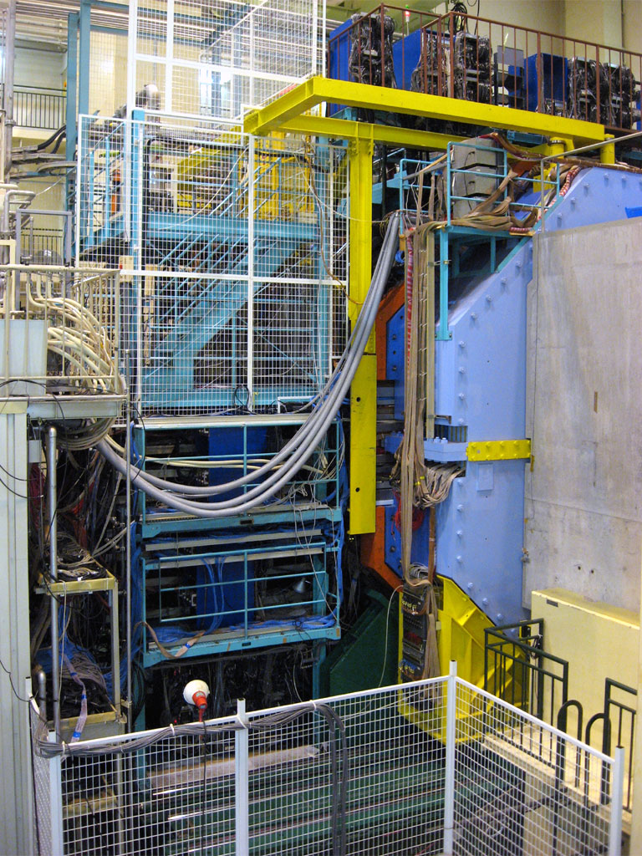
Location for FADCs
At side of KLM
Accessible during running
Or on top of KLM
(but then locked)
When I showed this slide at the B2GM, I noticed that Haba-san shook his head…
Approximately here
1 rack on each side
(forward, backward)
is enough

Slide 27
Location for FADCs
There is a lot of space on top of the yellow rail beams
No conflict with existing installations so far (probably PXD also think of this space)
Need to build access infrastructure. This is not an obstacle. Although we can not access to this area when accelerator is in operation
We may put FADC racks
(1 forward, 1 backward) + power suppplies there
24 Jan 2011

Slide 28
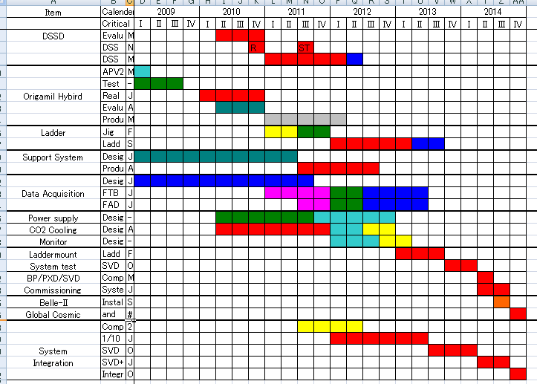
Schedule

