Slide 1
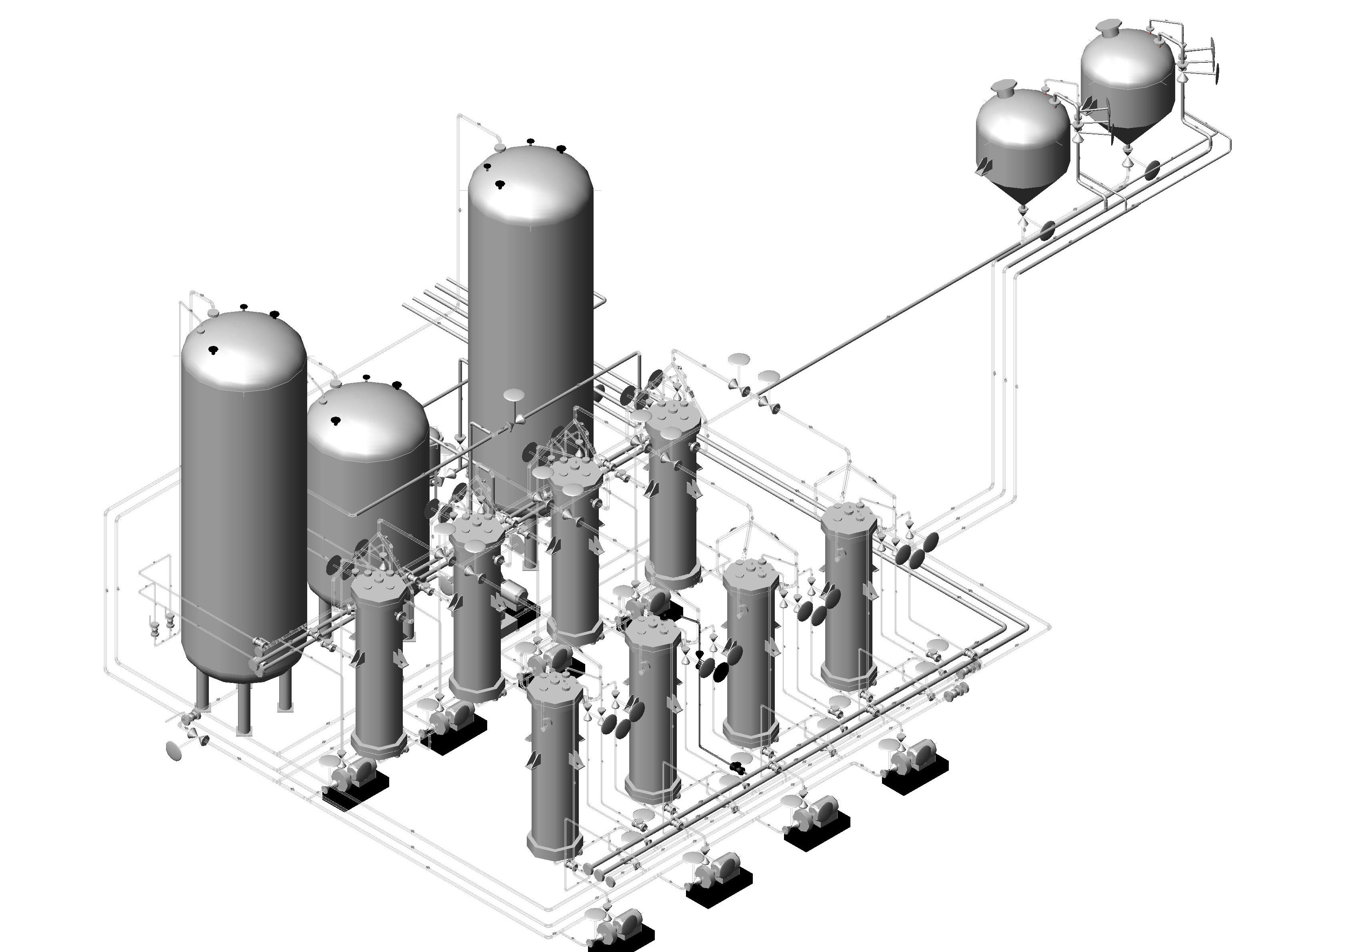
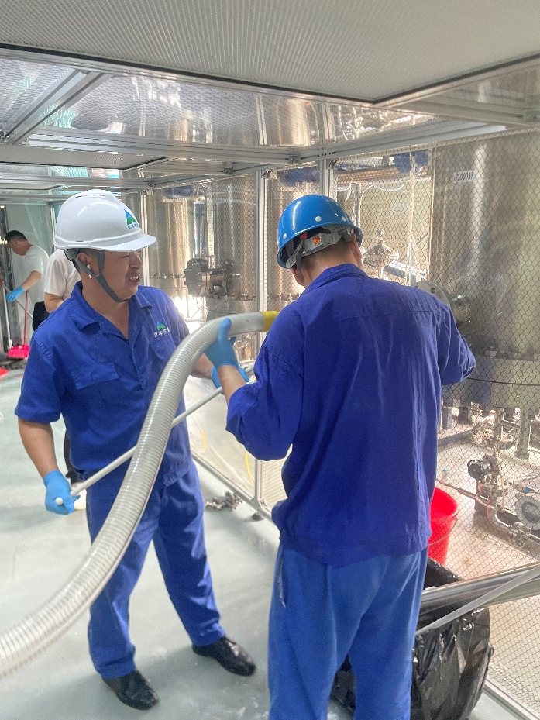
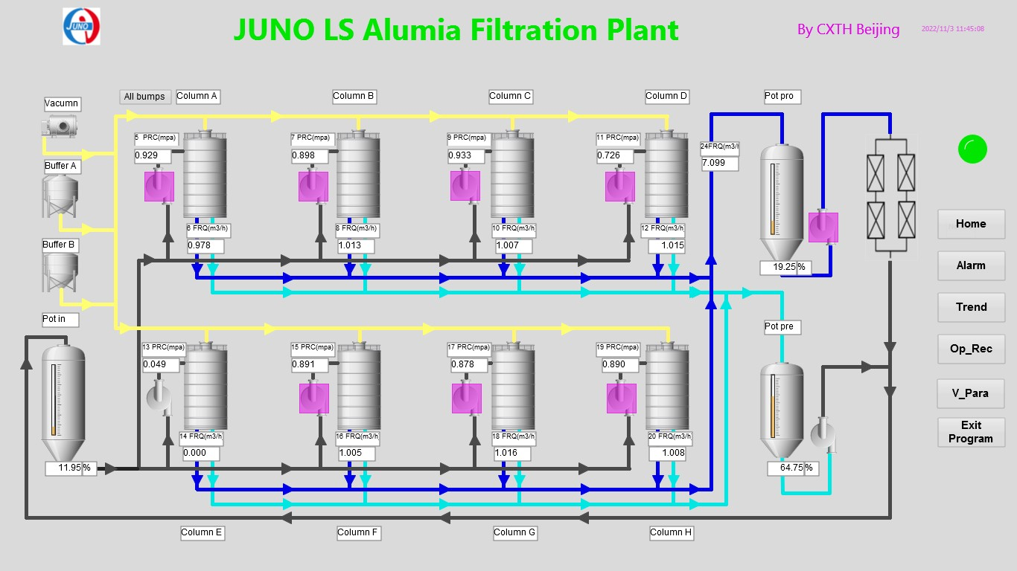
Alumina Filtration Plant
主要目的：通过氧化铝的层析原理去除烷基苯中的光学杂质，提高烷基苯的光学透明度。
Main goal: remove optical impurities naturally dissolved into the LS, increase the Attenuation Length of LS and reduce the absorption peak in LAB.
LAB Production tanks
Pre-purifcation tanks
8个参数表次序调换一下，
柱子结构
放吸收光谱的图。
衰减长度提高多少？文字表述
氧化铝材料的图，解释原理
2 alumina filling tanks
8 Filtration columns
LAB Feed tanks
8 high pressure pumps
AFP 参数—parameters
纯化速度-Flow rate | 7 m³/h
吸附柱数量-Column number | 8
柱床体积-Bed volume | 0.5 m³
过滤器精度-Filters | 220nm+50nm
最承压-Maximum Pressure | 20 bar
柱径-Column diameter | 0.6 m
柱高-Column height (packing) | 2.6 m
填料高度-Alumina height | 1.8 m
特性-Features:
Optical impurities dissolved in the LAB phase removed by alumina absorption
Increase the A.L. of LAB from 20 m to 24 m
The radiation of alumina is checked by HPGe batch by batch
Alumina is vacuum packed in company for reduce the radon in alumina.
质量要求-Quality requirements:
50 nm filters before and after the process
Vacuum leak tightness (< 10⁻⁷ mbar∙L/s overall)
N₂ blanketing for air removal in system
Cleanliness requirements: Class 50 of MIL STD 1246 C
Several QA/QC tests (particle counting, absorption and emission spectra, A.L., ICP-MS, NAA)

