Slide 1
CEPC Vacuum system EDR plan
Yongsheng Ma
2024.2.28

Slide 2
EDR task
Production line of vacuum chambers
Vacuum chamber
Spray for heating film
NEG coating
NEG coating optimization
Spray for heating film R&D
Tungsten alloy vacuum chamber
RF shielding Bellows for ultra Expansion/contraction
Double-hole extrusion tube R&D
RF shielding All metal gate valve

Slide 3
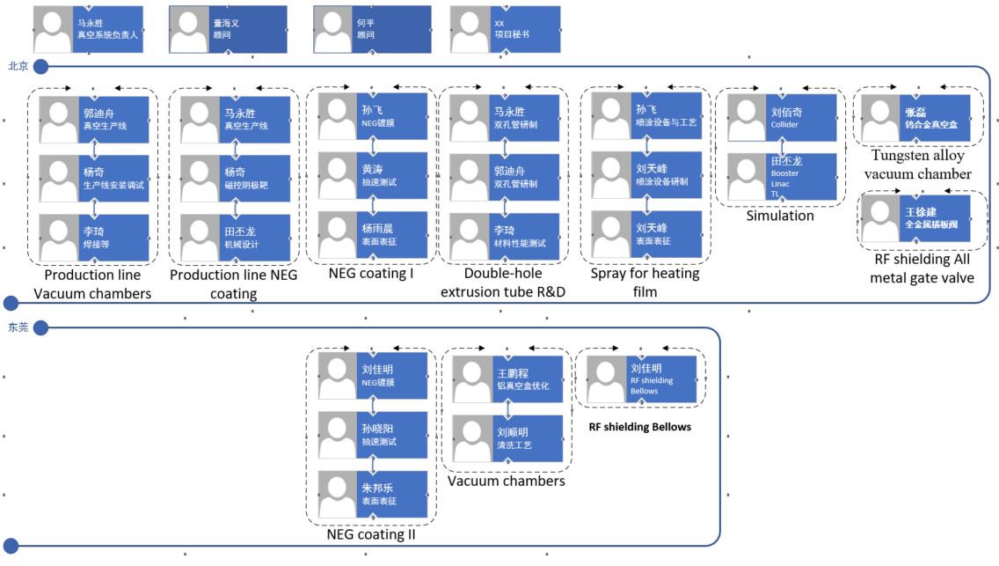
Personnel organization and work division
15人
3~5人

Slide 4
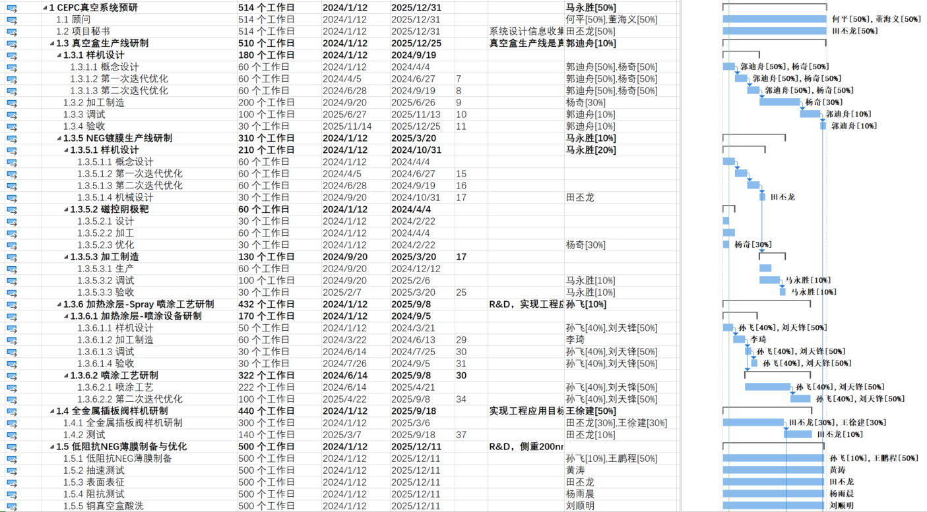
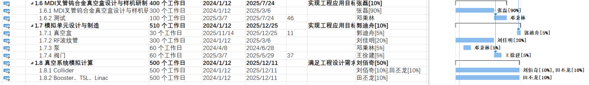
Project Gantt chart

Slide 5
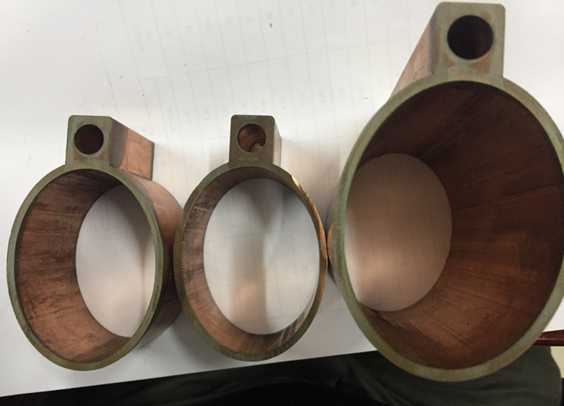
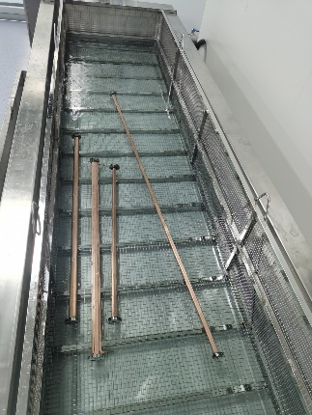
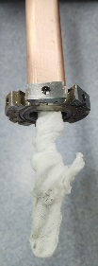
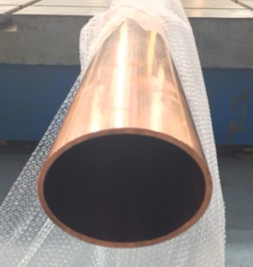
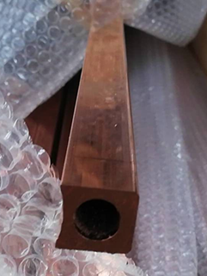
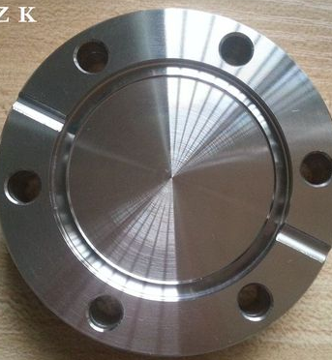
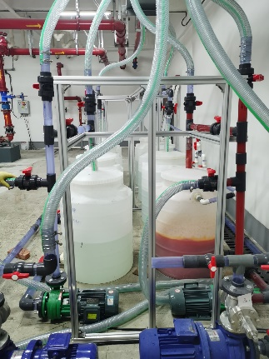
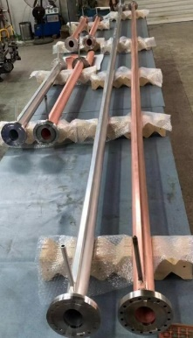
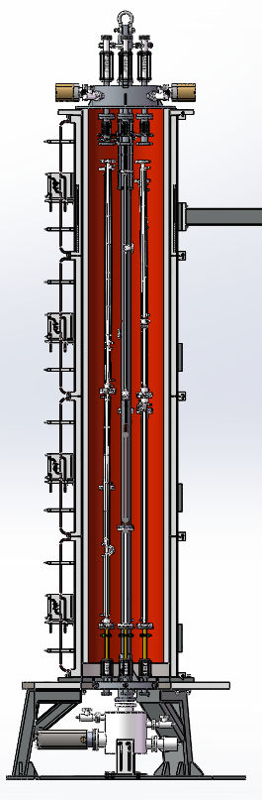
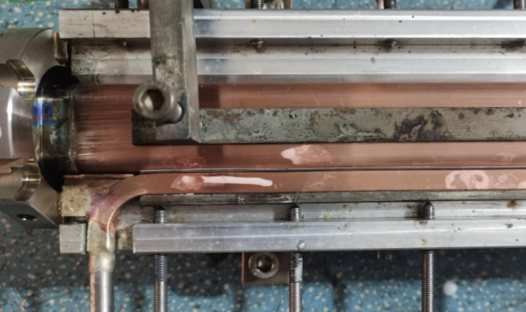
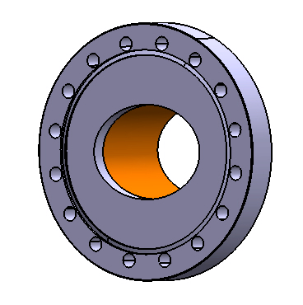
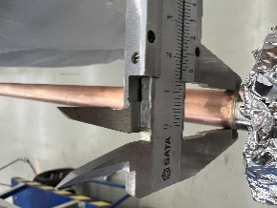
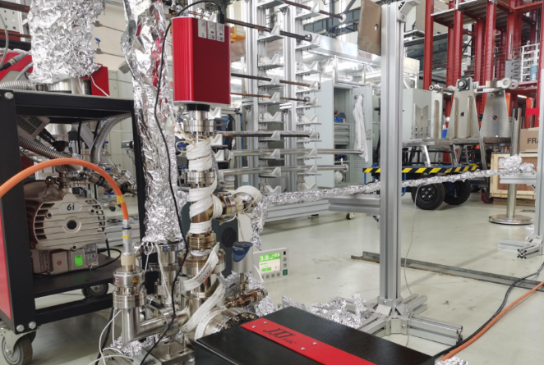
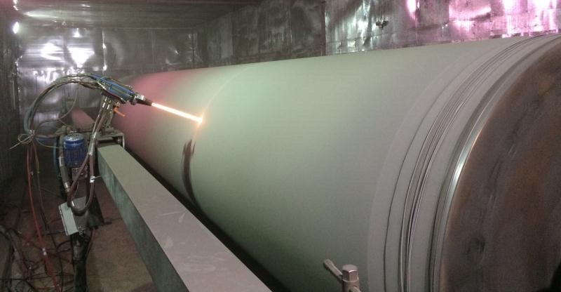
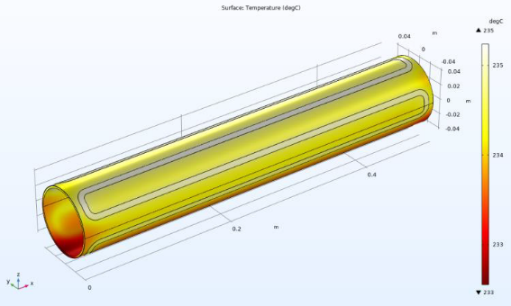
Production line of vacuum chambers and NEG coating, spraying
The flanges and beam pipe are welded by EBW, and low temperature brazing solder are used between the beam pipe and water cooling channel.
Capacity: 4000~8000 units annually; length: 11.4m for welding, 400~600 units annually; length: 11.4m for NEG coating and spaying.
Vacuum chamber 11.4m
1
3
NEG coating
Vacuum chamber
Beam pipe +
Cooling channel
Conflat Flange
Cleaning: etching, passivation, resining
Welding/Brazing
Electron beam welding（in vacuum ）
Testing: dimension, leakage
2
Multilayer of ceramic and conductivity layers
DCMS
In vacuum

Slide 6
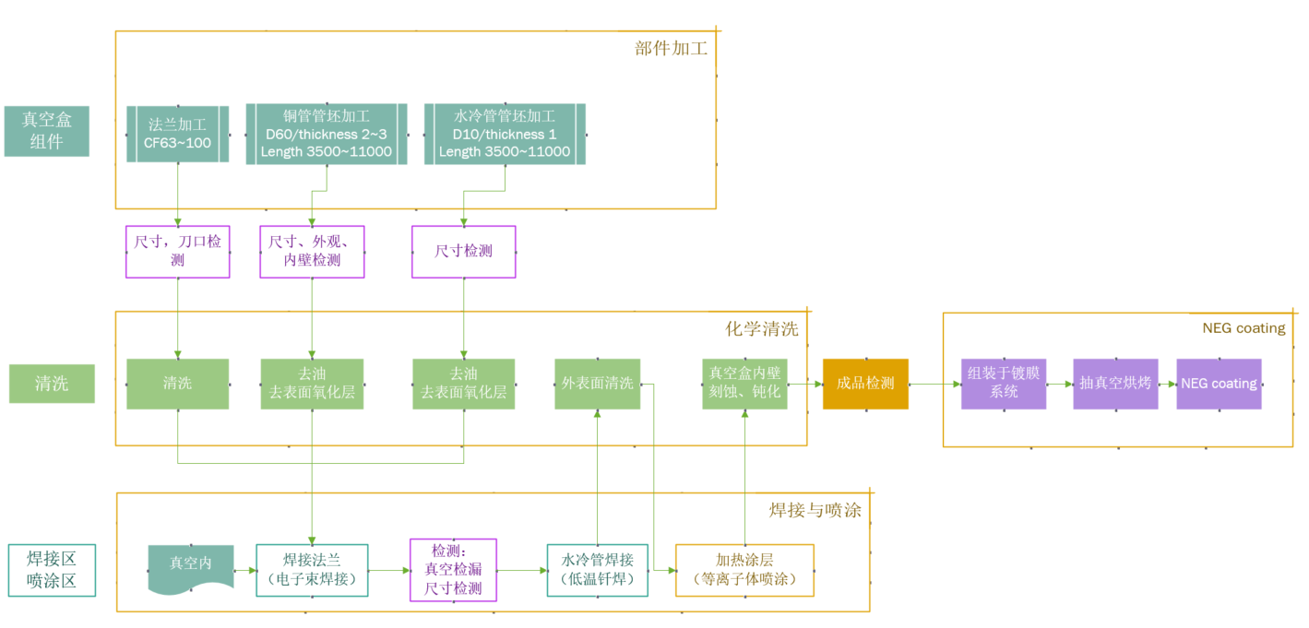
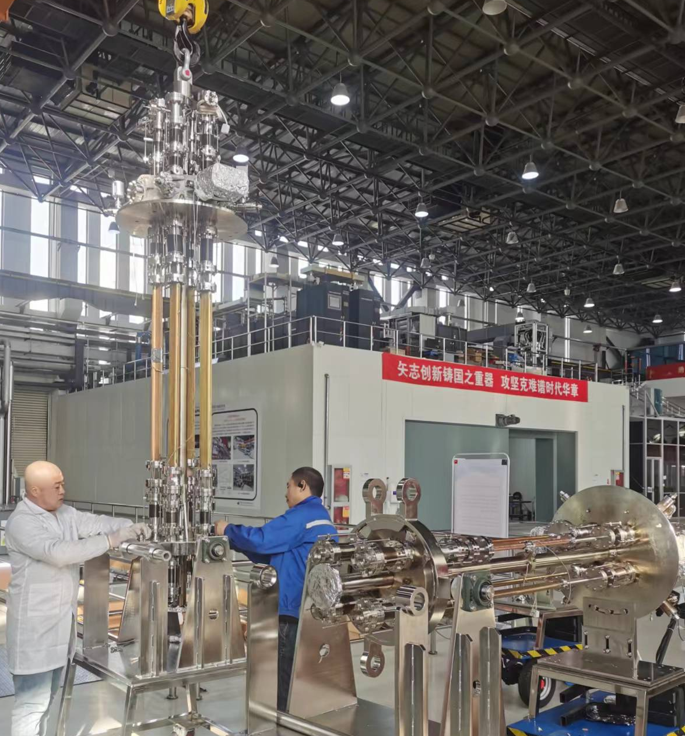
Fabricating &Technique process of Cu VC and NEG coating
酸液使用需要特殊资质
Notes:
The main difference between welding and brazing is the temperature at which they occur. Welding involves melting the base metals and then allowing them to cool and fuse together, while brazing uses a lower temperature and a filler metal that melts and flows into the joint, but does not melt the base metals. This means that brazing can join dissimilar metals, whereas welding typically requires the base metals to be similar. Additionally, brazed joints are generally not as strong as welded joints, but they are often more ductile.

Slide 7


Production line scheme
浙江岭川智能装备专注于工业自动化装备制造领域。业务聚焦在汽车
制造类、工程机械类、消费类电子、家用电器、电工电气、数字新能源
、物流输送、关键零部件、高端装备、AI机器人、军工类产品等领域
北京天玛智控科技股份有限公司(简称天玛智控)成立于2001年7月，由中国煤炭科工集团所属天地科技股份有限公司控股，注册于北京市顺义区林河南大街27号(科技创新功能区)，并于2023年6月在上交所科创板挂牌上市(股票代码: 688570)。

Slide 8
Production line composition
Classification | Sub-devices | Parameters | Note
Electron-beam welder | Electron-beam gun Power supply Vacuum chamber | Meets the Length of 11.4m vacuum chamber 6 working position | Design and manufacturing
Brazing | Mechanical holder Power supply | 350℃ 11.4m long | Low temperature brazing in air by conductivity heating, expecting stead by double hole copper tube
Spraying of heating film facility | Electron-beam gun Power supply Controller Mechanical Structure | Meets the Length of 11.4m vacuum chamber Multilayer Spray Ceramic and conductivity layer | R&D
NEG coating tower | Pumping system Vacuum measurement Power supply Vacuum chambers Discharge Gas Cathode、controller | Meets the Length of 11.4m vacuum chamber 6 working position Background vacuum <5e-7Pa Baking temperature 200℃ | Developing to be more fitted the production line
Measurement and testing | Dimension measurement Leakage testing | Dimension measurement 11.5m/0.1mm Leakage testing 1e-10 mbar·L/s | Design and manufacturing
Cleaning | Etching Passivation rinsing | 10~50um deionized water rinsing | Design and manufacturing
Production line auxiliary equipment | Moving band robot arm system controller | Meets the Length of 11.4m vacuum chamber | Design and manufacturing

Slide 9
Electron beam welding of vacuum chamber（in vacuum ）
序号 | 品目 | 规格型号 | 数量
1 | 电子束焊枪 | 70kV,100mA，7kW | 2
2 | 高频开关高压电源 | 70kV,100mA，7kW | 2
3 | 动枪机构 | X方向800mm行程 | 2
4 | 侧移式焊接室 | 内部尺寸：13.0m*2.0m*1.6m | 1
 |  | 合金钢材质
5 | 焊接室真空泵组系统 | 配置2套萊宝DIP20000扩散泵+2台SV630B机械泵+2台WH4400罗茨泵+2台D30C维持泵 | 1
6 | 电子枪真空泵组系统 | 中科科仪F100/150+RV2 | 2
7 | X/Y工作台 | 工作台平面尺寸：12000mm×900m | 1
 |  | X轴行程：800mm；Y轴行程：900mm；
 |  | 负载1300kg
8 | 6工位C轴转台 | 数控伺服驱动，0.1～30 转/分之间连续可调。定位精度±0.1°；负载1000kg | 1
9 | 引出台 | 非标 | 1
10 | CNC数控系统 | FANUC Series 0i-MF PLUS | 1
11 | 电子束控制系统 | BP-EBW-C控制系统 | 1
12 | 高清摄像观察系统 | 10倍放大 | 1
13 | 冷水机组 | KCA-06 | 2
4 vacuum chambers welding per batch in 3h
Vacuum chamber
Conflat Flange
8000 vacuum chambers could be welded per year under 16h/d duty, and the all vacuum chambers of collider will be welded in 2.5~3 years under the length distribution of TDR.
Electron beam welder
Inner dimension：13.0m*2.0m*1.6m

Slide 10
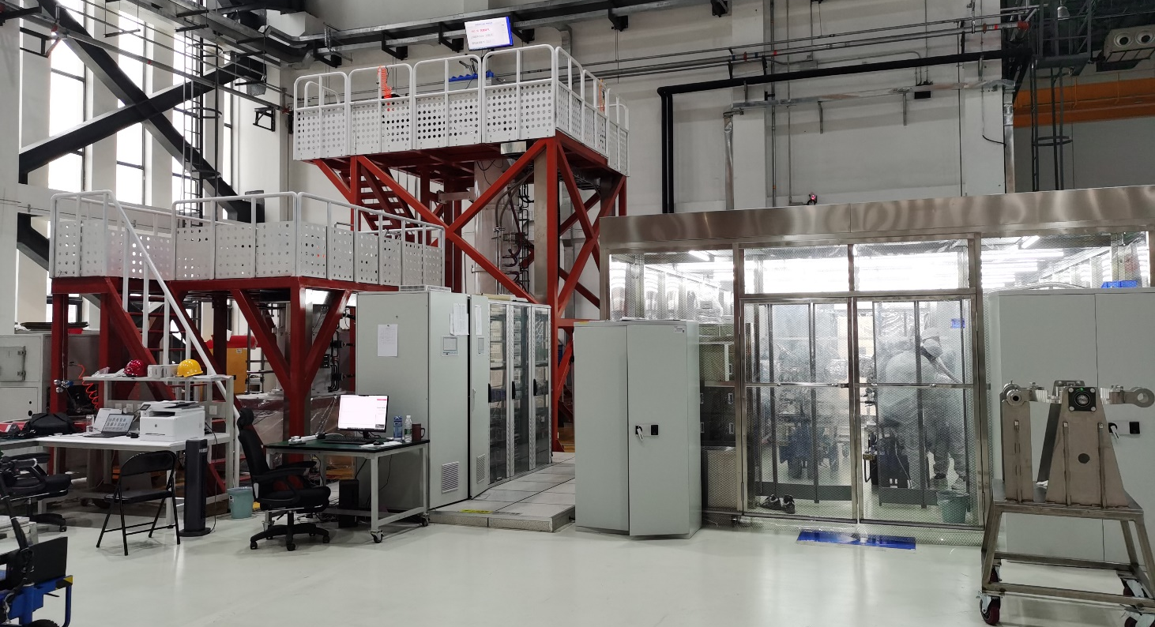
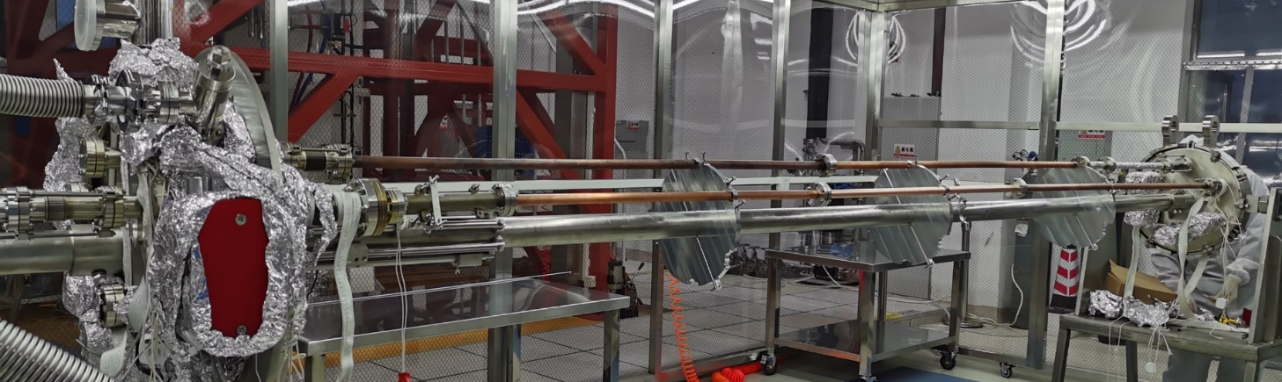
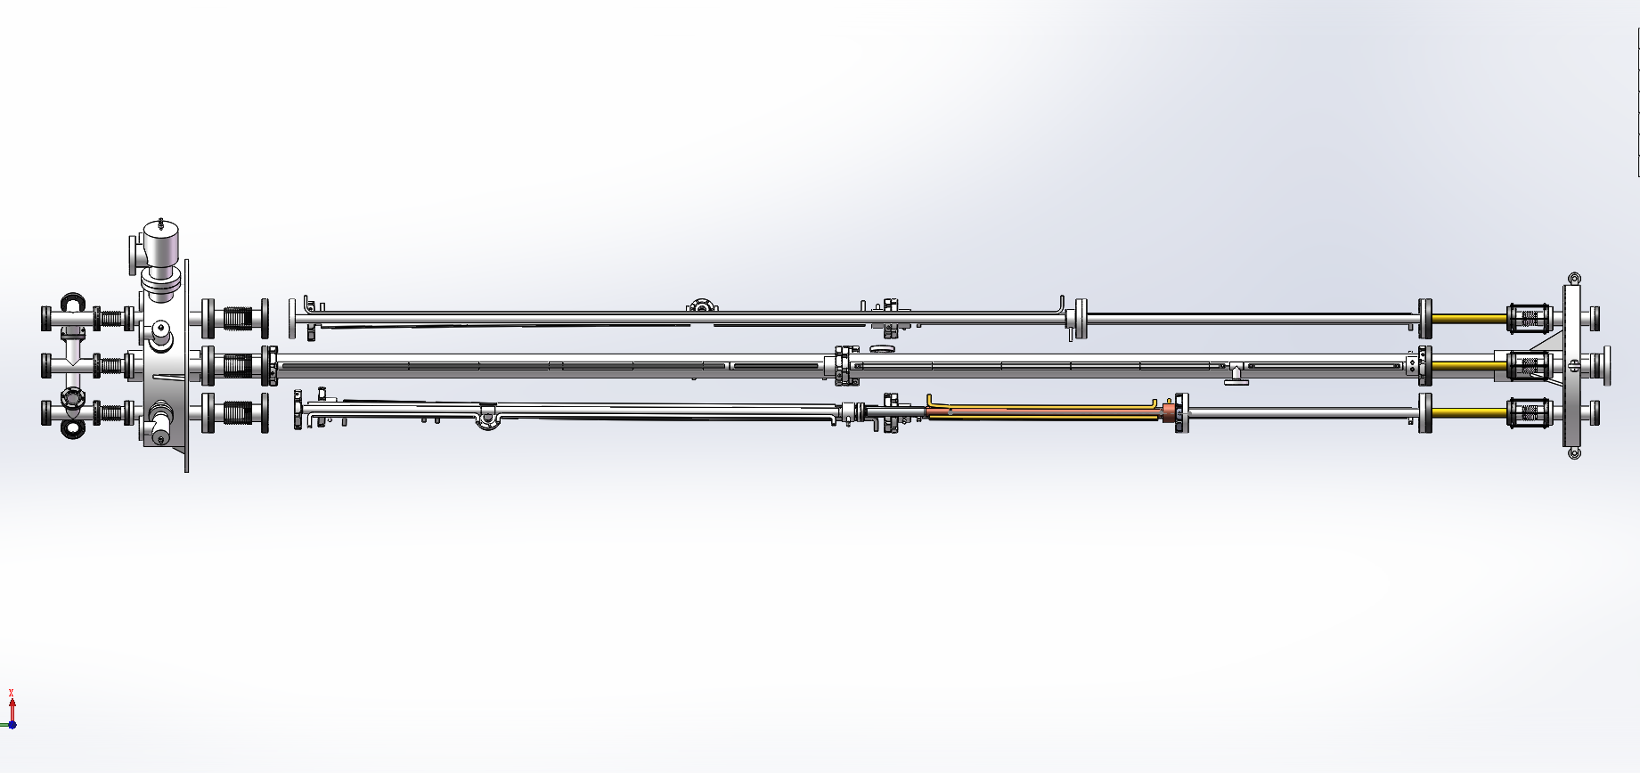
Massive production of NEG coating synergy of HEPS
The coating device A: Vacuum chambers are connected in parallel to 6 groups, each group of vacuum chambers length should be lower than 3.5m, outer diameter is about 0.47m;
The coating device B: Antechamber are connected in parallel to 4 groups, each group of vacuum chambers length should be lower than 1.5m, due to its discharge difficulty.
Two setups of NEG coating have been built for vacuum pipes of HEPS at IHEP Lab. And a lot of test vacuum pipes have been coated, which shows that NEG film has good adhesion and thickness distribution.
A：Circle, racetrack
B：Antechamber
Dust-free room
10

Slide 11
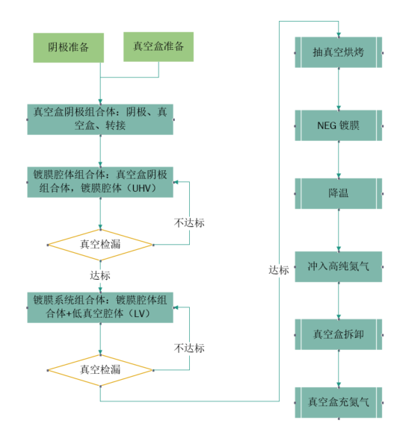
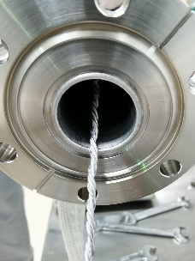
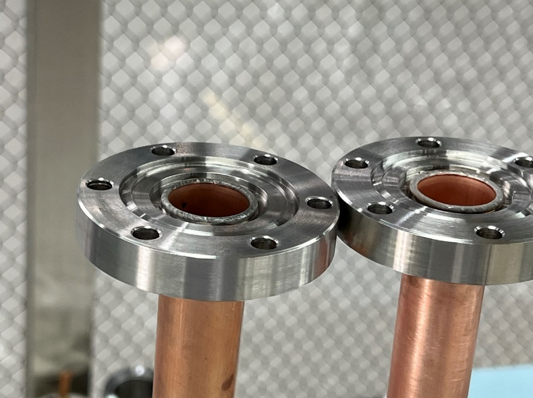
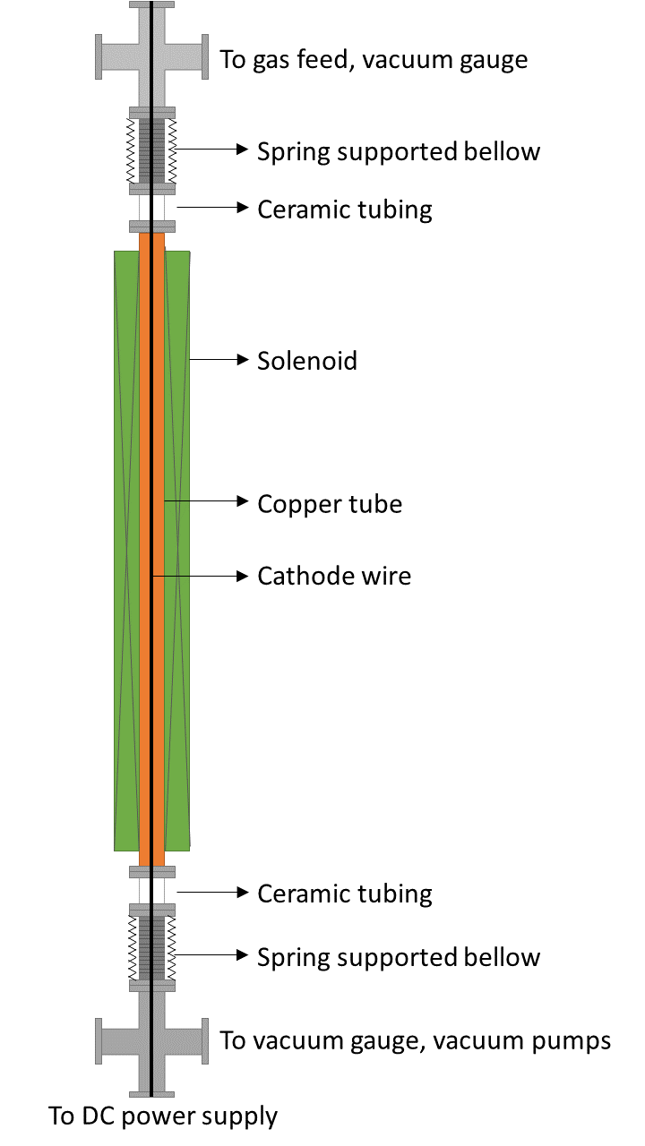
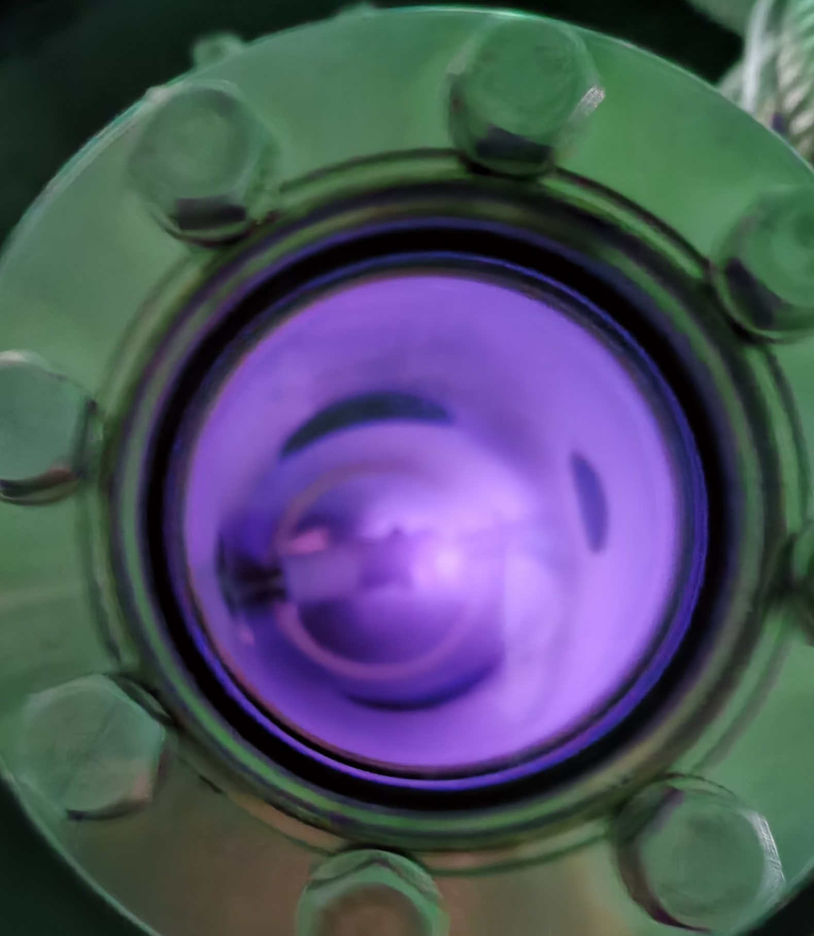
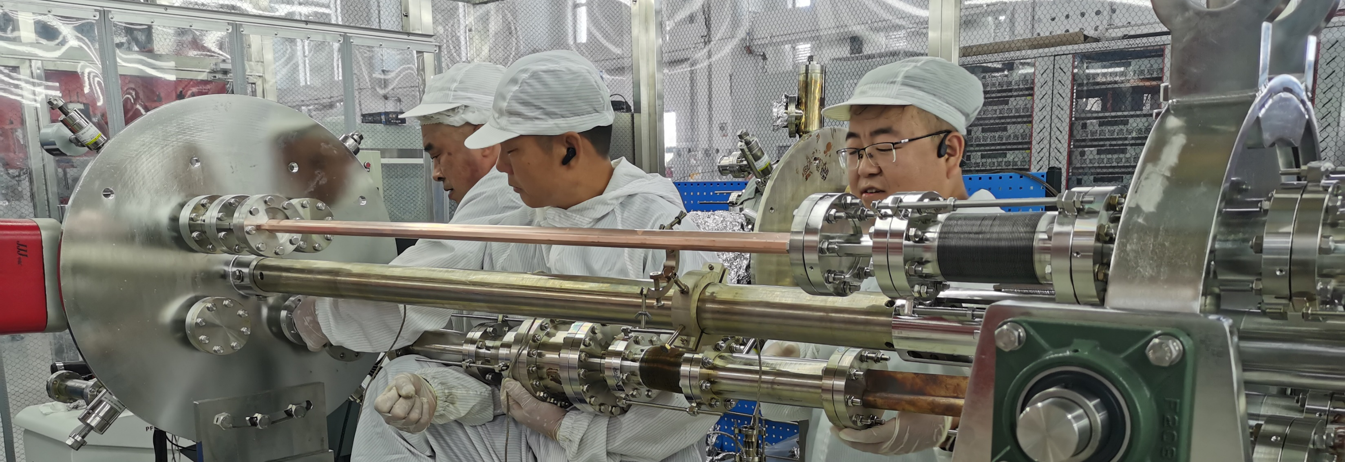
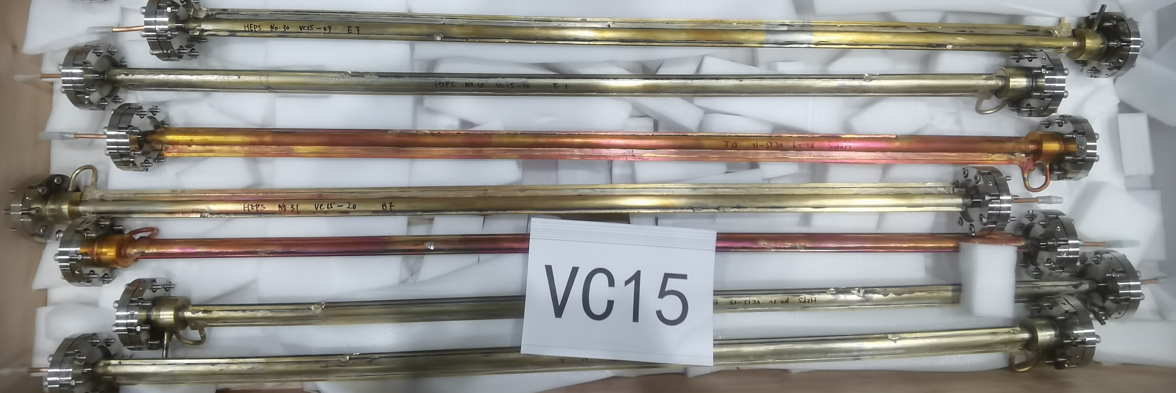
Process of NEG coating

Slide 12
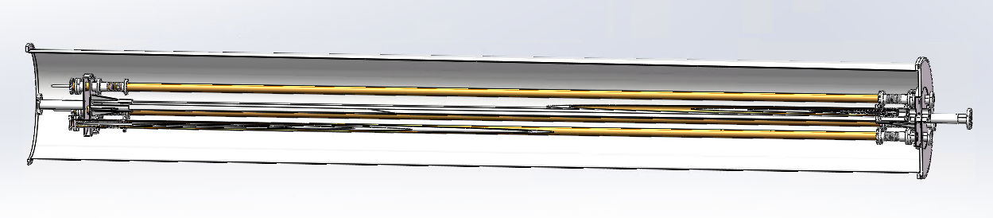
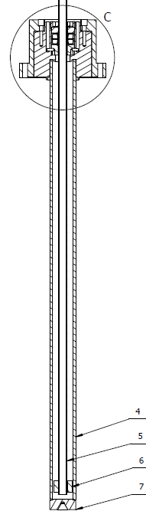
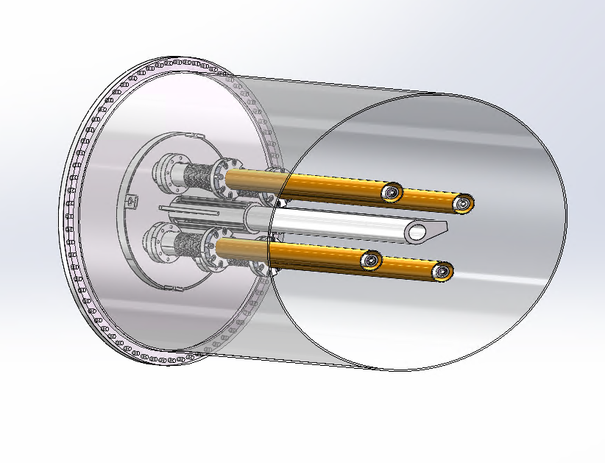
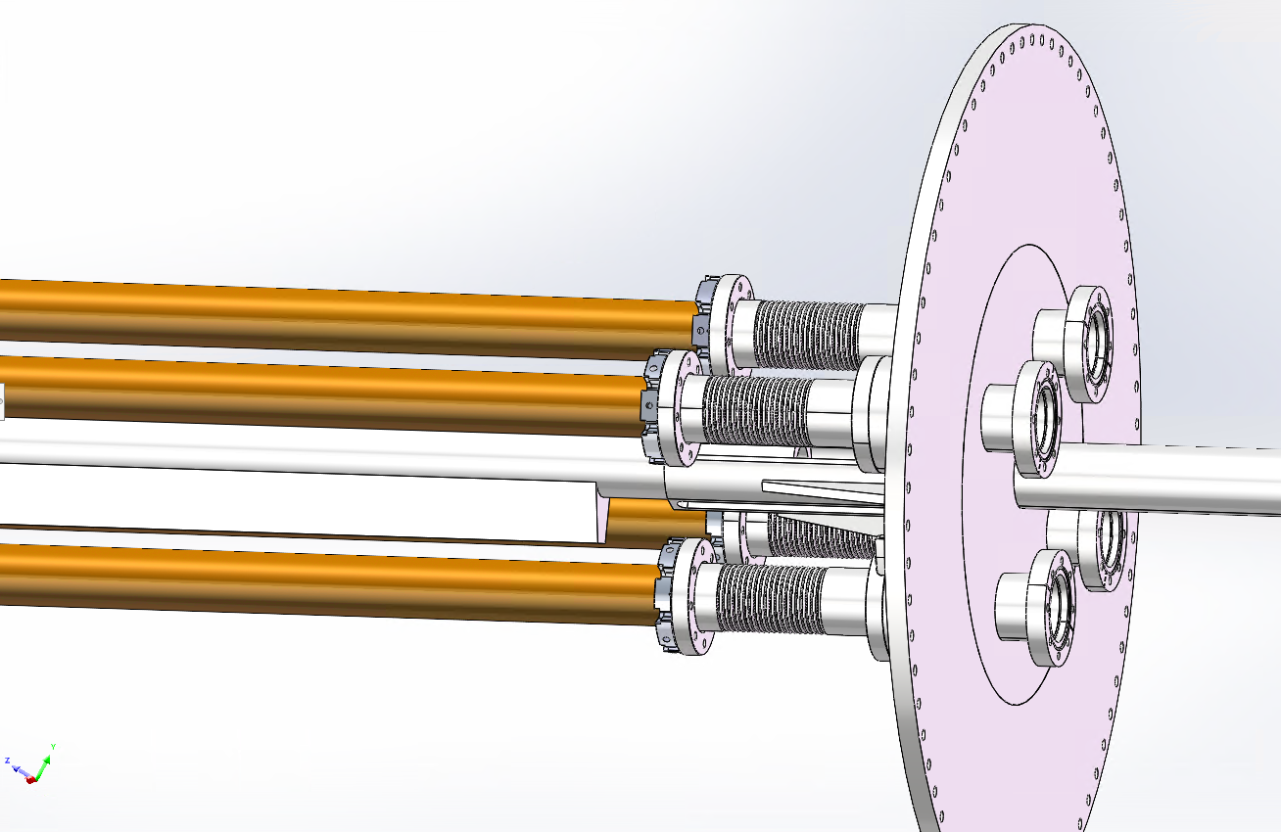
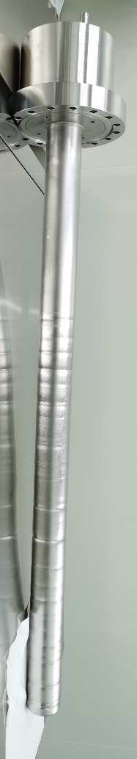
Massive production of NEG coating for CEPC——Upgrade plan
Due to the diameter of CEPC is D56, we plan to replace the cathode wire with a magnetron sputtering cathode
Permanent magnet instead of the solenoid which supplies magnetic field for DCMS;
By combining the low vacuum chamber outside of the vacuum chambers to be coated with NEG, the high vacuum process is simplified;

Slide 13
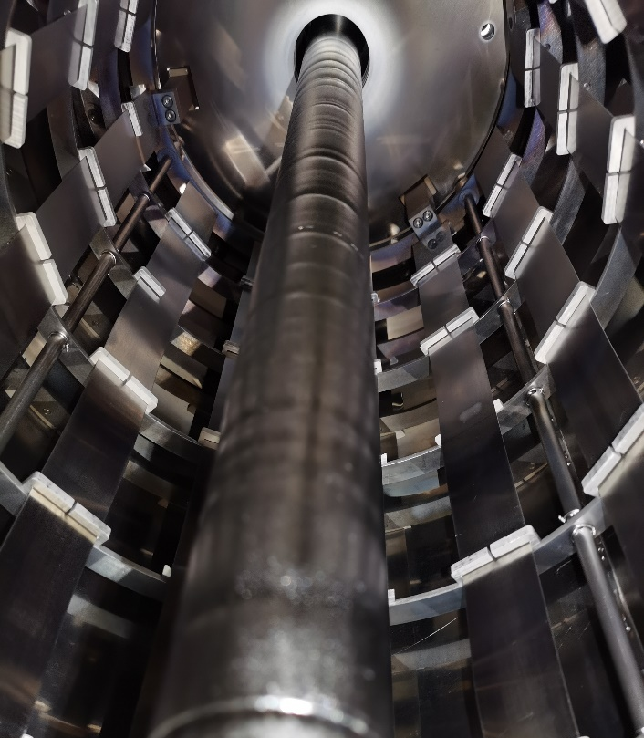
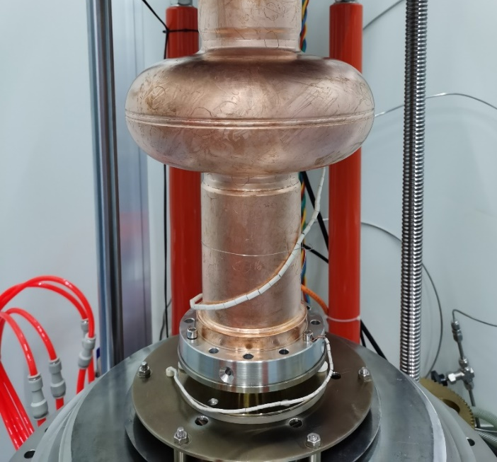
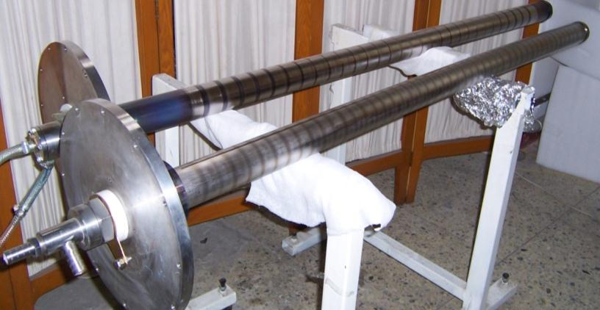
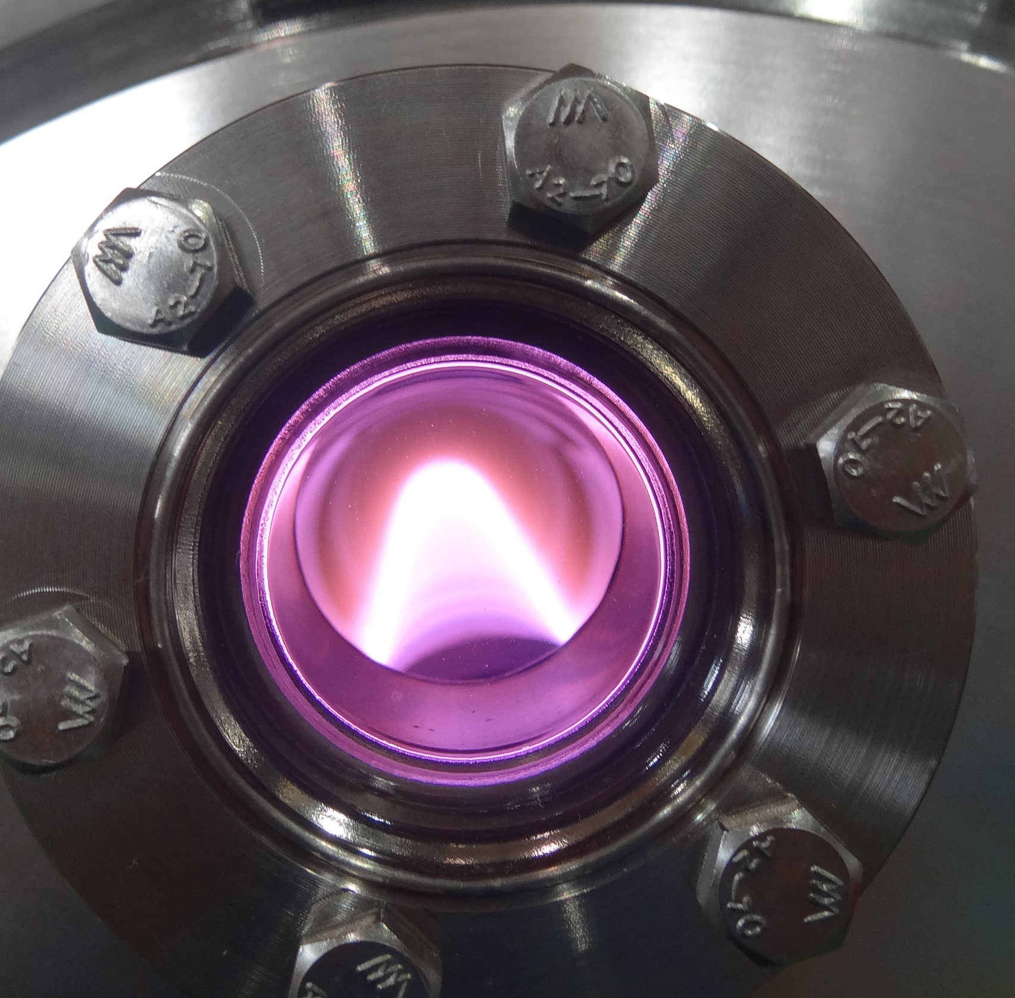
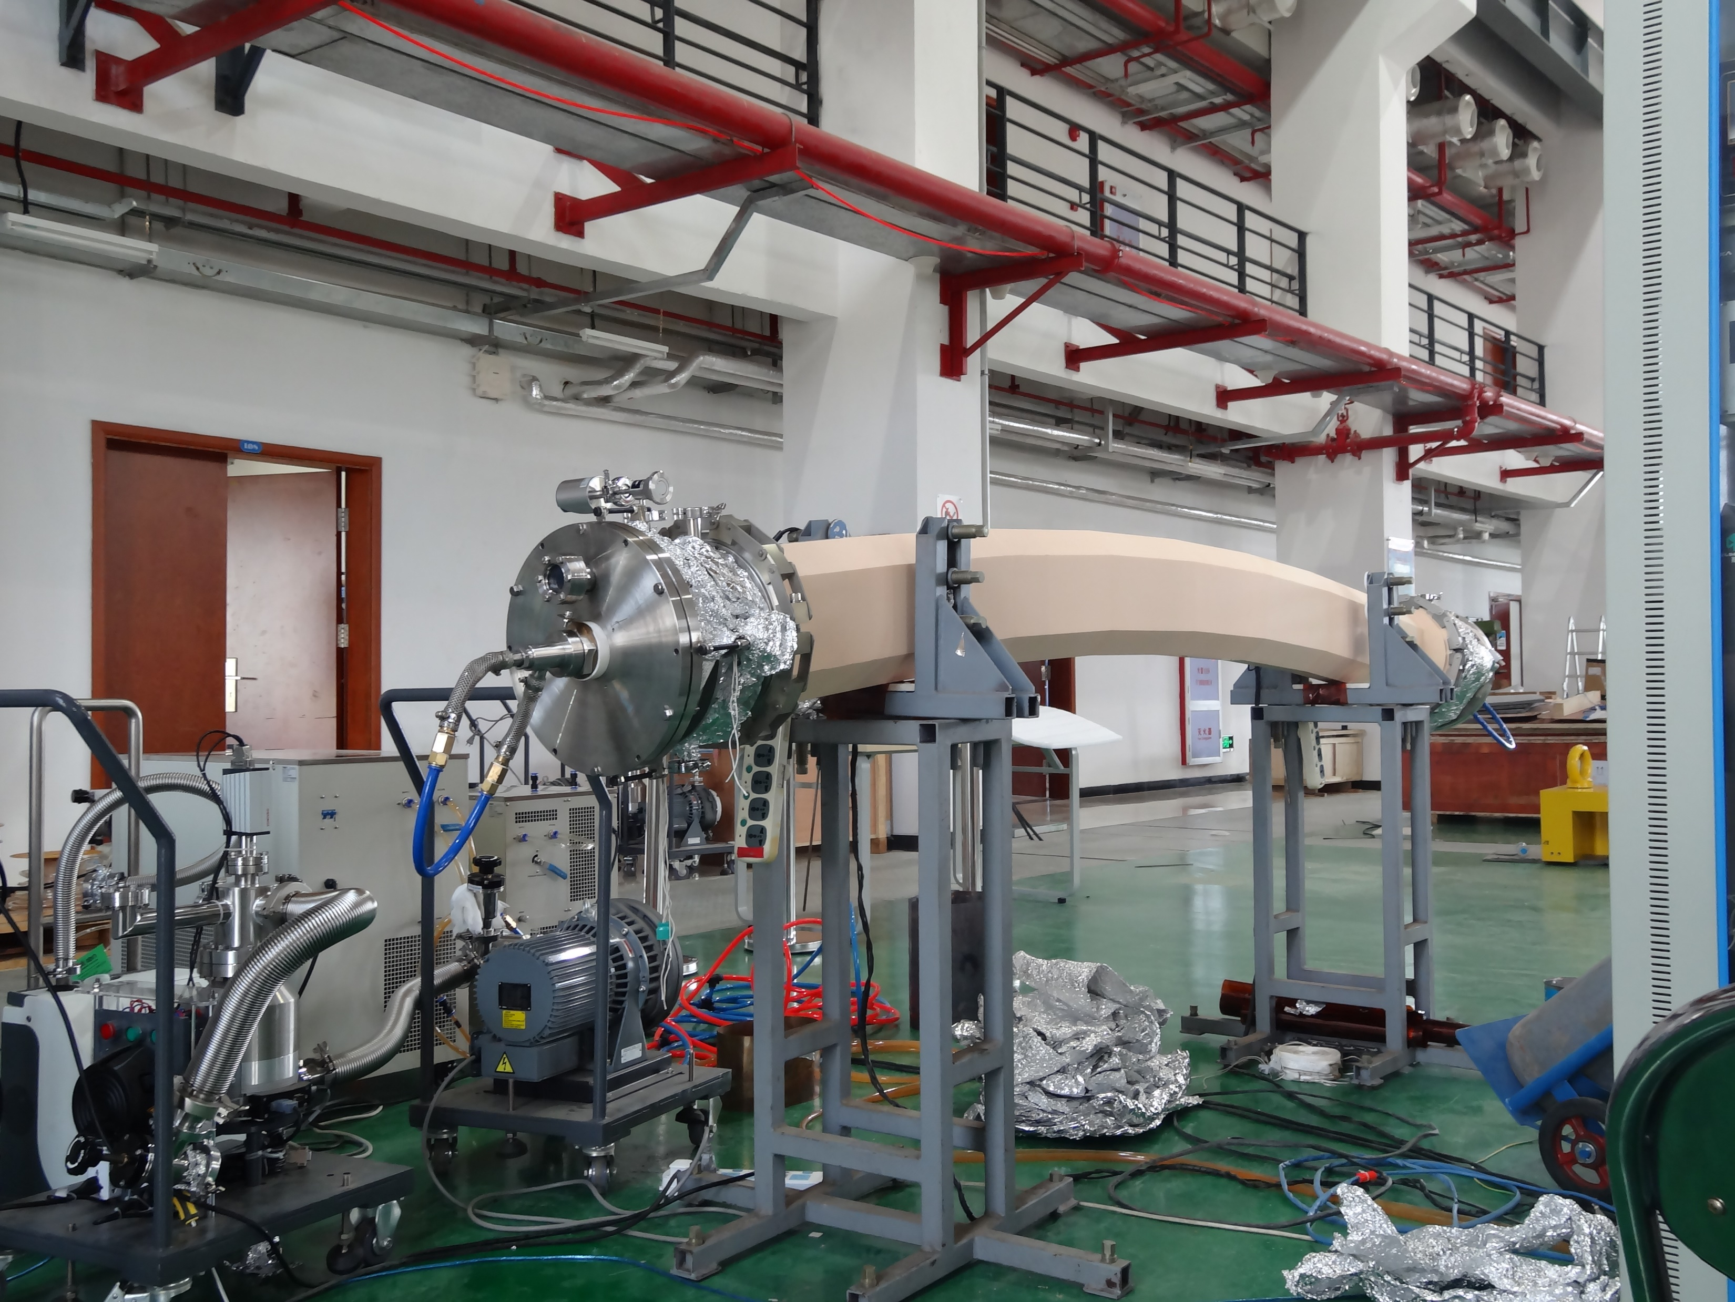
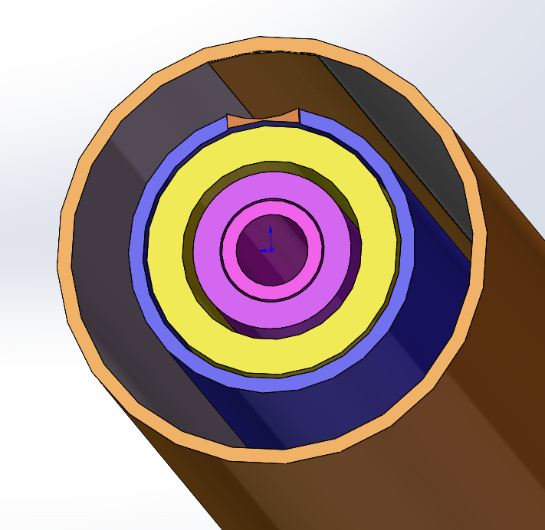
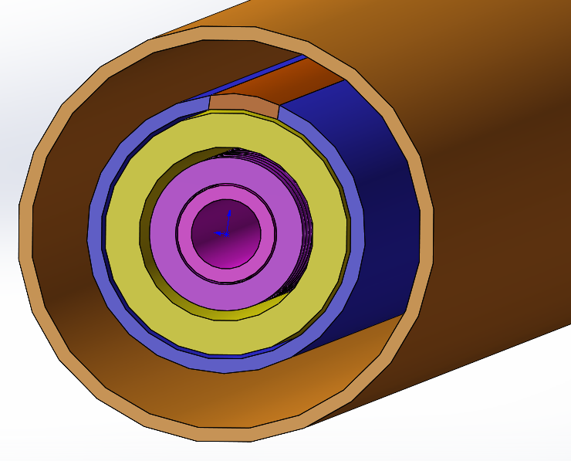
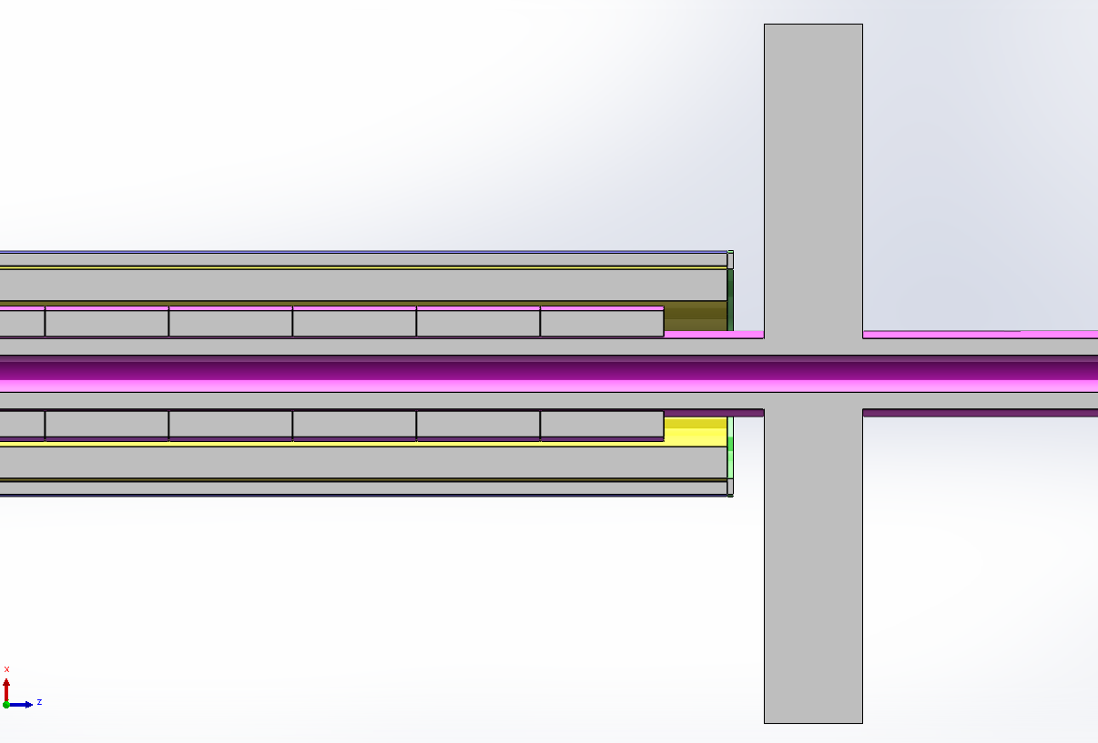
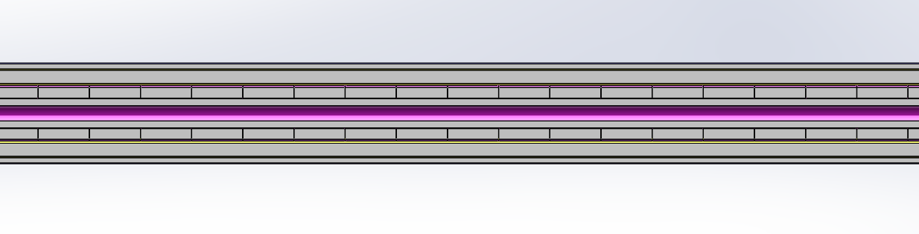
Work foundation magnetron-sputtering-cathode
Niobium coating by DCMS for 1.3GHz RF Copper substrate
TiN coating by DCMS for Ceramic vacuum chambers of CSNS
The challenging of magnetron-sputtering-cathode for CEPC
A prototype of the magnetron sputtering cathode needs to be developed before massive application in the NEG coating system. The prototype needs to address the support, sealing, plasma discharge, and cooling of the cathode.
Length 11.6m

Slide 14
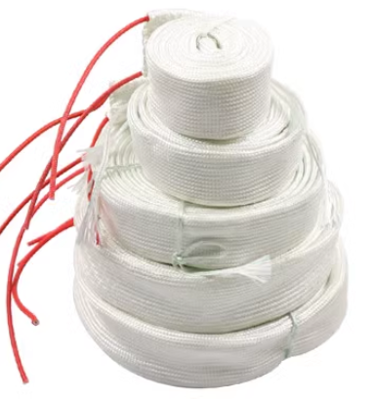
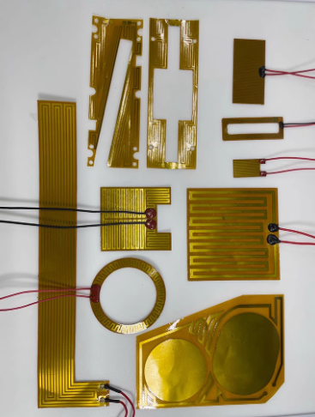
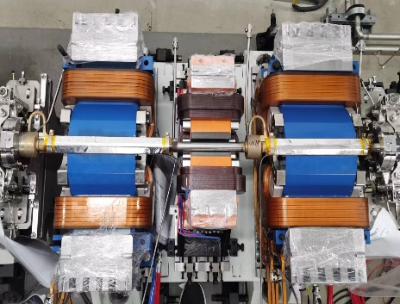
Why spray heating film
The baking is the most crucial procedure in achieving ultra-high vacuum
Necessity:
In order to meet the ultra-high vacuum requirement of achieving a dynamic vacuum level of 3.0E-10 mbar.
NEG coating reactivation
Too thick
Lifetime is very short under SR of CEPC
N₂
N₂
H₂
H₂
O₂
MO
O₂
Heat
O
High
vacuum
or
inert gas
H₂O
C
MC
CO
H₂O
CO₂
CO₂

Slide 15
Spray for heating film
Solution：multilayer heating film will be coated outside of the vacuum chamber which composited by ceramic and conductivity layer
solution
Ceramic layer
Convection
Radiation
电流I
Conductivity layer
Conduction
Ceramic layer
Heating layer
Thickness： 0.5mm
  The heating temperature could reach 250℃
Cu/ceramic transition layer
Vacuum chamber

Slide 16
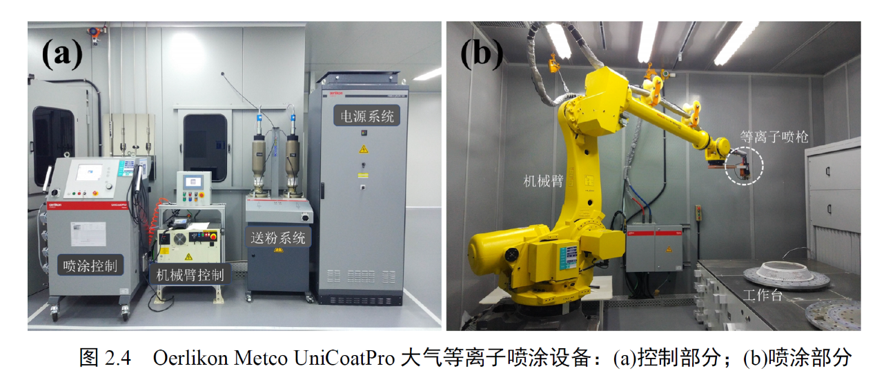
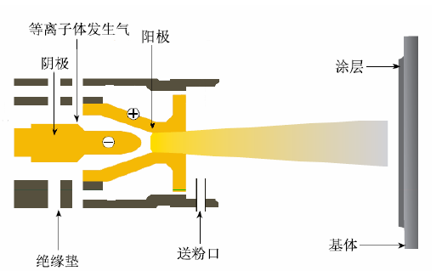
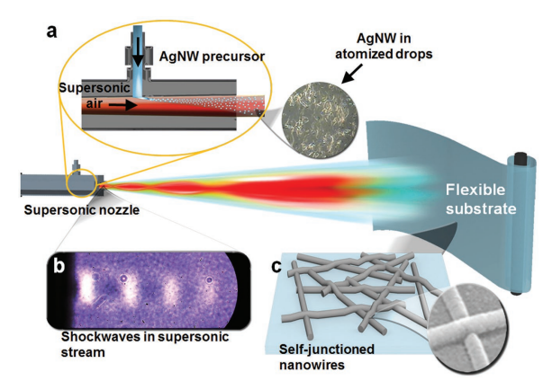

Spray heating film R&D
Atmospheric plasma spraying:
Can be carried out directly in the atmosphere, with low environmental requirements and strong adaptability. the spraying process can be fully automated for production.
可理解为“印刷电路”
Cu/Ag NW
Processing of spray
Plasma spraying

Slide 17

Process of spray heating film

Slide 18
Layout of production line

Slide 19
NEG coating optimization
Impedence
Round pipe of Copper (2~3mm) with NEG coating (200nm)
Strictly control on the coating thickness for impedance source to restrain the instability!【1】
Reactivation life-times
带来的问题：200nm薄膜，抽气性能（抽速与寿命）迅速下降
【1】Liu Yu Dong .Modification suggestion of vacuum chamber for the collider ring. 2021/3/25

Slide 20



NEG coating optimization
Scheme 1: Multilayer NEG coating: improve lifetimes, conductivity.
Add Pt、Au、Ag
Pd、Pt、Au、Ag 20~50nm
TiZrV （Hf）~0.2$μm$
chamber
DCMS
Direct Current Magnet Sputtering
Scheme 2: Copper & NEG coating: improve lifetimes, conductivity.
Copper film
NEG film
hybrid structure of magnetron sputtering cathode
Notes:
四元吸气薄膜已经有人提出，并得出结论：抽速大、激活温度更低

Slide 21





RF shielding Bellows for ultra Expansion/contraction
Vacuum bellow modules are needed to compensate the mechanical misalignments of the vacuum chambers during installation and to absorb their thermal expansion during the bake-out. In order to reduce the beam impedance during operation with beams these modules are equipped with RF bridges to carry the image current.[1]
Ultra Expansion/contraction RF bellows to meet the 11.4m long vacuum chambers and component for mock up line.
Prototypes in TDR

Slide 22


Tungsten alloy vacuum chamber
Tungsten alloy will be used to made the fork vacuum chamber of MDI
NEG coating is suggested to the fork vacuum chambers
Water cooling pipe will be designed due to the high thermal load of impedance at high light Z model

Slide 23





Double-hole extrusion tube development
Double-hole extrusion tube instead of the two single tube brazed together.

Slide 24


RF shielding All metal gate valve
Times | open | closed | Backgroud Leakage mbar·L/s | Leakage mbar·L/s | Note
1 | 2023/12/23 | 2023/12/23 | 1.00E-11 | 7.00E-09 | rise slowly
2 | 2023/12/23 | 2023/12/25 | 1.00E-12 | 7.00E-10 | rise slowly
3 | 2023/12/25 | 2023/12/27 | 1.00E-12 | 1.40E-09 | rise slowly
4 | 2023/12/27 | 2023/12/27 | 1.00E-12 | 8.60E-09 | rise slowly
5 | 2024/1/2 | 2024/1/2 | 1.00E-12 | 4.60E-09 | rise slowly
6 | 2024/1/2 | 2024/1/2 | 1.00E-12 | 4.70E-09 | rise slowly
7 | 2024/1/2 | 2024/1/2 | 1.00E-12 | 8.80E-09 | rise slowly
8 | 2024/1/3 | 2024/1/3 | 1.00E-12 | 2.60E-09 | rise slowly
9 | 2024/1/3 | 2024/1/3 | 1.00E-12 | 5.10E-09 | rise slowly
10 | 2024/1/4 | 2024/1/4 | 1.00E-12 | 1.40E-09 | rise slowly
11 | 2024/1/4 | 2024/1/4 | 1.00E-12 | 8.00E-10 | rise slowly
12 | 2024/1/4 | 2024/1/4 | 1.00E-12 | 9.60E-09 | rise slowly
13 | 2024/1/9 | 2024/1/9 | 1.00E-12 | 3.80E-09 | rise slowly
14 | 2024/1/10 | 2024/1/10 | 1.00E-12 | 6.80E-09 | rise slowly
15 | 2024/1/10 | 2024/1/10 | 1.00E-12 | 6.10E-09 | rise slowly
16 | 2024/1/11 | 2024/1/11 | 1.00E-12 | 2.60E-09 | rise slowly
17 | 2024/1/15 | 2024/1/15 | 1.00E-12 | 3.40E-09 | rise slowly
18 | 2024/1/15 | 2024/1/15 | 1.00E-12 | 1.60E-09 | rise slowly
19 | 2024/1/15 | 2024/1/15 | 1.00E-12 | 1.30E-09 | rise slowly
20 | 2024/1/15 | 2024/1/15 | 1.00E-12 | 1.60E-09 | rise slowly
21 | 2024/1/16 | 2024/1/16 | 1.00E-12 | 1.30E-08 | rise slowly
22 | 2024/1/16 | 2024/1/16 | 1.00E-12 | 8.60E-09 | rise slowly
23 | 2024/1/16 | 2024/1/16 | 1.00E-12 | 1.30E-08 | rise slowly
24 | 2024/1/17 | 2024/1/17 | 1.00E-12 | 1.30E-08 | rise slowly
25 | 2024/1/18 | 2024/1/18 | 1.00E-12 | 8.90E-09 | rise slowly
26 | 2024/1/18 | 2024/1/18 | 1.00E-12 | 1.40E-08 | rise slowly
27 | 2024/1/22 | 2024/1/22 | 1.00E-12 | 1.20E-09 | rise slowly
Two prototypes of RF shielding All metal gate valve have been developed, and the leakage of one of them have been tested.
Supported by HEPS-RF System.
Expectation leakage < 1×10⁻⁹ mbar ·L/s

Slide 25
Budget
分类 | 设备 | 万元 | 说明
生产线相关 （合计2320万元） | 电子束焊机 | 800 | 满足11.4米，4~6工位真空盒焊接
 | NEG镀膜机 | 450 | 满足11.4米，6工位真空盒镀膜
 | 喷涂机 | 300 | 满足11.4米，加热层喷涂
 | 清洗设备 | 100 | 满足11.4米，去离子水设备，化学清洗槽，超声波等
 | 检测平台 | 60 | 满足11.4米，尺寸与真空检漏
 | 生产线相关设备 | 550 | 整条产线上下料，传输，控制等
 | 洁净间 | 60 | NEG镀膜前后真空盒组装
性能优化与研究 （合计410万元） | MDI 钨合金真空盒 | 45 | R&D
 | NEG镀膜研究 | 45 | 性能优化
 | 全金属插板阀 | 70 | R&D
 | 双孔铜管拉制 | 100 | 新增
 | 模拟单元真空相关设备 | 150 | 含RF bellow 研发费用
 | 合计 | 2730

Slide 26
Conclusion
Production line of vacuum chambers and NEG coating will be R&D in 2 years;
Double-hole extrusion tube R&D plan to be carried out to simplified the vacuum chambers fabricating procedure;
NEG coating by magnetron sputtering cathode method R&D will be carried out to adapt the production line;
NEG coating optimization for low impedance film, Spraying for heating film plan to be carried out ;
The prototypes of tungsten alloy vacuum chamber, RF shielding Bellows for ultra Expansion/contraction, RF shielding All metal gate valve will be carried out in EDR.
Thank you

Slide 27


Configuration of Vacuum chamber in collider
CEPC day2023.4.21
Wang YW
LI MX
collider 真空盒的数量与长度统计：根据磁铁长度与布局得到
 | 根据磁铁分类 | 组合数量 | 真空盒长度 |  | 标准单元数量 | 真空盒总数量 | 合计长度 | 备注
标准单元 | 二级铁组合A | 30 | 11.4 | 米 | 64 | 3840 | 44160 | 磁铁组合放2根真空盒
 | 二级铁组合B | 16 | 9.8 | 米 | 64 | 2048 | 20070.4 | 磁铁组合放2根真空盒
 | 四六级铁组合 | 16 | 6.5 | 米 | 64 | 1024 | 6656 | 磁铁组合放1根真空盒
 | 四级，校正铁组合 | 31 | 3.8 | 米 | 64 | 1984 | 7539.2 | 磁铁组合放1根真空盒
弧区汇总 |  |  |  |  |  | 8896 | 78425.6
直线节 |  | 4000 | 11 |  |  | 364 | 4000
高频代用 |  | 5648 | 11 |  |  | 513 | 5648
对撞区 |  | 7000 | 5.5 |  |  | 513 | 7000
直线节汇总 |  |  |  |  |  | 1391 | 16648
合计 |  |  |  |  |  | 10287 | 95074

Slide 28


镀膜机
洁净组装间
清洗
喷涂机
焊接
检测

Slide 29




尚缺少的实验条件
等离子体喷涂设备——需研制
实验需要的材料——需采购
购买阴极材料、喷涂粉末等材料
喷涂系统核心部件：
喷枪机械手
工件机械手
喷枪是热喷涂设备的核心，其设计、加工水平的高低直接影响涂层质量的优劣
加料器将粉末或丝材形式的原材料供应到热喷枪，应用于不同涂料、不同热喷涂工艺、生产规模和范围。
其他部件包含：如喷枪机械手、工件机械手（转台和车床等）、以及一些外围设备（如集尘器，冷却系统，喷涂室等）

Slide 30
喷涂设备调研
河南莱帕克化工设备制造有限公司（供应商），等离子喷涂设备，248 6000元
北京最时代科技发展有限公司 （供应商）Unicoatpro 等离子热喷涂系统 （欧瑞康美科）341 9000元
北京国科军友工程咨询有限公司（招标代理）；高效率大功率大气等离子喷涂设备 347 3000元
兆锋机电设备（上海）有限公司（供应商） 真空等离子喷涂设备 欧瑞康美科 （Multicoat VPS）978 0000
北京联合涂层技术有限公司；四次时代巨创科技有限公司；江苏德意高航空智能装备有限公司；北京廊桥材料技术有限公司；河北和桥金属材料科技有限公司；吉林省博超科技有限公司

Slide 31


导电加热涂层方案
导电加热涂层材料选择：金属纳米线（如Cu/Ag NW）是一种直径从几纳米到几百纳米，长度从几微米到几百微米的一维纳米材料。
金属纳米线涂层制备过程简单，成品率高，通过喷涂、旋涂、丝网印刷、喷墨打印等方法制备
[1]不同条件下合成的AgNWs SEM形貌图
[2]喷涂法制备银纳米线薄膜涂层（a）制备流程图 （b）冲击波模式 （c）喷涂后银纳米线结点处的自熔融现象
[3]不同位置的AgNWs旋涂分布形貌
其中喷涂工艺制备：工艺操作简单，不受真空盒尺寸、形状限制，也适合大面积成膜，通过调节工艺参数可有效控制导电薄膜的膜厚和其电学性能，这种方法还能在一定程度上增大薄膜与基板间的结合力。
[1] Li B,Ye S,Stewart I E,et al.Synthesis and Purification of Silver Nanowires to Make ConductingFilms with a Transmittance of 99%[J].Nano Letters,2015,15(10):6722-6726
[2]Lee J G , Kim D Y , Lee J H ,et al.Production of Flexible Transparent Conducting Films of Self‐Fused Nanowires via One‐Step Supersonic Spraying[J].Advanced functional materials, 2017(1).DOI:10.1002/adfm.201602548.
[3] Wang J L,Jiang H J,He Z,et al.Radial Nanowire Assemblies under Rotating Magnetic Field EnabledEfficient Charge Separation[J].Nano Letters,2020,20(4):2763-2769 (俞书宏院士团队)

Slide 32



导电加热涂层的制备及稳定性优化
制备Cu/Ag纳米线，采用喷涂或旋涂的方式，在喷涂有陶瓷绝缘陶瓷Cu基片上制备纳米线涂层。
四探针测试示意图
Cu/Ag NW
喷涂法制备Cu/Ag 纳米线电热涂层示意图
旋涂法制备Cu/Ag 纳米线电热涂层示意图
通过控制喷涂或旋涂时间，实现不同厚度金属纳米线涂层的制备，并在涂层两端印刷电极
导电加热涂层单探针电映射示意图
涂层温度响应和稳态温度研究：在不同厚度样品上逐渐施加直流电压载荷，使用薄膜热电阻记录涂层表面以及基底表面的温度变化，通电一定
时间后后关闭电源使涂层自然降温。记录的升降温过程的温度-时间曲线以测试涂层的温度响应和稳态温度。
涂层宏观电气性能测试及研究 ：
采用单探针映射（1P映射）研究薄膜表面的电场分布：电极施加低电压（先保证薄膜在低载荷下完整性）在薄膜 表面形成通路。将电压表的一端接地，另一端与薄膜接触，接触点均匀分布薄膜表面，通过记录每个接触点位置 对应的电压值便可得到薄膜表面的电压等电位线分布。

Slide 33


制备高质量陶瓷绝缘层
采用大气等离子喷涂方法在Cu基体表面制备具有较高的电阻率和耐辐射性能的Al₂O₃绝缘陶瓷涂层及其粘结层。
大气下直接进行，环境要求不高，适应性强，操作便捷，可在几何形状复杂的工件表面制备相应涂层，结合机械臂可让喷涂过程实现全自动化生产
等离子喷涂原理图
引入掺杂优化Al2O3涂层
涂层表面电阻测试示意图
（ASTM D257—07标准）
通过向Al₂O₃粉末中添加适量的TiO₂、碳纤维/碳纳米管或稀土元素及其混合物等，改善涂层脆性较大，容易产生裂纹的问题。
采用大气等离子喷涂法制备结构致密的粘结层，通过对粘结层的微观结构进行优化，从而获得理想的、连续致密的涂层。
研究涂层的界面微观结构，提升涂层附着力，
进行加载条件下的绝缘性能表征，优化陶瓷涂层质量。

Slide 34


制备工艺
基体预处理
首先对金属基材进行喷砂处理，然后将其放入丙酮中超声处理。该处理是为了增强熔融粒子与金属基材的机械咬合，从而提高涂层与金属基材的结合强度。
引入粘合层
由于陶瓷涂层和金属基材的热膨胀系数有较大差异，为了改善陶瓷涂层与金属基材之间的结合力，首先，利用喷涂设备基体表面喷涂一层金属过渡层，过渡层厚度约100 μm，喷涂参数见表1。
制备绝缘陶瓷层
等离子喷涂系统（APS，UnicoatPro，USA）喷涂制备Al2O3陶瓷涂层，所制备陶瓷涂层的厚度约为320~400 μm，具体的喷涂参数见表2
MCrAlY（M=Ni、Co或NiCo）具有抗高温氧化和耐腐蚀性能，被广泛应用于高温防护涂层。该涂层最大的优点是能够根据不同的使用环境来设计粉末元素的含量。其中，Al的作用是高温的工作环境下生成一层具有防止氧通过的氧化铝保护膜，能够避免粘结层被进一步氧化。Cr的作用是加速保护膜氧化铝的生成，在Al被完全氧化后形成Cr2O3，能够进一步防止O的通过，另外Cr还具有耐腐蚀的作用。Y的作用是增强保护膜与基体的粘结性，同时还能够提高热震性能。

Slide 35



[1] S. CALATRONI P C, P. COSTA PINTO. <NEG THIN FILM COATING DEVELOPMENT FOR THE MAX IV VACUUM SYSTEM thpfi044.pdf> [J]. IPAC2013,
多根真空盒串联+并联的形式，实现批量化镀膜能力
Ceramic support
Flange
Cathode
a1
a4
a2
ceramic
a3
Total length 4200mm
增加陶瓷支撑的数量&优化支撑位置，尽可能让阴极丝处在正中的位置，协调薄膜厚度在周向方向的均匀性
Ceramic support

Slide 36
Vacuum requirements and configuration
 | Energy | Material | Cross Section/mm | Length/m | Dynamic pressure /Torr
LINAC | 30 GeV | Stainless steel, copper | Φ20~30 | 1,601+ 335 (BTL) | Acc <2×10⁻⁷ E-gun<2×10⁻⁸
Damping ring | 1.1 GeV | Extruded aluminum 6061 | Φ30/Al 6061 | 147 | <2×10⁻⁸
Booster | 30 to 180 GeV | Extruded aluminum 6061 | Φ56/thickness of 2mm | 100,000 | <3×10⁻⁸ tt<4×10⁻⁸
Collider | 45.5~180 GeV | Extruded copper, NEG film SEY<1.2 | Φ56/thickness of 2mm | 100,000×2 | Z<8×10⁻¹⁰ tt<1×10⁻⁸
MDI | 45.5~180 GeV | Copper/tungsten alloy, NEG film | Φ20 | 12 | <3×10⁻⁹
LTB | 30 GeV | Stainless steel | Φ56 | 3,000 | <1×10⁻⁷
BTC(CTB) | 6 GeV | Stainless steel | Φ56 | 240×6 | <1×10⁻⁷
DL | 1.1 GeV | Stainless steel | Φ30 | 240 | <1×10⁻⁷

Slide 37

Introduction -Cost distribution of components
Components | Specification | Total Price / (CNY 10,000) | Description
Arc beam pipe_Copper | D56/C10100 | 101602.7 | Collider
Vacuum heating | 220v | 20000.0 | Collider
NEG coating | Ti-Zr-V | 30000.0 | Collider
RF shielded bellows | DN63 | 32025.6 | Collider, DR
Arc beam pipe_Al | Al6060 | 32000.0 | Booster
Manifold | 316L | 10698.0 | All
Bellows | 316L | 4598.4 | Except of collider
Others |  | 17278.7 | Auxiliary devices
Ion pump | 50~100L/s | 40552.0 | All，Standard device
Gate valve | CF63 | 22148.0 | All，Standard device
Vacuum gauge | CCG | 16476.0 | All，Standard device
Residual gas analyzer | Amu 1~100 | 7980.0 | All，Standard device
Molecular pump | 400L/s | 3500.0 | All，Standard device
Total |  | 338859.4 | CEPC Vacuum system
73.2%
90656
26.8%
There is a wide variety of components required for the vacuum system, which spans a total length of 310km;
The cost of non-standard components accounts for approximately 73.2% of the total cost of the vacuum system.

Slide 38



Slide 39
生产线所需信息
长度：单根产品按11.4m，外径60~62mm；重量：估计在50~100kg，法兰（CF63）：最大外径114mm
厂房暂定长50m，宽30m；产能;暂时按年产5000根；
成品，最大长度11.4米
NEG coating
铜管
铜管
水冷管
法兰
清洗
铜管与水冷管钎焊
铜管与法兰电子束焊接（真空内完成）
检测：尺寸、漏率
直流磁控溅射镀膜
主要难点：真空封装
喷涂多层薄膜，厚度大约0.5mm

Slide 40









现有在线加热技术方案存在问题
占用空间大，场景受限：
不耐辐射
易损耗，占据空间大
加热带：目前主要有硅橡胶加热带和玻璃纤维加热带（BEPCII）
寿命差：此外硅橡胶加热带也会有刺激性气味；而玻璃纤维加
热带则有大量玻璃纤维脱落，寿命较差
有机加热膜（HEPS）：绝缘强度高，热传导效率，发热均匀
寿命差：不耐更高能量的高能同步辐射光辐射，如（CEPC），易过热失效
加热丝/棒：升温快，强度高，经久耐用等优势；
均匀性差： 贴向基体的某一侧使用，存在加热不均匀的问题。
加热片/板：具有结构简单，加热均匀等优势，同时绝缘性能好，热效率高，场景受限： 无法弯曲，只能用于平面的基体

Slide 41




现有加热技术在国内外加速器应用
国外加速器真空盒烘烤方案研究现状
MAX-IV EX-situ backing
SIRIUS In-situ backing
HEPS In-situ backing
现有真空盒烘烤加热方案
离线烘箱：烘烤效率低，需要打开磁体
在线加热薄膜：不耐高能同步辐射光的照射
均不适用
未来更高能量加速器（如CEPC）

