Slide 1

CEPC radiation/environment EDR plan
环形正负电子对撞机
Circular Electron Positron Collider
2024-02-28

Slide 2
Outline
Radiation Protection (RP) related issues
RP/Environment tasks in TDR
RP EDR research content and plan
Budget and manpower
Summary

Slide 3
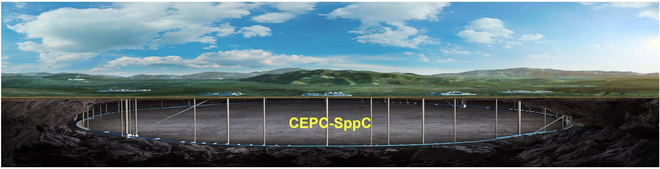
Introduction
RP issues in TDR
RP chapters in TDR:
  4.2.4/5.2.4: Synchrotron Radiation and Shield
  4.2.5.3: Beam Dump
  7.3: Radiation Protection and Interlock
    Radiation shielding; Radiation-Dose Monitoring Program; Personal Safety Interlock System;
  10: Environment, Health and Safety Considerations
    Training and work planning; Environmental impact; Ionizing radiation; Fire safety; Cryogenic and oxygen deficiency hazards; Electrical safety; Non-ionizing radiation; and General safety issue.

Slide 4
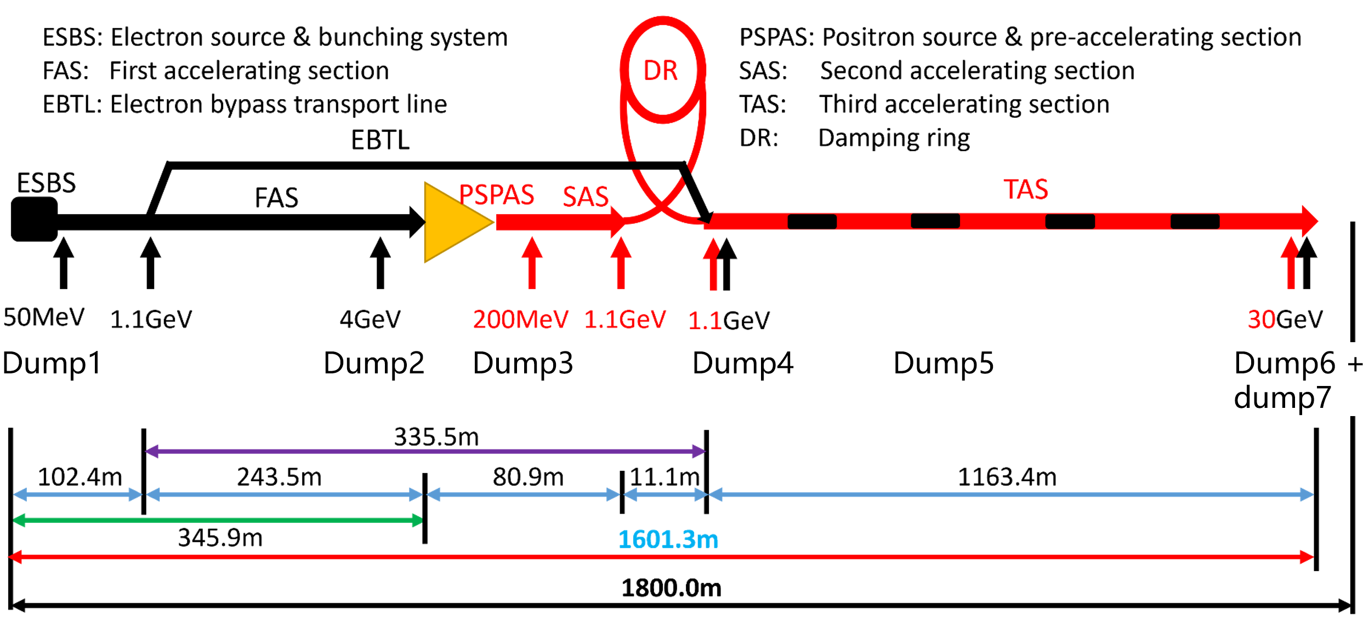
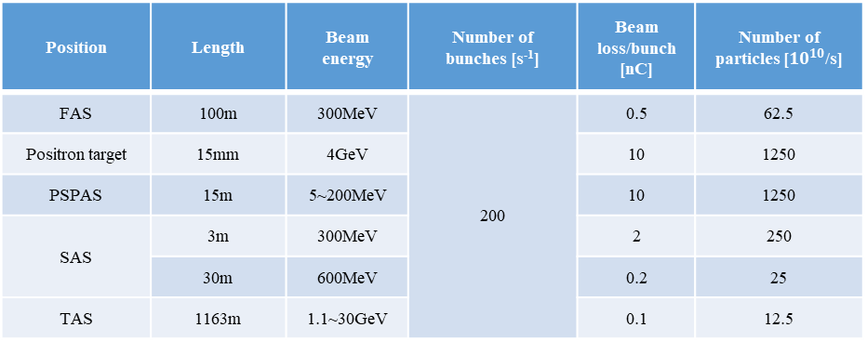
Shielding Design
Linac
Radom beam loss inside;
7 dumps;
Assess the radiation level inside Linac and the shielding optimization;
Optimized the dump size for tunnel space considerations.
Position | Length | Beam energy | Number of bunches [s⁻¹] | Beam loss/bunch [nC] | Number of particles [$10^{10}$/s]
FAS | 100m | 300MeV | 200 | 0.5 | 62.5
Positron target | 15mm | 4GeV |  | 10 | 1250
PSPAS | 15m | 5~200MeV |  | 10 | 1250
SAS | 3m | 300MeV |  | 2 | 250
 | 30m | 600MeV |  | 0.2 | 25
TAS | 1163m | 1.1~30GeV |  | 0.1 | 12.5

Slide 5
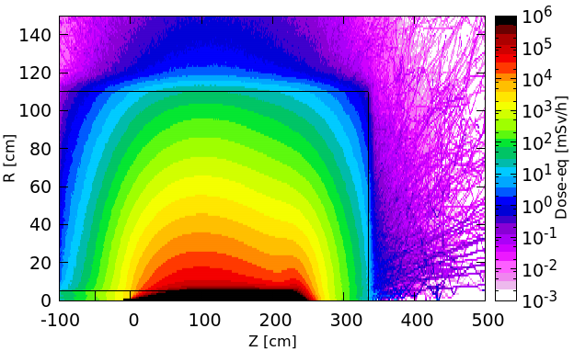
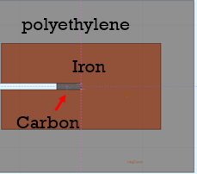
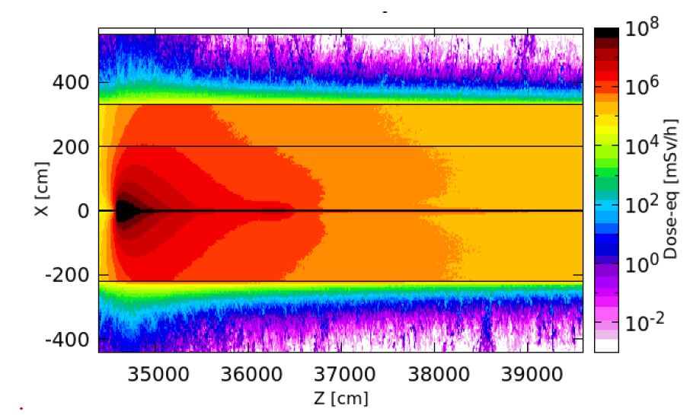
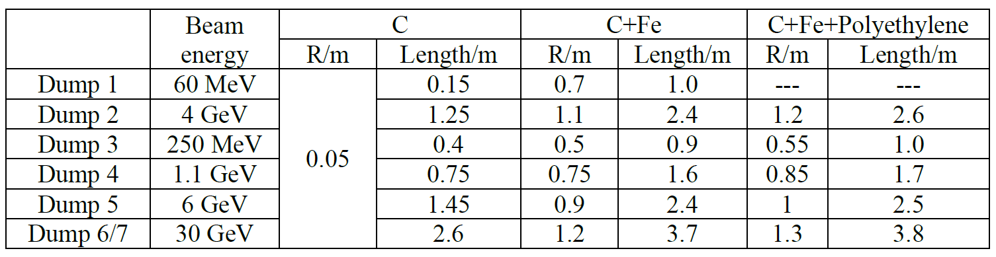
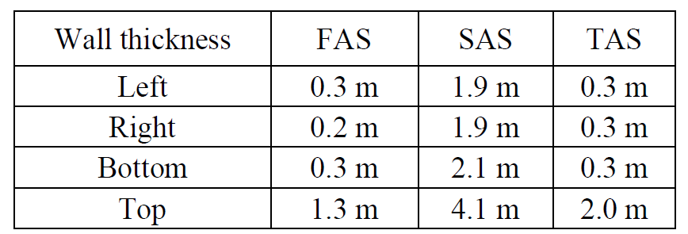
Shielding Design
Linac
Dump design geometry in FLUKA simulation
Radom beam loss induced radiation in SAS
The radii and lengths of the Linac dumps
The thickness of the linac wall
1. The thickness of Linac tunnel wall is designed.
2. The dump material and dimensions are given.

Slide 6
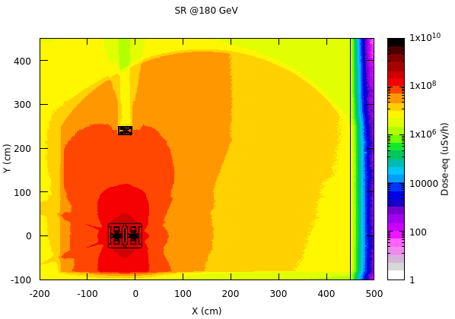
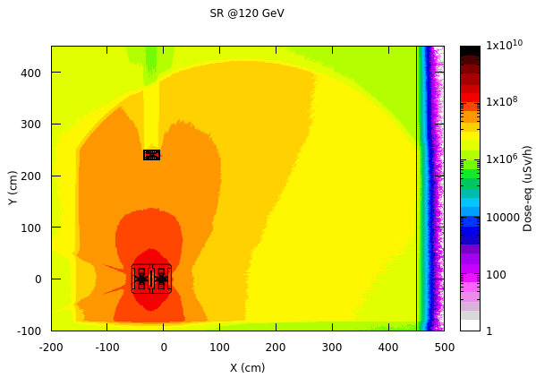
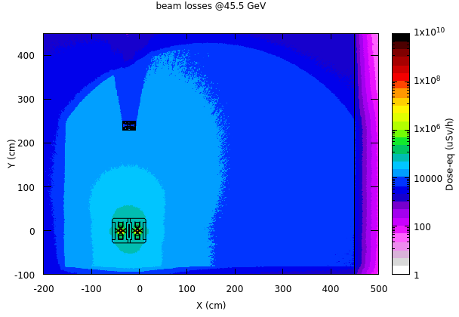
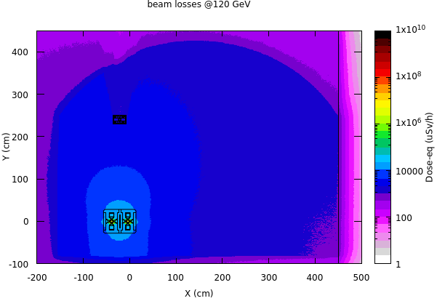
Shielding design
Main ring arc section
SR and random beam loss is the two main beam loss source in the arc section;
3. Radiation dose inside the tunnel is mainly caused by SR.
4. The radiation level caused by random beam loss near the tunnel wall is about mSv/h.

Slide 7
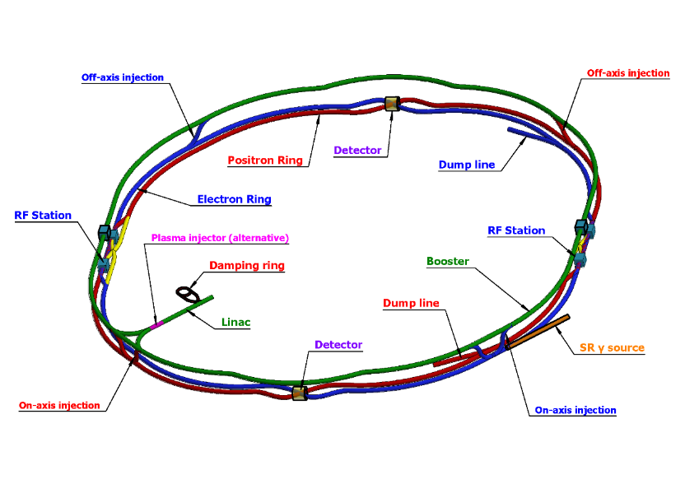
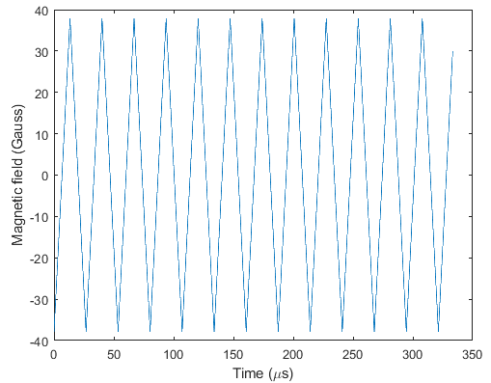
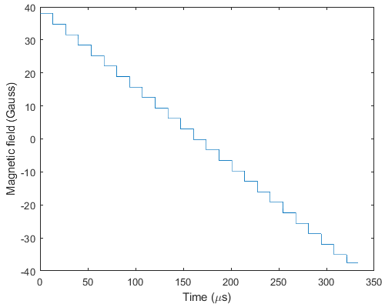
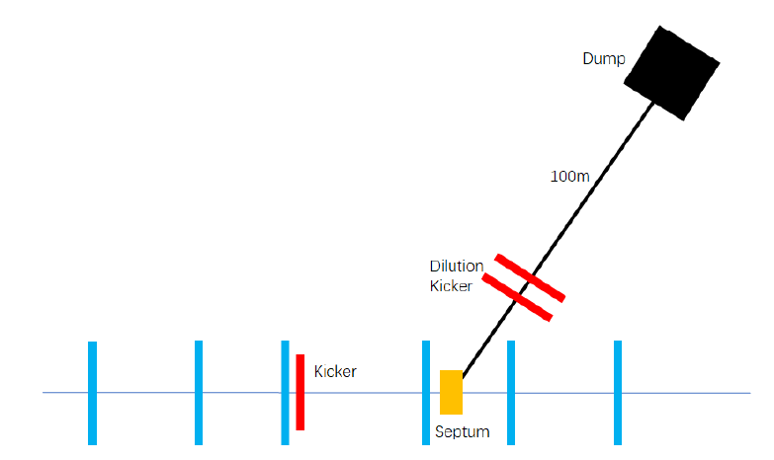
Dump for Main Ring
A set of kicker magnets is used to dilute the beam horizontally and vertically.
The length of transfer tunnel is about 100m.
The area of bunch distribution at dump entrance is optimized to be 6cm x 6cm @Z mode.
 |  | Extraction kicker | Septum | Dilution kickers
Length (m) |  | 2 | 20 | 10
Magnetic flux density (Gauss) | Z | 280 | 2600 | 40 (Max.)
 | WW | 493 | 4700
 | Higgs | 740 | 7000
 | ttbar | 1110 | 10500
Vertical kicker should periodic oscillate 12.5 times in 300 us
Horizontal kicker should reduce step by step from max. to min. in 300 us
Magnets parameters

Slide 8
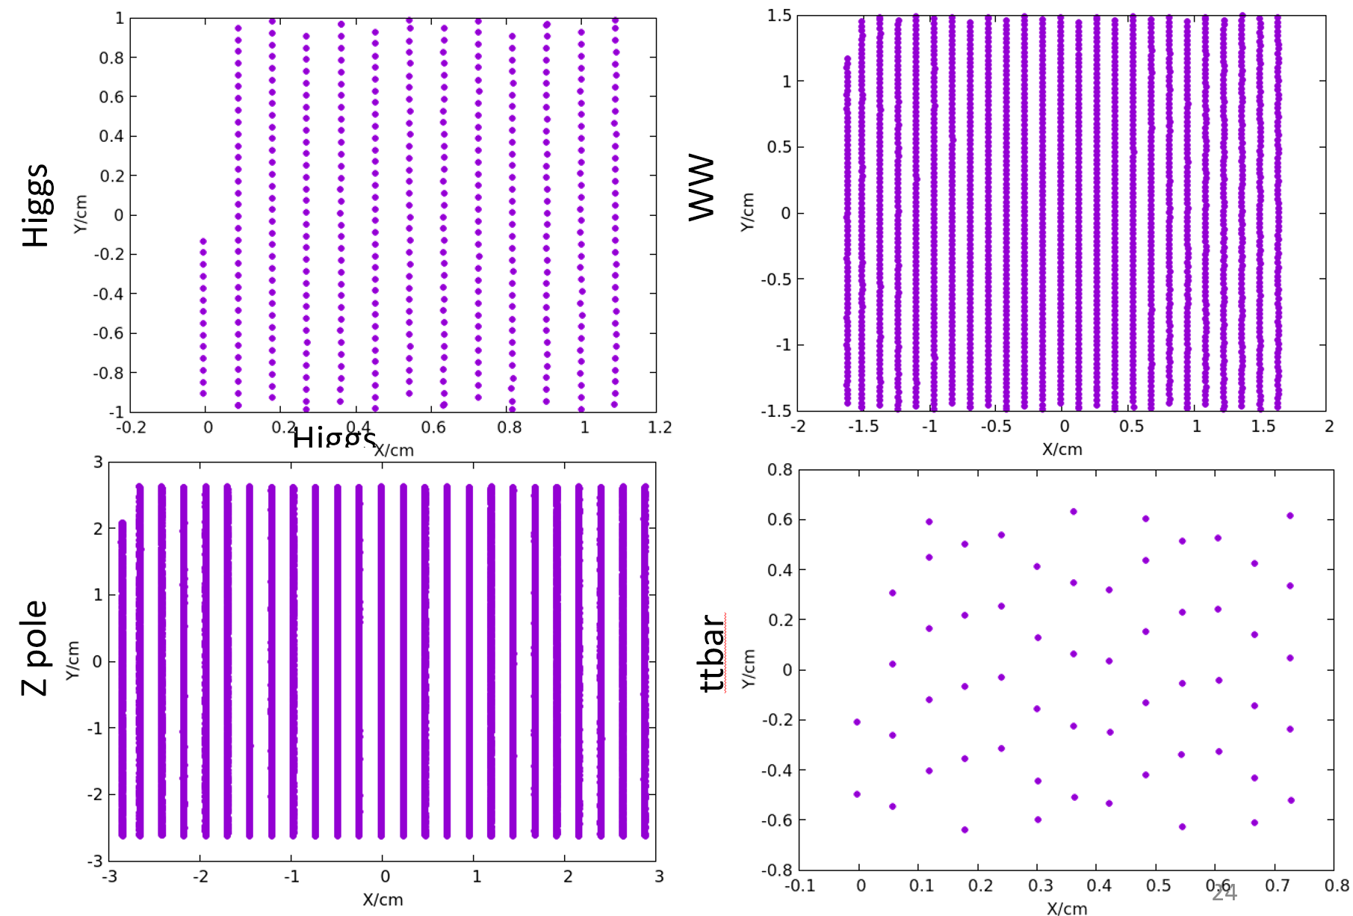
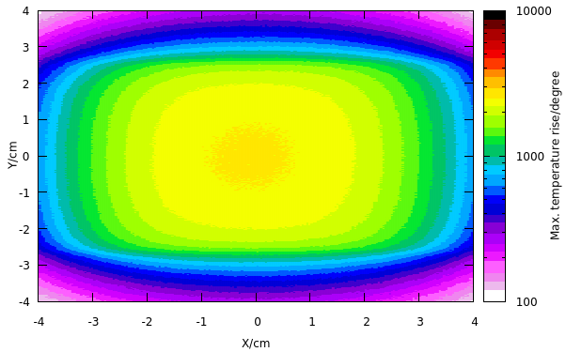
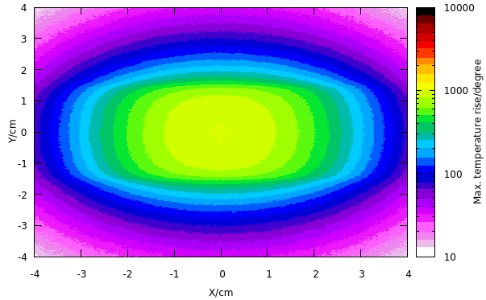
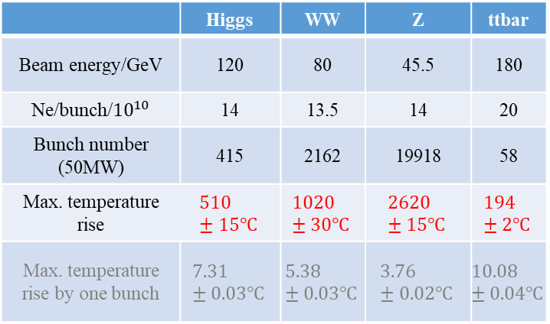
Dump for Main Ring
Max. temperature rise is smaller than graphite melting point.
Dimension (graphite + Iron): R~2.3m, L~8m; constrained by the condition dose-eq < 5.5mSv/h.
 | Higgs | WW | Z | ttbar
Beam energy/GeV | 120 | 80 | 45.5 | 180
Ne/bunch/${10}^{10}$ | 14 | 13.5 | 14 | 20
Bunch number (50MW) | 415 | 2162 | 19918 | 58
Max. temperature rise | $$510±15℃$$ | $$1020±30℃$$ | $$2620±15℃$$ | $$194±2℃$$
Max. temperature rise by one bunch | $$7.31±0.03℃$$ | $$5.38±0.03℃$$ | $$3.76±0.02℃$$ | $$10.08±0.04℃$$
Temperature rise @Z mode(left) and @ W mode (right)
5. Two sets of dump were designed for the main ring, and also considered to be used for dumping booster beam and for machine protection.

Slide 9
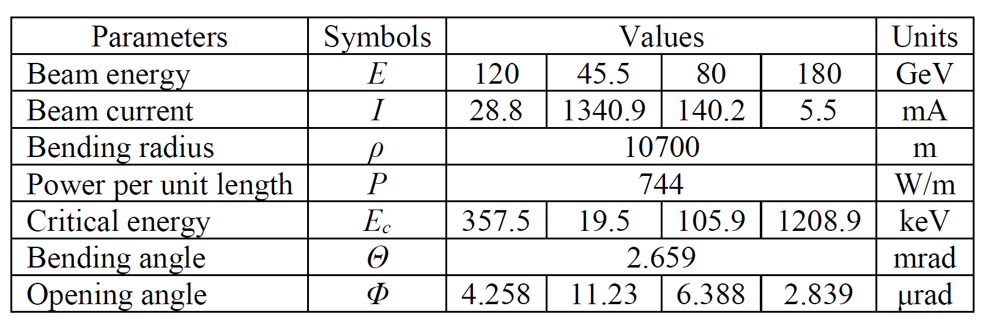
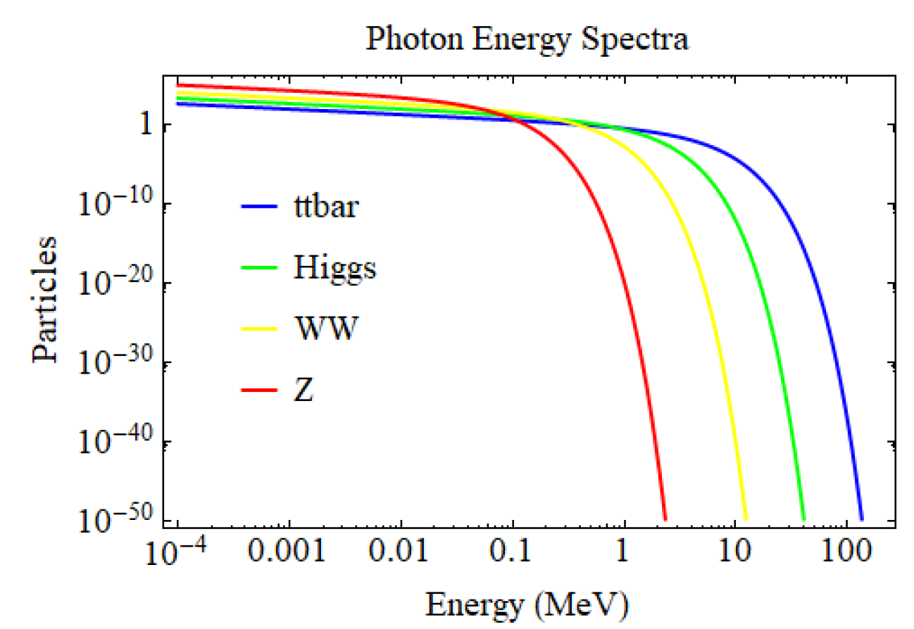
Synchrotron Radiation
SR is a major source of unwanted energy loss and heat deposition in colliders.
It has a broad energy spectrum ranging from visible light to several MeVs
As a result, SR significantly contributes to high radiation dose rates in the tunnel air and nearby components, leading to numerous issues such as vacuum chamber and air heating, ozone and nitrogen-oxide formation, and radiation damage.
To mitigate SR-related damage, special vacuum-chamber designs or shielding are necessary

Slide 10
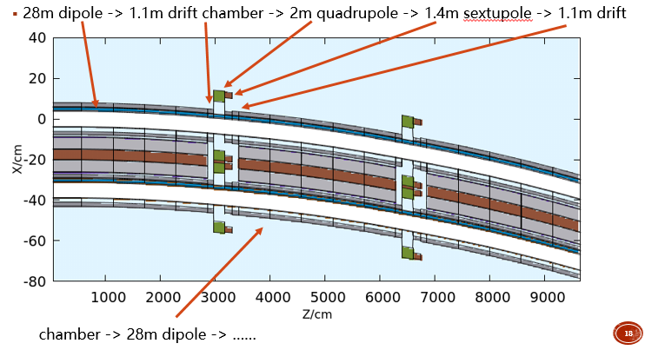
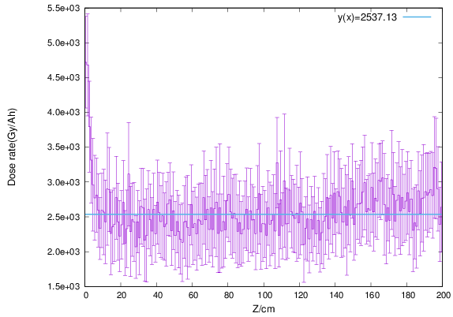
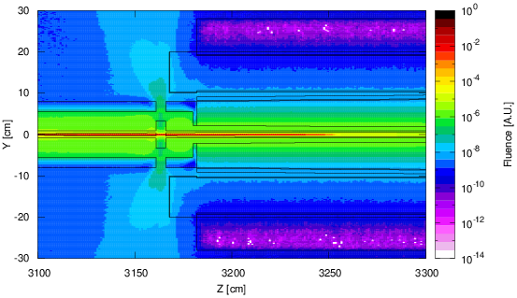
Synchrotron Radiation
Shielding scheme
For main ring, we consider 2.0cm and 2.5cm Pb shielding for 13years running or 18 years running, based on 50MW.
Geometry construction in FLUKA simulation

Slide 11
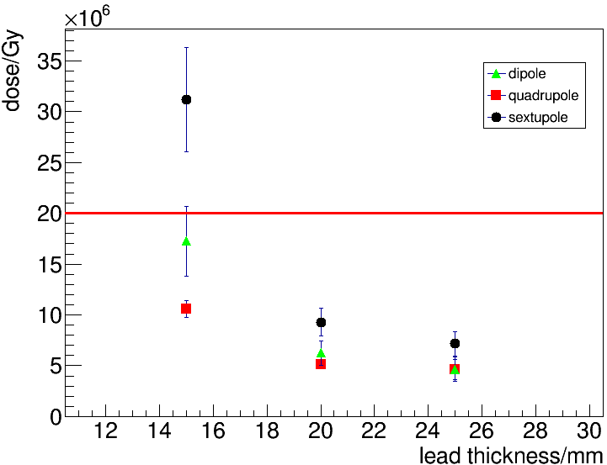
Synchrotron Radiation
Result -main ring
13 years running:
10 years Higgs+2years Z +1year W
* 8 months per year
18 years running:
10 years Higgs+2years Z +1year W+5years tt
6. Based on 50MW operation, 8 months per year, lead thickness is constrained by the operation schedule:
  2.5cm lead is needed for a 18 years running; possible to reduce less than 2cm if for 13 years running;

Slide 12
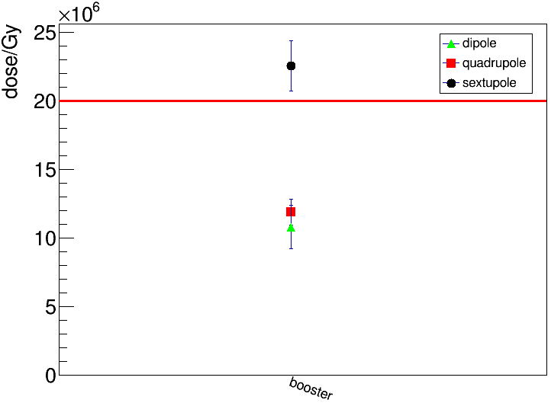
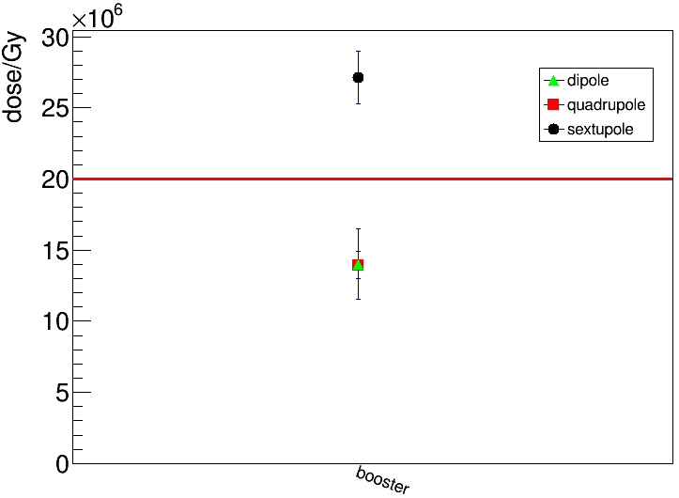
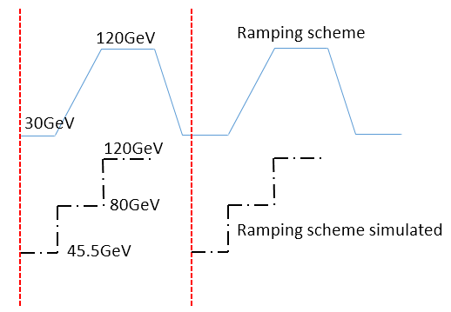
Synchrotron Radiation
Result - Booster
 | Higgs | WW | Z | ttbar
Current(mA) | 1 | 2.69 | 14.4 | 0.12
Injection duration(s) | 32.8 | 39.3 | 134.7 | 30
Injection interval(s) | 38 | 155 | 153.5 | 65
13 years running:
10 years Higgs+2years Z +1year W
* 8 months per year
Booster SR simulation parameters
18 years running:
10 years Higgs+2years Z +1year W+5years tt
Booster ramping simulation scheme
7. No lead shielding needed for booster, for 13 or 18 years running:
The dose to dipole and quadrupole is smaller than upper limit based on our simulation scheme;
Maybe local shielding for sextupoles, but maybe deduce through to more precise and accurate energy ramping scheme;

Slide 13
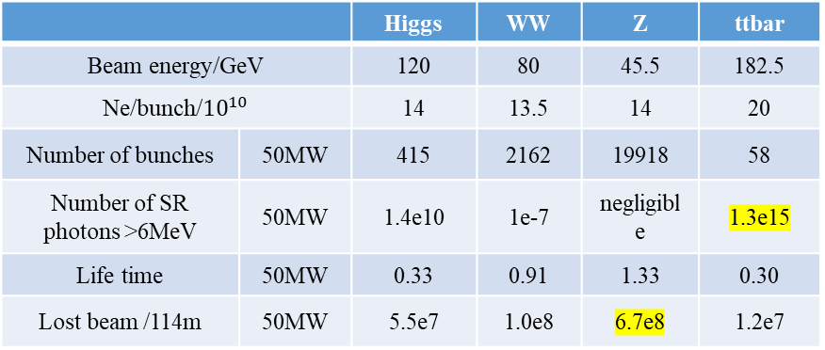
Induced radioactivity
Beam parameters: random beam loss @Z & SR @ttbar photon of energy >6MeV
Beam operation scenarios: continue running 1 year and no ventilation.
 |  | Soil | components of different rocks
density |  | 1.6g/cm^3 | 1.2~3.3g/cm^3
Major element (wt%) | C | 1.0 | ---
 | N | 0.12 | ---
 | O | 34 | 30~70
 | Na | 0.50 | 0.1~2.9
 | Mg | 0.52 | 0.4~3.7
 | Al | 8.0 | 3.5~9.7
 | Si | 40 | 26~39
 | P | --- | 0.02~0.16
 | K | 2.36 | 1.8~3.7
 | Ca | 2.26 | 0.2~4.8
 | Ti | 1.0 | 0.09~0.8
 | Mn | 0.24 | 0.02~0.12
 | Fe | 9.6 | 0.8~6.3
 |  | Higgs | WW | Z | ttbar
Beam energy/GeV |  | 120 | 80 | 45.5 | 182.5
Ne/bunch/${10}^{10}$ |  | 14 | 13.5 | 14 | 20
Number of bunches | 50MW | 415 | 2162 | 19918 | 58
Number of SR photons >6MeV | 50MW | 1.4e10 | 1e-7 | negligible | 1.3e15
Life time | 50MW | 0.33 | 0.91 | 1.33 | 0.30
Lost beam /114m | 50MW | 5.5e7 | 1.0e8 | 6.7e8 | 1.2e7
Beam parameters in simulation
Simulated productions of residual nuclei in:
Cooling water
Air in tunnel
Water around tunnel
Rock (leachable isotopes)
Rock components

Slide 14
Induced radioactivity
 |  | Half-life | Water wall
 |  |  | Specific activity/GB18871 | Stat. error (%)
Beam loss@Z-pole | O15 | 122s | 2e-3 | 2
 | C14 | 5700a | 5e-10 | 4
 | Be7 | 53d | 3e-5 | 5
 | H3 | 12a | 6e-9 | 3
 | F18 | 2h | 5e-6 | 52
SR @ttbar | C14 | 5700a | 2e-12 | 99
 | H3 | 12a | 1e-10 | 71
 |  | Half-life | Rock wall
 |  |  | Specific activity/GB18871 | Stat. error (%)
Beam loss@Z-pole | Mn54 | 312d | 6.94E-04 | 1.8
 | Ca45 | 163d | 5.49E-06 | 0.3
 | Na22 | 2.6y | 7.20E-04 | 1.4
 | H3 | 12a | 5.90E-09 | 0.9
SR @ttbar | H3 | 12a | 1e-10 | 71

Slide 15
Induced radioactivity
 |  | Half-life | Cooling water
 |  |  | Specific activity/GB18871 | Stat. error (%)
Beam loss@Z-pole | O15 | 122s | 2.44 | 10
 | C14 | 5700a | 3.5e-7 | 23
 | Be7 | 53d | 1.3e-2 | 34
 | H3 | 12a | 2.3e-6 | 22
SR @ttbar | None
 |  | Half-life | Air in tunnel
 |  |  | Specific activity/GB18871 | Stat. error (%)
Beam loss@Z-pole | O15 | 122s | 2.7e-4 | 52
 | C14 | 5700a | 7.7e-7 | 1
 | Be7 | 53d | 1.1e-5 | 57
 | H3 | 12a | 3.5e-9 | 32
 | P32 | 14d | --- | ---
 | P33 | 25d | 1.9e-8 | 100
 | Cl36 | 3e5a | --- | ---
 | Cl38 | 37m | --- | ---
 | Ar37 | 35d | 6.1e-9 | 59
 | Ar41 | 1.8h | 1.4e-3 | 12
SR @ttbar | C14 | 5700a | 6.5e-6 | 2
 | Ar41 | 2h | 1.5e-2 | 20
8. Radionuclide Production is calculated according to assumed running scenario
Radionuclide production amount is negligent under the beam loss assumptions;

Slide 16
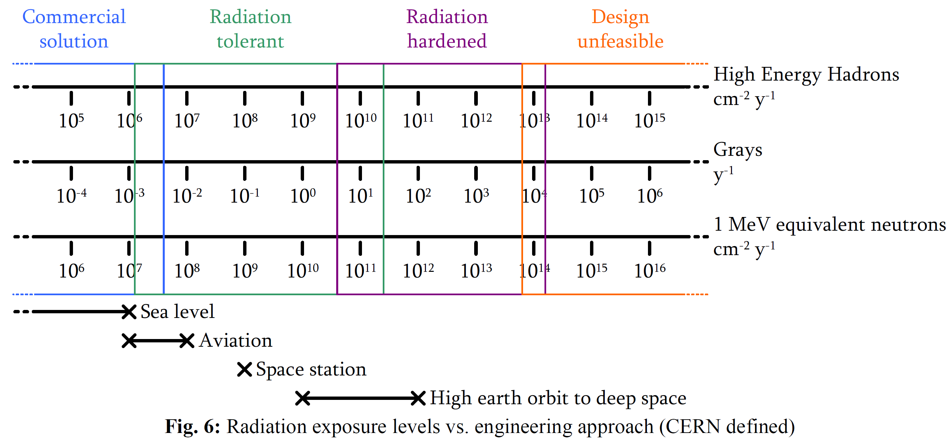
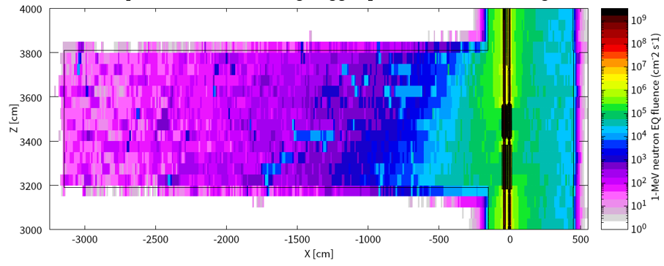
Radiation to Electronics
Demands: Electronics in the tunnel and auxiliary tunnel should be assessed or protected
  HEH, TID, 1MeV-eq can be simulated and the local shielding effect can be simulated.
  Participate in investigation, simulation, experiments and discussion.

Slide 17
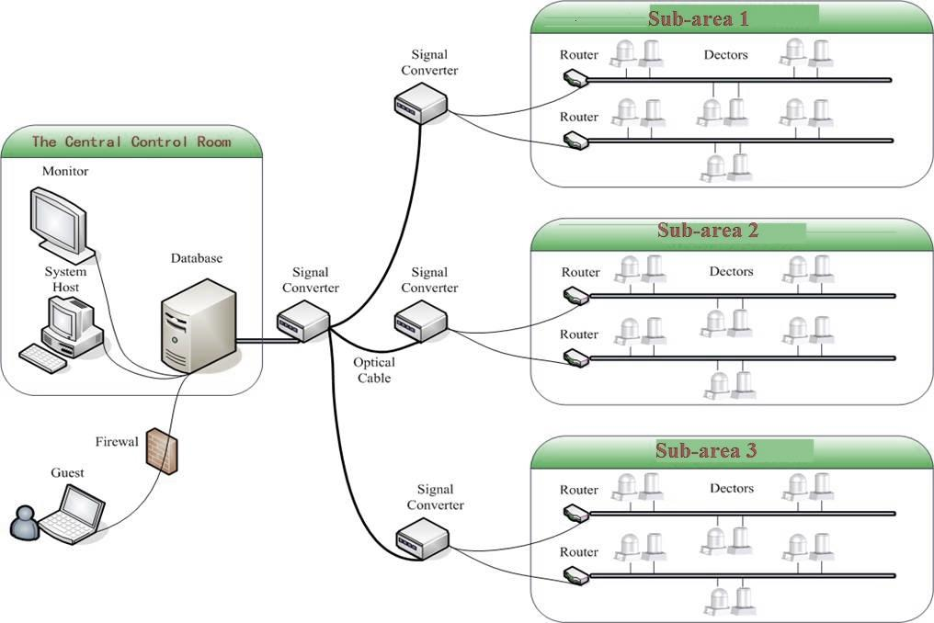
Radiation-Dose Monitoring system(RDMS)
)
The radiation-monitoring system is designed to meet the latest legal requirements and international standards.
It will be based on the results of the preliminary hazard analysis, the latest technical developments, and specific requirements such as the time structure and composition of the radiation fields.
It will provide reliable and accurate continuous measurements of the ambient dose equivalent rate in the monitoring areas.
It should includes:
  Workplace Monitoring Program
  Environmental Monitoring Program
  Personal Dose Monitoring Program
System framework

Slide 18
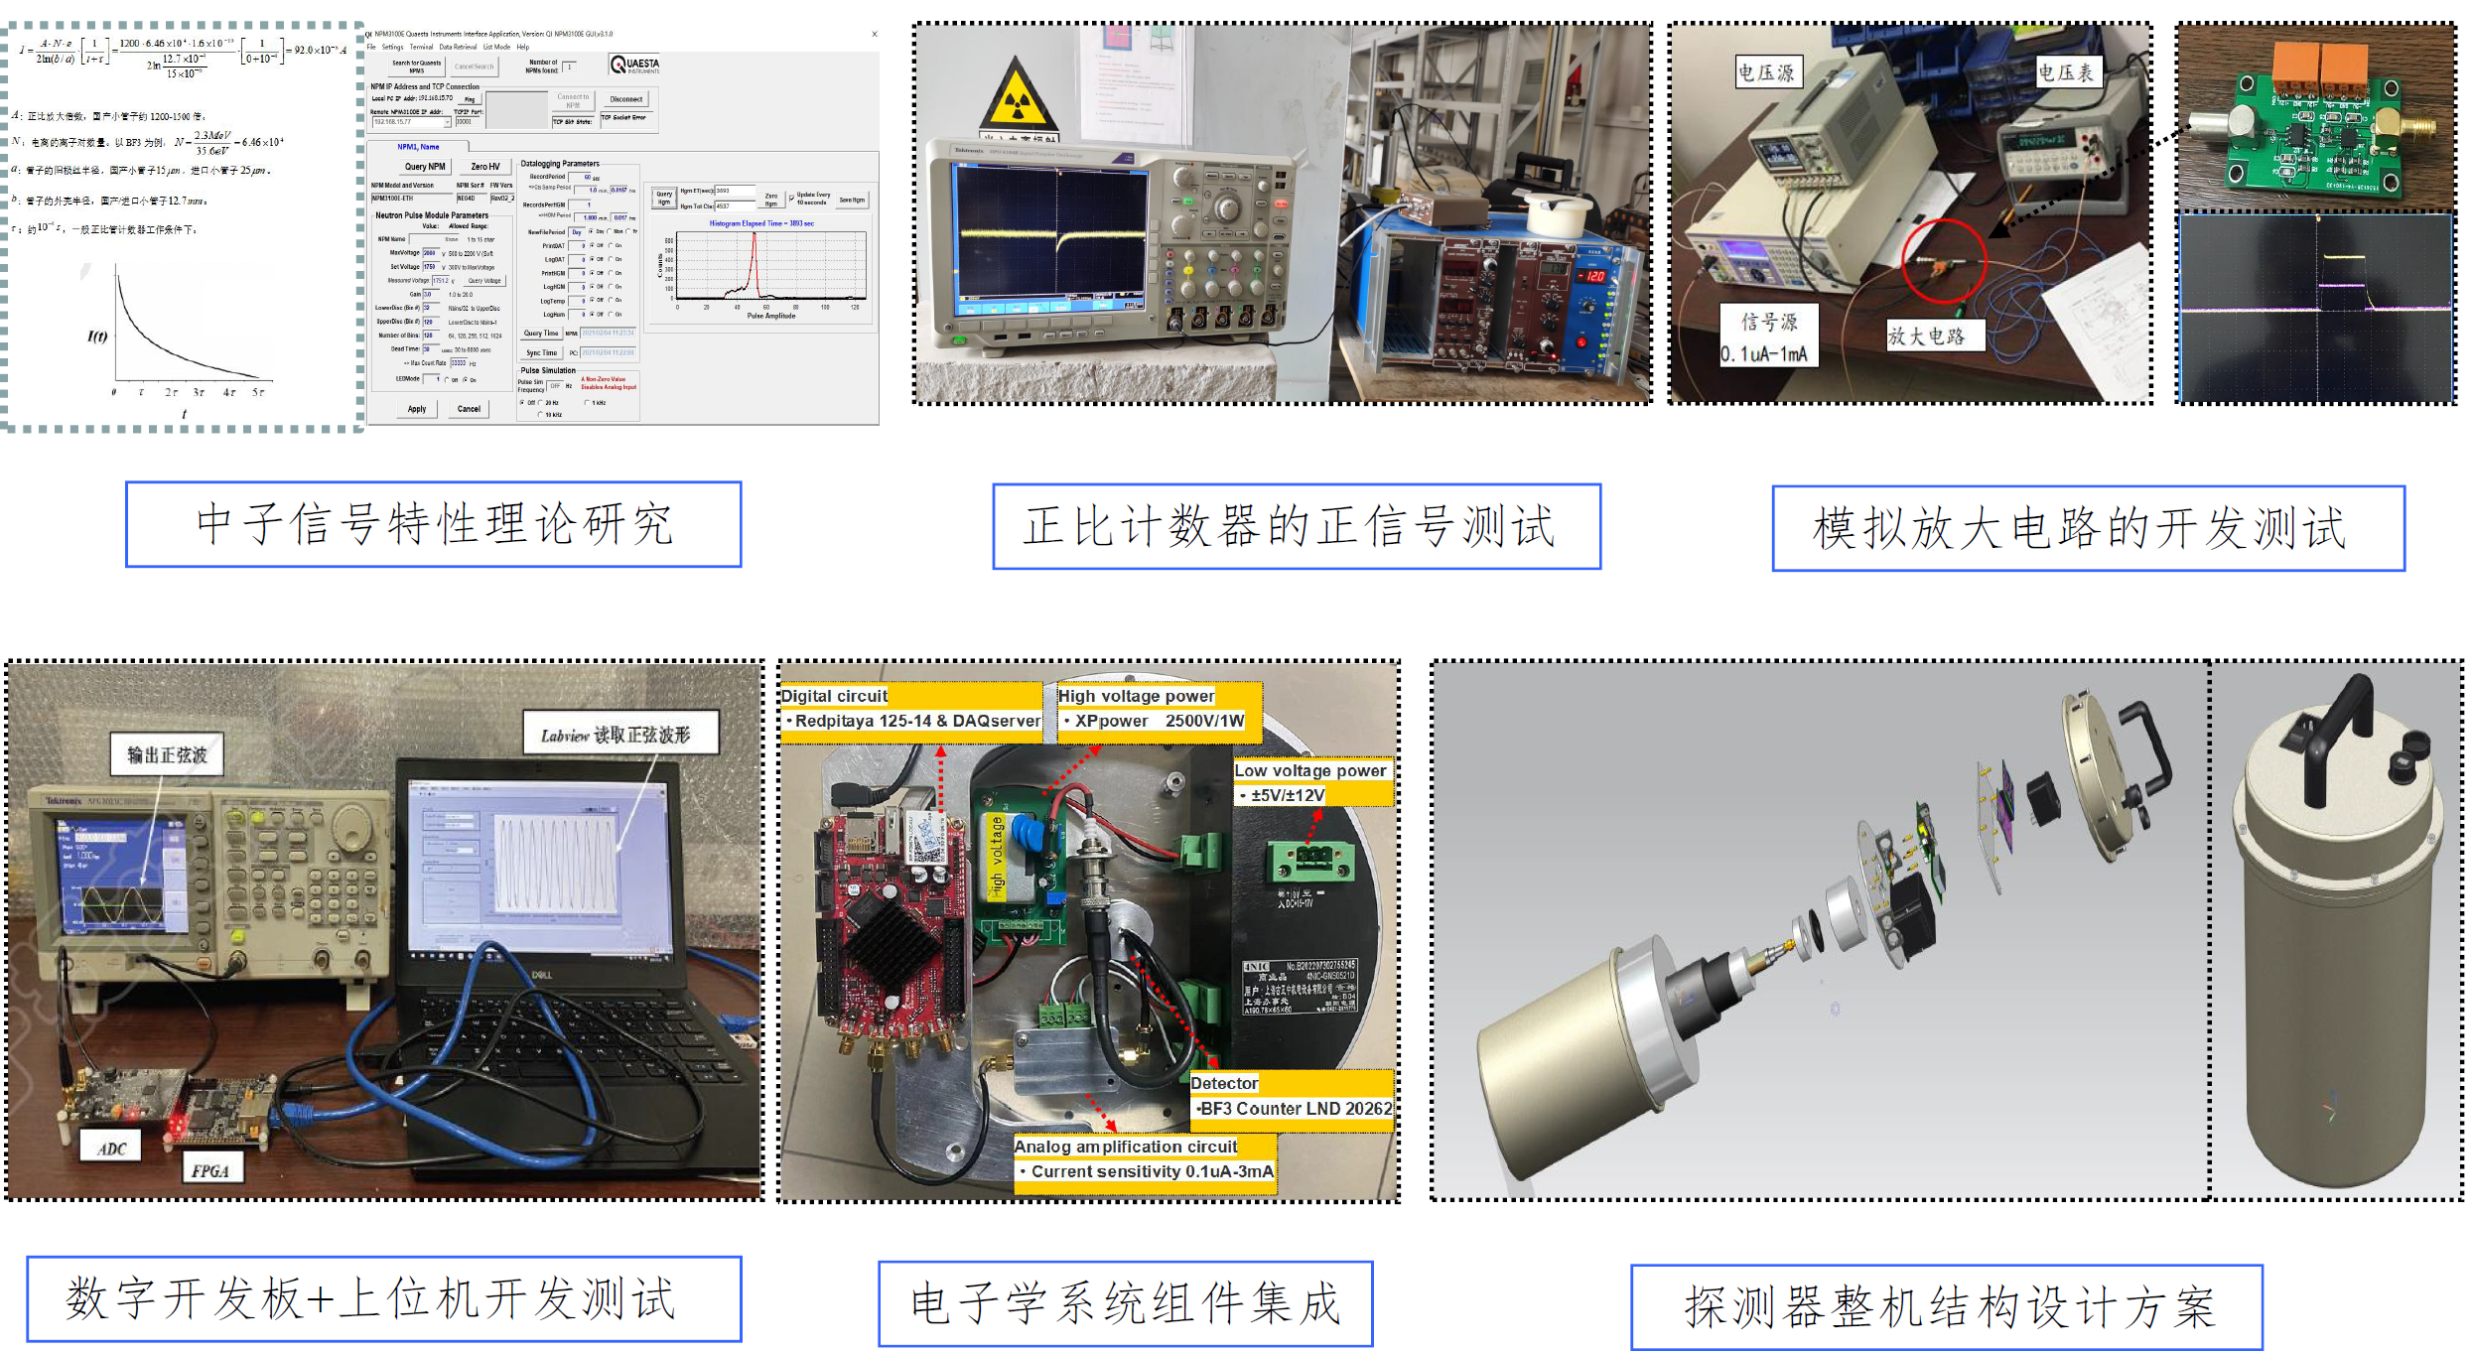
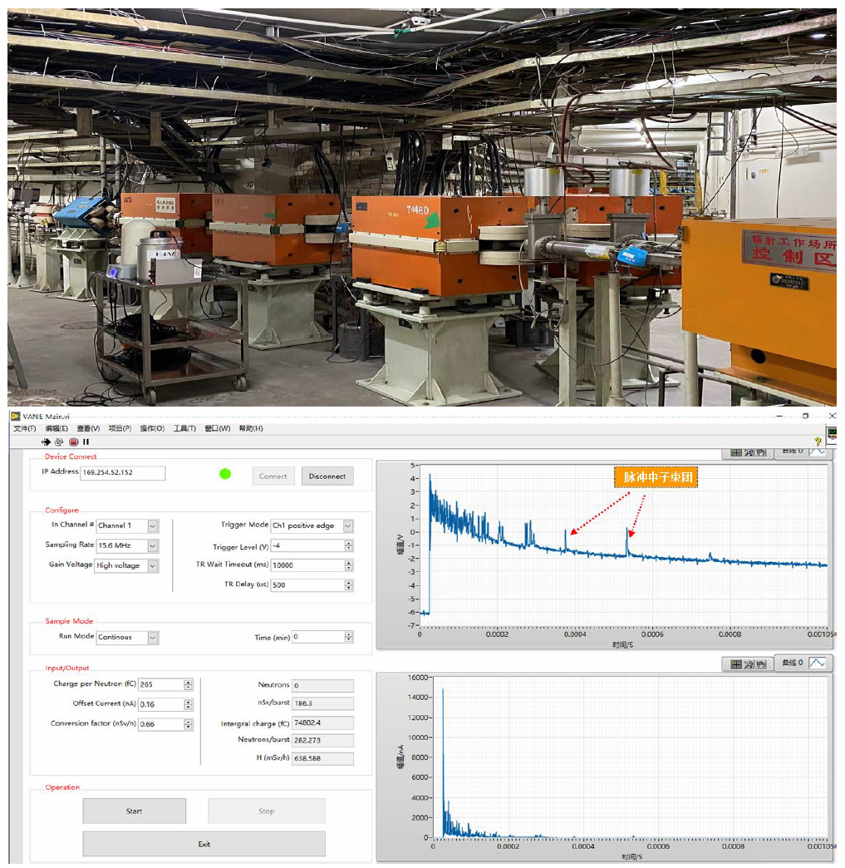
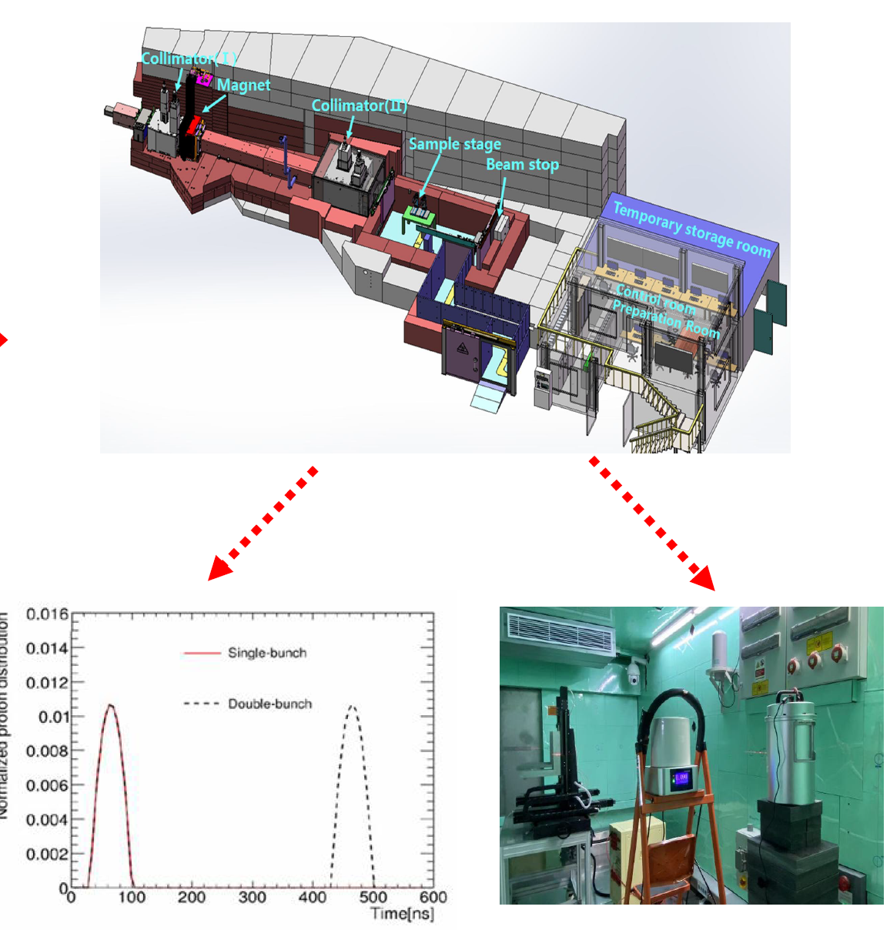
RDMS
A pre-researched project
完成了样机研制；
完成了性能测试和刻度；
初步完成了2轮实验；
基金支持和成果转化课题支持。
后续：
  实验&文章&专利&结题&转化
Experiment in BEPCII and CSNS tunnel

Slide 19
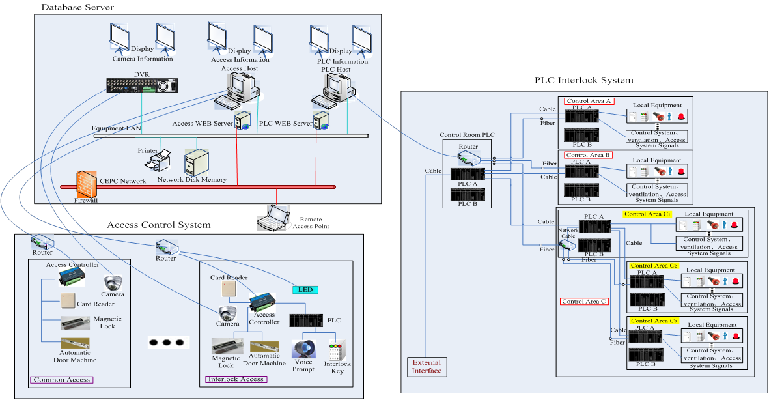
PPS
PPS (Personal Protection System) is in charged by Control Group.
  The system will be designed according to radiation shielding design, the area classification, ventilation scheme, access control management, etc
The designed interlock logic scheme and access control scheme should be discussed and checked with radiation protection staff.
Schematic diagram of the PPS
Notes:
这里，周二与金大鹏确定，是否pps有需要开展的edr工作。

Slide 20
RP EDR plan
Shielding design:
  Linac: shielding for damping ring; for positron target; for transport line;
  Main ring: shielding for collimation section; for transport line; for IRs and service carven; for RF section; for auxiliary tunnel; for holes/shielding doors/mazes/shafts;
Dumps design:
  Detailed design including beam dump window, transport line layout for Booster and main ring, beam dump installation and maintenance mode;
  Dump used for machine protection.

Slide 21
RP EDR plan
For SR:
  Lead shielding scheme should be well discussed among groups
    Fabrication, supporter method, Deformation analysis, etc;
  Accurate simulation optimization to fix the thickness in different parts
    Complete the hot spots between magnets, detailed shielding scheme;
    Optimize the thickness according to running scenario
For Induced radioactivity
  Total amount of radioactivity should be calculated according to ventilation scheme and shielding design.
Detailed design scheme for RDMS and PPS

Slide 22
CEPC Environmental Documentation
根据《中华人民共和国环境影响评价法》第三章第二十五条规定，建设项目的环境影响评价文件经审批部门审查获批后，方可开工建设；根据《中华人民共和国职业病防治法》第二章第十七条的规定，建设单位在可行性论证阶段应当进行职业病危害预评价。
  为了确保CEPC项目按时开工建设，需要在EDR阶段对该装置辐射防护设计进行细化和固化；开展拟建场址的人文地质情况调查、环境本底测量、公众参与等工作；通过环评相关文件编写、专家论证、申报审批等程序，获得CEPC项目环境影响评价等文件备案和批复。

Slide 23
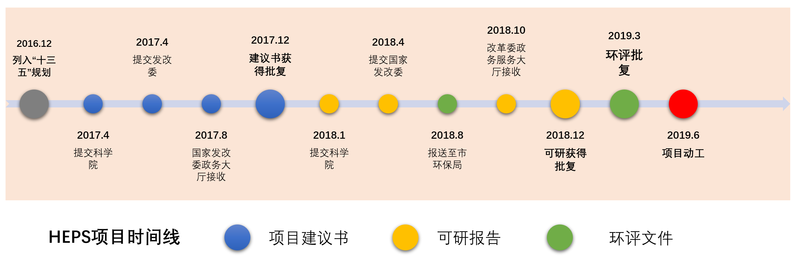
环境影响评价轴
HEPS 时间轴

Slide 24
RP EDR research content
1th stage
第一阶段任务目标是为项目的申请提供完善的CEPC辐射防护设计，完成对周围环境影响初步评估
  项目申请前需要完成辐射屏蔽设计，感生放射性评估，辐射剂量监测系统方案设计，人身安全联锁系统方案设计。
    2024年6月：完成隧道瞬发辐射剂量水平的计算评估；
    2024年9月：完成地下大厅及实验室瞬发辐射剂量水平计算评估；
    2024年12月：完成固液气感生放射性评估；完成辐射剂量监测系统方案设计；
    2025年6月：完成人身安全联锁系统方案设计；
    2025年9月：完成环境影响评价文件和职业病危害预评价编制（初稿）

Slide 25
RP EDR research content
2th stage
第二阶段任务目标是完成环境影响评价文件编写并经审批部门审查获批，为项目可开工建设提供必要的条件
  公众参与，环评相关文件编写，专家论证，申报审批等；获得项目环境影响评价等文件备案和批复。
    2026年6月：完成选定场址环境本底数据、水文地质等基础数据的调查和收集；
    2026年12月：完成公众参与调查；完成环境影响评价文件和职业病危害预评价委托编制（终版），并提交给生态环境保护主管部门。

Slide 26
Budget
年度 | 研究内容 | 分项经费（万元） | 备注
2024年度 135万 | 隧道瞬发辐射剂量水平计算评估 | 90 | 含直线、输运线、主环、阻尼环；注入、引出、准直等热点；废束桶区域
 | 地下大厅瞬发辐射剂量水平计算评估 | 20 | 含RF、IR、SR实验大厅的计算评估
 | 固液气感生放射性评估 | 10 | 固体部件；放射性流出物的放射性水平评估；
 | 专家咨询 | 10 | 针对瞬发和感生的计算方法和结果开展评价
 | 差旅费 | 5 | 参加国际、国内会议
2025年度 375万 | 环境影响评价文件和职业病危害预评价委托编制 | 300 | 材料收集、文件初步编制
 | 专家咨询 | 10 | 现场勘查、环评相关评价等
 | 环境本底调查 | 30 | 协助完成拟建场址环境辐射水平、噪声、水文等资料收集和调查
 | 劳务费 | 30 | 研究生、博士后劳务
 | 差旅费 | 5 | 参加国际、国内会议
2026年度 365万 | 环境影响评价文件和职业病危害预评价委托编制—续 | 300 | 文件编制、上报
 | 专家咨询 | 10 | 现场勘查、环评相关评价等
 | 环境本底调查 | 20 | 协助完成环境本底数据调查和收集
 | 劳务费 | 30 | 研究生、博士后劳务
 | 差旅费 | 5 | 参加国际、国内会议
2027年度 25万 | 劳务费 | 20 | 研究生、博士后劳务
 | 差旅费 | 5 | 参加国际、国内会议

Slide 27
Personnel
序号 | 姓名 | 主要工作内容 | 备注
1 | 马忠剑 | 辐射防护设计
2 | 唐光毅 | 辐射屏蔽设计及感生计算
3 | 石澔玙 | 辐射屏蔽设计及MDI设计
4 | 阎明洋 | 剂量监测系统设计（场所/环境）
5 | 刘琼瑶 | 辐射屏蔽、剂量监测系统
6 | 张会杰 | 人身安全联锁系统（控制组负责）

Slide 28
Summary
The shielding for the main part of CEPC tunnel is completed
  Detailed or some connection parts should be designed further.
Detailed RDM and PPS designed scheme should be completed according to IHEP Project experience.
Environmental impact and occupational hygiene assessment documents completeness also depends on the CEPC project progress.

Slide 29
End!
Many thanks for your attention!

Slide 30
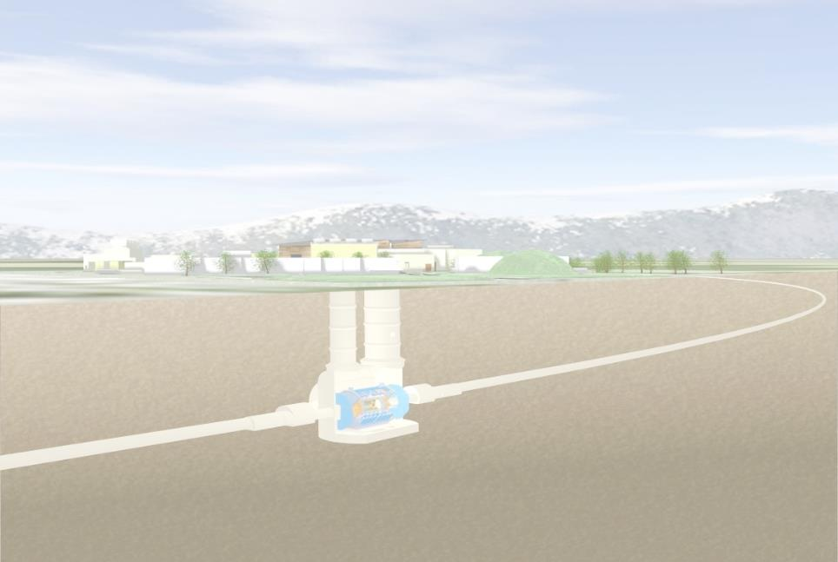
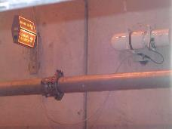
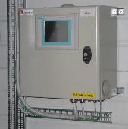
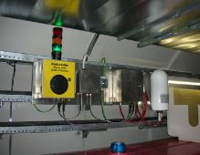
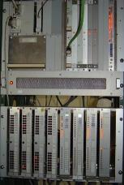
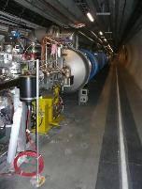
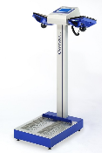
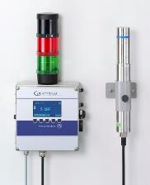
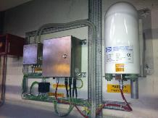
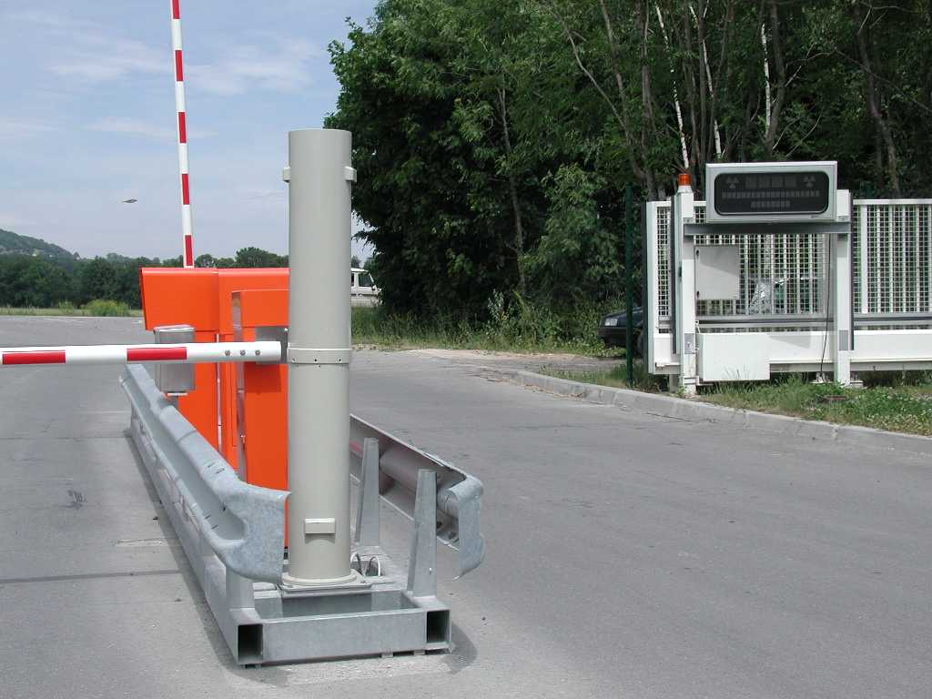
Radiation Protection monitoring
From: D. Perrin (HSE-RP)
Area radiation monitoring
With Alarm unit
Monitoring stations
Site Gate Monitor
Area monitoring
(ARCON)
RAMSES
Induced activity
monitors
Hand & Foot
monitors
GRAMS
Area radiation monitoring
VME chassis
(ARCON)
CERN REMS
January 2018
30

Slide 31
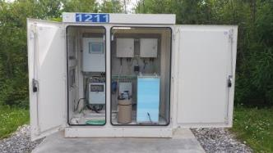
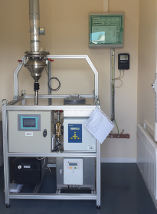





Environmental monitoring
From: D. Perrin
Stray radiation Monitoring
Ventilation Monitoring
Wind
Monitoring
Aerosol Sampling
Water Monitoring station
Air Quality Monitoring
Hydrocarbon detector
CERN REMS
January 2018
31

