Slide 1


CEPC MDI EDR Plan
Sha Bai
On behalf of CEPC MDI group
CEPC Day
February 28, 2024

Slide 2
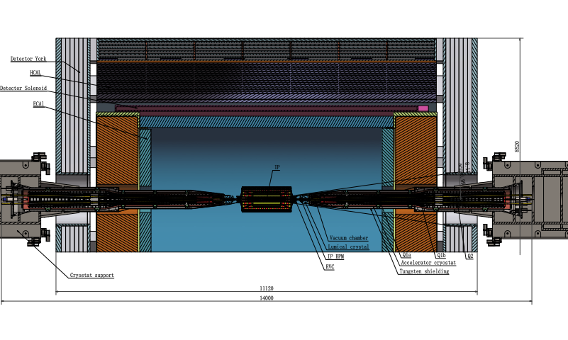
MDI components and topics in EDR
The Machine Detector Interface (MDI) of CEPC double ring scheme is about ±7m long from the IP.
MDI components and topics in EDR~ IR beam pipe including beryllium pipe and tungsten alloy beam pipe; radiative background especially consistent with experiment and software improvement; Masks; Shielding; collimators; RVC; SC magnet supporting system; fast luminosity tuning system; etc on.

Slide 3
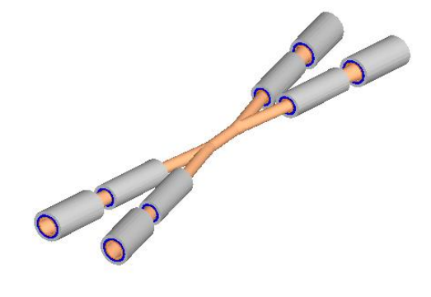
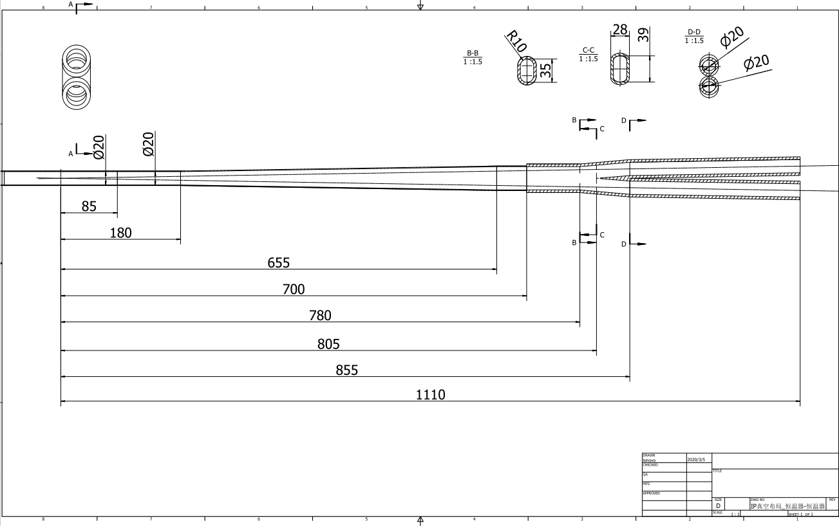
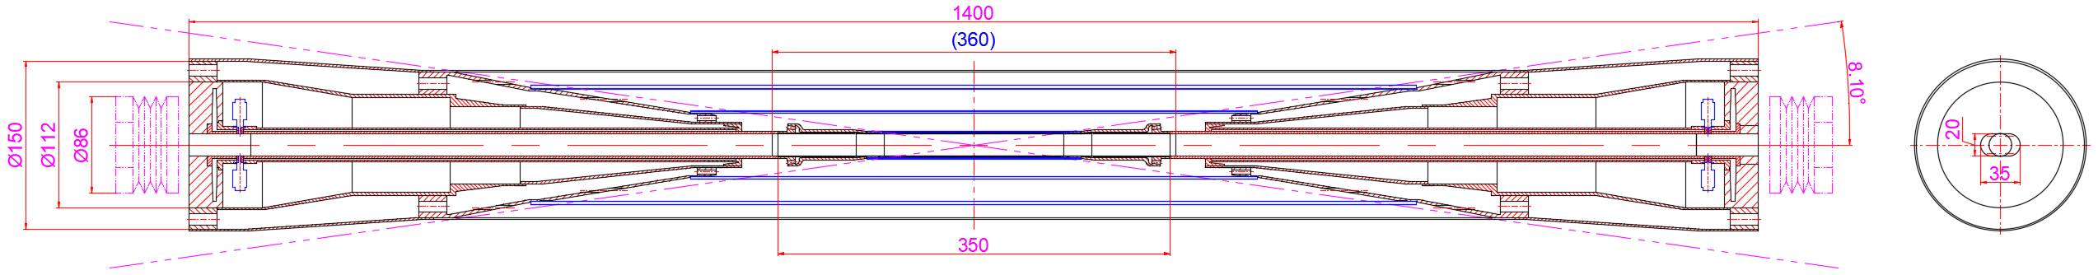
IR beam pipe plan in EDR
Q.Ji, J.S.Zhang, Y.S.Ma
Item | Budget (10000yuan)
Berryllium pipe (Processing, welding, and anti-corrosion testing of thin-walled beryllium pipe) | 200
Tungsten alloy IR beam pipe | 45
EDR Plan:
Processing and manufacturing of IR beam pipes, including beryllium pipe and tungsten alloy beam pipe.
To make prototypes of the beryllium beam pipe, and to improve the key technology such as the manufacture of the pure berryllium pipe, the choice of the coolant, the estimation between the coolant and the pipe in radiation environments, the welding between berryllium and other materials like aluminum, the window to LumiCal, and so on.

Slide 4
Radiative background in EDR
H.Y.Shi, B.Wang, S.Bai
EDR Plan:
A. Natochii
Improve the efficiency and accuracy of background simulation to narrow the difference with future experiments, including the improve the quality of the all the generation tools, the interface between different tools, and also made the new version of the beam background simulation toolkit dedicated to CEPC simulation.
Apply and test the toolkit on existing machines like BEPCII and SuperKEKB, to validate the toolkit, and use the new toolkit to simulate CEPC beam backgrounds, to estimate the background level in whole interaction region, including the detector and also the accelerator components, and optimize the interaction region layout based on the estimation.
More simulations and experiments based on BEPCII can help understand the background and narrow the differences between data and simulation.
Photon BG
Beam loss BG
Injection BG
A. Natochii
Background sources
  Photon backgrounds: SR, Pair production
  Beam loss backgrounds
    Radiative Bhabha scattering
    Beam Gas scattering
    Beam Thermal photon scattering
  Injection background

Slide 5
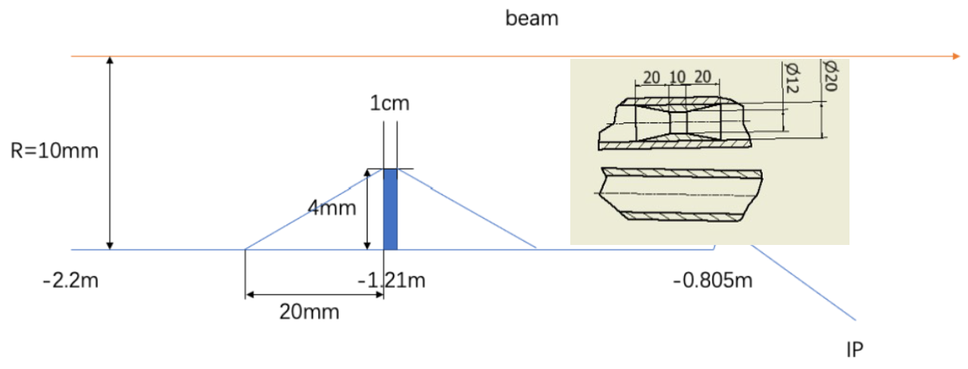
Masks
Methods | Photon hitting number on Be/BX | Deposition power on Be(W)
No mask | 39400.0 | 30.57*e-5
1.21-mask-Cu | 1736.0 | 1.45*e-5
1.21-mask-W | 1698.0 | 1.36*e-5
2.2-mask-Cu | 1147.0 | 0.94*e-5
1.21-mask-Cu-5㎛Au | 216.0 | 0.273*e-5
Masks design(two masks/IP/ring) :
  Tungsten
  One locates at -1.21m with 4mm height and 10mm long
  The other at -4.2m with 0.6mm height
5㎛ gold plating as baseline, can be improved for future
Photons hitting number on Be/BX reduced by two orders of magnitude
Deposition power on Be pipe suppressed to acceptable level by vertex detector
Masks will be processed and manufactured along with Tungsten alloy IR beam pipe

Slide 6
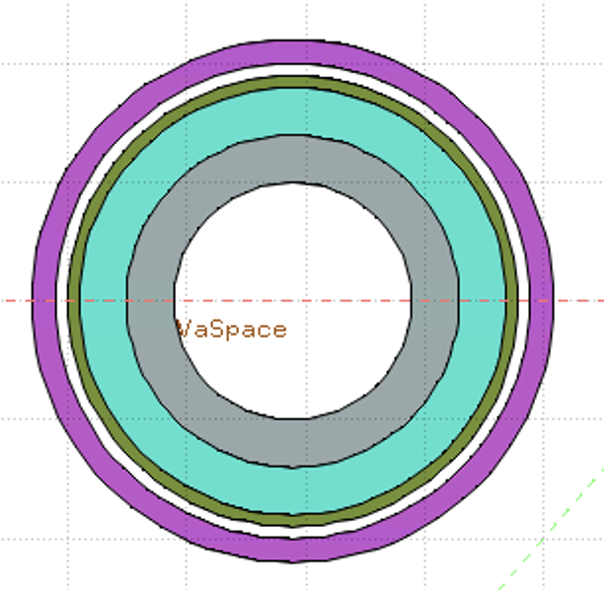
Shielding
Shielding in MDI including 5 parts:
Tungsten alloy IR beam pipe
Combined iron and tungsten yoke of SC magnet
Gold plating on beryllium pipe (~5µm)
Tungsten shielding outside of cryostat
Shielding for detector hall
Accelerator
Detector
White: Vacuum
Gray: Tungsten Pipe
Light Green: Helium
Heavy Green: Stainless Steel Vassel
Pink: Coil
Key Issues on Calculation and Simplification of Beam pipe model
Pure tungsten IR beam pipe with 4mm thickness without cooling taken into account, simulate the Absorbed Dose on Coil (Region)
The very tight space of thickness ~Tungsten IR beam pipe
Seek for better new shielding material
It is unlikely to use pure tungsten, which is too brittle.
WNiFe and WNiCu are two kinds of alloys that can be made. WNiCu is non-magnetic, but it is difficult to make this alloy too long. It must be welded in sections, with each section no more than 1m.
For the 6m long IR beam pipe, there will be many welds.
Tungsten alloy is made by powder pressing. It has certain machining performance and welding performance (brazing). The vacuum performance is unknown.

Slide 7
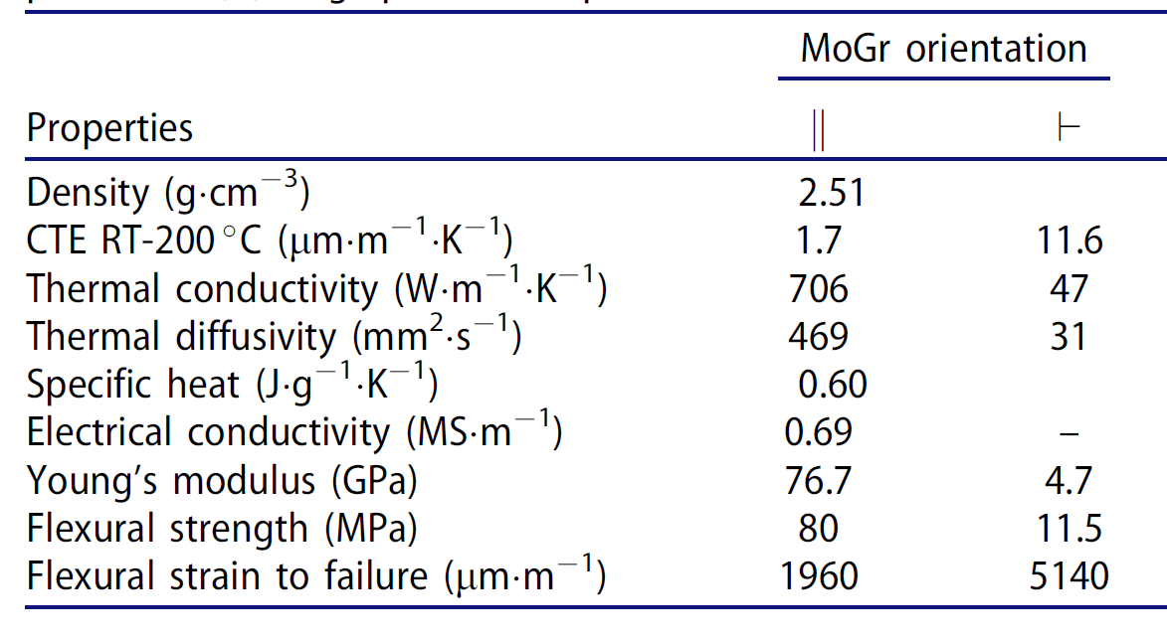
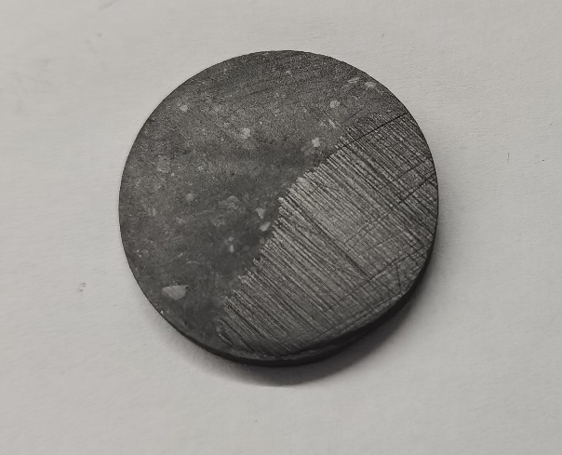
Key process validation of collimator
H.J.Wang
Budget of 890000 yuan
Development and welding experiments of MPS collimator scraping body materials
Development of impact resistant materials: plan to develop our own carbon based alloy, which has high thermal conductivity, high specific heat, and high melting point. And conduct welding tests on new materials and copper bodies.
EDR Plan：
  2024-2025: Development of New Materials
  2026-2027: Research on New Materials and Copper Welding
MG-2打磨后

Slide 8
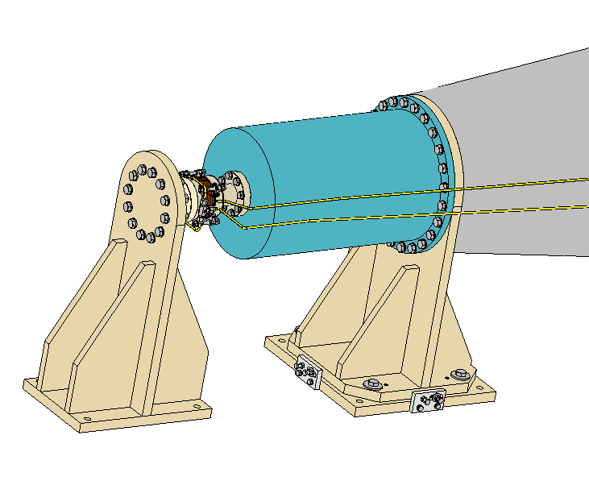
Remote Vacuum Connector plan in EDR
H.J.Wang
Budget 270000 yuan
vacuum leakage rate verification and simulate installation conditions.
Including: RVC prototype and IP/accelerator end analog components.
EDR Plan
  2024: Scheme and structural design
  2025: Conduct prototype preparation and experiments
  2026: Completion of experiments and structural optimization
Accelerator tip support component (adjustable and fixed in three directions), simulating deformation at the end of the cryostat
IP vacuum chamber simulator~is fixed
Remote connection device (using inflatable bellows as an example)

Slide 9
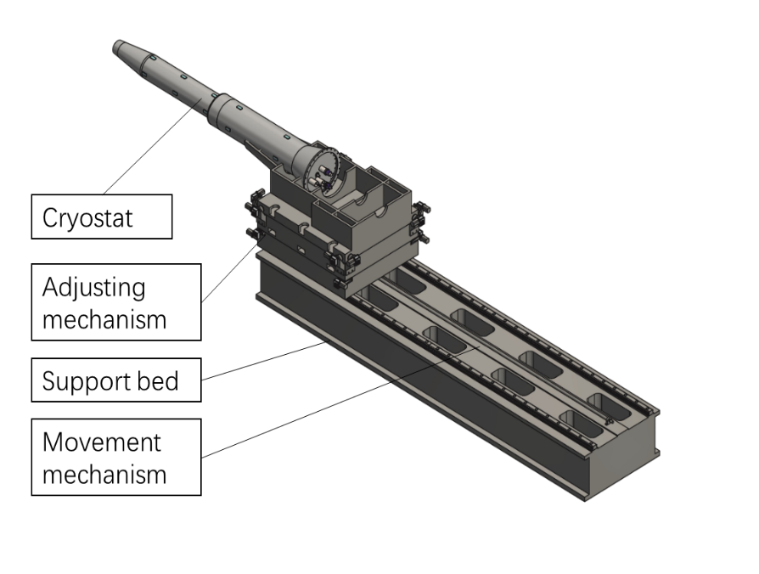
MDI SC magnet support adjustment and alignment verification prototype
H.J.Wang
Budget 560000 yuan
6-degree-of-freedom adjustment test on the upper bracket and verify the alignment of the cryostat in conjunction with the alignment system.
Including: upper bracket, adjustment mechanism, sensor, etc. Non radiation resistant products are used for motors, sensors, etc.
EDR Plan:
  2024-2025: Scheme and structural design
  2025-2026: Conduct prototype development and testing
  2027: Complete testing and structural optimization

Slide 10
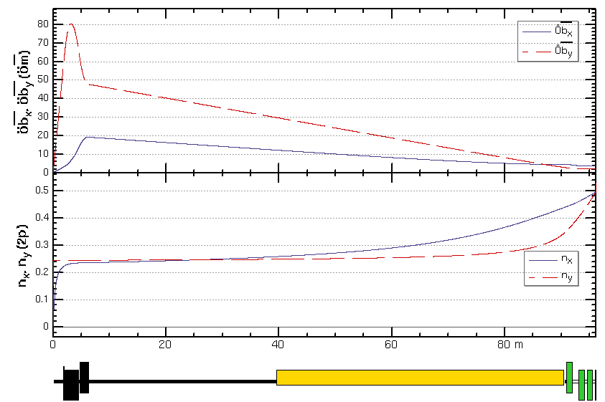
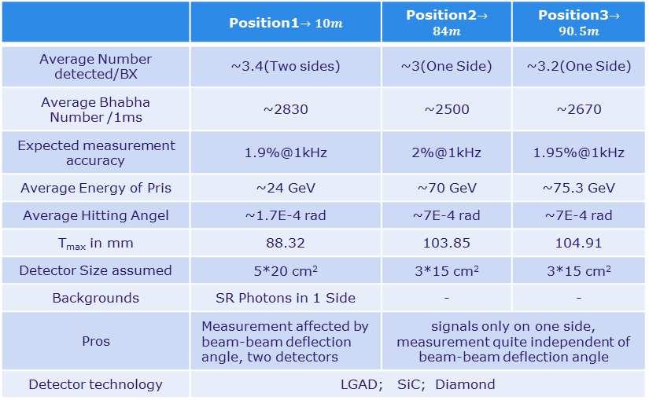
Fast luminosity tuning system
M.Li, P.Bambade, D.Wang
S.Y.Hou, L.Zhang etc on
With very small beam sizes at IP and the presence of strong FFS quadrupoles in the CEPC, the luminosity is very sensitive to the mechanical vibrations, Fast Luminosity Tuning System, including fast BPMs and fast luminosity monitor, would be necessary for CEPC.
Currently,
Using 4 sets of BPMs each ring and located at or near the largest beta function can be used for vertical orbit feedback in principle.
The Fast Luminosity Monitor are needed as input to luminosity optimization and feedback. We already have some candidate positions and potential detector solutions.
IP
1
2
3
 | Position1$→10m$ | Position2$→84m$ | Position3$→90.5m$
Average Number detected/BX | ~3.4(Two sides) | ~3(One Side) | ~3.2(One Side)
Average Bhabha Number /1ms | ~2830 | ~2500 | ~2670
Expected measurement accuracy | 1.9%@1kHz | 2%@1kHz | 1.95%@1kHz
Average Energy of Pris | ~24 GeV | ~70 GeV | ~75.3 GeV
Average Hitting Angel | ~1.7E-4 rad | ~7E-4 rad | ~7E-4 rad
T_{max} in mm | 88.32 | 103.85 | 104.91
Detector Size assumed | 5*20 cm² | 3*15 cm² | 3*15 cm²
Backgrounds | SR Photons in 1 Side | - | -
Pros | Measurement affected by beam-beam deflection angle, two detectors | signals only on one side, measurement quite independent of beam-beam deflection angle
Detector technology | LGAD; SiC; Diamond
Plan in EDR
More detailed simulations to study, including determine the detailed location and quantity of BPMs and the reaction between the primary Bhabha scattering electrons and beam pipe, as well as the design of detectors and feedback .
The detailed design of the detectors.

Slide 11
MDI EDR Budget
Item | Budget (10000yuan)
Gold plating/Mask/Shielding/Lumical installation and measurement | 60
Berryllium pipe (Processing, welding, and anti-corrosion testing of thin-walled beryllium pipe) | 200
Tungsten alloy IR beam pipe | 45
MDI RVC prototype | 27
MDI SC magnet support adjustment and alignment verification prototype | 56
Key process validation of collimator | 89
Software/toolkit/labor | 60
Total | 537

Slide 12
Thanks

