Slide 1


Circular Electron Positron Collider
CEPC Polarization EDR Plan
Zhe Duan
On behalf of the CEPC Polarization Working Group
28 Feb 2024, CEPC Day, email: duanz@ihep.ac.cn

Slide 2
Outline
Polarized beams @ CEPC
Design & R&D plan in the CEPC EDR Phase
Summary

Slide 3
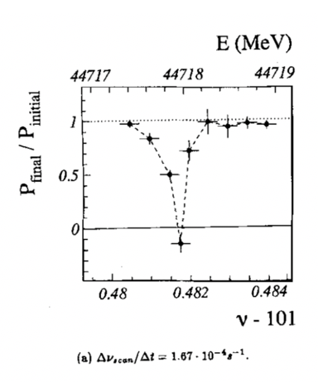
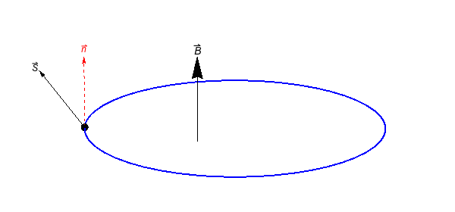



Polarized beams @ CEPC: transverse polarization
Precision beam energy calibration @ Z&W based on Resonant Depolarization (~1e-6 accuracy)
  Precision measurements of Z&W mass (FCC EPOL, arXiv:1909.12245, CDFII: Science 376, 6589)
  Fiducial for Higgs & ttbar mass measurements (LEP2 CM energy evaluation above 80 GeV, arXiv:9901002,)
Requirements:
  Transverse Compton polarimeter: stats uncertainty ~1%/second
  RF depolarizer: specs similar to bunch-by-bunch feedback kicker
  RD measurements every ~ 10 mins
  At least 5%~10% vertical polarization for e+/e-
CEPC Z&W mass, CDR 2019
CEPC W mass: EJPC 80, 66 (2020)
CEPC ttbar, arXiv:2207.12177
IP/detector
$$P_{Y}$$
$$P_{X}$$
IP/detector
polarimeter
depolarizer
$$P_{Z}$$
LEP: Z. Phys. C 66, 45-62 (1995).

Slide 4
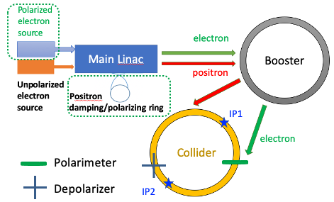
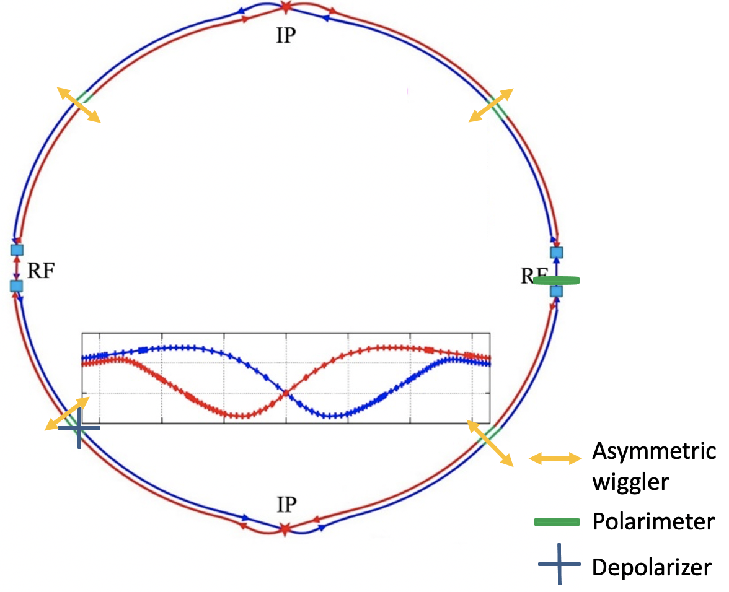
Two schemes of polarization generation for RD
Scheme 1: self-polarization in the Colliders
Scheme 2: Injection of polarized beams
Z-pole: >20 hour to reach 10% polarization
  10 asymmetric wigglers switched on to reduce to ~2 hours
  Incompatible with high luminosity (increase in U₀, energy spread) -> ~2 hours dead time for physics at each fill
  ~144 pilot bunches dedicated for RD measurements
W: ~2 hour to reach 10% polarization
  ~12 pilot bunches, wigglers not needed
Polarized beams from the source
  Polarized e- gun: > 85% polarization
  e+ damping ring(1.1 GeV -> 1.98 GeV) : > 40% polarization after 10 min store
Polarization loss in the Booster is small requiring no additional hardware ( 陈涛 et al, PRAB 26, 051003, 2023)
No dead time for physics at each fill

Slide 5
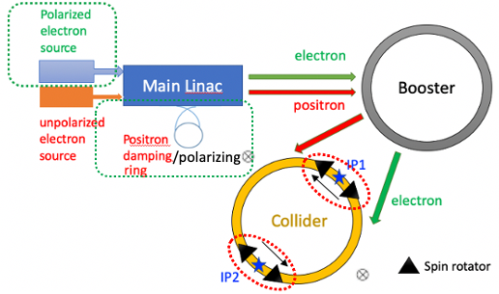
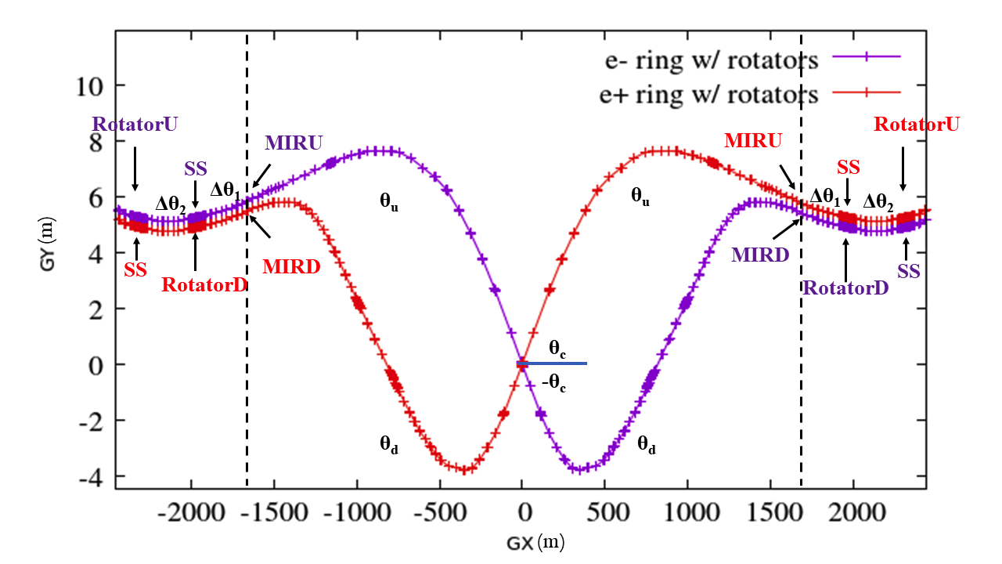
Polarized beams @ CEPC: longitudinal polarization
Weak mixing angle from A_{FB}, A_{LR} @ Z-pole
A_{FB} @ CEPC: CPC 47, (2023) 123002
Solenoid spin rotators around each IP (~500 T$∙$m per IP)
(夏文昊 et al, RDTM 6, 490, 2022)

Slide 6
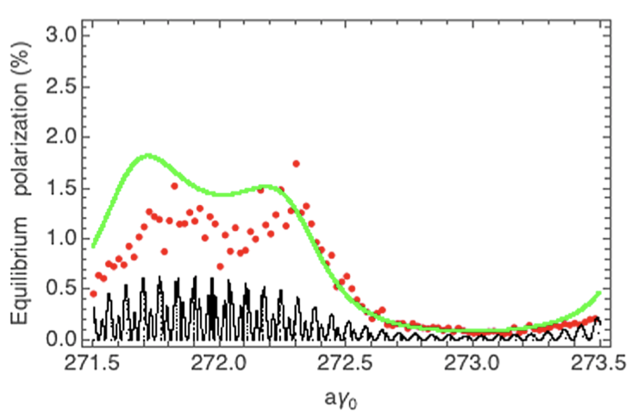
Polarization design studies in the EDR Phase
Advise the lattice designs to accommodate polarized beams
  Collider
    Compton polarimeters
    Wigglers
    Spin rotators (reserve space)
  Injector (improved design)
    Positron damping ring: raise energy
    Booster: lattice optimization for better polarization transmission
Polarized beam applications @ ILC, arXiv:2105.09691, 2111.06687, 2202.07385
岩斌 et al, PRL 131 (2023) 241801 e+/e-横向极化探测电弱偶极相互作用
Study the polarization utilities at Higgs
  It is possible to attain useful polarization in the Collider at Higgs or even higher energies
  The open question: how well can spin resonances be mitigated?
Booster transmission
Collider equilibrium
Higgs
Higgs
陈涛 et al, PRAB 26, 051003, 2023
夏文昊 et al, PRAB 26, 091001, 2023

Slide 7
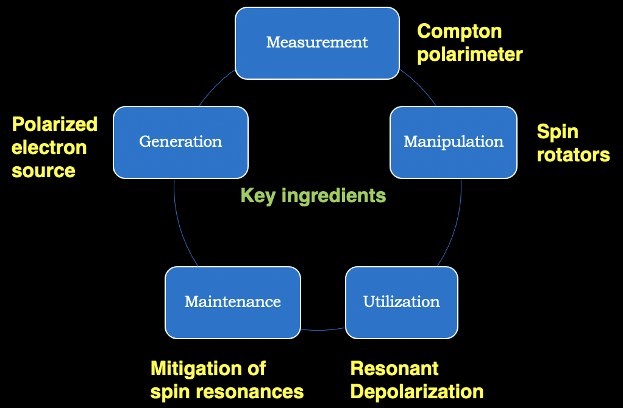
Polarization R&D in the CEPC EDR Phase
Hardware R&D and beam tests
Enable
Experimental studies
Verify
Physics design

Slide 8
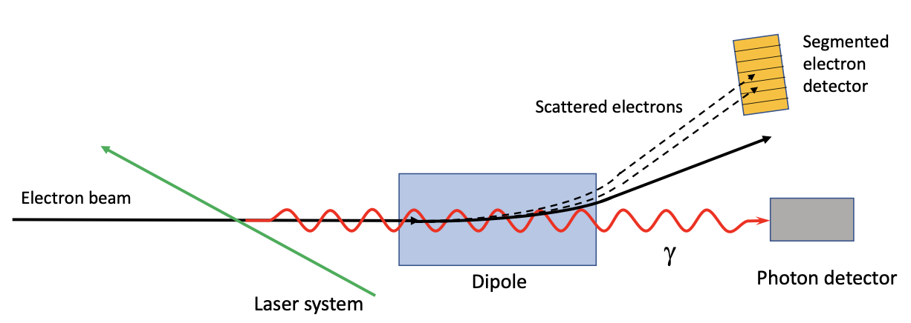
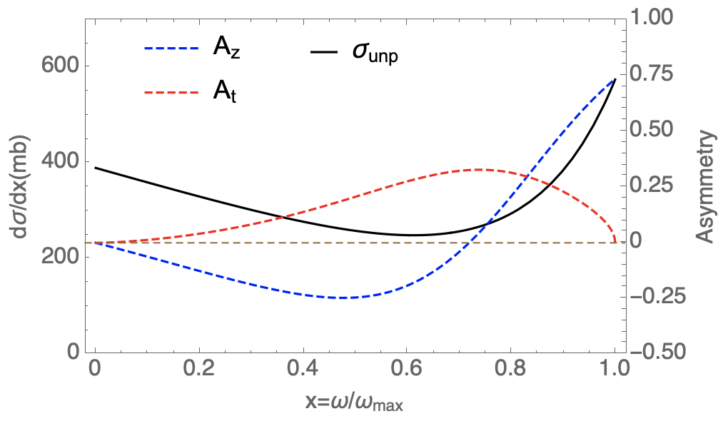
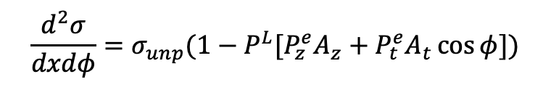
Compton polarimeter for CEPC
FCC-ee polarimeter, arXiv:1803.09595
$$\frac{d^{2}σ}{dxdφ}=σ_{unp}(1−P^{L}[P_{z}^{e}A_{z}+P_{t}^{e}A_{t}\cos{φ}])$$
Eb=45.6 GeV, λlaser=515 nm
Type | Transverse | Longitudinal | Challenges & limitations
Scattered γ | Position detector | Calorimeter | SR background, spatial resolution
Scattered e | Position detector |  | ~100m drift space, Limited to 2D
陈姗红, et al., JINST, 17 P08005, 2022
王欲听, in preparation
Polarimeter | Direction | Type | Energy (GeV) | Systematic Uncertainty
CERN LEP | Vertical | γ | 46 | 5%
HERA LPOL | Longitudinal | γ | 27 | 1.6%
HERA TPOL | Vertical | γ | 27 | 2.9%
SLD @ SLAC | Longitudinal | e | 45.6 | 0.5%
JLAB Hall A | Longitudinal | γ, e | 1-6 | 1-3%
JLAB Hall C | Longitudinal | γ, e | 1.1 | 0.6%
Demonstration of a Compton polarimeter @ BEPCII would prepare for CEPC
  Knowhow to design & operate such systems
  Pixel detectors for polarization measurement
  Laser polarization control & measurement
Key sources of systematic uncertainty
(In synergy with FCC EPOL collaboration)

Slide 9
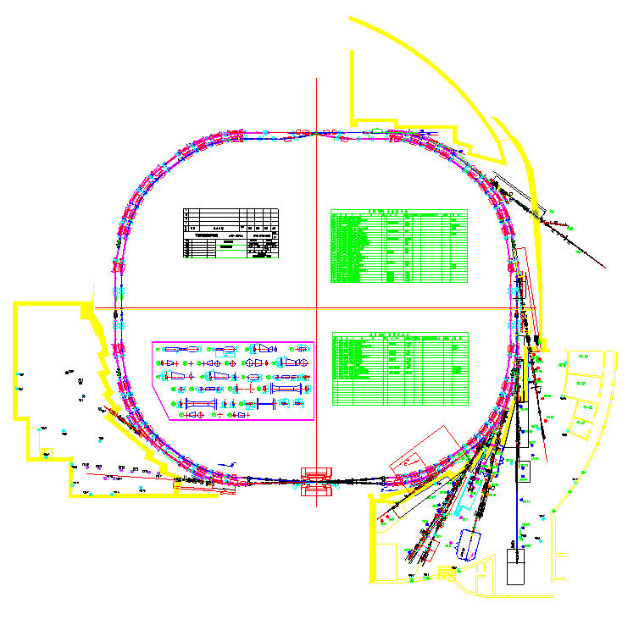
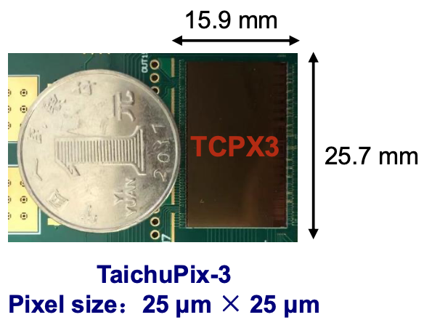
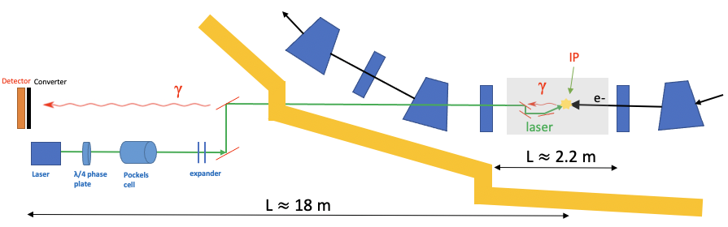
Compton polarimeter measuring self-polarization @ BEPCII
Reuse the beamline of the dismantled wiggler 4W2
  Laser & detector placed in the hutch
  Photon beamline transports both laser & scattered γ-ray
  Collision between laser & electron beams at the source point
Detection of scattered γ position with TaichuPix detectors
First domestic Compton polarimeter, essential for all polarized beam applications in e+/e- storage rings
BEPCII
e-
Hutch

Slide 10
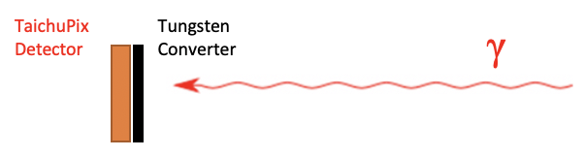
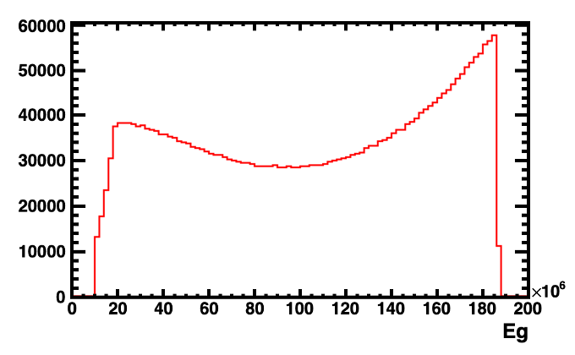
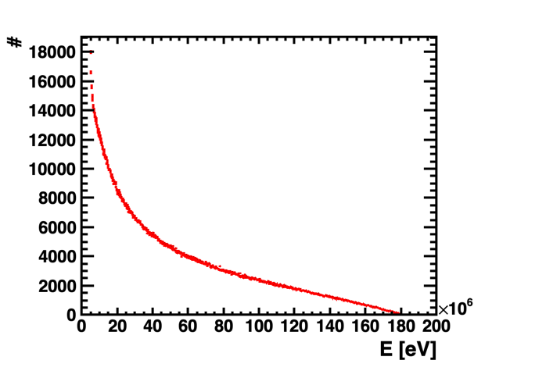
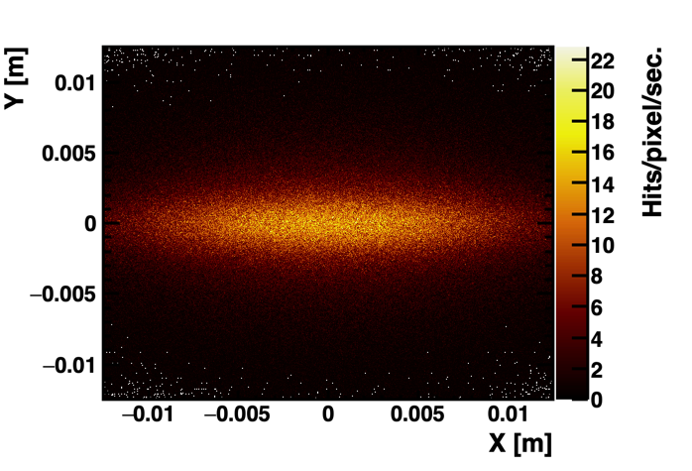
Detection of scattered γ (preliminary)
E_{e-} =2.35GeV, bunch population 3.7e10
laser: 5W, 515 nm, 12.6 kHz ~ 1.26MHz repetition rate
IP to converter ~ 18m
Tungsten converter: 3mm thickness
Detector placed 1 mm after converter
Several layers of detectors for detection and veto
25 * 25 mm
Scattered γ
Converted e+/e- pairs
e+/e- hits on detector
Compton edge: 187 MeV
Pixel size: 25*25 um^2

Slide 11
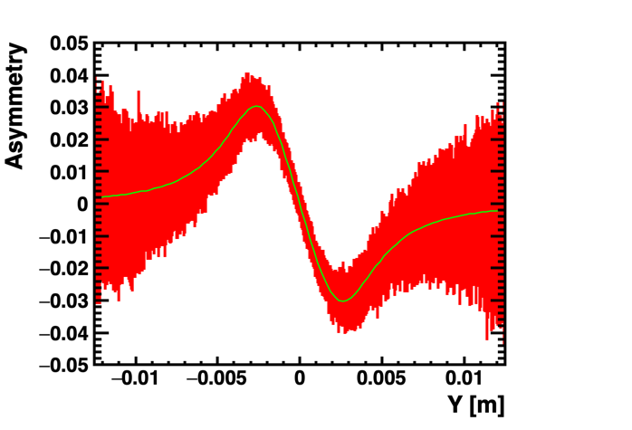
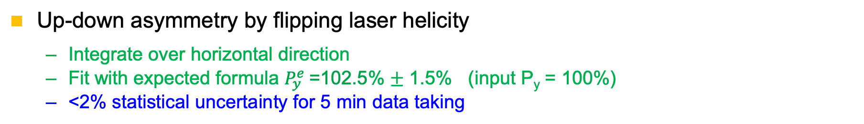
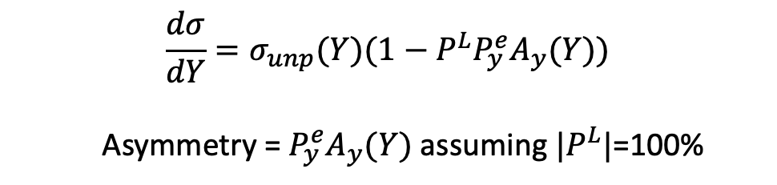
Polarization measurement sensitivity (preliminary)
Up-down asymmetry by flipping laser helicity
  Integrate over horizontal direction
  Fit with expected formula $P_{y}^{e}$=102.5% $±$ 1.5% (input P_{y} = 100%)
  <2% statistical uncertainty for 5 min data taking
$$\frac{dσ}{dY}=σ_{unp}(Y)(1−P^{L}P_{y}^{e}A_{y}(Y))$$
Asymmetry = $P_{y}^{e}A_{y}(Y)$ assuming ${|P}^{L}|$=100%
Preliminary studies find no showstopper in this Compton polarimeter
More detailed system design is under way

Slide 12
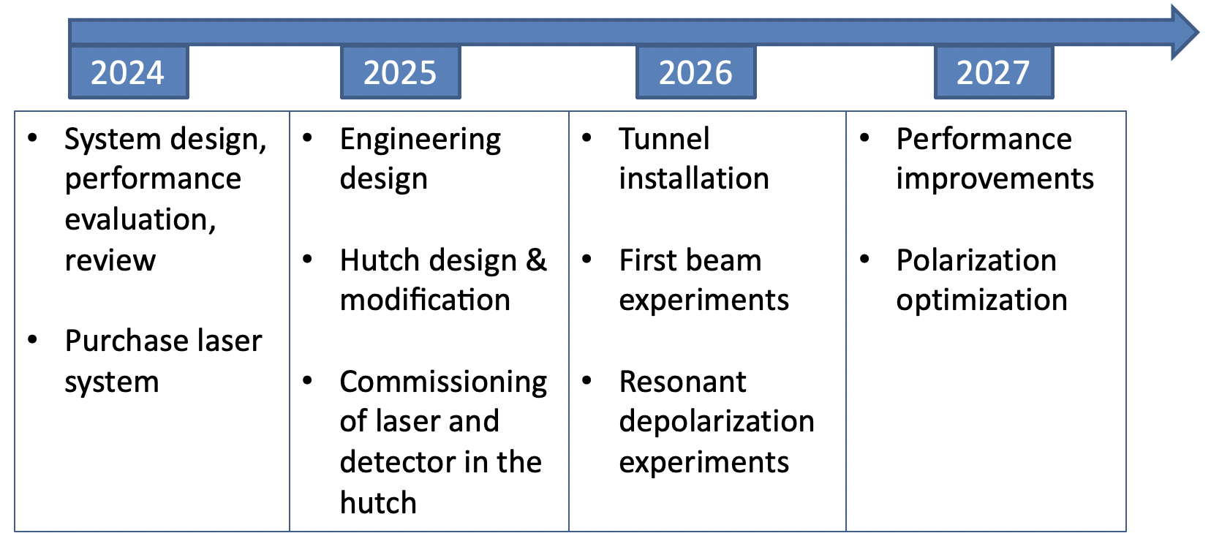
Collaborators, preliminary plan and cost estimates
Aurelien Martens (IJCLab, joint application for FCPPL 2024 funding): optics & polarimeter simulations
Liang Zhijun and his TaichuPix team : detector
BEPCII (support from Yu Chenghui) : accelerator modification
BSRF (first contact with Li Yanchun): front end, optics & hutch
Potential international collaborators: BINP laser polarimeter team, FCC EPOL Collaboration
A graduate student starting research this autumn
设备 | 说明 | 经费 （共500万）
γ探测系统 | 转换靶-探测器集成、数据获取、探测器标定等 | 50万元
515nm驱动激光系统 | 5W，5ps，重频可调（12kHz ~ 1.26MHz） | 200万
激光传输系统 | 相互作用腔室、光学传输、诊断等 | 150万元
束线设备 | 前端区改造、束测、真空、机械和控制等 | 100万元

Slide 13
Polarization R&D in the CEPC EDR Phase
Hardware R&D and beam tests
Enable
Experimental studies
Verify
Physics design

Slide 14
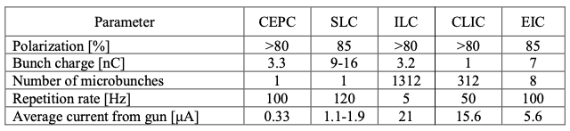
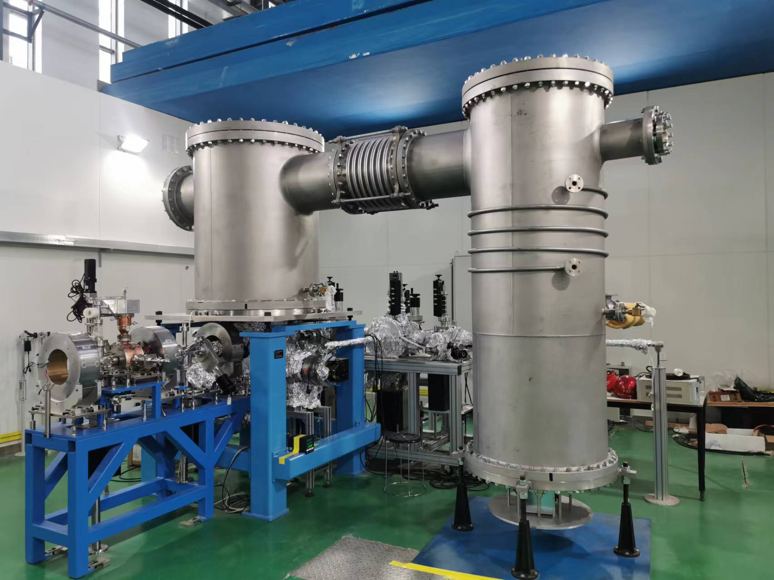
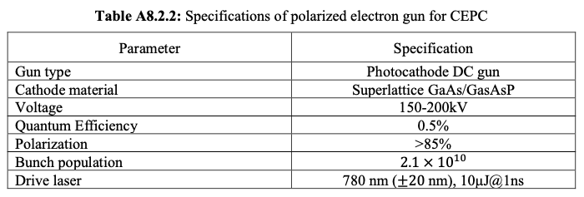
Polarized electron source for CEPC
Polarized electron gun is a key technology in e+e- colliders, well developed in major high-energy physics labs SLAC, JLAB, BNL, KEK, BINP, KPH etc
The parameters required for CEPC is less challenging than ILC and EIC, expecting better cathode lifetime
Polarized electron gun requires ultrahigh vacuum (<10⁻⁹ Pa), is a natural extension of the HV Photocathode DC gun @ PAPS. Cathode material is now regulated by US export control, requires domestic R&D.
PAPS 500kV Photocathode DC gun

Slide 15
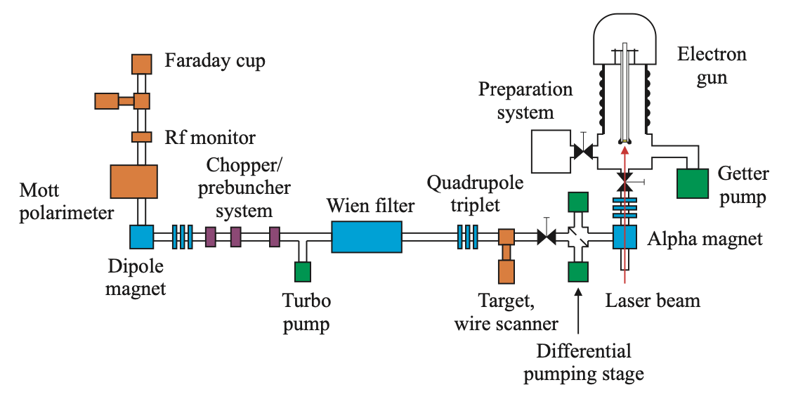
Polarized electron source: polarized DC gun
Convert HV DC photocathode gun @ PAPS to first domestic polarized electron gun for use in high energy accelerators
设备 | 功能 | 经费 （共760万）
超晶格GaAs/GaAsP材料 | 光阴极材料。必须通过分子束外延在GaAs基底上生长，工艺极其复杂。目前国内尚无产品，国际上没有现成产品。计划与国内外有条件的实验室合作研制 | 110万
极高真空阴极运输和导入系统 | 生长好的超晶格GaAs/GaAsP材料需要在极高真空环境中运输、保存并通过Load-Lock系统传递至直流高压电子枪内 | 70万
780nm驱动激光系统 | 光阴极的驱动激光，用于激发出光电子。包括钛宝石振荡源、光纤放大器、激光整形、展宽器、光路传输、同步锁相等 | 300万
Mott极化仪 | 用于低能极化电子束的极化度测量 | 140万
Wien filter及其高压电源 | 由于Mott仪只能进行横向的极化测量，而电子枪出射的电子束为纵向极化，需要采用Wien filter将纵向极化偏转至横向极化 | 110万
束线设备 | 必要的束线设备，包括束测、真空、机械和控制等 | 30万
Schematic drawing of a PES and associated beamline
EPAC 2006, THPCH161
GaAs/GaAsP superlattice cathode + 780nm drive laser -> ~85% polarization
Wien filter + Mott polarimeter: manipulation and measurement of e- beam polarization
Notes:
需要介绍关键技术关键在什么地方？ 材料卡脖子？

Slide 16
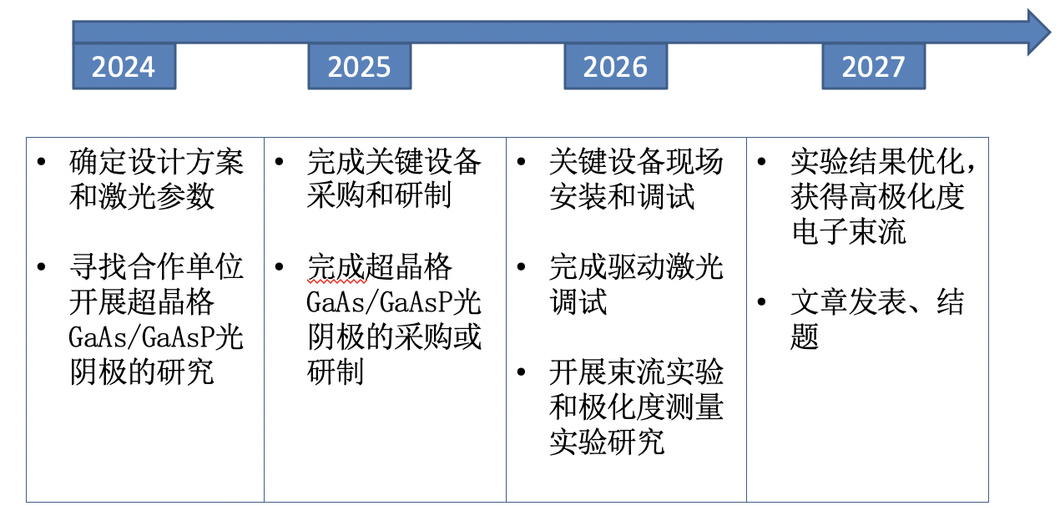
Polarized electron source: polarized DC gun
研究团队：
李小平，段哲，Valery Tyukin（KPH, PIFI starting from 2024.03），徐航，徐金强，刘佰奇，刘劲东，博士研究生: 2-3人

Slide 17
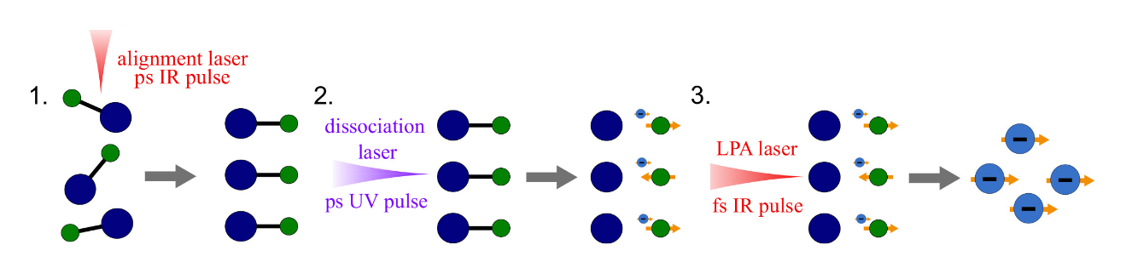
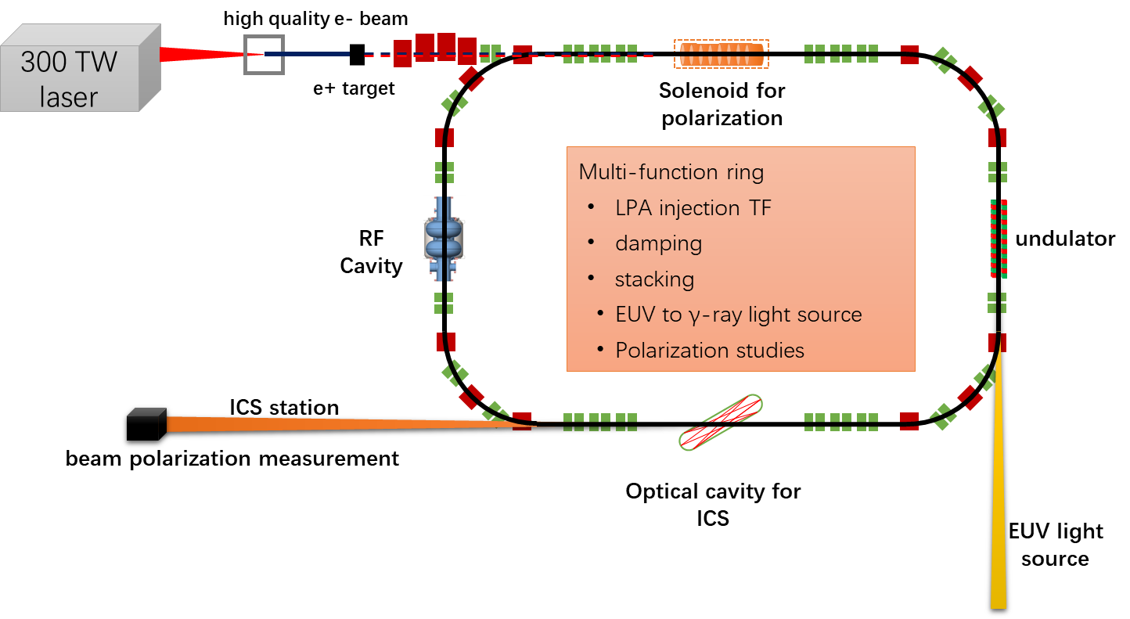
Polarized electron source: laser-plasma interaction
Polarized electrons could be produced by certain laser-plasma interactions:
Many proposals based on simulations (arXiv: 2205.00421)
Laser Plasma Accelerator + e-/e+ Damping Ring Test Facility
Potential for first experimental demonstration of various polarized electron generation approaches

Slide 18
Polarization R&D in the CEPC EDR Phase
Hardware R&D and beam tests
Enable
Experimental studies
Verify
Physics design

Slide 19
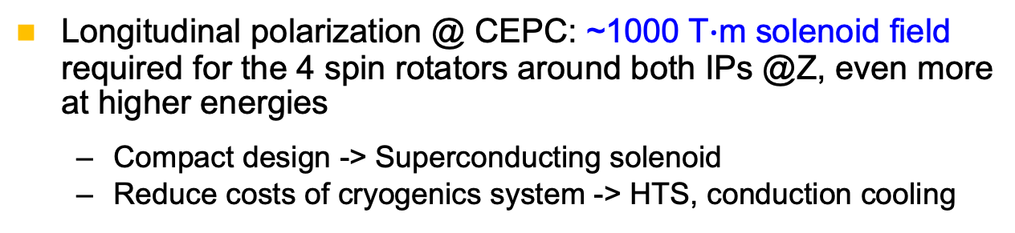

Polarization manipulation: SC solenoid spin rotator
Longitudinal polarization @ CEPC: ~1000 T$∙$m solenoid field required for the 4 spin rotators around both IPs @Z, even more at higher energies
  Compact design -> Superconducting solenoid
  Reduce costs of cryogenics system -> HTS, conduction cooling
CEPC IR
R&D: A 12T, 10.5 T$∙$m HTS solenoid prototype based on ReBCO
Beam test in the LPA- e+/e- Damping Ring Test Facility
Longitudinal polarization:
SC solenoid rotator serves as a Siberian snake
  Spin manipulation, mitigation of spin resonances
Kinetic polarization:
First precise measurement and test of
theoretical prediction
10.5 T$∙$m Solenoid as a Siberian snake
Longitudinal polarization

Slide 20
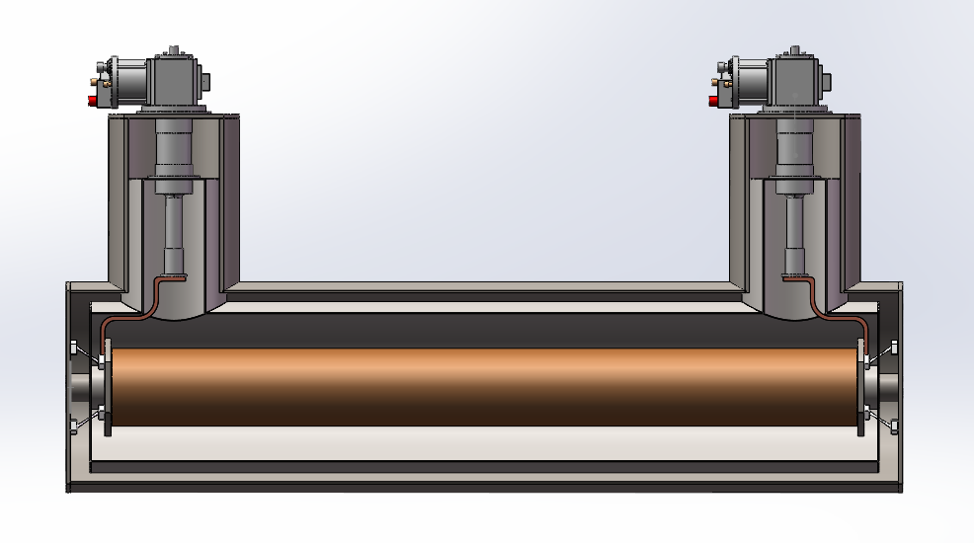
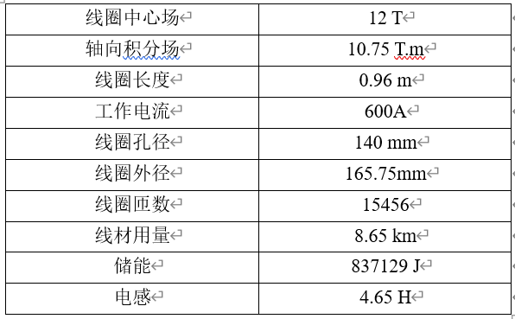
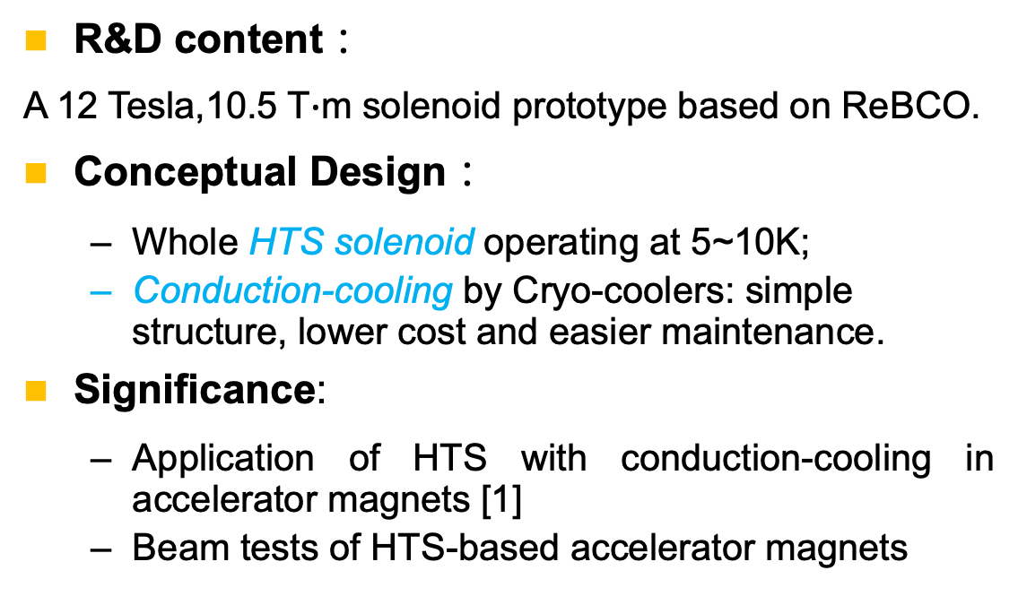
R&D of HTS solenoid spin rotators
R&D content：
A 12 Tesla,10.5 T$∙$m solenoid prototype based on ReBCO.
Conceptual Design：
  Whole HTS solenoid operating at 5~10K;
  Conduction-cooling by Cryo-coolers: simple structure, lower cost and easier maintenance.
Significance:
  Application of HTS with conduction-cooling in accelerator magnets [1]
  Beam tests of HTS-based accelerator magnets
Cryo-cooler
Vacuum Dewar
Solenoid
HTS solenoid
[1] Similar technology is being pursued for FCC-ee Crab Sextupoles (Foussat, presentation on FCC Week 2023)
Notes:
基于传导冷却的12T方案更符合超导磁体未来的发展，为其他高场超导磁体技术进行技术积累，同时基于传导冷却可以简化磁体结构，减少低温系统造价，运行维护简单。目前BESIII超导磁体的失超大约90%来自于低温系统的不稳定。HTS能够应用于粒子物理和加速器领域，必将促进整个超导行业的发展，对HTS材料的技术提升和广泛应用奠定基础。

Slide 21
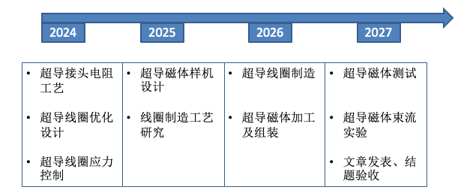
R&D of HTS solenoid spin rotators
12T ReBCO超导螺线管磁体关键技术
HTS线圈的失超保护拟采用无绝缘设计，会造成磁体励、退磁时间较长；
2. HTS带材的接头工艺；
3. HTS长螺线管线圈的应力控制和制作工艺；
4. HTS线圈的传导冷却方案需优化设计；
5. HTS线圈长期运行稳定性研究
项目 | 明细 | 预算
设备费 | 电源 | 40万
 | 制冷机 | 50万
 | 温度监控 | 10万
材料费 | 超导材料 | 310万
 | 其他材料 | 40万
加工及测试费 | 线圈及杜瓦 | 170万
 | 电流引线 | 20万
合计 |  | 640万
研究团队
徐庆金 ，赵玲，侯治龙，周谨，刘钟秀，2~3名研究生

Slide 22
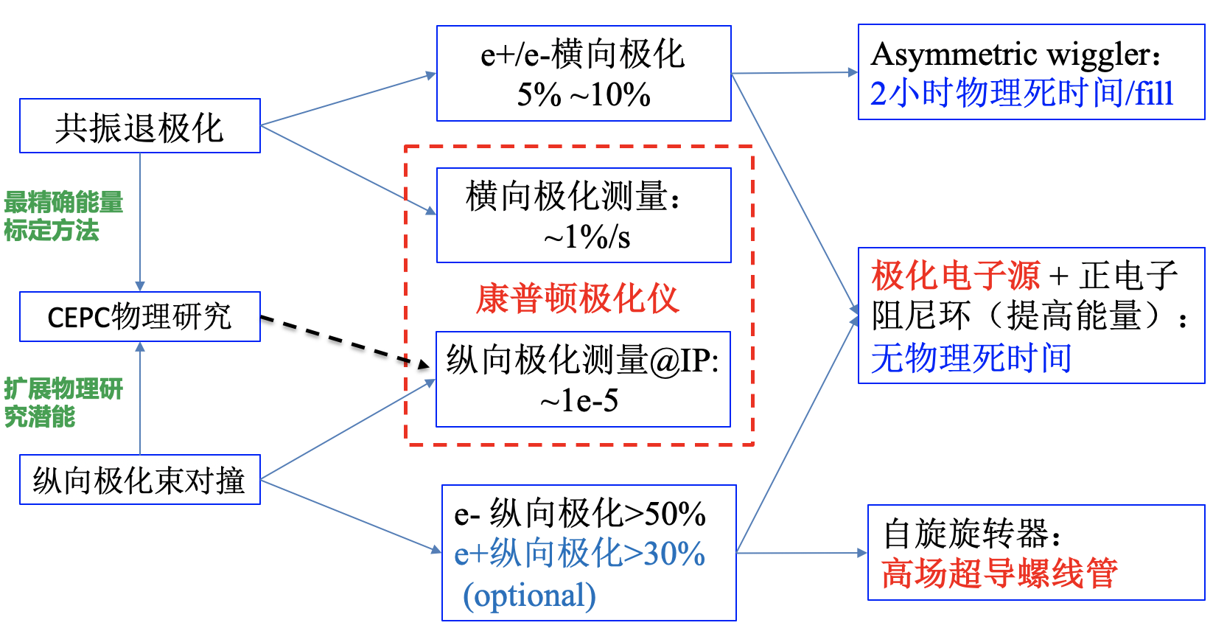
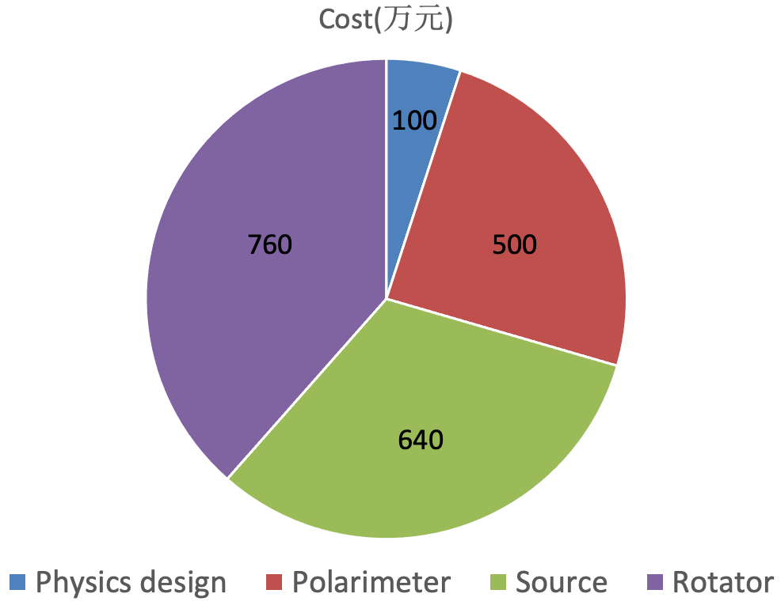
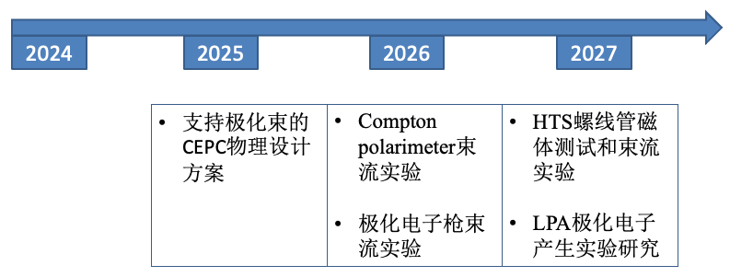
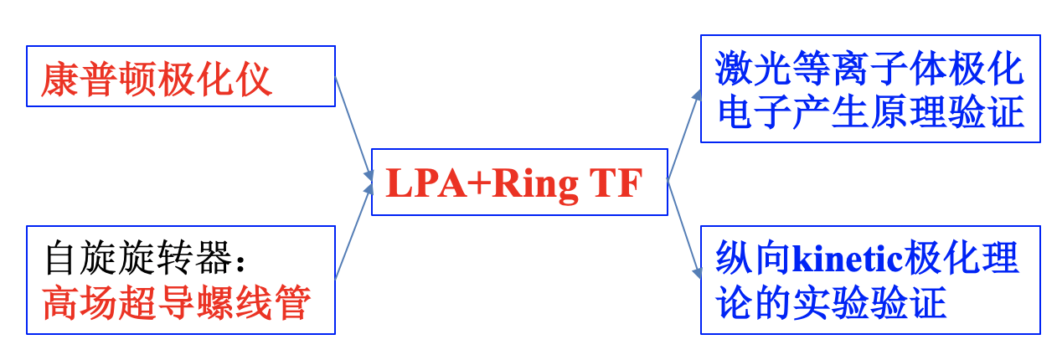
Summary
Costs （共2000万元）
Milestones

Slide 23
Backup

Slide 24
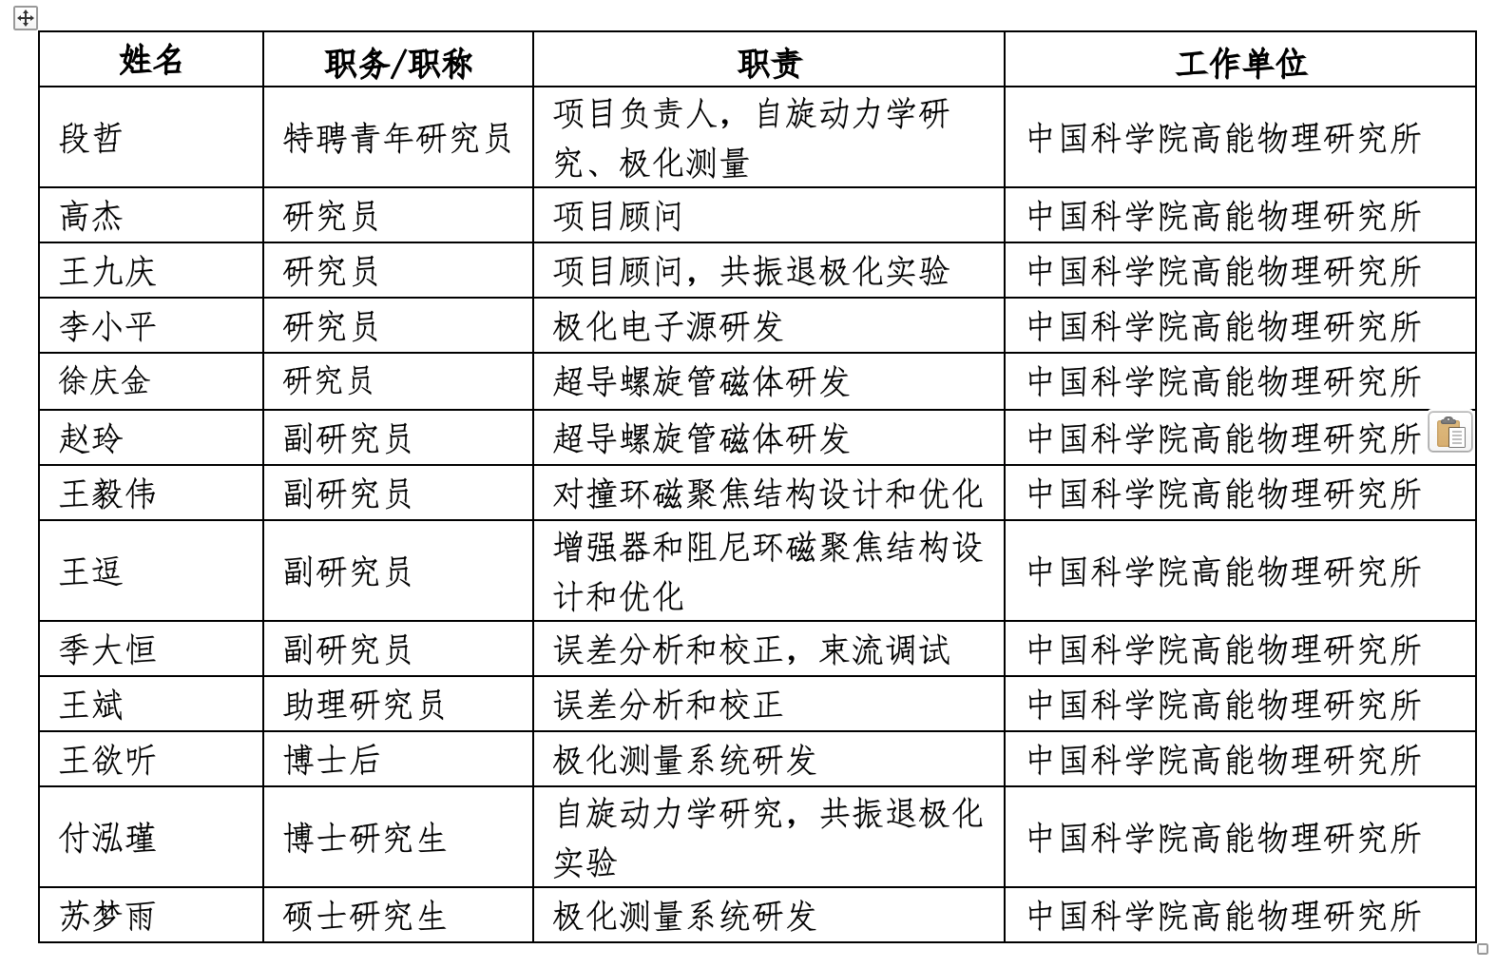
研究团队

Slide 25
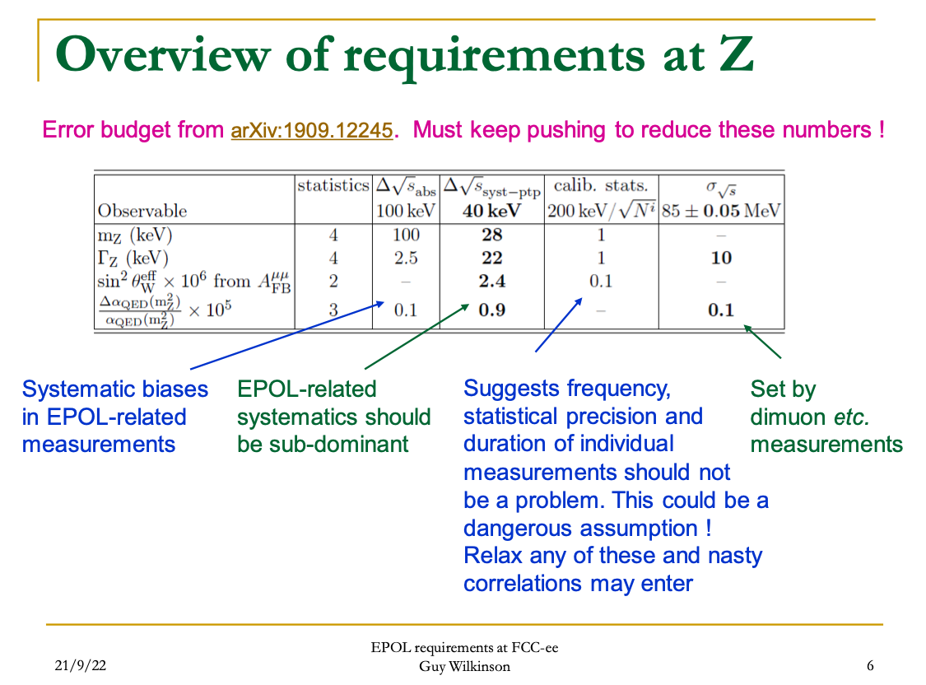
EPOL requirements

Slide 26
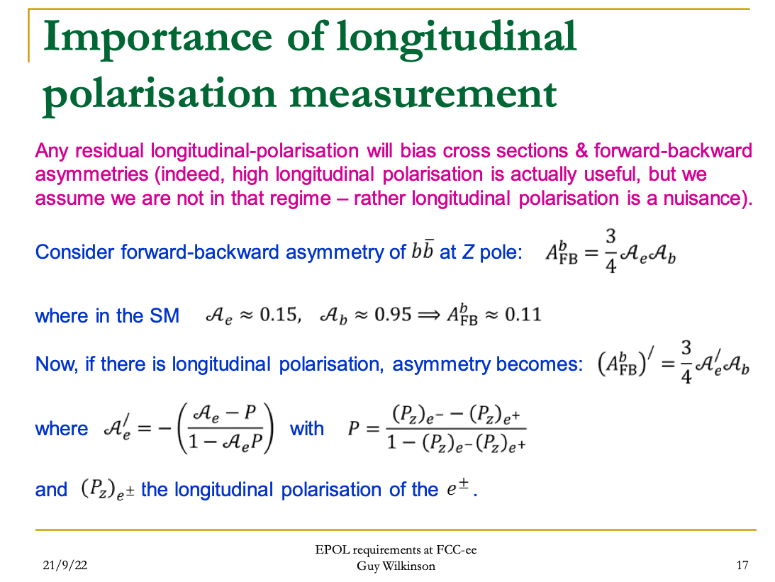
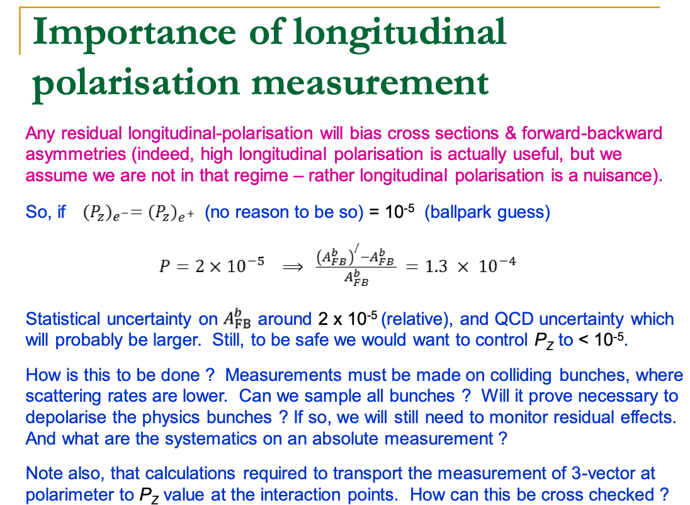
Longitudinal polarization as a nuisance

Slide 27
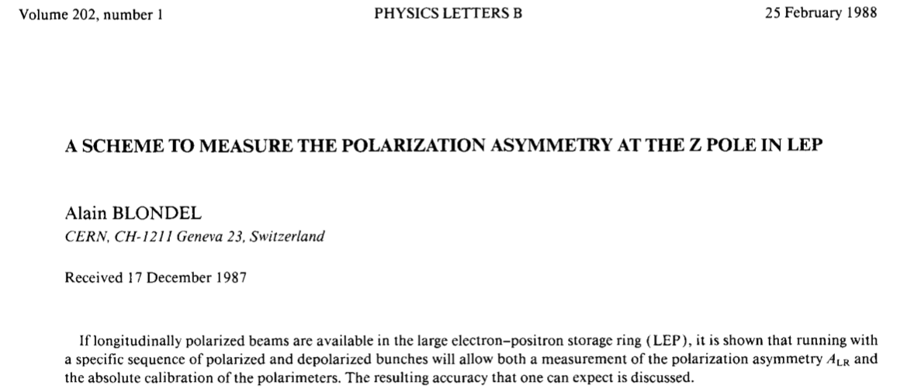
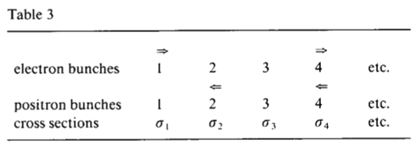
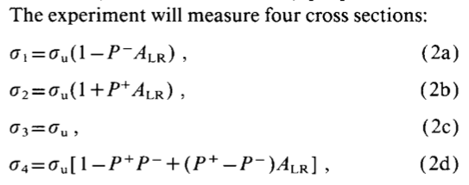
Polarization asymmetry and polarimeter calibration

Slide 28
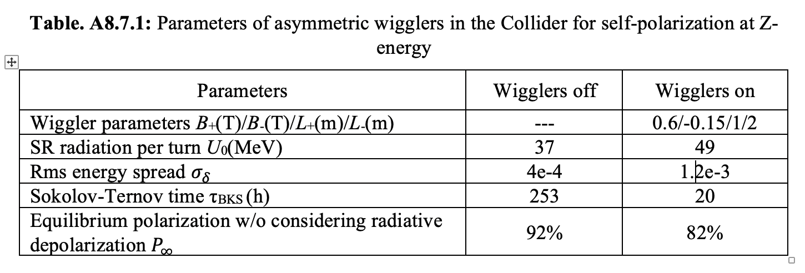
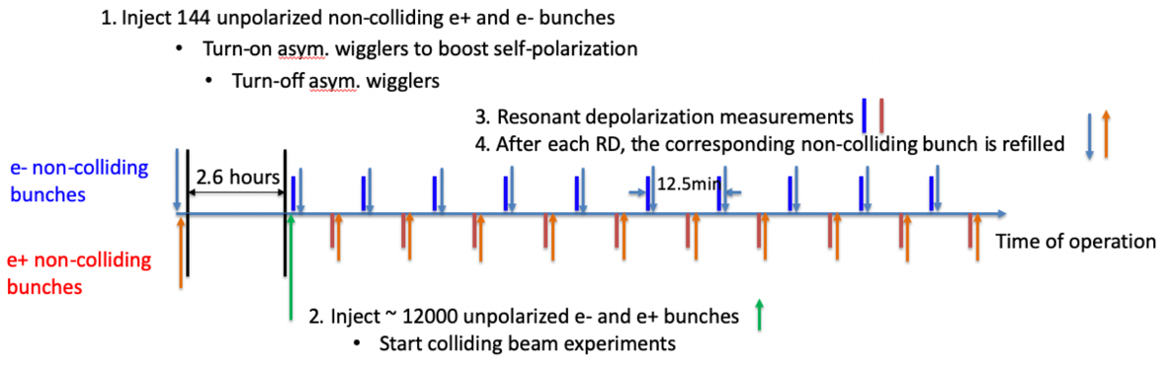
Asymmetric wigglers

Slide 29
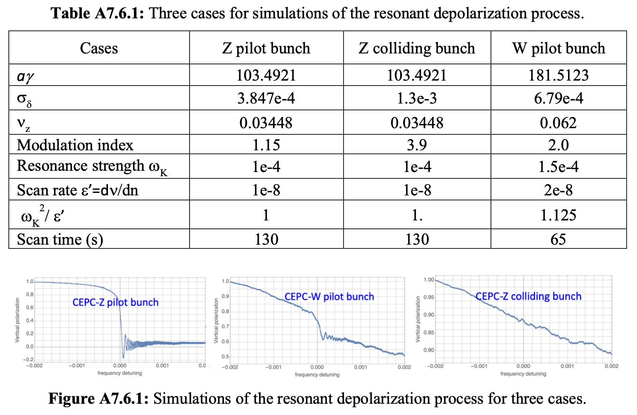

Slide 30
Laser repetition rate and data acquisition pattern
Laser repetition rate | Pulse energy (μJ) | γ-yield (photons per interaction) | Comments
166.6 MHz | 0.03 | 0.02 | Each bunch, incompatible with readout design
1.261 MHz | 4 | 2.6 | 1 revolution
126.1 kHz | 40 | 26 | 10 revolutions
12.61 kHz | 400 | 260 | 100 revolutions
Laser synchronized with an arbitrarily selected electron bunch, at a high repetition rate
Hit rate: 10~20 hits/pixel/second
Laser polarization helicity flipped at kHz rate to reduce measurement uncertainties
If the same pixel is fired twice or more within a very short time (<= 200 ns), then the detector would count these as a single hit on that pixel.
  If the laser repetition rate is lower than 1.26MHz, the interval between adjacent interaction is greater than 800 ns, this would not be an issue
  Even if the laser repetition rate is 166MHz, since each interaction has a very low gamma-yield, within 200 ns the expected total gamma-yield is only 0.02 * 200 / 6 ~ 0.7. And the hits distribute on a large number of pixels. Multiple hits on the same pixel within 200 ns are still very unlikely.
If the firing pixels are in different positions, we can read them out one by one. The chip is based on data-driven architecture and can treat up to 120 hits within 1 μs (limited by the capacity of the memory), This limit scales with the time, i.e., up to 1200 hits within 10 μs. If the hit rate is below this limit, all the hits can be processed without any problem.
  For a laser repetition rate of 1.261 MHz (~800 ns), the gamma number per interaction is ~ 2.6, i.e., ~3 hits/μs, much lower than the limit.
  The hit rate is almost independent of the laser repetition rate, so much lower than the limit for the considered range of laser repetition rate.
If multiple pixels in the same column are fired within a very short time (<= 200 ns), the detector will read out all these fired pixels and register them with the same time tag, rather than reading out only one pixel of the column.
  For a laser repetition rate of 12.61kHz, the gamma number per interaction is ~ 260, still a small fraction of the total number of pixels (1024*512). These gammas are a small sample (following the same random distribution) of the hits shown on the Figure 3 on Page 9. Even if several pixels in the same column could be fired at the same time, the detector is still capable of reading out all these hits.
The background noise sources (spurious electrons, SR) can be considered as distribute uniformly with time. If using a lower laser repetition rate, the instantaneous signal is more likely to exceed the noise, and would be more convenient for the early commissioning.

Slide 31
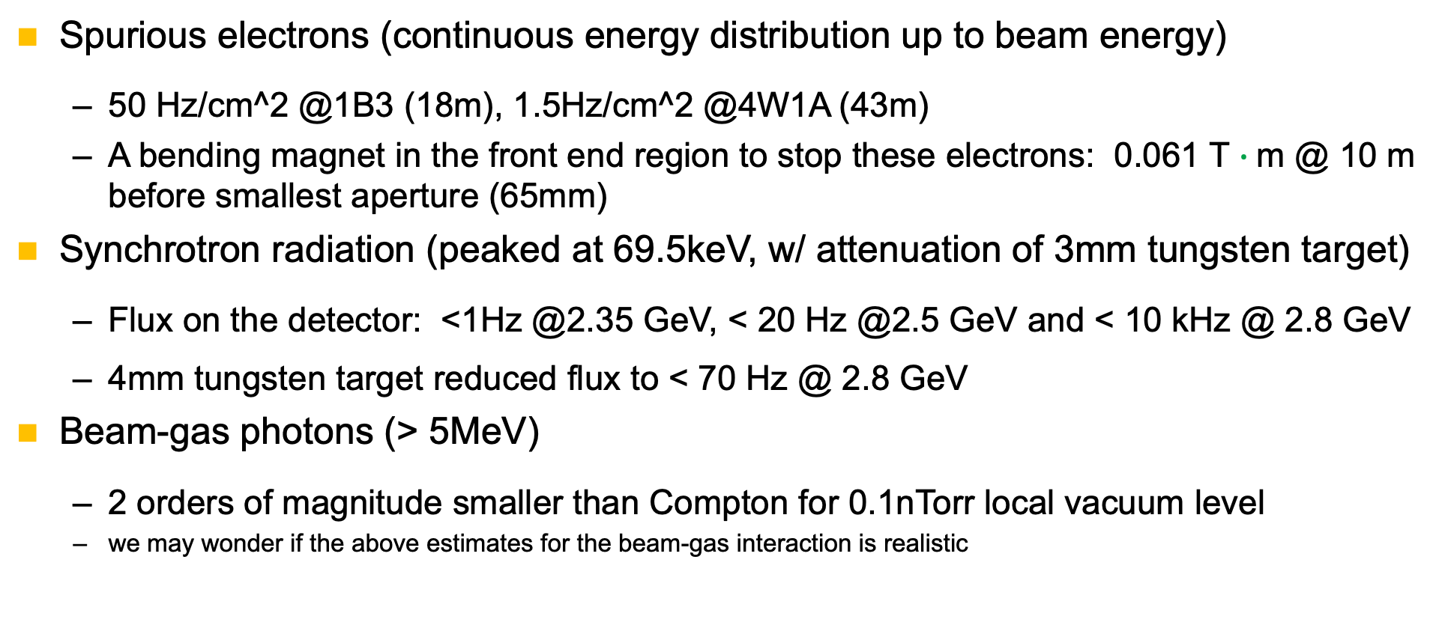
Background sources
Spurious electrons (continuous energy distribution up to beam energy)
  50 Hz/cm^2 @1B3 (18m), 1.5Hz/cm^2 @4W1A (43m)
  A bending magnet in the front end region to stop these electrons: 0.061 T $∙$m @ 10 m before smallest aperture (65mm)
Synchrotron radiation (peaked at 69.5keV, w/ attenuation of 3mm tungsten target)
  Flux on the detector: <1Hz @2.35 GeV, < 20 Hz @2.5 GeV and < 10 kHz @ 2.8 GeV
  4mm tungsten target reduced flux to < 70 Hz @ 2.8 GeV
Beam-gas photons (> 5MeV)
  2 orders of magnitude smaller than Compton for 0.1nTorr local vacuum level
  we may wonder if the above estimates for the beam-gas interaction is realistic

Slide 32
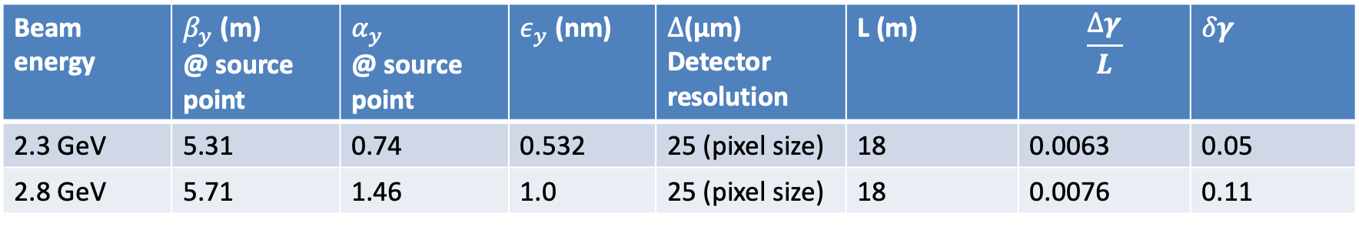


Influence of electron beam divergence & detector resolution
It must be ensure the electron beam divergence and detector resolution does not smear out the vertical distribution of Compton γ
$$δ=\sqrt{\frac{ε_{y}}{β_{y}}\left[1+{(α_{y}−β_{y}/L)}^{2}\right]+{\left(\frac{Δ}{L}\right)}^{2}}≪\frac{1}{γ}$$
(NIM 165 (1979) 177-186)
Vertical direction
Beam energy | $β_{y}$ (m) @ source point | $$α_{y}$$ @ source point | $ε_{y}$ (nm) | $Δ$(μm) Detector resolution | L (m) | $$\frac{∆γ}{L}$$ | $$δγ$$
2.3 GeV | 5.31 | 0.74 | 0.532 | 25 (pixel size) | 18 | 0.0063 | 0.05
2.8 GeV | 5.71 | 1.46 | 1.0 | 25 (pixel size) | 18 | 0.0076 | 0.11
Horizontal direction
Beam energy | $β_{x}$ (m) @ source point | $$α_{x}$$ @ source point | $ε_{x}$ (nm) | $Δ$(μm) Detector resolution | L (m) | $$\frac{∆γ}{L}$$ | $$δγ$$
2.3 GeV | 5.66 | -1.447 | 152 | 25 (pixel size) | 18 | 0.0063 | 1.49
2.8 GeV | 5.95 | -1.58 | 200 | 25 (pixel size) | 18 | 0.0076 | 2.17

Slide 33
TO DO List
Laser system design and integration
  Choice of laser technology in the context of a reduced laser repetition rate
  Laser optics, polarization control & measurement
  Laser transport to IP, tuning mechanisms and diagnostics
Accelerator
  Interaction chamber
  Updates to the lattice
  Diagnostics of electron position/angle (nearby BPMs)
Detector system design
  More detailed detector design and GEANT4 simulations
  Target-detector assembly and integration
DAQ, control and timing
  Synchronization between the laser and the RF reference
  The timing system sends trigger signal to the laser and the detector
Modification to the hutch, beamline, front end (add a cleaning dipole)
Commissioning strategy and knobs

Slide 34



对几个问题的回应
BEPCII已经有两台激光器，在高频区可以与束流有效产生康普顿散射，并能观测到。是否可用？
  现有的激光为CO2激光（波长为10.8 μm，能量0.12eV），同1.77GeV电子，背散射光子能量不超过6MeV
  目前的能量测量装置利用高纯锗探测器，测量散射光子的能量分布（康普顿边缘）
  按照Aurelien的初步分析，若沿用CO2激光器，散射光子能量太低，对测量散射后的粒子空间分布不利
  为测量散射光子的空间分布，需要激光-电子对撞点到探测器之间有足够的漂移距离，目前的漂移距离仅1.5m，远远不够

Slide 35
R&D of HTS Solenoid spin rotators
关键技术及风险：
对比了6T和12T两种方案。6T低温超导方案技术较为成熟，成本低，但是运行温度裕度较小。12T 高温超导磁体方案存在一定的技术风险，需要进行预研。
HTS线圈的失超保护与低温超导有很大差别，目前通常考虑无绝缘设计，会造成磁体励退磁时间较长；
2. HTS 带材的接头工艺研究；
3. HTS带材容易出现分层，侧面受压时容易出现损伤，所以长螺线管线圈的应力控制和制作工艺需要研究；
4. 现有的高场超导线圈通常基于液氦浸泡结构，采用传导冷却方案需要优化设计；
5. HTS线圈长期运行稳定性研究。
经费预算（积分场相同）
 |  | 6T(NbTi/Cu) | 12T(ReBCO)
设备费 | 电源 | 20万 | 40万
 | 制冷机 | 50万 | 50万
 | 温度监控 | 10万 | 10万
材料费 | 超导材料 | 20万 | 310万
 | 其他材料 | 40万 | 40万
加工及测试 | 线圈及杜瓦 | 100万 | 170万
 | 电流引线 | 15万 | 20万
合计 |  | 255万 | 640万

Slide 36
Milestones and cost distribution
100
760
500
640

