Slide 1
Status and plan of
the mechanical and integration
Ji quan ，Xia shang，Zhang junsong
Feb. 28, 2024

Slide 2
content:
progress of general drawing
progress of subdetector
personnel placement and division of work
next plan

Slide 3
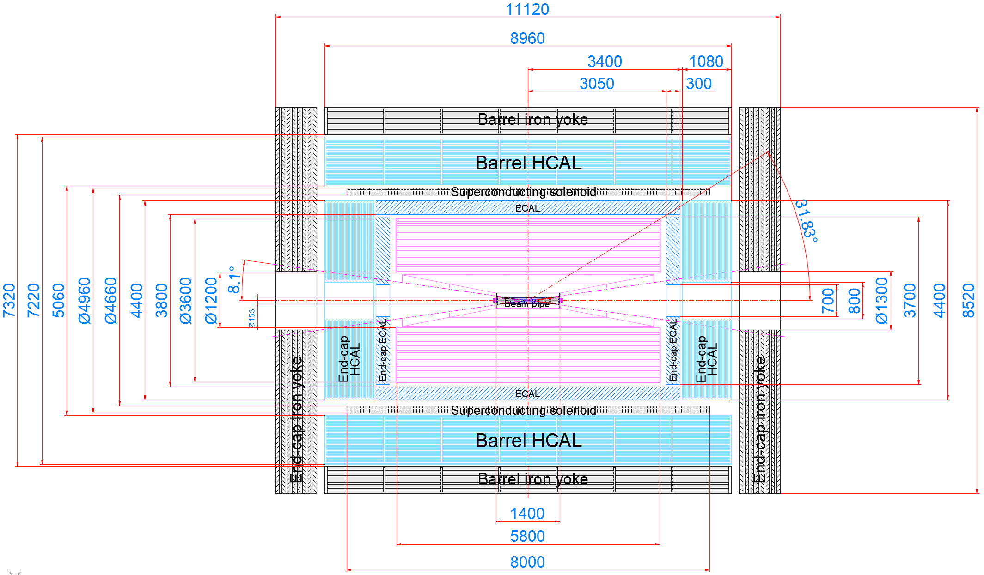
progress of general drawing：(Structural frame integrity)
Tracker confirm (Feb.23th)
HCAL ECAL (March 1st discussion)
Accelerator (Feb.29thdiscussion)
no shape
束流管不变
tracker
ecal

Slide 4
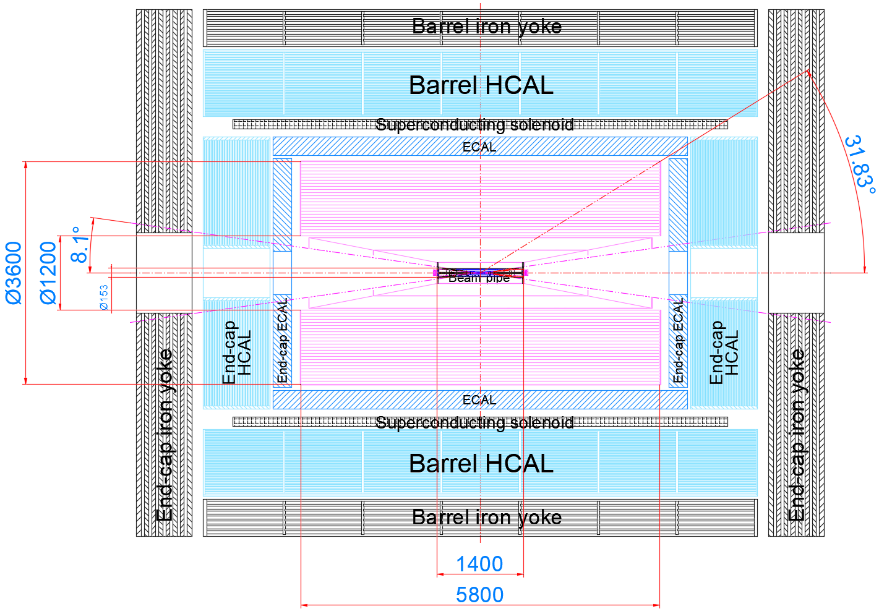
Determine the Tracker detector boundary size：(Feb.23th，Tracker)
Ø1200 mm = r 0.6 m
Ø3600 mm = r 1.8 m
Silicon Tracker : 3 layers
How to react correctly to the detection angle?

Slide 5
progress of subdetector
Confirm the boundary size of track detector —— 2月23日
Accelerator interface ——order(2月29日)
ECAL and HCAL discussion： ——order(3月1日)
Superconducting magnet discussed twice(张俊嵩) ——2月23日 26日
The iron yoke discussion (王小龙，宁飞鹏，夏商，张俊嵩，纪全) ——(2月20日)

Slide 6
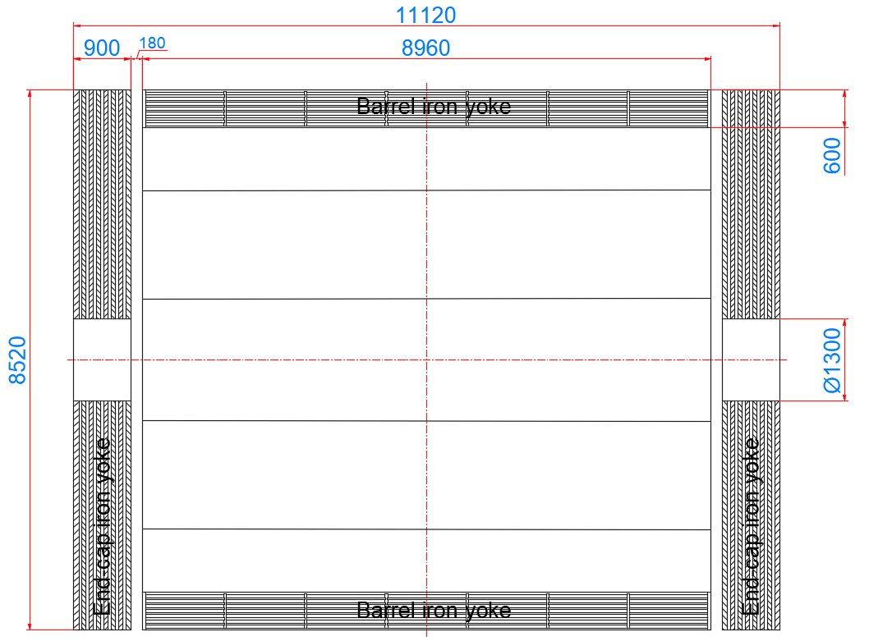
Progress of the iron yoke design
Preliminary work: (on the base of mechanical design and installation)
1、Spiral and symmetrical structure
2、Optimal design of liron plate thickness
3、Top-level installation design
The yoke iron includes a barrel part and an end part, and the thickness of the barrel part is 600mm
Total weight: 1155 tons

Slide 7
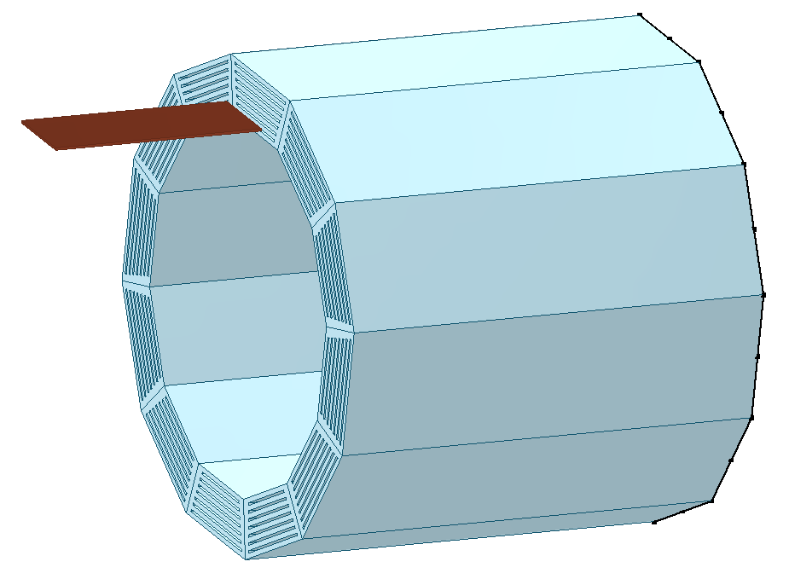
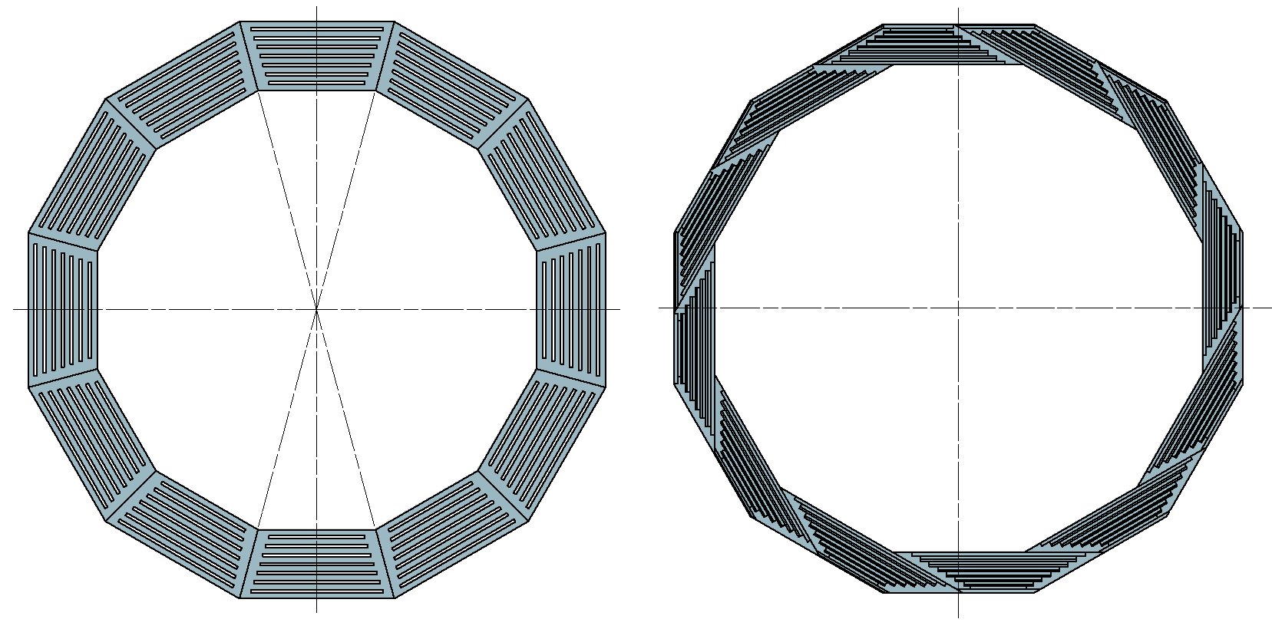
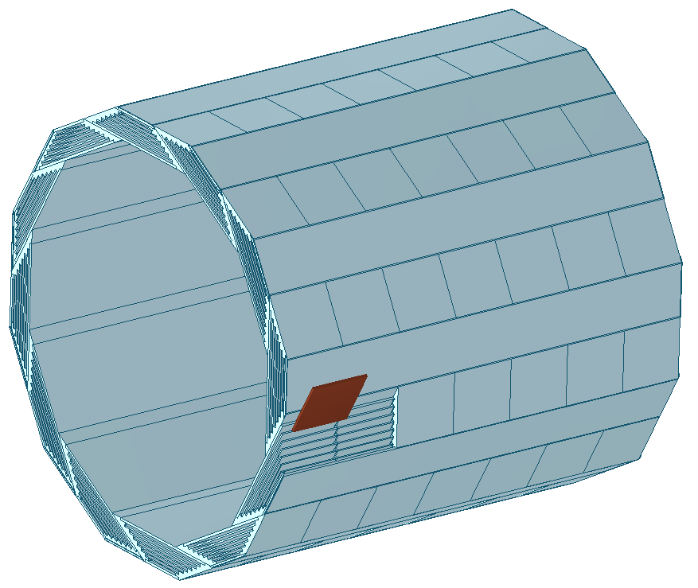
Progress of the iron yoke design
recommend to choose the spiral structure
axial mount
side mount
Symmetrical structure
spiral structure
Spiral type can achieve full coverage, symmetric type can not achieve full coverage
Spiral type can achieve maintainability

Slide 8
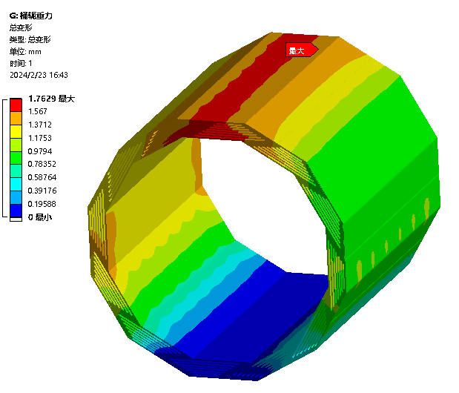
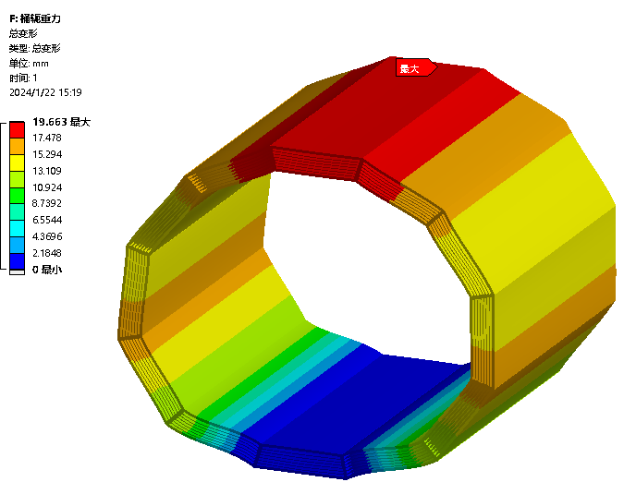
Progress of the iron yoke design
ecommend to choose the spiral structure
spiral structure stiffening plate
1.76mm max.
Symmetrical structure no stiffening plate
the spiral structure yoke iron strength is higher.
19.7mm max.

Slide 9
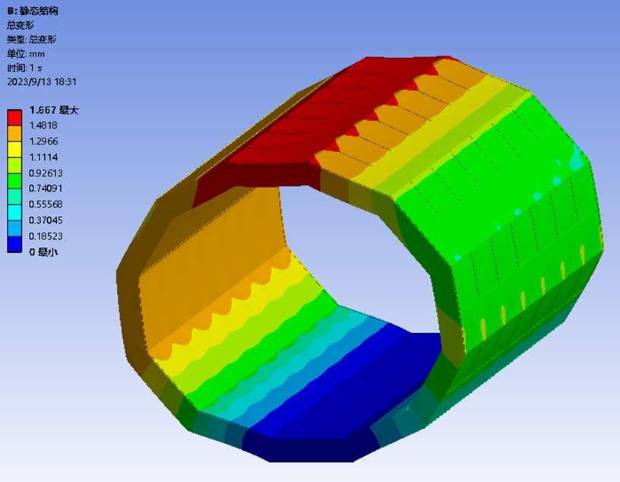
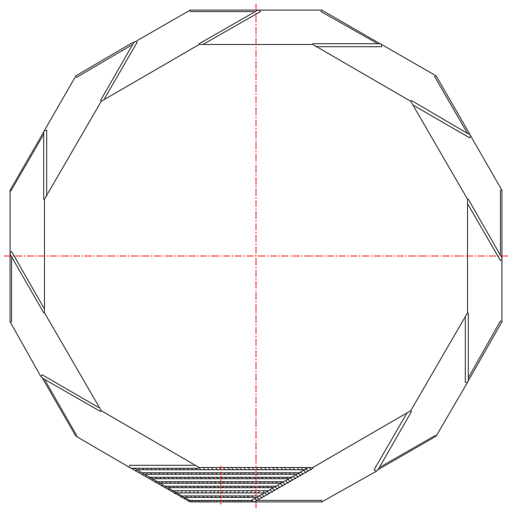
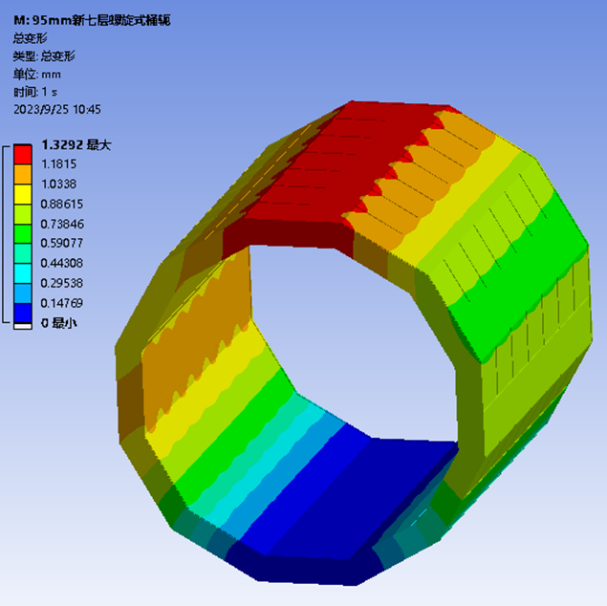
Progress of the iron yoke design
Increasing the thickness of the upper and lowest iron layers can increase the overall rigidity of the yoke iron and install more μ-detector layers.
50 X 7 = 350 (μ space)
limit design
1.67mm max.
uniform thickness
1.32mm max.
off-gauge thickness

Slide 10
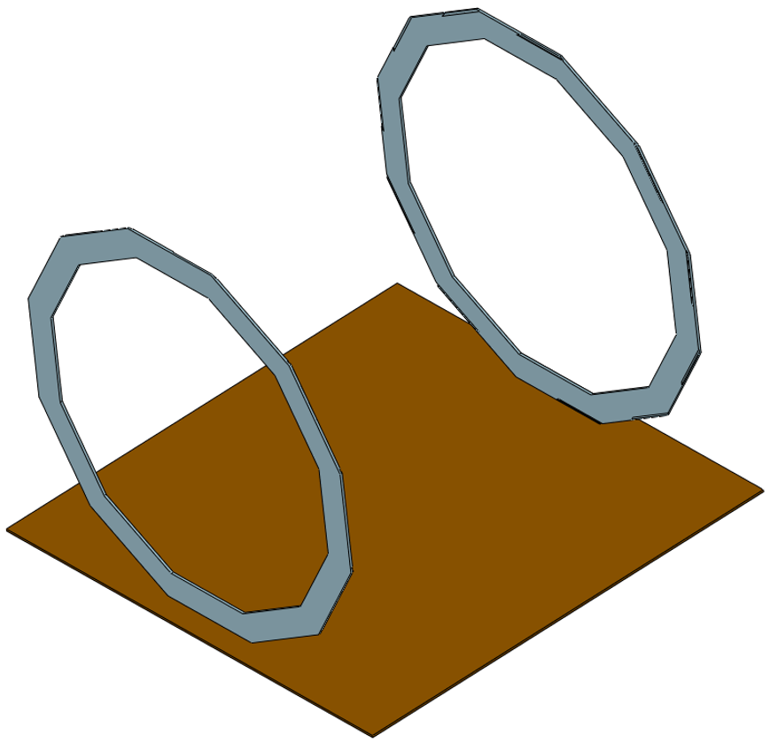
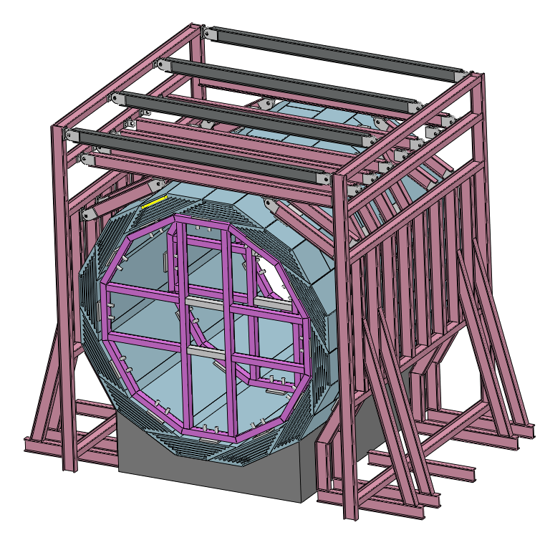
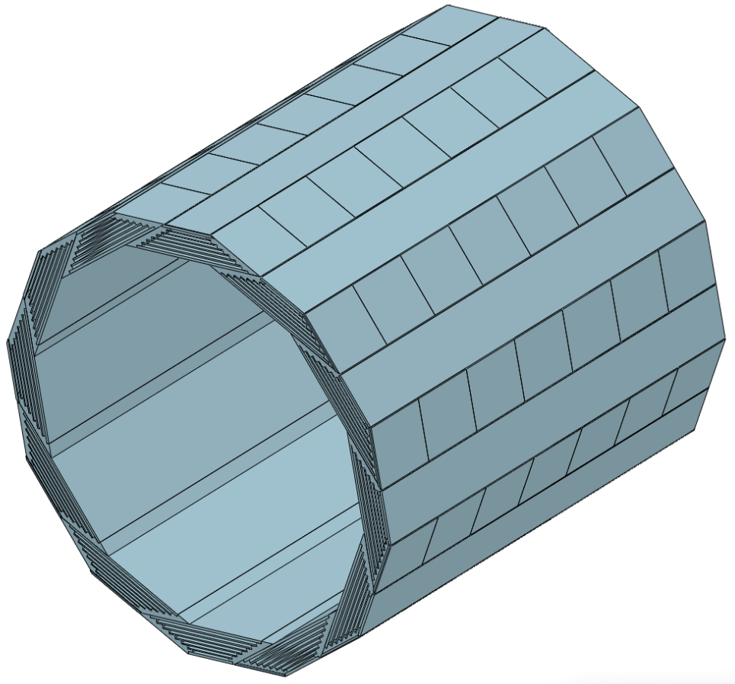
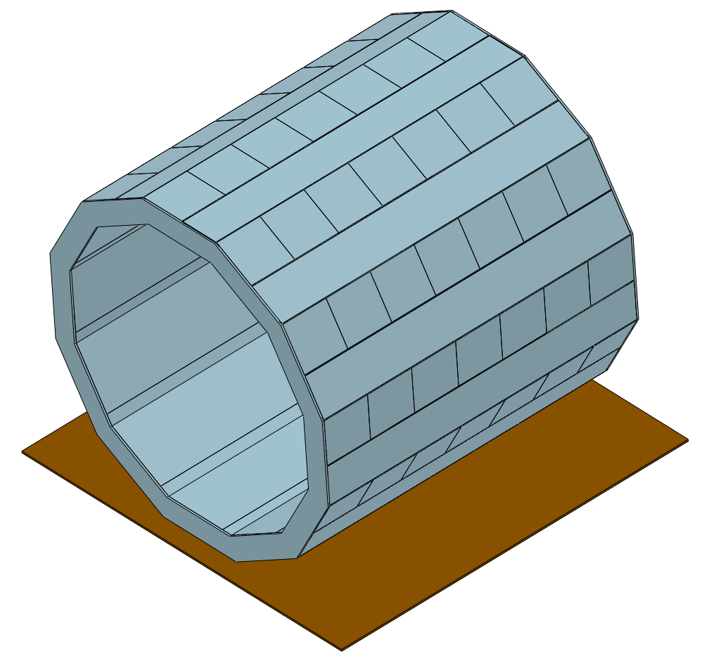
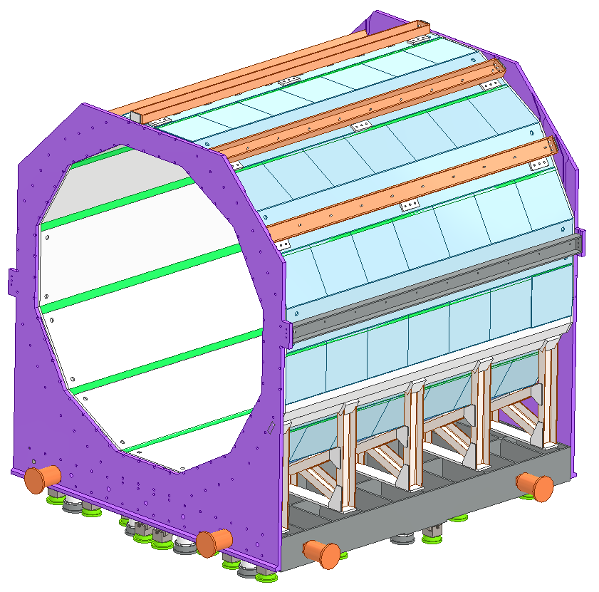
Progress of the iron yoke design
Column scheme
Suggestion: Top-level design must be high demanding
Installation design with tooling
interconnecte
Column installation scheme
High demand top-level design
“make”
Structure innovation.
Efficient installation design
no tooling installation

Slide 11
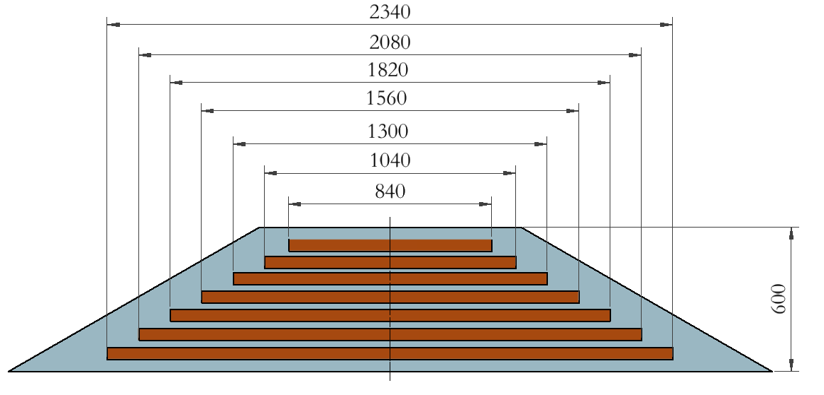
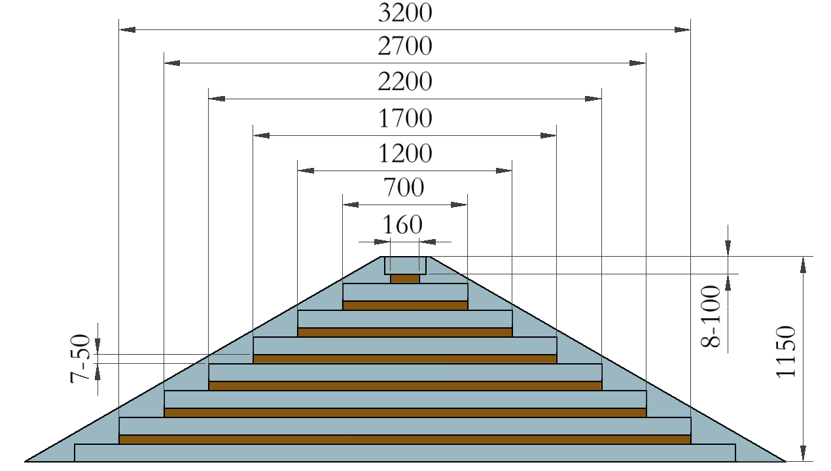
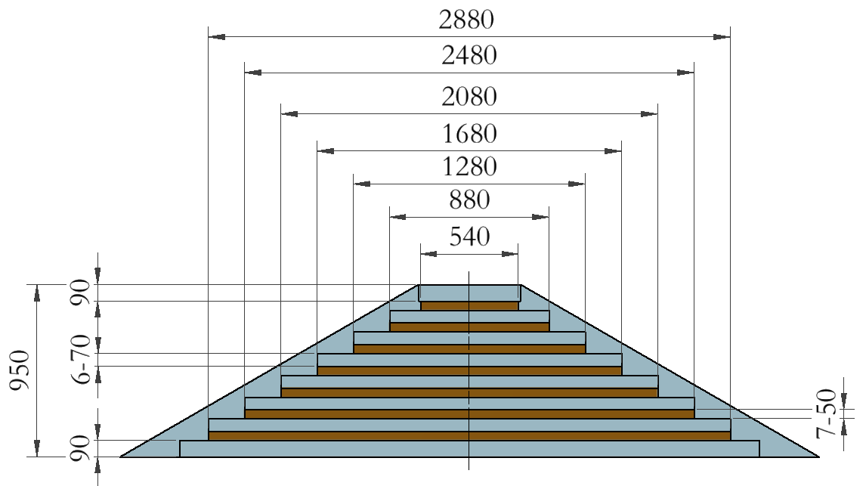
Progress of the iron yoke design
Iron yoke dicussion (Feb. 20th)：(王小龙，宁飞鹏，夏商，张俊嵩，纪全)
7layers μ
620 ton
7layers μ
1710 ton
Avoid magnetic saturation
No. of μ layers is
invariant
Previous design：thickness 600mm
Feb. 23th：thickness 1150mm
reason for suggestion：
1. thickness 600mm，20mm iron plate layers
meet stiffness requirements
2. thickness 950mm，70mmiron plate layers
meet stiffness requirements
3. thickness1150mm，
The width of detector varies greatly
7layers μ 1280 ton
conclusion：
The larger the total thickness, the greater the difference in μ detector width
Final design：thickness 950mm

Slide 12
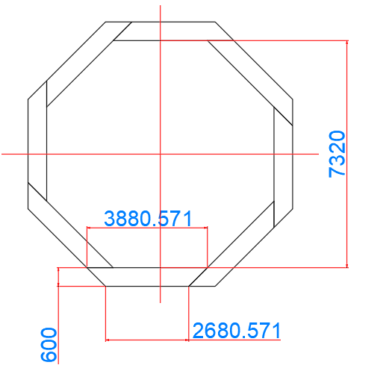
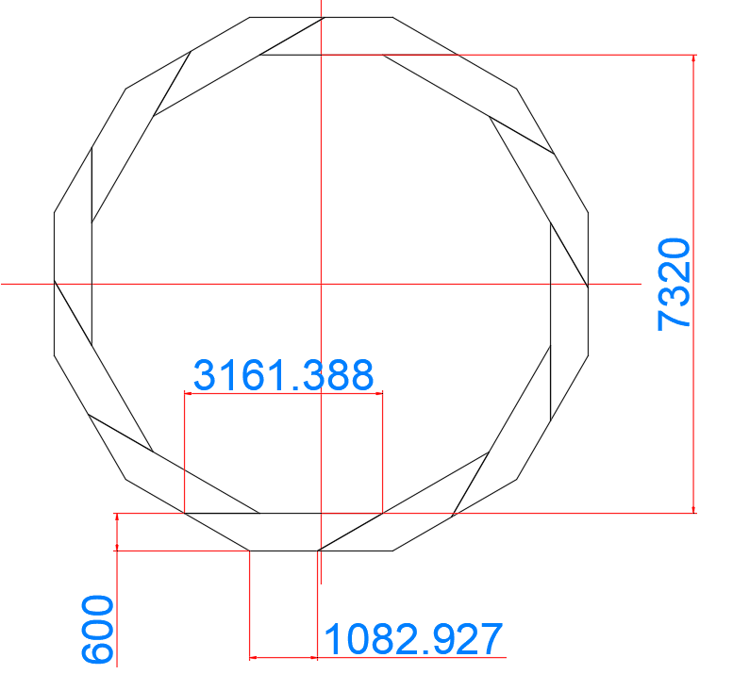
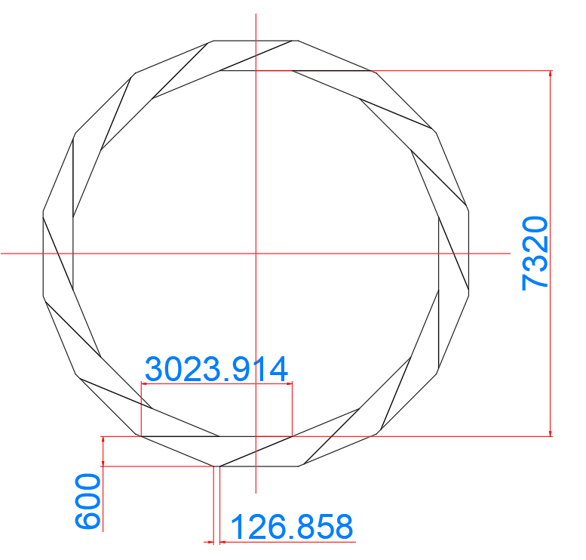
Progress of the iron yoke design
Superconducting magnet built-in scheme
8-sided
12-sided
16-sided
Conclusion: It is found that the larger the number of edges is, the larger the difference of detector size is

Slide 13
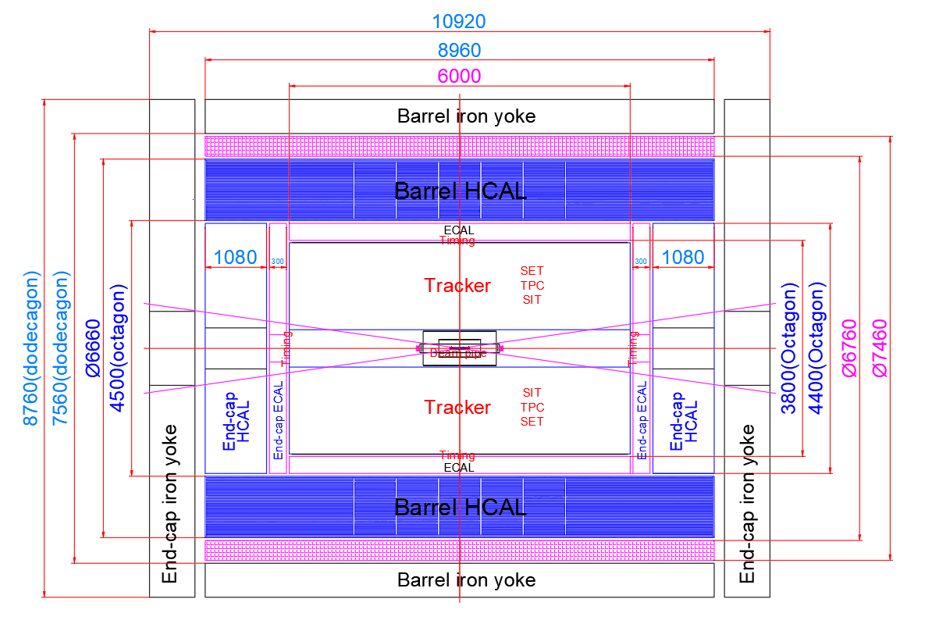
Progress of the iron yoke design
Superconducting magnet built-out scheme

Slide 14
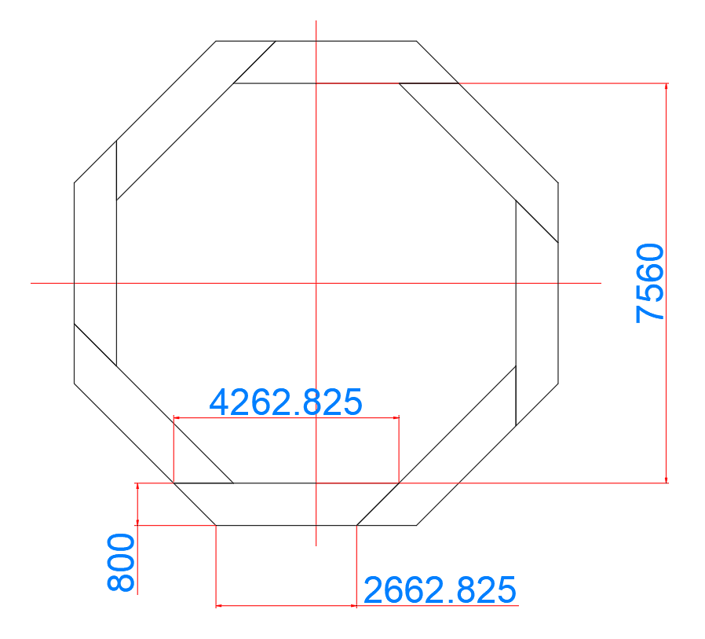
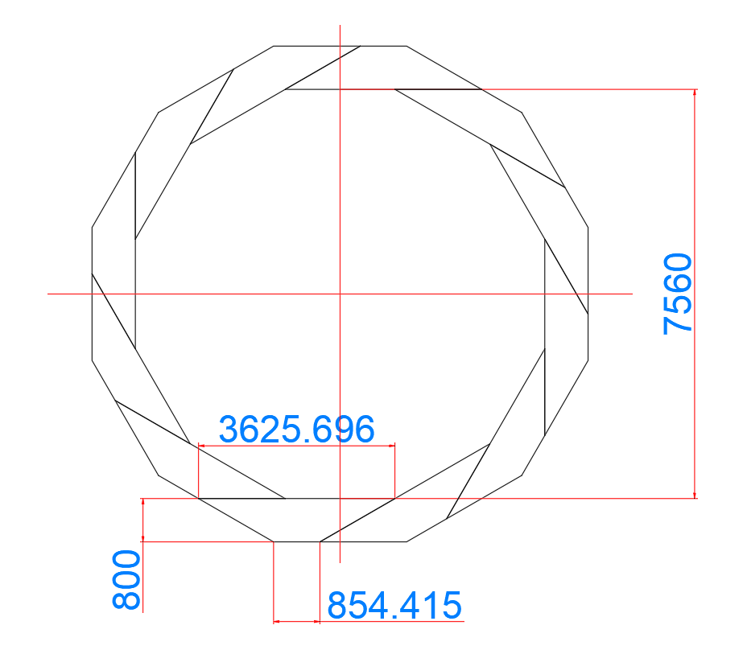
Progress of the iron yoke design
Superconducting magnet built-out scheme
8-sided
12-sided
Conclusion: It is recommended to adopt 12-sided and 800mm yoke thickness scheme

Slide 15
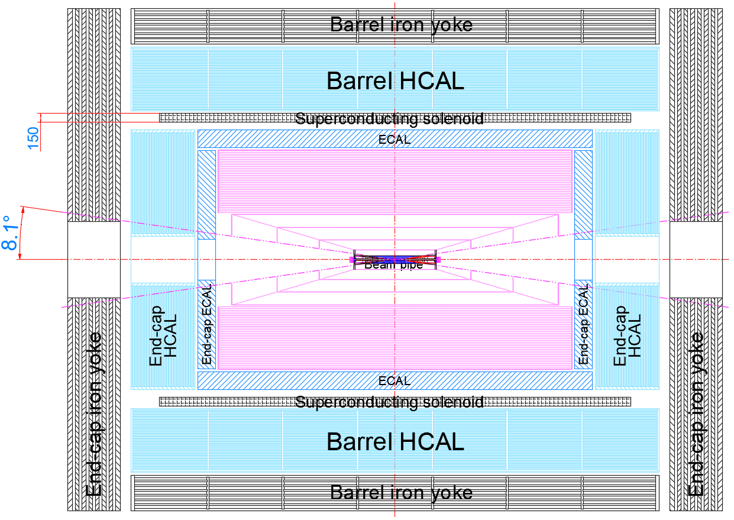
personnel placement：
February 19th，am.10:00 – 12:20，
personnel：
Mechanical Engineer：纪全，张俊嵩，付金煜，侯少静，夏商(students)
other staffs：王铮，石澔屿
DC or TPC
subdetector division：tentative
Iron yoke： 夏商
HCAL： 侯少静
Magnet： 张俊嵩 (南华，陈梓勃)
ECAL： 侯少静 (湖大，李宇杰)
Tracker： 付金煜
Beampipe： 张俊嵩(湖大，何龙岩)
Silicon tracker

Slide 16
Next plan
Sub-detector frame structure
Iron yoke and base
ECAl
HCAL
superconducting magnet
Tracker
Beam pipe
Complete general drawing
Design boundary constraint
interface structure
leading line
Connecting structure
optimization gap
leading line space and requirment
Installation plan
Iron yoke
ECAL
HCAL
superconducting magnet
Tracker
Beam pipe

Slide 17
Thanks

