Slide 1
Status and Plan of the Tracker
WANG Meng 王萌
2024.2.28

Slide 2
activities since Jan. 30th
weekly meeting, 10 am Friday, minutes on the following links
  Feb. 2nd, https://indico.ihep.ac.cn/event/21546/
  Feb. 16th, https://indico.ihep.ac.cn/event/21584/
  Feb. 23rd, https://indico.ihep.ac.cn/event/21621/
communication with other systems
  LI Gang, on fast simulation
  SUN Shengsen, on full simulation and reconstruction
  WEI Wei, on electronics as well as cost estimation
  RUAN Manqi, on physics requirements
  JI Quan, on mechanical overall drawings (总图)

Slide 3
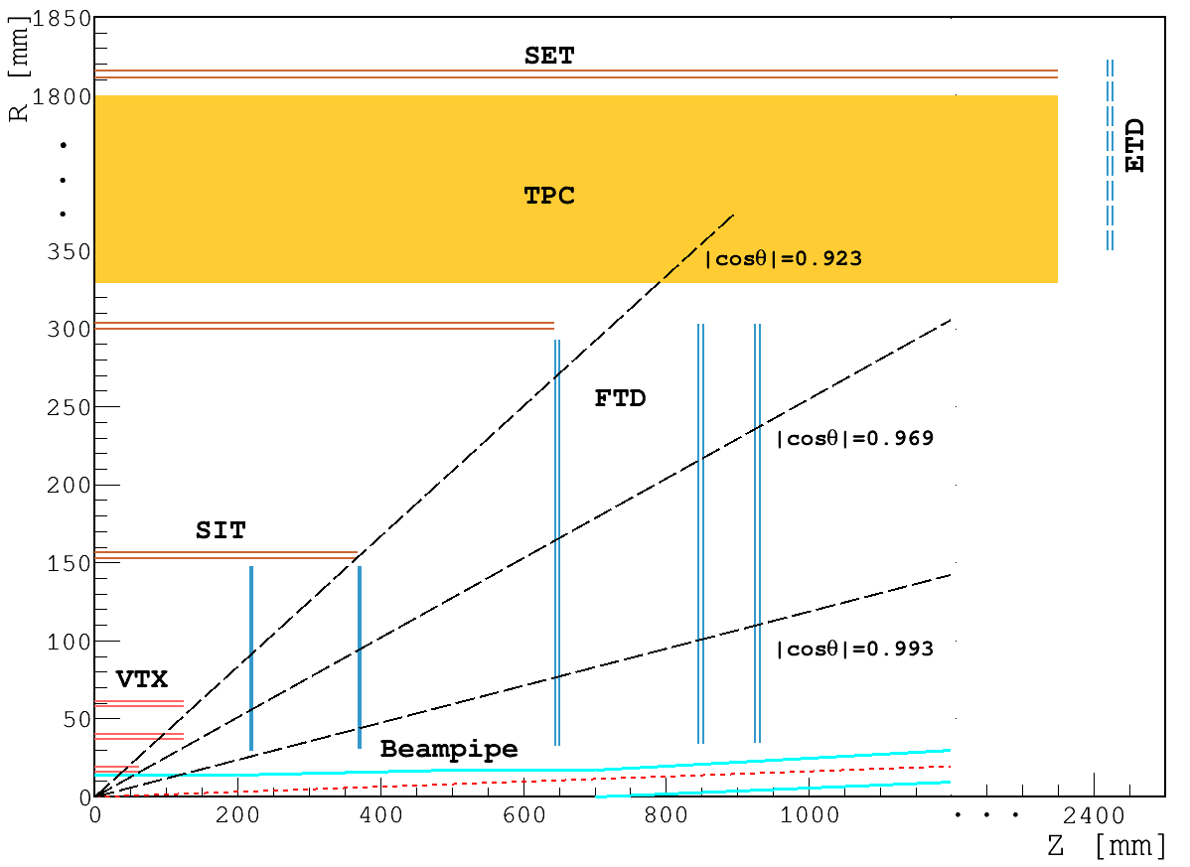
CDR layout for acronyms

Slide 4
key questions for reference-detector TDR
Jianchun on Feb. 6th

Slide 5
Q1: TPC for Z-pole run?
A: Yes, somehow.

Slide 6
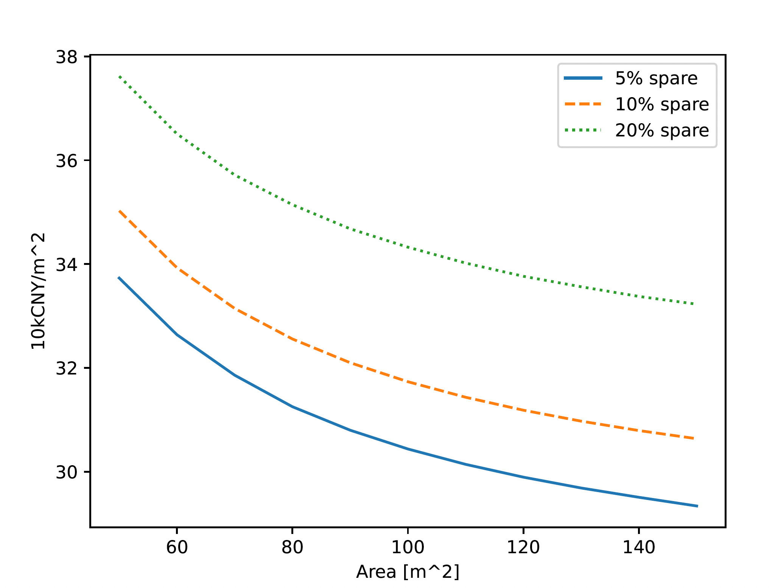
Q2: silicon strip vs. pixel (performance & cost)
pixel sensors: unit cost drops with area increasing.
  quotes for SMIC 55 nm process
  ~310 kRMB/m² for 140 m² with 10% yield and spare
TODO
  include cost of electronics and others
  investigate readout scenarios
  justify detector design
  strips: update relevant information

Slide 7
Q3: π/K separation at about 1 GeV?
most of them can NOT reach TOF on barrel
can reach endcaps however, particularly forward tracks
SUN Shengsen on Feb. 27th

Slide 8
roadmap towards decisions
Q1. TPC vs DC
  update performance for the new geometry
  decide now?
Q2. silicon microstrip vs CMOS pixel
  initial design (layout, mechanics, electronics)
  simulation, fast and full
  cost estimation
Q3. TOF and LGAD
  physics impact for Higgs run if w/o TOF
Q4. AC-LGAD
  after Q2 and Q3 answered

