Slide 1

The R&D for muon detector
XiaoLong Wang (for MuonD group)
Fudan University
CEPC Day, 2/28/2024

Slide 2
Muon detector group
There are 4 institutions:
  Fudan University (Xiaolong Wang)
  Shangai Jiaotong University (Jun Guo)
  University of Shanghai for Science and Technology (Qibin Zheng)
  Nankai University (Minggang Zhao)
Weekly group meeting launched.

Slide 3
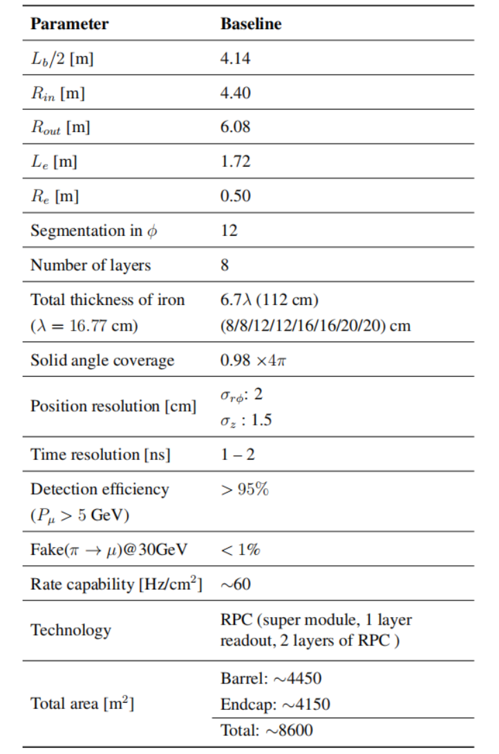
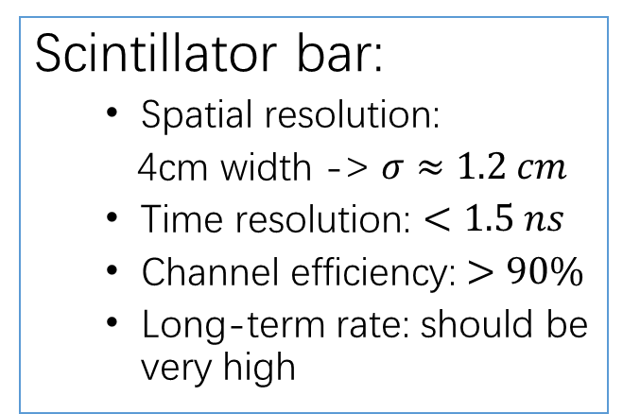
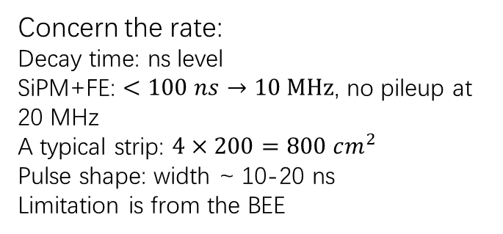
Two scenarios: plastic scintillator bar, RPC
Scintillator bar:
  Spatial resolution:
  4cm width -> $σ≈1.2 cm$
  Time resolution: $<1.5 ns$
  Channel efficiency: $>90\%$
  Long-term rate: should be very high
Parameter | Value
Spatial resolution: η, φ | 1 cm x 1 cm
Time resolution | 1-2 ns
Muon efficiency | 95%
Total surface | 6785 m²
Typical singlet surface | 2 m²
# of front-end channels | 374,912
Designed duration | 20 years
Long-term rate limit | 100 Hz/cm²
Peak luminosity | ~2 x 10³⁴ cm⁻²s⁻¹
Concern the rate:
Decay time: ns level
SiPM+FE: $<100 ns→10 MHz$, no pileup at 20 MHz
A typical strip: $4×200=800 cm^{2}$
Pulse shape: width ~ 10-20 ns
Limitation is from the BEE
RPCs in ATLAS
From 郭军
CEPC CDR 2018

Slide 4
Cost Estimation: Scintillator scenario
SiPM和电子学部分：
  KLM造价，电子学部分平均价格为$20，SiPM约为$20。我们估计的SiPM造价可以在$10水平。即每一道的总价格约为￥210。因此，电子学和SiPM总造价约为(14208+6290)*210=4.3M￥。
WLS光纤部分：
  桶部：一个超层，垂直方向3.2m*8m/4cm=640m，沿束流方向8m*3.2m/4cm=640m，共1280m。桶部一共需要光纤长度为1280m*4*8=40960m。
  端盖：34000m(eKLM)*0.37=12580m。
  因此，总共53540m。单价估计$4/m，光纤所需造价为1.5M￥。
塑闪：
  探测总面积约1600m^2，因此，总体积为1600m^2*1cm（厚）=16000L。塑闪造价估计200￥/L，总造价为3.2M￥。
总造价：4.3+1.5+3.2=9.0M。
Recent estimation (5 layers) according to Geant4 simulation:
探测层：
  桶部: (300*5+93+95+97+99+102)*8=15,888道
  端盖： 996*5*2=9,960道
  总共： 25,848道
厄铁层：
  桶部： 300*0.04m*0.04m*(93+95+97+99+102+104)*0.10m*8 = 226.5m^3
  端盖：129.5 m^2 *0.10m*5*2= 129.5 m^3
  总共：356 m^3，约2,776.8吨。

Slide 5
Cost Estimation: RPC scenario
From 郭军
ATLAS RPC 6700 m²; BESIII RPC, 1200 m². CEPC could be somewhere between 1200 m² and 6700 m², depending on the actual size
A very rough estimate, scaling from ATLAS Phase-II upgrade(add 3 gaps), which costs 8M CHF, estimated a few years ago
  Detectors, installation mock-up and tooling, on-detector electronics
For 6 gaps to have a similar performance like ATLAS, 16M CHF(?), with uncertainties
  Inflation
  Price difference between Europe and China
  Operation: gas, …

Slide 6
Tasks of Ref TDR
PS scheme:
  Build prototype module → Fudan (+IHEP)
  (高能科迪 is preparing to produce scintillator strips)
  BEE R&D → USST (+Fudan)
  Software and detector simulation → Nankai + Fudan
RPC scheme: SJTU has some RPCs in hand

Slide 7
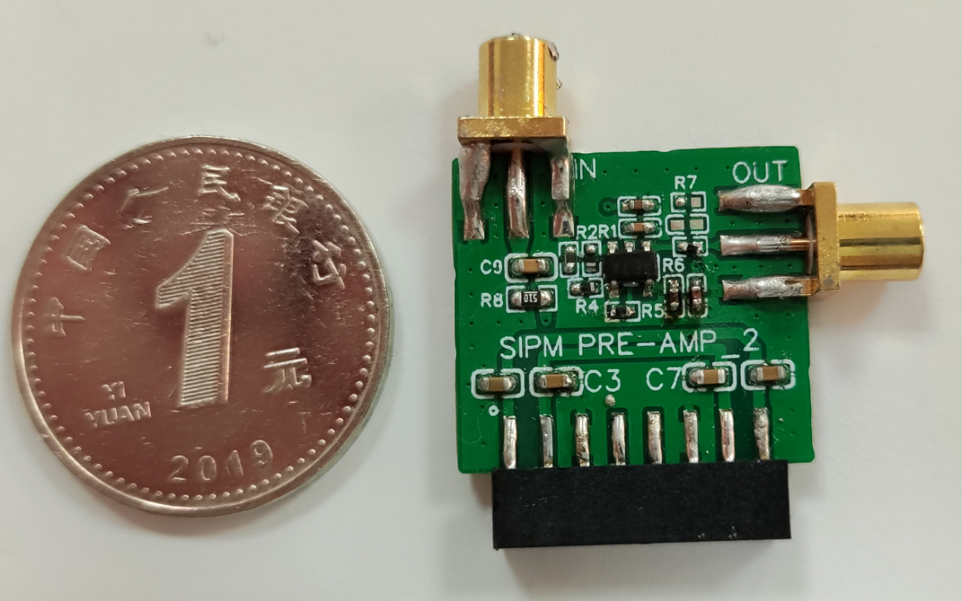
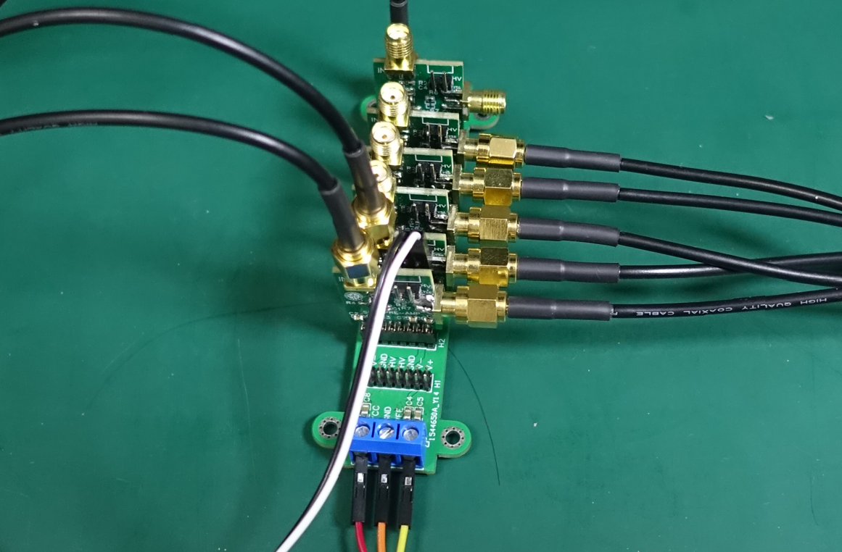
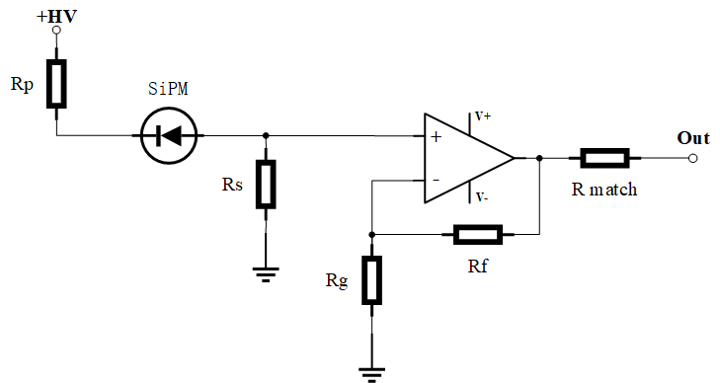
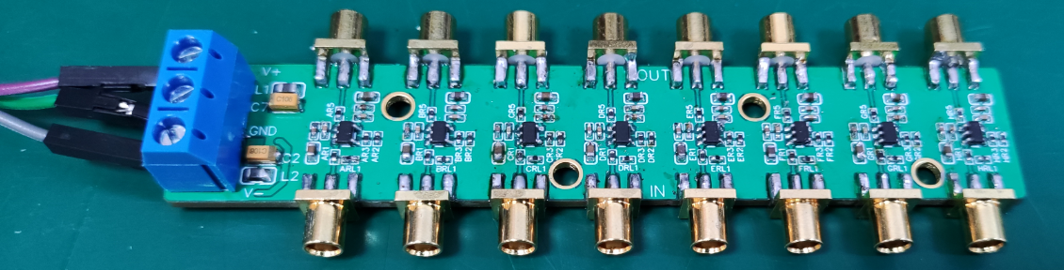
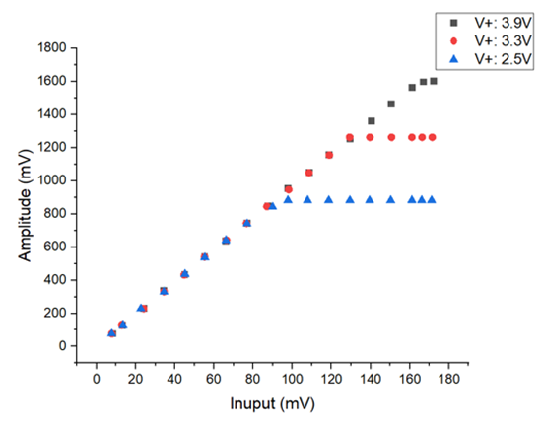
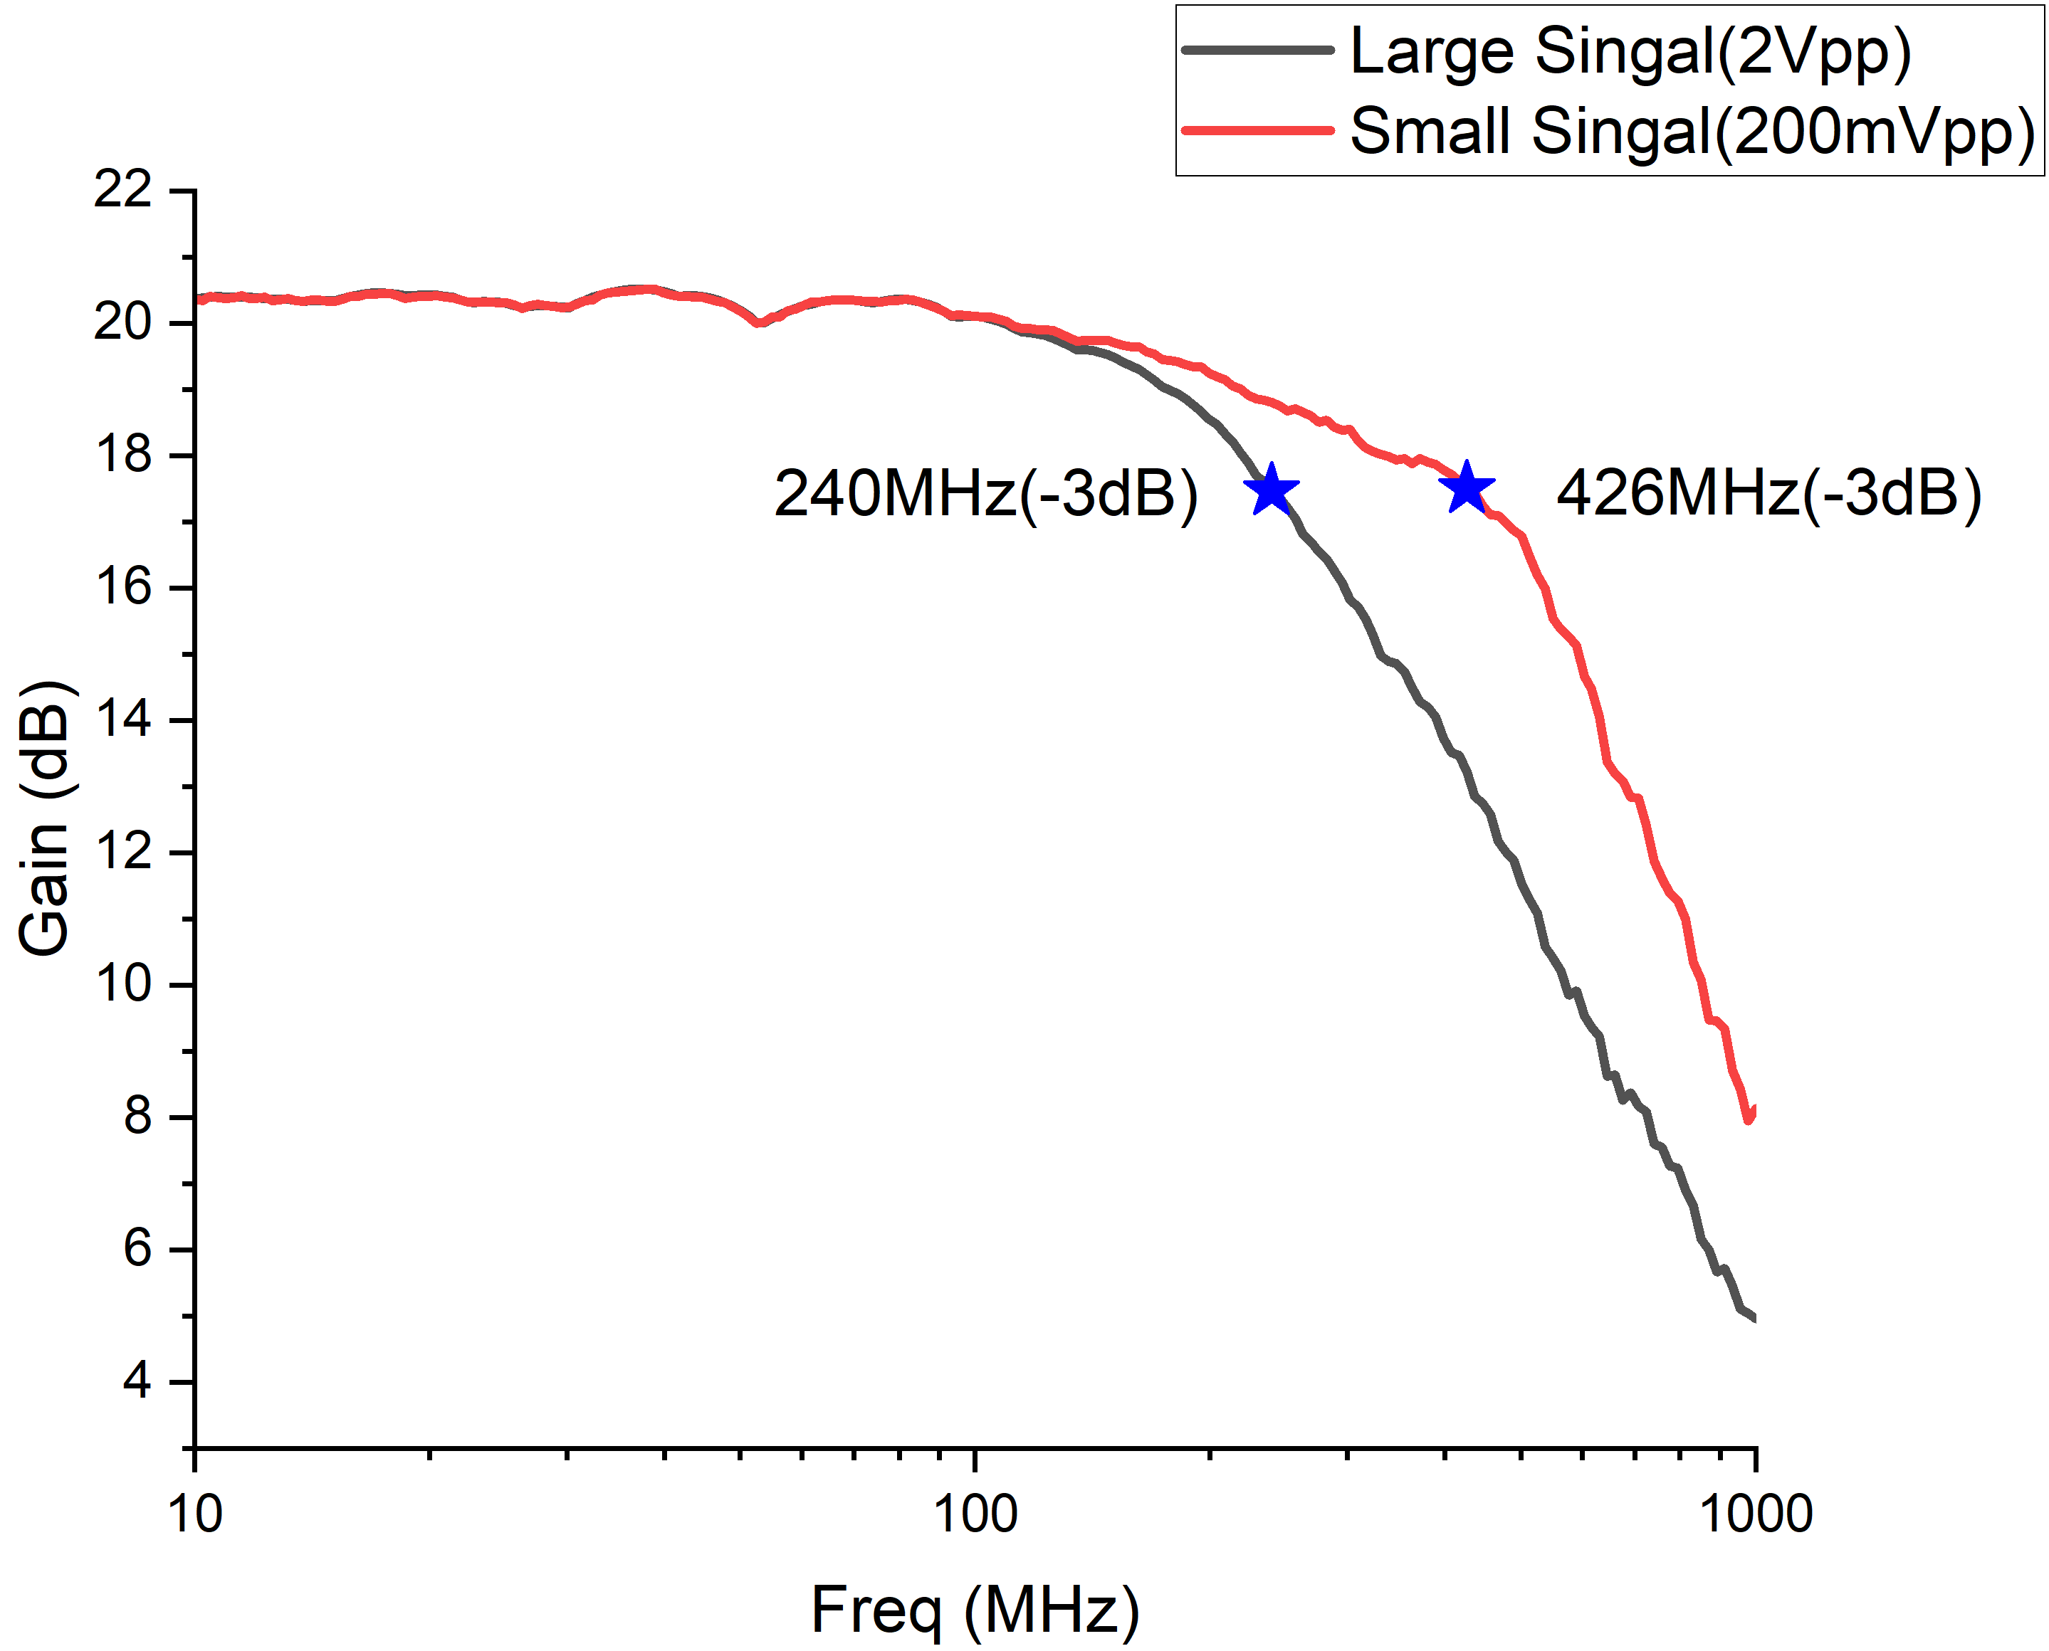
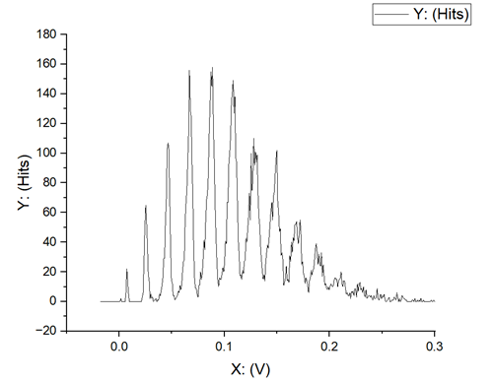
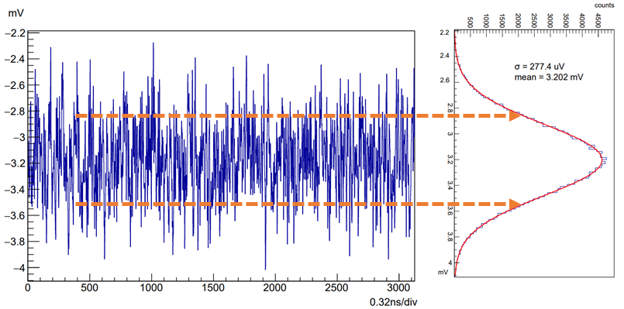
Design of preamplifier
We have many designs of high time resolution preams with very low cost.
preamp
Gain：+20 V/V
Bandwidth(-3dB)：400 MHz
Baseline noise(RMS): 300uV
Input impedance: 50Ω
AMP
Power supply
Nucl. Sci. Tech 34, 169(2023)
Performance test of preamplifier
Dynamic range testing
Baseline noise test
Bandwidth testing
SiPM photoelectron peak

Slide 8
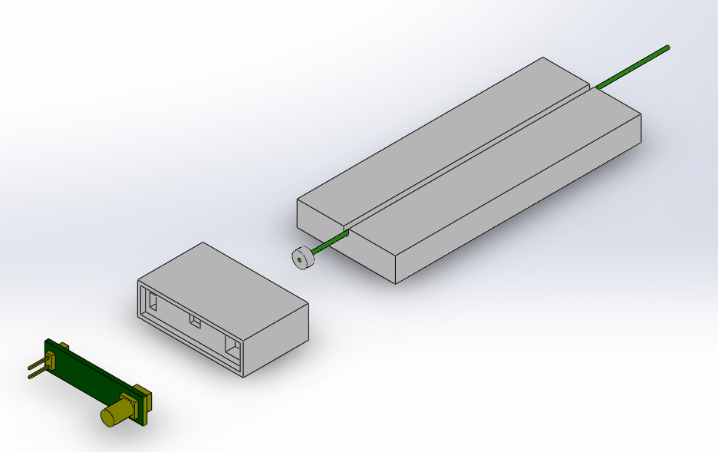
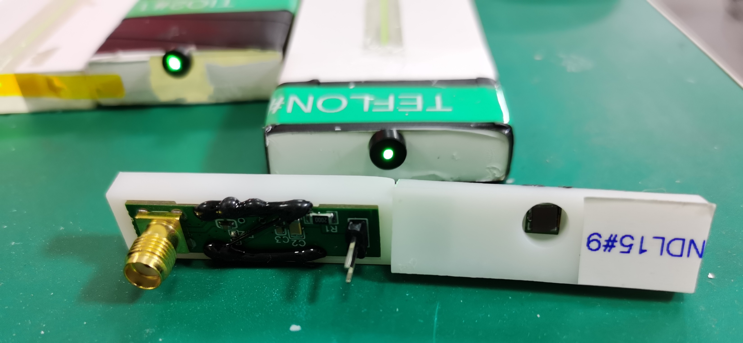
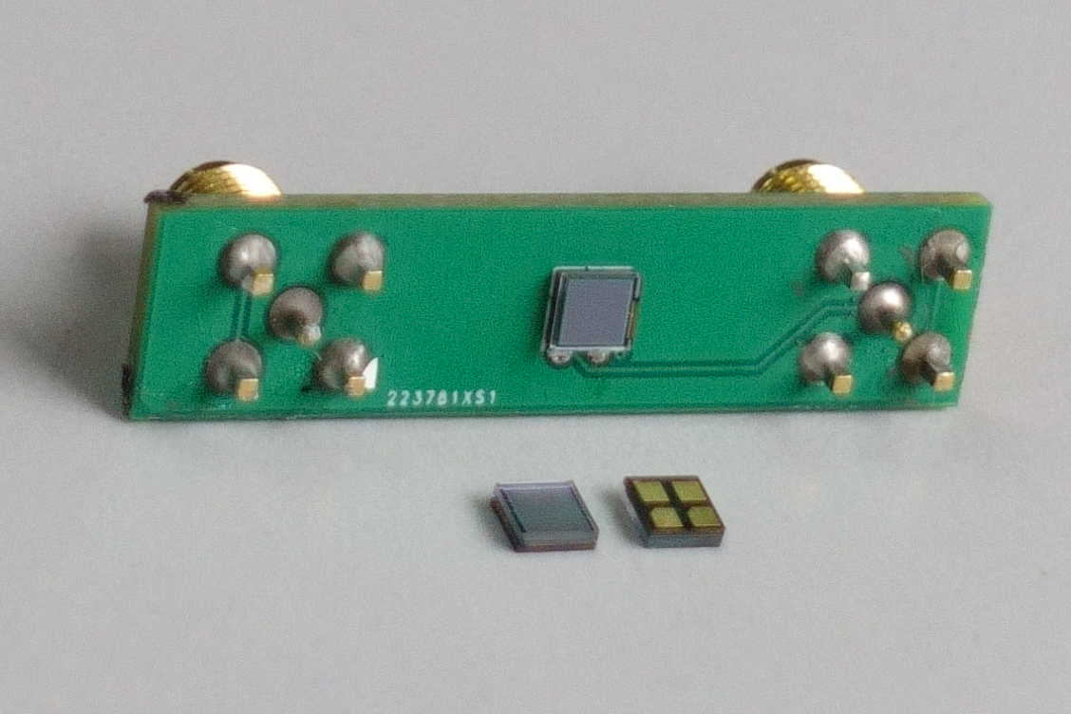
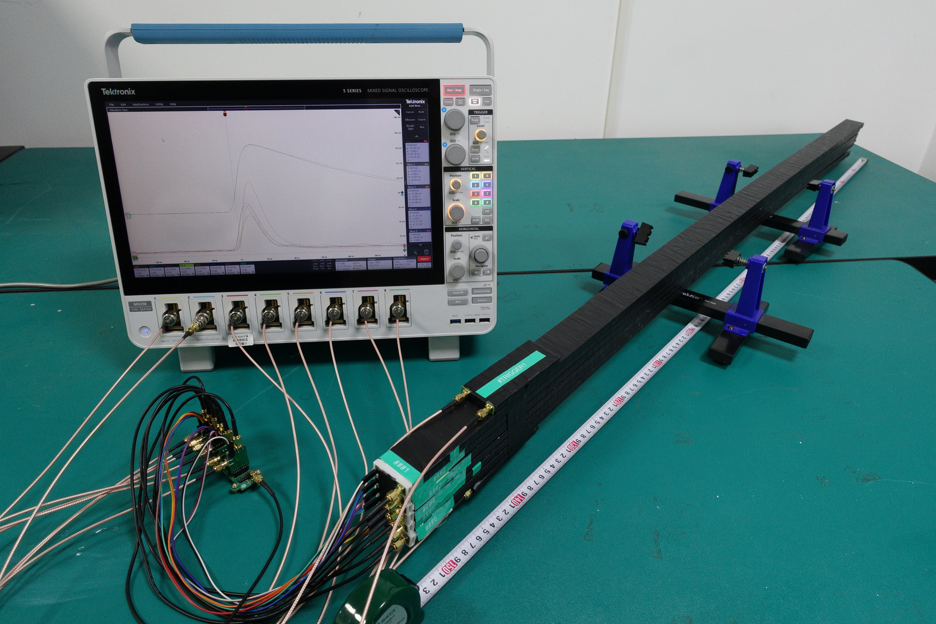

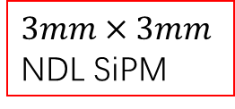
Status of R&D for PS strip
Performance is good enough, ready for prototype module production.
GNKD scintillator + Kuraray WLS fibre + NDL SiPM($3mm×3mm$)
We have new NDL SiPMs.
$3mm×3mm$ NDL SiPM
CR test
Cross talk of about 21%
$$4cm×1cm×150cm$$

Slide 9
电子学方案对比 （From 郑其斌）
方案对比
Muon子探测器：约20k（20k）个通道，同步测量时间信息(TDC)与能量信息(QDC)。
方案1：基于TDC和低速40MSPS ADC方案，采用脉冲定时+TDC技术测量TOF, 同时采用低速40MSPS ADC 测量能量（寻峰/积分）。
  资源占用大、集成度低，既要设计ADC、也要设计TDC
  成本高
方案2：基于高速ADC方案，要实现1ns的时间分辨率，需要≥1GSPS的采样速率。
  产生极大的冗余数据
  成本高
方案3：基于低速40MSPS ADC和FPGA算法的方案，采用40MSPS的ADC结合前端电荷灵敏放大器，在FPGA中硬件实现能量信息（积分/寻峰）和时间信息（相位拟合算法等）的算法提取。
  占用资源较少，只用40MSPS ADC和FPGA实现能量和时间测量
  降低了成本

Slide 10
前端电子学原理框图
Muon探测器前端定制电子学：
  实现Muon子TDC与QDC测量
  单板实现64/128通道数据采集

Slide 11
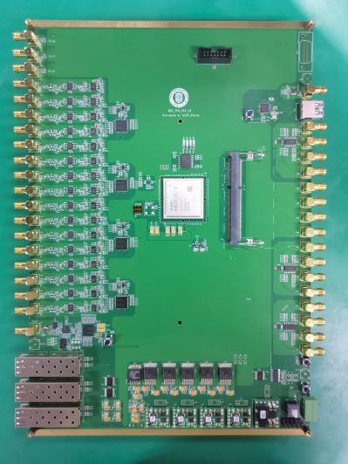
下一步计划
Fudan will prepare an array of 16 scintillator strips+FE for test.
仿真不同幅度与信噪比的准高斯型信号
电子学测试准高斯型信号QDC和TDC的精度
16通道10MSPS-100MSPS @16bit Multi-ch ADC 与探测器（闪烁体+WLS光纤+NDL SiPM）联调

Slide 12
Software and detector simulation
Software: work with IHEP, do the simulation in the CEPCSW frame, and then optimize the detector design and develop the reconstruction algorithm.
Detector simulation:
  A preliminary Geant4 simulation for CEPC muon detector performed in 2021.
  More Geant4 simulation works performed by students from Nankai at our lab.

Slide 13
Some experiences in Geant4 simulation

Slide 14
Backup

