Slide 1
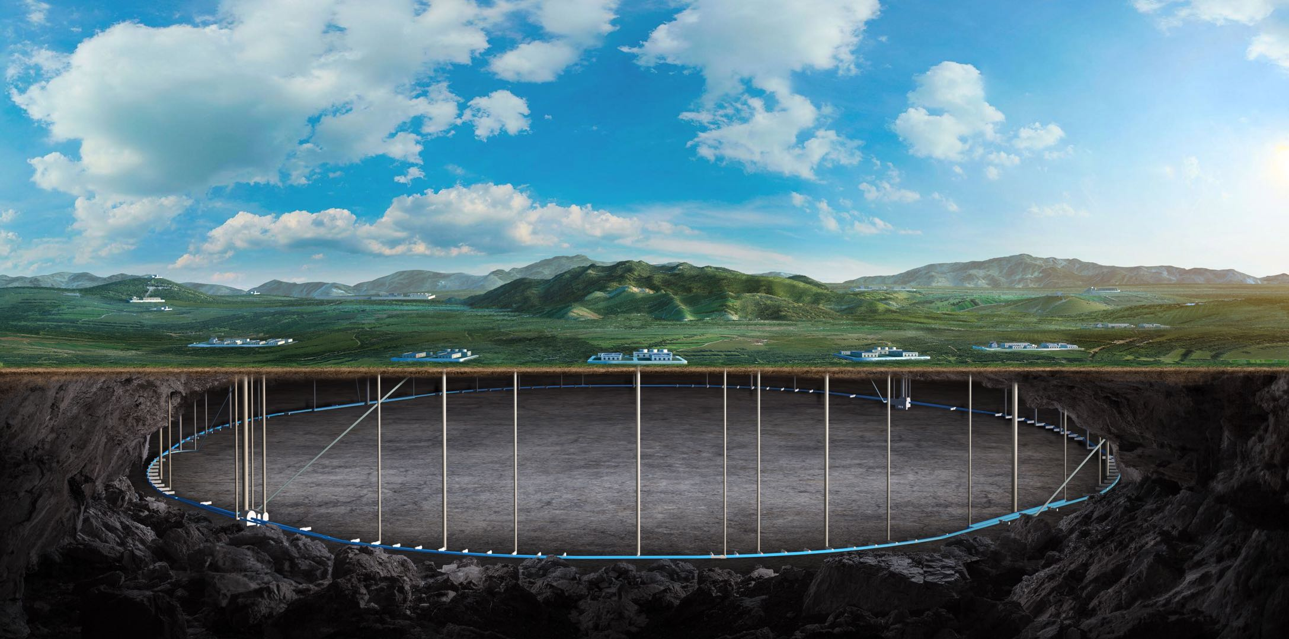
CEPC Injection and Extraction System EDR Plan
Jinhui Chen
On behalf of the CEPC injection & extraction team
15. March. 2024, CEPC Day

Slide 2
Content
Injection & extraction system EDR plan
Research status in TDR phase
Hardware R&D plan and schedule
New RF region beam separating scheme research
The adverse issues of electrostatic separator
New scheme conception design
Hardware challenges and potential schemes
Funding and manpower requirements
Summary

Slide 3
Injection & extraction system EDR plan

Slide 4
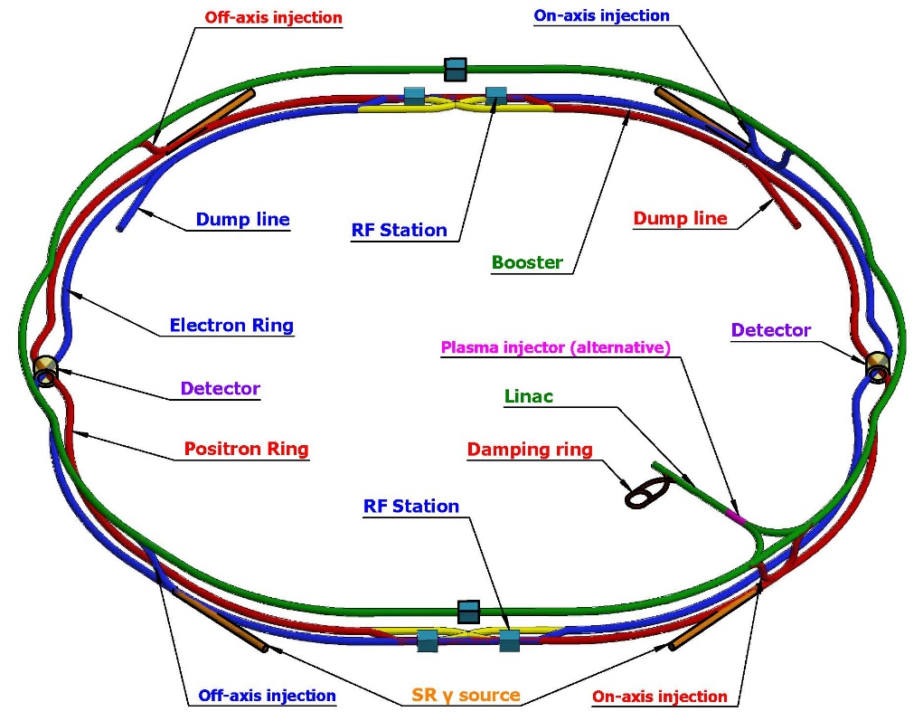
Overview of the inj.&ext. systems in CEPC
The CEPC complex consists of 4 circular accelerators：
A damping ring (1.1Gev/147m)
A booster ring (30~120GeV/100km)
2 storage rings (120GeV/100km)
there are 10 injection and extraction sub-systems, including:
DR injection and Extraction system(e+)
Booster LE injection system (e+,e-)
Booster Extraction system1 (e+,e-)
Collider off-axis injection system (e+,e-)
Booster Extraction system2 (e+,e-)
Booster HE injection system (e+,e-)
Collider swap out injection system (e+,e-)
Collider swap out extraction system (e+,e-)
Collider beam dump system(e+,e-)
Booster beam dump system(e+,e-)
Off-axis injection
(in W and Z mode)
On-axis injection
(only in Higgs mode)
③
④
⑤
⑦
①
②
Collider
Linac
Booster
⑥
⑧
⑨
30~120GeV
120GeV
dump
DR
1.1GeV
⑩

Slide 5
Proportion of inj.&ext. hardware costs
Hardware：septums、kickers and pulsers
Statistics by machines（million CNY）
Statistics by hardware type (million CNY)

Slide 6
Type and quantity of septum magnets
Lambertson magnet (LSM)with DC exciting was adopted in CEPC inj.&ext. system due to its higher reliability.
The total number of LSM is180 sets.
No | Hardware | Type | Typical parameters |  |  |  | Unit | Number | Unit price (10,000 CNY) | Total Price (10,000 CNY)
 |  |  | Length | B | Septum | Clearance
1 | thin septa | In-vac LSM | 1.75m | 0.8T | 2mm | 20*20mm | set | 28 | 58 | 1624
2 | thick septa1 | In-air LSM | 1.75m | 0.8T | 6mm | 20*20mm | set | 148 | 25.8 | 3818.4
3 | thick septa2 | In-air LSM | 1.2m | 0.8T | 5.5mm | 50*50mm | set | 2 | 22.8 | 45.6
4 | thick septa3 | In-air LSM | 0.5m | 0.8T | 3.5mm | 30*30mm | set | 2 | 20.8 | 41.6
 |  |  |  |  |  | Total Number: | set | 180 | Total price: | 5529.6

Slide 7
Two types of Lambertson magnets
To realize thinner septum as possible, 2 novel structures of magnet were proposed:
Magnet pole
Wall of stored beam pipe
+
Wall of injected beam pipe
+
Iron septum
+
installation margins
Installation margin
Septum
thickness
Injected bunch
=
Yoke
half-in-vacuum
(for septum of 2mm)
Stored bunch
Thin septum
(IN-VAC)
Magnet pole
Installation margin
Injected bunch
SS
Half in-vacuum
Quantity:28 sets
Installation margin
Yoke
Magnet pole
Stored bunch
Installation margin
Injected bunch
embedded thin-wall vacuum chamber
(for septum≥3.5mm)
SS
Iron or
VP(FeCoV，1J22)
Thick septum
(IN-AIR)
Yoke
Traditional LSM
Stored bunch
Quantity:152 sets
in-air

Slide 8
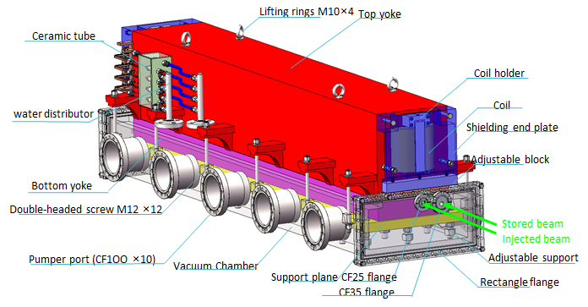
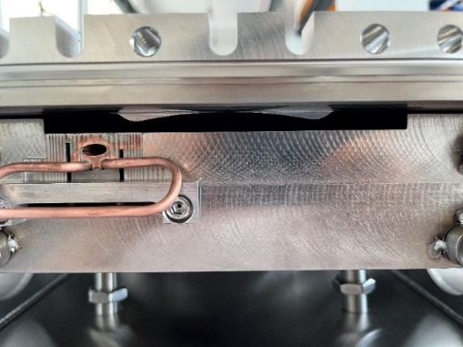
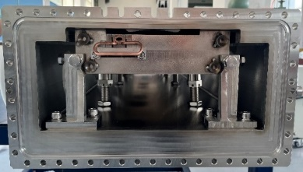
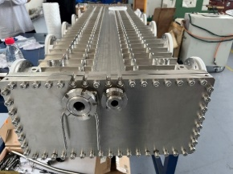
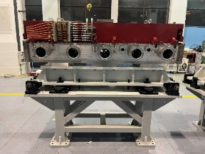
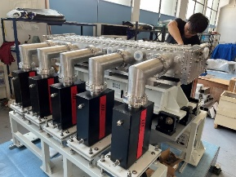
IN-Vacuum LSM
Research status：final magnets for HEPS SR injection will see first beam this year.
FeCoV
2mm
DT4
Cu

Slide 9
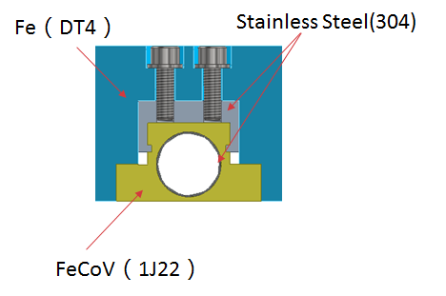
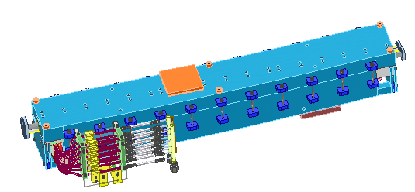
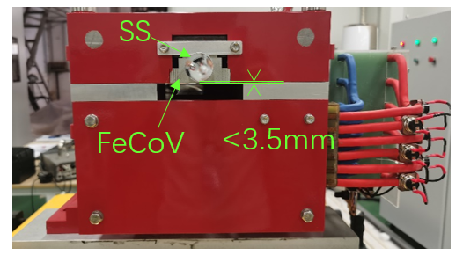
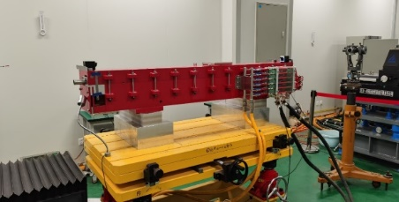
IN-Air LSM
Research status：final magnets for HEPS BST injection was applied in beam commissioning successfully last year.

Slide 10
Type and quantity of kicker and pulser
In CEPC inj.&ext. System, there are 6 kinds of kicker and its pulser.
The total quantity of kicker and its pulser in CEPC is 100 sets, and the delay-line kicker and trapezoidal wave pulser account for largest proportion.
No | Hardware | Type | Typical parameters | Unit | Number | Unit price (10,000 CNY) | Total Price (10,000 CNY)
1 | kicker1 | delay-line dipole kicker | in-air delay-line dipole kicker, horizontal, 0.1mrad, 0.04T·m, L=1m, B=0.04T(H), inc. ion pump | set | 24 | 50 | 1200
2 | kicker pulser1 | trapezoidal wave pulser | PFN, solid-state,440~2400ns, inc. cable | set | 24 | 100 | 2400
3 | kicker2 | ferrite-core dipole kicker | in-air ferrite-core dipole kicker, horizontal,0.2mrad,0.08T·m, L=1m, B=0.04T(H)， inc. ion pump | set | 6 | 33 | 198
4 | kicker pulser2 | half-sine wave pulser | LC, solid-state,1360ns, halfsine, inc. cable | set | 6 | 31 | 186
5 | kicker3 | strip-line kicker | Strip-line kicker, vertical, 46ns, L=1m, inc. ion pump | set | 6 | 28 | 168
6 | kicker pulser3 | DSRD pulser | 46ns, ±12.5kV,DSRD pulser, inc. cable | set | 6 | 67 | 402
7 | kicker4 | slotted-pipe kicker | Slotted-pipe kicker,vertical,250ns,L=0.25m, DR beam pipe φ=30mm, inc. ion pump | set | 2 | 23 | 46
8 | kicker pulser4 | trapezoidal wave pulser | solid-state,inductive adder, 250ns, inc. cable | set | 2 | 40 | 80
9 | dilution kicker | CW full-sine | CW full-sine，L=2m，150Gauss，T=25us, total length=10m | set | 10 | 30 | 300
10 | dilution kicker pulser | CW full-sine | CW full-sine，T=25us | set | 10 | 30 | 300
11 | NLK | NLK | in-air Nonlinear kicker or pulsed sextupole, horizontal, 0.1mrad, 0.04T·m, L=1m, inc. ion pump | set | 2 | 38 | 76
12 | NLK pulser | half-sine wave pulser | LC, solid-state,0.3ms, halfsine, inc. cable | set | 2 | 15 | 30
 |  |  | Total Number: | set | 100 | Total price: | 5386

Slide 11
Design parameters of ferrite core kickers for CEPC
There are 2 kinds of kicker with ferrite core for trapezoid wave and half-sine wave pulsed system.
parameter | Unit | BST-EXT-kicker1/CR-inj-kicker1/dump （for CR off-axis inj.） | BST-EXT-kicker2/CR-inj-kicker2 （for CR on-axis inj.）
Type | - | In-air delay-line dipole kicker | In-air lumped parameter dipole kicker
Deflect direction | - | Horizontal | Horizontal
Beam Energy | GeV | 120 | 120
Deflect angle | mrad | 0.1 | 0.2
Magnetic effective length | m | 1 | 1+1
Magnetic strength | T | 0.04 | 0.04
Integral magnetic strength | T·m | 0.04 | 0.08
Clearance region(H×V) | mm | 56×56 | 56×56
Good field region(H×V) | mm | 50×50 | 50×50
Field uniformity in good field region | - | ±1.5% | ±1.5%
Repetition rate | Hz | 1k | 1k
Amplitude repeatability | - | ±0.5% | ±0.5%
Pulse jitter | ns | ≤5 | ≤5
Bottom width of pulse(5%-5%) | ns | Trapezoid：440~2420 | Half-sine：1360
Tr/Tf(5%-95%) | ns | <200 | <680
40~2000ns
1kHz
200ns
200ns
1360ns,1kHz

Slide 12
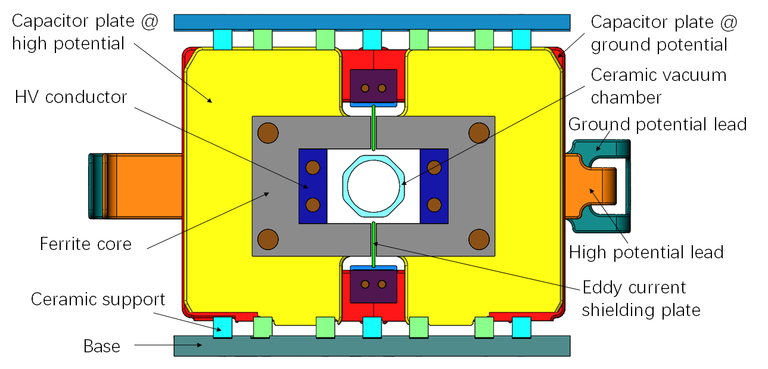
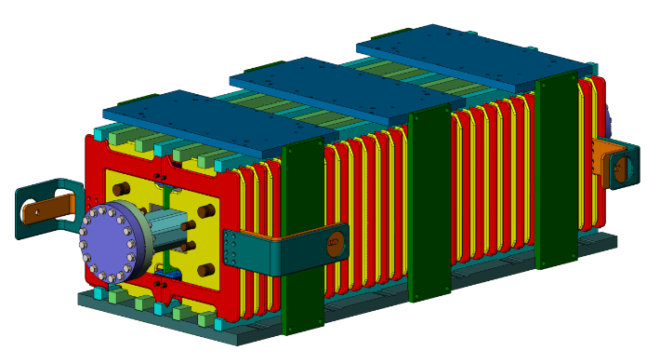
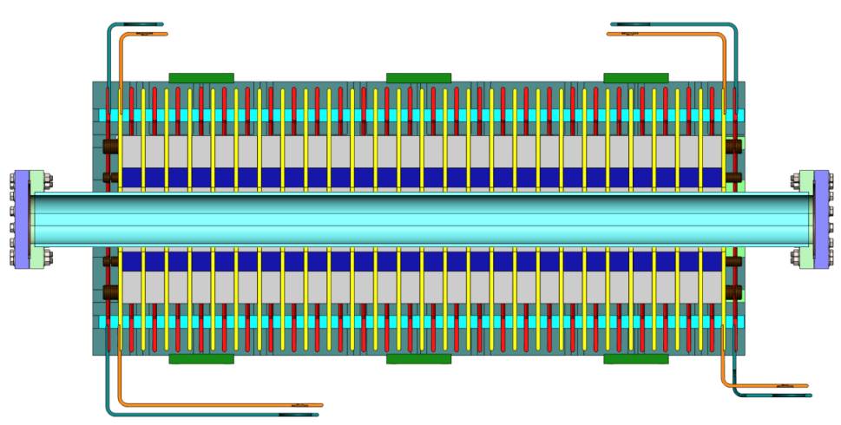
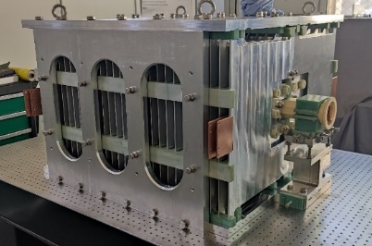
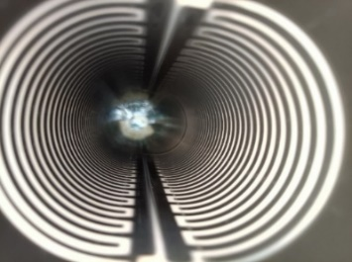
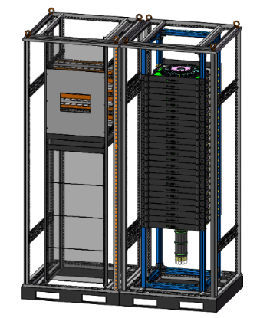
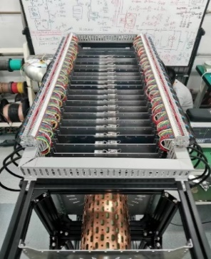
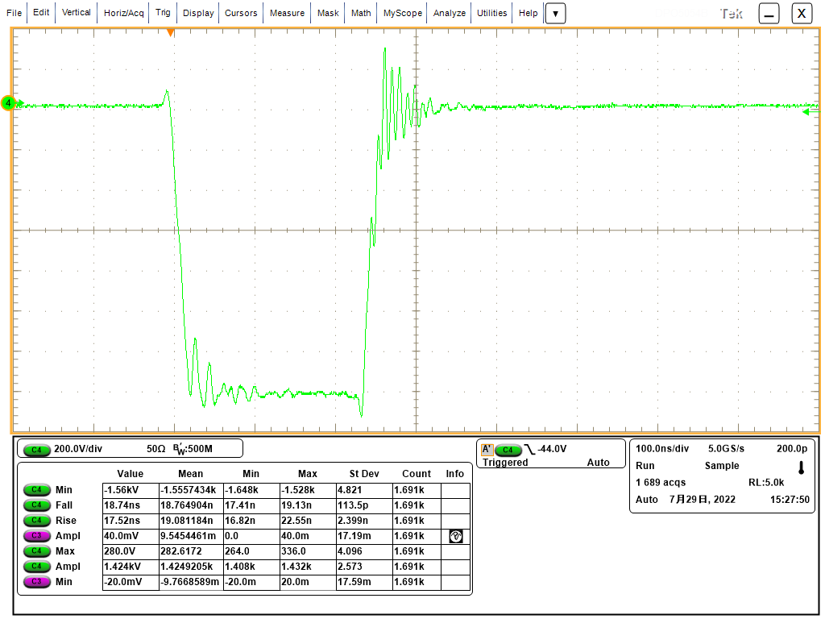
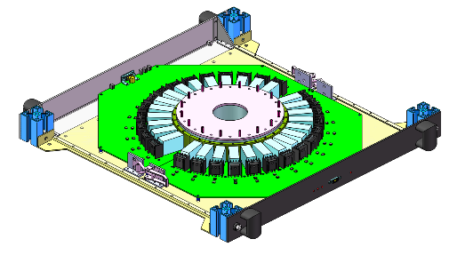
Trapezoid wave kicker system
40~2000ns
1kHz
200ns
200ns
Research status：
A delay-line kicker (NLK) prototype was done. But magnet characteristic impedance is a little high and volume is Large; Beam impedance issue of ceramic vacuum chamber with Ti coating is not clear
A solid-state pulser prototype based on SiC MOSFET was done. But the pulse HV dose not meet CEPC requirement yet.
Delay-line dipole kicker and pulser Parameter | Value
Aperture of magnet (mm) | 100 × 80
Longitudinal length of magnet cell (mm) | 36
Cell number of magnet | 26
Differential impedance of magnet (Ω) | 12.5
Length of magnet (mm) | 942
Total mechanical Length of magnet (mm) | 1018
Inductance of magnet cell (nH) | 56.6
Total inductance of magnet (nH) | 1471.6
Capacitance of magnet cell (pF) | 362
Total capacitance of magnet (nF) | 9.412
Magnetic strength (Gs) | 425
Exciting current of magnet (A) | 2703
Differential voltage of magnet (V) | +/-16895.5
Pulse waveform | trapezoid
Rise/fall time (ns) | 200
Flat-top width of pulse (ns) | 40~2000 adjustable
Filling time of magnet (ns) | 117.728
Rise/fall time of pulser (ns) | 80
Repetition rate (kHz) | 1
Voltage is lower
18-stage@800V：14.2kV into 10Ω

Slide 13
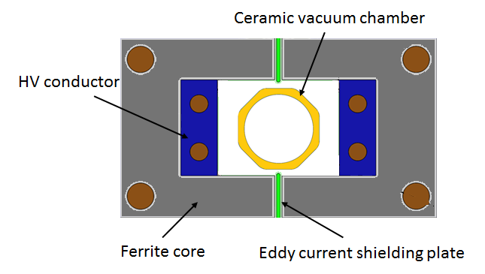
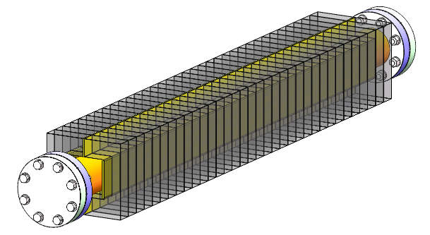
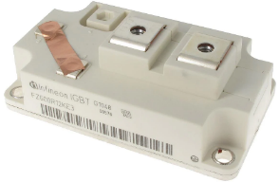
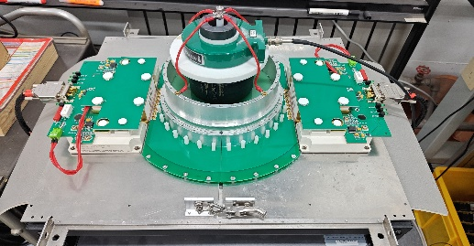
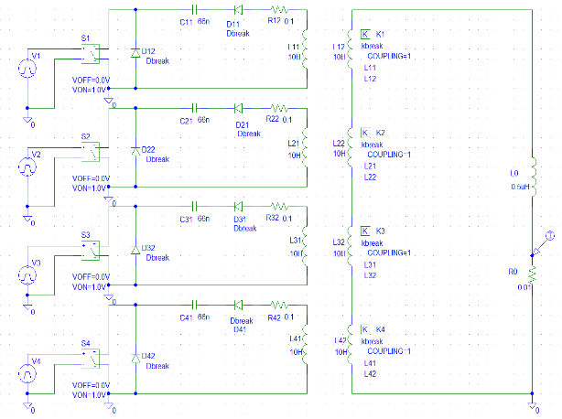
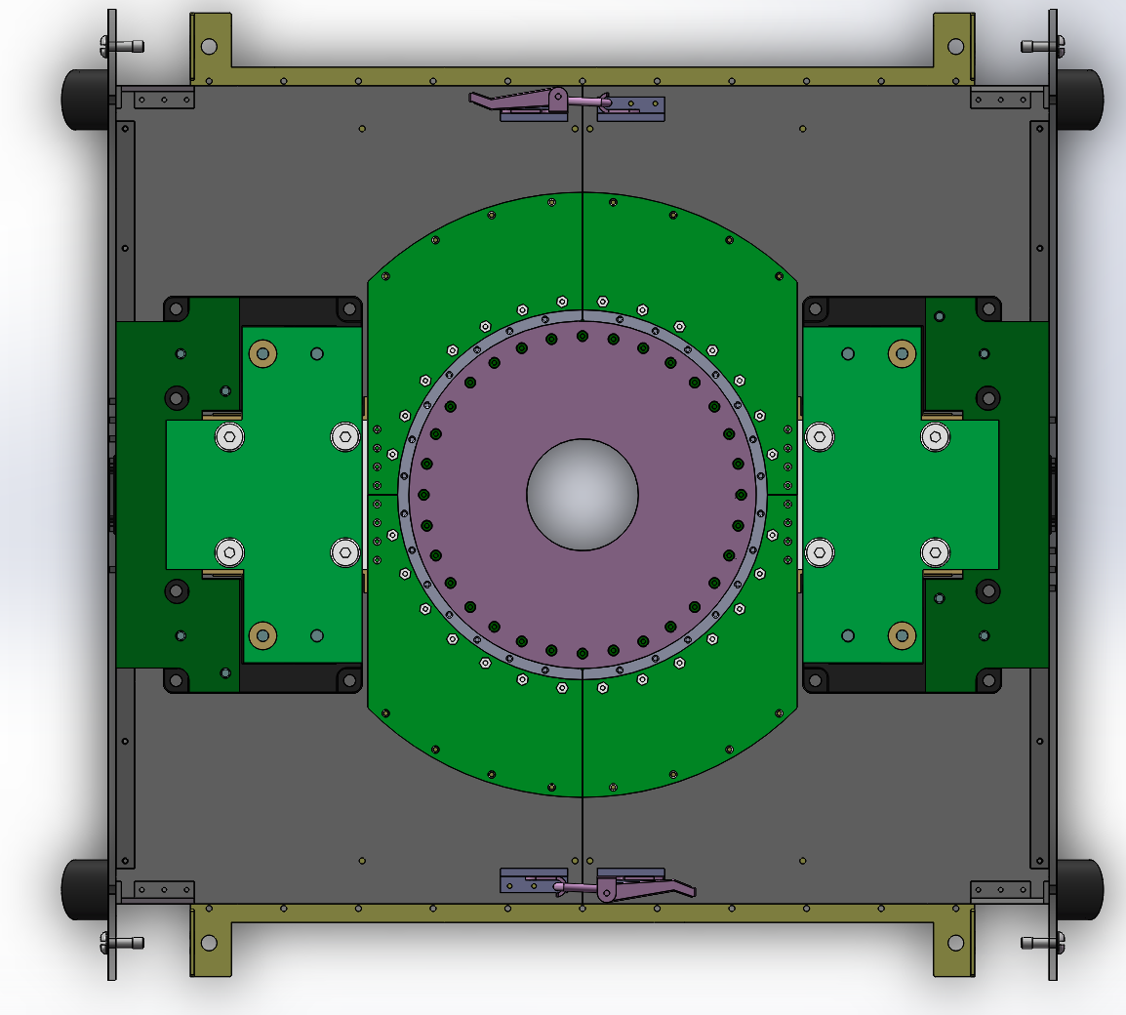
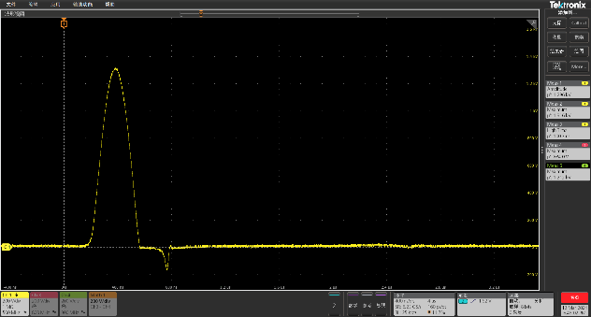
Half-sine wave kicker system
<1360ns,1kHz
Research status：
A novel solid-state pulser circuit is proposed. (LC resonance discharge with inductive-adder based on IGBT and SiC-SBD) .
The IGBT module(FZ600R12KS4: 1.2kV/1200A) is adopted for its higher performance-cost ratio.
Principle verify circuit in condition of 2 stages is being test
Lumped dipole kicker Parameter | Value
Magnetic field B (T) | 0.04
Inner aperture of ceramic vacuum chamber (mm×mm) | 56×56
Ceramic vacuum chamber outer aperture (mm×mm) | 85×66
Magnet aperture w × h (mm×mm) | 100×80
Length of magnet l (m) | 1
Inductance of magnet L (μH) | 1.6
Magnet exercitation current I (kA) | 2.6
Impedance Z (Ω) | 3.7
Voltage of magnet U (kV) | 9.62
Pules bottom width τ (ns) | 1360
Repetition rate（Hz） | 1000
DC=800V
Ip=~1300A，Tw=~400ns

Slide 14
Plan in EDR phase
Main goals in EDR
To complete the design iteration of all kinds of component
To verify the feasibility of the schemes
To train the engineering team
To cultivate manufacturers
（ To ensure the CEPC being completed in 2035, it need around 25 FTEs and 4 factories. ）
Hardware R&D plan to be considered：
3m-long-Lambertson septum magnet: machining、structure、magnet field measurement、cost
trapezoidal-wave kicker magnet and pulser
Half-sine kicker pulser
Schedule:
2023：To complete the engineering design of all components, including 4 kinds of kicker system, 3 kinds of Lambertson magnets.
2024：To start the prototype R&D of trapezoidal-wave kicker system and Lambertson magnet.
2025：Complete R&D on prototype of the trapezoidal-wave kicker system and Lambertson magnet.

Slide 15
New RF region beam separating scheme research

Slide 16
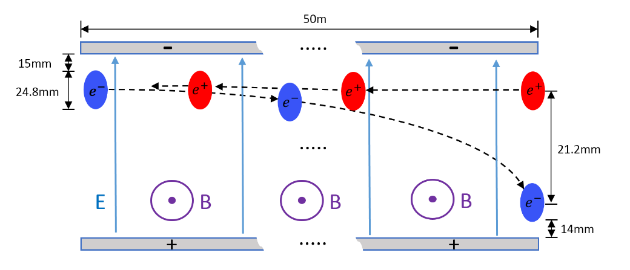
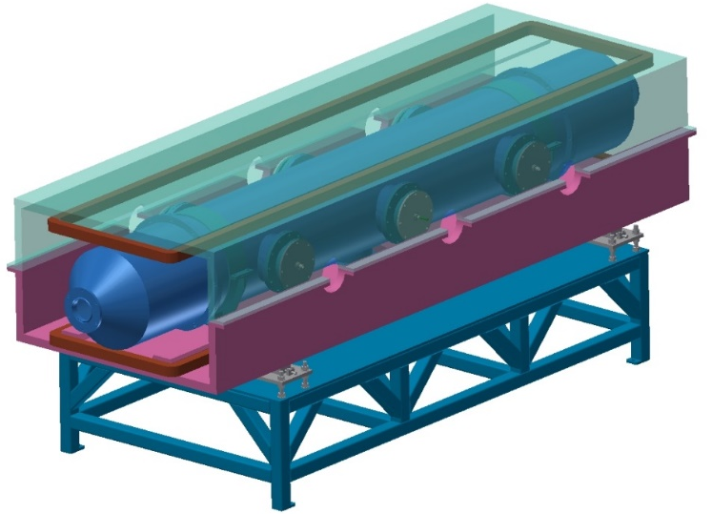
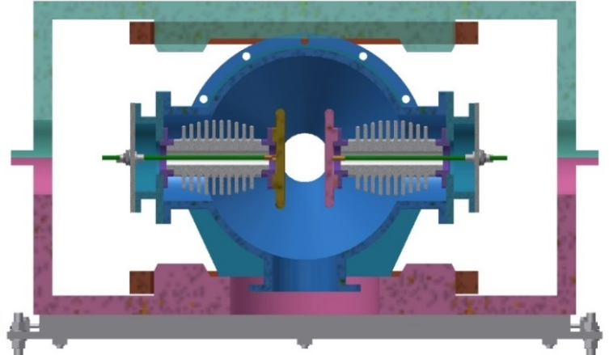
Electro-magnetic Separator R&D（陈斌）
Introduction
The Electro-Magnetic Separator is a device consisting of perpendicular electric and magnetic fields.
One set of Electro-Magnetic Separators including 8 units, total 32 units will be need for CEPC.
 | Filed | Effective Length | Good field region | Stability
Electrostatic separator | 2.0MV/m | 4m | 46mm×11mm | 5×10⁻⁴
Dipole | 66.7Gauss | 4m | 46mm×11mm | 5×10⁻⁴
Separator length | 4.5m
Inner diameter of separator tank | 380mm
Electrode length | 4.0m
Electrode width | 180mm
Nominal gap | 75mm
Maximum operating field strength | 2MV/m
Maximum operating voltage | ±75kV
Maximum conditioning voltage | ±135kV
Good field region (0.5‰ limit) | 46mm×11mm
Nominal vacuum pressure | 2.7×10⁻⁸ Pa
Metal-ceramic support
High voltage feedthrough
UHV tank
Support
Magnet
Coil
Electrode

Slide 17
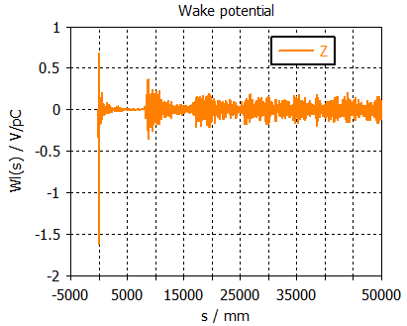
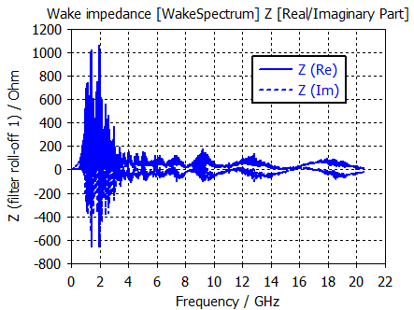
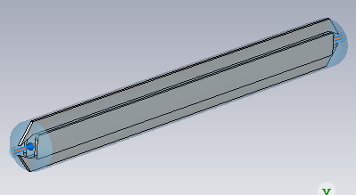
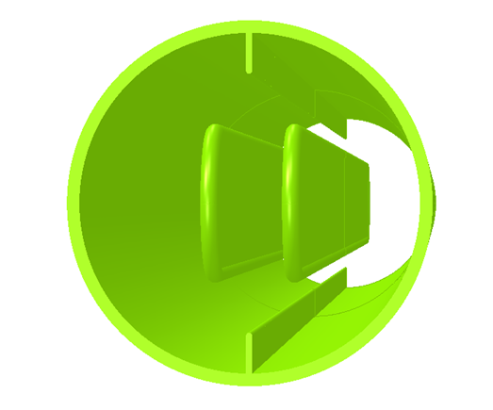
Beam impedance of electro-static separator（王娜）
Beam thermal power deposition of a separator is high（>10kW, most loss power on electrodes）
存在丰富的HOM，可能引起耦合束团不稳定性，需要进一步模拟明确HOM信息及抑制措施
 | Higgs-30MW |  | Z-30MW |  | LEP
 | with ZL | with ZL&BB | with ZL | with ZL&BB | /
Beam current [mA] | 16.7 | 16.7 | 803.5 | 803.5 | 5.5
Bunch length [mm] | 3.0 | 4.1 | 6.0 | 8.7 | 20
kloss [V/pC] | 1.7 | 1.4 | 1.0 | 0.8 | 0.4
Ploss [W] | 590 | 486 | 18045 | 14436 | 575
High power loss deposition can induce：
High voltage arcing/breakdown
Burning of energy absorbing resistors
Increased outgassing which would raise the electron background in the experiments

Slide 18
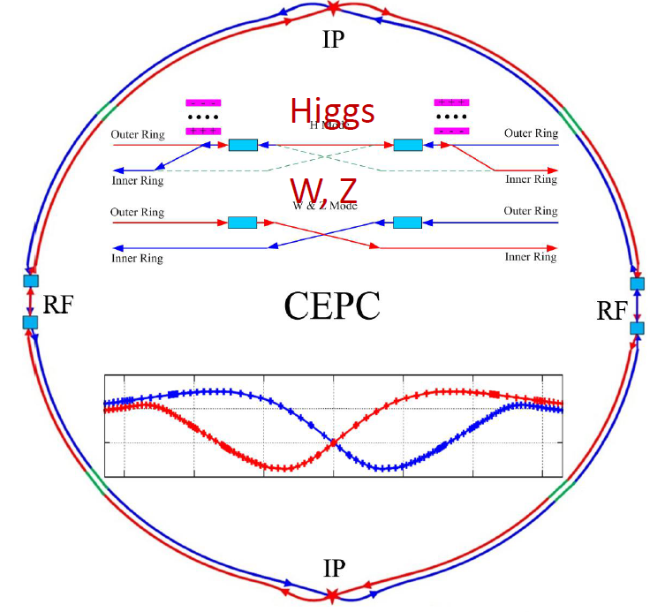
Alternative scheme of RF region beam separating system
Motivations：The adverse issues of DC HV as high as hundred kV and beam impedance of the electrostatic separator are inevitable
The alternative scheme was proposed first in 2019. Similar idea was found in ILC head-on-collision option scheme*（EPAC2006，TESLA-scheme is electrostatic-separator）.
In Higgs mode，e- /e+ beams only fill half ring respectively. So, it is possible to separate beams by kickers.
Compared with static-electrical separator, kicker magnet is stronger and contributes lower beam impedance.
4 sets of kicker locate at both sides of RF region, K1 and k4 applied for e+ beam,K2 and K3 applied for e- beam;
The waveform of kicker pulsers is square wave with duty cycle of 50%, pulse width of 165 us and frequency of 6.06 kHz;
The phase difference between K1 (K3) and K2(K4) is π.
k1
k3
k2
165us
165us
k4
k1
165us
k2
k3
k4
CW=6.06kHz, 50%
RFC
RFC
 | Kicker | Septa
Integrated strength BL [T*m] | 0.1624 | 1.4
Strength B [Guass] | 203 | 1000
Effective length Leff [m] | 8 | 14
Half width of good field region Hgf/Vgf [mm] | 10.1/3.8 @ 5E-4 | 18.9/3.8 @ 5E-4
Half width of beam stay clear Hbsc/Vbsc [mm] | 9.6/3.6 | 9.2/3.6
Septum width width [mm] | - | 10
K2
K1
Yiwei Wang
k1
DC septas
Last e+ Bunch
First e- Bunch
Top view
kickers

Slide 19
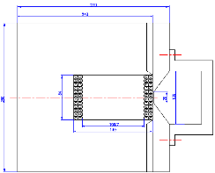
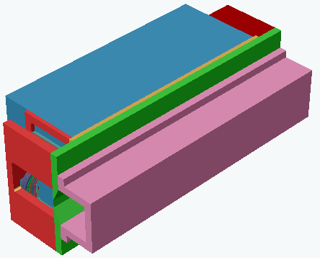
Challenge of new beam separating system
Septa: horizontal vacuum out DC Cu septum magnet（septum wall=10mm）or Lambertson?
kicker: horizontal vacuum out delay-line kicker+coating ceramic chamber+PFN-based solid-state pulser ？？？
Kicker pulser requirements are special:
Flat-top dropping
Amplitude long term stability
High repetition rate (CW)
Pulse width is large (PFN is too long)
compensate topology
controlling technique
Energy recycling tech.
Pulse forming tech.
CW=6.06kHz,50%
165us
165us
ISPB near IP of BEPCII
Ideal waveform ：
165us
overshoot
Top-drop
Amplitude drift
Practical waveform：
Tail
Very high Power loss
P=I²R*50%=1000A*1000A*10Ω*0.5=5MW
Delay-line kicker model

Slide 20
连续方波电源方案
CSNS RCS环主环磁铁电源采用怀特电路，是一个带直流偏置的25Hz CW 正弦波电流，采用开关电流源技术（怀特电路实质是利用谐振原理，对无功功率进行补偿）
是否可以类似的动态开关电源技术来产生带直流偏置的6kHz CW方波信号呢？
电路拓扑如何？（励磁电流、负载电感参数未知）
闭环控制带宽是否足够快？控制算法（HEPS快校正磁铁）
Kicker磁铁可以采用慢凸轨磁铁？真空外设计，镀膜陶瓷真空盒，束流阻抗低
R_{M}
L_{M}
R_{M}
AC+DC
C_{R}
L_{R}
AC
L_{R}
C_{R}
L_{M}
DC
串联怀特谐振电路
并联怀特谐振电路

Slide 21
高重复频率窄脉冲kicker电源方案
自由电子激光的束流分配系统上有类似的kicker电源设计。
优点：效率更高，脉冲电源的充能元件体积更小。匹配放电电路，按照10ns/10kV/50Ω计算，终端电阻上的平均功率是：16.7kW. 谐振放电电路，能量可以回收
特点：重复频率高达1.5MHz，商业的半导体开关器件MOSFET和特殊DSRD开关工作频率已达到这个量级。为HEPS研发的strip-line kicker10ns快脉冲电源测试结果显示，可以工作在1MHz。
难点：高重复频率下如何解决脉冲幅度一致性和稳定性的问题。需要研究快速充电技术和补偿控制技术。
CW=6.06kHz,50%
165us
165us
165us
理想波形：
165us
(242bunch)
242,1.5MHz
680ns，1.5MHz，占空比50%
实际波形：

Slide 22
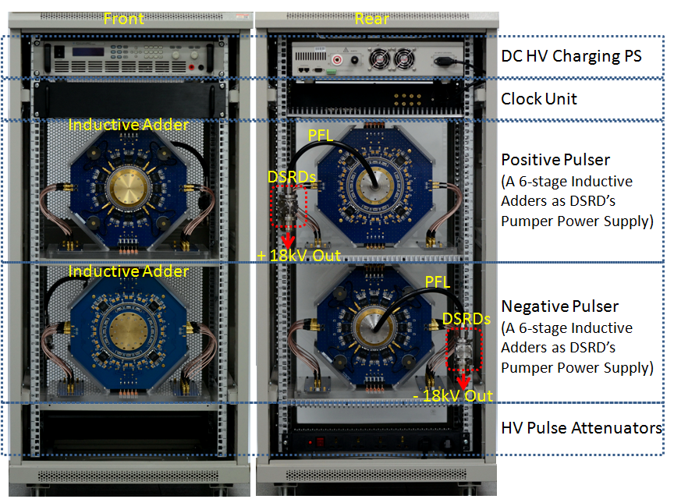
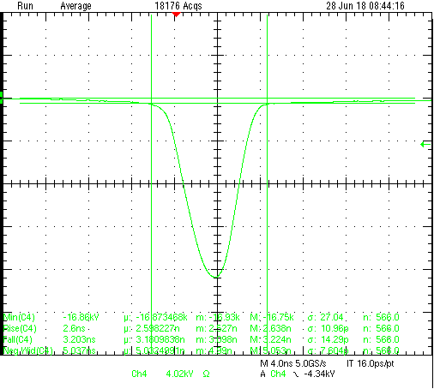
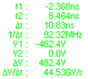
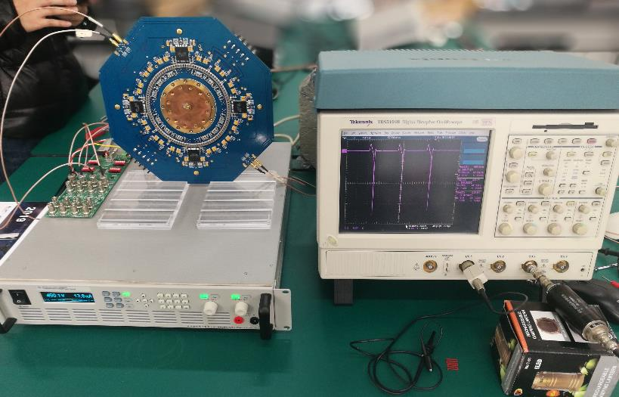
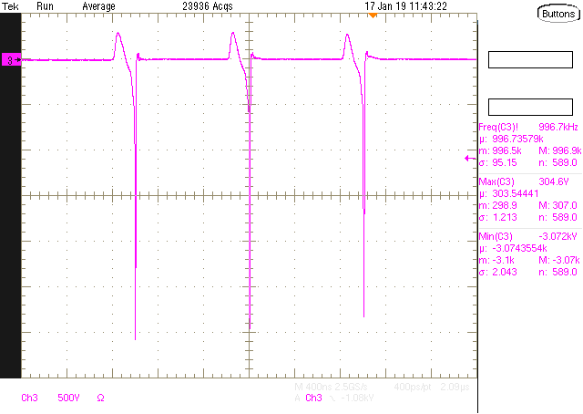
高重复频率窄脉冲kicker方案
HEPS fast kicker pulser
PFL=0.3m
Vpeak=17kV,
FWHM=5ns,
T_{r}(10-90%)<2.6ns,
T_{f}(90-10%)<3.2ns,
Bottom width(3%-3%)<10ns
4ns
Operating at 1MHz test
Amplitude dropping
A DSRD driven by a single stage pumper
3 pulses at 1MHz rate in every 2ms cycle

Slide 23
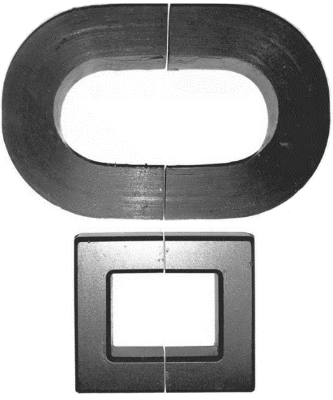
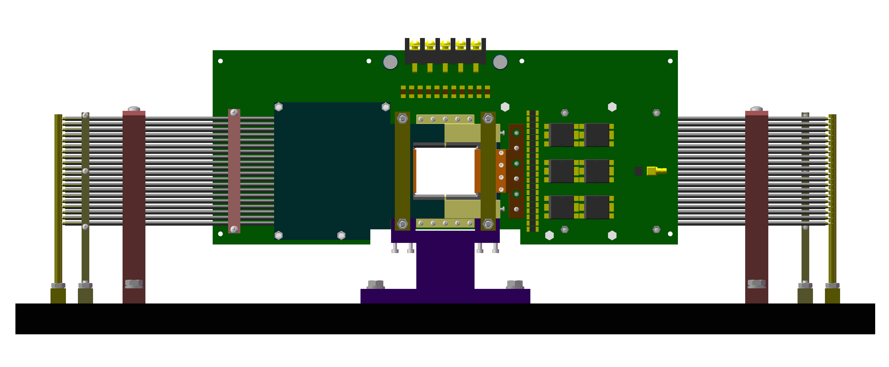
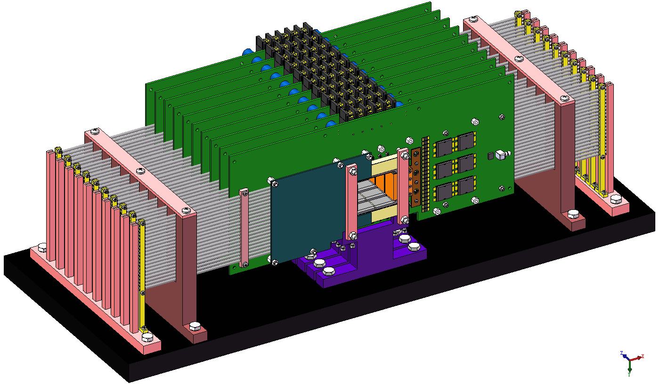
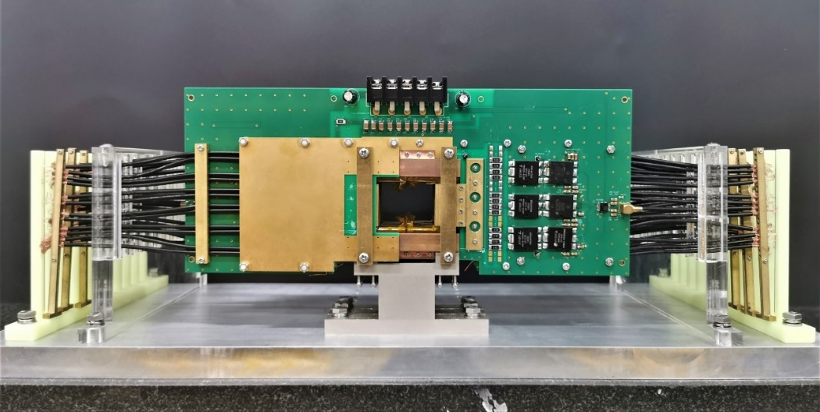
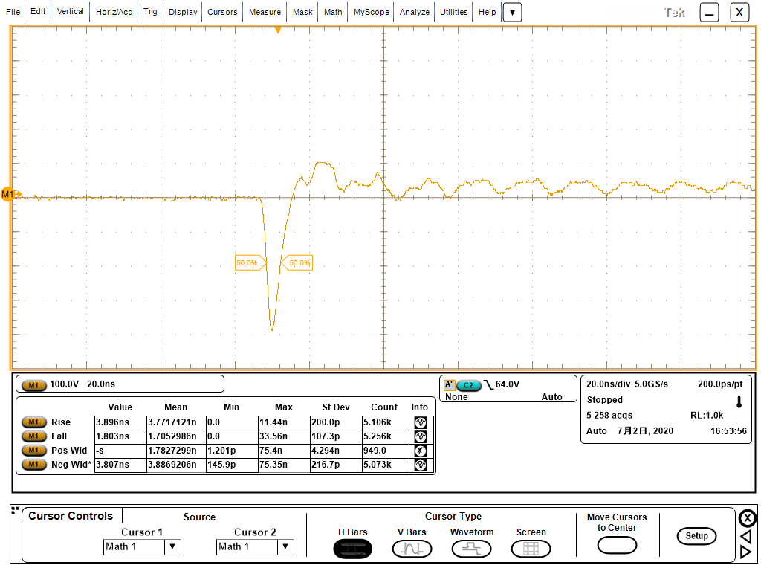
高重复频率窄脉冲kicker方案
已结题基金课题：紧凑型超快冲击器

Slide 24
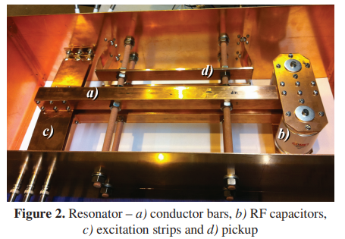
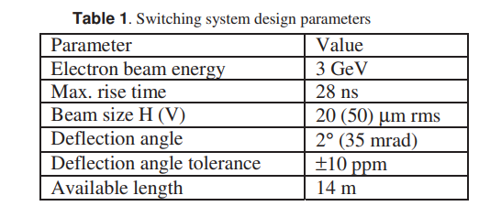
谐振kicker磁铁方案
680ns
165us
165us
Swiss FEL beam separating system

Slide 25
谐振kicker磁铁方案
RESONANT KICKER SYSTEM FOR HEAD-ON-COLLISION OPTION OF LINEAR COLLIDER*

Slide 26
谐振腔式kicker方案

Slide 27
商业谐振式高频电源

Slide 28
R&D plan for separating system research
连续方波方案
建议由电源组动态电源团队研发
谐振kicker方案
谐振kicker研制
谐振电源研制

Slide 29
Manpower and funding requirements

Slide 30
Research Team
Team member in TDR phase : 11 persons
Researcher: Jinhui Chen
Associate-researcher: Lei Wang, Lihua Huo, Yuwen Wu, Hua Shi
Engineer: Guanwen Wang, Peng Liu, Xiaolei Shi
Post-doctor: Guanjian Wu, Zilin Chen
Doctoral-graduate-student: Xinzhe Zhai
Problems：
Team members are from several groups
All people is part-time: HEPS (first half of this year), BEPCII-U(second half of this year), CSNSII
Some people are leaving
Need at least 25 FTEs in future construction phase

Slide 31
Funding and manpower requirements
R&D item | Budget (X10000CNY) | Man power（FTEs）
Lambertson magnet | 45 | 1 （霍丽华、吴官健、吴煜文）
Delay-line Kicker | 45 | 2 （王磊、吴官健）
Kicker pulser | 80 | 2（翟心哲、王冠文、陈锦晖）
Resonance kicker | 80 | 2（王磊、吴官健、霍丽华、施华）
Resonance power supply | 80 | 2（陈锦晖、翟心哲、王冠文、刘鹏）
Bumper magnet（6kHz） | 20 | 1（霍丽华）
Continue square wave power supply | 30 | 2（刘鹏、？）
total | 380 | 12

Slide 32
Summary
There are various types of hardware for CEPC injection system
In a limited time of EDR phase, we plan to select only the most important or difficult components for R&D
CEPC injection system and RF region beam separating system research plans are both proposed.
The R&D schedule, budget and manpower requirements are considered.

Slide 33
END
Thank you for attentions!

Slide 34
Backup

Slide 35
List of all type of hardware
No | Hardware | Type | Typical parameters | Unit | Number | Unit price (10,000 CNY) | Total Price (10,000 CNY)
1 | kicker1 | delay-line dipole kicker | in-air delay-line dipole kicker, horizontal, 0.1mrad, 0.04T·m, L=1m, B=0.04T(H), inc. ion pump | set | 24 | 50 | 1200
2 | kicker pulser1 | trapezoidal wave pulser | PFN, solid-state,440~2400ns, inc. cable | set | 24 | 100 | 2400
3 | kicker2 | ferrite-core dipole kicker | in-air ferrite-core dipole kicker, horizontal,0.2mrad,0.08T·m, L=1m, B=0.04T(H)， inc. ion pump | set | 6 | 33 | 198
4 | kicker pulser2 | half-sine wave pulser | LC, solid-state,1360ns, halfsine, inc. cable | set | 6 | 31 | 186
5 | kicker3 | strip-line kicker | Strip-line kicker, vertical, 46ns, L=1m, inc. ion pump | set | 6 | 28 | 168
6 | kicker pulser3 | DSRD pulser | 46ns, ±12.5kV,DSRD pulser, inc. cable | set | 6 | 67 | 402
7 | kicker4 | slotted-pipe kicker | Slotted-pipe kicker,vertical,250ns,L=0.25m, DR beam pipe φ=30mm, inc. ion pump | set | 2 | 23 | 46
8 | kicker pulser4 | trapezoidal wave pulser | solid-state,inductive adder, 250ns, inc. cable | set | 2 | 40 | 80
9 | dilution kicker | CW full-sine | CW full-sine，L=2m，150Gauss，T=25us, total length=10m | set | 10 | 30 | 300
10 | dilution kicker pulser | CW full-sine | CW full-sine，T=25us | set | 10 | 30 | 300
11 | NLK | NLK | in-air Nonlinear kicker or pulsed sextupole, horizontal, 0.1mrad, 0.04T·m, L=1m, inc. ion pump | set | 2 | 38 | 76
12 | NLK pulser | half-sine wave pulser | LC, solid-state,0.3ms, halfsine, inc. cable | set | 2 | 15 | 30
13 | thin septa | In-vacuum Lambertson | Lambertson,vertical,DC,L=1.75m,B=0.8T,Septum=2mm, mainfield clearance=20*20mm, 13mrad, 5.22T·m,inc. ion pump | set | 28 | 58 | 1624
14 | thick septa1 | In-air Lambertson | Lambertson,vertical,DC,L=1.75m,B=0.8T,Septum=6mm, mainfield clearance=20*20mm, 13mrad, 5.22T·m,inc. ion pump | set | 148 | 25.8 | 3818.4
15 | thick septa2 | In-air Lambertson | Lambertson,horizontal,DC,L=1.2m, B=0.8T, Septum=5.5mm, mainfield clearance=50*50mm, 45mrad, 0.92T-m,inc. ion pump | set | 2 | 22.8 | 45.6
16 | thick septa3 | In-air Lambertson | Lambertson,horizontal,DC,L=0.5m,Septum=3.5mm, DR beam pipe φ=30mm,inc. ion pump | set | 2 | 20.8 | 41.6
17 | septa power supply | DC power supply | DC switch power supply, inc. cable | set | 28 | 12.5 | 350
18 | local control system1 |  | PLC，touch screen，oscilloscope | set | 16 | 10 | 160
19 | local control system2 |  | PLC，touch screen，oscilloscope | set | 2 | 5 | 10
20 | Field measurement devices1 | hall | Hall point measurement system for Lambertson | set | 2 | 160 | 320
21 | Field measurement devices2 | inductive coil measurement | inductive coil measurement system for kicker | set | 1 | 10 | 10
 |  |  |  |  |  | Total cost： | 11765.6
 |  |  |  |  |  | Toal cost with installation fee(3%)： | 12118.568

