Slide 1



CEPC cryogenic system
EDR plan
Rui Ge
CEPC day, 15th, March, 2024, IHEP

Slide 2
Content
Brief Introduction
SRF and SC magnet cryogenic system TDR design overview
Cryogenic system EDR plan
Summary
Notes:
The outline is including 4 parts: first of all, I will give you a brief introduction of the cryogenic system, Then, the cryogenic system for SRF design. The cooling scheme optimization and process calculation and key equipment and technology R&D are concluded. The third one, is the cryogenic system for SC magnets. Last, a shsort summary.

Slide 3
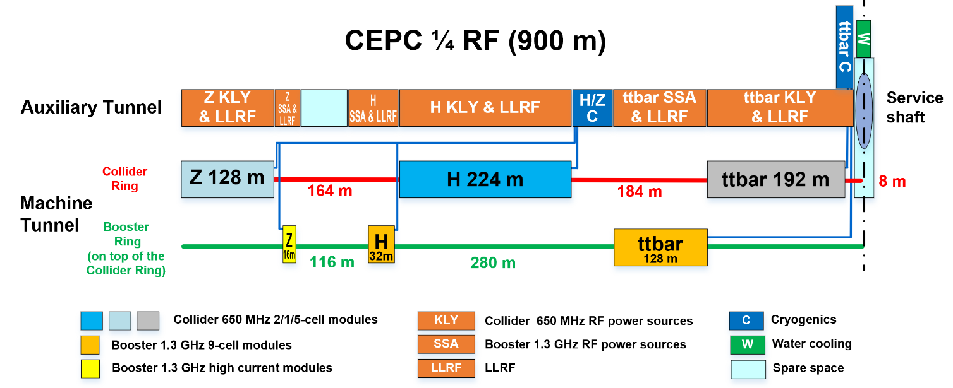
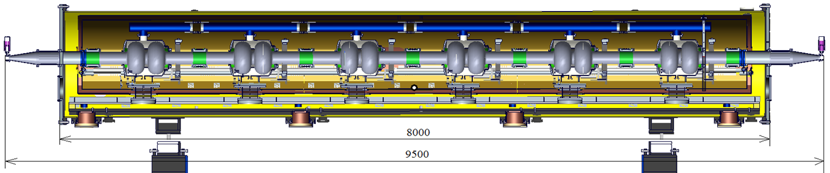
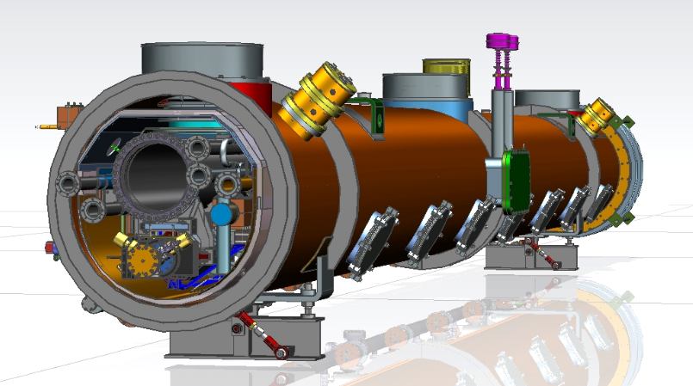
CEPC Cryogenic System Brief Introduction
Cryomodules for Higgs 30 / 50 MW
  30 MW Higgs:
Collider: 192 650 MHz 2-cell cavities in 32 modules (6 HV / CM)
Booster: 96 1.3 GHz 9-cell cavities in 12 modules (8 HV / CM)
  50 MW Higgs:
Collider: add 24 modules, in total 56 650 MHz modules
Booster: 96 1.3 GHz 9-cell cavities in 12 modules (8 HV / CM)
Notes:
The auxiliary tunnel and beam tunnel layout are shown in this diagram. For the Higgs 30 and 50 MW, the cryo-equipment locates in this blue section, and the liquid helium is transferred to the collider ring and booster ring cryomodule through the multiple transfer lines.

Slide 4
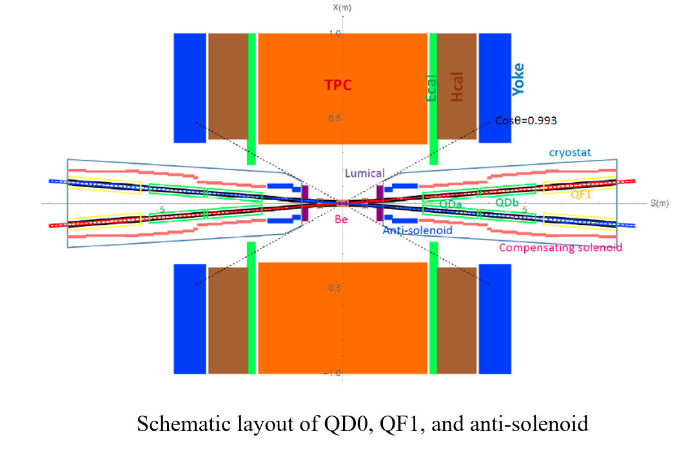
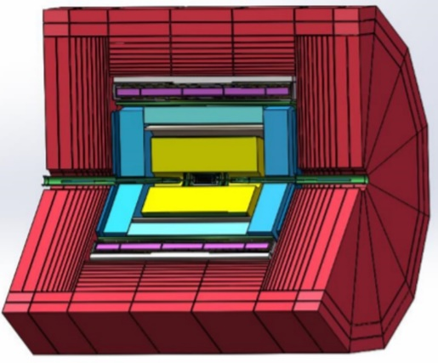
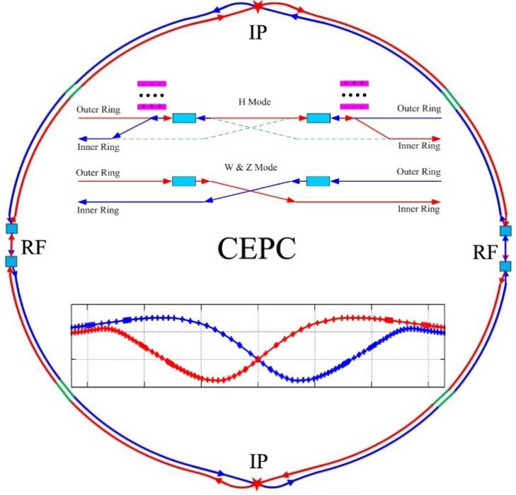
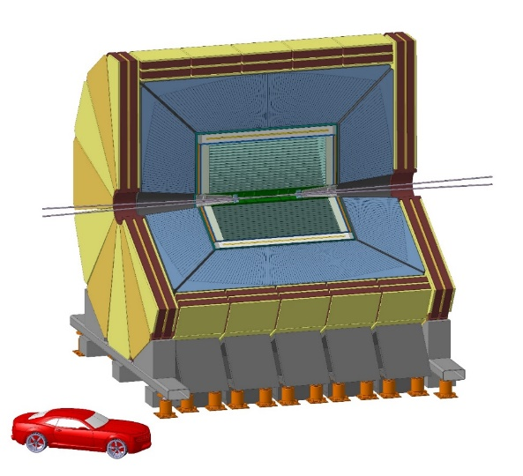
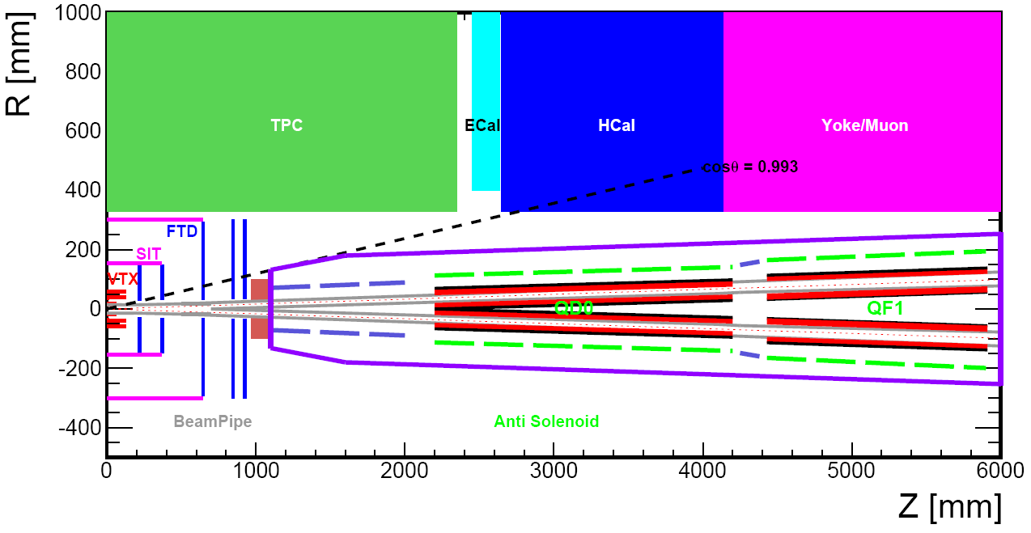
CEPC Cryogenic System Brief Introduction
SC magnets cryogenic system overview
LTS Solenoid
LTS Solenoid ：
Solenoid located outside calorimeter
Inner diameter 7.2 m, length 7.4 m
Central field：3 T
Superconductor：NbTi
Operation temperature：4.2 K
HTS Solenoid
From Zhu Ying-shun
IDEA detector
Zhu Zian，Wang Meifen
HTS Solenoid ：
Solenoid located inside calorimeter/less material
Inner diameter 4 m, length 6 m
Central field：2 T
Superconductor：YBCO
Operation temperature：20 K
Notes:
For the SC magnets side, there are total 4 IR magnets working 4K in the MDI. Besides, the detectors locate at two Ips with two separated schemes., And it’s cooling scheme is designed by Professor Zhu Zian and Wang Meifen. Now this two colleagues have left IHEP, and this section needs to be designed in detail. Therefore, my report mainly introduce the IR magnets cryogenic system.

Slide 5
Content
Brief Introduction
SRF and SC magnet cryogenic system
Cryogenic system EDR plan
Summary
Notes:
The outline is including 4 parts: first of all, I will give you a brief introduction of the cryogenic system, Then, the cryogenic system for SRF design. The cooling scheme optimization and process calculation and key equipment and technology R&D are concluded. The third one, is the cryogenic system for SC magnets. Last, a shsort summary.

Slide 6
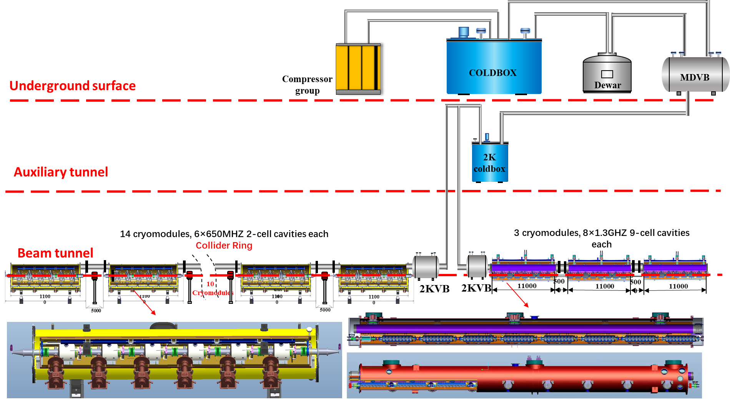
Flow chart of SRF TDR Scheme
To improve the cryogenic system efficiency and reduce the cost, the cooling scheme has been modified, from parallel to series.
In this way, there will not have a lot of small valve boxes in the tunnel, and much expenses and space will be saved.
Notes:
This is the flow chart of the SRF TDR scheme. In the previous conceptional design report, the cooling scheme is parallel for the SRF cryomodules. That means each cryomodule has a separated valve box in the auxiliary tunnel. And the length of main TL is very long.
Later, to improve the cryogenic system efficiency and reduce the cost, the cooling scheme has been modified, from parallel to series. In this way, there will not have a lot of small valve boxes in the tunnel, and we just use two big valve box to replace them. Besides, the length of the TL is much reduced, and the process scheme looks more easier. Most importantly, much expenses and space will be saved.

Slide 7
cryogenic system process flow diagram in the SRF system
5K@3bara supercritical helium subcooled to 4.5K, and then through 2K JT heat exchanger reduced to 2.2K@3bara.
2.2K@3bara helium throttled by JT valve to produce the 2K super fluid helium.
40-80K thermal shield is set to reduce the radiation loss.
5-8K loop to cool down the coupler.
Notes:
5K@3bara supercritical helium subcooled to 4.5K, and then through 2K JT heat exchanger reduced to 2.2K@3bara.
2.2K@3bara helium throttled by JT valve to produce the 2K super fluid helium.
40-80K loop to cool down the cryomodules' thermal shield.
5-8K loop to cool down the coupler.

Slide 8
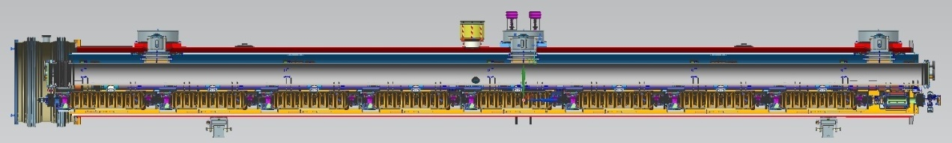
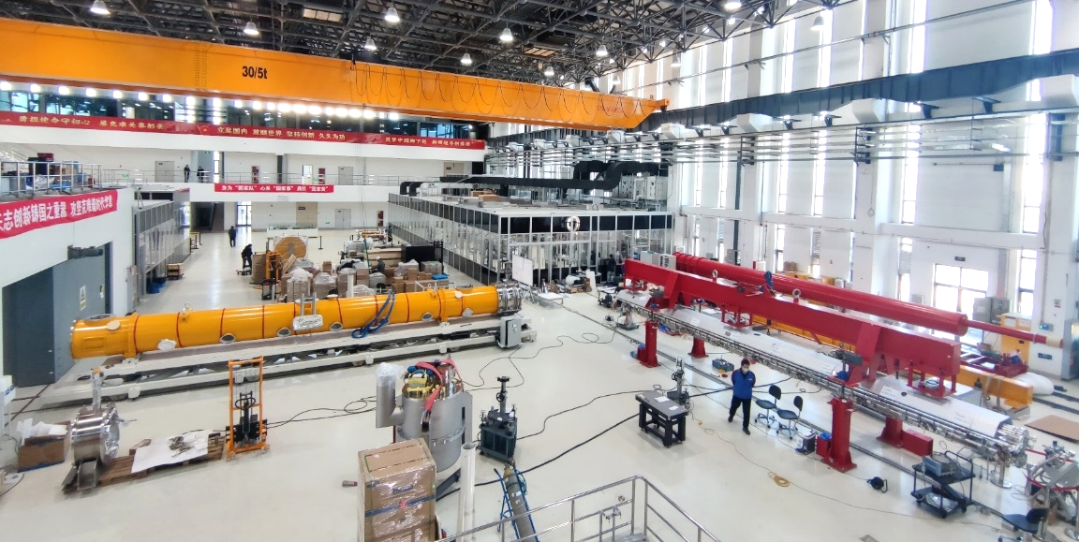
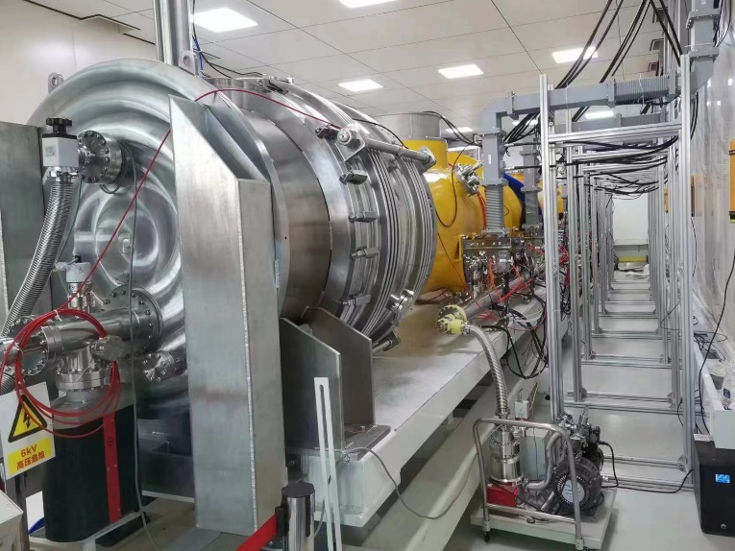
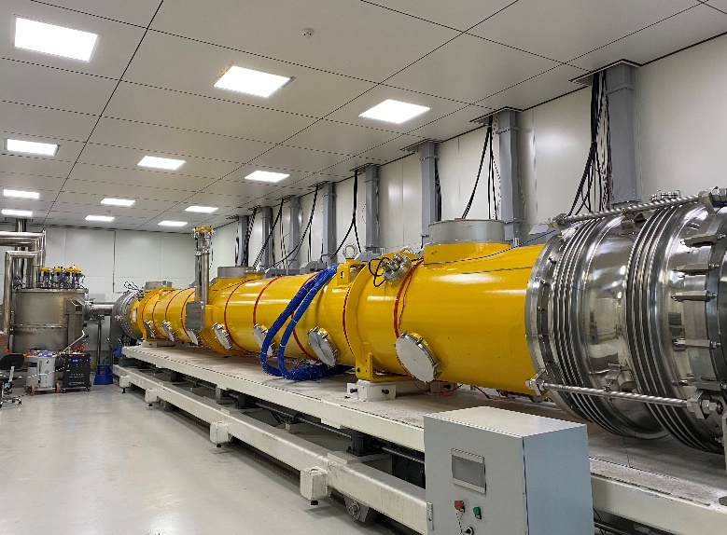

1.3GHz cavity Cryomodule
Notes:
Another key technology is 1.3 GHz cavity cryomodule. The horizontal test has been carried out in PAPS project, and all cryogenic functions, including cooldown, 2K operation, warming up process, have been verified successfully.

Slide 9
1.3GHz cavity Cryomodule
5K helium
2K superfluid helium is produced by the JT valve, and the cavity can be immersed in 2K helium bath. The GHe returns to heat exchanger to recover the cold quantity. And it is heated by the electrical heater, then enter the pump station. Finally, it goes to compressor suction side to complete the whole circle.
2.9bara@2.2K
31mbar@2K
Subcooled 4.5K LHe
2K Valve Box
Feedcap
CRYOMODULE
Endcap
Notes:
The 5K helium from coldbox is supplied to be transferred, in 2K valve box, the helium is subcooled by the saturated liquid helium from DW. And then go to the heat exchanger, the temperature is further lowered, then transferred to cryomodule. 2K superfluid helium is produced by the JT valve, and the cavity can be immersed in the helium bath. The helium vapor gas is collected in gas return pipe, return to heat exchanger to recover the cold quantity. And then is heated by the electrical heater, then enter the pump station. Finally, it goes to compressor suction side to complete the whole circle.

Slide 10
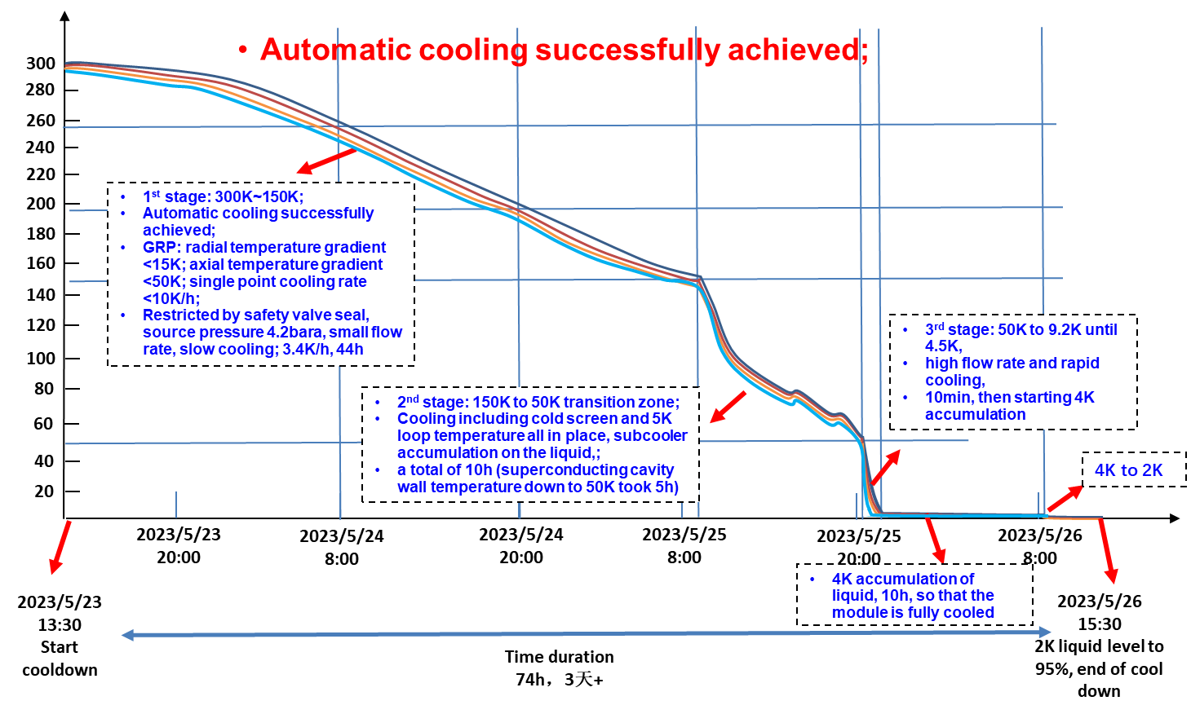
1.3GHz cavity Cryomodule Cooldown
The first stage is from 300K to 150K.
Automatic cooling method was adopted to guarantee the cavity can be cooled smoothly and safely.
Temperature difference in the radial and axial direction should be controlled in the accepted domain.
The second stage is 150K to 50K transition zone;
To increase the cooling speed to prevent "hydrogen poisoning" phenomenon happening.
The third stage : large flow rate fast cooldown.
Established a large temperature gradient to expel magnetic flux, which can improve the cavity performance greatly.
Notes:
The first stage is from 300K to 150K. In this stage, we use the automatic cooling method to guarantee the cavity can be cooled smoothly and safely. And the temperature difference in the radial and axial direction should be controlled in the accepted domain.
The second stage is 150K to 50K transition zone, we need to increase the cooling speed to prevent "hydrogen poisoning" phenomenon happening.
When the temperature reaches 50K, we start the third stage : large flow rate fast cooldown. In this way, it will be established a large temperature gradient to expel magnetic flux, which can improve the cavity performance greatly.
The whole cooldown process is about more 3 days.

Slide 11
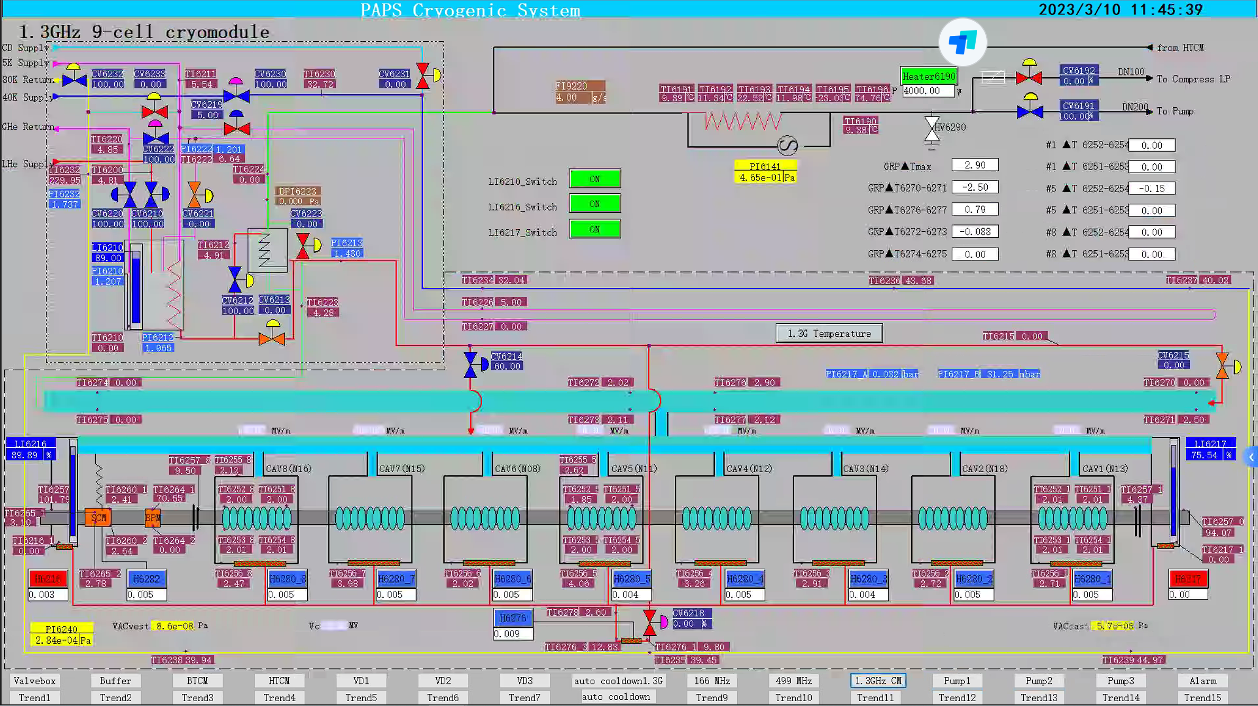
1.3GHz cavity Cryomodule
Notes:
This is the 2K operation control interface. All the temperatures on the cavity surface are all 2K. And Prof. Jiyuan Zhai has already introduced the test results, so I won’t go over this part again.

Slide 12
650MHz cavity Cryomodule
Including six 2-cell 650 MHz superconducting cavities, six high power couplers, six mechanical tuners and two HOM absorbers
Six 2-cell Cavities Cryomodule
Overall length(flange to flange, m) | 8.0
Diameter of Vacuum vessel ,m | 1.3
Beamline height from floor, m | 1.5
Cryo-system working temperature, K | 2
Number of 200-POST | 6
Cryomodule performance |  | Specification
Number of leakage | He →insulation | 0
 | He →beam pipe | 0
 | Insulation →coupler | 0
 | Insulation →beam pipe | 0
 | Coupler →beam pipe | 0
Alignment x/y inside (Cavities) |  | ±0.5mm
Alignment z inside |  | within 2 mm
Coupler antenna design z |  | within 2 mm
Notes:
Ok, the above-mentioned content is the 1.3GHz 9-cell cavity cryomodule, another cryomodule is 650MHz 2-cell cavities cryomodule. This diagram shows the cross section view, Including six 2-cell cavities, high power couplers, mechanical tuners and Higher-Order-Mode (HOM) Absorbers. The total length is about 9.5 meters. These two table shows the parameters.

Slide 13
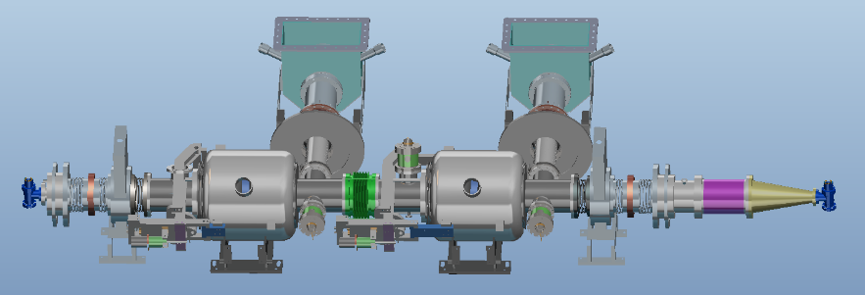
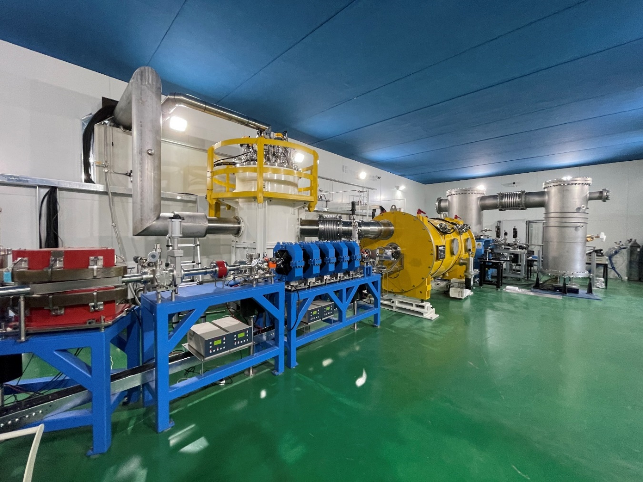
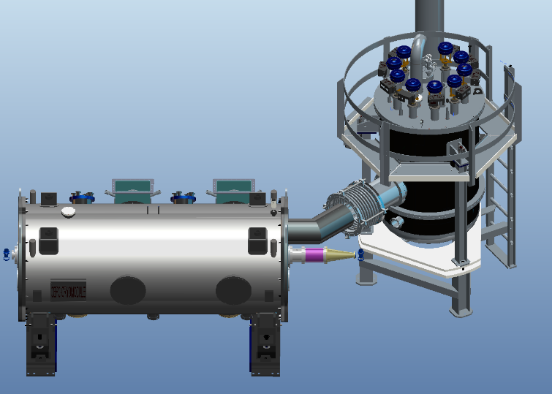
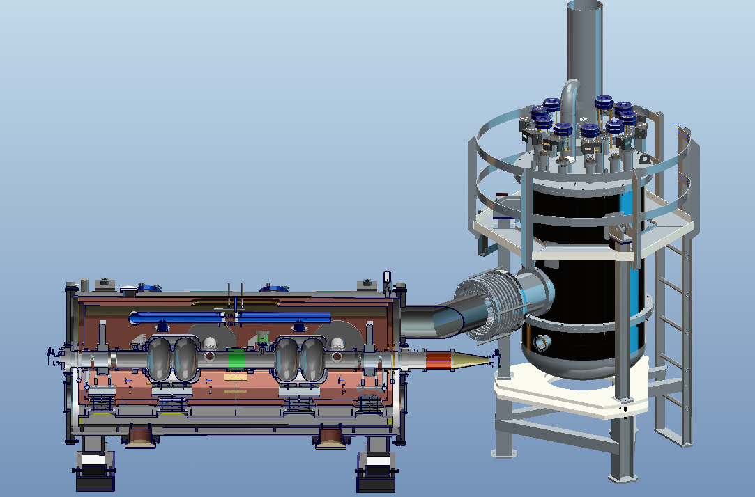
650MHz cavity Cryomodule
Prototype of 650MHz cryomodule with 2* 2cell cavities have been installed in PAPS tunnel and past the cryogenic test in 2021.
Notes:
The prototype cryomodule with two 2-cell 650 MHz superconducting cavities was operated in the PAPS system beam test stand last year, but without beam, just completed the cryogenic test.

Slide 14
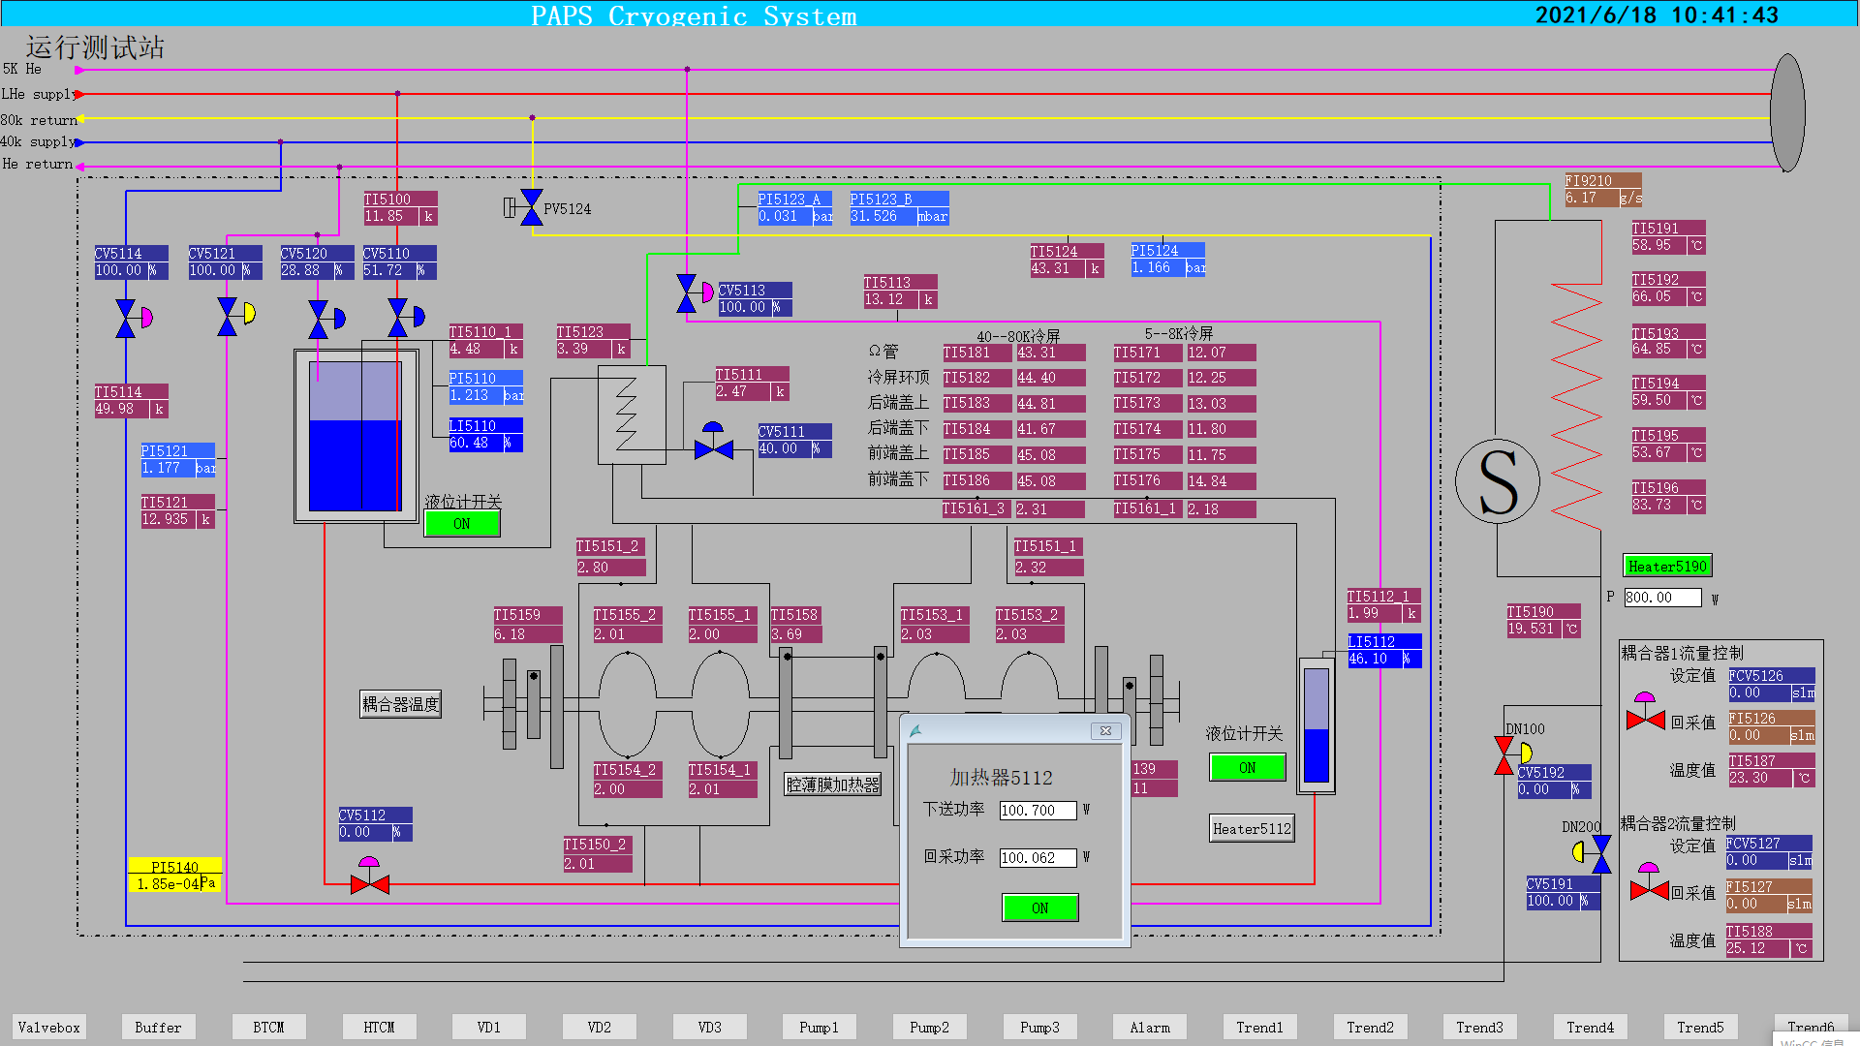
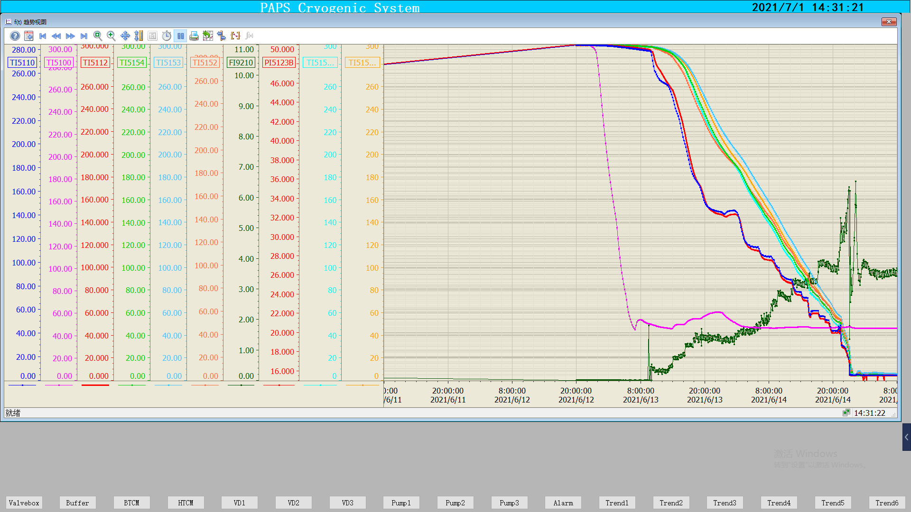
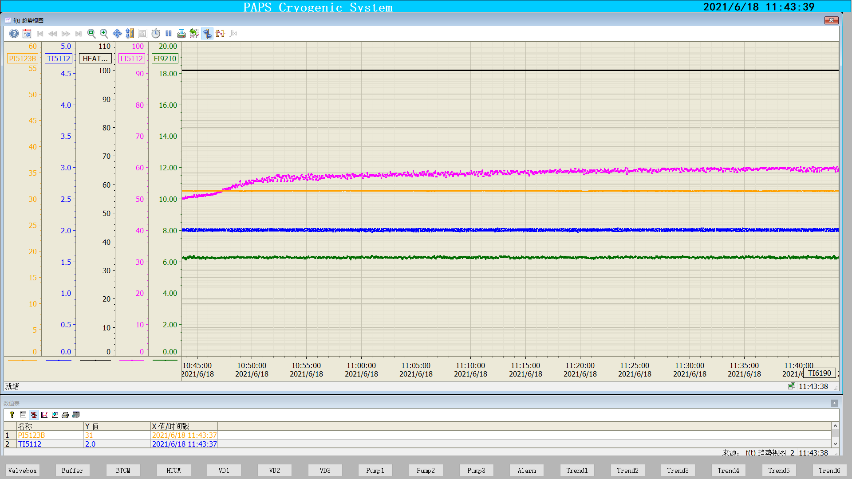
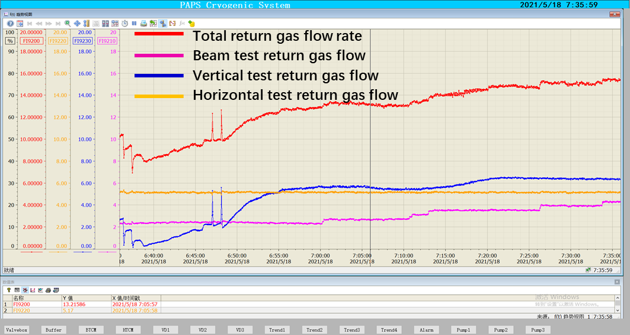
650MHz cavity Cryomodule
BTCM cooldown
BTCM: 100.7W@2K
Level
Temperature
Pressure
Mass flow
Pressure 31mbar±10Pa
Temperature 2K±0.02K
BTCM 2K stable operation
Cryogenic capacity test, 300W@2K return gas flow rate
Notes:
And during the cryogenic test period, the pressure stability and temperature stability at 2K have been verified to meet the requirements . And the whole cooling capacity test is 300W@2K.

Slide 15
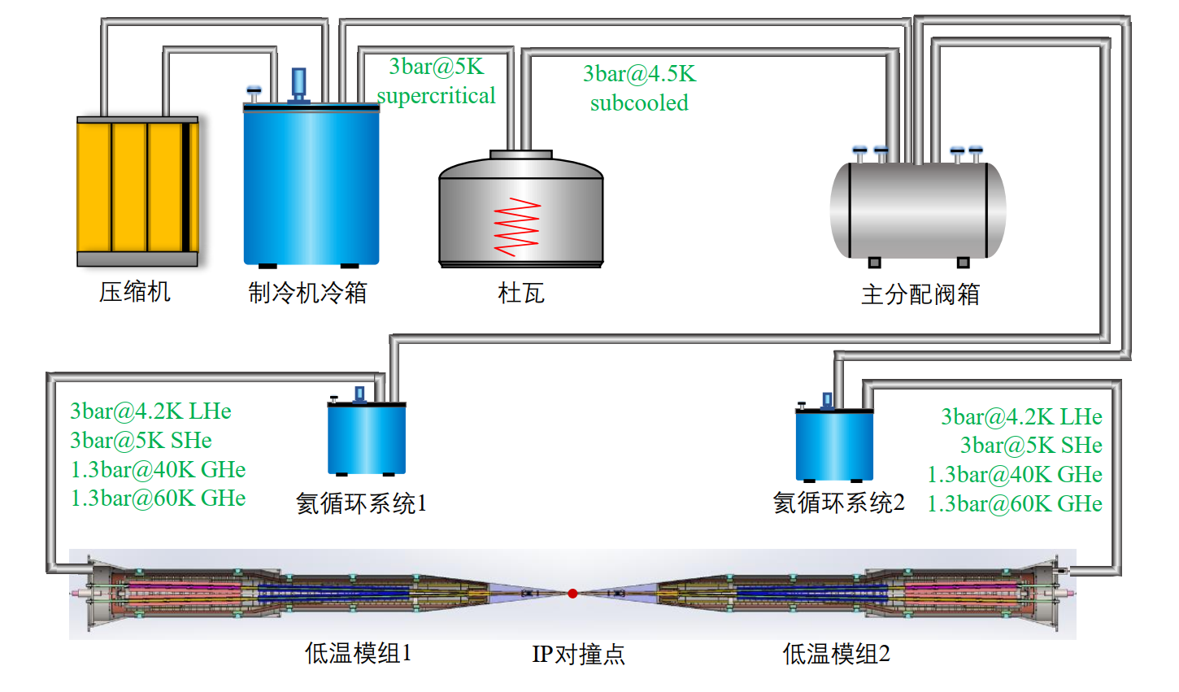
Detailed flow chart for the IR Cryostat
In CEPC collider ring IPs, there are four IR SC magnets cryomodules. The primary goal of the cryostat design is to create reliable safe cryogenic system with the possibility of failure-free operation for SC magnets with helium refrigerator.
Compressor
Cold box
Dewar
Main Distribution Valve Box
Helium circulating system 1
Helium circulating system 2
Cryostat 1
IP collision point
Cryostat 2
Notes:
In the both sides of the collision points in the interaction region of CEPC collider ring, there are four IR sc magnets cryomodules. The primary goal of the cryostat design is to create reliable safe cryogenic system with the possibility of failure-free operation for SC magnets with helium refrigerator.

Slide 16
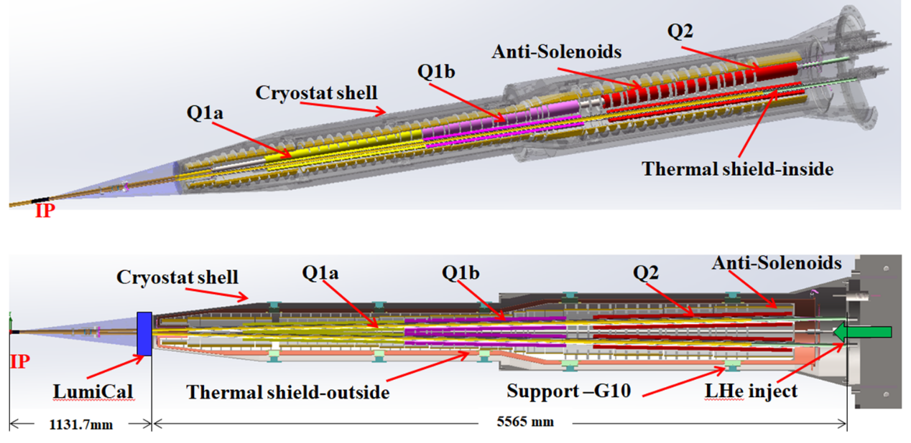
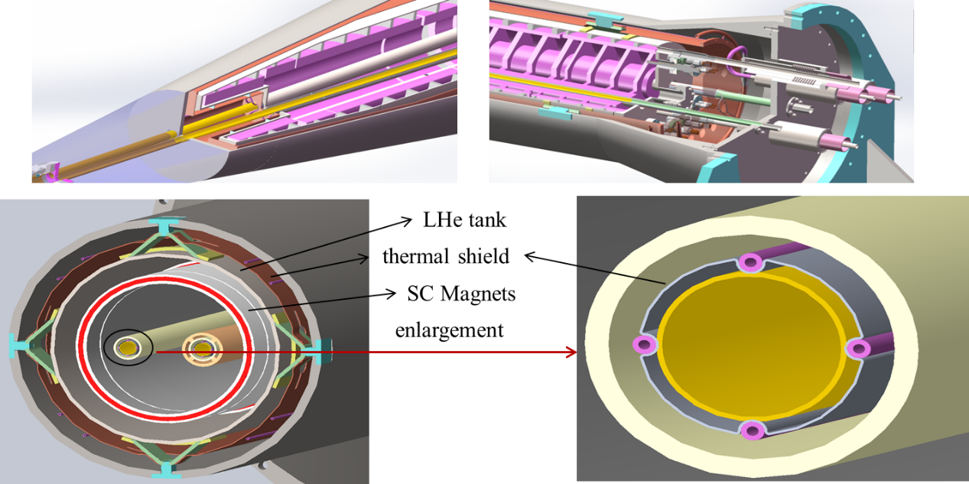
Mechanical structure of IR Cryostat
The structure of the IR SC magnets cryostat has been designed.
The total weight of cryostat is about 2.5 Tones, total length is 6.7m.
Mechanical design, stress analysis and thermal simulation have been finished.
Notes:
Here is for the key equipment for the CEPC magnets side, that is IR magnets cryostat. This is the structure of the cryostat, the total weight of cryostat is about 2.5 Tones, total length is 6.7m. Mechanical design, stress analysis and thermal simulation have been finished.

Slide 17
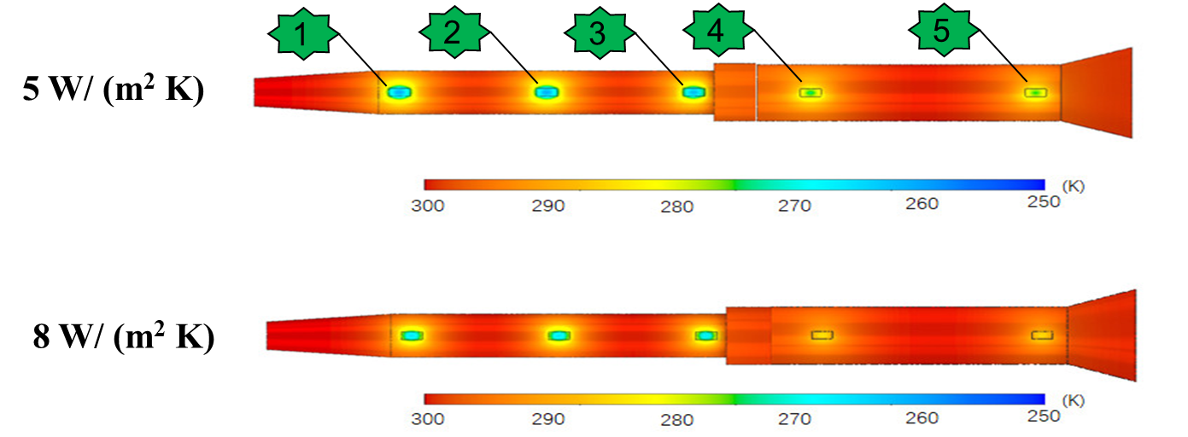
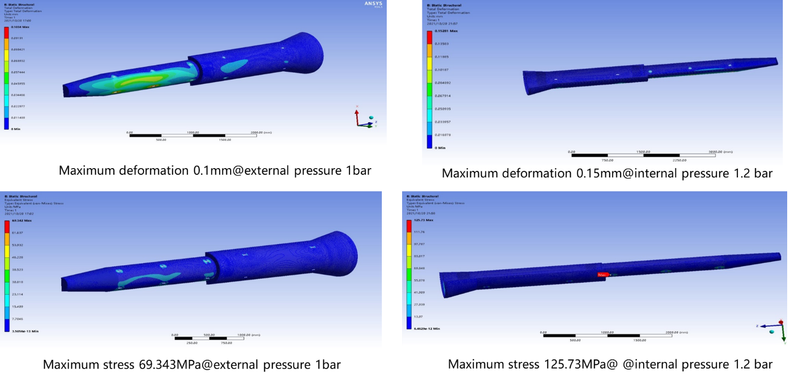
Thermal dynamics simulation
Research on the flow and heat transfer of helium in the narrow channels.
Choose the appropriate cooling method.
Notes:
We also simulated the temperature field of the vacuum chamber, and the stress analysis.

Slide 18
Content
Brief Introduction
SRF and SC magnet cryogenic system
Cryogenic system EDR plan
Summary
Notes:
The outline is including 4 parts: first of all, I will give you a brief introduction of the cryogenic system, Then, the cryogenic system for SRF design. The cooling scheme optimization and process calculation and key equipment and technology R&D are concluded. The third one, is the cryogenic system for SC magnets. Last, a shsort summary.

Slide 19
Our Plan in EDR
Conventional work:
CEPC 650MHz cavity Cryomodule 2K test
Detailed PID;
Mechanical layout；
Large refrigerator；
KW 2K HX 2K test；
SC magnet cryostat more detailed design
……
More creative work:
Virtual system establishment
Green accelerator
……
Notes:
Next, I will introduce the Development of the key equipment and technology, including :

Slide 20
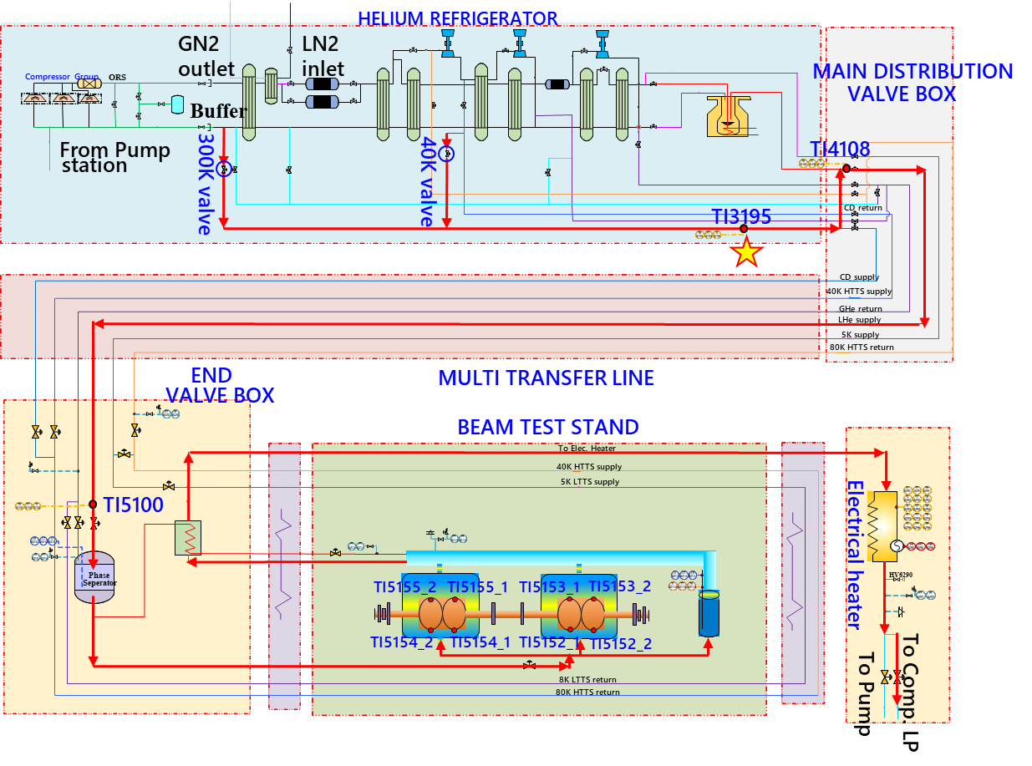
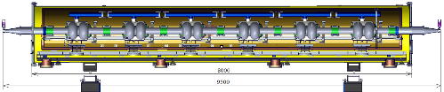
Next: CEPC 650MHz cavity Cryomodule
新设计650MHz超导模组低温冷却方案；
参考1.3GHz超导模组测试站在PAPS平台北侧水平测试站建设低温测试平台；
2024年完成低温测试方案，低温流程、低温控制逻辑等设计，并投入加工制造
时间安排在2025年底，完成低温测试平台搭建。

Slide 21
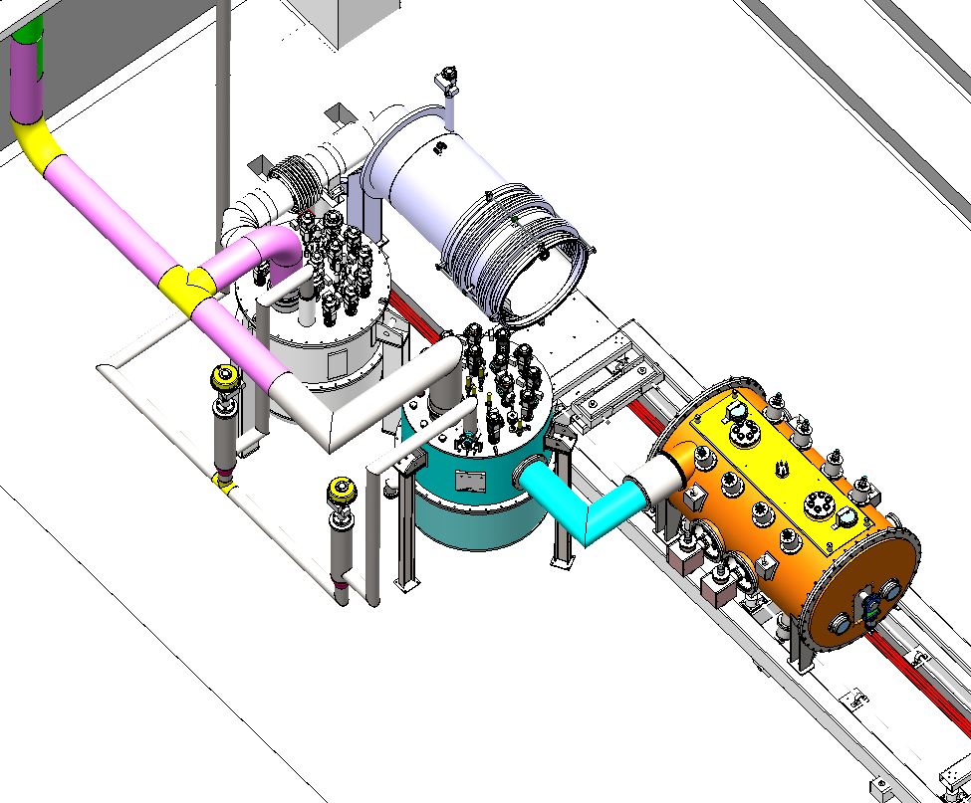
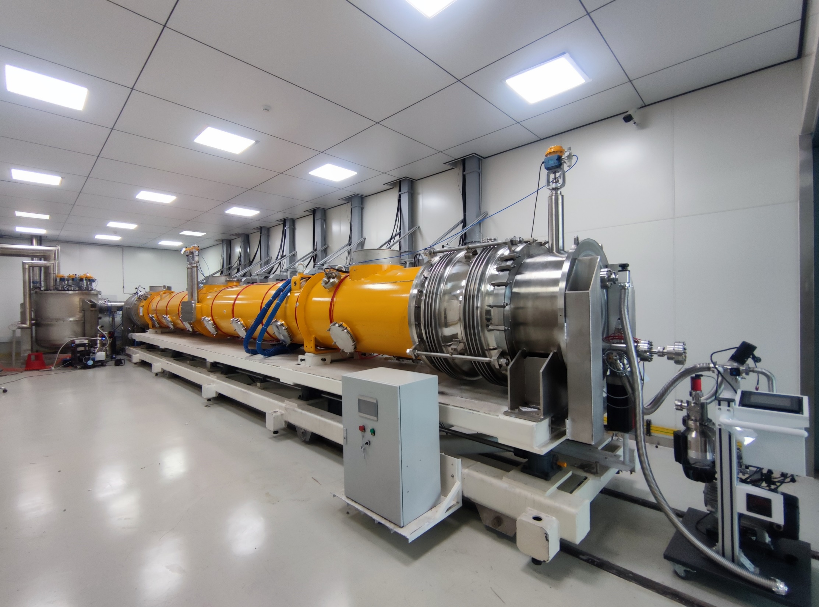
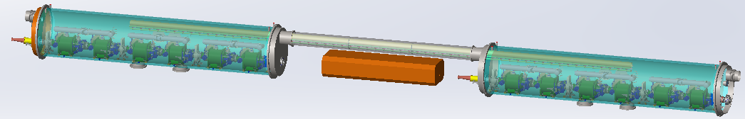
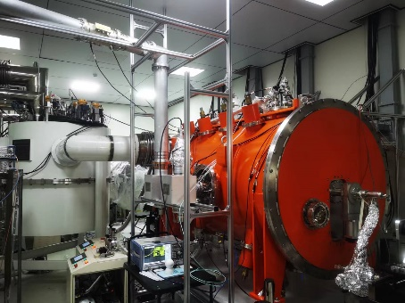
Next: CEPC 650MHz cavity Cryomodule
1.3GHz模组本身长度12米
5230mm
离屏蔽体移动门距离为9500mm
1.3GHz模组水平测试用2K阀箱
1.3GHz模组水平测试用2K阀箱
散裂水平测试用2K阀箱
单个650组元示意图，总长约10米

Slide 22
Next: CEPC 650MHz cavity Cryomodule
序号 | 分项名称 | 新建/改造内容 | 数量 | 单位 | 综合单价(万元) | 总价 (万元) | 其它
1 | 低温测试阀箱 | 2K低温测试阀箱，含2K换热器、过冷器 | 1 | 套 | 220 | 220
2 | 组装工装 运输小车 | 模组推进水平测试站需要专门的运输小车，需新研制 | 1 | 套 | 60 | 60
3 | 低温管线改造 | 设备移除及恢复、低温传输线改造，与其他测试系统隔离改造，增加相关阀门。 | 1 | 套 | 60 | 60
4 | 低温测量及 控制系统 | 1.温度、压力、液位、流量传感器 2.针对650组元新铺设控制电缆、控制柜、PLC和电缆槽等 3.针对650组元测试开发控制软件和UI界面 4.系统调试 | 1 | 套 | 150 | 150
5 | 低温测试费用 | 1.液氮消耗 2.液氦/氦气消耗 3.水、电等 | 1 | 批 | 70 | 70
6 | 真空泵组及配件 | 隔热真空泵、规计、波纹管及接头、角阀等 | 2 | 套 | 20 | 40
总计（万元） |  |  |  |  |  | 600

Slide 23
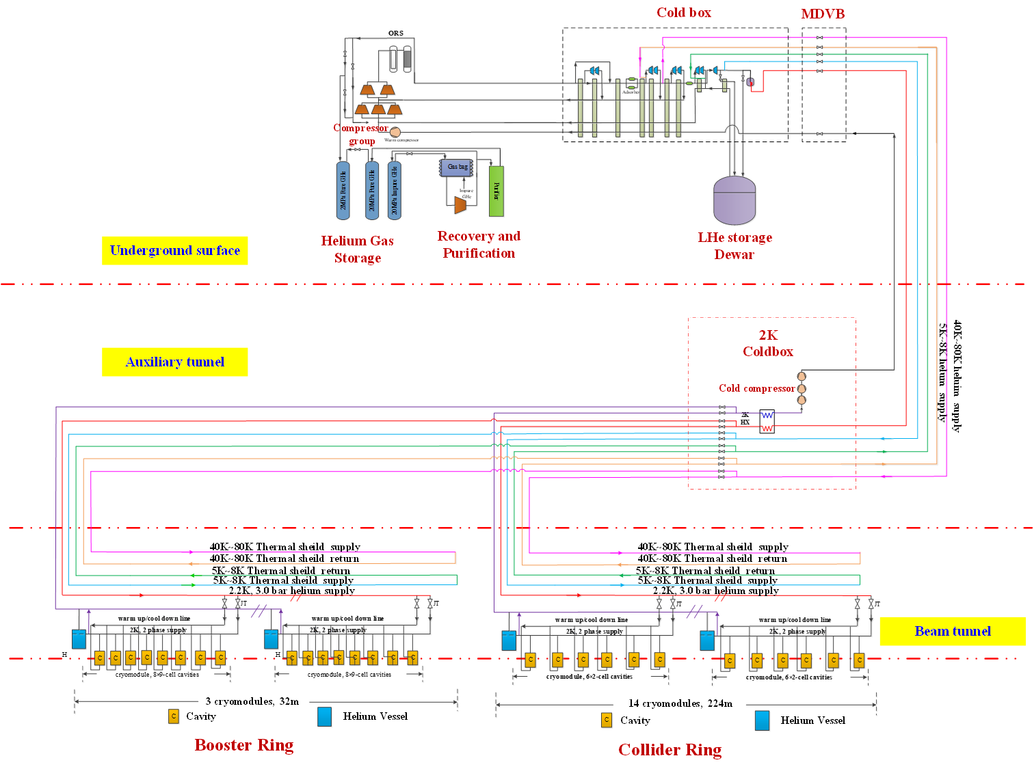
Next: Detailed PID in CAD version
Detailed PID in CAD version
Proper cryogenic transfer lines (TL) sizes
Measurement point (P, T, F, etc.)
Control logic
Contains all process flow function, meeting different operation requirements
……
Safety valve and cryomodule quench protection

Slide 24
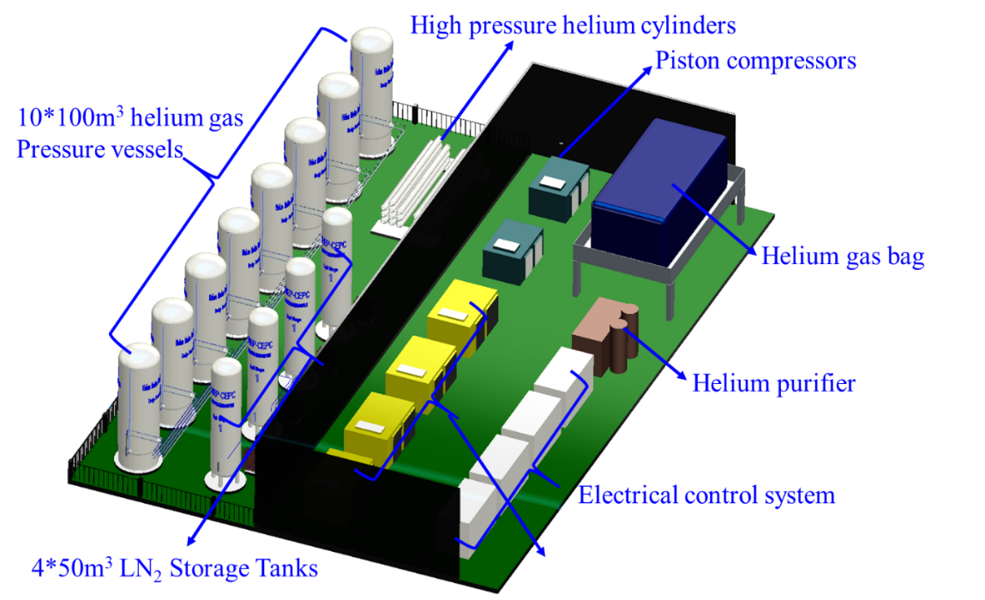
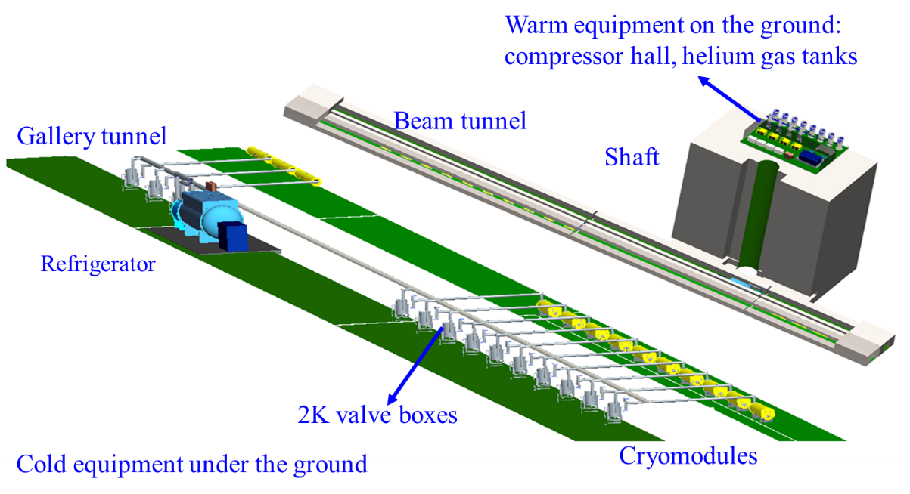
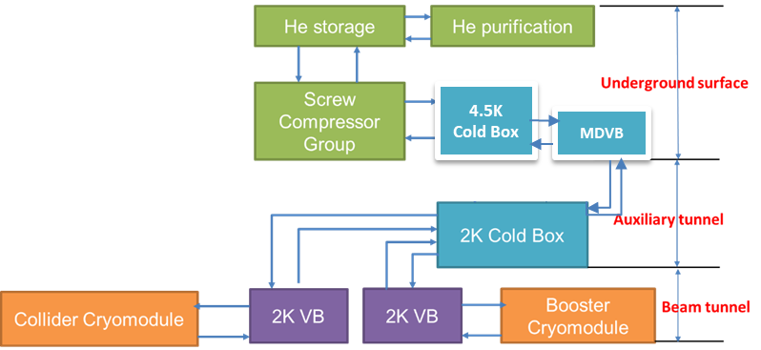
Cryogenic system mechanical layout diagram upgrade

Slide 25
Large refrigerator
Large refrigerator
Technical supported by FULL CRYO Company and TIPC, CAS
2.5 kW @4.5K or 500W @2K refrigerator have passed test and will be installed in CIADS campus for the long time running to verify the stability.
The CAS pilot project for the 10 kW @4.5K or 15 kW @4.5K (required for CEPC) has been approved, and it is expected to be developed and fully prepared for CEPC in the next few years.

Slide 26
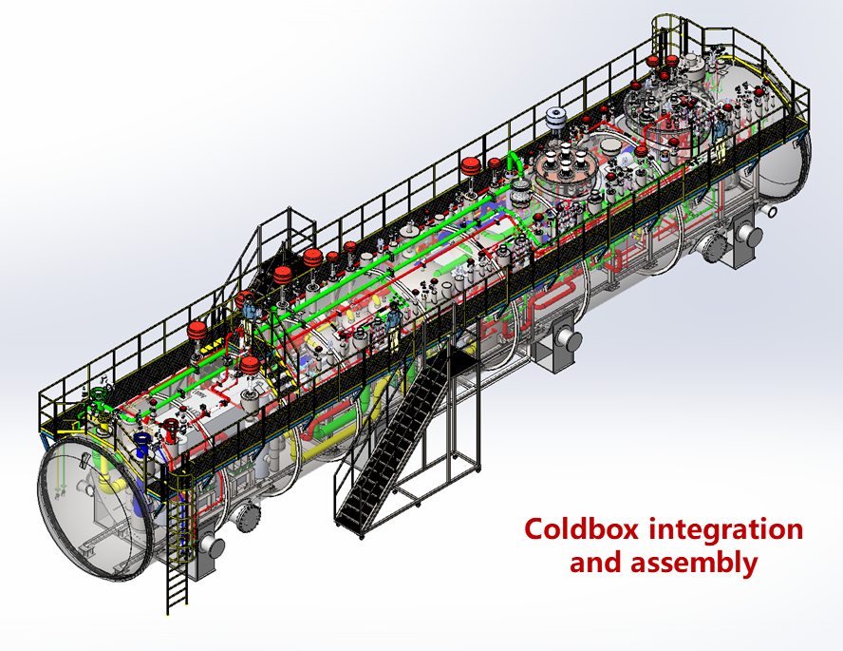
Large refrigerator Parameters
Parameters of the refrigerator
Large refrigerator
Other parameters | Precooled by Turbin expanders | Precooled by liquid nitrogen
The consumption of the Liquid Nitrogen | 0g/s (0L/h) | 428.7g/s(2043L/h)
Gas flow for precooling | 100g/s | 0g/s
Gas flow（g/s） | 1668g/s | 1551g/s
Power Consumption（KW） | 3935.13 | 3721.3
中科院理化所&中山低温研究院万瓦级制冷机
Parameters of the cold compressor
Parameters | The high pressure compressor | The medium pressure compressor | The low pressure compressor
Gas flow (g/s)* | 1668.00 | 862.80 | 230.7
Pressure of the inlet (bara) | 4.05 | 1.05 | 0.40
Pressure of the outlet (bara) | 18.54 | 4.05 | 1.05
Adiabatic efficiency （%） | 85 | 85 | 85
Power consumption (kW) | 2568 | 1155 | 196.3

Slide 27
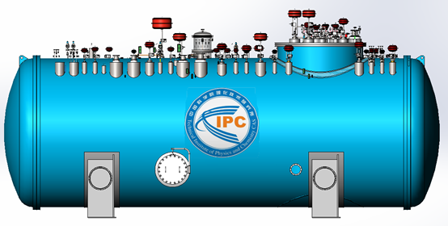
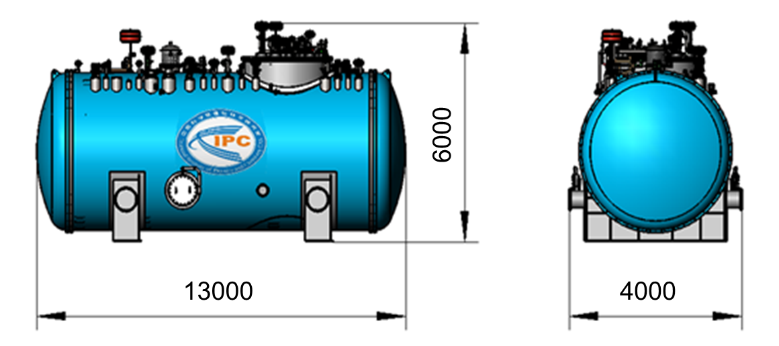
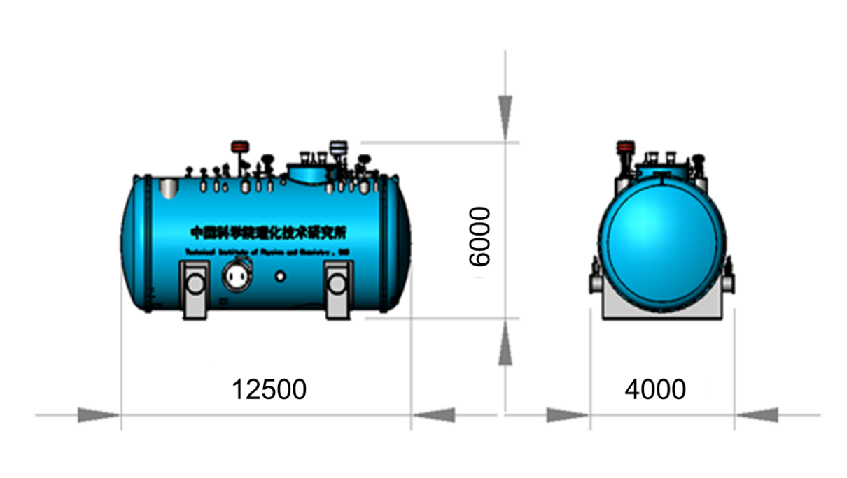
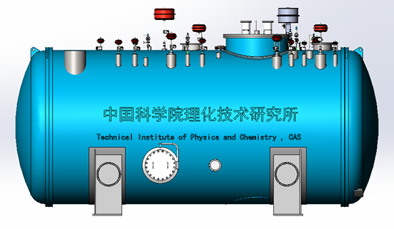
Large refrigerator Mechanical Design
a) 4K coldbox
b) 2K coldbox

Slide 28
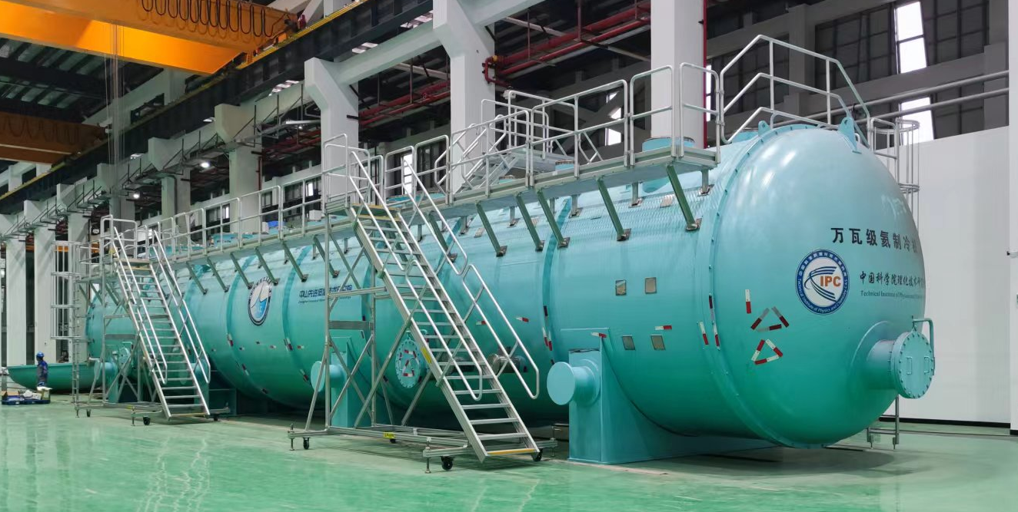
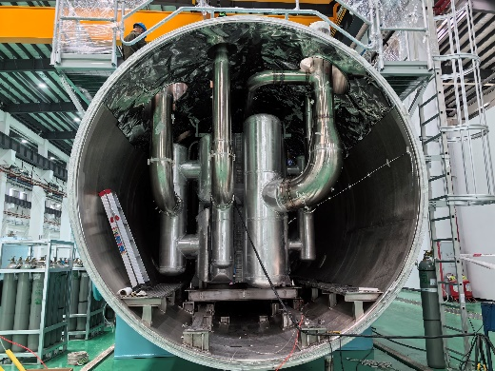
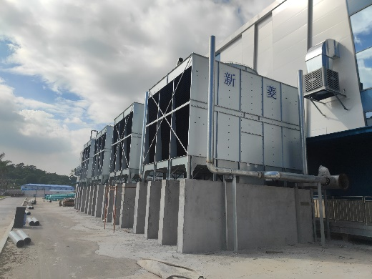
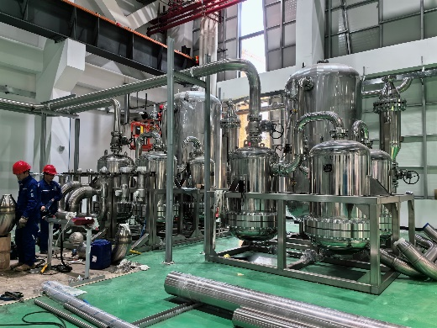
Large refrigerator Assembling
万瓦级氦制冷机
中科院理化所&中山低温研究院万瓦级制冷机
进展：
1、已完成所有部件研制；
2、已完成冷箱撬装研制；
2、正在同步开展冷箱整体集成及公用工程施工；
目标：
2024年5月底完成冷箱研制；
2024年11月底前完成整机调试，全面达到预期指标。

Slide 29
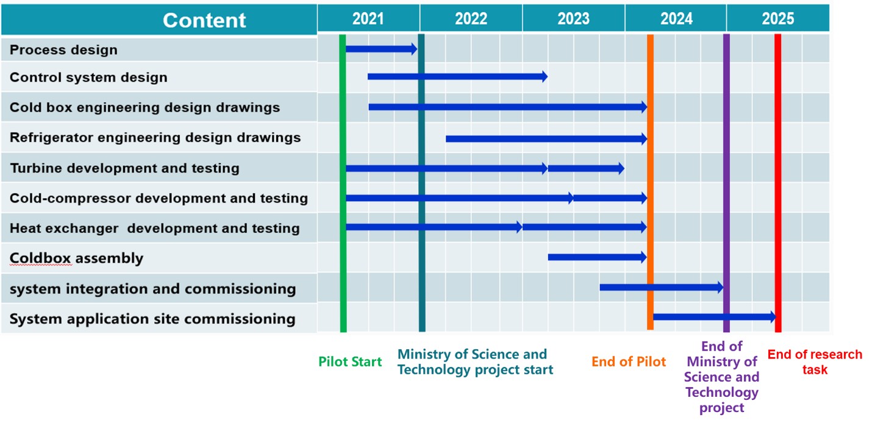
Large refrigerator Plan by FULLCRYO

Slide 30
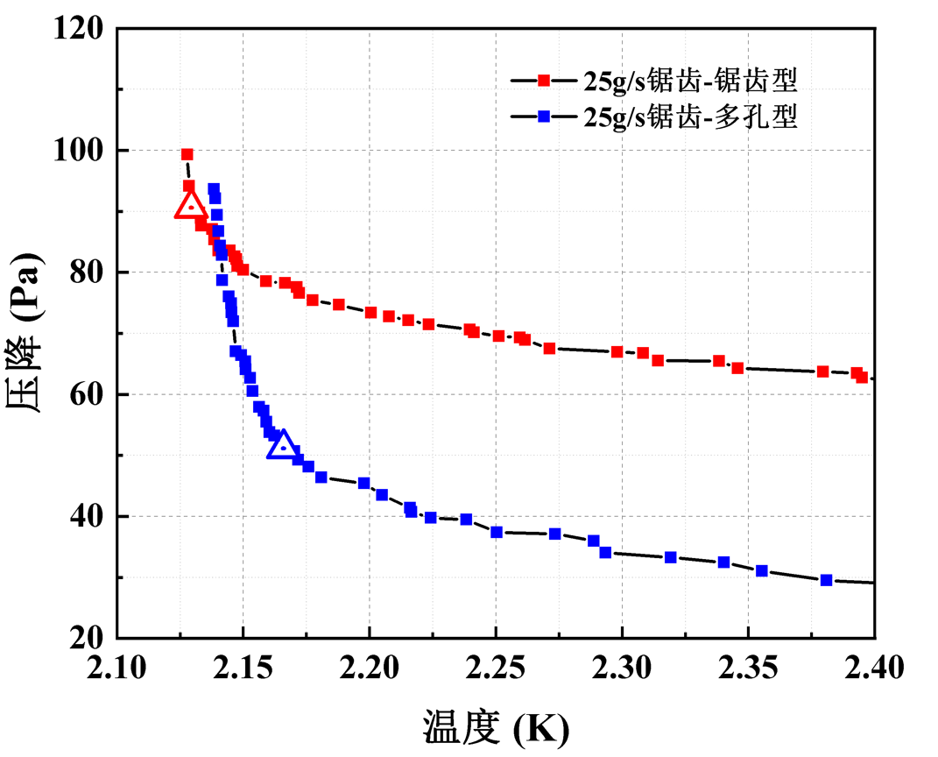
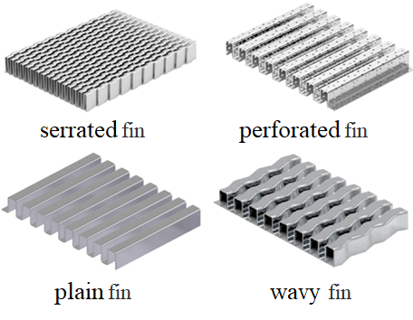















KW JT heat exchanger
JT heat exchanger is an indispensable component in the 2K cryogenic system. According to our experience, it is demonstrated that an efficient HX can increase the liquid helium concentration from 62% to 89% after the JT valve.
For CEPC, there are 4 cryo-stations with the cooling capacity 2kW@2K, so we need 4 JT heat exchanger with the larger mass flow rate.
2022.05-2022.10 Basic Design and Optimization.
NSGA-II Optimization
Designing & Verification
CFD Designing Reslut
Notes:
Next, I will introduce another key technology--the 2K JT HX. JT heat exchanger is an indispensable component in the 2K cryogenic system. According to our experience, it is demonstrated that an efficient HX can increase the liquid helium concentration from 62% to 89% after the JT valve.
For CEPC, there are 4 cryo-stations with the cooling capacity 2kW@2K, so we need 4 JT heat exchanger with the larger mass flow rate. The kilo-watt scale heat exchanger project began in 2022.

Slide 31






KW JT heat exchanger
2022.10-2023.05 Manufacturing and Quality Detection.
Checking Thickness
Before Brazing
Build Up
Leakage Detection
After Product

Slide 32



KW JT heat exchanger
2023.06-2024.12 Cryogenic experiment design and similarity experiment design.
The similarity experiment has completed in 2024.1
and cryogenic experiment will hold in 2024.12
Similarity Experiment Dewar
and Inner structure

Slide 33
Digital Cryogenic System
Research Target
Establish a complete digital twin for the cryogenic system of CEPC, and enhance the digitalization, automation, and intelligence level of the cryogenic system.
The digital cryogenic system is an essential component of the virtual accelerator and will play a role in various stages of equipment design, manufacturing, optimization, and operation.
It enables more efficient and faster simulation, more precise measurement and evaluation, more effective optimization and control, as well as accurate prediction and fault diagnosis.

Slide 34



Digital Cryogenic System
Background: Why do we need to carry out this research?
In line with the trend of international development, CERN/ ESS/ DESY and other institutions have carried out work related to digital cryogenic systems.
Better and faster simulation, monitoring, evaluation, prediction, optimization and control of large and complex CEPC cryogenic systems.
Consistent with dual-carbon strategy, intelligent manufacturing, AI4Science and other national science and technology development requirements.
ESS Cryoplant Dynamic simulation
Y Chao et al 2022 IOP Conf. Ser.: Mater. Sci. Eng. 1240 012071
Dynamic simulations of the HL-LHC cryogenic
https://doi.org/10.1016/j.cryogenics.2020.103214
加速器中心低温组

Slide 35

Digital Cryogenic System
Background: Why do we need to carry out this research?
Currently, most digital work is still at Level 0, with some research being conducted on L1 and L2.
Digital Twin Technology Maturity

Slide 36

Digital Cryogenic System
Research Contents: What works need to do?
Numerical simulation: Develop high-precision, fast dynamic simulation methods for key components of cryogenic systems to achieve real-time online operation.
Automatic control: Implement advanced control methods such as model predictive control based on online computational results to improve the automatic control accuracy of critical cryogenic equipment.
Data fusion: Quantify the uncertainty of measurement and simulation data, and reduce overall uncertainty through data fusion methods.
Optimized design: Develop automatic optimization criteria and methods to achieve online parameter calibration and data assimilation, improving the accuracy of numerical models.
Fault prediction and diagnosis: Reduce overall failure rates and shorten fault recovery time.
PE: Physical Entity
VE: Virtual Entity
DD: Digital Data
Ss:Support Service
Cn: Connection
Five-dimension model for the Digital Twin Model
DOI: 10.1109/TII.2018.2873186

Slide 37

Digital Cryogenic System
Methods / Key Technology: How to do?
For CEPC digital cryogenic system
High-precision surrogate models
Advanced control methods research
Data fusion framework and data fusion methods
Application of AI algorithms for online optimization and design optimization
Technologies and Tools in Digital Modeling
https://doi.org/10.1016/j.jmsy.2022.06.015

Slide 38


Digital Cryogenic System
Research Foundation
In this research field:
1 national natural science foundation general project, 2 youth projects, 2 Xie Jialin funds;
10+ SCI papers;
2 Invention patent;
2022.01-2025.12 No.12175250. Dynamic simulation modeling and advanced process control strategies for large helium cryogenic system of superconducting accelerator.
2020.01-2023.12 No.11905230. Study on Flow and Heat Transfer Mechanism and Automatic Control Technology in Superconducting Cavity Cooling Process
2021.01-2024.12 No.12005237. Research on the coupling mechanism and simulation method of multiple physical fields for power input coupler
2022.01-2023.12 XieJialing Fund. Research on key technologies of digital twin for superconducting accelerator cryogenic system
2024.04-2026.04 XieJialing Fund. Online optimization method for dynamic simulation model of large-scale cryogenic system based on reinforcement learning
https://doi.org/10.1016/j.applthermaleng.2022.118178 (Q1,IF 6.4)
https://doi.org/10.1016/j.applthermaleng.2023.120767 (Q1,IF 6.4)
https://doi.org/10.1016/j.tsep.2023.102007 (Q1, IF 4.8)
https://doi.org/10.1016/j.tsep.2021.101100 (Q1, IF 4.8)
https://doi.org/10.1016/j.cryogenics.2024.103824 (Q3, IF 2.1)
https://doi.org/10.1016/j.applthermaleng.2023.119973 (Q1, IF 6.4)
…
Configuration interface for virtual cryogenic system
(Valve box and cryomodule in HEPS)

Slide 39
Digital Cryogenic System
经费预算及计划
序号 | 分项名称 | 新建/改造内容 | 数量 | 单位 | 综合单价(万元) | 总价 (万元) | 其它
1 | 设备改造 | 含精密温度、压力、流量等传感器及二次仪表 | 1 | 套 | 80 | 80
2 | 数字化低温控制系统搭建 | 含服务器及控制网络搭建 | 1 | 套 | 60 | 60
3 | 低温测试 | 耗材及技术服务费 | 4 | 次 | 20 | 80
总计（万元） |  |  |  |  |  | 220
因为缺少固定的实验和测试平台，拟以千瓦级2K低温换热器测试平台为研究对象，并进行相应的改造，初步形成数字化低温测试平台。
经费预算及计划
2024年完成低温测试平台及控制网络搭建，完成数字模型和程序代码设计。
2025年完成2-3次低温实验，形成初步成果。

Slide 40

千/万安培高温超导二元电流引线及其测试台研制
研究背景
超导磁体电流引线整体上是高能所薄弱环节之一，实际工程项目出现较多问题
需求，CEPC超导螺线管磁体需要研制20 kA级别的电流引线；CEPC超导插入四极磁体需要研制2kA级别的电流引线；
传统的一元纯铜引线远不能满足要求，当前可行的解决方案是采用基于高温超导的二元电流引线；
其中的冷源选取、冷却方式、高效换热和低温热负荷优化等问题需要结合CEPC冷源具体研究；
同时，超导线焊接电阻优化、失超安全防护和低温绝缘等问题，需要开展工艺试验；
当前，所内本方面实验条件较为薄弱，即使小电流引线，仅物理设计工作可在所内完成，制作、测试工作均借助外协单位实验条件开展，效率较低；
为此，设计搭建一套多功能引线测试台，并研发测试一对2kA级别的电流引线满足MDI磁体要求，是迫切解决的问题。
BⅡ一元电流引线（1kA）
德国KIT研制20 kA二元电流引线

Slide 41


千/万安培高温超导二元电流引线及其测试台研制
二元电流引线
高纯无氧铜
高温超导+分流器
低温超导
氦气冷却3kA高温超导二元电流引线初步示意图
初期基于Bi-2223高温超导体和高纯铜材料，制作一对3 kA量级的液氮或氦气冷却的二元电流引线；
借助数值仿真计算，兼顾载流能力和冷却经济性，对铜段冷却进行强化换热方案设计；
研究当前电流引线普遍存在的结露、结霜问题，探索引线的固有无霜属性或者主动室温控制方式；
研究冷源多样设计，例如传导冷却、低温氦气冷却、液氮冷却等方式。
新型翅片冷却设计
引线测试平台
最大适配20 kA量级二元电流引线的低温测试；
具备液氮供应的接口，可以连接移动杜瓦；
具有储存和气化氦气模拟氦池；
可以完成氦气流量的精确控制；
具备安装小型制冷机安装口，可以实现氦液化；
具备真空筒体，将冷质量置于其中，进行隔热；
具备引线安装塔，预留引线位置、信号线出口。
具备测控系统，采集引线低温接头处、氦池内引线、常温接头、氦池等温度，采集氦池液位、压力，设置加热器，设置常温流量控制器，液氦回收或排空；

Slide 42
千/万安培高温超导二元电流引线及其测试台研制
经费预算
序号 | 项目 | 初步参数 | 数量 | 成本/万
1 | 二元电流引线样品 | Bi2223，高纯铜RRR>40，3-4 KA | 1对 | 40
2 | 引线外管 | 不锈钢316L，适配多接口 | 1对 | 2
3 | 测试台非标制作 | 真空室、多功能法兰、管路、氦池、导冷带、排放管 | 1套 | 70
4 | 温度传感器 | 液氮温区10个，液氦温区7个，配二次仪表 | 17个 | 15
5 | 流量控制器 | 0-300SLM控制 | 2个 | 4
6 | 压力变送器 | 液氮路和液氦路进出口位置 | 4个 | 1
7 | 加热器 | 配高功率电源 | 1个 | 1
8 | 液面计 | 液氦温区4.2K，配二次仪表 | 1个 | 3
9 | 控制阀门 | 卡套球阀，低温阀门，减压阀等 | 6个 | 1
10 | 测控系统 | 压力、温度、流量、液位、真空采集，流量、加热器等控制 | 1套 | 10
11 | 液氮杜瓦 | 250L | 1个 | 3.5
12 | 低温传输管 | 非标定制 | 6米 | 5
13 | 水冷机组 | 冷热一体 | 1台 | 2
14 | 失超保护系统 | 失超检测和保护 | 1台 | 8
15 | 直流电源 | 3000A | 1台 | 30
总 计 |  |  |  | 195.5

Slide 43
人员安排
葛锐：系统负责人
李梅：流程设计
徐妙富：低温恒温器
常正则、：数字化低温系统
朱柯宇：千瓦级换热器
张祥镇：超导磁体电流引线
姜永诚、杨啸辰：布局设计
桑民敬、叶瑞：低温控制系统
张卓：氦气回收纯化
孙良瑞：平台运行维护

Slide 44
summary
低温系统EDR阶段主要工作内容主要包括：优化系统设计、完善整体布局、开展关键设备和技术的研究，并给出相应时间计划。
EDR阶段所需经费分为三个部分：650MHz超导模组低温测试平台建设，600万元；数字化低温系统研究，220万元；超导磁体电流引线测试平台，200万元；总计1020万元。
Thanks for Your Attention！

Slide 45









Green Particle Accelerator：issues and challenges
China is reducing energy pollution, promoting green accelerator and boosting unit energy GDP (China dual carbon strategy: achieve peak CO2 emissions before 2030 and carbon neutrality before 2060)
Huge energy is needed for modern large colliders such as LHC, ILC, CEPC…
Huge energy means huge cost and huge pollution.
LCLSII 照片
功率 200MW
LHC 照片
功率 200MW
APS 照片
功率 125MW
LHC
Power 200MW
APS
Power 125MW
LCLSII
Power 200MW
Super KEKB
Power 90MW
BEPCII 照片
功率 ？MW
上海光源 照片
功率 ？？W
CiADS 照片
功率 7MW
HEPS
Power 38MW
BEPCII
Power 6.5MW
SSRF
Power 10MW
CiADS
Power 7MW
HEPS 照片
功率 ？MW
Saving power=lower pollution=lower operation cost

Slide 46


CEPC waste heat recovery/reuse requirements
CEPC Higgs 30MW power consumption power is about 262MW*, according to 8,000 hours of operation annual power consumption will be as high as 2,096 GWh (about 2.1 billion yuan electricity);
The CEPC collision ring has 16 cooling water circuit sites with a cooling water circuit heat load of 221MW**.
The cooling water system comprises a low-conductivity water (LCW) closed-loop circuit, a cooling tower water (CTW) circuit, and a deionized water make-up system.
LCW system absorbs heat from the various accelerator equipment, which is transferred through a heat exchanger to the cooling water circuit CTW, and finally taken away by the cooling water system;
TDR report **P851
TDR report *P973

Slide 47
Possible solutions for CEPC waste heat reuse

Slide 48






Advantages of AHP
Recovering 14MW waste heat from 1 site (221MW/16 sites);
Two different schemes:
Photovoltaic (PV) to power → electric driven heat pumps (EDHP)
Photovoltaic (PV) to heat → absorption heat pumps (AHP)
Conclusion:
For the same recovery of 14MW of waste heat, the PV → AHP solution requires 25% less solar energy than the PV →providing 50% more heating energy
A smaller initial investment for a larger gain.
required solar energy
heating supply capacity
What is the efficiencies difference between PV to power and PV to heat?
(1) PV to power → EDHP:
EDHP
Required PV energy to power:
$W_{E}=\frac{Q_{W}}{COP_{\text{ED}\text{HP}}−1}=\frac{\text{1}\text{4}\text{MW}}{3−1}=7\text{MW}；COP_{\text{CHP}}$ is the coefficient of performance of EDHP
$$\text{PV}\text{→}\text{power}\text{→}\text{heat}$$
$$\text{15\%} \text{∗} \text{3} \text{=} \text{45\%}$$
Required solar energy：
$W_{S}=\frac{W_{E}}{η_{\text{PV}}}=\frac{\text{7}\text{MW}}{15\%}=46.67MW,η_{\text{PV} }$is the coefficient of solar photovoltaic efficiency
1
2
AHP
heating supply capacity:
$$Q_{S}=Q_{W}+W_{E}=14\text{MW}+7\text{MW}\text{=}\text{21}\text{MW}$$
$$\text{PV}\text{→}\text{PV} \text{heat}\text{→}\text{heat}$$
$$\text{50\%} \text{∗} \text{1.8} \text{=} \text{90\%}$$
(2) PV to heat → AHP:
Required PV energy to heat:
$Q_{H}=\frac{Q_{W}}{COP_{\text{AHP}}−1}=\frac{\text{14}\text{MW}}{1.8−1}=17.5\text{MW}$， COP_{AHP} is the coefficient of performance of AHP
3
4
GB/T 39857-201
GB/T 18430
GB/T 17581-2021
GBT 34620-2017
Required solar energy：
$W_{S}=\frac{Q_{H}}{η_{\text{PT}}}=\frac{\text{17.5}\text{MW}}{50\%}=35\text{MW}$； $η_{\text{PT}}$ is the PV to heat efficiency
heating supply capacity:
$$Q_{S}=Q_{W}+Q_{H}=14\text{MW}+17.5\text{MW}\text{=}\text{31.5}\text{MW}$$

Slide 49
Energy efficiency and economic analysis--CEPC project
Waste heat power：221MW; Waste heat capacity：636.5GWh
Refrigeration power：197MW; Refrigeration capacity：985GWh
Preliminary evaluation: Using absorption CHP can save 477 million yuan/year; total investment of the project is 1.18 billion yuan;;
the static recovery cycle is 2-3 years. Detailed calculation is under going on.
Parameter | Winter-value
Total waste heat + PV heat capacity | 1145.7GWh
Total heating capacity | 1909.5GWh
Total heating area* | 13.26 million m²
Reduce natural gas consumption** | 114.57 million standard m³
Save natural gas cost/¥ | 344 million
parameter | Summer-value
Total refrigeration capacity | 985GWh
natural gas consumption | 73.8 million standard m³
natural gas cost | 148 million
Save electricity power | 351.8GWh
Save power cost | 281 million
Reduced operating costs | 133 million
Item | Cost value（100 million）
Core equipment investment (absorption CHP units) | 6.8
Auxiliary equipment investment (solar thermal collectors, etc.) | 2.3
installation | 1.2
Pipe network renovation and construction | 0.7
other | 0.8
sum | 11.8
Winter (heating):
Natural gas price：3CNY/m³
Heating supply efficiency：1.5
Heat supply period：2880（4Ms）
Waste heat power：221MW
Waste heat capacity：636.5GWh
Summer (cooling):
Natural gas price：2CNY/m³
Refrigeration efficiency：0.8
Refrigeration period：5000h（~7Ms）
Refrigeration power：197MW
Refrigeration capacity：985GWh
*Heating power per unit of building area: 50 w/m²
**Calorific value of natural gas: 36000 kJ/m³
Notes:
供暖工况：供热效率为1.5=（燃气+光热+余热）/（燃气+光热）=（0.6+0.4+0.5）/(0.6+0.4)，意味着回收0.5份余热消耗1份驱动热(余热+光热)来供应1.5份热，余热+光热总量=636.5*（0.4+0.5）/0.5=1145.7GWh；总供暖量为余热回收量的3倍；单位建筑面积供暖功率为50w/m2，可以得到总供暖面积=（1909.5/2880)/50*10^9/10000=1326万平方米；天然气热值按照36000kJ/m3，可得：减少燃气消耗=余热+光热总量÷天然气热值=1145.7*10^9*3600/(36000*10^3)/10000=11457万标方；节约燃气成本用燃气标方*价格就可以
制冷工况：吸收式制冷效率为0.8意味着消耗1份驱动热能获得0.8份冷量，因此天然气燃烧热=制冷总量÷0.8*0.6=985/0.8*0.6，738.8GWh，天然气热值按照36000kJ/m3，天然气消耗量=天然气燃烧热÷天然气热值=738.8*10^9*3600/(36000*10^3)/10000=7380万标方，燃气成本7380*10000*2/10^8=1.48亿元；电驱压缩式制冷效率按照2.8，耗电量=制冷总量÷2.8=351.8GWh，工业用电0.8元/kWh，节约电成本=351.8*10^6*0.8=2.81亿元。

