Slide 1



CEPC final focus superconducting magnet and cryomodule EDR plan
Yingshun Zhu, Miaofu Xu
On behalf of CEPC MDI SC magnet research team
3.15 2024, CEPC Day

Slide 2
Content
Component
Design requirement
Status
EDR plan

Slide 3
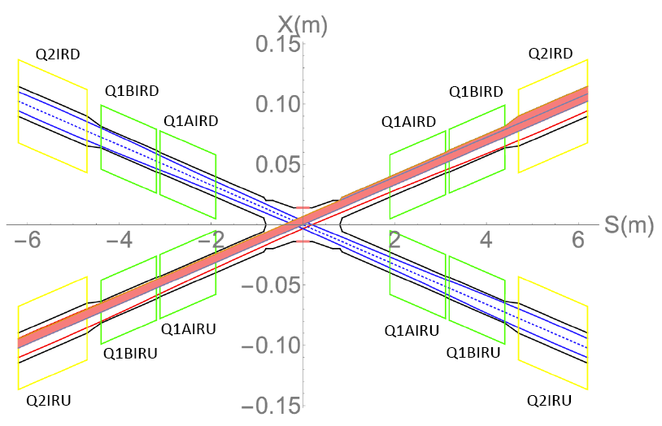
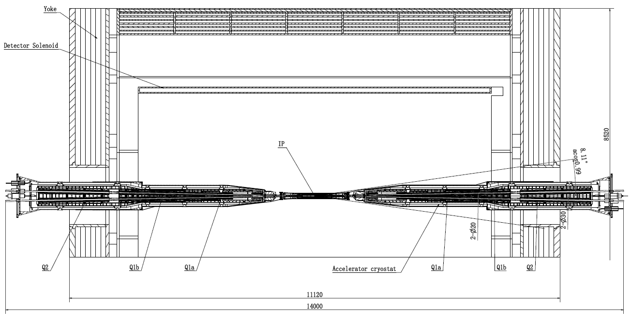
Component
In CEPC, there are a total of 4 combined-function Superconducting magnets in MDI
One combined-function magnet includes
Double aperture quadrupole (Q1a, Q1b, Q2) (final focus the beam)
Anti-solenoid (cancel detector solenoid field)
Cryomodule (provide cryogenic environment for sc coils)

Slide 4
Design requirement
Design requirement comes from both Accelerator and Detector
Optimization of SC magnets is on going (iterations with beam dynamics system)
Requirements of quadrupoles are based on L* of 1.9 m, beam crossing angle of 33 mrad
1) Strength requirement of CEPC Interaction Region quadrupole magnets
Magnet | Field gradient (T/m) |  |  |  | Magnetic length (m) | Width of GFR (mm) | Minimal distance between two aperture beam lines (mm)
 | tt | Higs | W | Z
Q1a | 142 | 142 | 95 | 110 | 1.21 | 14.92 | 62.71
Q1b | 64 | 85 | 57 | 65 | 1.21 | 18.17 | 105.28
Q2 | 51 | 96 | 64 | 0 | 1.5 | 24.48 | 155.11
2) Ratio of multipole field to quadrupole field ≤ 3×10⁻⁴
3) Integral of dipole field in one aperture center is zero
Local dipole field at longitudinal positions ≤300 Gs (跳动量)
From Detector background

Slide 5

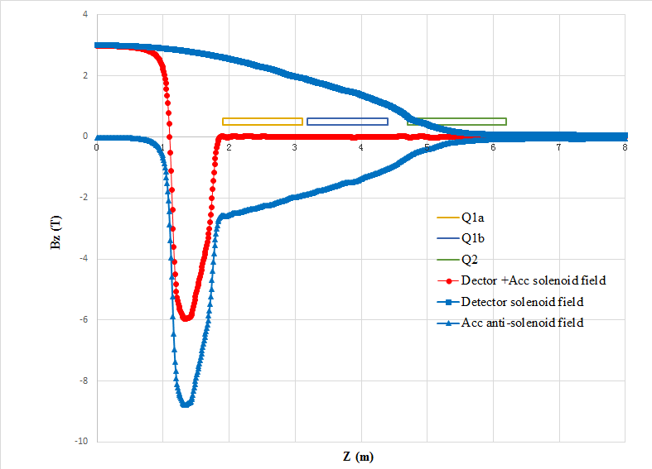
Design requirement
Design requirements of anti-solenoid:
1) The total integral solenoid field generated by the detector solenoid and anti-
solenoid coil is zero
2) The solenoid field inside Q1a, Q1b and Q2 should be smaller than a few
hundred Gauss at each longitudinal position
3) The distribution of total solenoid field along longitudinal direction should meet
the requirement of the beam optics for emittance
Anti-solenoid closely related to the Detector solenoid
4) Supported by cantilever, use compact magnet structure
and reduce weight

Slide 6
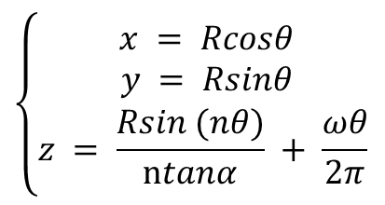
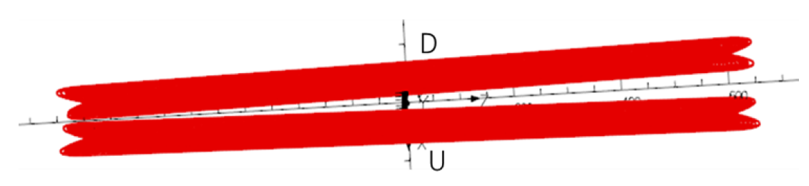
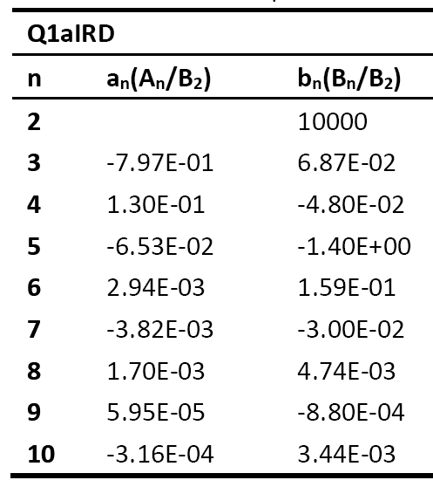
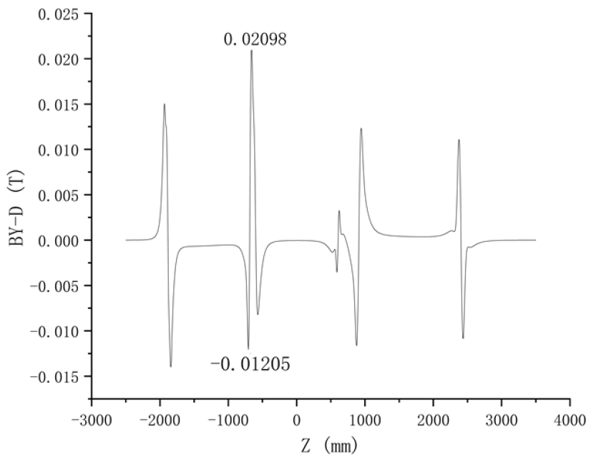
Status
Design Status of quadrupole magnets
1) Iron free CCT option (Canted Cos2θ)
Field cross-talk correction by changing the shape of conductor
Meet requirement of field strength and harmonics
Can not meet local dipole ≤300 Gs (跳动量)
Further optimization is needed
Field harmonics
Local dipole field after correction

Slide 7
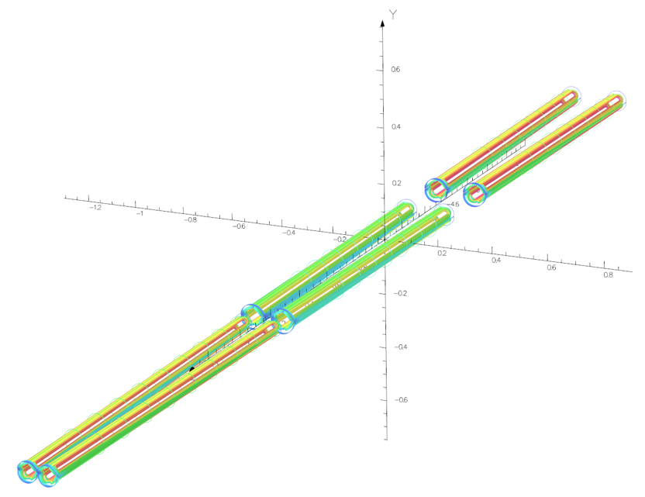
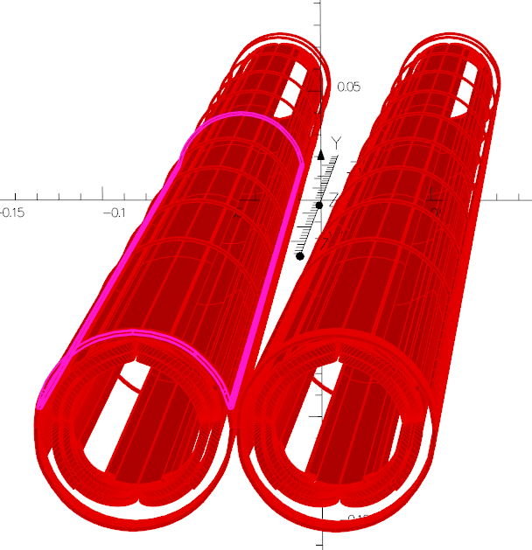
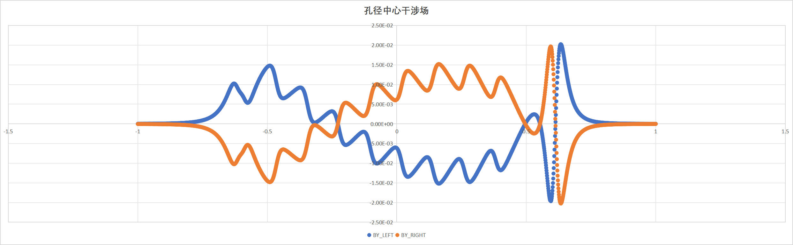
Status
Design Status of quadrupole magnets
2) Iron free Cos2θ option
Field cross-talk correction by adding corrector coil
Meet requirement of field strength and multipole field, can not meet local dipole ≤300 Gs (跳动量)
Further optimization is needed
Other option (etc, Serpentine with self correction) is under design
Local dipole field after correction

Slide 8
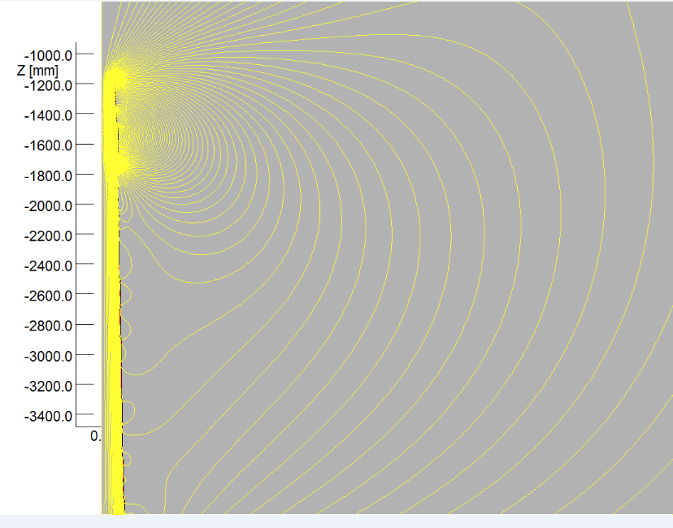
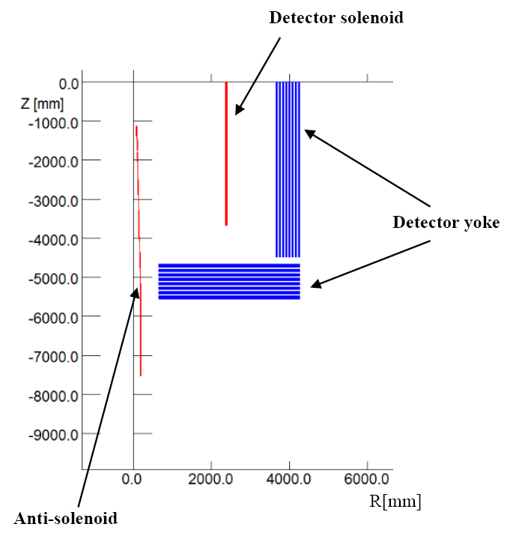
Status
Design Status of Anti-solenoid
In order to reduce magnet size, energy and cost, the anti-solenoid is divided into a total of 29 sections with different inner coil diameters
The Detector solenoid recently is updated
Anti-solenoid needs to be redesigned

Slide 9
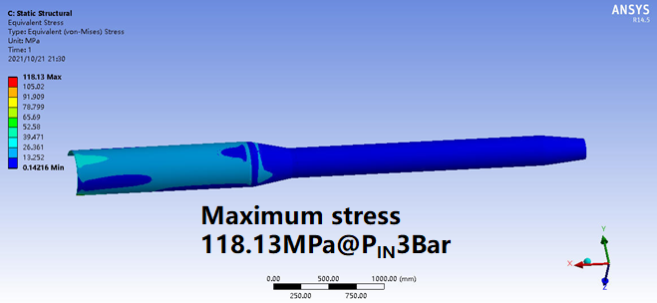
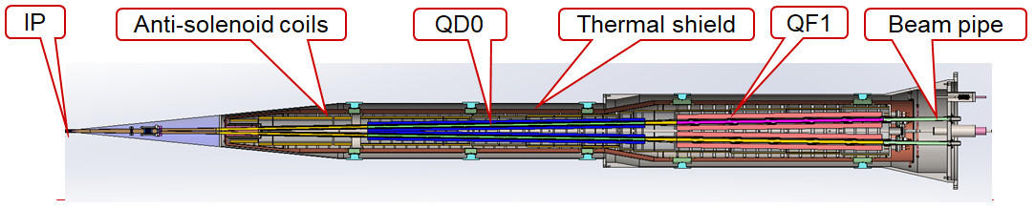
Status
Design Status of Cryomodule
Update the cryomodule according to the optimized design of the SC magnet
Optimal cooling scheme
Structure R@D and Heat load calculation
Initial consideration of processing and manufacturing technology

Slide 10
EDR plan
EDR goal:
Optimize and find good magnet design
meet all design requirements, innovative, technically achievable
Optimize the cryomodule design
Perform detailed magnetic field analysis, mechanical design and stress analysis, cryogenic analysis, quench analysis, etc
Complete the Engineering Design Report for superconducting magnets and cryomodule

Slide 11
EDR plan
EDR plan for SC magnets:
2024
Iteration and finalize design requirements for SC quadrupole magnets
Refined design and comparison of design options for quadrupole magnets (CCT, Serpentine, etc.)
Calculate magnet deformation on cantilever support
Update the design of anti-solenoid, optimize solenoid field distribution
2025
Detailed magnetic field analysis, mechanical design and stress analysis, quenching analysis
Finish full 3D magnetic field analysis with all MDI magnetic components together
Evaluate magnetic performance of each superconducting magnet (LTS/HTS)
2026
Summary of SC magnet design, main parameters, and magnetic field calculation results
Determination of magnet processing and manufacturing technology
Draft and revise the Engineering Design Report for superconducting magnets
Cost evaluation of CEPC MDI Superconducting magnets and cryomodule

Slide 12
EDR plan
EDR plan for cryomodule:
2024:
Update the design of the cryomodule
Heat load calculation
Flow field simulation analysis
2025:
Process scheme determination
Assembly process design
2026:
Machine-finishing technological design
Cryogenic performance test of critical component

Slide 13
EDR plan
Manpower for SC magnets:
Magnet design and magnetic field analysis, 3 persons
Mechanical design and analysis, 1 person
Quench analysis, 1 person
Magnet processing and manufacturing route, 1 person
Manpower for cryomodule:
Cryomodule design and manufacturing technology analysis, 2 persons
Cooling process analysis, 1person
Integrated assembly analysis, 1 person
Simulation analysis, 1 person

Slide 14
Thanks for your attention!

