Slide 1
Truly Conventional e⁺ Source for ILC
T. Omori (KEK)
29-Aug-2011
POSIPOL 2011 Beijing
Truly Conventional Collaboration
Wei Gai, Jie Gao, Shin-ichi Kawada, Wanming Liu, Natsuki Okuda,
Tsunehiko Omori, Guoxi Pei, Sabine Riemann, Tohru Takahashi,
Junji Urakawa, and Andriy Ushakov
Special Thanks to Takahashi-san:
About half of the slides are taken from Takahash-san's talk at ALCPG11

Slide 2
Target Issues
of
ILC e+ Source

Slide 3
Target Issues
Two Issues
• Heat Load (by beam): Time Scale ~ 1 m sec.
• Thermal shock wave: Time scale ~ sub micro sec.

Slide 4
Target Issues
Two Issues
• Heat Load (by beam): Time Scale ~ 1 m sec.
• Thermal shock wave: Time scale ~ sub micro sec.
• Undulator Scheme (base line)
• In order to create e+s, it uses e- beam in the main linac.
• It creates 2600 bunches of e+s in 1 m sec.
• Heat load is a serious problem.
• It requires a challenging rotation target (100 m/s).
(spreads 2600 bunches in 100 mm length)

Slide 5
Target Issues
Two Issues
• Heat Load (by beam): Time Scale ~ 1 m sec.
• Thermal shock wave: Time scale ~ sub micro sec.
• Undulator Scheme (base line)
• In order to create e+s, it uses e- beam in the main linac.
• It creates 2600 bunches of e+s in 1 m sec.
• Heat load is a serious problem.
• It requires a challenging rotation target (100 m/s).
(spreads 2600 bunches in 100 mm length)
• 300 Hz Truly Conventional
• It creates 2600 bunches of e+s in 63 m sec. (stretching)
• Heat load is not a problem.
• Do we have a solution? Issue : shock wave

Slide 6
300 Hz scheme
e+ generation in 63 m sec (cf. undulator : in 1 m sec)

Slide 7
How?
• Total Number of bunches: 2640
• Divide into 20 triplets
(1 Triplet = 3 Mini-Trains)
• Each triplet contains 132 bunches
• 2640 = 20 x 132
• 300 Hz creation of triplets
triplet to triplet time space = 3.3 m sec
• Create 20 triplets : 63 m sec
Stretching in time

Slide 8
Conventional e+ Source for ILC
Normal Conducting Drive and Booster Linacs in 300 Hz operation
e+ creation
go to main linac
20 triplets, rep. = 300 Hz
• triplet = 3 mini-trains with gaps
• 44 bunches/mini-train, T_{b_to_b} = 6.15 n sec
2640 bunches/train, rep. = 5 Hz
• T_{b_to_b} = 369 n sec
Drive Linac
Several GeV
NC
300 Hz
Booster Linac
5 GeV
NC
300 Hz
DR
Target
T_{b_to_b} = 6.15 n sec
Crystal / Amorphous Hybrid
or
Liquid Lead
or
Amorphous Tungsten
2640 bunches
60 mini-trains
Time remaining for damping = 137 m sec
We create 2640 bunches
in 63 m sec
Notes:
8

Slide 9
Conventional e+ Source for ILC
Normal Conducting Drive and Booster Linacs in 300 Hz operation
e+ creation
go to main linac
20 triplets, rep. = 300 Hz
• triplet = 3 mini-trains with gaps
• 44 bunches/mini-train, T_{b_to_b} = 6.15 n sec
2640 bunches/train, rep. = 5 Hz
• T_{b_to_b} = 369 n sec
Drive Linac
Several GeV
NC
300 Hz
Booster Linac
5 GeV
NC
300 Hz
DR
Target
T_{b_to_b} = 6.15 n sec
Crystal / Amorphous Hybrid
or
Liquid Lead
or
Amorphous Tungsten
2640 bunches
60 mini-trains
Time remaining for damping = 137 m sec
We create 2640 bunches
in 63 m sec
Stretching
Notes:
9

Slide 10
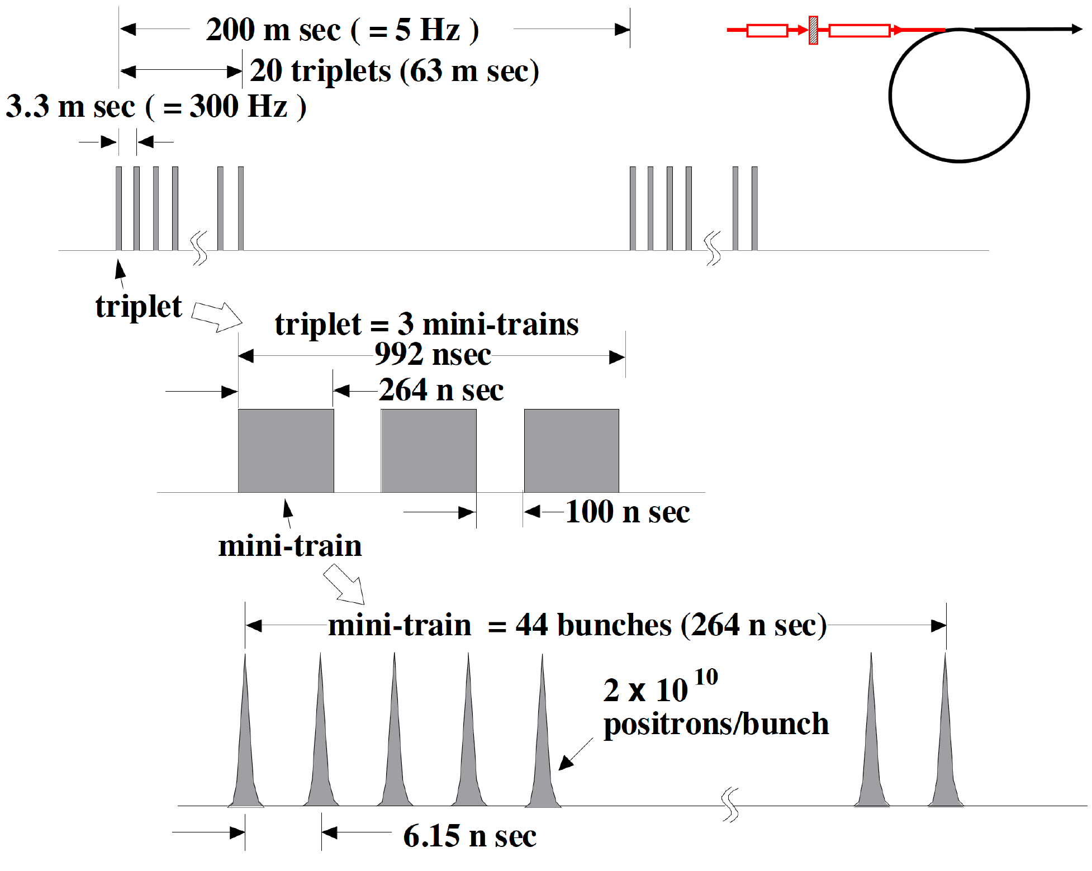
Beam before DR
<-- the 100 ns gap is required to cure
an e- cloud problem in e+ DR.

Slide 11
Beam before DR
Injection: usual kicker ( ~ 1 us)
no stacking is necessary
<-- the 100 ns gap is required to cure
an e- cloud problem in e+ DR.

Slide 12
Conventional e+ Source for ILC
Normal Conducting Drive and Booster Linacs in 300 Hz operation
e+ creation
go to main linac
20 triplets, rep. = 300 Hz
• triplet = 3 mini-trains with gaps
• 44 bunches/mini-train, T_{b_to_b} = 6.15 n sec
2640 bunches/train, rep. = 5 Hz
• T_{b_to_b} = 369 n sec
Drive Linac
Several GeV
NC
300 Hz
Booster Linac
5 GeV
NC
300 Hz
DR
Target
T_{b_to_b} = 6.15 n sec
Crystal / Amorphous Hybrid
or
Liquid Lead
or
Amorphous Tungsten
2640 bunches
60 mini-trains
Time remaining for damping = 137 m sec
We create 2640 bunches
in 63 m sec
Notes:
12

Slide 13
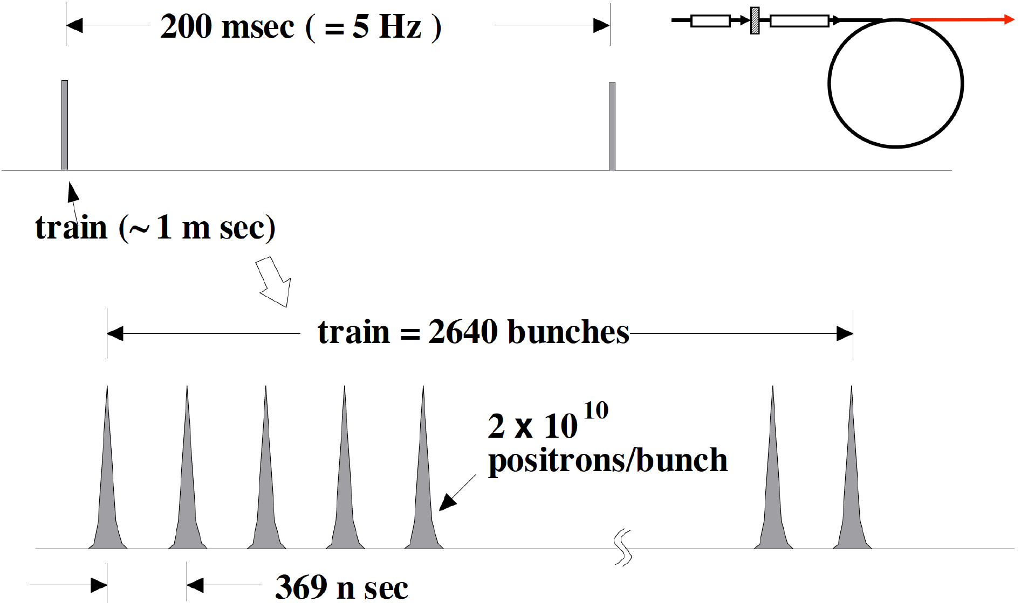
Beam after DR

Slide 14
Beam after DR
Extraction:
fast kicker ( 3 ns kicker: Naito kicker)
the same as the baseline

Slide 15
300 Hz scheme
• Stretching in time

Slide 16
300 Hz scheme
• Stretching in time
• The Same as Warm colliders
NLC 120 Hz
GLC 150 Hz
CLIC 50 Hz

Slide 17
Conventional e+ Source for ILC
Normal Conducting Drive and Booster Linacs in 300 Hz operation
e+ creation
go to main linac
20 triplets, rep. = 300 Hz
• triplet = 3 mini-trains with gaps
• 44 bunches/mini-train, T_{b_to_b} = 6.15 n sec
2640 bunches/train, rep. = 5 Hz
• T_{b_to_b} = 369 n sec
Drive Linac
Several GeV
NC
300 Hz
Booster Linac
5 GeV
NC
300 Hz
DR
Target
T_{b_to_b} = 6.15 n sec
Crystal / Amorphous Hybrid
or
Liquid Lead
or
Amorphous Tungsten
2640 bunches
60 mini-trains
Time remaining for damping = 137 m sec
We create 2640 bunches
in 63 m sec
Stretching
Notes:
17

Slide 18
300 Hz scheme
• Stretching in time
• The Same as the Warm colliders
NLC 120 Hz
GLC 150 Hz
CLIC 50 Hz
Employs 3-4 targets
Thermal Shockwave

Slide 19
300 Hz scheme
• Stretching in time
• The Same as the Warm colliders
NLC 120 Hz
GLC 150 Hz
CLIC 50 Hz
Employs 3-4 targets
Thermal Shockwave
• We try to employ single target.
Crystal / Amorphous Hybrid
or
Liquid Lead
or
Amorphous Tungsten

Slide 20
300 Hz scheme
• Stretching in time
• The Same as the Warm colliders
NLC 120 Hz
GLC 150 Hz
CLIC 50 Hz
Employs 3-4 targets
Thermal Shockwave
• We try to employ single target.
Crystal / Amorphous Hybrid
or
Liquid Lead
or
Amorphous Tungsten
Today's talk
Just solid tungsten target is OK
with slow rotation.
Truly Conventional

Slide 21
Conventional e+ Source for ILC
Normal Conducting Drive and Booster Linacs in 300 Hz operation
e+ creation
go to main linac
20 triplets, rep. = 300 Hz
• triplet = 3 mini-trains with gaps
• 44 bunches/mini-train, T_{b_to_b} = 6.15 n sec
2640 bunches/train, rep. = 5 Hz
• T_{b_to_b} = 369 n sec
Drive Linac
Several GeV
NC
300 Hz
Booster Linac
5 GeV
NC
300 Hz
DR
Target
T_{b_to_b} = 6.15 n sec
Crystal / Amorphous Hybrid
or
Liquid Lead
or
Amorphous Tungsten
2640 bunches
60 mini-trains
Truly Conventional
Time remaining for damping = 137 m sec
We create 2640 bunches
in 63 m sec
Notes:
21

Slide 22
Target and Drive_Beam
Optimization for
Truly Conventional
e+ Source

Slide 23
Target & Drive_Beam Optimization
Conventional e+ sources
thermal load,
shock wave
used to be
Well established
300Hz scheme
e+ gen. in 60ms rather than 1ms
targets
relax thermal
problem for
increase survivability w/
slow rotation targets
worth while
looking into
feasibility again
Capture section
larger aperture for RF section
larger acc. gradient

Slide 24
Method
EM shower simulation
e+ capture efficiency
e+ yields
Peak Energy Deposit Density (PEDD)
total energy deposit
# of e+ in the Damping Ring
+
Empirical formula by CLIC note 465
Geant 4
EM shower and particle tracking w/ Geant 4

Slide 25
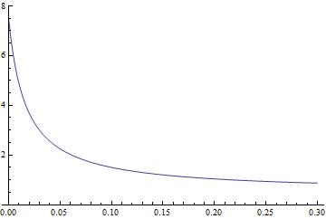
Parameters in capture section 300Hz scheme w/ slow rotation target ～ CLIC
target
AMD
RF section
Bz(T)
Z(m)

Slide 26
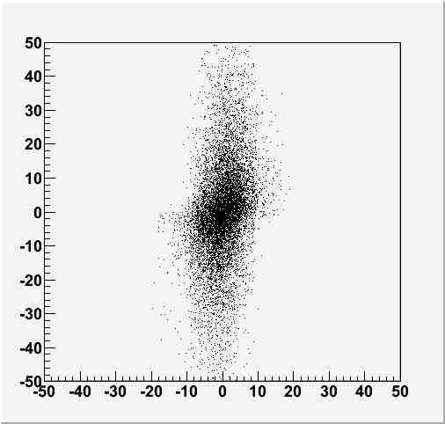
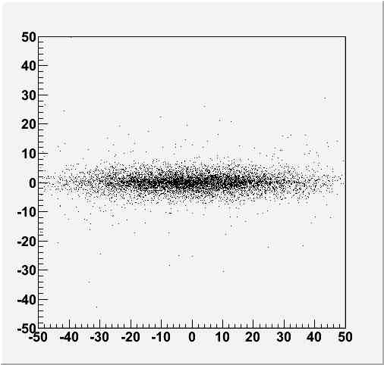
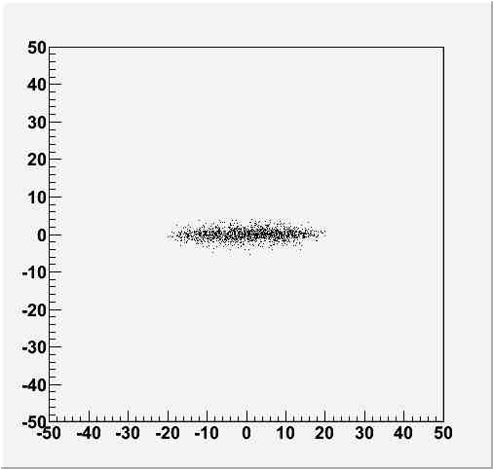
Simulation: Transeverse phase space
AMD Entrance
AMD exit
γx’
γx’
x(mm)
RF exit
DR transverse acceptance :
fron RDR
γx’
x(mm)

Slide 27
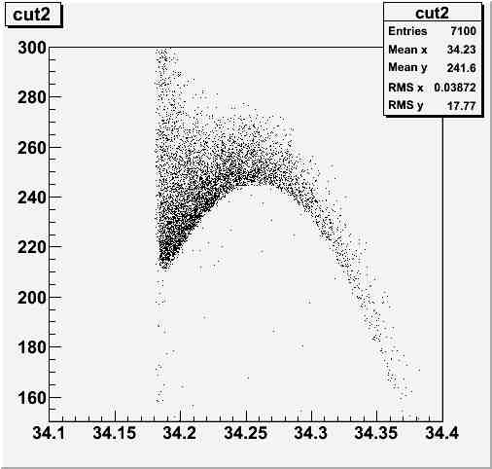
Longitudinal phase space
Pz(MeV)
Time (ns)

Slide 28
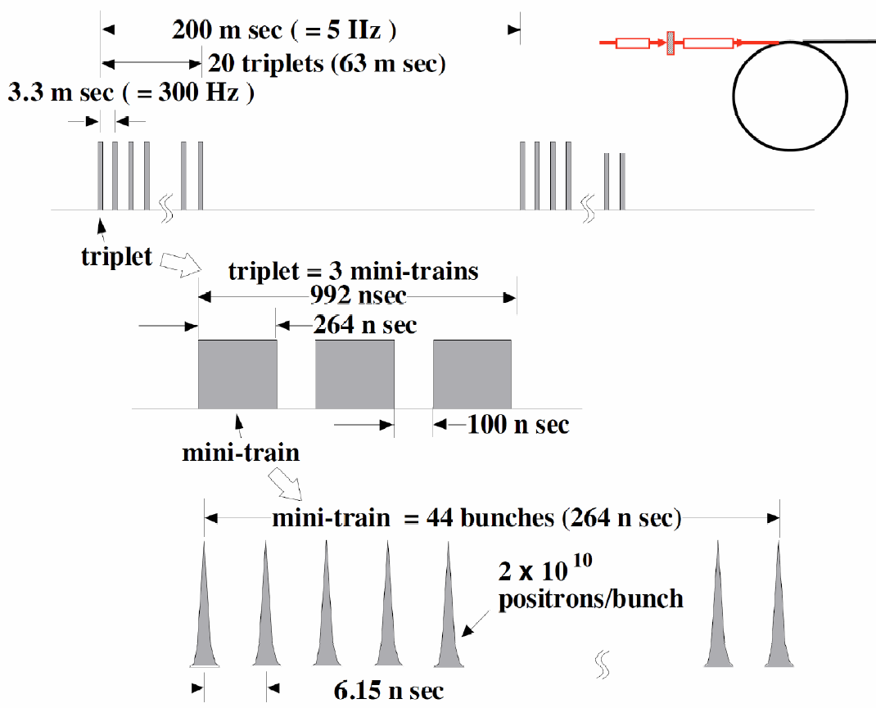
In the case of 300Hz scheme
spacing between triplets
=3.3ms
132bunches in 992ns
good for a FC
we can use existing FC technology

Slide 29
Assumptions
132 bunches
make a shock wave
heat same position on the target
drive electrons
2×10¹⁰/bunch
a triplet: 132 bunches 992ns
each triplet hits
different position on the target
3.3ms
a train: 20 triplet
= 2640 bunches 63ms
slow rotation target

Slide 30
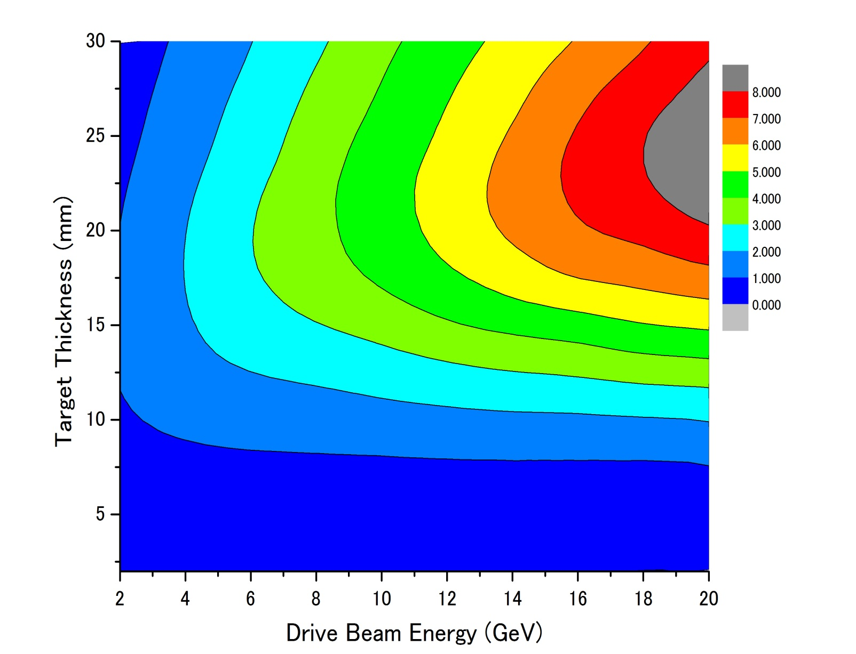
Parameter Plots for 300 Hz scheme
e- directly on to Tungsten
σ=2.5mm
colored band
accepted e+/e-
PEDD J/g
dT max by a triplet
１
２
３
４
５
６
７
８
1000k
35J/g
500k
100k

Slide 31
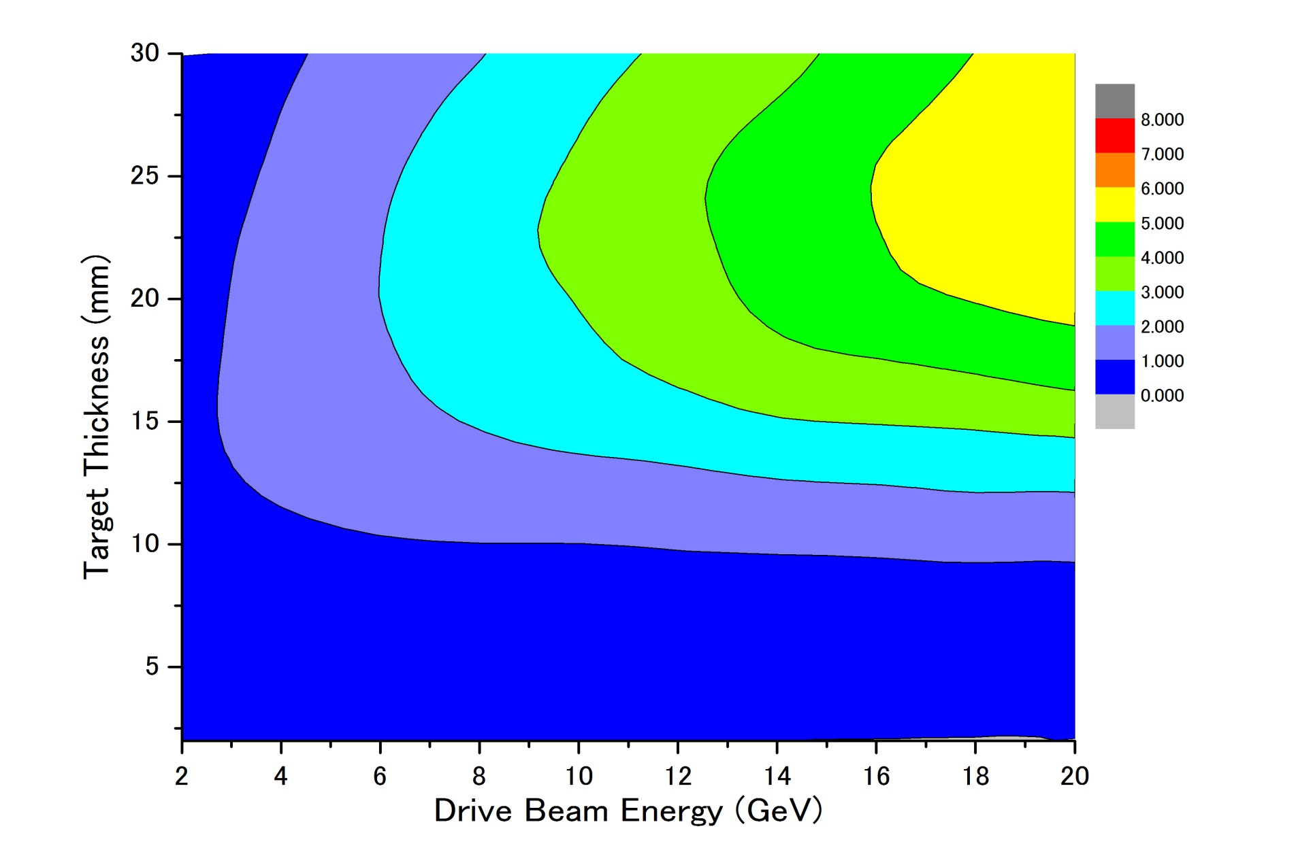
Parameter Plots for 300 Hz scheme
colored band
accepted e+/e-
e- directly on to Tungsten
σ=4.0mm
PEDD J/g
dT max by a triplet
１
２
３
４
5
35J/g
500k
100k

Slide 32
Parameter Plots for 300 Hz scheme
colored band
accepted e+/e-
e- directly on to Tungsten
σ=4.0mm
PEDD J/g
dT max by a triplet
１
２
３
４
５
35J/g
500k
there seems to be solutions
100k

Slide 33
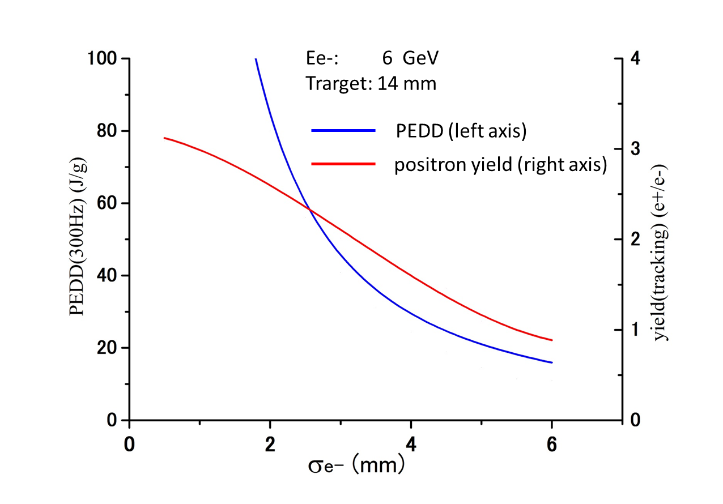
Dependence on Drive beam size
35J/g
σ of the Drive e- Beam (mm)

Slide 34
Numbers for a Reference Point
Parameters for target and captures |  | Parameters for 300Hz scheme
Drive beam energy | 6 GeV | # drive e- /bunch | 2×10¹⁰
Beam size | 4.0 mm (RMS) | # bunches/triplet | 132 (in 996ns)
Target material | Tungsten | # bunches/train | 2640 (in 63 ms)
Target thickness | 14 mm | repetition | 5 Hz
Max AMD field | 7 T | Results numbers in () are for 300Hz operation
Taper parameter | 60.1/mm | e+ yield | 1.6 /e-
AMD length | 214 mm | PEDD in the target | 1.04 GeV/cm³/e- (22.7 J/g)
Const. field | 0.5 T | E. deposit in the target | 823 MeV/e- (35kW)
Max. RF field | 25 MV/m | E. deposit in the AMD | 780 MeV/e- (33kW)
RF frequency | 1.3 GHz | E. deposit in the RF section | 470 MeV/e- (20kW)

Slide 35
Target Rotation Speed (Tangential)
.
SLC (actual achievement)：
0.1 m/s (Swinging/Troll target: Not really rotating)
ILC baseline (design: test will be done):
100 m/s
Truly Conventional (assumption）：
5 m/s
triplet and triplet are fully separated on target (spatial separation).
0.5 m/s
large spatial overlap between triplets --> But OK in temperature.
Design study with cooling <-- NOT yet
shockwave : OK because triplet to triplet separation 3.3 ms in time.
Probably 0.5 m/s is OK.
.
.

Slide 36
Target Heat Simulation

Slide 37
300 Hz scheme
• Stretching in time
• The Same as the Warm colliders
NLC 120 Hz
GLC 150 Hz
CLIC 50 Hz
Employs 3-4 targets
Thermal Shockwave
• We try to employ single target.
Crystal / Amorphous Hybrid
or
Liquid Lead
or
Amorphous Tungsten
Today's talk
Just soild tungsten target is OK
with slow rotation.
Truly Conventional

Slide 38
300 Hz scheme
• Stretching in time
• The Same as the Warm colliders
NLC 120 Hz
GLC 150 Hz
CLIC 50 Hz
Employs 3-4 targets
Thermal Shockwave
• We try to employ single target.
Crystal / Amorphous Hybrid
or
Liquid Lead
or
Amorphous Tungsten
Today's talk
Just soild tungsten target is OK
with slow rotation.
Truly Conventional
Why just single solid target is
OK in ILC ?

Slide 39
What is the difference wrt GLC/NLC design
Old GLC/NLC design employed 3 targets.
Why single target can survive in ILC 300 Hz.

Slide 40
What is the difference wrt GLC/NLC design
Old GLC/NLC design employed 3 targets.
Why single target can survive in ILC 300 Hz.
Because, improved optimization in ILC 300 Hz.

Slide 41
What is the difference wrt GLC/NLC design
ILC 300 Hz GLC(JLC) 3 targets NLC 3/4 targets
(for each) (for each)
Eb 6 GeV 10 GeV 6.2 GeV
Ne-/bunch 2x10¹⁰ 1x10¹⁰ 1.5x10¹⁰
N of bunches 132 (triplet) 64 (192/3) 63 (190/3)
t_target 14 mm 21 mm 14 mm
spot (σ) on target 4 mm 2.5 mm 1.6 mm
DR/preDR accpt ΔE<25 MeV ΔE<19.8 MeV ΔΕ<10MeV
ΔT< 115ps ΔT<? ΔΤ<30 ps
γA_{x}+γA_{y}=0.09 m γA_{x}&γA_{x}<0.03 m γA_{x}&γA_{x}<0.03 m
PEDD 23 J/g 35 J/g 35 J/g
e+/e- 1.5 1 1.8
Old GLC/NLC design employed 3 targets.
Why single target can survive in ILC 300 Hz.
Because, improved optimization in ILC 300 Hz.

Slide 42
DR/
e+/e-

Slide 43
Summary

Slide 44
Summary
Conventional e+ source can be a solution for
ILC, with 300Hz scheme and optimized
beam/target/DR parameters.
to go forward
heating has to be studied including cooling system
shock wave tolerance ?
better than GLC/NLC design, but is it OK?

Slide 45
backups

Slide 46
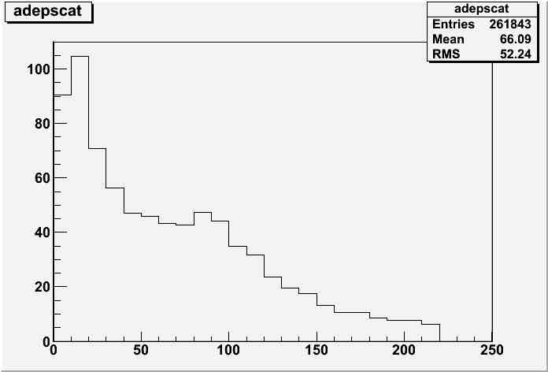
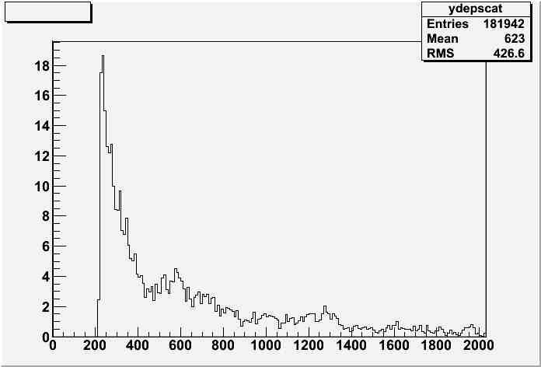
Energy deposit in capture section
MeV/10mm
MeV/10mm
Z(mm)
Z(mm)

Slide 47
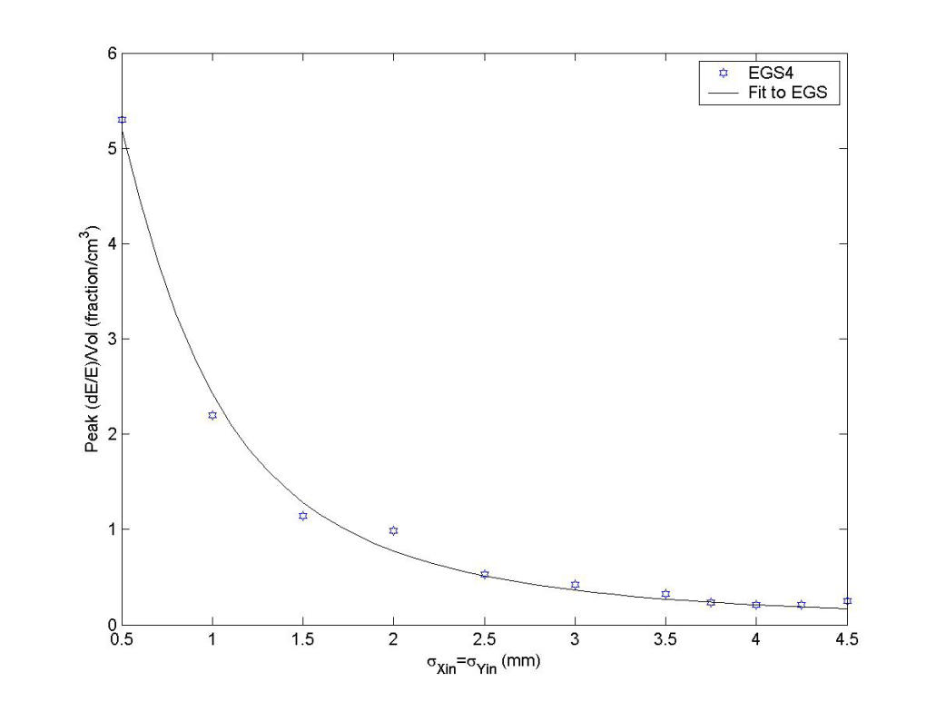
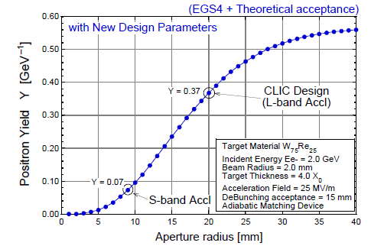
a few comments
numbers shown here are consistent w/
independent calculation by a colleague in KEK and French colleague for Hybrid
comparison w/ SLC study
both assumed AMD but acceptance for linac is;
SLC S-band linac ←→ this study (CLIC) L –band
PEDD
John C. Sheppard
SLAC-TN-03-032
CLIC-note 465
consistent

Slide 48
Assumption
each triplet hits different position on the target
relatively low (1~2m/s)rotational target
duration of a triplet ~ dumping time of shock wave
shoter than time scale of thermal dissusion
132 bunches in a triplet contributes both shock wave and thermal damage

Slide 49
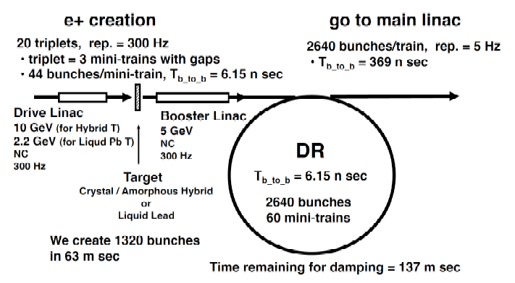
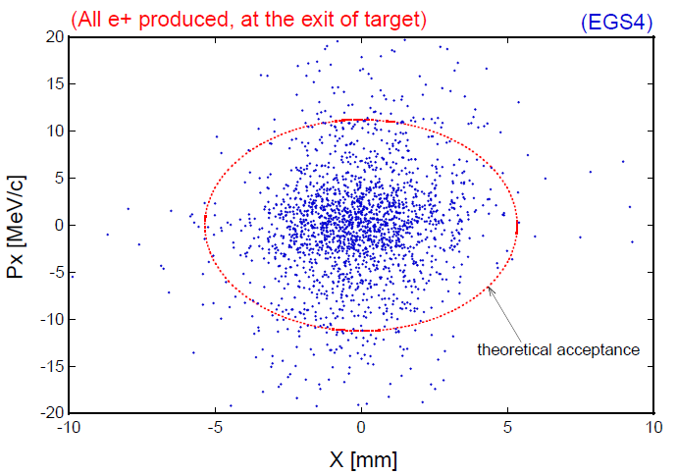
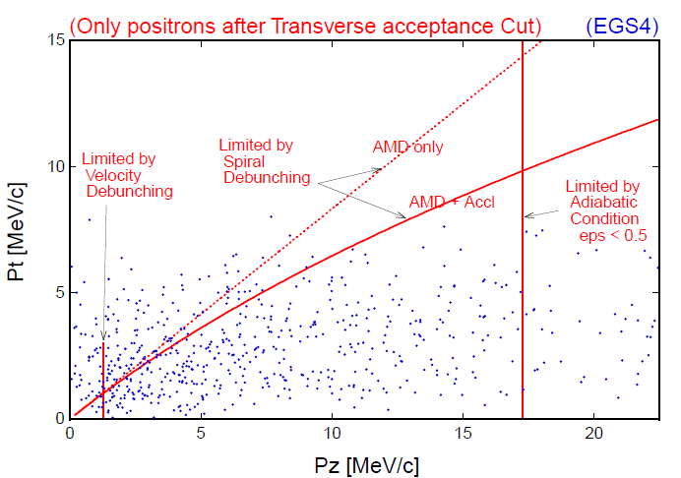
Acceptance estimate
CLIC note 465
[r/5.3[mm]]² + [pT[MeV]/11]² =＜1
pT < 0.1875 MeV/c + 0.625 pL
1.5 MeV/c < pL < 17.5 MeV/c
～# of e+ in DR (or booter linac)

Slide 50
Thermal diffusion
time constant of the diffusion depends on beam spot size ~1/β
numerical calculation of
thermal diffusion shows
 |  | 1D | 2D | 3D
time constant | σ=2.5mm σ=4.0mm | 280ms 750ms | 80ms 200ms | 40ms 100ms
time constant is order of 100ms >> Ttriplet ~1μs

Slide 51
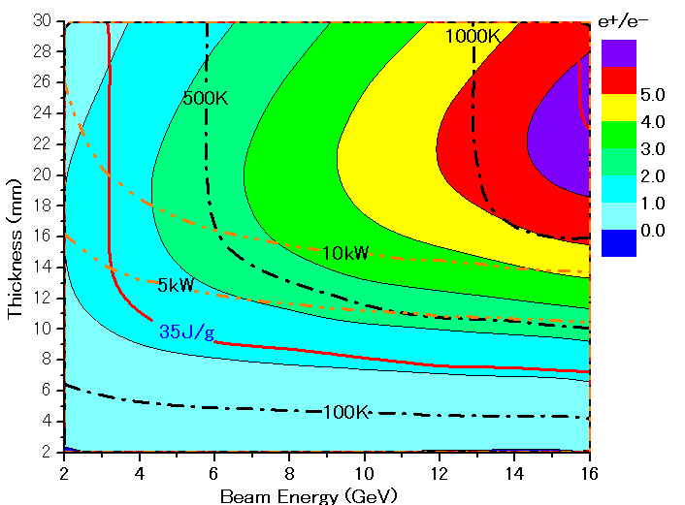
Parameter Plots for 300 Hz scheme w/ clic note formula
e- directly on to Tungsten
σ=2.5mm
colored band
accepted e+/e-
PEDD J/g
dT/triplet (132 bunc)
ToTal deposit kW

Slide 52
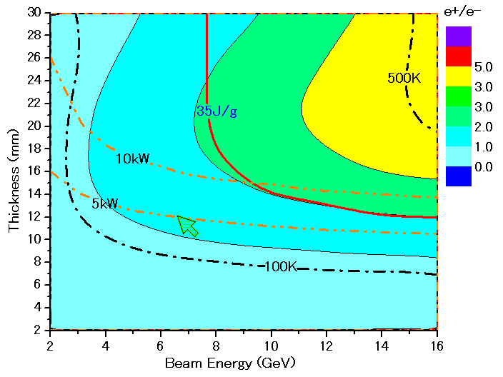
Parameter Plots for 300 Hz scheme w/ CLIC note formula
colored band
accepted e+/e-
e- directly on to Tungsten
σ=4.0mm
PEDD J/g
dT/triplet (132 bunc)
ToTal deposit kW

