Slide 1
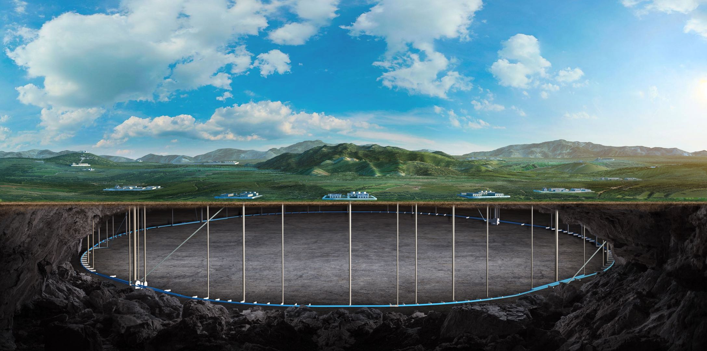
CEPC MDI SC quadrupole cryostat design considerations
Miaofu Xu, Penghui Li
On behalf of cryogenics group
Cryogenics Group, Accelerator Research Center Institute of High Energy Physics(IHEP) Email: xumf@ihep.ac.cn

Slide 2
Content
Introduction
Simulation results about the cooling scheme for SC magnets
Solutions of cryogenic system
Summary and plan

Slide 3
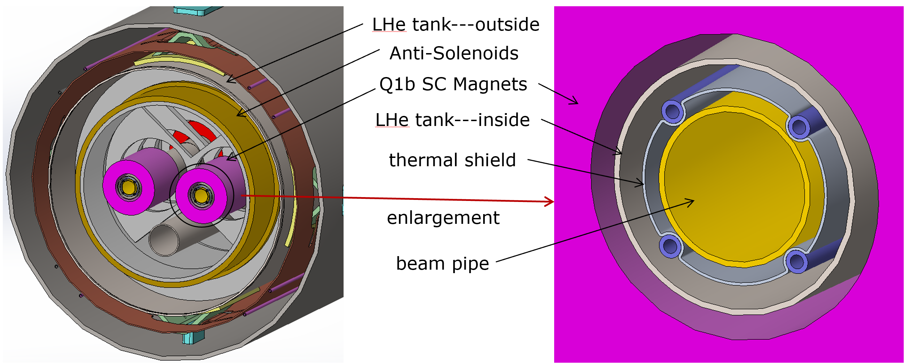
Introduction
CEPC is a Circular Electron Positron Collider with a circumference about 100 km，beam energy up to 120 GeV Proposed by IHEP
Both sides of the collision points in the interaction region of CEPC collider ring require compact high gradient final focus quadrupole magnets
IP

Slide 4
Basic Parameter of SC Magnet
In CEPC, there are a total of 4 combined-function Superconducting magnets in MDI
One combined-function magnet includes double aperture high gradient quadrupole (Q1a, Q1b, Q2) and anti-solenoid, around each side of the IP point
TDR requirements of CEPC Final Focus quadrupoles are based on L* of 1.9 m, beam crossing angle of 33 mrad.
ITEM | Q1a | Q1b | Q2 | Anti-solenoid
Central field gradient (T/m) | 142.3 | 85.4 | 96.7
Cooling type | LHe | LHe | LHe | LHe
Operating current (A) | 780 | 650 | 770 | 1300
Magnetic storage energy (KJ) | 11.5 | 11 | 33.2 | 630
Operating temperature（K） | 4.5K | 4.5K | 4.5K | 4.5K
Magnet length (m) | 1.21 | 1.21 | 1.5 | 5.1
Net weight (Kg) | 25 | 32 | 43 | 302
Total weight of magnets (Kg) |  |  |  | 402
From Yingshun Zhu

Slide 5
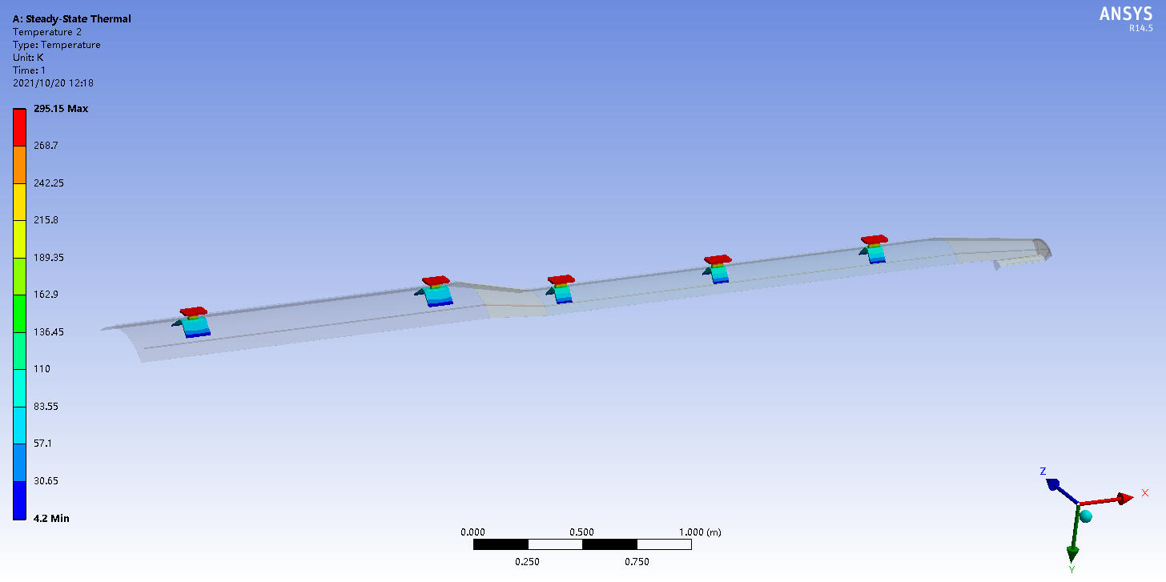
Simulation results
Characteristics of the MDI SC Quadrupole superconducting insert magnet helium vessel:
long longitudinal space;
large deformation amount;
multiple internal magnets (Anti-solenoid, Q1a, Q1b, Q2);
complex helium flow path due to a large number of magnet support frames;
need to fully consider the uniformity and safety of magnet cooling
Q1a
Q1b
Q2
Heat load ：3.42*4=13.68W@4.2K

Slide 6
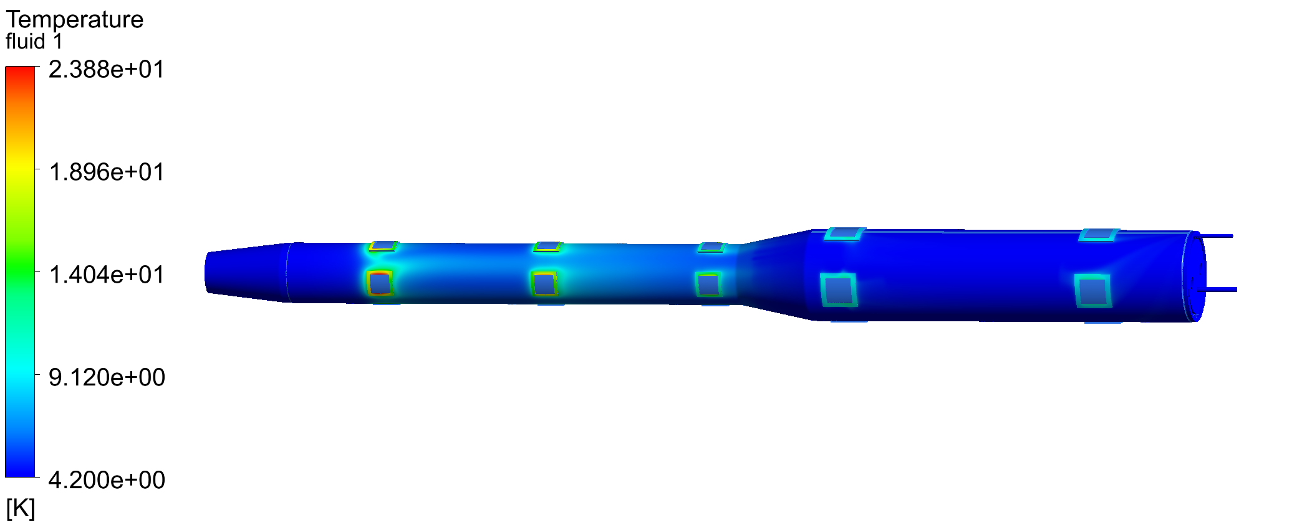
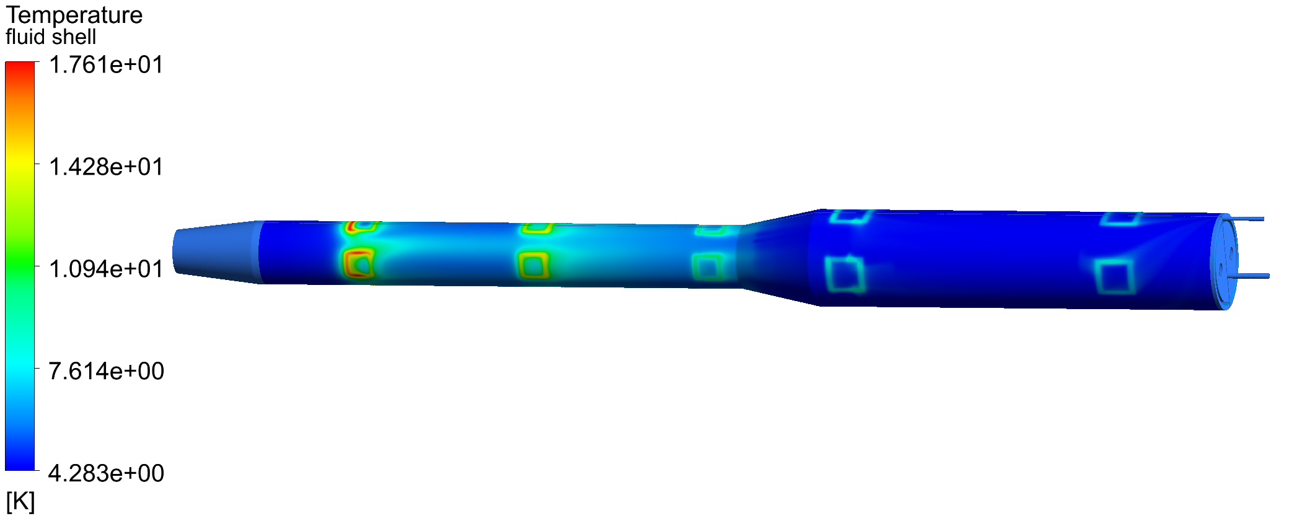
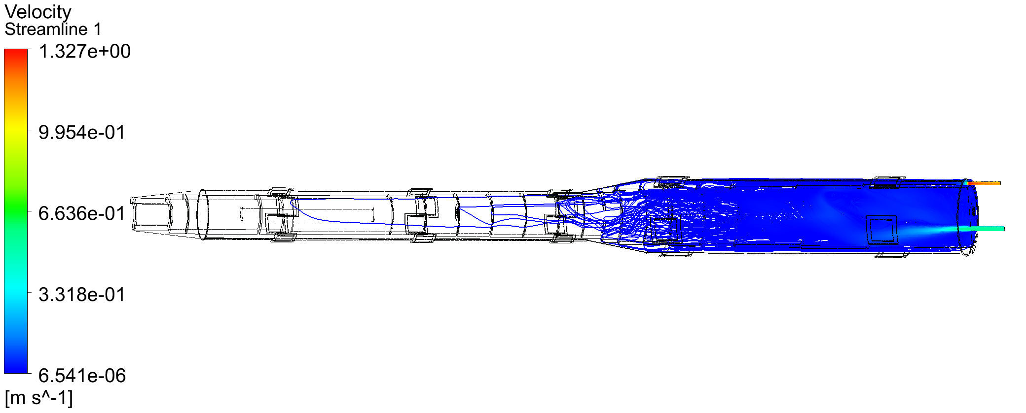
Simulation results
Without considering the magnetic support structure:
Supports conductive heat load@ 13.68W; radiative heat loss is 0.1W/m²;
Helium inlet flow is 3.0bar@4.2K, 12.0g/s
One-way in and out
outlet
inlet
Temperature distribution of outer cylinder of helium pool
Temperature distribution of fluid domain

Slide 7
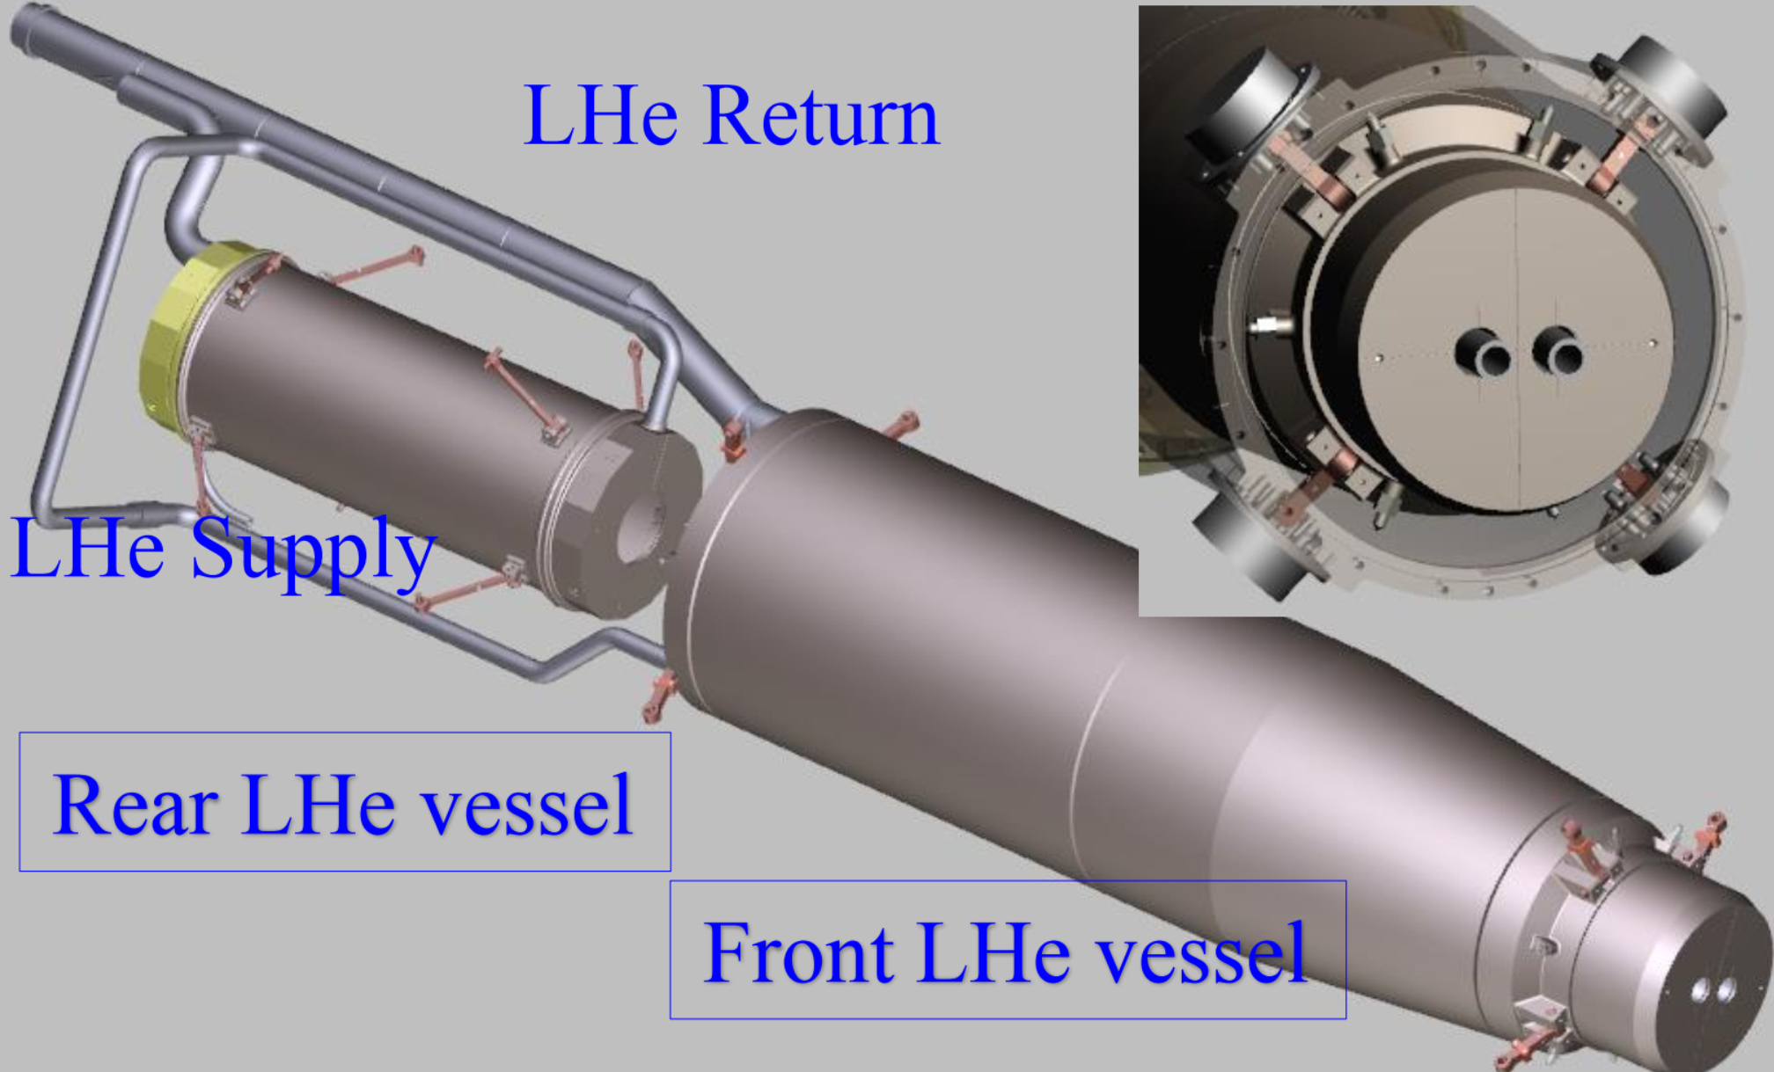
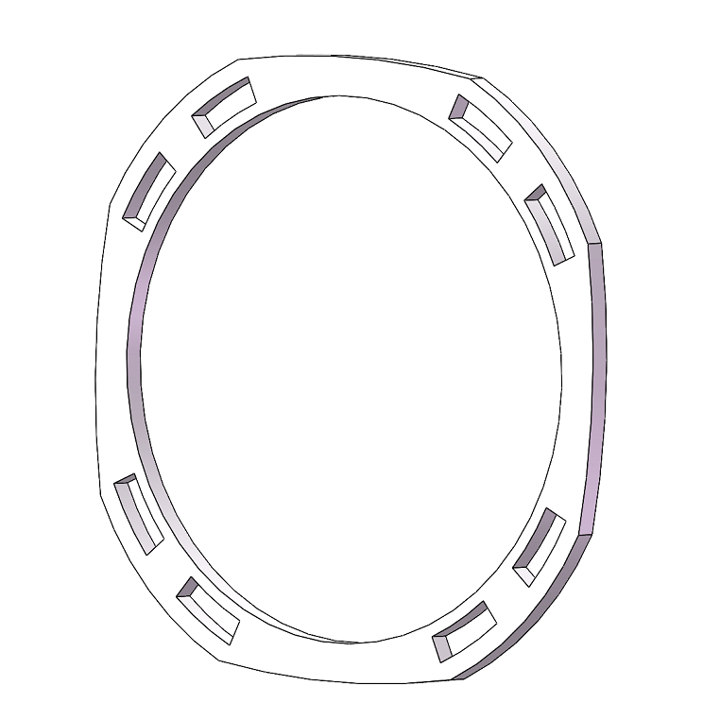
Simulation results
The Anti-solenoid is supported by a ring on the inner wall of the helium pool.
The superconducting magnets Q1a,Q1b and Q2 are supported on the inner wall of the reverse solenoid assembly;
Supports:
befor：
optimized：
SuperKEKB IR site Helium channel

Slide 8
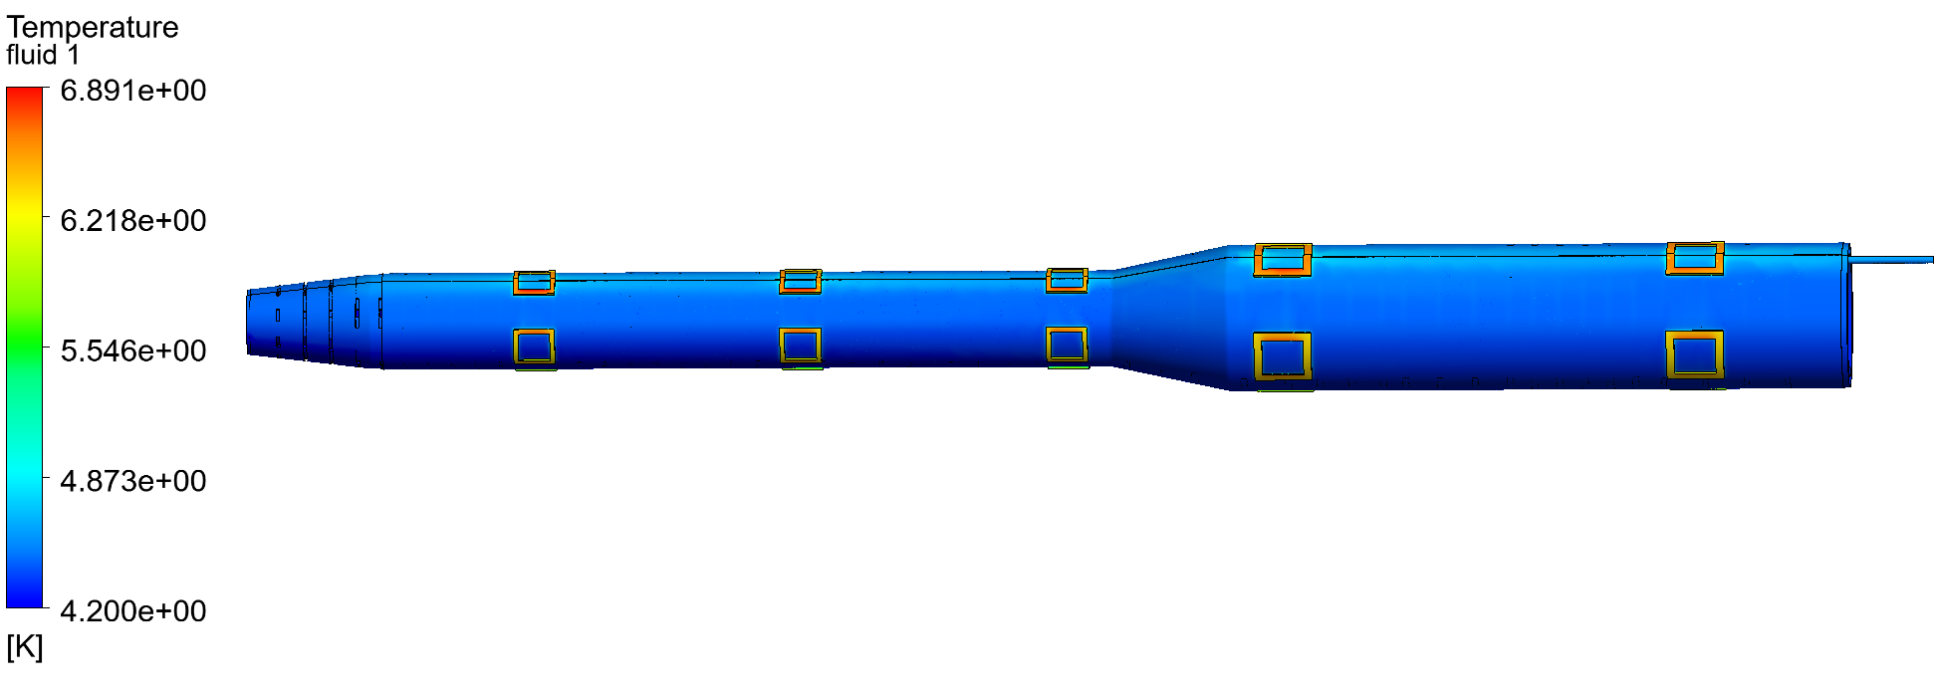
Simulation results
Outer single-layer flow channel ：
Temperature distribution of the outer cylinder of the helium pool: 3bar@4.2K 10g/s

Slide 9
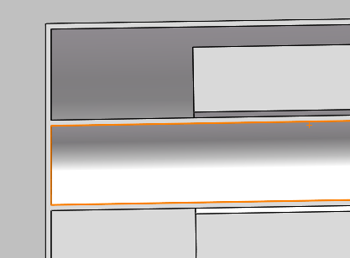
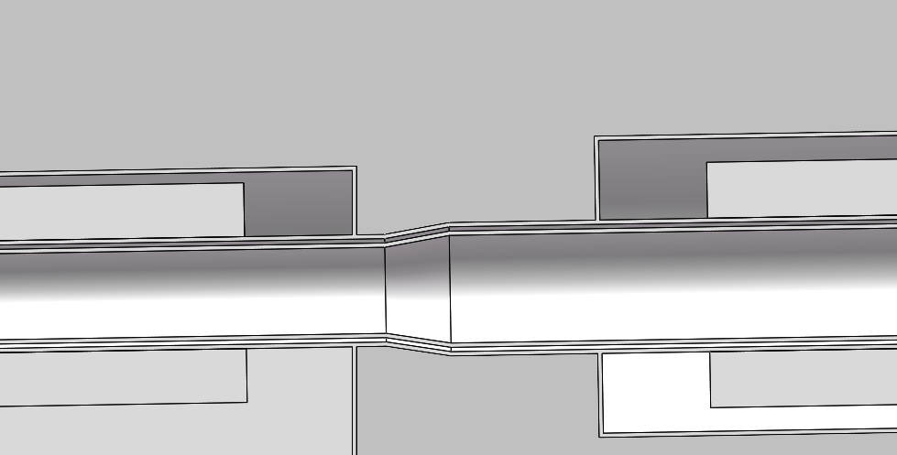
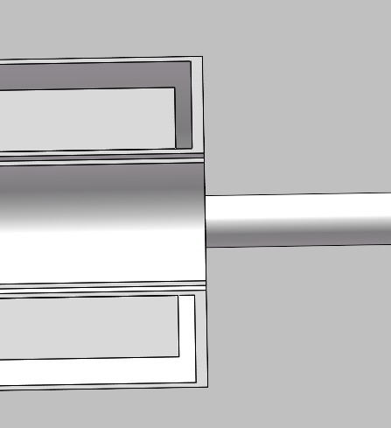
Optimized the helium channel
Inner and outer double flow channel design：
Quadrupole flow channel:
Minimum gap is 2mm
outlet
inlet
The magnetic body support cylinder is constrained by the outer flow channel wall, and the outer flow channel is constrained by the supporting framework.
Anti-solenoid flow channel :
outlet
inlet
Minimum gap is 4mm

Slide 10
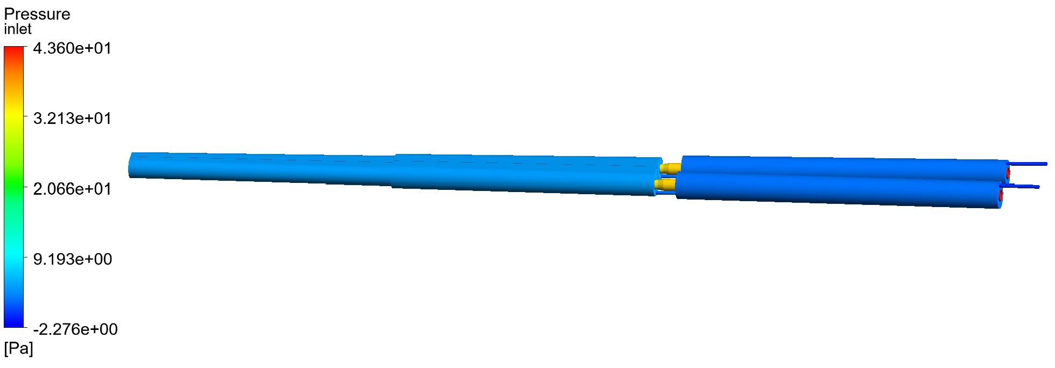
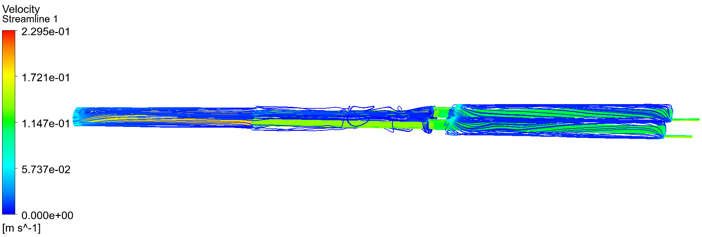
Optimized the helium channel
Inner and outer double flow channel design： Quadrupole cooling flow channel
Pressure difference 3.0bar@4.2K 10g/s
Streamline diagram in fluid domain 3.0bar@4.2K 10g/s

Slide 11
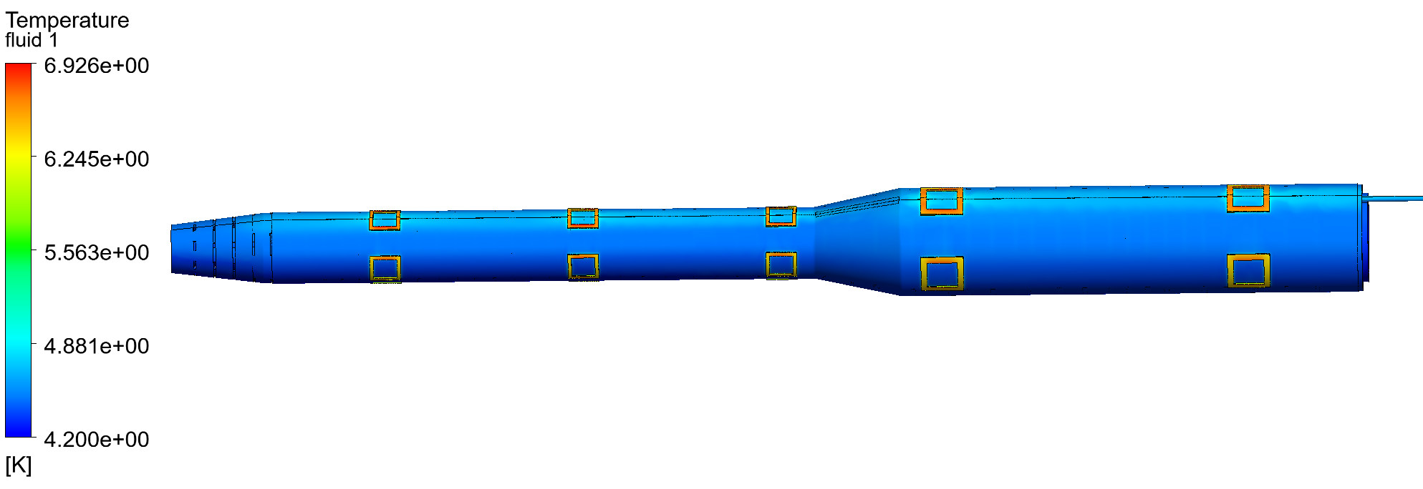
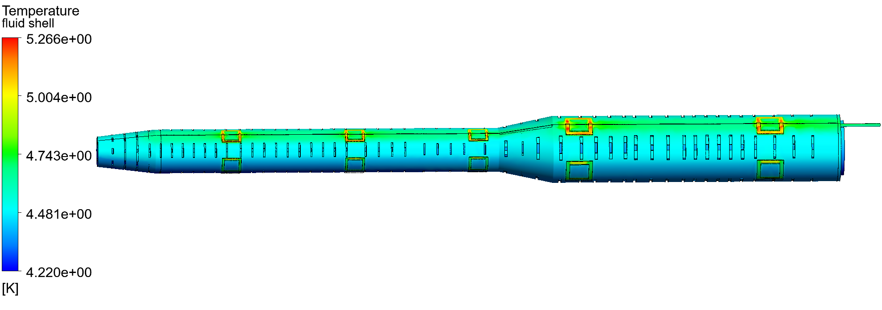
Optimized the helium channel
Inner and outer double flow channel design： anti-solenoid cooling flow channel
Heat load of supports is 13.68W；
Radiation heat load 0.1W/m2；
Inlet helium is 3.0bar@4.2K，8.0g/s
Temperature distribution of outer cylinder of helium pool
Temperature distribution of fluid domain

Slide 12
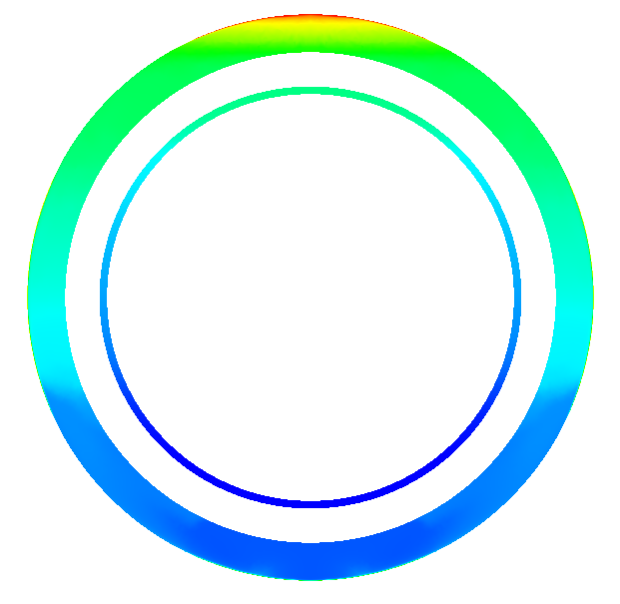
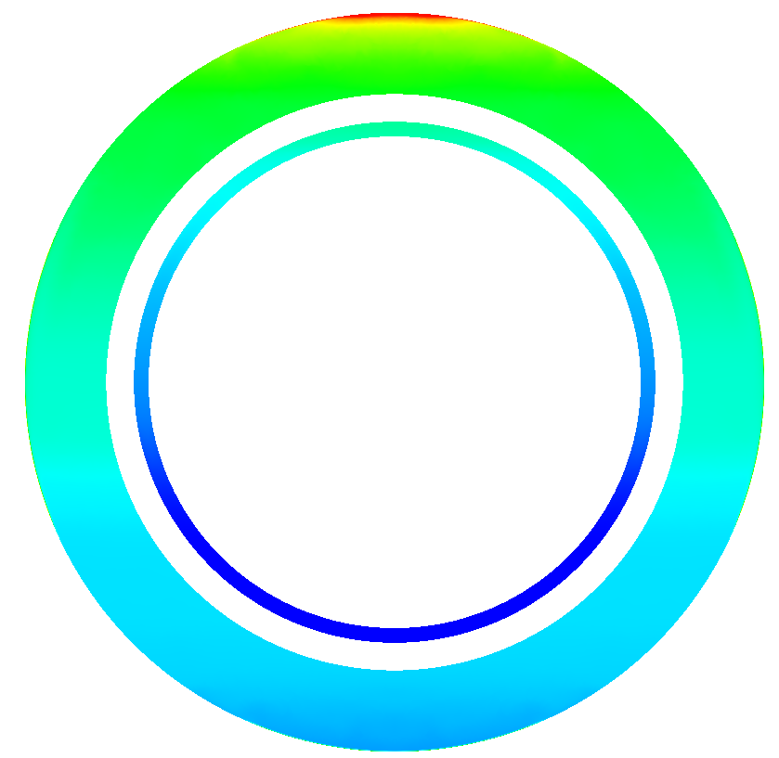
Optimized the helium channel
Characteristics of single-layer and double-layers cooling channels ：
Z
Z=-2.05m
Z=-2.88m
Z=-3.84m
Z=-4.38m
Z=-5.85m
The temperature distribution 3bar@4.2K 10g/s
The radiation heat loss on the outer surface of the helium pool is minimal, while the conductive heat loss from the 20 K-type supports has a significant impact on the helium pool.
The surface temperature near the K-type supports is higher, especially near Group 3 supports where there is a small gap between the outer wall of the reverse field coil and the inner wall of the helium pool, resulting in limited space for circulating liquid helium and insufficient heat exchange between fluid and helium pool walls, leading to higher temperatures on coil surfaces.
In both cooling channels, at the same longitudinal (Z-direction) position, as temperature increases, helium density decreases and heat exchange at bottom becomes more sufficient with lower temperatures
Notes:
氦池外表面的辐射漏热影响很小，20个K型支撑的传导漏热对氦池影响大；
反抵螺线管线圈靠近K型支撑处表面温度高，尤其是在第2组支撑附近，此处反抵螺线管外壁与氦池内壁间隙小，流通液氦的空间更小，流体与氦池壁面换热并不充分，致使线圈表面温度偏高；
两种冷却流道中，在同一纵向（Z方向）位置处，氦的密度随温度升高而减小，底部换热更加充分，温度更低。

Slide 13
Optimized the helium channel
Characteristics of single-layer and double-layers cooling channels ：
The heat load of cooling channel for quadrupole can be disregarded；
Designing a double-layers flow channel is more effective for cooling superconducting magnets compared to a single-layer flow channel, especially when the helium flow rate is low ；
Double-layers flow channel has more advantages, considering the heat management, quench recovery or magnet cooldown time

Slide 14
Cryogenic System of BEPCII-U IR SC Magnet
Conventional helium cooling mode: SHe is directly provided by helium refrigerator
Helium circulation pump cooling mode: SHe is provided by helium circulating pump
The inlet pressure is determined by the resistance loss of the superconducting magnet and the length of cryogenic transport line

Slide 15
The Solution of Cryogenic System
Application cases of large flow forced flow cooling ---- supercritical helium cycle pump:
The electron-proton collider HERA at the electron synchrotron laboratory (DESY) in Hamburg, Germany, uses a 45g/s helium circulating pump. 德国汉堡电子同步加速器实验室（DESY）
The Atlas-LHC at CERN in Geneva, Switzerland, uses two 600g/s helium circulation pumps and two 1.2Kg/s helium circulation pumps. 瑞士日内瓦的欧洲联合核子研究中心
The Superconducting magnet Test Facility at the Atomic Energy Research Institute of Japan.日本原子能研究所
TOSKA at the Institute of Technical Physics at the Karlsruhe Research Center in Germany.德国卡尔斯鲁厄研究中心技术物理研究所
Refrigerator
Refrigerator
LHe
LHe
helium circulating pump
SC Magnet
SC Magnet
Conventional helium cooling mode
Helium circulation pump cooling mode

Slide 16
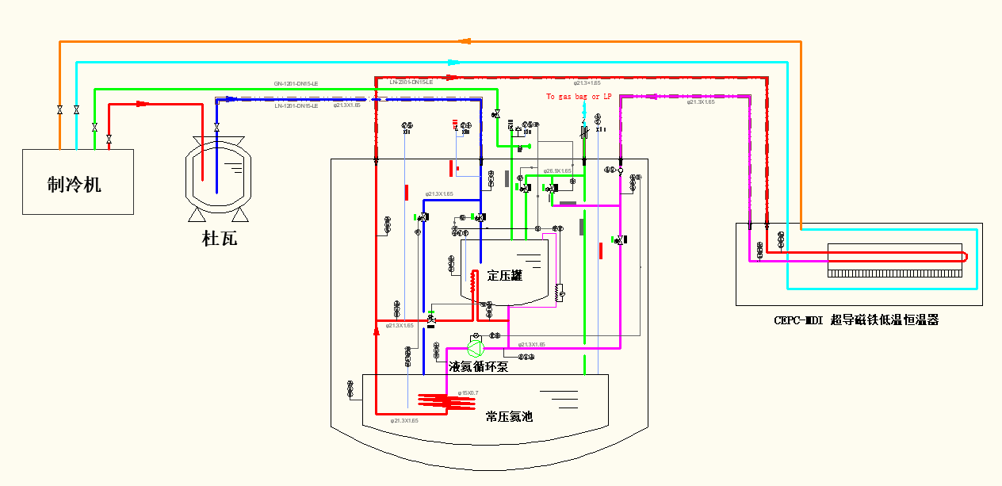
Supercooled Helium Circulation System

Slide 17
Summary
Design Status of Cryomodule:
Large flow forced cool scheme is chosen as the SC magnets cryogenic system
Update the cryomodule according to the optimized design of the SC magnet
Optimal cooling scheme(singe-layer @ double layers)
Structure R@D and Heat load calculation
Initial consideration of processing and manufacturing technology
Solutions to be Determined:
Strength check calculation (quench protection, energy storage@ power supply , supports )
Current lead and cryogenic system
Measurement requirements (temperature/pressure/BPM)
Alignment requirements

Slide 18
EDR plan
EDR plan for MDI SC cryostat:
2024:
Update the design of the cryomodule
Heat load calculation
Flow field simulation analysis
2025:
Process scheme determination
Assembly process design and alignment considerations
2026:
Machine-finishing technological design
Cryogenic performance test of critical component

Slide 19
Thanks for your attention!

