Slide 1
Tracker for CEPC reference detector TDR
WANG Meng 王萌
CEPC day, 2024.4.23

Slide 2
mini-review on TPC and DC of CEPC
on April 1st at IHEP, https://indico.ihep.ac.cn/event/22016/
committee: Ouyang Qun(chair), Li Yulan, Liu Jianbei, Zhao Lei, Wang Jianchun, Wei Wei
participants: a few foreign experts in addition to Chinese members of two groups
Charge of the review
justify the feasibility of both TPC and DC
identify critical R&Ds for TDR
prioritise the choice of technology, if possible
justify cost estimations
Key recommendations
Both scenarios are feasible, but are challenging in key techniques as well.
Most of results are based on simulation and lack of experimental validation, which is NOT enough for TDR.
According to their current R&D status, it is impossible to give a choice.
It’s recommended to take further reviews, for which a list of support materials are suggested.
It’s suggested that cost estimations shall be reviewed separately.

Slide 3
cost comparison among options of outer tracker+TOF
three options: AC-LGAD only, silicon pixel/microstrip tracker + LGAD
Costs of LGAD based TOF-only and TOF+Tracker are the same, no matter what kind of LGAD, DC or AC.
Although CMOS pixel may provide ns-level of timing information, neither pixel nor strip tracker can provide ps-order of timing resolution.
Hence, the choice is obvious……
LGAD cost estimation ➔
Cost （RMB） | CEPC barrel | endcap
LGAD sensor | 35M（70m²） | 4.85M（9.7m²）
Electronics total | 4.86M | 0.565M
Total (sensor+elec.) | 39.86M | 5.415M
Electronics R&D | 14.6M
Total | 59.875M

Slide 4
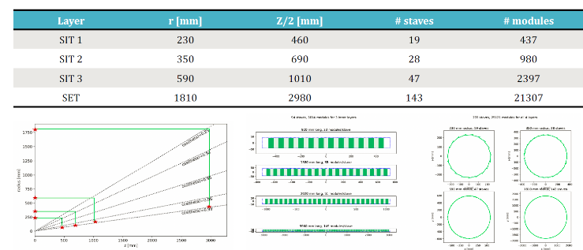
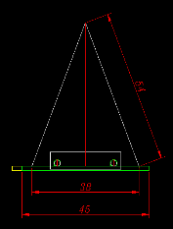
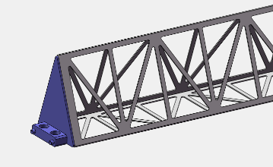
mechanical design in progress
Stave of the ITK outer barrel
Truss structure : section 38 x 54 x 54 mm, L= 2280 mm
Material: CFRP M55
Thickness 0.5 mm (0 90 0 90 0)
Material budget of the CFRP truss:
0.18% X0 (smeared to 45 mm wide)
FEA of the stave deformation
CFRP truss 78.7 g, Bare stave 107 g, Roughly estimated load : 144 g Include: water cooling (pipe+water+CF+graphite), FPC, glue, chips, power bus
CFRP truss vertically supported : 0.04 mm
Loaded stave horizontally supported: 0.24 mm
Loaded stave vertically supported: 0.11 mm

Slide 5
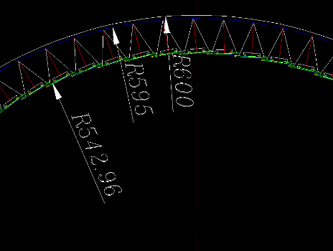
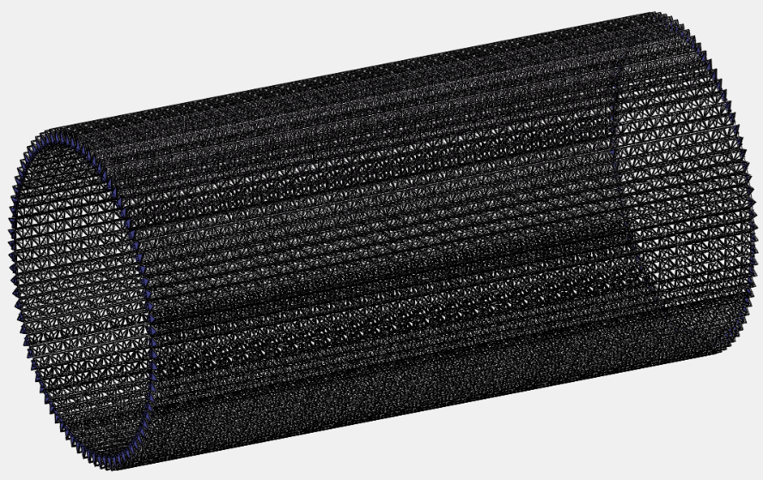
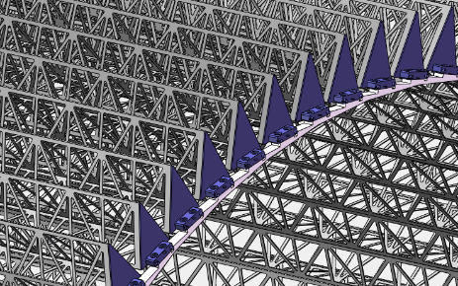
mechanical design in progress
Outer barrel of the ITK
Number of Staves: 82
Gross weight: ~ 20.6 kg (without barrel support)

Slide 6
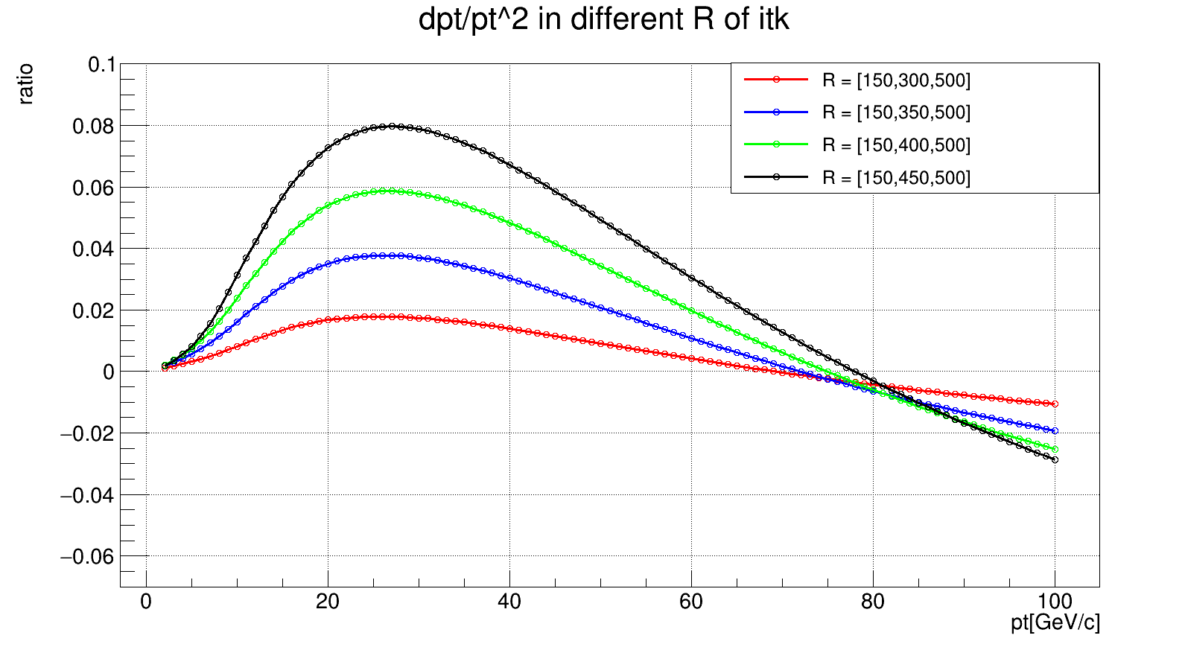
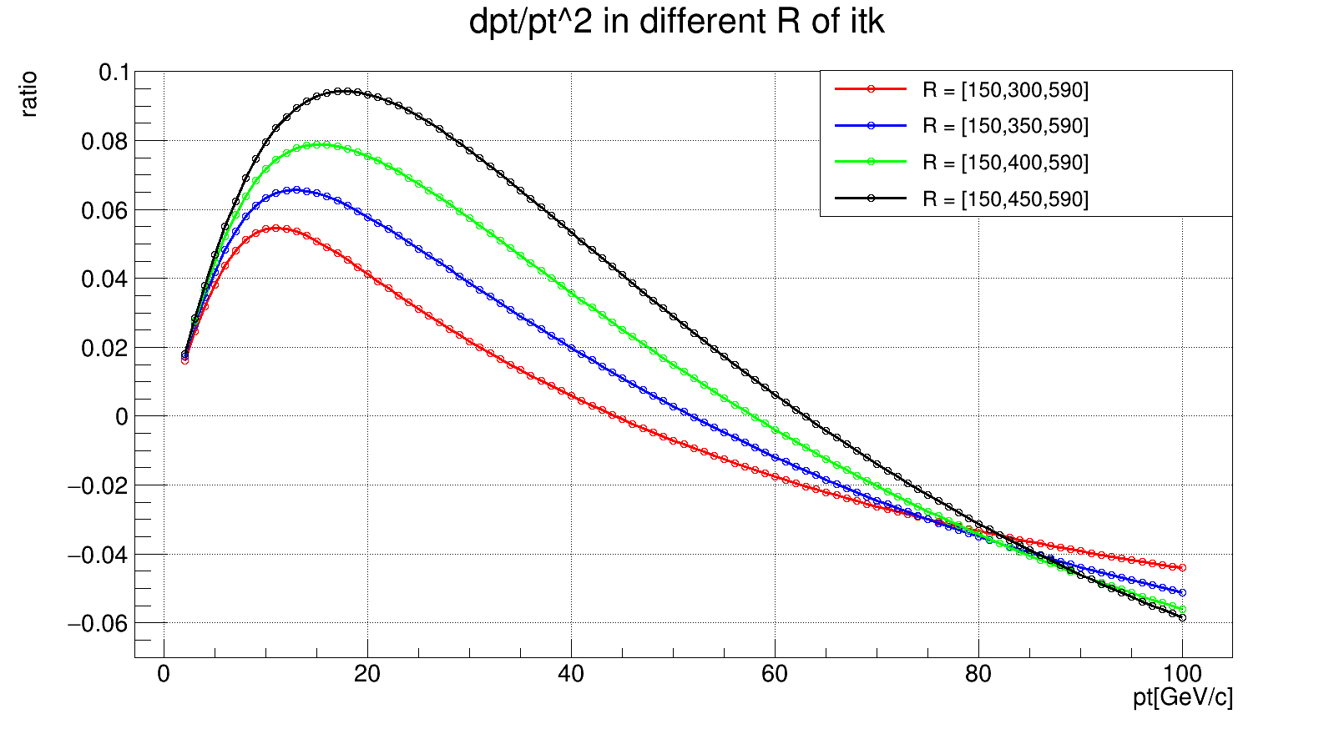
fast simulation to optimise layout of Si inner tracker
vary R of 2nd layer and fix those of 1st and 3rd layers
ratio = result/Ref – 1, Ref. Rs = [150, 250, 500] mm
observations
inward layout looks better for p_{T} < 80 GeV/c
the outmost layer is better at R = 500 mm than 590 mm

Slide 7
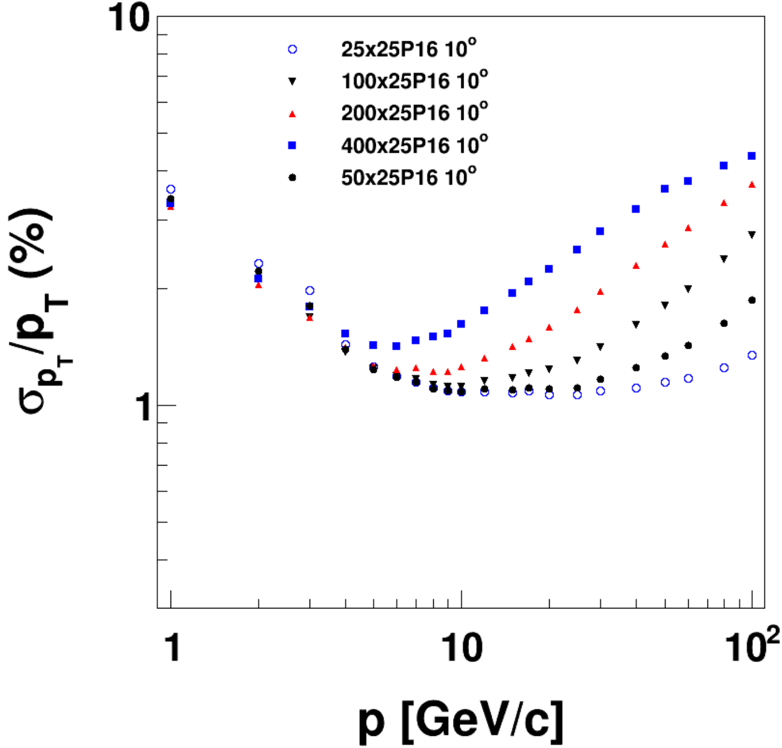
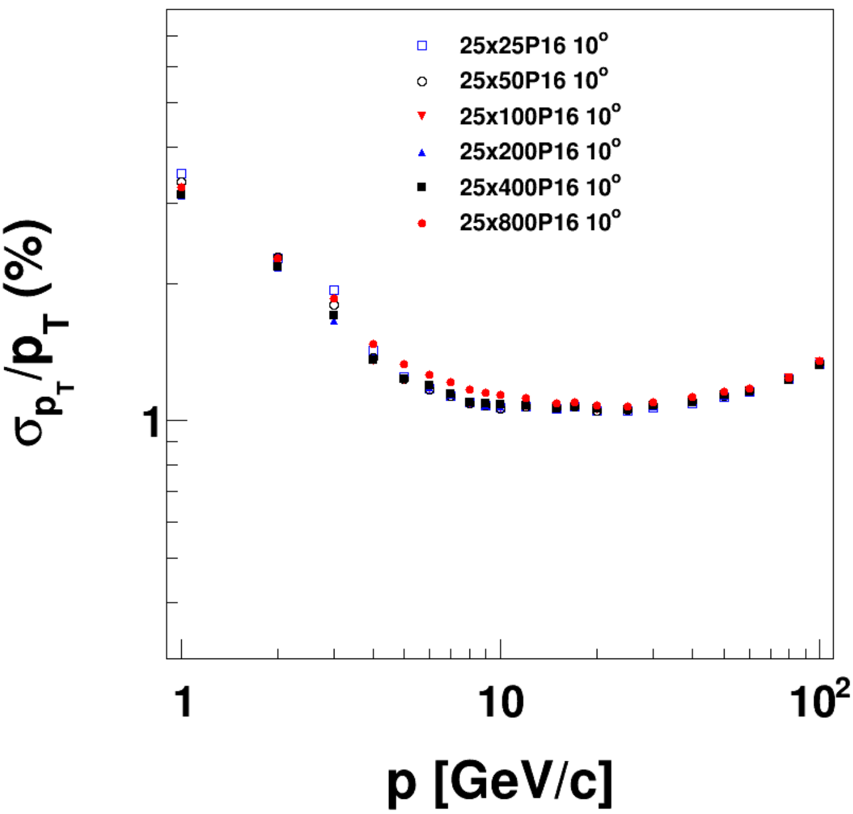
full simulation + tracking
on requirements of single point resolutions of trackers at endcap
configuration: VTX + 3 Endcap-ITk + 1 Endcap-OTk
material budget at θ = 10°: 16.9%X₀ at φ = 0°, 21.1%X₀ at φ = 45°
varying σ_{φ} or σ_{R} simultaneously for all endcap trackers
σ_{φ}: significant effect
σ_{R}: little effect
σ_{φ} dependent at 10°
σ_{R} dependent at 10°

Slide 8
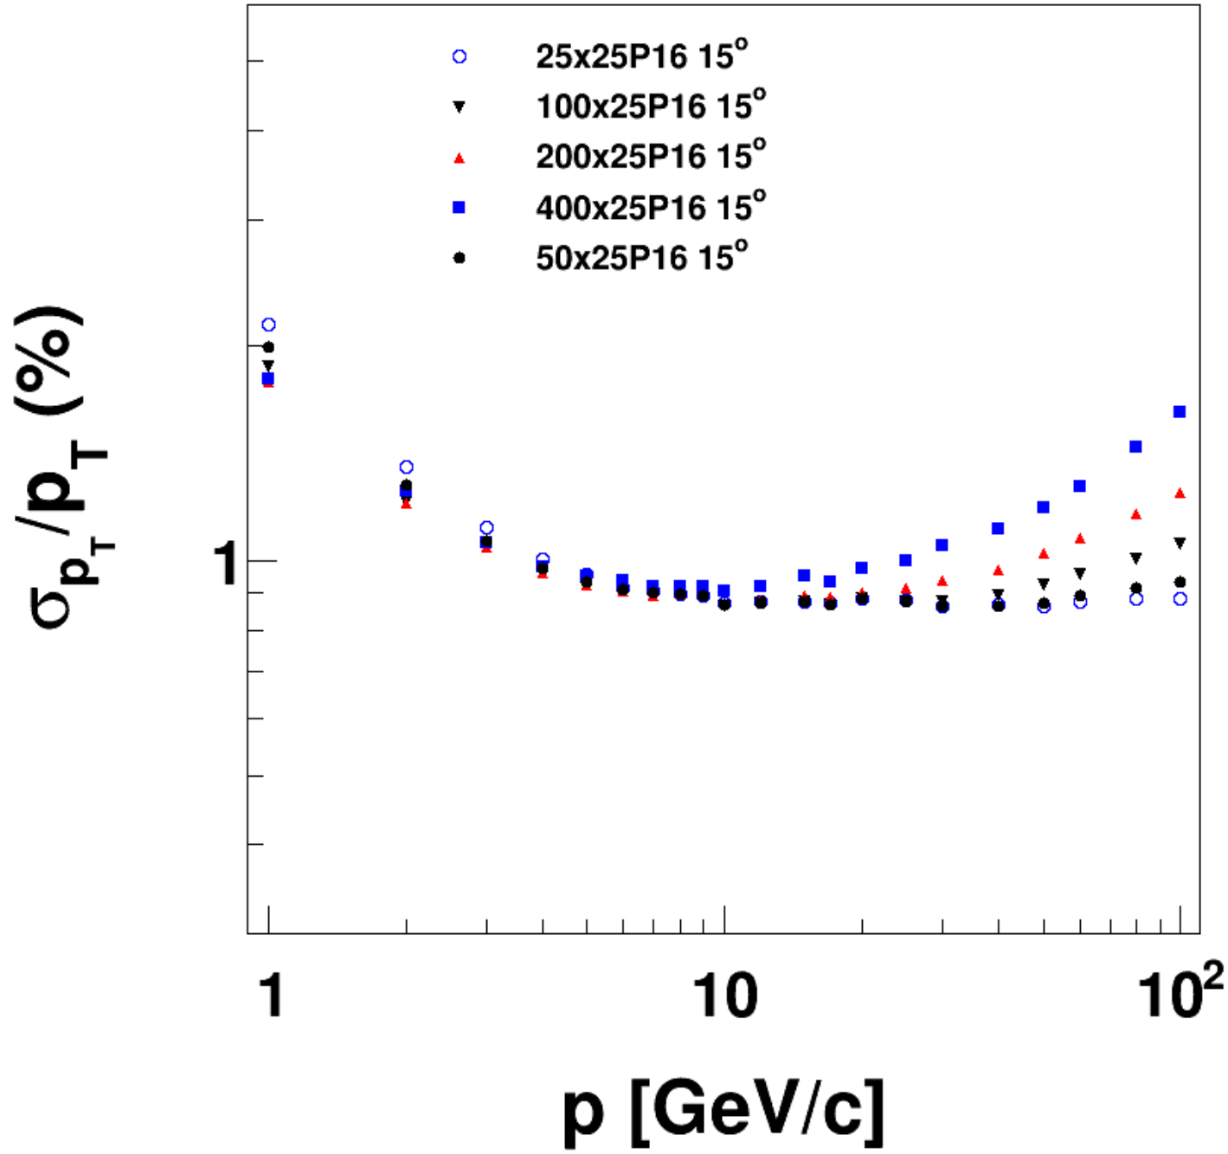
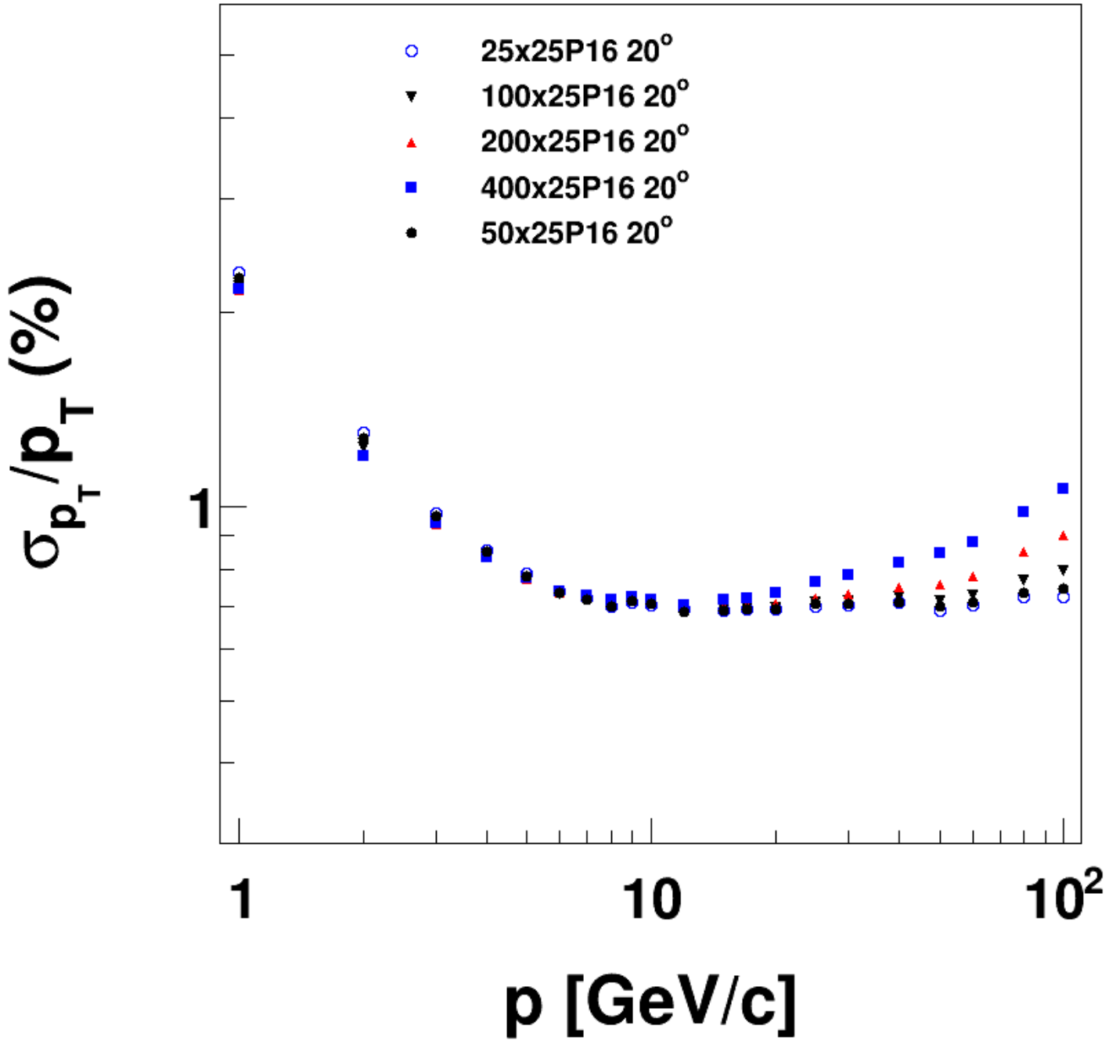
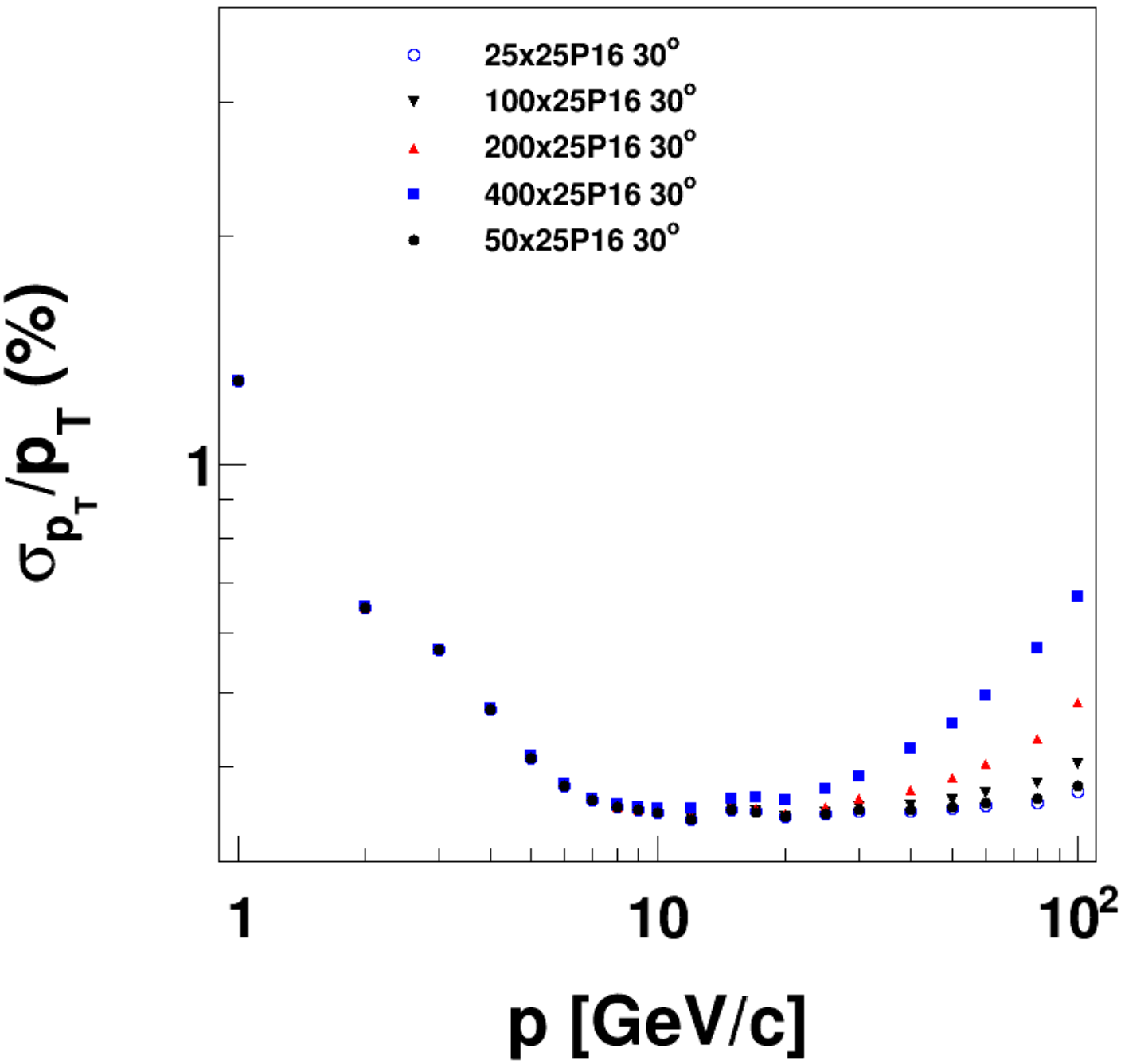
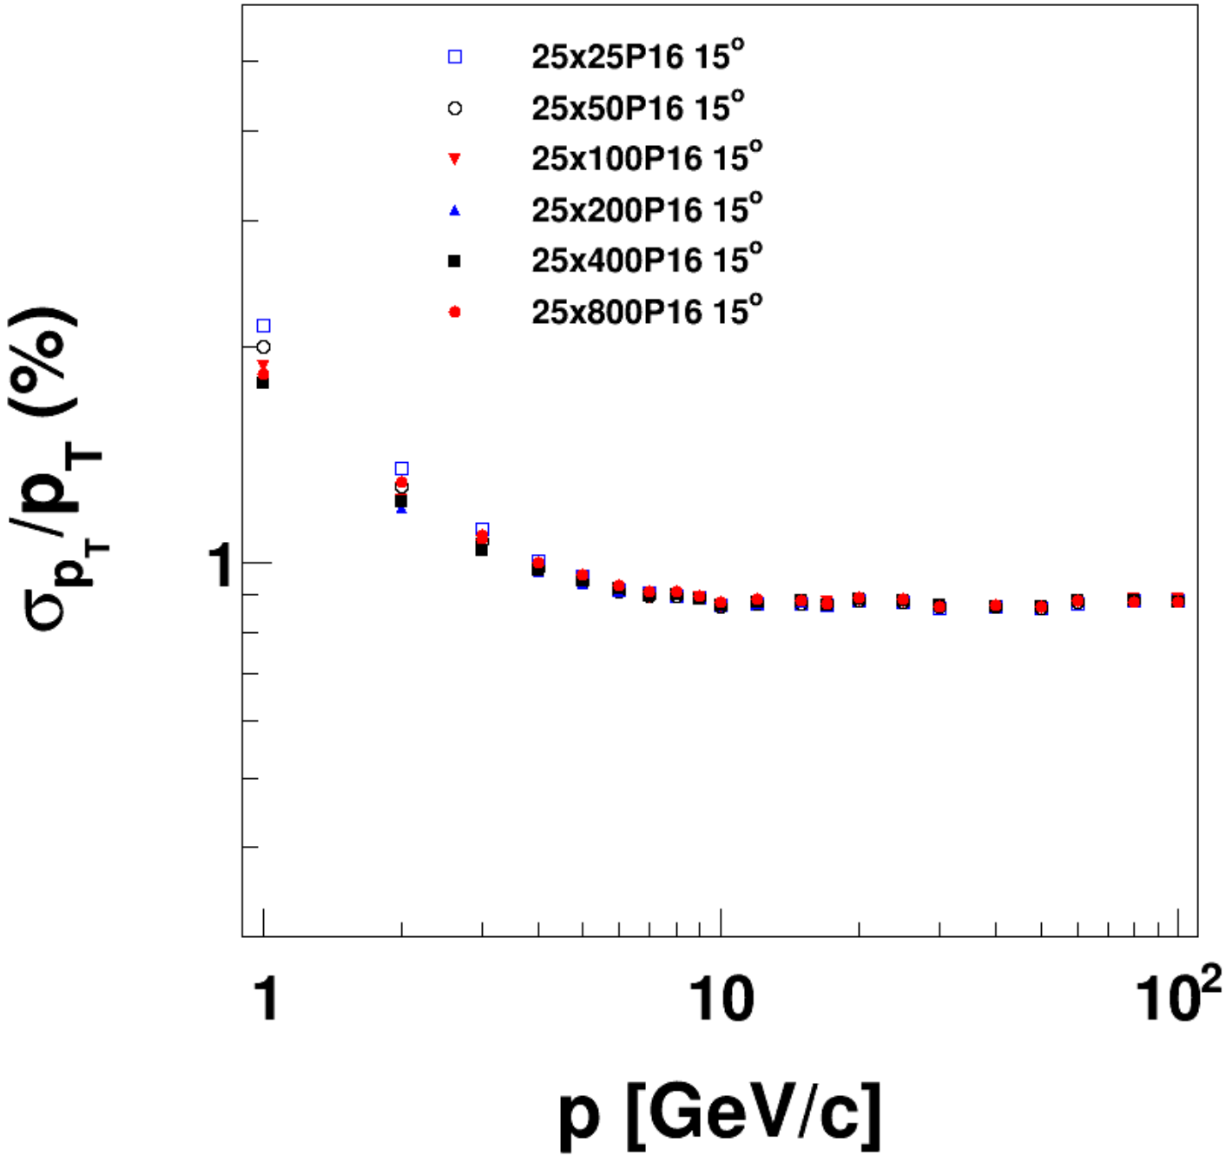
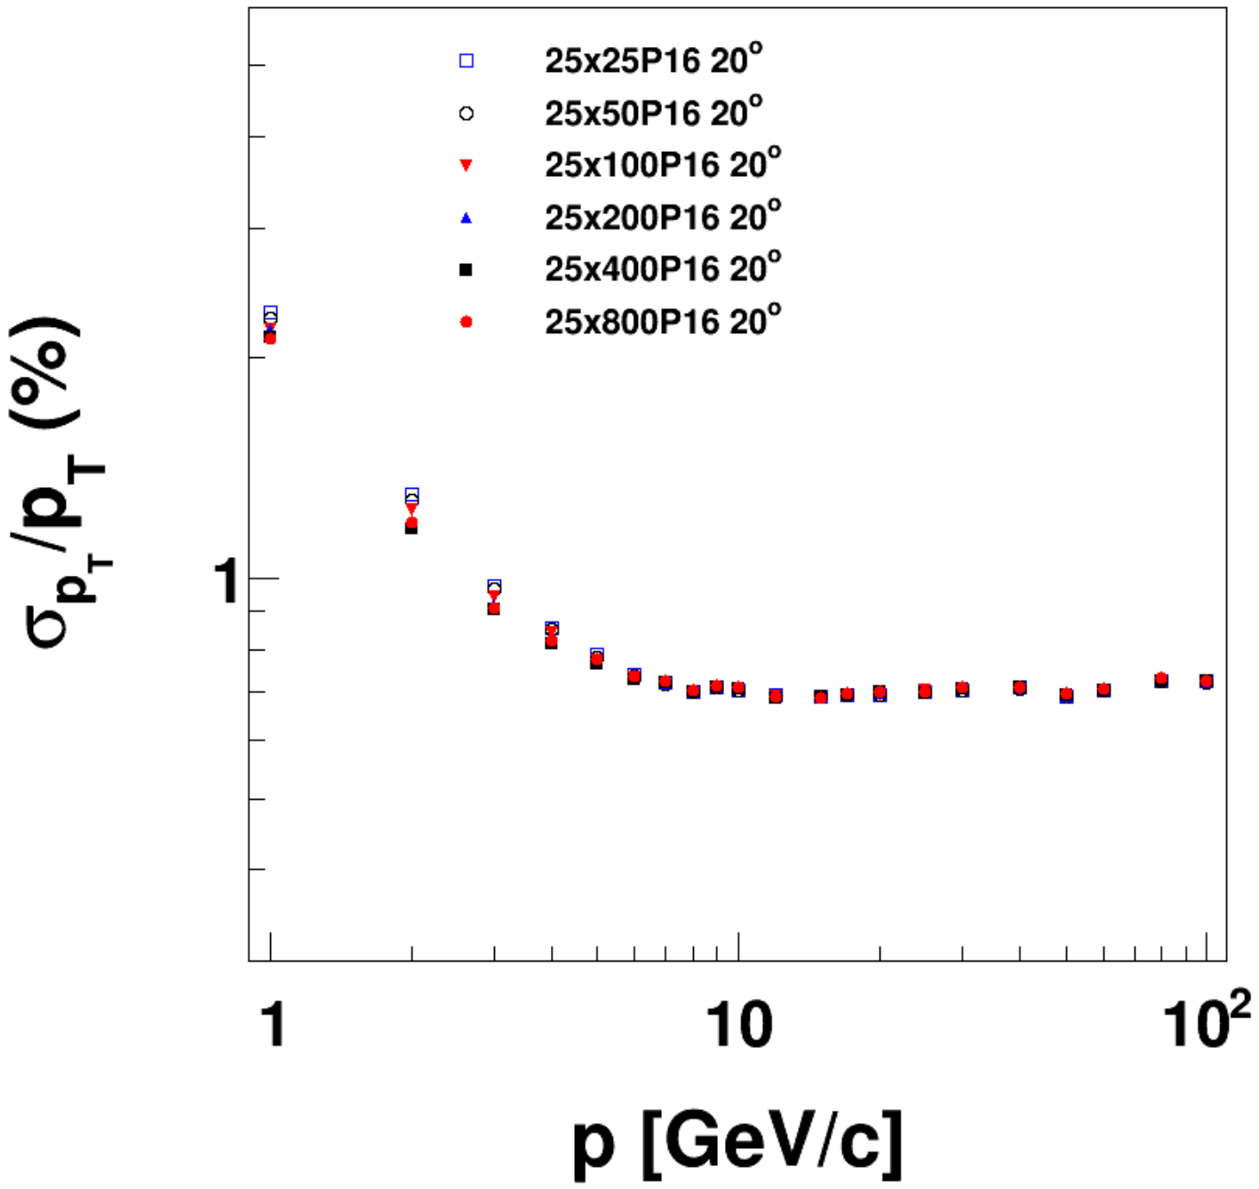
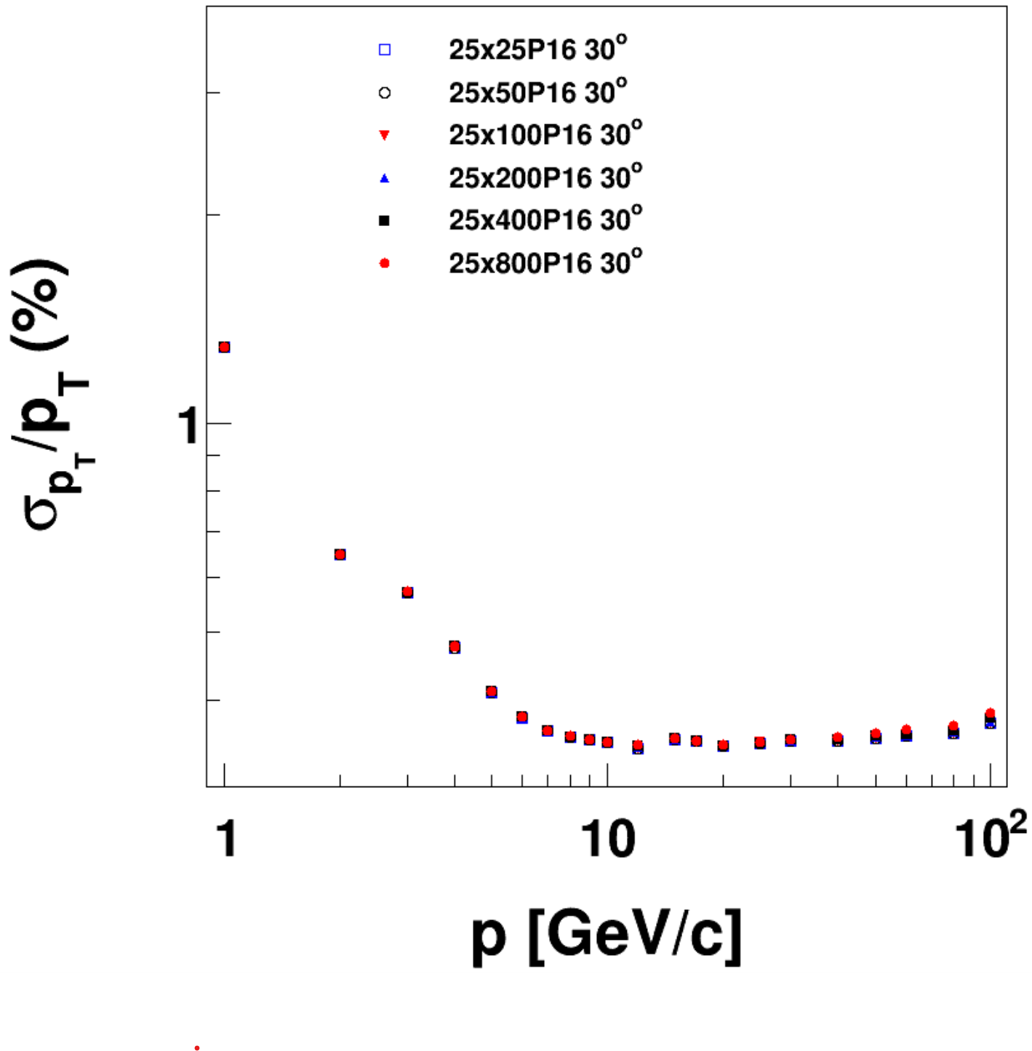
σ_{φ} dependent at 30°
σ_{φ} dependent at 15°
σ_{φ} dependent at 20°
σ_{R} dependent at 30°
σ_{R} dependent at 15°
σ_{R} dependent at 20°

Slide 9
Thanks!

Slide 10
backup

Slide 11
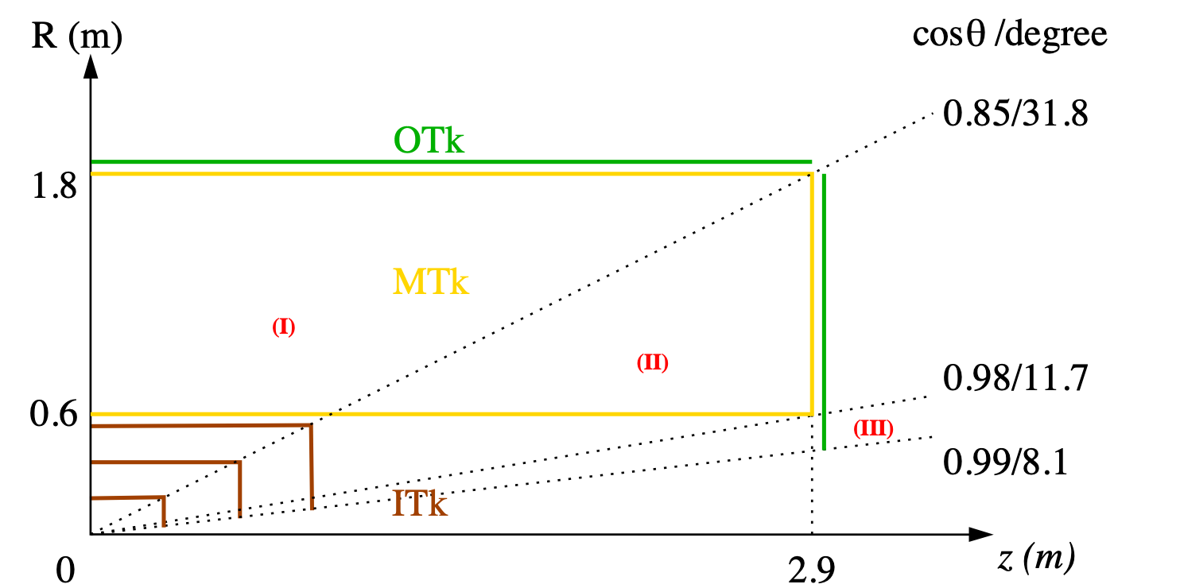
CEPC tracking system, draft
Three tracking regions
barrel: full Main + Si trackers
endcap: partial Main tracker
forward: Si tracker only

Slide 12
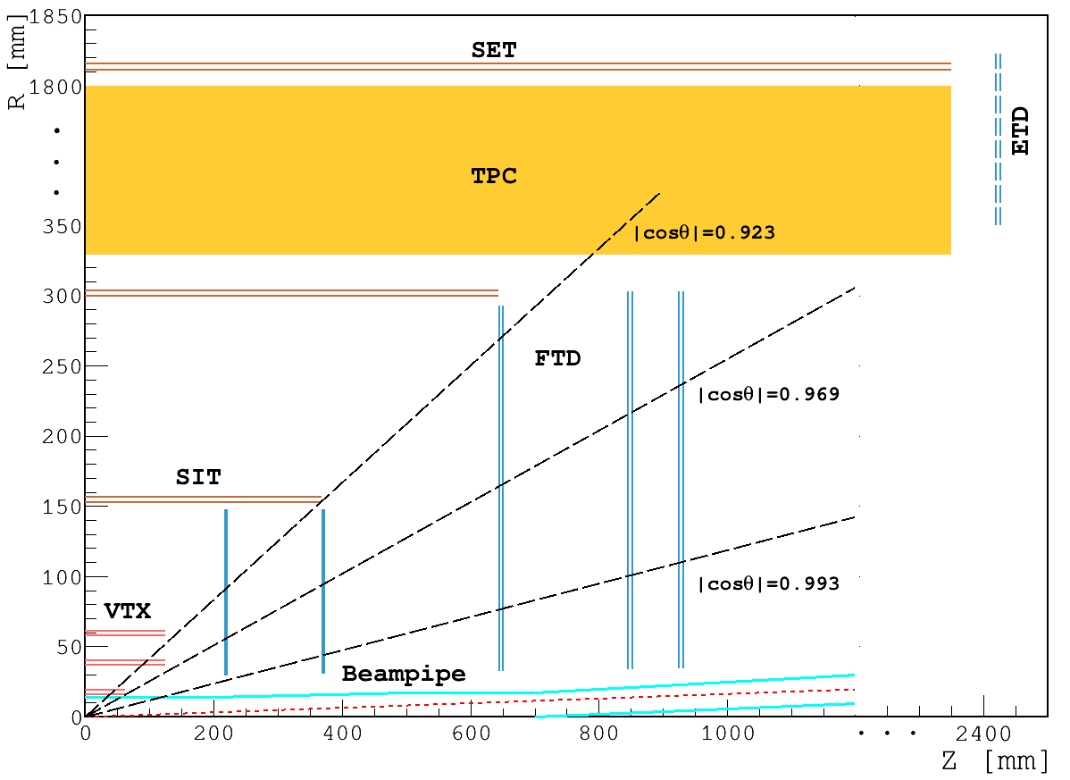
CDR layout for acronyms

