Slide 1
Scintillator ECAL Digitization update
2024/04/19
Jiaxuan Wang

Slide 2
Digitization process 1
MC process:
Input : MC truth hit energy
Output: photoelectron number
Process:
MIP energy : 0.305 MeV
SiPM gain (ADC/p.e.) and MIP spectrum MPV (ADC/MIP)
Poisson smear
Input : photoelectron number
Output: photoelectron number(after saturation correction)
Process:
SiPM type 10um-10000 15um-4489
Physics process:
Energy deposited in scintillator
Photon emission : $N_{photon}$
Of Poisson distribution
PDE : $N_{seed}$
SiPM saturation :$N_{fired}$

Slide 3
Digitization process 2
MC process:
Input : photoelectron number(after saturation correction)
Output: calibrated ADC value
Process:
SiPM gain (ADC/p.e.)
Gaussian smear : ADC = p.e. * gain
Input : calibrated ADC value
Output: ADC high low gain ADC
Process:
Gaussian smear :
Mean : calibrated ADC / Hl-ratio + pedestal mean
Sigma : pedestal sigma
High-low switch point
High gain saturation: high adc > switch point , let highadc =4000
Low gain saturation : low adc > 3000, let lowadc = 3000
Physics process:
Calibrated ADC : p.e. * gain
Gain error : fit error
Single photoelectron spectrum Width : statistical error
ADC converted into high-low gain mode
ADC saturation

Slide 4
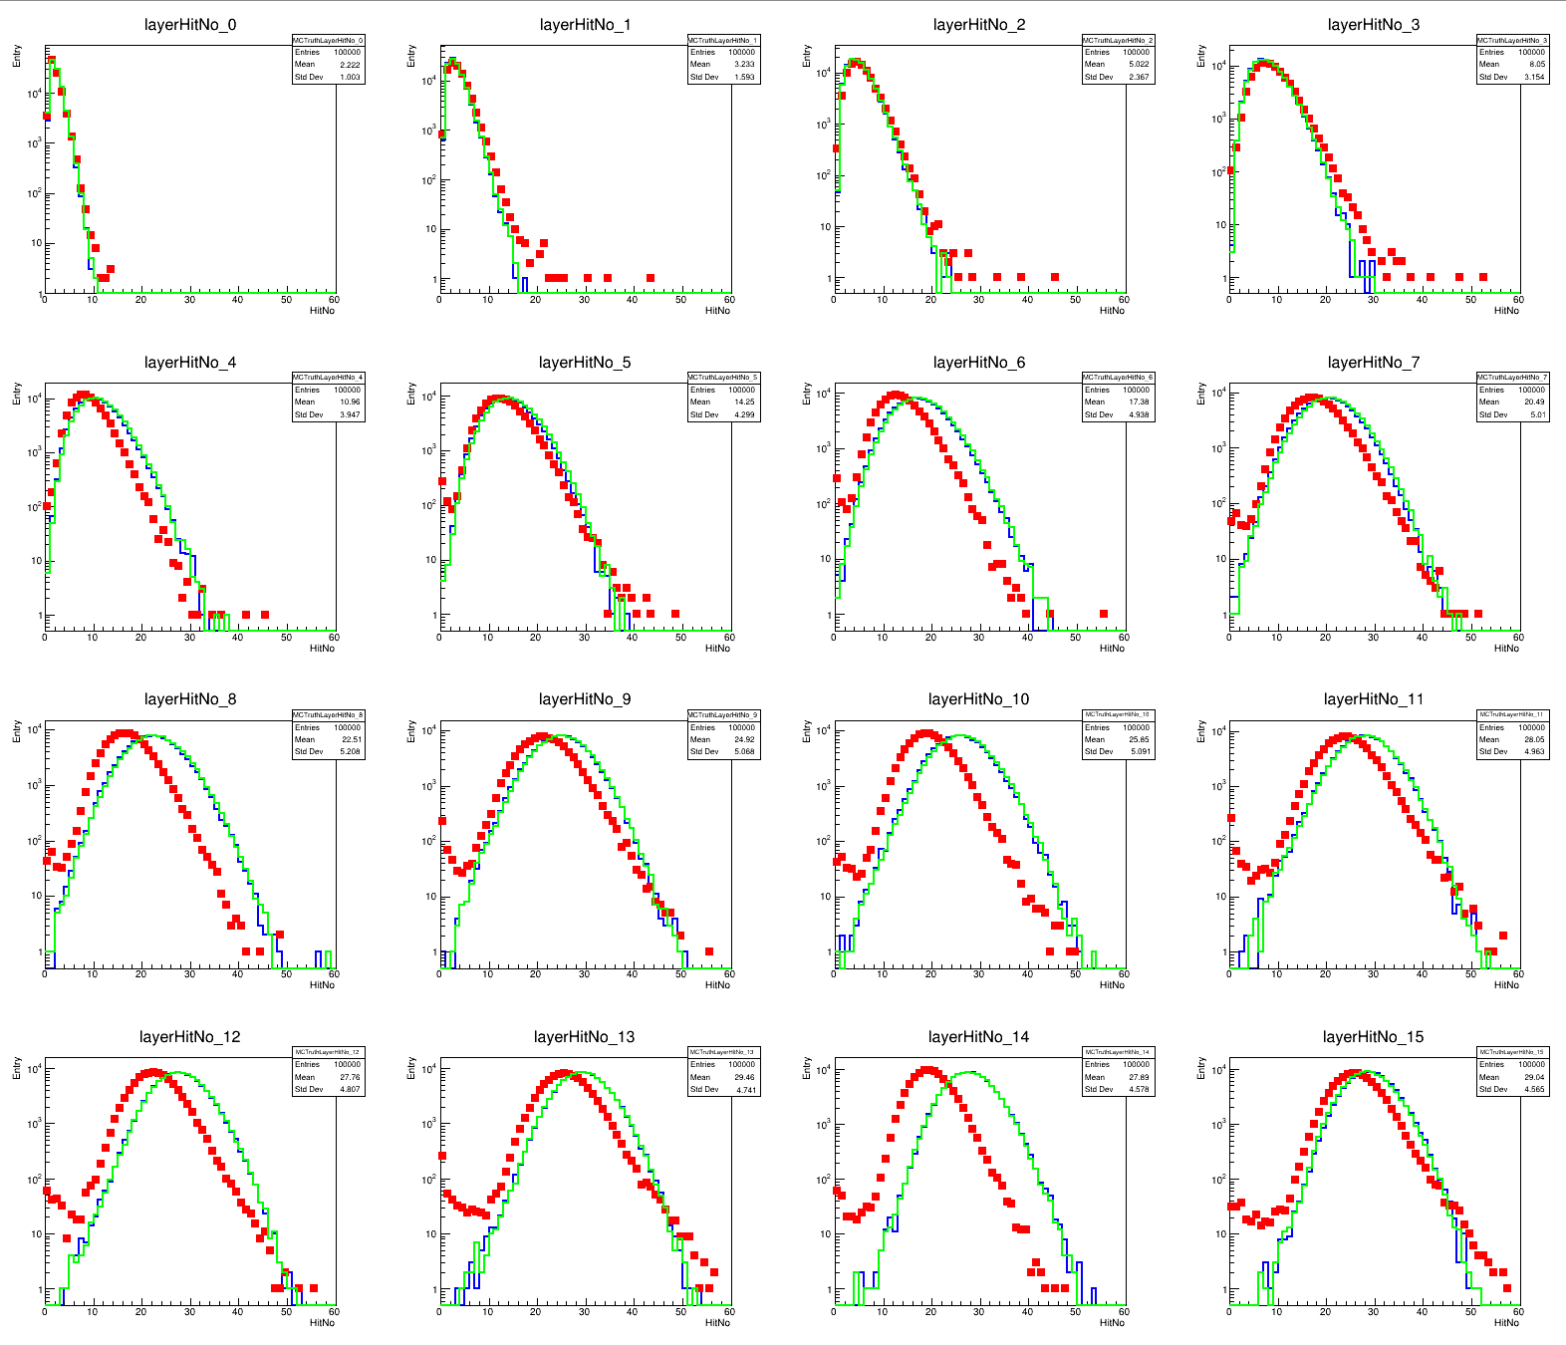
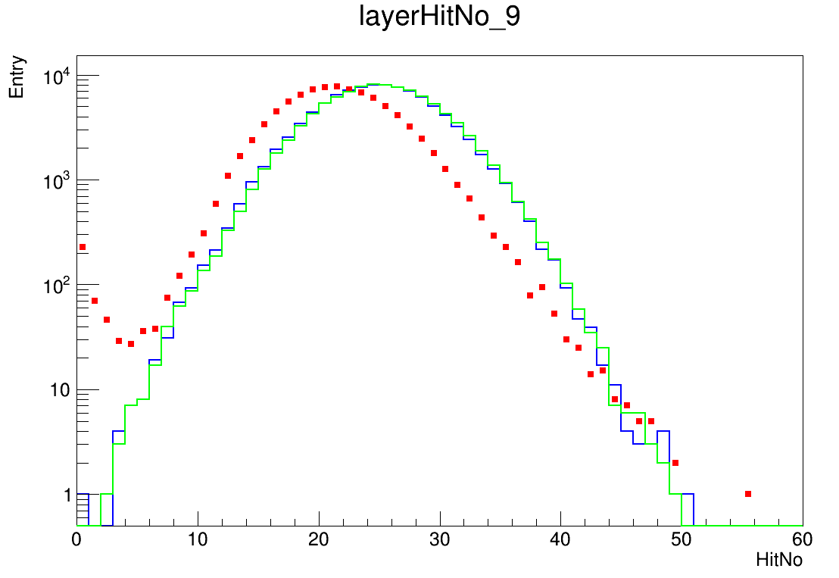
Layer hitNo
40GeV e-
Hit: 0.5MIP cut
Event: >50MeV and >100hits cut
Dead channel exclusion
Red: data
Blue: MC_truth
Green: MC_digi

Slide 5
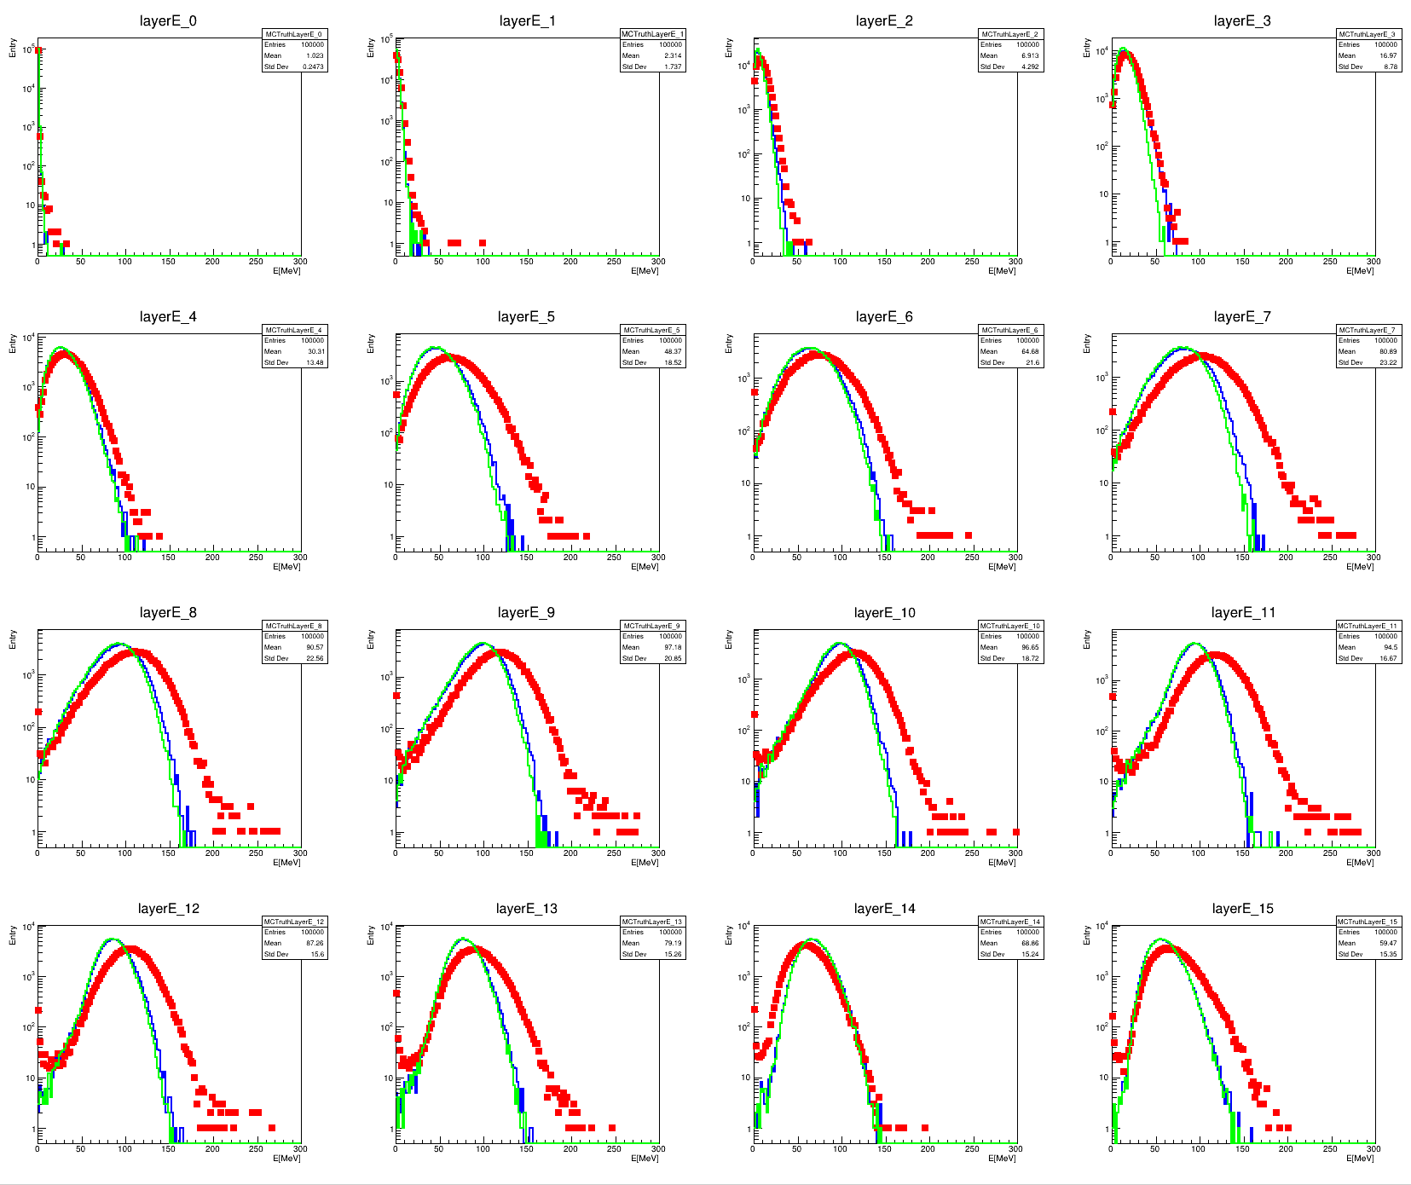
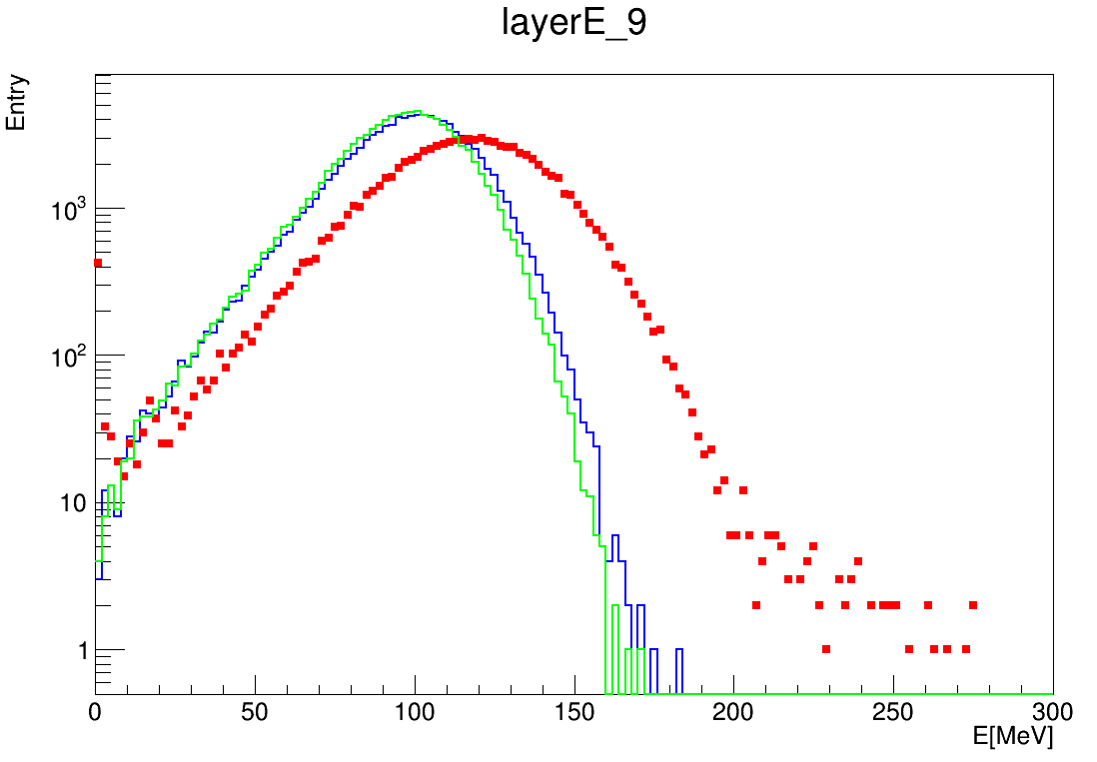
Layer energy deposition
40GeV e-
Hit: 0.5MIP cut
Event: >50MeV and >100hits cut
Dead channel exclusion
Red: data
Blue: MC_truth
Green: MC_digi

Slide 6
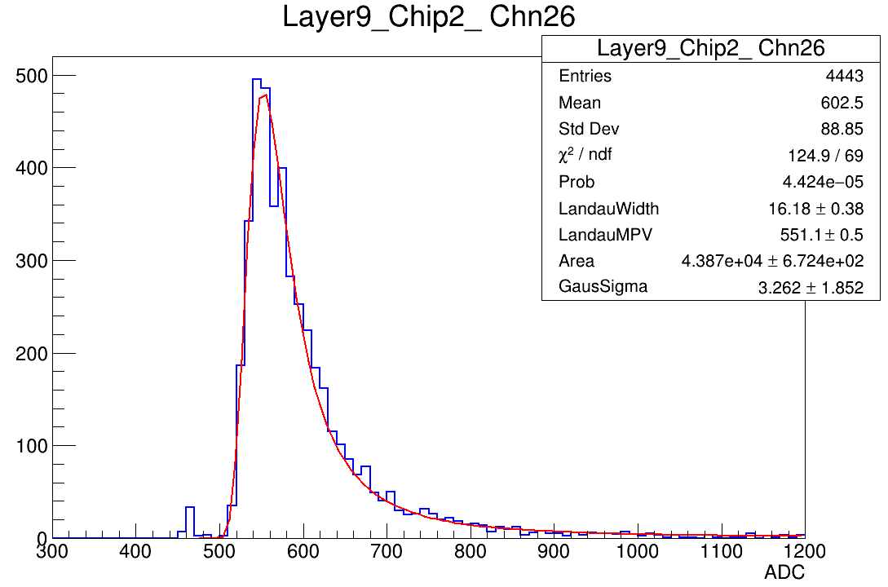
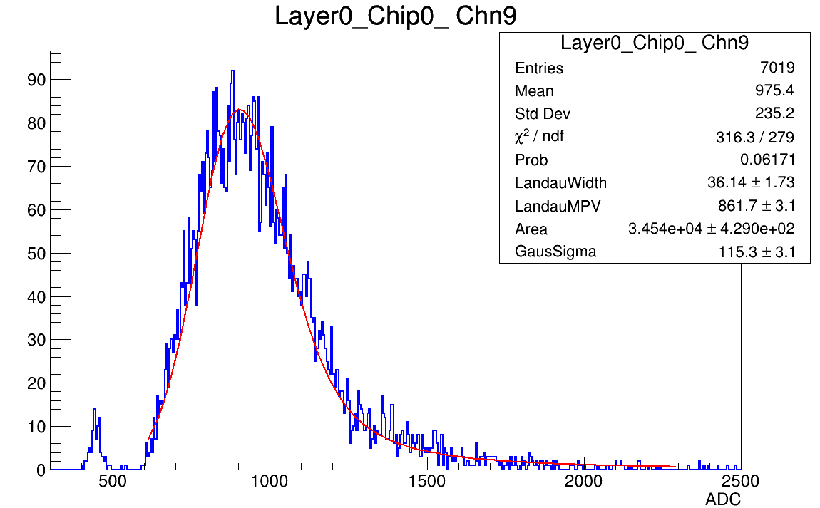
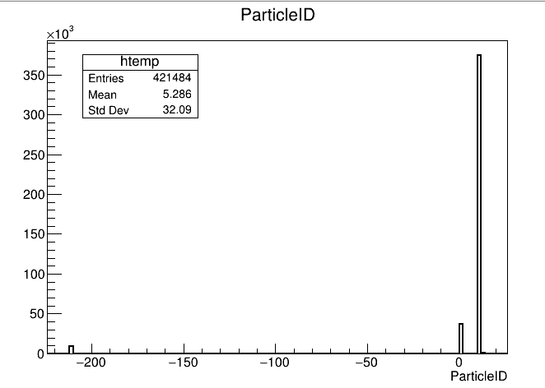
MC settings update
Threshold : 0.5MIP 1.0MIP
Mixed MC mac file setting
Electron: ~ 3.75*1e5
Hadron: ~ 9000
Noise: ~ 40000
electron
pion
noise

Slide 7
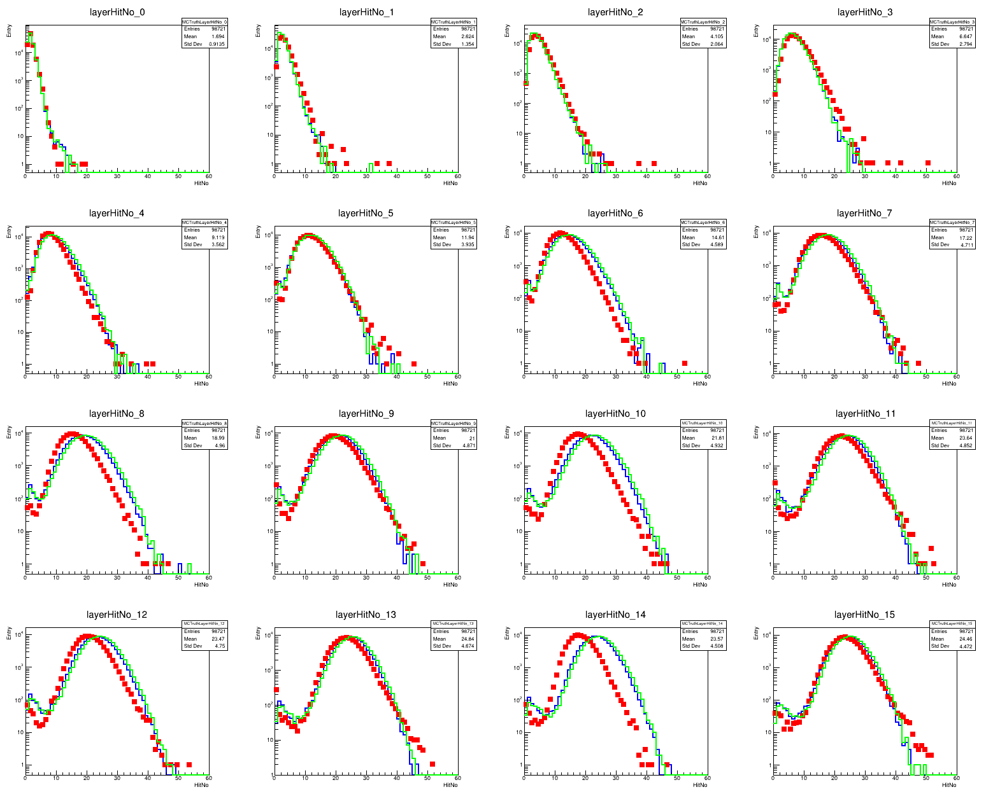
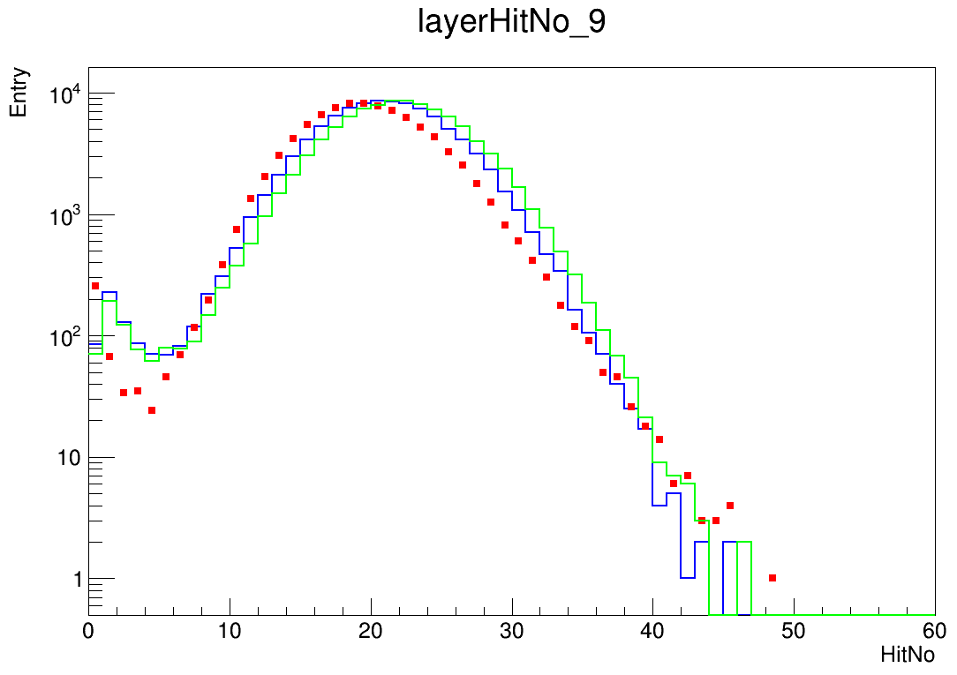
Layer hitNo improvement
40GeV e-
Hit: 1MIP cut
Event: >50MeV and >100hits cut
Dead channel exclusion
Red: data
Blue: MC_truth
Green: MC_digi
Odd layers match better, still difference on even layers

Slide 8
Summary && Plan
Not too much difference between MC truth and MC digitization
Data has larger deposited energy but less hitNo
Raise of threshold cut would help with hitNo matching, meanwhile odd layers and even layers show different behavior
Digitization needs to be improved
SiPM gain: Muon data and LED calibration
Single photoelectron peak width
Noise model

Slide 9
BACKUP

Slide 10
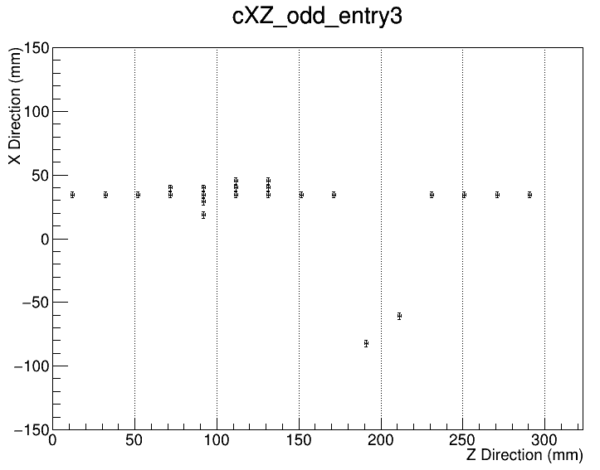
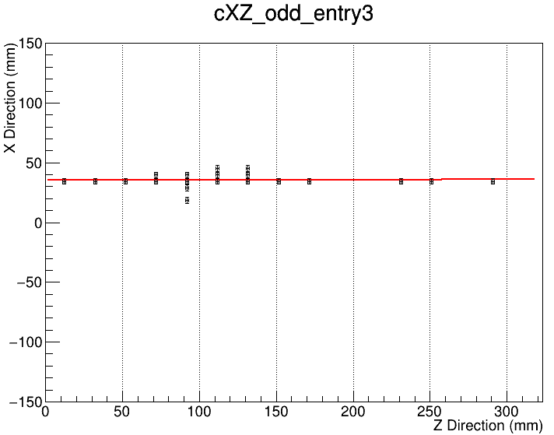
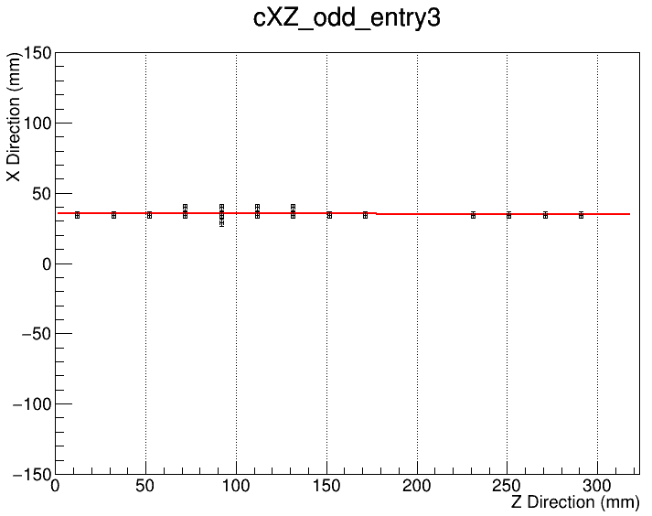
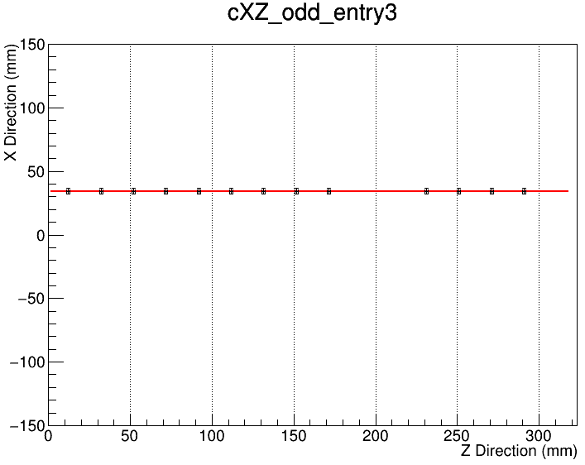
Track Fit - XZ
All hits
First fitting
Second fitting
Third fitting

Slide 11
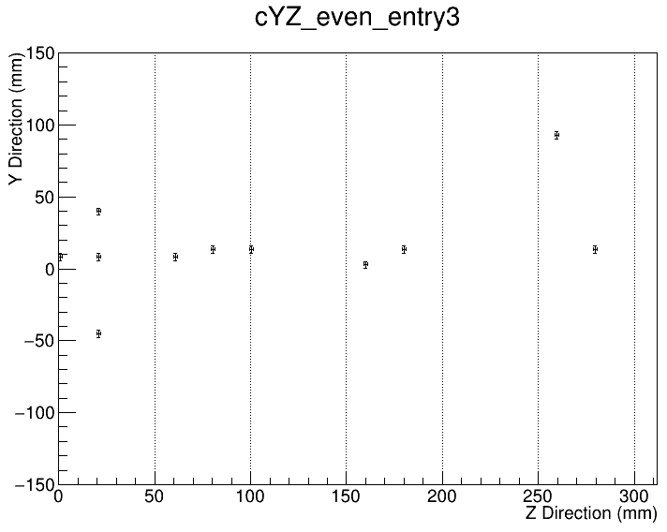
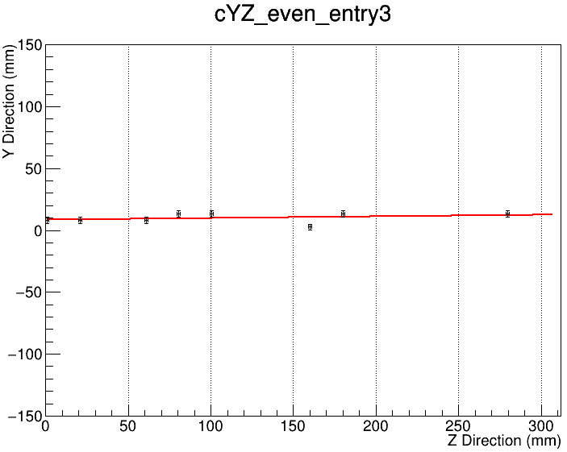
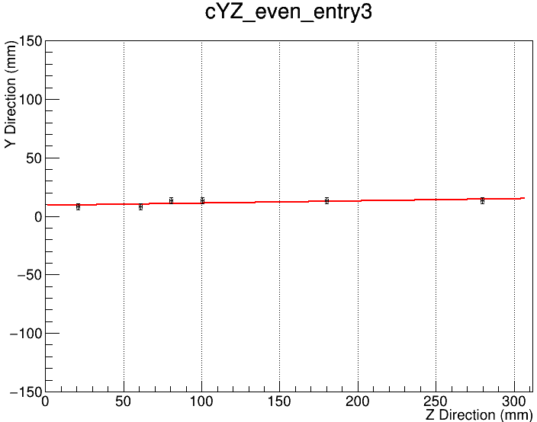
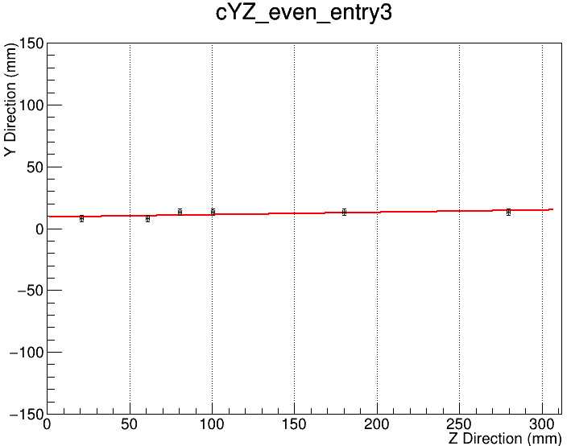
Track Fit - YZ
All hits
First fitting
Second fitting
Third fitting

Slide 12
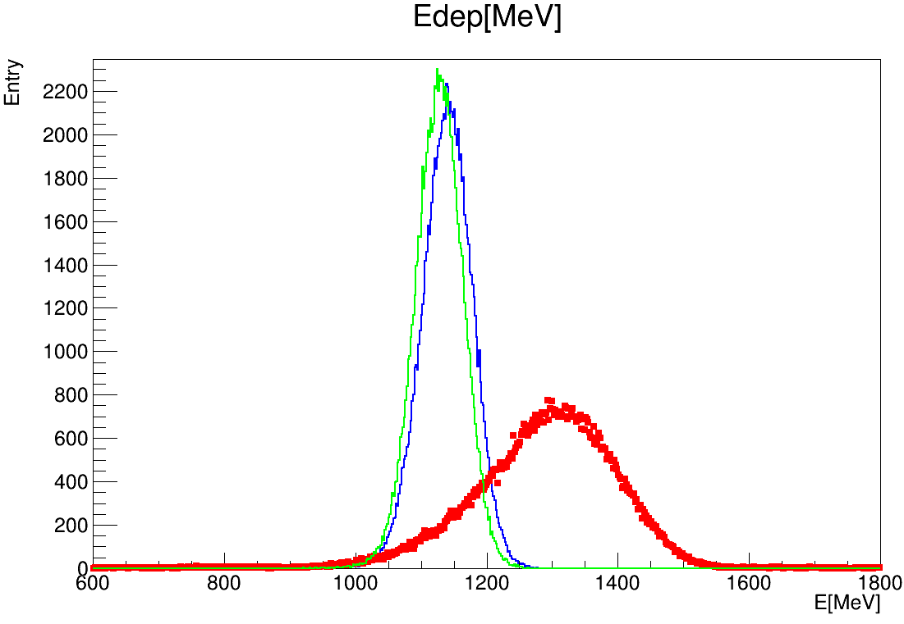
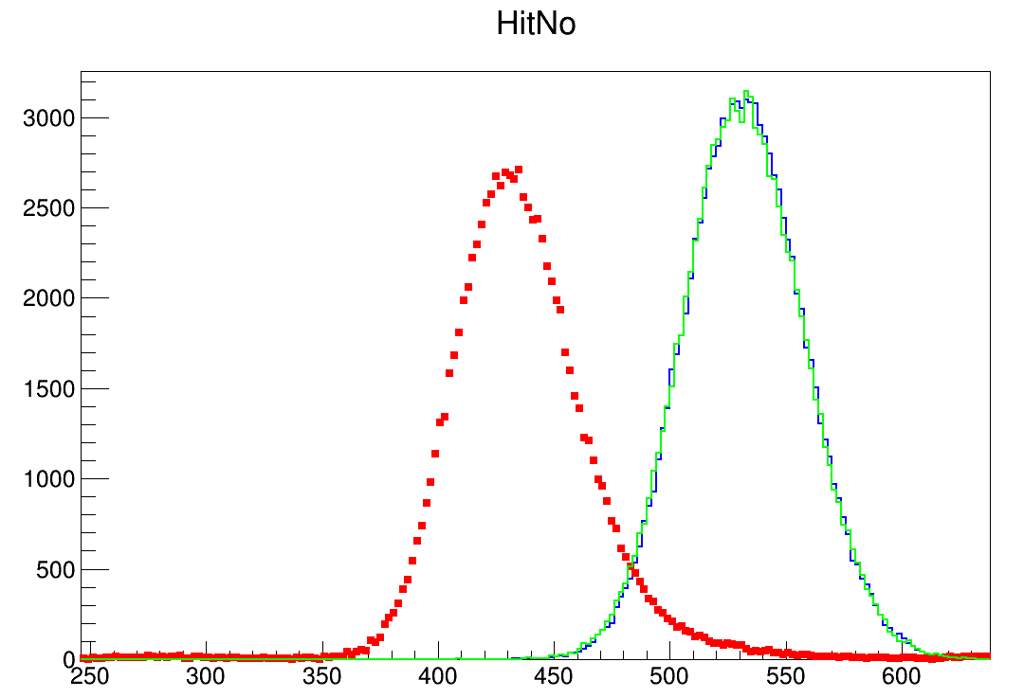
General comparison
Data with low hitNo but high deposited energy according to energy reconstruction
0.5MIP cut
Dead channel cut
>50MeV and >100hits cut for 40GeV electron data sets
Red: data
Blue: MC_truth
Green: MC_digi
Red: data
Blue: MC_truth
Green: MC_digi

Slide 13
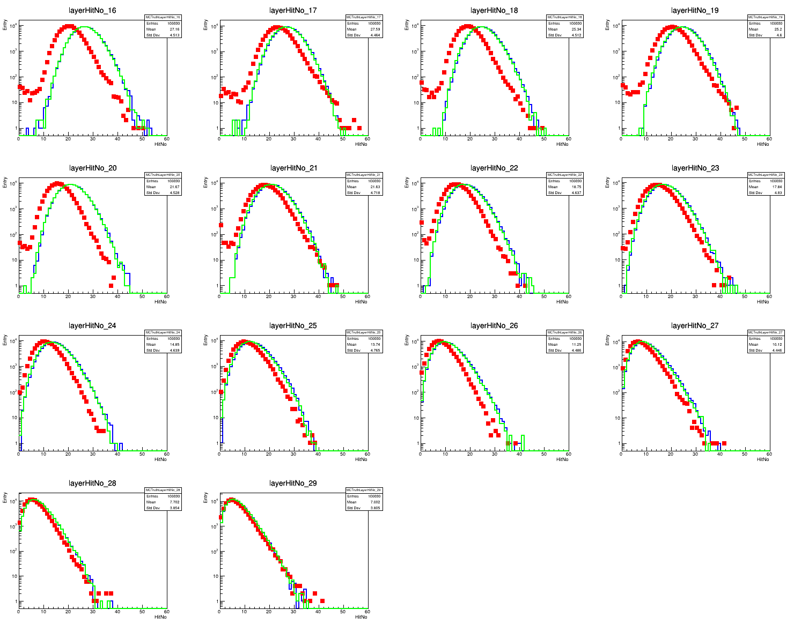
Layer hitNo
Layer No.16-29

Slide 14
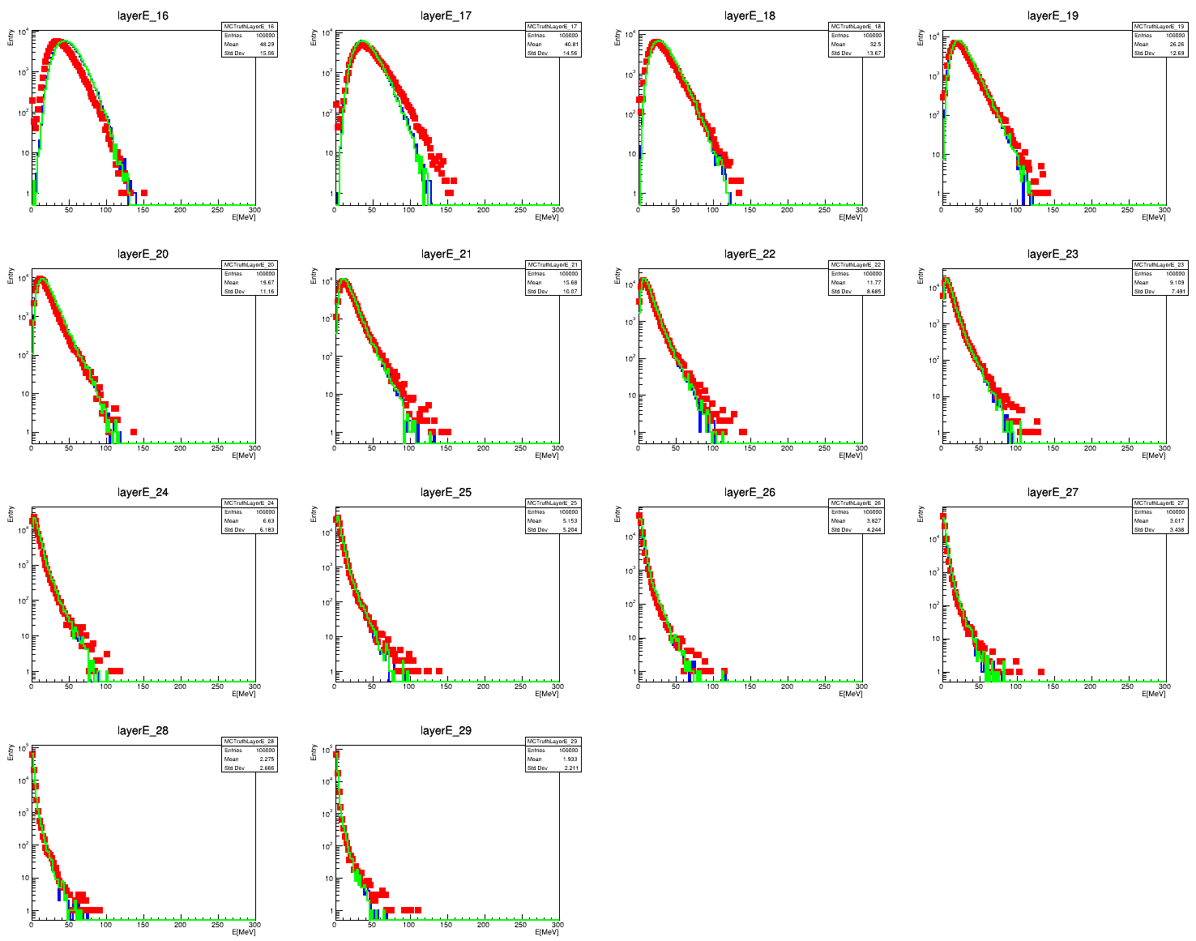
Layer energy
Layer No.16-29

Slide 15
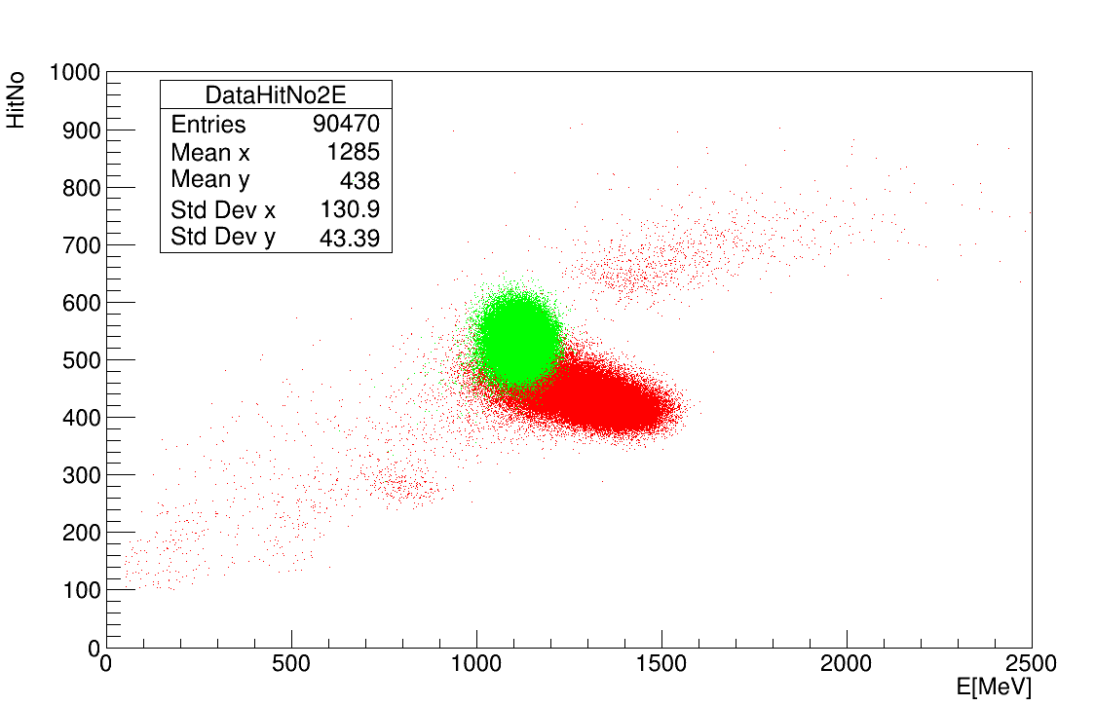
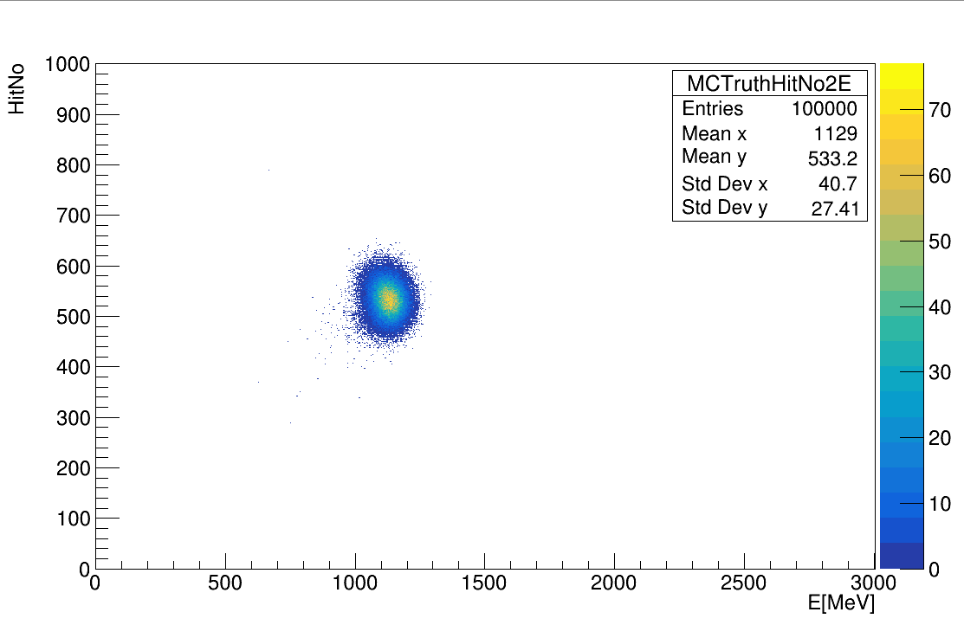
HitNo2Energy
Red: data
Green: MC_digi

