Slide 1
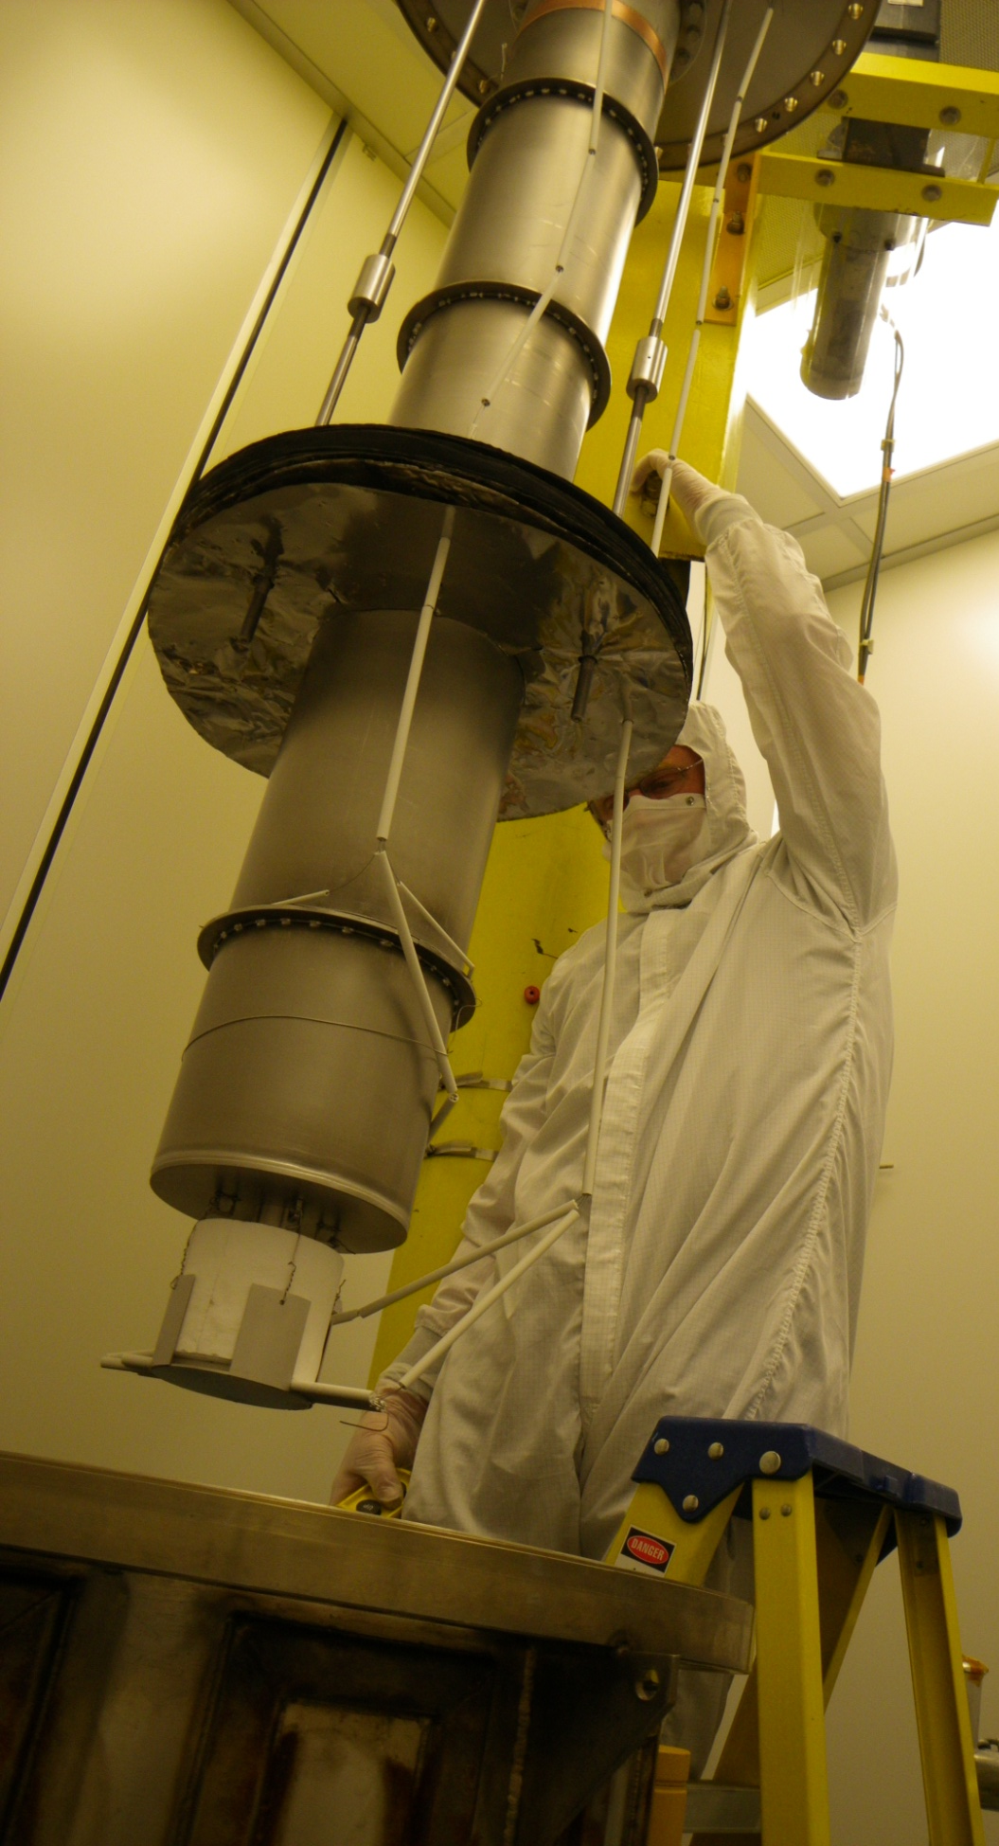
Cornell SRF New Materials Program Nb₃Sn Development
Sam Posen and Matthias Liepe
Cornell University
TTC Meeting
6 December 2011
Beijing, China

Slide 2
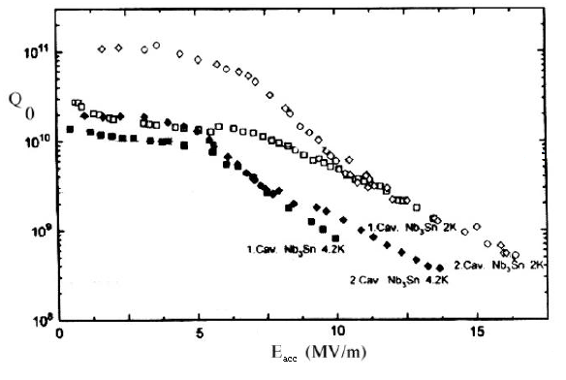
Motivation: Why Coat Cavities with Nb₃Sn?
Higher Q₀ than Nb for surface fields <~30 mT proven
Higher RF critical field than Nb predicted from theory
Great promise shown in experiments at University of Wuppertal in 80s-90s
We can add techniques that improved the performance of Nb cavities
HPR, EP, 120 deg C bake, CBP, single crystal Nb

Slide 3
Coating Mechanism
Vapor Diffusion
Coating chamber in UHV furnace
Sn vapor arrives at surface
Nb
Nb-Sn interdiffusion
Sn Vapor
Sn
Nb₃Sn
By independently controlling Sn vapor abundance, it can balanced with Nb-Sn interdiffusion rate to achieve desired stoichiometry
T_{f} = furnace temperature
=~1100 C
T_{s} = Sn source temperature
=~1200 C
Heater

Slide 4
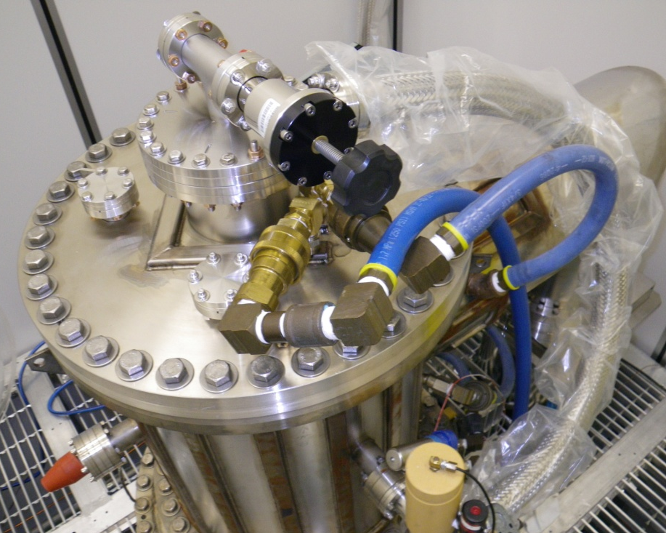
Nb₃Sn Coating Chamber
Copper transition weld from stainless to Nb
Coating chamber is inserted into UHV furnace. Separate vacuum system keeps cavity furnace free from tin contamination
Flange to UHV furnace
Nb heat Shields
Top of insert
UHV Furnace
Power for heater

Slide 5
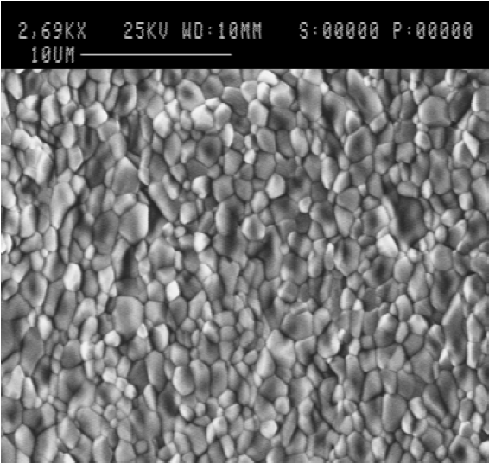
Accomplishments: Surface Studies of Samples
SEM shows micron sized grains similar to Wuppertal
Anodization color indicates Nb₃Sn on surface
Wuppertal, 1996
Cornell, 2011
1”
Not anodized
Anodized

Slide 6
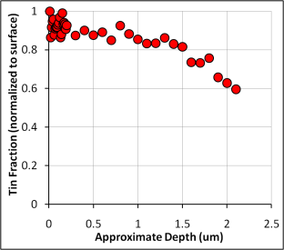
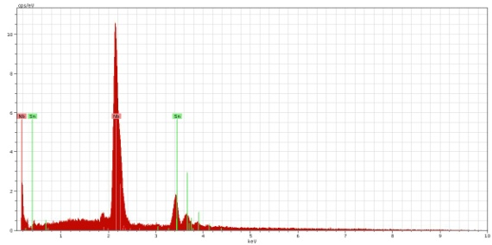
Accomplishments: X-ray Analysis
EDX: uniform composition over surface of 24.2±0.5 atm%Sn
XPS: uniform composition to a depth of 1.5 um

Slide 7
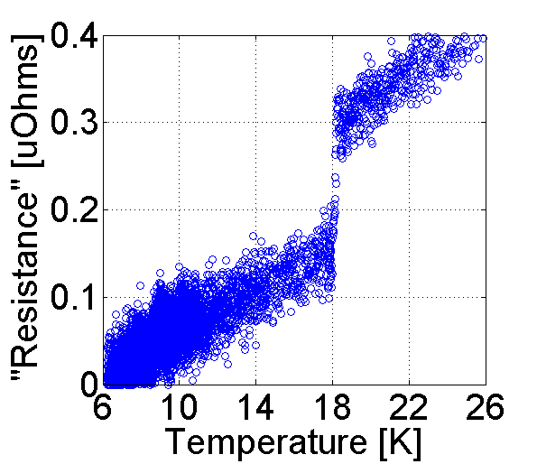
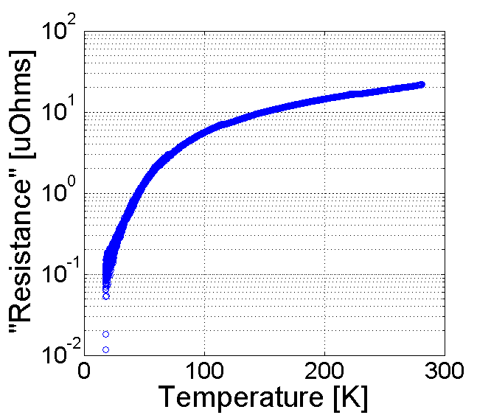
Accomplishments: Low Temperature Tests
Transition at 18.1±0.2 K, close to the highest recorded value of 18.3 K
Negligible RRR degradation from coating process
T_{c}
RRR

Slide 8
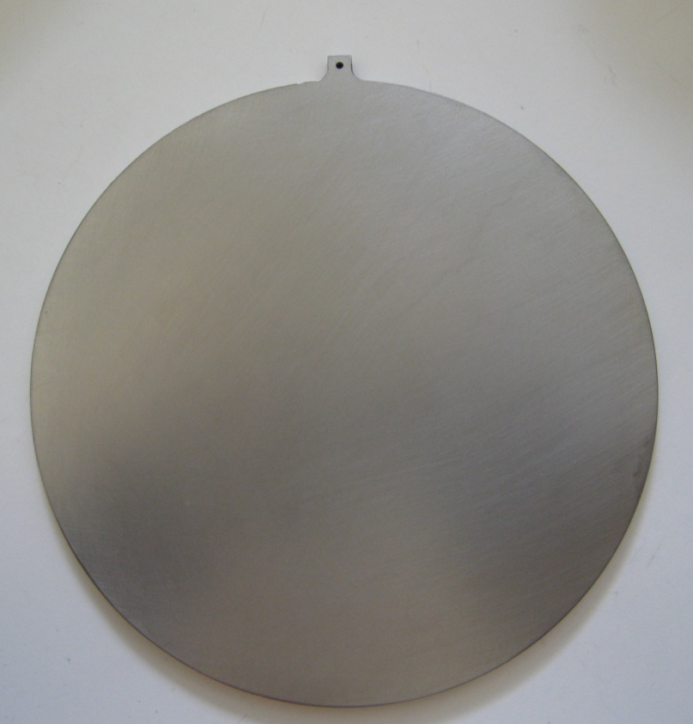
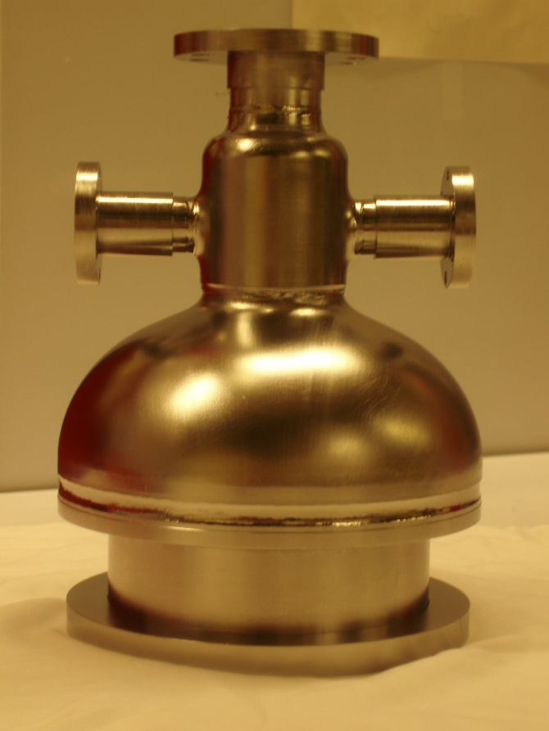
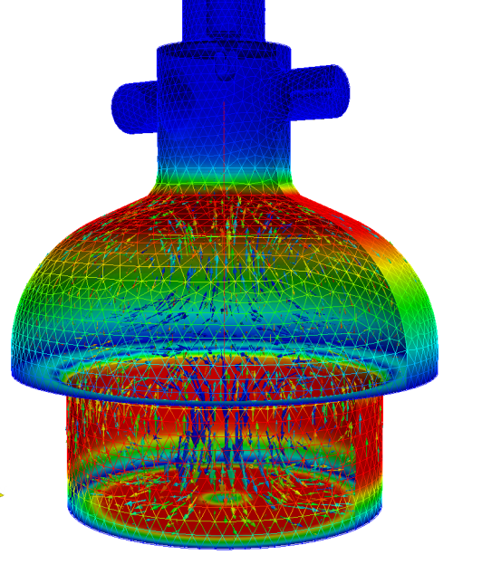
Current Work: Nb₃Sn Samples in TE Mushroom Cavity
Commissioning is under way of 6 GHz TE mushroom cavity with removable bottom plate
Plan: EP and coat 5” plate with Nb₃Sn then RF test
For holding during coating
5”

Slide 9
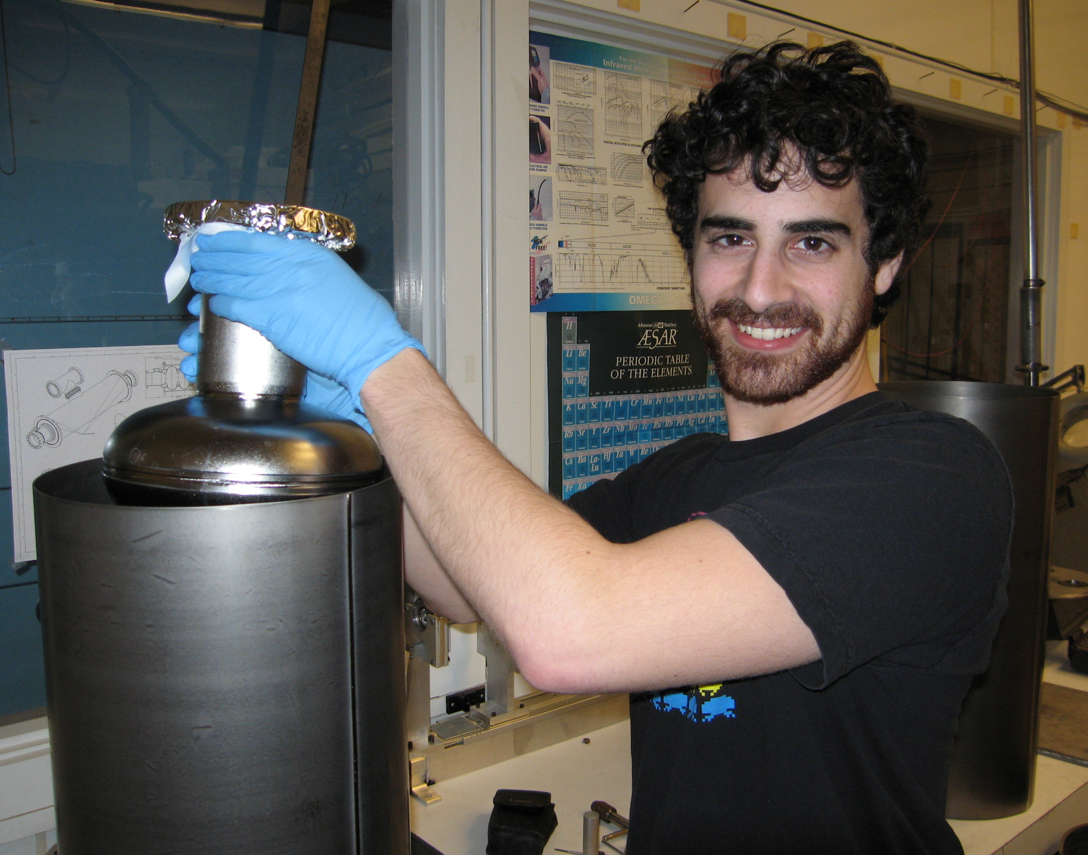
Current Work: Nb₃Sn Coated Single Cell Cavities
Designed upgraded coating chamber capable of loading full single cell 1.3 GHz cavities
Parts acquisition and fabrication has begun
Optimistic estimate for first coating: March
Tube for main body of coating chamber (niobium)

Slide 10
Outlook
Coat 5” sample with Nb₃Sn and RF test in TE mushroom cavity
Fabricate and commission new coating chamber
Coat ILC single cell cavity with Nb₃Sn and RF test with full T-map
Use RF performance as feedback to improve coating parameters

