Slide 1
SLIM BLADE TUNER. Modifications & Reliability. Lessons learned from FNAL’s Cryomodule #2 & S1-Global
Presented by Yuriy Pischalnikov (FNAL)
S1-Global tuners dis-assembly & failure analysis performed by
A. Bosotti, R. Paparello (INFN), Y.Pischalnikov (FNAL)

Slide 2
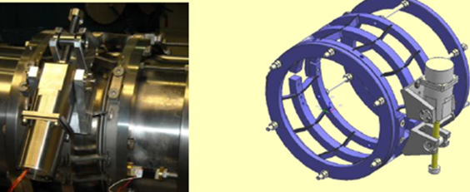
History
Fermilab adopted Slim Blade Tuner developed at INFN (Carlo Pagani team);
10 tuners built by INFN and delivered to FNAL (2 tuners went to S1-G & 8 used for CM2);
Later FNAL procure 40 more tuners with USA vendor (using INFN drawing);
INFN used transmission unit
(stepper motor/harmonic drive/CuBe shaft/SS nut) from original SACLAY I/DESY /TTF tuner

Slide 3
CM2 assembly at ICB/TD FNAL (11/23/2011)

Slide 4
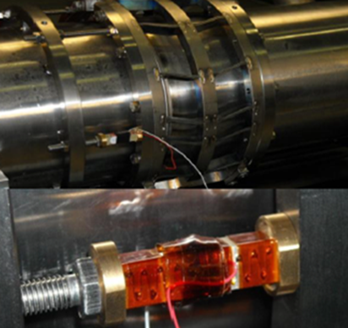
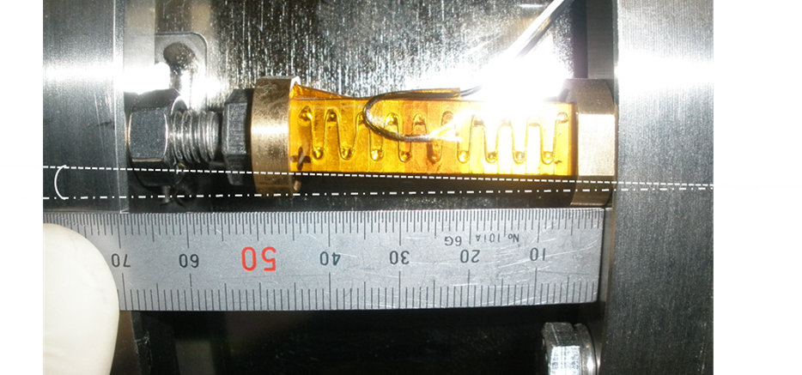
Modification of the FAST PIEZO Tuner
1) Shearing Forces applied to piezostack
S1-Global
2) Brass cup modifications
3) Piezostack insulation/HV breakdown issues
200V
Ceramic end plate
ground

Slide 5
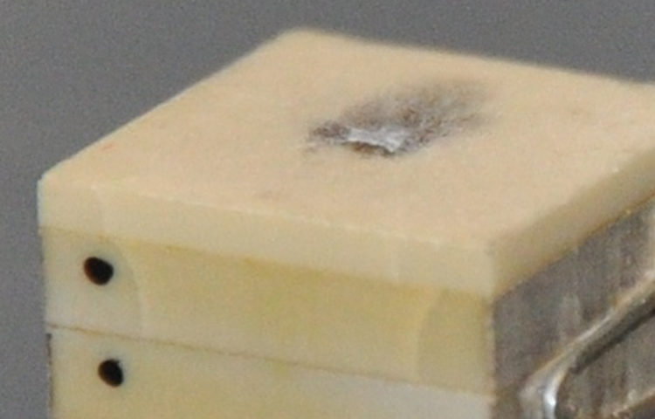
Piezo tuner failure at S1-G (cavity C2) as a result of large shearing forces on piezo and bump in the center of the brass cup
Post removal analysis revealed that coupler side piezo in C2 was significantly damaged with fractures found at one edge of the stack:
Cracks passing through electrical layers with possible sputtering of metal, thus explaining the systematic discharge at lower voltage.
Integrity of piezo ceramic impaired, thus explaining the lack of piezo tuning efficiency observed (damaged stack acted, on the small range, as a soft element in series with the cavity)

Slide 6
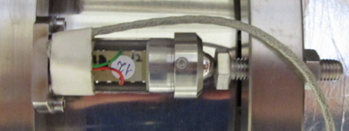
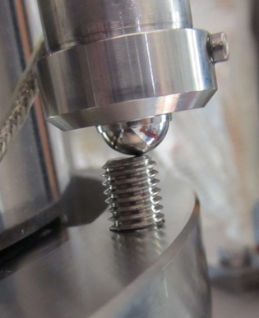
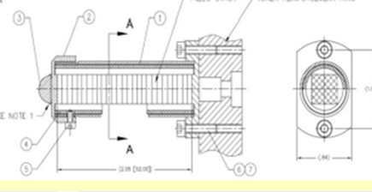
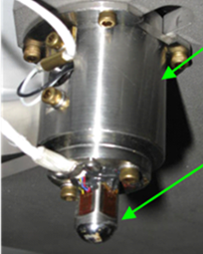
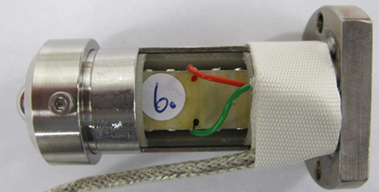
Fast (Piezo) Tuner Fixture Modification for CM2 encapsulation of the piezo
Original INFN design
CM2 Piezo Holder
SSR1 piezo encapsulation

Slide 7
Slow Tuner Failure at S1-Global triggered more extensive test of Blade (slow) Tuner test at HTS (as a part of 1.3GHz cavities qualification for CM2)

Slide 8
CM2 Slow Tuner Failure#1 Failure of INFN/FNAL tuner at S1-G led to development of the automated system for Slow Tuner test. Tuner failed after just first extended test (400 motor increments instead of 20-as it was done before)
M3 Set screw holding part of the harmonic drive on the shaft of the stepper motor became loose.
Rotation of the stepper motor shaft do not translated to harmonic drive/BeCu shaft/blade tuner

Slide 9
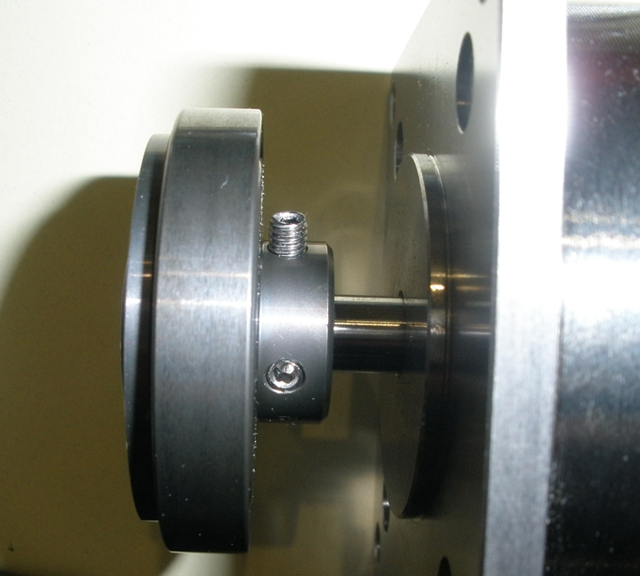
set screws unscrewed ➔failed to hold wave generate on the stepper motor shaft

Slide 10
Solution of problem (#1) implemented for CM2 (proposed and implemented by C.Grimm)

Slide 11
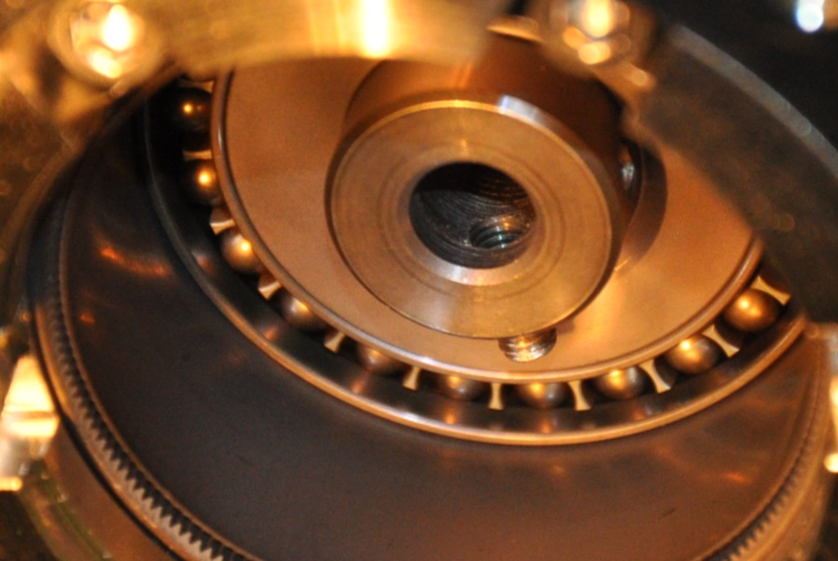
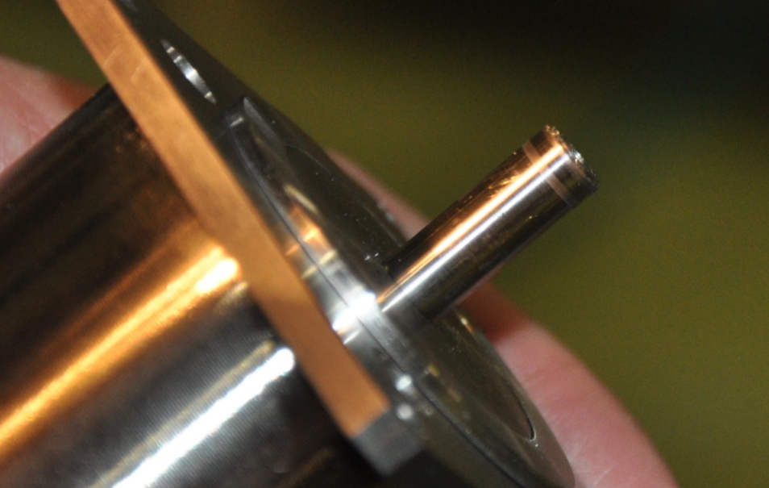
Motor failure in C2
Stepper motor in C2 has been removed to reveal the issue:
Loss of grip between the motor shaft and the harmonic drive wave generator
One of the two screws connecting the parts was found totally unscrewed due to operational vibrations
The only screw in position was not sufficient to provide grip and it was sliding over the motor shaft

Slide 12
As Rocco expressed it:
Originated by a lack in the drive unit design:
DESY experience on this specific issue was somehow “lost in translation” …

Slide 13
“ Expected lifetime” of the Slow Tuner

Slide 14
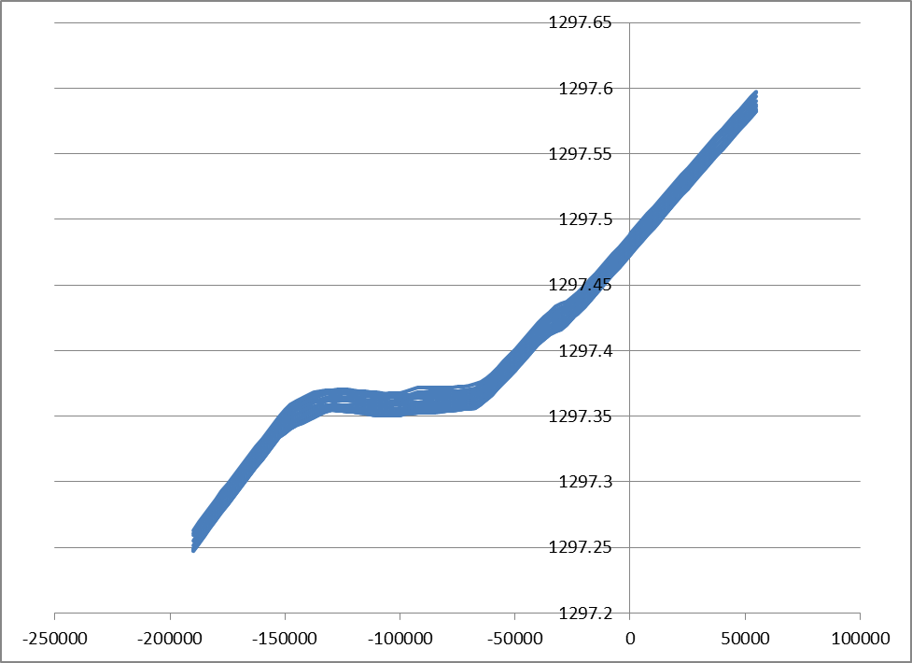
10% (5Mstep) warm test of the all re-assembled StepperMotor/HD/CuBe/SSnut units with dummy cavity/tuner assembly
Cavity frequency, MHz
Motor steps

Slide 15
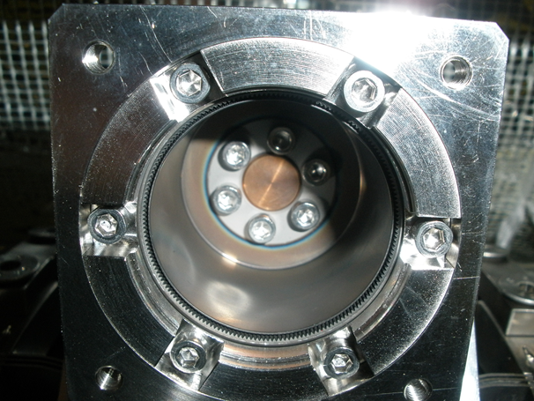
CM2 Slow Tuner Failure #2
During test at warm condition for 10% of “L-T” ==5Msteps second failure.
6 screws, used to attached CuBe shaft to harmonics drive gear, became loose.
All 8 tuners –harmonics drive/motor/CuBe have been disassemble again..
Special washers used to fix problem.
To reduced vibration:
Stepper motor operation with 700step/sec (instead of 200steps/s) and microstepping (sinewave pulse)
6 screws, used to attached CuBe shaft to harmonics drive gear

Slide 16
Cold test of the tuner at HTS Extended “life-time” test
Our objective was to do “extended” –”life-time” cold test of Slim Blade Tuner”.
So far Slim Blade Tuner never tested for extended range ~50Msteps.
FNAL had only 8 CuBe shafts in hands… all of them were installed on the CM2.
INFN send us CuBe shaft and SS nut (pitch was 1.5mm instead of 1mm)
Tuner FAILED after ~ 6Mstep.
SS nut seized on the CuBe shaft.

Slide 17
Picture of damage CuBe shaft after last cold “extended” range test

Slide 18
Status of the Extended cold test of Slim Blade Tuner at HTS
New 10 CuBe shaft build at USA have been procured--- (pitch 1mm)
New shaft installed on the tuner on the cavity at HTS.
Plan is to proceed with 30Mstep test.
Do it sloooow. Not more than 3Mstep per day
So far after 2 days of testing (Dec. 3-4)we accumulated 6Mstep …. NO PROBLEMS

Slide 19
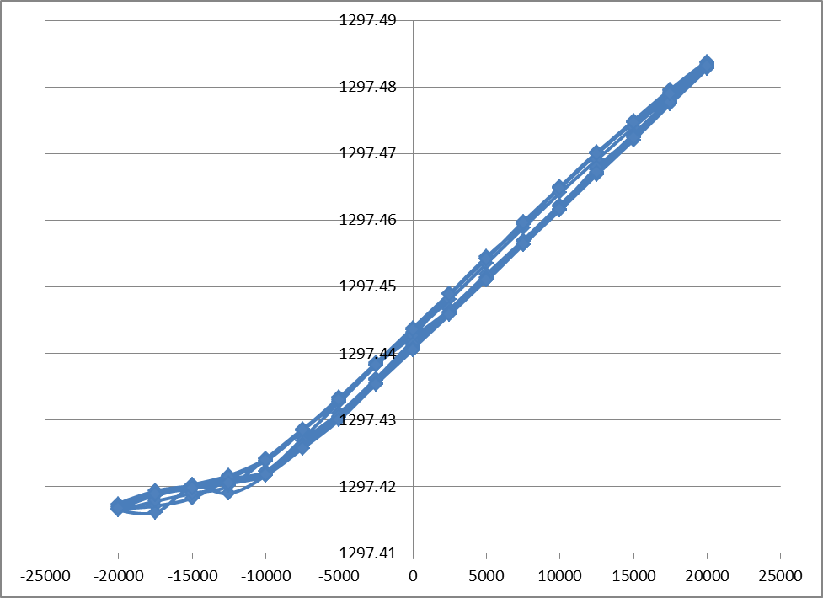
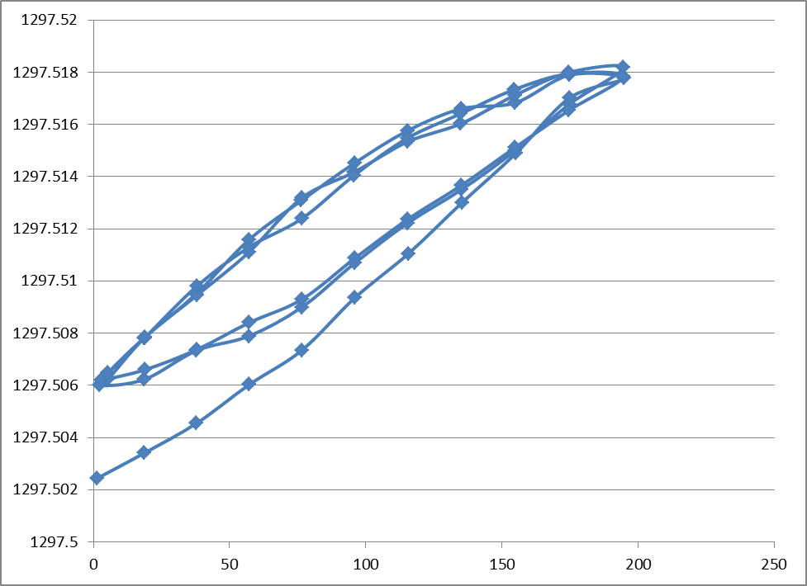
Status of QC testing of Tuners for CM2 1) All 8 Motor Units went throught warm test for 5Mstep (10%) before installation on the CM2 tuners 2) 500kstep (1%) warm test for all 8 slow tuner & Piezo tuners installed on Cold mass assembly done.
MOTOR TEST
PIEZO TEST
12kHz~40um
200V
Piezo Voltage

Slide 20
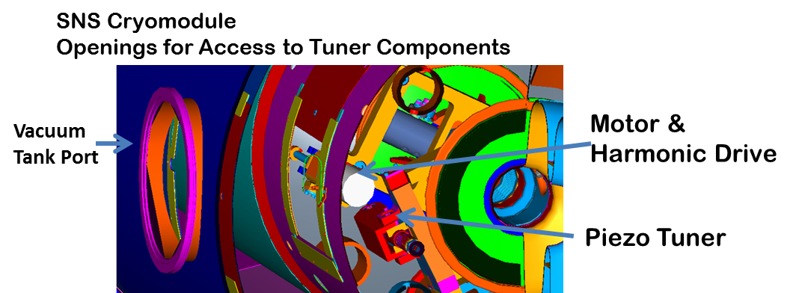
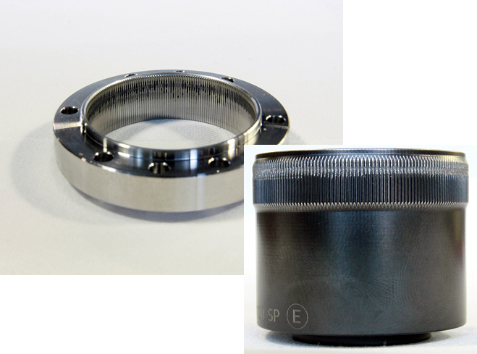
Tuners Reliability Issues Coarse/slow tuner
TTF/DESY experience (burn 4 motor just by leaving (by mistake) holding current on the stepper motors)
SNS
A total of 14 tuners failed at SNS due to combination of harmonic drive failures and fractures of the piezo encapsulation. The harmonic drive failures have been attributed to misalignment during assembly.
Vacuum port (penetration to reach & replace ) failed tuner

Slide 21
Summary
Extensive tests of all components of the tuner (warm & cold) during design stage (with quick feed-back to designers) very important..
Extended “lifetime” test at real condition
Design of cryo-module with access/capability (vacuum port) to replace/fix tuner (SNS experience…)

