Slide 1
Design of a SHORT Cryomodule for the
Superconducting Proton Linac of CERN
IPNOrsay – CNRS
Sébastien ROUSSELOT
Patxi DUTHIL
Patricia DUCHESNE
Philippe DAMBRE
Denis REYNET
CERN
Vittorio PARMA
Arnaud VANDE CRAEN
Paulo AZEVEDO
Lloyd R. WILLIAMS
Ofelia CAPATINA
CEA
Stéphane CHEL
Guillaume DEVANZ

Slide 2
contents
- Context of the SPL
- β=1 cryo-module in a possible SPL layout
β=1 cavity layout
2K Heat loads
Segmented configuration, dimensions
- Goal & motivations of the short cryomodule
Goal & motivations
Cryostat specific main objectives
- Cryogenic aspects
Short cryomodule cryogenic scheme
Cooling lines
Filling lines
Coupler cooling lines
- Cavity Supporting System
The supporting system concept
The vacuum vessel/coupler interface
The inter-cavity supporting system
- Short cryomodule layout
- Vacuum vessel design
Constraints
Requirements
Vacuum vessels and tooling concepts
Cold magnetic shielding
Thermal shielding
- Summary

Slide 3
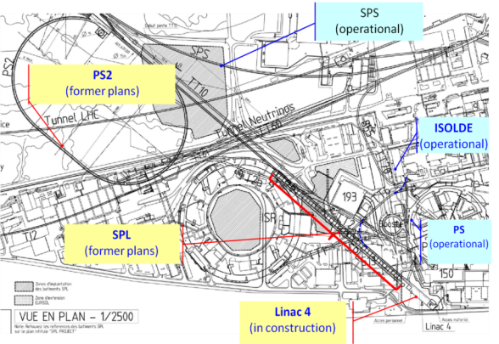
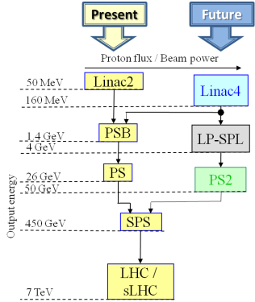
Context of the spl
CERN’s expected new LHC injection line (former plans)
LP-SPL: Low Power-Superconducting Proton Linac (4 GeV)
PS2: High Energy PS (~ 5 to 50 GeV – 0.3 Hz)
sLHC: “Super-luminosity” LHC (up to 10³⁵ cm⁻²s⁻¹)

Slide 4
Goal & motivations of the short cryomodule
CERN’s new scientific strategy: R&D for a High Power SPL (HP-SPL)
General orientation:
Focus on R&D for key technologies for a high-intensity proton source (HP SPL) for a neutrino facility
In particular, for the cryo-module development:
Development, construction and test of β=1 elliptical cavities, 704 MHz
Development, construction and test of RF couplers
Test of a string of 4 β=1 cavities in a machine-type configuration
This program calls for the design and construction of a short cryo-module for testing purposes

Slide 5
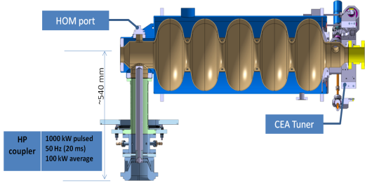
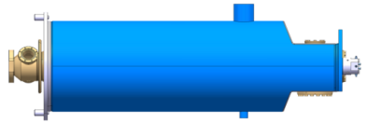
β=1 cryo-module in a possible SPL layout
β=1 cavity layout
Cryogenic connection
CEA cavity design
Stainless steel He vessel
Reserve port
Tooling interface
Tooling interfaces
Tooling interface
Requirement | Value
β | 1
Frequency | 704.4 MHz
Qo | 5 x 10⁹
Gradient | 25 MV/m
Operat. T | 2 K
The He vessel includes specific interfaces for the cryomodule integration:
Inter-cavity supports
1 cryogenic feed
External magnetic shielding via cryoperm™ (not shown)
Tooling (in/outside the clean room)

Slide 6
β=1 cryo-module in a possible SPL layout
2K Heat Loads (per β=1 cavity)
Operating condition | Value
Beam current/pulse lenght | 40 mA/0.4 ms beam pulse | 20 mA/0.8 ms beam pulse
cryo duty cycle | 4.11% | 8.22%
quality factor | 10 x 10⁹ | 5 x 10⁹
accelerating field | 25 MV/m | 25 MV/m
Source of Heat Load | Heat Load @ 2K (per cavity)
Beam current/pulse lenght | 40 mA/0.4 ms beam pulse | 20 mA/0.8 ms beam pulse
dynamic heat load per cavity | 5.1 W | 20.4 W
static losses | <1 W (tbc) | ~ 1 W (tbc)
power coupler loss at 2 K | <0.2 W | <0.2 W
HOM loss in cavity at 2 K | <1 | <3 W
HOM coupler loss at 2 K (per coupl.) | <0.2 W | <0.2 W
beam loss | 1 W | 1 W
Total @ 2 K | 8.5 W | 25.8 W

Slide 7
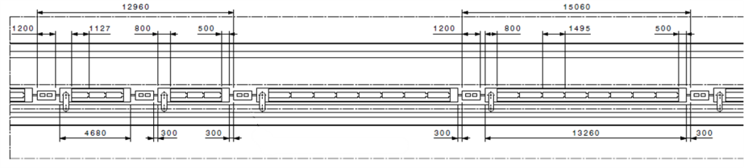
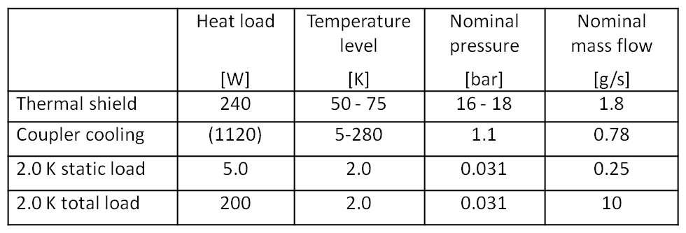
β=1 cryo-module in a possible SPL layout
« Segmented » architecture with warm quads and a cryo distribution line
60 β=0.65 cavities in 20 cryomodules
184 β=1 cavities in 23 cryomodules
SRF linac ∼ 500 m long
Warm quadrupole
Cryogenic Distribution Line
β=0.65 cryomodule (3 cavities)
β=1 cryomodule (8 cavities)
Jumper
Heat loads for SPL high-β module
Static load estimated to 2.5 % of total load.
Assessment of static load is of minor importance at this state
(end of conceptual design)

Slide 8
Goal & motivations of the short cryomodule
The short cryomodule design strategy
Test-bench for RF testing on a multi-cavity assembly driven by a single or multiple RF source(s)
Enable RF testing of cavities in horizontal position, housed in machine-type configuration
Validate the design of critical components like RF couplers, tuners, HOM couplers in their real operating environment → short cryomodule design
Goal
Design and construct a ½-lenght cryomodule
for the test of 4 β=1 cavities (instead of 8 in a machine type cryomodule)
in conditions as close as possible to a machine-type cryomodule
4 cavities less
  Mechanical design
  Cryogenics (Heat loads, T and P profiles, segmented machine layout)
  Designed for 0%-2% test (for 1.7% expected tunnel slope)

Slide 9
Goal & motivations of the short cryomodule
Cryostat and tooling overview
Cryostat specific main objectives
Learning of the critical assembly phases:
From the assembly of cavities in the clean room to the a cryomodule test
Alignment/assembly procedure
Proof of concept of “2-in-1” RF coupler/cavity supporting:
Fully integrated RF coupler: assembly constraints
Active cooling effect on cavity alignment
Operation issues:
Cool-down/warm-up transients, thermo-mechanics, heat loads
Alignment/position stability of cavities
Cryogenic operations (He filling, level controls, RF coupler support tube cooling)
Technical solutions focus on the ½-lentgh cryomodule
But technical solutions are developed for the full length cryomodule
(Specifically the tooling for the cryostating)

Slide 10
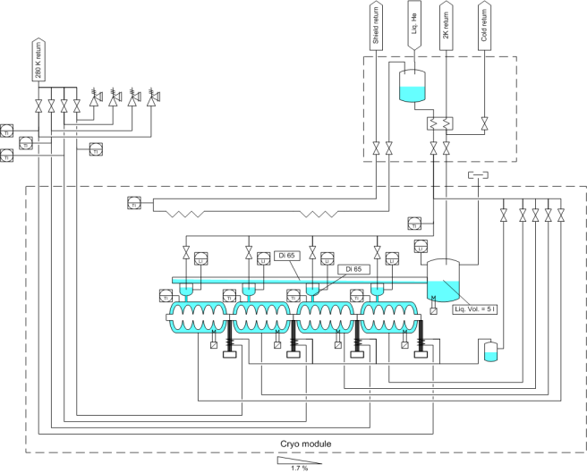

Cryogenic aspects
Short cryomodule cryogenic scheme
Coupler
cooling
SM18 connexion valves
Thermal shield (50-75K)
Pumping line
Cavity top supply
Cavity cooling down lines
Bi-phase pipe
Coupler
cooling

Slide 11
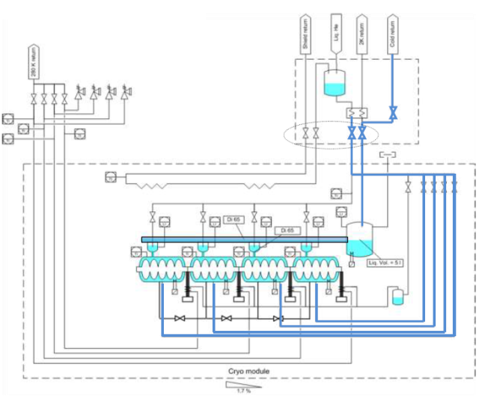
Cryogenic aspects
Cooling lines
Requirements: 1 cooling line per cavity
Cavity cooling down lines
Mass flow rate ∼2.5g/s per cavity
Expectation (machine): 1 cooling line for the hole string of cavities ?

Slide 12
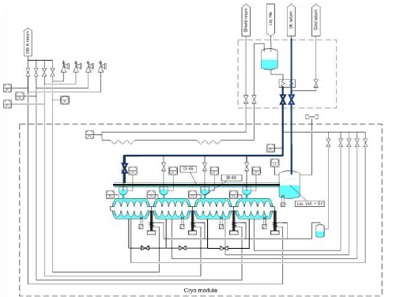
Cryogenic aspects
Filling lines
Requirements: 1 JT valve may allow for the filling of the first cavity then for the filling of the others via a roman fountain (successive helium fall filling via the diphasic pipe)
Cavity top supply
Mass flow rate ∼10g/s
Slope : 1.7% (ajustable from 0 to 2% for the tests)

Slide 13
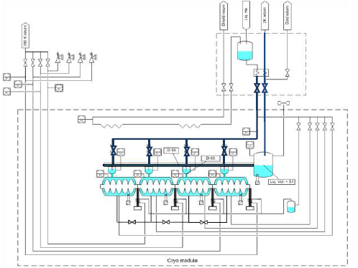
Cryogenic aspects
Filling lines
Requirements: If slope = 0% or in case of a problem with the roman fountain (superfluid)
⇒1 filling line per cavity (each being equipped with a JT valve)
(Prototype only:
priority = test bench for a string of 4 cavities)
Cavity top supply
Mass flow rates ∼2.5g/s per cavity
Slope : (0% for the tests)

Slide 14
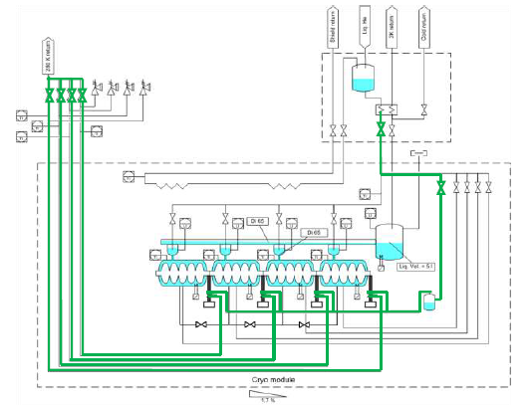
Cryogenic aspects
Coupler cooling line
Requirements: One single line for the cooling of the couplers.
4 outlets with 4 control valves @ 300K
1 vaporizer (boiler)
Vaporizer
Mass flow rate ∼0.8g/s
Outlets

Slide 15
Cavity Supporting system
The concept
Intercavity supports
RF coupler double-walled tube flange fixed to vacuum vessel
The RF coupler (its double-walled tube) provides:
fixed point for each cavity (thermal contractions)
mechanical supporting of each cavity on the vacuum vessel
The intercavity supports provide:
a 2nd vertical support to each cavity (limits vertical self-weight sag)
relative sliding between adjacent cavities along the beam axis
enhancement of the transverse stiffness to the string of cavity
(increases the eigenfrequencies of first modes)

Slide 16
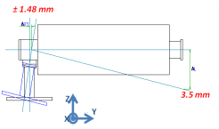
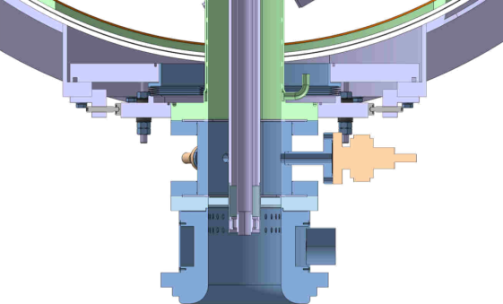
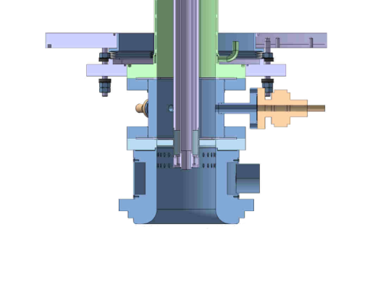
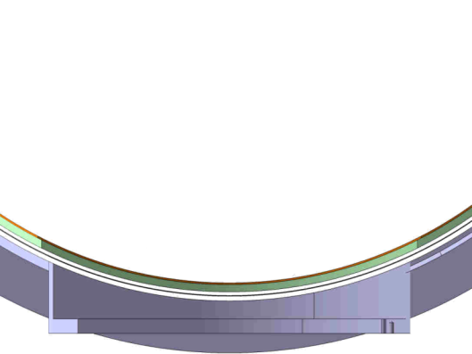
Cavity Supporting system
Coupler / Vacuum vessel interface
Interface → fixed point, compensation of the geometrical defaults {coupler + cavity}
Status:
Detail designed done
A mock-up is under construction by CERN
To be tested (Q1/2012)

Slide 17
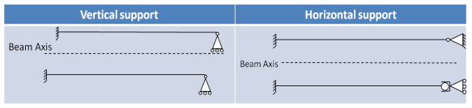
Cavity Supporting system
Inter-cavity supports
Thermal contraction:
Longitudinal
  4.5 mm
Transversal
  1.15 mm
  Max displacement
  of beam axis = 0.6 mm (transient)
  ⇒ deformation of helium tank
Vertical
  1.2 mm
  Blocked
  ⇒ deformation of helium tank
Free space for supports
2 supports
Detail designed under progress
A mock-up is under construction by CERN
To be tested (Q1/2012)
Status:
“rigid”{Coupler+cavity}

Slide 18

Vacuum Vessel design
Constraints
Constraints due to the assembly method of the string of cavities
  Pre-Alignment in the clean room required (interconnection bellows)
  Cavities cleaned and filled with nitrogen (1020mbar) → 2 x valves minimum
≈6000
Impact on the vacuum vessel global size
≈7000

Slide 19
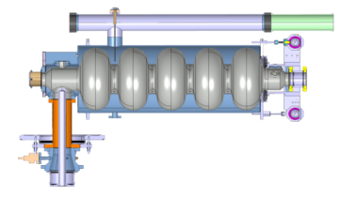
Vacuum Vessel design
Constraints
Constraints due to the supporting System:
  Cavities supported and fixed by the lower flange of the double-wall tube of the coupler
  Size of the power coupler
  Size of the vacuum gauge
1130
minimum
Ø480
246
Outer part of the coupler disassembled
Impact on the vacuum vessel global size
Ø_{int}1200 min
h∼1500
Ø600
Coupler Bearing Ports

Slide 20
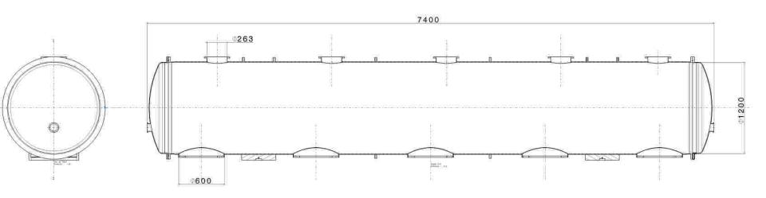
Vacuum vessel design
Requirements
Maintenance aspects :
Access to the tuner, the HOM, without decryostating
Maintenance access ports
Bearing Ports

Slide 21
Vacuum vessel design
Vacuum vessel concepts
Cylindrical vacuum vessel (LHC type)
⇒ Horizontal cryostating
Vacuum vessel with longitudinal aperture
Bottom aperture
Top apperture
⇒ Vertical cryostating

Slide 22
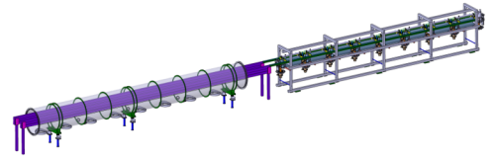
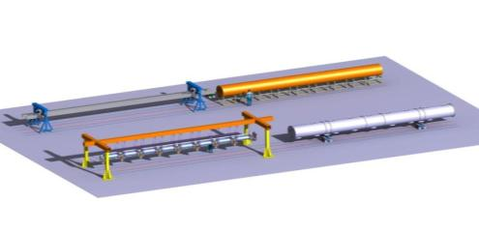
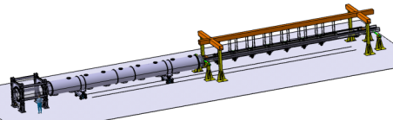
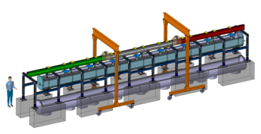
Vacuum vessel design - Tooling
Reference beam path
and rolling frame
Horizontal cryostating Tooling Studies
  3 concepts were studied (8 cavities cryomodule)
  Assembly procedure
    dressing of the string of cavities
    alignment
    cryostating
Rolling reference tool
Cantilever tooling
Vertical Cryostating Tooling Study
  1 concept was studied (8 cavities)
All tools were compared (for long and short cryomodule)

Slide 23
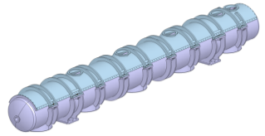
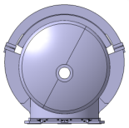
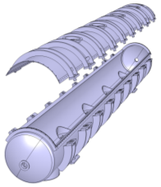
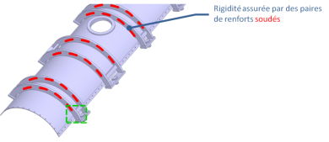
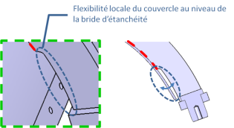
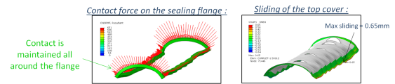
Vacuum vessel design
Retained concept
Main dimensions
1054
Cylindrical vacuum vessel with long top aperture
Ø_{int}800
1021
Aperture concept
7400
e=6mm
e=10mm
Aperture sealing
Prototype (short cryomodule) : polymer seal placed in a groove / (soft) welding
Machine cryomodule (long) : welding

Slide 24
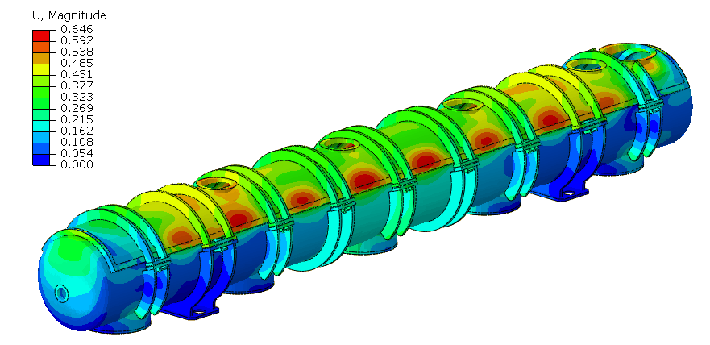
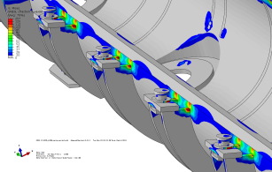
Vacuum vessel design
Mechanical studies
  Static analysis
  Different loading scenarii (linked to the cryostating procedure)
    VV Weight
    VV Weight + loading with the string of cavities
    Vacuum
    Transport
Maximum deflection = 0.65mm
Max sliding between cover and flange = 0.65mm
  Buckling (linear) analysis
⇒ The vessel fulfills mechanical requirements (optimization still needed)
Construction study
A company was consulted to verify the possibility (and cost) of constructing this vacuum vessel.
NB: The company (CMI) is currently in charge of 3 vacuum vessels (being 9, 10 and 11m long) for spare connection cryostats for the LHC.
⇒ The vessel seems to be feasible (with a 20% higher cost – 1 unit)

Slide 25
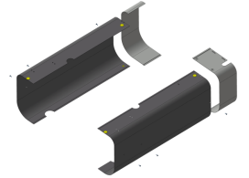
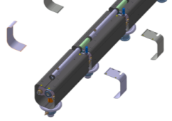
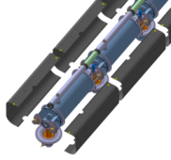
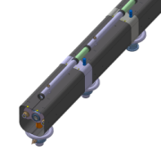
Cryostat components
Cold magnetic shielding
2 concepts were studied:
Discontinuous shielding:
Continuous shield:
Need to be mounted before the tuner
End cap closures:
- lack of space
- needs of several apertures (tuner supports)
→ solution abandoned
Alternative solution (CERN):
magnetic shield inside the cavity LHe tank
→ difficulty to manufacture the tank
→ solution abandoned
(now for the prototype;
could be studied again
in the future)
Solution retained

Slide 26
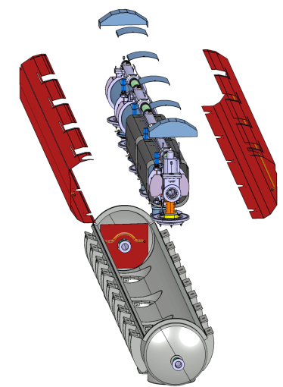
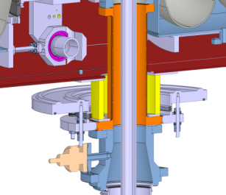
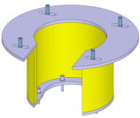
Cryostat components
Thermal shielding
Several concepts were studied (some for a cylindrical vacuum vessel)
Favored solution:
Continuous shield 2 (or 3) main parts
Interfaced on the coupler flange
50K
300K

Slide 27
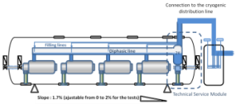
Cryostat components
Cryogenic distribution
Diphasic line + filling line + 2K phase separator
One component
Assembled separately outside the clean room
Tightness can be fully tested independently
Mounted on the string of cavities during the dressing phase
Filling lines
Diphasic line ∅80mm 2K, 31mbar
Cooling line
Coupler cooling line
Coupler cooling line (+boiler)
The line is assembled on the couplers during the dressing phase
The vapor generator (boiler) is integrated in the string of cavities

Slide 28
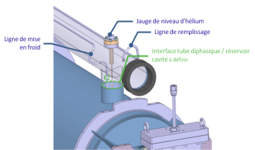
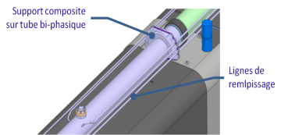
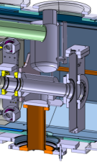
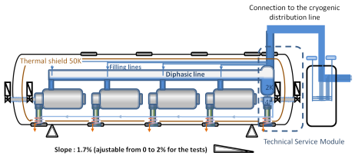
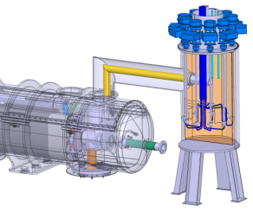
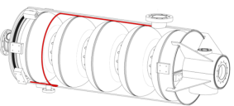
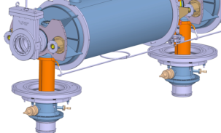
Cryostat components
Cryogenic distribution

Slide 29
SUMMARY
A ½-lenght cryomodule for the full test of 4 β=1 cavities is being design for the CERN
Issued from a collaboration between different institutes, it will be as similar as possible to a machine-type cryomodule for a possible SPL machine
For now:
Cryo-module requirements are settled
Most of the conceptual choices are made (cavity supporting system, cryogenic scheme…)
Conceptual design study is (nearly) over → review: November 4th 2011
Still needing of some conceptual design work (cryogenic jumper connection, thermal shield)
Perspectives:
Detailed design is beginning (→mid 2012)
Test of the cryomodule → 2014
SPL on indico:
  http://indico.cern.ch/categoryDisplay.py?categId=1893 ]

Slide 30
Thank you for your attention

