Slide 1
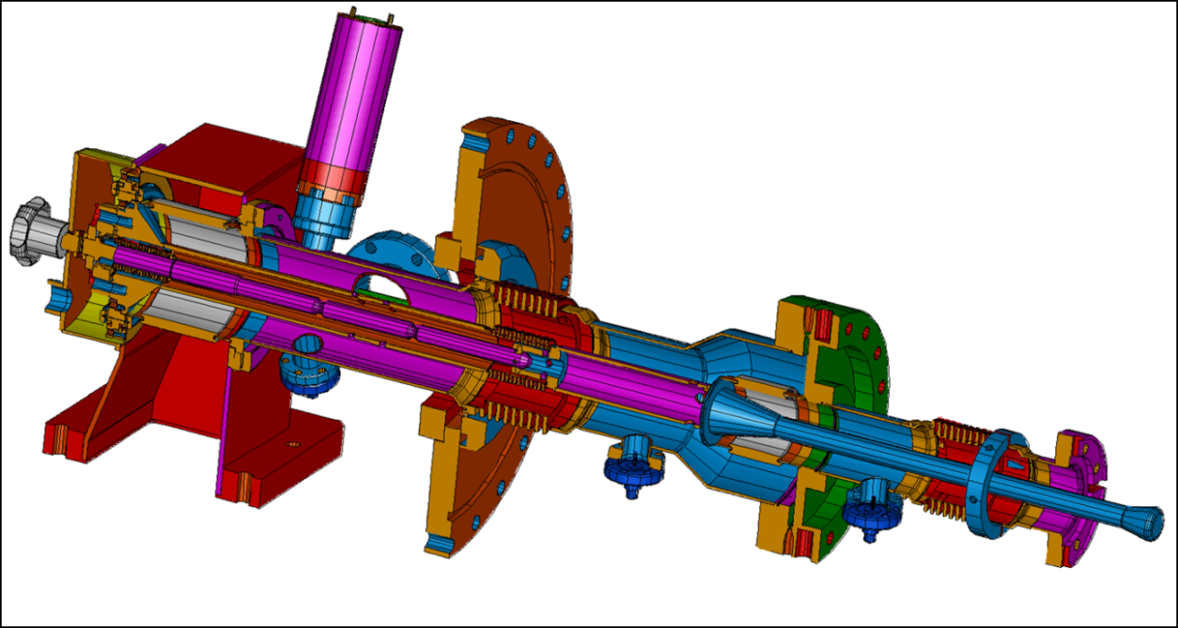
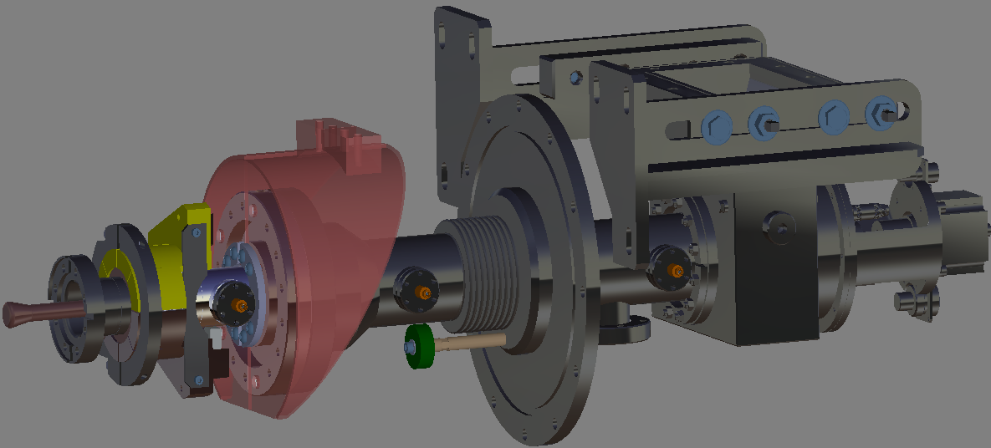
Power coupler at DESY & for XFEL
TTF3
XFEL
TTF3 power coupler performance
XFEL coupler status
Wolf – Dietrich Möller
TTC Meeting, Dec. 2011, IHEP, Beijing, China

Slide 2
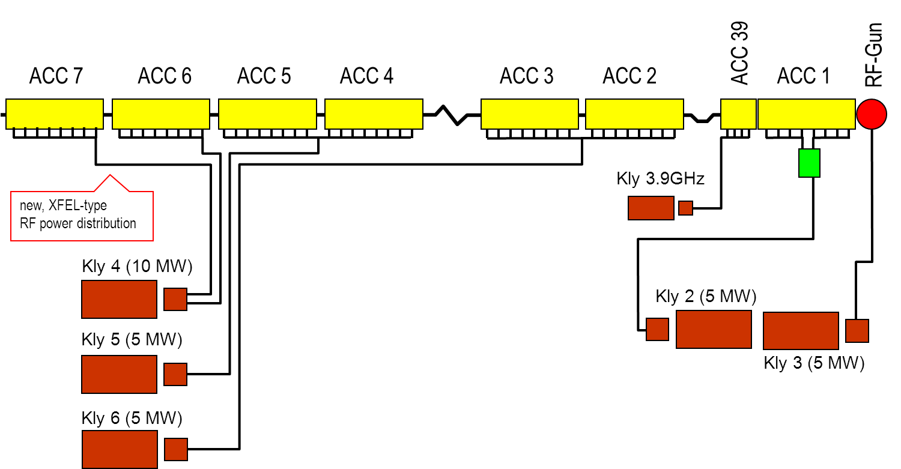
TTF3 Operating in FLASH
5 modules are equipped with TTF3 couplers
40 TTF3 couplers are operated in FLASH
Operation of nearly 1 Mio. coupler hours have been collected
FLASH operation was never limited by the TTF3 coupler
Cavity performance was never limited by TTF3 coupler
TTF3
TTF3
TTF3
TTF3
TTF3

Slide 3
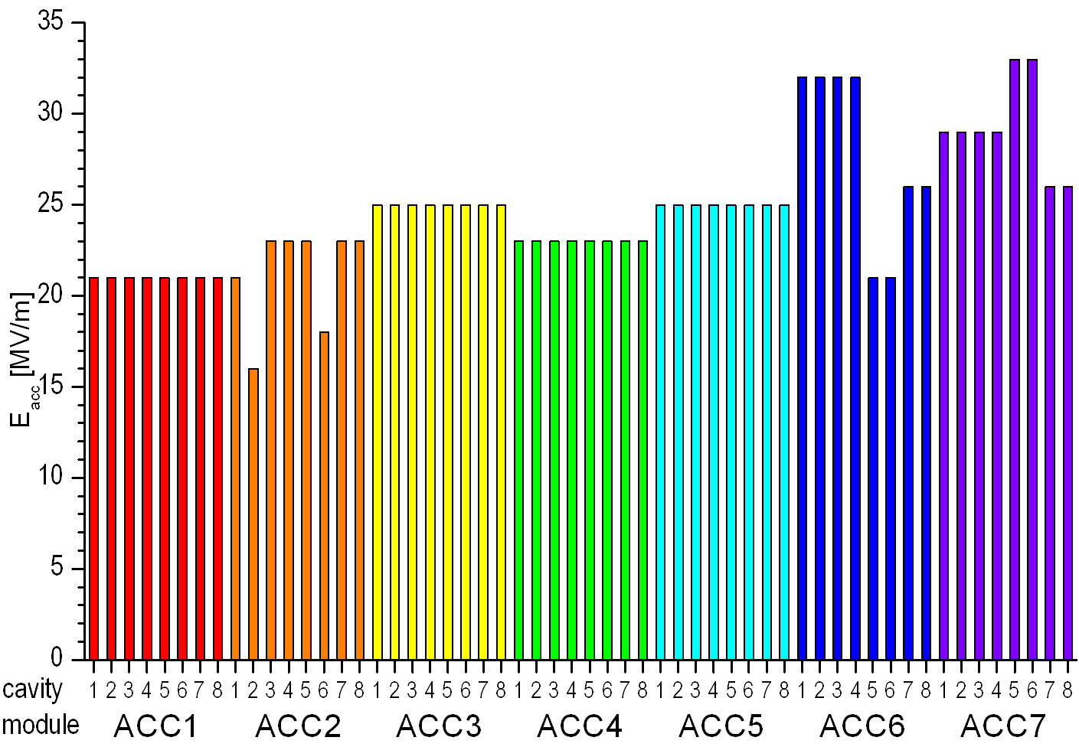
FLASH Module operation, gradient

Slide 4
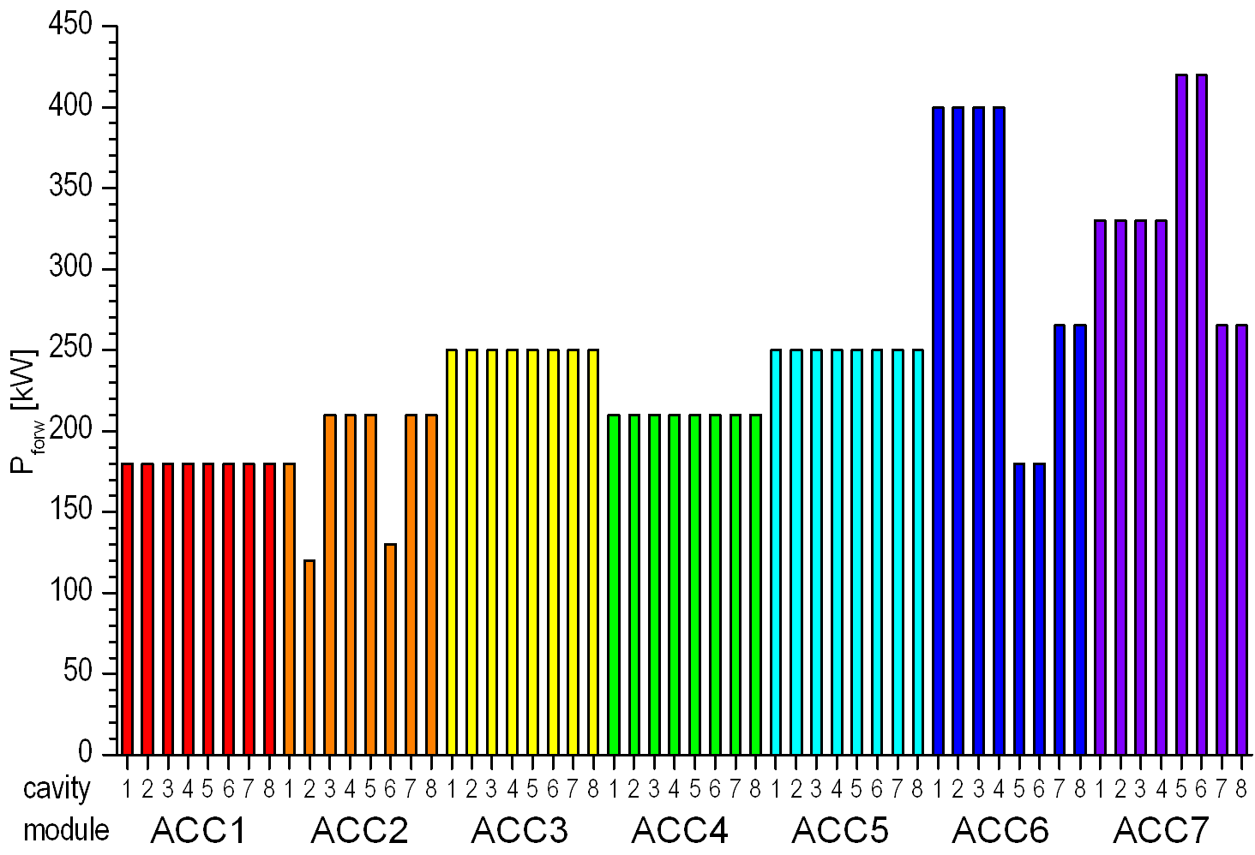
FLASH Module operation, RF power

Slide 5
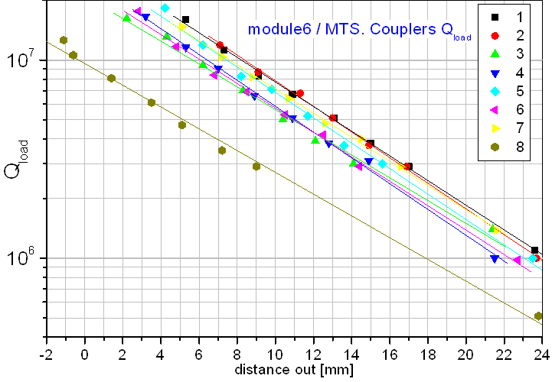
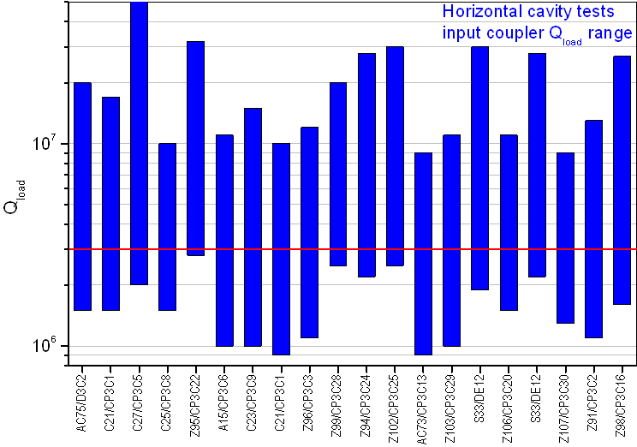
FLASH Module operation, Qext tuning
Different tuning range depending from
Field flatness of cavity
Eccentricity of coaxial antenna
Qload = 3*10⁶

Slide 6
RF power coupler measured heat loss
⁽¹⁾ all cavities are detuned, ⁽²⁾ one cavity is detuned
2 K Dynamic heat load of couplers had not been measured separately.
2 K dynamic heat load includes those of couplers and cavities.
Dynamic heat load of couplers and cavities are within the specified values.
XFEL specification (P_{RFav.} = 1.9kW, static + dynamic)
per coupler: P_{40/80K}=6 W, P_{5/8/K}=0.5 W, P_{2K}=0.06 W,
per module: P_{40/80K}=48 W, P_{5/8/K}=3 W, P_{2K}=0.48 W
cavity + coupler

Slide 7
Changes: TTF3 → XFEL (LAL in-kind contribution)
New 80K and 5K shields and connections
Bellow supports for better long time mechanical stability (transport)
Seals to improve the RF contacts
Brazed wave guide box instead of soldered one
Motor driven Qext tuning (already tested at FLASH)

Slide 8
New 4K and 70K shields
Four braids connection instead of two, for 4K and 70K
Improved connection to the coupler coax
Bellow support integrated in the shield

Slide 9
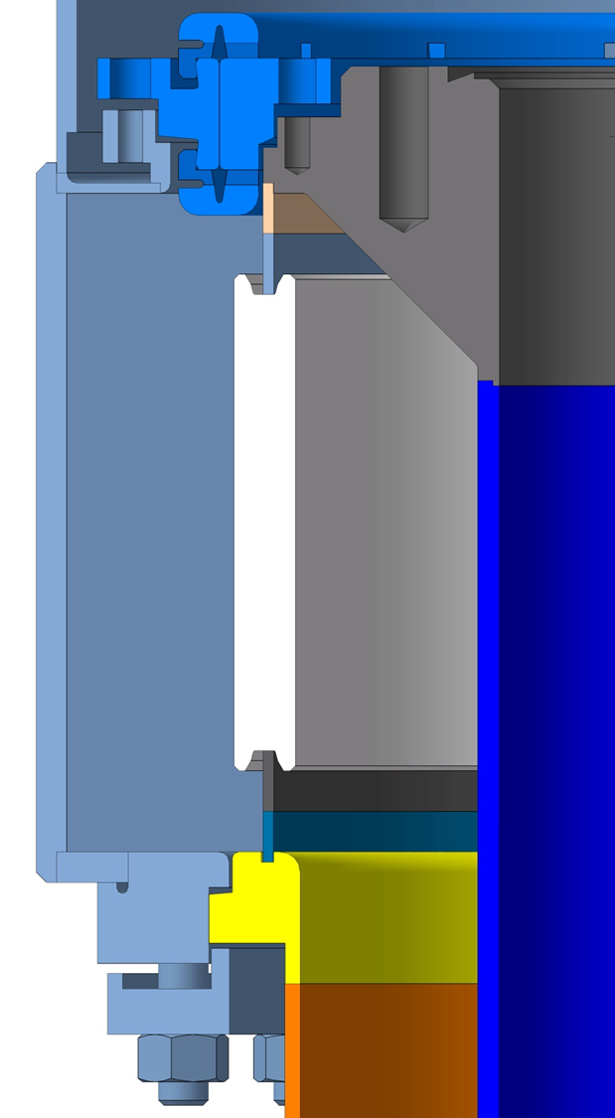
New RF seals
Additional RF seals between the
  capacity
  wave guide box
  and outer coax
  for better RF contact
Cu seal

Slide 10
XFEL Power Coupler fabrication, 1
Contract for XFEL power coupler placed by LAL to THALES / RI consortium at July 2010
Chaired fabrication:
  THALES: Cold part, warm part, inner conductor and antenna including copper plating
  RI: ceramic and ceramic integration, wave guide, cleaning and final assembly of couplers by pairs on the test stand
THALES prototype fabrication:
  Internal and external copper plating of all separate coaxial parts
  Brazing of all parts in one step (Cu-Ag, 850C)
  Removal of copper from outer side by sandblasting
This process was chosen by THALES because of their fabrication experience, but not sufficiently discussed with LAL/DESY

Slide 11
XFEL Power Coupler fabrication, 2
Inspection of prototypes:
gaps at brazing joints braze material on bellow envelopes
copper plating at sealing surfaces sharp edges

Slide 12
XFEL Power Coupler fabrication, 3
Specification is: 30 < RRR < 80
The braze cycle of 850C reduces the RRR

Slide 13
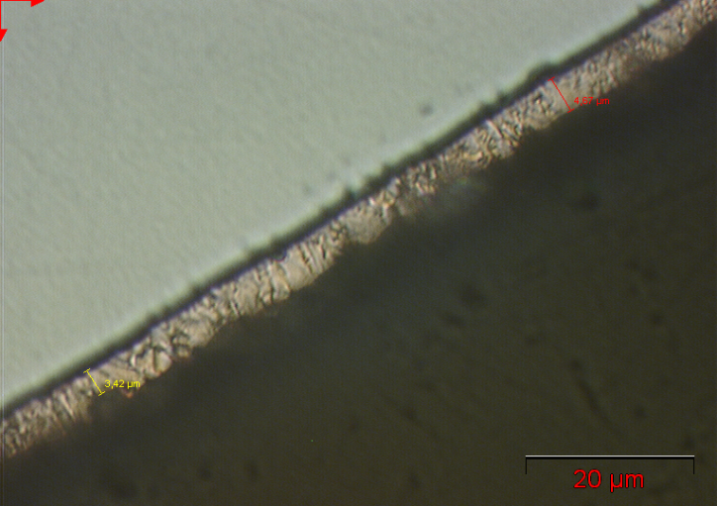
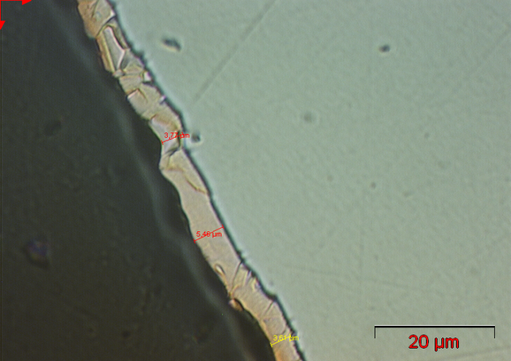
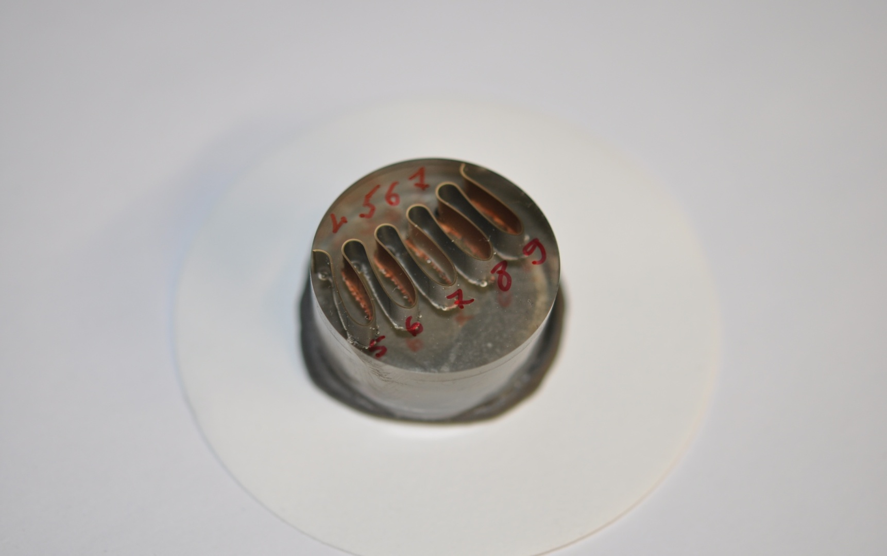
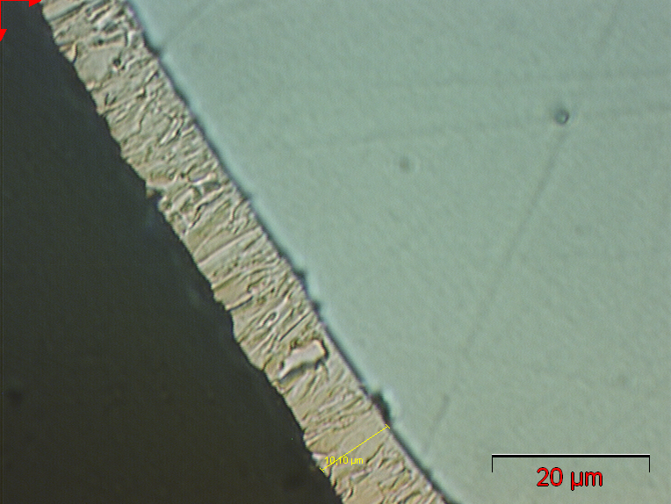
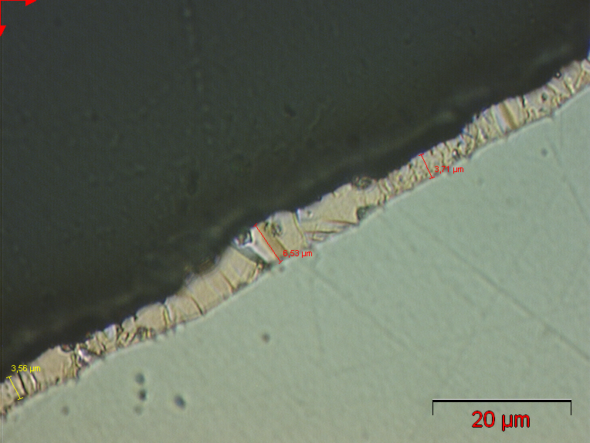
XFEL Power Coupler fabrication, 4
Copper plating thickness on bellows, XFEL Spec.: 10µm ± 30%
Thales
3-4,5 µm
3,5-5,5 µm
X. Singer
ca. 10µm
3,5-6,5 µm

Slide 14
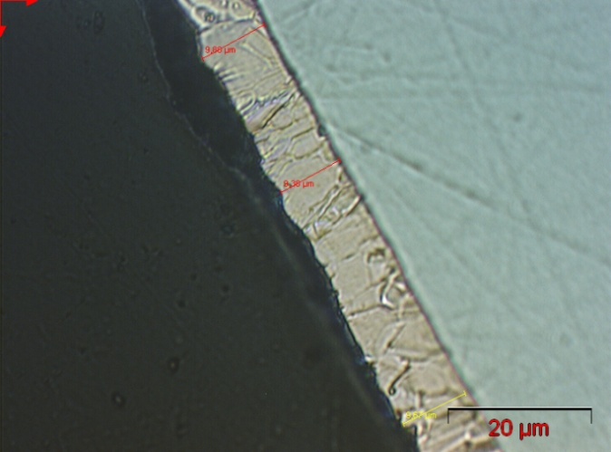
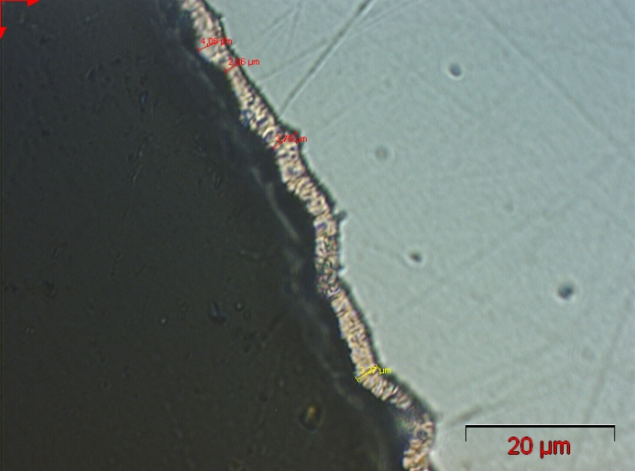
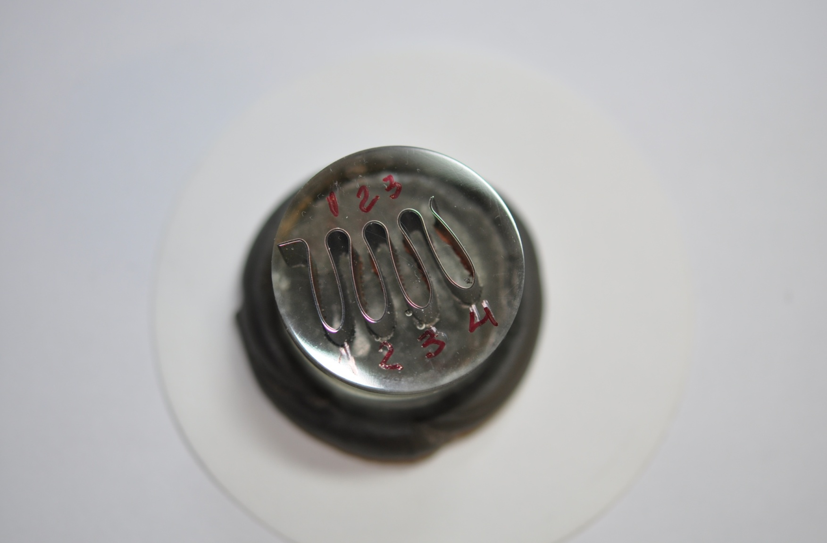

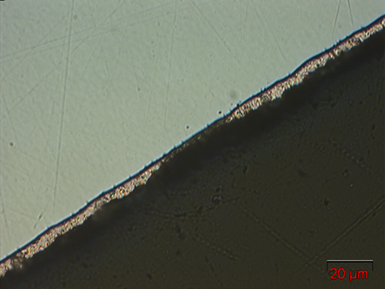
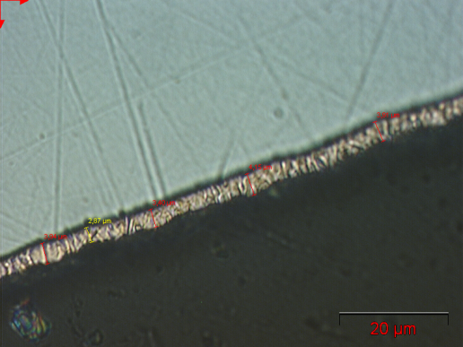
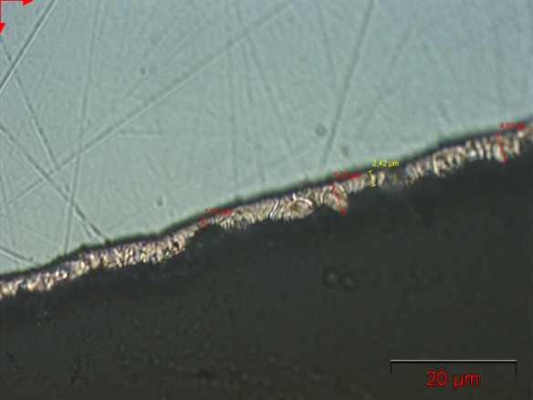
XFEL Power Coupler fabrication, 5
9-10 µm
defect
X. Singer
2-4 µm
4-6 µm
Thales

Slide 15
XFEL Power Coupler fabrication, 6
Inspection visit at Thales-Thonon for the first prototypes (April 2011)
RRR measurements results (August 2011)
Inspected parts have been investigated and rejected
Proposal for new fabrication sequence (August 2011)
Brazing all coupler pieces and copper plating afterward
Brazing material: Cu/Au 50/50
Intensive sample program was started:
  Brazing samples to validate and control brazing process
  RRR samples
Brazed prototype samples accepted

Slide 16
XFEL Power Coupler fabrication, 7
New RRR measurements on samples show promising results
Next steps:
  Plating of whole assembly including bellows and flanges
  Measurements of RRR, thickness, roughness…

Slide 17
XFEL Power Coupler fabrication, 8
Revised schedule:
Coaxial parts for the first prototypes will be send to RI for ceramic integration and test stand assembly: March 2012
First test stand with couplers will arrive at LAL for conditioning: end April 2012
Start of series delivery: Mai 2012 – Jan. 2013, ramp up
from Feb. 2013, 8 coupler per week
XFEL pre-series modules will be assembled with available TTF3 couplers

Slide 18
Thank you for your attention

