Slide 1


CW and LP operation of the
XFEL-type cryomodule
Jacek Sekutowicz

Slide 2
Acknowledgments
The experiment was prepared within one year. Many thanks to Colleagues from:
Technical University Lodz
Warsaw University of Technology
Institute for Nuclear Studies in Świerk
DESY Groups:
    Energy Supply / Senderstromversorgung (MKK / MKK7)
    Radio frequency technology / electrons (MHF-e)
    Radio frequency technology / protons (MHF-p)
    Radio frequency technology / superconductivity (MHF-sl)
    Beam control (MSK)
    Machine Physics Group (MPY)
    Cryogenics and superconductivity (MKS)
Notes:
Before you start editing the slides of your talk change to the Master Slide view:
Menu button “View”, Master, Slide Master:
Edit the following 2 items in the 1st slide:
1) 1st row in the violet header:
Delete the existent text and write the title of your talk into this text field
2) The 2 rows in the footer area: Delete the text and write the information
regarding your talk (same as on the Title Slide) into this text field.
If you want to use more partner logos position them left
beside the DESY logo in the footer area
Close Master View

Slide 3
Outline
Introduction and Motivation
First Test
Second Test
Summary and Final Remarks
Notes:
Before you start editing the slides of your talk change to the Master Slide view:
Menu button “View”, Master, Slide Master:
Edit the following 2 items in the 1st slide:
1) 1st row in the violet header:
Delete the existent text and write the title of your talk into this text field
2) The 2 rows in the footer area: Delete the text and write the information
regarding your talk (same as on the Title Slide) into this text field.
If you want to use more partner logos position them left
beside the DESY logo in the footer area
Close Master View

Slide 4
Introduction and Motivation: Bunch properties for the nominal operation of XFEL
Bunch properties along the linac
σ_{s}= 2 mm
I_{peak}= 50 A
σ_{s}= 1 mm
I_{peak}= 100 A
σ_{s}= 0.1 mm
I_{peak}= 1 kA
σ_{s}= 0.02 mm
I_{peak}= 5 kA
Collimation section
Injector linac 4 cryomodules
Main linac 84 cryomodules
Booster Linac 12 cryomodules
BC2
R56 = 15-25mm
BC0
R56 = 40 mm
BC1
R56 = 100mm
3rd harmonic RF section
-20 MeV
Undulator
e- gun
E=5MeV
E= 0.5 GeV
E= 2 GeV
E = 120 MeV
Slice energy spread: 50 keV
Slice emittance: ε_{x,y}~1µrad
σ_{x,y} < 0.8 mm
E= 17.5 GeV
Slice energy spread: 1 MeV
Slice emittance: ε_{x,y}~1.4 µrad
σ_{x,y} < 30 µm
Notes:
Before you start editing the slides of your talk change to the Master Slide view:
Menu button “View”, Master, Slide Master:
Edit the following 2 items in the 1st slide:
1) 1st row in the violet header:
Delete the existent text and write the title of your talk into this text field
2) The 2 rows in the footer area: Delete the text and write the information
regarding your talk (same as on the Title Slide) into this text field.
If you want to use more partner logos position them left
beside the DESY logo in the footer area
Close Master View

Slide 5
Introduction and Motivation: Beam properties for the nominal operation of XFEL
Beam parameters:
Nominal Energy | GeV | 17.5
Beam pulse length | ms | 0.60
Repetition rate | Hz | 10
Max. # of bunches per pulse |  | 2700
Min. bunch spacing | ns | 220
Bunch charge | nC | 1
Bunch length, σ_{z} | µm | < 20
Emittance (slice) at undulator | µrad | < 1.4
Energy spread (slice) at undulator | MeV | 1
Time structure of the beam:
600 µs
~100 fs
100 ms
220 ns
Notes:
Before you start editing the slides of your talk change to the Master Slide view:
Menu button “View”, Master, Slide Master:
Edit the following 2 items in the 1st slide:
1) 1st row in the violet header:
Delete the existent text and write the title of your talk into this text field
2) The 2 rows in the footer area: Delete the text and write the information
regarding your talk (same as on the Title Slide) into this text field.
If you want to use more partner logos position them left
beside the DESY logo in the footer area
Close Master View

Slide 6
Introduction and Motivation: Future operations of XFEL
The 27000 high quality bunches/s will generate high average brilliance photon beams at very short wavelength.
Two addition features could make the XFEL photon beam even more attractive:
  The first is an increased to several µ-seconds intra pulse distance between bunches, which will allow for less demanding detectors.
  The second is a few kHz photon burst repetition rate, which will allow for less expensive optical lasers for pump-and-probe experiments.
  With the present nominal beam, these features will lead to substantially reduced number of bunches/s and significantly lower average brilliance.
Notes:
Before you start editing the slides of your talk change to the Master Slide view:
Menu button “View”, Master, Slide Master:
Edit the following 2 items in the 1st slide:
1) 1st row in the violet header:
Delete the existent text and write the title of your talk into this text field
2) The 2 rows in the footer area: Delete the text and write the information
regarding your talk (same as on the Title Slide) into this text field.
If you want to use more partner logos position them left
beside the DESY logo in the footer area
Close Master View

Slide 7
Introduction and Motivation: Future operations of XFEL
Two assumptions for new operation modes:
We want to keep the bunch quality as for the nominal short-pulse operation
Total heat load per cryomodule is 20-25 W:
  This should be sufficient for cw operation at 7.5 MV/m and for long pulse (lp) operation at higher Eacc the DF scales ~ (7.5 /Eacc)²
Example of the time structure of the electron beam (1 nC bunches):
~100 ms for Eacc = 23 MV/m
f_{rep} = 1Hz
900 ms
1nC
4 µs
~100 fs
Notes:
Before you start editing the slides of your talk change to the Master Slide view:
Menu button “View”, Master, Slide Master:
Edit the following 2 items in the 1st slide:
1) 1st row in the violet header:
Delete the existent text and write the title of your talk into this text field
2) The 2 rows in the footer area: Delete the text and write the information
regarding your talk (same as on the Title Slide) into this text field.
If you want to use more partner logos position them left
beside the DESY logo in the footer area
Close Master View

Slide 8
First Test: Setup
  The first test of the cw and long pulse (lp) operation of the XFEL-like cryomodule PXFEL2_1 with IOT amplifier was performed in June this year.
Setup
Load
IOT
85+ kW
Circulator
Driver 760 W
  We could operate the PXFEL2_1 cryomodule at 1.8 K and 2 K
  No special measures have been undertaken to stabilize LHe pressure (36 Hz /mb)
  No special cw/lp dedicated LLRF was used for that test
Notes:
Before you start editing the slides of your talk change to the Master Slide view:
Menu button “View”, Master, Slide Master:
Edit the following 2 items in the 1st slide:
1) 1st row in the violet header:
Delete the existent text and write the title of your talk into this text field
2) The 2 rows in the footer area: Delete the text and write the information
regarding your talk (same as on the Title Slide) into this text field.
If you want to use more partner logos position them left
beside the DESY logo in the footer area
Close Master View

Slide 9
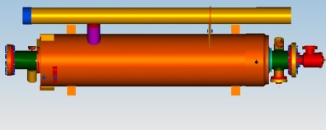
First Test: Thermal features of the PXFEL2_1 cryomodule
TESLA cavity and its auxiliaries were designed in 1992:
For short pulse operation at 25 MV/m and DF of ~1%.
Cost of the TESLA cavity was one of the driving criteria (22000 cavities for the collider).
That is why HOM couplers are located outside the LHe vessel (other than for example for cw operated HERA cavities).
      HOM couplers
Notes:
Before you start editing the slides of your talk change to the Master Slide view:
Menu button “View”, Master, Slide Master:
Edit the following 2 items in the 1st slide:
1) 1st row in the violet header:
Delete the existent text and write the title of your talk into this text field
2) The 2 rows in the footer area: Delete the text and write the information
regarding your talk (same as on the Title Slide) into this text field.
If you want to use more partner logos position them left
beside the DESY logo in the footer area
Close Master View

Slide 10
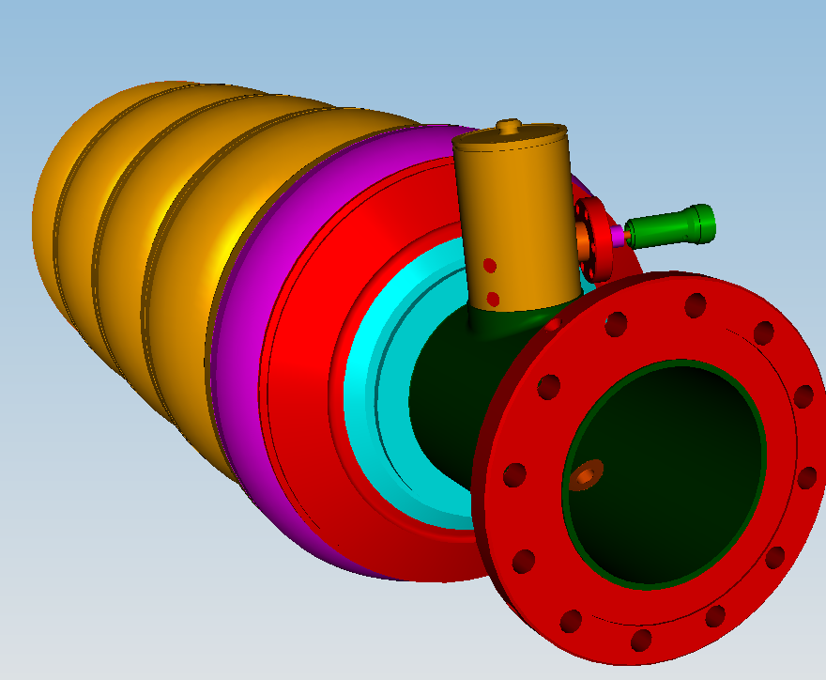
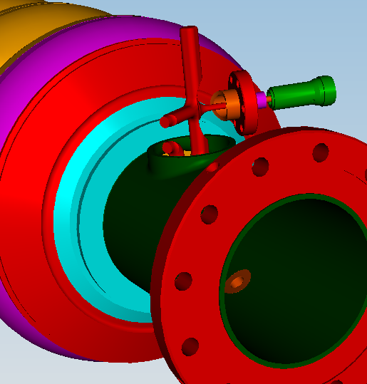
First Test: Thermal features of the PXFEL2_1 cryomodule
We expected that limitation will be due to the heating of the HOM antennae .
Notes:
Before you start editing the slides of your talk change to the Master Slide view:
Menu button “View”, Master, Slide Master:
Edit the following 2 items in the 1st slide:
1) 1st row in the violet header:
Delete the existent text and write the title of your talk into this text field
2) The 2 rows in the footer area: Delete the text and write the information
regarding your talk (same as on the Title Slide) into this text field.
If you want to use more partner logos position them left
beside the DESY logo in the footer area
Close Master View

Slide 11
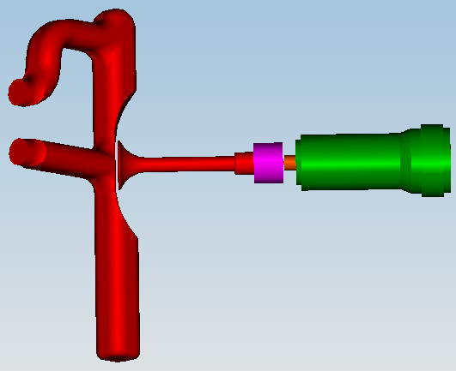
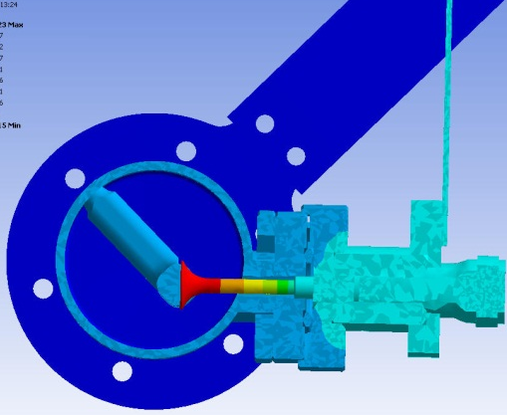
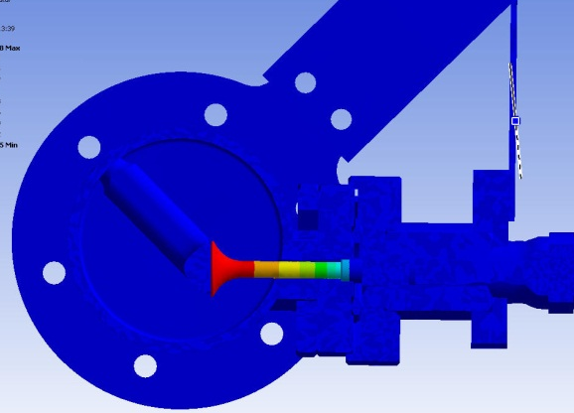
First Test: Thermal features of the PXFEL2_1 cryomodule
B_{antenna}=B_{equator}/10
In cryomodule (vacuum)
Heat | T_{antenna} vacuum | T_{antenna} superfluid He
[mW] | [K] | [K]
20 | 7.0 | 6.8
5 | 4.6 | 4.5
4 | 4.2 | 4.2
3 | 4.0 | 3.9
2 | 3.6 | 3.5
1 | 3.1 | 3.0
In vertical cryostat (LHe)
Conclusion from the modeling was that T of antenna is almost the same for either condition
Notes:
Before you start editing the slides of your talk change to the Master Slide view:
Menu button “View”, Master, Slide Master:
Edit the following 2 items in the 1st slide:
1) 1st row in the violet header:
Delete the existent text and write the title of your talk into this text field
2) The 2 rows in the footer area: Delete the text and write the information
regarding your talk (same as on the Title Slide) into this text field.
If you want to use more partner logos position them left
beside the DESY logo in the footer area
Close Master View

Slide 12
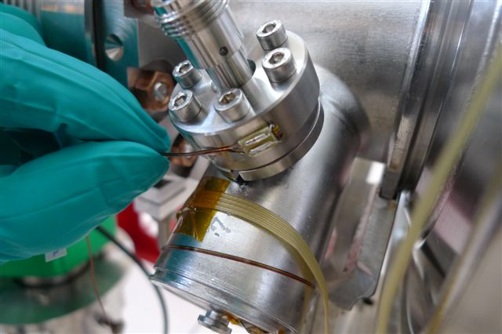
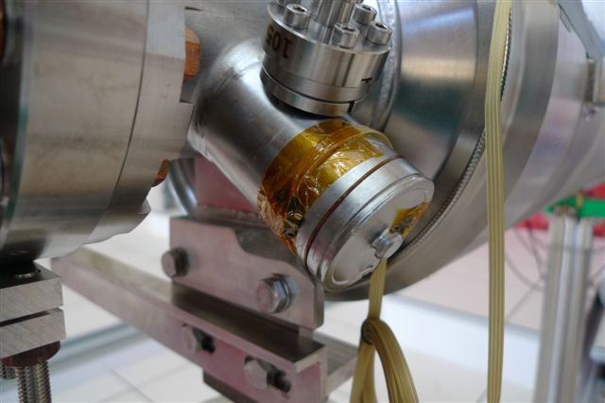
First Test: Thermal features of the PXFEL2_1 cryomodule
Old type of feedthrough with temperature sensors.
Note: there is no thermal connection to the 2K tube.
Cavity | HOM feedthroughs | Thermal conn. to 2K tube | Diameter of the antenna [mm] | Qext [1E7] | Feedthrough# / Comments
1/Z141 | Low conduct. | No | 11 | 1.6 | 105/106
2/AC150 | Low conduct | No | 11 | 1.6 | 135/136
3/Z133 | Low conduct | No | 11 | 0.8 | 107/108, 16 MV/m
4/Z139 | Low conduct | No | 11 | 1.6 | 131/132
5/AC122 | Low conduct | No | 11 | 1.6 | 129/130
6/AC121 | Low conduct | No | 11 | 1.6 | 55/56
7/AC128 | High conduct. | No | 11 | 1.6 | OM28/OM30
8/AC115 | Low conduct | No | 11 | 0.4 | 109/110, FMC blocked
Notes:
Before you start editing the slides of your talk change to the Master Slide view:
Menu button “View”, Master, Slide Master:
Edit the following 2 items in the 1st slide:
1) 1st row in the violet header:
Delete the existent text and write the title of your talk into this text field
2) The 2 rows in the footer area: Delete the text and write the information
regarding your talk (same as on the Title Slide) into this text field.
If you want to use more partner logos position them left
beside the DESY logo in the footer area
Close Master View

Slide 13
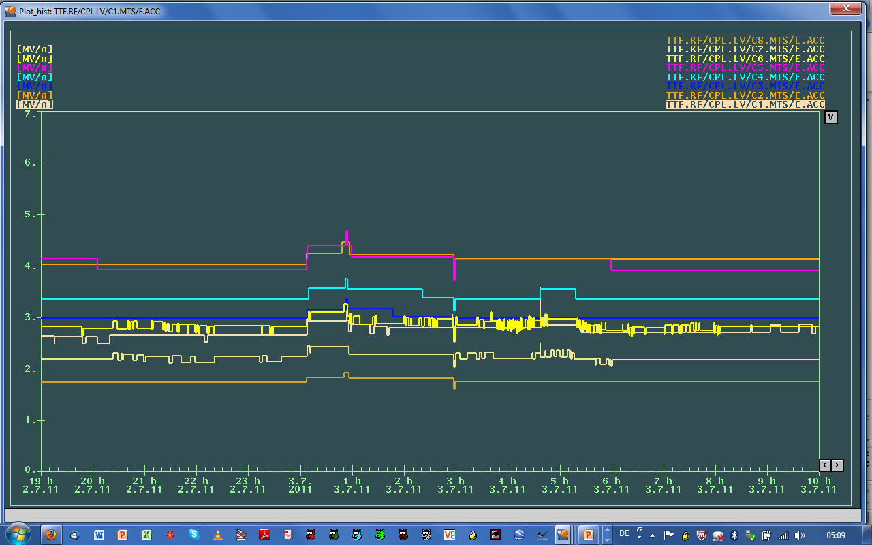
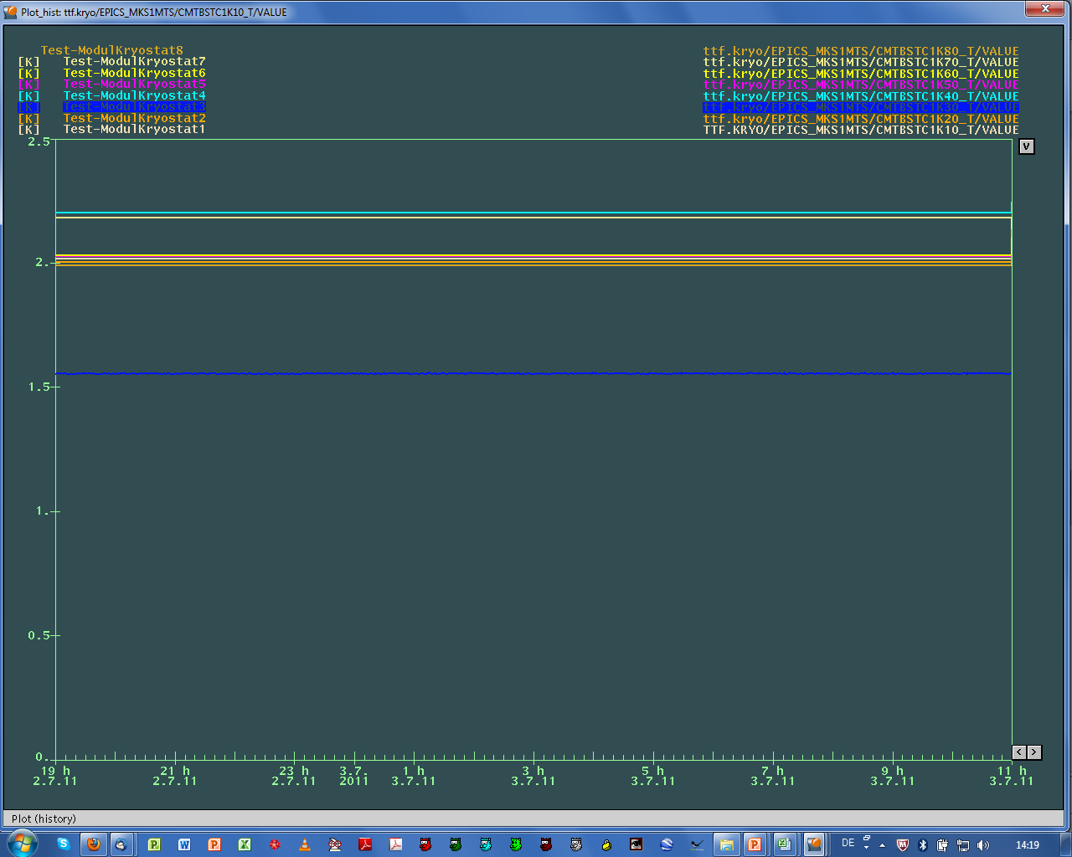
First Test: Results
The thermal conditions for PXFEL2_1 in that test were kind of a “worst case scenario”.
  The longest run (15 h):
  no LLRF (6 cavities with 81Hz resonance width)
  no frequency control
  T-helium vessels [K]
  Eacc [MV/m]
Notes:
Before you start editing the slides of your talk change to the Master Slide view:
Menu button “View”, Master, Slide Master:
Edit the following 2 items in the 1st slide:
1) 1st row in the violet header:
Delete the existent text and write the title of your talk into this text field
2) The 2 rows in the footer area: Delete the text and write the information
regarding your talk (same as on the Title Slide) into this text field.
If you want to use more partner logos position them left
beside the DESY logo in the footer area
Close Master View

Slide 14
First Test: Heat load measurements at 2K for cw (~1h)
<Gradient> | Total Heat at 2K | Dynamic Heat at 2K | Estimated (Qo=1.5E10) Dynamic Heat at 2K | ΔDH
[MV/m] | [W] | [W] | [W] | [W]
5.5 | 27 | 20.8 | 16.0 | ~5
Notes:
Before you start editing the slides of your talk change to the Master Slide view:
Menu button “View”, Master, Slide Master:
Edit the following 2 items in the 1st slide:
1) 1st row in the violet header:
Delete the existent text and write the title of your talk into this text field
2) The 2 rows in the footer area: Delete the text and write the information
regarding your talk (same as on the Title Slide) into this text field.
If you want to use more partner logos position them left
beside the DESY logo in the footer area
Close Master View

Slide 15
First Test: Heat load measurements at 2K for cw (~1h)
  No T change of LHe bath (vessels) for all 8 cavities, no quench..
  18% (5/27) of the total heat was very probably due to the heating of the HOM antennae (~0.3W/antenna):
cw at 5.5 MV/m
Notes:
Before you start editing the slides of your talk change to the Master Slide view:
Menu button “View”, Master, Slide Master:
Edit the following 2 items in the 1st slide:
1) 1st row in the violet header:
Delete the existent text and write the title of your talk into this text field
2) The 2 rows in the footer area: Delete the text and write the information
regarding your talk (same as on the Title Slide) into this text field.
If you want to use more partner logos position them left
beside the DESY logo in the footer area
Close Master View

Slide 16
First Test: Heat load measurements at 1.8 K for cw (~20 min)
<Gradient> | Total Heat at 1.8 K | Dynamic Heat at 1.8 K | Estimated (Qo=3.5E10) Dynamic Heat 1.8 K | Comment
[MV/m] | [W] | [W] | [W]
3.3 | 9.3 | 2.6 | 3.1 | No additional heat
Flanges
Housing
Notes:
Before you start editing the slides of your talk change to the Master Slide view:
Menu button “View”, Master, Slide Master:
Edit the following 2 items in the 1st slide:
1) 1st row in the violet header:
Delete the existent text and write the title of your talk into this text field
2) The 2 rows in the footer area: Delete the text and write the information
regarding your talk (same as on the Title Slide) into this text field.
If you want to use more partner logos position them left
beside the DESY logo in the footer area
Close Master View

Slide 17
  Second Test : Cryomodule PXFEL3_1
  Next test in February 2012, with dedicated LLRF (µTCA) and better thermal conditions for the end-groups.
Thermal features of the PXFEL3_1 cryomodule (“half way” to the standard XFEL cryomodule)
Cavity | HOM feedthroughs | Thermal con. to 2K tube | Diameter of the antenna [mm] | Qext [1E7] | Feedthrough#
1/Z140 | H conduct. | Yes | 7.8 | 1.5-2.5 | OM75/OM78
2/Z97 | H conduct | Yes | 7.8 | 1.5-2.5 | OM76/OM77
3/Z101 | Low conduct | Yes | 11 | 1.5-2.5 | 79/147
4/Z104 | H conduct | Yes | 11 | 1.5-2.5 | KY111/KY112
5/Z134 | H conduct | Yes | 7.8 | 1.5-2.5 | OM72/OM73
6/Z135 | Low conduct | Yes | 11 | 1.5-2.5 | 121/122
7/Z138 | H conduct. | Yes | 11 | 1.5-2.5 | OM70/OM71
8/AC124 | Low conduct | Yes | 11 | 1.5-2.5 | 139/140

Slide 18
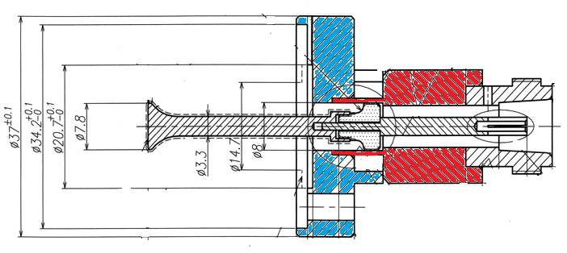
Summary and Final Remarks
  The first test of the cw and lp operation of the XFEL-like cryomodule with IOT amplifier.
  In that test:
  Achieved gradients: for cw up to <5.5 MV/m>, for lp ~ 11 MV/m (tp = 300 ms)
  Vector sum stabilization: rms 1E-3 with no “dedicated” LLRF system
  Temperature rise was observed but it did not lead to quench
  The result was encouraging and will perform second test in February 2012 with new LLRF, dedicated to the cw/lp mode.
Thermal features of a series XFEL cryomodules:
All cavities will be equipped with high conduction feedthroughs, in which alumina is replaced with sapphire brazed directly to the copper ring. So, cooling of high RRR Nb antenna will be much better. Diameter of the antennae is 7.8 mm (11.8 mm now).
Nb
Ti
Cu
Sapphire
  All HOMs feedthroughs will be thermally connected to 2K two–phase tube.

