Slide 1




Overview of ERL Projects:
SRF Issues and Challenges
Matthias Liepe
Cornell University
Overview of ERL projects: SRF issues and challenges

Slide 2
Outline
Introduction: SRF for ERLs
  What makes it special / challenging?
Challenges for…
  …the cavity
  …the HOM damper
  …the RF power system and control
  …the cryostat and cryoplant
Summary and outlook
Outline

Slide 3
Introduction: SRF for ERLs
What makes it special / challenging?
Introduction: SRF for ERLs

Slide 4
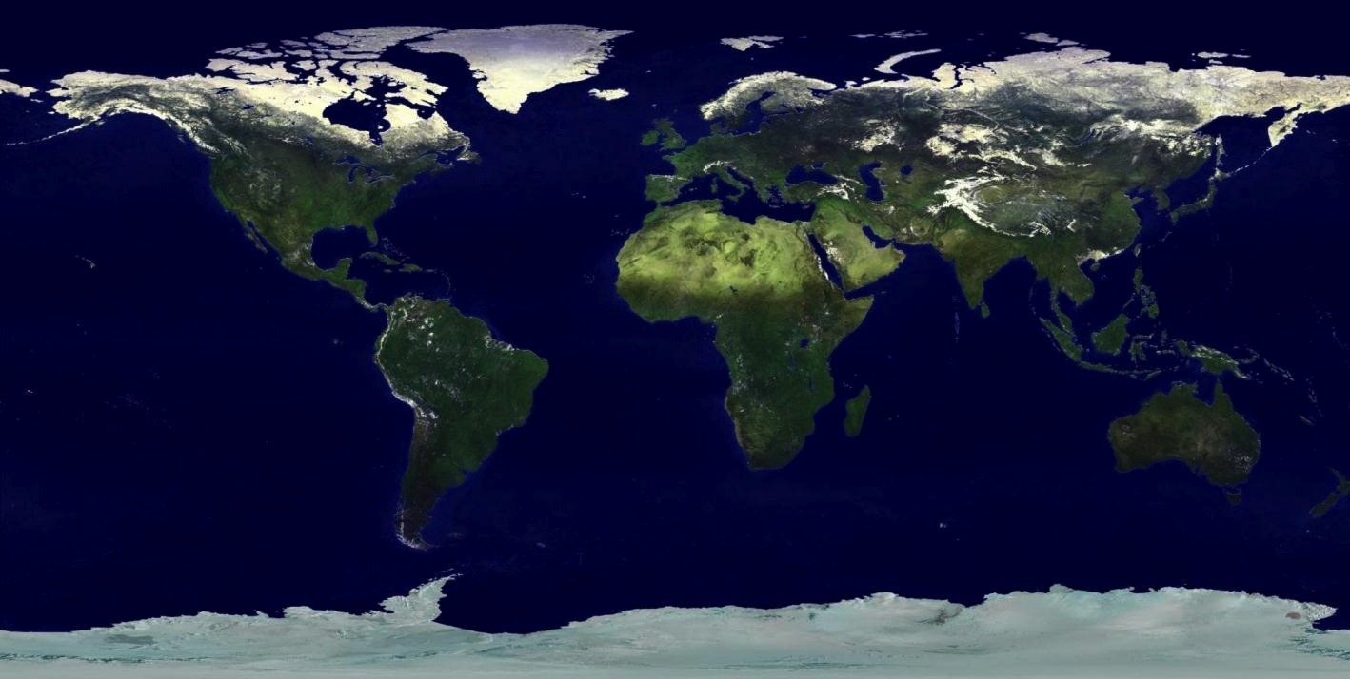
SRF for Future Particle Accelerators
Project X (FNAL)
3 GeV, 1 mA
Future: muon collider?
XFEL
17.5 GeV, 800 s.c. cavities
European Spallation Source (ESS)
2.5 GeV,50 mA
China Spallation Source (CSNS)
1.6 GeV SRF linac
Facility for Rare Isotope Beams (FRIB)
HZB ERL
100 mA
Introduction: SRF for ERLs
NGLS
Cornell ERL
5 GeV, 100 mA, 400 s.c. cavities
Accelerator Driven Subcritical Reactor pilot facility
KEK ERL Light Source
5 GeV, 100 mA
BNL ERL Electron Cooler and eRHIC
50 mA
International Linear Collider
500 GeV, 16000 s.c. cavities

Slide 5
Need for Multi-Gev, CW, High Current SRF Linacs
Key technology: Multi-GeV SRF linacs
Only technology that will allow realizing such linacs in the foreseeable future is superconducting radio-frequency
  Operated in continuous wave or long pulse mode
  Accelerating high beam currents of many tens of mA
  Need lower surface resistance to support efficient cw operation (lower cryogenic losses), and better control of unwanted cavity-beam interaction (higher-order cavity modes) to support high beam currents
Introduction: SRF for ERLs

Slide 6
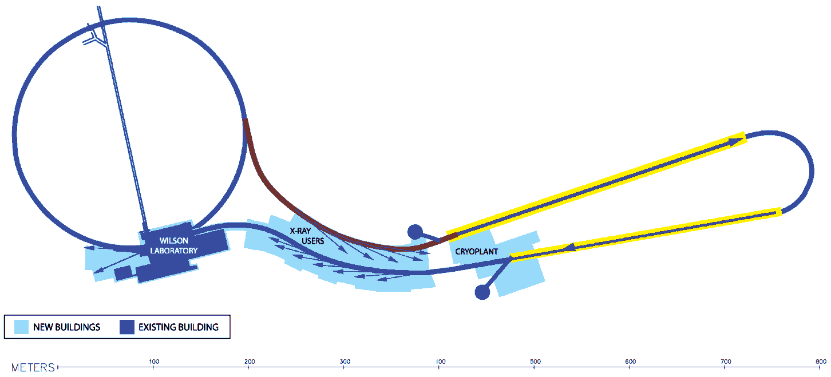
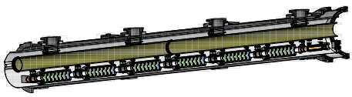
Example: SRF for the Cornell ERL
ERL injector: 15 MeV SRF linac, 100 mA without energy recovery, >100 kW RF power per cavity
ERL main linac: 5 GeV SRF linac, 100 mA with energy recovery, 5 kW RF power per 7-cell cavity
Introduction: SRF for ERLs

Slide 7
Cornell ERL SRF Parameters
Parameter | Injector Linac | Main Linac | Note
Total energy gain [GeV] | 15 MeV | 5 GeV | Multi-GeV
Total # cavities | 12 | 384 | ~ CEBAF
CW beam current [mA] | 100 | 2 x 100 | High!
CW Operating gradient [MV/m] | 6 | 16 | Limited by Q₀
Cavity intrinsic quality factor Q₀ | 1•10¹⁰ | 2•10¹⁰ | Cost driver!!
Total cryogenic load at 1.8K [W] | 60 | 5000 | 5 MW AC power
Cavity loaded quality factor Q_{L} | 5•10⁴ | >6.5•10⁷ | High! (no effective beam loading)
RF field stability | 1•10⁻⁴ / 0.1 deg | 2•10⁻⁴ / 0.1 deg | Very tight!
Introduction: SRF for ERLs
Significant progress has been made during the last year towards achieving these ambitious goals!

Slide 8
ERL SRF related Challenges
The SRF system for high current ERLs is extremely demanding:
SRF cavities:
  Continues operation at high fields with low cryogenic losses -> high Q₀
  Reliable operation with very low trip-rate
  Very low microphonics levels -> optimized mechanical cavity design
  Design optimized for strong HOM damping
Higher-Order-Mode damping:
  Strong HOM damping and efficient HOM power extraction for high beam currents
RF power system and control:
  Low cost, low CW RF power input couplers
  Low cost RF power sources
  Active and fast cavity frequency control
  Very good RF cavity field stabilization at highest loaded Q for energy stability
Cryostat and Refrigeration:
  Cryogenic system for high cryo-loads
  Cryostat design for low mechanical vibrations and vibration damping
  Cryostat design for excellent magnetic shielding (high Q₀)
  Very accurate cavity alignment
  Significant progress in these fields is needed for high current ERLs to work!
Introduction: SRF for ERLs

Slide 9
Challenges for…
…the cavity
…the HOM damper
…the RF power system and control
…the cryostat and cryoplant
Challenges for…

Slide 10
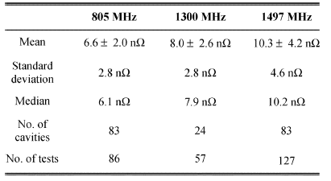
Challenges for…the Cavity (I)
High Q₀ at medium (!!) fields
  GeV scale, CW SRF linacs -> MW-scale cryoplants
  Consistent Q₀ > 2x10¹⁰ highly desirable for cost reasons
    Higher Q₀ -> higher cost optimal gradient (2x10¹⁰: 15 – 20 MV/m)
    Understanding residual resistance is key! Why does it fluctuate between 1 and > 10 nOhm?
    Medium field Q slope?
    Best surface preparation??
    How to preserve high Q₀ in a a cryomodule?
Design optimized for strong HOM damping
  Impacts cell shape, number of cells, frequency…
  Important: Optimized shape must be stable under realistic shape imperfections!
…the cavity
G. Ciovati, et al., IEEE Trans. Appl. Supercond. Vol. 21, No. 3, 2011

Slide 11
Challenges for…the Cavity (II)
Very low microphonics
  No effective beam loading, so could operate at Q_{L}>1x10⁸
  But: High Q_{L} needs low microphonics to be effective!!
  -> Mechanical design for low microphonics! (reduce df/dp sensitivity to pressure fluctuation in LHe bath)
Reliable operation with very low trip-rate
  User facilities (especially x-ray) require uninterrupted beam
  Mean time between trip per cavity > months!?
  Trips caused by occasional peak detunings and insufficient RF power
    How frequent? What is the peak detuning over weeks, and how can it be reduced?
…the cavity

Slide 12
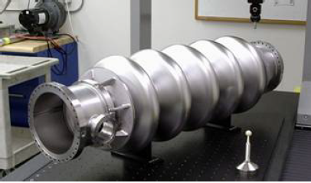
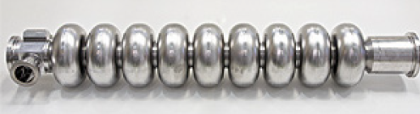
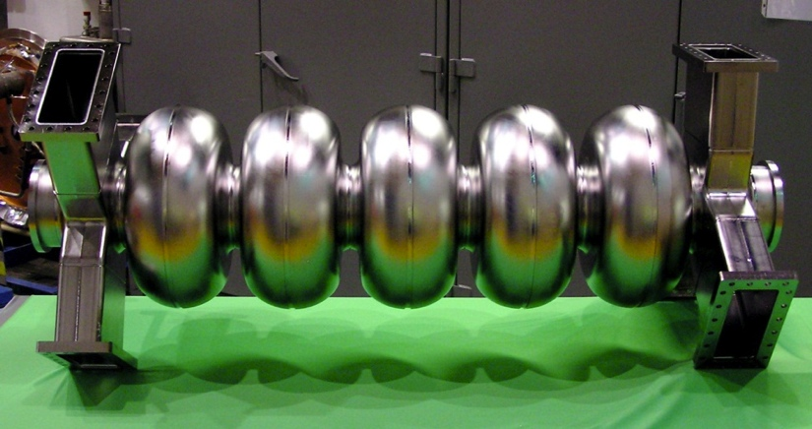
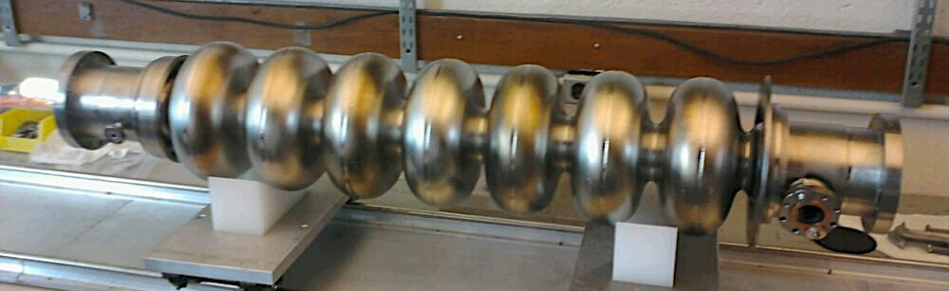
Examples: ERL Cavities
BNL 5-cell, 703 MHz
KEK 9-cell, 1.3 GHz
…the cavity
JLAB 5-cell, 748.5 MHz
Cornell 7-cell, 1.3 GHz

Slide 13
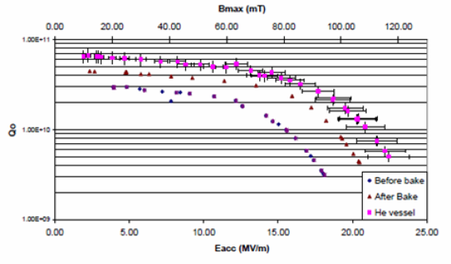
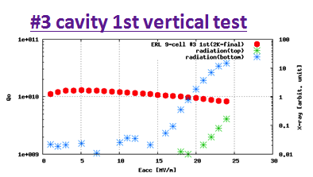
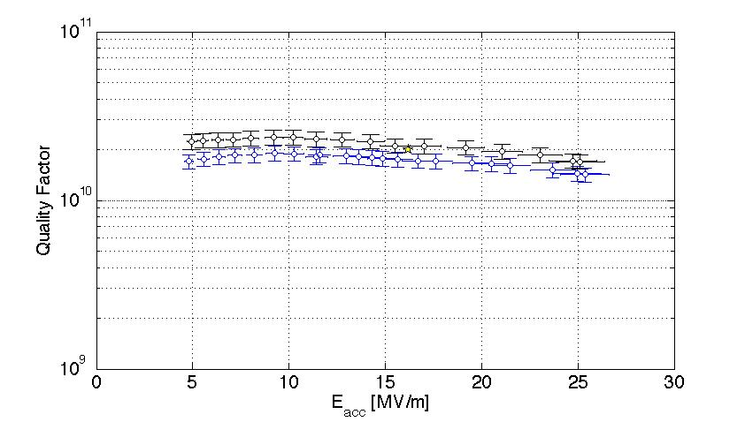
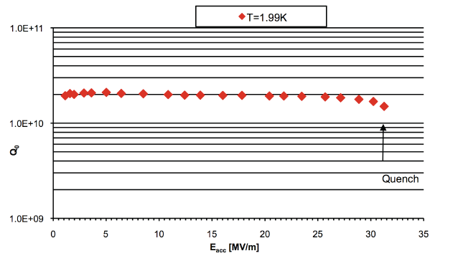
ERL Cavities: Q₀ in Vertical (!) Tests
BNL 5-cell, 703 MHz
KEK 9-cell, 1.3 GHz
…the cavity
JLAB 7-cell, 1.3 GHz
Cornell 7-cell, 1.3 GHz
BCP&120C bake
BCP&120C bake
ERL main linac spec

Slide 14

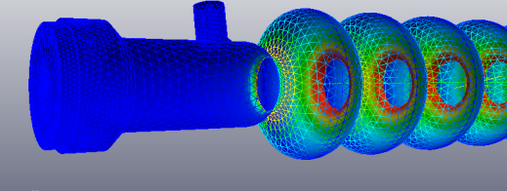
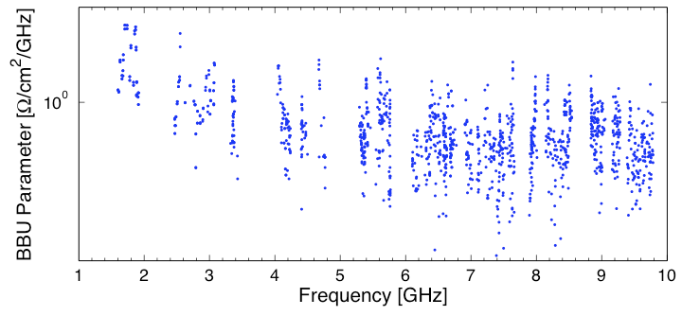
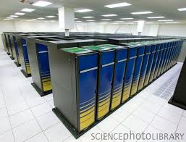
RF Optimization of Cornell’s ERL Main Linac Cavity (I)
Cell shape optimization:
  ~20 free parameters
  Full Higher-Order Mode characterization (1000’s of eigenmodes)
  Verification of robustness of cavity design
…the cavity
I_{BBU} ~ 1/(worst BBU-parameter)
Franklin Cray XT4
Dipole mode damping calculated up to 10 GHz with realistic RF absorbers
Worst mode limits beam current!
Notes:
optimization used an unconstrained downhill simplex search method.
the simultaneous mini- mization of n-HOMs was treated as the analytic problem of minimizing the worst HOM, under the non-analytic con- straint that each BBU parameter of all other dipole modes in the spectrum be less than the maximal BBU parameter of all the modes ≡ M

Slide 15
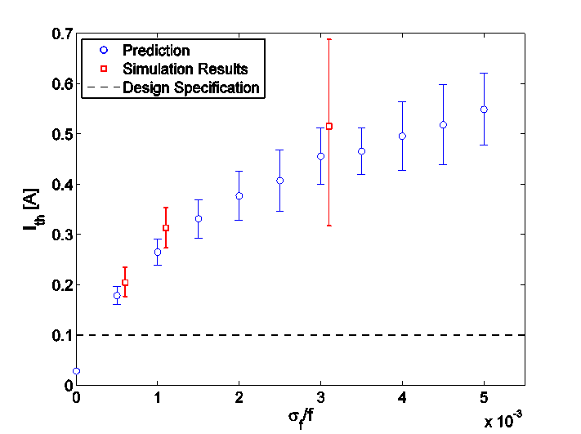
RF Optimization of Cornell’s ERL Main Linac Cavity (II)
Optimize Cavity
W.R.T. BBU parameter
Introduce realistic shape variations
(400 cavities)
Compute dipole HOMs to 10 GHz
(1692 modes /cavity)
Generate realistic ERL
(x100)
Compute BBU current
…the cavity
±0.5mm
±0.25mm
±1mm
±0.125mm
Optimized cavity with ±0.25 mm shape imperfections supports ERL beam currents well above 100 mA!
Notes:
Point out grad student Nick Valles!!!

Slide 16
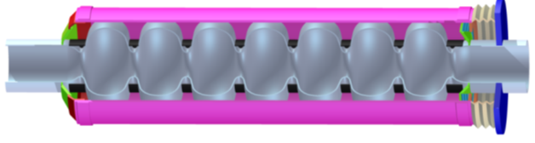
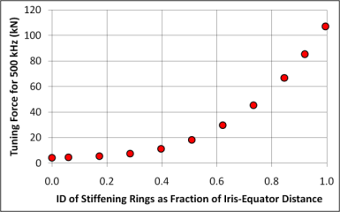


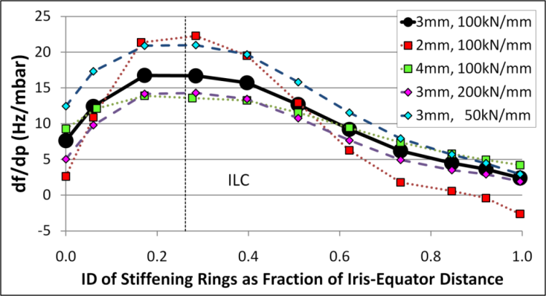

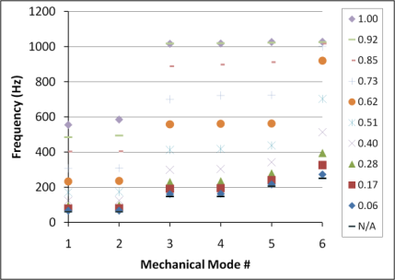




Mechanical Design of Cornell ERL Cavity for efficient Cavity Operation
Model of Cornell ERL Main Linac Cavity
Small bandwidth cavity vulnerable cavity microphonics (frequency modulation), especially by helium pressure fluctuations
Diameter of cavity stiffening rings used as free parameter to reduce df/dp
ANSYS simulations: large diameter rings and no rings at all have smallest df/dp
Stiffening rings can vary from ID at iris to OD at equator
…the cavity
No Rings
ID of rings as Fraction of Iris-Equator Distance
Cavity optimized!
No Rings
Notes:
Point out grad student Sam Posen

Slide 17
Cavity: Current Status
Residual resistance and medium field Q₀ still mostly a mystery and need much more attention!
  Including performance (degradation) in cryomodules
  -> Test cryomodules at 1.8K!
  -> Cornell Horizontal Test Cryomodule
Several cavities designed specifically for ERLs (BNL, KEK, JLAB, Cornell…), i.e. primarily for high currents. Also some optimization of mechanical design done (Cornell…)
Reliability of long term cavity operation at very high Q_{L} needs more study:
  Operate cavities CW for weeks and monitor detuning
    -> International ERL cryomodule to be tested at Daresbury in 2012
…the cavity

Slide 18
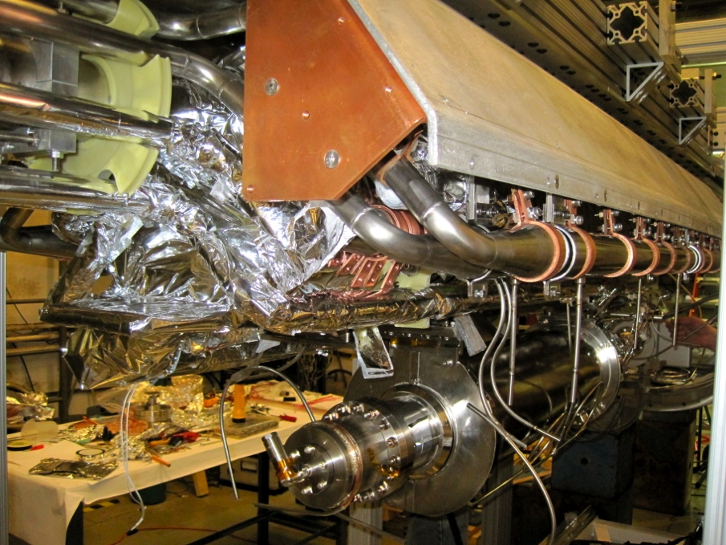
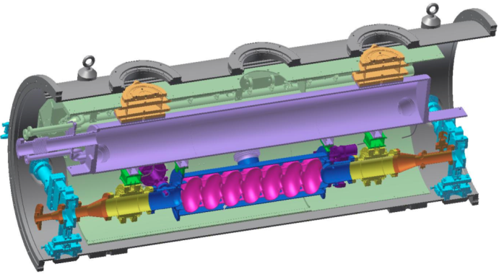
Cornell’s Horizontal Test Cryomodule
TTF, JLAB, Fermilab: see occasional significant degradation of cavity performance once installed in cryomodule. WHY?
Cornell test cryomodule: show that quality factor can be maintained after cavity has been equipped with helium vessel, RF coupler and HOM absorbers
…the cavity
80K shield
HGRP
HOM load
cavity
HOM load
Gate valve

Slide 19
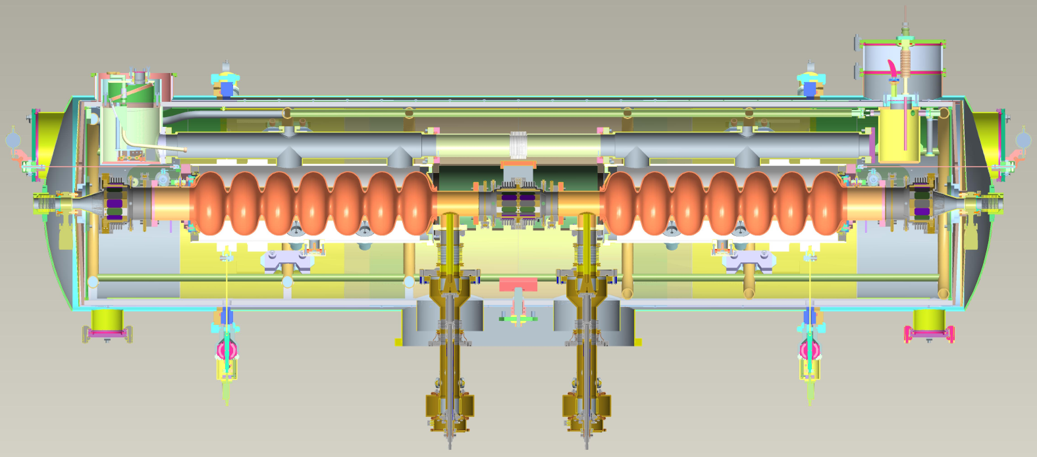
International ERL Cryomodule
Modified
Two 1.3 GHz 7 cell cavities (fabrication at test at Cornell)
Cornell-style cold HOM load
Cornell-style input coupler (from ERL injector)
…the cavity
International collaboration:
  ASTeC (STFC), Cornell University, DESY, FZD-Rossendorf, LBNL, Stanford University, TRIUMF
Test staring in 2012
  Focus on long term cavity operation at high loaded Q

Slide 20
Challenges for…the HOM Damper
Strong, broadband HOM damping
  Q’s of < 10,000 typically needed
  2ps bunches excite HOMs to ~100 GHz
Efficient HOM power extraction
  High power handling needed: Few 100 W to >1000 W of HOM power per cavity
  Best temperature to absorb power at?
Antenna, waveguide or beamline load based?
Best RF absorbing material?
  Graphite loaded SiC, Ceralloy, ferrite, CNT loaded ceramic?
Cost
  - 10% to 40% of cavity cost
…the HOM damper

Slide 21
Beam Current and HOM Damping Requirements
High beam current requires high power handling capabilities of HOM damping scheme
Risk of resonant mode excitation and beam stability require strong HOM damping by HOM damping scheme
Project | Beam current [mA] | Average HOM power per cavity [W] | Required monopole Q < | Required dipole Q <
CEBAF 12GeV | 0.10 | 0.05 | 1.40E+09 | 1.50E+09
Project X | 1 | 0.06 | 2.00E+07 | 1.00E+09
XFEL | 5 | 1 | 1.00E+05 | 1.00E+05
SPL | 40 | 22 | 1.00E+04 | 1.00E+07
BERLinPro | 100 | 150 | 1.00E+04 | 1.00E+04
KEK-CERL | 100 | 185 | 1.00E+06 | 1.00E+04
Cornell ERL | 100 | 185 | 5.00E+03 | 1.00E+04
eRHIC | 300 | 7,500 | 1.00E+04 | 4.00E+04
…the HOM damper

Slide 22
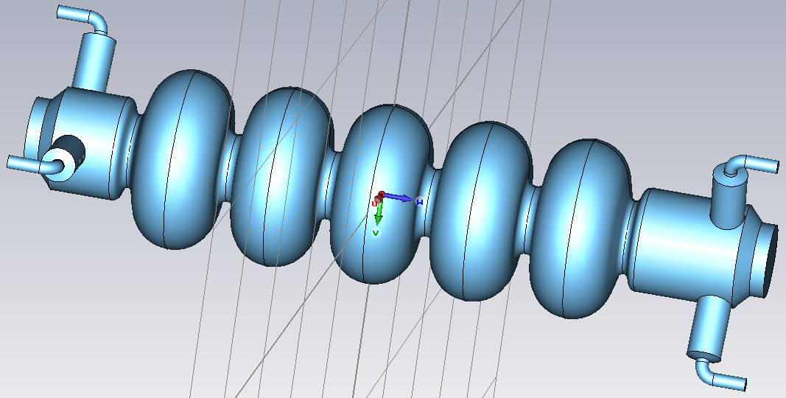
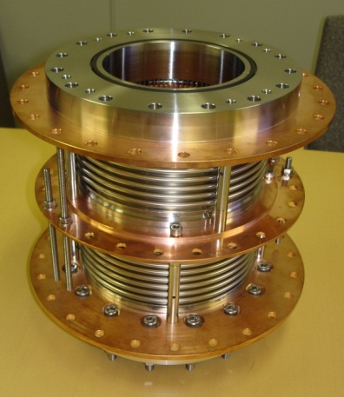
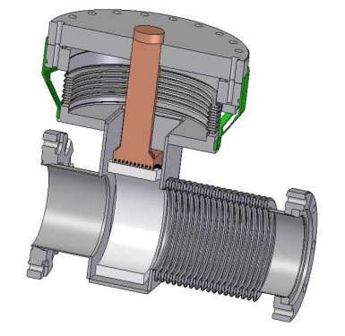
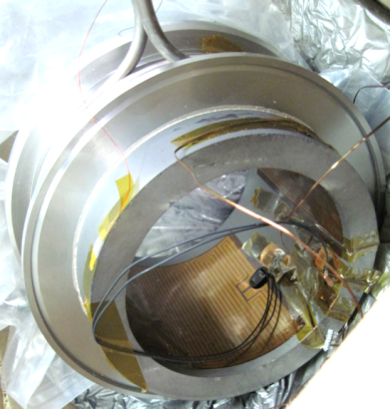
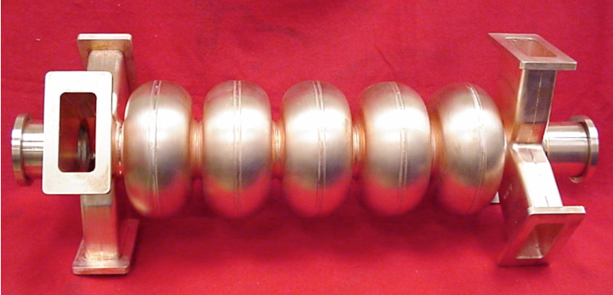
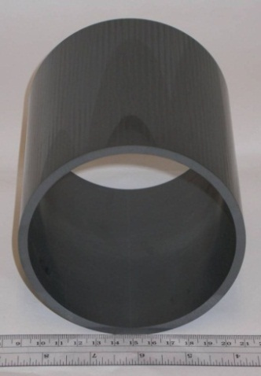
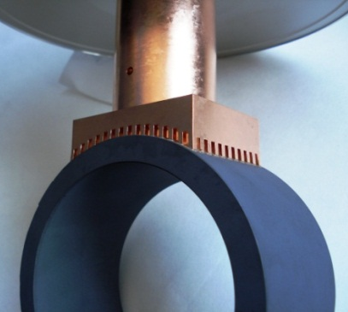
HOM Dampers
BNL 5-cell: antenna
KEK, Cornell, DESY: Beamline
…the HOM damper
JLAB 5-cell: waveguides
RF absorber Rings

Slide 23
HOM Damper: Current Status
Lots of activity worldwide
  Antenna HOM couplers
  Waveguide HOM couplers
  Beamline loads
Some good RF absorbing materials are available for operation at room temperature and cryogenic temperatures
  Reproducibility of properties needs to be addressed
Cost remains an issues
…the HOM damper

Slide 24
Challenges for… the RF Power System and Control
Active and fast cavity frequency control
  Desirable to further reduce microphonics
  Also needed to compensate Lorentz-force detuning during field camp up
  Tuner design / stiffness also impacts microphonics level
Very good RF cavity field stabilization at highest loaded Q
  Very tight field stability needed at very high loaded Q
Low cost, few kW CW input coupler (main linac)
  Currently 30 to 40% of cavity cost!
High CW input coupler (injector)
  Voltage in injector cavities limited by coupler RF power
Reliable, efficient, low cost 5 - 15 kW RF source
  Need low trip and failure rate
  Need lower cost/Watt (<10$/Watt for full system)
…the RF power system and control

Slide 25
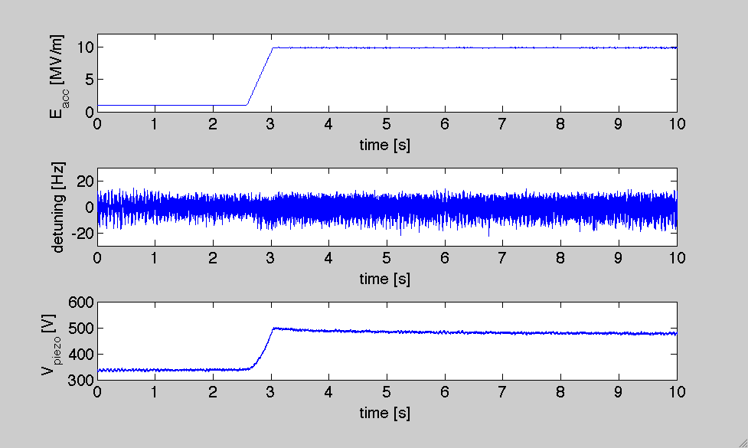
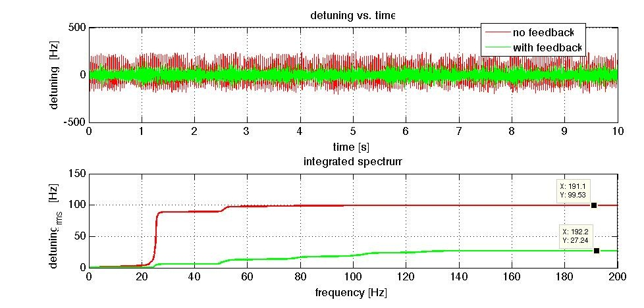
RF Power System and Control:
Current Status (I)
Active compensation of Lorentz-force detuning works well
Initial steps taking in active microphonics control, but very challenging and still limited in effectiveness. Note: peak detuning most important!
Lorentz-force detuning and microphonics compensation at the Cornell ERL injector module
…the RF power system and control
Reduces rms microphonics by up to 70%!

Slide 26
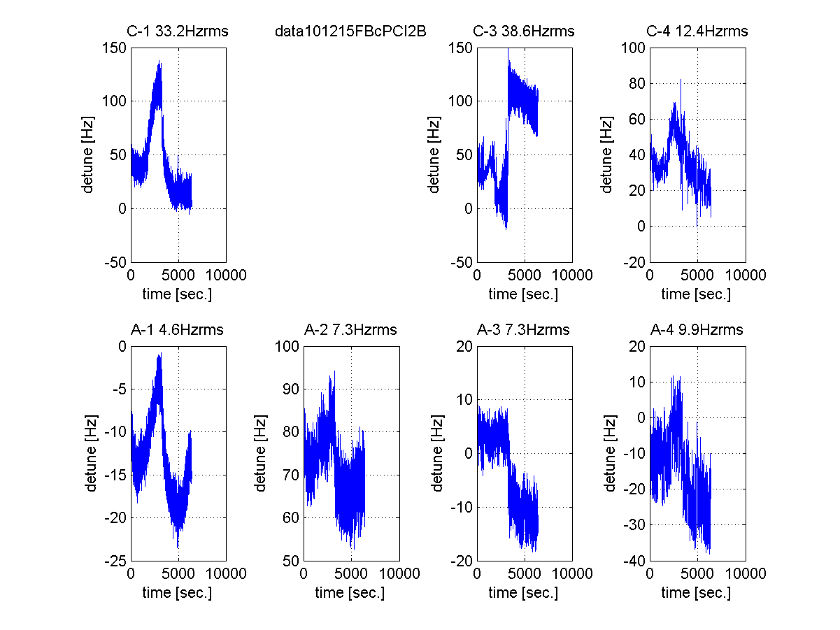
S1 Global Cryomodule:
Detuning change during 2 hour operation
He pressure
quench
…the RF power system and control
Shin MICHIZONO (KEK)
Significant differences in df/dp sensitivity! Need more data!

Slide 27
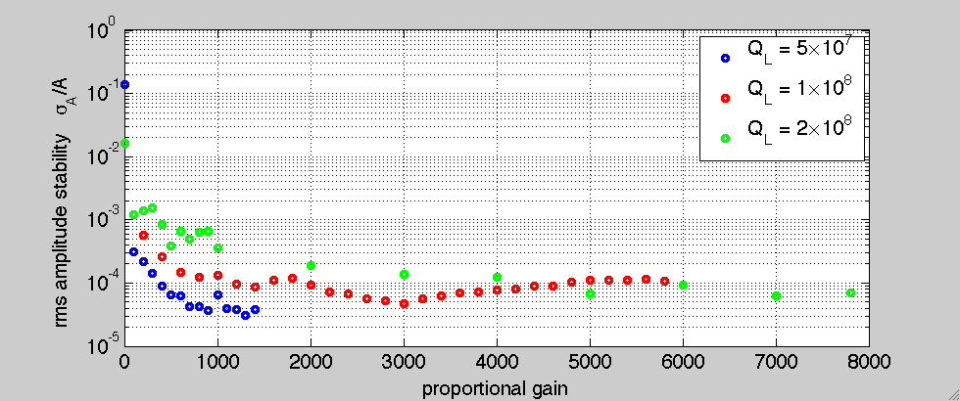
RF Power System and Control:
Current Status (II)
Excellent field stability at very high loaded Q demonstrated:
Tests of Cornell’s novel LLRF system
  At JLAB ERL-FEL, CEBAF, HZ-Berlin horizontal test cryostat
  Demonstrated highly efficient operation at record high loaded quality factors up to 2⋅10⁸
  Exceptional field stability: σ_{A}/A <1⋅10⁻⁴, σ_{ϕ} ~ 0.01 deg
…the RF power system and control

Slide 28
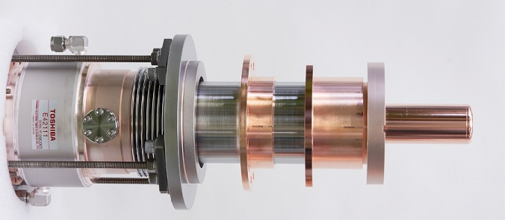
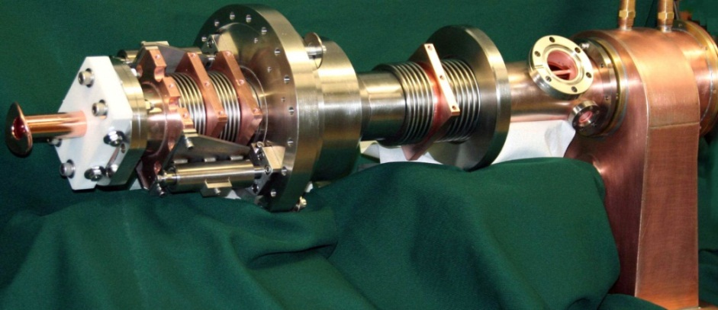
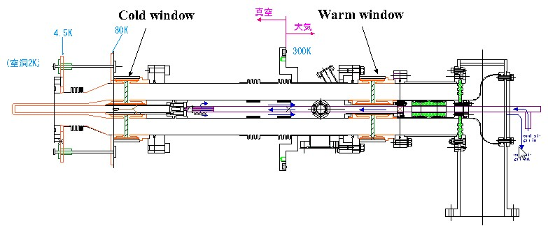
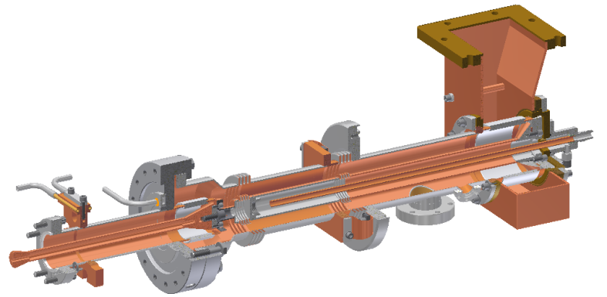
RF Power System and Control:
Current Status (III)
Various CW RF input coupler developed for ERLs:
  Also waveguide couplers (JLAB)
But: High cost remains major issue
KEK, >50 kW, 1.3 GHz
Cornell, 50 kW, 1.3 GHz
…the RF power system and control
Coax
Coax
-
-
waveguide
2K
waveguide
2K
80K
80K
300K
5K
300K
5K
transition
KEK, 20 kW, 1.3 GHz
transition
Cold window
vacuum
Warm window
Cornell, 5 kW, 1.3 GHz
bellows
5K
80K
RF power

Slide 29
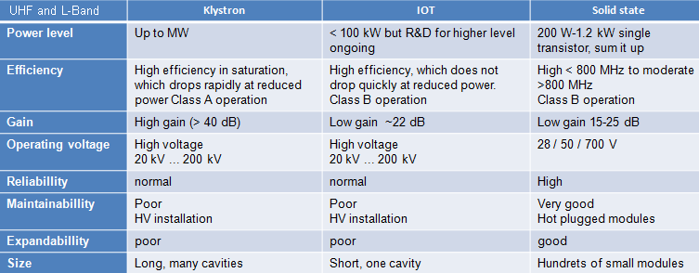
RF Power System and Control:
Current Status (IV)
Solid state amplifier start to emerge as best choice for a few kW CW RF power source
    Reliable, linear, good efficiency at all power levels
    Cost competitive with IOT, klystron
…the RF power system and control
W. Anders, HZB

Slide 30
Challenges for… the Cryostat and Cryoplant (I)
Cryogenic system for high CW cryo-loads: Optimization
  Large number of significant dynamic heat loads: cavity, HOM loads, CW input couplers
  Cool in series, parallel? How to ensure uniform cooling?
  Huge difference in cooling power between RF and beam on and standby. Cryoplant must have sufficient flexibility!
  Optimal temperatures:
    Shield temperature? 80K?
    Cavity operating temperature? Large cryoplant stability at 1.6K and below
  Cryoplant contributes >50% to total wall plug power
    Improvements in coefficient of performance desirable
…the cryostat and cryoplant

Slide 31
Challenges for… the Cryostat and Cryoplant (II)
Cryostat design for low mechanical vibrations and vibration damping
  How do external vibrations get to the cavities?
  What matters, i.e. drives microphonics?
Excellent magnetic shielding
  Excellent magnetic shielding essential for high Q₀ in cw operation (B < few mG at cavities)
  How many layers of shield needed?
Accurate cavity alignment (0.5 – 1mm)
…the cryostat and cryoplant

Slide 32
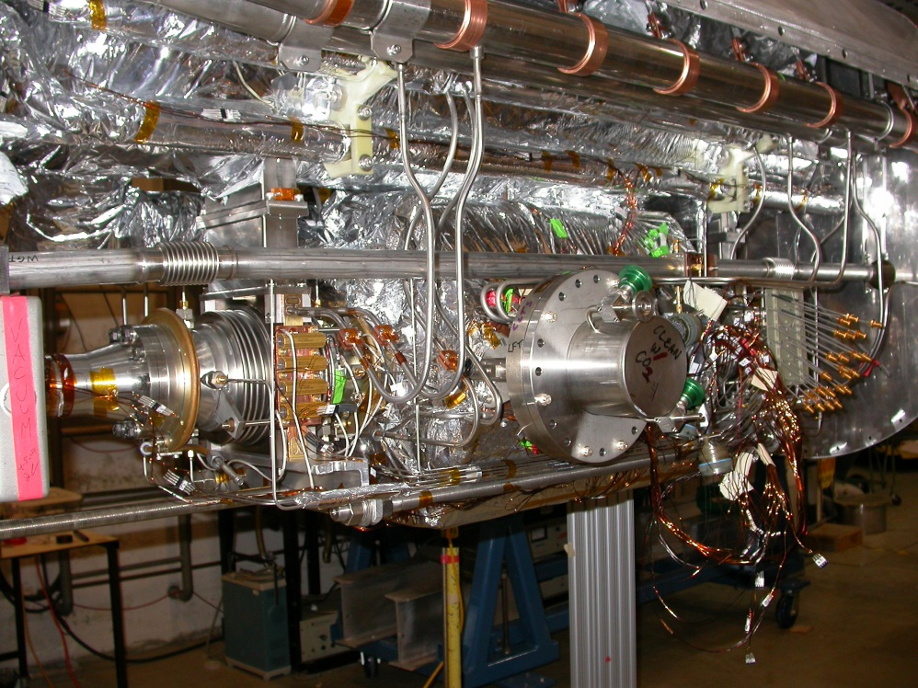
Cryostat and Cryoplant:
Current Status
Experiences with DESY, LHC, JLAB, and SNS cryoplants provide excellent opportunities to learn from
  Need to explore operation below 1.8 K
Test / prototype modules important to verify module cryogenic manifold sizing and layout
5K supply
80K supply
…the cryostat and cryoplant
5K distribution to heat exchanger
80K distribution to heat exchanger

Slide 33
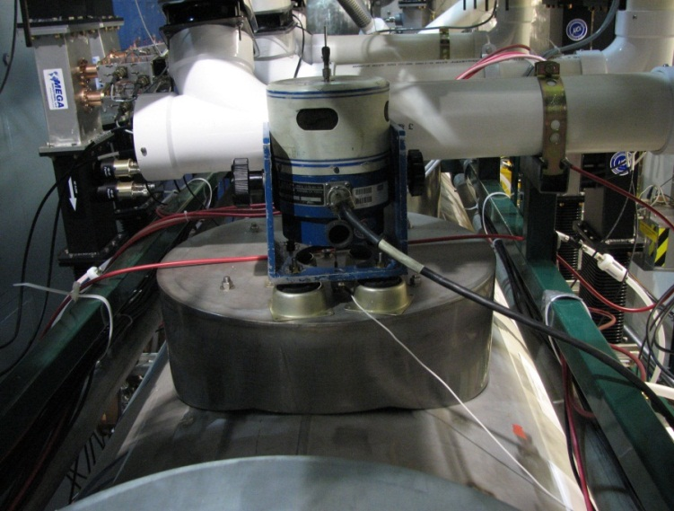
Mechanical Coupling Characterization Measurements with a Modal Shaker at Cornell Injector Module
Excitation Point | Excitation Force | Detectable With Cavity Accelerometer | Detectable On Cavity RF Frequency (>0.1Hz modul.)
Coupler Waveguide | 110 N (25 lbs) | No | No
Coupler | 110 N (25 lbs) | No | No
Cryomodule Saw-Horse Support | 110 N (25 lbs) | Yes | No
Helium Gas Return Pipe Support | 110 N (25 lbs) | Yes | Yes
Beam Line | 10 N (2 lbs) | No | No
Helium Supply/Return | 110 N (25 lbs) | No | No
Ground vibrations and other mechanical vibrations do not strongly couple to the SRF cavities
Main contribution to cavity microphonics comes from fast fluctuations in the He-pressure and the cryogenic system
…the cryostat and cryoplant

Slide 34
Cryostat and Cryoplant:
Current Status
Sufficient magnetic shielding and cavity alignment has been demonstrated
…the cryostat and cryoplant
B < 3 mG
1.00
0.50
Cornell ERL injector cryomodule: Cavity string is aligned to ±0.2 mm after cool-down!
0.00
X1 [mm]
X position [mm]
ERL Injector Cooldown WPM Horizontal
X3 [mm]
-0.50
X4 [mm]
-1.00
X5 [mm]
4/29/08 0:00
4/30/08 0:00
5/1/08 0:00
5/2/08 0:00
Date-Time

Slide 35
Summary and outlook
Summary and outlook

Slide 36
Summary and outlook (I)
Challenges that have been resolved:
  Cavity design for strong HOM damping
  Operation at very high loaded Q (5x10⁷ to >1x10⁸) with excellent RF field stability
  Cryomodule providing excellent cavity alignment and magnetic shielding
Challenges that need some additional work:
  Long term cavity operation at high loaded Q with very low trip rates
  Microphonics reduction by passive and active means
  Broadband HOM dampers
  Low cost, reliable RF power sources (few kW range)
  Cryostat design for large number of significant dynamic loads supporting wide range in loads
Summary and outlook

Slide 37
Summary and outlook (II)
Challenges that need much more work:
  Reliably achieving high Q₀>2x10¹⁰ at medium fields
  Reducing cost of lower CW power RF input couplers (few kW range)
How you can help:
  Routinely test cavities at 1.6K, 1.8K, and 2K
  Test full modules at 1.6K, 1.8K, and 2K
  Study microphonics in cryomodules, especially long term, sensitivity to LHe pressure…
  Test operation of cryoplants below 1.8K
Summary and outlook

Slide 38
The End
Thanks for you attention!

