Slide 1
ILC GDE Status and Challenge
Akira Yamamoto
KEK and ILC-GDE Project Manager
To be presented at TTC,
Held at IHEP, 5th December, 2011

Slide 2
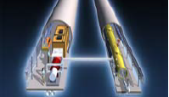
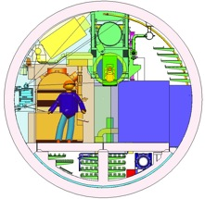

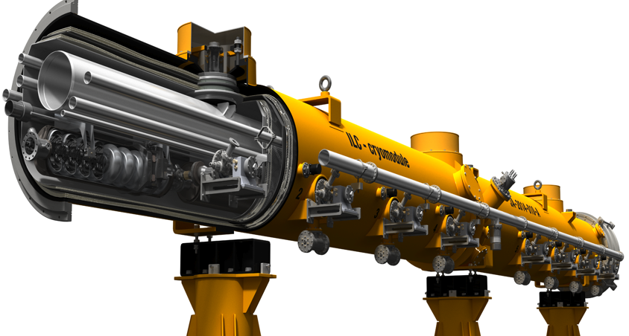
Design Update in SB2009
RDR → SB2009
Motivation: Cost containment
Single accelerator tunnel
Smaller damping ring
e+ target at high-energy end,
SCRF: 31.5 MV/m +/- 20 %,
HLRF: KCS and DRFS with RDR-RF unit as backup

Slide 3
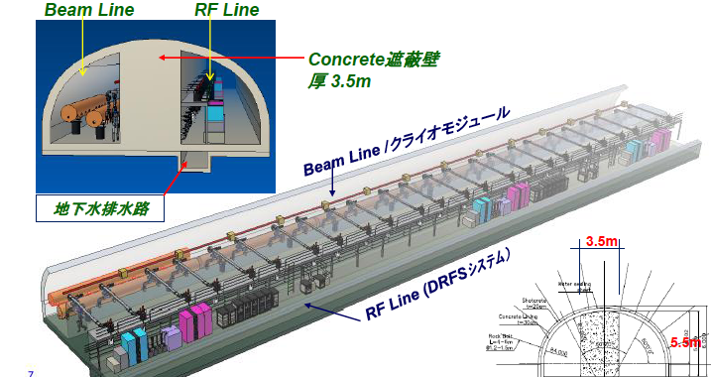
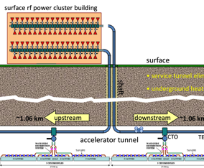
Single Tunnel Options with HLRF
DRFS:
CM-unit→ 8+8+8
Distributed RF Sources (DRFS)
  800 kW MAK
  Everything in tunnel
Klystron Cluster Scheme (KCS)
  Surface clusters of klystrons (2×32 MBK)
  RF power distributed via over-moded waveguide (350 MW)
    ±1 km
RDR HLRF Technology
  e.g. XFEL-like solution
  (pulsed cables)
  Back-up (risk-mitigation)

Slide 4
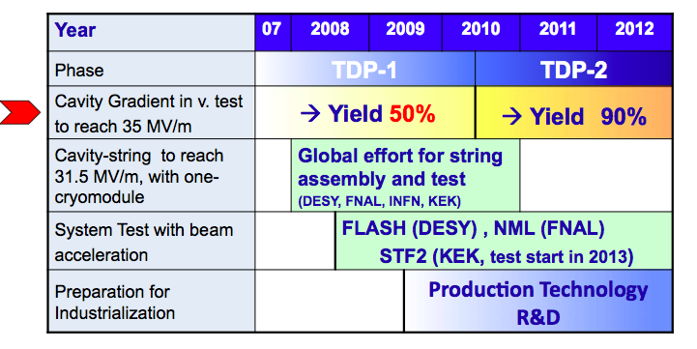
Global Plan for ILC Gradient R&D
New baseline gradient:
Vertical acceptance: 35 MV/m average, allowing ±20% spread (28-42 MV/m)
Operational: 31.5 MV/m average, allowing ±20% spread (25-38 MV/m)

Slide 5
Global Yield of Cavities in 2008 tested at DESY and JLab
Originally reported by H. Padamsee
H. Padamsee, ILC-08 (Chicago)
Process Yield: ~ 23 % @ 35 MV/m, based on 48 Tests for19 cavities
Manufactured by ACCEL, AES, Zanon, KEK (Ichiro-type), and JLab
Reported by H. Padamsee at TTC-08 (IUAC), and ILC-08, (Chicago), based on the status in 2008。
50%
Definition for production yield, not well established yet
5

Slide 6
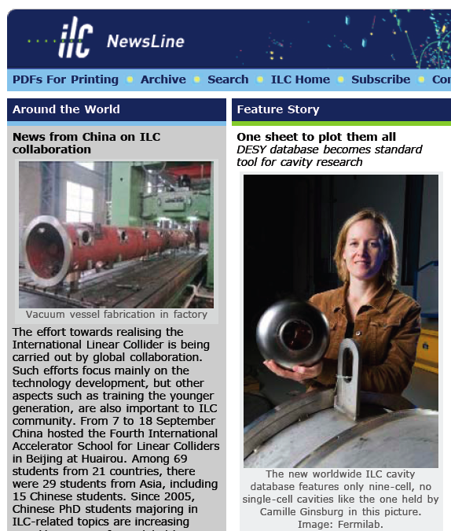
Creation of a Global Database for
Better Understanding of “Production Yield”
Global Data Base Team formed by:
  Camille Ginsburg (Fermilab), leader
  Rongli Geng (JLab)
  Zack Conway (Cornell University)
  Sebastian Aderhold (DESY)
  Yasuchika Yamamoto (KEK)
Activity
  July 2009:
  - Determine DESY-DB to be viable option,
  Sept., 2009: (ALCPG/GDE)
  - Dataset, web-based, support by FNAL/DESY,
  Dec., 2009: (SB2009) : 1st update
  March, 2010 (IW-ILC) : 2nd update
  June, 2010 (End TDP-1) : 3rd update
  March, 2011 (ILC-ALCPG): 4th update
  RI, Zanon, AES, MHI manufactured
  Cavity data included.
  -- Sept. 2011, Latest update
Production yield allowing to:
- include the 2nd chemical process

Slide 7
Standard Procedure Established for ILC-SCRF Cavity evaluation, in guidance of TTC
 | Standard Fabrication/Process
Fabrication | Nb-sheet purchasing
 | Component Fabrication
 | Cavity assembly with EBW
Process | EP-1 (~150um)
 | Ultrasonic degreasing with detergent, or ethanol rinse
 | High-pressure pure-water rinsing
 | Hydrogen degassing at > 600 C
 | Field flatness tuning
 | EP-2 (~20um)
 | Ultrasonic degreasing or ethanol (or EP 5 um with fresh acid)
 | High-pressure pure-water rinsing
 | Antenna Assembly
 | Baking at 120 C
Cold Test (vertical test) | Performance Test with temperature and mode measurement
Key Process
Fabrication
Material
EBW
Shape
Process
Electro-Polishing
Ethanol Rinsing or
Ultra sonic. + Detergent Rins.
High Pr. Pure Water cleaning
allow twice

Slide 8
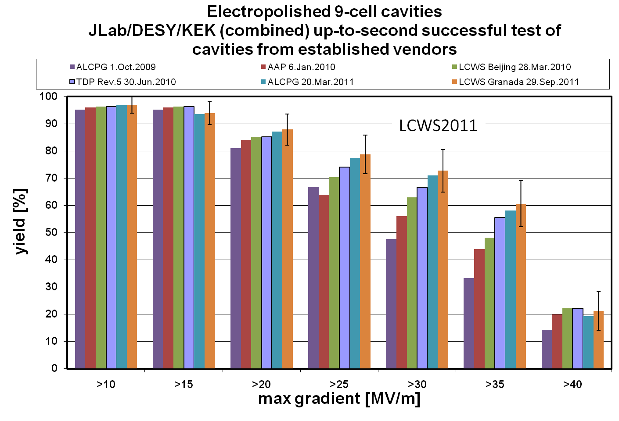
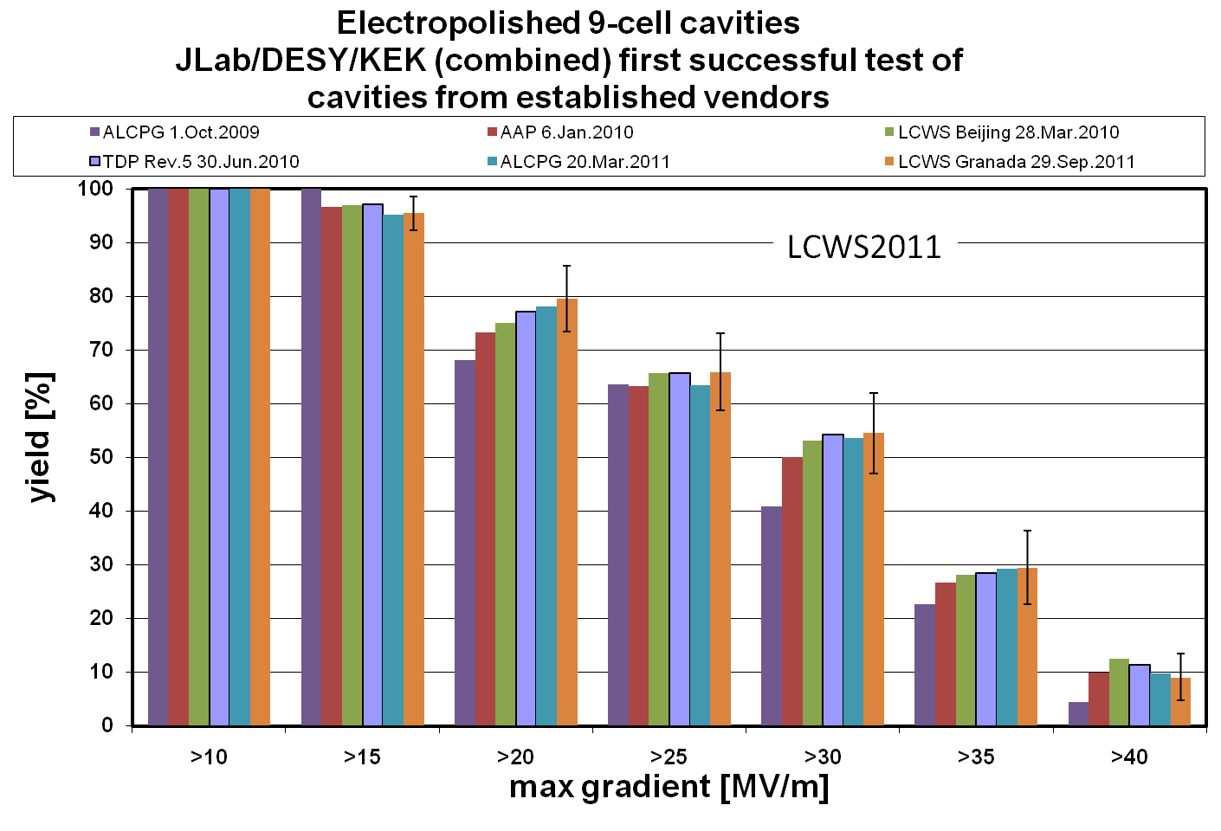
Gradient Yield: Time Progression with most recent update, Sept. 2011
1st pass
2nd pass

Slide 9
Global ILC Cavity Gradient Yield
Updated, March, 2011
Plot courtesy
Camille Ginsburg of FNAL
TDP-2 Goal
35 MV/m usable
TDP-1 Goal
Achieved
> 50 %

Slide 10
Global ILC Cavity Gradient Yield
Updated, Sept., 2011
Plot courtesy
Camille Ginsburg of FNAL
TDP-2 Goal
> 28 MV/m usable
Effectively
Achieved:
> 75 %

Slide 11
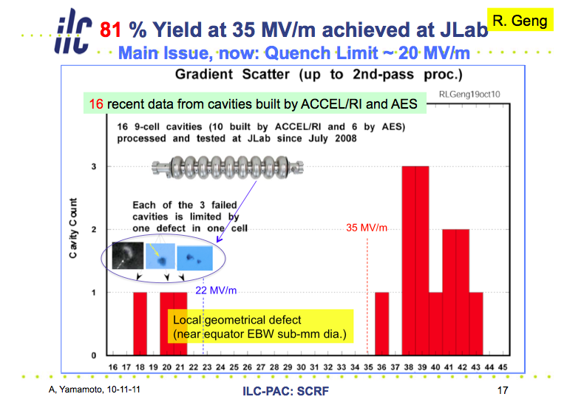
Impact of Mechanical Polishing progress in Nov, 2010 ~ May, 2011
✔
✔
AES5 After
Mechanical
Polishing
at Cornell
ACC15 after
Mechanical
Polishing
at FNAL
This cavity
AES6 is being
treated with
mechanical
polishing at
FNAL and will
be then EP
processed and
tested at JLAB
Courtesy: R. Geng

Slide 12
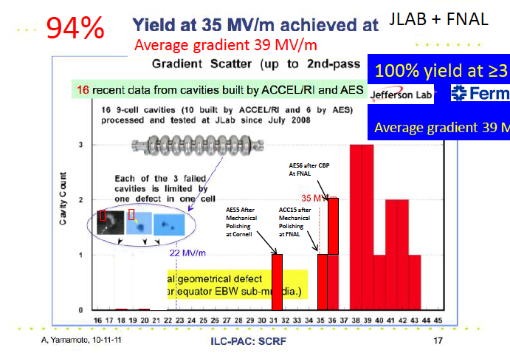
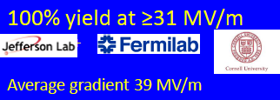



Impact of Mechanical Polishing as of July, 2011
88%
JLAB + FNAL
Average gradient 39 MV/m
94% yield at ≥31 MV/m
+ +
Average gradient 38.8 MV/m
✔
✔
AES5 After
Mechanical
Polishing
at Cornell
ACC15 after
Mechanical
Polishing
at FNAL
This cavity
AES6 is being
treated with
mechanical
polishing at
FNAL and will
be then EP
processed and
tested at JLAB
Courtesy: R. Geng

Slide 13
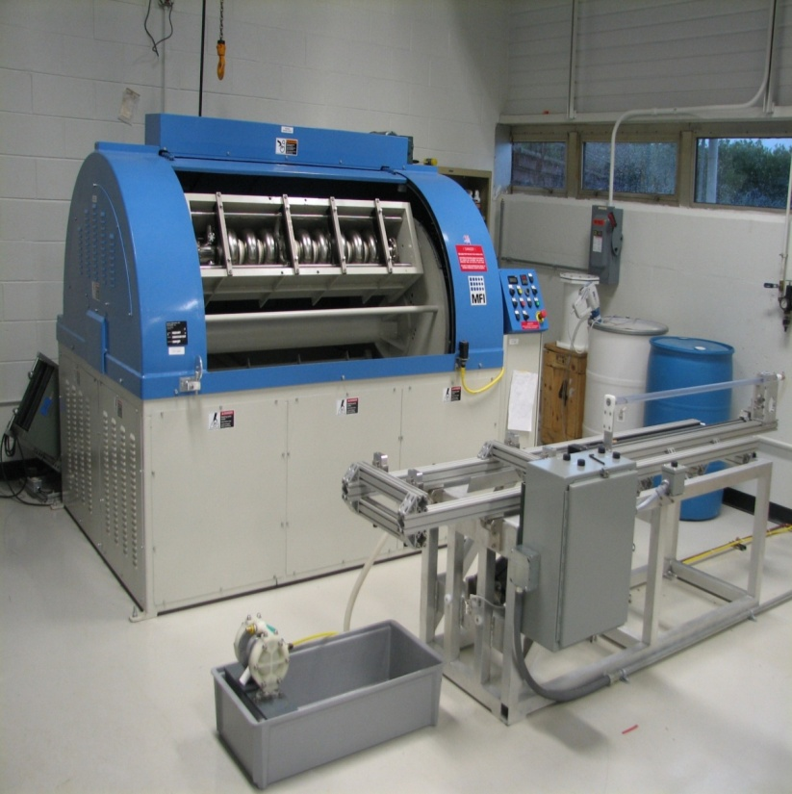
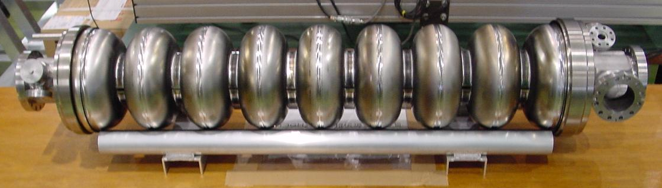
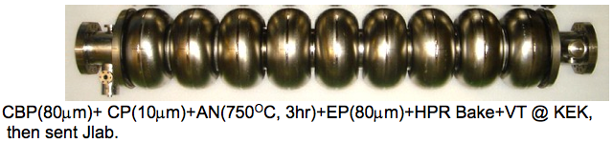
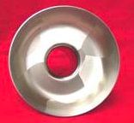
SRF Cavity and Gradient Highlights 2010~ 2011
R. Geng
Americas
  FNAL mechanical polishing improved 9-cell cavity ACC15 gradient from 19 MV/m to 35 MV/m
  JLAB started processing and testing DESY seamless 9-cell cavity built from DESY 3-cell seamless units
  6 of AES 3rd production & 4 Niowave-Roark 1st production received by FNAL
Asia
  PKU-JLab reached 28.6 MV/m
  KEK MHI-12 reached ≥ 40 MV/m gradient at Q0 6.2E9
  KEK-JLAB: ACD shape cavity ICHIRO7 reached 40 MV/m gradient at Q0 8E9
Europe
  DESY large-grain 9-cell cavity AC155 reached 45 MV/m at Q0 > 1E10, and more reached in the next, …

Slide 14
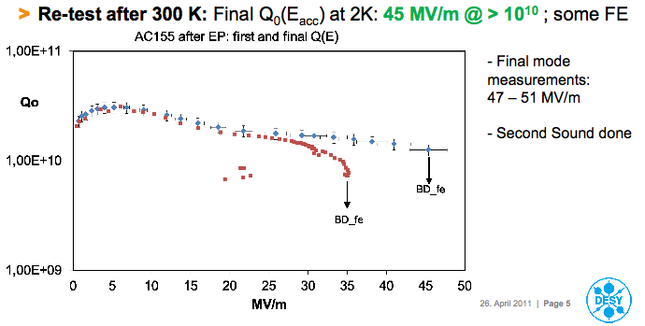
DESY Large-Grain Cavity AC155 Reached > 45 MV/m at Q0 > 1E10
Heavy BCP + EP + low temperature bake
7 more cavities
on the way…

Slide 15
Cavity R&D Beyond 2012
R. Geng
Importance
  Maintain “global” nature for coherence
  Project oriented, targeted R&D, benchmarked progress
  Resource sharing, cross-region experience exchange
ILC: driver for high gradient SRF cavity technology
  Pursuit of ultimate gradient continues to motivate innovation
  Gradient success continues to benefit SRF based accelerators
year | # of >35 MV/m 9-cell cavities | # of labs capable of 35 MV/m processing | # of Industrial manufacturers capable of 35 MV/m fabrication
2006 | 10 | 1 DESY | 2 ACCEL, ZANON
2011 | 41 | 4 DESY, JLAB, FNAL, KEK and others joining soon | 4 RI, ZANON, AES, MHI, and others joining soon

Slide 16
Cavity R&D to be extended toward possible ILC 1 TeV Upgrade
M. Ross
High gradient
  Shape: LL/ICHIRO, RE, LSF – on going
  Processing: Mechanical polishing – on going
  Material
    Large grain – on going
    Nb/Cu laminate – needs re-start
    Multi-layer and material beyond Nb – to be encouraged
High Q0
  Large grain – on going
  ALD over coating – R&D started
Suppress field emission
  CO2 snow cleaning – on going
  HOM can cleaning – R&D started

Slide 17
Global Plan for SCRF R&D
Year | 07 | 2008 |  | 2009 |  | 2010 |  | 2011 | 2012
Phase | TDP-1 |  |  |  |  |  | TDP-2
Cavity Gradient in v. test to reach 35 MV/m | → Yield 50% |  |  |  |  |  | → Yield 90%
Cavity-string to reach 31.5 MV/m, with one-cryomodule |  | Global effort for string assembly and test (DESY, FNAL, INFN, KEK)
System Test with beam acceleration |  |  | FLASH (DESY) , NML (FNAL) STF2 (KEK, test start in 2013)
Preparation for Industrialization |  |  |  |  | Production Technology R&D
Communication with industry: | 2009: 1st step: Visit Vender (2009) 2010: 2nd step: Organize Workshop (2010) 2011: 3rd step: Send specification & receive response
We are here

Slide 18
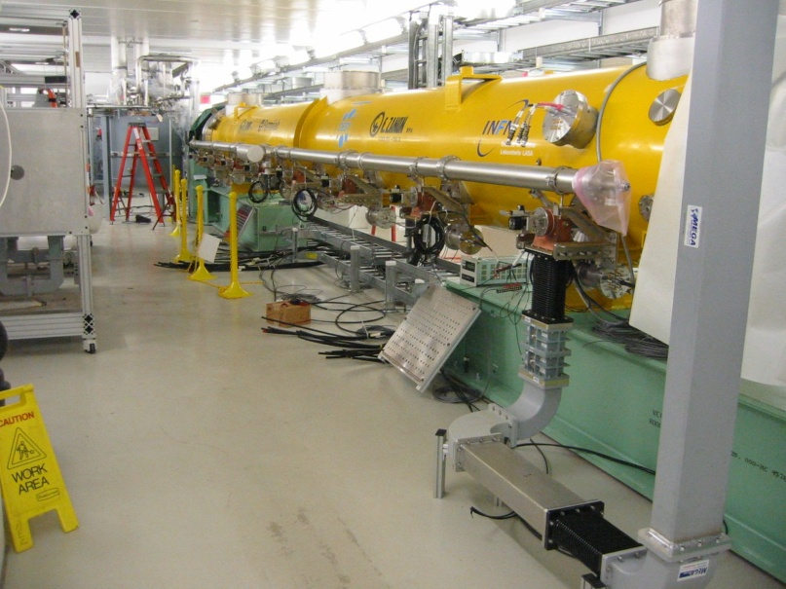
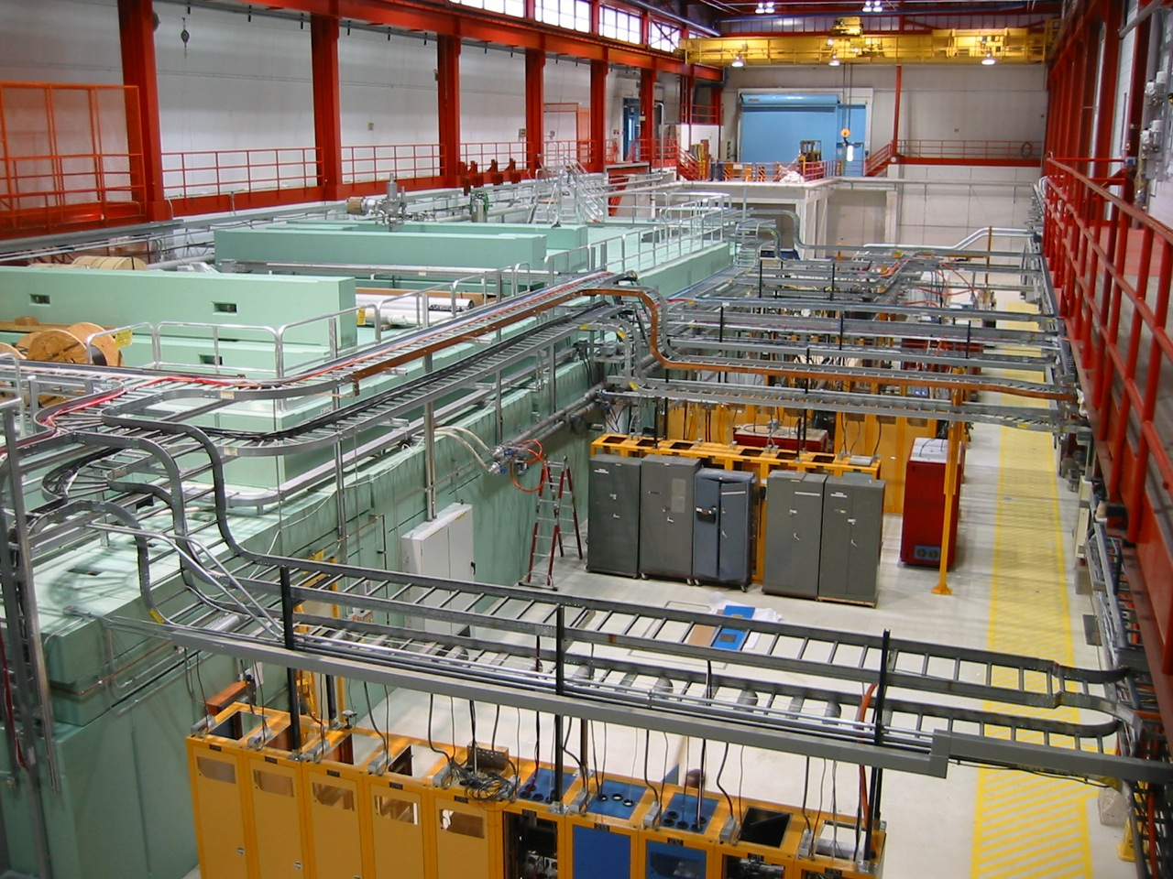
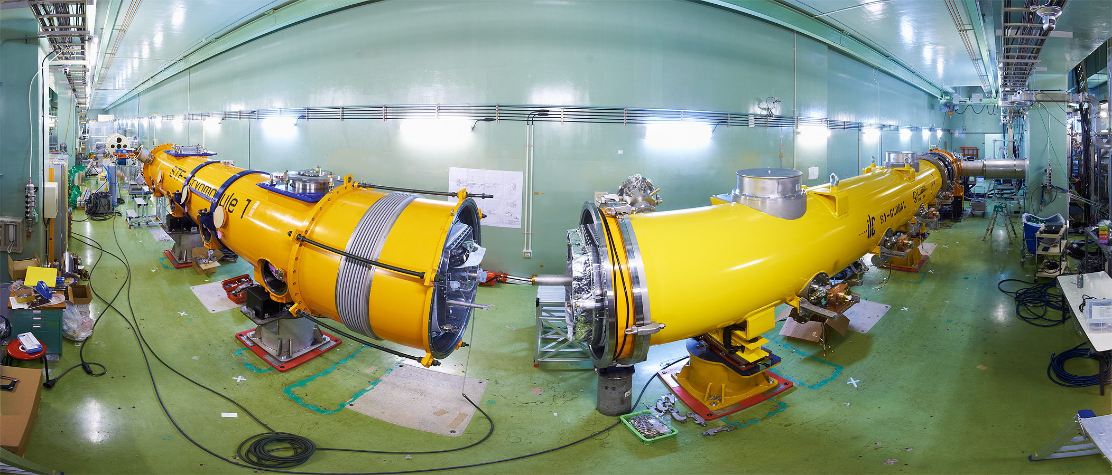
Integrated Systems Tests
2009 ~
Full systems integration testing
FLASH (DESY)
NML (FNAL)
STF (KEK)
TDP focus
Under construction
Up to 6 cryomodules
Operation: end 2012
“Quantum Beam” experiment 2011
1 CM with beam 2013
7 CM → 1.2 GeV beam
photon user facility
(2 CM 2015)
(3 CM)
“9mA experiment”
achieved ~1800 bunches at 9mA in 09.2009
ΔE/E_{RMS} ~0.5% (@ 0.8 GeV)
~0.1% within pulse

Slide 19
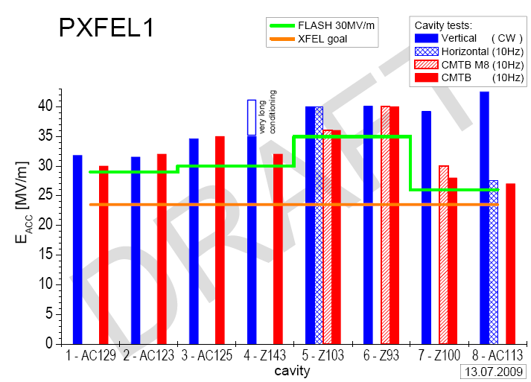
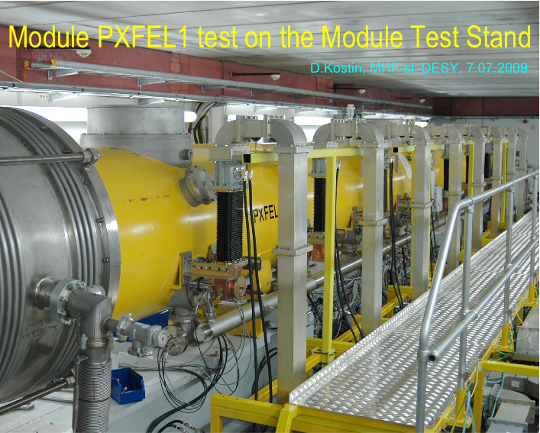
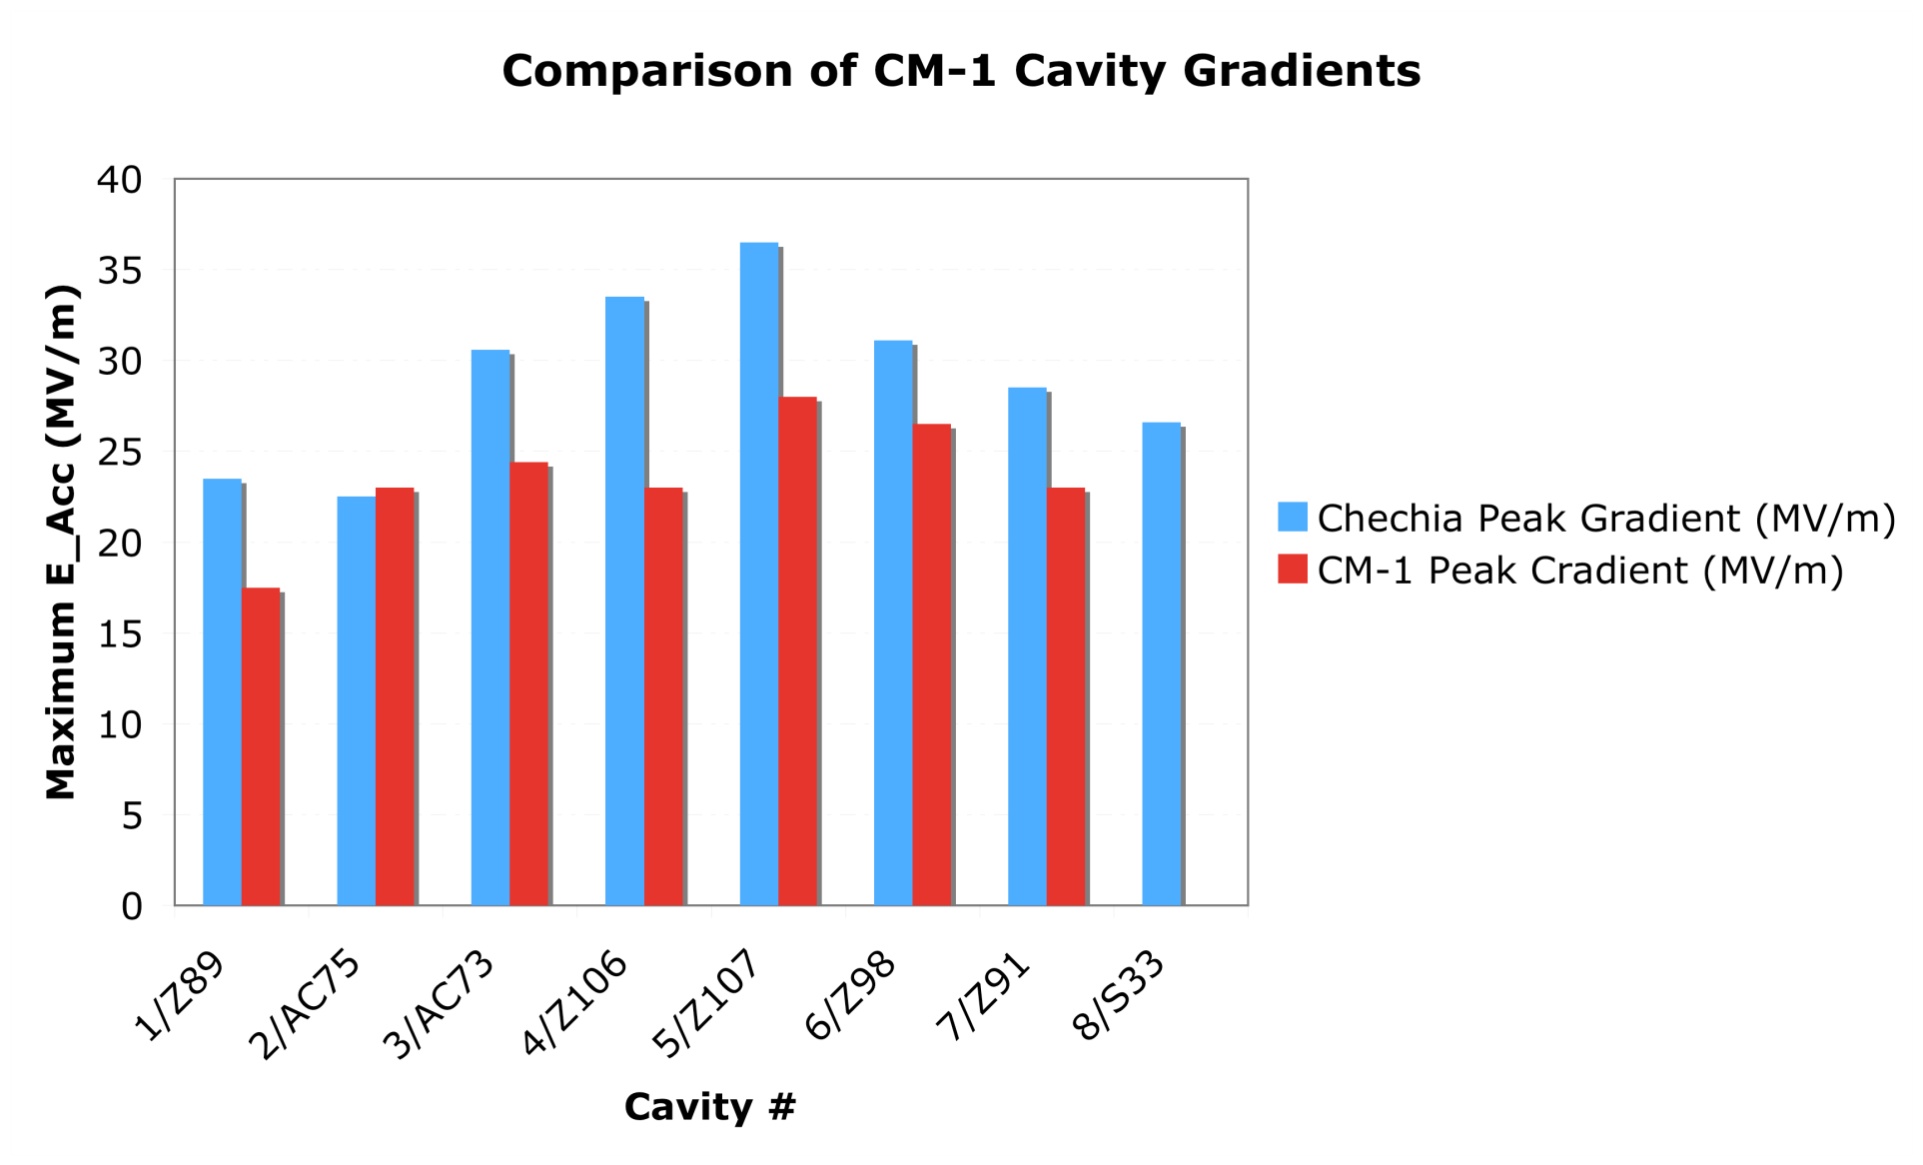
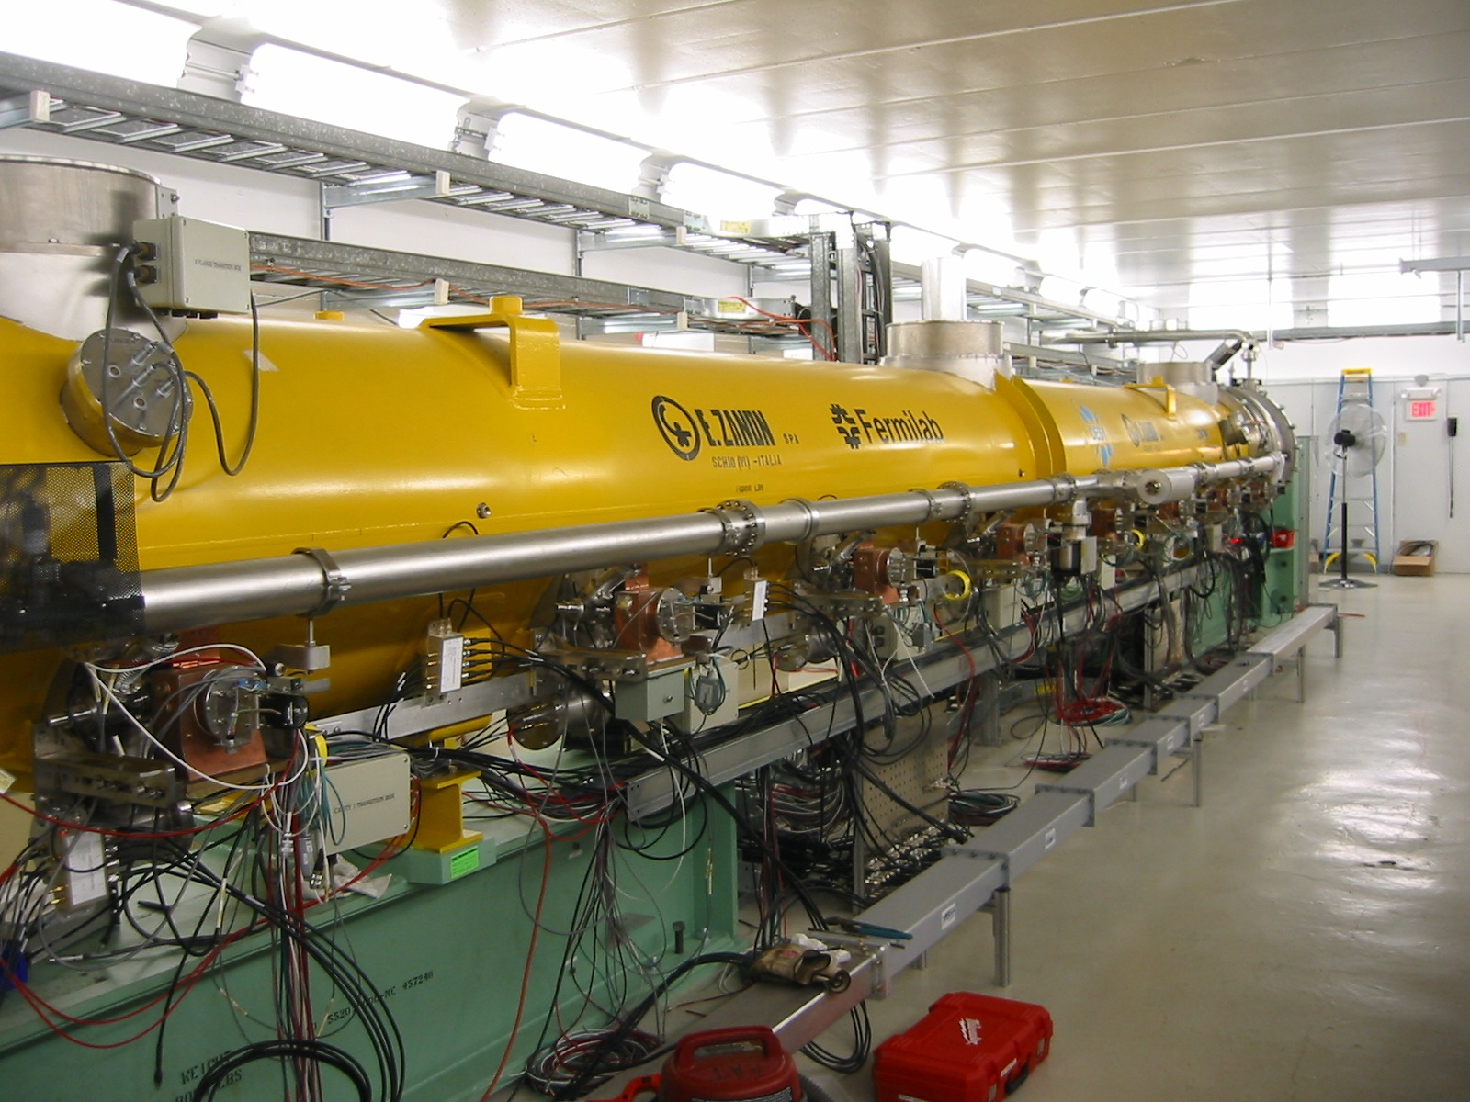
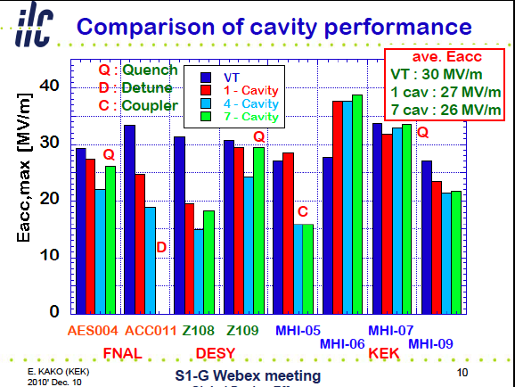
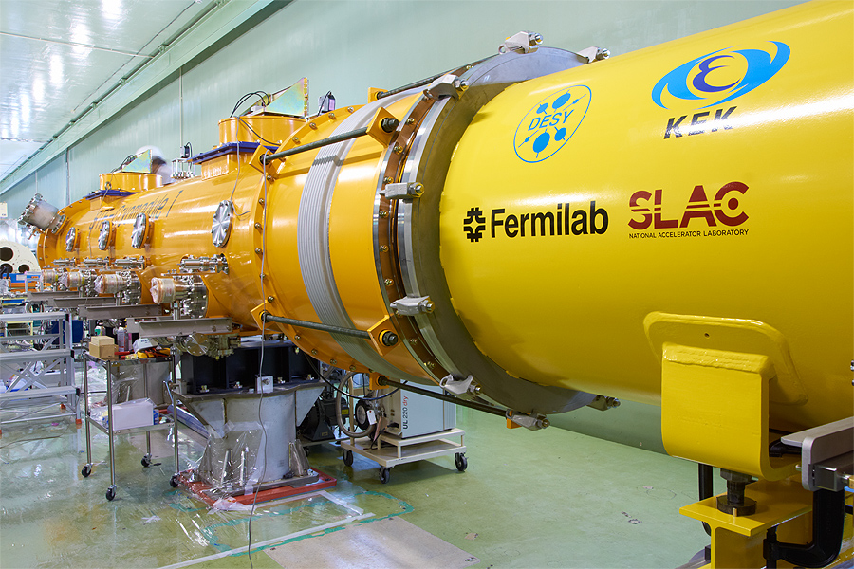
Cryomodule Development & Test
FLASH (DESY)
  <32 MV/m> in CM operation, PXFEL-1
  < 30 MV/m> in FLASH operation
NML-CM1 (Fermi)
  In progress
STF: S1-Global (KEK)
  Global effort
    DESY/INFN/FNAL/SLAC/KEK
  <26 MV/m> in CM operation

Slide 21
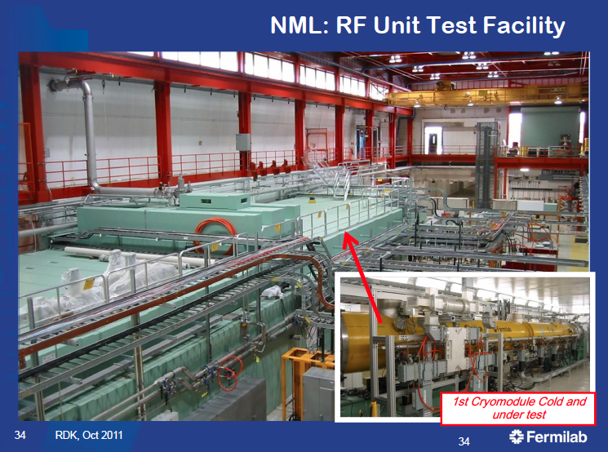
Fermilab: RF Unit Test Facility

Slide 22
Cryomodule-1 Testing at Fermilab
E. Harms
Preliminary
7 of 8 cavities powered,
2 with high heat; no FE?
1 tuner motor failure
Calibrations under study

Slide 23
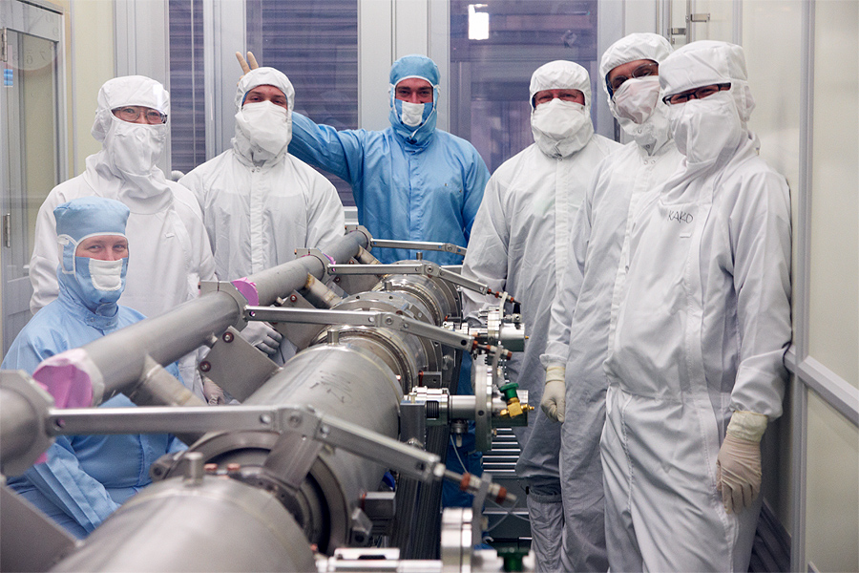
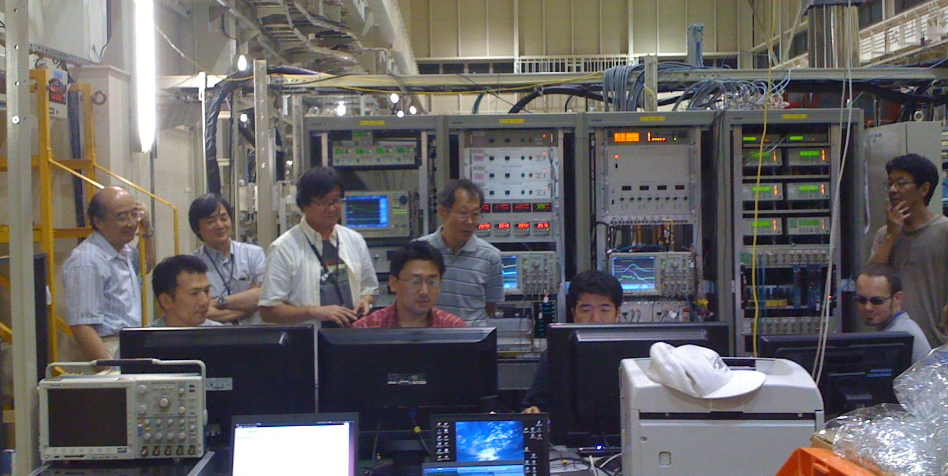
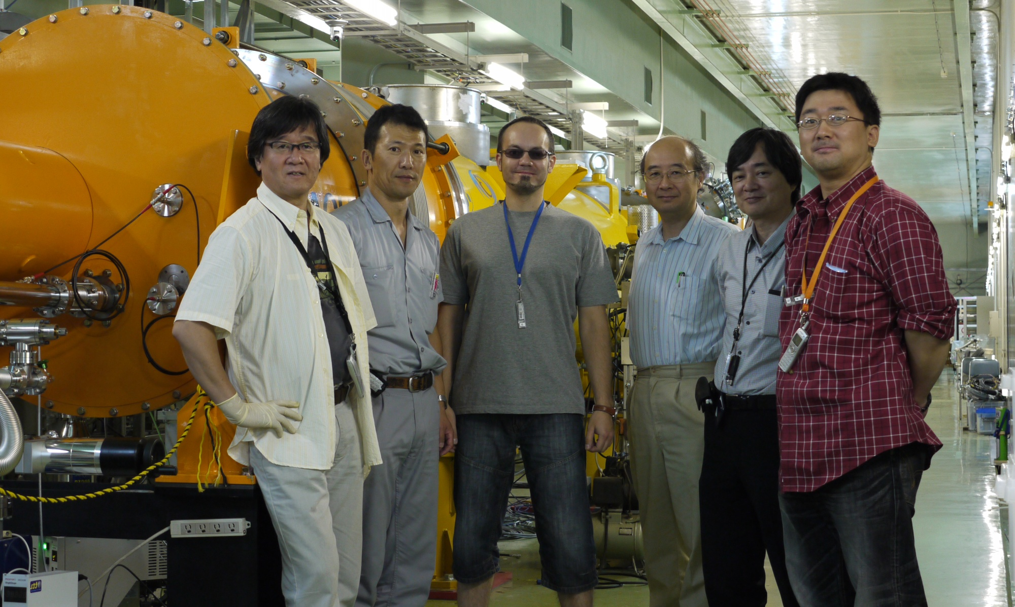
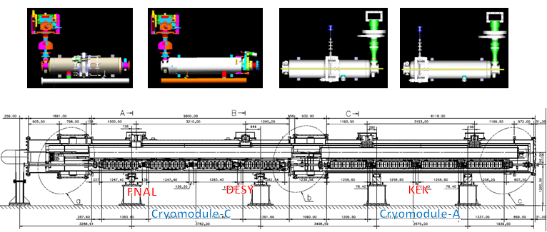
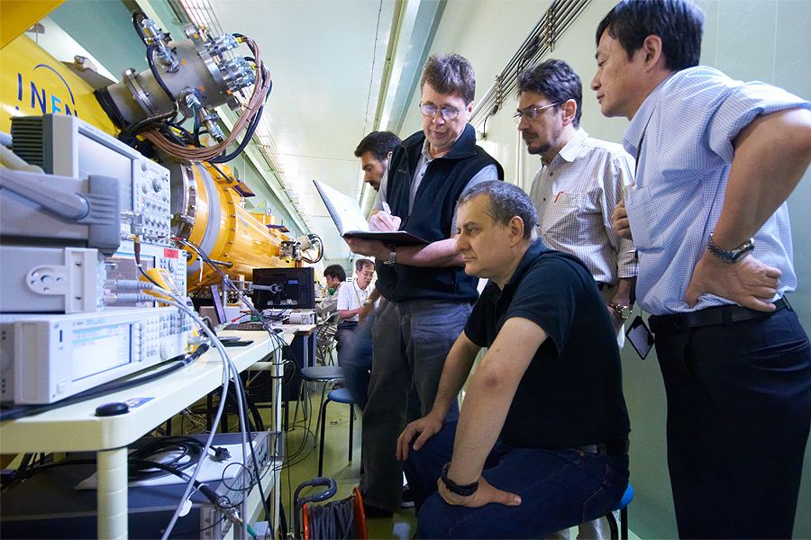
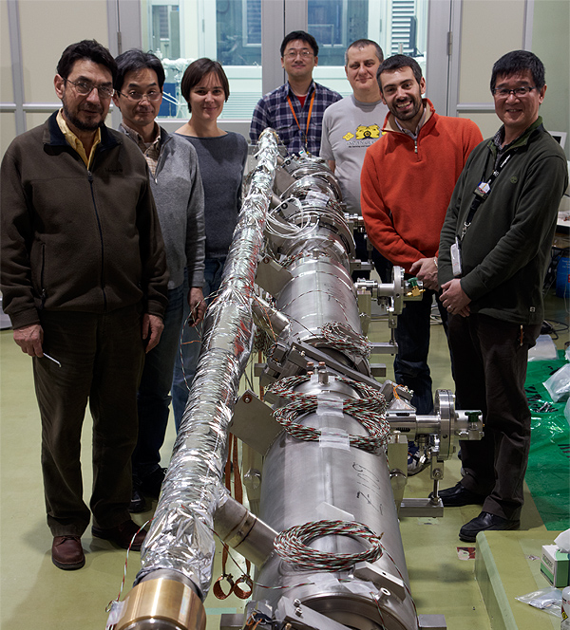
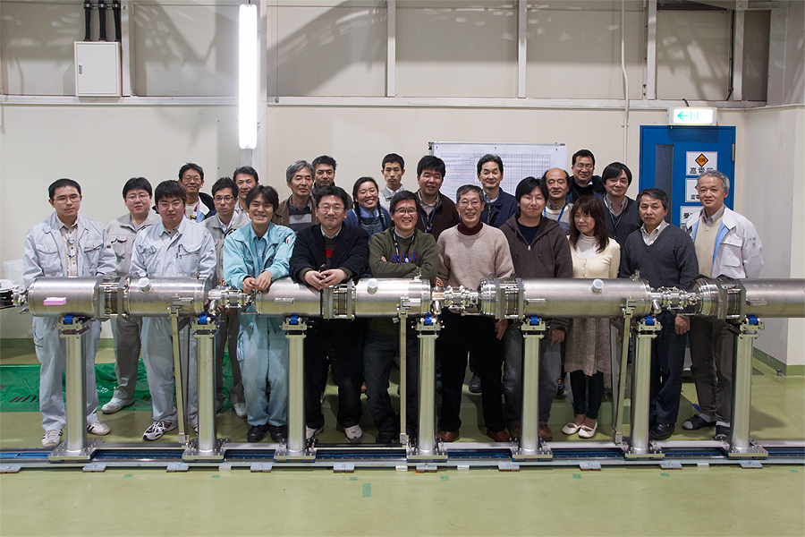
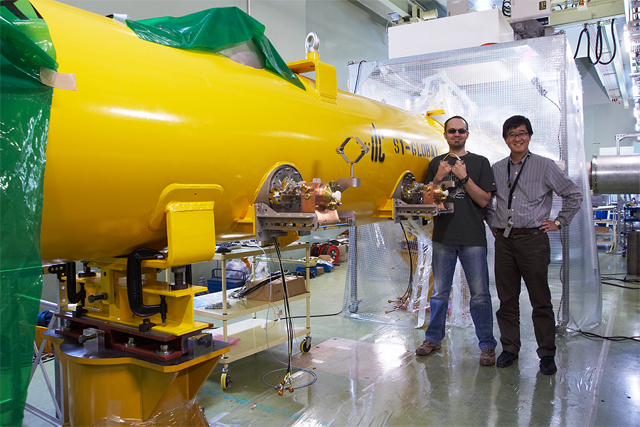
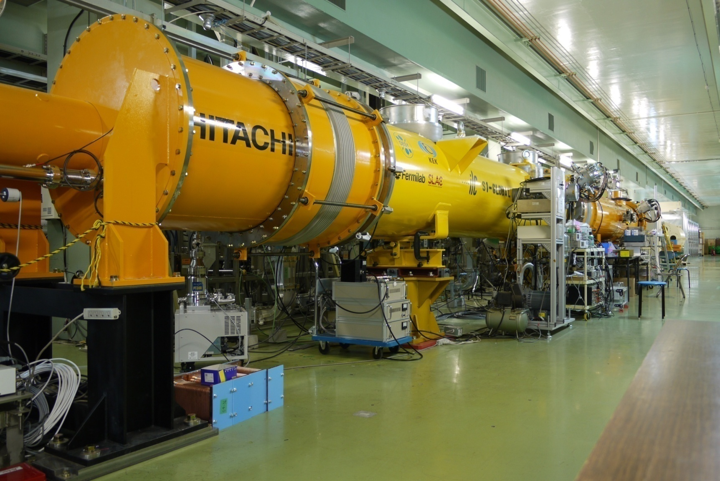
S1-Global Assembly/Test with Global Effort
DESY, FNAL, Jan., 2010
DESY, Sept. 2010
FNAL & INFN, July, 2010
INFN
and
FNAL
Feb.
2010
March, 2010
DESY, May, 2010
June, 2010 ~

Slide 24
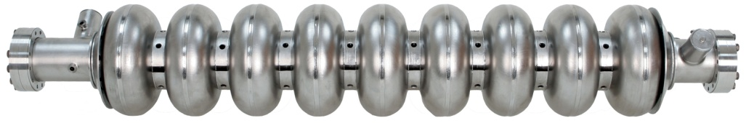
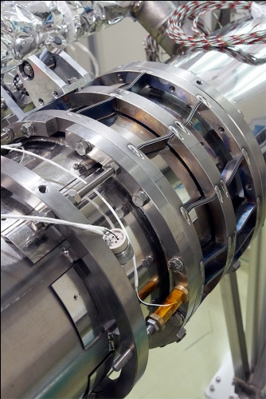
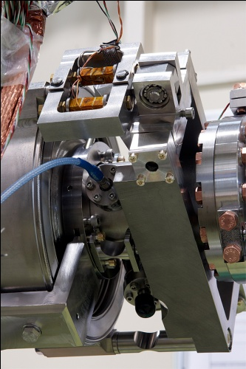
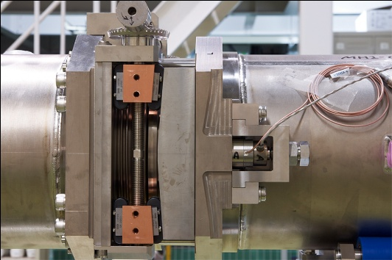
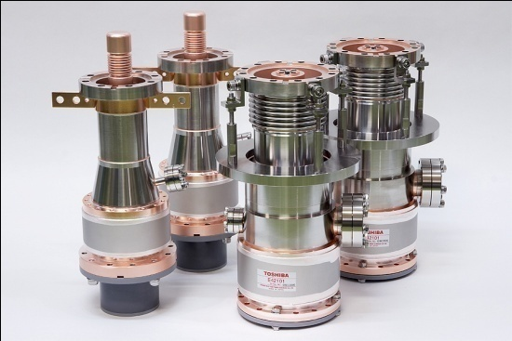
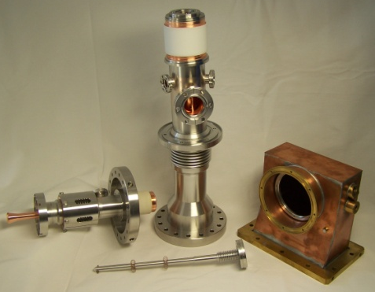
Cavities, Tuners, Couplers in S1-G Cryomodule
TESLA Cavity (DESY/FNAL)
Tesla-like Cavity (KEK)
Slide-Jack Tuner (KEK)
Blade Tuner (FNAL)
Saclay Tuner
(DESY)
TTF-III Coupler
(DESY/FNAL)
STF-II Coupler (KEK)

Slide 25
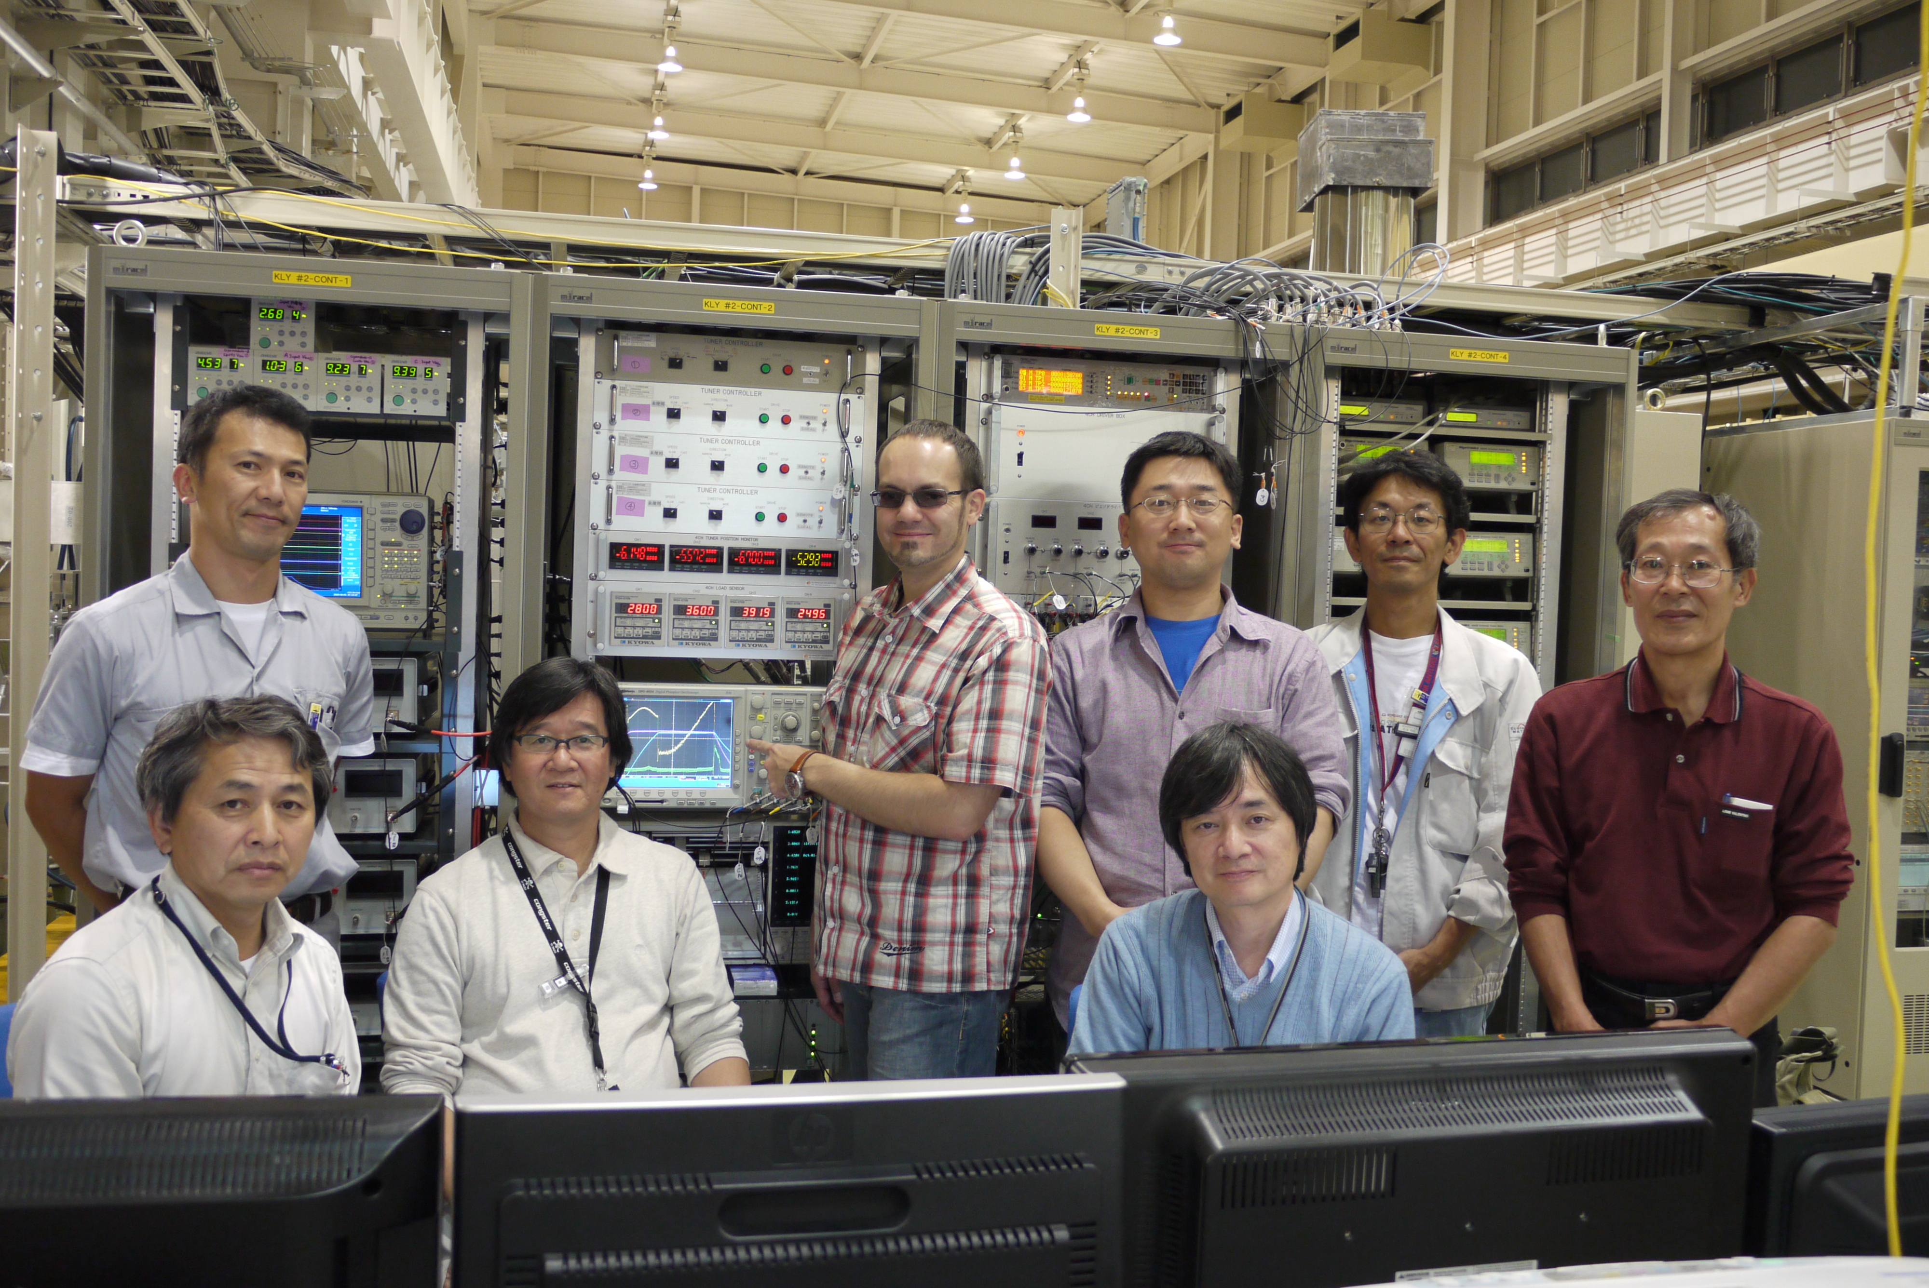
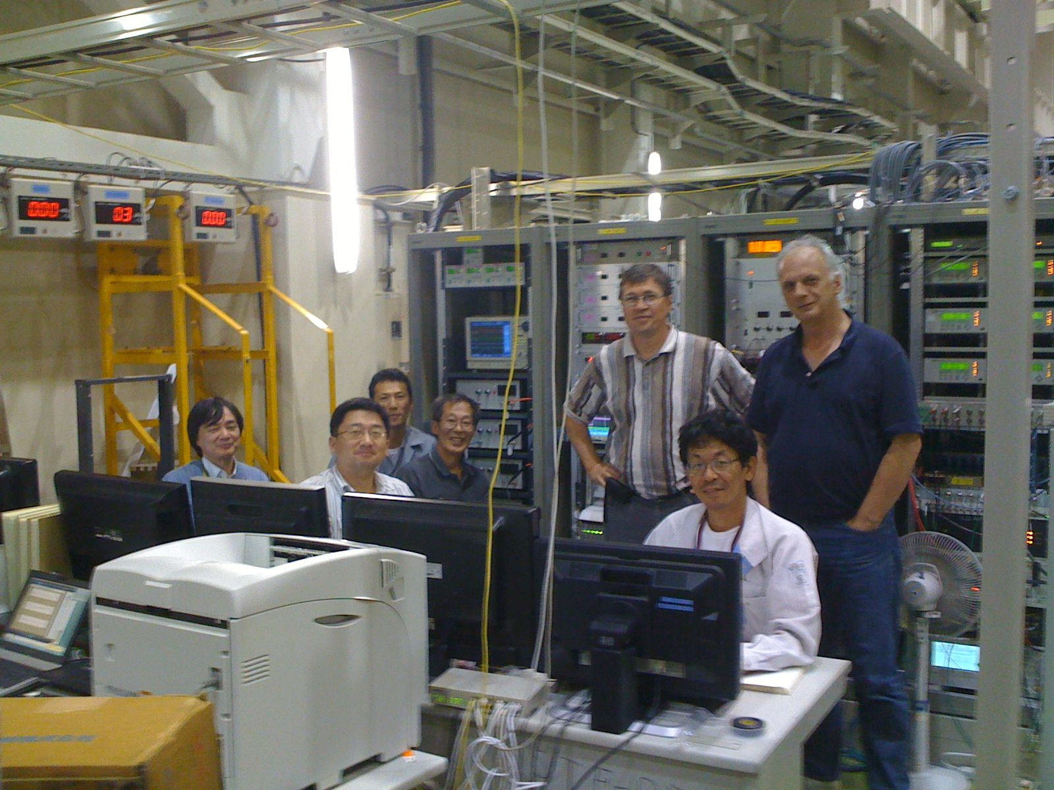
S1-Global High Power Test
at STF/KEK, Sep., 2010 ~
With
Yuriy Pischalnikov
Warren Schappert
(FNAL) Oct. 2010
With
Denis Kostin
(DESY) Sept. 2010
Notes:
777
888
25
777
25
888

Slide 26
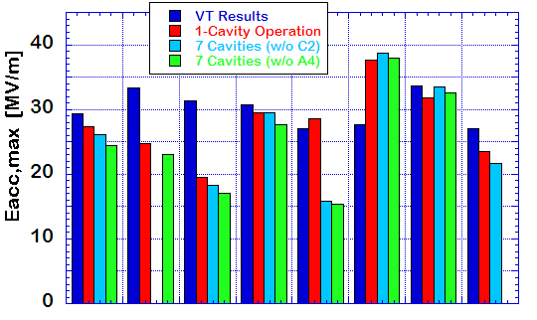
Comparison of cavity performance
ave. Eacc,max
VT : 30 MV/m
1 cav : 27 MV/m
7 cav : 26 MV/m
C
D
D
AES004
ACC011
D : Detune
C : Coupler
Z108
Z109
MHI-05
MHI-07
MHI-06
MHI-09
FNAL
DESY
KEK
Performance reduction in two cavities and one coupler
Tuner mechanics trouble in two cavities

Slide 27
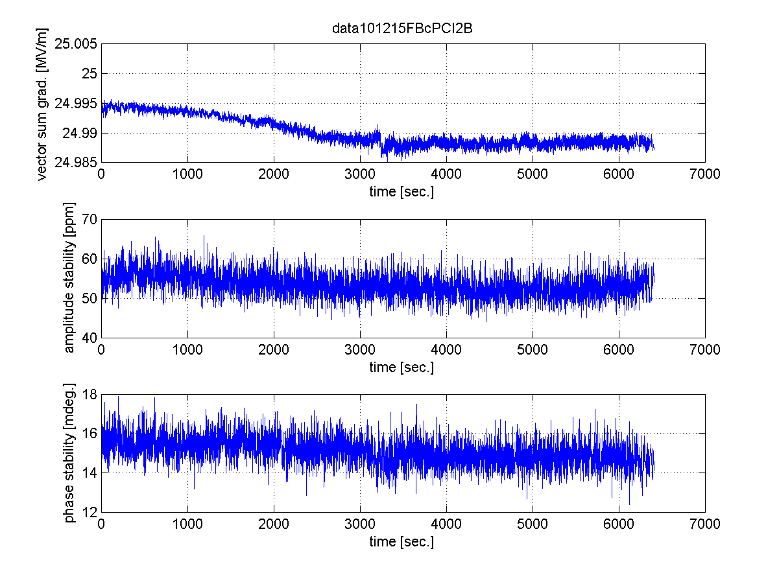
7-cavity operation by digital LLRF
LLRF stability study with 7 cavities operation at 25MV/m
Field Waveform of each cavity
Stability in 6300 sec.
vector-sum gradient
amplitude stability in pulse flat-top
phase stability in pulse flat-top
- Vector-sum stability: 24.995MV/m ~ 24.988MV/m (~0.03%)
- Amplitude stability in pulse flat-top: < 60ppm=0.006%rms
- Phase stability in pulse flat-top: < 0.0017 degree.rms

Slide 28
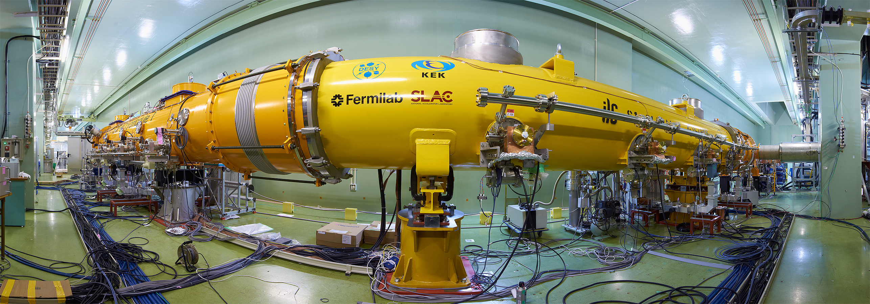
Many Thanks for
Global Collaboration for S1-Global
M. Akemoto, S. Fukuda, K. Hara, H. Hayano, N. Higashi, E. Kako,
H. Katagiri, Y. Kojima, Y. Kondo, T. Matsumoto, S. Michizono, T. Miura,
H. Nakai, H. Nakajima, K. Nakanishi, S. Noguchi, N. Ohuchi, T. Saeki,
M. Satoh, T. Shishido, T. Shidara, T. Takenaka, A. Terashima,
N. Toge, K. Tsuchiya, K. Watanabe, S. Yamaguchi,
A. Yamamoto, Y. Yamamoto, K. Yokoya,
KEK (Japan)
A. Bosotti, C. Pagani, R. Paparella, P. Pierini,
INFN (Italy)
K. Jensch, D. Kostin, L. Lilje, A. Matheisen, W.-D. Moeller,
M. Schmoekel, P. Schilling, N. Walker, H. Weise,
DESY (Germany)
T. Arkan, S. Barbanotti, M. Battistoni, H. Carter,
M. Champion, A. Hocker, R. Kephart, J. Kerby, D. Mitchell,
Y. Pischalnikov, T.J. Peterson, M. Ross, W. Schappert,
B. Smith
FNAL (USA)
C. Adolphsen, C. Nantista, SLAC (USA)
More results and analyses to be discussed in WG-1, Dec. 7

Slide 29
Gradient Degradation need to be investigated and improved
D. Kostin & E. Kako
PXFEL-1 PXFEL-2 PFEL-3
12 of 40 cavities degraded after installation into CM
S1-Global

Slide 30
Global Plan for SCRF R&D
Year | 07 | 2008 |  | 2009 |  | 2010 |  | 2011 | 2012
Phase | TDP-1 |  |  |  |  |  | TDP-2
Cavity Gradient in v. test to reach 35 MV/m | → Yield 50% |  |  |  |  |  | → Yield 90%
Cavity-string to reach 31.5 MV/m, with one-cryomodule |  | Global effort for string assembly and test (DESY, FNAL, INFN, KEK)
System Test with beam acceleration |  |  | FLASH (DESY) , NML (FNAL) STF2 (KEK, test start in 2013)
Preparation for Industrialization |  |  |  |  | Production Technology R&D
Communication with industry: | 2009: 1st step: Visit Vender (2009) 2010: 2nd step: Organize Workshop (2010) 2011: 3rd step: Send specification & receive response
We are here

Slide 31
SCRF Procurement/Manufacturing Model
ILC Host-Lab
Technical Coordination
for Lab-Consortium
Regional Hub-Lab:
A
Regional Hub-Lab:
E, & …
World-wide
Industry responsible to
‘Build-to-Print’ manufacturing
Regional Hub-Lab:
B
Regional Hub-Lab:
D
Regional Hub-Lab:
C: responsible to
Hosting System Test and Gradient Performance
Regional hub-laboratories responsible to regional procurements to be open for any world-wide industry participation
: Technical
coordination link
: Procurement link

Slide 32
Production Process/Responsibility
Step hosted | Industry | Industry/Laboratory | Hub-laboratory | ILC Host-laboratory
Regional constraint | no | yes | yes | yes
Accelerator - Integration, Commissioning |  |  |  | Accelerator sys. Integ.
SCRF Cryomodule - Perofrmance Test |  |  | Cold, gradient test | As partly as hub-lab
Cryomodule/Cavity - Assembly |  | Coupler, tuner, cav-string/cryomoduleassmbly work |  | As partly as hub-lab
Cryomodule component - Manufacturing | V. vessel, cold-mass ...
9-cell Cavity - Performance Test |  |  | Cold, gradient test | As partly as hub-lab
9-cell Cavity - Manufacturing | 9-cell, end-group assembly, Chem-process, He-Jacketing
Sub-comp/material - Production/Procurement | Nb, Ti, specific comp. … |  | Procurement

Slide 33
Visiting Companies in Progress
 | Date | Company | Place | Technical sbject
1 | 2/8 | Hitachi | Tokyo (JP) | Cavity/Cryomodule
2 | 2/8 | Toshiba | Yokohana (JP) | Cavity/Cryomodule, Magnet
3 | 2/9 | MHI | Kobe (JP) | Cavity / (Cryomodule)
4 | 2/9 | Tokyo-Denkai | Tokyo (JP) | Material (Nb)
5 | 2/18 | OTIC | NingXia (CN) | Material (Nb, NbTi, Ti)
6 | 3/3. 9/14 | (Zanon) mtg at INFN | Verona (IT) | Cavity/(Cryomodule)
7 | 3/4 | RI | Koeln (DE) | Cavity (Cryomodule)
8 | 3/14, (4/8) | AES | Medford, NY (US) | Cavity (Cryomodule)
9 | 3/15, (4/7) | Niowave | Lansing, MI (US) | Cavity/ (Cryomodule)
10 | 4/6 | PAVAC | Vancouver (CA) | Cavity, EBW-machine
11 | 4/25 | ATI Wah-Chang | Albany, OR (US) | Material (Nb, Nb-Ti, Ti)
12 | 4/27 | Plansee | Ruette (AS) | Material (Nb, Nb-Ti, Ti)
13 | 5/24 | SDMS | Sr. Romans (FR) | Cavity, Vessel, joint
14 | 7/6 | Heraeus | Hanau (DE) | Material (Nb, Nb-Ti, Ti)
16 | 11/16 | SST | Munchen (DE) | EBW-machine

Slide 34
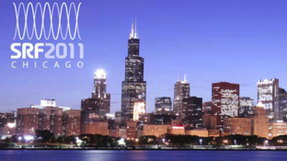
The 2nd workshop on SCRF Technology and Industrialization for the ILC
as a satellite meeting of SRF 2011
Date: July 24, 2011
Place: Chicago
Agenda:
  Introduction
  Reports from SCRF cavity/cryomodule industry
  Reports from SC material vendor
  Comments from Potential Regional Hub-laboratory
  Discussions on the ILC SCRF industrialization model
Note:
  Open for everybody,
  Many Industrial participations acknowledged

Slide 35
Some Outlook
Participants
  More than 90 participants, more than expected,
Presentations
  Cavity: AES, NW, Pavac, RI, MHI, and Hitachi
  Material: OTIC, Tokyo-Denkai, ATI-WC, Plansee, and Heraeus
  Labs: Fermilab, KEK , and (DESY in SRF conf.)
Fruitful discussions
  Hub-laboratory concept/model postively discussed,
  Specially on assembly and integration site to be hosted by companies or laboratories,

Slide 36

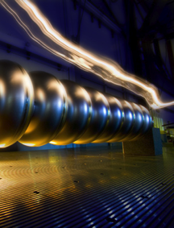
TDR Technical Volumes
2007
2011
2013*
TDR Part I:
R&D
~250 pages
Deliverable 2
ILC Technical Progress Report
(“interim report”)
AD&I
TDR Part II:
Baseline
Reference
Report
~300 pages
Deliverables 1,3 and 4
Technical Design Report
Reference Design Report
* end of 2012 – formal publication early 2013

Slide 37
How to prepare for BTR and TDR?
Technical discussion in TTC, Dec. 5 – 8, to evaluate technically satisfactory/acceptable design for projects.
ILC Specific discussion in post-TTC, Dec. 8-9, to seek for cost-effective technical choice to prepare for BTR
  Agenda available at a satellite URL from TTC URL
Consensus/Decision for TDR writing, BTR at KEK, Jan. 19 – 20, 2012
Please additionally register for SCRF meeting.
We need to count “working lunch!”

Slide 38
GDE-SCRF Meeting as a post-TTC meeting, Dec. 8-9
Based on the cryomodule test results and on technical discussions made in TTC,
  Present PM’s guidelines (as Introduction)
    Current view for the baseline design
  Discuss baseline technology for the ILC TDR and the cost estimates
    Project-oriented, cost-effective technology choice for the TDR
    Group leaders respond to the current view of the baseline

Slide 39
Technical Change Guideline Proposal
(preliminary)
ML Integration | Parameters and layout | Confirmed including alignment tolerance CM and Q periodicity: → 8+4Q4+8 requiring additional ML length ( ~ 100 m) How we shall provide additional backup length and utility of 400 m?
Cavity performance | Yield Gradient spread Degradation | 1st pass: 50 (or 60) %, 2nd pass: 80 (or 70) % 31.5 +/- 20 % confirmed Assume 1/10 cavity to degrade 20 %
Cavity integration | Envelope | Tuner type, coupler warm-flange, beam pipe, magnetic shield (inside/outside), etc.
Cryomodule | Envelope/interface Unit 5 K radiation shield | Piping interface, inter-connect condition, etc, 8+4Q4+8 Simplification
Cryogenics | Unit capacity | 5 → 4 units / linac
RF power | Configuration | DRFS in mountain site, KCS in flat land
Cost | (Conversion) | (PPP)

Slide 40
Summary
SRF 1.3 GHz cavity R&D progressed
  9-cell cavity Gradient R&D:
    Maximum gradient reaching > 45 MV/m (w/ large-grain)
    Production-yield progressed in ILC Global data-base:
      ~ 23 % in 2008 → ~ 60 % (effectively ~75 %) at 35 MV/m in 2011
  Cavity-string performance in Cryomodule
    FLASH/PXFEL-1: reached <32 MV/m>
    NML: in progress
    S1-Global: reached <26 MV/m> with 7 cavity-string
    Urgent action required to prevent degradation in cryomodule assembly
  Superconducting accelerator system test
    FLASH: progressing in acceleration for 9 mA demonstration
Industrialization study in progress in comunication w/ industry
Further high-gradient R&D (~ 45 MV/m) motivated for,
  Possible 1-TeV upgrade, as a program beyond TDR

Slide 41
Acknowledgments
Many thanks to all collaboration members
  In many participating institutes
Special thanks to all colleagues providing information

Slide 42
backup

Slide 43
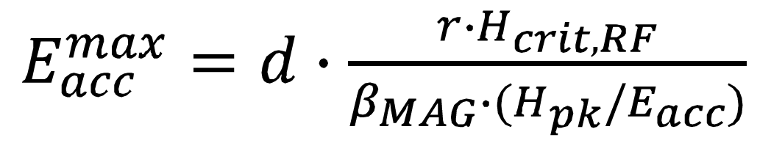
Main Issues at Very High Gradient
R. Geng
“Knobs” for improved reproducibility in overcoming local quench at very high gradient of 40-50 MV/m
Material
Nb: > 2000 Oe (exp.)
2400 Oe (the.)
Nb₃Sn: > 4000 Oe (the.)
Achievable gradient
Cavity surface chemistry
Cavity wall
thermal conductance
Cavity surface smoothness
Cavity shape
Alternate cavity shape for reduced Hpk/Eacc ratio. In hand (LL, RE, LSF).
Uniform cavity processing for reduced local “bad” spots. In hand (EP).
Smooth surface for reduced local magnetic field enhancement. In hand(CBP & derivative + EP).
Improved wall thermal conductance for increased local heating tolerance.
  Cavity heat treatment optimization for “phonon peak engineering”
  Use Nb/Cu composite material (such as explosion bonded material)
(5) The game-changing knob is a Nb replacement material (such as Nb₃Sn or Mg₂B w/ multi-layer).

Slide 44


ILC Cavity Database Update
C.M. Ginsburg (FNAL)
On behalf of the ILC database team:
S. Aderhold (DESY), G.Eremeev (JLab), F.Furuta (Cornell), Y.Yamamoto (KEK)
And many thanks to the DESY ILC DB Support Group:
D.Gall, V. Gubarev, S. Yasar

Slide 45
Updates
Previous update was ALCPG11 (Eugene) March 2011
  41 cavities for 1st pass, 31 cavities for 2nd pass
Additional plots made with ALCPG11 data at Akira’s request
  Yield time dependence by workshop and by year(s)
Updates which affect standard yield plots
  KEK (Kirk)
    MHI016: test#1 E_{acc}=20.8 MV/m added
    MHI017: test#1 E_{acc}=38.4 MV/m added
    Note: MHI015 2nd VT after localized grinding, not (yet) accepted process, not included
  JLab (Camille)
    TB9RI028 2nd pass: test#1 22.0 MV/m -> test#2 E_{acc}=38.8 MV/m (mistake corrected)
  DESY (Sebastian)
    AC146: test#1 E_{acc}=23.63 -> 26.13 MV/m (mistake corrected)
    AC146: test#2 E_{acc}=40.2 MV/m added
    Z162: test#1 E_{acc}=31.0 MV/m added
  44 cavities for 1st pass, 33 cavities for 2nd pass

Slide 46


Time Progression by Workshop

Slide 47
Communication w/ Industry:
Status and Further Plan
Cost-study in Communication with industry
  In progress, and more than half companies responding to our ‘request for information’, and we are getting very important information for our further study,
  We are getting the hint that SCRF cavity costs are not more than twice RDR cost estimate (at present), and it may contribute to keep the ILC overall budget within the cost-containment of SB2009.
  We are planning to organize the 2nd stage of communication to prepare for our own final stage study in autumn,
Cost study in Communication with Laboratories
  Information given by DESY/EXFEL team lead by H. Weise has been critically important, valuable, and acknowledged,
  Further communication with potential regional hub-lab to develop a whole scope of the industrialization model..

Slide 48
Technical Issues toward TDR
Cavity gradient : (discussion led by R. Geng)
  Update and fix the cavity production and process recipe.
  Update and fix the successful production yield definition in production stage,
    including new parameters such as radiation, and the process w/ tumbling
  Gradient spread of 31.5 MV/m +/-20 %, with sorting method,
  Gradient degradation after assembly into the cryomodule (see: HLRF/DRFS w/ circulator)
Cavity Integration (discussion led by H. Hayano)
  A baseline design chosen for the TDR cost-estimate base,
    Including selection of tuner, coupler, beam-flange, magnetic shield, and LHe tank
  Plug-compatible design to be allowed in case of cost equivalent or more cost effective.
  Cavity delivery condition with LHe-tank, and cold-test sequence/monitor,
Cryomodule and Cavity-string Assembly (discussion led by P. Perini)
  Cryomodule string configuration with 8 + (4+Q+4) + 8 cavity-string assembly
  Simplification of 5K radiation-shield: simplification of bottom, and removal at inter-connect.
  Split-yoke, conduction-cooled quadrupoles
  Efficient alignment
Cavity and Cryomodule Test (discussion led by H. Hayano)
  Warm conditioning of Input Coupler: before or after installation into the tunnel
  Cold performance test: How much fraction to be cold tested? Subjects to be tested?

Slide 49
Continued
Cryogenics (discussion led by T. Peterson)
  Location and the options (reducing the number of station) of cryogenic systems,
  Capacity optimization and heat balance with cryomodule heat-load
HLRF (discussed led by S. Fukuda and C. Nantista)
  KCS/DRFS/RDR-unit HLRF system configuration including backup power supply and utilities with the single tunnel design
  Marx generator to be a baseline modulator,
  AC power capacity optimization with gradient spreads,
  Adaptability against cavity degradation after installation into cryomodule, by using circulator and power distribution system,
  Optimizations for low-power and high-power option.
  Tunable power distbribution system
ML Integration (discussion led C. Adolphsen)
  Beam dynamics
    Quadrupole/BPM periodicity, locations, alignment, and beam tunability,
    Bunch spacing limit specially on KCS (requirement of DR beam dynamics)
  Availability, reliability, and backup of cryomodules to be required

Slide 50
How to prepare for TDR?
Discussion during LCWS
Further technical discussion in TTC, Dec. 5 - 8
ILC Specific discussion in post-TTC, Dec. 8-9,
Consensus for TDR writing, BTR at KEK, Jan. 19 – 20, 2012

Slide 51
Our Direction to prepare for
TDR-SCRF
Operational cavity gradient :
  31.5 MV/m +/-20 %, with sorting /grouping
  Prepare for cavity gradient degradation after cavity-string/cryomodule assembly,
      With assuming 1/10 cryomodule to be degraded with a level of 20 %
Cavity plug-compativility condition to be simplified
  Discussion to be necessary specially for beam flange, tuners and couplers
Cryomodule configuration:
  8 + (4+Q+4) + 8 cavity-string assembly as a baseline
  Further study required for
    periodicity of quadrupoles and
    cost effective assembly technology

Slide 52

Comparison of vertical and horizontal test results from Tesla Technical Design Report

Slide 53
Average Gradient Observed in Cavity/Cryomodule Tests at DESY and KEK
Project: Cryomodule | XFEL: PXEL-1 | XFEL: PXFEL-2 | XFEL: PXFEL-3 | ILC-TDP: S1-Global |  | ILC: Spec.
9-Cell Cavity Vertical Test (CW-mode) | < 36 > | < 31 > | < 30 > | < 30 > |  | < 35 >
Cryomodule Test (10 or 5 Hz) | < 32 > | < 30 > | < 25 > | < 28 > |  | < 34 >
G. degradation VT→CMT, % | ~10 % | ~ 4 % | ~15 % | ~ 7 % |  | ≤ 3 %
Accelerator Operation (10 or 5 Hz) | < 30 > used in FLASH (ACC7) | N/A | N/A | N/A |  | < 31.5 >

