Slide 1
FRIB Cavity Status: SRF issues and challenges
John Popielarski
EM Modeling and RF Measurement Group Leader
SRF Department

Slide 2
Outline
FRIB SRF Scope and evolving Cavity Requirements
FRIB SRF Department Highlights in the Last Year
QWR Status, Experimental results, and Design Changes
  80.5 MHz β=0.041 installed in ReA3, β=0.085 developments
HWR Status, Experimental Results, and Design Changes
  322 MHz β=0.530, β=0.290
Summary

Slide 3
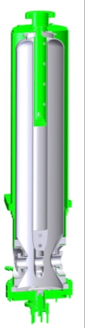
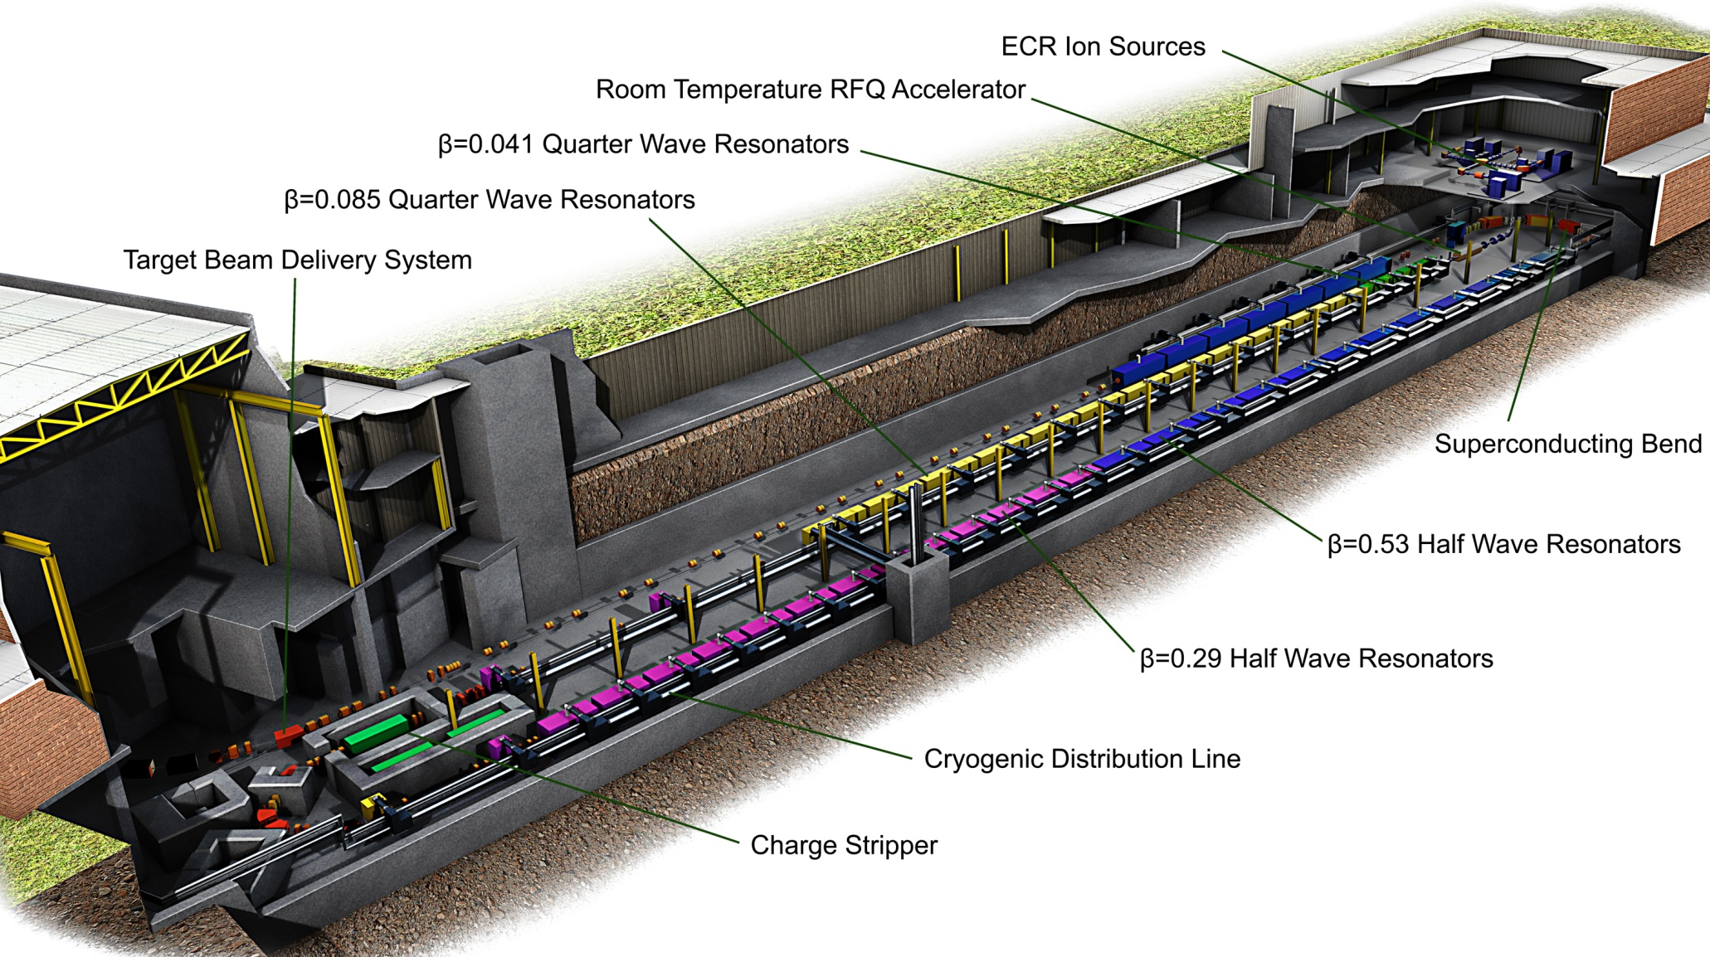
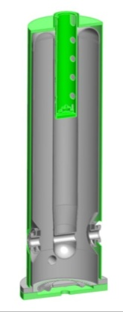
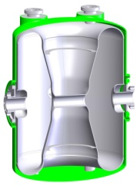
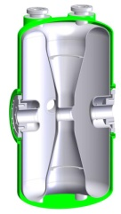
The FRIB Driver Linac: 327 SRF Resonators
12
96
147
76

Slide 4
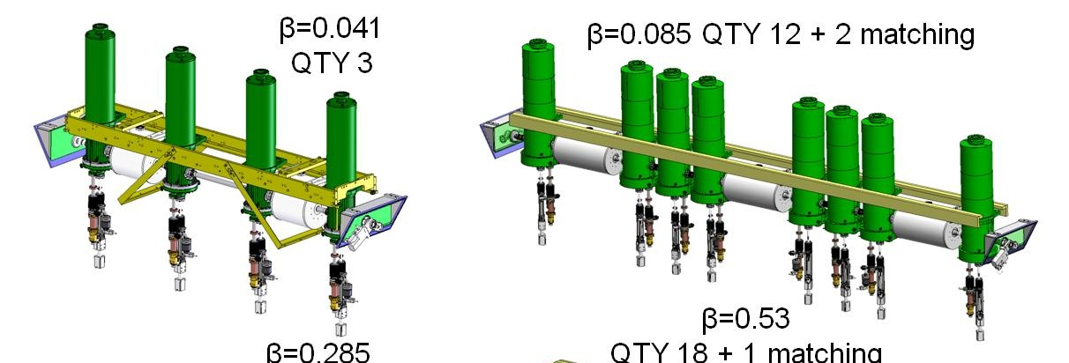
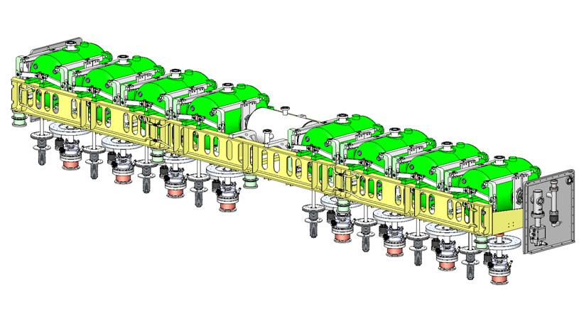
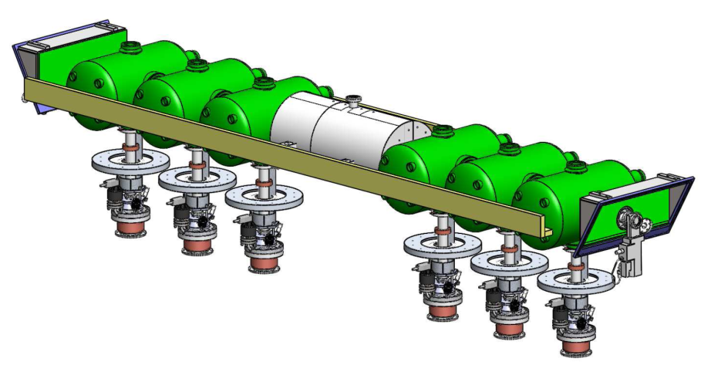
SRF Department Main Deliverable:
All FRIB Cold Masses
β=0.085 QTY 11 + 2 matching
(under design optimization)
β=0.53
QTY 18 + 1 matching
β=0.29
QTY 12 + 2 matching
(under design optimization)
Total 47 plus 3 spares

Slide 5
FRIB Resonator Requirements with Updated Cavity Designs
Type | QWR | QWR ReA3 | QWR NEW¹ | HWR NEW¹ | HWR OLD | HWR NEW¹
β_{opt} | 0.041 | 0.085 | 0.085 | 0.29 | 0.53 | 0.53
f (MHz) | 80.5 | 80.5 | 80.5 | 322 | 322 | 322
V_{a} (MV) | 0.81 | 1.62 | 1.80 | 2.10 | 3.70 | 3.70
E_{a} (MV/m) | 5.2 | 5.1 | 5.7 | 7.8 | 7.4 | 7.4
E_{p} (MV/m) | 30.0 | 31.5 | 32.4 | 34.2 | 31.5 | 26.5
B_{p} (mT) | 53 | 71 | 67.1 | 59.8 | 77 | 63.2
R/Q (Ω) | 433 | 416 | 464 | 224 | 219 | 230
G (Ω) | 15 | 18 | 23 | 78 | 101 | 107
Design Q₀ | 2.0×10⁹ | 2.0×10⁹ | 2.5×10⁹ | 8.0×10⁹ | 1.0×10¹⁰ | 1.0×10¹⁰
Module Q₀ | 1.4×10⁹ | 1.7×10⁹ | 1.7×10⁹ | 2.0×10⁹ | 2.0×10⁹ | 2.0×10⁹
Aperture (mm) | 30 | 30 | 30 ² | 40 | 40 | 40
T (K) ³ | 2.0 | 2.0 | 2.0 | 2.0 | 2.0 | 2.0
¹ “New” cavities (preliminary figures of merit) will be built and tested soon
² QWR cavity aperture being evaluated
³ Considering the possibility of 2.1K

Slide 6
FRIB SRF Department & Infrastructure
Four Groups, 18 Full time staff with 8 students (undergraduate and graduate), A. Facco, Department Manager
  EM Modeling and RF Measurement (John Popielarski)
  Cavity Fabrication (Chris Compton)
  Processing and Cold Mass Assembly (Laura Popielarski)
  EM Design (Lee Harle, SRF Project Engineer)
Cryomodule assembly is part of the a separate Cryomodule Department (John Weisend)
Weekly SRF teleconference with collaborators
  (Alberto Facco, Kenji Saito, Bob Laxdal, Peter Kneisel, Curtis Crawford)
Chemistry facility capable of BCP (upgrading for production)
Cryomodule Test Area (upgrading for production)
Clean room (upgrading for production)
Cavity vertical test area (upgrading for production)
Vacuum furnace for hydrogen degassing (being installed next month)
NSCL Cryoplant will support cavity and cryomodule tests

Slide 7
2011 SRF Highlights
All FRIB cavities will operate at 2 K (still evaluating 2.1K vs. 2.0K), originally just 322 MHz HWRs would run at 2 K
All FRIB cavities will be hydrogen degassed via 600C furnace treatment
The prototypes have reliably exceeded the FRIB accelerating field at the specified Q for 3 of the 4 FRIB cavity types; the 4th cavity type is now ready for prototyping (β=0.290 HWR, very similar design as the β=0.530 HWR)
The β=0.085 QWR cavities have been refurbished leading to top level performance of the new prototypes
The first two SRF cryomodules with seven β=0.041 QWRs are now successfully operating in the ReA3 linac (NSCL)
The SRF Department is presently designing and producing low-β SRF resonators with high performance and high reproducibility
We have upgraded the previous design of the β=0.085, β=0.029 and β=0.53 FRIB resonators with significant improvement in their parameters

Slide 8
FRIB Resonator Production Steps
Niobium material will be purchased by FRIB
Cavities will be fabricated to meet mechanical and frequency specifications
Bulk BCP (remove 150 micrometers)
600 C furnace treatment for degassing
Light BCP
High pressure rinse
Vertical tests for certification
Cold mass assembly
120C bake of cold mass
Cryomodule fabrication
Cryomodule certification tests (high power RF)

Slide 9
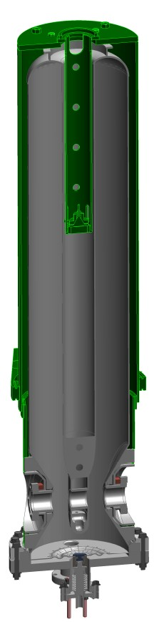
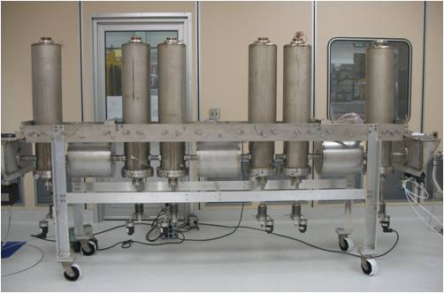
FRIB Beta=0.041 QWR & ReA3
Michigan State University funded the Reaccelerator project at NSCL prior to FRIB site selection
The beta=0.041 resonators installed in ReA3 are being used as a test bed for FRIB cavities. FRIB production cavities will be slightly different after production experience for ReA3. Beta=0.085 R&D has benefitted from the ReA3 project
Two cryomodules (seven 041 cavities) have been installed and are being commissioned on ReA3
Cold Mass
Beta=0.041 QWR

Slide 10
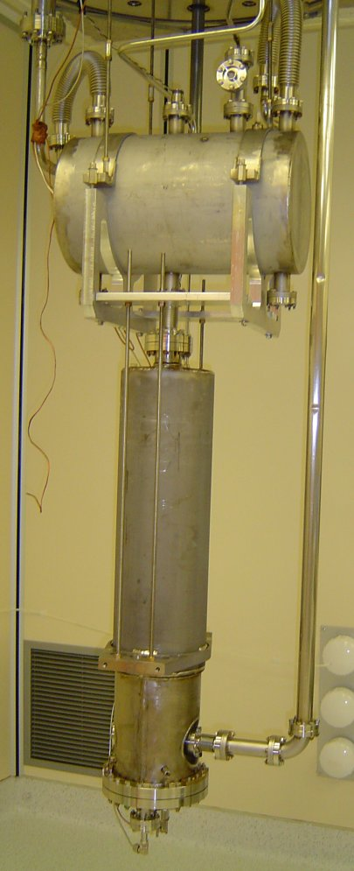
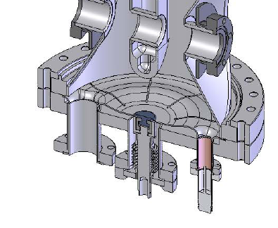
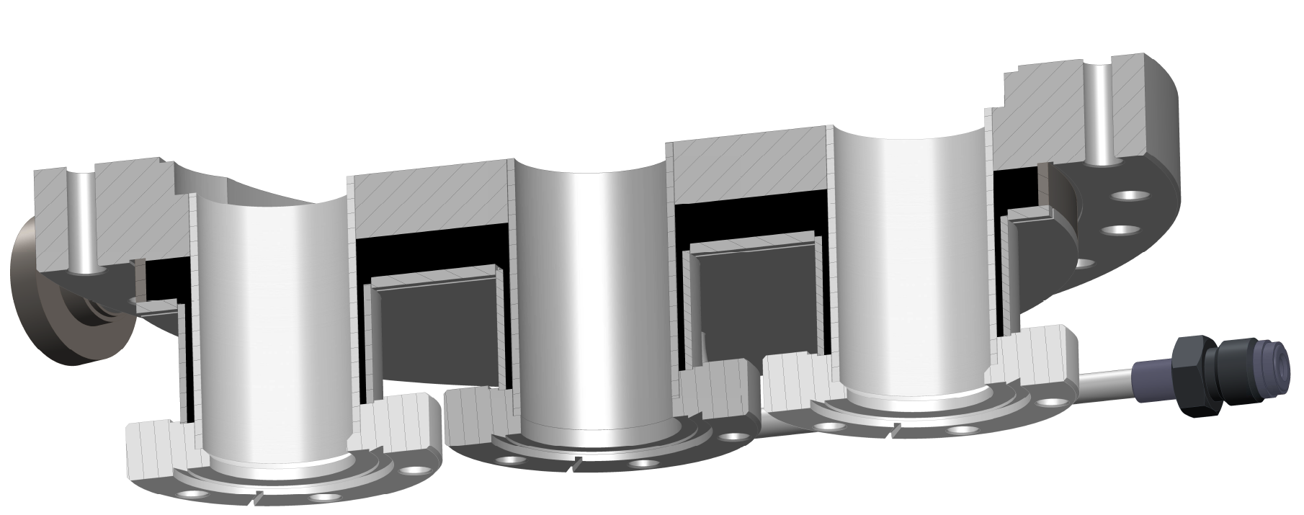
Beta=0.041 QWR Production
Beta=041 cavities had good performance in dunk tests, but results in the realistic cryostat testing had lower Q’s.
  This lead to a design change in the lower bottom flange for better cooling.
  This cooling requires additional cryogenic plumbing
Original
design
Redesign (liquid He in black)

Slide 11
Beta=0.041 QWR Production (without cooling bottom flange)
Bp/Ep=1.77

Slide 12
Beta=0.041 QWR Production (with cooling bottom flange)

Slide 13
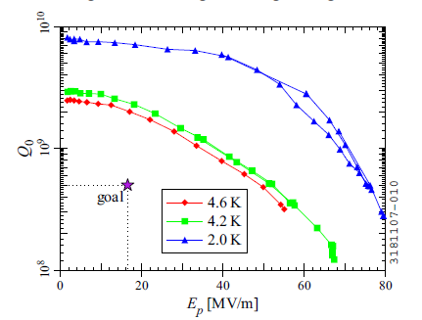
Beta=0.041 Summary
Initial problems with tuning plate cooling was solved by adding a liquid helium reservoir on the bottom flange assembly.
2K dunk tests show promising results (right), additional testing at 2K is planned for next week.
The bottom reservoir flange did not help the cooling of the larger beta=0.085 cavities, so additional changes have been made on the 0.085 cavities which eliminate the need for additional cryogenic plumbing.
Seven QWR’s have been produced, and are running in the ReA3 linac. They can all reach the FRIB requirements in gradient, but need additional testing at 2 K.
FRIB
ReA
Beta=0.041 cavity with cold BPM

Slide 14
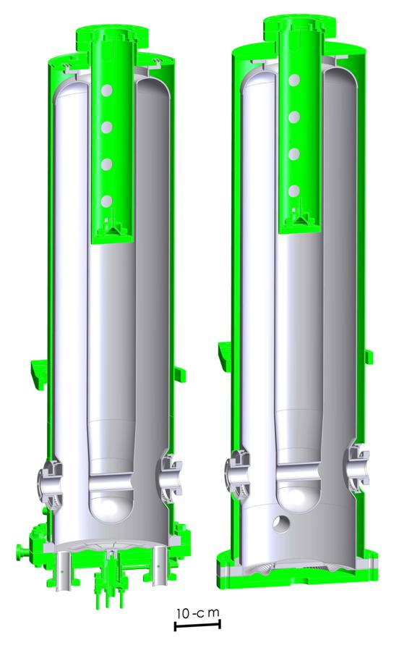
80.5 MHz, β=0.085 QWRs:
Past Problems Solved
ReA3 requires 8 beta=0.085 QWRs, which will be refurbished
  Upgrades to ReA3 will use additional β=0.085 QWRs which will use the new FRIB design
A first lot of ReA3 cavities built in 2010 hardly reached FRIB specs, with little reproducibility
Problem detected by means of a measurement campaign: unsatisfactory design of the bottom flange assembly
  Bad RF joint between cavity and tuning plate
  High RF losses and peak fields on the tuning plate
  Insufficient cooling of the tuning plate due to low thermal conductivity of the NbTi bottom flange
Design modified: the refurbished cavity exceeded FRIB E_{a} and Q
  V_{acc}=1.62 MV, E_{p}=32 MV/m,
  B_{p}=71 mT
old
refurbished
Ep/Ea | Bp/Ea mT/(MV/m) | R/Q Ohm | G Ohm
6.2 | 13.9 | 408 | 18

Slide 15
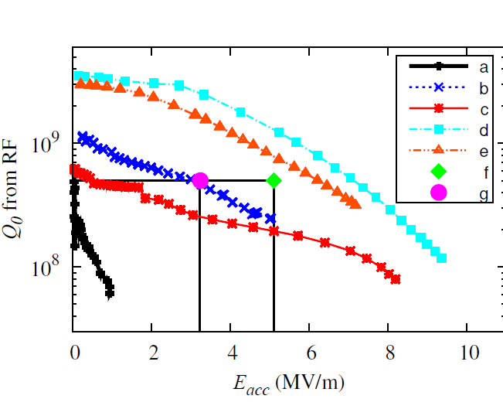
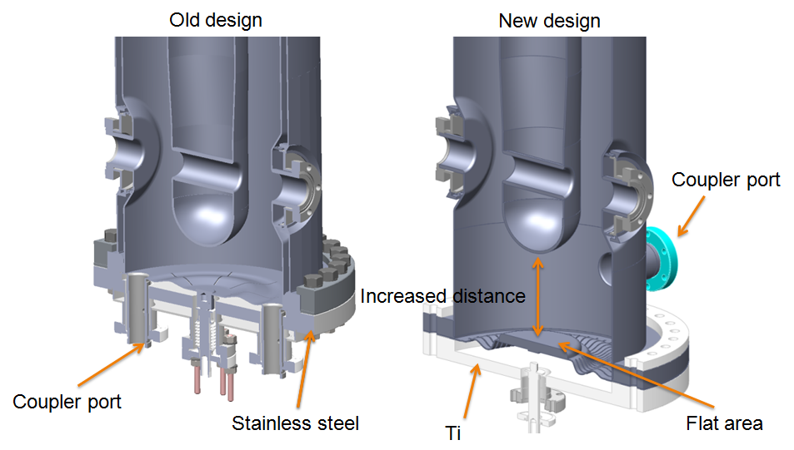
QWR β=0.085 Performance Evolution
RF Test results of one cavity as it evolved through an R&D campaign
1st test, problem detected (even dunk tests)
Extended cavity, same tuning plate assembly
After degassing, but no Q-disease
Dunk test, thick niobium plate + indium RF & vacuum seal
Dunk test, full prototype
ReA6 design goal (4.5K, FRIB field)
ReA3 design goal (4.5K, 2/3 of FRIB field)
High RRR niobium needed on the flange backing ring

Slide 16
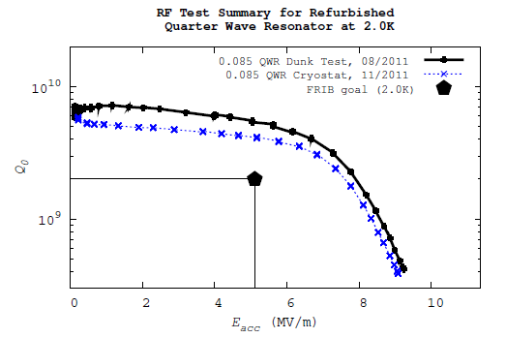
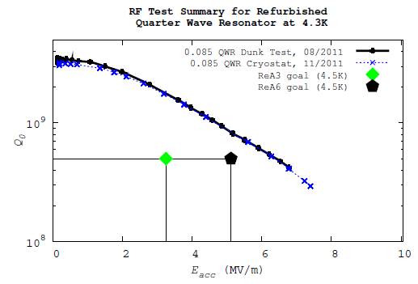
Refurbished β=0.085 QWR Prototype:
Results Confirmed With He Vessel
The cavity was tested again after installation of the He vessel
The naked test results have been confirmed with He vessel
  Same maximum fields at 2 K, limited by rf power (no quench)
  Higher max fields at 4.3K
  Similar Q within error bars
  No X-rays, no field emission
  Q largely exceeding the FRIB specifications
  Tuning plate artificially heated up to 12 W
  without quenching the resonator
2.0 K
4.3 K
Bp/Ea=13.9
Epk/Ea=6.2
Ea=Va/(βλ)

Slide 17
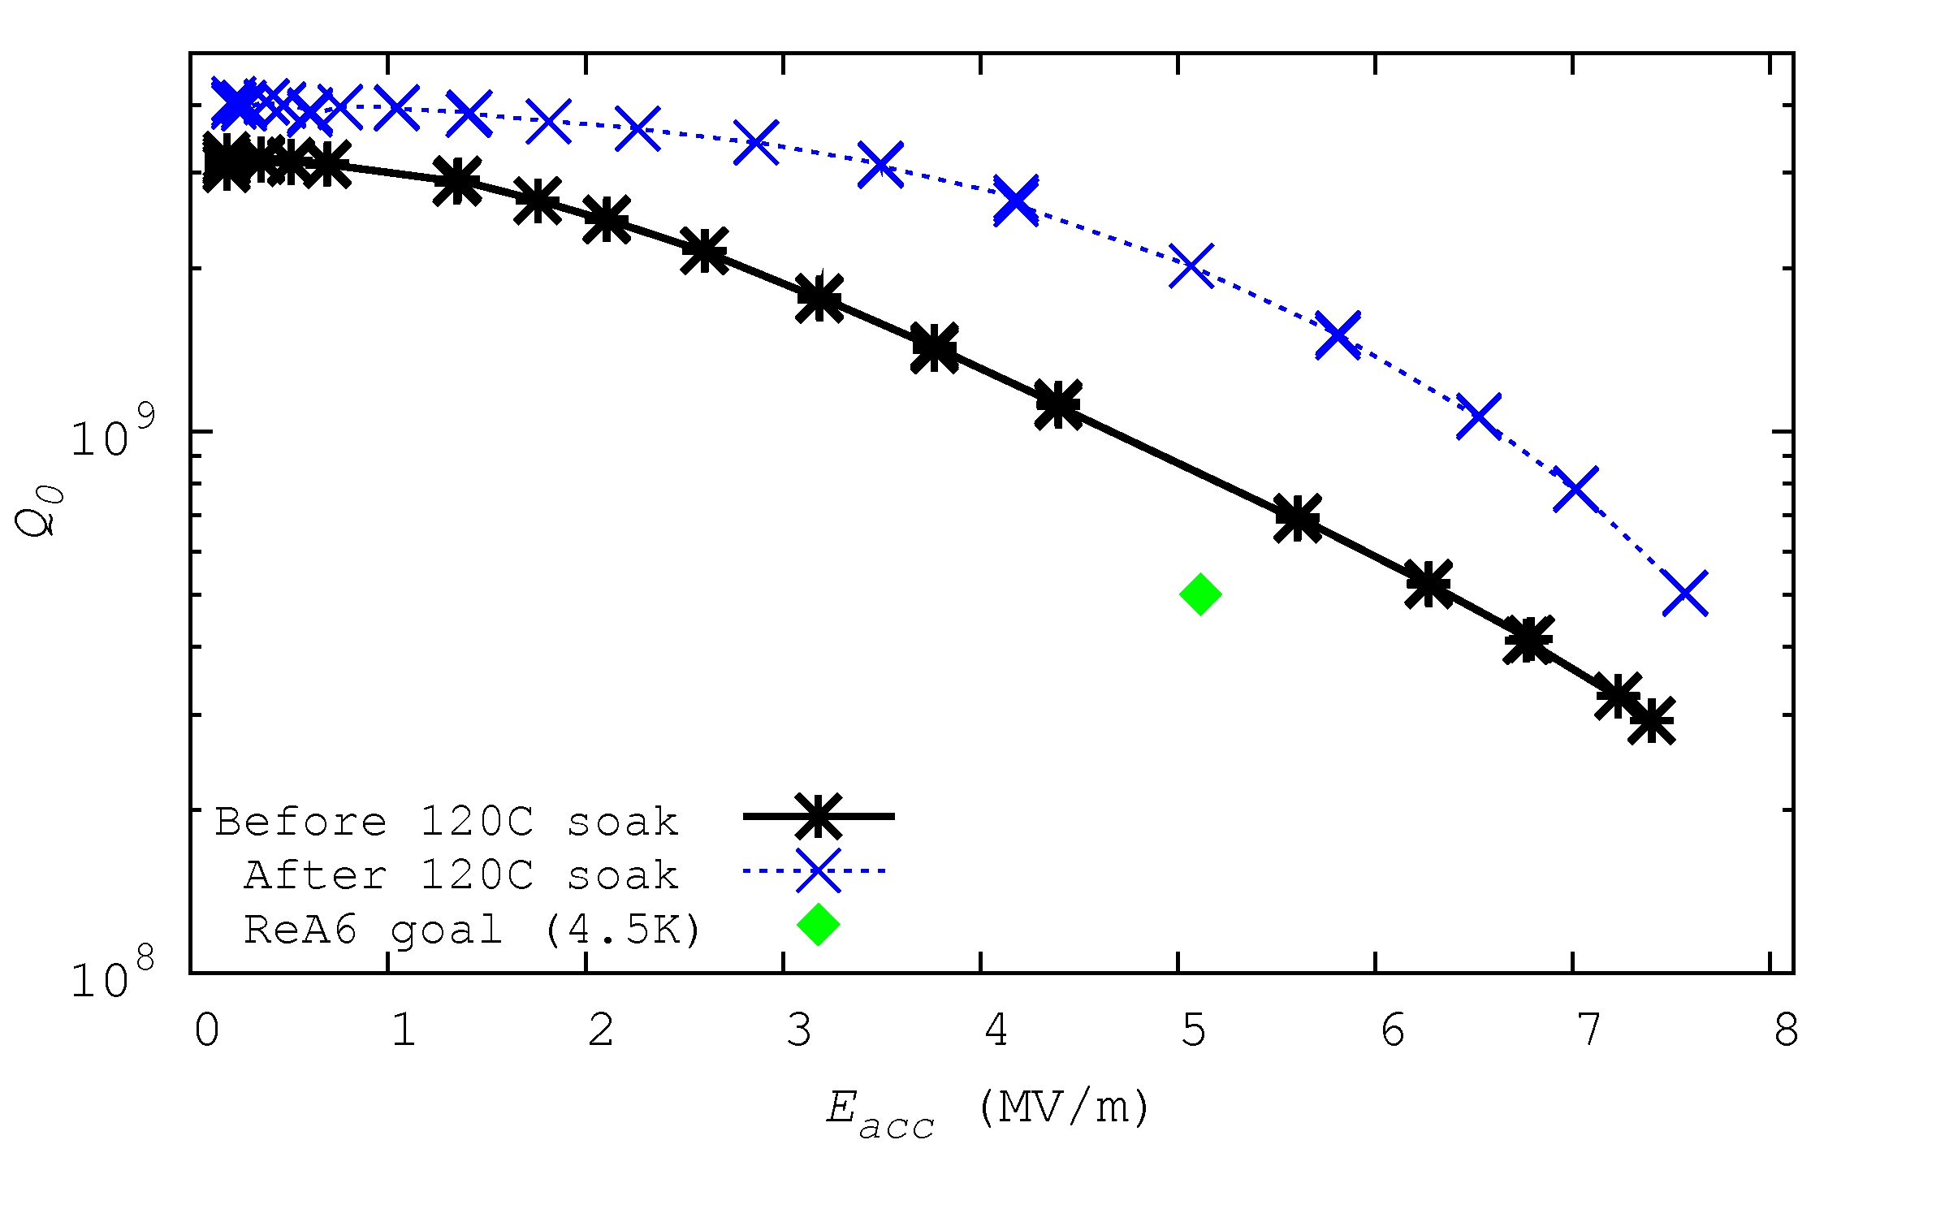
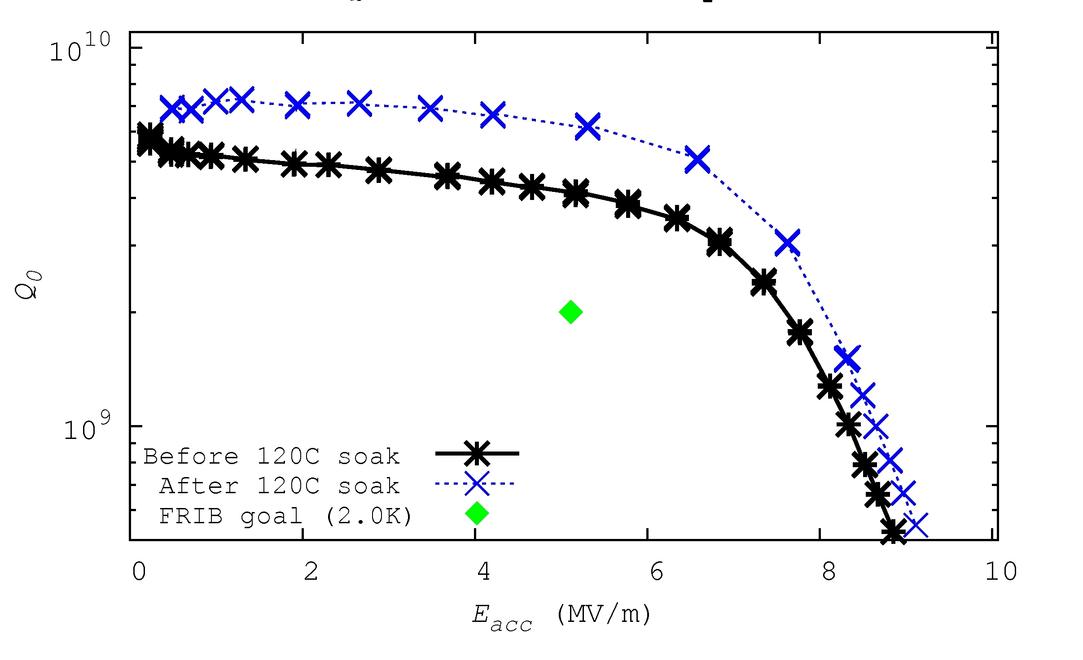
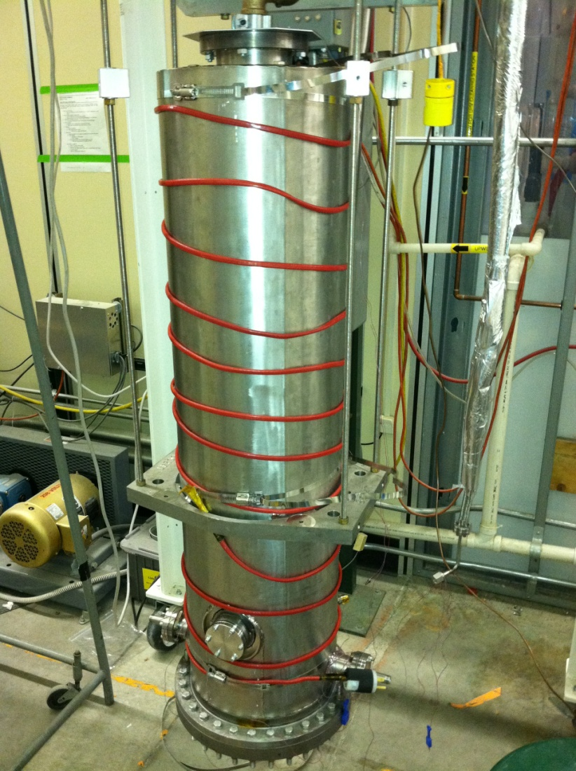
120 C in-situ bake increases margin on Q
The cavity was restested after a 120 C in-situ bake for 48 hours
  The bake used hot air in the helium vessel while the cavity was evacuated, and some heat tapes on the helium vessel wall
A higher Q was measured at both 4.3 K and 2.0 K
  We will may add a 120 C in-situ bake for all remaining ReA3 and ReA6 cavities.
  We will do a bake on the full assembled cold mass for FRIB

Slide 18
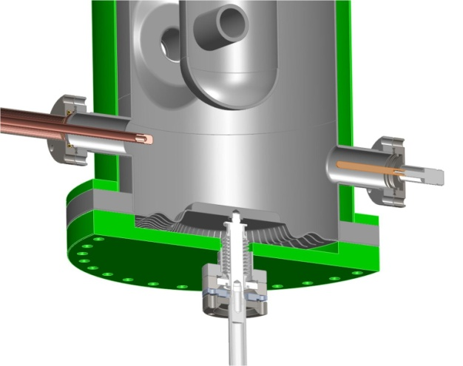
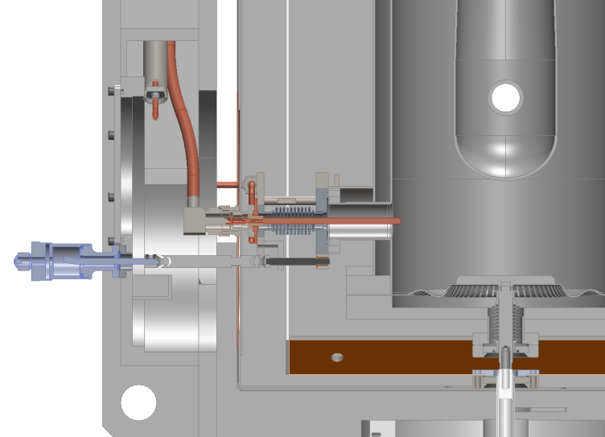
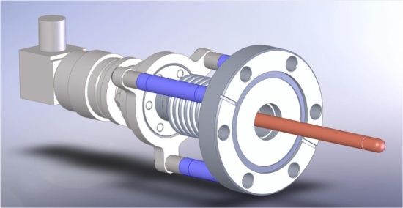
β=0.085 Refurbished Cavity Accessories
The refurbished cavity will require a modification of the ReA3 cryostat to allow for side RF couplers
A new LN cooled, 2 windows side coupler is under development
Flexible RF cable between the two windows to accommodate thermal contraction
The RF tuners actuators will be unchanged
Couplers will be tested in the next two months
new ReA3 side coupler (preliminary design)

Slide 19
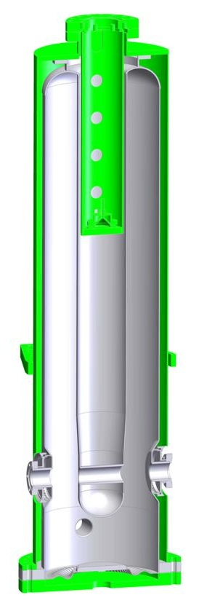
80.5 MHz, β=0.085 ReA3 Cryomodule: Construction Started
Refurbishment of 8 existing cavities
Construction of the ReA3 cryomodule with side couplers
Cryostat in operation in 2012
ReA cryomodule
Refurbished QWR

Slide 20
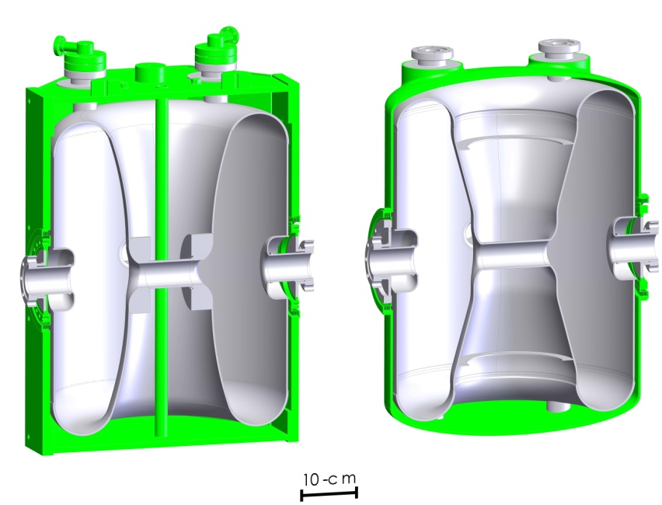
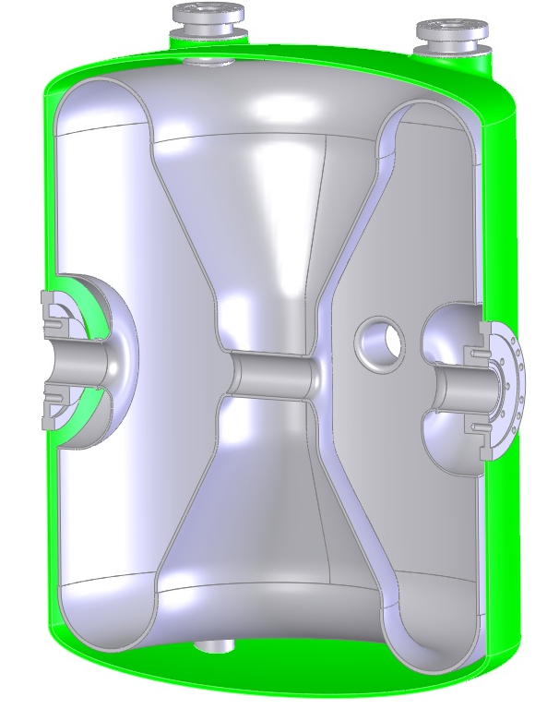
322 MHz, β=0.53 HWRs: Specs Achieved
Status
  Prototypes from 2 different vendors reached FRIB specifications in vertical tests
    V_{acc}=3.7 MV,E_{p}=31 MV/m, B_{p}=77 mT
  2 HWR Test Demonstration Cryomodule under construction with prototype HWRs (testing in Spring)
  Design problems detected
    Rinse ports required superconducting plungers (eliminated)
    He vessel Ti bellows not reliable
    Cavity welding procedure to be improved (straight section)
  2nd generation HWR “naked” design near complete
  Titanium helium vessel is being designed to eliminate bellows
Prototypes (testing)
Production
 | Ep/Ea | Bp/Ea mT/(MV/m) | R/Q Ohm | G Ohm
Prototype | 4.3 | 10.4 | 219 | 101
Production | 3.6 | 8.5 | 230 | 107

Slide 21
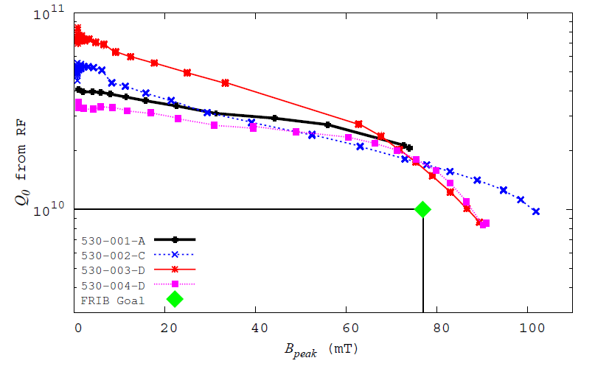
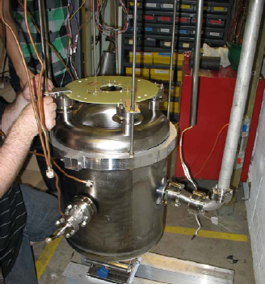
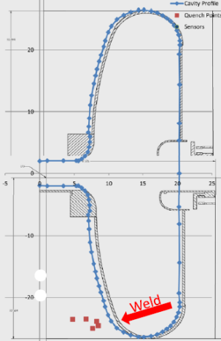
HWR β=0.53 Performance (Prototypes)
Five cavities so far have been constructed
One was built by MSU completely
Two vendors built two each
The MSU cavity quenched before reaching the design gradient (no field emission)
Both cavities from vendor ‘D’ quenched at the same field (< 90 mT). The quench is on the inner conductor short plate weld.
  We will look at it more closely with temperature mapping
One test on a vendor ‘C’ cavity reached higher than 100 mT, and also quenched. This cavity leaked after the helium vessel was added
We will test the other cavity from vendor ‘C’ soon
2K results naked
2nd sound hot spot detection diagnostics tool

Slide 22
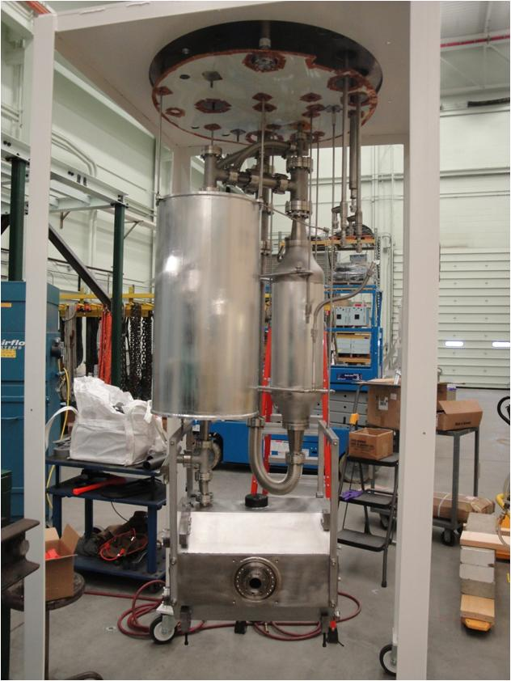
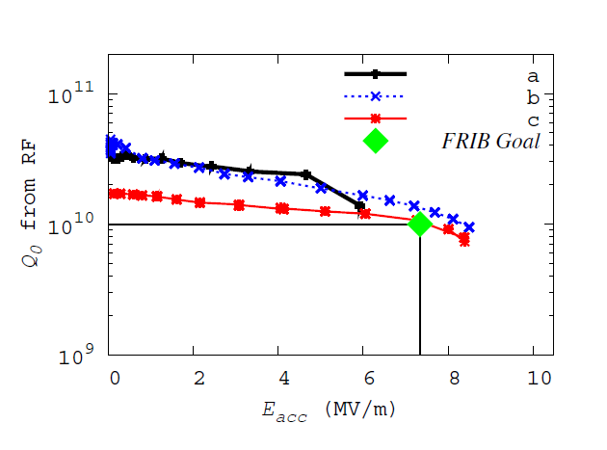
HWR β=0.53 Performance (1st Generation)
2K results with 2K insert
MSU built cavity with vessel, thermal breakdown from field emission
Vendor ‘D’ cavity, had FE, developed leak in helium vessel bellows on next test
Vendor ‘D’ cavity after bellows rework, had FE, did not retest (installed in test cryomodule)
HWR with helium vessel in the 2K test insert

Slide 23
53 HWR Measured Mechanical Parameters with Helium Vessel
Parameter | Units | Goal | Measured
Pressure sensitivity to bath pressure fluctuations | |Hz/ torr| | < 2.6 | 10 to 78†
Lorenz force detuning coefficient | |Hz/(MV/m)²| | < 2 | -2.8 to -5.1‡
Tuning Stiffness | kN/mm |  | 3.2 kN / mm
† df/dP is +10 Hz / torr with stiff boundary conditions at the tuner mounting location and +78 Hz / torr with the free condition. df/dP for the naked cavity was – 10 Hz / torr
‡ LFD for the vendor prototype HWR’s is -2.8 Hz/(MV/m)² and -5.1 Hz/(MV/m)² for the MSU prototypes
The new cavity and vessel design addresses these issues.

Slide 24
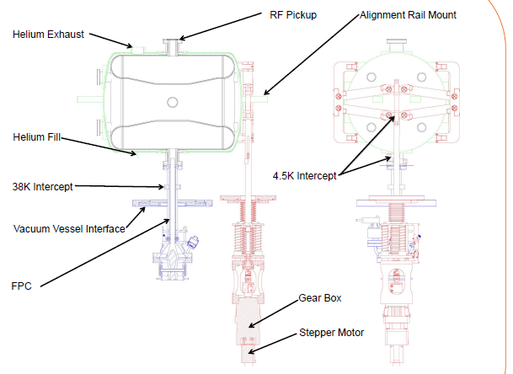
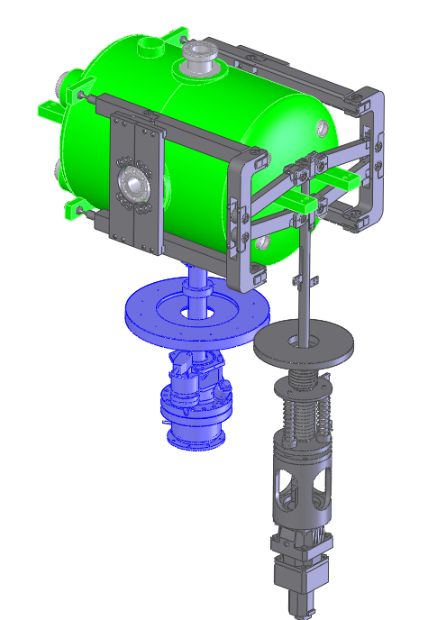
HWR Accessories: Tuner and Fundamental Power Coupler

Slide 25
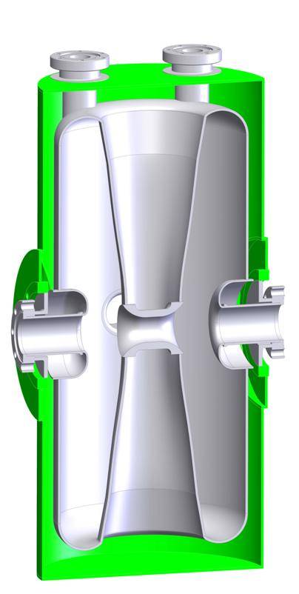
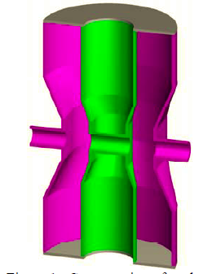
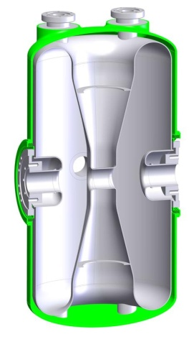
MSU β=0.29 HWR: Ready for Prototyping
  1st generation prototyped in 2002
  Standard FRIB operating fields reached in a Dewar test (naked)
    V_{acc}=1.90 MV,E_{p}=31.5 MV/m,B_{p}=75 mT
  Severe Lorentz force detuning and df/dP in the 1st generation cavity
  2nd generation cavity designed with improved mechanical stability, never built
  3rd generation designed with significantly improved RF parameters
2nd generation
1st generation
3rd generation
 | Ep/Ea | Bp/Ea mT/(MV/m) | R/Q Ohm | G Ohm
1st generation | 4.3 | 11.8 | 199 | 63
2nd generation | 4.5 | 10.7 | 202 | 59
3rd generation | 4.3 | 7.7 | 224 | 78

Slide 26
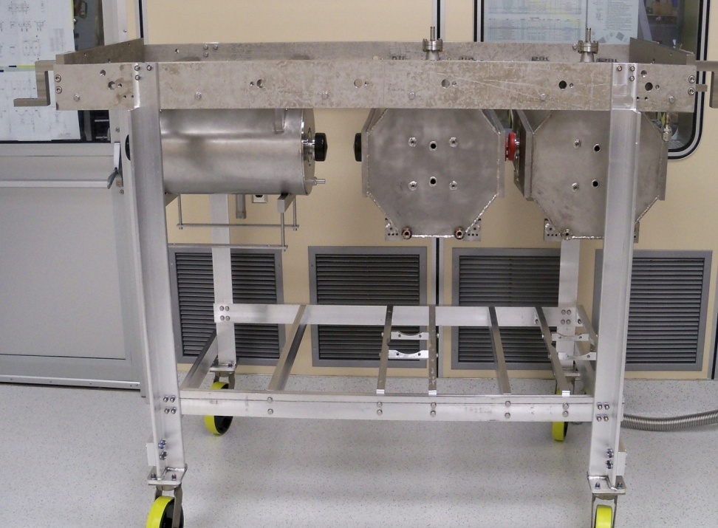
Test Demonstration Cryomodule
(“Two Seater”)
Aim
  Develop HWR cryostat assembly procedures
  Test HWR53 cavities at full power with final couplers and in the presence of a SC solenoid
  Cryogenic test of the module prototype
Components
  2 β=0.53 HWRs already tested off line
  1 superconducting solenoid
  Cryomodule components foreseen for FRIB
Status: under construction, completion by 12/2011, testing in Spring 2011
Tests planed:
  Cavity performance, LLRF performance, microphonics, magnetic sheilding capabilities, cavity-cavity interaction, cavity-magnet interaction, coupler performance, cryogenic performance, tuner performance

Slide 27
Summary
The prototypes of the β=0.041 QWR, β=0.085 QWR and β=0.53 HWR have reached the FRIB gradient and Q specifications
The first ReA3 cryomodule with β=0.041 QWRs was successfully put in operation and the cavities reached the FRIB gradients at 4.5 K
Improved procedures of cavity preparation allowed to reach very high Q and nearly field emission free cavities in the latest tests with HWRs and QWRs
A new design optimization of the β=0.085 QWR, β=0.29 HWR and β=0.53 HWR cavities resulted in resonators with significantly lower peak fields and higher shunt impedance than previously.
The design optimizations for the 085 QWR along with the experimental data from the existing allow us to propose a new baseline with less cavities as safety margins are quite high already.
The design optimizations for the HWR’s will give us more safety margin for a spread of performance.

