Slide 1
Tuner performance with LLRF control at KEK
Shin MICHIZONO (KEK)
S1G (RDR configuration)
- Detuning monitor
- Tuner control
- LLRF performance
- Microphinics
- Detuning and Quench
S1G (DRFS configuration)
- Detuning monitor
- LLRF performance
- Adaptive tuner control

Slide 2
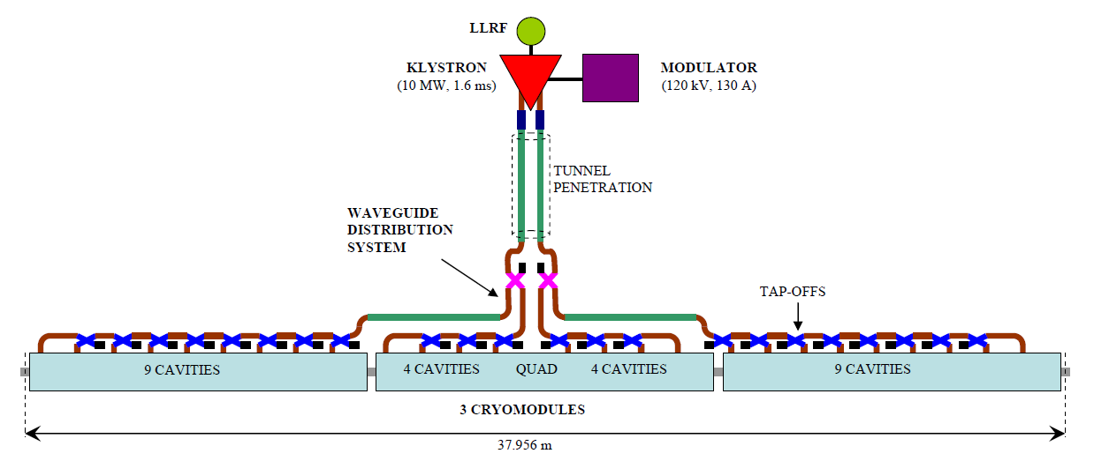
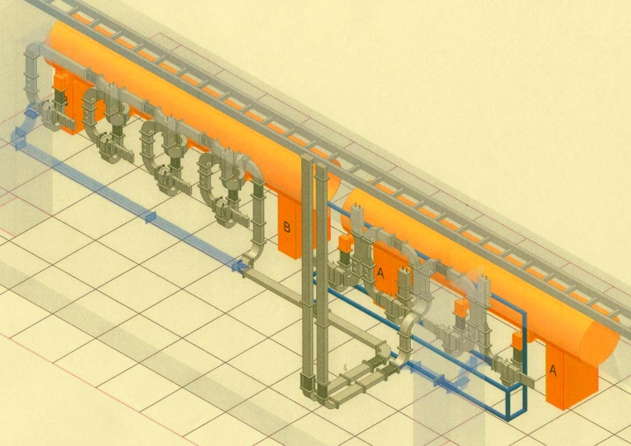
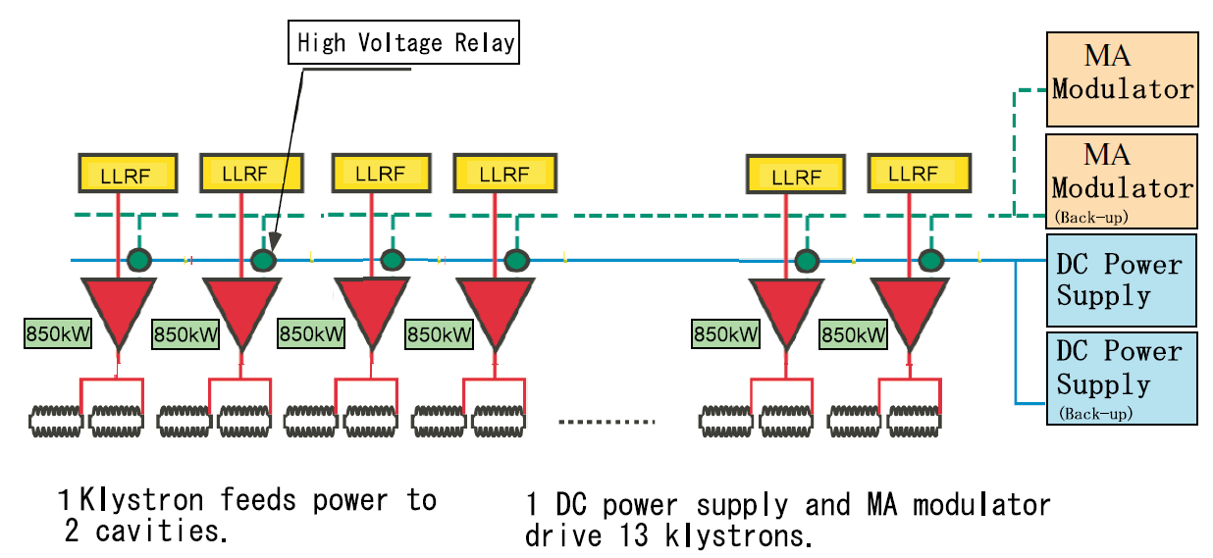
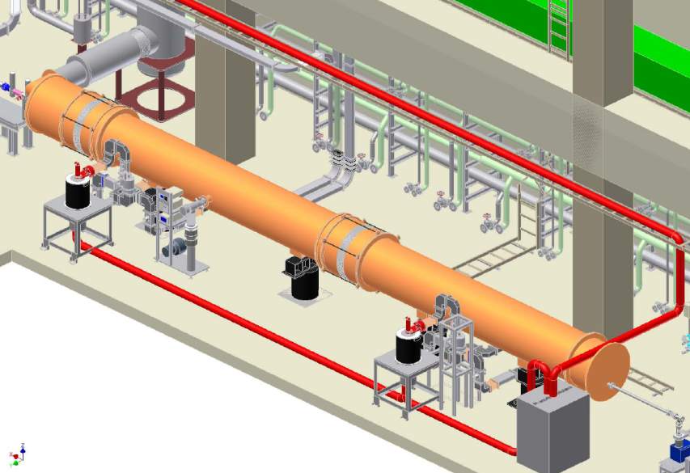
HLRF schemes for ILC
RDR: Reference Design Report of ILC
Layout in S1-Global
One klystron drives 26-cavities
5MW klystron drives 8 cavities
Demonstration
DRFS: Distributed RF Scheme
Each klystron drives 2-cavities in circulator-less PDS
Minimum DRFS units
Each 800kW klystron drives 2 cavities

Slide 3
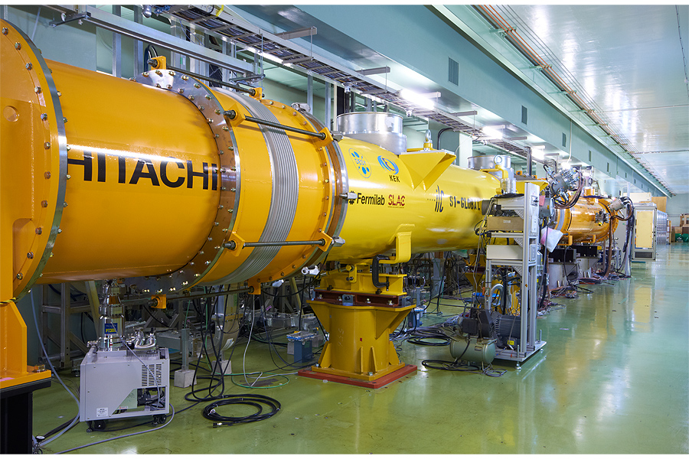
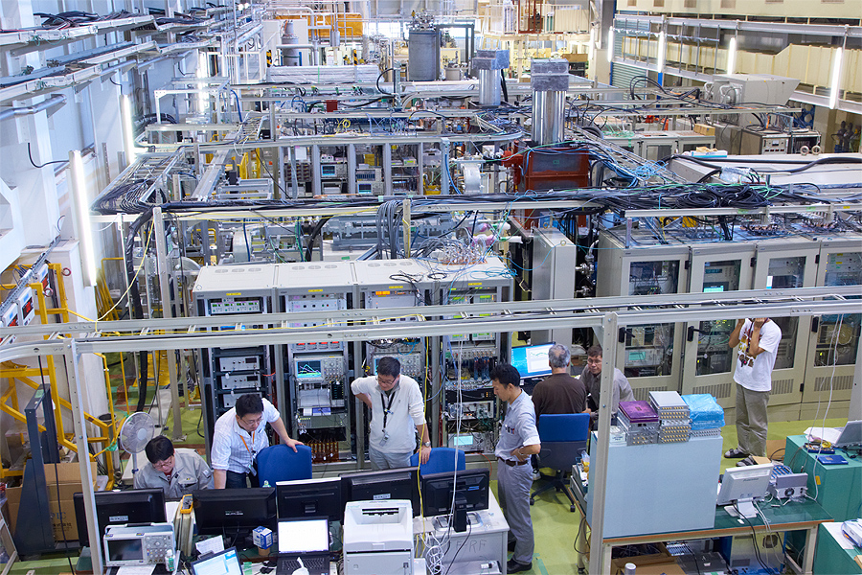
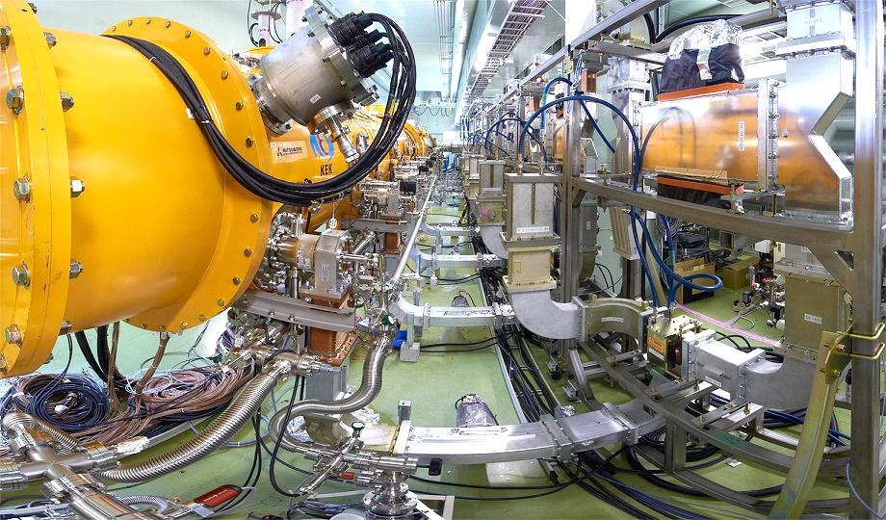
Photos of S1-Global (RDR-type)
5 MW klystron
(1.3GHz, 5 Hz, 1.6ms)
LLRF
digital FB system
& Interlock modules
Tunner controllers
& monitors (vac., power)
Klystron Hall
Cryomodule & WG in the tunnel
3

Slide 4
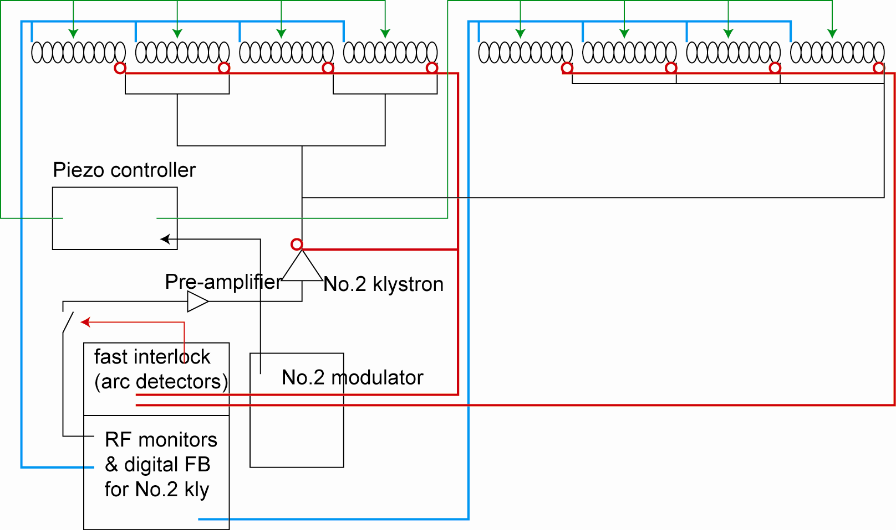
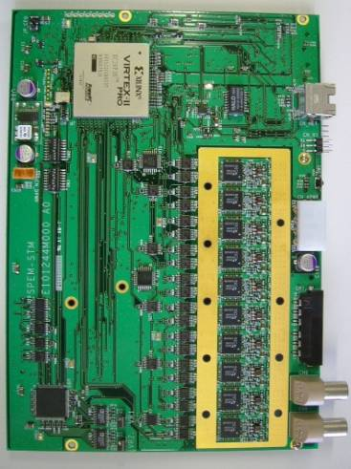
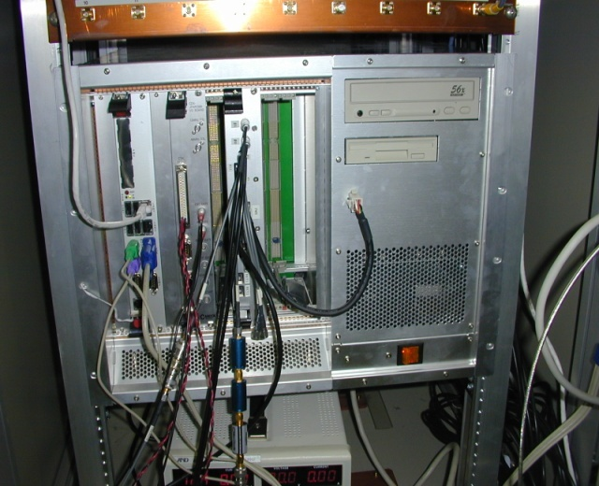
S1 Global LLRF for 8 cav. operation
All the cavities are driven by 5 MW klystron.
Digital LLRF system using an FPGA board on cPCI.
10 16bit-ADCs are installed.

Slide 5
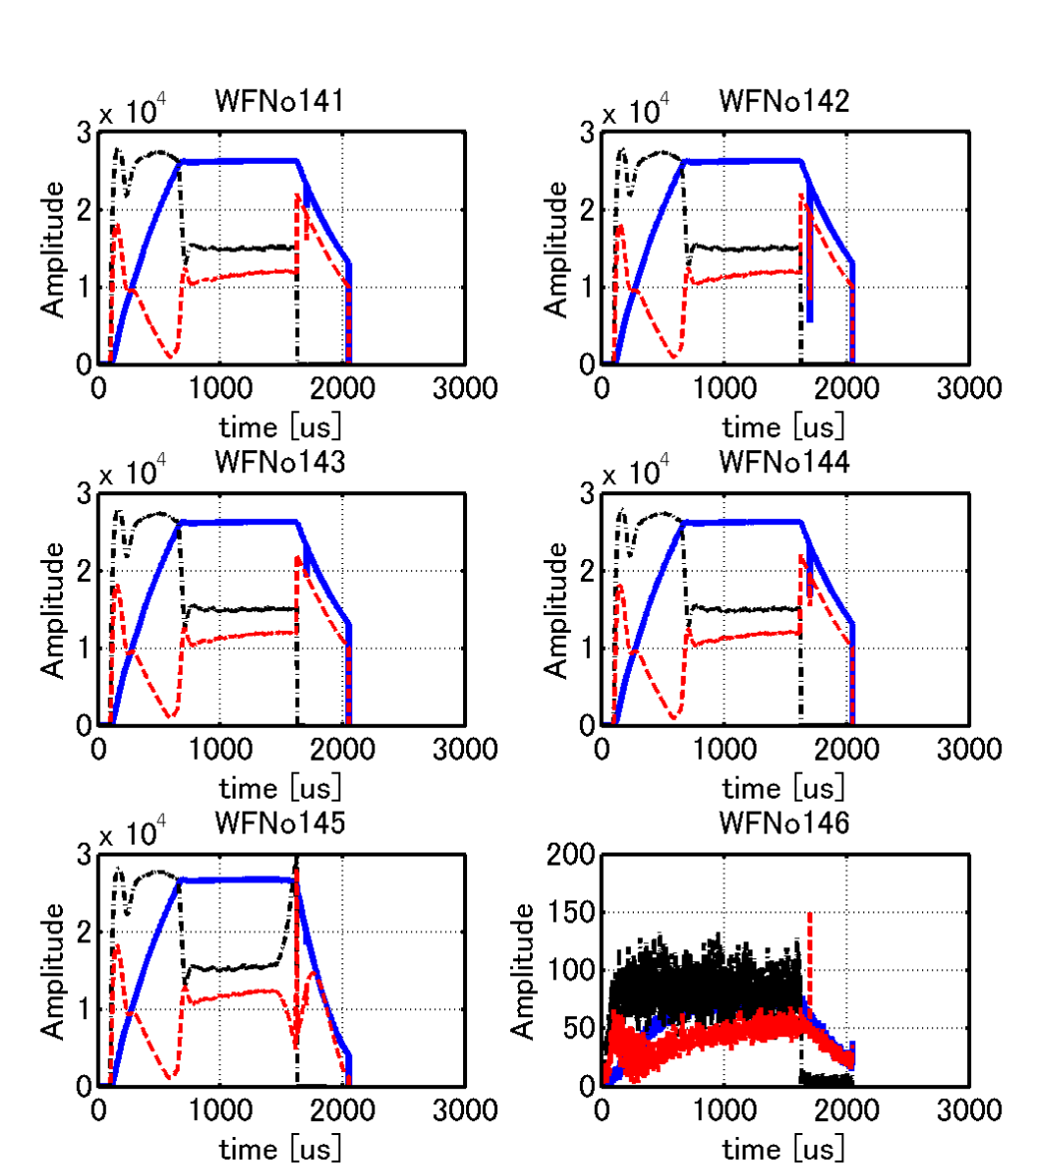
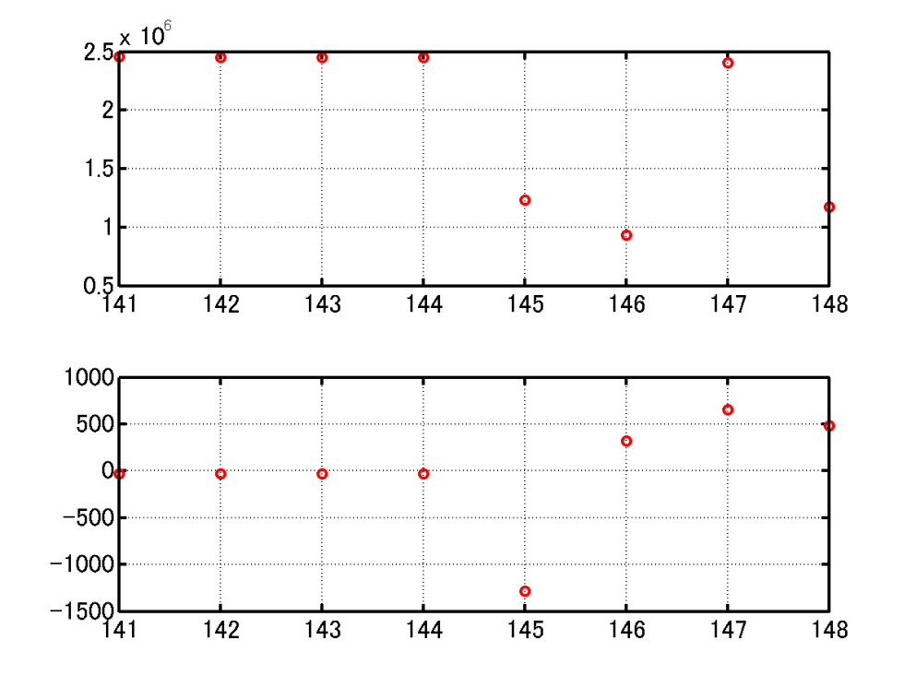
loaded-Q interlock
Calculate the loaded Q from the decay of the rf signal
The interlock works well and contributes to the lower heat load to the cryogenics.
RF off
RF off

Slide 6
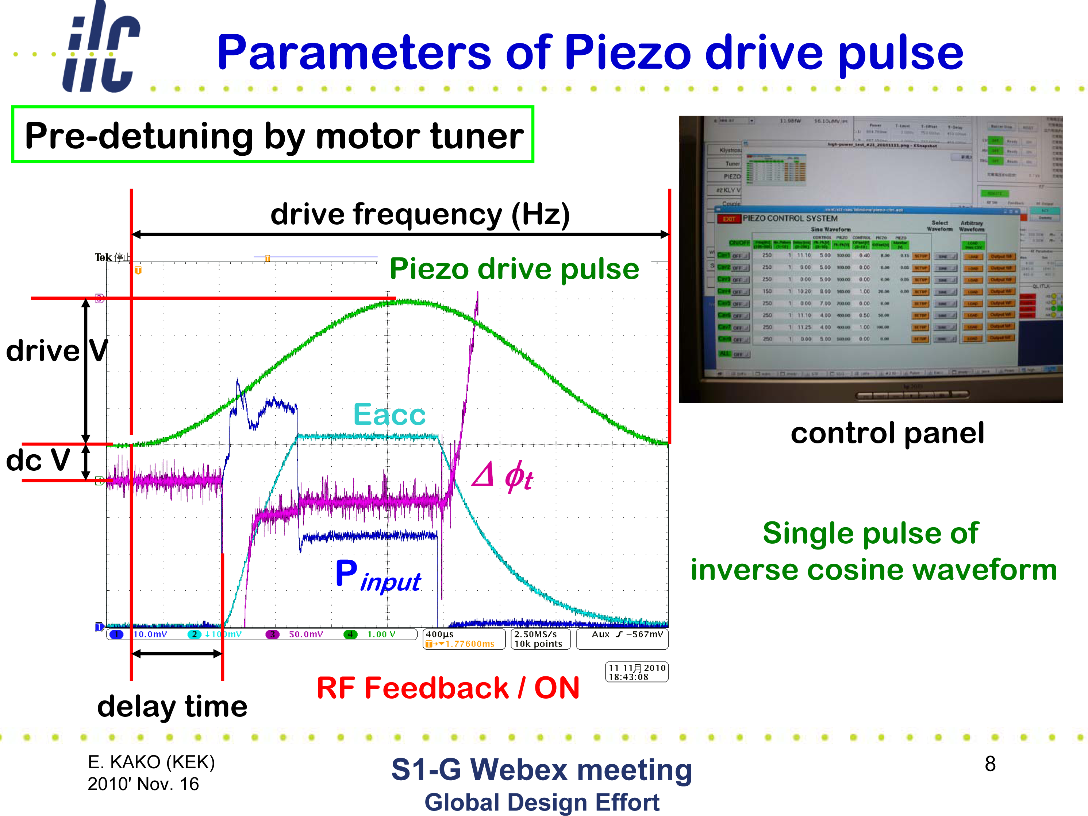

Slide 7
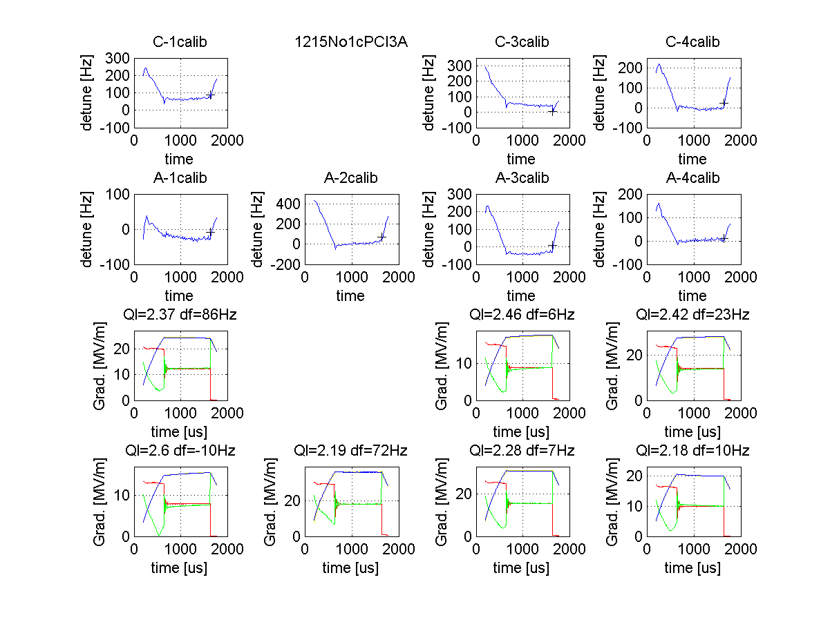
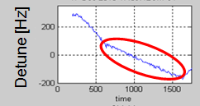


Real time detuning monitor
Correction of the dynamic detuning in real time is effective for good RF performance.
Derivation of dynamic detuning
Detuning is derived by using these 3 signals;
$$V_{cav}{= V}_{for}+ V_{ref},$$
Vcav: Cavity voltage
Vfor : Cavity input voltage
Vref : reflection voltage from cavity
$$\frac{d}{dt}V_{cav}=−\left(ω_{1/2}−j∆ω(t)\right)V_{cav}+2ω_{1/2}V_{for}$$
For 8 cavities, total 8cav x 3 = 24 signals are required.
<Examples of detune curves>
Without correction by Piezo tuner
With correction by Piezo tuner
Dynamic detuning is seen at flat-top region
Dynamic detuning is well corrected.
Real time detuning monitor is quite helpful to adjust the Piezo tuners.

Slide 8
Tuner performance with LLRF control at KEK
Shin MICHIZONO (KEK)
S1G (RDR configuration)
- Detuning monitor
- Tuner control
- LLRF performance
- Microphinics
- Detuning and Quench
S1G (DRFS configuration)
- Detuning monitor
- LLRF performance
- Adaptive tuner control

Slide 9
Result of vector sum operation
Average acceleration field=25 MV/m
0.0049% rms
0.015deg. rms
Flat-top
These results satisfy the requirement of ILC, 0.07% and 0.24°.

Slide 10
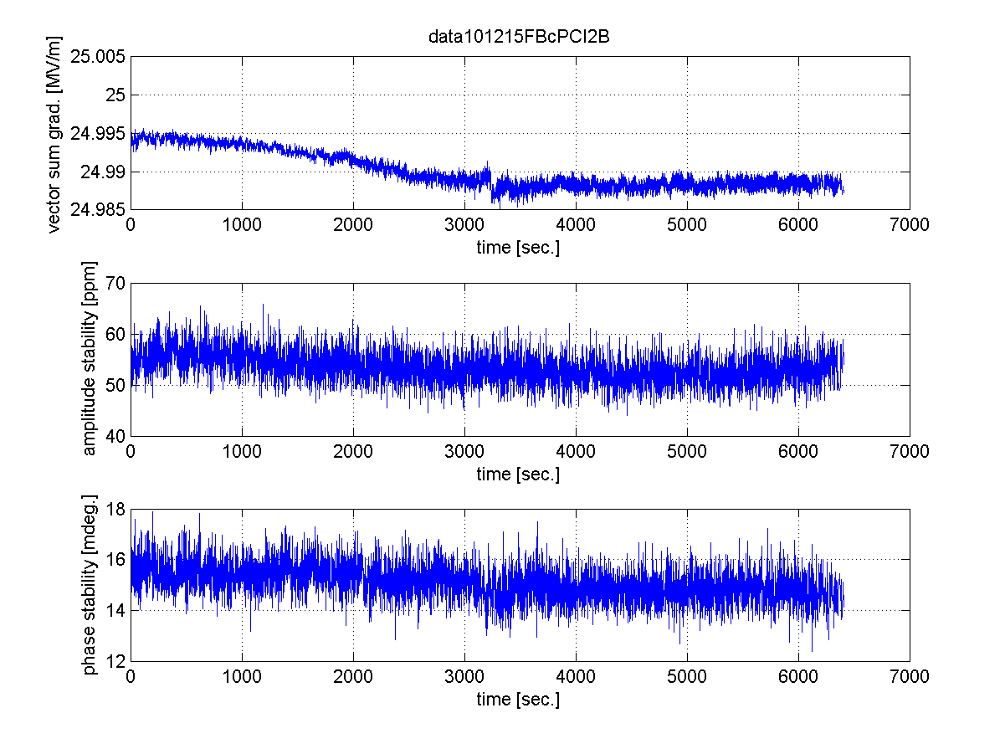
RF stabilities during 2H operation
Vector sum amplitude and phase are kept constant during 2H operation.
0.04%

Slide 11
Tuner performance with LLRF control at KEK
Shin MICHIZONO (KEK)
S1G (RDR configuration)
- Detuning monitor
- Tuner control
- LLRF performance
- Microphinics
- Detuning and Quench
S1G (DRFS configuration)
- Detuning monitor
- LLRF performance
- Adaptive tuner control

Slide 12
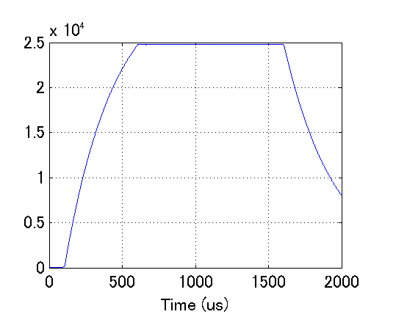
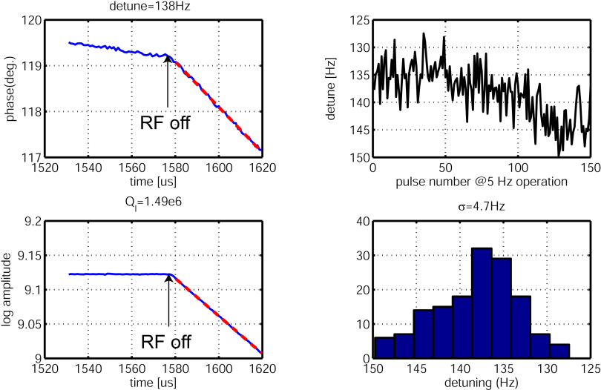
Detuning measurements
RF OFF
cavity
Amplitude decay (after rf off) -> Ql
Phase change (after rf off) -> detuning
Filling
Flat top
0.5 ms
1 ms

Slide 13
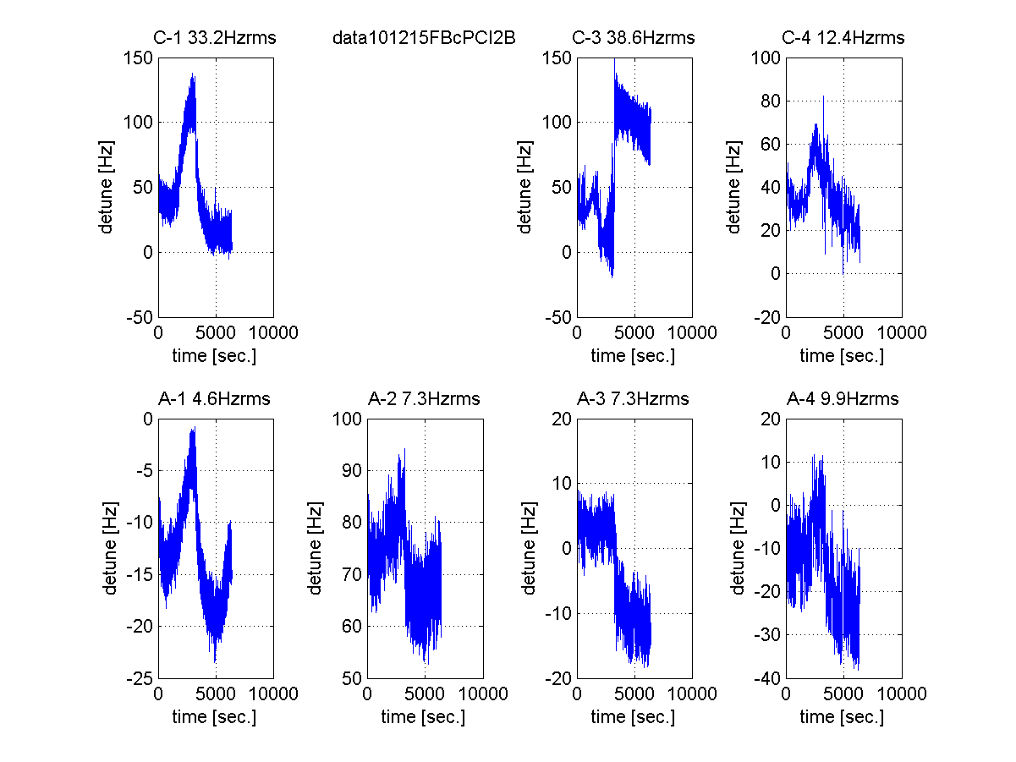
Detuning change during 2H operation
Detuning depends on cavity structure.
He pressure
25 MV/m 18 MV/m 29 MV/m
16 MV/m 37 MV/m 32 MV/m 21 MV/m
quench
Similar tendency with He pressure
Rather stiff at A-1~4. (~1/4 compared with C-1~4)

Slide 14
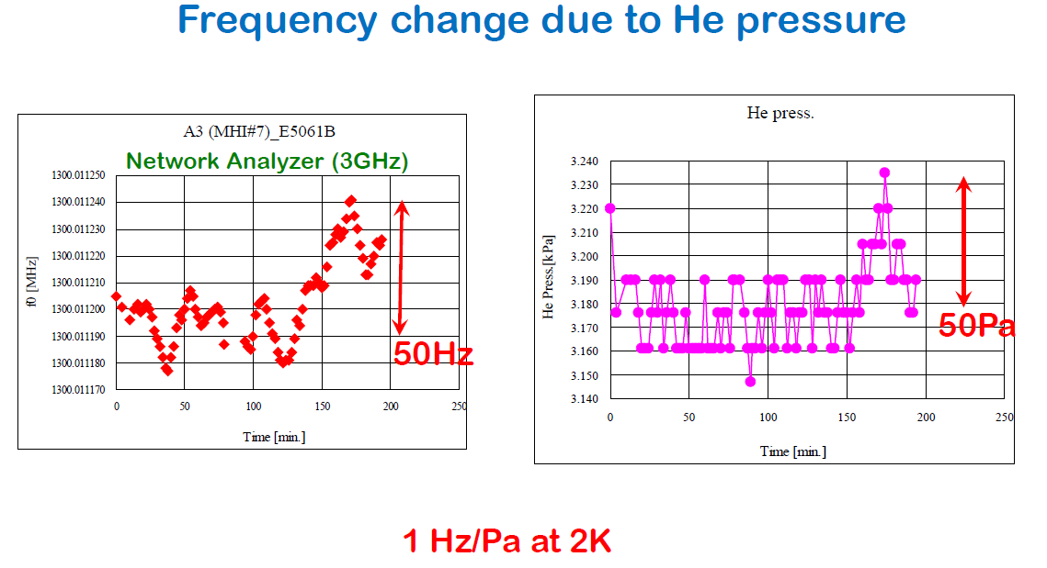
From E. Kako

Slide 15
Detuning change during 2H operation
He pressure
20 Hz
100 Hz
150 Pa
25 MV/m 18 MV/m 29 MV/m
16 MV/m 37 MV/m 32 MV/m 21 MV/m
quench
15 Hz
Opposite direction
20 Hz
The measured detuning is ~1/10 of expected detuning from He pressure change.
Non-linearity of pressure dependence, combination with Lorentz forece detuning could be the reasons of them.

Slide 16
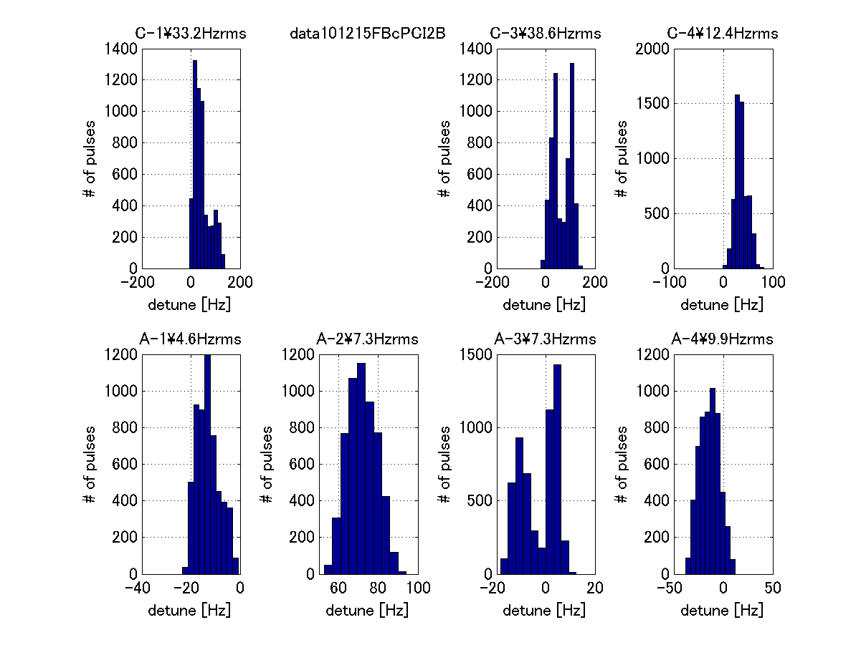
Histgrams of detuning
25 MV/m 18 MV/m 29 MV/m
16 MV/m 37 MV/m 32 MV/m 21 MV/m
Detuning looks sensitive to the stiffness of the cavity.

Slide 17
Tuner performance with LLRF control at KEK
Shin MICHIZONO (KEK)
S1G (RDR configuration)
- Detuning monitor
- Tuner control
- LLRF performance
- Microphinics
- Detuning and Quench
S1G (DRFS configuration)
- Detuning monitor
- LLRF performance
- Adaptive tuner control

Slide 18
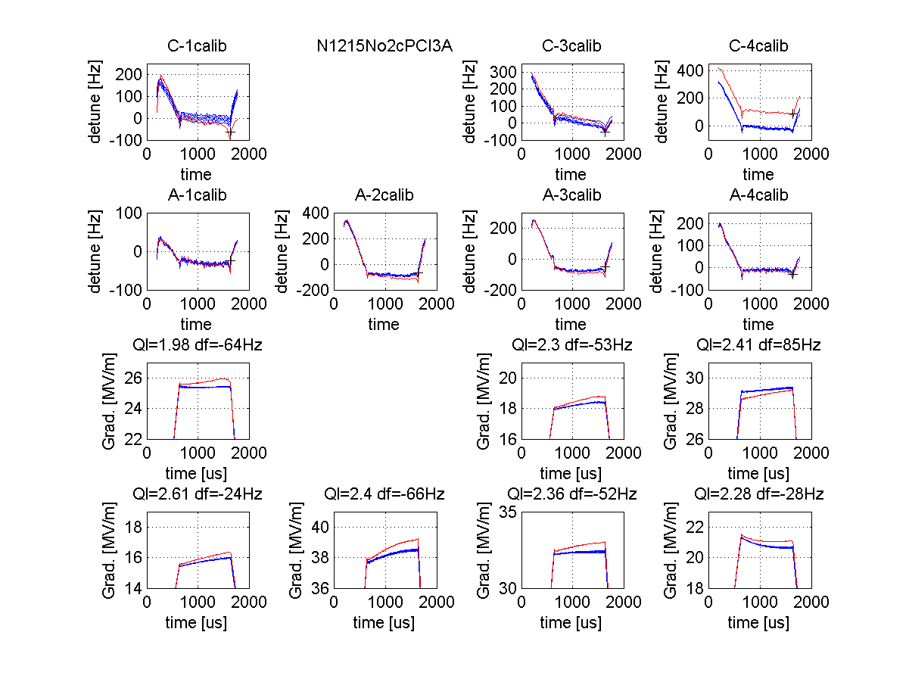
Quench phenomena
Detuning change at C-4 may result in C-1 Quench
Cavity detuning:
Red: Quench
Blue: Previous 4 pulses
Cavity gradient:
Red: Quench
Blue: Previous 4 pulses

Slide 19
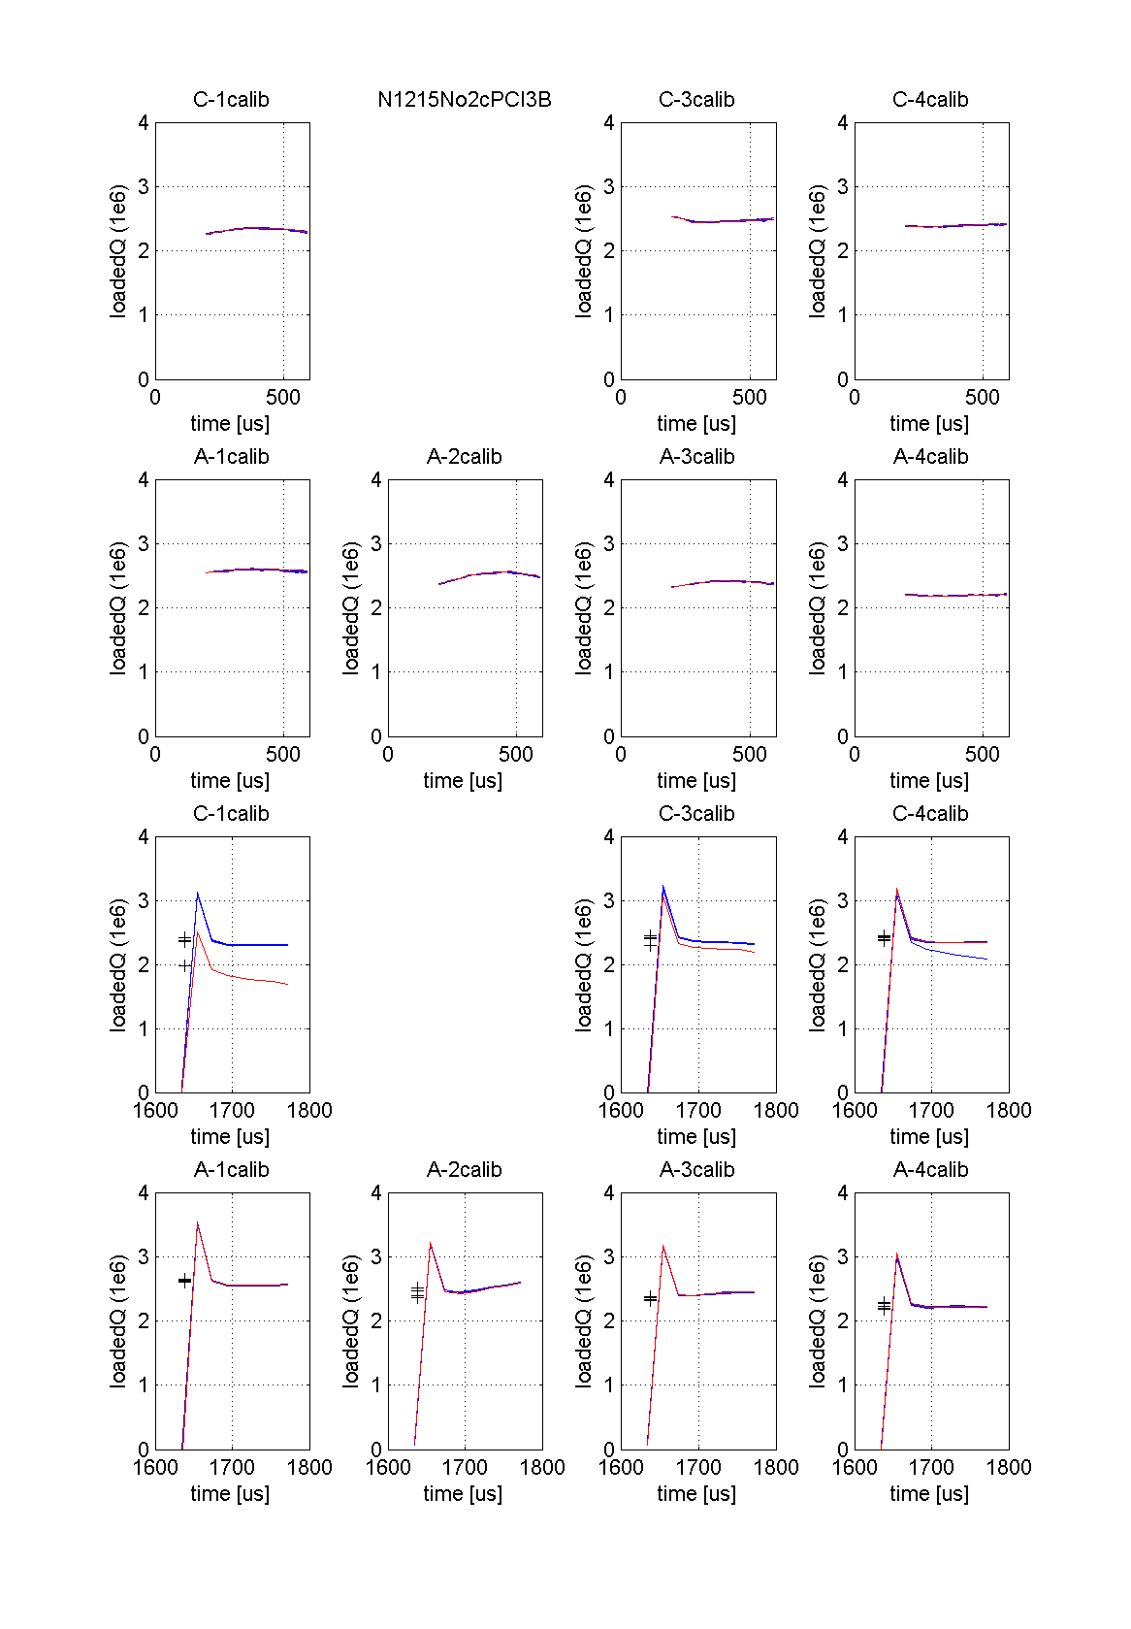
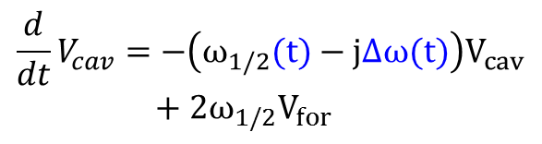

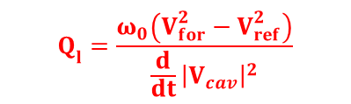
Time variation of Ql
Caivty differential equation
Time variation of Ql can be obtained from cavity differential equation.
(except flat-top)
$$V_{cav}{= V}_{for}+ V_{ref},$$
$$Q_{l}=\frac{ω_{0}\left(V_{for}^{2}−V_{ref}^{2}\right)}{{\frac{d}{dt}\left|V_{cav}\right|}^{2}}$$
$$\frac{d}{dt}V_{cav}=−\left(ω_{1/2}(t)−j∆ω(t)\right)V_{cav}+2ω_{1/2}V_{for}$$
Quench took place after filling.
C-1 Ql (after rf off): Quench(red)
Previous 4 (blue)
C-1 Ql (fliilng): Quench(red)
Previous 4 (blue)

Slide 20
Example of quench sequence
Detuning change at C-4 -> Lower gradient of C-4 -> Higher gradient at other cavity (due to Vetor-sum) -> Quench at lowest margin.
C-4 gradient
C-1 gradient
C-1 Ql (fliilng): Quench(red)
Previous 4 (blue)
C-1 Ql (after rf off): Quench(red)
Previous 4 (blue)
Detuning control (including microphonics) is important to avoid quench.

Slide 21
Detuning issue
Cavity detuning during pulsed rf operation comes from
    Static microphonics (1~100Hz)
    Dynamic Lorentz force (~500 Hz)
Lorentz force detuning can be compensated within the range of ~10 Hz by Piezo using the real-time detuning monitor.
Microphonics can be partly explained from He pressure change. (not perfectly)
Sudden detuning change (~100 Hz) takes place by exceeding some elastic limit.
This induces the quench of other cavity (vector-sum control)
This can be avoided if the adaptive detuning correction is carried out.

Slide 22
Tuner performance with LLRF control at KEK
Shin MICHIZONO (KEK)
S1G (RDR configuration)
- Detuning monitor
- Tuner control
- LLRF performance
- Microphinics
- Detuning and Quench
S1G (DRFS configuration)
- Detuning monitor
- LLRF performance
- Adaptive tuner control

Slide 23
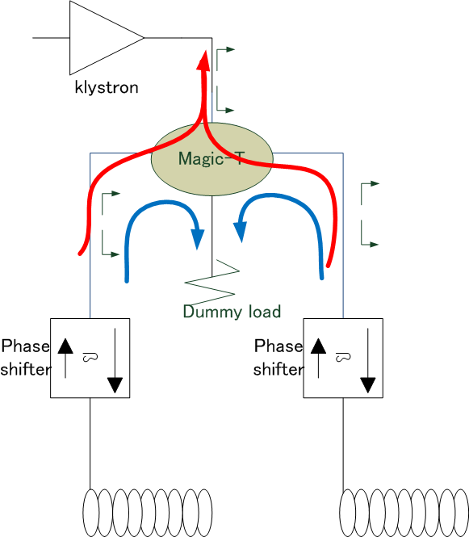
RF distribution at DRFS
One klystron drives two cavities.
Circulator-less system.
Same (amplitude and phase) reflection signals go to the dummy load.(blue line)
Un-balanced reflection signals move to the klystron. (red line)
-> careful operation is required to protect the klystron.
Phase-shifters are introduced to evaluate the system. (not to be used at ilc-DRFS)

Slide 24

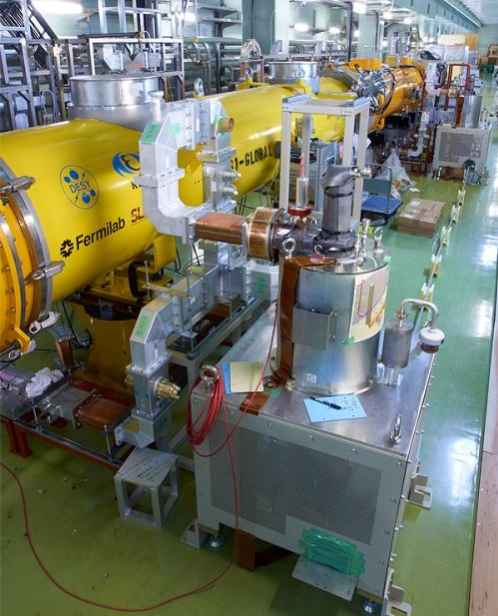
S1-Global (DRFS)
The first test of DRFS for ILC was conducted at the end of S1-Global.
KLY #1
KLY #2
MA modulator
Two klystrons with modulation anodes(MA) were connected to a DC power supply and an MA-modulator .
Each klystron drove 2 cavities. (KLY#1→C1+C2, KLY#2→A2+A3)

Slide 25
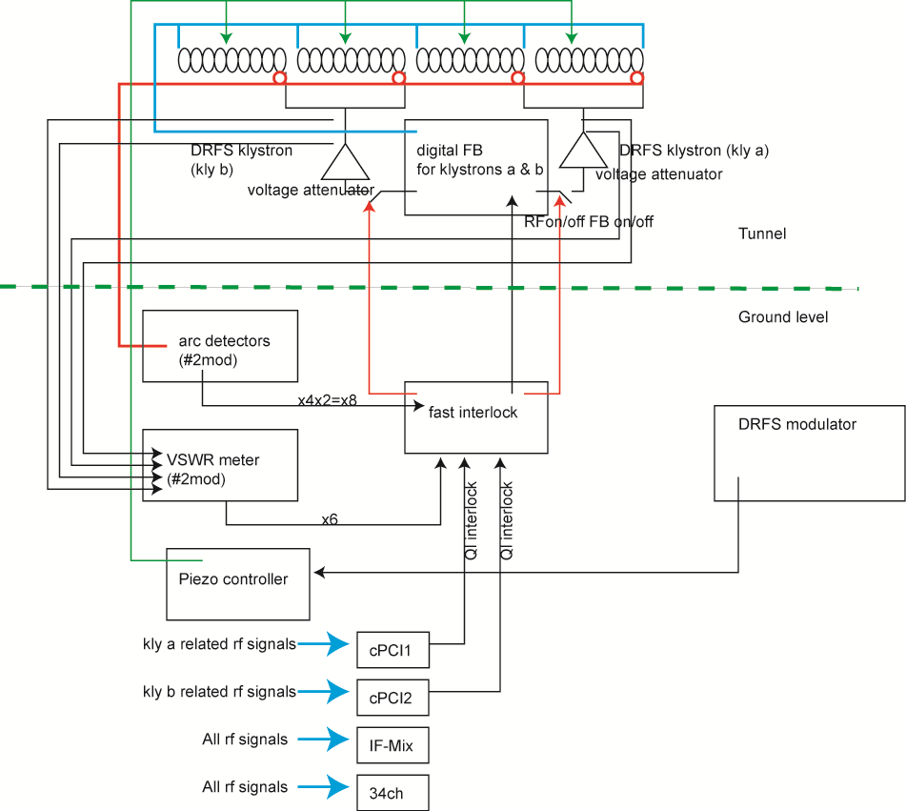
S1 Global 3rd stage (DRFS)（1）
Digital system is located in the tunnel
Fast interlock (and Arc detectors, VSWR meter) are located on the ground.
cPCIs are used for the monitor and also they are the backup digital system.

Slide 26
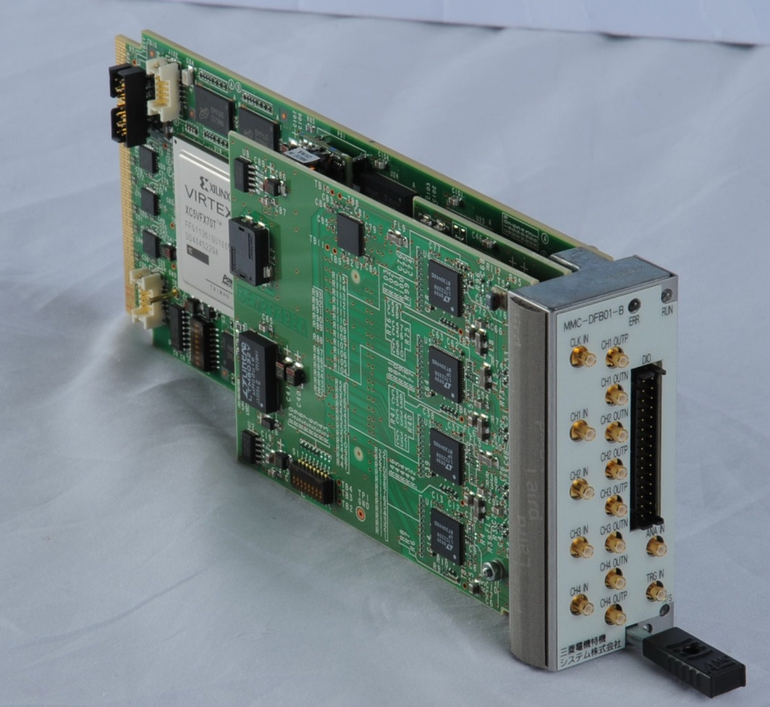
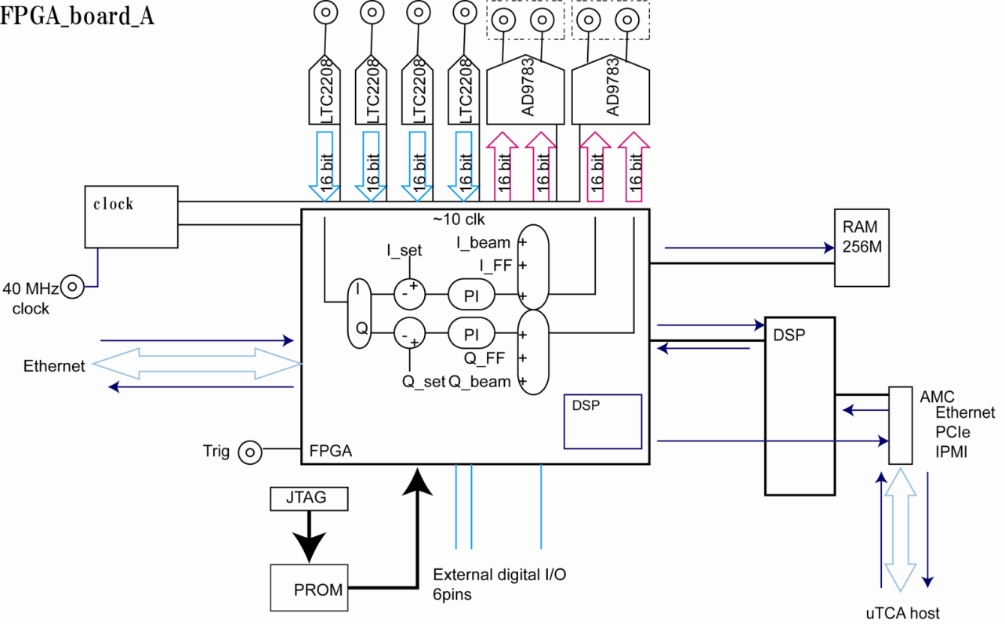
Field regulation with uTCA
cERL like uTCA FPGA system was installed.
An FPGA board have 4 16-bit ADCs and 4 16-bit DACs.
Two cavity-pickups, klystron output, reflection are observed.
The system was located in the tunnel.

Slide 27
Tuner performance with LLRF control at KEK
Shin MICHIZONO (KEK)
S1G (RDR configuration)
- Detuning monitor
- Tuner control
- LLRF performance
- Microphinics
- Detuning and Quench
S1G (DRFS configuration)
- Detuning monitor
- LLRF performance
- Adaptive tuner control

Slide 28
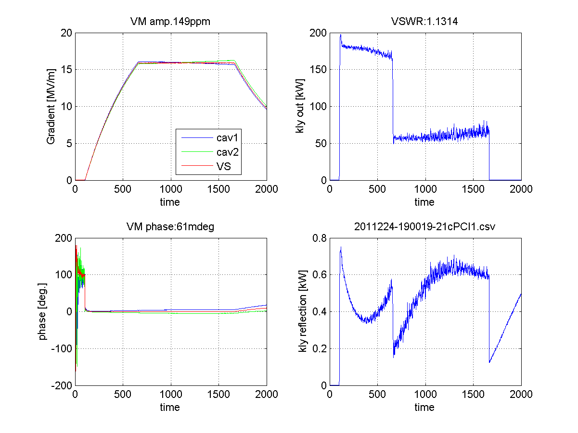
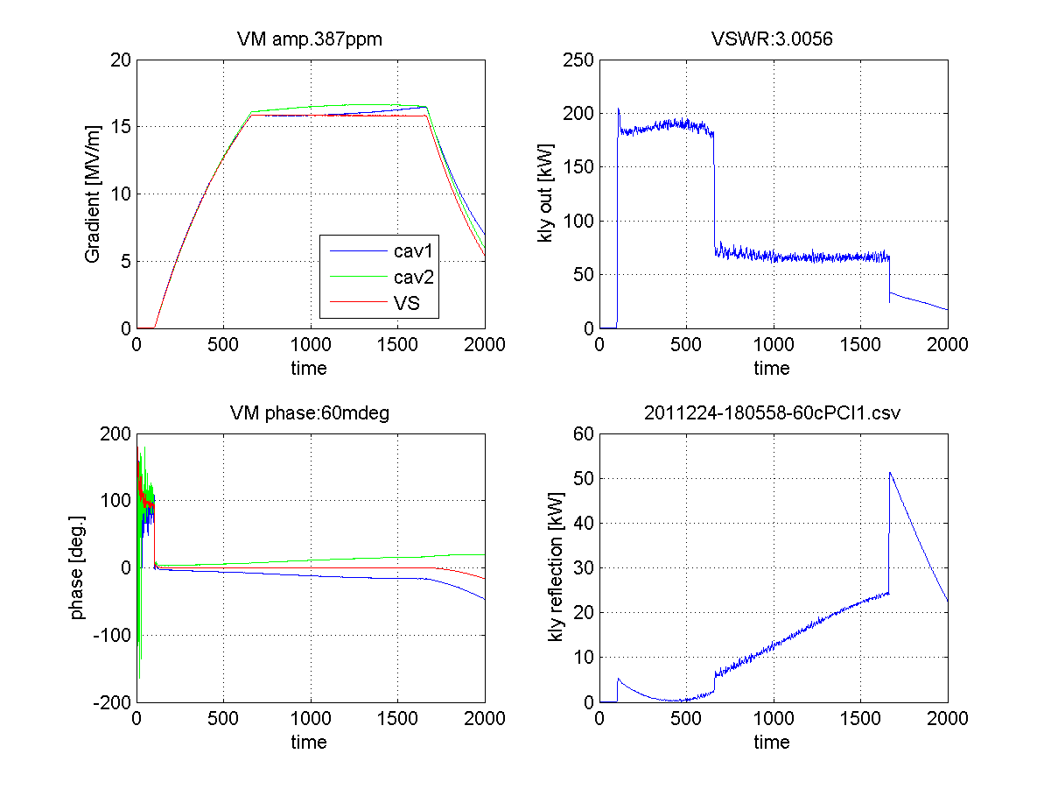
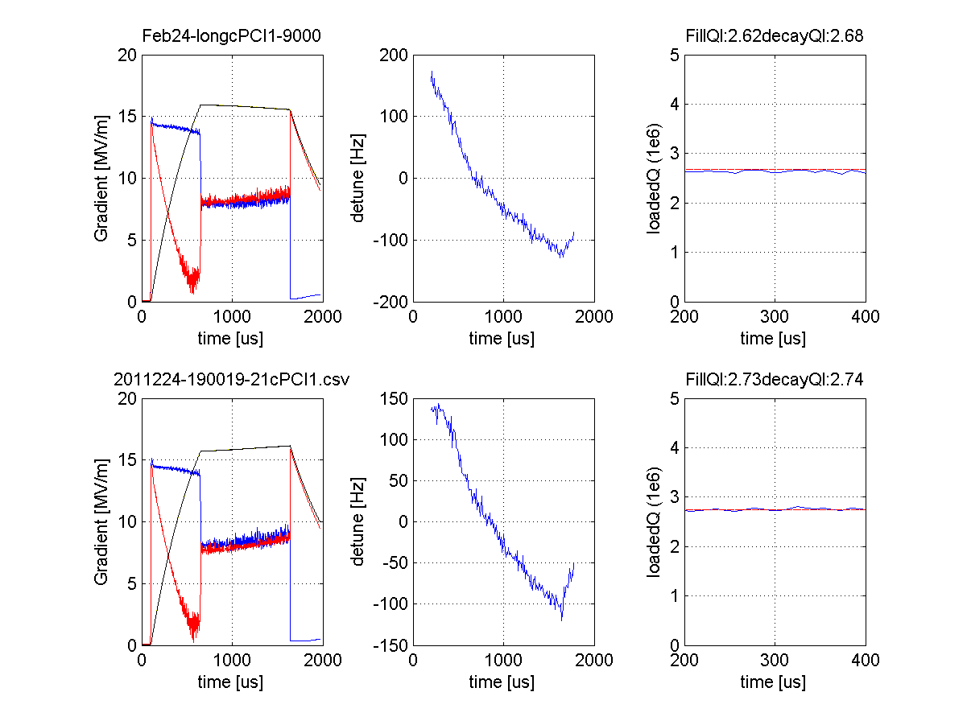
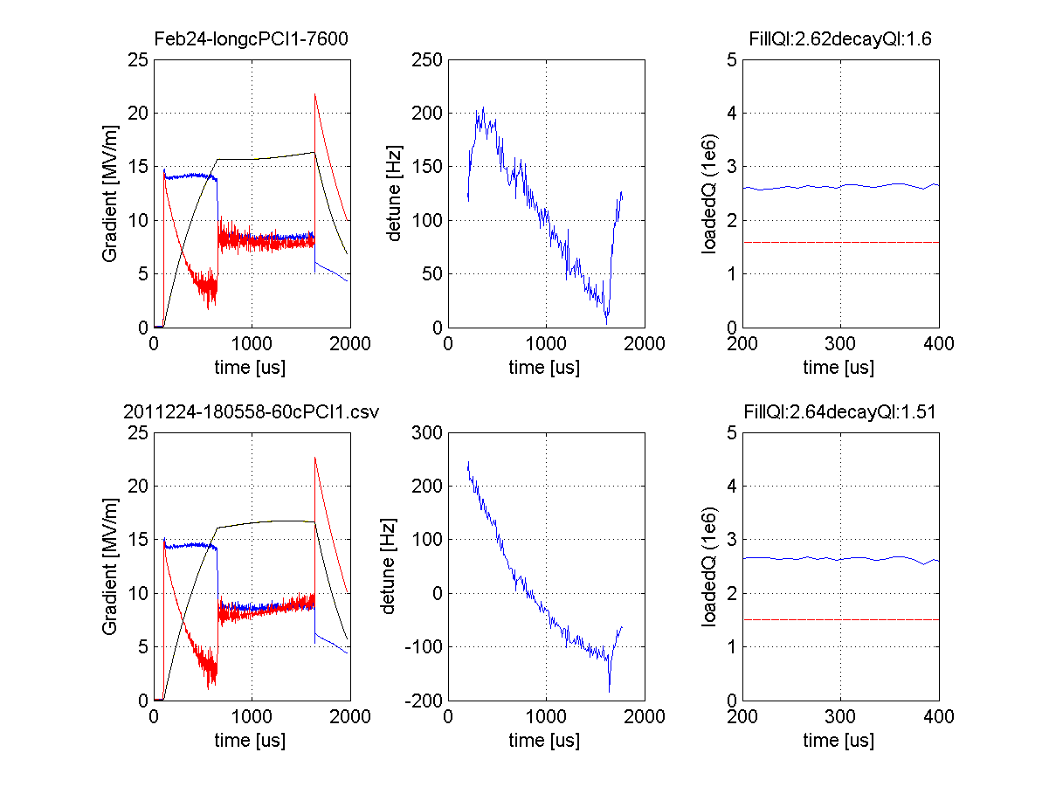
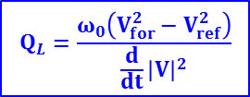
Result for circulator-less operation
(When reflection is not canceled or large, circulator-less system should be checked.)
Typical Operation
Operation under different detuning
Δf1 > Δf2
~130Hz
Low reflection : VSWR~1.1
Large reflection: max VSWR~3
Vector sum is still regulated stably. (0.04%rms, 0.06deg.rms)
Stability
0.015% rms, 0.06deg.rms
cavity eq.
$$Q_{L}=\frac{ω_{0}\left(V_{for}^{2}−V_{ref}^{2}\right)}{{\frac{d}{dt}\left|V\right|}^{2}}$$
V_{for} exists even after RF-off
Q_{L} by cavity eq.
Q_{L} by cavity eq.
Reasonable value
Both are same results.
Q_{L} by decay
Wrong value
Q_{L} by decay
Therefore, under large reflection, vector sum operation and Q_{L} diagnostics using cavity eq. worked well.

Slide 29
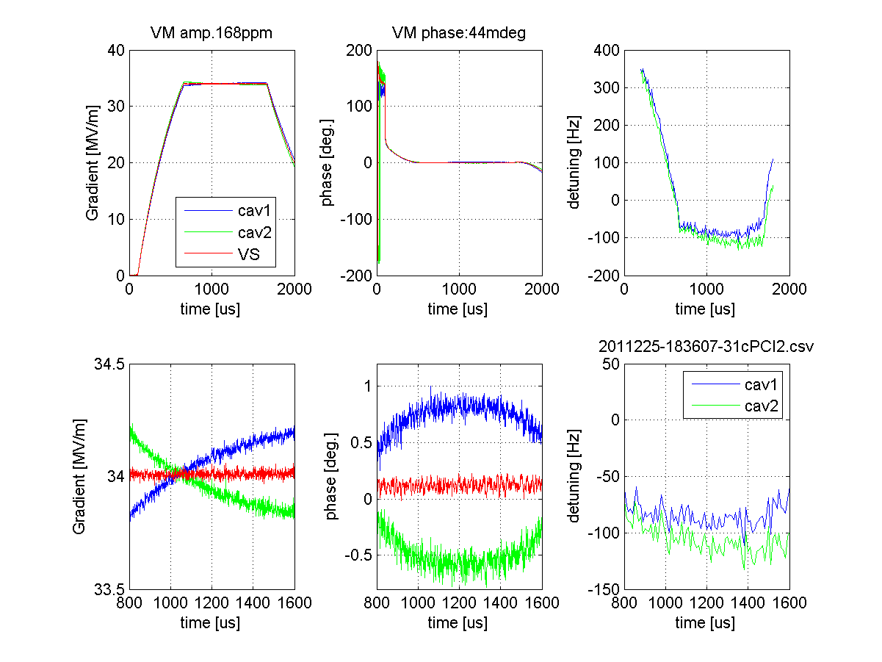
RF waveform and detuning

Slide 30
Tuner performance with LLRF control at KEK
Shin MICHIZONO (KEK)
S1G (RDR configuration)
- Detuning monitor
- Tuner control
- LLRF performance
- Microphinics
- Detuning and Quench
S1G (DRFS configuration)
- Detuning monitor
- LLRF performance
- Adaptive tuner control

Slide 31
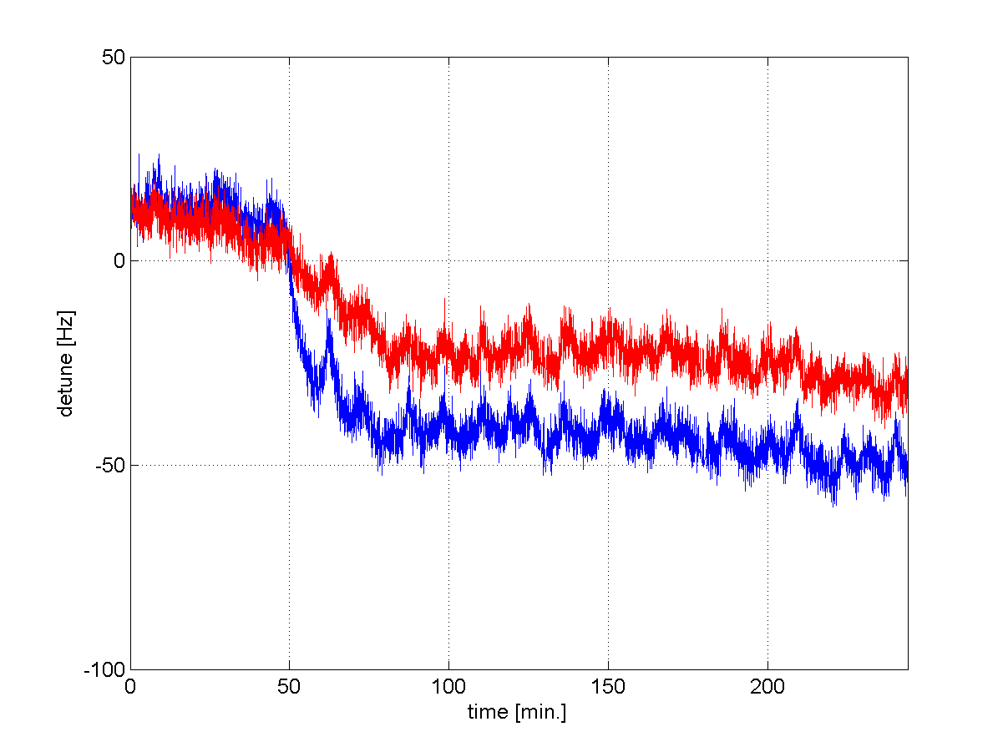
Adaptive detuning correction via EPICS
DC piezo bias is controlled every ~2 min. for detuning correction.
The detuning after filling were kept constant
Detuning correction
Even these simple (and slow) detuning correction looks promising to compensate the long-time detuning fluctuation (microphonics).
Piezo output to change
from 0Hz to -50Hz

Slide 32
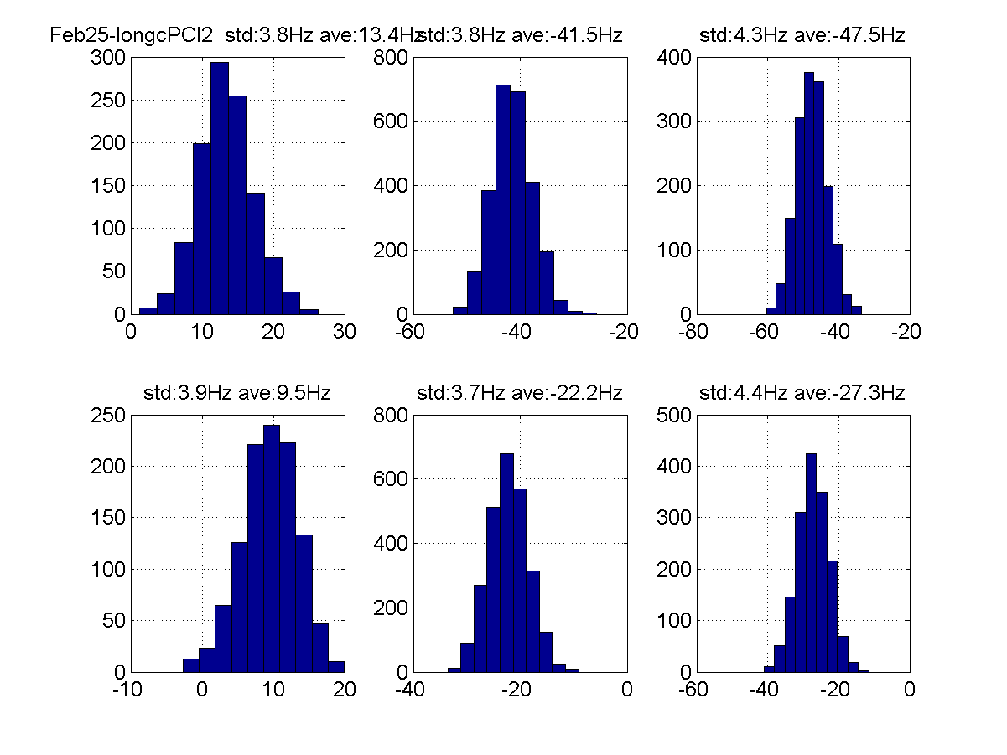
Long term stability (microphonics)
A-2
No piezo control
Adaptive control
No piezo control
A-3
Microphonics are about 3~5Hz rms.
Since KEK cavities are stiff enough, the effect of adaptive piezo control is not clear.

Slide 33
Summary
Two types of rf system (RDR-type, DRFS-type) were evaluated.
Field regulation (with vector-sum) worked well.
Real time detuning monitor supported the proper piezo-operation.
Microphonics were measured and many of the cavity detuning were related with He pressure.
The sensitivity is ~10 times lower than He pressure dependence.
Quench took place from the detuning of one cavity. In order to operate near quench limit, careful tuning control is essential.
Adaptive detuning control (using piezo DC bias) carried out and it was successful.

Slide 34
Thank you for your attention

