Slide 1
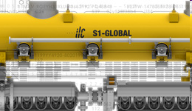
5K Shield Study & HL Measurements
Summary of work presented at CEC and LCWS
for the S1-G Collaboration
Norihito Ohuchi – KEK
P. Pierini – INFN

Slide 2
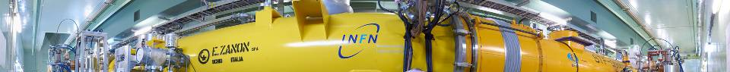
S1-Global HL Measurements
S1-G: 2 “short” (6 m) modules (A & C)
Different component types
  Cavities & Tanks
  Couplers
  Tuners
Modules and facilities were instrumented to allow determination of heat load contributions
(static and dynamic)
  Comparison with simulation models
+ Campaign of measurements to investigate effect of removal of 5 K shield

Slide 3
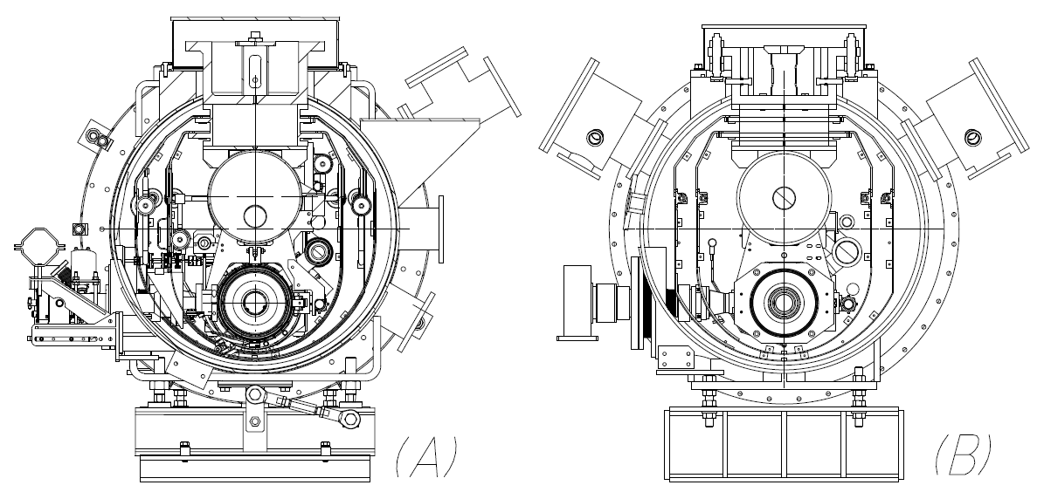
Module C and Module at S1-G
INFN Design (Type III)
KEK Design
3

Slide 4
 | Static load evaluations | Module-A, [W] | Module-C, [W]
2K | Thermal radiation | ~0.0 | ~0.0
 | 4 input couplers | 0.29 | 0.08
 | HOM RF, Piezo cables | 2.1 | 0.71
 | 4 tuner driving shafts | 0.48 | NA
 | Temp. sensor wires | 0.18 | 0.18
 | WPM, Pin diodes wires | 1.72 | 0.82
 | WPM connection pipe | 0.17 | ~0.0
 | 2 support posts | 0.25 | 0.25
 | Beam pipe | 0.02 | <0.01
 | Total | 5.2 | 2.1
5K | Thermal radiation | 0.66 | 0.68
 | 4 input couplers | 4.00 | 0.92
 | 2 support posts | 1.54 | 1.54
 | Beam pipe | 0.1 | 0.05
 | Sensor wires | 0.9 | 0.9
 | Total | 7.2 | 4.1
80K | Thermal radiation | 16.6 | 15.9
 | 4 input couplers | 9.60 | 7.28
 | 2 support posts | 10.78 | 10.78
 | RF cables | 6.88 | 1.30
 | Beam pipe | 0.37 | 0.10
 | Sensor wires | 0.08 | 0.08
 | Total | 44.3 | 35.3
Heat Load Assesments
4

Slide 5
Static Measurements
Static loss measurement at 2 K
  Evaporation rate of LHe in the 8 vessels
    Evaporation of LHe= 6.87 m³/h (= 0.314 g/s at latent heat 23.045 J/g at T=2.0 K)
Static loss at 5 K and 80 K
  Measuring temperature rises (enthalpy rise) of the shields at 5K and 80 K after stopping the LHe and LN2 flow
    15 PtCo thermometers (on 5 K shield) and 13 Type-T thermocouples ( on 80 K shield) for each module
5

Slide 6
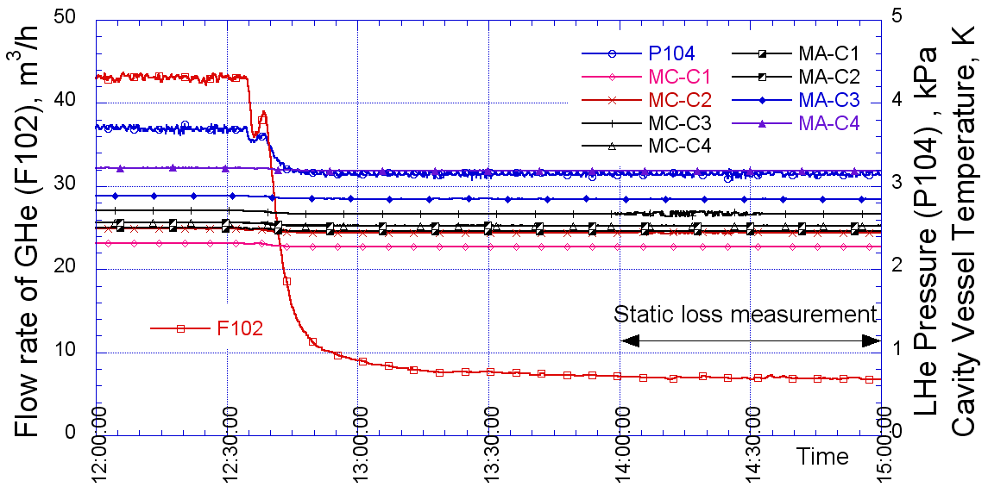
2 K circuit
Static loss measurements at 2 K:
flow rate of He=F102, pressure of 2K He=P104,
T of cavity vessels =MC-C1~C4, MA-C1~C4.
6

Slide 7
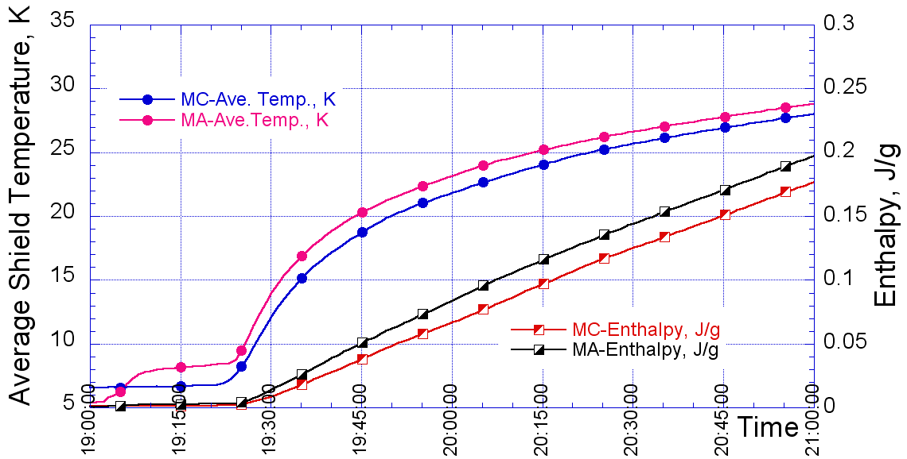
5 K shields
9/26/2011
7

Slide 8
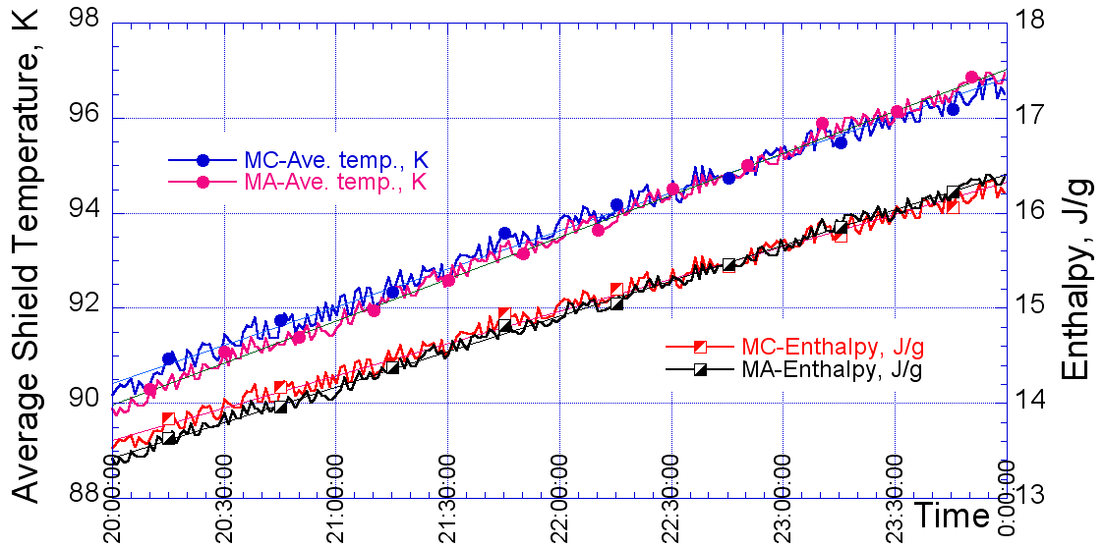
80 K shields
8

Slide 9
Estimation vs. Measurements
Comparison of the estimated (in parenthesis) static heat loads vs. the measured values at S1 Global
Static losses are evaluated to a fairly good approximation
 | Module-A | Module-C
2K | 7.2 W [ 6.8 W ],+6%
5K | 7.3 W [ 7.2 W ],+1% | 5.3 W [ 4.1 W ],+29%
80K | 48.7 W [ 44.3 W ],+10% | 34.4 W [ 35.3 W ],-3%
9

Slide 10
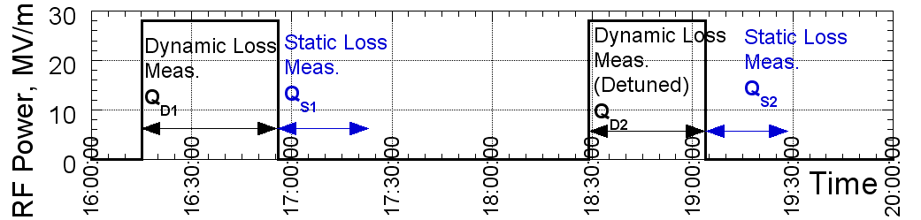
Dynamic losses: procedure
Dynamic loss by single cavity, to identify intrinsic loss at cavity
  Measure Dynamic/Static losses:
    on resonance : Q_{D1},Q_{S1}
    in detuned conditions : Q_{D2},Q_{S2}
  Dynamic loss at cavities and couplers ：
    Q_{D} = Q_{D1} － Q_{S1}
  Dynamic loss at detuned condition ：
    Q_{D-det} = Q_{D2} － Q_{S2}
  Dynamic loss at cavities (and then Q)：
    Q_{D-cav} = Q_{D} － Q_{D-det}
10

Slide 11
Single/Multiple cavity HL Tests
 | MC-4 | MC-1 | MA-3 | MA-2 | MA-2
 | Z109 | AES004 | MHI07 | MHI06 | MHI06
G, MV/m | 28 | 25.2 | 32.3 | 38 | 32
Q_{D}, W | 0.84 | 1.4 | 2.8 | 4.8 | 2.6
Q_{D-det}, W | 0.09 | 0.18 | 0.7 | 1.8 | 1.2
Q_{D-cav}, W | 0.75 | 1.3 | 2.0 | 2.9 | 1.3
Q₀ | 8.8×10⁹ | 4.3×10⁹ | 4.3×10⁹ | 4.2×10⁹ | 6.5×10⁹
11
Q₀ values in the range 4-9 10⁹ at ~30 MV/m
Repeated with multiple cavities with consistent results
  See WG1-Session 5 for couplers

Slide 12
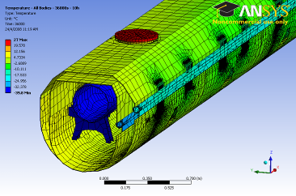
Simulations agreement!
In the past simulations were important to go from Type I to Type III
Transient shield conditions with good agreement with DESY CMTB data
EPAC08
5 K
70 K

Slide 13
5 K Shield Study
Measurements to explore the feasibility and consequences of removing the inner 5 K shield of the cryomodules
  a possible measure leading to
    some decrease in fabrication costs
    possible simplifications of the assembly operations
  cryogenic consequences?
  mitigations?
Concept tested at KEK on STF 6 m cryomodule
  heat load measurements w & w/o shield

Slide 14
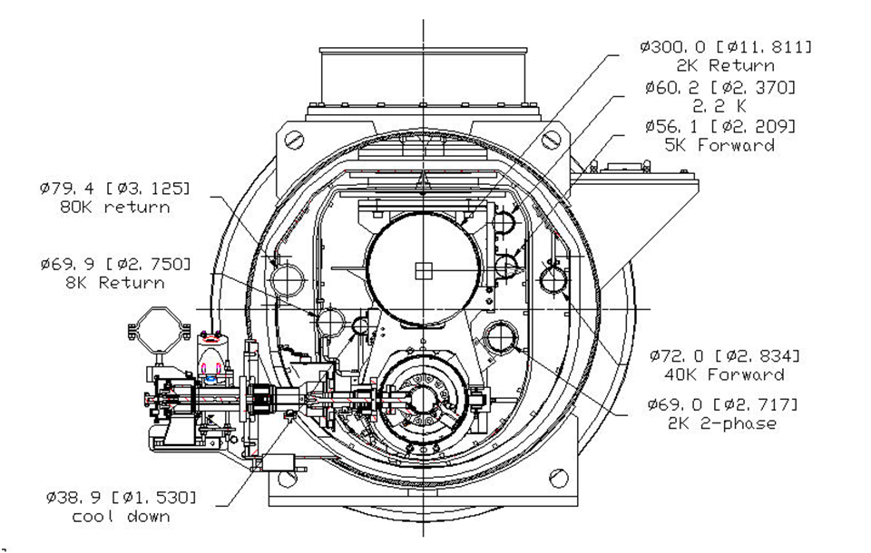
Type III TTF Module (STF variant)
Shield is also surface for thermalization of conduction path to the 2 K environment
“40-80 K” shield
Inner “5-8 K” shield
[radiation to 2 K is negligible]

Slide 15
Removal of bottom shield parts
Complete elimination not feasible
Only top part left
“40-80 K” shield

Slide 16
Heat load measurement
Heat loads were measured with and without bottom shield parts to support and validate heat load estimation obtained by FEM models
  cavities replaced by SS dummy vessels, no couplers
    Instrumented with T sensors
    Integral heat load by evaporated He flow
  Assess differences in heat loads to 2 K level in the two conditions
  Allows to derive emissivity coefficients in order to investigate a revised cooling scheme, to assess the possibility to remove portions of the 5 K shield

Slide 17
Measurements of 2 K load
Performed measurements with different static load conditions (varying LHe level)
  Removal of bottom shield leads to an increase of 0.78-0.80 W
5 K shield condition | Temp. LHe, K | T 5K shield, K | T 80K shield, K | LHe Evaporation g/s | Heat load, W
Full 5 K shield | 1.93 | 4.82 | 84.5 | 0.132 | 3.07
Without 5 K lower shield | 1.96 | 4.51 | 84.2 | 0.167 | 3.85
Full 5 K shield | 1.93 | 4.81 | 84.9 | 0.048 | 1.11
Without 5 K lower shield | 1.96 | 4.51 | 84.0 | 0.083 | 1.91

Slide 18
Measurements of shield loads
Stopping coolant flow (in each circuit independently) and measuring T rise of the thermal shields
  From the enthaply increase the average total heat load is derived
    5 K: 2.8 W
    80 K: 35.5 W
  Conductive heat load from the posts and sensor wires is then subtracted to derive radiation load
    5 K: 0.58 W (0.04 W/m²)
      Literature: 0.05-0.1 W/m²
    80 K: 25.1 W (1.5 W/m²)
      Literature: 0.5-1.2 W/m²

Slide 19
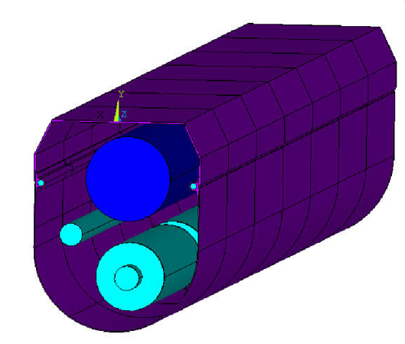
ANSYS 3D Model
Radiation model implemented into ANSYS with the values derived from exp.
  Removal of shield leads to 0.76 W increase
  well matched to measurements (0.78-0.80 W)
 | Vacuum vessel | 80 K shield outer/inner | 5 K shield outer/inner | GRP LHe sup. | Dummy vessel
Temperature, K | 300 | 84 | 5 | 2 | 2
Emissivity | 0.2 | 0.0035/0.06 | 0.02/0.06 | 0.03 | 0.2
Heat load [with 5K shield], W | NA | 27.2 | 0.68 | 0.19E-3 | 0.57E-3
Heat load [w/o 5K low shield], W | NA | 26.7 | 0.74 | 0.20 | 0.76

Slide 20
Alternative cooling scheme
Removing the bottom shield part in the present design leads to an increase of heat losses in the 2 K circuit
An alternative arrangement for the cooling circuit allows to avoid this heat load increase
RDR
  Forward Line (<54 K>)
    conduction load: HOM, HOM abs, input couplers
  Return Line (<74 K>)
    radiation load (pipe welded to the shield), supports, current leads and cables
Alternate (Flow reversal)
  Forward Line (<46 K>)
    radiation load (pipe welded to the shield)
  Return Line (<66 K>)
    conduction load: HOM, HOM abs, input couplers

Slide 21
Adoption of cooling scheme
Static load case for ILC reference module
 | Full set of 5 K shield |  |  | Without 5 K lower shield
 | 2 K | 5 K | 40 K | 2 K | 5 K | 40 K
Thermal radiation | < 0.001 | 1.14 | 54.4 | 0.10 | 0.18 | 54.6
Supports | 0.32 | 2.06 | 16.6 | 0.23 | 1.06 | 19.0
Input coupler | 0.26 | 1.29 | 17.6 | 0.26 | 1.60 | 16.8
HOM coupler (cables) | 0.01 | 0.22 | 1.81 | 0.01 | 0.27 | 2.03
HOM absorber | 0.14 | 3.13 | -3.27 | 0.14 | 3.13 | -3.27
Current leads | 0.28 | 0.47 | 4.13 | 0.28 | 0.47 | 4.13
Cables | 0.12 | 1.39 | 2.48 | 0.12 | 1.39 | 2.48
Sum | 1.13 | 9.70 | 93.8 | 1.14 | 8.10 | 95.8

Slide 22
Power consumption kept constant
W_{300K}/W_{2K} = 702.98, W_{300K}/W_{5-8K} = 197.94, W_{300K}/W_{40-80K} = 16.45.
Overall static/dynamic
 | Full set of 5 K shield |  |  | Without 5 K lower shield
 | 2 K | 5 K | 40 K | 2 K | 5 K | 40 K
Static load, W | 1.13 | 9.70 | 93.8 | 1.14 | 8.10 | 95.9
Dynamic load, W | 10.02 | 7.06 | 83.0 | 10.02 | 7.06 | 83.0
Sum (static +dynamic) | 11.15 | 16.76 | 176.8 | 11.16 | 15.16 | 178.9
Work at 300 K, W | 7838.2 | 3317.5 | 2908.4 | 7845.3 | 3000.8 | 2942.9
Sum (2K+5K+40K), W | 14064 |  |  | 13789

Slide 23
How can it be implemented?
To properly evaluate this cooling scheme for ILC the transverse cross section should be rearranged, “flipping” some cold mass components
  cross-section update (see next)
Concerning mere fabrication cost the bottom 5 K shield is very marginal (basically limited to material cost)
  We have to avoid introducing the long bulky braids which were used in the first generation TTF modules, that turned out to be very expensive

Slide 24
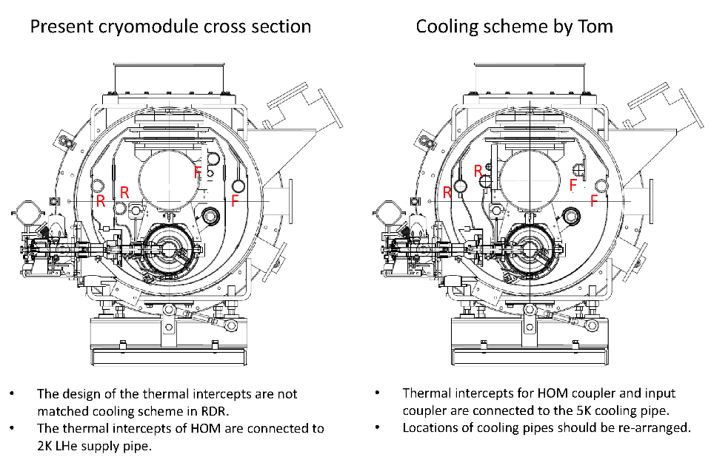
N.O. ILC CM 2011/5/24
9/26/2011
Grenada, LCWS2011
24

Slide 25
Summary
Static and Dynamic heat load estimations were confirmed with a very good agreement in the S1-Global experiment
  Thanks to the large amount of diagnostics planned and handled by the KEK team
  Once again a useful tools to compare design options with respect to thermal performances
    it was for Type I-Type II-Type III evolution
This provides solid ground towards ILC TDR activities
  e.g. include HL in plug-compatibility concept

