Slide 1
LHeC Superconducting RF challenges
D. Schulte for the LHeC team
TTC meeting, Beijing, December 2011

Slide 2
LHeC Goal
Collide LHC beam with electrons or positrons
  Required lepton energy is ≥60GeV
  Luminosity of ≈10³³cm⁻²s⁻¹
  Polarisation
  No interference with pp physics
  Detector acceptance down to 1°
  Power consumption for lepton complex ≤100MW
Study team provided draft of CDR this year
  Ring-ring option
  Linac-ring option
  Show that a solution exists, will now have to find the best solution
    Already have a baseline and alternatives for some components
See http://www.cern.ch/hec

Slide 3
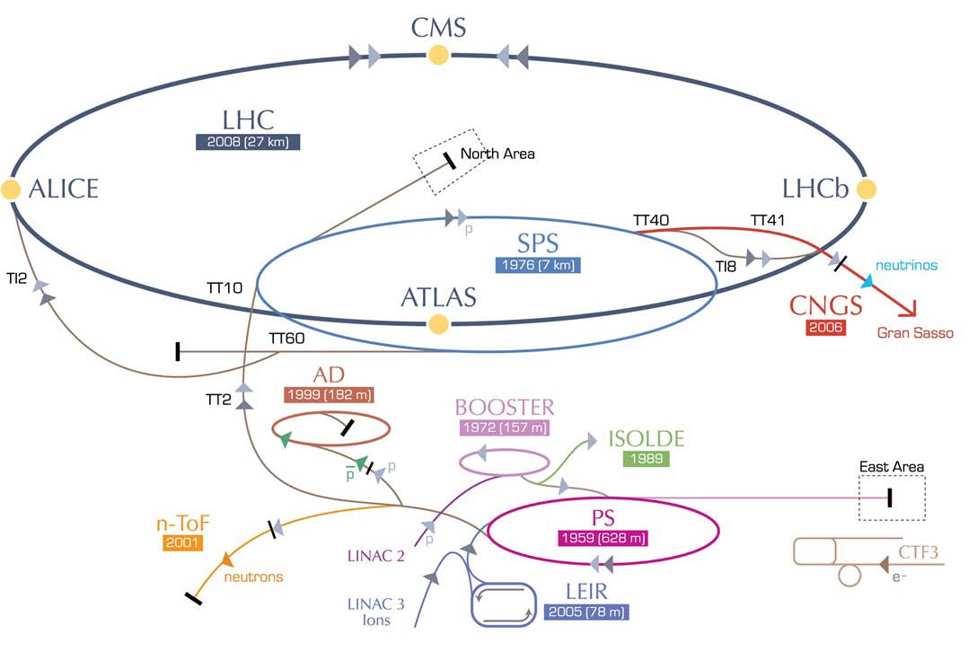
LHeC Options: Ring-ring and Linac-ring
RR LHeC:
new ring in
LHC tunnel,
with bypasses
around
experiments
RR LHeC
e-/e+ injector
10 GeV,
10 min. filling time
LR LHeC:
recirculating
linac with
energy
recovery,
or straight
linac

Slide 4



















Participating Institutes
TOBB ETU
KEK

Slide 5
CDR Authorlist 29.6.11
C. Adolphsen (SLAC)
S. Alekhin (Serpukhov, DESY)
H. Aksakal (CERN)
P. Allport (Liverpool)
J.L. Albacete (IPhT Saclay)
V. Andreev (LPI Moscow)
R. Appleby (Cockcroft)
N. Armesto (St. de Compostela)
G. Azuelos (Montreal)
M. Bai (BNL)
D. Barber (DESY)
J. Bartels (Hamburg)
J. Behr (DESY)
O. Behnke (DESY)
S. Belyaev (CERN)
I. Ben Zvi (BNL)
N. Bernard (UCLA)
S. Bertolucci (CERN)
S. Bettoni (CERN)
J. Bluemlein (DESY)
H. Boettcher (DESY)
S. Brodsky (SLAC)
A. Bogacz (Jlab)
C. Bracco (CERN)
O. Bruening (CERN)
A. Bunyatian (DESY)
H. Burkhardt (CERN)
R. Calaga (BNL)
E. Ciapala (CERN)
R. Ciftci (Ankara)
A.K.Ciftci (Ankara)
B.A. Cole (Columbia)
J.C. Collins (Penn State)
J. Dainton (Liverpool)
A. De Roeck (CERN)
D. d'Enterria (CERN)
A. Dudarev (CERN)
A. Eide (NTNU)
E. Eroglu (Uludag)
K.J. Eskola (Jyvaskyla)
L. Favart (IIHE Brussels)
M. Fitterer (CERN)
S. Forte (Milano)
P. Gambino (Torino)
T. Gehrmann (Zurich)
C. Glasman (Madrid)
R. Godbole (Tata)
B. Goddard (CERN)
T. Greenshaw (Liverpool)
A. Guffanti (Freiburg)
C. Gwenlan (Oxford)
T. Han (Harvard)
Y. Hao (BNL)
F. Haug (CERN)
W. Herr (CERN)
B. Holzer (CERN)
M. Ishitsuka (Tokyo I.Tech.)
M. Jacquet (Orsay, LAL)
B. Jeanneret (CERN)
J.M. Jimenez (CERN)
H. Jung (DESY)
J. Jowett (CERN)
D. Kayran (BNL)
F. Kosac (Uludag)
A. Kilic (Uludag}
K. Kimura (Tokyo I.Tech.)
M. Klein (Liverpool)
U. Klein (Liverpool)
T. Kluge (Hamburg)
G. Kramer (Hamburg)
M. Korostelev (Cockcroft)
Kosmicki (CERN)
P. Kostka (DESY)
H. Kowalski (DESY)
M. Kuze (Tokyo I.Tech.)
T. Lappi (Jyvaskyla)
P. Laycock (Liverpool)
E. Levichev (BINP)
S. Levonian (DESY)
V.N. Litvinenko (BNL)
C. Marquet (CERN)
B. Mellado (Harvard)
K-H. Mess (CERN)
S. Moch (DESY)
I.I. Morozov (BINP)
Y. Muttoni (CERN)
S. Myers (CERN)
P.R. Newman (Birmingham)
T. Omori (KEK)
J. Osborne (CERN)
E. Paoloni (Pisa)
C. Pascaud (LAL Orsay)
H. Paukkunen (St. de Compostela)
E. Perez (CERN)
T. Pieloni (CERN)
E. Pilic (Uludag)
A. Polini (Bologna)
V. Ptitsyn (BNL)
Y. Pupkov (BINP)
V. Radescu (Heidelberg U)
S. Raychaudhuri (Tata)
L. Rinolfi (CERN)
R. Rohini (Tata India)
J. Rojo (Milano)
S. Russenschuck (CERN)
C. A. Salgado (St. de Compostela)
K. Sampai (Tokyo I. Tech)
E. Sauvan (Lyon)
U. Schneekloth (DESY)
T. Schoerner Sadenius (DESY)
D. Schulte (CERN)
N. Soumitra (Torino)
H. Spiesberger (Mainz)
A.M. Stasto (Penn State)
M. Strikman (Penn State)
M. Sullivan (SLAC)
B. Surrow (MIT)
S. Sultansoy (Ankara)
Y.P. Sun (SLAC)
W. Smith (Madison)
I. Tapan (Uludag)
P. Taels (Antwerpen)
H. Ten Kate (CERN)
J. Terron (Madrid)
H. Thiesen (CERN)
L. Thompson (Cockcroft)
K. Tokushuku (KEK)
R. Tomas Garcia (CERN)
D. Tommasini (CERN)
D. Trbojevic (BNL)
N. Tsoupas (BNL)
J. Tuckmantel (CERN)
K. Tywoniuk (Lund)
G. Unel (CERN)
J. Urakawa (KEK)
P. Van Mechelen (Antwerpen)
R. Veness (CERN)
A. Vivoli (CERN)
P. Vobly (BINP)
R. Wallny (ETHZ)
G. Watt (CERN)
G. Weiglein (Hamburg)
C. Weiss (JLab)
U.A. Wiedemann (CERN)
U. Wienands (SLAC)
F. Willeke (BNL)
V. Yakimenko (BNL)
A.F. Zarnecki (Warsaw)
F. Zimmermann (CERN)
F. Zomer (Orsay LAL)

Slide 6
LHeC Ring-ring Option
 | protons | electrons
beam energy [GeV] | 7000 | 60
Luminosity [cm⁻²s⁻¹] | 0.85 (1.8) 10³³
Norm. emittance γε_{x}/γε_{y} [μm] | 3.75 / 3.75 | 590 / 295
RMS IP beam size σ*_{x,y} [μm] | 45 (30) / 22 (15.8)
bunch spacing [ns] | 25 | 25
bunch population | 1.7x10¹¹ | 2x10¹⁰
Add an electron/positron ring in the LHC tunnel
  Originally foreseen with LEP
Hence, no fundamental feasibility issues
  But have to avoid running through the LHC detectors
  Have to install new hardware in reasonably full tunnel
  Have to find a good collision point geometry

Slide 7
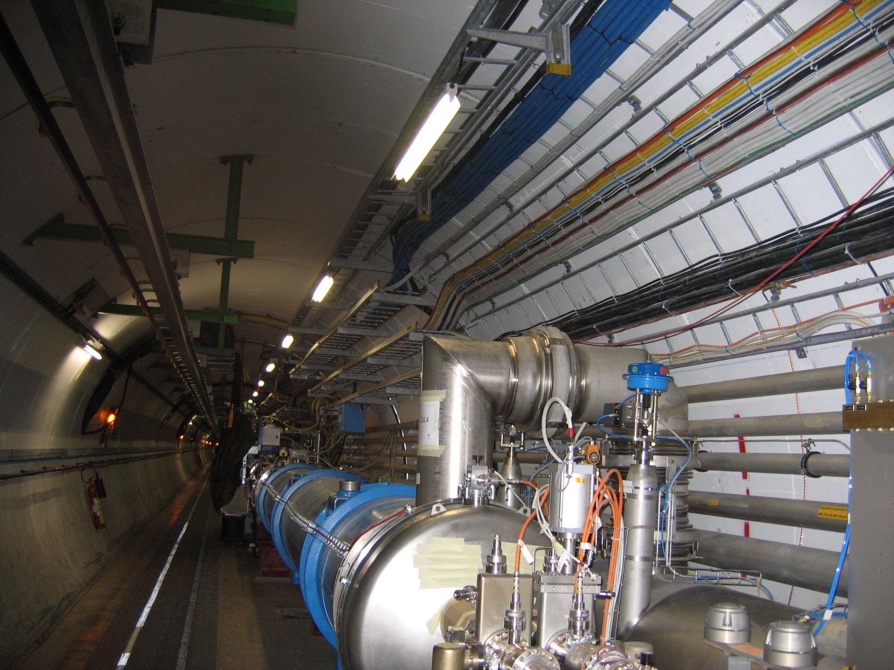
The jumpers come in a regular pattern
The e-ring optics takes these positions into account

Slide 8
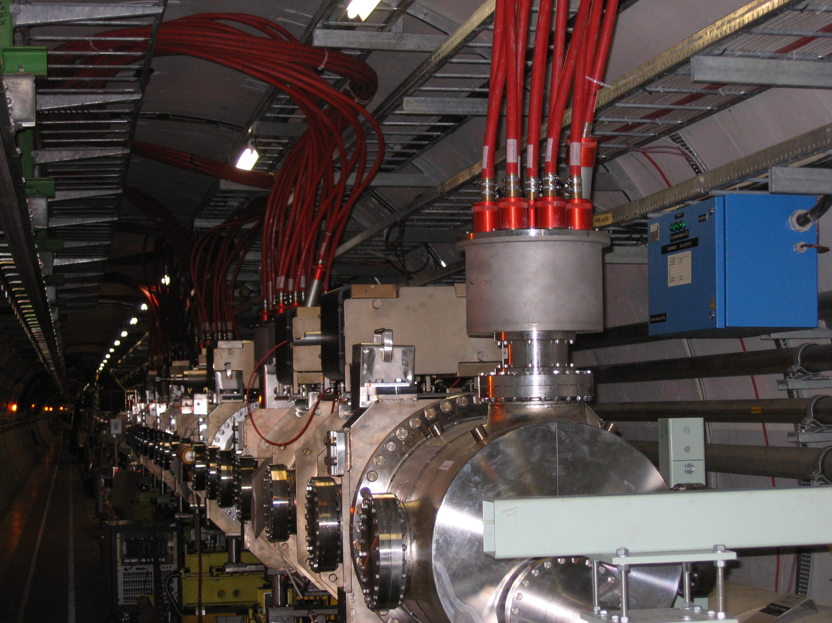
Kicker at point 6
Magnet support from above (steel roman arch) will be needed to bridge the kickers

Slide 9
LHeC: Linac-Ring Options
p-60
erl
1.67 km
LHC p
injector
0.34 km
dump
10-GeV linac
injector
30-GeV linac
IP
dump
2.0 km
“least expensive"
LHC p
1.0 km
high
luminosity
p-140
10-GeV linac
IP
2.0 km
LHC p
3.9 km
injector
70-GeV linac
IP
dump
high
energy
p-140’
7.8 km
IP
injector
140-GeV linac
dump

Slide 10
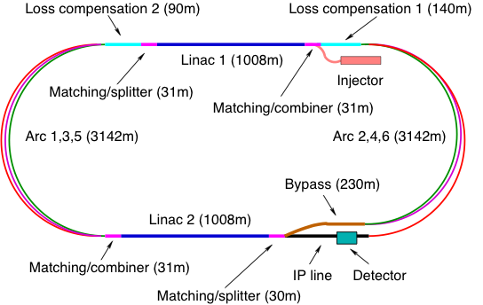
LHeC Layout

Slide 11
IP Parameters (ERL Option)
 | protons | electrons
beam energy [GeV] | 7000 | 60
Luminosity [cm⁻²s⁻¹] | 10³³
normalized emittance γε_{x,y} [μm] | 3.75 | 50
rms IP beam size σ*_{x,y} [μm] | 7 / 7
bunch spacing [ns] | 25 or 50 | 50
bunch population | 1.7x10¹¹ | 2x10⁹
Electron beam power is about 400MW >> 100MW consumption
-> energy recovery

Slide 12
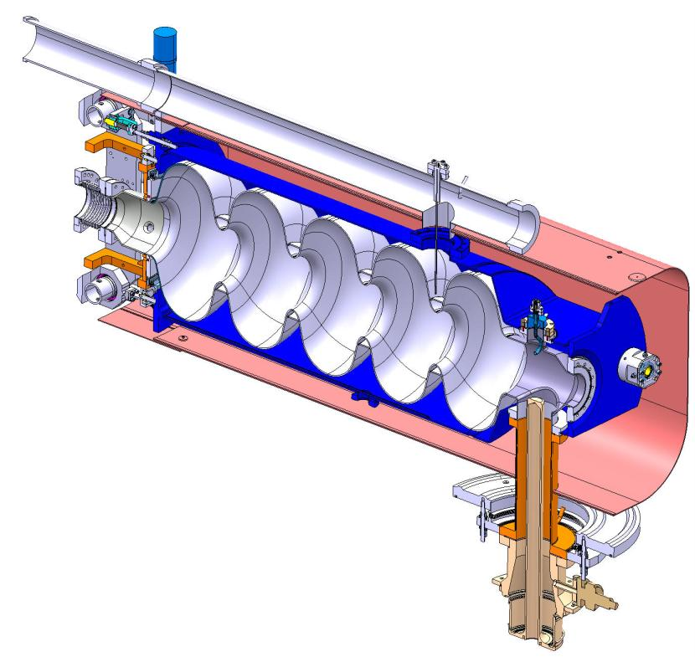
Linac Cavity Design
Helium Tank
Bulk Niobium 5-cells Cavity
HOM Coupler
Tuner
Magnetic Shielding
Power Coupler
721.42MHz, 1.06m, 570Ω (linac convention), 20GV/m
  Q₀=2.5 10¹⁰ assumed, R=1.43 10¹³Ω (ILC: R=1.04 10¹³Ω)

Slide 13
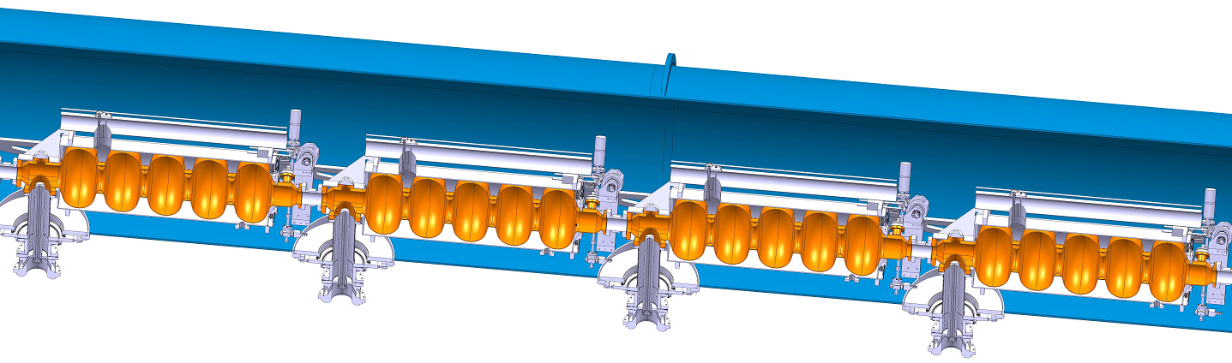
Linac Design
8 cavities per 14m long module
2 modules per quadrupole pack (2m)
59 modules per 900m long linac
Beam physicists assumed slightly different parameters (and only 18MV/m)

Slide 14
Linac Lattice
Lattice is optimised for beam stability
Alternative optics exists
no focusing in linac

Slide 15
Arc Design
Lattice exist for all 6 arcs
alternatives exist
Synchrotron radiation is OK for emittance
A. Bogacz
Total of 1440 quadrupoles
3600 4m-long bends
Magnet designs exists

Slide 16
Energy Loss
Energy loss due to synchrotron radiation in arcs
ρ=764m
Total loss about 1.9GeV
i.e. 12.2MW beam power

Slide 17
Power Consumption
Cryo power of linacs
  21 MW
  Depends on cavity and gradient
RF power to control linacs
  24 MW
  Microphonics, phase stability, …
Synchrotron radiation loss compensation RF
  20 MW
  Can be calculated reliably
  Include cryogenics etc for this part of the linacs
Injector and other consumers
  Depends on injection energy, hence wakefields etc.

Slide 18
Energy Compensation Linacs
Twice the frequency of main linacs (1.4428GHz)
  Have to accelerate both beams
  Gradient ≤ 10MV/m, power per cavity ≤ 130kW
  2 cavities per klystron (O(300kW))
  Could use beating frequencies as well
    E.g. 842MHz ML and 741MHz compensation
The linac at 60GeV can be same as main linacs
  But need significant RF input power
  4 cavities per klystron (O(700kW))
RF to beam efficiency 60% (use of klystrons)
  12.2MW power to beam -> total grid power 20.3MW
  Plus cooling (few % of main linacs)

Slide 19
Alternative Scheme
Change beam phase for different turns
  Adjusting arc lengths
Requires similar total RF power as energy compensation linacs
  but distributed over linacs

Slide 20
Linac RF Power
Power recovery inefficiency | 4%
Loaded Q | 4.7 10⁷
Compensating RF power required per cavity | 16.8kW
Transmission losses | 7%
RF power needed per cavity | 17.9kW
Total RF power | 17MW
Wall plug to RF power efficiency | 70%
Total power | 24MW
One solid state amplifier per cavity

Slide 21
Linac Cooling
Load from accelerating RF
  R/Q = 570 Ω (linac convention)
  Gradient 20MV/m
  Q₀=2.5 10¹⁰
  31.5W/cavity
  Cooling inefficiency factor 700
  944 cavities
  Yields 21 MW expected cooling (dynamic heat load)
Need to evaluate other cryo-loads
  Beam induced HOM 0.1W in ILC RDR
  Small correction for static heat load

Slide 22
Multi-bunch Beam Break-up
SPL cavity dipole modes used (thanks to M. Schuh)
Q=10⁵
0.1% mode detuning
Longitudinal modes need also to be studied
Beam is stable
Strong effect for Q=10⁶
Current design not stable with
Tesla Cavity, would need Q=O(10³)

Slide 23
Multi-bunch Beam Break-up
Damping and detuning are essential
Q=10⁶ would not be OK

Slide 24
Fast Beam-ion Instability
Ions are trapped if f_{c}<f_{limit}
Frequency f_{c} is shown for continuous train
-> All gases are trapped
-> likely will need to add a gap in the train

Slide 25

Beam Pulse
Could use 20μs trains and 10μs gaps
  Beam loading in injectors 0.6% for 720MHz cavities
  Increase bunch charge by 50%
  This fixes LHeC circumference to be 1/n of LHC
    Each LHC bunch always or never collides with electron bunches
Need to study consequences on RF
Still need good vacuum (O(10⁻¹¹hPa)) in linacs, more study needed

Slide 26
Design Choices
Fundamental is RF frequency and cavitiy design
No optimisation for cost/power consumption performed yet
  Expect better efficiency at 720MHz than at 1.3GHz
  Frequency should be harmonic of 40MHz
  Worth to study two frequencies: O(700MHz) and O(1.3GHz)
Frequency choice is coupled to choice of cavity design
  R/Q ,Q_{0,} Q_{L}, beam phases and frequency errors
  Wakefields and damping, transverse RF kicks
  …
Could use 1.322 GHz (33 buckets/25ns)
  Will have to address transverse wakefields effects
    Currently too high
  But might be cheaper
  Energy compensation could be at 1.2024GHz, 1442.8GHz or 2.6452 GHz

Slide 27
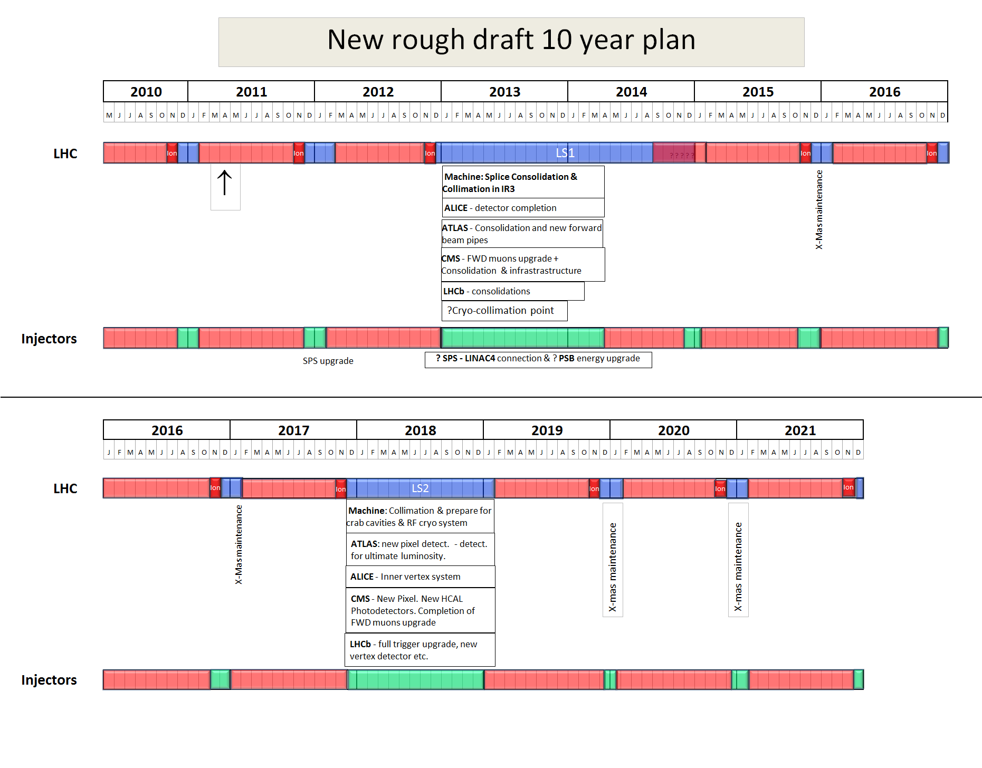
Not yet approved!
2022
LS3
Installation of the HL-LHC hardware
EPS-HEP, 23 July 2011, Grenoble
Oliver Brüning CERN

Slide 28
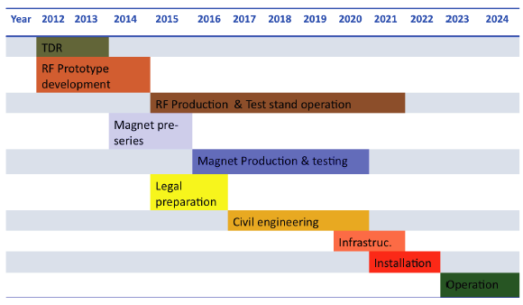
LHeC Tentative Time Schedule
Oliver Brüning CERN, EPS-HEP, 23 July 2011, Grenoble
LS3 --- HL LHC

Slide 29
R&D Needs
Very challenging schedule
  Need to be based on existing designs where possible
Actual design, prototyping and test of components and cost reduction/improvement
  Cavities
  Microphonics suppression
  Couplers
  Modules
  Amplifiers
  …
Beam dynamics studies

Slide 30
Conclusion
LHeC appears feasible
But significant room for optimisation
  Basic parameter choices
Need to develop components
  Actual performance tests
And improve them
Beam studies need to be continued and improved
Your help will be valuable

Slide 31
Reserve

Slide 32
IP Parameters (ERL option)
 | protons | electrons
beam energy [GeV] | 7000 | 60
Lorentz factor γ | 7460 | 117400
normalized emittance γε_{x,y} [μm] | 3.75 | 50
geometric emittance ε_{x,y} [nm] | 0.50 | 0.43
IP beta function β*_{x,y} [m] | 0.10 | 0.12
rms IP beam size σ*_{x,y} [μm] | 7 | 7
rms IP divergence σ’_{x,y} [μrad] | 70 | 58
beam current [mA] | ≥430 | 6.6
bunch spacing [ns] | 25 or 50 | 50
bunch population | 1.7x10¹¹ | 2x10⁹
crossing angle | 0.0

Slide 33
LHeC Ring-ring Option Parameters

Slide 34
Interaction Region

Slide 35
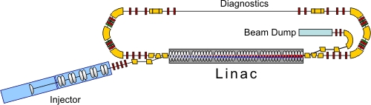
BERLinPro

Slide 36
Fast Beam-ion Instability
Trapping can be avoided by using a gap in the beam
Ions are lost if
|tr(M)|>2
Ion are removed almost everywhere

Slide 37
Linac Cavity Design
Close to SPL design
  RF frequency is 721.42MHz
    Corresponds to 18 buckets per 25ns (shortest LHC bunch spacing)
  Cavities have 5 cells, i.e. 1.06m long
  R/Q = 570 Ω (linac convention)
  Gradient of 20MV/m (CW)
  Q₀=2.5 10¹⁰ assumed
    Challenging but eRhIC results are encouraging
    Roughly comparable to 10¹⁰ for 1.3GHz
  ILC: R=1.04 10¹³Ω, LHeC: R=1.43 10¹³Ω

