Slide 1
HF rinsing studies of 1.3 GHz single cells
A. Romanenko

Slide 2
Motivation
Anodizing experiments (Eremeev et al, SRF’2005, TuAO8; Ciovati et al, PRST AB 10, 062002 (2007)) demonstrated that the depth of the layer modified by 120C baking is about 20 nm
Distribution of lossy layers within this depth can be explored by step-by-step material removal
HF rinsing as a tool for that
Maybe maximization of medium Q0 possible in the process – “selecting” the highest Q layer

Slide 3
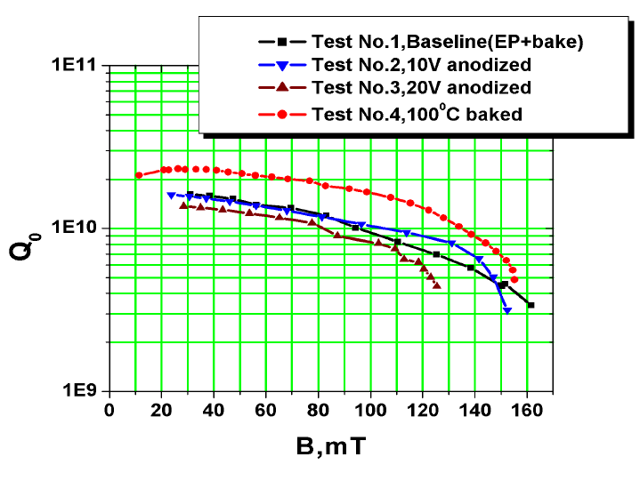
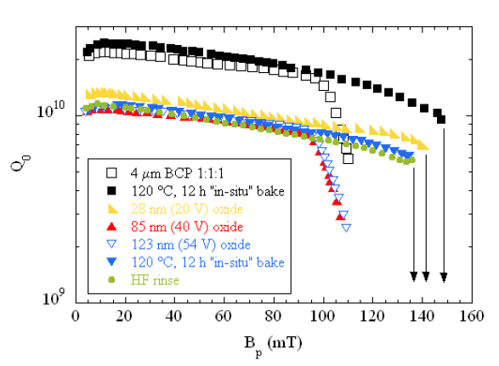
Anodizing experiments
Eremeev et al, SRF’2005, TuAO8
Fine grain EP cavity
Ciovati et al, PRST AB 10, 062002 (2007)
Large grain BCP cavity

Slide 4
HF rinse - principle
Nb
Water rinse grows new oxide layer
Nb₂O₅
~5nm
Nb₂O₅
HF acid dissolves natural oxide layer
Nb
~2nm
RF layer
Nb
RF layer
RF layer
~2nm
Each HF/water rinse step consumes about 2 nm of niobium from the top of the RF layer determining the surface resistance and moves deeper into the bulk – depth profiling of the losses

Slide 5
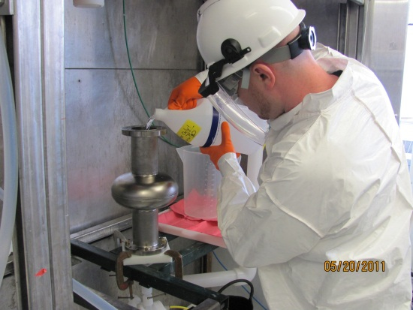
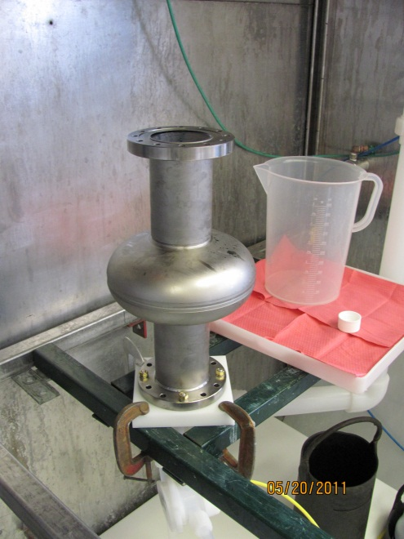
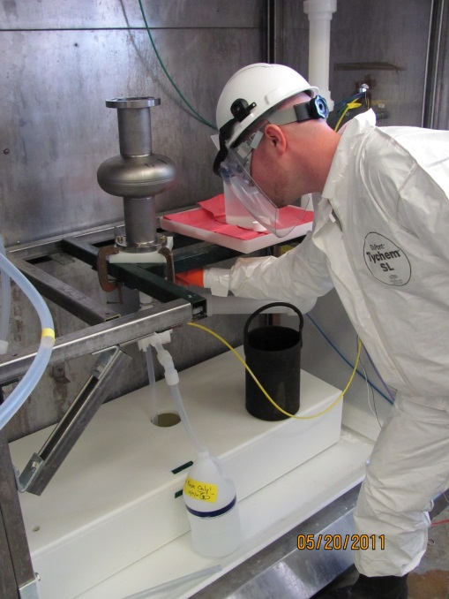
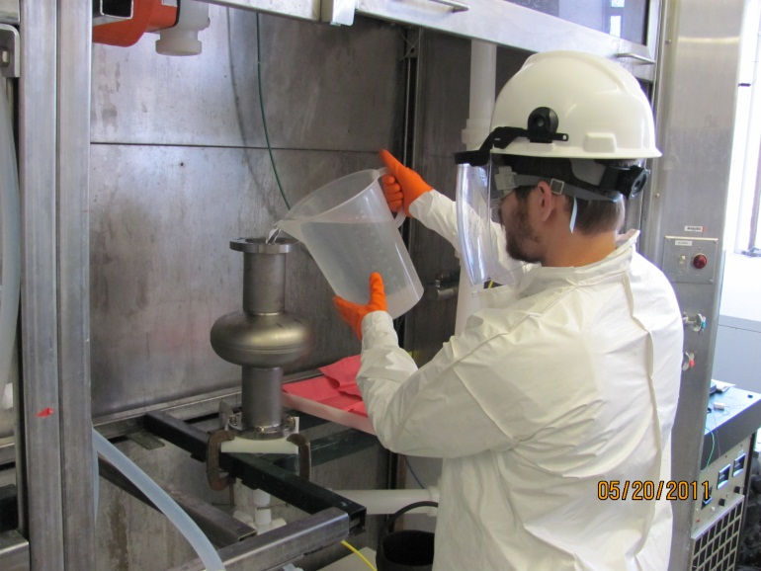
HF rinse procedure
Filling with HF
5 minutes hold
HF dumping
DI water rinse

Slide 6
Reproducibility

Slide 7
Results on EP fine grain (tumbled)
Single HF rinse after mild baking significantly improves medium field Q0
Multiple HF rinse cycles do bring the high field Q-slope back
Onset field is still higher than before baking by ~25 mT after total 5 HF rinse cycles
Further rinses in queue

Slide 8
Results on EP fine grain cavity
Single HF rinse improves low and medium field Q0
Six HF rinses do bring the high field Q-slope back but with the higher onset (~125 mT vs 100 mT)

Slide 9
Results on BCP fine grain cavity
Single and double HF rinse cycles significantly improve medium field Q0
High field Q-slope is present after mild baking

Slide 10
Development of higher Q recipe for Project X
35%
30%
T=2K
T=2K
FNAL single cell data -> single HF rinse (5 min) followed by water rinse is beneficial for the medium field Q value – gains of up to 35% measured at 70 mT
11%
T=2K

Slide 11
Possible interpretation
Literature – 120C enhances residual resistance; possibly due to suboxide formation
Single HF rinsing and regrowing oxide – restores residual resistance to pre-bake state while keeping the improvement in R_{BCS}
After 120C
+HF rinse
Nb
Nb₂O₅
~5nm
Nb
Nb₂O₅
Baking modified - no HFQS losses
Baking modified - no HFQS losses
Layer of high residual losses
+5 HF rinses
Nb₂O₅
~20nm
An estimate of the remaining thickness from the HFQS onset:
125 mT * exp (-h/λ) = 100 mT => h~8nm
B=B₀exp(-z/λ)
Bulk – susceptible to HFQS
losses
Bulk – susceptible to HFQS
losses
Bulk – with HFQS
losses

Slide 12
Conclusion
HF profiling results are so far consistent with the layer of 10-20 nm being modified by mild baking
Practically - single HF rinse/DI water rinse after 120C mild baking appears to be a simple route to increase the medium field Q₀ by 10-35% in fine grain cavities
Important for Project X and other CW projects

Slide 13
Acknowledgements
J. Ozelis – cavity testing
A. Rowe, D. Bice, T. Reid, R. Murphy – cavity processing

