Slide 1

Extended Brueckner Hartree-Fock theory for nuclear matter with realistic nucleon-nucleon interaction
Jinniu Hu
Collaborators:
Hiroshi Toki (RCNP, Osaka University)
Yoko Ogawa (RCNP, Osaka University)
Hong Shen (Nankai University)
International symposium on frontiers in nuclear physics@ BeihangUniversity, Beijing

Slide 2
Outline
Introduction
Extended Brueckner Hartree-Fock theory
Numerical results
Conclusion

Slide 3
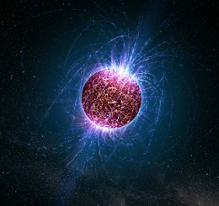
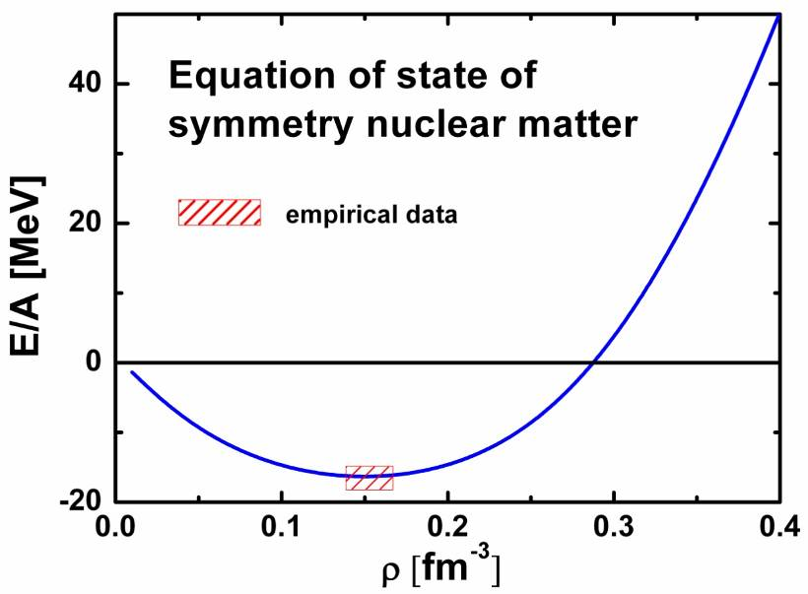
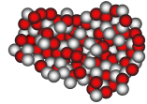
Introduction
Neutron star and supernovae
  natural laboratories…
Nuclear matter
  Definition: an infinite uniform system of nucleons interacting through the strong force
  pure neutron matter (δ=0)
  symmetric nuclear matter (δ=1)
Nucleon-nucleon (NN)
interaction
Many-body theory
2011/11/2

Slide 4
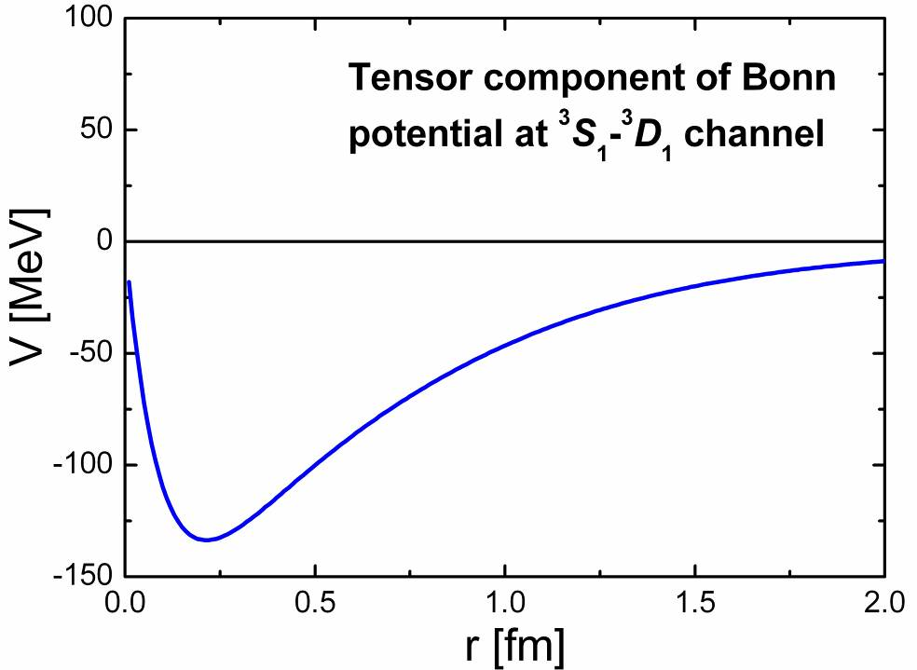
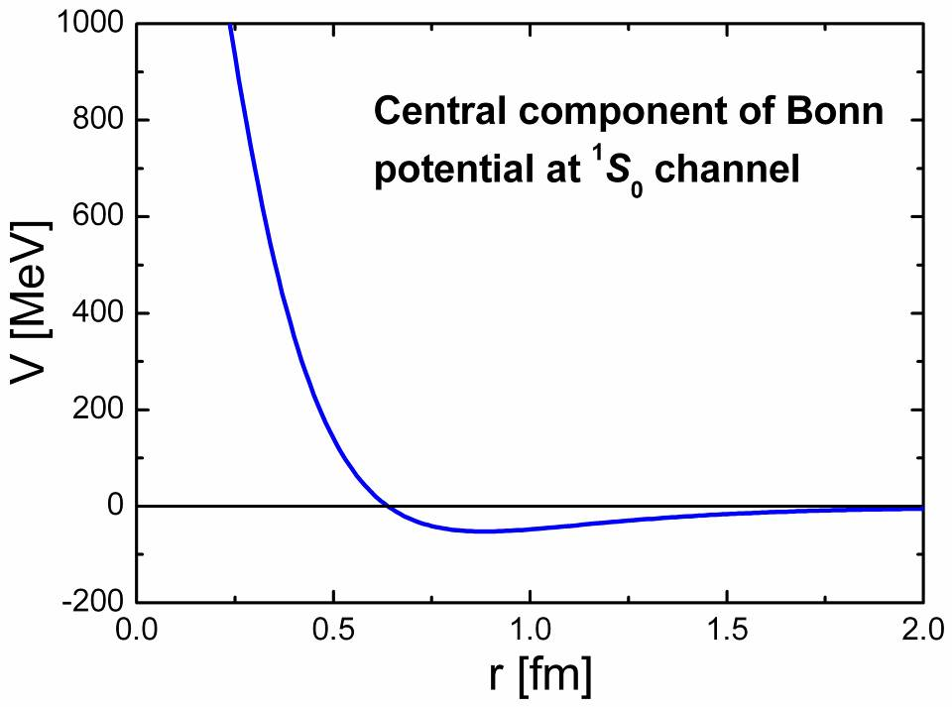
NN interaction
How do we know?
  Quantum chromodynamics (QCD)
    Very difficult…
  NN scattering
    Bonn potential, AV18
Two important characters:
strong tensor force
(isospin dependence)
b. strong repulsion at short
range distance between
two nucleons for central
part (isospin independence)

Slide 5
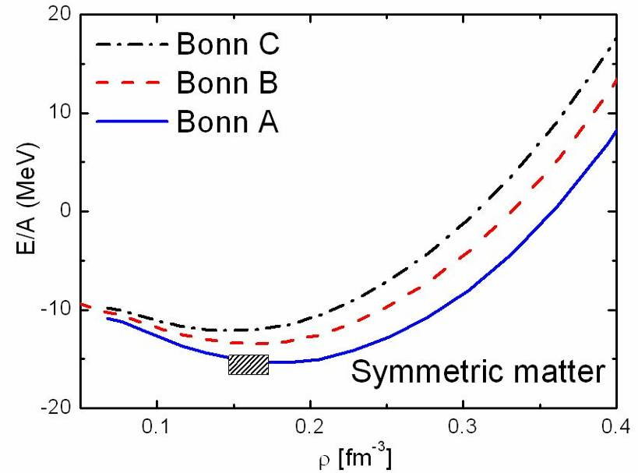
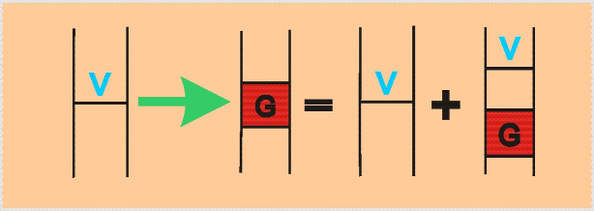
Many-body theory for nuclear matter
Brueckner Hartree-Fock
(BHF) theory
√ Accurate for nuclear matter
× Too difficult for finite nuclei
R. Brockmann et al. PRC42(1990)1965
It is very hard to distinguish the role of tensor force and short range correlation in BHF theory

Slide 6
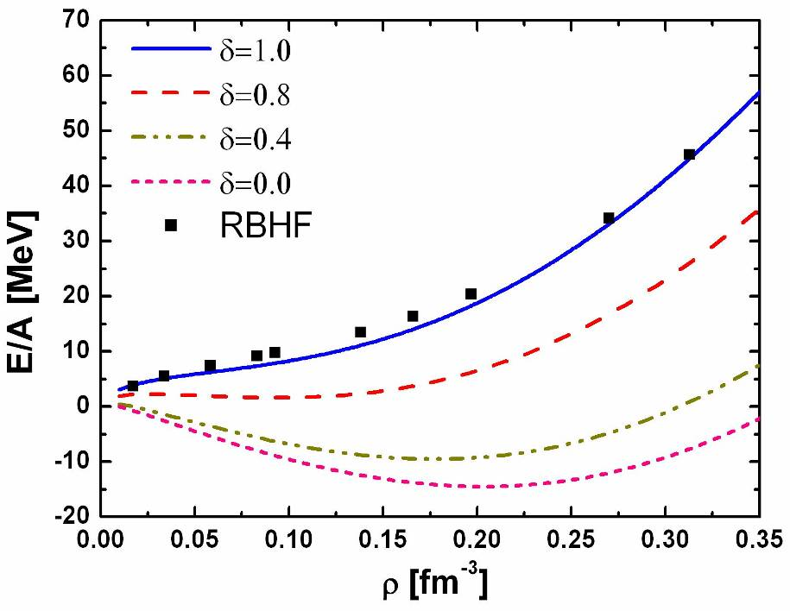
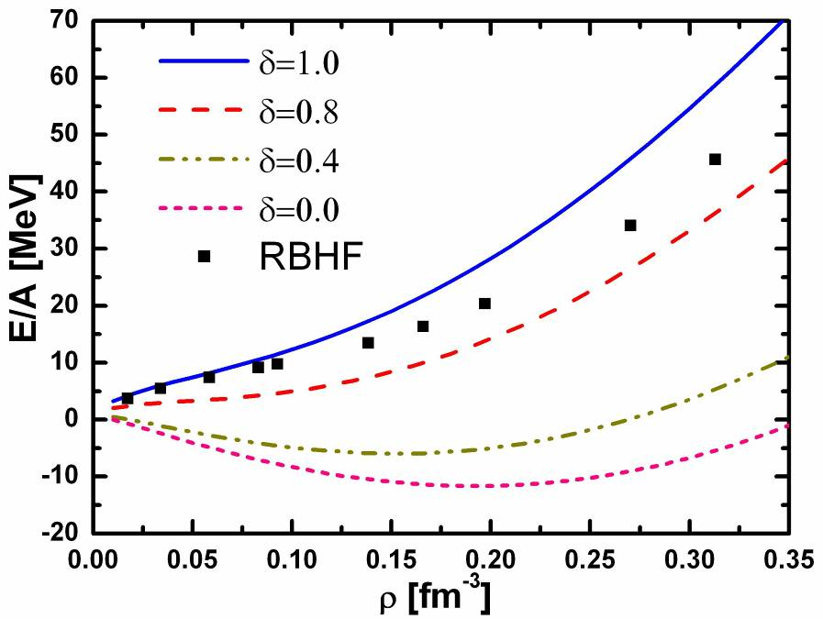
Short range correlation for nuclear matter
Relativistic Hartree-Fock
UCOM method
C is a unitary correlation operator
J. Hu et al. Phys. Lett. B 687(2010)271
Relativistic Hartree-Fock
Jastrow method
f(c) is the central correlation function
J. Hu et al. J. Phys. G 38(2011)085105

Slide 7
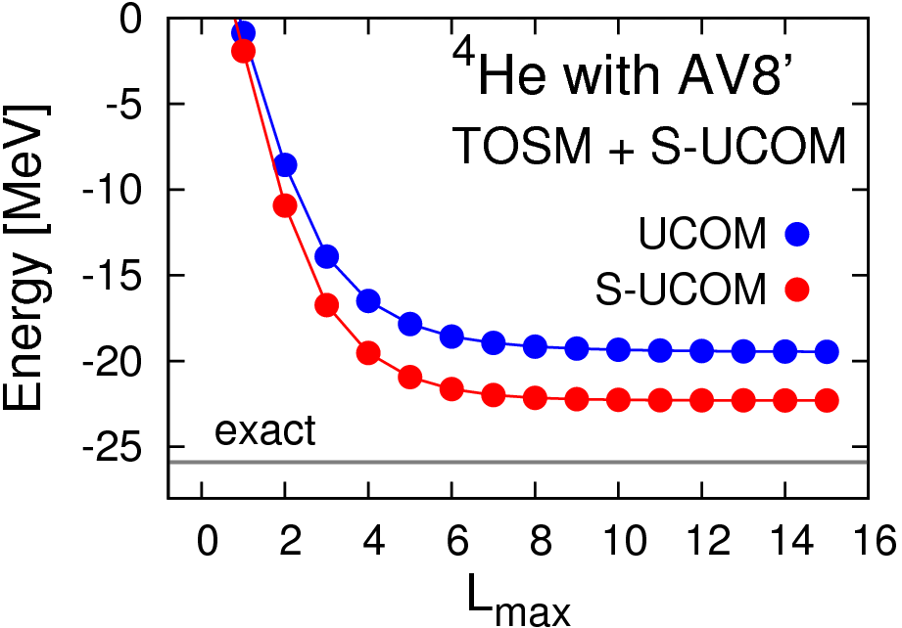
How to deal with tensor force
Tensor optimized shell model
(TOSM) for light nuclei
Tensor force due to 2p-2h states
T. Myo et al. PTP 121(2009)511
Chiral Mean Field model for finite nuclei
Ogawa et al. PTP122(2009)477
Extended Brueckner Hartree-Fock formula for finite nuclei
Ogawa et al. Ann. Phys. 326(2011)2039

Slide 8
Motivation
We hope to construct a new framework
which can deal with both nuclear matter
and finite nuclei.
This work
We establish extended Brueckner Hartree-Fock theory for nuclear matter with realistic NN interaction, where the short range correlation and tensor force can be treated in 2p-2h states.

Slide 9
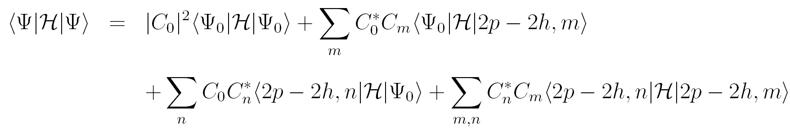
The extend Brueckner Hartree-Fock theory
The Hamiltonian of nuclear matter system
Nuclear wave function
Total energy

Slide 10
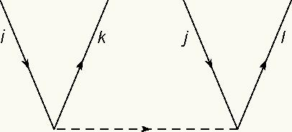


Matrix elements
Between 0p-0h and 0p-0h states
Between 0p-0h and 2p-2h states
Between 2p-2h and 2p-2h states
is the single particle energy

Slide 11
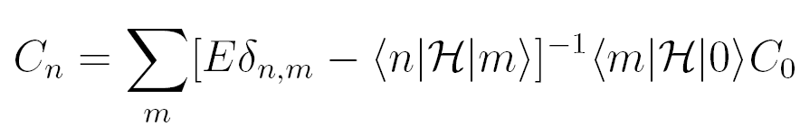
Variational principle
about the coefficient
about the hole states
We can obtain,
Equation of motion for single state

Slide 12
Extended Brueckner Hartree-Fock theory
Equivalent form of equation of motion
Similar to G-matrix
Effective interaction in EBHF theory
G-matrix in BHF theory

Slide 13
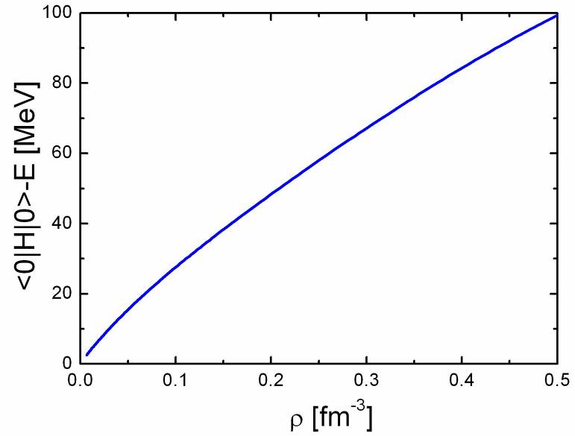
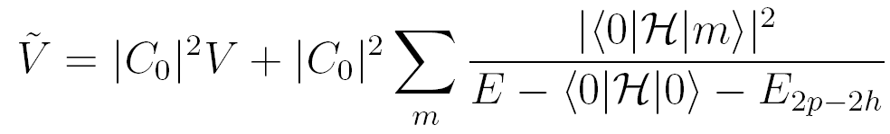
Diagonal approximation
Equation of motion
Effective interaction
Total energy

Slide 14
Numerical results
Single particle energy
EOS of symmetric
nuclear matter for
Bonn B potential
Saturation properties are improved!

Slide 15
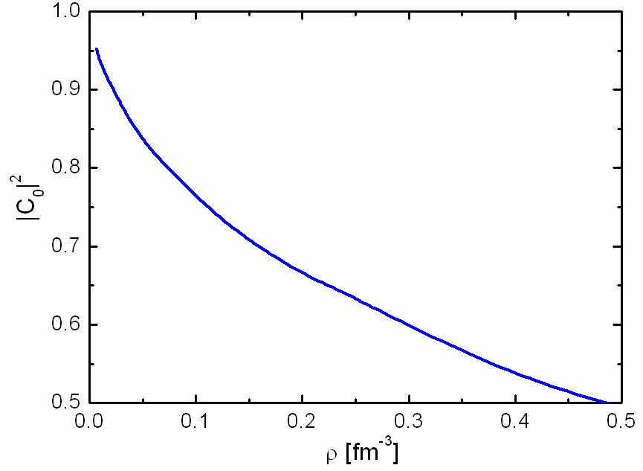
Vector potential and
Scalar potential in
REBHF theory
The coefficients of 0p-0h states
The more 2p-2h states
are needed in relativistic
case

Slide 16
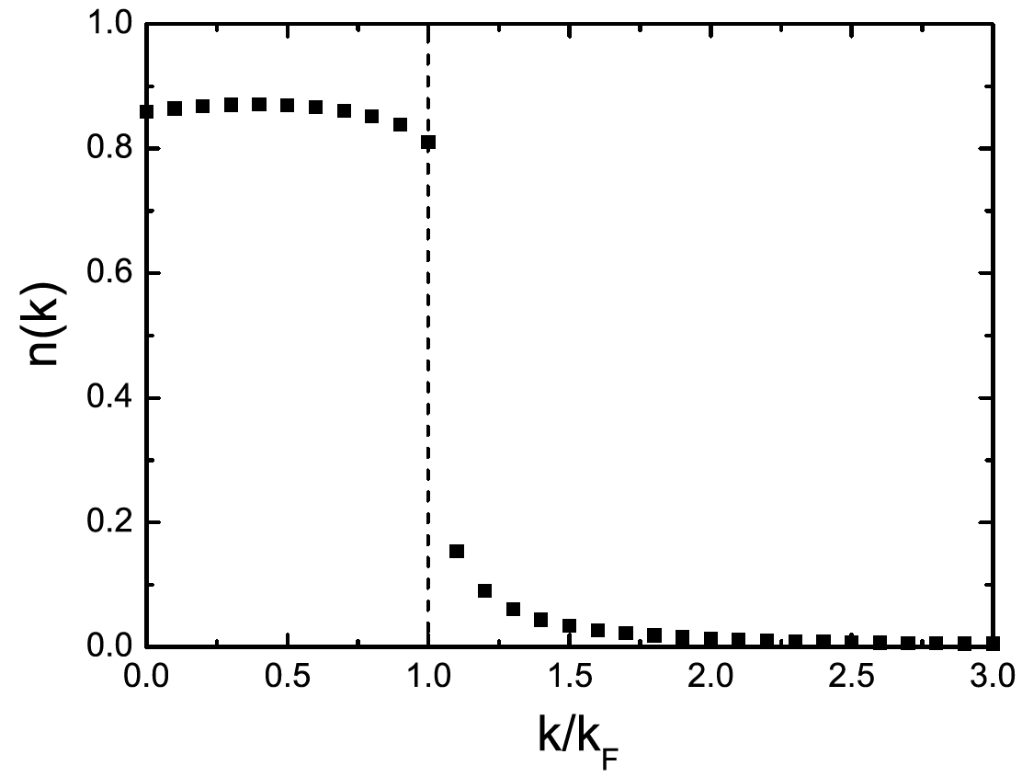
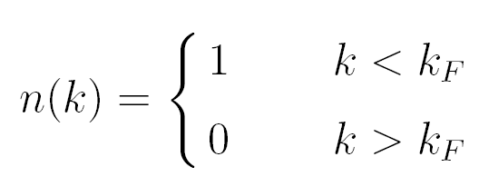
The momentum distribution
In Brueckner Hartree-Fock theory
In EBHF theory

Slide 17
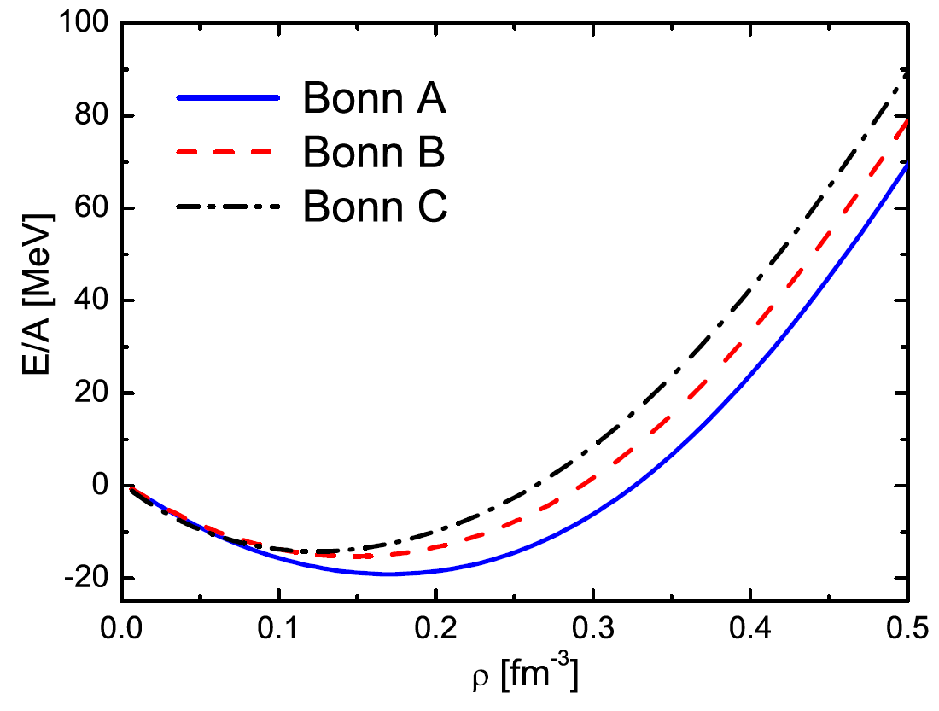
EOS of symmetric
nuclear matter for
Bonn A, B, C potentials
The empirical saturation properties
Bonn B is the best one!

Slide 18
The EOS of pure neutron matter with Bonn potentials
They are almost identical because the tensor
effectis very small in T=1 isospin channel.

Slide 19
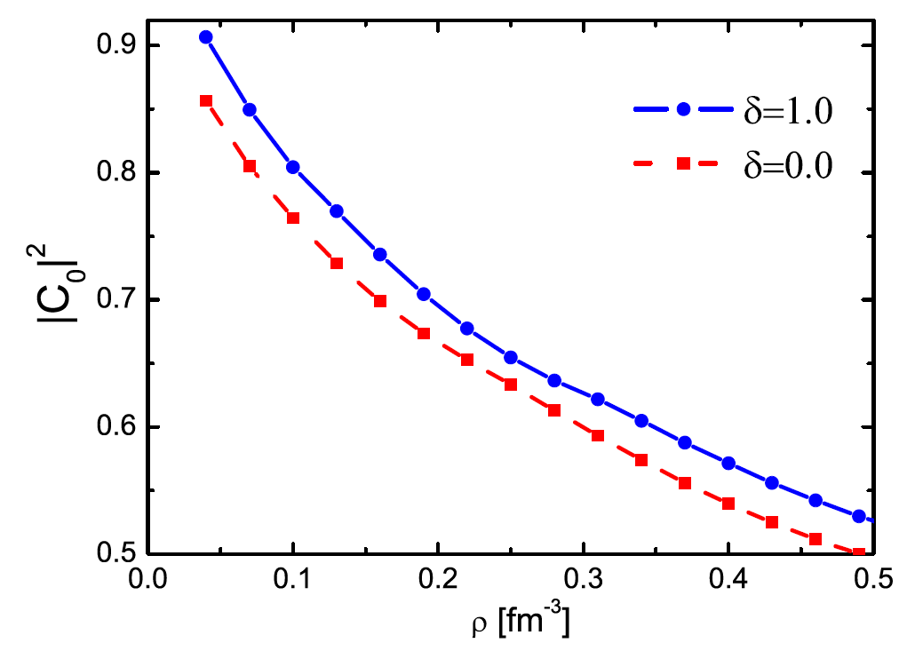
The coefficients C₀ in symmetric nuclear matter
( ) and pure neutron matter ( )
The 2p-2h correlation in pure neutron matter is
weaker than the one in symmetric nuclear matter

Slide 20
The effective nucleon mass in symmetric nuclear
matter ( ) and pure neutron matter ( )
The effective nucleon mass in symmetric nuclear
matter is smaller than the one in pure neutron matter

Slide 21
Conclusion
We have formulated EBHF theory for nuclear matter with a realistic NN interaction
We also applied this theory to nuclear matter in relativistic framework
a. The empirical saturation properties are reproduced
b. The momentum distribution is obtained.
c. We calculated the neutron matter case.
We have included the high momentum components explicitly in our theory. We hope that the experiment can measure them.
Future work
The off-diagonal terms of 2p-2h matrix elements will be contained
We can apply our theory to hyperon nuclear matter and study the properties of neutron star.
We can extend our theory to calculate the finite nuclear system.

Slide 22
Thank you very much
for your attention!

Slide 23
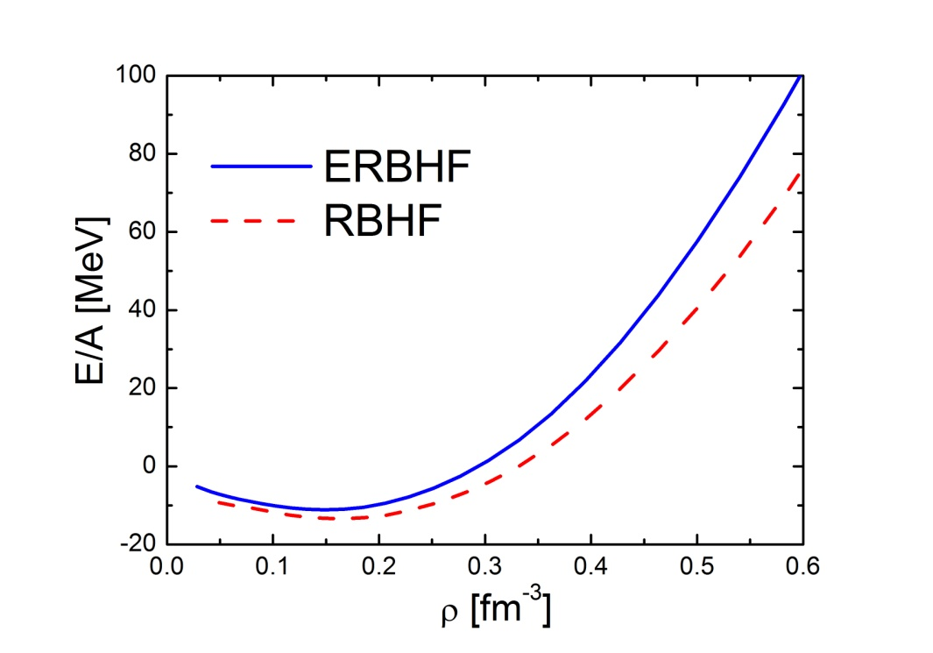
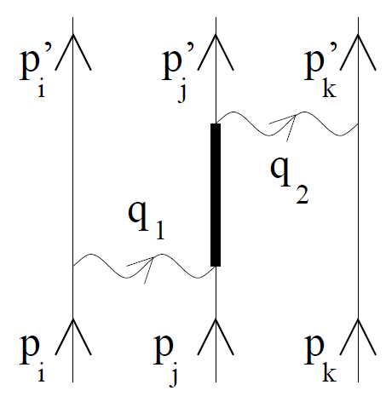
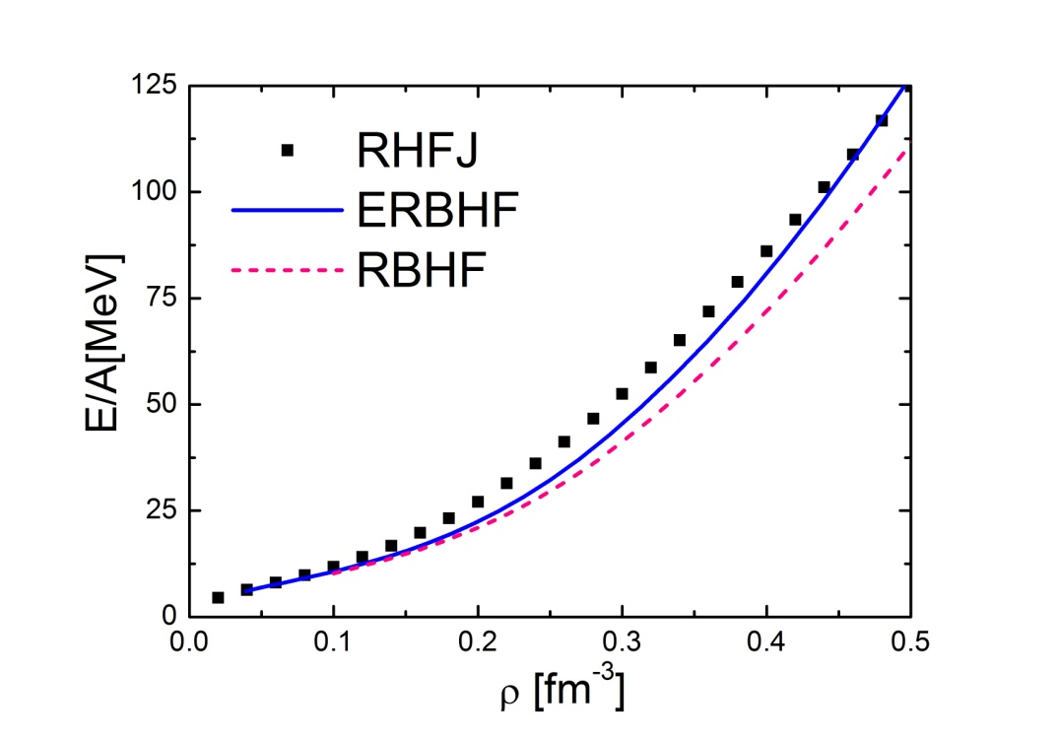
The off-diagonal pp interaction is included
We can find some lacks of Brueckner-Hartree-Fock model from our theory
Symmetric nuclear matter:
The attraction part of three -
body interaction is needed
Pure neutron matter:
Short range correlation on kinetic energy

Slide 24
Non relativistic framework
Single particle energy
Relativistic framework
Dirac equation
where,
Single particle energy
Effective nucleon mass

Slide 25
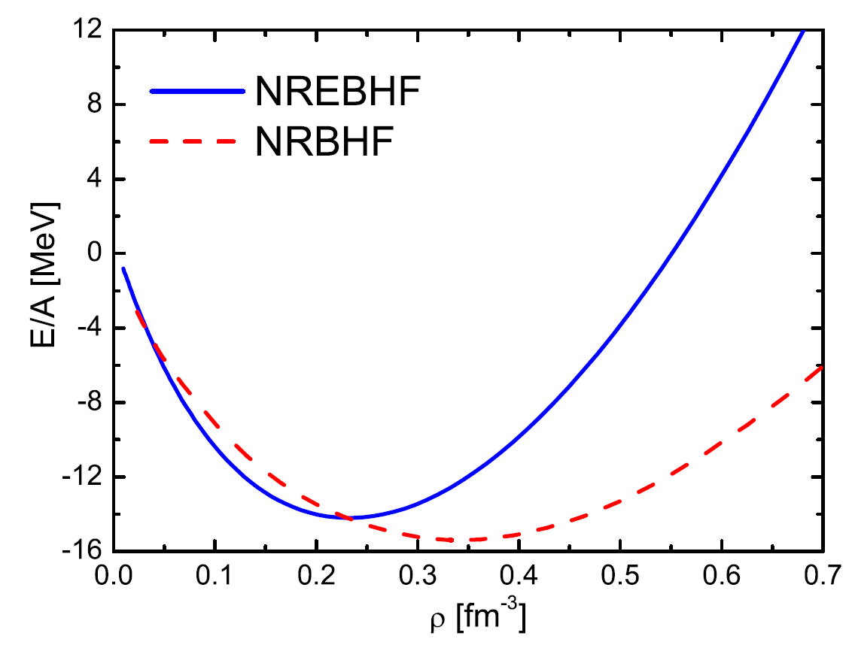
Numerical results
Non-relativistic version
Equation of state
(EOS) for symmetric
matter with Bonn B
potential
The more repulsive contribution is provided
by the 2p-2h correlation in kinetic energy

Slide 26
Effective nucleon mass
Single particle potential

Slide 27
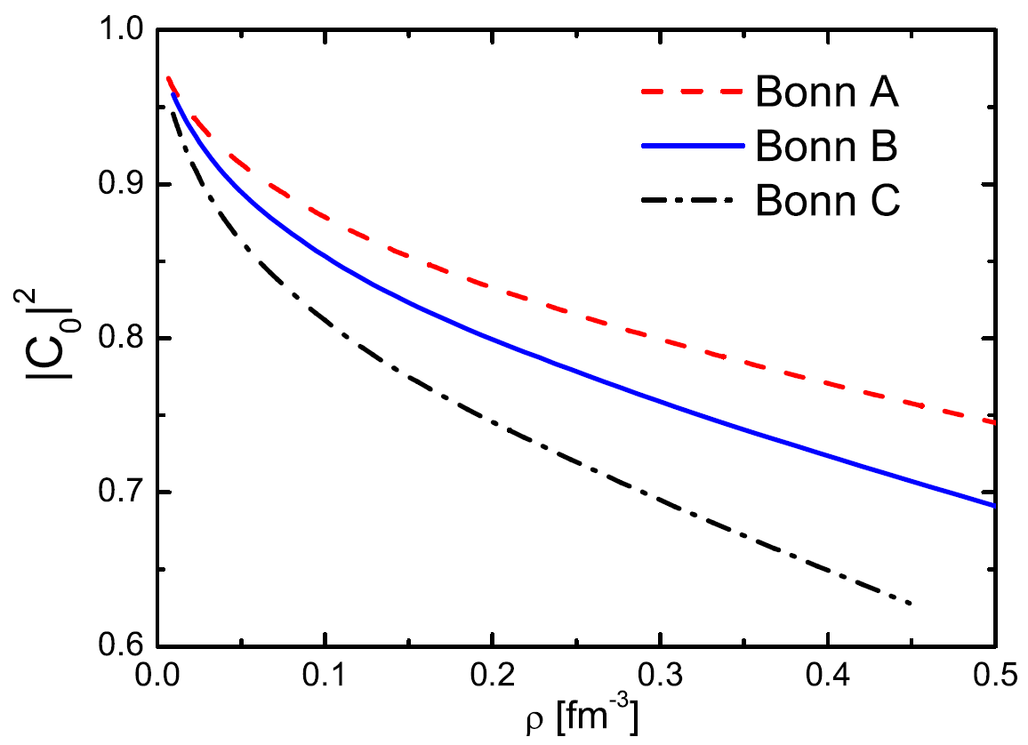
The EOS with
different Bonn
potentials
Bonn C includes
strongest tensor force
The coefficients C₀ of 0p-0h
states with different Bonn
potentials
Bonn C needs more 2p-2h
states correlation

Slide 28
Backup
Semi-empirical Bethe-Weizacker mass formula
The Lagrangian of Bonn Potential

Slide 29
The unitary correlation operator method

Slide 30
Correlated Hamiltonian in Jastrow function
Jastrow function method
Saturation properties

Slide 31
Hamiltonian in particle-hole representation
2p-2h states in particle-hole representation

Slide 32
Matrix elements between 2p-2h and 2p-2h states

Slide 33
Matrix elements between 0p-0h and 2p-2h states

Slide 34
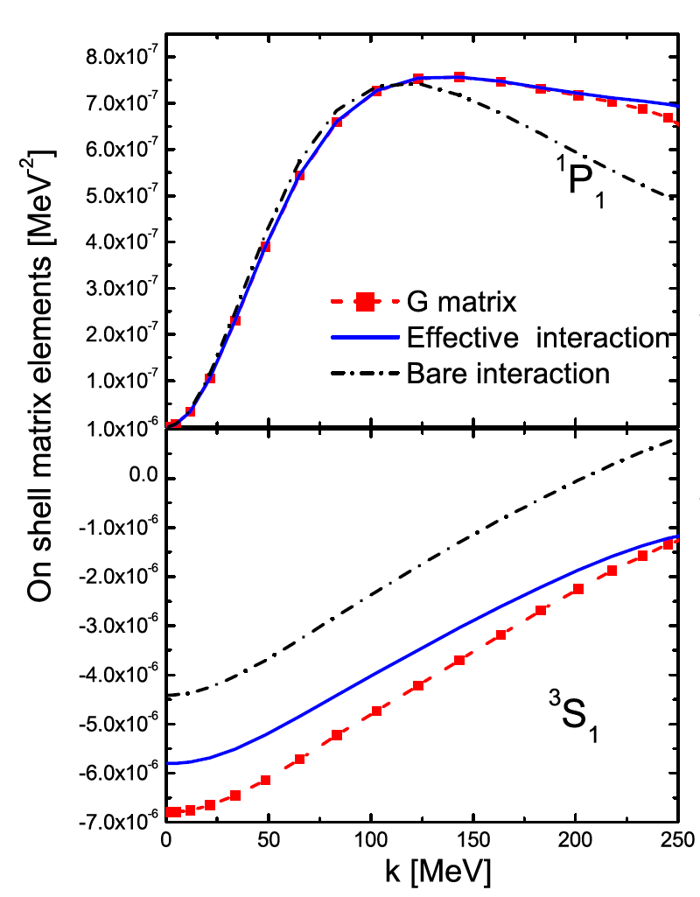
Effective interaction

Slide 35
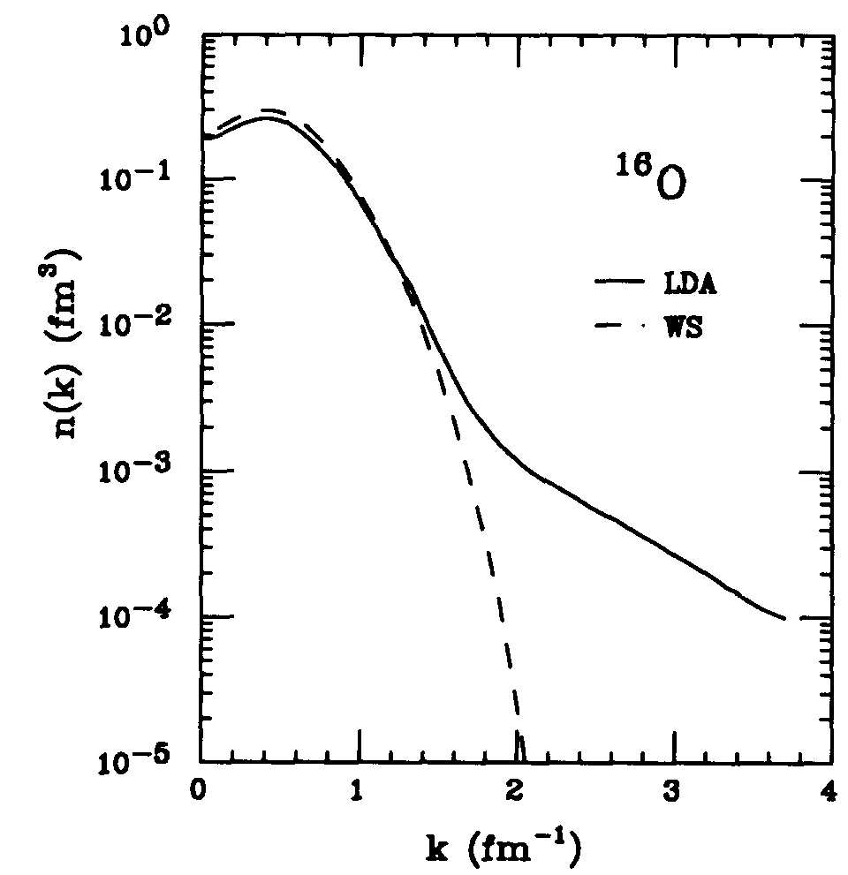
Momentum distribution for finite nuclei in experiment

Slide 36
Bonn Potentials

Slide 37
empirical saturation properties
saturation density
incompressibility

