Slide 1

The KATRIN Neutrino Mass Experiment
Joachim Wolf (KATRIN Collaboration)
NPB 2012
Neutrino mass measurement
β-decay and MAC-E-Filter
KATRIN experiment
  setup
  test measurements
  sensitivity
  schedule and future goals
Conclusions

Slide 2
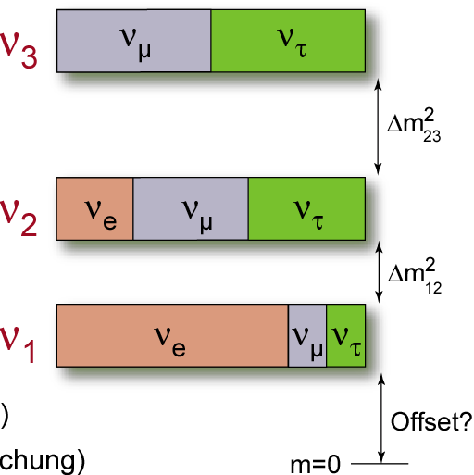
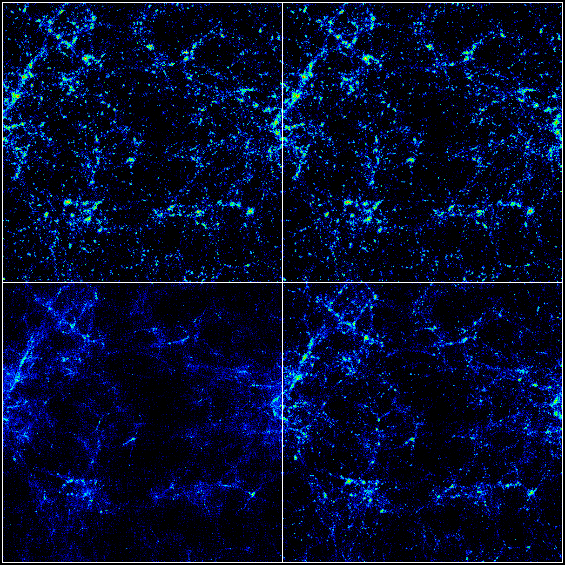
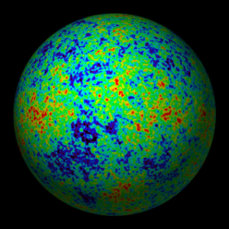
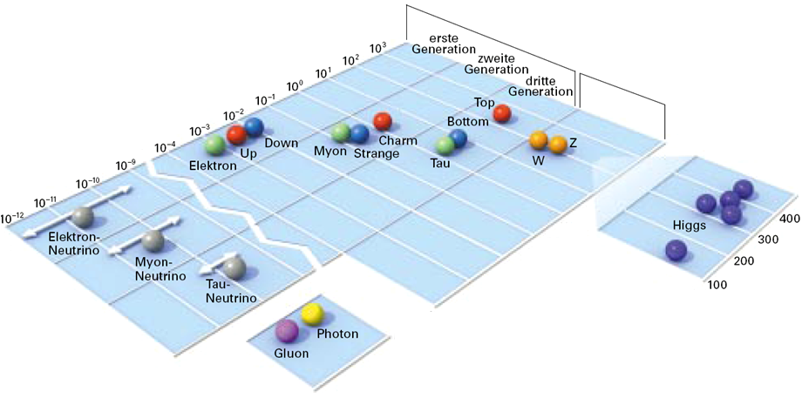
Motivation: ν´s in Astroparticle Physics
cosmology: role of ν´s as hot (warm) dark matter?
particle physics: origin and hierarchy of the ν-mass?
Majorana/Dirac, CP, sterile ν, ... ?
cosmology
particle physics
m_{ν} = 0 eV
m_{ν} = 1 eV
CMB
fermions
mass [GeV]
bosons
m_{ν} = 7 eV
m_{ν} = 4 eV
neutrinos
LSS
massless
bosons

Slide 3
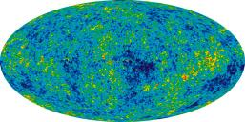
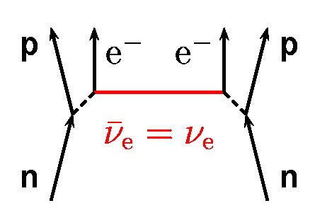
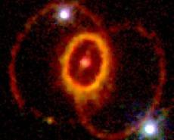
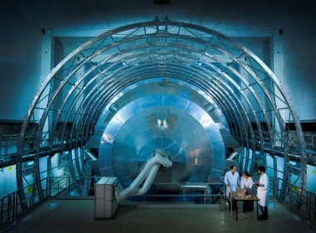
Methods to determine the ν mass scale
Cosmology
effect of neutrino mass on structure formation, CMB, …
Search for 0νββ decays
decay only possible for massive Majorana neutrinos
Direct neutrino mass detection:
kinematic measurement of m_{ν} (E² = p²c² + m²c⁴)
  Time-of-flight measurements
  ν from supernova
  Kinematics of weak decays (β-decay)
        tritium β-decay spectrometers
        ¹⁸⁷Re β-decay bolometers
        search for other low-Q isotopes ?
WMAP
NASA-HST: SN1987A

Slide 4
Current limits for the neutrino mass
Cosmology:
LSS, CMB, …
model dependent
status: Σm_{ν} < 0.4 eV (0.3 – 2.0 eV)
future sensitivity: 0.1 – 0.6 eV
Supernova:
ToF measurement SN 1987A
status: m_{ν} < 5.7 eV (PDG 2006)
future sensitivity: sub-eV ?
S. Hannestad et al., JCAP 08 (2010) 001
complementary
measurements
neutrino mass
measurements
0νββ-decay:
eff. Majorana mass
model dependent (NME)
cancellation ? (Majorana phase α)
status: m_{ββ} = 0.32 eV ? (K.-K.)
future sensitivity: 20 – 50 meV
β-decay:
eff. neutrino mass
model independent (kinematics)
status: m_{β} < 2 eV (Mainz, Troitsk)
future sensitivity: 200 meV

Slide 5
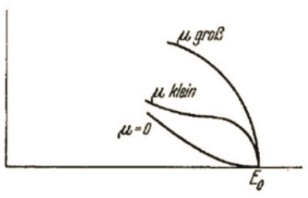
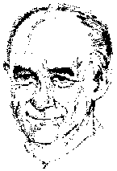
β-decay – Fermi theory & neutrino mass
β-decay kinematics close to endpoint E₀: model independent measurement
of m(ν_{e}), based solely on kinematic parameters & energy conservation
observable m_{β}²
effective
´electron-ν-mass´
Fermi function F(E,Z)
´incoherent´ sum of the
mass eigenstates m_{i}
E W Otten and C Weinheimer
Rep. Prog. Phys. 71 086201 (2008)
small modifications by final states, radiative & recoil corrections

Slide 6
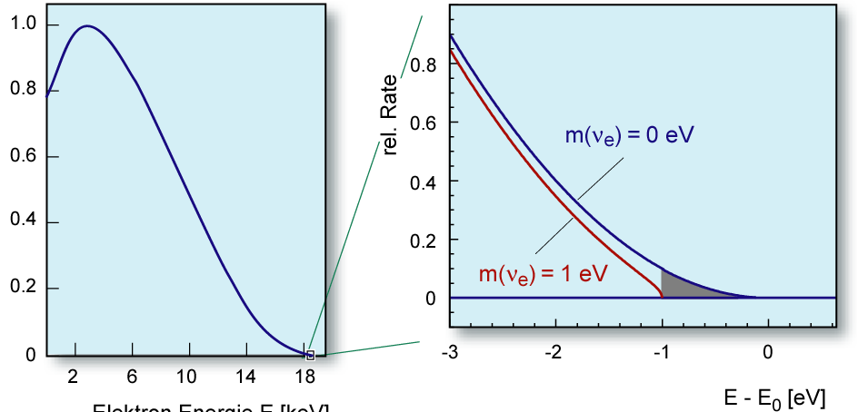
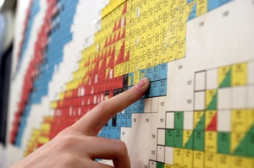
β-decay – Fermi theory & neutrino mass
β-decay kinematics close to endpoint E₀: model independent measurement
of m(ν_{e}), based solely on kinematic parameters & energy conservation
which isotope
yields the highest
β-intensity &
ν-mass sensitivity?
only 2 ∙10⁻¹³ of all ³H
β-decays in last 1 eV
electron energy [keV]
rel. rate
electron energy [keV]

Slide 7
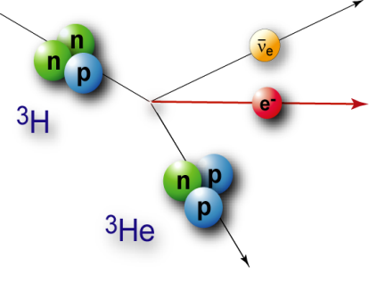


β-decay – Fermi theory & neutrino mass
β-decay kinematics close to endpoint E₀: model independent measurement
of m(ν_{e}), based solely on kinematic parameters & energy conservation
which isotope
yields the highest
β-intensity &
ν-mass sensitivity?
ß-source requirements
short half life t_{½}  high luminosity
low endpoint energy E₀
superallowed/allowed transition
simple atomic/molecular structure
¹⁸⁷Re
³H: super-allowed
E₀ | 18.6 keV
t_{1/2} | 12.3 y
¹⁸⁷Re: unique 1st
E₀ | 2.47 keV
t_{1/2} | 43.2 Gy
¹⁸⁷Os
_
_
³H → ³He + e⁻ + ν_{e}
¹⁸⁷Re → ¹⁸⁷Os + e⁻ + ν_{e}

Slide 8
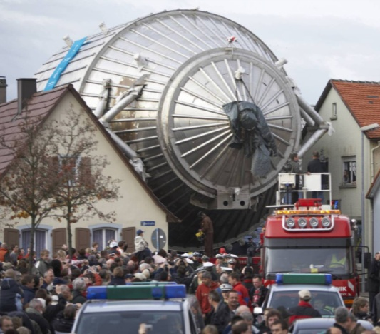
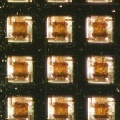
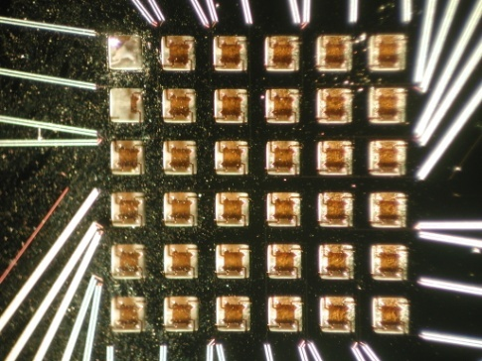
β-decay – Fermi theory & neutrino mass
β-decay kinematics close to endpoint E₀: model independent measurement
of m(ν_{e}), based solely on kinematic parameters & energy conservation
which detector?
β-detection requirements
large solid angle (~2π)
low background rate
high energy resolution (~eV)
short dead time, no pile up
spectrometer
external β-source
β-source: ³H
calorimeter
β-source = detector
β-source: ¹⁸⁷Re,¹⁶³Ho

Slide 9
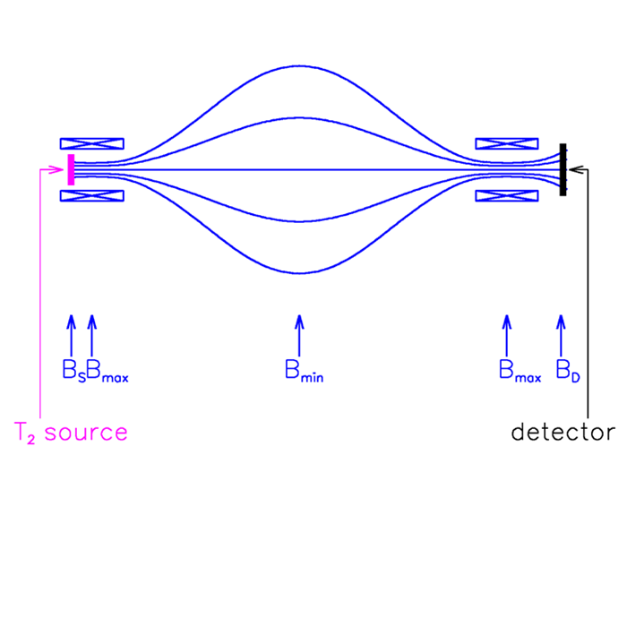
Principle of the MAC-E-Filter
Magnetic Adiabatic Collimation + Electrostatic Filter
A. Picard et al.,
Nucl. Instr. Meth. 63 (1992) 345
Two supercond solenoids compose magnetic guiding field
Electron source (T₂) in left solenoid
Detector in right solenoid

Slide 10
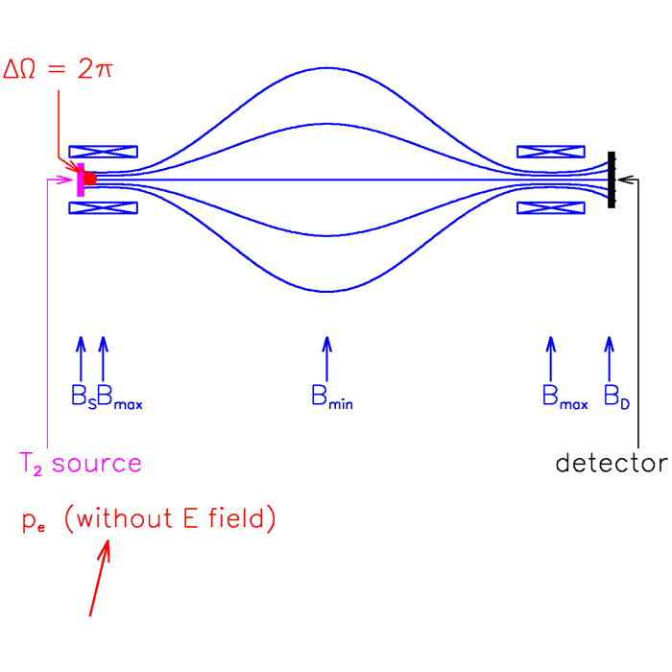
Principle of the MAC-E-Filter
Magnetic Adiabatic Collimation + Electrostatic Filter
A. Picard et al.,
Nucl. Instr. Meth. 63 (1992) 345
Two supercond solenoids compose magnetic guiding field
Electron source (T₂) in left solenoid
Detector in right solenoid
e⁻ magnetically guided
  cyclotron motion
adiabatic transformation:
  μ = E⊥/B = const. (magn. moment)
  parallel e⁻ beam (analysing plane)
analysing plane

Slide 11
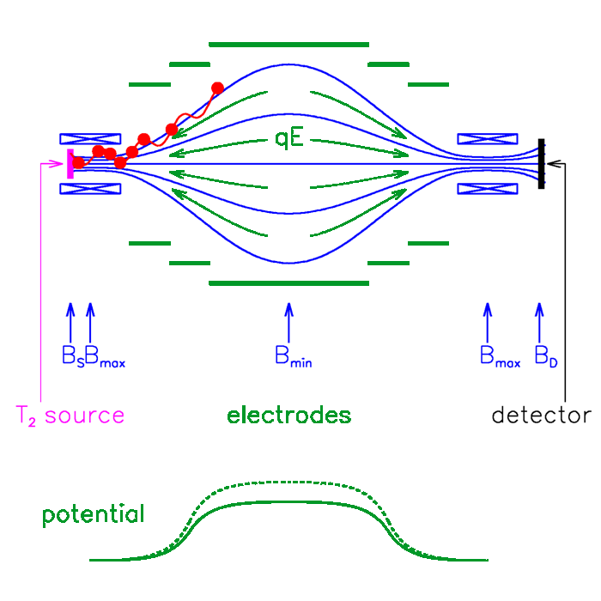
Principle of the MAC-E-Filter
Magnetic Adiabatic Collimation + Electrostatic Filter
A. Picard et al.,
Nucl. Instr. Meth. 63 (1992) 345
Two supercond solenoids compose magnetic guiding field
Electron source (T₂) in left solenoid
Detector in right solenoid
e⁻ magnetically guided
  cyclotron motion
adiabatic transformation:
  μ = E⊥/B = const. (magn. moment)
  parallel e⁻ beam (analysing plane)
Energy analysis by electric field
  ΔE = E ⋅ B_{min}/B_{max} (magn. moment)
  ΔE = E ⋅ A_{src}/A_{ana} (magn. fluxtube)
analysing plane

Slide 12
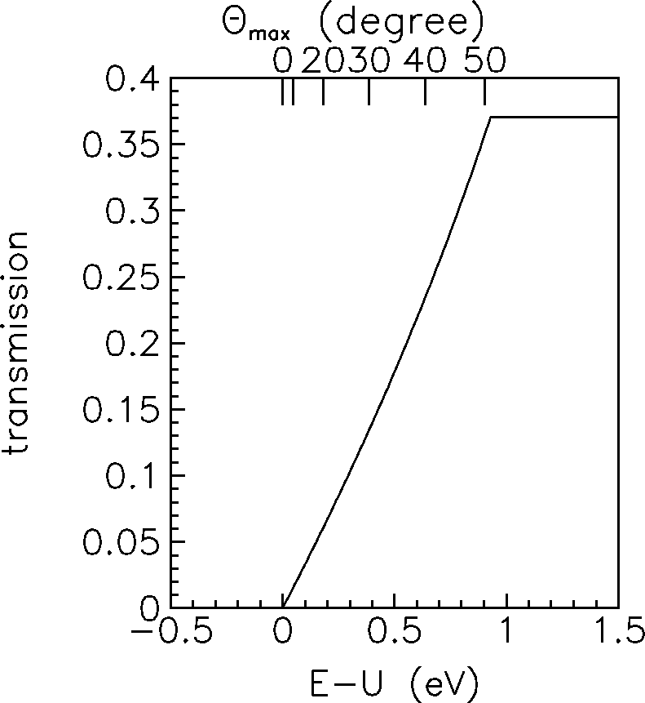
Principle of the MAC-E-Filter
Magnetic Adiabatic Collimation + Electrostatic Filter
A. Picard et al.,
Nucl. Instr. Meth. 63 (1992) 345
⇒ sharp integrating transmission function without tails:
Integral spectrum
ΔE = E ⋅ B_{min}/B_{max}
ΔE = E⋅A_{s,eff}/A_{analyse}
Mainz: ΔE = 4.8 eV
KATRIN: ΔE = 0.93 eV

Slide 13

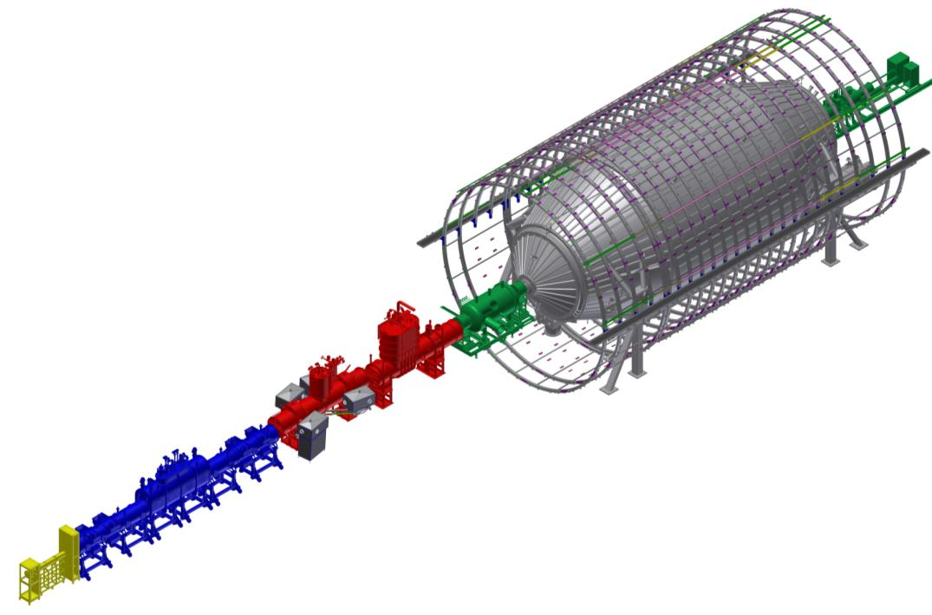
















The KATRIN Experiment @ KIT
(KArlsruhe TRItium Neutrino experiment)
Collaboration:
130 scientists
5 countries
14 institutions
Experimental objective:
model-independent neutrino mass
sensitivity: 0.2 eV/c²
source: gaseous tritium (β-decay)
23.09.2012
J. Wolf: The KATRIN Neutrino Mass Experiment NPB 2012, Shenzhen/China

Slide 14
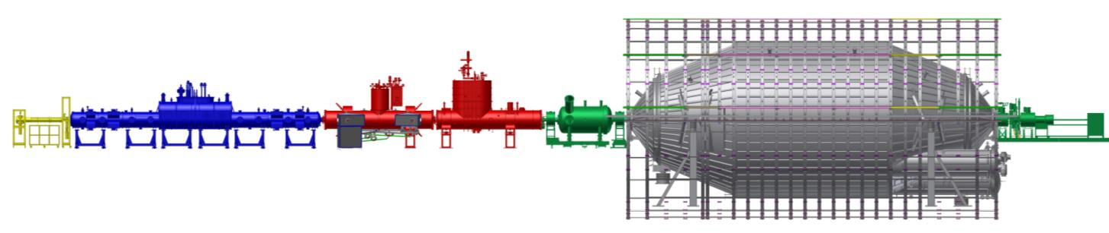
KATRIN Setup and Requirements
source & transport section (tritium) spectrometer & detector section
CMS
source (WGTS)
pumping section
pre-spec.
main spectrometer
detector
Tritium
β- decay
³He
e⁻
³He
e⁻
e⁻
e⁻
³H
³H
10¹¹ e⁻ /s
5·10¹⁰ e⁻ /s
10³ e⁻ /s
10⁻² …1 e⁻ /s
³He
~70 m
<10⁻³ stability of tritium column density ρd
tritium suppression factor >10¹⁴
effective removal of ions (R = 10⁸)
fully adiabatic (meV scale) transport of e⁻
energy resolution = 0.93 eV
absolute energy scale: ppm accuracy
avoid particle storage in Penning-like traps
background rate < 10⁻² cps

Slide 15
KATRIN Setup and Requirements
source & transport section (tritium) spectrometer & detector section
CMS
source (WGTS)
pumping section
pre-spec.
main spectrometer
detector
Tritium
β- decay
³He
e⁻
³He
e⁻
e⁻
e⁻
³H
³H
10¹¹ e⁻ /s
5·10¹⁰ e⁻ /s
10³ e⁻ /s
10⁻² …1 e⁻ /s
³He
~70 m
<10⁻³ stability of tritium column density ρd
tritium suppression factor >10¹⁴
effective removal of ions (R = 10⁸)
fully adiabatic (meV scale) transport of e⁻
energy resolution = 0.93 eV
absolute energy scale: ppm accuracy
avoid particle storage in Penning-like traps
background rate < 10⁻² cps

Slide 16
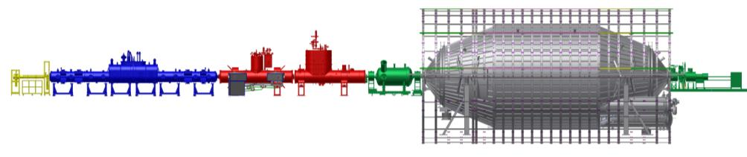
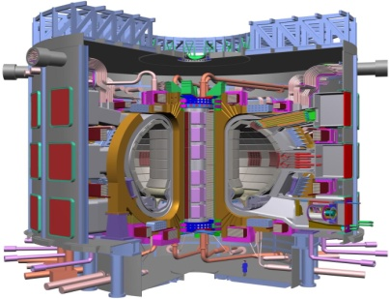
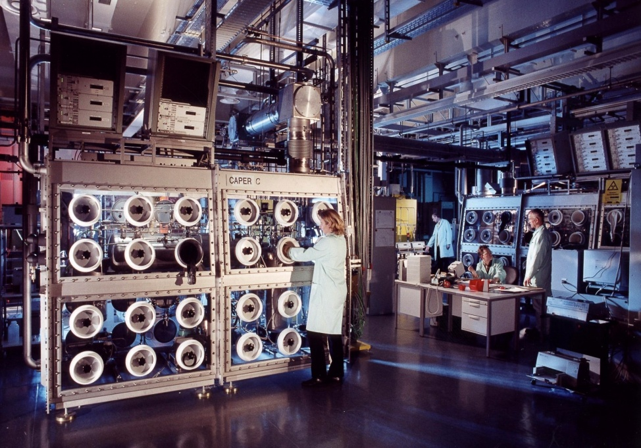
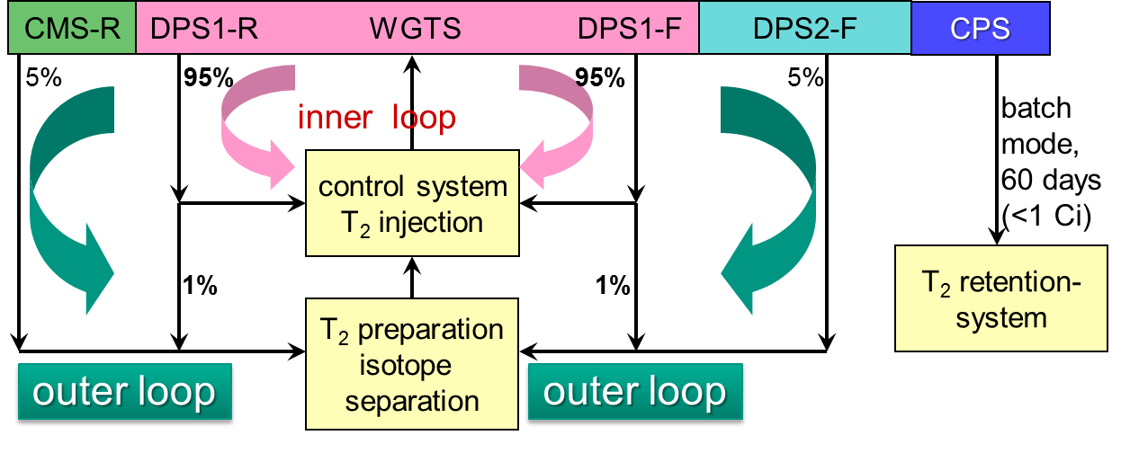
Tritium Source: Loop System
KATRIN tritium throughput per year is equivalent to ITER fusion facility
tritium source is operated as closed cycle:
thoughput of 40 kg/year
TLK – a unique research facility

Slide 17
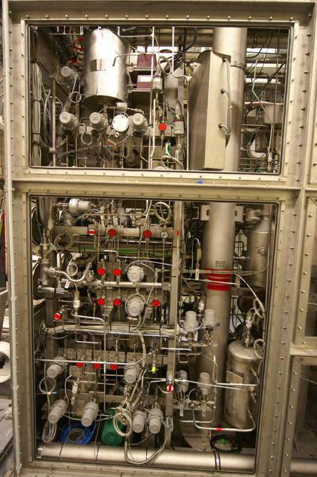
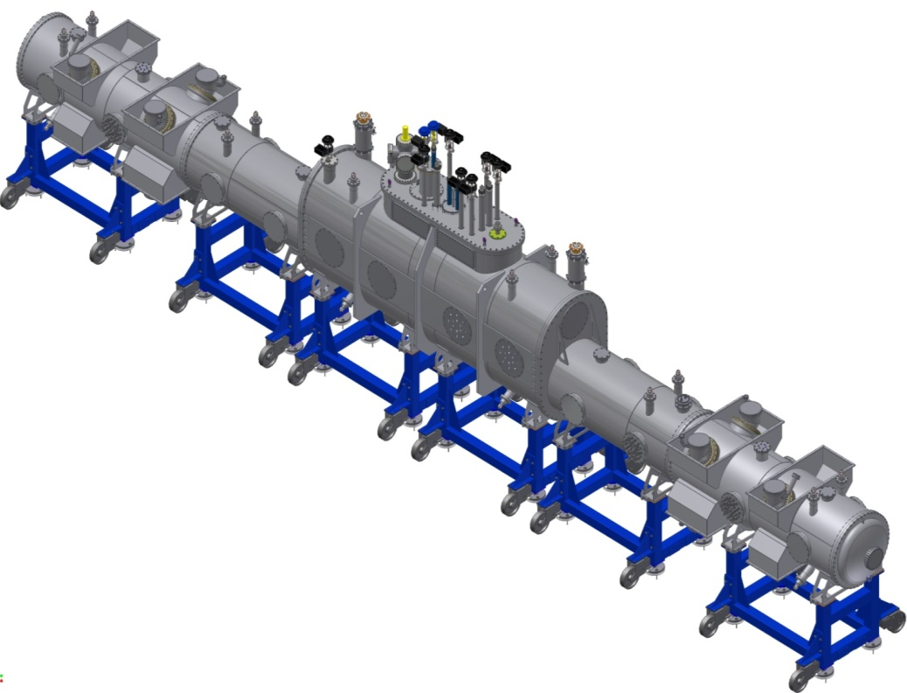

Tritium Source: Loop System
10⁻⁴ stability for p_{in} achieved in test set-up
⋅
⋅
⋅
⋅
p_{in}
TLK – a unique research facility

Slide 18
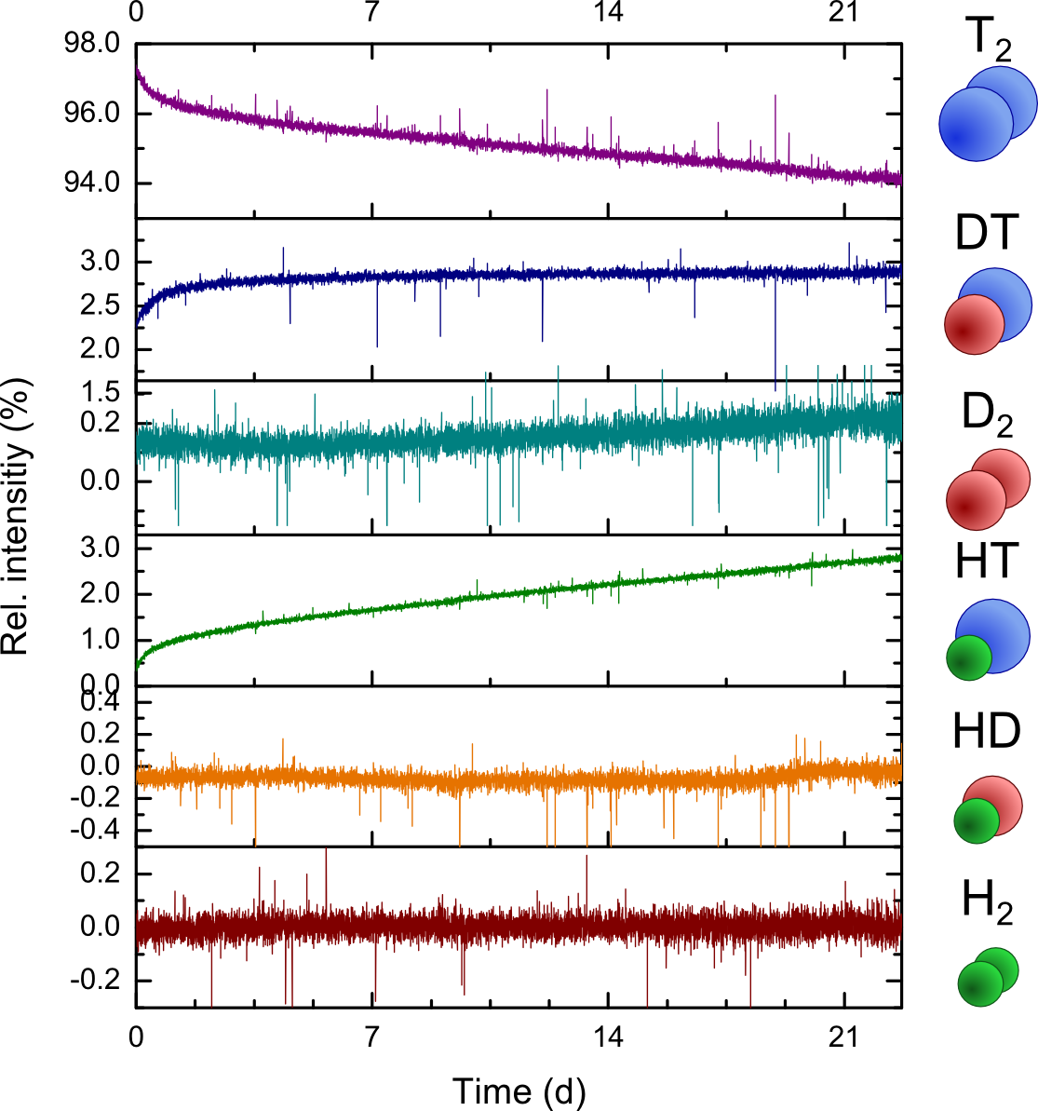
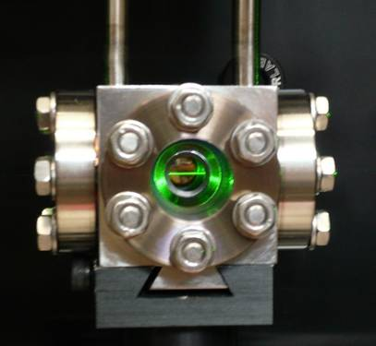
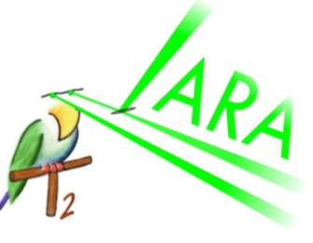
Tritium Source: Loop System
Laser-Raman spectroscopy: 10⁻³ in 60 s
⋅
p_{in}
S. Fischer et al.,
Fus. Sci. & Techn., 60 (2011) 925-930

Slide 19
Tritium Source: WGTS
Windowless Gaseous Tritium Source
molecular tritium source
high luminosity
high stability
diff. pumping
WGTS design value precision
luminosity | 1.7 × 10¹¹ Bq | ± 0.1 %
injection rate | 5 × 10¹⁹ mol/s | ± 0.1 %
column density ρd | 5 × 10¹⁷ mol/cm² | ± 0.1 %
tritium purity | > 95% | ± 0.1 %
magnetic field | 3.6 T | ± 2%
tritium injection
diff. pumping

Slide 20
Tritium Source: WGTS
Windowless Gaseous Tritium Source
one of the world´s most complex cryostats:
tritium gas flow
  radioactivity (pumps, sensors, …)
  stability better 10⁻³
cryogenics
  12 cryogenic circuits
  6 cryogenic fluids
  temperature (4 – 600 K)
instrumentation (≈500 sensors)
  magnetic field
  pressure, gas flow
  liquid levels
  temperature
diff. pumping
tritium injection
diff. pumping

Slide 21
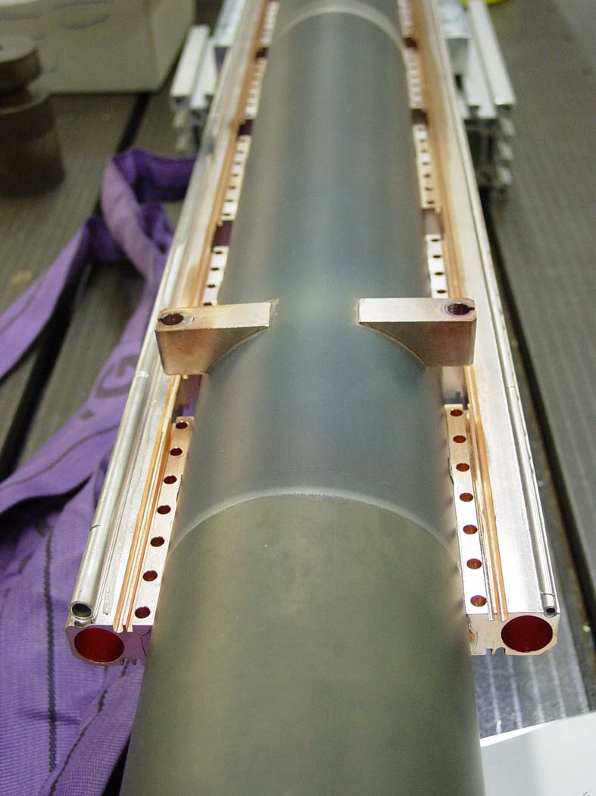
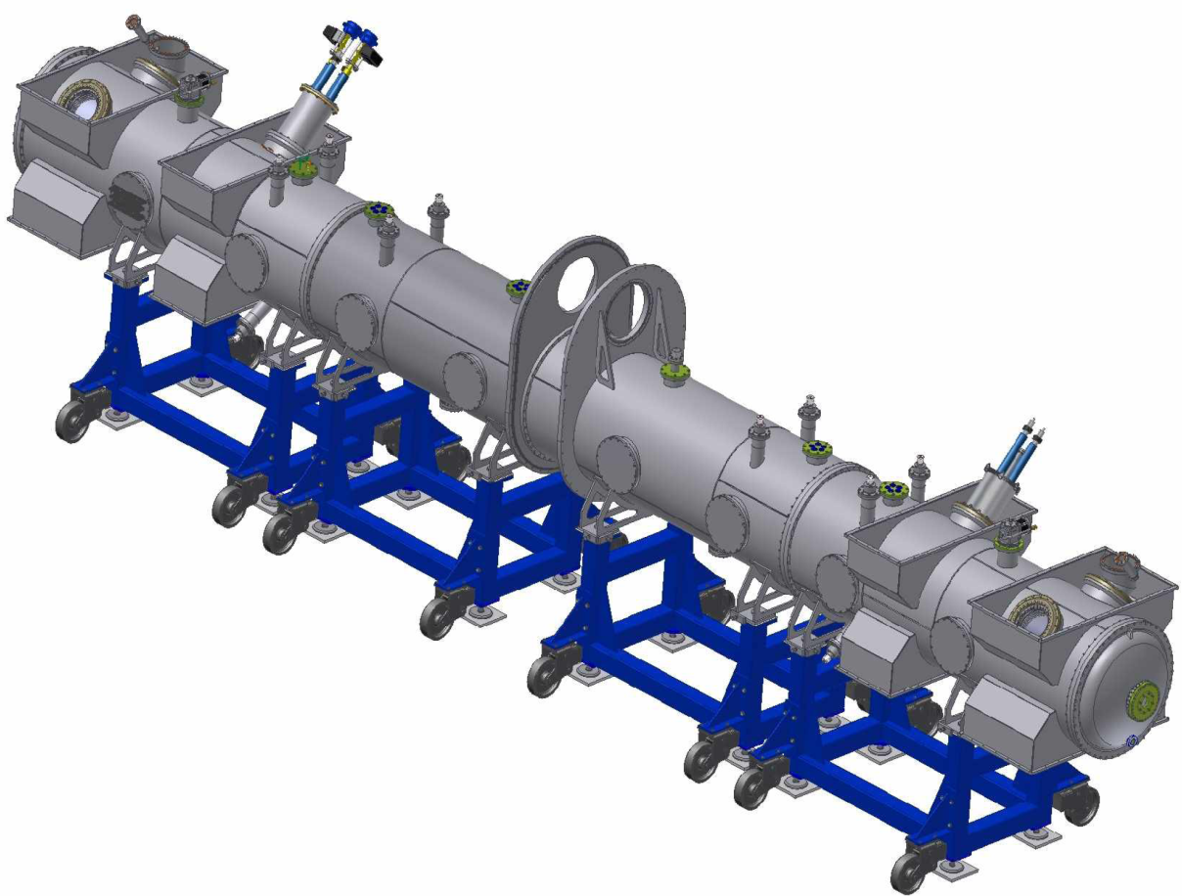
Tritium Source: Demonstrator
Components of WGTS:
outer cryostat housing
beam tube
cryogenic system
no magnets
stainless steel
beam tube
Ø=90mm
2-phase
Neon
2-phase
Neon

Slide 22
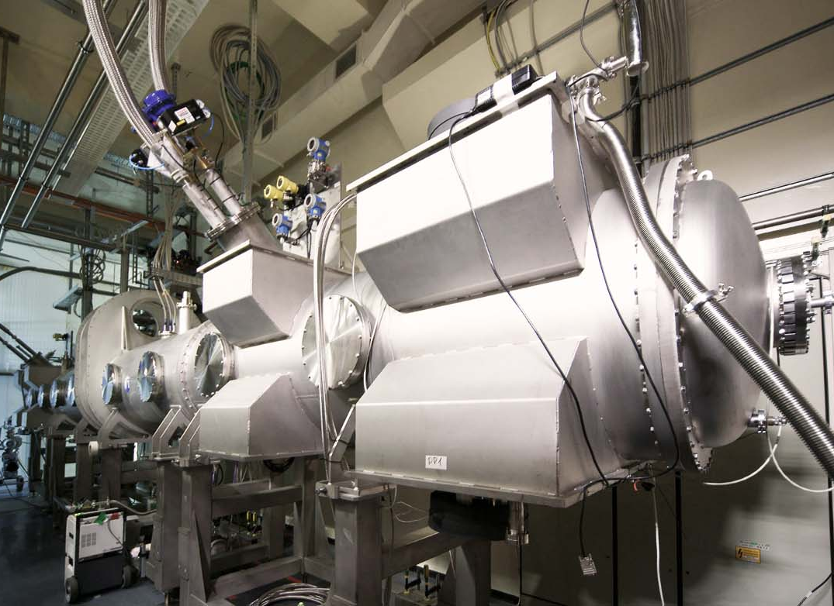
Tritium Source: Demonstrator
Objectives of measurements:
demonstrate feasibility of novel 2-phase (LNe/GNe) beam tube cooling system
WGTS-BT requirements:
  operation at T_{BT} = 28 - 32 K
  ΔT = ± 30 mK
    stability (1h)
    homogeneity (10 m)

Slide 23
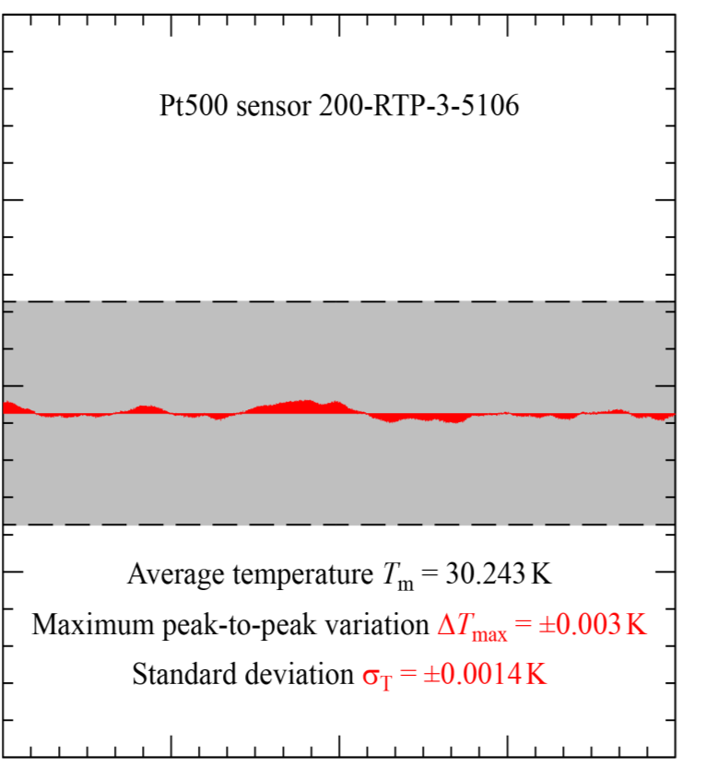
Tritium Source: Demonstrator
30.35
30.30
30.25
30.20
4h measurement
KATRIN specification
temperature T_{BT} [K]
σ_{t} = 1.6 mK (4h)
vapour pressure sensor
noise band width < 0.2 mK
06:00 07:00 08:00 09:00 10:00

Slide 24
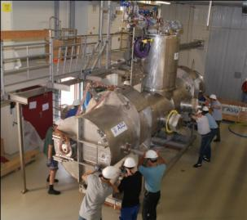
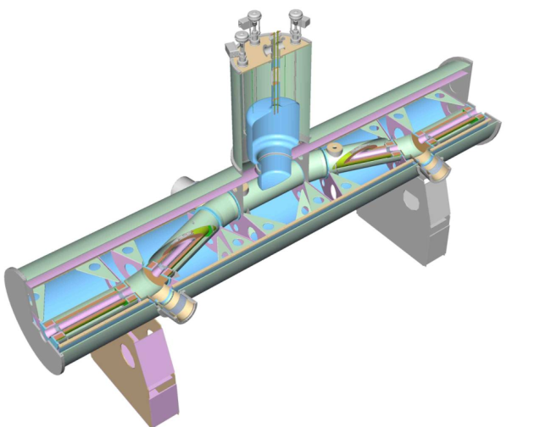
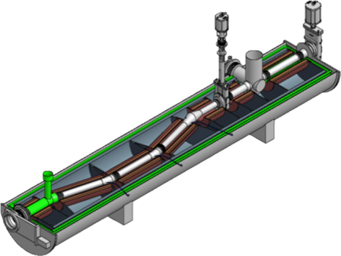
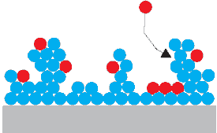
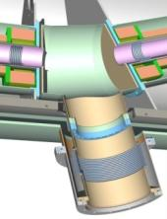
Transport & Pumping Sections
DPS2-F
CPS
cryo-sorption
T₂
(repair necessary after diode failure during quench)
Ar Frost
ß´s
stainless steel
ß´s
Argon Frost Pump
T = 3 – 4.5 K
ß´s
T₂
active pumping, 4 TMPs
Tritium retention 10⁵
magnetic field: 5.6 T
on-site since 08/2009
pumping by cryo-sorption
Tritium retention >10⁷
magnetic field: 5.6 T
on schedule: delivery 2013

Slide 25
Transport & Pumping Sections
DPS2-F
CPS
cryo-sorption
T₂
Ar Frost
ß´s
stainless steel
ß´s
Argon Frost Pump
T = 3 – 4.5 K
ß´s
T₂
active pumping, 4 TMPs
Tritium retention 10⁵
magnetic field: 5.6 T
on-site since 08/2009
pumping by cryo-sorption
Tritium retention >10⁷
magnetic field: 5.6 T
on schedule: delivery 2013

Slide 26
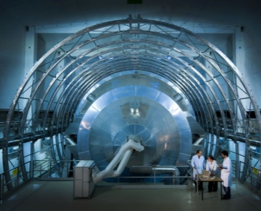
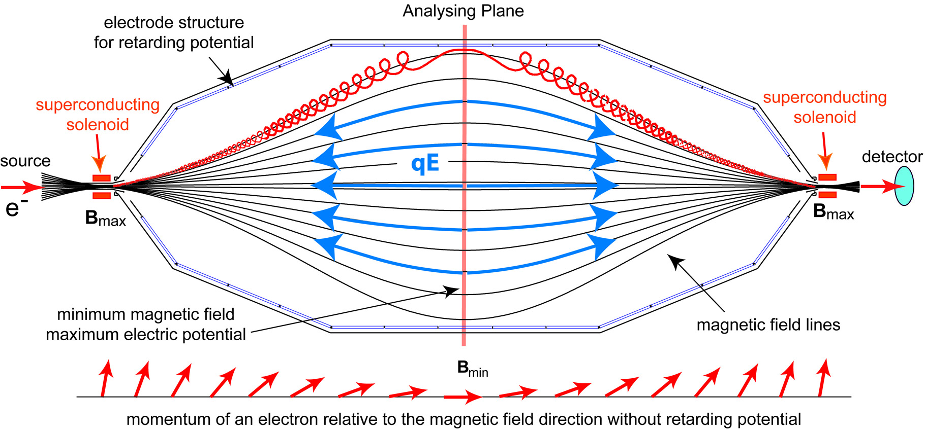
Spectrometer and Detector Section
MAC-E-Filter

Slide 27
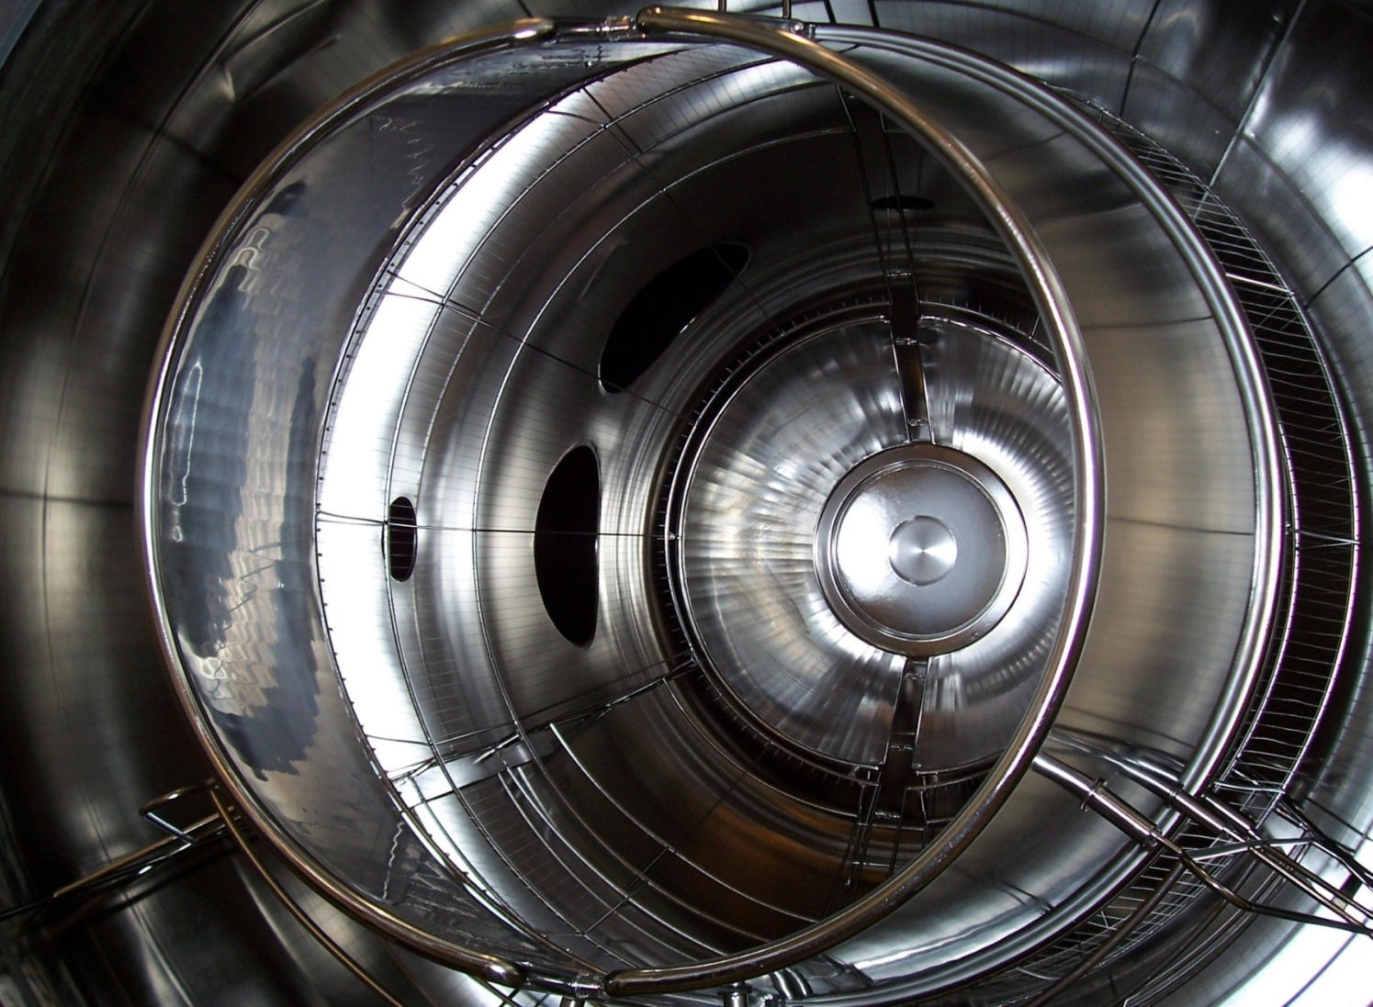
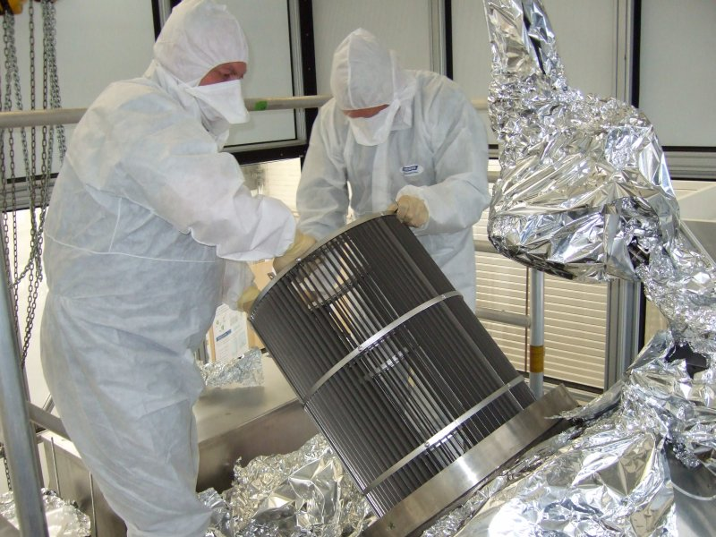
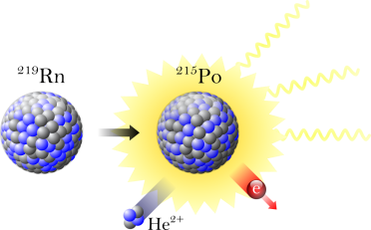
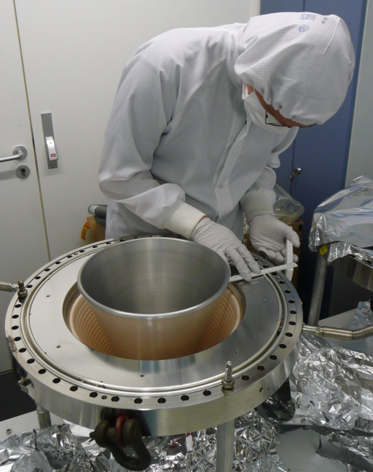
Pre-spectrometer
pre-filter for electrons
prototype for main spectrometer
  vacuum design
  electro-magnetic design
  background suppression

Slide 28
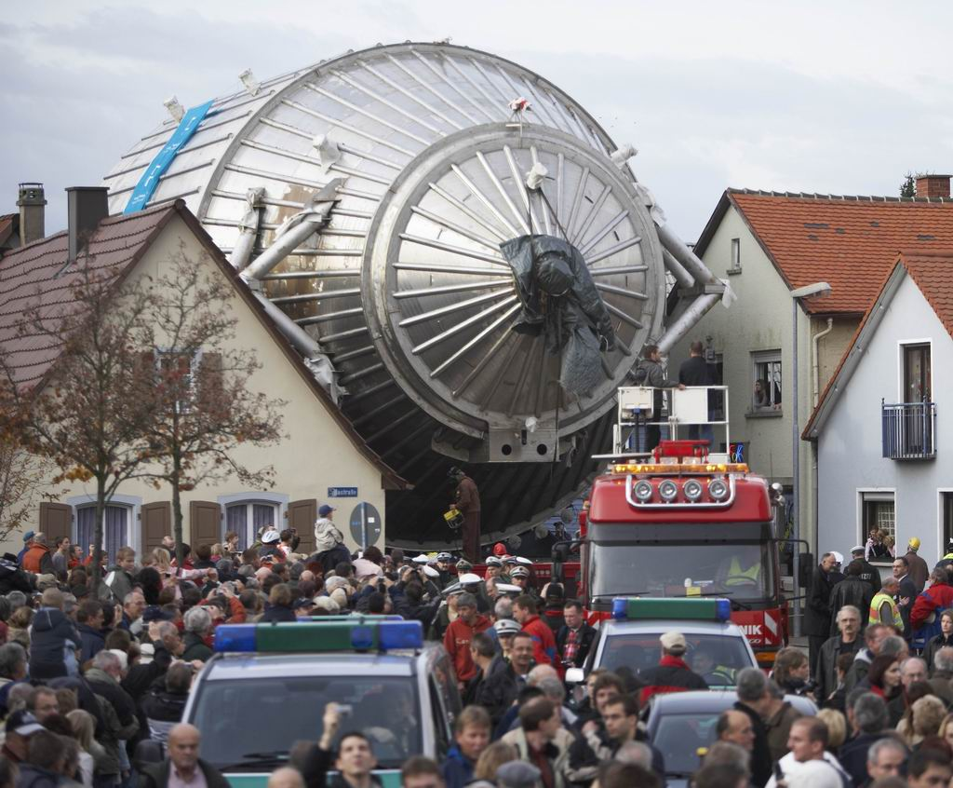
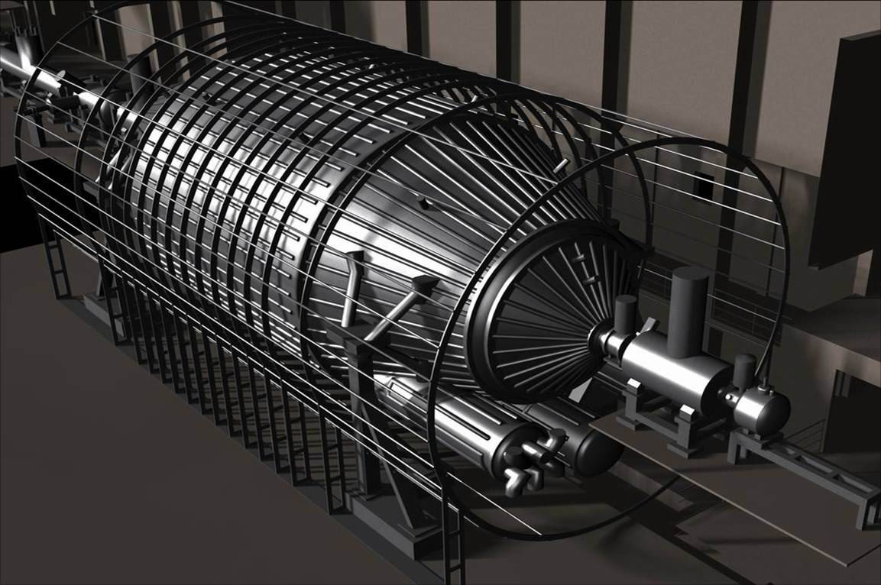
Main Spectrometer
Ultra-precise energy analysis of electrons close to endpoint E₀
  energy resolution: ΔE = 0.93 eV (0% → 100% transmission) @ 18.6 keV
Features:
  Ø = 10 m, length = 24 m, surface = 690 m², volume = 1240 m³,
  p < 10⁻¹¹ mbar (world´s largest UHV recipient)
  inner wire electrode system & external Helmholtz-type air coil system
external
air coil system

Slide 29
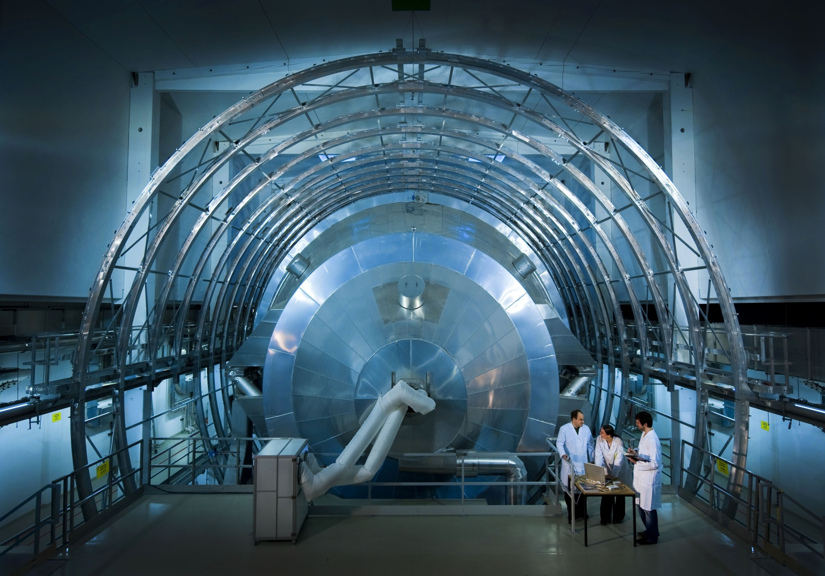
LFCS
EMCS
large
Helmholtz
coil system
main
spectrometer
vessel
Ø = 12.7 m
G. Drexlin – KATRIN
G. Drexlin – VL0x
G. Drexlin – KATRIN
G. Drexlin | KATRIN | GDR Strasbourg 2009

Slide 30
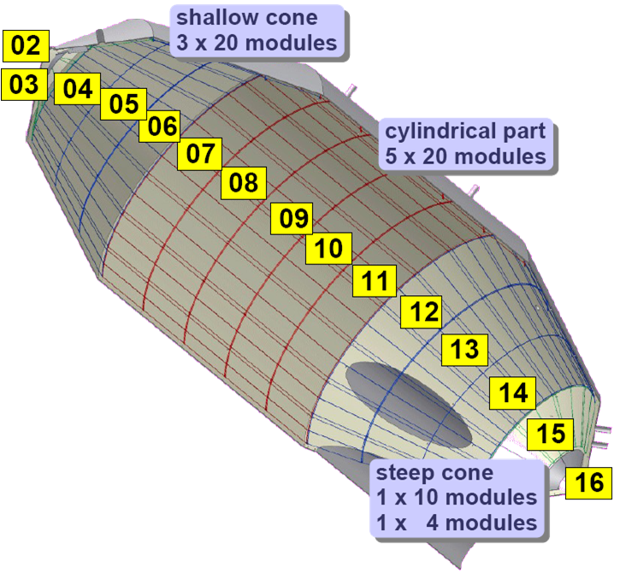

Inner Electrode System – Objectives
double-layered inner wire electrode system
2 shallow cones
3x20 modules
#1: background suppression
inelastic reactions of cosmic µ
low-energy secondary electrons
from the 690 m² inner surface
are repelled electrostatically
cylindrical part
5x20 modules
#2: fine forming of retarding field
precision HV power supplies:
intrinsic HV precision ~1 ppm
dipole/ECR mode: eject particles
stored in Penning traps
2 steep cones
1x10 module
1x4 module
≈24,000 wires
(in 248 frames)

Slide 31





Main Spectrometer: Inner Electrode System
Jan. 31, 2012

Slide 32




KASSIOPEIA: signal & background
KASSIOPEIA: KATRIN simulation code for electron trajectories
B [T]
transmission of β-electrons:
magnetic guiding
electrostatic retardation
θ [°]
trapping of bg-electrons:
spectrometer acts as a magnetic bottle,
long storage time (h)

Slide 33





Radon induced background
²¹⁹Rn emanation from St707 NEG getter strips (3 x 1 km)
in pump ports of spectrometer
F.M. Fränkle et al.,
Astropart. Phys. 35 (2011) 128
shake-off
electrons
S. Mertens,
PhD thesis KIT (2012)
conversion
electrons
Auger
electrons
shell reorganisation electrons
NEG

Slide 34


Radon induced background
Passive background reduction: LN2-cooled baffles to cryosorb ²¹⁹Rn
shake-off
electrons
conversion
electrons
Auger
electrons
shell reorganisation electrons
NEG

Slide 35




KASSIOPEIA: background reduction
^{219,220}Rn emanation from bulk material of vessel: need active bg-suppression
stored multi-keV electrons:
rapid cyclotron motion
intermediate axial oscillation
slow magnetron drift
time [s]
ECR technique:
stochastic heating
by short RF pulses
with ω_{RF} = ω_{cycl}
energy [eV]
Electron
Cyclotron
Resonance
S. Mertens, et al.,
arXiv:1205.3729v2

Slide 36

KASSIOPEIA: background reduction
ECR-tests at pre-spectrometer very successful: promise of low background !
stored multi-keV electrons:
rapid cyclotron motion
intermediate axial oscillation
slow magnetron drift
ECR technique:
stochastic heating
by short RF pulses
with ω_{RF} = ω_{cycl}
energy [eV]
Electron
Cyclotron
Resonance
S. Mertens, et al.,
arXiv:1205.3729v2

Slide 37



Main Detector
segmented Si-PIN diode (148 pixel)
detection of transmitted β decay electrons (mHz to kHz)
low background for T₂ endpoint investigation
high energy resolution ΔE ≈ 1 keV
commissioning
at KIT in 2011

Slide 38


KATRIN sensitivity
1
0.99
0.98
0.97
0.96
reference ν-mass sensitivity
for 3 ´full beam´ years:
4σ
statistical & systematic errors
contribute equally:
  statistics σ_{stat} = 0.018 eV²
  systematics σ_{syst} < 0.017 eV²
Ratio of specta
10σ
sensitivity m(ν) = 200 meV (90% CL)
350 meV (5σ)
66 68 70 72 74
electron energy - 18.5 keV [eV]
plans for a later KATRIN phase II:
differential β-energy spectrum:
  cryo-bolometer array with ΔE ~ 1eV?
  synchrotron emission (GHz-range)?
precision external value end point E₀
atomic tritium source?
1200
1000
800
600
400
200
sensitivity 90% CL [meV]
0 2 4 6 8 10
full beam time [months]

Slide 39

Sterile neutrinos: (sub-)eV scale
Hannestad et al. - initial estimates of KATRIN sensitivity for sterile ν´s assume very light active neutrinos m(ν_{e}) ~ 0 eV, mixed with sterile m (ν_{s})
3 σ detection of ´kink´ by m_{sterile} if active-sterile mixing |U_{es}|² ≥ 0.055
3+2 scenarios can also be disentangled, measure absolute value m (ν_{s})
0.5
0.4
0.3
0.2
0.1
O.L.G. Peres, A. Esmaili, arXiv:12.032632 [hep-ph]
´heavy´ sterile m(ν_{s})
light active m(ν_{e})
-0.4 -0.3 -0.2 -0.1 0
E – E₀ [eV]

Slide 40



Sterile neutrinos in astroparticle physics
Cosmology: role of sterile ν´s as warm dark matter
dark energy
idea: sterile ν´s in the 1-10 keV mass regime would constitute warm dark matter
sterile neutrino ν_{s} would manifest itself as a
kink (10⁻⁷-10⁻¹⁰) deep in the ß-spectrum
need reliable calculation of spectral shape
dark matter
baryons
stars
gas
|U_{es}|²
DM & dwarf statellites
m(ν_{s})
CDM WDM

Slide 41
Conclusions
Studies of β-decay/EC kinematics
  only model-independent method to determine absolute ν-mass scale
  KATRIN will probe cosmologically relevant scale down to m(ν_{e}) = 200 meV
  studies for phase II to go beyond this value
Calorimetric experiments will provide an independent check
  MARE: ¹⁸⁷Re (β-decay); ECHO: ¹⁶³Ho (electron capture)
  advantage: scalable approach
  still a lot of R&D work for m(ν_{e}) = 200 meV
New ideas: Project 8 and others
KATRIN next steps:
  electromagnetic tests of main spectrometer (start in Oct. 2012)
  commissioning of CPS (end of 2013) and WGTS (end of 2014)
  beginn of neutrino measurement: 2015

Slide 42




Conclusions
The complete picture of neutrino masses is obtained only
by comparing high-precision results from direct neutrino mass searches
with 0νββ experiments and cosmological studies
β-decay 0νββ
m(ν_{e}) m_{ββ}
Σ m_{i}
cosmology

Slide 43

Thank you for your attention

Slide 44

Discussion

Slide 45



Absolute neutrino mass
Results of recent oscillation experiments: Θ₂₃, Θ₁₂, Δm²₂₃, Δm²₁₂
ν_{e} ν_{μ} ν_{τ}
?
ν₁
ν₂
ν₃
Ω
1
degenerated masses
accessible to β-experiments
cosmologically relevant:
HDM
large scale structure formation
0.1
0.01
relic neutrinos:
336 ν / cm³ →
Δm²₂₃
0.001
hierarchical masses
Δm²₁₂

Slide 46

Absolute neutrino mass
Results of recent oscillation experiments: Θ₂₃, Θ₁₂, Δm²₂₃, Δm²₁₂
ν_{e} ν_{μ} ν_{τ}
?
ν₁
ν₂
ν₃
Ω
1
degenerated masses
accessible to β-experiments
cosmologically relevant:
HDM
large scale structure formation
0.1
0.01
Δm²₁₂
relic neutrinos:
336 ν / cm³ →
0.001
hierarchical masses
Δm²₂₃

Slide 47


Cosmology and neutrino mass
massive neutrinos contribute to hot dark matter
kinematic effect of HDM on structure formation
sensitive to total energy density of neutrinos (Σm_{i})
different models using various sets of parameters and data
minimal ΛCDM plus m_{ν} : Σm_{j} < 0.4 eV (CMB + LSS)
current bounds: 0.3 eV ≤ Σm_{j} ≤ 2 eV
S. Hannestad: arXiv:1007.0658v2
SDSS DR7
WMAP 7

Slide 48

Cosmology and neutrino mass
Future probes of neutrino mass:
new galaxy redshift surveys (BOSS, HETDEX, WFMOS,…)
weak lensing surveys
CMB: PLANCK satellite (launched: 14.May 2009)
Lyman-α forest measurements (BOSS)
cluster surveys
21 cm measurements
Expected sensitivity:
short term (5-7 y): 0.1 eV ≤ Σm_{j} ≤ 0.6 eV
long term (7-15 y): 0.05 eV ≤ Σm_{j} ≤ 0.4 eV
S. Hannestad: arXiv:1007.0658v2

Slide 49


Neutrino-less double-β-decay and neutrino mass
O. Cremonesi: arXiv: 1002.1437v1
2 decay modes in double-β-decay:
  normal (2ν2β)
    allowed by standard model
    continuous energy spectrum
    has been observed (t ~ 10⁻¹⁹ – 10⁻²¹ y)
  neutrinoless (0ν2β)
    needs massive Majorana neutrinos
    energy peak at endpoint
    τ > 10²⁵ y
    violation of total lepton number conservation

Slide 50
Neutrino-less double-β-decay and neutrino mass
Measurement: decay rate
  phase space integral
  (exactly calculable)
  nuclear matrix element
  (wide range of different calculations)
  effective neutrino mass with Majorana phases α
  (cancellation of mass terms possible)

Slide 51

Neutrino-less double-β-decay and neutrino mass
accuracy limited by nuclear matrix element calculation
O. Cremonesi: arXiv: 1002.1437v1

Slide 52

Neutrino-less double-β-decay and neutrino mass
Current results:
  Heidelberg-Moskau (⁷⁶Ge)
  KHDH analysis:
    T_{1/2} = 2.23 x 10²⁵ y (6σ)
    m_{ββ} = 0.32 ± 0.03 eV
  physics beyond the SM ?
  right-handed weak parameters:
    <η> = 3.05 ± 0.26 x 10⁻⁹
    <λ> = 6.92 ± 0.58 x 10⁻⁷
0ν2β only provides upper limit on neutrino mass
H. V. Klapdor-Kleingrothaus and I. V. Krivoshein,
Mod. Phys. Let. A, Vol. 21, No. 20 (2006) 1547

Slide 53
Standard β-decay and neutrino mass
kinetic measurement of the effective neutrino mass
E W Otten and C Weinheimer
Rep. Prog. Phys. 71 086201 (2008)
Fermi’s golden rule:
If the energy resolution is much larger than Δm_{ν}
we see only an effective neutrino mass m_{β} :
measurement: look for missing energy close to the endpoint
  high energy resolution
  high activity source
23.09.2012
J. Wolf: The KATRIN Neutrino Mass Experiment NPB 2012, Shenzhen/China
Notes:
In der Fermi-Theorie für nichtrelativistische Elektronen gilt…

Slide 54
Measurement of the β-spectrum
Spectrometer (tritium)
energy selected by electric or magnetic fields
external β-source
energy loss due to scattering
energy resolution 0.93 eV (100%)
low count rate in detector
lower energies rejected
event fraction in last 10 eV: 3·10⁻¹⁰
present sensitivity: 2 eV
planned sensitivity: 0.2 eV
Micro-calorimeter (¹⁸⁷Re)
energy measured by cryogenic bolometer
β-source = detector
measures entire β-decay energy
energy resolution ≈ 5 –10 eV (FWHM)
full count rate (pile-up !)
many small detectors needed
event fraction in last 10 eV: 1.3·10⁻⁷
present sensitivity: 15 eV
planned sensitivity I: 2 eV
planned sensitivity II: 0.2 eV
KATRIN
MARE

Slide 55




bolometer experiments for ¹⁸⁷Re
■ ¹⁸⁷Re-experiments (MANU, MIBETA, MARE)
¹⁸⁷Re as ß-emitter: natural isotope content = 62.8 %
¹⁸⁷Re: unique 1st
E₀ | 2.47 keV
t_{1/2} | 43.2 Gy
5/2⁺ → 1/2⁻ ´unique´ 1st forbidden
transition (shape factor), BEFS
previous ¹⁸⁷Re-experiments MANU, MIBETA
MANU: metallic Rhenium group in Genova
MIBETA: dielectric AgReO₄ crystals group in Milano
measure entire
ß-decay energy
source = detector
MIBETA:
10 crystals
dielectric AgReO₄ crystal
23.09.2012

Slide 56

MARE experiment
■ Microcalorimeter Arrays for a Rhenium Experiment
■ general strategy to increase sensitivity to sub-eV regime:
- deploy large arrays of cryogenic micro-bolometers
up-scaling of source intensity with 1 mg Re ≈ 1 decay/s
- avoid pulse pile-up: develop faster detectors
- develop multiplexed read-out technologies
- improve energy resolution to 1 eV-level
MARE-I
~ 10⁹-10¹⁰ ß-decays
- set-up small bolometer array: ν-mass sensitivity m(ν_{e}) ~ few eV
- test & select different isotopes (¹⁶³Ho-EC/¹⁸⁷Re-ß-decay)
and read-out/sensor techniques (TES, Si-thermistor, MMC, …)
MARE-II
~ 10¹⁴ ß-decays
- full set-up, large bolometer array with 10⁴-10⁵ pixels
- aim for statistical ν-mass sensitivity m(ν_{e}) ~ 0.1-0.2 eV
23.09.2012

Slide 57


MARE experiment: phase-I
Genova
m(ν_{e}) ~ 2 eV
Milano-Bicocca
m(ν_{e}) ~ 3-4 eV
- metallic Re absorbers, up to 300
- m = (0.2-0.3) g  ~0.25 Bq
- TES sensors (Ir-Au bi-layer),
multiplexed SQUID read-out
- ΔE ~ 11 eV
- τ_{rise} ~ 160 µs
- 6x6 arrays of AgReO4 crystals
(up to 8 arrays can be
housed in cryostat)
- m = 0.5 mg  0.27 Bq
- readout: Si-implanted
thermistors
- ΔE ~ 25 eV
- τ_{rise} ~ 250 µs
23.09.2012

Slide 58


electron capture & ν-mass
■ electron capture: non-zero m(ν_{e}) value affects the EC de-excitation spectrum
EC of ¹⁶³Ho is suitable candidate: ¹⁶³Ho + e⁻ → ν_{e} + ¹⁶³Dy* → ¹⁶³Dy + E_{C}
10²
10
1
10⁻¹
10⁻²
10⁻³
N1
full de-excitation spectrum
spectrum close to Q
(here: Q = 2.5 keV)
O
14
12
10
8
6
4
2
M1
N2
1/λ dλ/dE_{C} [keV⁻¹]
M2
Breit-Wigner
resonance (Γ_{i})
10⁻¹² ∙1/λ dλ/dE_{C} [eV⁻¹]
m(ν_{e}) = 0 eV
where is Q?
m(ν_{e}) = 0.5 eV
0 0.5 1 1.5 2 2.5
-1.4 -1.2 -1.0 -0.8 -0.6 -0.4 -0.2 0
E_{C} [keV]
E_{C} – Q [eV]
23.09.2012

Slide 59


Measuring the Neutrino Mass
3rd approach, proposed recently: Project 8
source: gaseous T₂
technique: radio-frequency spectroscopy of
coherent cyclotron radiation of β decay electrons
more details: arXiv:0904.2860v1 [nucl-ex]
design values: projected energy resolution: 1 eV
estimated sensitivity on m(ν_{e}): 0.1 eV
status: preparations for a proof-of-principle experiment

Slide 60




Project 8 collaboration
Cyclotron radiation from T₂
first prototype at UW, Seattle

Slide 61

History of ³H β-decay experiments
Mainz & Troitsk have reached
the limit of their sensitivity
MAC-E-filter
both experiments are used now
to conduct systematic studies
for the next generation:
KATRIN

Slide 62






magnetic field & electrostatic potential
tritium source
B_{max}
1
10⁻¹
10⁻²
spectrometer
B-field [T]
1:20000
B_{min}
-20
-10
0
potential [kV]
PS-1 Wed. 18.20-18.40 Ernst Otten
Electrostatic filter potential at KATRIN
-40 -30 -20 -10 0 +10
distance from analysing plane [m]

Slide 63


The electro-static tandem-spectrometer
diameter: 10 m
length: 23.3 m
weight: 200 t
pressure: 10⁻¹¹ mbar
pre-
spectrometer
Pre-filter
fixed potential:
E = 18.3 keV
ΔE ≈ 100 eV
prototype for m.s.
main spectrometer
Precision MAC-E-filter
variable retarding potential
for scanning the energy:
energy range: E = 18,4 - 18,6 keV
energy resolution: ΔE = 0.93 eV
detector
pump ports: 10⁶ l/s
Notes:
anderes Bild
MAC-E-Filter (Beates Perspek…)
Je kleiner Theta_{Max}, desto kleiner DeltaE am Spektrometer, aber dadurch sinkt die Signalrate.
Kleines Theta_{Max} bedeutet, dass nur Elektronen mit kleinen Wegen durch die Quelle akzeptiert werden => weniger Energieverlust.
Theta_{Max} bestimmt sich aus dem Quotienten der magnetischen Feldstärken (arcsin und Wurzel!). Der stärkste Magnet befindet sich am Detektor.

Slide 64
Requirements for the vacuum system
final pressure: < 10⁻¹¹ mbar
outgassing: < 10⁻¹² mbar l/s cm² (innere surface: 690 m²)
effective pumping speed
  3000m getter strips: 1 000 000 l/s (H₂ and other active gases)
  6 turbo-molecular pumps: 8 400 l/s (all gases)
max. allowed gasload
  H₂ < 10⁻⁵ mbar l/s
    outgassing vessel: <6 x 10⁻⁶ mbar l/s
    outgassing electrodes: <3 x 10⁻⁶ mbar l/s
    6 TMPs, beamline, gauges: < 10⁻⁶ mbar l/s
  non-getterable gases < 10⁻⁷ mbar l/s (hydrocarbons, noble gases,...)

Slide 65


Arrival of the main spectrometer
after a voyage of 8800 km around Europe
340 km
25.11.2006
8800 km
Notes:
Mehr Bildchen (Photos)

Slide 66





KATRIN: ≈ 240 double layer wire electrode modules
@ Münster University
C-shaped rod
2. wire layer Ø = 0.2 mm
25 mm
70 mm
comb
1. wire layer
Ø = 0.3 mm
3-dim coordinate
measurement setup
in Münster clean-room

Slide 67
Systematic uncertainties
any unaccounted variance σ ² leads to negative shift of m_{ν}²: Δ m_{ν}² = -2 σ ²
1. inelastic scatterings of ß´s inside WGTS
- requires dedicated e-gun measurements,
unfolding techniques for response fct.
2. fluctuations of WGTS column density (required < 0.1%)‏
- rear detector, Laser-Raman spectroscopy, T=30K stabilisation,
e-gun measurements
3. transmission function
- spatial resolved e-gun measurements
4. WGTS charging due to remaining ions (MC: φ < 20mV)‏
- inject low energy meV electrons from rear side,
diagnostic tools available
5. final state distribution
- reliable quantum chem. calculations
6. HV stability of retarding potential on ~3ppm level required
- precision HV divider (PTB), monitor spectrometer beamline
}
some contributions
each with
Δm_{ν}² ≤ 0.007 eV²

Slide 68





Statistics
1) beta spectrum
2) final states
  Inelastic scattering
0.93 eV
⊗
3) response
function
KATRIN
4) measurement point distrib.
⇒ MC data
Mainz
□ m = 0.5 eV
○ m = 0.35 eV
● m = 0 eV

Slide 69
Recent developments in β-spectroscopy
Sterile neutrinos not disfavoured by cosmology
  might be seen by KATRIN
    if mass of ν_{s} is large enough (for instance LSND neutrinos)
    mixing with is large enough
New ideas
  Project 8: measures E_{β} via cyclotron radiation
  search for ultra-low Q value isotopes
    decay in excited daughter states
    partial ionization of parent isotope
  radioactive ions in storage ring
  ultra-cold atoms in trap (E_{β}, p_{β}, p_{rec})
  direct mass difference and heat
Hamann et al.: arXiv: 1006.5276
Riis, Hannestad: arXiv: 1008.1495
Monreal, Formaggio, Phys. Rev. D80, 051301(R) (2009)
Kopp, Merle: arXiv: 0911.3329v2
Lindroos et al.: arXiv: 0904.1089
Jerkins et al.: arXiv: 0901.3111v4
Matsuzaki et al.: arXiv: 0908.4163v3

