Slide 1
PandaX DM Search Exp
Xiangdong Ji (季向东）
Shanghai Jiao Tong University (上海交通大学）/ University of Maryland
ShenZhen, International Symposium on Neutrino Physics
And Beyond, 2012, 9, 25

Slide 2
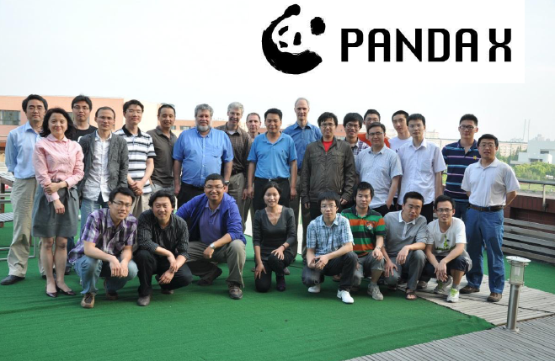
PandaX collaboration
Started in 2009
上海交通大学 (Shanghai Jiao Tong University)
中科院上海应用物理研究所 (Shanghai Inst. of Applied Physics)
山东大学 (Shandong University)
北京大学 (Peking University)
University of Michigan
University of Maryland

Slide 3
PandaX goal
PandaX: Particle AND Astrophysical
Xenon TPC
Build a state-of-art large-size xenon dual-phase TPC detector working at the lowest background possible
Used for both dark matter search and
¹³⁶Xe double beta decay search
Two important features:
Emphasize light collection efficiency so as to enhance the sensitivity to low-mass WIMPs
Accommodate a ton-scale experiment

Slide 4
Outline
Direct Detection of Dark Matter
Xenon Technology
PandaX Status
Closing Remarks

Slide 5
Assumptions for direct detections
That dark matter consists of WIMPs, weakly interacting particles with mass GeV-TeV range
That local dark matter density is around 0.3 GeV/cm³
That the dark matter has a velocity distribution centered around the speed of the sun around the center of the Milky Way.

Slide 6
Xenon Technology
Liquid Xenon has been developed into a mature technology in the last ten years or so as an excellent medium for dark matter detection!
Liquid Xe is an excellent liquid scintillator
Free charges In LXe drift under an electric field and can be collected/detected through a proportional chamber (gas phase).
Xenon does not have long-lived radioactive isotopes, can be purified relatively easily.
⁸⁵Kr
Electro-negatives (getter)
Xenon is not terribly expensive and the cost for ton scale experiment is manageable.

Slide 7
PandaX Design Concept
All aspects of the exp are designed for 1 ton LXe fiducial target.
Except for the central TPC, which depends on the funding stages…
Stage 1a: 100kg target (300kg Xe)
Stage 1b: 500kg target (1.3ton Xe)
Stage 2: 1.5 ton target (3 ton Xe)

Slide 8
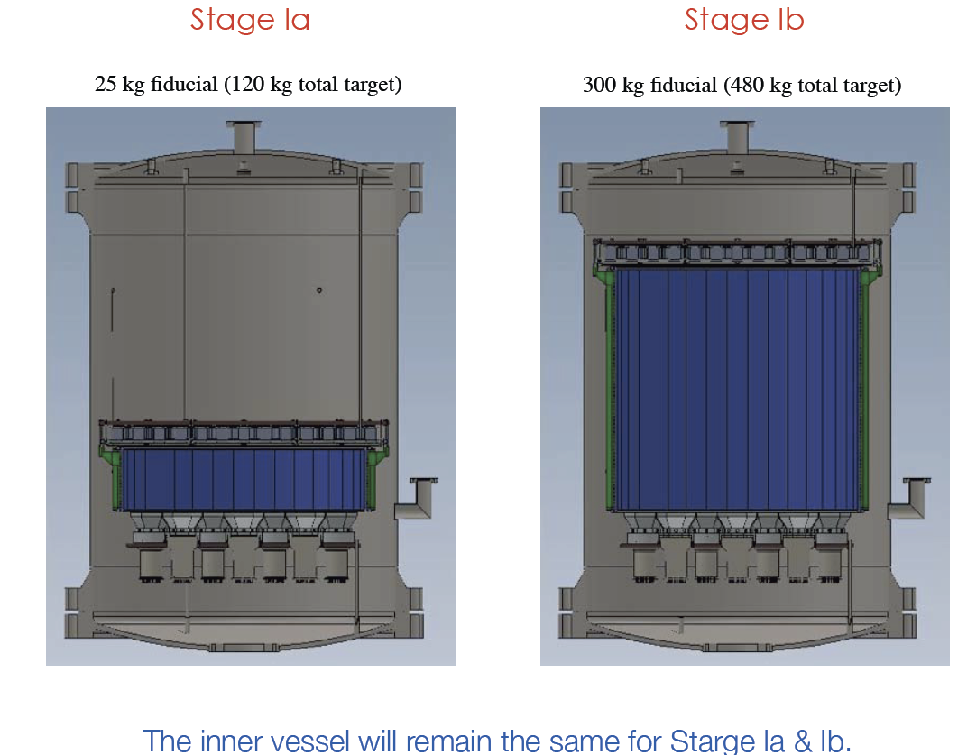
First stages

Slide 9
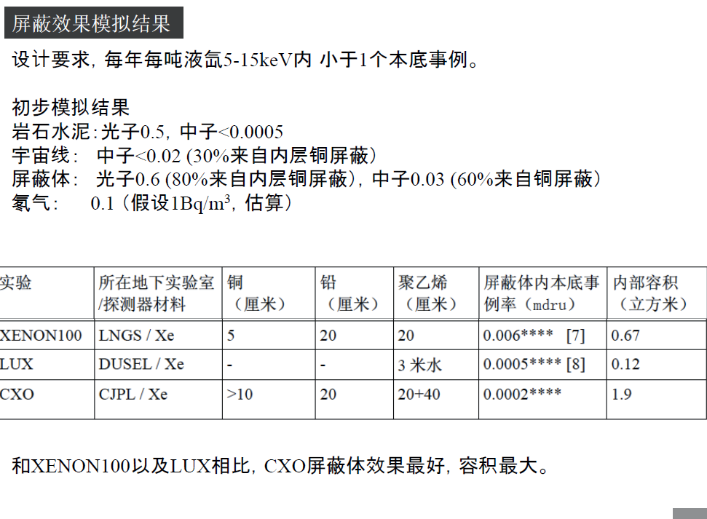

Slide 10
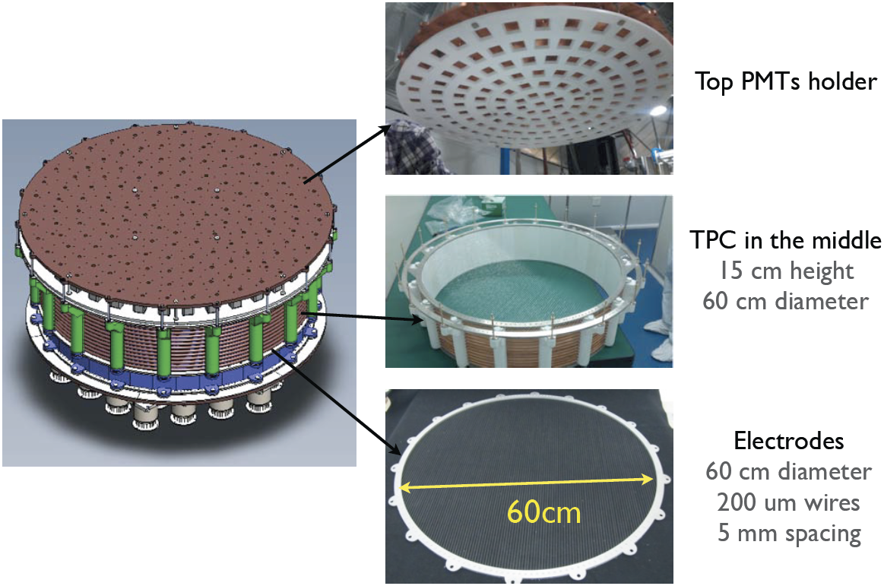
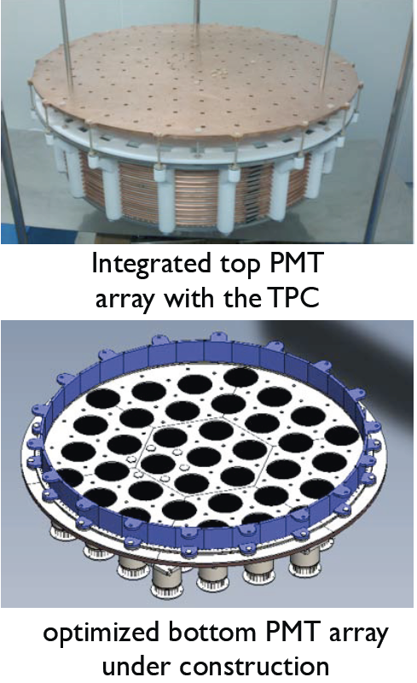
TPC construction

Slide 11
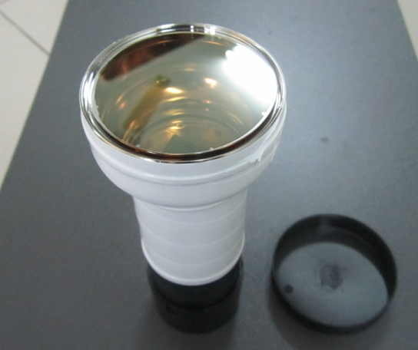
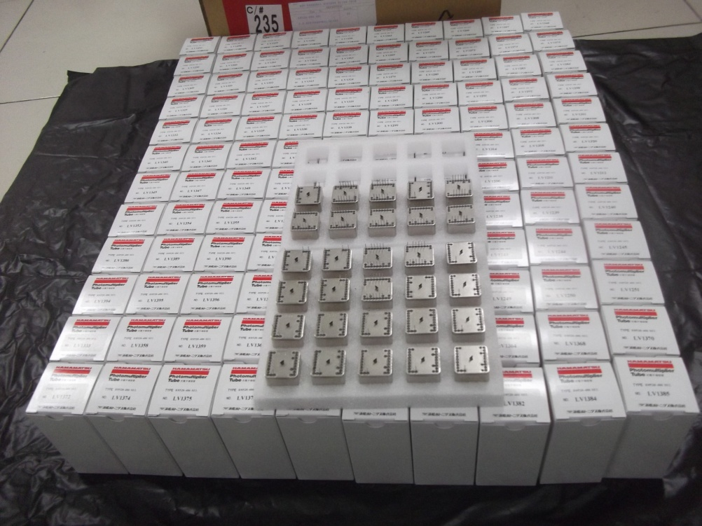
PMTs
150 1-in R8520-406 PMT, bases and decoupler designed and constructed. PMT’s tested . A data base has been established.
50 3-in PMT for the bottom TPC.

Slide 13
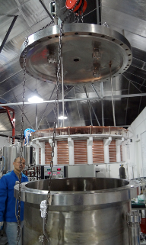
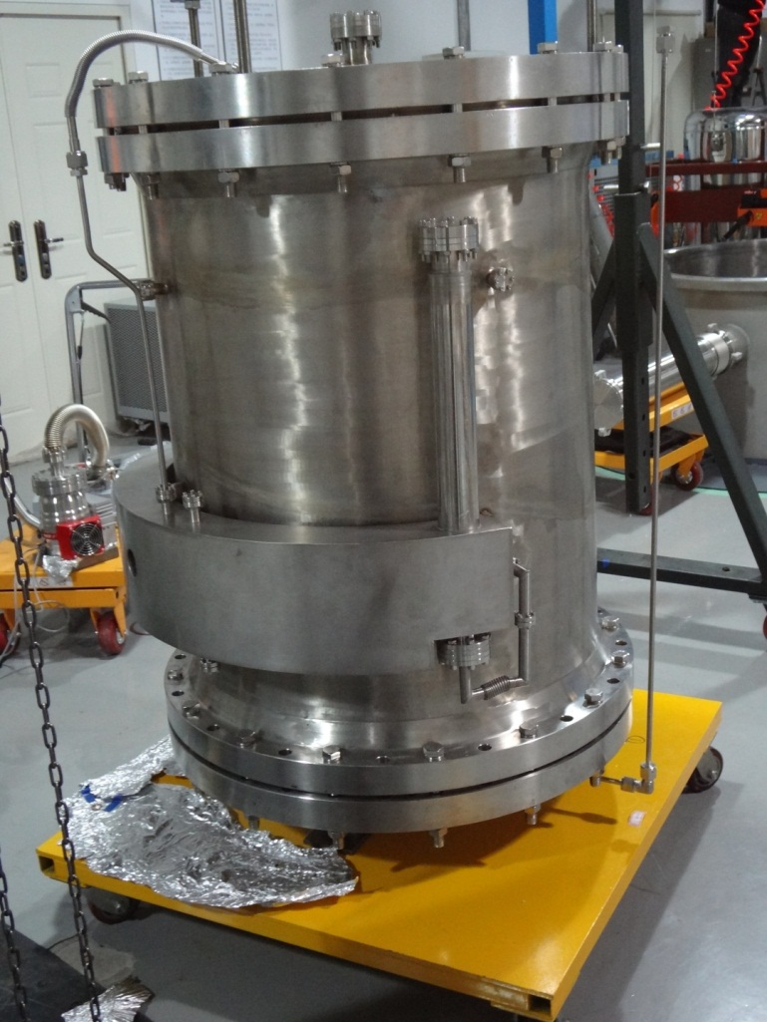
InnerVessel

Slide 14
Cryogenic system
Outer Vessel (vacuum) part of shield 5 cm OFHC copper
All auxiliary structures removed to outside of shield
Overflow chamber to control liquid level instead of the ‘Bell’
Minimize PTFE use. Neutron production on Fluorine
Reduced cabling in xenon. less outgassing

Slide 15
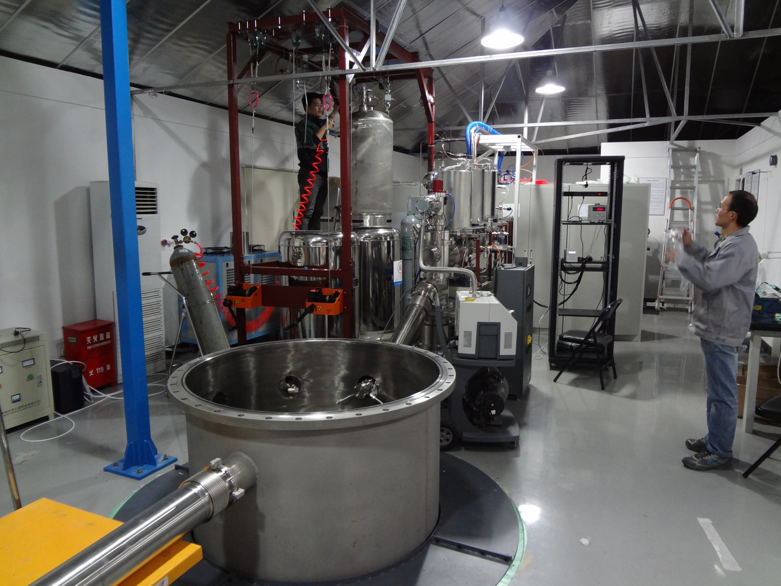
Testing Vessel and gas handling

Slide 16
Cooling bus
with Heat Exchanger ,
with speed 100 to 200 SLPM.

Slide 17
Background
Internal
Vessels
PMTs
Xenon (Krypton)
….
External
Cosmic ray (Jinping Underground lab)
Rocks and concrete
Shield
….

Slide 18
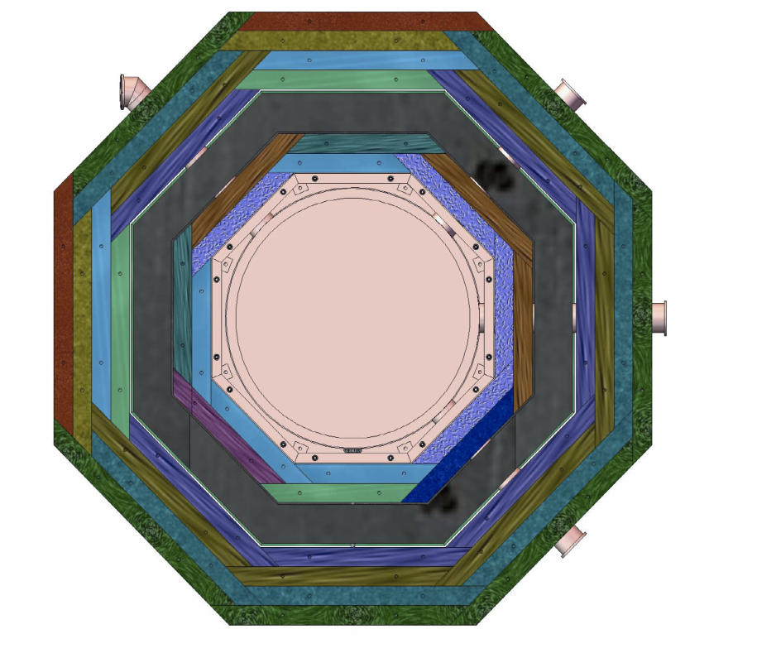
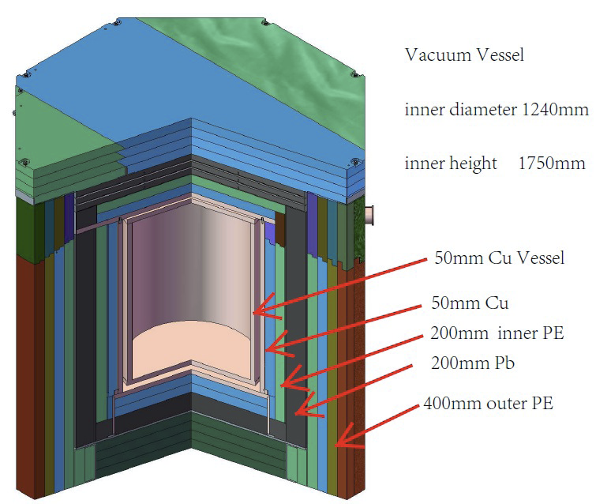
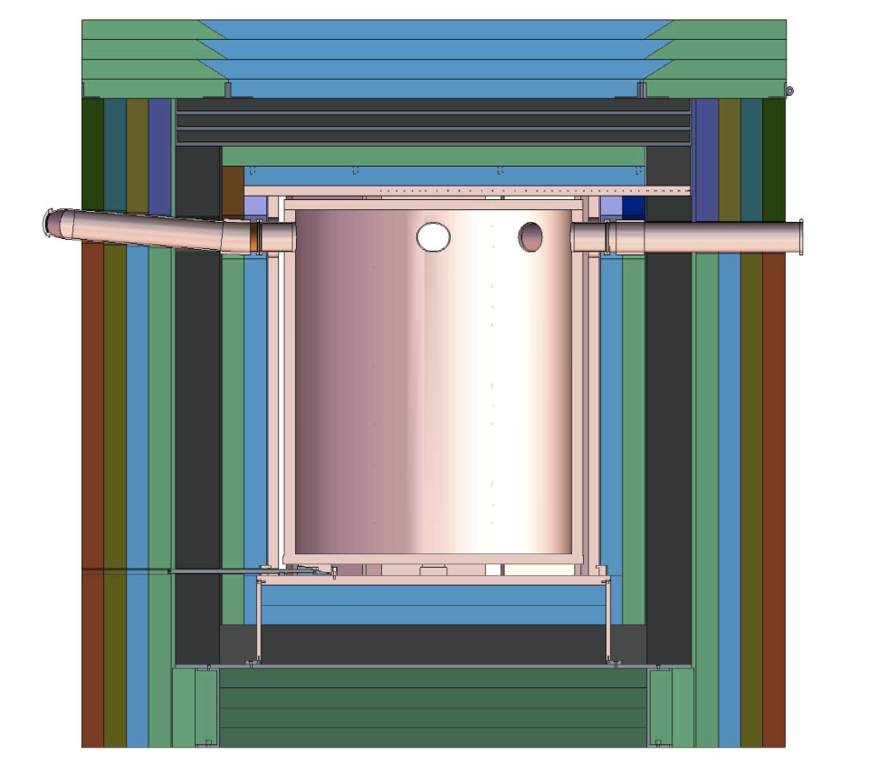
Shield design

Slide 19
Purify Kr from ppb to ppt level

Slide 21
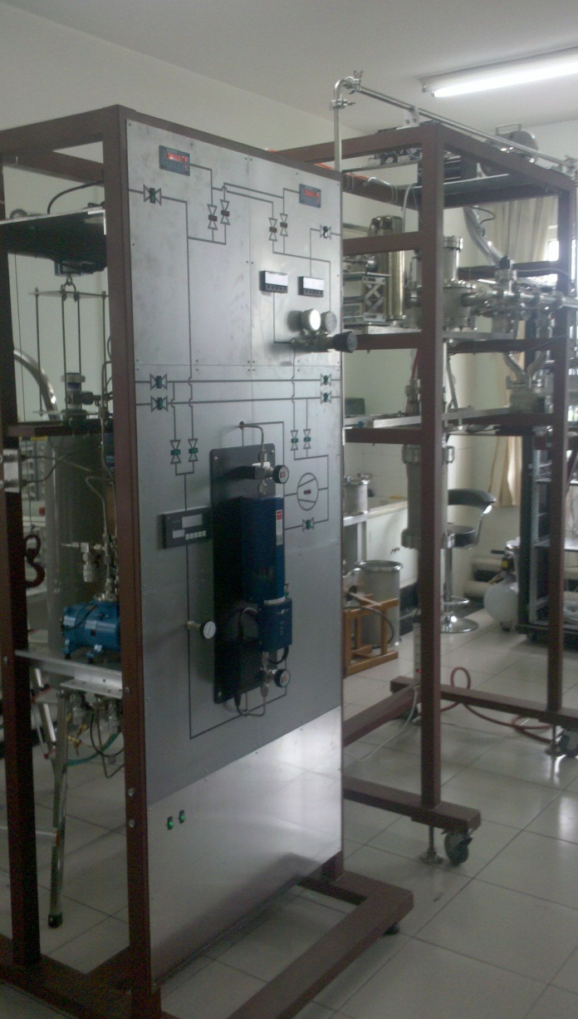
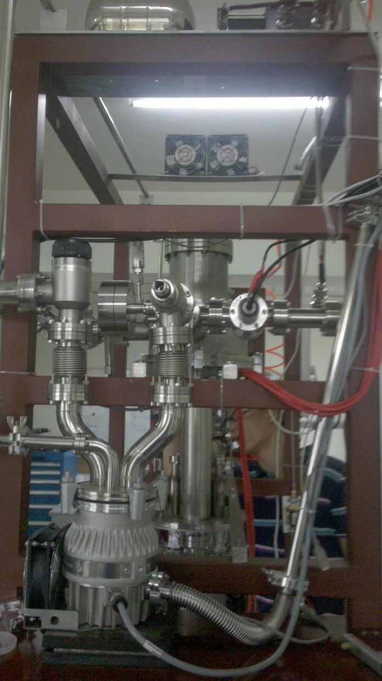
Running of a small testing system

Slide 23
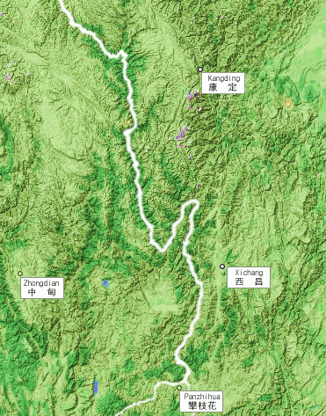
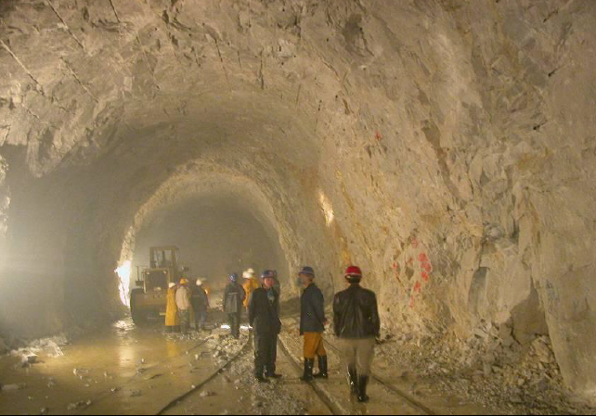
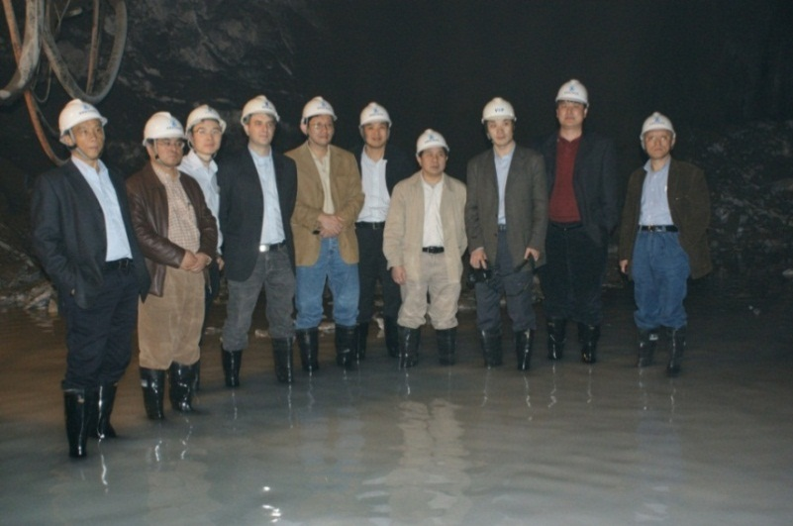
Jinping lab in Sichuan, China

Slide 25
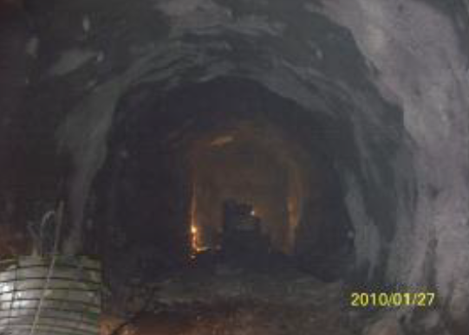

Slide 26
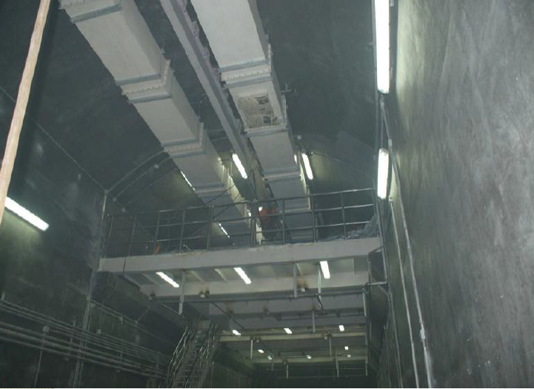

Slide 27
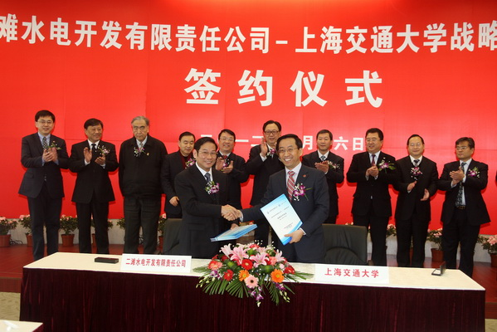

Slide 28
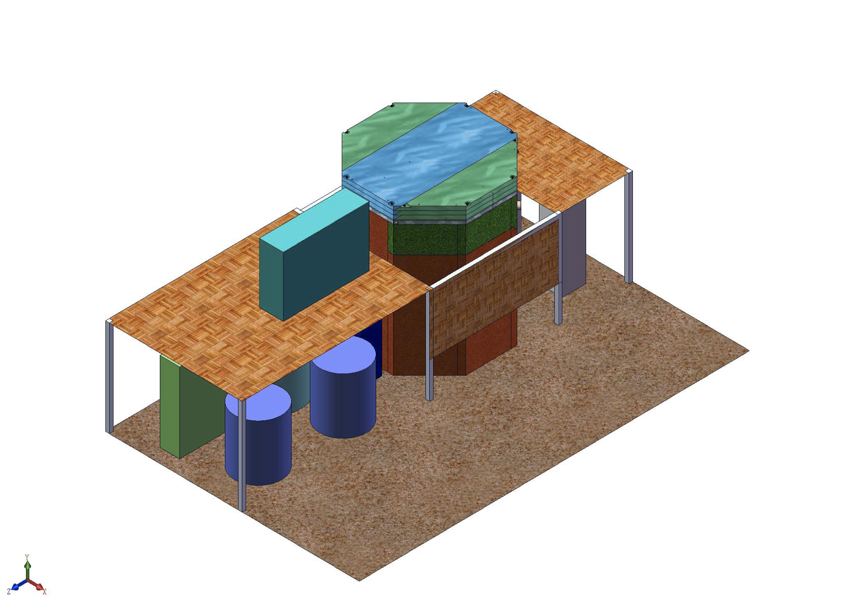
Layout of the exp in Jinping lab
Shield
Cooling Bus
Xe Storage

Slide 29
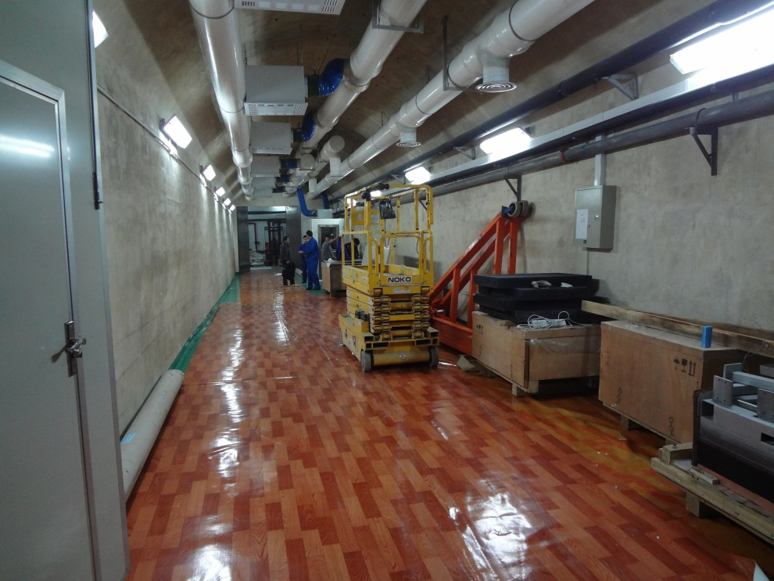
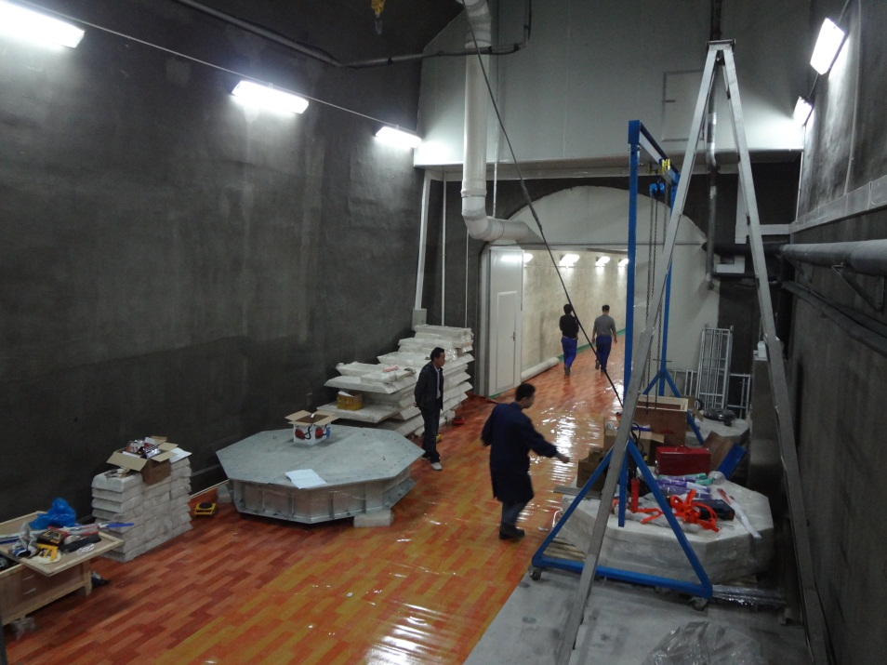
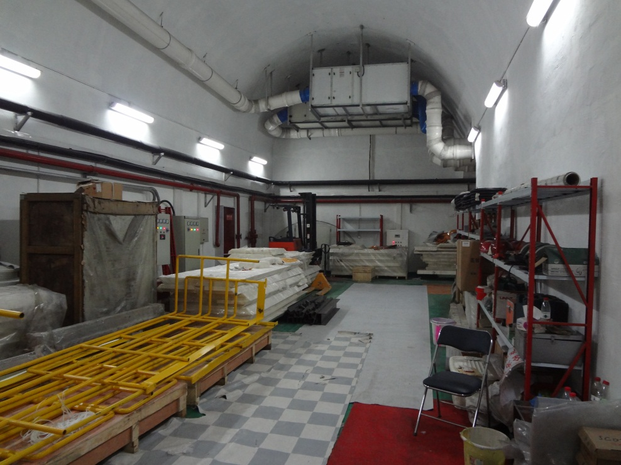

Slide 30
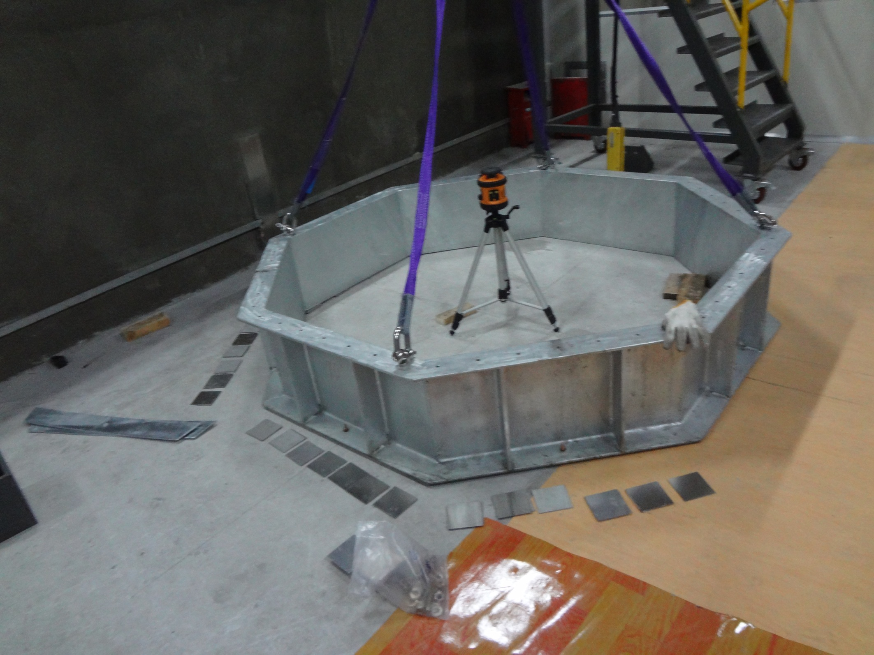

Slide 31
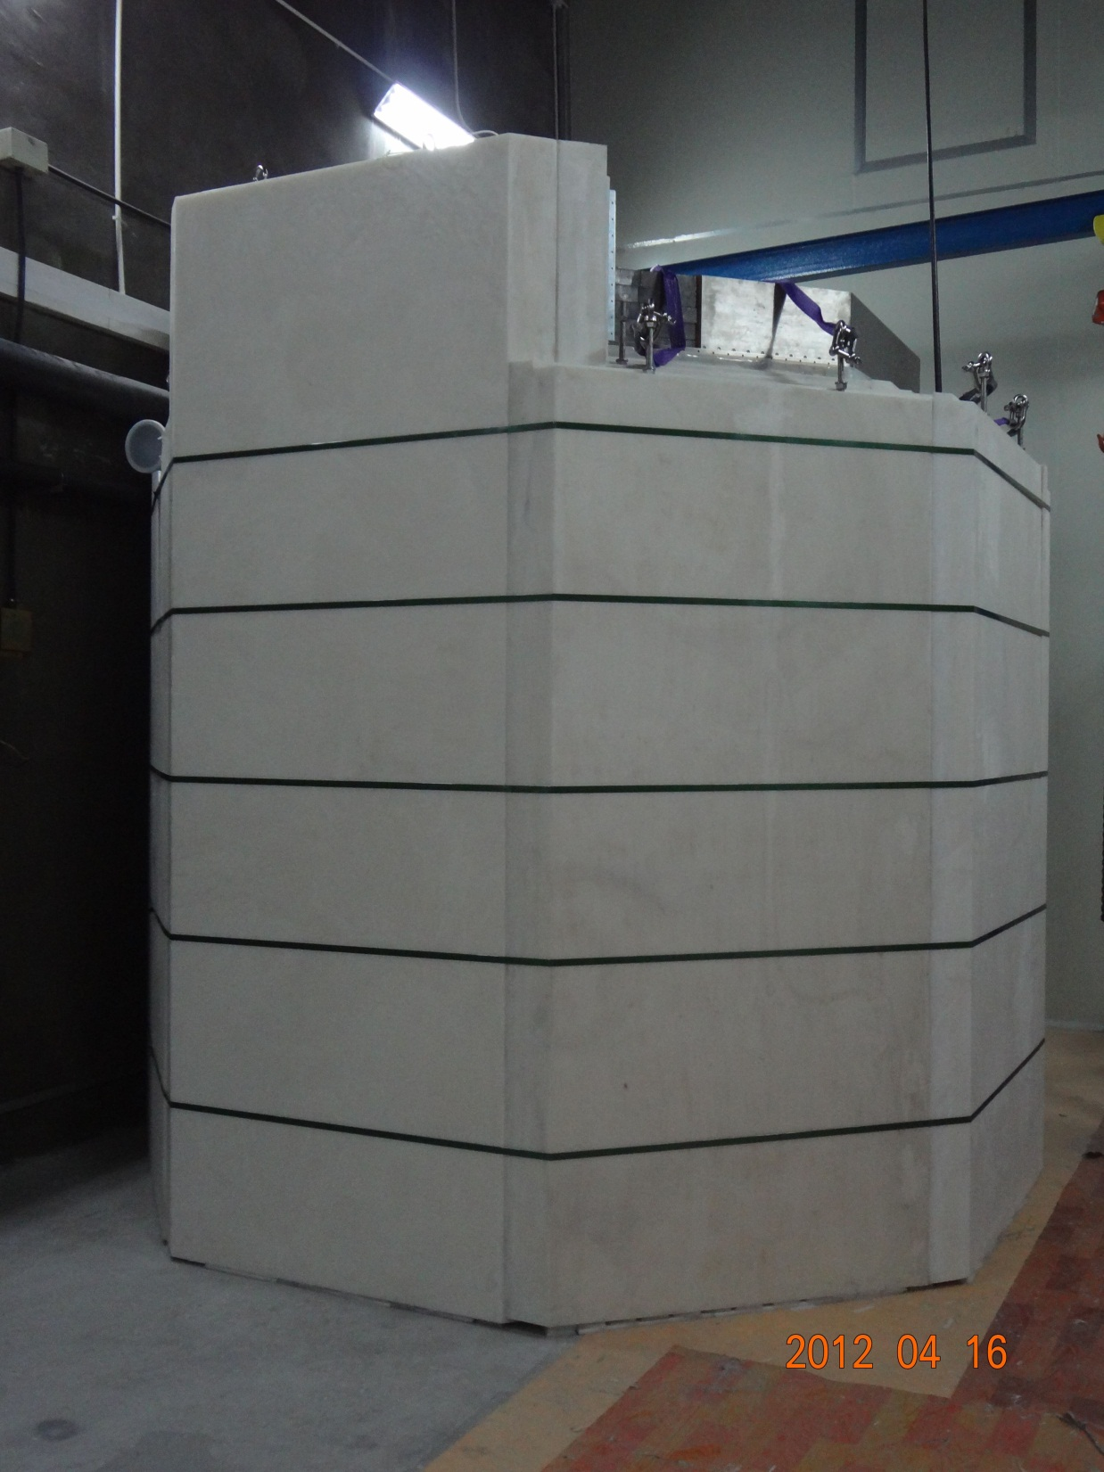
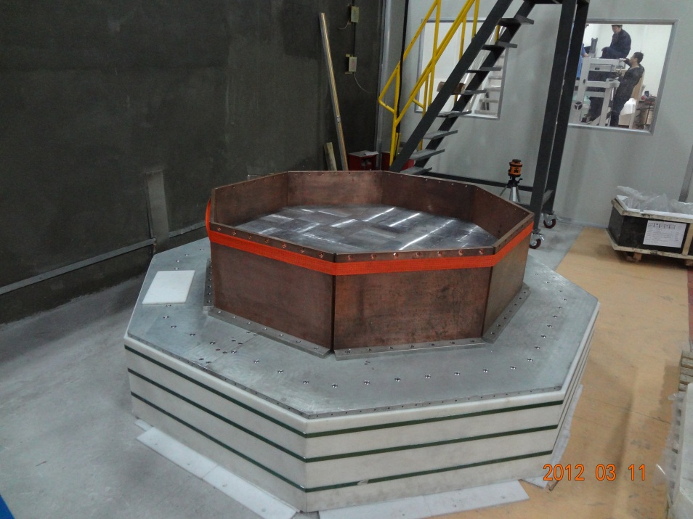
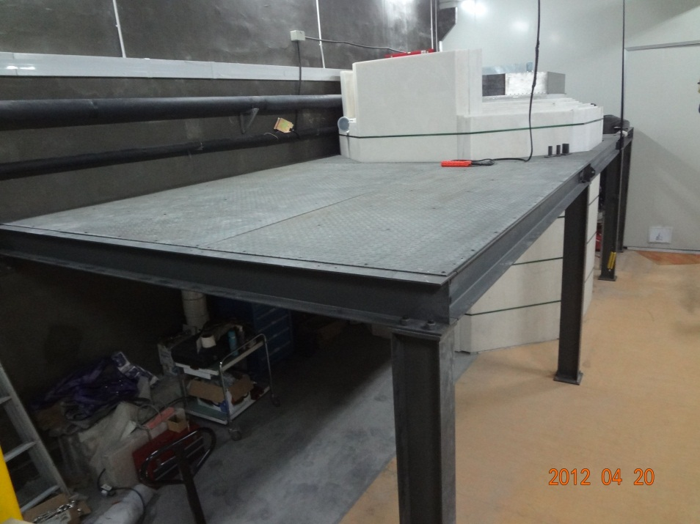

Slide 32
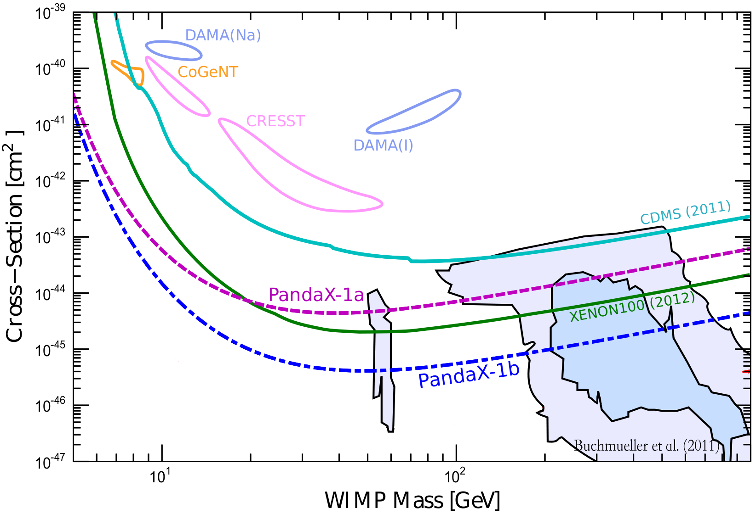
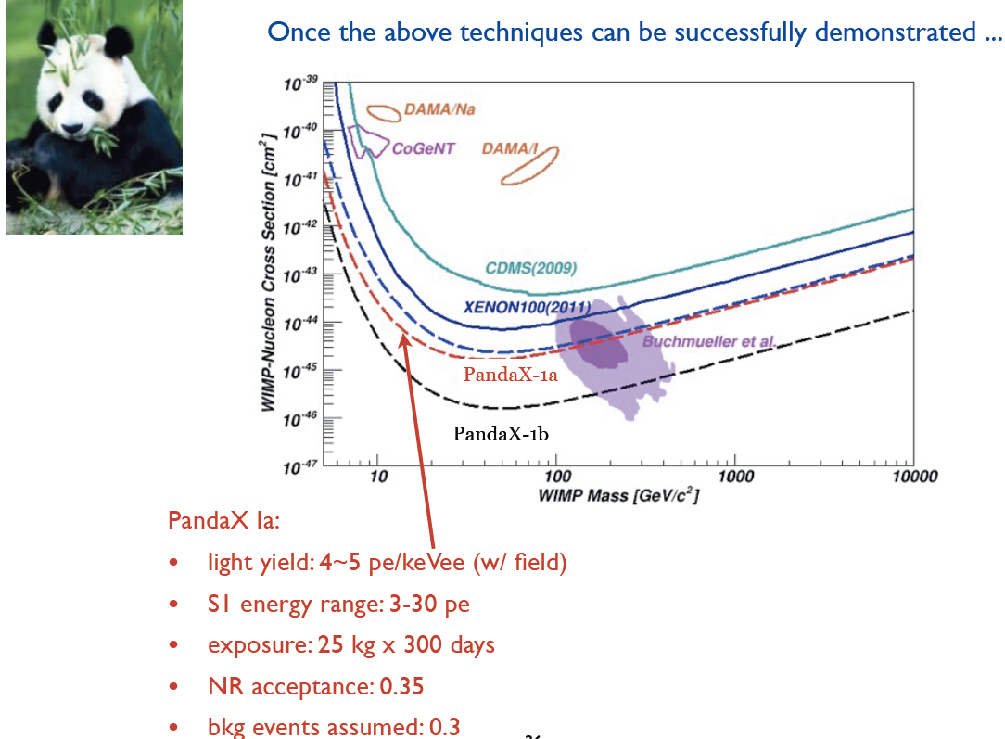
PandaX sensitivity

Slide 33
Summary
Direction detection of DM particle is a hot international pursuit with significant astrophysical and particle physics implications.
PandaX is a new DM search exp in China with the goal of ton-scale detection target.
PandaX Ia is now onsite to finish installation and testing, we hope to take initial data next year.

Slide 34
Acknowledgement of support
Majority of the funding from Shanghai Jiao Tong University
MOST 973 project
NSFC
ShanDong University
Peking University
University of Michigan
…

Slide 35
PandaX sensitivity

Slide 36
PandaX Schedule
We are building up the system now at JinPing lab.
Hopefully finish construction by the end of 2012
Start running 1a in 2013 and preparing for stage 1b
Stage 1b running by the end of 2013.

