Slide 1


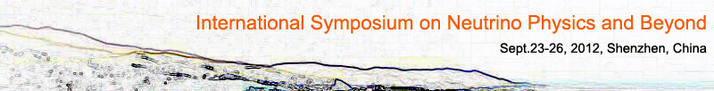
Daya Bay-II
A 60km-baseline Reactor Experiment and Beyond
Jun Cao
Institute of High Energy Physics

Slide 2
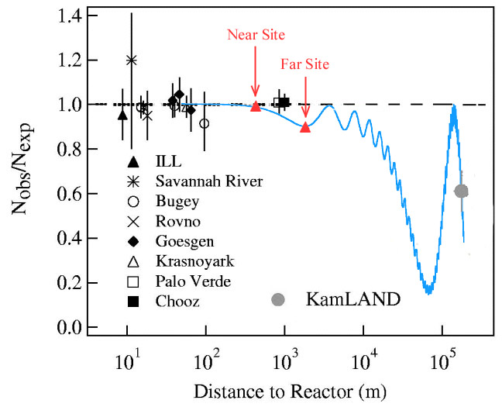
Daya Bay-II Experiment
60 km
Daya Bay II
20 kton LS detector
3%/√E̅ resolution
Rich physics
  Mass hierarchy
  Precision measurement of 4 oscillation parameters to <1%
  Supernovae neutrino
  Geoneutrino
  Sterile neutrino
  Atmospheric neutrinos
  Exotic searches
Daya Bay
Talk by Y.F. Wang at ICFA seminar 2008, Neutel 2011; by J. Cao at Nutel 2009, NuTurn 2012;

Slide 3
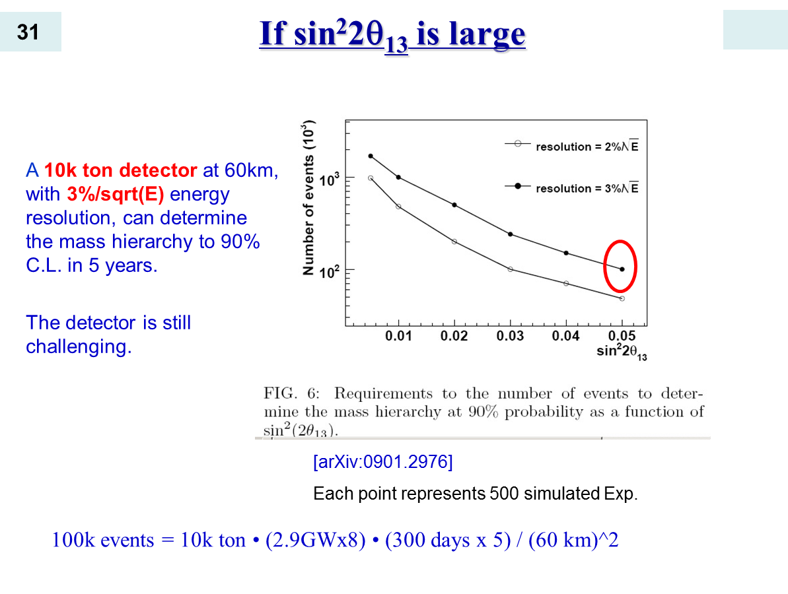
A Slide at NuTel 2009, Venice
We may not afford larger detector
If we are lucky, sin²2θ₁₃ may be as large as 0.05
In general,
neutrino exps were not precise.
8 cores planned @DYB

Slide 4
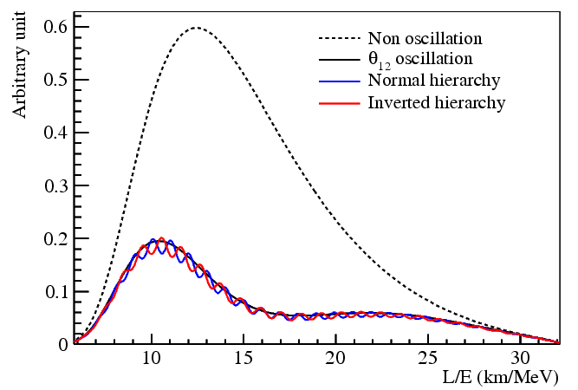
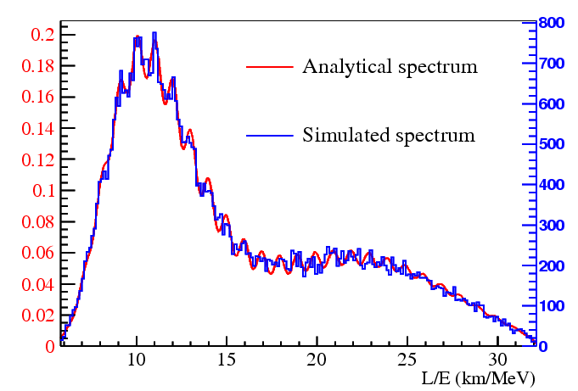
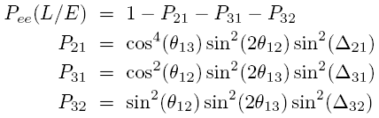
Reactor Exp. to determine MH
S.T. Petcov et al., PLB533(2002)94
S.Choubey et al., PRD68(2003)113006
J. Learned et al., hep-ex/0612022
L. Zhan, Y. Wang, J. Cao, L. Wen,
PRD78:111103, 2008
PRD79:073007, 2009

Slide 5
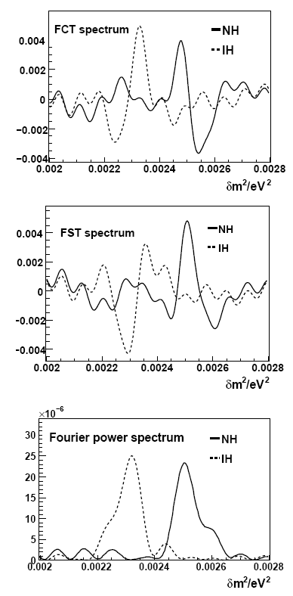
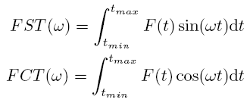
Fourier transformation of L/E spectrum
Frequency regime is in fact the ΔM² regime ➔ enhance the visible features in ΔM² regime
Take ΔM² ₃₂ as reference
  NH: ΔM² ₃₁ > ΔM² ₃₂ , ΔM² ₃₁ peak at the right of ΔM² ₃₂
  IH: ΔM² ₃₁ < ΔM² ₃₂ , ΔM² ₃₁ peak at the left of ΔM² ₃₂
The Fourier formalism:
Distinctive features
No pre-condition of Δm²₂₃

Slide 6
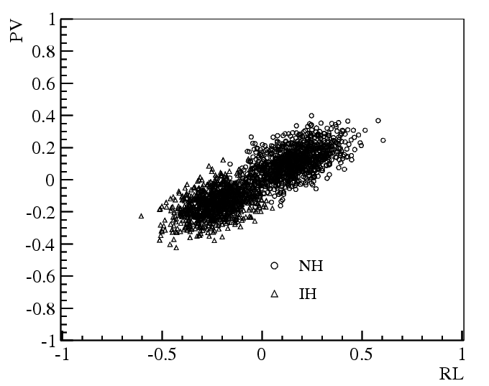
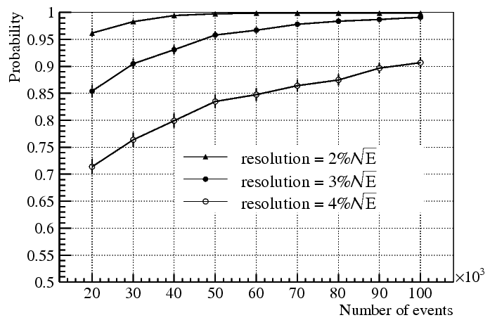
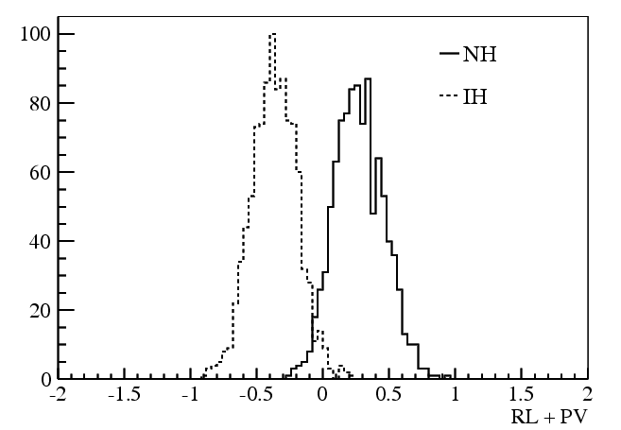
Easier now with a large θ₁₃
New default parameters:
  Detector size: 20kt
  Energy resolution: 3%
  Thermal power: 36 GW
  Baseline 58 km
3 years, 2σ
6 years,3σ

Slide 7
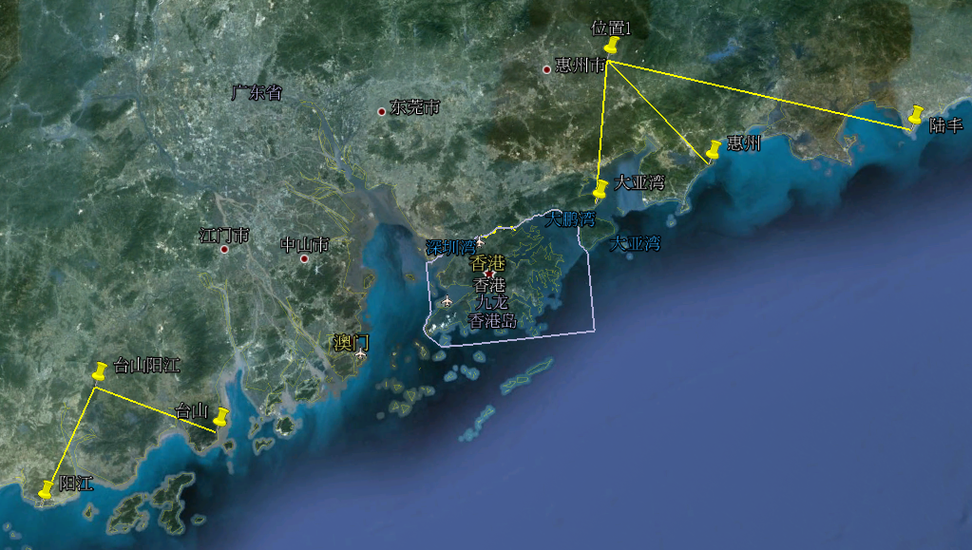
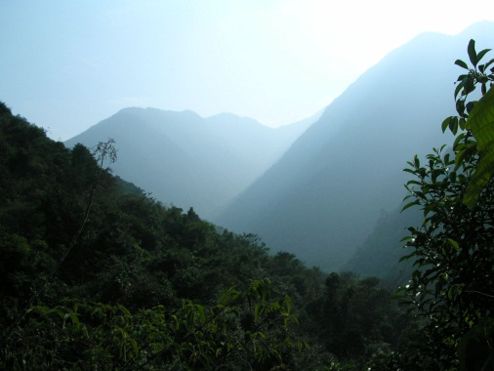
The reactors and possible sites
 | Daya Bay | Huizhou | Lufeng | Yangjiang | Taishan
Status | Operational | Planned | Planned | Under construction | Under construction
Power | 17.4 GW | 17.4 GW | 17.4 GW | 17.4 GW | 18.4 GW
Huizhou
1st scout in 2008
Bai-Yun-Zhang@Huizhou
1000 meter mountain
Lufeng
Huizhou
Daya Bay
Taishan
Yangjiang

Slide 8
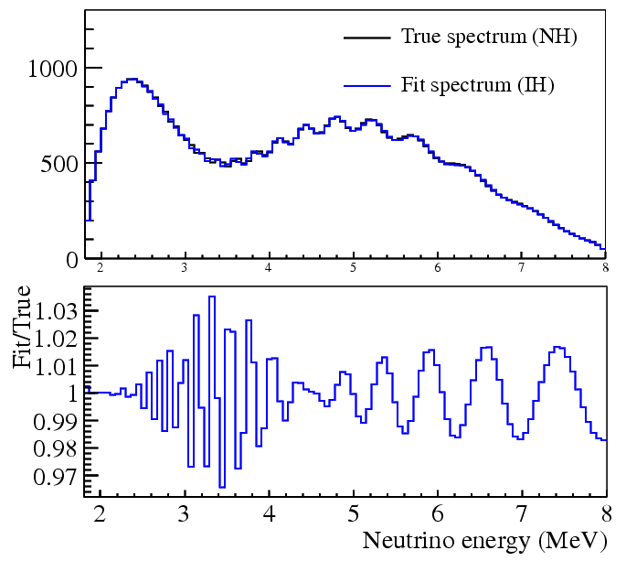
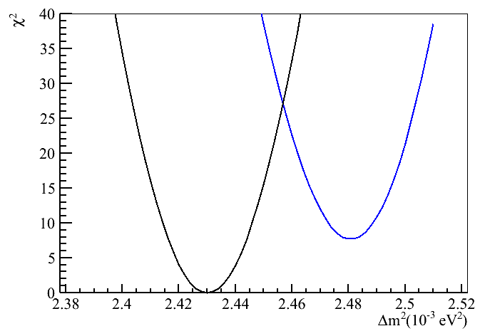
Alternative method to FT: χ² fit
Assume the truth is NH/IH, and calculate the truth spectrum.
Calculate the spectra for NH and IH case and fit them to the truth spectrum respectively.
Energy resolution is taking into account.
NH spectrum fits to NH
IH spectrum fits to NH
Δm²=(Δm²₃₁+Δm²₃₂)/2
Input value: 2.43
If truth is NH, NH spectrum may fit it better.
Δm² is fitted without constrain.

Slide 9
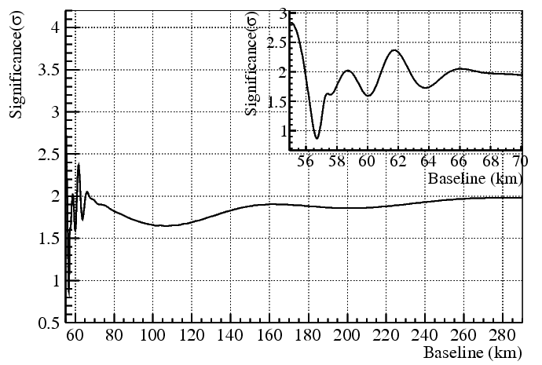
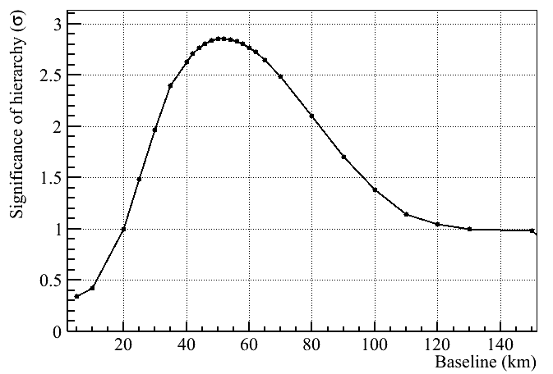
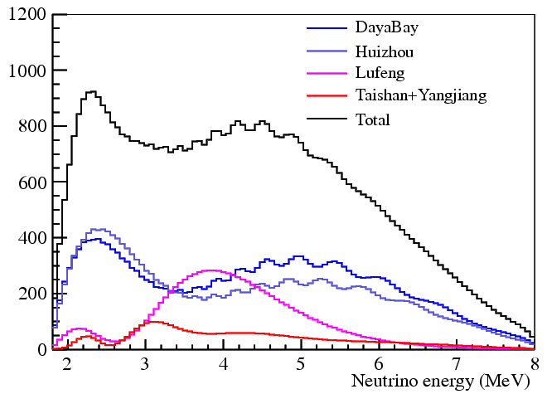
Optimum baseline ?
Multiple reactors may cancel the oscillation structure
We are still working on
  Different fitting methods
  Effects of multiple baselines
  Optimum site selection
Fix 18 GW, move the other 18 GW
Single 36 GW reactor X 3 years
3%/sqrt(E) energy resolution

Slide 10
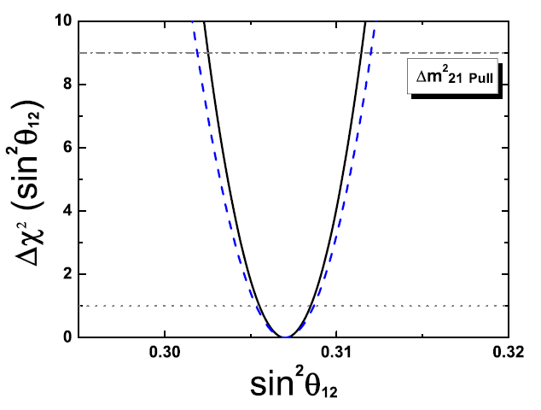
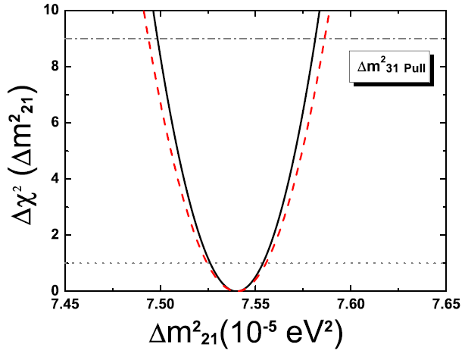
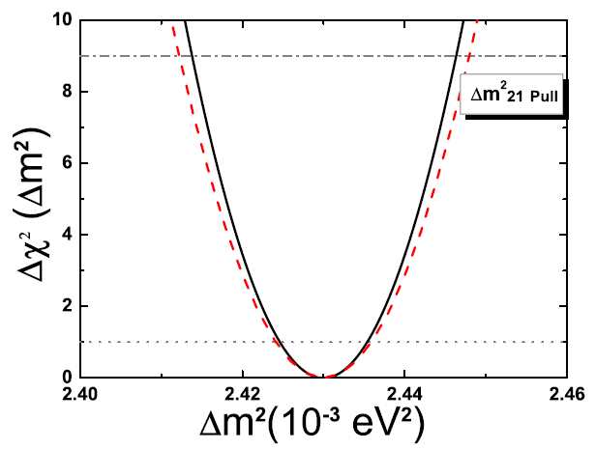
Precision Measurements
Fundamental to the Standard Model and beyond
Probing the unitarity of U_{PMNS} to ~1% level !
 | Current | Daya Bay II
Δm²₁₂ | 3% | 0.26%
Δm²₂₃ | 5% | 0.30%
sin²θ₁₂ | 6% | 0.63%
sin²θ₂₃ | 20% | N/A
sin²θ₁₃ | 14%➔ 4% | ~ 15%

Slide 11
Supernova neutrinos
Less than 20 events observed so far
Assumptions:
  Distance: 10 kpc (our Galaxy center)
  Energy: 3×10⁵³ erg
  L_{ν} the same for all types
  Tem. & energy
Many types of events:
  ν_{e} + p → n + e⁺, ~ 3000 correlated events
  ν_{e} + ¹²C → ¹²B* + e⁺, ~ 10-100 correlated events
  ν_{e} + ¹²C → ¹²N* + e⁻, ~ 10-100 correlated events
  ν_{x} + ¹²C →ν_{ｘ}+ ¹²C*, ~ 600 correlated events
  ν_{x} + p → ν_{ｘ}+ p, single events
  ν_{e} + e⁻ → ν_{e} + e⁻, single events
  ν_{x} + e⁻ →ν_{ｘ}+ e⁻, single events
  T(ν_{e}) = 3.5 MeV, <E(ν_{e})> = 11 MeV
  T(ν_{e}) = 5 MeV, <E(ν_{e})> = 16 MeV
  T(ν_{x}) = 8 MeV, <E(ν_{x})> = 25 MeV
Water Cerenkov detectors can not see these correlated events
Energy spectra & fluxes of all types of neutrinos

Slide 12
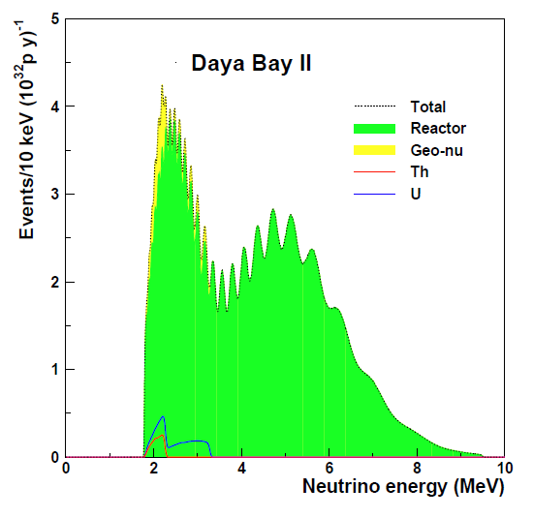
Geoneutrinos
Current results:
  KamLAND:
  40.0±10.5±11.5 TNU
  Borexino:
  64±25±2 TNU
Desire to reach an error of 3 TNU: statistically dominant
Daya Bay II: >×10 statistics, but difficult on systematics
Background to reactor neutrinos
Stephen Dye

Slide 13
Others
Exotics searches
  Sterile neutrinos
  Monopoles, Fractional charged particles, ….
Target for neutrino beams
Atmospheric neutrinos
Solar neutrinos
High energy cosmic-rays & neutrinos
  Point source: GRB, AGN, BH, …
  Diffused neutrinos
  Dark matter

Slide 14
Detector Concept (Traditional)
Muon tracking
Stainless steel tank
Water Seal
Liquid Scintillator
20 kt
Water Buffer 10kt
Acrylic sphere：φ34.5m
Oil buffer 6kt
~15000 20” PMTs
optical coverage: 70-80%
SS sphere ： φ 37 .5m
VETO PMTs
Alternate: acrylic -> ballon
Alternate: acrylic -> PET sphere

Slide 15

Alternate One: Water
Option 1
Muon tracking
PMT support Structure
Water Seal
Liquid Scintillator
20 kt LAB/PPO/bisMSB
Black sheet
Acrylic sphere：34.5m
~15000 20“ PMTs
optical coverage: 70-80%
PMT diameter ：37 .5m
Buffer H₂O

Slide 16
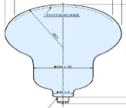
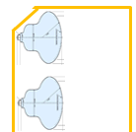
Alternate Two: MO module
connect to other modules
Seal the Mineral Oil in the optical modules.
LS contact with SS vessel
pipe for filling MO and cabling
Detector can be cylindric or spheric
Disadvange:
  Radioactivity: LS in the gap produce light
  Contamination to LS from complex structure
MO
MO
LS
LS
MO

Slide 17
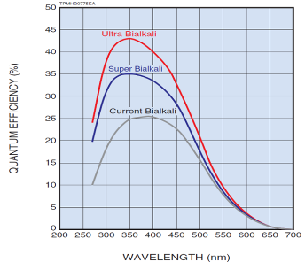
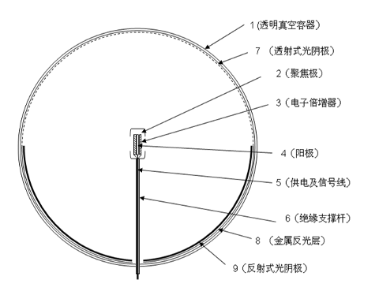
More Photoelectrons -- PMT
SBA photocatode
MCP PMT with reflection photocathode at bottom
20" + 8" PMT
8" PMT better timing
No clearance: coverage 86.5%
1cm clearance: coverage: 83% *(d/D)²= 73%

Slide 18
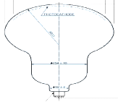
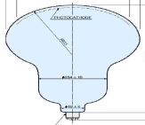
More Photoelectrons -- reflection
Two thin acrylic panels with air gap – Total internal reflection
For uniformly distributed events, MC simulation shows 6-8% increase on p.e. in average.
Reflecting to local PMTs won't impact on vertex reconstruction

Slide 19
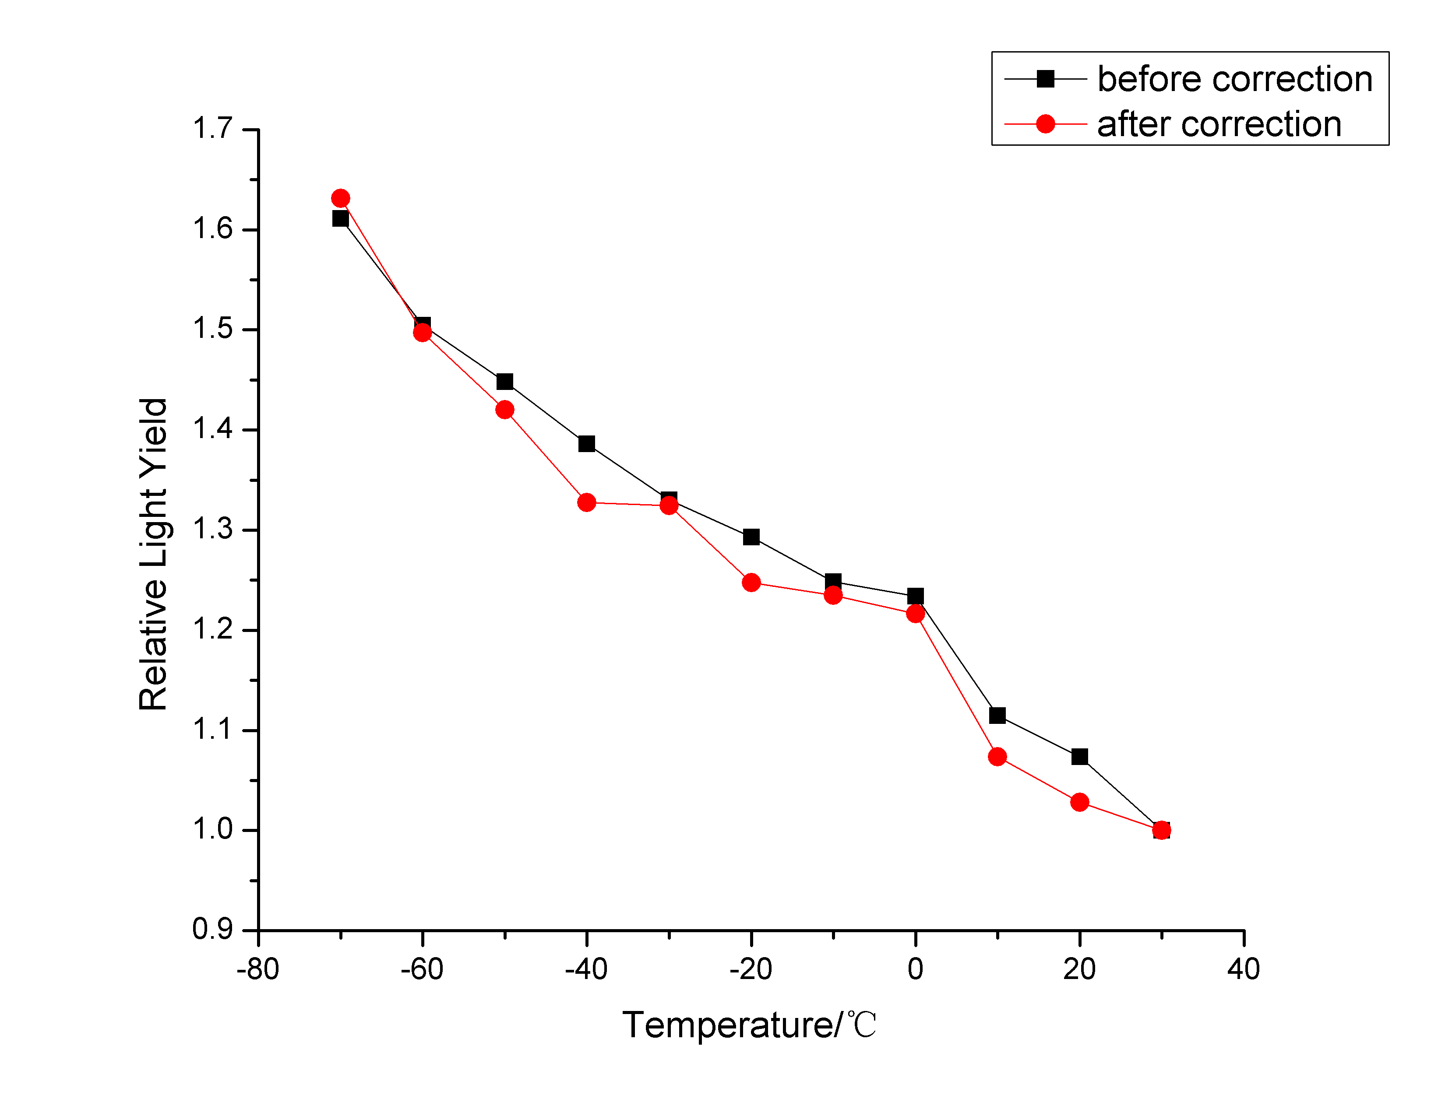
More Photoelectrons-- LS
Attenuation length.
Low temperature (4 degree)
fluor concentration optimization (especially at low temperature
Linear Alky Benzene | Atte. Length @ 430 nm
RAW | 14.2 m
Vacuum distillation | 19.5 m
SiO₂ coloum | 18.6 m
Al₂O₃ coloum | 22.3 m

Slide 20
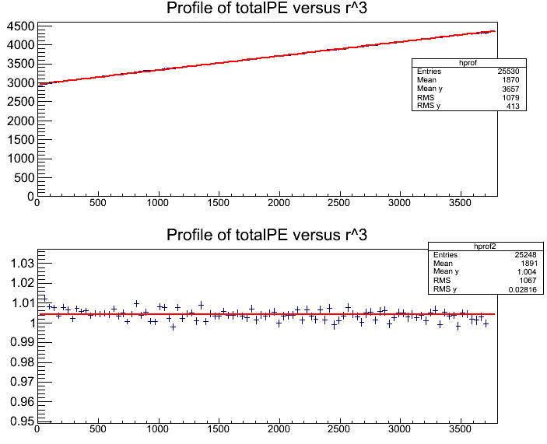
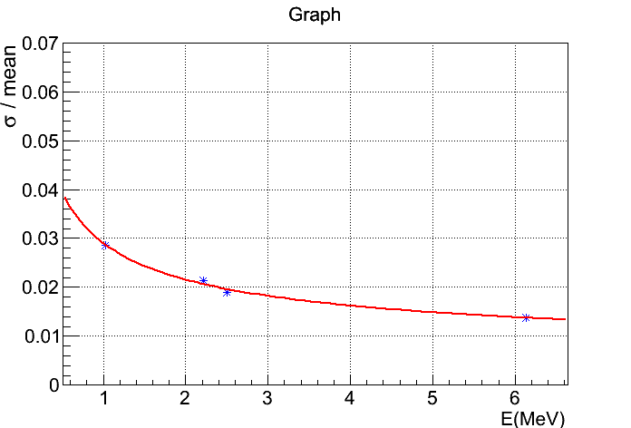
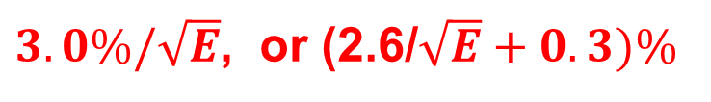
DYBII Energy Resolution
DYBII MC, based on DYB MC (p.e. tuned to data), except
  DYBII Geometry and 80% photocathode coverage
  SAB PMT: maxQE from 25% -> 35%
  Lower detector temperature to 4 degree (+13% light)
  LS attenuation length (1m-tube measurement@430nm)
    from 15m = absoption 24m + Raylay scattering 40 m
    to 20 m = absorption 40 m + Raylay scattering 40m
Uniformly Distributed Events
R³
After vertex-dep. correction
$3.0\%/\sqrt{E}$, or (2.6/$\sqrt{E}+0.3)\%$

Slide 21

Background Estimation
Signal rate: ~ 40 IBD/day/20kt, DYB far: ~70 IBD/day/20t
$n+p→d+γ \left(2.2 MeV\right) τ\sim 200 μs$
 | Daya Bay |  | DYBII
 | Near | Far
Accidentals (B/S) | 1.4% | 4.0% | ?
Fast neutrons (B/S) | 0.1% | 0.06% | 120%?
⁸He/⁹Li (B/S) | 0.4% | 0.3% | 600%?
Signal redcued by 2000 times
Suppose at the same overburden of DYB far site:
~ 350 m
Suppose 500 m overburden (1350 m.w.e.)
E_{μ} ~ 200 GeV, R_{μ} ~ 0.011 Hz/m², or 10 Hz total
Fast neutron bkg:
 | Daya Bay near | Daya Bay II
R_{μ} (Hz) | 21 | 10
Fast neutron bkg | 0.84 /day | 0.4 /day B/S = 1%
Suppose similar water shielding and similar muon efficiency as DYB

Slide 22
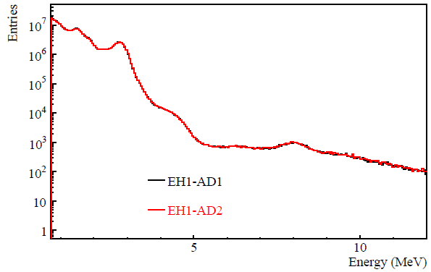
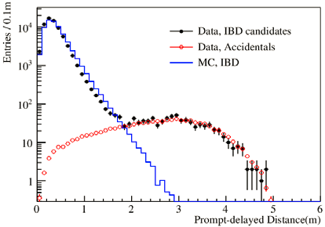
Accidental Backgrounds
Singles (back-on-the-envelope estimation)
PMT Radioactivity | ~5 Hz | DYB PMT radioactivity w/ 2 m shielding
LS Radioactivity | ~ 0.5 Hz | 10⁻¹⁶ g/g for K-40, U, and Th
Cosmogenic | ~700/day | scaling from DYB
Spallation neutron | ~20/day | 4 Hz n yield, w/ 2ms muon veto
280/day!
Toy MC: Distance < 2m, suppress to 1/300, R_{acc}~ 1/day
Singles spectrum at DYB

Slide 23
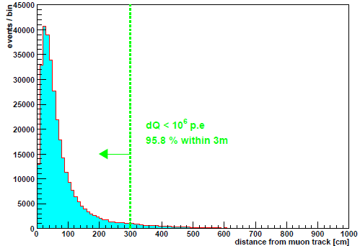
⁹Li/⁸He background
Muon track
 | Daya Bay near | Daya Bay II
E_{μ} (GeV) | 57 | 200
L_{μ} (m) | ~1.3 | ~ 23
R_{μ} (Hz) | 21 (both in GdLS and LS) | 10
 | (50%*5% + 50%*85%) = 45% n-Gd | ~100% n-H
⁹Li bkg rate | 6.5/day | 308/day
Neutron generated in LS and spill in
If cut R_{d2m} < 3m and 2s veto for non-shower muon, 4.2% ⁹Li/⁸He events survive(from KamLAND).
R_{d2m}<5m and 2s veto, the ⁹Li/⁸He is expected to be <0.5%. The dead volume fraction:
The B/S for ⁹Li/⁸He 0.8/40 = 2%
vertex profile
KamLAND

Slide 24
Background Summary
Based on a very rough back-on-the-envelope calculation,
500 m (1350 m.w.e.) is the minimum overburden
 | DYBII
Accidentals (B/S) | ~ 2.5% | Accurate subtraction
Fast neutrons (B/S) | ~ 1% | Roughly flat
⁸He/⁹Li (B/S) | ~ 4% | Known spectrum
Used track and distance between vertices.
Since we are looking at the small oscillations, slow varying in energy spectrum backgrounds are not serious.

Slide 25
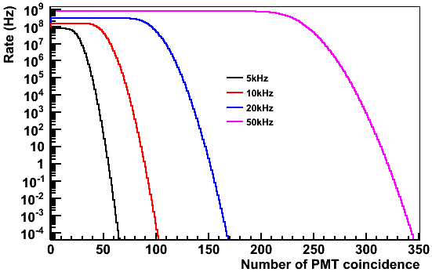
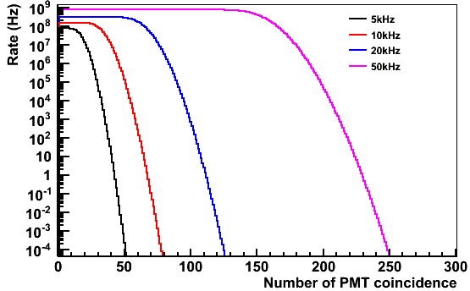
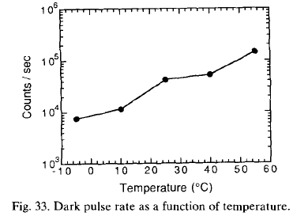
PMT Dark Rate Coincidence
15000 PMTs
~ 40 m distance -> 200 ns
1200 p.e./MeV
The worst case threshold ~ 0.3 MeV in the right plots (50 kHz/PMT, 300 ns windows)
Lower temperature to 4 degree:
~ 4 reduction in PMT dark rate,
threshold: 0.3 MeV --> 0.1 MeV
300ns windows
200ns windows

Slide 26
Summary
The large θ₁₃ discovery accelerates the experiments on mass hierarchy and CP phase.
Daya Bay II proposed in 2008-2009, now boosted by the large θ₁₃
  Science case is strong with significant technical challenges
  Very rich physics.
  Funding are promising.
  Possible time schedule:
    Proposal to government: 2015
    Construction: 2016-2020
Thanks many colleagues for providing slides and materials

