Slide 1

Status of the LBNE project and collaboration
Long-Baseline Neutrino Experiment
Maury Goodman
Argonne National Lab
International Symposium on Neutrino Physics and Beyond
26 September 2012

Slide 2
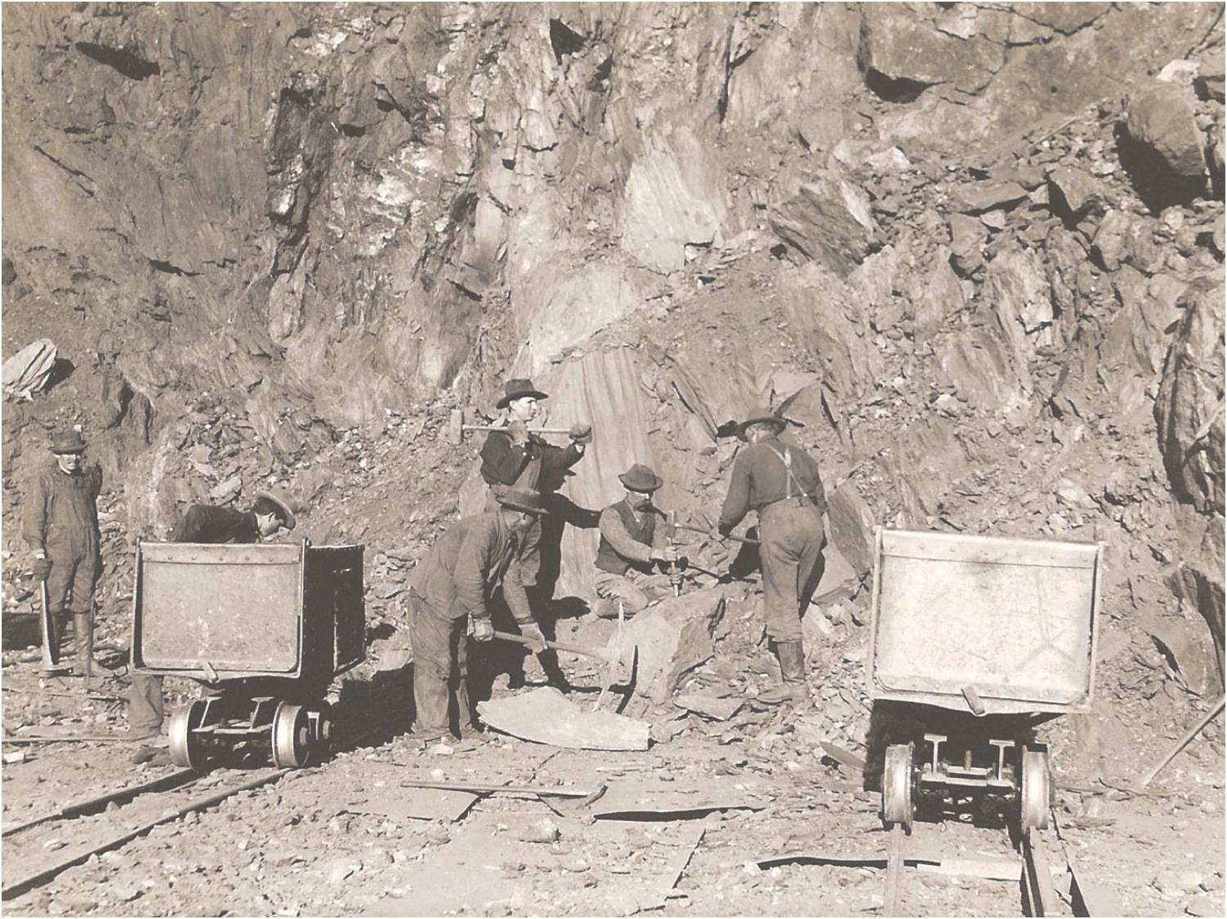
Long-Baseline Neutrino Experiment Collaboration
Alabama: S. Habib, I. Stancu
Argonne: M. D’Agostino, G. Drake. Z. Djurcic, M. Goodman, V. Guarino, S. Magill, J. Paley, H. Sahoo, R. Talaga, M. Wetstein
Boston: E. Hazen, E. Kearns, S. Linden
Brookhaven: M. Bishai, R. Brown, H. Chen, M. Diwan, J. Dolph, G. Geronimo, R. Gill, R. Hackenburg, R. Hahn, S. Hans, Z. Isvan, D. Jaffe, S. Junnarkar, S.H. Kettell, F. Lanni, Y. Li, L. Littenberg, J. Ling, D. Makowiecki, W. Marciano, W. Morse, Z. Parsa, V. Radeka, S. Rescia, N. Samios,R. Sharma, N. Simos, J. Sondericker, J. Stewart, H. Tanaka, H. Themann, C. Thorn, B. Viren, S. White, E. Worcester, M. Yeh, B. Yu, C. Zhang
Caltech: R. McKeown, X. Qian
Cambridge: A. Blake, M. Thomson
Catania/INFN: V. Bellini, F. La Zia, F. Mammoliti, R. Potenza,
Chicago: E. Blucher, M. Strait
Colorado: S. Coleman, R. Johnson, S. Johnson, A. Marino, E. Zimmerman
Colorado State: M. Bass, B.E. Berger, J. Brack, N. Buchanan, D. Cherdack, J. Harton, W. Johnston, W. Toki, T. Wachala, D. Warner, R.J.Wilson
Columbia: R. Carr, L. Camillieri, C.Y. Chi, G. Karagiorgi, C. Mariani, M. Shaevitz, W. Sippach, W. Willis
Crookston: D. Demuth
Dakota State: B. Szcerbinska
Davis: M. Bergevin, R. Breedon, D. Danielson, J. Felde, C. Maesano, M. Tripanthi, R. Svoboda, M. Szydagis
Drexel: C. Lane, S. Perasso
Duke: T. Akiri, J. Fowler, A. Himmel, Z. Li, K. Scholberg, C. Walter, R. Wendell
Duluth: R. Gran, A. Habig
Fermilab: D. Allspach, M. Andrews, B. Baller, E. Berman, R. Bernstein, V. Bocean, M. Campbell, A. Chen, S. Childress, A. Drozhdin, T. Dykhuis, C. Escobar, H. Greenlee, A. Hahn, S. Hays, A. Heavey, J. Howell, P. Huhr, J. Hylen, C. James, M. Johnson, J. Johnstone, H. Jostlein, T. Junk, B. Kayser, M. Kirby, G. Koizumi, T. Lackowski, P. Lucas, B. Lundberg, T. Lundin, P. Mantsch, A. Marchionni, E . McCluskey, S. Moed Sher, N. Mokhov, C. Moore, J. Morfin, B. Norris, V. Papadimitriou, R. Plunkett, C. Polly, S. Pordes, O. Prokofiev, J.L. Raaf, G. Rameika, B. Rebel, D. Reitzner, K. Riesselmann, R. Rucinski, R. Schmidt, D. Schmitz, P. Shanahan, M. Stancari, A. Stefanik, J. Strait, S. Striganov, K. Vaziri, G. Velev, T. Wyman, G. Zeller, R. Zwaska
Hawai’i: S. Dye, J. Kumar, J. Learned, J. Maricic, S. Matsuno, R. Meyhandan, R. Milincic, S. Pakvasa, M. Rosen, G. Varner
Houston: L. Whitehead
Indian Universities: V. Singh (BHU); B. Choudhary, S. Mandal (DU); B. Bhuyan [IIT(G)]; V. Bhatnagar, A. Kumar, S. Sahijpal(PU)
Indiana: W. Fox, C. Johnson, M. Messier, S. Mufson, J. Musser, R. Tayloe, J. Urheim
Iowa State: I. Anghel, G.S. Davies, M. Sanchez, T. Xin
IPMU/Tokyo: M. Vagins
Irvine: G. Carminati, W. Kropp, M. Smy, H. Sobel
Kansas State: T. Bolton, G. Horton-Smith
LBL: B. Fujikawa, V.M. Gehman, R. Kadel, D. Taylor
Livermore: A. Bernstein, R. Bionta, S. Dazeley, S. Ouedraogo
London: A. Holin, J. Thomas
Los Alamos: M. Akashi-Ronquest, S. Elliott, A. Friedland, G. Garvey, E. Guardincerri, T. Haines, D. Lee, W. Louis, C. Mauger, G. Mills, Z. Pavlovic, J. Ramsey, G. Sinnis, W. Sondheim, R. Van de Water, H. White, K. Yarritu
Louisiana: J. Insler, T. Kutter, W. Metcalf, M. Tzanov
Maryland: E. Blaufuss, S. Eno, R. Hellauer, T. Straszheim, G. Sullivan
Michigan State: E. Arrieta-Diaz, C. Bromberg, D. Edmunds, J. Huston, B. Page
Minnesota: M. Marshak, W. Miller
MIT: W. Barletta, J. Conrad, B. Jones, T. Katori, R. Lanza, A. Prakash,
NGA: S. Malys, S. Usman
Notre Dame: J. Losecco
Oxford: G. Barr, J. de Jong, A. Weber
Pennsylvania: S. Grullon, J. Klein, K. Lande, T. Latorre, A. Mann, M. Newcomer, S. Seibert, R. vanBerg
Pittsburgh: D. Naples, V. Paolone
Princeton: Q. He, K. McDonald
Rensselaer: D. Kaminski, J. Napolitano, S. Salon, P. Stoler
Rochester: L. Loiacono, K. McFarland, G. Perdue
Sheffield: V. Kudryavtsev, M. Richardson, M. Robinson, N. Spooner, L. Thompson
SDMST: X. Bai, C. Christofferson, R. Corey, D. Tiedt
SMU.: T. Coan, T. Liu, J. Ye
South Carolina: H. Duyang, B. Mercurio, S. Mishra, R. Petti, C. Rosenfeld, X Tian
South Dakota: D. Barker, J. Goon, D. Mei, W. Wei, C. Zhang
South Dakota State: B. Bleakley, K. McTaggert
Syracuse: M. Artuso, S. Blusk, T. Skwarnicki, M. Soderberg, S. Stone
Tennessee: W. Bugg, T. Handler, A. Hatzikoutelis, Y. Kamyshkov
Texas: S. Kopp, K. Lang, R. Mehdiyev
Tufts: H. Gallagher, T. Kafka, W. Mann, J. Schnepps
UCLA: K. Arisaka, D. Cline, K. Lee, Y. Meng, A. Teymourian, H. Wang, L. Winslow
Virginia Tech.: E. Guarnaccia, J. Link
Washington: H. Berns, S. Enomoto, J. Kaspar, N. Tolich, H.K. Tseung
Wisconsin: B. Balantekin, F. Feyzi, K. Heeger, A. Karle, R. Maruyama, B. Paulos, D. Webber, C. Wendt
Yale: E. Church, B. Fleming, R. Guenette, K. Partyka, A. Szelc
17 September 2012 (346)

Slide 3
Institutions in LBNE (58)
Argonne
Alabama
Boston
Brookhaven
Caltech
Cambridge
Catania
Columbia
Chicago
Colorado
Colorado State
Columbia
Crookston
California at Davis
Drexel
Duke
Duluth
Fermilab
Hawaii
Houston
Indian Universities[BHU, Delhi U., IIT(G), Panjab U.]
Indiana
Iowa State
IPMU-Tokyo
California at Irvine
Kansas State
Lawrence Berkeley National Lab
Livermore
London UCL
Los Alamos
Louisiana State
Maryland
Michigan State
Minnesota
MIT
NGA
Notre Dame
Oxford
Pennsylvania
Pittsburgh
Princeton
Rensselaer
Rochester
Sheffield
South Carolina
South Dakota
South Dakota State
SDSMT
Southern Methodist
Syracuse
Tennessee
Texas
Tufts
UCLA
Virginia Tech
Washington
Wisconsin
Yale

Slide 4
The Vision
The LBNE collaboration is planning for an experiment
with these elements:
✦ A long-baseline to allow full exploration of neutrino
oscillations: mass hierarchy, CP violation, and
precision measurements with sensitivity to new
physics and non-standard interactions.
✦ A capable large detector located deep to obtain
statistics and explore rare physics of proton decay
and supernova.
✦ An advanced near detector for precision
measurements of oscillations and other precision
measurements.

Slide 5
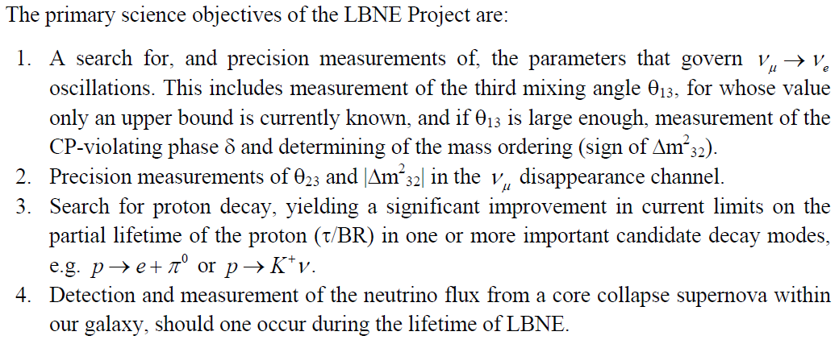
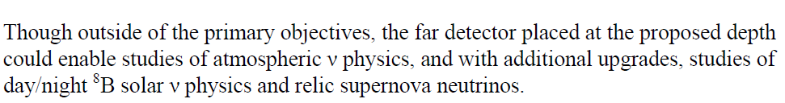
LBNE Goals
In addition to the physics goals of the far detector, the near detector complex will enable precision mesurements of neutrino cross sections which are needed for the long-baseline physics.

Slide 6
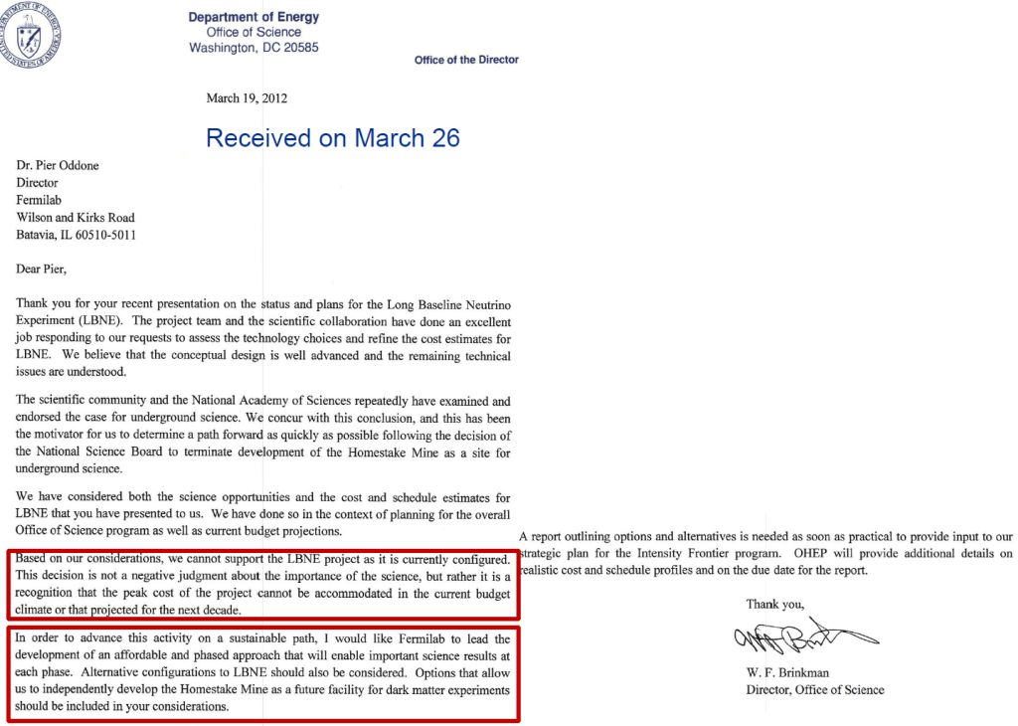
The Vision meets reality

Slide 7
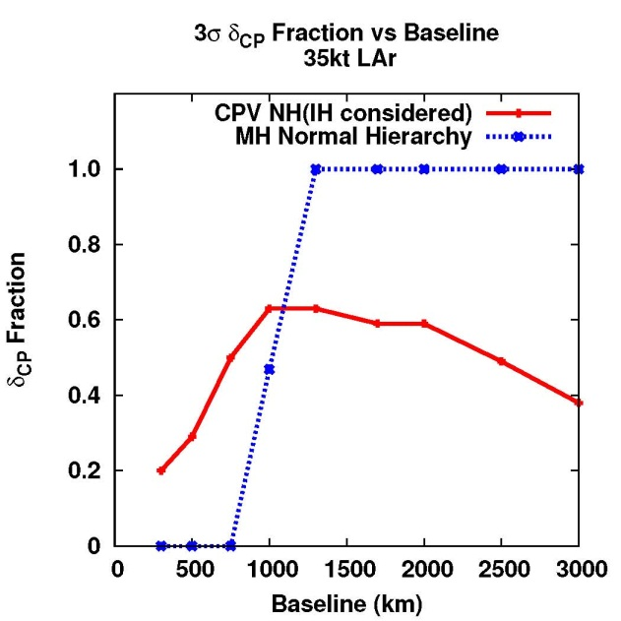
Baseline

Slide 8
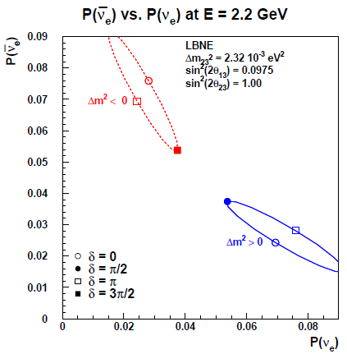
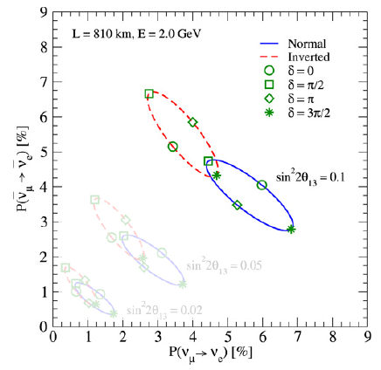
Baseline
810 km
1300 km
L = 1300 km

Slide 9
Beam
We need a high-power, broad-band, high-purity neutrino beam, sign-selected beam.
Broad-band, sign-selected => Horn Focused
Cover first and if possible second oscillation max
=> large diameter decay pipe to collect low energy pions
High purity => shorter decay pipe to reduce high-energy tail and minimize μ± → e ± ⁽ν^{─)} _{e} ⁽ν^{─)} _{μ} decay in flight.
Tunable over wide range of primary proton energy and tunable spot size to optimize flux and allow study systematics.
Capable of handling ≥ 2.3 MW from Project X.

Slide 10

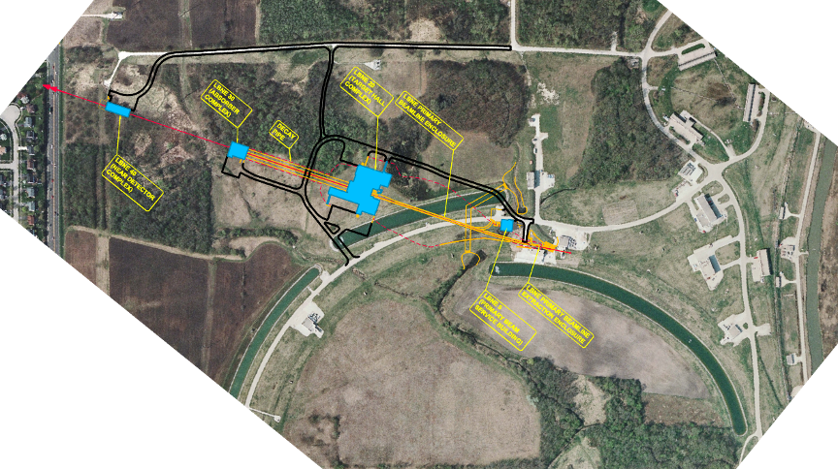
Neutrino Beam Chosen Design:
MI-10 Extraction, Shallow Beam

Slide 11
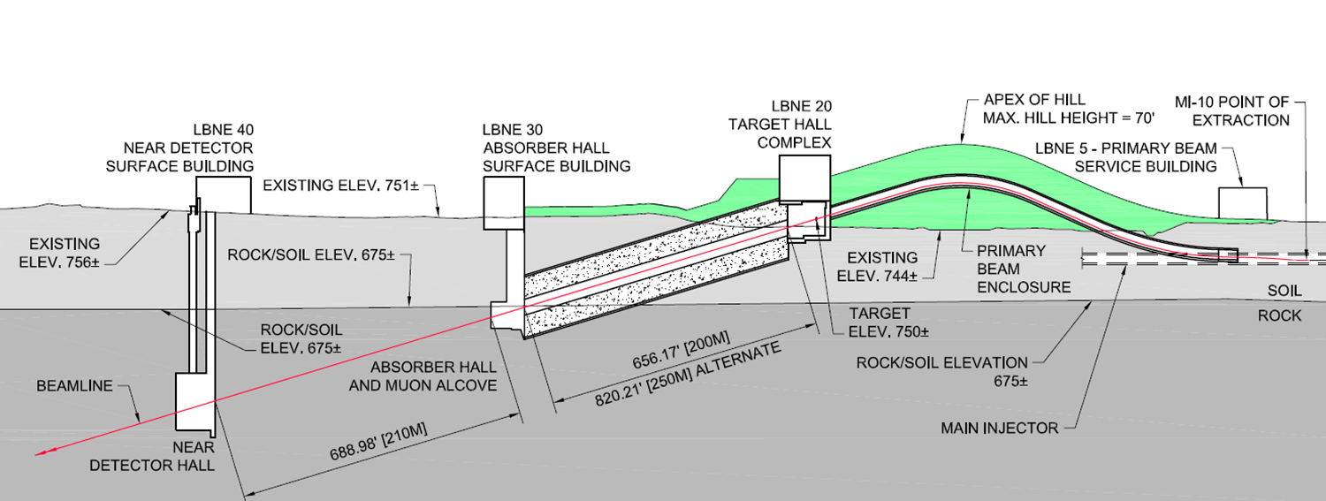
Beam
Target hall with remote handling in high-radiation environment
Beam extraction and transport from the Main Injector to target
Focusing horns for secondary particles
Beamline to Homestake
(not to scale)
Large underground decay pipe (4m x 200m for Homestake ; 2m x 675m for NuMI)
Homestake beamline: much better aquifer protection than the NuMI beamline

Slide 12
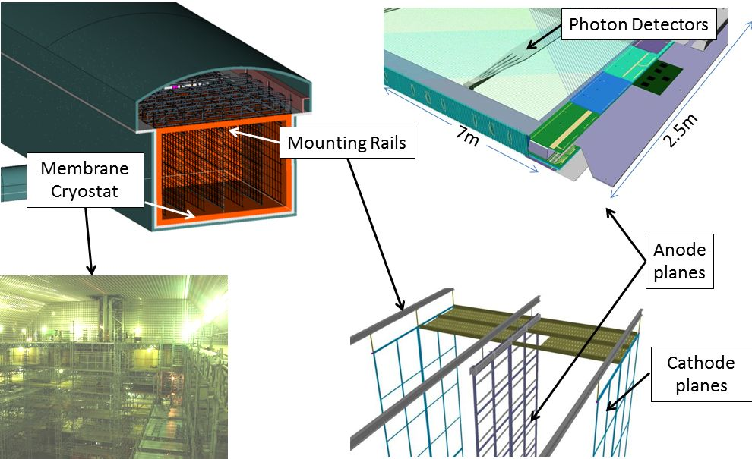
Detector

Slide 13
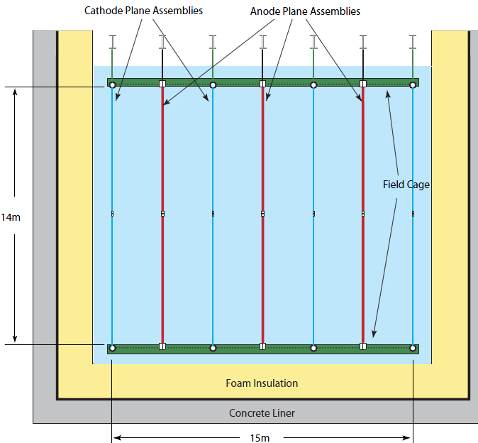
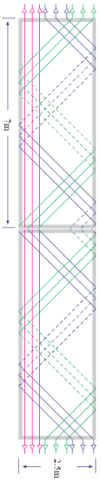
Detector Configuration
Anode Plane Ass’y (APA) - Standard wire chamber construction
2.5m
3.7m
e
e
Cathode Plane Ass’y (CPA) - SS mesh
Field cage wraps detector
Membrane cryostat
22 m

Slide 14
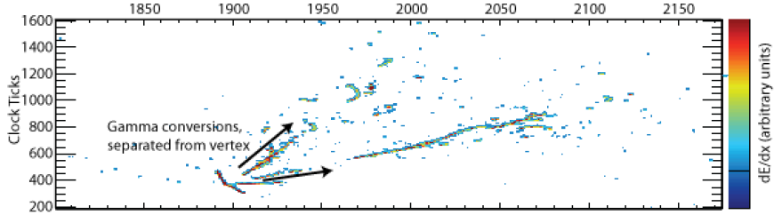
Detector

Slide 15
ν_{e} appearance (vacuum)
P(ν_{μ}→ν_{e}) = P₁ + P₂ + P₃ + P₄
  P₁ = sin²(θ₂₃) sin²(2θ₁₃) sin²(1.27 Δm₃₁² L/E)
  P₂ = cos²(θ₂₃) sin²(2θ₁₂) sin²(1.27 Δm₂₁² L/E)
  P₃ = J sin(δ) sin(1.27 Δm₃₁² L/E)
  P₄ = J cos(δ) cos(1.27 Δm₃₁² L/E)
  where J = cos(θ₁₃) sin (2θ₁₂) sin (2θ₁₃) sin (2θ₂₃) x
  sin (1.27 Δm₃₁² L/E) sin (1.27 Δm₂₁² L/E)

Slide 16
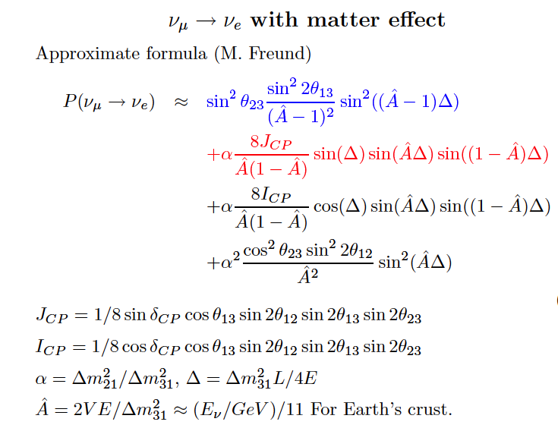
ν_{e} appearance (matter)

Slide 17
ν, ν
The mass hierarchy and CP effects each give a difference between neutrino and antineutrino oscillation probabilities.
The differences are different.

Slide 18
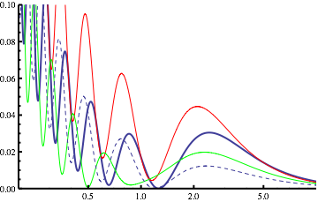
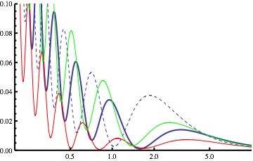
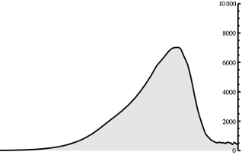
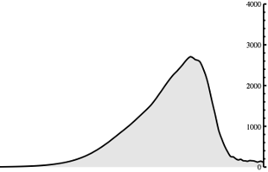
P(E) and dN/dE(E)
Neutrino
Anti-Neutrino
CC Events/GeV/100kT/MW-yr
Probability
E/GeV
E/GeV
δCP r:+90, b: 0, g: -90, dashed: Inverted Hierarchy, L: 1300 km
With 700 kW of 120 GeV protons from the Main Injector, we have designed a beam optimized for the 0.5 to 5 GeV. (yr=2 10⁷sec)
The baseline and energy allows us to measure the spectral distortion and disentangle MH from CPV.

Slide 19
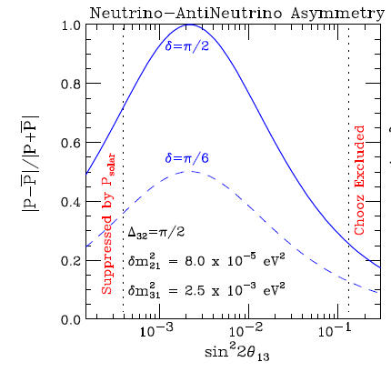
An incorrect statement
The large ϴ13 will allow a smaller detector for CP measurement.
  The large ϴ13 will reduce the CP asymmetry requiring more events for the same statistical significance.

Slide 20
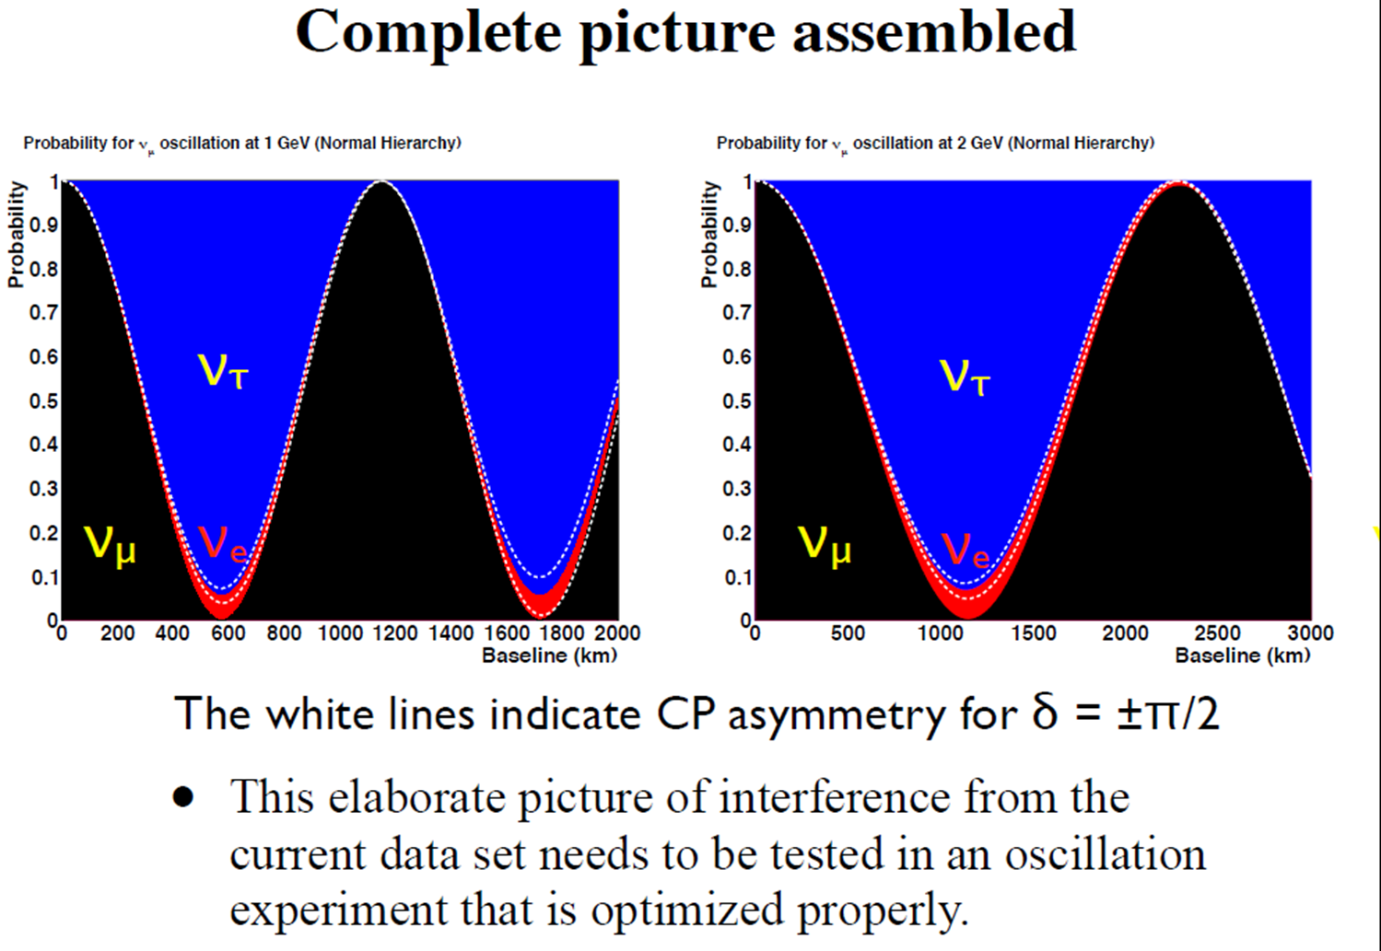
Physics (1)

Slide 21
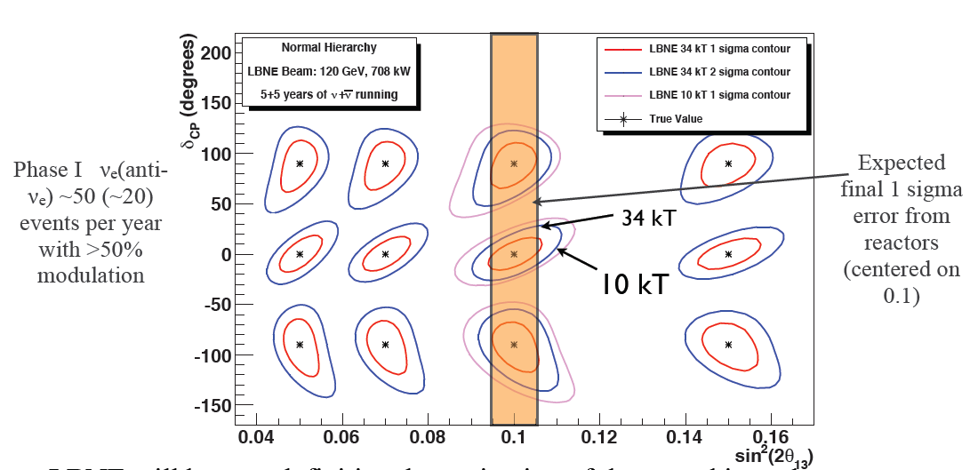
Physics (2)
20 degree measurement of δ (with reactor)

Slide 22
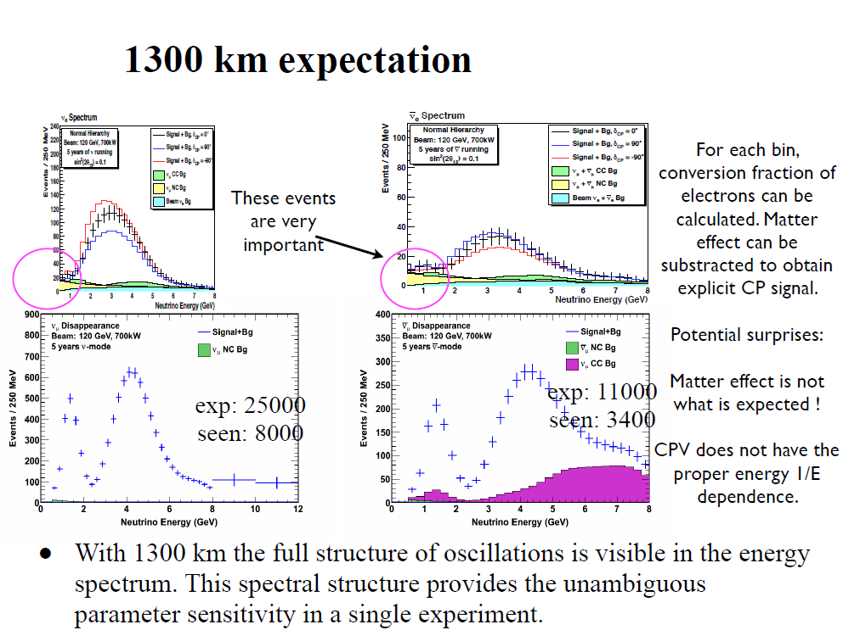
ν─_{e}
ν_{e}
ν_{μ}
ν─_{μ}

Slide 23
I thought I heard that LBNE was dead?
Up through 2011, the US National Science Foundation was considering operation of the Deep Underground Science and Engineering Lab (DUSEL) at Homestake
  (After several reviews…) The DOE will operate the lab, but just for 3 DOE physics programs; not as a new National Lab

Slide 24
I thought I heard that LBNE was dead?
In 2012, didn’t the price come in too high?
  DOE/FNAL “reconfigured” the project to be within cost constraints (~$800M)

Slide 25
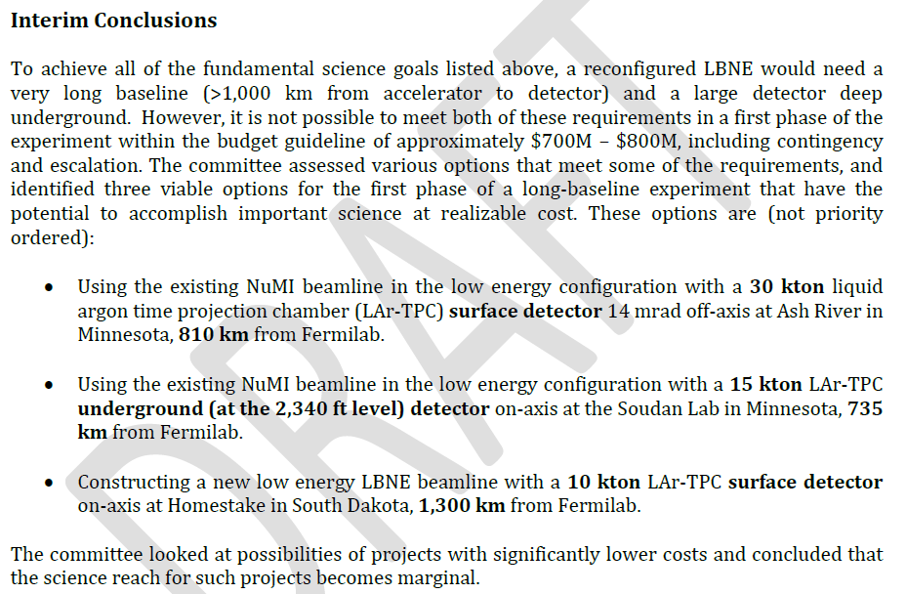
Reconfiguration Interim Report

Slide 26
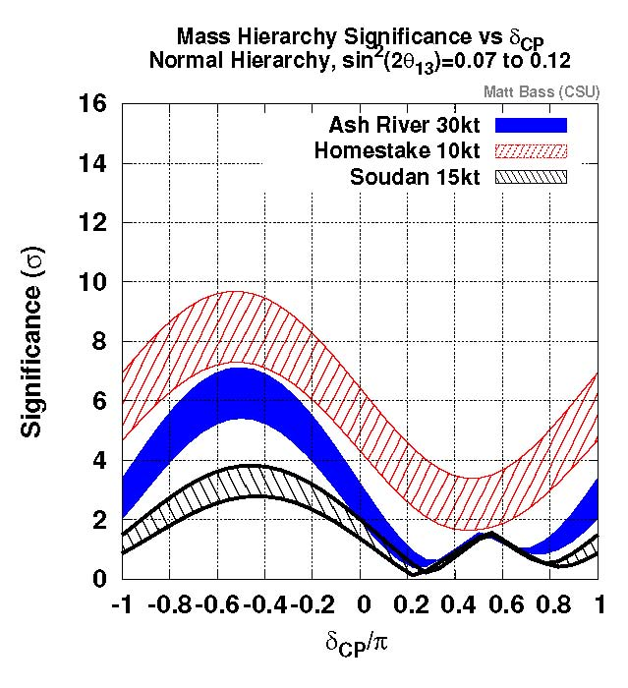
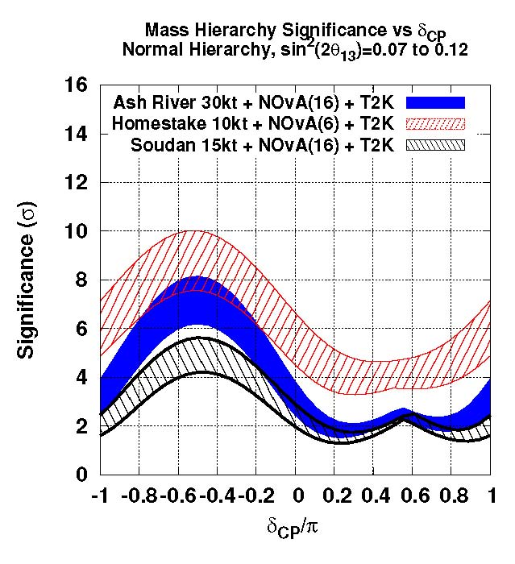
Mass hierarchy reach for 3 options
experiment alone combined with NOvA and T2K
widths – impact of sin²(2θ₁₃) range (0.07 ~ 0.12) on Mass Hierarchy

Slide 27
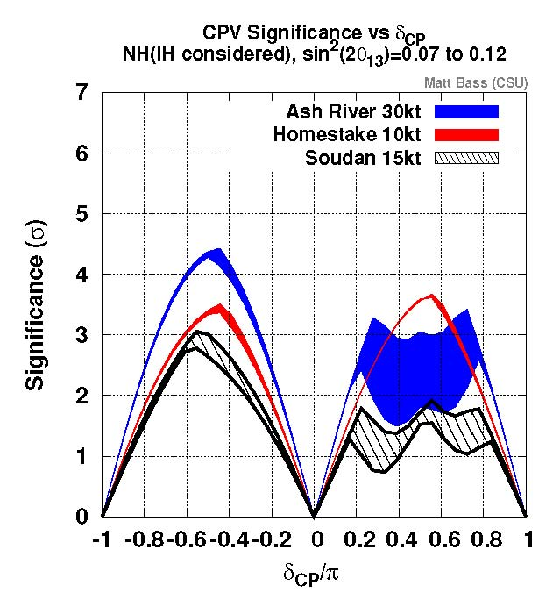
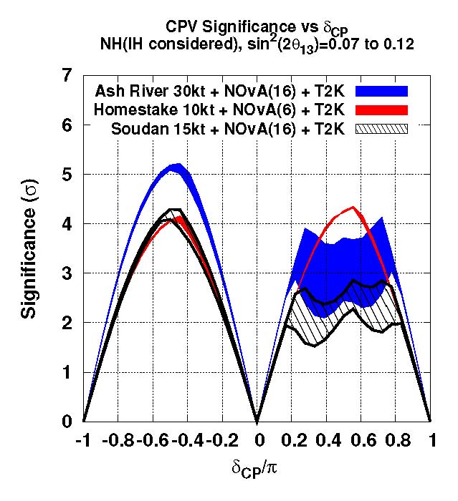
CP reach for three options
experiment alone combined with NOvA and T2K
widths – impact of sin²(2θ₁₃) range (0.07 ~ 0.12) on CP reach

Slide 28
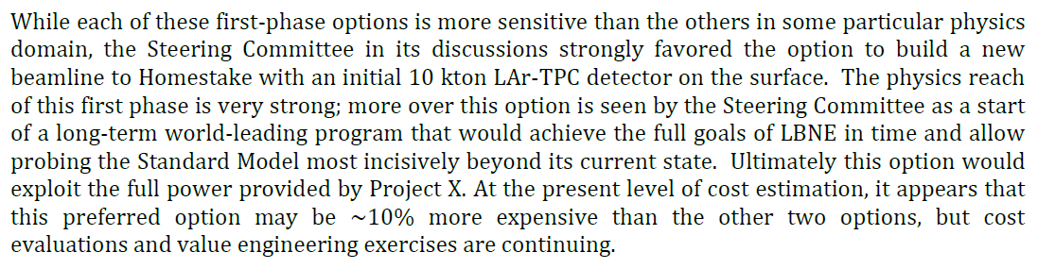
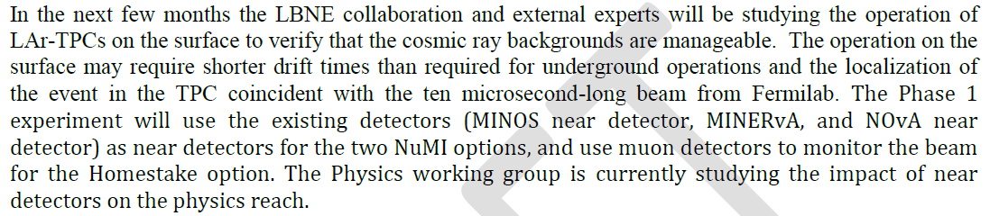
Steering Committee Conclusions
But there are risks:
First studies suggest that the risks are manageable, but work continues

Slide 29
Summary: 10 kt at Homestake (1300km, surface)
Pros | Excellent (3σ) mass ordering reach in the full δ_{CP} range. Good CP violation reach: not dependent on a priori knowledge of the mass ordering. Longer baseline and broad-band beam allow explicit reconstruction of oscillations in the energy spectrum: self-consistent standard neutrino measurements; best sensitivity to Standard Model tests and non-standard neutrino physics. Clear Phase 2 path: a 20 – 25 kt underground (4850 ft) detector at the Homestake mine. This covers the full capability of the original LBNE physics program. Takes full advantage of Project X beam power increases.
Cons | Cosmic ray backgrounds: impact and mitigation need to be determined. Only accelerator-based physics. Proton decay, supernova neutrino and atmospheric neutrino research are delayed to Phase 2. ~15% more expensive than the other two options: cost evaluations and value engineering exercises in progress.

Slide 30
Phased Program
The preferred configuration would be the first step in a phased program.
In the 1st phase, LBNE would determine the sign(Δm²₃₂) and measure δ_{CP}, as well as measuring other oscillation parameters: θ₁₃, θ₂₃, and |Δm²₃₂|. Subsequent phases would include:
Build a highly capable near neutrino detector,
- reduce systematic errors on the oscillation measurements
- enable a broad program of non-oscillation neutrino physics.
Increase the detector mass or increase the beam power (Project X)
Add a large detector at the 4850 foot (4300 mwe) level at Homestake
- enable proton decay, supernova neutrino, and other non-beam physics
- further improve the precision of the main oscillation measurements
- enable use of more difficult channels for a fully comprehensive program of
oscillation measurements
The actual order and scope of the next phases would, of course, depend on physics, resources, and the interests of current and new collaborators.

Slide 31
Next Steps
The next step in the DOE project approval process is “CD-1,” which approves the conceptual design and overall cost scale and schedule of the Project.
We have been encouraged by DOE to achieve this milestone by the end of December 2012.
A prerequisite is to pass two major reviews:
Fermilab Director’s Review 25-27 September
- Validates the design
DOE (“Lehman”) Review 30 October – 1 November
- Validates the project plan
CD-1 will allow us to move forward to complete the design and to prepare for construction.

Slide 32
What about…
The technology?
Other baselines?
The mass
Surface or Underground
Near Detector?
Water and Liquid Argon were considered. Ar was chosen. For LBNE, we get the same physics for m_{AR} = 1/6 m_{H2O}
Only Homestake (1300km) and NuMI (730-810km) were considered
We long planned for 34 kTon. The current plan is 10 kTon
The current plan is for the surface. Additional funds $130M would allow it to go underground and contribute to Supernova & PDK
Systematic error calculations suggest the physics goals in phase 1 don’t require a near detectcor.

Slide 33
The reality check
There are many ideas for future long-baseline ν experiments with similar goals to LBNE
LBNE is going through its Directors review for CD1 right now. It has been thoroughly engineered/costed/constrained by money
It is in the U.S. HEP facility plan at ~$800M.
It is not imminent, but it is real.

Slide 34
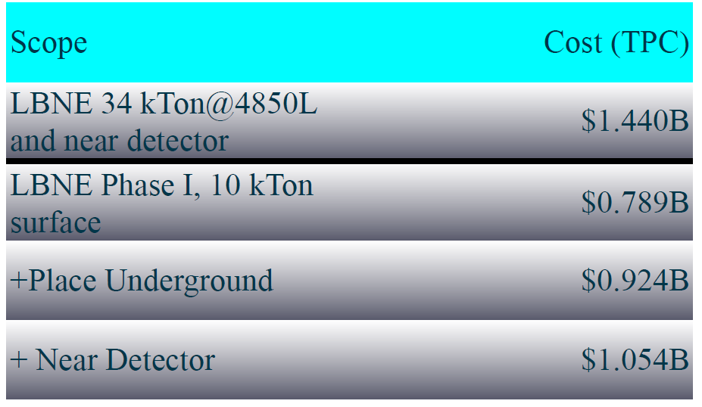
Costs

Slide 35
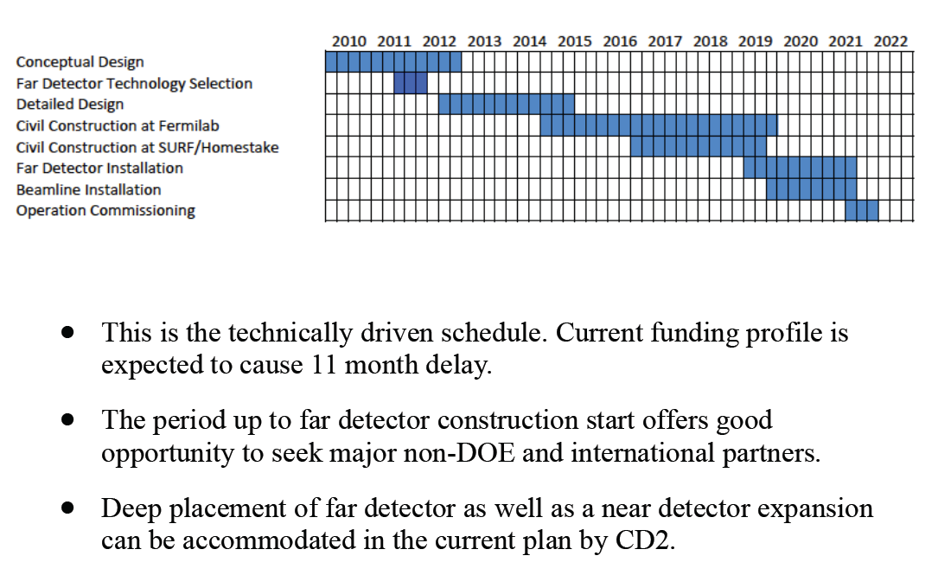
Schedule

Slide 36
Summary
LBNE remains focused on its long-term goals:
Comprehensive program to measure neutrino oscillations
- determine the mass hierarchy and look for CP violation
- precision measurement of other oscillation parameters
- test the validity of the three-neutrino mixing model
Search for baryon number violating processes
Measure neutrinos from astrophysical sources, especially from a core-collapse supernova in our galaxy
Fiscal constraints require us to approach our goals in a phased program
The LBNE Project will build the first phase, and is expecting DOE approval of “CD-1” this year.
New national or international collaborators could add scope to phase 1 or accelerate the implementation of later phases.

Slide 37
BACKUP

Slide 38
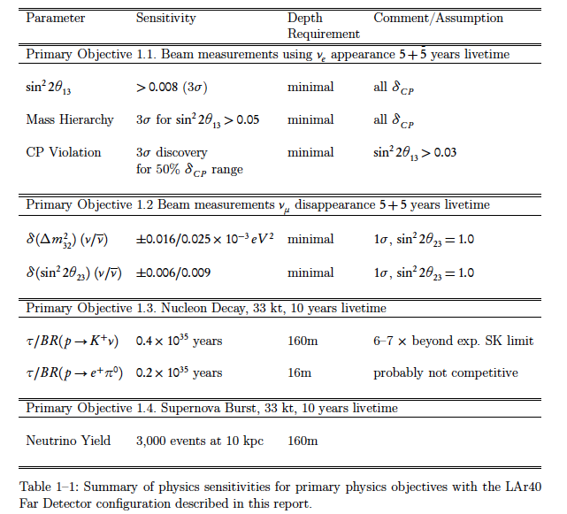
Full science agenda for Liquid Argon
Liquid Argon Technology chosen because of superior pattern recognition, complementary proton decay and Supernova capability
Additional physics with atmospheric neutrinos not listed

Slide 39
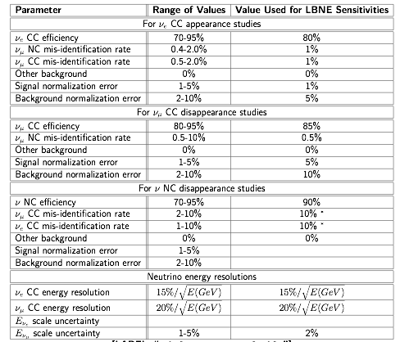
Detector performance parameters

Slide 40
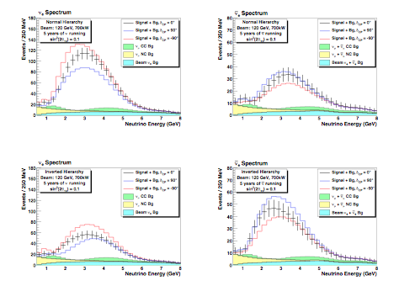
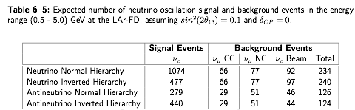

Slide 41
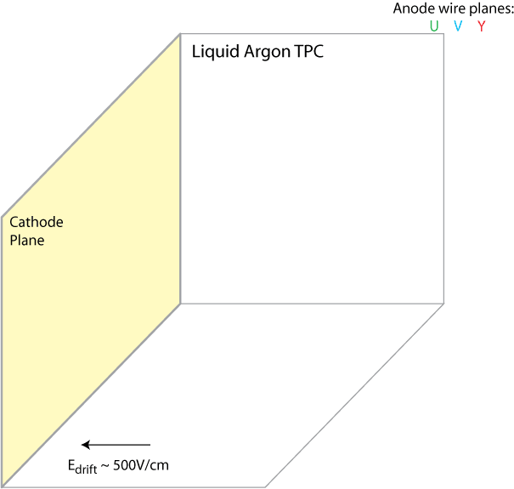
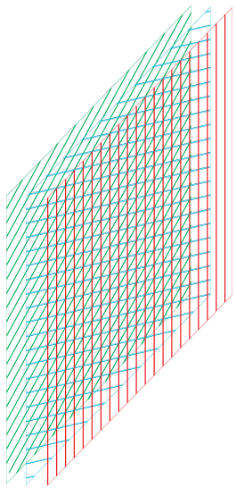
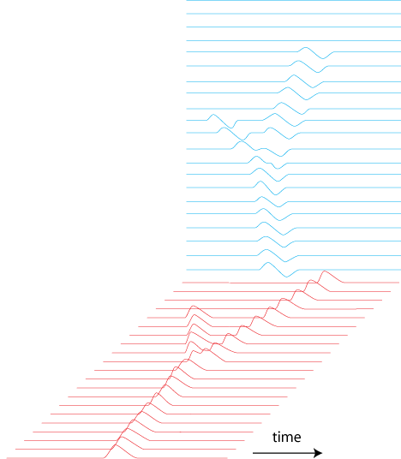
How Does a LArTPC Work
dE/dx of 1 MIP: 2.1MeV/cm
41

Slide 42
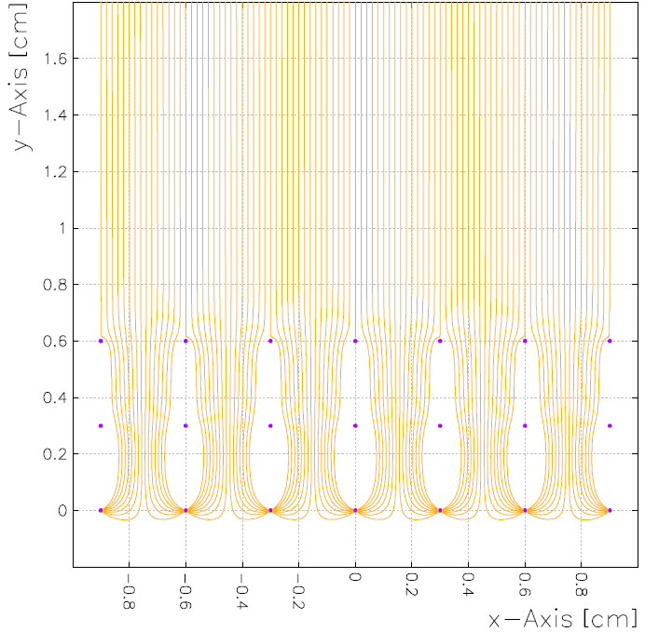
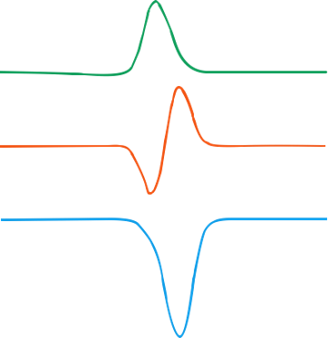
Charge Signal Formation
Time (μs)
Drift Distance (cm)
U
Induction
(small, bipolar)
V
Induction
(small, bipolar)
u
v
y
Y
Collection
(large, unipolar)
Current
Out of Wire
4.5mm Y
5mm U,V
ArgoNeuT
1 MIP peak ~ 26 ADC counts
Noise rms ~ 1 ADC count

Slide 43
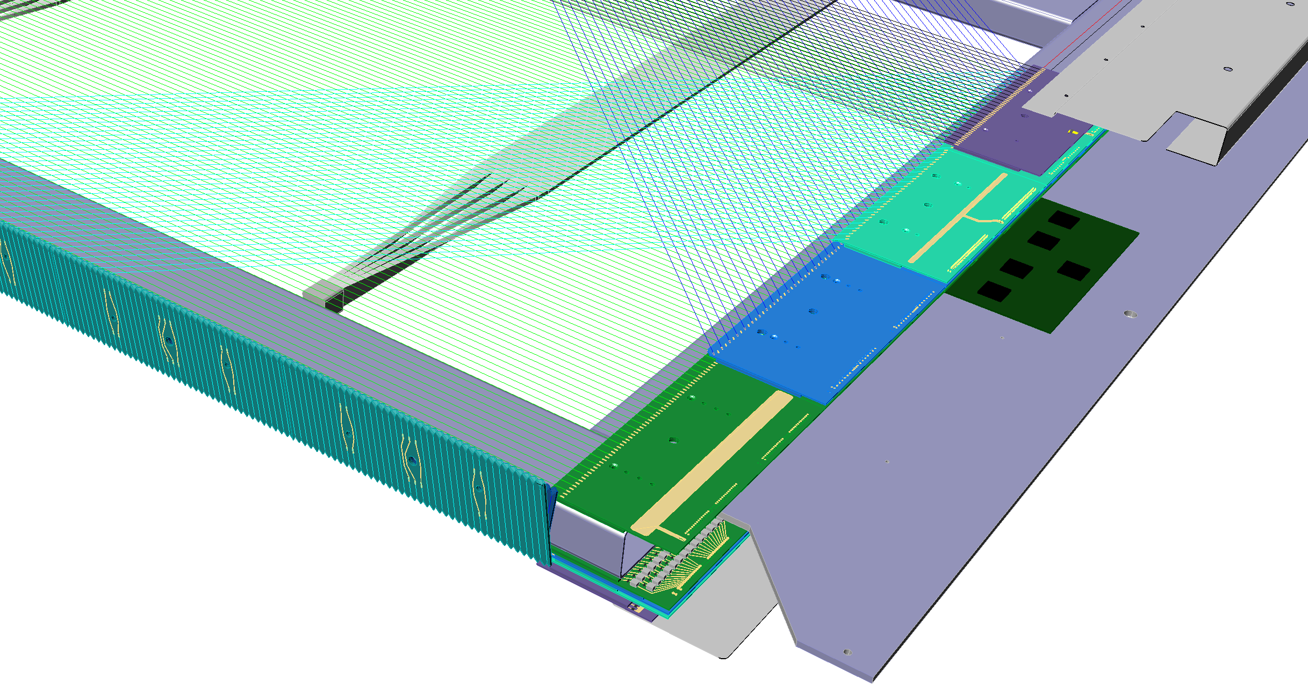
APA Construction
Photon detection paddle
10 per APA
5mm wsp
5mm wsp
Readout board
4.5mm wsp
APA frame
Wire termination boards
7m
2.5m
APA support

