Slide 1


The Latest MINOS Results
Xinjie Qiu
Stanford University
(for the MINOS Collaboration)
International Symposium on Neutrino Physics and Beyond
Sept.23-26.2012

Slide 2

Neutrino Mixing
PMNS Matrix (Pontecorvo-Maki-Nakagawa-Sakata)
analogue to CKM-Matrix in quark sector
weak “flavor” eigenstates
mass eigenstates
Unitary mixing matrix:
3 mixing angles & complex phases
accessible by MINOS
solar sector
Majorana phases

Slide 3
MINOS Physics Goals
Beam neutrino
  Test ν_{μ} → ν_{τ} oscillations (Measure precisely |Δm²₃₂| and sin²2θ₂₃)
  Search for ν_{μ} → ν_{e} oscillations (determine θ₁₃)
Atmospheric neutrinos
Combine results from the beam and atmospheric neutrino
Compare ν to ν oscillations
Test exotic models
  Decay, decoherence, sterile neutrinos, time of flight
Neutrino interaction physics
Cosmic rays physics
_

Slide 4
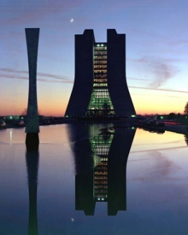
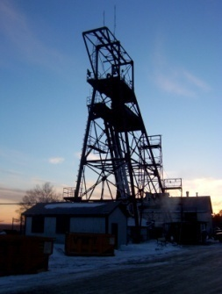
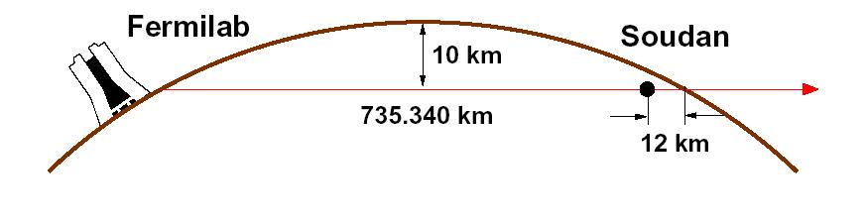
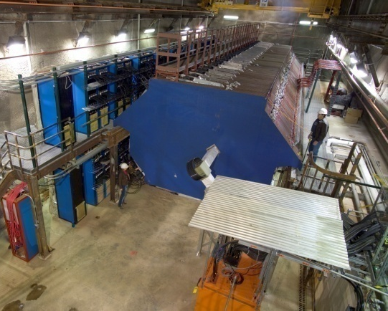
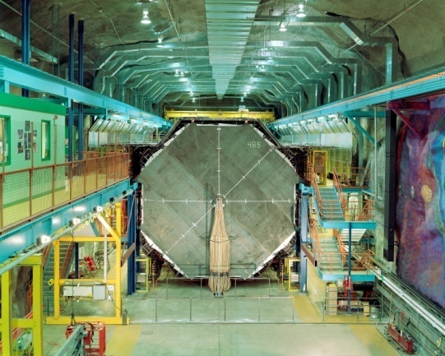
The MINOS Experiment
MINOS - Main Injector Neutrino Oscillation Search
Two functionally identical detectors to reduce systematics
Near Detector
  1 km from target
  94 m underground, 225 mwe
  Measures the energy spectrum
  and beam composition
Far Detector
  735 km from target
  700 m underground, 2070 mwe
  Re-measures the neutrino beam composition
ν_{μ}
735 km
Near Detector
980 tons
Far Detector
5,400 tons

Slide 5
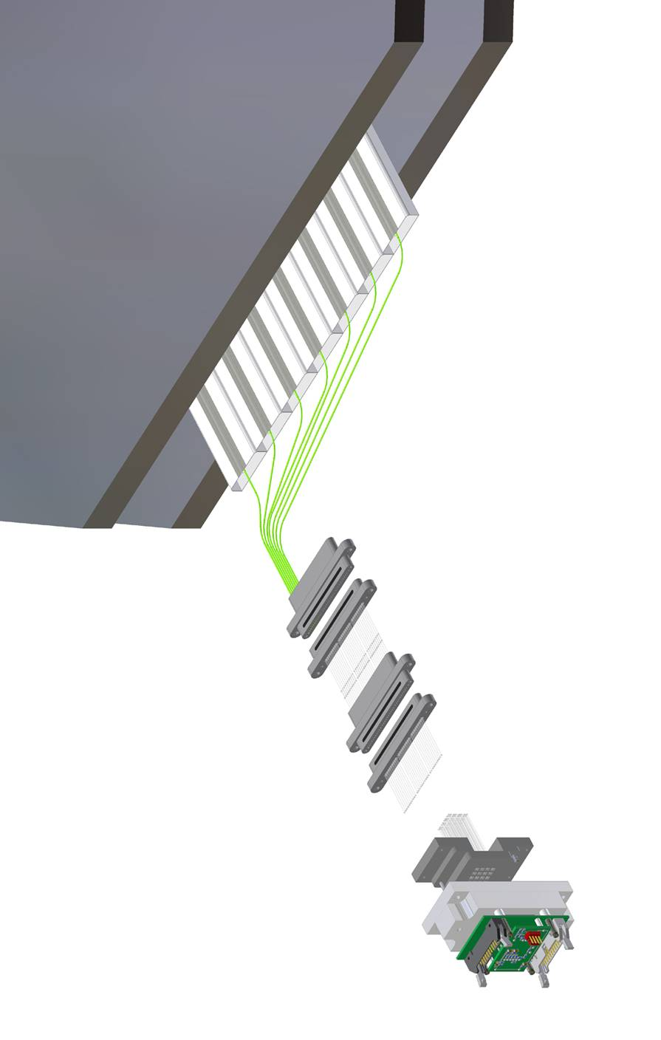
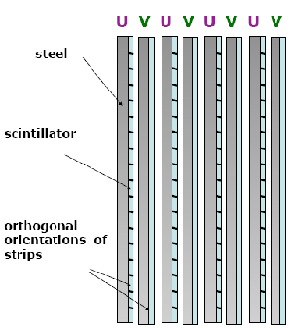
Detector Technology
Steel/scintillator tracking calorimeters
Alternate orthogonal orientation planes
Steel absorber 2.54 cm thick
Scintillator strips 4.1 cm wide, 1.0 cm thick
1 GeV muons penetrate 28 layers
Longitudinal sampling = 1.4 radiation lengths
Optical WLS fiber readout to multi-anode PMTs
2.54 cm Fe
Extruded
PS scint.
4.1 x 1 cm
U V planes
+/- 45⁰
WLS fiber
Magnetized
<B> = 1.3T
Muon energy from range/curvature
Distinguish μ⁺ from μ⁻ tracks
Clear
Fiber cables
Multi-anode PMT

Slide 6
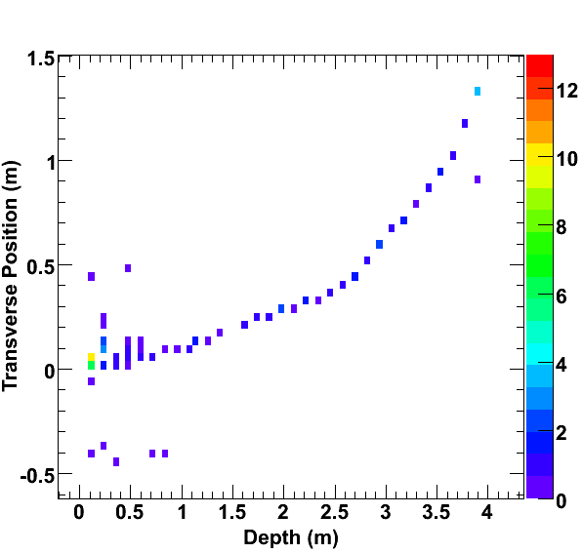
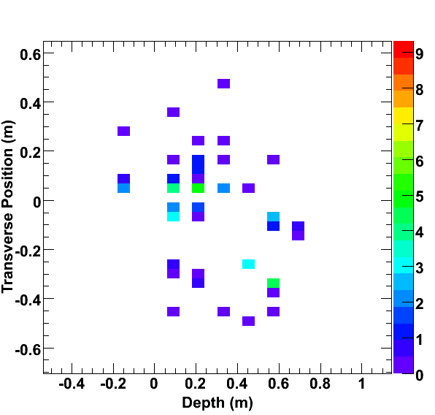
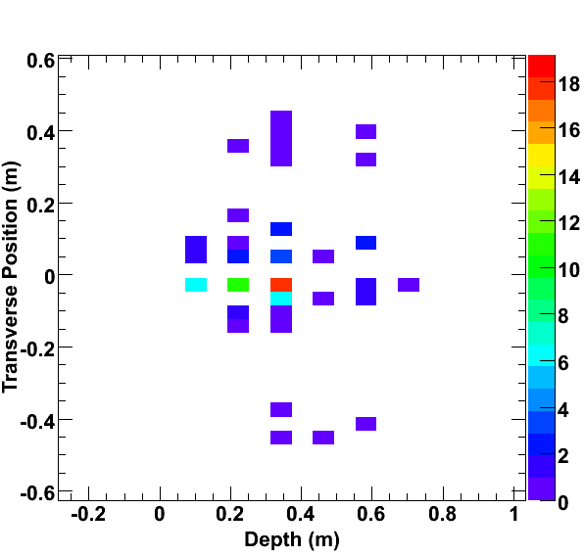
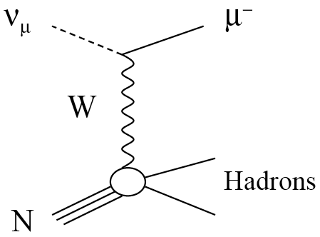
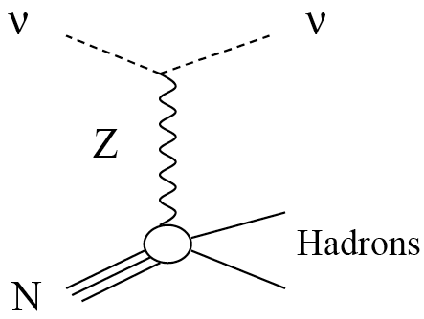
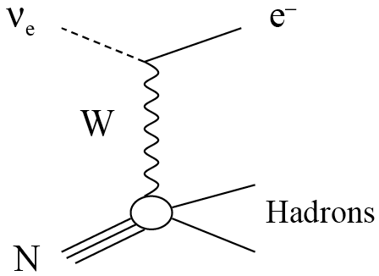
Neutrino Interactions in Detectors
ν_{μ} Charged Current
ν_{x} Neutral Current
ν_{e} Charged Current
ν
e⁻
transverse direction
μ⁻
beam direction
color scale represents energy deposition
long μ track & possible hadronic activity at vertex
short with diffuse shower
short with compact EM shower profile

Slide 7
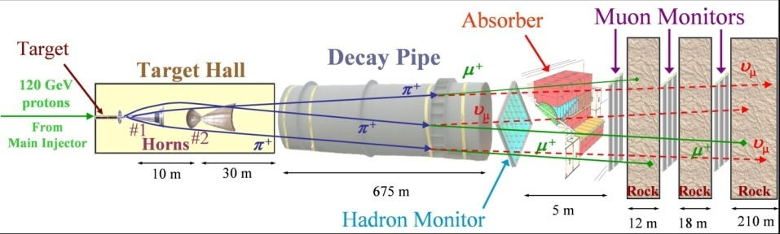
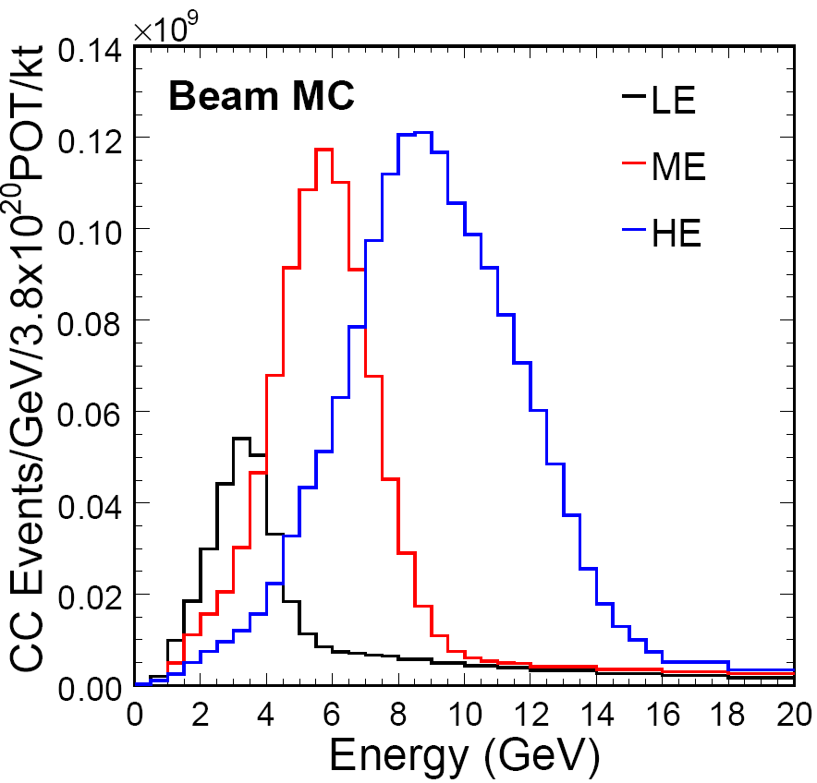
NuMI Beam
Accelerate protons in the Main Injector
10 μs spill of 120 GeV protons every 2.2 s
Strike with a graphite target to produce
mesons (π’s and K’s)
Decay into neutrinos in the 675 m decay pipe
Neutrino spectrum changes with target position

Slide 8
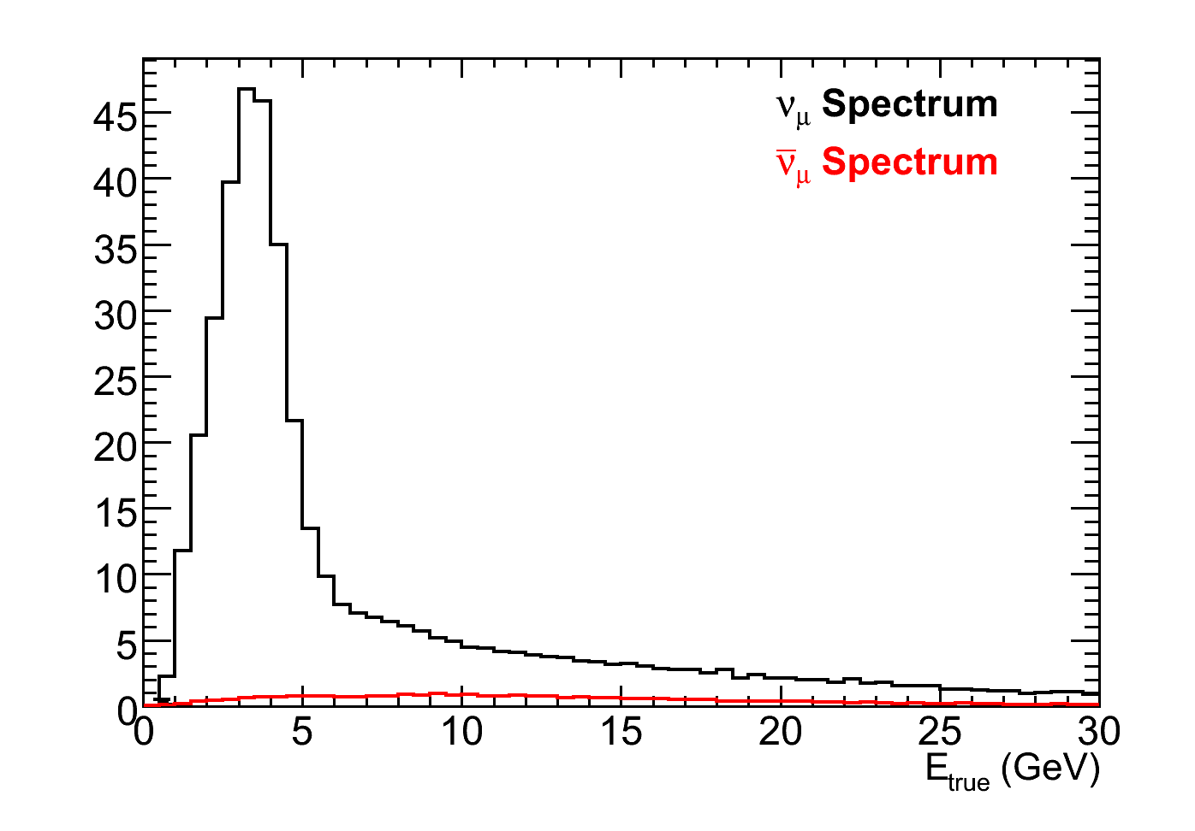
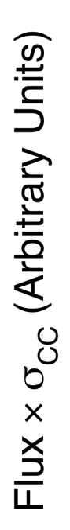
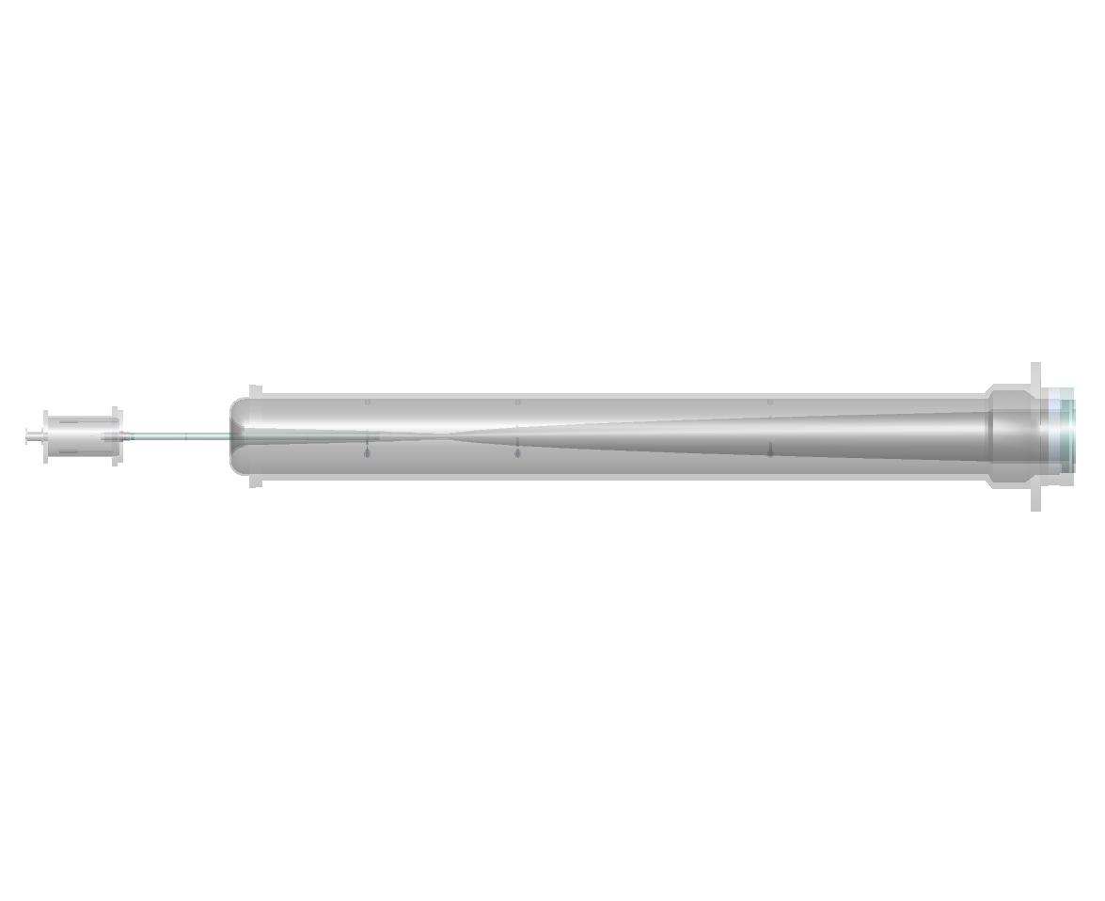
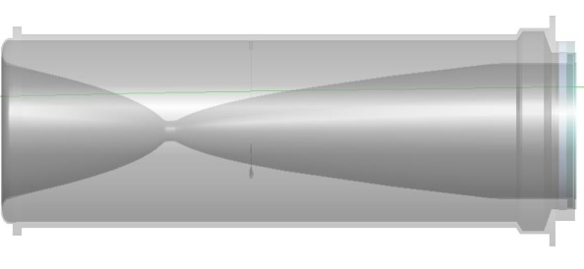
Neutrino Mode
Monte Carlo
Neutrino mode
Horns focus π⁺, K⁺
Target
Focusing Horns
Decay Pipe
π⁻
2 m
ν_{μ}
120 GeV protons
ν_{μ}
π⁺
15 m
30 m
675 m

Slide 9
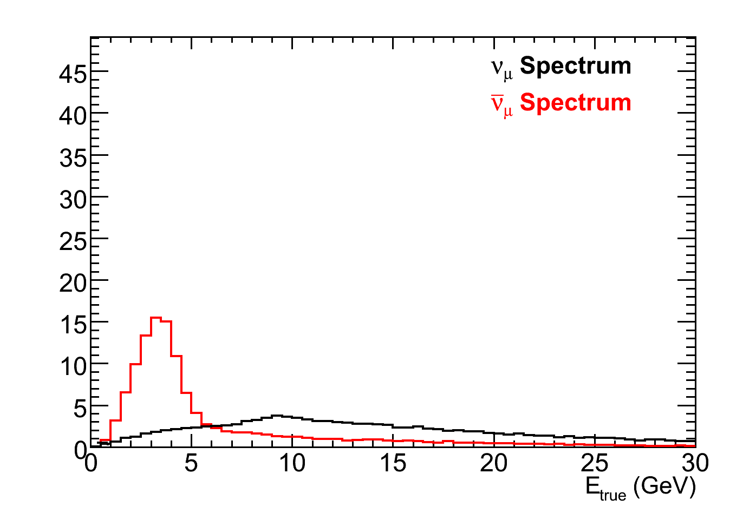
Antineutrino Mode
Monte Carlo
Monte Carlo
Antineutrino mode
Horns focus π⁻, K⁻
Neutrino mode
Horns focus π⁺, K⁺
Target
Focusing Horns
Decay Pipe
π⁺
2 m
ν_{μ}
120 GeV protons
ν_{μ}
π⁻
15 m
30 m
675 m

Slide 10
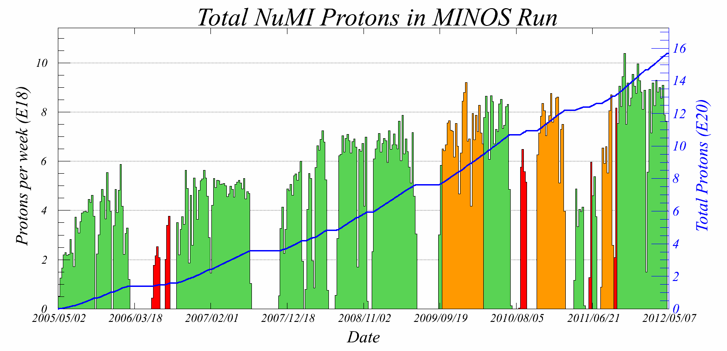
The MINOS Exposure History (2005-2012)
LE neutrino mode
LE antineutrino mode
Special Runs
NuMI beam shut off April 30, 2012
Accumulated more than 15 x 10²⁰ POT
  10.7 x 10²⁰ POT in (LE) neutrino running
  3.36 x 10²⁰ POT in antineutrino running

Slide 11
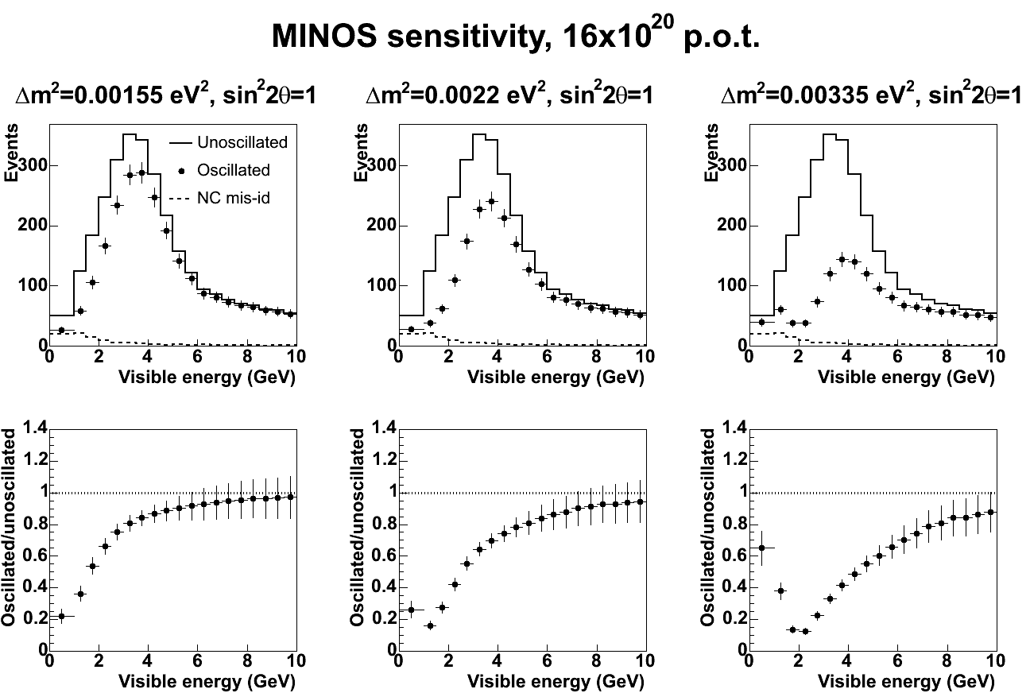
ν_{μ} Disappearance Measurement
MINOS full 3 flavor analysis in progress
ν_{μ} spectrum
Spectrum ratio
Unoscillated
Oscillated
Δm²
sin²(2θ)
Monte Carlo: Input parameters: sin²2θ = 1.0, Δm² = 3.35x10⁻³ eV²

Slide 12
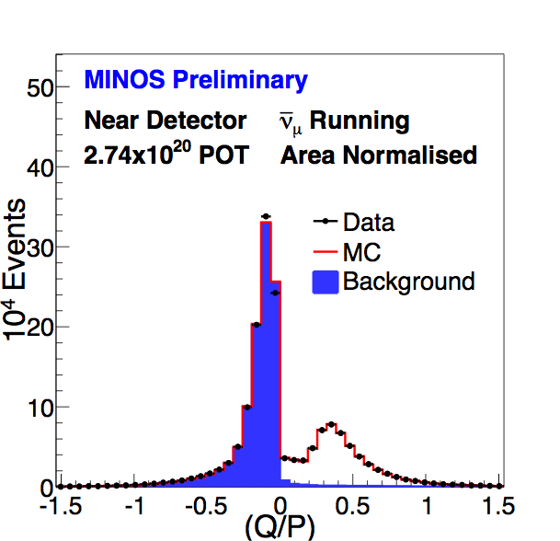
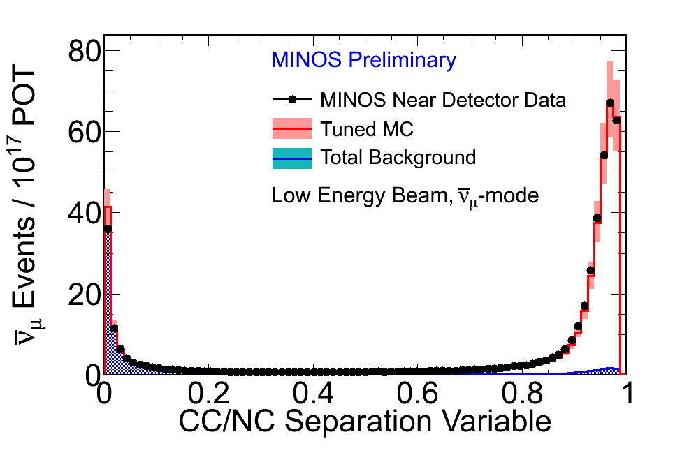
Charge Identification and CC-NC Separation
Charge identification via magnetic field bending and track fitting
CC-NC separation via a kNN (k-Nearest-Neighbors) algorithm
hadron-like
μ -like
Require q/p > 0
μ⁻
μ⁺
Require μID > 0.3
Track Charge / Momentum
q/p (c/GeV)

Slide 13
Muon Neutrino Oscillation Results
No oscillation Prediction: 3564
Observed: 2894

Slide 14
Muon Antineutrino Oscillation Results
No oscillation Prediction: 312
Observed: 226

Slide 15
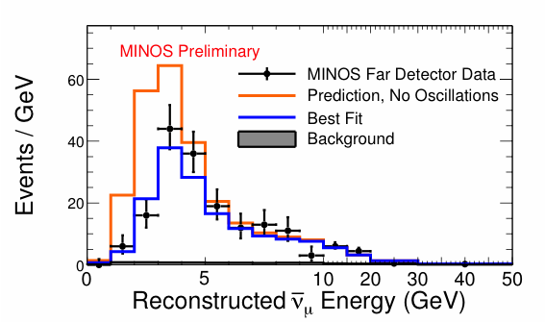
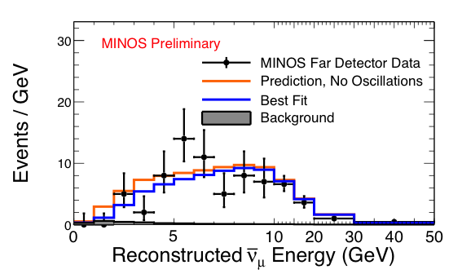
More Antineutrinos in Neutrino Mode
in antineutrino mode
in neutrino mode
No oscillation Prediction: 536
Observed: 414

Slide 16
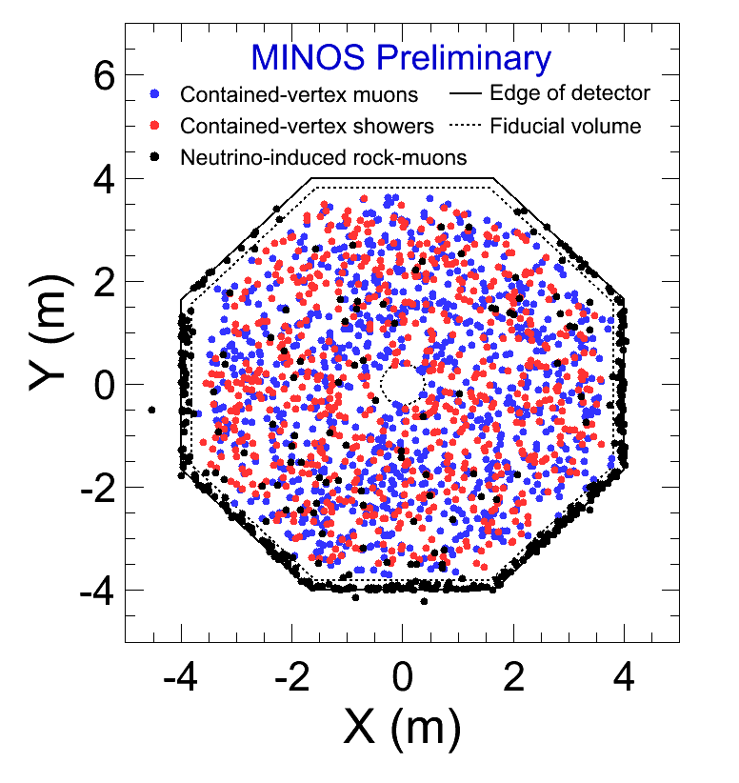
Atmospheric Neutrinos & Antineutrinos
37.9 kton years of atmospheric neutrino data since 2003
2072 additional observed events
  905 contained-vertex muon events
  466 neutrino-induced rock-muon events
  701 contained-vertex shower events
Notes:
3000 beam CC, 1470 in atm

Slide 17
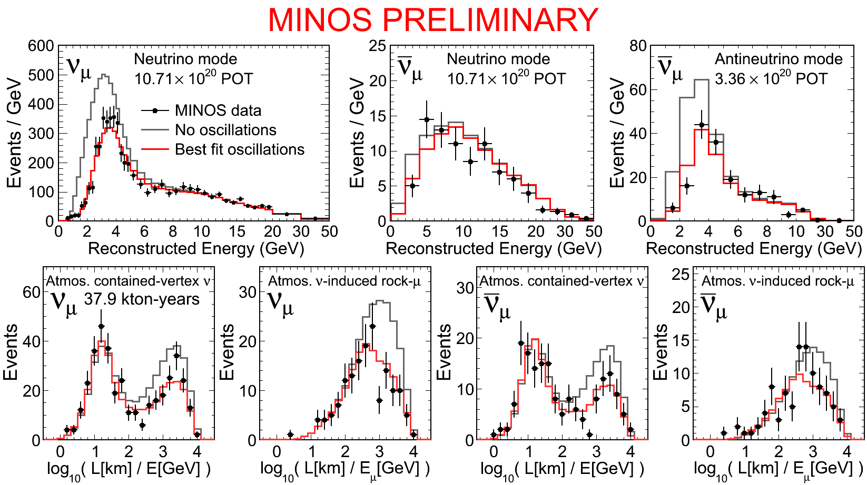
Atmospheric Neutrinos & Antineutrinos
Notes:
FHC neutrinos see 188 with 224 expected

Slide 18
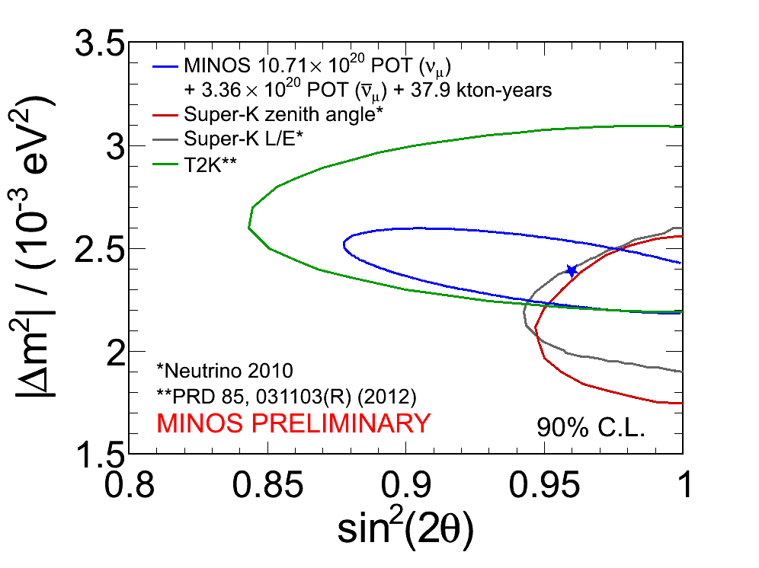
MINOS Combined Full Exposure Contours
Combined neutrino/antineutrino oscillation parameters (joint fit ):
All MINOS beam and atmospheric neutrino data in a 2-flavor oscillation parameter maximum likelihood fit (assumes neutrinos and antineutrinos oscillate the same)
Notes:
0.957 _{-0.036}^{+0.035}

Slide 19
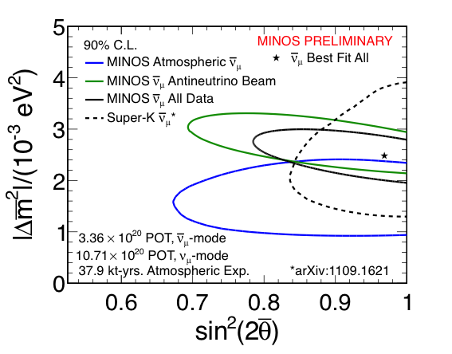
MINOS Combined Antineutrino Contours
All MINOS beam and atmospheric samples in a four parameter fit (neutrinos and antineutrino may oscillate differently)
Notes:
Δ(Δm²) = 1.0 ± 2.8 × 10⁻⁴ eV²

Slide 20
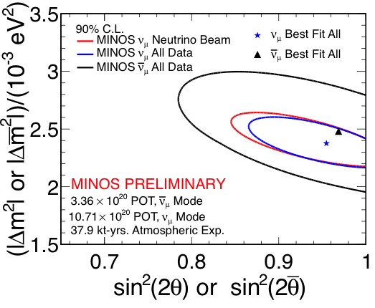
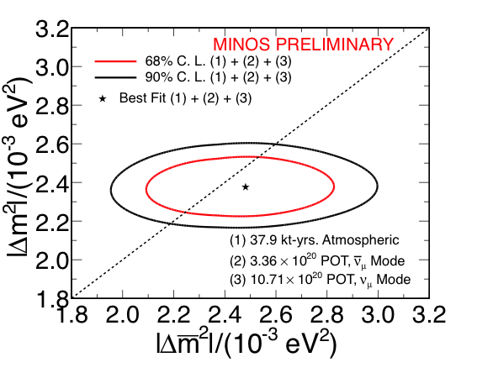
Comparing Neutrinos and Antineutrinos
The new data resolves the tension between neutrino & antineutrino parameters in the first batch of data

Slide 21
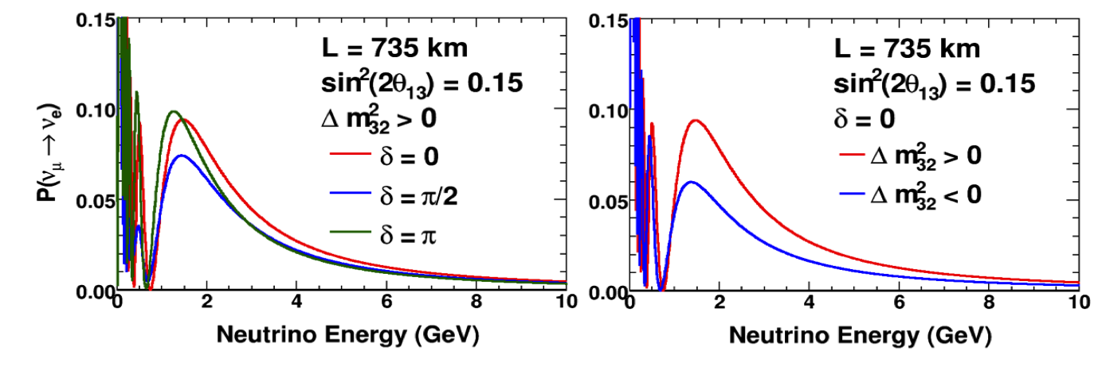
ν_{e} Appearance Measurement
In matter, ν_{e} CC scattering modifies
oscillation probability ~30% in MINOS
sensitive to neutrino mixing angle θ₁₃, δ_{CP}, mass ordering

Slide 22
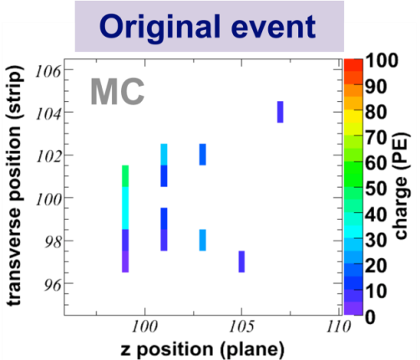
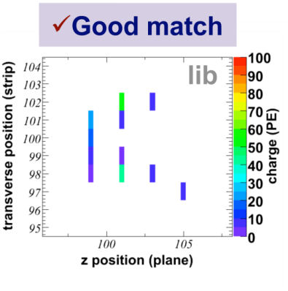
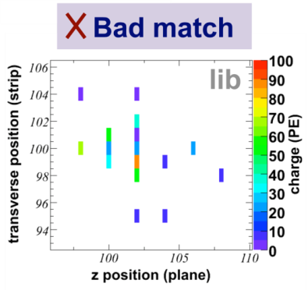
Library Event Matching (LEM) Particle ID
Cannot identify electrons in an event-by-event basis due to the coarse sampling
  Library Event Matching (LEM)
  Compare candidate events to a library of MC events strip-by-strip (raw detector hits information)
  PID based on properties from the best matched library candidate events
Sensitivity improvement
  15% from LEM over neutral network only
  12% more from fitting 3 bins of LEM PID times 5 bins of reconstructed energy
  More than 20% from analysis improvements alone

Slide 23
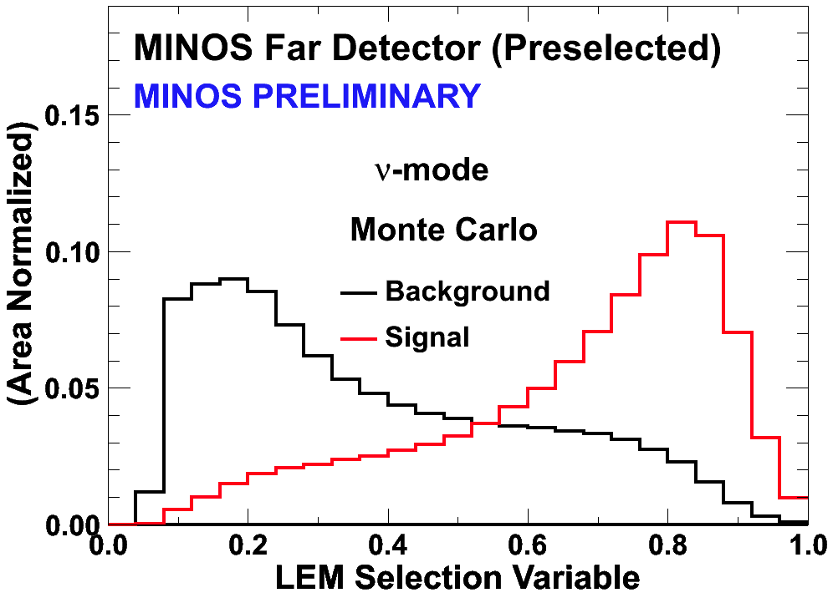
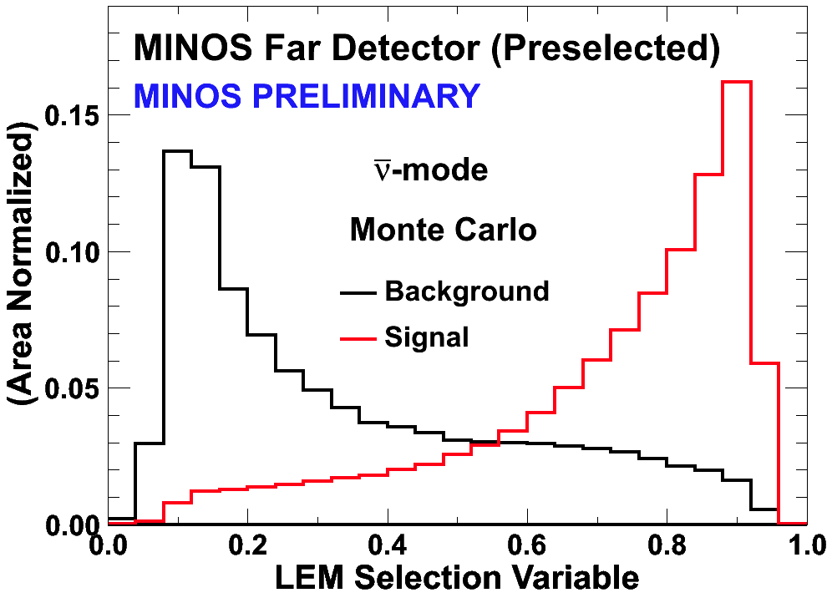
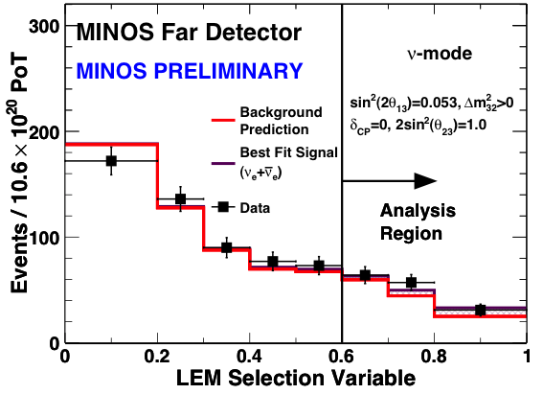
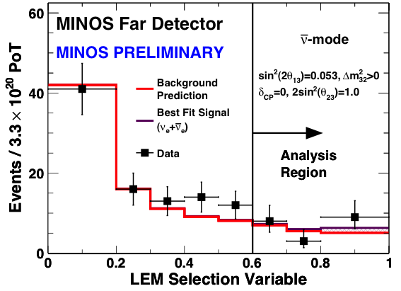
Electron Appearance in FHC and RHC Beam
ν mode
Expected (LEM>0.7):
69.1 (background, if θ₁₃=0)
26.0 (signal, if sin²(2θ₁₃)=0.1)
Observe:
88 events
͞ν mode
Expected (LEM>0.7):
10.5 (background , if θ₁₃=0)
3.1 (signal, if sin²(2θ₁₃)=0.1)
Observe:
12 events
10.6×10²⁰ POT (ν mode)
3.3×10²⁰ (͞ν mode)

Slide 24
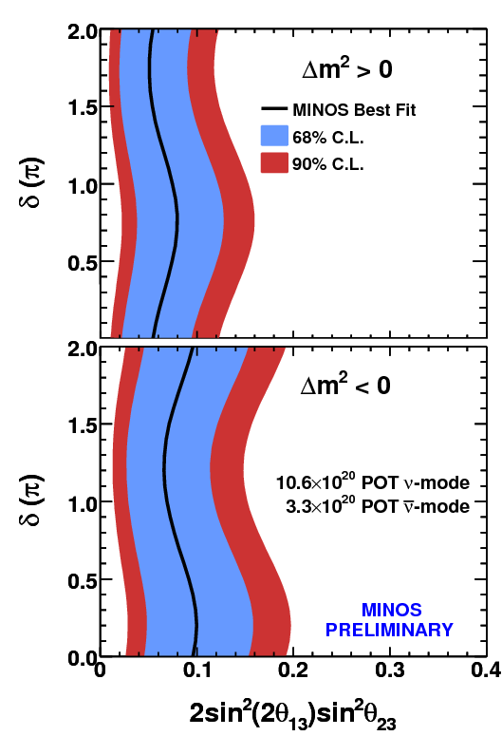
ν_{e} Appearance: ν and ͞ν Combined Contour
Notes:
At 68% C.L. 0.02 - 0.09 (NH) 0.05 - 0.15 IH or 2.0σ

Slide 25
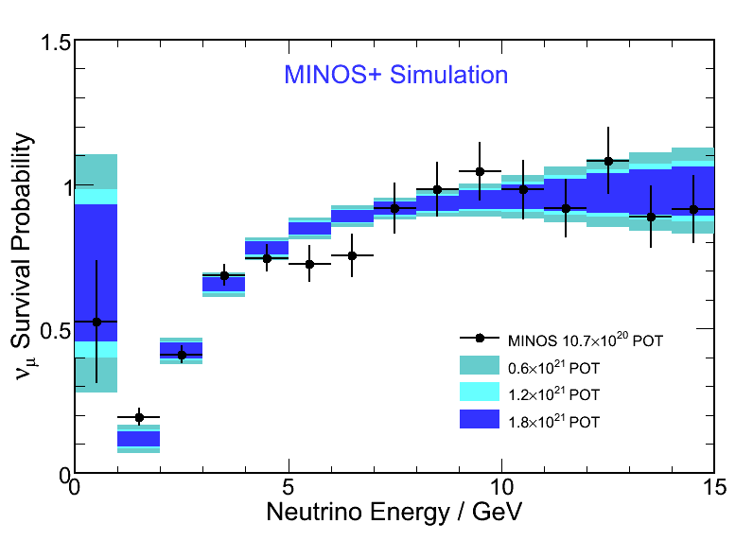
MINOS → MINOS+
MINOS will continue to run in the NOvA era
ME beam peaks above the oscillation dip on axis
Beam power: 320 kW → 700 kW
Roughly 4000 far detector ν_{μ} CC events/year
Precision studies of oscillation shape
Sensitivity to exotic signals

Slide 26
Summary of New MINOS Results
MINOS has completed its low-energy running after 1.5×10²¹ POT
Analysis with Beam + Atmospheric neutrinos finds:
muon neutrino disappearance muon antineutrino disappearance
Electron neutrino appearance:
MINOS+ has an exciting program with medium energy running

Slide 27






Acknowledgments
The MINOS Collaboration would like to thank the many Fermilab groups who provided technical expertise and support in the design, construction, installation and operation of the MINOS experiment.
We also gratefully acknowledge financial support from DOE, STFC(UK), NSF and thank the University of Minnesota and the Minnesota DNR for hosting us.

Slide 28
Back Up

Slide 29
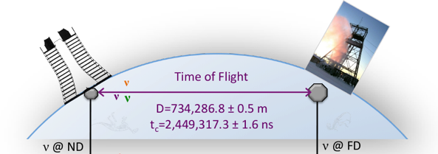
Measure Neutrino Time of Flight
Initial result after first year of data indicated neutrinos arrived at FD earlier than expected:
126 ± 32 (stat.) ± 64 (syst.) ns†
We revisit this analysis with a factor of 8 more events and a refined systematic error analysis
†Phys. Rev. D76 (2007) 072005
Notes:
OPERA arxiv1109.4897v2 57.8 ± 7.8 ^{+8.3}_{-5.9} ns or 58⁺¹¹₋₁₀ ns

Slide 30
Major Systematic Uncertaities
Arrival times as recorded at each detector must be corrected for (sizeable) cable delays and electronics latencies
Dominant systematics in first analysis improved:
Relative ND/FD electronics latencies determined by special purpose Auxiliary Detector with independent readout: ±1 ns
Total systematic from cable/electronic latency: ±4 ns
 | 2007 | 2012
GPS antenna to ND cable delay | 1275 ± 29 ns | 1309 ± 1 ns
GPS antenna to FD cable delay | 5140 ± 46 ns | 5098 ± 2 ns

Slide 31
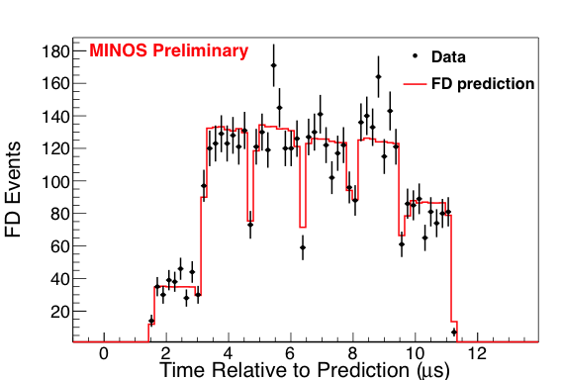
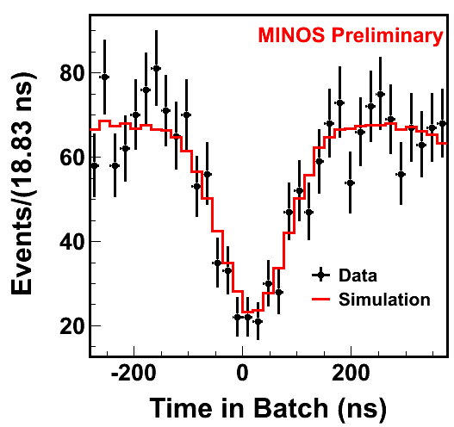
TOF Analyses and Results
Full spill approach
  event time within spill in ND predicts FD distribution
  Vary time of flight to match data
Wrapped Spill approach
  Measure event time within batch
  Find batch gap time in each detector
  Subtract for time of flight
neutrinos arrive earlier than expected by:
18 ± 11 (stat.) ± 29 (syst.) ns
11 ± 11 (stat.) ± 29 (syst.) ns
The two approaches give consistent results
The two results are consistent with neutrinos traveling at the speed of light
Analysis with improved timing system pending

