Slide 1
ALICE Expert System
Costin Ionita, CERN
for the ALICE DAQ collaboration
ACAT 2013, Beijing, May 16th – 21st , 2013

Slide 2
Introduction
ALICE – A Large Ion Collider Experiment
Study the physics of quark-gluon plasma using heavy-ion collisions
Comprises a set of 18 detectors that measure different aspects of a collision
e.g. number of resulting particles, trajectories, radiation emitted etc
Operations are controlled using an experiment control system (ECS)
receives status information from the ‘online systems’
sends commands to them through interfaces based on Finite State Machines (FSM).

Slide 3
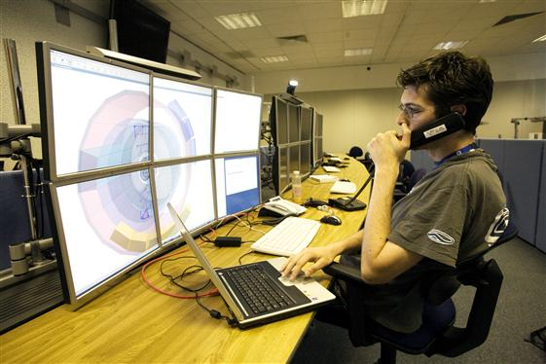
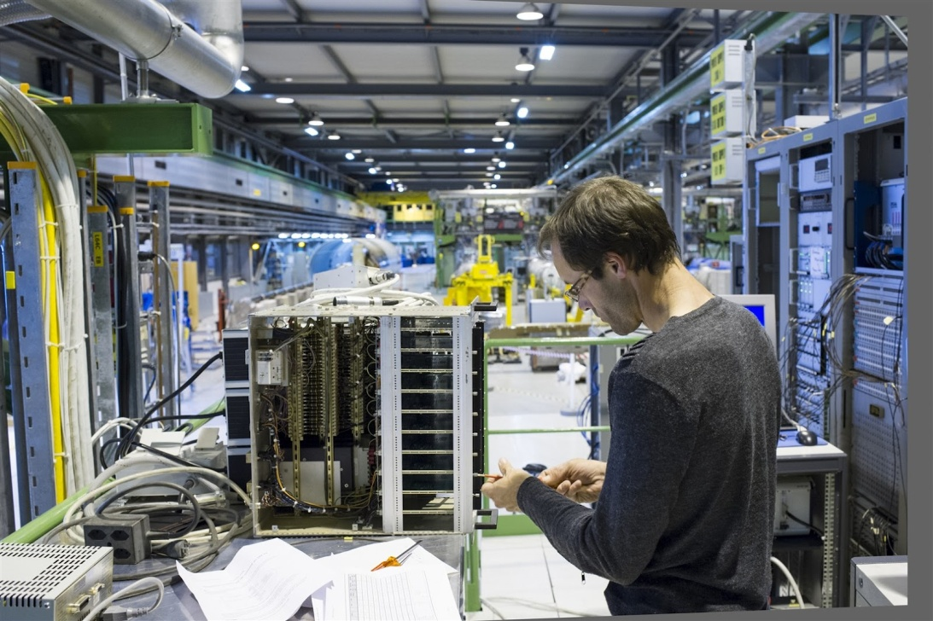
The need for expert knowledge
Shifters are not expert users of the system
When they cannot solve the problem, shifters reach for the on-call expert
Not all problems require advanced expert knowledge
Some issues can be diagnosed and solved just by inspecting the state of certain sub-systems

Slide 4
ALICE expert system
Goals
Assist human shifters in the ALICE control room
Diagnose potential issues
Make smart recommendations for troubleshooting
Improve the efficiency of shifters with limited expertise
Reduce the number of interventions of on-call people

Slide 5
A generic expert system

Slide 6
Knowledge representation and reasoning
Facts & rules
Facts - logic predicates that describe a given object
running(a) indicates detector a is running
Rules - Horn clauses that are used to reason whether a goal/action can be satisfied
rc_servers_available([H|T]) :-
check_running(H),
check_not_locked(H),!,
rc_servers_available(T).

Slide 7
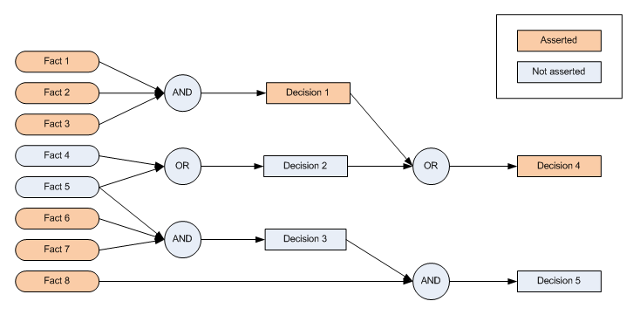
Knowledge representation and reasoning
Forward chaining
Given some facts, work forward through inference net
Discovers what conclusions can be derived from data

Slide 8
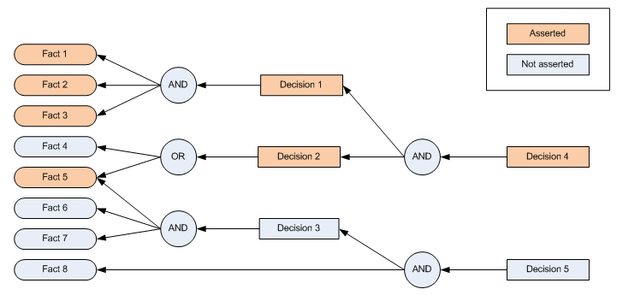
Knowledge representation and reasoning
Backward chaining
Work backwards looking for justifications for the decision
Eventually, each decision must be justified by facts

Slide 9
Knowledge representation and reasoning
Forward vs backward chaining
Forward chaining
process not directed towards a goal
disadvantage: cannot establish the reasons why a goal could not be satisfied
Backward chaining
backtrack whenever a predicate cannot be satisfied
use this feature to store all reasons for which a certain action could not be performed
Choose Prolog as an inference engine

Slide 10
Knowledge representation and reasoning
Storing failure reasons
Prolog cannot deal natively with the root causes for a failure
Work-around solution using its built-in backtracking mechanism
check_granted(X) :-
granted(X); % if true, continue
failures(F), % get the list of current failures
append(F,[X,'not granted'],F2), % append new failure
retractall(failures(_)), % remove old list
assert(failures(F2)), fail. % assert new list and return

Slide 11
Architecture

Slide 12
Diagnosis
A priori detection
Split the problem in smaller chunks that can be analyzed independently
Attempt to recursively solve each problem until the most specific diagnose is found
Limitation: not all problems can be detected a priori
Runtime analysis is also needed, for instance to detect processes that have crashed during the run and need to be restarted

Slide 13
Diagnosis
Run-time failures
Use the information stored by the logging system
Identify frequently occurring faults and, using expert knowledge, define rules to handle them
Unlike a priori diagnosis, run-time analysis is not real-time
wait until the events have been stored in the database
however, no action can be performed before a run stops anyway

Slide 14
Use cases
Recursive diagnosis
Check specific actions
Check whether a run can start
Check why the previous run failed

Slide 15
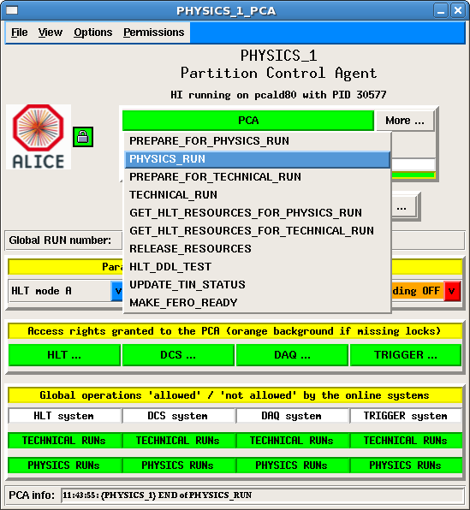
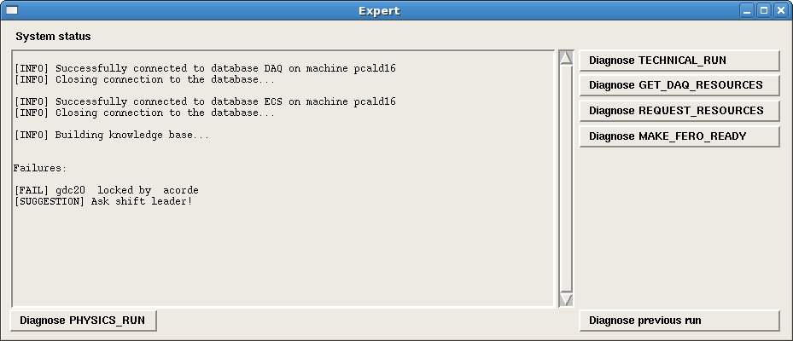
Use cases
ECS vs Expert system

Slide 16
Future work
Instead of being just an assistant, allow the system to perform actions on behalf of users
e.g. run scripts, send email alerts etc
Improve user experience
Integrate the expert system GUI within the ECS
Revamp the GUI using more modern technologies

