Slide 1
FairRoot framework
Mohammad Al-Turany
(GSI-Scientific Computing)

Slide 2
This Talk:
Introduction
Database redesign
Building and testing system
Online reconstruction and analysis
Transport data using message queuing technology
Test beams support
Support direct communication with DAQ Systems
Summary

Slide 3
What is FairRoot Framework? And why it is needed?
Simulation-, Reconstruction-, and Analysis-Framework (not only) for the FAIR experiments
2003 started as 2 person project for the CBM experiment at FAIR
Long list of base and/or ready to use modules and base classes of needed by the particle experiments
http://fairroot.gsi.de

Slide 4
Initially designed and implemented for CBM collaboration at GSI with following goals :(2003)
Decouple the detector simulation description from the simulation engine
Use different simulation engines (Geant3, Geant4, …) with the same user code (Virtual Monte Carlo)
Reuse existing software and tools, use standards as much as possible
Code should run on all platforms
The Framework should be
Easy to install
Easy to use
Should allow fast development cycles
Flexible to easily change experimental setup
Extensible for new developments

Slide 5
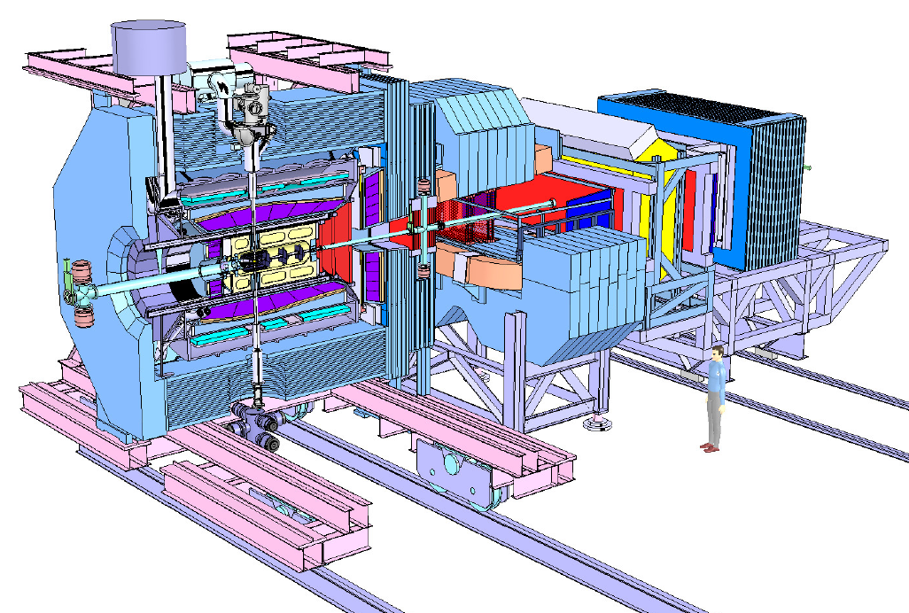
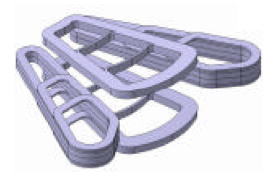
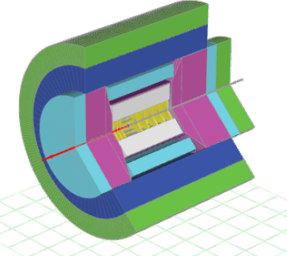
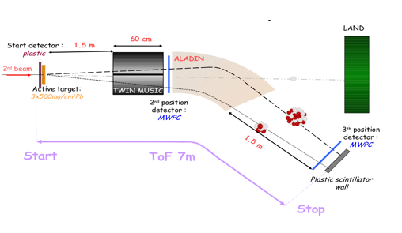
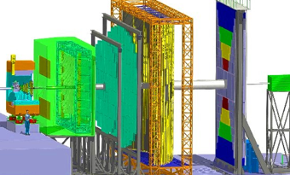
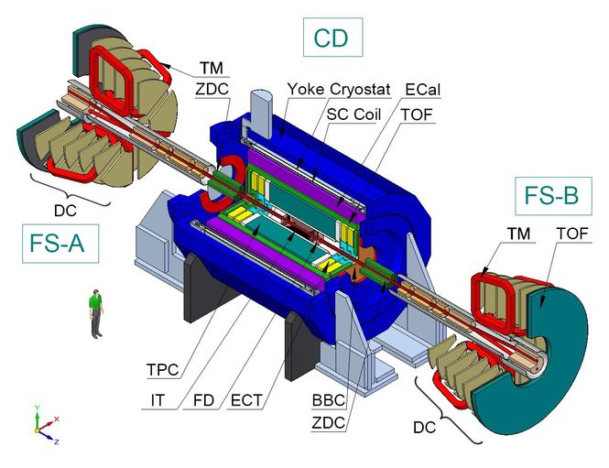
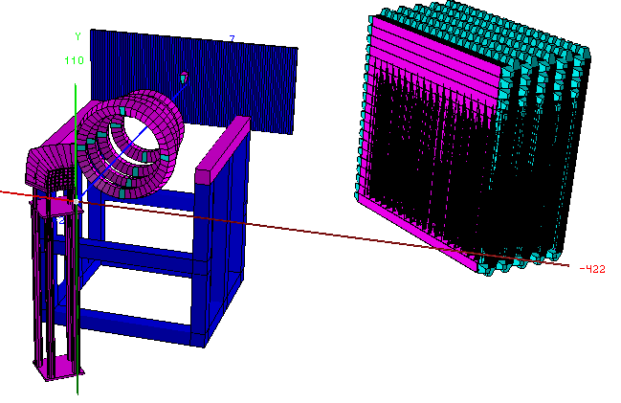
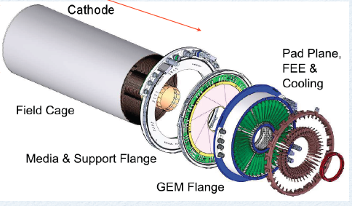
FairRoot : Timeline
Start testing the VMC concept for CBM
Panda decided to join->
FairRoot: same Base package for different experiments
EIC (Electron Ion Collider BNL)
EICRoot
SOFIA (Studies On Fission with Aladin)
R3B joined
2004
2006
2010
2011
2012
2013
First Release of CbmRoot
MPD (NICA) start also using FairRoot
GEM-TPC seperated from PANDA branch (FOPIRoot)
ENSAR-ROOT
Collection of modules used by structural nuclear phsyics exp.
ASYEOS joined
(ASYEOSRoot)

Slide 6
Design
CbmRoot
R3BRoot
SofiaRoot
MPDRoot
PandaRoot
AsyEosRoot
FopiRoot
EICRoot
FairRoot
Run Manager
IO Manager
MC Application
Event Display
Runtime DB
DB Interface
Task
Magnetic Field
Module
Detector
Event
Generator
…
…
Root
Libraries
Cint
ROOT IO
TTree
TGeo
TVirtualMC
TEve
Proof
Geant4
Genat4_VMC
Geant3
VGM
…
…
Florian Uhlig ROOT Users Workshop, Saas Fee
13.03.13
R3BRoot was presented today in Track 2:
http://indico.ihep.ac.cn/contributionDisplay.py?contribId=43&confId=2813

Slide 7
Core Team:
FairRoot Developers:
Student:
Dennis Klein (finished 02.2013)
Alexey Rybalchenko (EE)
Mohammad Al-Turany SC
Denis Bertini SC
Florian Uhlig CBM / SC
Radek Karabowicz PANDA / SC
Dmytro Kresan R3B/ SC
Tobias Stockmanns PANDA
long list of people who have contributed pieces of code to FairRoot since the project started end of 2003
People participated
to major features:
Ilse König HADES
Volker Friese CBM
Olaf Hartman PANDA

Slide 8
Database Re-Design

Slide 9
FairRoot DB Design (Old)
ASCII File
Configuration
parameters.
FairRoot
Run Manager
RunTime Database
Root File
Configuration
parameters.
IO Manager
Root File
MC-points
Digits, etc
Oracle

Slide 10
FairRoot DB Implementation (Old)
HADES
Oracle only solution base on server-side PL/SQL code
different versions
Generic
parameter container
parameter
object
name
type: Int_t, Float_t, Double_t, Char_t,
Text_t, UChar_t, class type
stored as byte array (RAW or BLOB)
number of values (single value or array)
class version
streamer info, root version for ROOT classes
own version management
any class derived from TObject decoded in the analysis interface by ROOT streamer

Slide 11
FairRoot DB Design (Old)
ASCII File
Configuration
parameters.
FairRoot
Run Manager
RunTime Database
Root File
Configuration
parameters.
IO Manager
Root File
MC-points
Digits, etc
Oracle

Slide 12
FairRoot DB extended
ASCII File
Configuration
parameters.
FairRoot
Run Manager
RunTime Database
Root File
Configuration
parameters.
DB Interface
IO Manager
Root File
MC-points
Digits, etc
TSQLServer
Oracle
MySQL
Postgresql

Slide 13
Re-design Database interface based on ROOT Database Connectivity (RDBC) API which provides uniform interface to Oracle, MySQL, PgSQL
Database Interface in FairRoot using TSQLServer
(MySQL, Oracle, PostGre,... )
Allows multiple connections to Dbs at runtime
Adds Version Management
Data type: Real and/or MC
Detector type
Date and Time Range
Reduces SQL coding
Simple Predefined Table
Only Simple SQL used
Ultimately Generic Container
Handles Write/Read access

Slide 14
FairDB interface Concept
D. Bertini
GUI Report Queries
Offline
Analysis Client
Monte Carlo Client
Online
Trigger
RunControl
LVL1
FairDB Interface
C++, ROOT
Connect
SQL I/O
Versions
Caching
Rollback
LVL2
TSqlServer
DBMS
LVL3
DBMS
DBMS
SQL
DBMS

Slide 15
Version Management
D. Bertini
Version
STS CAL
Time
MVD CAL
MVD TEMP
Detector
Validity time range (UTC)
Time
RunID ⬄ t

Slide 16
Version Management
D. Bertini
The Query process
Context ( Timestamp,Detector,Version) is the primary key
Context converted to unique SeqNo
SeqNo used as keys to access all rows in main table
System gives user access of all such rows
Validity Frame
SeqNO | Col 1 … | Col n
Context
matched
 |  |  | SEQNo
900001020
900001020
Auxiliary validity table
900001020
Bigtable a Distributed Storage System for
Structured Data, Google inc. OSDI 2006
900001020

Slide 17
Building & Testing system

Slide 18
Testing and building system
CMake
Creates Makefiles (and/or project files) for different platforms.
Test support.
Large user base assures support.
CDash to handle data created with CMake
PHP framework
MySQL database
Both tools are open source.

Slide 19
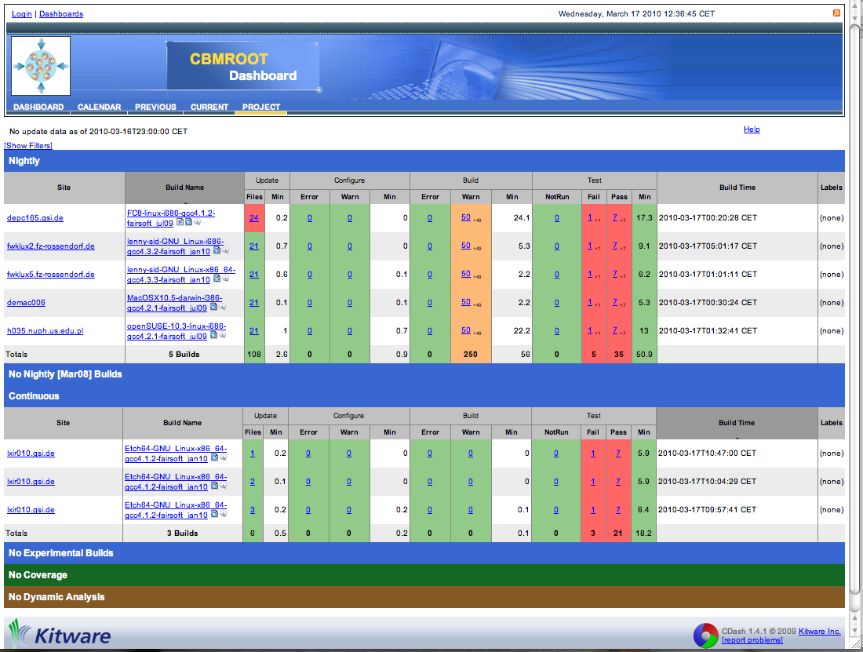
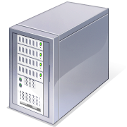
If someone experiments with new features in his local working copy and wants to test them (experimental build)
2. Configure, build and test
on local machine
3. Send results automatically
to central web page
1. Update (optional)
4. Dashboard prepares and display results
Central SVN repository
5. Developer check results

Slide 20
If new code enters the central code base (continuous build)
Central SVN
repository
Dedicated test server
2. Basic checks:
Style, etc
3. SVN triggers
test server
4. Configure, build and test
on local machine
Pass
5. Send results automatically
to central web page
Fail
Reject commit
Developer
commit code
7. In case of problems Dashboard sends an E-mail to Developer and Administrator
6. Dashboard prepares and display results

Slide 21
From time to time a full check on all supported platforms should be done (nightly build)
Central SVN repository
5. In the morning Developers and Administrators check
their mails and the dashboard. And the development
cycle starts again
4. In case of problems
Dashboard sends
an E-mail to Developer
and Administrator
3. Dashboard prepares and display results
1. Update
2. Send results automatically
to central web page

Slide 22
New Data transfer layer for FairRoot

Slide 23
Data transfer layer for FairRoot
FairRoot must be extended to support the continuous pipeline-processing scenario of the online analysis
Tasks have to be put on different compute nodes
Transport data using message queuing technology
Scheme would also allow to enable concurrency in FairRoot for offline analysis
The long term plan is to have the same framework for online and offline
Flexible data transport for the online reconstruction of FAIR experiments
http://indico.ihep.ac.cn/contributionDisplay.py?contribId=72&sessionId=3&confId=2813

Slide 24
Where we are going with FairRoot?
ROOT Files, Lmd Files, Remote event server, …
Root (Event loop)
ZeroMQ
FairRootManager
FairRunAna
FairTasks
Init()
Re-Init()
Exec()
Finish()
FairMQProcessorTask
Init()
Re-Init()
Exec()
Finish()

Slide 25
Online (Test beams) support

Slide 26
New Data sources and histogram server for online monitoring
FairRoot Analysis
System Directory
Histogram server
Data Source
DAQ
(MBS, …)
MBS client
Remote event server
Remote event server client
…..
....
Online monitor
Online monitor
Online monitor
Online monitor
Online monitor

Slide 27
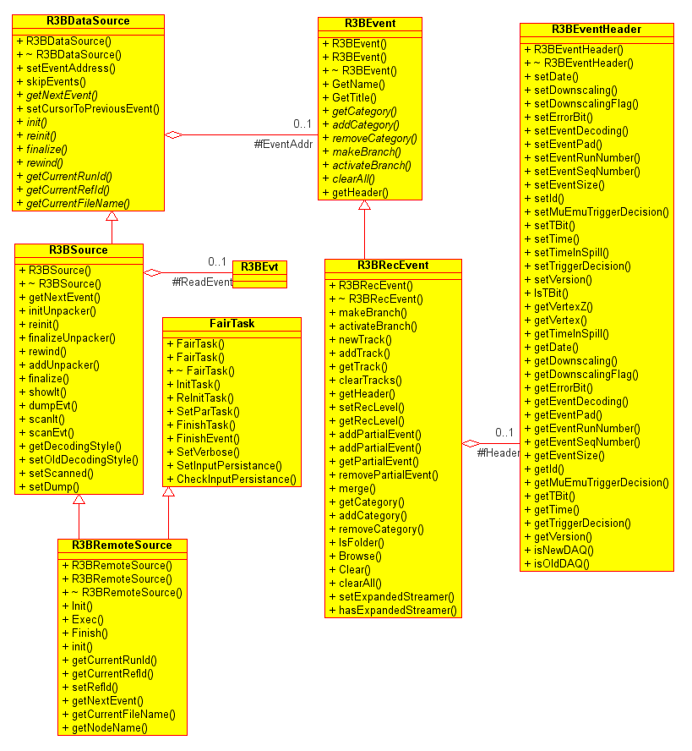
New Data Source for FairRoot
A client for the GSI remote event server is implemented
Incoming data can be saved to root objects/files processed on the fly with offline code

Slide 28
Summary
In the last year we moved from event by event simulation to time based (pile up simulation)
The database interface has been re-designed
With the new source design, the offline code can run online and can be used for online monitoring
We are moving slowly toward massage passing concept.
Thanks!

