Slide 1
Flexible data transport for the online reconstruction of FAIR experiments
Mohammad Al-Turany
Dennis Klein
Alexey Rybalchenko
(GSI-IT)

Slide 2
Contents
Introduction to FAIR
CBM and Panda Experiments
Why to use Message Queues
Current status
Results
Summary

Slide 3
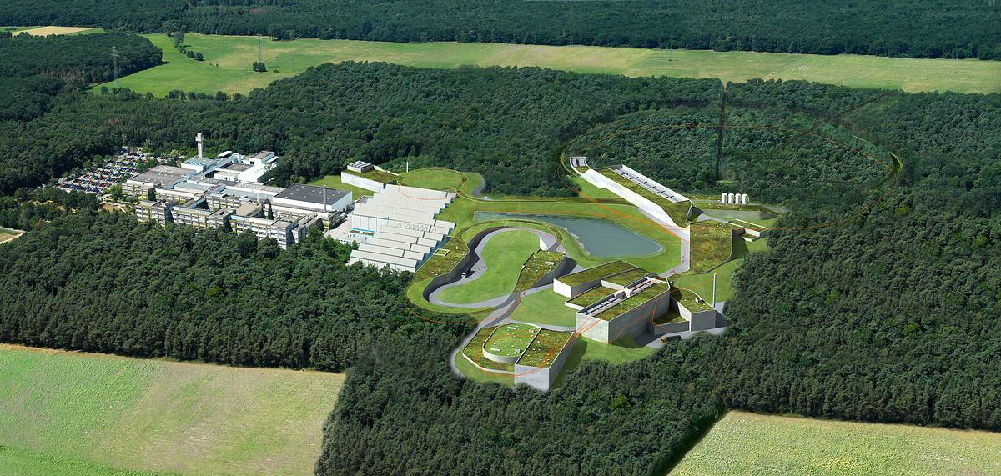
Facility for
Antiproton and
Ion
Research
Observer:
EU, United States, Hungary, Georgia, Saudi Arabia
Darmstadt (Germany)
FAIR
GSI

Slide 4
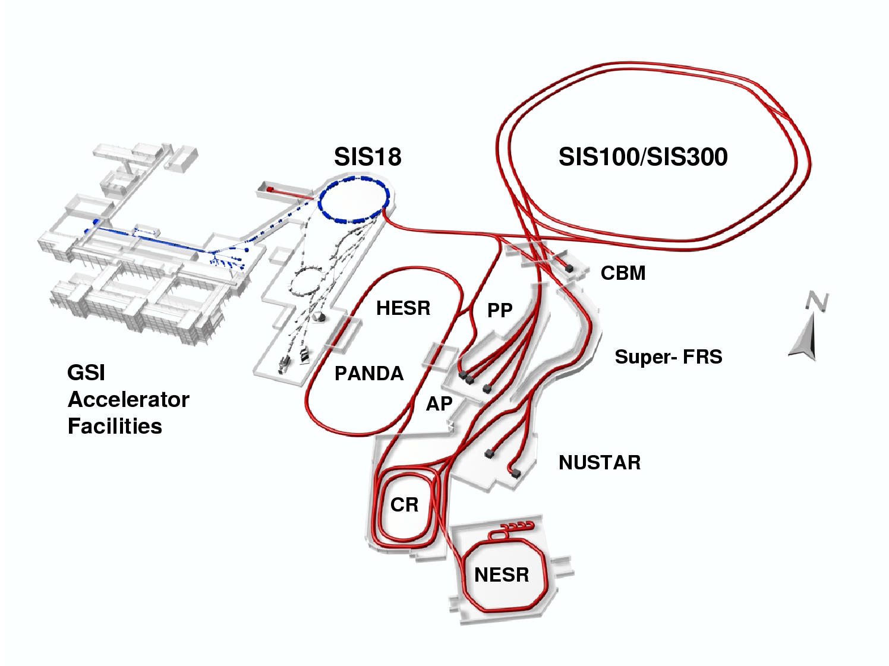

Slide 5
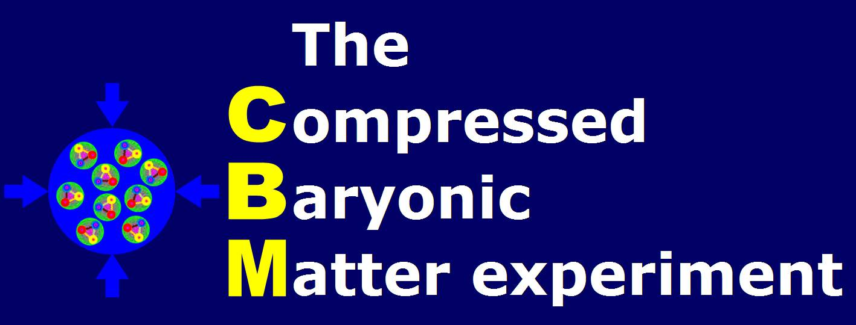
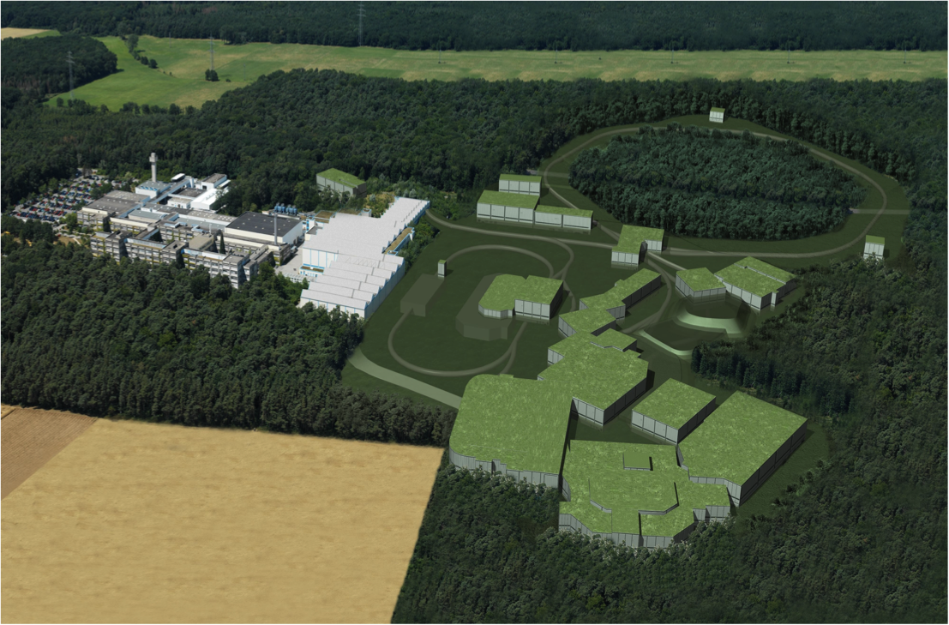
~400 Physicists
50 Institutes
15 countries
Physics program:
Equation of state at high baryonic density
QCD phase transition
Critical end point of QCD phase diagram
Restoration of Chiral Symmetry

Slide 6
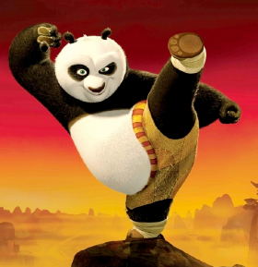
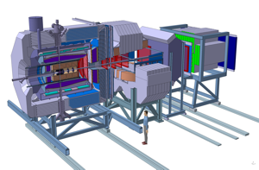
Anti-Proton ANnihilation at DArmstadt
Physics Programm:
Charmonium Spectroscopy
Search for Glueballs & Hebrides
Hyper nucleus
Drell-Yan Physics
Electromagnetic form factors
Rare decays
~450 Physicists
52 Institutes
17 Countries
Data rate ~10⁷ Event/s
Data volume ~10 PB/yr

Slide 7
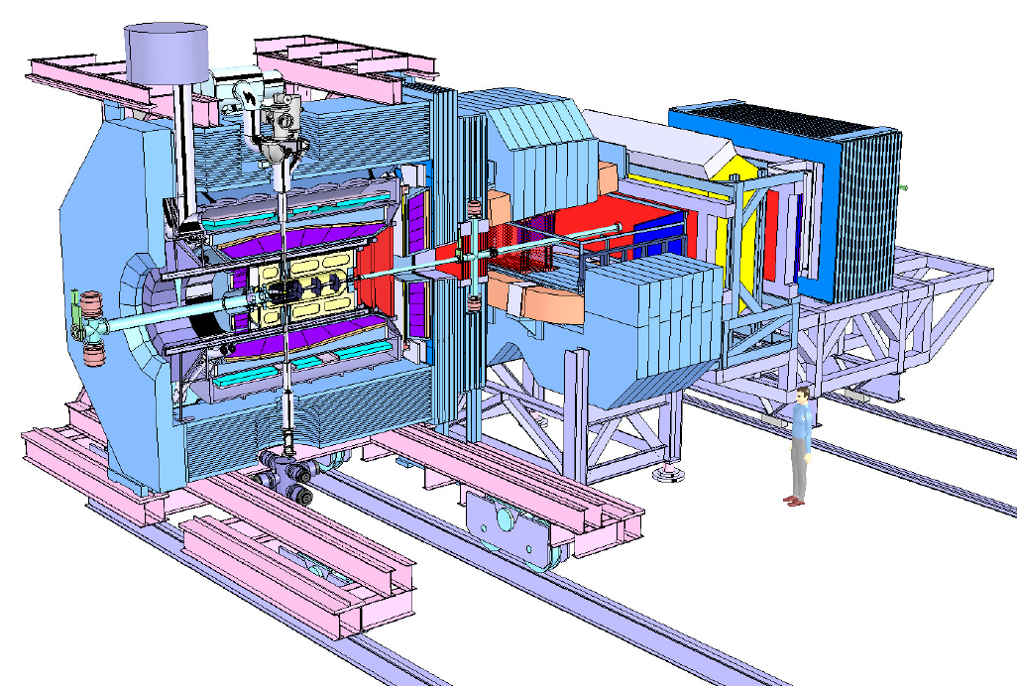
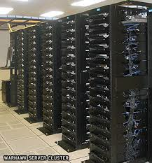
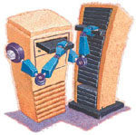
The Online Reconstruction and analysis
300 GB/s
20M Evt/s
> 60 000
CPU-core
or Equivalent
GPU, FPGA, …
< 1 GB/s
25K Evt/s
How to distribute the processes?
How to manage the data flow?
How to recover processes when they crash?
How to monitor the whole system?
……
1 GB/s
1 TB/s
> 60 000
CPU-core
or Equivalent
GPU, FPGA, …

Slide 8
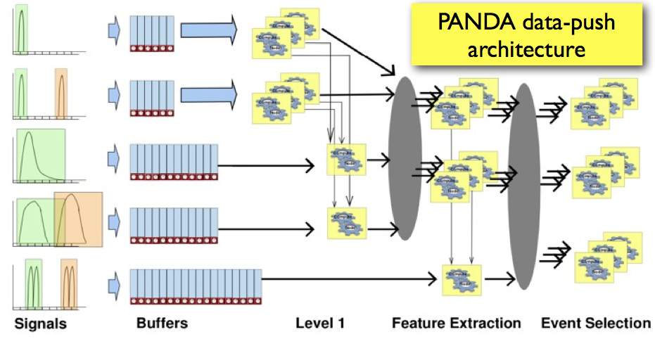
Trigger-less Data Acquisition

Slide 9
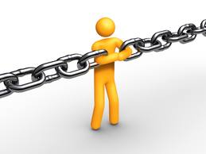
Design constrains
Highly flexible:
different data paths should be modeled.
Adaptive:
Sub-systems are continuously under development and improvement
Should works for simulated and real data:
developing and debugging the algorithms
It should support all possible hardware where the algorithms could run (CPU, GPU, FPGA)
It has to scale to any size! With minimum or ideally no effort.

Slide 10
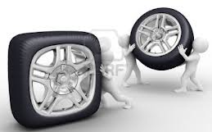
Before Re-inventing the Wheel
What is available on the market and in the community?
A very promising package: ZeroMQ is available since 2 years
Do we intend to separate online and offline? NO
Multithreaded concept or a message queue based one?
Message based systems allow us to decouple producers from consumers.
We can spread the work to be done over several processes and machines.
We can manage/upgrade/move around programs (processes) independently of each other.

Slide 11
ØMQ (zeromq)
A socket library that acts as a concurrency framework.
Carries messages across inproc, IPC, TCP, and multicast.
Connect N-to-N via fanout, pubsub, pipeline, request-reply.
Asynch I/O for scalable multicore message-passing apps.
30+ languages including C, C++, Java, .NET, Python.
Most OS’s including Linux, Windows, OS X, PPC405/PPC440.
Large and active open source community.
LGPL free software with full commercial support from iMatix.

Slide 12
Why ØMQ?
A messaging library, which allows you to design a complex communication system without much effort
Presents abstraction on higher level than MPI →programming model is easier
Is suitable for loosely coupled and more general distributed systems

Slide 13
Zero in ØMQ
Originally the zero in ØMQ was meant as "zero broker" and (as close to) "zero latency" (as possible).
In the meantime it has come to cover different goals:
zero administration,
zero cost,
zero waste.
More generally, "zero” refers to the culture of minimalism that permeates the project. Adding power by removing complexity rather than exposing new functionality.

Slide 14
ZeroMQ sockets provide efficient transport options
Inter-thread
Inter-process
Inter-node
which is really just inter-process across nodes communication
PMG : Pragmatic General Multicast (a reliable multicast protocol)
Named Pipe: Piece of random access memory (RAM) managed by
the operating system and exposed to programs through a file descriptor and a named mount point in the file system. It behaves as a first in first out (FIFO) buffer

Slide 15
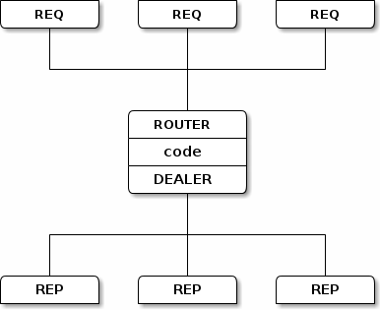
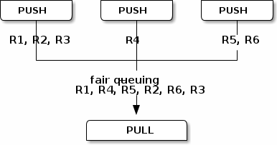
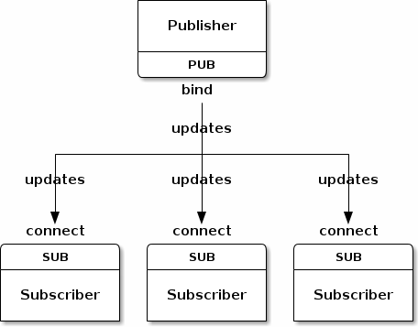
The built-in core ØMQ patterns are:
Request-reply, which connects a set of clients to a set of services. (remote procedure call and task distribution pattern)
Publish-subscribe, which connects a set of publishers to a set of subscribers. (data distribution pattern)
Pipeline, which connects nodes in a fan-out / fan-in pattern that can have multiple steps, and loops. (Parallel task distribution and collection pattern)
Exclusive pair, which connect two sockets exclusively

Slide 16
Current Status
The Framework deliver some components which can be connected to each other in order to construct a processing pipeline(s).
All component share a common base called Device (ZeroMQ Class).
Devices are grouped by three categories:
Source: Sampler
Message-based Processor:
Sink, BalancedStandaloneSplitter, StandaloneMerger, Buffer
Content-based Processor: Processor

Slide 17
Design
Experiment/detector specific code
Framework classes that can be used directly

Slide 18
Example for CBM online reconstruction hierarchy
STS data
Mvd data
TRD data
TOF data
Clusterer
Clusterer
Clusterer
Pre-Processing
Tracker
TRD Tracker
Global Event Reconstruction
Trigger event selection

Slide 19
Example for CBM online reconstruction hierarchy Simulation
STS Sampler
Mvd Sampler
TRD Sampler
TOF Sampler
Clusterer
Clustrer
Clustrer
Pre-Procceing
Tracker
TRD Tracker
Global Event Reconstruction
Trigger event selection

Slide 20
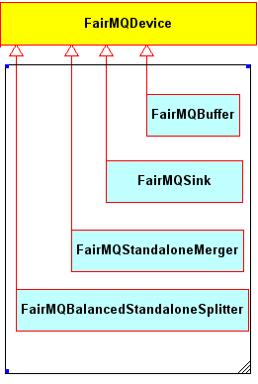
Message-based Processor
All message-based processors inherit from Device and operate on messages without interpreting their content.
Four message-based processors have been implemented so far

Slide 21
Example for Fan-out/Fan-in
the data path for load balancing
TRD data
TRD data
FairMQBalancedStandaloneSplitter
Clusterer
Clustrer
Clustrer
Clustrer
Tracker
Tracker
Tracker
TRD Tracker
FairMQStandaloneMerger

Slide 22
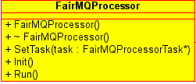
Content-based Processor
The Processor device has at least one input and one output socket.
A task is meant for accessing and potentially changing the message content.

Slide 23
Example for CBM online reconstruction hierarchy (scenario)
Detector
Simulation
STS data
Mvd data
REP
REP
SUB
Parameter database
SUB
REQ
SUB
SUB
REQ
SUB
PUB
Clusterer
Clusterer
REP
REP
SUB
REQ
Tracker
PUB
REP
PUB

Slide 24
Results
Throughput of 940 Mbit/s was measured which is very close to the theoretical limit of the TCP/IPv4/GigabitEthernet
The throughput for the named pipe transport between two devices on one node has been measured around 1.7 GB/s
Each message consists of digits in one panda event for one detector, with size of few kBytes

Slide 25
Payload in Mbyte/s as function of message size
ZeroMQ works on InfiniBand but using IP over IB

Slide 26
Native InfiniBand/RDMA is faster than IP over IB
Implementing ZeroMQ over IB verbs will improve the performance.

Slide 27
Integrating the existing software:
ROOT Files, Lmd Files, Remote event server, …
Root (Event loop)
ZeroMQ
FairRootManager
FairRunAna
FairTasks
Init()
Re-Init()
Exec()
Finish()
FairMQProcessorTask
Init()
Re-Init()
Exec()
Finish()

Slide 28
Summary
ZeroMQ communication layer is integrated into our offline framework (FairRoot)
On the short term we will keep both options ROOT based event loop and concurrent processes communicating with each other via ZeroMQ.
On long Term we are moving away from single event loop to distributed processes.
Thanks you !

Slide 29
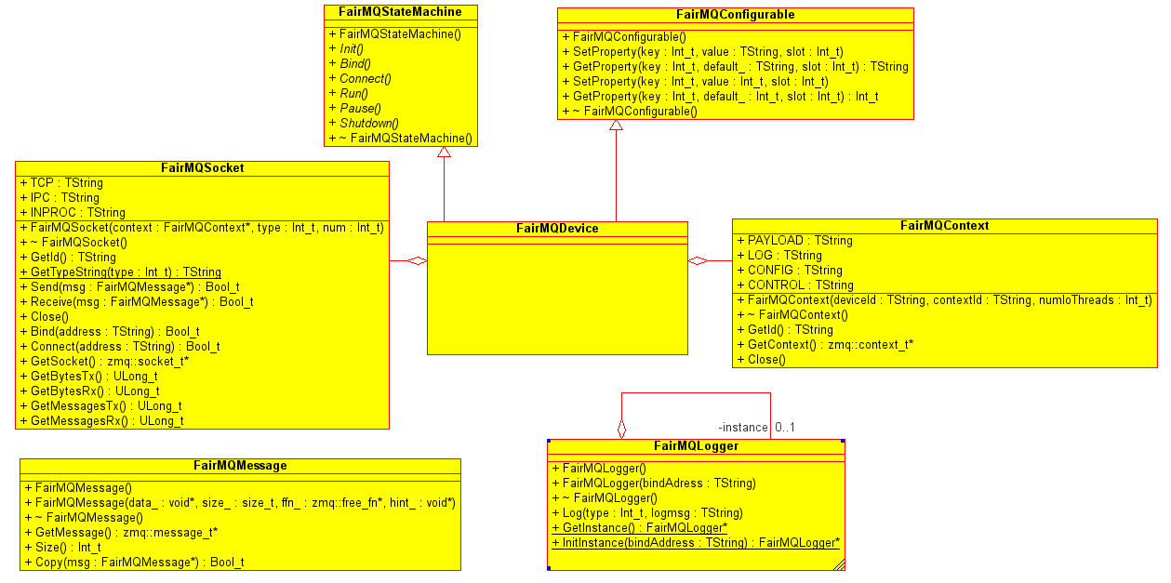
Device
Each processing stage of a pipeline is occupied by a process which executes an instance of the Device class

Slide 30
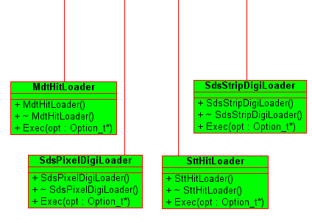
Sampler
Devices with no inputs are categorized as sources
A sampler loops (optionally: infinitely) over the loaded events and send them through the output socket.
A variable event rate limiter has been implemented to control the sending speed

Slide 31
Message format (Protocol)
Potentially any content-based processor or any source can change the application protocol. Therefore, the framework provides a generic Message class that works with any arbitrary and continuous junk of memory (FairMQMessage).
One has to pass a pointer to the memory buffer, the size in bytes, and can optionally pass a function pointer to a destructor, which will be called once the message object is discarded.

Slide 32
New simple classes without ROOT are used in the Sampler (This enable us to use non-ROOT clients) and reduce the messages size.

