Slide 1
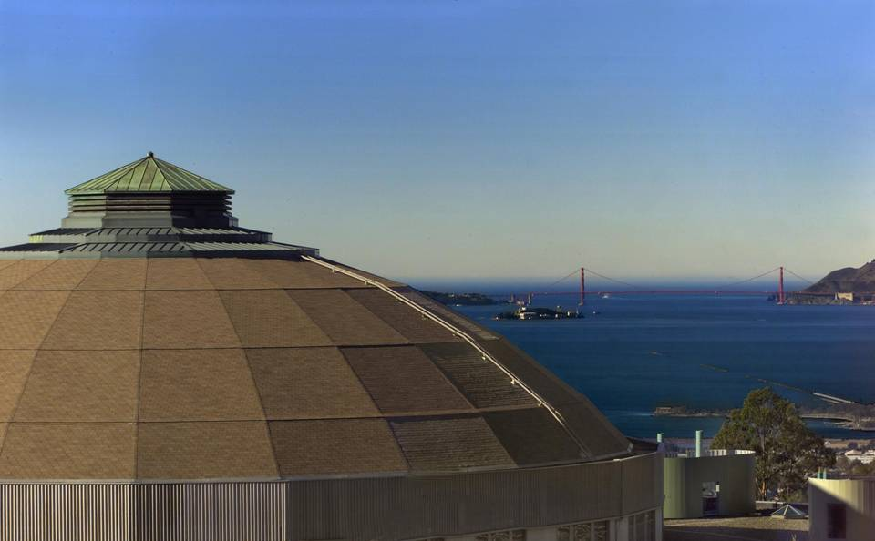
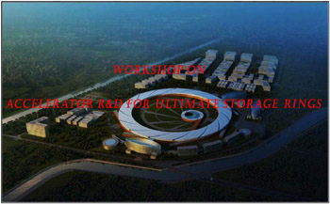
Workshop on Accelerator R&D for Ultimate Storage Rings : Beijing / IHEP, October 2012
  Feedbacks for Ultimate Storage Rings
  Christoph Steier
  Advanced Light Source
  Accelerator Fusion Research Division
  Lawrence Berkeley National Laboratory

Slide 2
Topics
Introduction
Orbit FF/Feedbacks
  Architecture
  Photon BPMs
  Achieved Performance
Examples of current development efforts
  APS, NSLS-II, …
Beamsize Stability
  Correction of Lattice functions / Coupling
Areas for future development
Summary

Slide 3
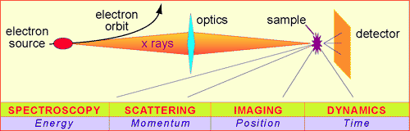
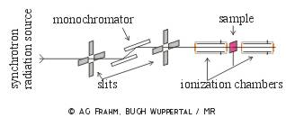
Motivation
Typical requirements of modern SR user experiments:
All of those requirements relate back into stability requirements for beam position + angle, beamsize + emittance, beam energy, beam energy spread, …
Often stability can be more important to SR users than brightness+flux
For current SR sources, this translates to submicron orbit stability requirements (for USRs in both planes)
Measurement parameter | Stability Requirement
Intensity variation ΔI/I | <<1% of normalized I
Position and angle | <2-5% of beam σ and σ’
Energy resolution ΔE/E | <10⁻⁴
Timing jitter | <10% of critical time scale
Data acquisition rate | 10⁻³ – 10⁵ Hz
Adapted from B. Hettel
Notes:
3

Slide 4
Causes for Orbit Distortions
Beam energy drift– (thermal, IDs, tides)
Thermal
Vibration (water, ground)
Insertion Device Errors
Power Supply Ripple
.1
1
10
100
1000
Hertz
Stability requirements in terms of magnitude very similar for USRs and current rings (vertical emittance already down to 5-50pm in rings vertically)
  Short term stability goals achieved for rings in both planes (<<10% of σ_{y}) evolving user demands->further evolution necessary
Changes for USRs:
  USRs will likely have somewhat larger lattice amplification factors
  Highest energy USRs also might have even smaller emittances
  Tighter user requirements for high-end experiments?
Long term stability in current rings does not quite meet goals, yet.
Notes:
4

Slide 5
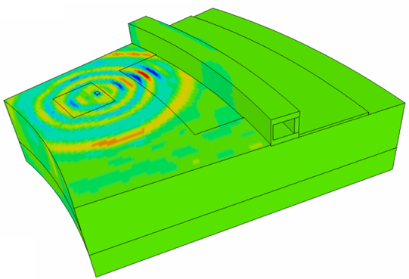
Stability / Design
Soleil
Girder
ALS water
temperature
Slab design, utility location, Courtesy: N. Simos, NSLS-II
Stability design requirements very similar for USRs and existing rings
  Need to tailor to site properties and machine footprint
  Overall system integration is important

Slide 6
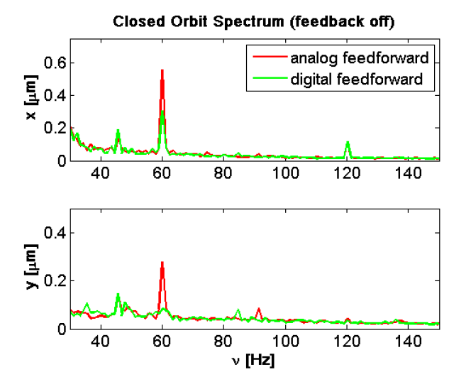
Good power supplies are essential
Achievable power supply performance increased over the years – Higher digital resolution
State-of-art good enough for USRs
One caveat:
  Strong corrector magnets with high vacuum chamber cut off frequencies can be significant sources of orbit noise
    Observed at several light sources
Notes:
6

Slide 7
Example: Insertion Device Compensation
In Light Sources, insertion devices are often the biggest source of orbit / beamsize distortions
Users require full control of their photon energy (gap/field) and potentially polarization (EPUs, …)
State-of-art compensation in rings:
  Steering compensation (FF)
  Optics compensation (FF)
  Coupling compensation (FF)
    Those three FF combined also correct dispersion
  Slow+fast orbit feedback (up to 10 kHz update rate – up to 200 Hz bandwidth)

Slide 8
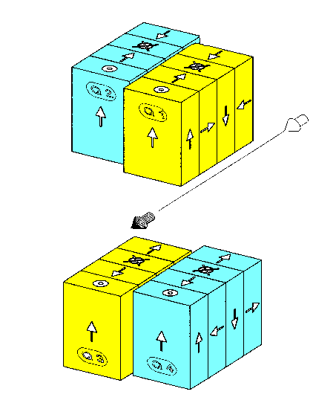
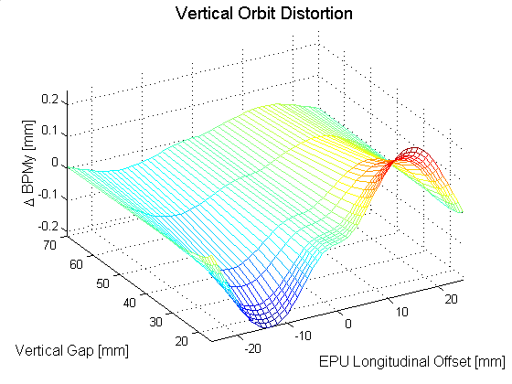
Feed-forward example: EPU Compensation
EPU
Electron Beam
Corrector Magnets
Mechanically, an ALS EPU can move from left to right circular polarization mode in ~1.6 sec.
Without compensation the EPU would distort the electron beam orbit by ±200 μm vertically and ±100 μm horizontally. Using corrector magnets on either side of the EPU, 2-dimensional feed forward correction tables are used to reduce the orbit distortion to the 2-3 μm level. Update rate of feed-forward is 200 Hz.
Notes:
8

Slide 9
Fast orbit feedback topologies
Many different types of fast orbit feedbacks are in use
State of the art are systems with update rates of 1-10 kHz and closed loop bandwidths between 80 and about 200 Hz
In some systems, PID algorithms are supplemented by notch filters, …

Slide 10
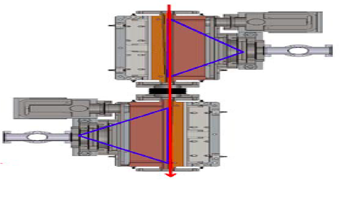
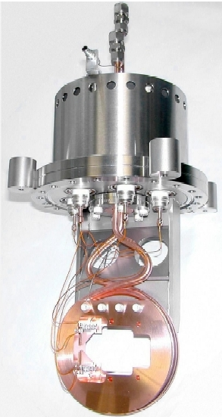
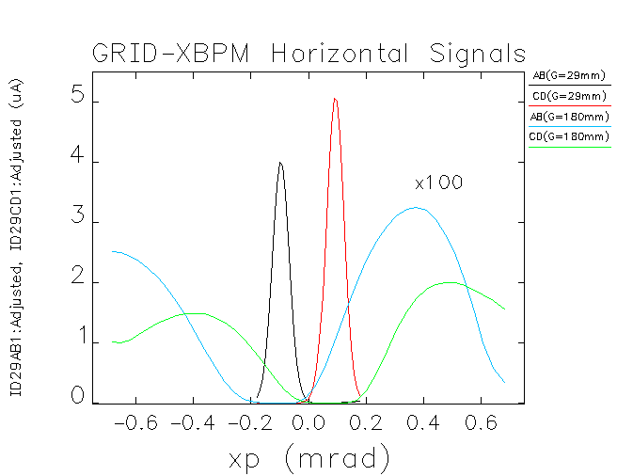
Photon BPMs
RF-BPMs are excellent at position detection, but remaining error for angular determination is still significant. Long lever arm to x-ray BPMs makes those more sensitive.
FMB
BESSY II,
ALS,
SLS,
LNLS
Work very well for dipoles in the vertical plane
For undulators OK for planar ID hard x-rays (‘Decker distortions’)
Difficult for VUV, no solution for EPUs
One example of ongoing R+D: x-ray fluorescence (Grid-XBPM) at APS (Yang, et al.)
  For APS case, bend magnet background almost completely suppressed

Slide 11
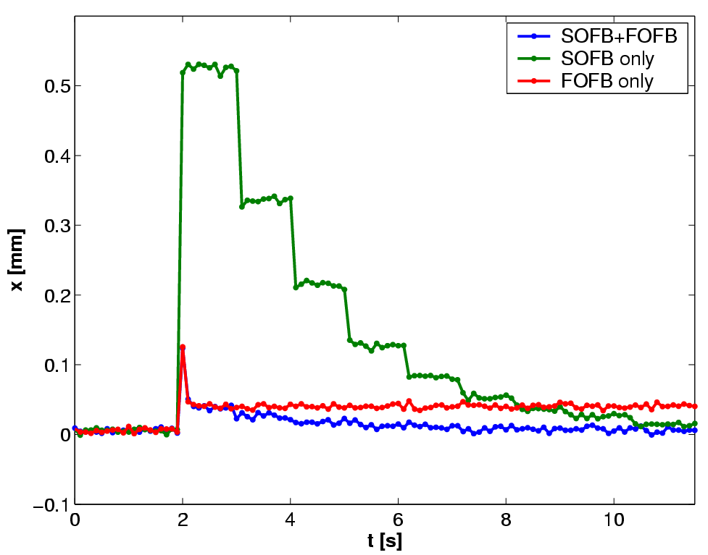
Combining different feedbacks
Many accelerators need feedbacks of different speed (fast/medium/slow)
  Limitations of correctors, limitations of BPMs, Layout, RF noise consideration, …
Potentially provides problems of interaction / how to implement DC blocking, … -> Many good solutions available
Another challenge is the integration of systems like BPM position sensors, girder/magnet movers, photon BPMs, photon beamline sensors and actuators -> No generally accepted best solution, room for improvement

Slide 12
Achieved Stability at 3rd generation Rings
Orbit stability
  Fast: (0.01 Hz-1 kHz) micron - submicron
  Medium: (minutes-hours) submicron
  Slow: (days-weeks) few microns
Beamsize stability (also energy spread)
  Better than 1% (in some facilities)
Intensity Stability
  Depending on facility 0.1-1% (top-off)
  Very stable fill pattern (important for some experiments – time resolved STXM)
Energy stability
  10⁻⁵ with frequency feedback
  <0.05 degree phase stability (500 MHz)

Slide 13
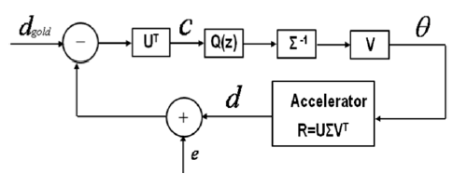
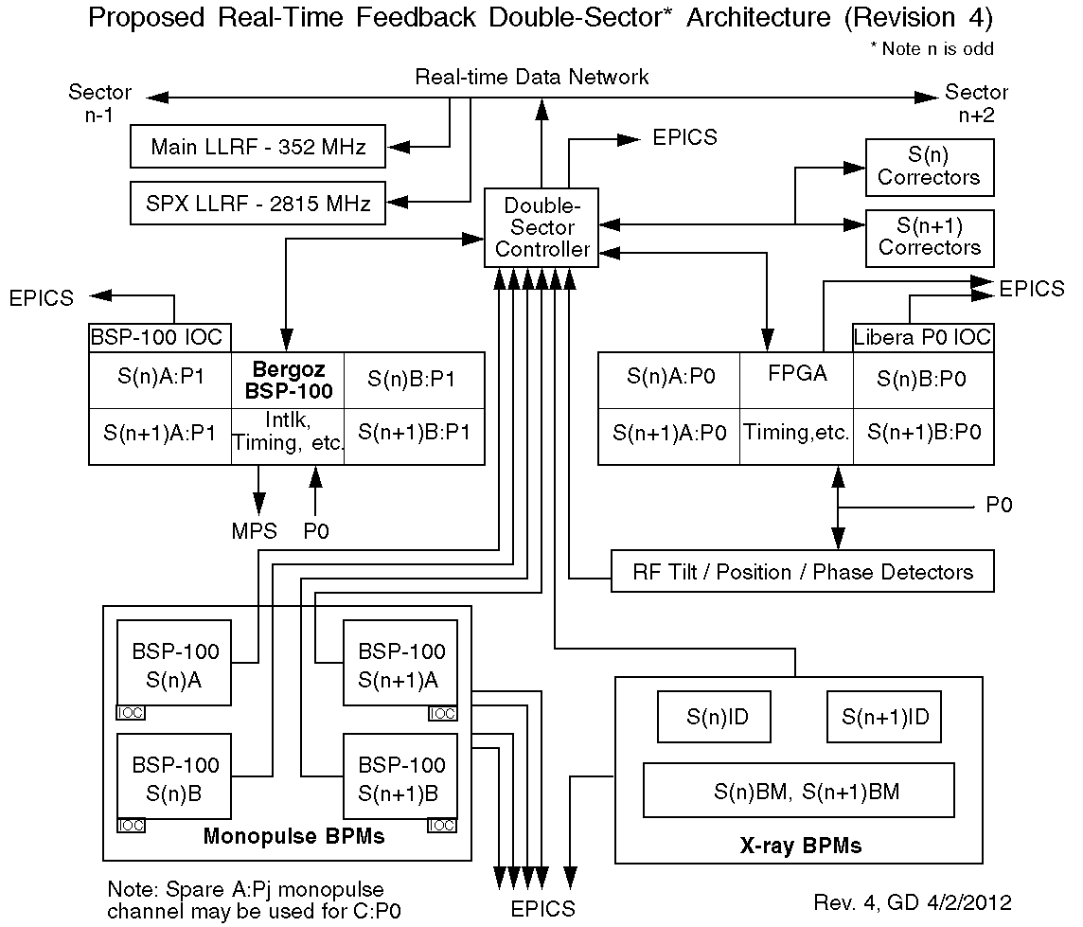
Some Examples of ongoing Feedback R+D
NSLS-II (Singh, Tian, Yu, Dalesio, et al.):
  Faster deterministic network and controller -> possibility for feedback rate of 20-30 kHz -> increased closed loop bandwidth possible
  Distributed computation power allows to apply feedback (PID) in SVD eigenspace -> Tailored gain and better noise rejection – idea already in use at SPEAR-III (Straumann, Terebilo) in a centralized feedback system
APS (Decker, et al.)
  Faster data rate (20 kHz) -> increased closed loop bandwidth
  Combining many diverse inputs
  Integration of X-ray BPMs

Slide 14
Beamsize Stability
Beamsize/emittance Stability is very important as well, challenging at low energy light sources with many EPUs
Some examples of affected experiments:
  STXM (scanning transmission X-ray microscopes) – intensity normalization difficult, not included in state-of-the-art beamlines
  Microfocus beamlines investigating dirt samples
At USRs problem will be different (large instead of small coupling)
  Need to simulate sensitivity of possible equal emittance schemes (coupling, mobius, wigglers, dispersion) to errors
Correction using feed-forward (and sometimes feedback) of
  Optics distortion (beta functions)
  Skew gradients
  Potentially horizontal/vertical natural emittance

Slide 15
Very Fast Feedbacks
Very fast stability / single+multibunch instabilities
Routinely addressed by multibunch feedback system (longitudinal/transverse) – most recent ones all digital
Recently switch to digital transverse feedbacks
  Commercially available
ALS TFB: W. Barry
Multibunch feedbacks will likely remain essential in USRs
  Larger impedance of smaller vacuum chambers
In some cases larger gain desirable than currently available
  More ADC Bits, lower noise frontend, better pickups, …
Also can be helpful to damp out injection transients (top-up or swap out) before filamentation occurrs

Slide 16
Outlook / Challenges
Light source development continues to ever smaller emittances -> tighter stability requirements (not large factors)
Photon BPMs work well for hard x-ray undulators (potentially with Decker distortions), not so well for VUV, no good solution for EPUs -> Development needed
In some light sources, frontend Photon BPMs are used in feedback, but usually beamline is treated separate from accelerator -> integrated front-to-end approach for diagnostics and feedback necessary including all available diagnostics, end-station detectors and actuators along the beamlines
BPM/feedback update rates have improved (1 kHz->10 kHz). Latency times of digital BPMs are typically more than one cycle -> Need to improve
Smaller chambers -> larger impedance -> higher gain for multibunch feedbacks -> lower noise necessary (more Bits, …)
Are there better ways to incorporate HLS, BPM position sensors, … into feedback systems
Are girder/magnet movers desirable or not (flexibility of correction versus shift in vibration eigenfrequencies)

Slide 17
Summary
Storage ring based 3rd generation light sources are already extremely stable (submicron except for long timescales)
  Combination of passive source suppression
  Active feed-forward, feedback
USRs with larger lattice amplification factors and smaller beamsizes will be slightly more challenging and need to incorporate stability in design from beginning
  Ground plate/site, temperature, girder, magnet mounting, …
  Orbit feedback for ‘slow’ (<200 Hz) effects seems well in reach with technology extrapolation
  Injection transient correction/damping needs to be tailored to selected injection scheme
No revolution necessary (except maybe for undulator/EPU x-ray BPMs) but continuation of steady evolution over the years

Slide 18
Backup Slides

Slide 19
Long-term + thermal stability
Top-up provides extremely good (thermal) stability
  Average current stability
    Heat load on user beamlines, normalization, …
    Very important for ultimate (slow) performance of BPMs, …
  Fill pattern (bunch-by-bunch current stability)
    Some timing users
    Fill pattern dependence of BPMs
  Reliability (MTBF of 40 – 200 h)
    Accelerator and Beamline Optics – Some beamlines need about 1h after refill before data taking can restart

