Slide 1
Ultimate Storage Ring Light Sources:
Design and Performance Objectives
R. Hettel, SLAC
USR Accelerator R&D Workshop
Huairou (Beijing), China
October 30, 2012

Slide 2
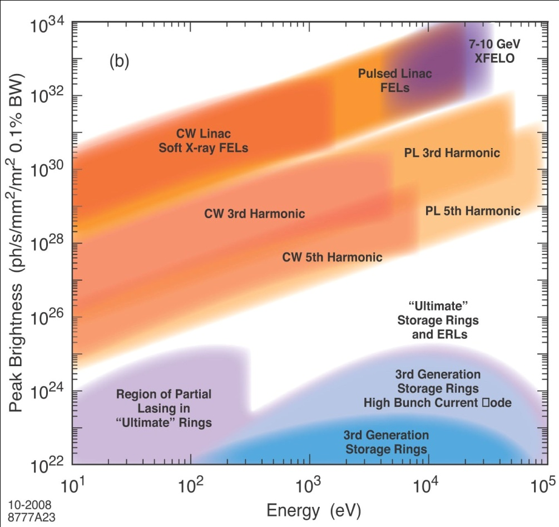
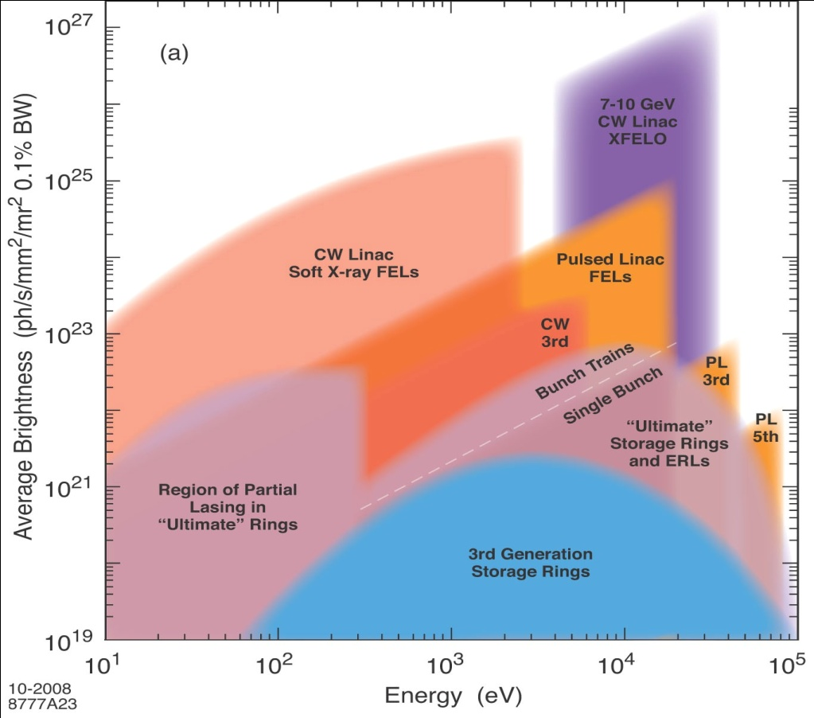
Ring sources are complementary to FELs
The low peak power and high average power provided by high repetition rate ring-based X-ray sources, enabling non-destructive study of experimental samples, complementary to the high peak brightness low rep-rate beams provided by X-ray FELs
Ring-based sources will remain a mainstay of X-ray research in the future.

Slide 3
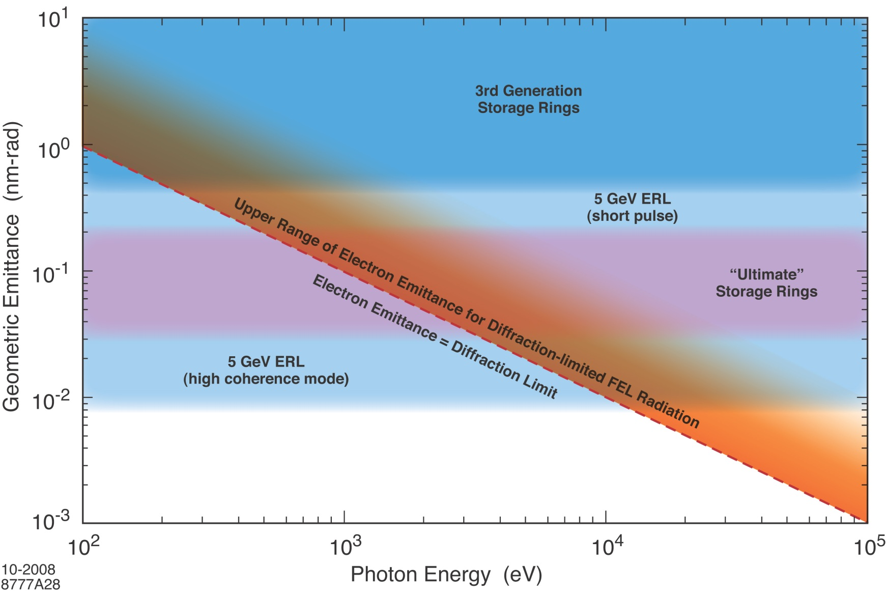
Diffraction-limited emittance
“Ultimate storage rings

Slide 4
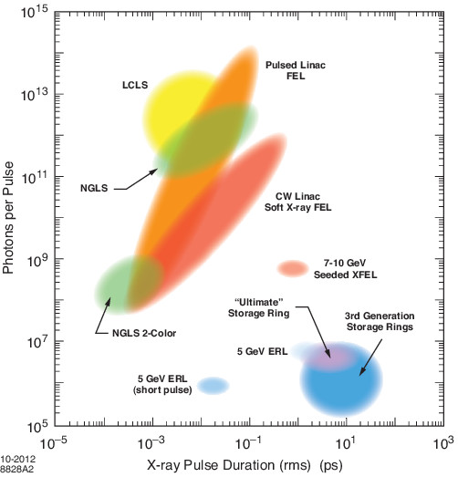
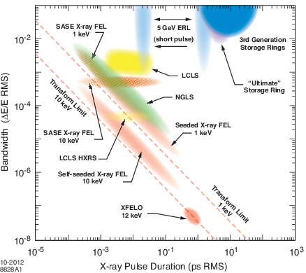
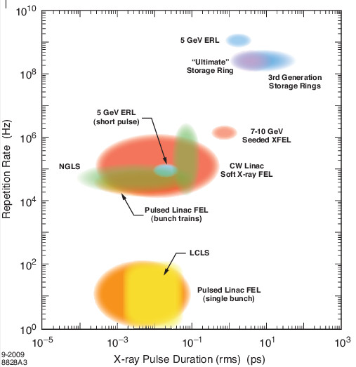
Light source performance: other metrics

Slide 5
USR performance capabilities
Performance capabilities are constrained by available ring size, cost and, in the case of ring upgrades (e.g. SPring-8, ESRF, etc.) by the need to conform to existing beam line geometries and infrastructure
Ignoring imposed constraints, what are the potential capabilities of green-field USR implementations?

Slide 6
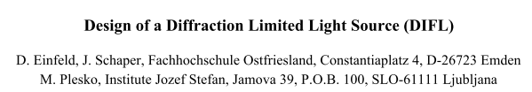
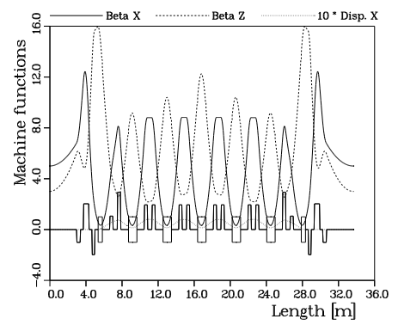
MBA Lattice
PAC 95

Slide 7
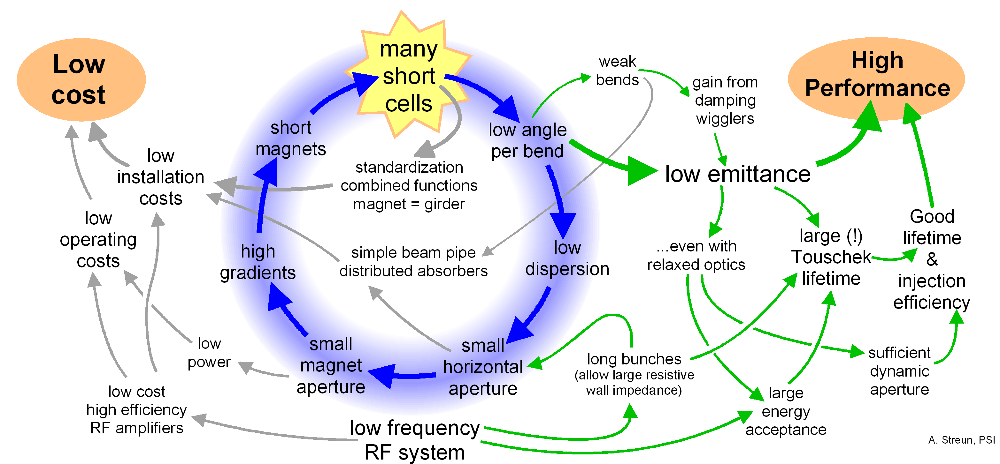
The multibend achromat optimization cycle
A. Streun, PSI

Slide 8
Consolidated x-ray beam lines for large rings?
vs.
PEP-X 7BA
PEP-X hybrid DBA-TME

Slide 9
USRs – different energy ranges

Slide 10
USRs - spectral brightness

Slide 11
USRs – superconducting undulators

Slide 12
USRs – coherent fraction

Slide 13
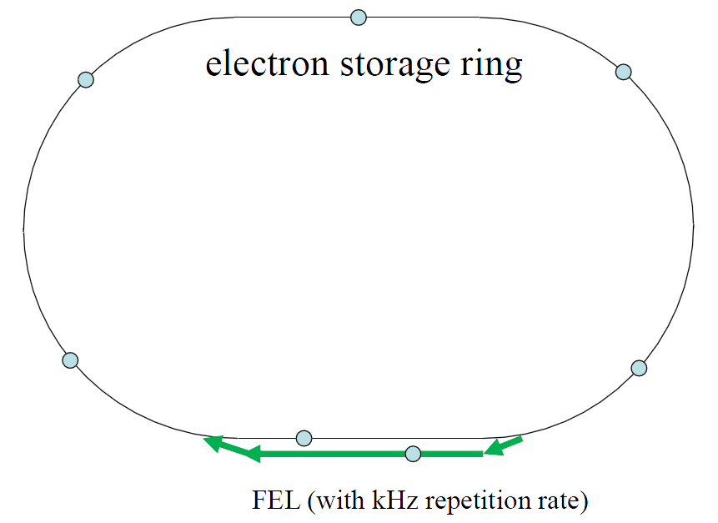
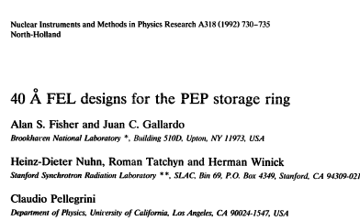
Soft X-ray FEL in switched bypass
    E_{e-} = 4.5 GeV ε_{x,y} = ~11 pm-rad
    λ_{FEL} = 1 nm λ/4π = 80 pm-rad
    I_{pk} = 300 Apk L_{ID} = 50-100 m
    P_{pk} = few hundred kW rep rate: kHz
    multiplex bunches into bypass, return to ring for damping
Can inject special short, high peak current bunch to lase for a few turns

Slide 14
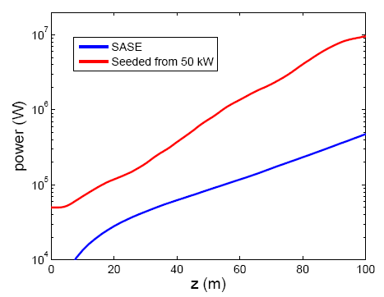
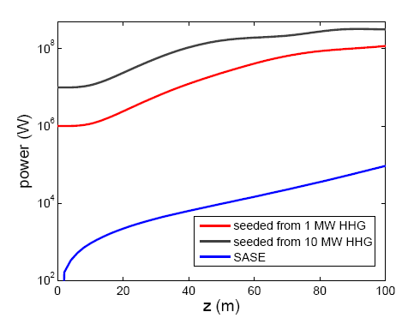
Soft X-ray partial lasing with stored beam in PEP-X
Z. Huang, C. Pellegrini et al.
3.3 nm
379 eV
30 nm
42 eV
Preliminary studies show that radiation from 50-100 m undulator whose first harmonic is tuned to < ~380 eV (> 3.3 nm) would be enhanced by one to two orders of magnitude by the SASE FEL process acting with the stored beam.

Slide 15
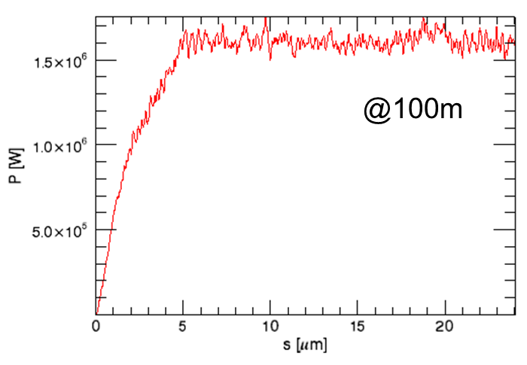
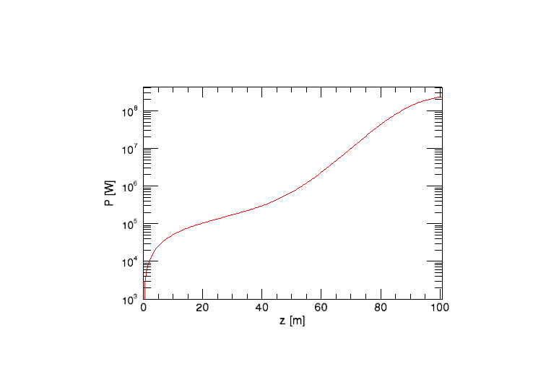
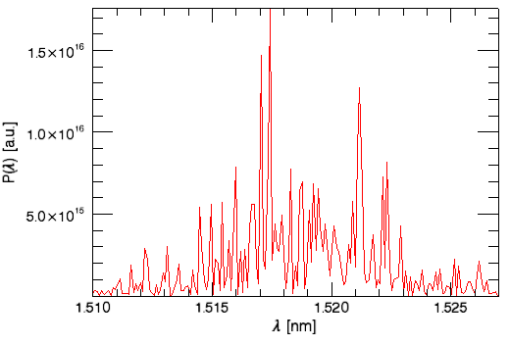
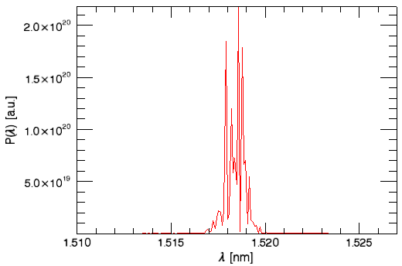
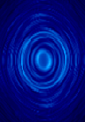
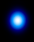
SASE with transverse gradient undulator
                Z. Huang, Y. Cai, Y. Ding
E = 4.5 GeV ε_{x/y}=160 / 1.6 pm δE/E = 1.6x10⁻³ rms σ_{z}=1ps Q = 0.75 nC I_{pk} = 300 A
η_{y} = 0.05 m β_{x/y} = 16 / 50 m σ_{β} = 52 mm σ_{η} = 78 mm
vertical undulator: λ_{u} = 3 cm K = 3.7 λ_{ph} = 1.5 nm
ID grad = 22.9 m⁻¹
no ID gradient
pulse energy = 0.5 mJ
Hard XFEL oscillator in 1-pm ring? – K-J Kim

Slide 16
USRs: design issues and R&D requirements
International discussions:
  BES workshop 2009
  ICFA FLS2010 (SLAC)
  ICFA FLS 2012 (TJNAL)
  Beijing Advanced Photon Source workshop – to be held in Fall 2012
  USR workshop – to be held Dec 2012 at SPring-8
an R&D White Paper (US, for now):
  ANL/APS: M. Borland, L. Emery, R. Gerig, D. Haeffner, A. Xiao
  BNL/NSLS: F. Willeke, J. Bengtsson
  LBNL/ALS: D. Robin, C. Steier
  SLAC/SSRL: K. Bane, Y. Cai, A. Chao, R. Hettel, X. Huang, C.-C. Kao, Y. Nososchkov, T. Rabedeau, J. Safranek, M-H Wang
Hopefully more will join R&D working groups

Slide 17
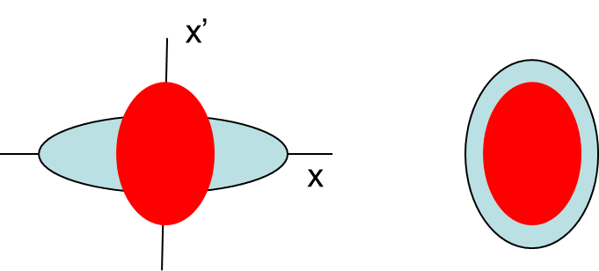
USR design issues - accelerator
Scientific applications
Optimized ring parameters
  • brightness • flux • coherent flux • coherent fraction
  • spectrum (e- energy) • bunch length • etc.
Lattice and geometry
  • lattice cell types • number, length of straight sections • beam line layout
  • electron-photon phase space match • hybrid latrtices • etc.
Accelerator physics
• round beams • stronger longitudinal focusing • emittance manipulation
Injection
Code development and benchmarking
• integrated optimization of lattice, collective effects • source to expt modeling
Accelerator systems and components
Insertion Devices
Value engineering
vs.
electron-photon phase space matching

Slide 18
USR design issues – beam lines
Photon beam line systems and components
  • preservation of brightness, coherence and stability through optical systems
  • advances in micro-focusing optics, such as smaller zone plate line widths
  • Improved optical cooling, thermal designs for high average beam power and power density
  • advanced beam position and shape monitors incorporated into feedback systems
  • improvements in optics support and experimental hall floor stability
  • developments in minimal optics and lensless imaging methods
Detectors
  • improvements in resolution, sensitivity, dynamic range, speed, read-out rates, etc.
  • ways to maximize performance and minimize costs for large USR facilities

Slide 19
USRs: design questions and challenges
Is there an optimal M for a greenfield MBA lattice?
Can beam lines be consolidated using hybrid lattices without sacrificing emittance in large rings?
What are limits to high gradient magnets and small aperture vacuum chambers?
Can there be a leap in combined function magnet technology?
Can short beam lifetime (~1 h) being accommodated with top-up injection?
Can on-axis injection satisfy top-up current constancy needs?
  Injection from accumulator/booster?
  Injection from linac (that can be used for FEL too)?
  What is optimal RF frequency or combination of frequencies?

Slide 20
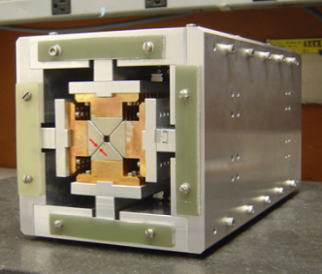
USRs: design questions and challenges – cont.
Can short bunches be propagated for several turns?
Can the USR lattice be modified for ERL implementation?
Can longitudinal emittance be reduced?
Can lasing be achieved? (requires very long straight sections)
  can energy spread be < ~0.05%?
  can peak current be >200 Apk (e.g. with temporary compression)?
  Should emittance exchange technology be developed (RF and laser)?
  are XFELOs possible (using TGUs)?
Can beam stability requirements be met?
Can USRs accommodate vertical or delta IDs?
Can beam line technology preserve source brightness and coherence?
What should be the emittance goal for a new 1.2-1.5 km ring in the near future?

Slide 21

Looking forward to future diffraction-limited rings!
But the workshop may have a problem:

Slide 22
USR features
• High coherent fraction
• Possibility for “round” beams
• Short bunches (~5-10 ps RMS from low momentum compaction factor)
• “Long” lifetime: if the bunch dimensions are small enough Touschek lifetime increases (NSLS-II and MAX-IV may begin to see this effect)
• Large circumference for multi-GeV rings (km)
• Damping wigglers in some cases to reduce emittance by ~x2
• On-axis injection (maybe) and “swap-out” injection for small dynamic aperture
• Special operating modes could include:
  few-turn, sub-ps bunch mode
  100-1000 turn mode with injection from superconducting linac operating without energy recovery (e.g. ~1 mA @ few GeV)
  localized bunch compression systems in long straight sections
  bunch tailoring with low alpha, non linear momentum compaction
  lasing in an FEL located in a switched bypass
  partial lasing at soft X-ray wavelengths using the stored beam

