Slide 1
Insertion Devices: Wigglers and Undulators Session 6
Insertion Devices Group
11/1/12

Slide 2
Wigglers-what we learned
Novel concept of Robinson Wigglers (Amor Nadji)
The horizontal emittance can be divided by a factor 2.
Drawback:
Energy dispersion is increased by a factor
Reachable of high gradient
Effect of magnetic field homogeneity on injection and beam lifetime
Radiation property

Slide 3
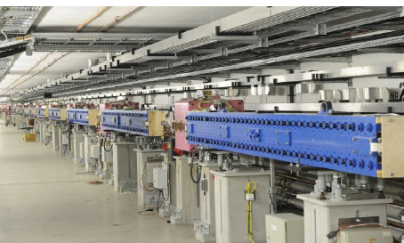
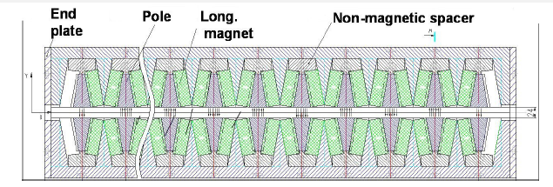
Wigglers-what we learned
Permanent Design of Damping Wigglers (Alexander Kling, PETRA-Ⅲ)
Main Parameters:
Peak Field:1.58T
Period Length: 20cm
Total Length: 80m
Operation effectively, horizontal emittance reduction from 4.65 to 1nmrad
Radiation issues to be considered
→Absorber

Slide 4
Wigglers - Issues
Emittance Reduction
Robinson Wiggler (SOLEIL)
Permanent Magnet Damping Wiggler (PETRA-Ⅲ)
Superconducting Damping Wiggler (BINP)
Wigglers for broadband, and high energy x-rays for users

Slide 5
Wigglers – R&D
Are damping wigglers superfluous?
Likely needed for an upgrade of existing ring
Need to continue to interact with lattice designers and users.
Robinson Wiggler – pursue concept, need to understand where they are appropriate, and what the requirements are from accelerator physics issues

Slide 6
Insertion Devices-Aims
Beamlines Demand Motivated by User
High Brilliance, flux, photon energy → Short Period Length, More numbers of Periods, Small Gap, High Peak Field
IVU, CPMU, SCU
Hard X-ray Source
SCW
Variably Polarization
EPU (APPLE Ⅱ), Helical
Other requirements from User
QPU (Harmonic Suppression),

Slide 7
Insertion Devices – what we learned
For many users conventional planar devices will be appropriate, particularly for higher energy machine.
IVU will also continue to play significant role
Existing R&D on CPMU and SCU will benefit USR

Slide 8
Insertion Devices-what we learned
ESRF Today (J. Chavanne)—Typical ID types for Storage Ring

Slide 9
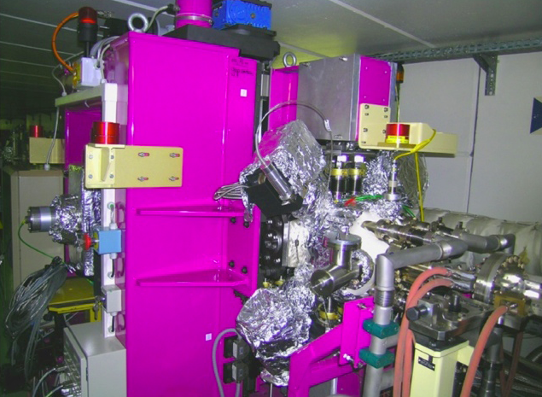
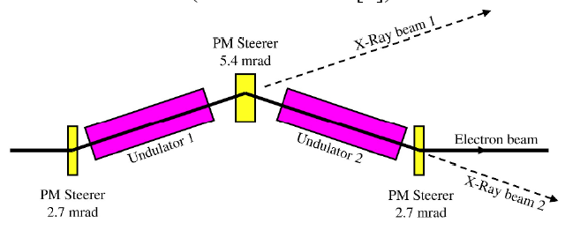
Insertion Devices-what we learned
ESRF Upgrade (J. Chavanne)
CPMU with PrFeB material
Canted undulator with Permanent Magnet Steerers (PMS) of 5.4 mrad
Proceedings of IPAC’10

Slide 10
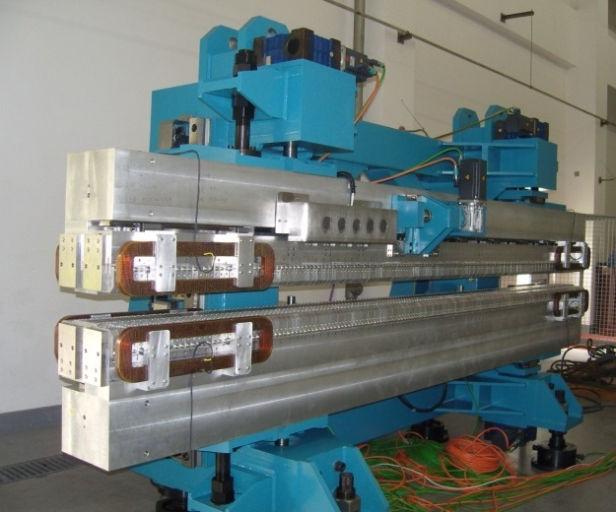
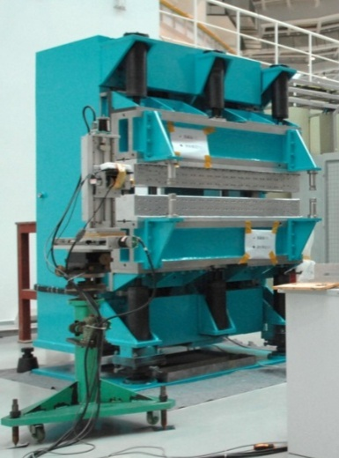
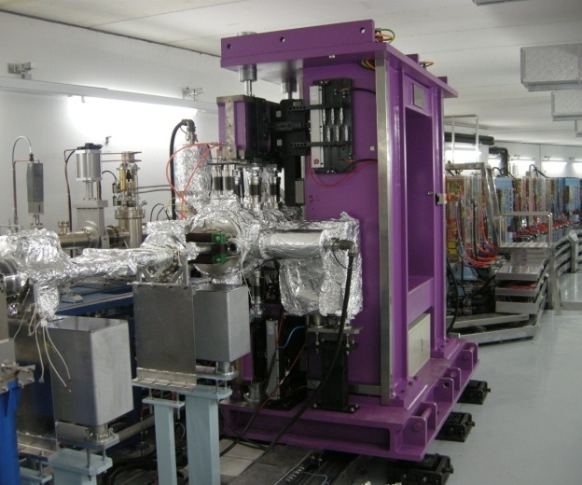
Insertion Devices-what we learned
SSRF (Qiaogen Zhou)
ID development pushed by user demand
Wiggler, IVU, EPU are operational for the first phase.
CPMU, DEPU, SCW are needed for the second phase.
EPU
Wiggler
IVU
DEPU

Slide 11
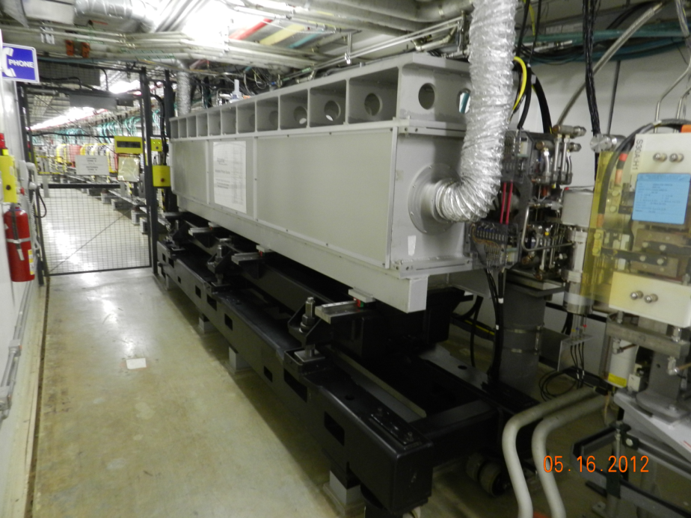
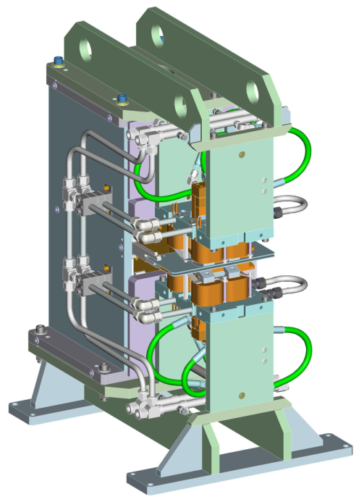
Insertion Devices-what we learned
APS (M. Jaski)----attractive design of electromagnetic ID
Electromagnetic Variably Polarizing Undulator With Quasi-periodic Capabilities
ElectroMagnetic Variably Polarizing Undulator (EMVPU) with 10 Hz

Slide 12
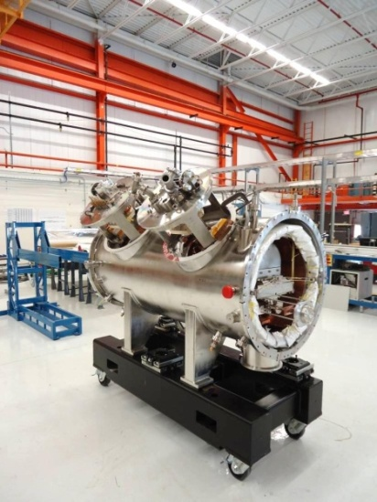
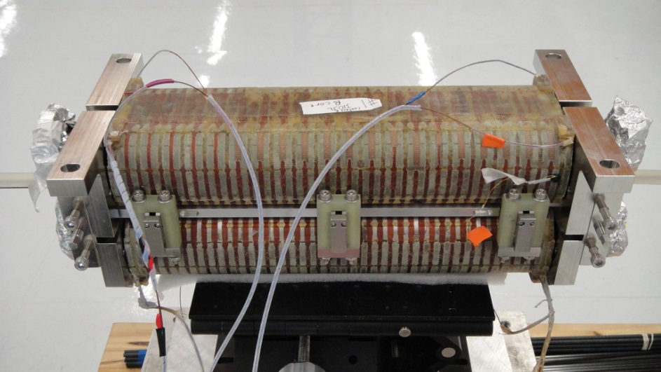
Insertion Devices-what we learned
APS (M. Jaski)----Exciting progress of SCU
SCU has been built at the APS
Beff = 0.64 T at 500 A
Installation is scheduled for December 2012
Completed magnet assembly
Fit test of cold mass and current lead assemblies in cryostat

Slide 13
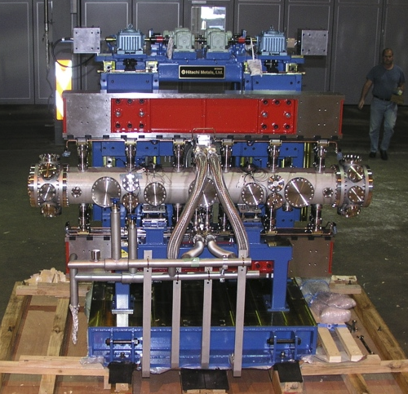
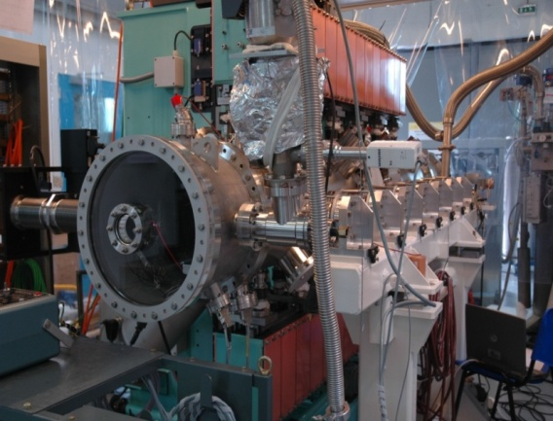
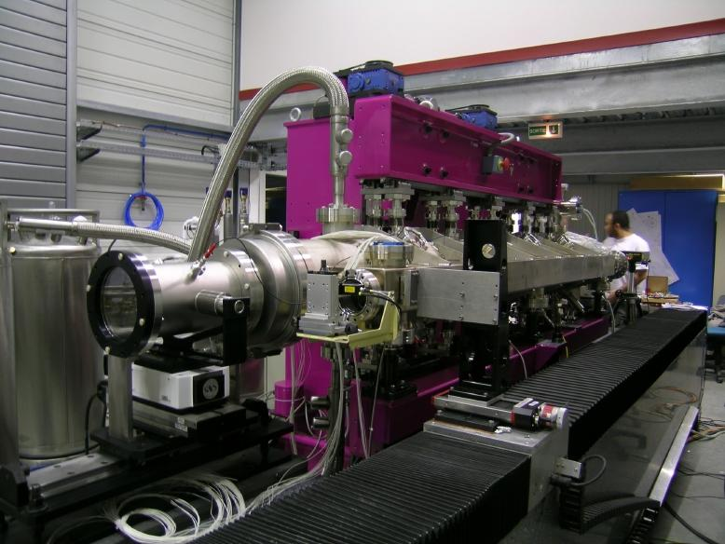
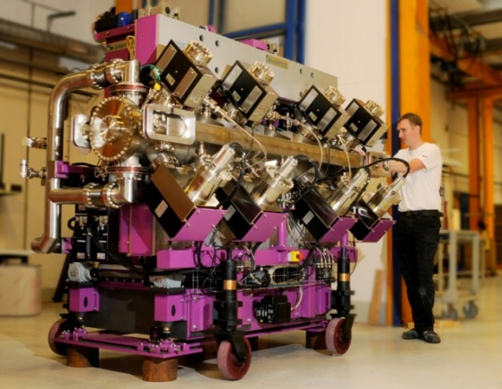
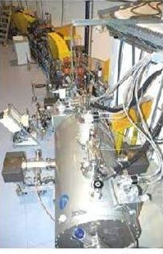
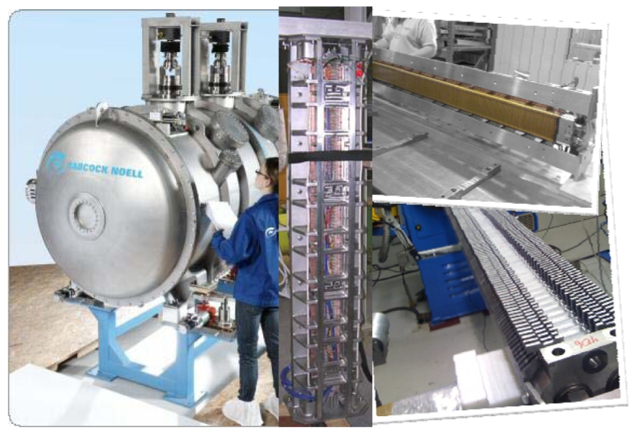
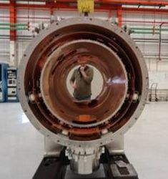
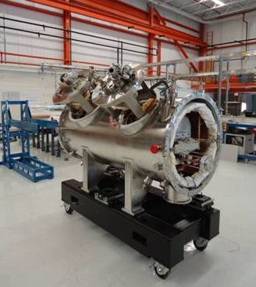
Insertion Devices-what we learned
BESSY (J. Bahrdt)----Overall overview for small period CPMU & SCU
APS

Slide 14
Insertion Devices-Issues
In USR, changes to the ID may impact the machine performance in a greater way. We will want the users to be able to maintain control of their experiments.
Polarization Control
Gap Motion----high precision compensation schemes:
Tune, beta beat, dynamic effects, closed orbit, emittance
Match of beam phase space to X-ray phase space; lattice design, what is optimal length of ID with respect to beta.

Slide 15
Insertion Devices - Issues
Can USRs accommodate vertical or delta IDs?
Energy spread will be an important issue, impacting higher harmonics
Heat load may be issue in high energy machine
Optimal length of straight section. (e.g., not to cant)
Magnetic environments in straight section: background field, magnetic materials in ID, magnet fringe field, ion pumps … etc
Commissioning will be more difficult and may require new strategies.

Slide 16
Insertion Devices - Issues
Need to continue the dialog with lattice designers and users to determine error tolerances.

Slide 17
Insertion Devices – R&D
Studies on dynamic effects and compensation schemes of EPU.
Reduction of power on optics----Photon Shutter , mask showed by M. Jaski
What is minimum gap for given machine? Will these issues be different in USRs than in 3rd Gen?
Commissioning strategies, these can be tried on existing machines
Need improvement in X-ray BPMS, and other diagnostics

Slide 18
Thanks!

