Slide 1
BAPS Lattice Design
XU Gang
IHEP, Beijing, China
Oct. 30, 2012, Huairou, China

Slide 2
Topics
Goals
Linear lattice design
Damping wiggler
Round beam
Chromaticity correction
Summary

Slide 3
Design Goals
E=5GeV
Circumference 1200~1500m
High brightness operation mode
Emittance 10pm/10pm(diffraction limit for 10keV X-ray)
Beam current 100mA~150mA
High flux operation mode
flat beam(no damping wiggler)
Beam current 200mA~300mA
Large enough dynamic aperture for injection

Slide 4
Linear lattice design
7BA*36
25mm magnet pole diameter, combined bending magnet
15BA*16
25mm magnet pole diameter, combined bending magnet
6BA*40
48mm magnet pole diameter, quadrupole with sextuple components
Damping wiggler
31mm period 2.3Tesla damping wiggler about 60m
Round beam
local: solnoid+ID+antisolenoid
global: Mobius ring or other

Slide 5
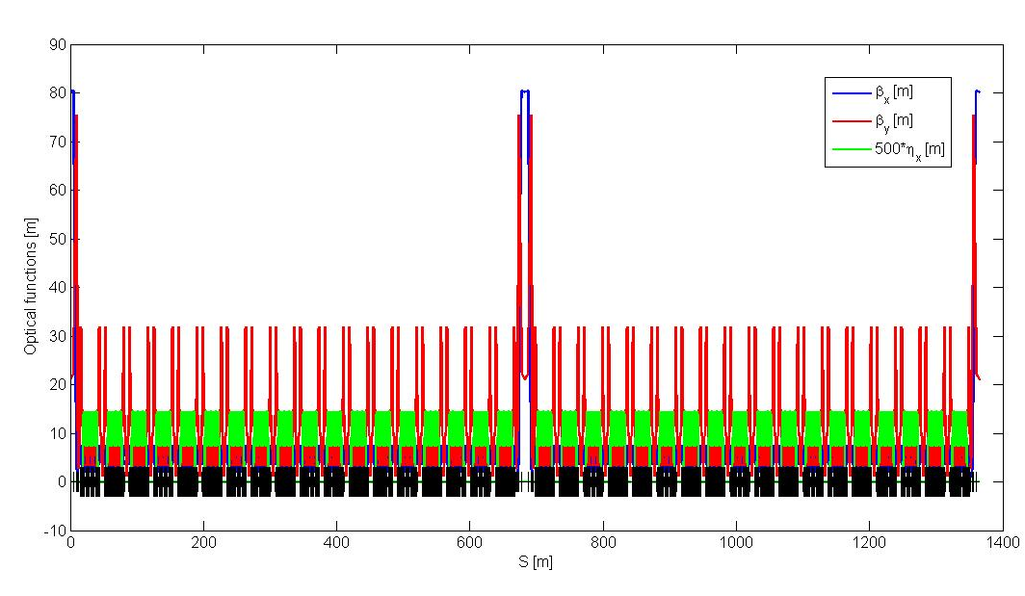
7BA*36 Linear Optics
Circumference: 1364.8 m, 2 superperiods, 36 supercells
Working point: 111.39, 39.30
Natural chromaticity: -184, -181
Natural emittance: 51 pm.rad

Slide 6
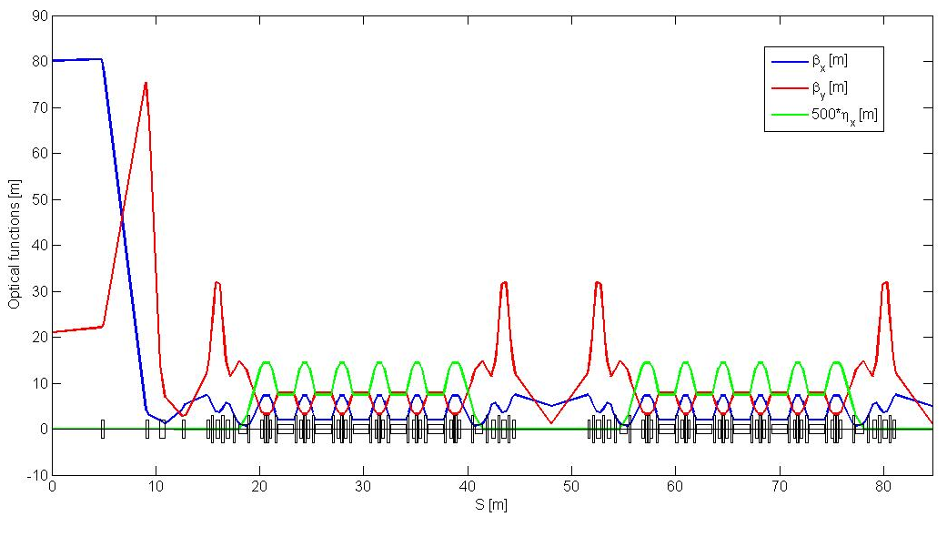
Lattice layout in one superperiod
7-m low-beta straight section
High-beta 10-m Straight section *2, β_{x/y} = (80, 21) m;
Low-beta 7-m Straight section *36, β_{x/y} = (5,1.11) m ;
Phase advance per supercell: (6π + π/6 + δυ_{x}π/36, 2π + π/6 + δυ_{y}π/36)
with δυ_{x} = 0.39, δυ_{y} = 0.30.

Slide 7
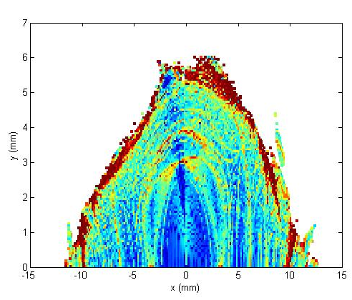
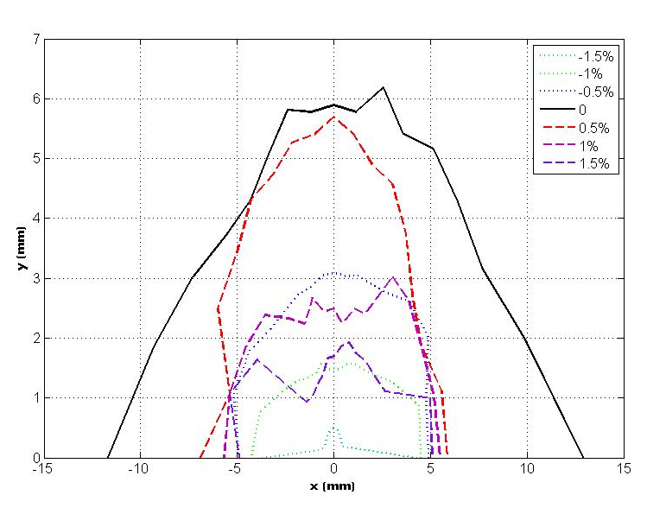
Dynamic aperture
Large enough on-momentum DA, satisfies the requirements of pulsed sextupole injection;
Momentum acceptance is not large, ~ 1.5%, not long Touschek lifetime. However, this can be cured with top-up injection.
On-momentum DA
Off-momentum DA

Slide 8
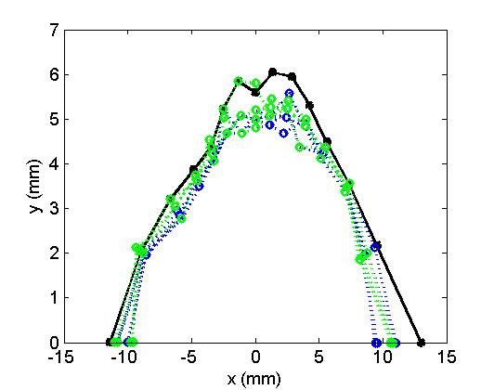
Black: bare lattice, Green: multiple error=10⁻⁴,
Blue: multiple error & bending error

Slide 9
Injection insertion
φx_{inj}= φx_{std}+2π
φy_{inj}= φy_{std}
Keep the symmetry for linear lattice
Help for dynamic aperture for on-momentum
Straight length>9m for pulse sextupole injection

Slide 10
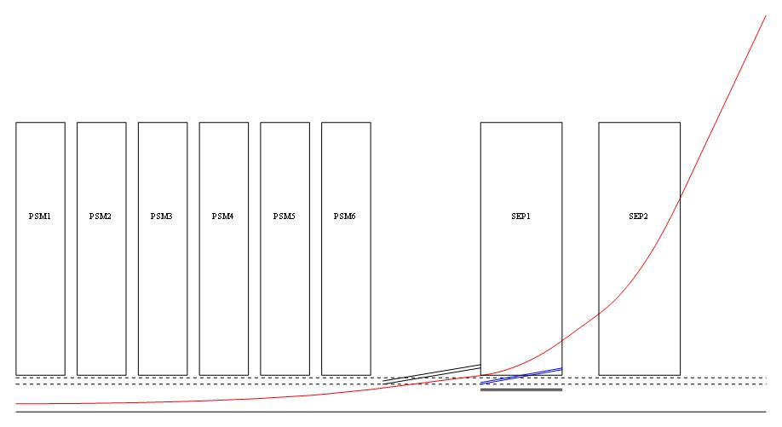
PSM: pulse sextupole magnet for injection,
L=0.6m, 1000Tesla/m² 52mm pole diameter
bottom width<4μs
(details ref. KANG Wen also JIAO Yi talk)
SEP: Septum magnet
Straight length 9.2m
>5mm dynamic aperture

Slide 11
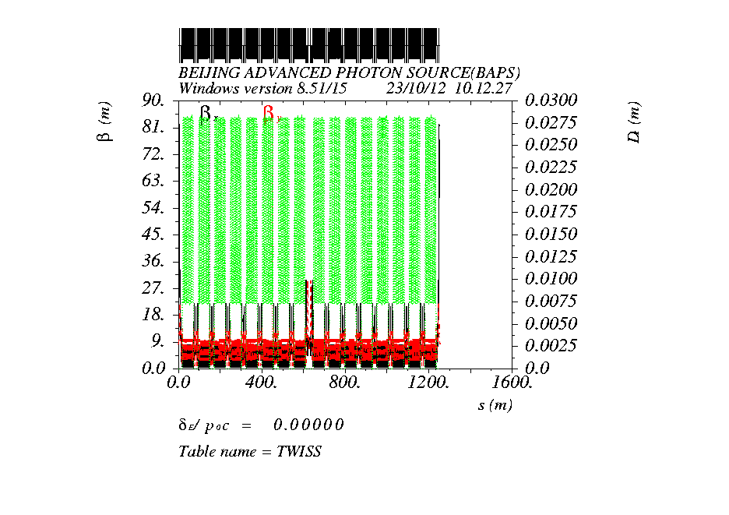
15BA*16

Slide 12
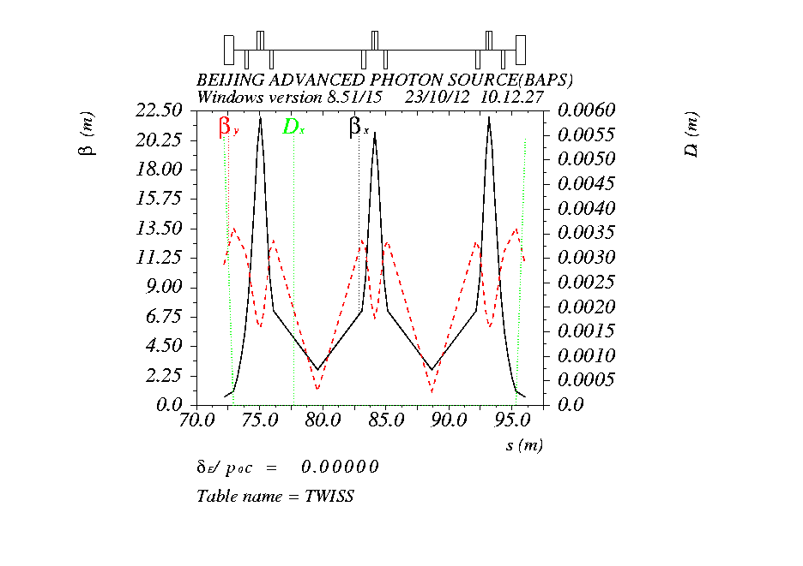
Lower β section with double wraists
β_{x} =3m, β_{y} =1m, straight section 7m*2
Canting structure is neccesary

Slide 13
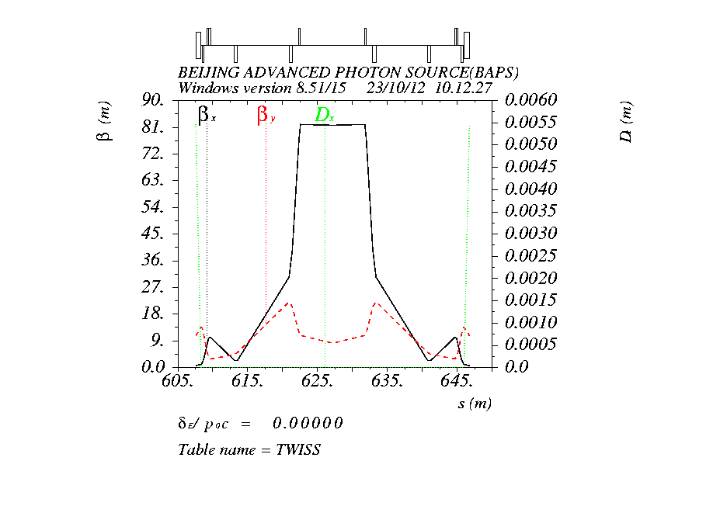
higher β section for injection
β_{x} =80m, β_{y} =8m, middle straight section 9.2m for injection
φx_{inj}= φx_{std} φy_{inj}= φy_{std}(hope improve dynamic aperture for off-momentum)

Slide 14
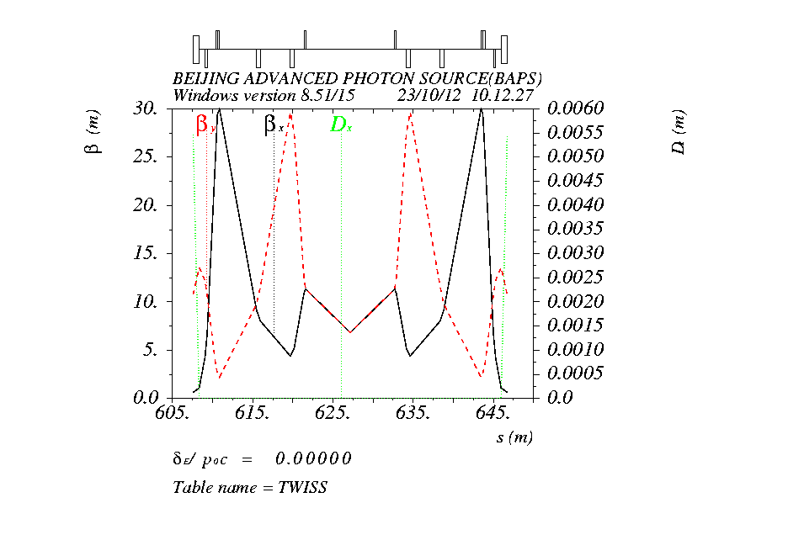
Middle β section for Mobius ring
β_{x} = β_{y} =7m, straight section 14m
φx_{Mob}= φx_{std} φy_{Mob}= φy_{std}
Length between the two arc bending magets is equal to each other for high beta and middle beta section

Slide 15
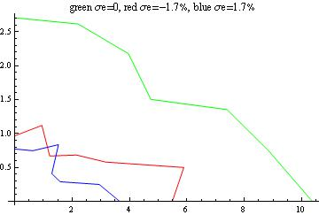
Dynamic aperture for 15BA

Slide 16
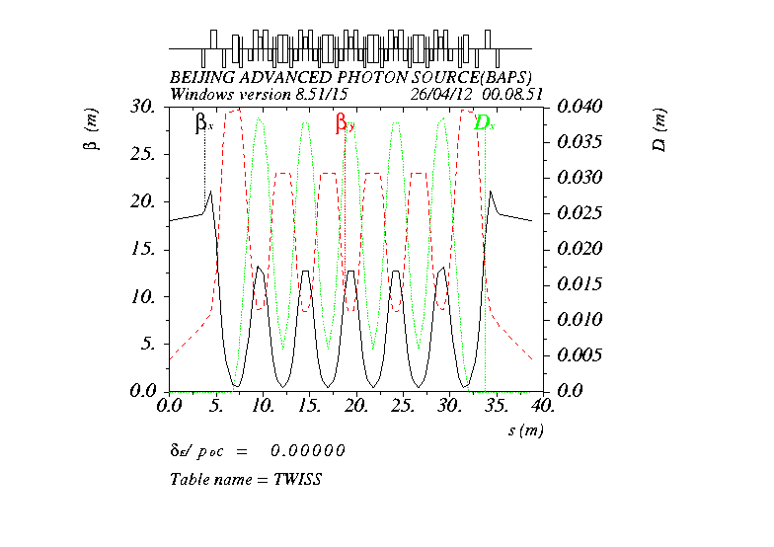
6BA*40

Slide 17
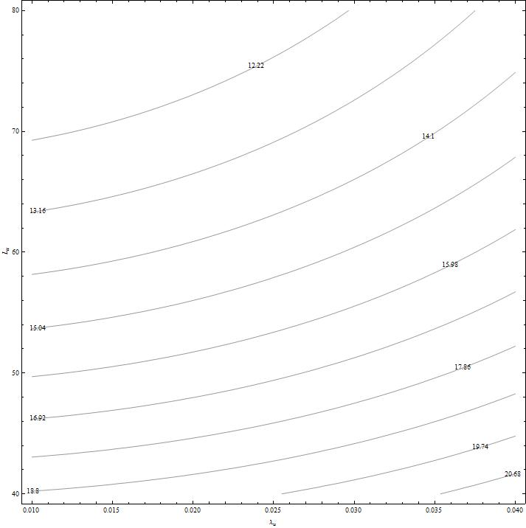
Damping wiggler effects
Damping wiggler (DW), peak field 2.3 Tesla,
Undulator period 3.1 cm,
40-m DW → 20 pm
50-m DW → 17 pm
60-m DW → 15 pm
70-m DW → 14 pm
L_{u} (m)
λ_{u} (m)

Slide 18
Round beam
Local round beam
1.75m 15Tesla solenoid( π/4 x-y rotating )
+2.5m ID(circle polarity EPU is best for decouple)
+ 1.75m 15Tesla anti-solenoid (- π/4 x-y rotating )
at least 6m space
local scheme by A. Chao and P. Raimondi
Global round beam:
π/2 x-y rotating solenoid(Mobius ring)
other method

Slide 19
εx= (AA DD-BB CC) Cos[(c z)/2]²
εy= (AA DD-BB CC) Sin[(c z)/2]²

Slide 20
Chromaticity correction
Up to 5th order DA map( polynomial ) with sextupole, octupole, decuple, duodecupole strength variables(can reach to about 30 variables)
Up to 6th order corresponding Hamiltonian
Up to 4th order chromaticity
Up to 2nd detuning coefficients
Up to 6th resonance coefficients
Optimizing chromaticity curve under controlling detuning and resonance coefficients (mainly on 3rd order and 4th order)

Slide 21
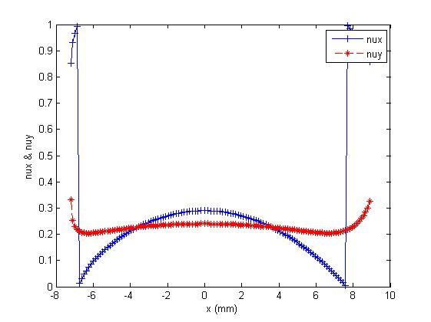
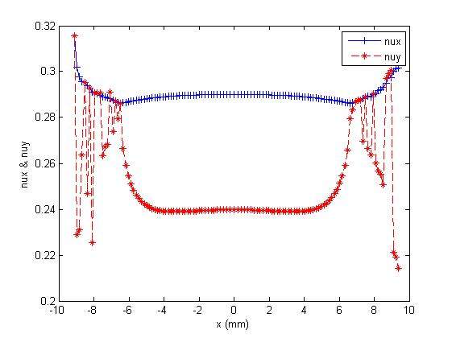
Comparison for different detune coefficient(dq/dx)

Slide 22
Summary
The lattice design of BAPS is still in progress.
To reach diffraction limit very strong damping wiggler and solenoid is necessary in our design
The dynamic aperture for bare lattice and 10⁻⁴ multiple error looks acceptable for pulse sextupole injection
For NBA structure, N=7 is popular in USR design, How large N(>7) is applicable?

