Slide 1
LIAMA, Chinese-European Interdisciplinary Lab From a dream to a dynamic consortium
Chinese Director : Tianzi JIANG – CASIA
European Director : Vania JOLOBOFF – INRIA
Notes:
1

Slide 2
Agenda
LIAMA History
1997: The first stage
2000: The second stage
2004: Third stage
2008 The LIAMA Consortium
Mission Statement, Organization
2013: The future

Slide 3
Context
1981 : signature of a cooperation agreement between France INRIA (National Research Institute for Informatics and Automation) and CAS (Chinese Academy of Sciences)
1997 : foundation of the LIAMA joint laboratory to promote cooperation in the areas of computer science, automation and applied mathematics, between
CASIA institute
INRIA
3
Notes:
3

Slide 4
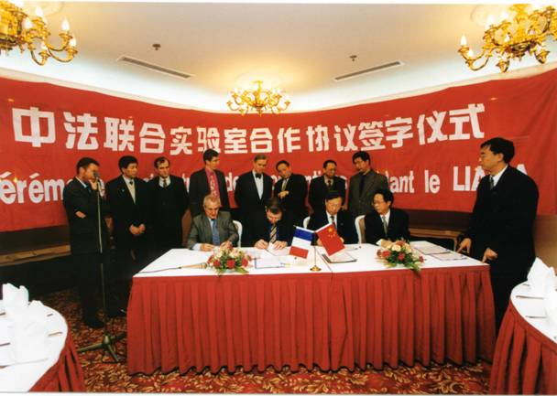
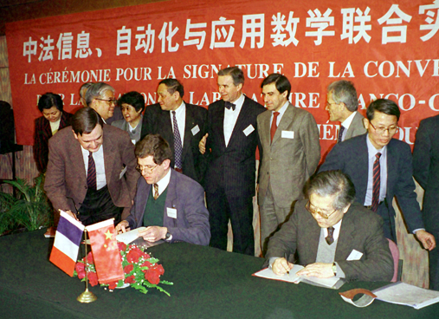
1997:
1997 : Foundation of the LIAMA joint laboratory for Sino-French Cooperation in ICT
Professor Ma Song De
Professor Philippe de Reffye

Slide 5
The first stage
LIAMA organized as teams of French and Chinese researchers and students
working together on joint research projects
Headquartered at the Institute of Automation (CASIA) in Beijing Zhongguancun
LIAMA Office
Small research projects funded by both parties selected each year by a joint scientific committee
5
Notes:
5

Slide 6
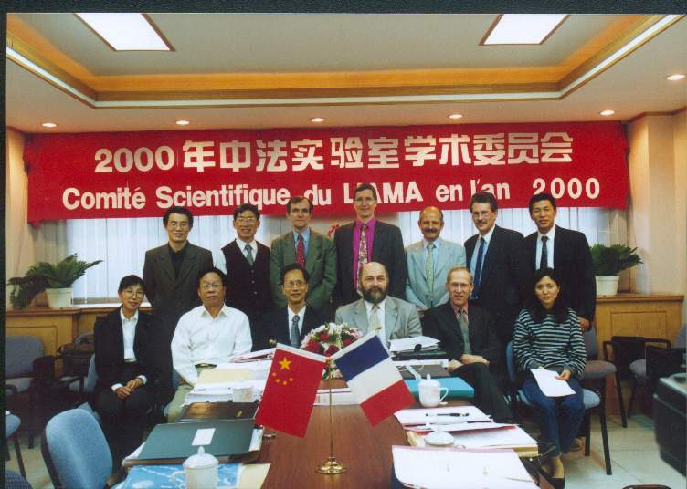
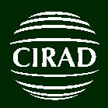
2000 The second stage
Two French institutes join the LIAMA
CNRS: the French National Center for Scientific Research (2000)
CIRAD: the French Agricultural Research Center for International Development (2000) followed by INRA National Institute for Research on Agriculture
Scientist exchanges with long stays

Slide 7
2004: Third Stage
Collaboration expands to new partners
Other CAS Institutes: ISCAS, ICT, CAAS
Chinese Universities
Industrial collaborations

Slide 8
2008
More than 100 Projects involving more than 1000 scientists have been launched between 1997 and 2004
The network of partner institutions enlarges
Establishment of the LIAMA Consortium
Need to move to a more flexible organization,
with more Chinese Strategic partners
and open to Europe

Slide 9
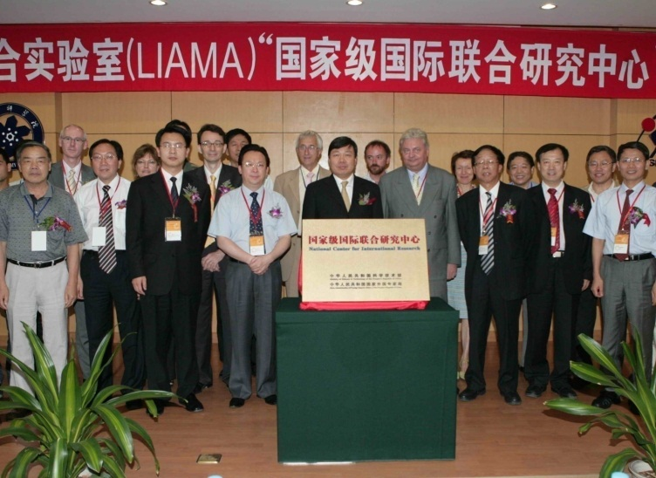
2008: Creation Of The LIAMA Consortium
Open to Chinese and European institutions at large
Tsinghua University joins in 2008 as new funding member
Open to European institutions
Open to industry
National Center for International Research
label from MOST
9
Notes:
9

Slide 10
LIAMA Consortium
A Consortium of Member Institutions
Funding Members contribute to maintain the laboratory infrastructure and resources
Associate Members contribute to projects in cash or in kind.
LIAMA strategy, annual budget and action plan are decided by a Steering Committee from Members representatives
LIAMA is managed daily by a Directorate with a Chinese Director and a European Director

Slide 11
Mission of LIAMA
Research
Conduct world class research projects
with europe-chinese scientific cooperation
Increased visibility in both directions
Training through research
Post-Docs, PhDs and masters.
Scientists and students exchange
Transfer to industry
11
Notes:
11

Slide 12
LIAMA and Intellectual Property
The LIAMA Consortium has no legal existence.
It is only an agreement between members institutions
Therefore the LIAMA Consortium does not own any IP
Members institutions individually or jointly own the IP that they develop within the LIAMA Projects,
Only within the project they contribute to
A set of Intellectual Property rules is defined in the Consortium Agreement defining general principles
Similar to rules of European Union FP7 Framework program rules with distinction between background and foreground
Members of a LIAMA project may mutually agree to have project specific rules,
as long as they comply with the generic rules

Slide 13
Funding
The Funding Members maintain the infrastructure
LIAMA Office hosted at CASIA
Administrative support, multi-lingual administrative staff
Global Computing resources
Funding and Associate Members institutions fund the projects they contribute to
In particular for each project, the Chinese Host institution provides office space, computing resources, administration facilities…
Ex: CCM project at CASIA, CAD project at Tsinghua, MPR Project at Beida, etc.
All projects independently seek funding from funding agencies and industrial contracts
Ex: France ANR, China NSFC, MOST, etc.

Slide 14
LIAMA Consortium
INRIA
CNRS
CASIA
Tsinghua
ISCAS
ICT
ISS
GEC
SIAT
CIRAD/INRA
NPU
LIAMA Consortium
PKU
ISI
ECNU
WUR
Steering Committee
Scientific
Visiting
Committee
VUB
UJF
EADS
Directorate
Information Technology for Earth and Life Science
Multimodal Scene
Understanding
Trustworthy
Software
projects
projects
projects

Slide 15
LIAMA 2008-2012
2008-2011 New Members join the Consortium
China
Peking University (Beida)
CAS Institutes: AMSS (formerly ISS), ICT, ISCAS, SIAT
Northwestern Polytechnic University (Xi’An)
Europe
Belgium: Free University of Brussels
France: Ecoles Centrales, University of Grenoble
Netherlands: University of Wageningen
European Industry: EADS
2012 : The Consortium is dynamic and evolving
Members leave: University of Utrecht
Members continue to join
Shanghai ECNU (Funding Member)
France Technology University of Compiegne

Slide 16
LIAMA Projects
LIAMA is organized in Projects.
Each project is hosted by one of the member institution and at least one funding member must be contributing to the project.
Each project is autonomous in terms of scientific directions, lead by two Principal Investigators PI : one from China, one from Europe
Projects are evaluated regularly by a Visiting Committee constituted of world wide renowned scientists
A Visiting Committee occurred in 2012

Slide 17
LIAMA Projects
Currently organized around 3 themes
Computational Models for Earth and Life Science
CCM : Center for Computational Medicine
CPLANT: Plant Growth Modeling and Visualization
TIPE: Turbulences, Imaging, Physics, Environment
Multi modal sensing and Scene Understanding
CAD: Geometry and Computer Graphics
CAVSA: Computational Audio Visual Scene Analysis
MPR: Multimodal Perception and Reasoning
Trustworthy computing
CRYPT crypto analysis
ECCA :Exact Certified Computation with Algebraic Systems
FORMES: Formal Methods for Embedded Systems
YOUHUA: Design and programming of large scale many-cores platforms
Notes:
17

Slide 18
LIAMA Achievements 2009-2012
Currently, over 250 scientists and students contribute to 10 LIAMA projects
Since the Consortium was created
164 joint publications
34 Ph.D’s graduated
37 events were organized
Summer Schools, Conferences, Workshops…
LIAMA projects have obtained over 10 Millions of Euros of funding in the past three years coming partly from LIAMA members and mostly from external funding organizations such as ANR, Europe FP7, NSFC, MOST, China Army, Shenzhen STF. Industry contracts.
18
Notes:
18

Slide 19
Conclusion
The vision is to sustain its international cooperation structure for world class scientific projects in the ICT area through its funding members
Seeking continuous support from both European and Chinese funding institutions that are both implementing programs within 2020 horizon.

Slide 20
谢谢, Thank You, Merci
Notes:
20

