Slide 1
The
Tianshan
Radio
Experiment for
Neutrino
Detection:
Status & Perspectives
Olivier Martineau-Huynh for the TREND collaboration
NAOC, IHEP & IN2P3
VIth FCPPL workshop, Nanjing, March 28, 2013

Slide 2
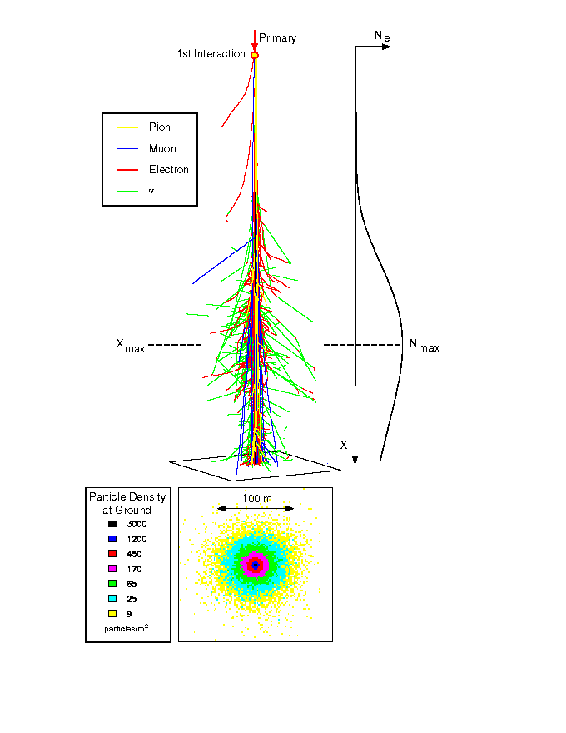
Detection of HE cosmic particles
Extensive Air Shower
radio detection (@MHz)
(Allan et al. 1971, CODALEMA & LOPES, 2004)
  Synchrotron radiation of charged particle into geomagnetic field.
  Well adapted to large areas (cheap, easy deployment, stable)
  Rapid progress in the last decade, but...
  many issues still pending, among which background rejection/EAS identification .
B_{geo}
⊗
F = qv∧B_{geo}
-
+

Slide 3
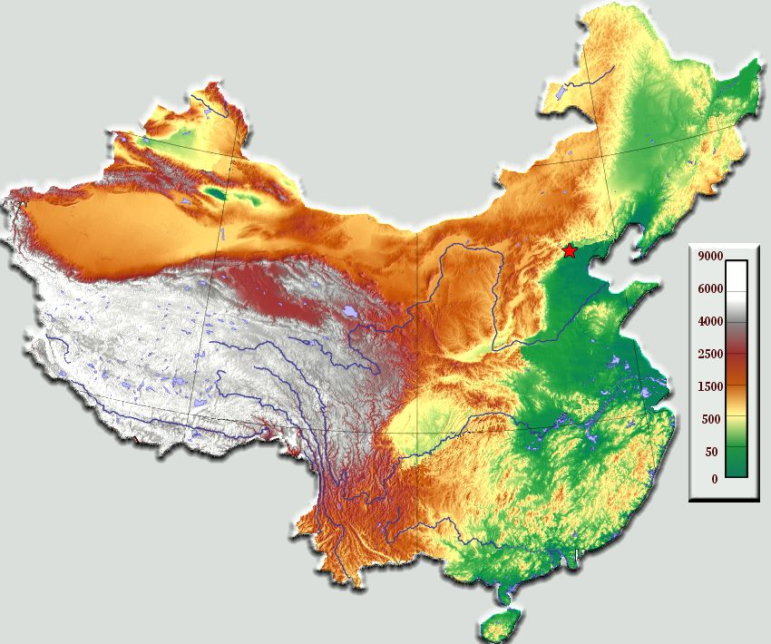

TREND-21CMA site
Urumqi
AM emitters
Background electromagnetic level ≡ Galactic emission
Electronics noise
Ulastai
Beijing
Antenna measurment
Galactic emission
model
Nanjing
Ulastai, Tianshan mountains, XinJiang autonomous province
Site of the 21CMA radio interferometer (Epoch of Reionization)

Slide 4
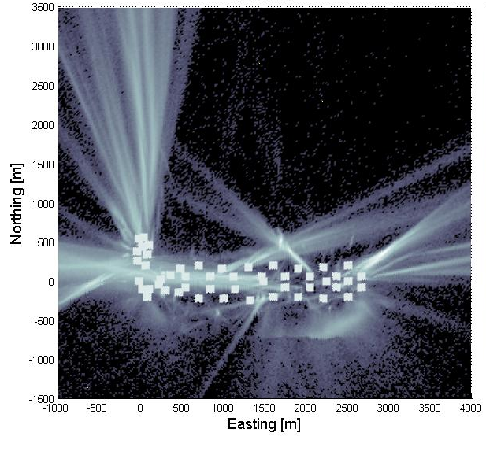
Radio background
Exemple:
TREND-50 antennas
radio array:
2011-2012 data
220 real days analysed
1.2 10¹⁰ triggers recorded
1.4 10⁹ coincidences
~100Hz background event rate
over whole array
(physical origin)
Expected EAS trigger rate:
~2 events/day for E>10¹⁸ eV
TREND antenna
Background rejection is a key issue for EAS radio-detection.

Slide 5
Background rejection
External trigger (hybrid setup): CODALEMA, LOPES, …
  No elm background.
  Depends on trigger biases (e.g. no acces to large zenith angles).
  « Slave » technique: unsatisfying
Self–triggering: TREND, AERA
Shower axis
Close source:
- Spherical wavefront
Fast drop of amplitude when moving
away from source.
Distant source:
~ Plane wavefront
~ Constant amplitude
~ Plane wavefront.
Fast drop of amplitude when moving away from shower axis.
Radio cone
EAS signal
Background

Slide 6
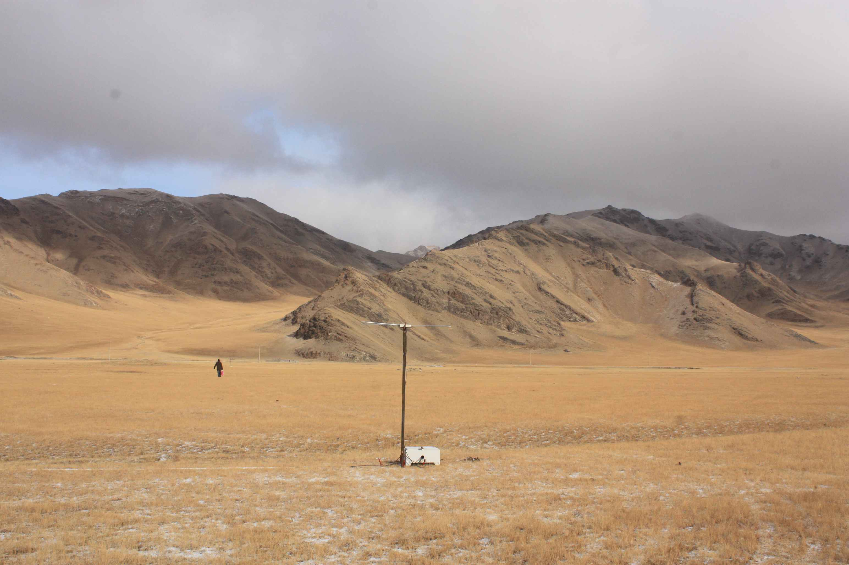
TREND-50
Objectives: perform autonomous detection & identification of EAS, with limited background contamination ⬄ prove that radio detection can work in stand-alone mode.
50 antennas deployed on the 21CMA site. Total surface ~1.5km².
Running since January 2011.
Tools: selection on:
  Signal wavefront
  Amplitude pattern at ground
  Spatial & temporal event distribution
  (array of limited extension)

Slide 7
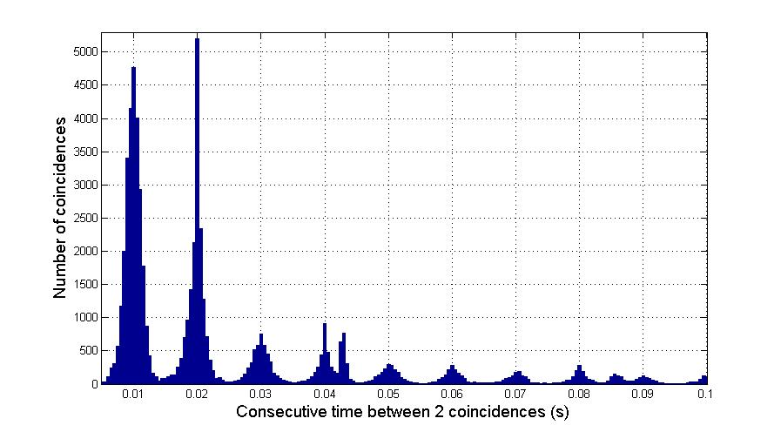
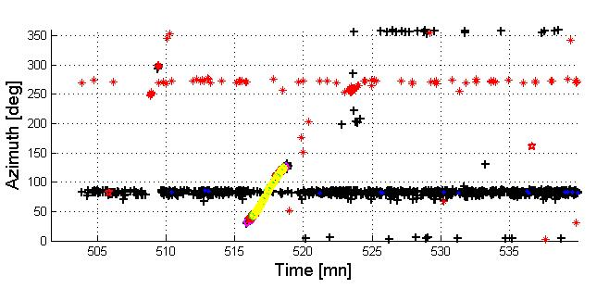
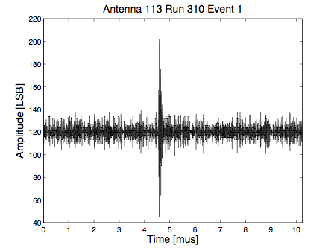
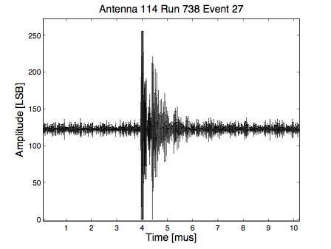
TREND-50 candidate selection procedure
Rejection of event bursts
Rejection of events with neighbours
10 ms
Rejection of waveforms with bad shape
Rejection of radius of curvature<500m
Rejection of events with A_{max}/A_{min}<1.5
Info on direction of arrival hidden during selection process.
☺
☹

Slide 8
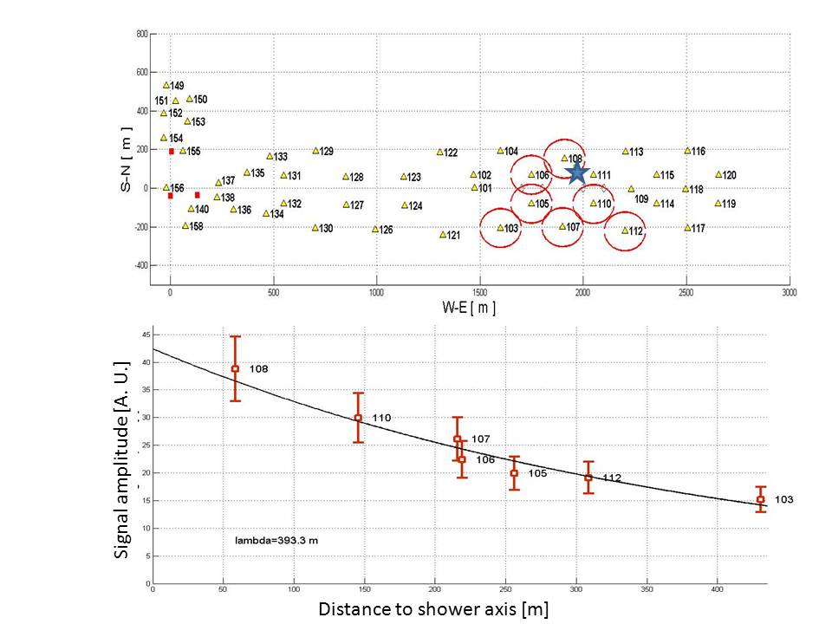
TREND-50 EAS candidates
2011-2012 dataset:
  Jan 14, 2011 to Dec 6, 2012: 691 days
  8 data taking campaigns: 574 days (83%)
  DAQ running time: 320 days (56%) ☹
  Data analyzed so far: 220 days (69%) [100% off-line treatment]
  Acceptance = 103 km².days
  ⬄ 69 days with full array @100% efficiency (31%) ☹
  140 EAS candidates (2/ live day)
Valid candidate?

Slide 9
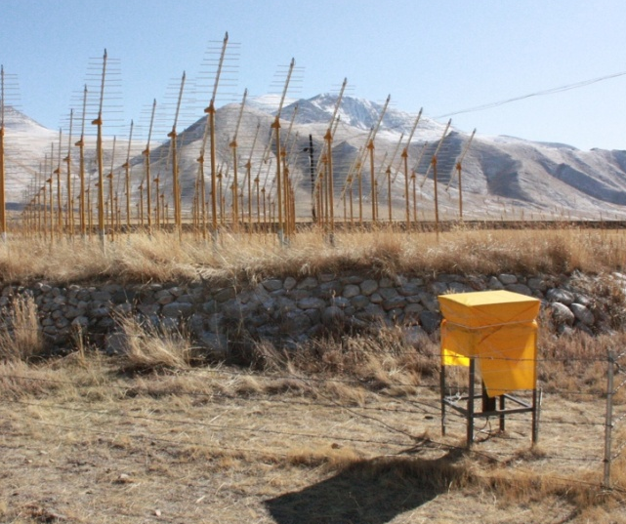
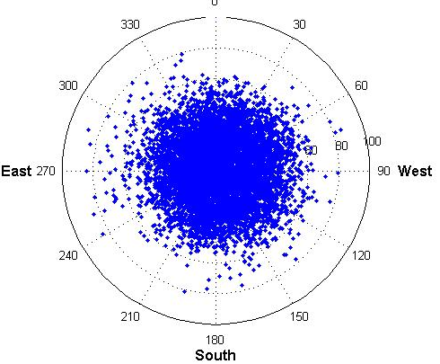
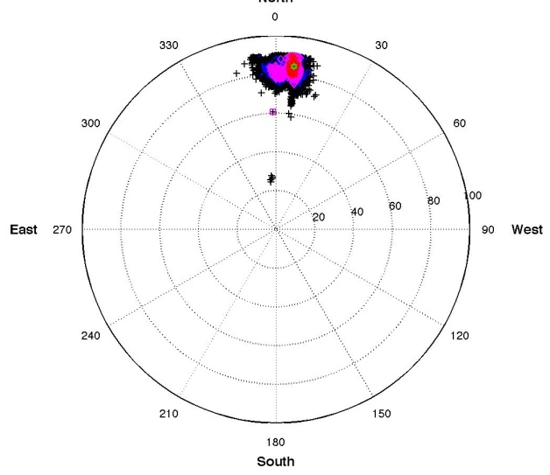
2010 results
Hybrid: radio + 3 particle detectors≡CR detector (IHEP)
Independant trigger & analysis of scint data (EAS) & radio data (EAS radio candidates).
Reconstruction of 3-fold
scintillator coincidences ≡ EAS
Selection of radio EAS candidates with dedicated algorithm
Some radio EAS candidates are coincident with scintillator coincidences + direction recons match
Scintillator
data
Radio data
(subset)
N_{ants} | θ_{radio} | θ_{scints} | ϕ_{radio} | ϕ_{scints}
4 | 61±3 | 67±5 | 359±2 | 3±4
4 | 52±1 | 49±3 | 195±2 | 191±4
5 | 42±1 | 36±3 | 55±4 | 56±5
4 | 45±1 | 49±3 | 12±1 | 10±5
7 | 56±2 | 53±4 | 323±2 | 331±5
First EAS identification with autonomous radio array
Ardouin et al., Astropart. Phys 34, 2011 <arXiv:1007.4359>

Slide 10
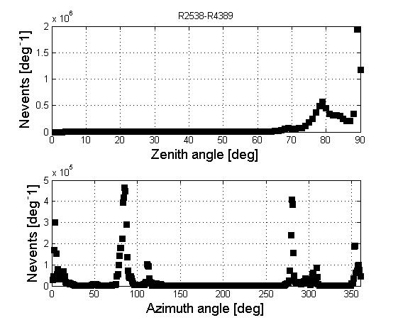
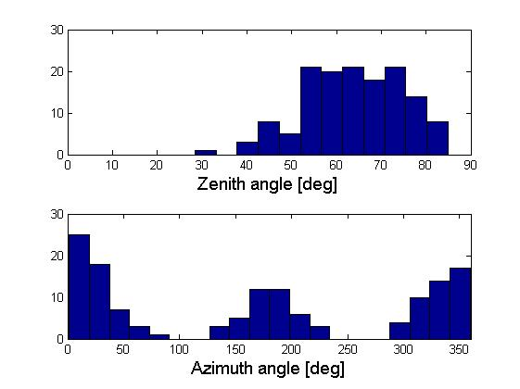
EAS candidate search
Observed distribution very different from background one.
All events
EAS
candidates
Deficit for ϕ = 90 & 270°
All events

Slide 11
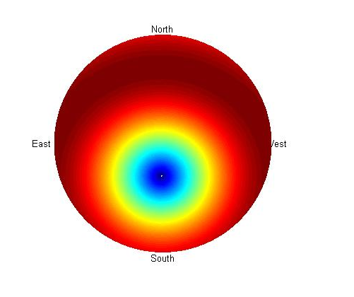
Expected distribution
EAS radio emission mostly due to geosynchrotron effect:
E_{EAS} α v∧B_{geo}
║ E_{EAS} ║ skymap
: geomagnetic field direction
(θ = 28°, ϕ = 183°)
East
270°
West
90°
South
180°

Slide 12
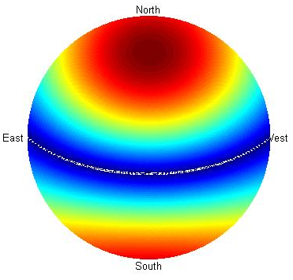
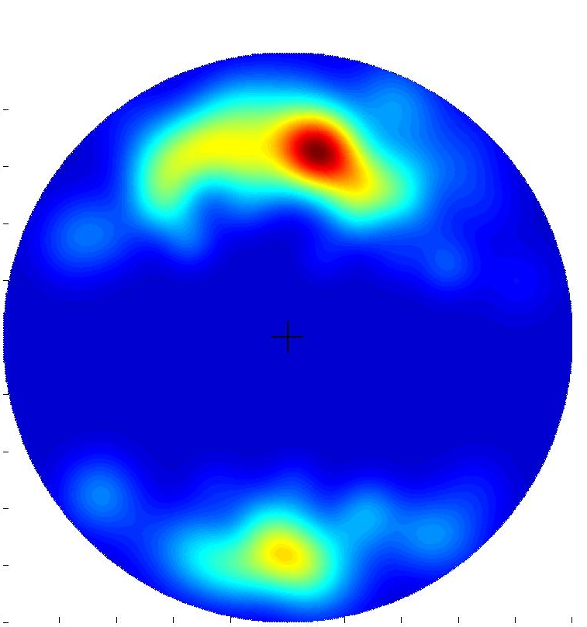
Expected distribution
Antennas sensitive to East-West polarization only (x axis):
A α E_{EAS} .x α v∧B_{geo} .x
North
0°
90°
90°
60°
60°
30°
E_{EAS} . x skymap
30°
Looks promising, but requires better modeling:
Full simulation of radio signal & system response
to produce expected EAS distribution.
[on-going work]
East
270°
West
90°
West
90°
South
180°
Experimental distribution

Slide 13
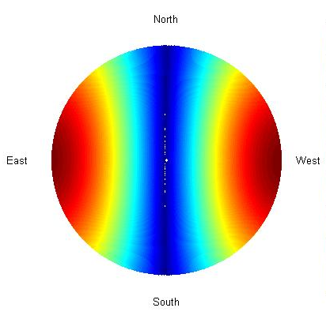
EAS candidate search
Ultimate test: rotate antennas to N-S
Same background distribution (random polar)
but
EAS expected distribution radicaly different.
Antennas rotated December 2012.
Background distribution unchanged.
EAS candidates search to begin soon.

Slide 14
TREND on the path to validate stand-alone mode…
…then towards neutrino astronomy ?

Slide 15
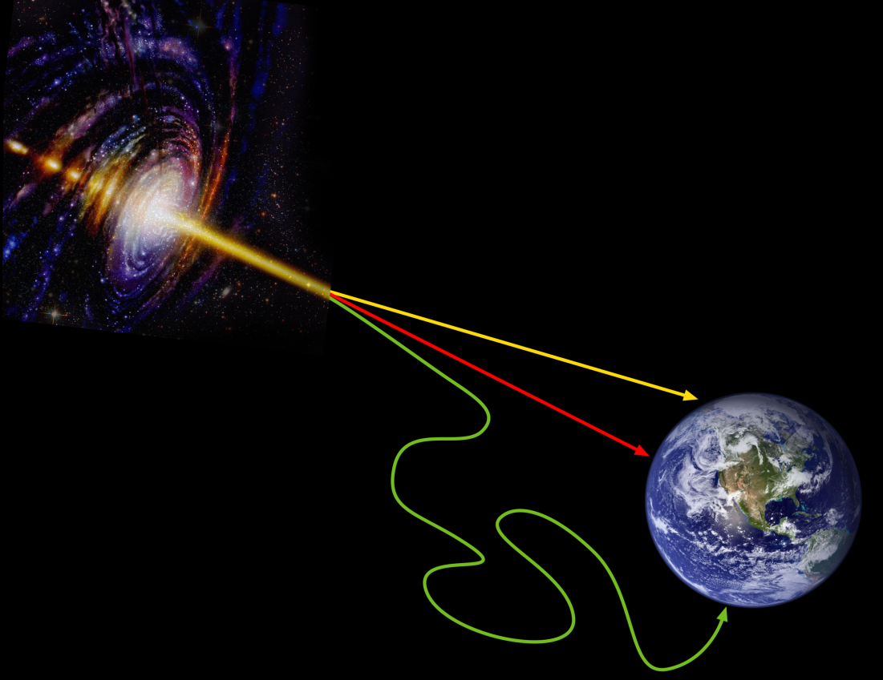
Why neutrino astronomy?
After EM radiation and cosmic rays, 3rd window on the Universe.
Vast perspectives ahead.
Signature for hadronic processes: clean & unambigious messengers.
No deflection (≠ cosmic rays) and no attenuation (≠ EM radiation): great probe for astronomy & cosmology
ν
γ
cosmic
rays

Slide 16
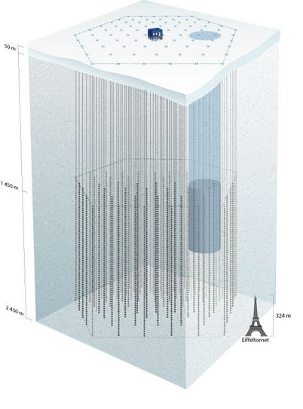
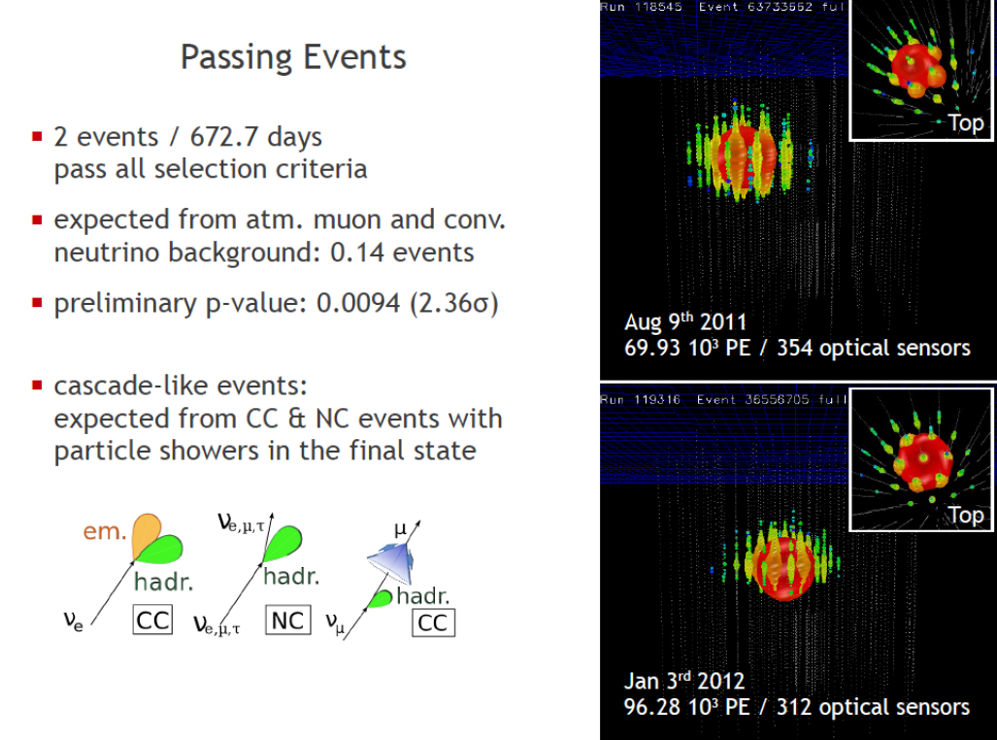
Cosmic neutrinos: experimental status
Km³ neutrino telescopes: ANTARES-KM3NET (deep sea, France) & AMANDA – IceCube (ice, Antartica).
Sensitivity ~ high range of predictions
IAU2012: 2 candidates in 2 years of data (bckgd: 0.14)
ICE TOP
AMANDA
Neutrino astronomy about to beggin!
But will requires larger detection potential.
Could radio detection be the solution?
ANITA, ARA, ARIANA @ South Pole…and TREND
ICECUBE
F. Halzen, IAU2012, Beijing

Slide 17
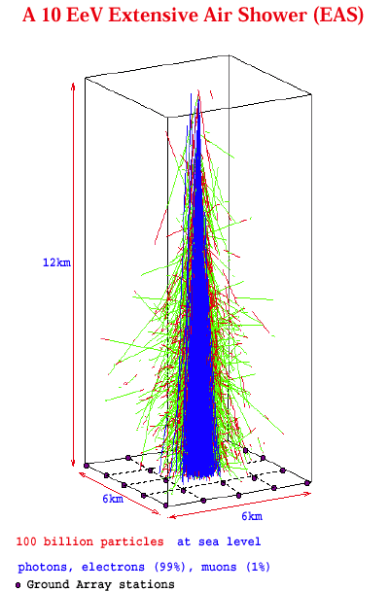

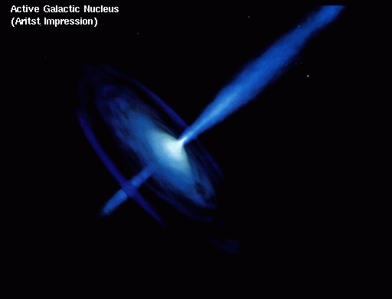

UHE neutrino detection
~horizontal shower
τ
ν_{τ}
Radio detection
E_{th} ~10¹⁷ eV
Earth + mountains as target for neutrino interaction
Benefit from radio efficiency for distant/inclinded showers.

Slide 18
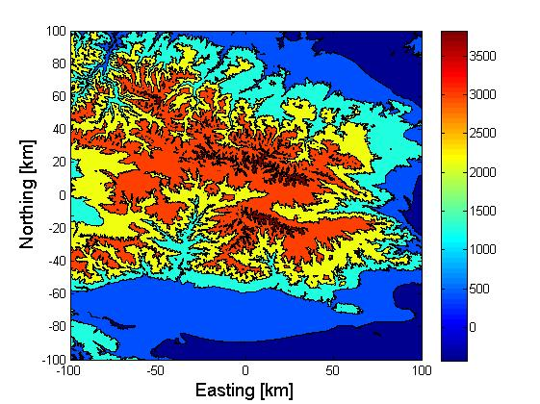
Neutrino sensitivity study
End-to-end MC chain on toy setup
(250’000 antennas deployed over 200x200km² in Tianshan)
Neutrino trajectory
Neutrino interaction in rock
(PYTHIA)
Tau energy losses (GEANT4)
Tau decay (PYTHIA+TAUOLA)
Shower development (CONEX)
Radio signal generation (EVA)
Antenna response (NEC2)
Trigger (TREND DAQ)
Running on France-Asia VO with
DIRAC (see Fabio & Andrei’s
talks in Computing session)
[PRELIMINARY]
Issues at large zenith angles:
simplified hypothesis
for shower detection:
E>10¹⁷eV
N_{ants}>5 with:
  - d_{Decay}>5km
  - dΩ<5°

Slide 19
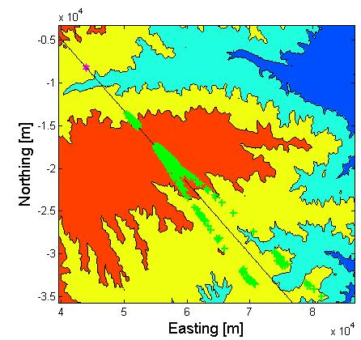

Neutrino-induced events
One example (θ = 91°, ϕ = 60°)
Neutrino interaction
Tau decay

Slide 20
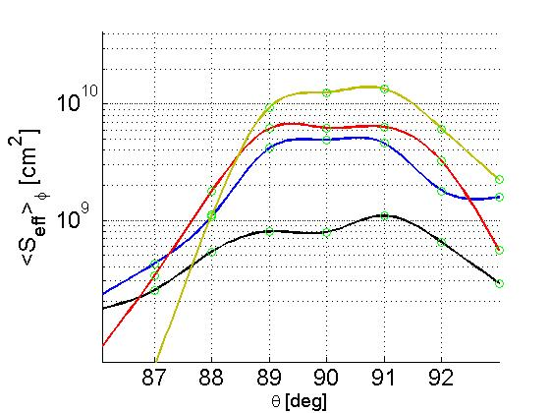
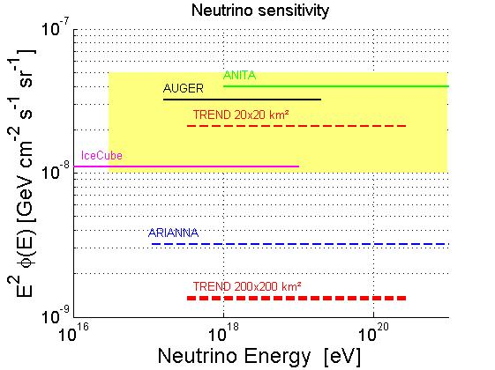
Expected sensitivity
Earth-skimming events.
Mountains are sizable targets.
Sensitivity:
  ~30 events/year
  for Φ = 10⁻⁸ E⁻² /GeV/cm²/s/sr
  if 0 candidate in a year: limit
  Φ₀ = 1.3 10⁻⁹ GeV/cm²/s/sr
( assuming E⁻² spectrum)
~factor 10 better than present best.
~twice better than other projects.
TREND400: 2500 antennas over 20x20km² would give best limit in 2 years if 0 candidates.
Results to be confirmed with end-to-end MC [on-going]
3.10²⁰eV
3.10¹⁹eV
3.10¹⁸ eV
3.10¹⁷ eV
PRELIMINARY
Upward
Going
(Earth)
Downward
Going
(mountains)

Slide 21
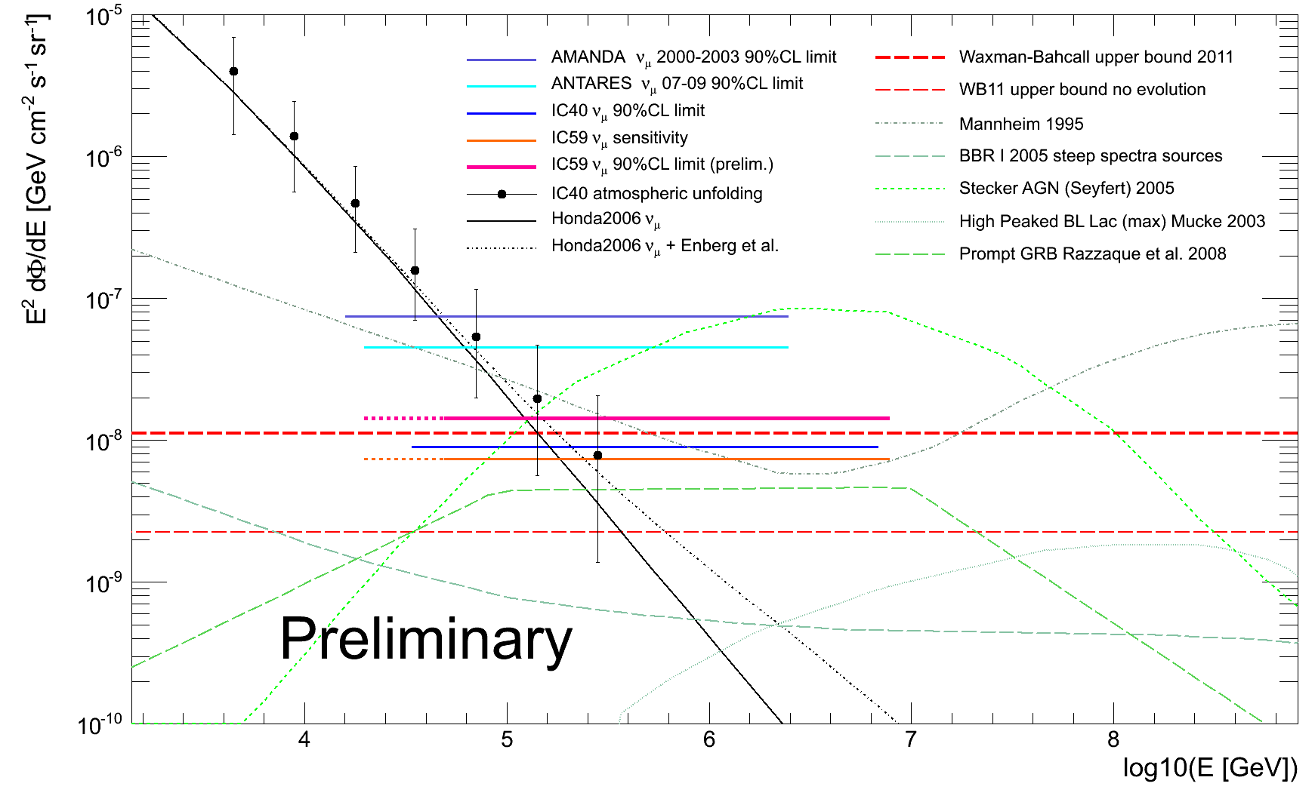
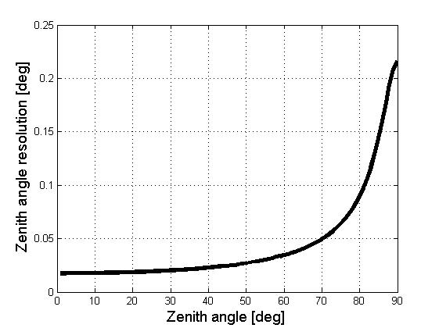
Background rejection
Atmospheric neutrinos
  Negligeable at high energy
HE muons
  Decay path too long
Standard cosmic ray EAS
  Cut 1° below horizon
  5σ for 0.2° angular resolution
  5 10⁻⁷ suppression factor
  Discrimination on young (neutrinos)
  vs old (CRs) showers
Non-cosmic background
  Human sources…
  Thunderstorms…
  TREND50 tells us we need R>10¹¹
0.2° angular resolution
at worst for σ_{t} = 1ns

Slide 22
Non-cosmic background
Key parameter: polarization
  EAS radio emission: F = qv∧B_{geo}
  Linear polarisation ┴ EAS propagation direction
  ┴ B_{geo}
  Background: circular polarisation in general
EAS selection by:
  measuring polarisation on all triggering antennas.
  checking if compatible with EAS hypothesis.

Slide 23
TREND Giant Array prototype
Principle : study showers coming from North
(up to very inclined angles)
North
B_{Geo}
Pure East-West polarization:
no vertical polarization
on ALL antennas
⊗
8
8
8
8
8
8

Slide 24
TREND Giant Array prototype
Prototype array of 30 antennas ( )
+ 21 scintillators ( )
  Scintillator array used for offline validation of EAS nature (IHEP lead, NSFC proposal)
  quantitative evaluation of technique
  rejection power.
  Array along 21CMA North-South baseline (fibers for signal transmission)
  Bipolar antennas developed in collab with CODALEMA (built by Xi’An XiDan Uni)
  Fast front-end digitization (1GHz+12bits) developped by IHEP (Liu ZhenAn trigger Lab) & tested succesfully on site early March.

Slide 25
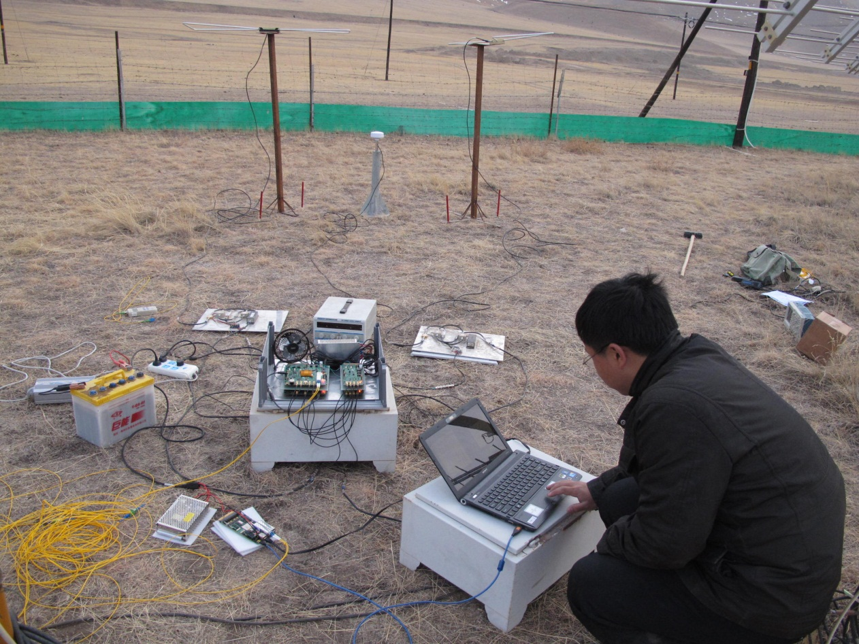
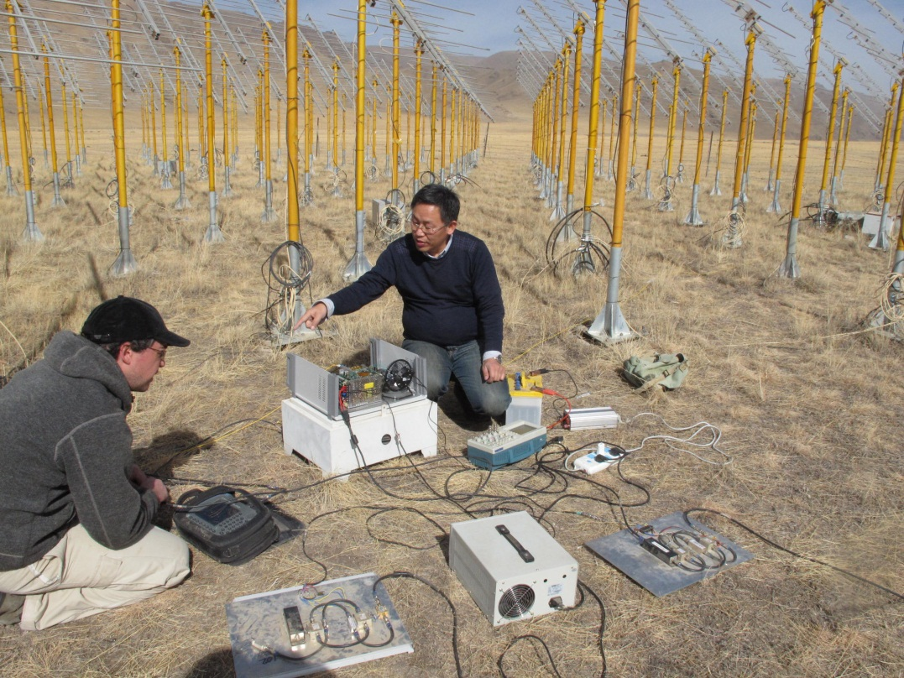
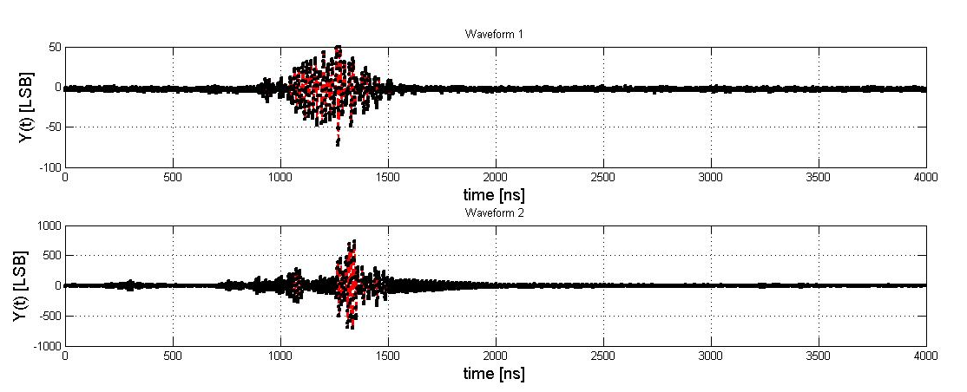
Electrionic prototype test
Liu ZhenAn
2 antennas
Front-end trigger + digitization
Early amplification
Fiber to DAQ
TREND signals @ 1GHz!
Lin HaiChuan
More in development session by Zhenan & Haichuan (tomorrow @ 11:20am)

Slide 26
谢谢 !
Merci !

