Slide 1
Physics in Underground Laboratories
G Gerbier IRFU-CEA
& slides from Hue Qian (THU)
Underground Labs uopdate Current programs
Status of FCPPL 012 activities
Some details
Projects for 2013
6th workshop of FCPPL
NJU
March 28th 2013

Slide 2
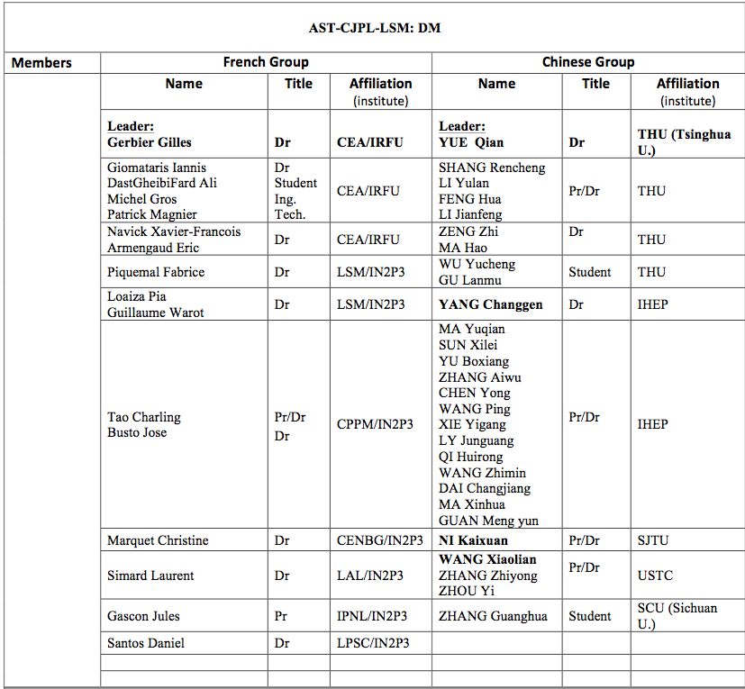
2013
Saclay
+ Jinping Lab
3rd year
Fréjus Lab
Marseille
2012 budget :
2 k€ * 2
Grenoble

Slide 3
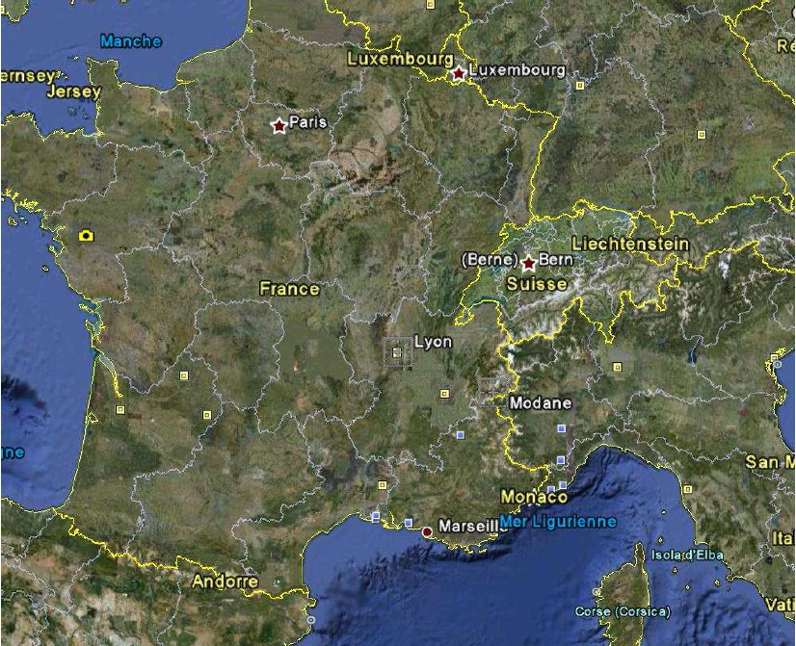
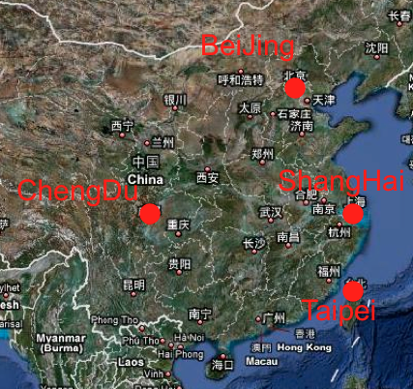
Two underground labs
LSM-Fréjus 1983
CJPL-Jinping 2010
LSM
JinPing

Slide 4
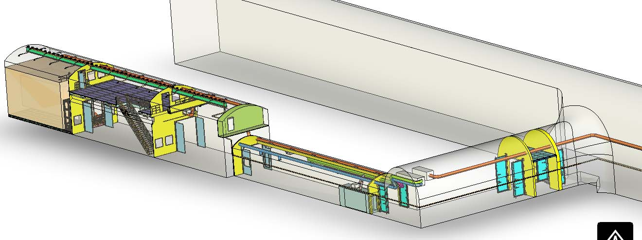
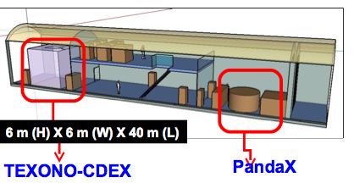
JinPing CJPL : status
40 m
Low background facility
2012 : New ventilation installation completed : The fresh air outside has started to supply CJPL.
2012 : Two expts planned : Ge & Xe
DM direct search Experiments

Slide 5
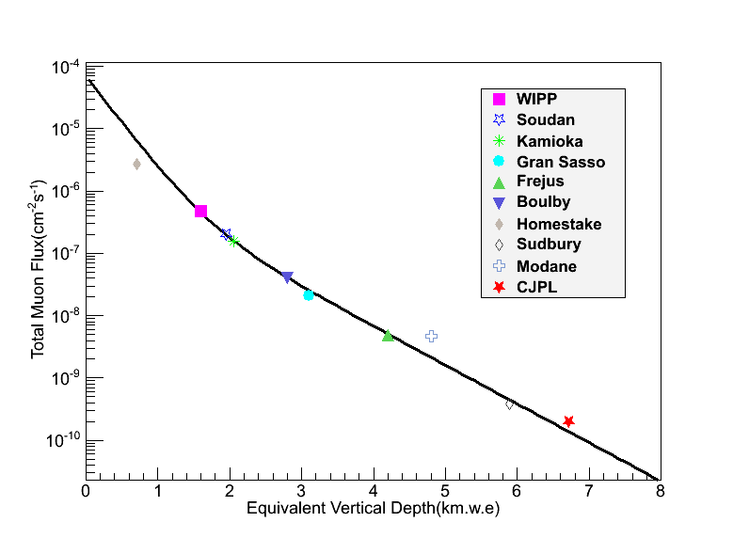
Muon flux at CJPL
4.0 μ/m²/day
0.2 μ/m²/day
Muon flux in CJPL: ~61muons/year/m²
Paper submitted to Chinese Physics C
YUE, Qian / Tsinghua University

Slide 6
Status and plans for CJPL
CJPL with deepest rock overburden in the world run now. Muon and Neutron flux measured and first LBF running!
CJPL can provide larger space in the near future to host more low background experiments. The target is built an underground lab with available space 20 times more than the recent one.
YUE, Qian / Tsinghua University

Slide 7
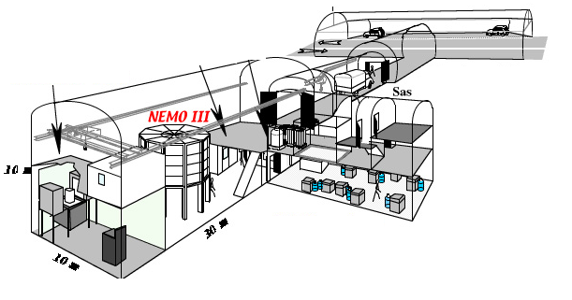
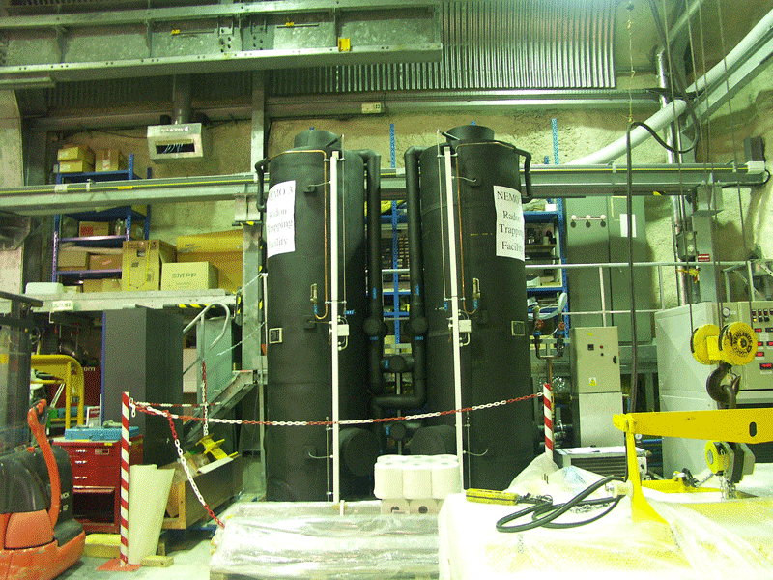
Main actual programs @ LSM
EDELWEISS III : dark matter search : Ge @ 10 mK
TGV : double electron capture
Spherical gazeous detectors (low activity prototype“SEDINE”)
Low background facilities & low level monitors
Gamma ray spectroscopy : 12 HPGe
Radon trapping facility
Neutron ( 10⁻⁶ n/cm2/s) & radon ( mBq/m³) monitors
Edelweiss
150 m³/h air w 15 mBq/m³ Rn (standard 15 Bq/m³)

Slide 8
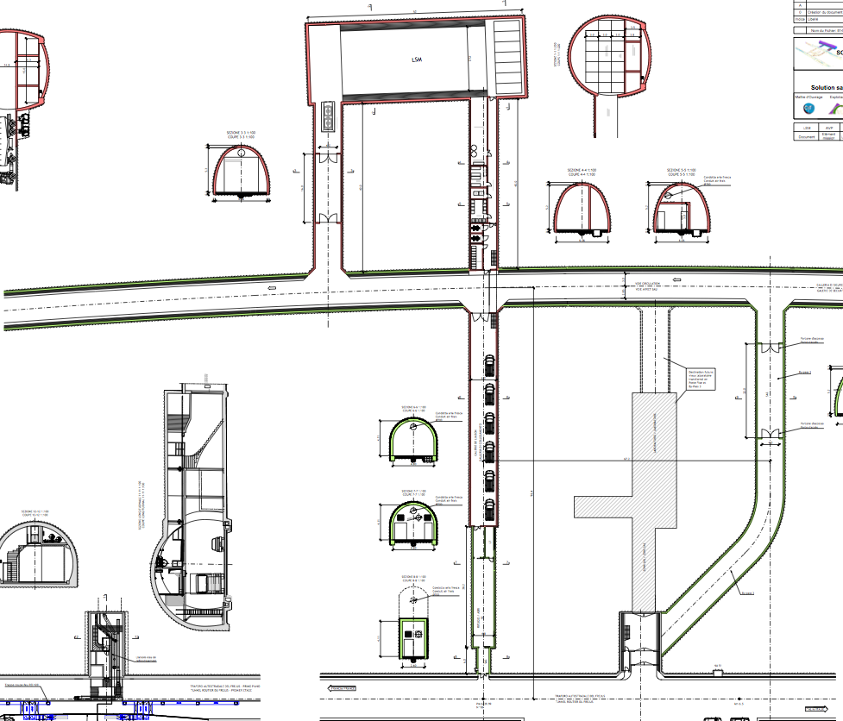
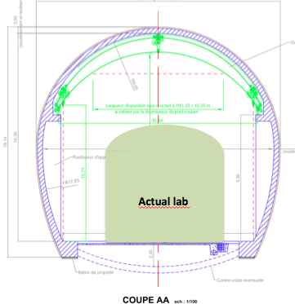
LSM underground lab extension
Last status jan mar 2013
Excavation of the extension 2014 or 2015.
In operation in 2016/2017.
Detailed studies funded by Savoie departement and Rhone-Alpes Region
Agreement from Ministery and CNRS for the project
Funding in progress (85% already obtained CNRS, Region Rhone-Alpes, FEDER funds)
Technical discussion in progress
50 m
New
100 %
for SuperNEMO / EURECA type expts
New
Actual
France
Italy

Slide 9
Activities in 2012
Paperwork (CERN/CNRS/THU) for shipping a 1.3 m Ø spherical detector from France to Tsinghua : 18 months ! OK now !
Visit of Wang Zhimin (IHEP) at Saclay for 4 weeks in june 2012 to get acquainted with spherical detector running, participation to Tessaloniki -Greece- collaboration meeting
Measurements of copper samples at LSM for use in JinPing experiments CDEX
Preparation of agreement on MiMac (directional detector for DM) common development between LPSC an THU

Slide 10
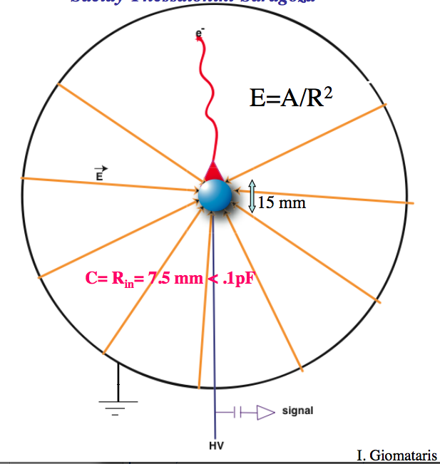
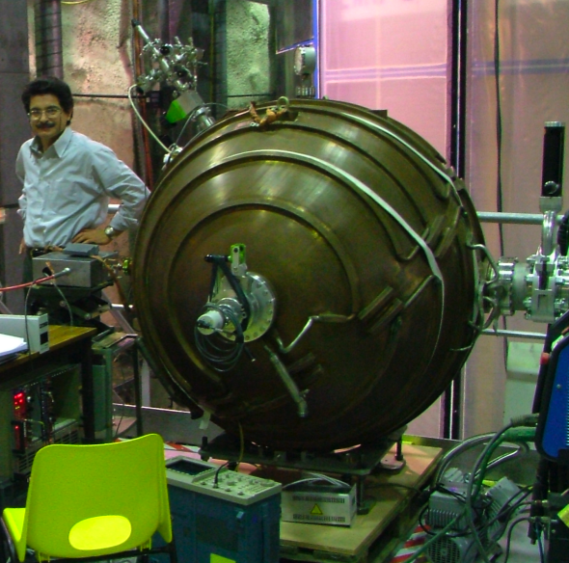
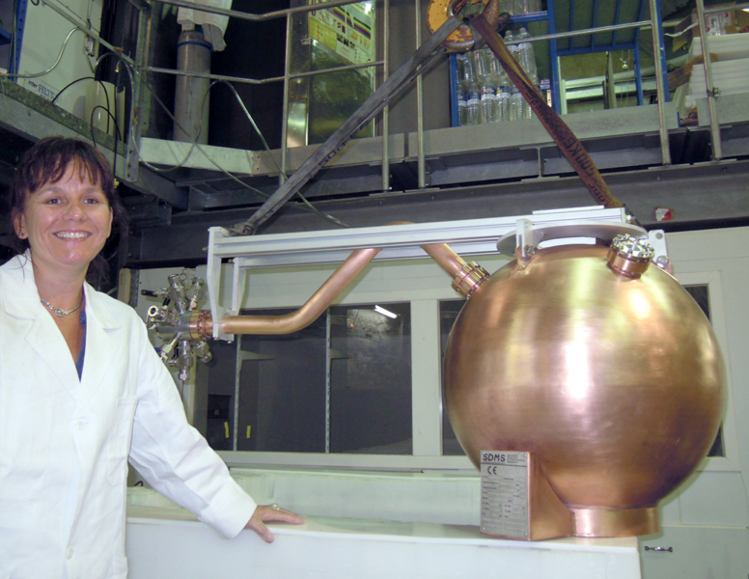
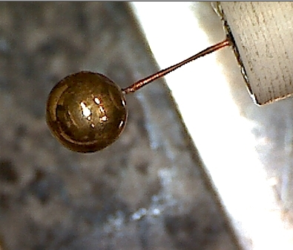
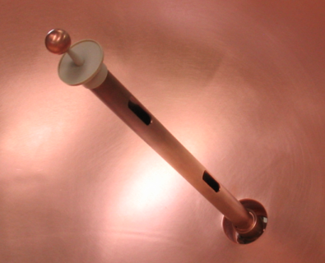
Spherical Proportional Counters
Sphere cavity + spherical sensor + HT
Low threshold (low C)
Fiducial selection by risetime
Flexible (P, gaz)
Large mass / large volume
Robust, simple, cheap, sealed mode
Digitisation @ 1 MHz, soft trigger
2 LEP cavity 130 cm Ø tested
1 low activity 60 cm Ø in operation @ LSM
Drift region
Ampl region

Slide 11
Spherical Proportional Counters
Sphere cavity + spherical sensor + HT
Low threshold (low C)
Fiducial selection by risetime
Flexible (P, gaz)
Large mass / large volume
Robust, simple, cheap, sealed mode
Digitisation @ 1-2 MHz, soft trigger
2 LEP cavity 130 cm Ø tested @ Saclay
Alpha / trace
Drift region
Dépôt
ponctuel
Ampl region
=> 2012 : characterisation at < 1 keV, volume calibration

Slide 12
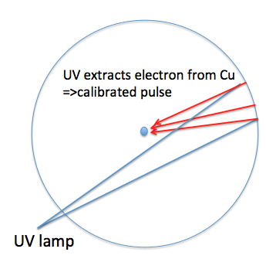
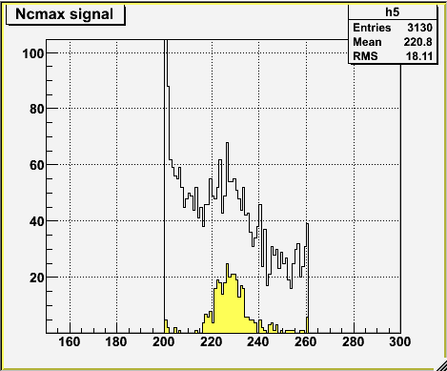
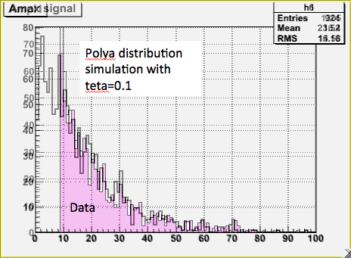
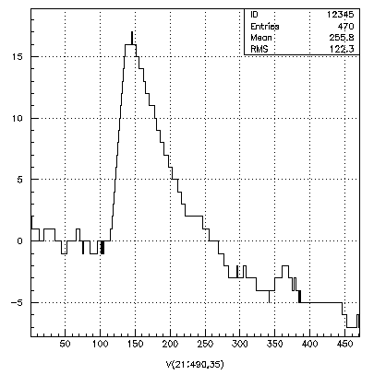
Calibration with UV flash lamp for single electron response
250 mb, Ar/2%CH4
μs
Digitised region around where UV induced pulse expected => Look for pulse in 200-260 μs window
About 1 in 10 => single electron response
Trigger efficiency for single electron = 54 %
NB : single electron = 30 eV
1 electron
16 ADU
Single electron
distribution
Trigger @ 10 ADU

Slide 13
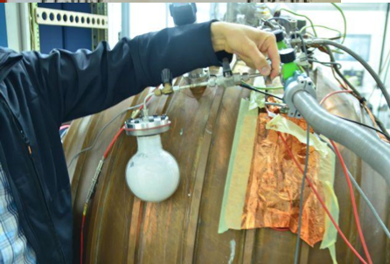
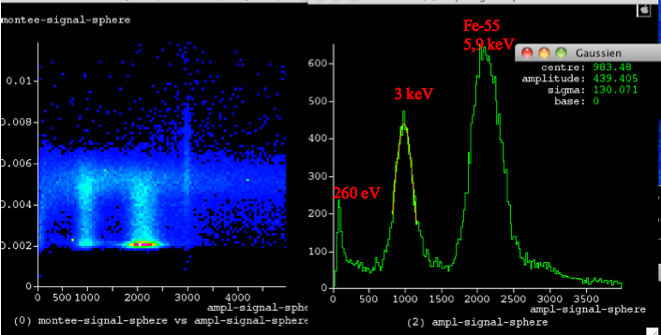
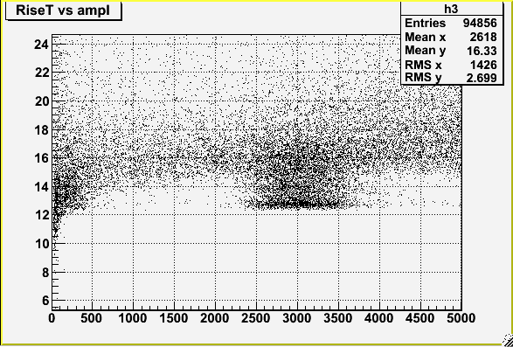
Volume calibration with ³⁷Ar source
³⁷Ar, EC, 35 days lifetime, Kα 2.6 keV and Lβ 260 ev
Can be made with Calcium salt irradiated with fast neutrons
=> first experiments successful !
2.6 keV
Behaviour at E<300 eV

Slide 14
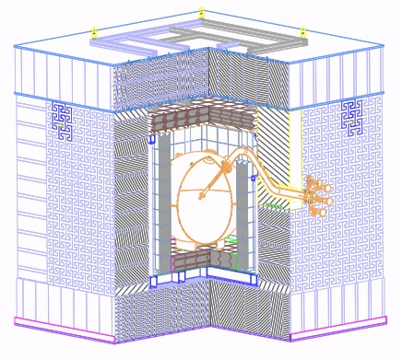
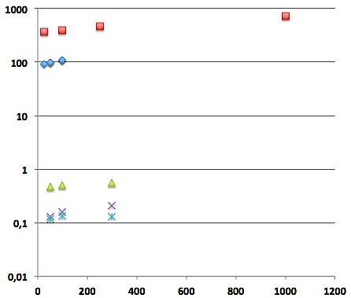
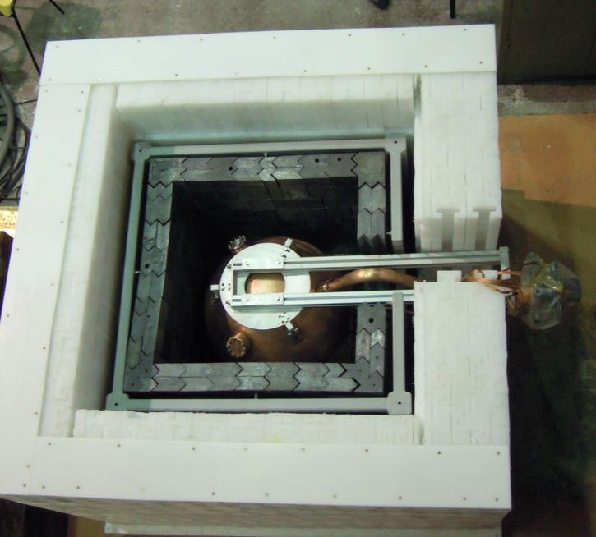
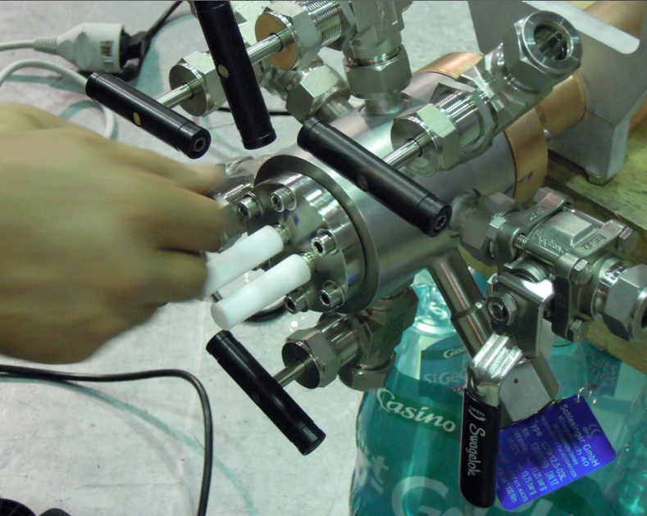
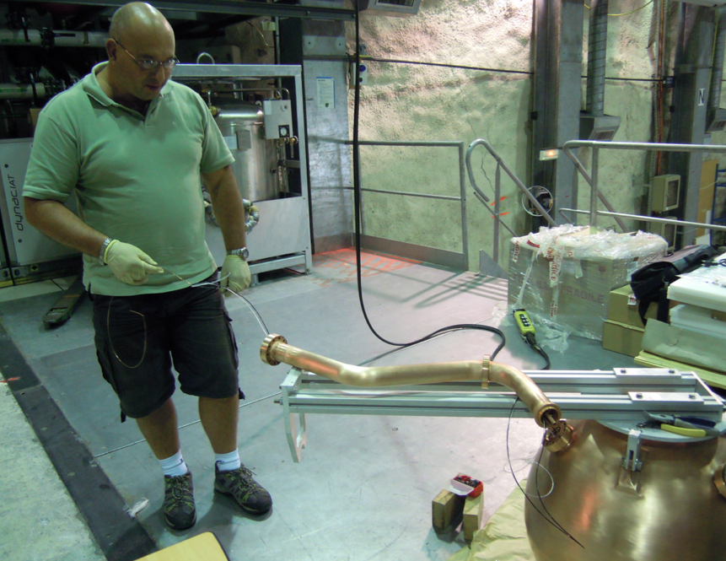
Data with « SEDINE » the 60 cm low activity detector @ LSM
Rate Hz
SPC
130 cm
Tot rate surface
Tot rate @LSM no shield
Ar CH4(2%)
SEDINE
@LSM
In shield
Alpha’s (Po 210 + Rn induced)
Argon 39 (1 Bq/kg)
Residual e rate
Jan 2013
Pressure mb

Slide 15
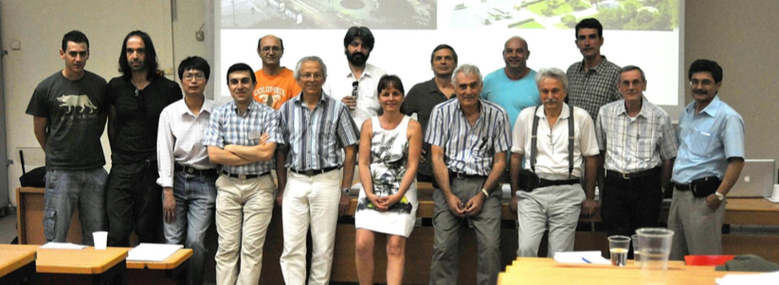
New Experiments With Spheres
Neutrino Experiments With Spheres
New Experiments for Wimps with Spheres
CEA-IRFU/Saclay (GG, IG) ,LSM (F Piquemal),
Aristotle University of Tessaloniki (I Savvidis), University of Ioannina (I Vergados), NCSR DemoKritos (G Fanourakis), Hellenic Open University (S Tzamaria)
University of Tsinghua Beijing (C Tao), Shanghai Jiao Tong University (K Ni), IHEP-Beijing ( C Yang)
University of Saragoza (I Irastorza), Livermore (JR Armendariz)
F : R&D at Saclay and LSM, sensors, high P
F : Coherent neutrino scattering experiment feasibility
G : Neutron monitor
C : R&D with SPC 130 cm shipped to Beijing, investigating large sphere building / tests
F G C : SN monitor, DM …
+ Liverpool ?
Tessaloniki 2012

Slide 16
Plans for 2013
Spherical detectors
Tune for lowest count rate in volume at LSM, develop measurement of neutrons with N2 : THU/Saclay, develop sensors and use of gaz : THU/Saclay
Visit of a Saclay colleague (P Magnier) at Tsignhua (1 week)
Visit of a Tsinghua student (Liu Ruoqing) in Saclay/Modane for few weeks
Directional MiMAc low pressure detector
Agreement between THU, LPSC & possibly Shanghai U
Visit of chinese collaborator for 6 months at Grenoble
Low radioactivity samples to measure
Around 4 k€ on each side asked for 2013

Slide 17
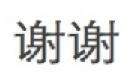
Thank you
Merci

Slide 18
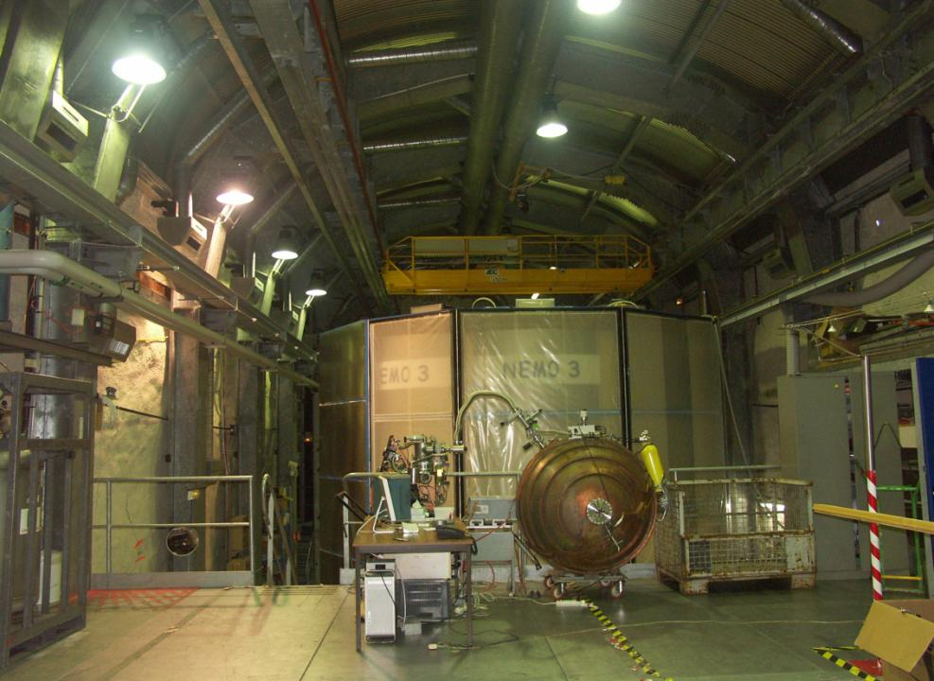
Spherical Proportional Counter SPC plans for 2012

