Slide 1



Gravitational-wave research in China: overview
Eric O. Lebigot
Tsinghua University, Beijing
University of Paris 7 / CNRS (APC)

Slide 2
Main themes
Detection of gravitational waves (GW)
Study of gravitation (including theory)
Electromagnetic follow-up after GW detection
Notes:
!F I can put images that illustrate each point

Slide 3
Gravitational-wave detection

Slide 4
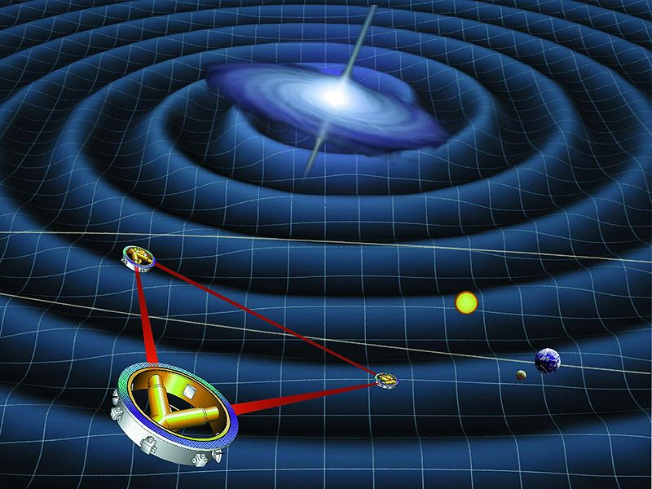
Space gravitational-wave observatory
Interferometer in space: ASTROD-GW proposed
  Low-frequency GW
  (~1–0.01 Hz)
Nanjing U, Chin. Acad. Sc., Chin. Space Agency,…
Plus: collaboration with Europe on the similar New Gravitational wave Observatory (NGO)

Slide 5
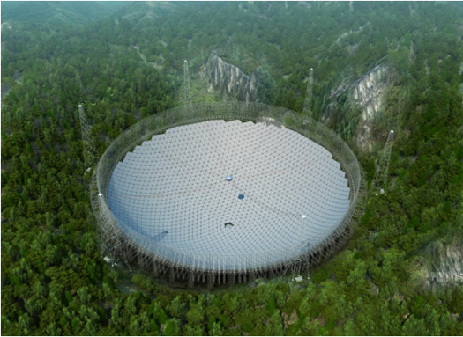
Use of Pulsar Timing Arrays
Gravitational waves make pulsars shimmer: measurement of the arrival time of radio waves from an array of pulsars
Chinese 500-meter Spherical Telescope (FAST) under construction
(computer image)

Slide 6
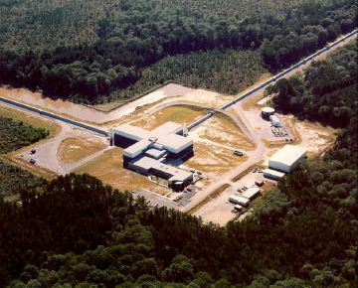
Collaboration with LIGO (MIT-Caltech)
Laser Interferometer Gravitational-Wave Observatory

Slide 7
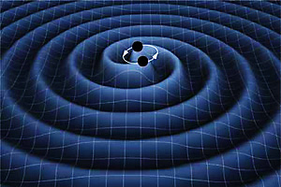
Collaboration with LIGO
Automatic detection of interferometer glitches
Detection of Compact Binary Coalescence with GPU acceleration
Easy access to the LIGO software suite through a virtual machine
At Tsinghua U (Beijing)

Slide 8
High-frequency gravitational waves
(~0.1–10 GHz)
Proposed by Prof. Li Fangyu (Chongqing):
coupling of gravitational waves
with electromagnetic waves
in a strong magnetic field
Detector in development
(Chongqing)
Congqing U, Shanghai Inst. of Optics and Mech., Chengdu Microwave Laboratory,…

Slide 9
Electromagnetic follow-up (after gravitational-wave detection)

Slide 10
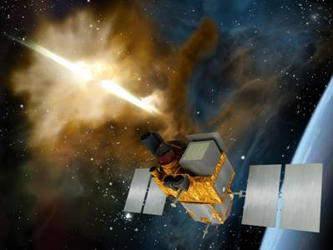
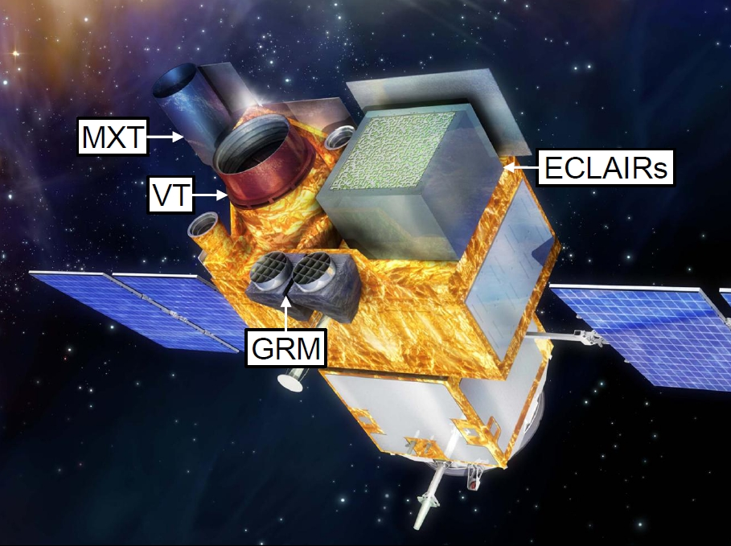
SVOM: X rays (4 keV–5 MeV)
Gamma ray burst detection
1 satellite, 3 ground-based instruments
French-Chinese collaboration (Nat. Astronomical Observatories [Beijing], Tsinghua U [Beijing],…)

Slide 11
Hard X-ray Modulation Telescope (20–200 keV)
Can be used for X-ray follow-up
Launch in 2014–2016
China's first astronomy satellite
Chin. Acad. of Sciences, Tsinghua U (Beijing),…

Slide 12
Study of gravity

Slide 13
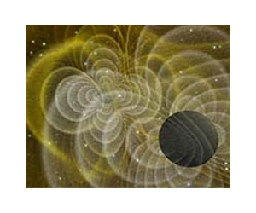
Measurement of the speed of gravity
Measurement of small changes in the Earth surface
Prof. Tang Keyun et al., World Data Center for Geophysics (Beijing)

Slide 14
Theory

Slide 15
There is more…

Slide 16
Thank you!
谢谢你们！

