Slide 1
Advanced pixels status for futurE HEP experiments
ATLAS Projects:
FEI4 Project
3D Project
Smart Sensor Project
Leader: Alexandre ROZANOV | Dr. | CPPM, In2p3 | Leader: Zheng WANG | Pr. | IHEP, CAS
Patrick PANGAUD | Eng. | CPPM | Wei WEI | Dr. | IHEP
Jean Claude CLEMENS | Eng. | CPPM | Jiangping LUO | Dr. | IHEP
Patrick BREUGNON | Eng. | CPPM | Xinchou LOU | Pr. | IHEP
Stephanie Godiot | Eng. | CPPM | Qun OUYANG | Pr. | IHEP
Frederic Bompard | Eng. | CPPM | Meng WANG | Pr. | Shandong U.
Emmanuel MONNIER | Dr. | CPPM | Jian LIU | St. | Shandong U.
 |  |  | Fuwei WU | St. | Nanjing U.
 |  |  | Ming QI | Pr. | Nanjing U.

Slide 2
OUTLINE
3D approach
Smart Sensor
Irradiation and test
3D, smart sensor and 65nm projects are R&D for ATLAS upgrades and FEI4 for IBL

Slide 3
3D Approach
A collaboration project between CPPM/IHEP since 2008
A regular collaboration meeting every week (Video conference)
Building blocks designed at CPPM in the last chip (FEC4_P3 @ Chartered 0.13μm LP) and successfully tested under proton irradiations at CERN up to 600Mrads
Analog Output Buffer
Calibration Pulse generator
Will be put in the next FETC4 project
Future Development
We started to work on the next FETC4 version dedicated to the future Atlas pixels development
New Building blocks design:
Low power dynamic pixel
Current reference design at low supply voltage
Full chip simulation
Preparation for the next FETC4 tapeout
Process transmision
Pixel layout preparation
Re-floorplan for the new chip

Slide 4
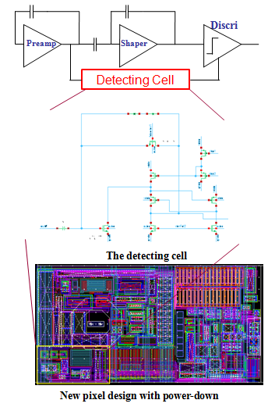
Building blocks design – A new low power pixel cell
To save power:
Design optimization (static)
Sleep – low power standby – wakeup – working – sleep (dynamic)
A most power consuming block: discriminator (4 μA → 1.2μA)
Design issue:
Very large gain: Preamp output → Digital level
Speed: Wakeup pulse to be faster than TOT output
Area: very limited space in the exsited pixel design
Low power: ultra low self power consumption
Input charge range: 1k e⁻ ~ 100k e⁻ (full)
Special design:
DC close loop, AC open loop for large gain
Clamp for large signal stabilization
Designed by Wei WEI
Will be included for two columns in the next 3D run

Slide 5
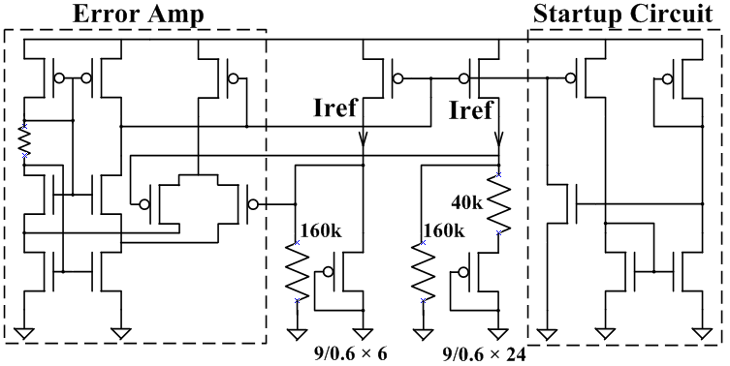
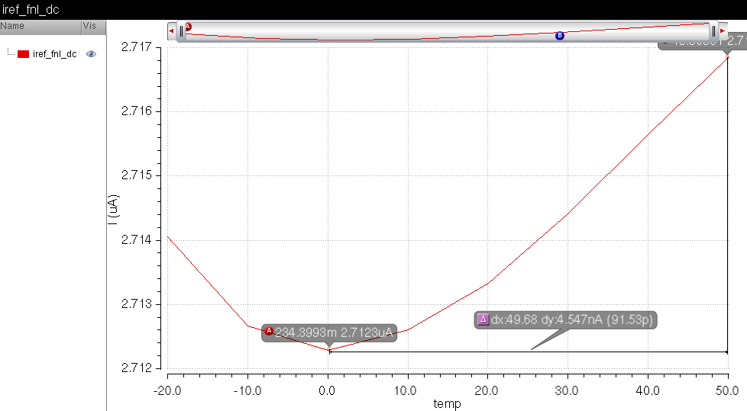
Building blocks design – Current Reference at low power supply voltage
Classical current reference bases on parasitic vpnp, but hard to design when vdd < 1.5V
Using DTMOS (Dynamic Threshold MOS), a pmos with gate, drain and sub connected together to replace vpnp
A current reference design with:
Current summing
Error Amplifier
Startup circuit
Trimming and bypassed output
Temperature stability: : 2.714μA±2.274nA
All process corners passed
Will be tapeout in the next 3D run

Slide 6
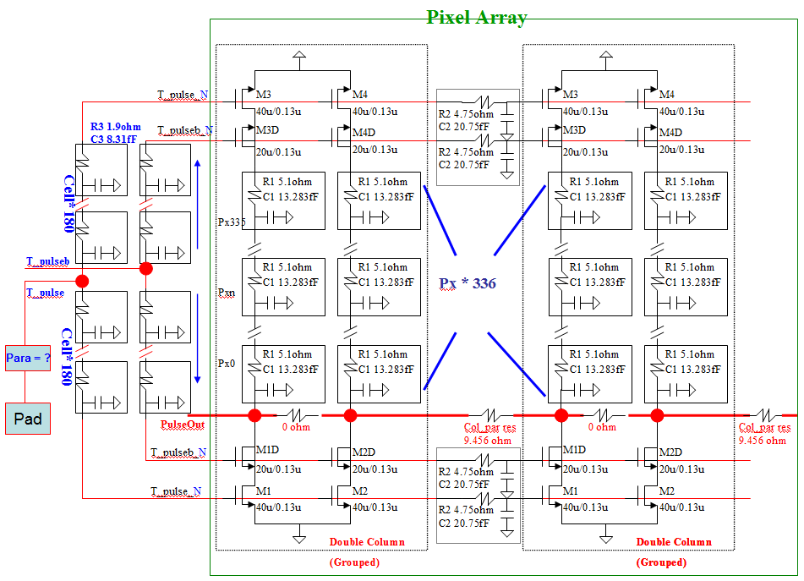
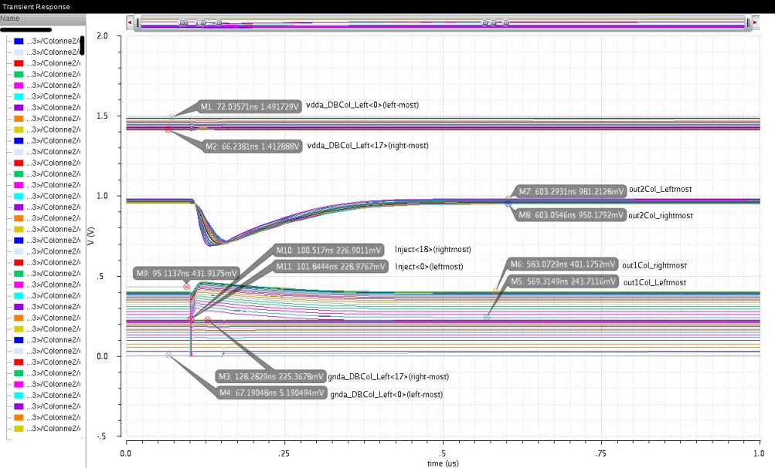
Full chip simulation
Cell uniformity is a critical spec for pixel readout chip
Power/bias network has a direct impact due to parasitic resistance
To run a full chip simulation and verify the pixel uniformity and baseline distribution
By fast simulator – ultrasim
First parasitic extraction from chip layout, then modelization
Verify a 60*336 pixel array, with the same scale as FEI4
Focusing on critical nodes due to the simulation complexity

Slide 7
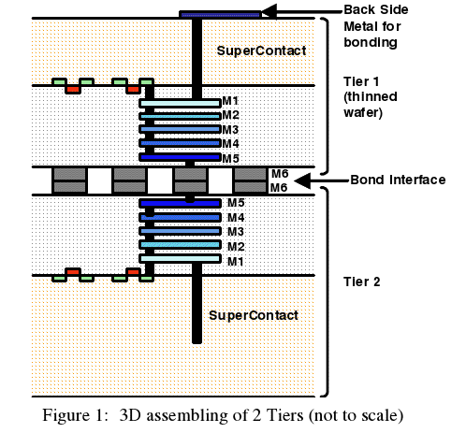
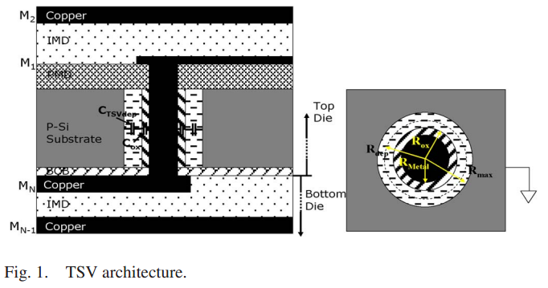
3D Project : test
From the first 3D prototype made for the ATLAS Project, some test were done to measure TSV and Bond-Interface performance.
The TSV (Through Silicon Via) consists of a vertical conductor, often referred to as “nail” or “plug”, entirely crossing the Si substrate of the stacked dies.
Measure the TSV daisy chain(51520 tsv), to understand its electrical properties.
Jian Liu/Shandong University
13 Sep 2012-09 Oct 2012, 30 Nov 2012- 16 Jan 2013

Slide 8
FE-TC4-P1 TSV and BI test at CPPM
We measured 19 chips, which show good tsv daisy chain interconnection. Yielding ~84%.
Single tsv resistance is . Agree with reference value <600mohm(Tezzaron report)
Single tsv capacitance(metal-insulator-semiconductor) in inversion region is around 5.5fF. The calculated value is 3.6fF. In addition, we cannot measure accumulation region capacitance because ESD diodes limit bias voltage.
The BI test results reveal some problems. Only 1 chip shows good interconnection. Perhaps the alignment issues and chip surface irregularities lead to these problems.
Jian Liu/Shandong University
13 Sep 2012-09 Oct 2012, 30 Nov 2012- 16 Jan 2013

Slide 9
3D Project : TSV simulation at CPPM
Be aimed to investigate tsv depletion features, try to find the probability of using tsv as charge collection area.
Using Silvaco tcad for 2D and 3D tsv device simulation
Jian Liu/Shandong University
21 Jan 2013-now

Slide 10
Smart Sensor
We started an R&D development on Smart Sensor
P-substrate
Pixel electronics in the deep n-well
Ivan Peric, FEE2011, Bergamo, Italy
Deep n-well
NMOS transistor
in its p-well
PMOS transistor
The sensor is based on the depleted area between the “deep” n-well and the p-substrate
E-field
Particle
The CMOS signal processing electronics are placed inside the deep-n-well. PMOS are placed directly inside n-well, NMOS transistors are situated in their p-wells that are embedded in the n-well as well.
A first prototype was made in AMS HV 0,18µm technology and tested, glued to a FEI4 chip, in order to create an advanced sensor .

Slide 11
Irradiation and test
The 2012 year was dedicated to test prototypes at CERN, under protons Beam of 24Gev
chip | date | Main test items
FEI4 chip for IBL
FE-I4-165 | 02.Aug-16.Oct | GR SEU test; Analog scan; GADC linearity test
FE-I4-162 | 02.Aug-16.Oct | GR SEU test; GADC linearity test
Futur Atlas pixels chips : 65 nm technology
65nm chip | 02.Aug-16.Oct | SEU test; single transistor IV curve test
Futur Atlas pixels chips : HV Smart pixel
CCPD2 | 02.Aug-16.Oct | Counting rate ; ToT(time over threshold); analog scan
CCPD8 | 18.Oct-08.Nov | Counting rate; analog scan
CCPD9 | 18.Oct-08.Nov | Counting rate; analog scan
All the tests were performed by CPPM with the help of
Fuwei WU(Nanjing University) and Jian Liu(Shandong University)

Slide 12
Irradiation and test
Other electrical tests were done on 2012.
chip | date | Main test items
Futur Atlas pixels chips : 65 nm technology
65nm chip | 19.Oct-30.Oct | single transistor IV curve annealing test
Futur Atlas pixels chips : HV Smart pixel
CCPD10 | 09.Nov-18.Nov | Counting rate(Fe55);ToT(Fe55 spectrum); analog scan
CCPD11 | 19.Nov-28.Nov | analog scan(all pixels mapping)
Jian Liu/Shandong University

Slide 13
Conclusion and future plans
Continue the development on advanced pixels, by using 3D approach and smart sensors this year
Expand the collaboration between Chinese institutes and CPPM
More active discussions
Scheduled visit in mid-April:
Meeting Chinese designers from Chinese university groups
Involving Chinese university groups, interested into Si and pixels developments, especially on new technologies (3D, High Voltage, High Resistivity, Deep-Sub micronic CMOS...)
Visiting SMIC fab : Headquarters and fab
Discussing financial sharing aspects
Discussing irradiation facilities

