Slide 1
OBSERVATIONS OF VERY HIGH ENERGY GAMMA-RAY WITH THE GROUND-BASED EAS ARRAYS
Songzhan Chen
Institute of High Energy Physics (IHEP)
Nanjing.2013-3-28
6th workshop of the France China Particle Physics Laboratory

Slide 2
Outline
1. Introduction to VHE gamma-ray astronomy
2. AGN
3. Extended sources
4. Galactic plane diffuse gamma-ray
5. Conclusion

Slide 3
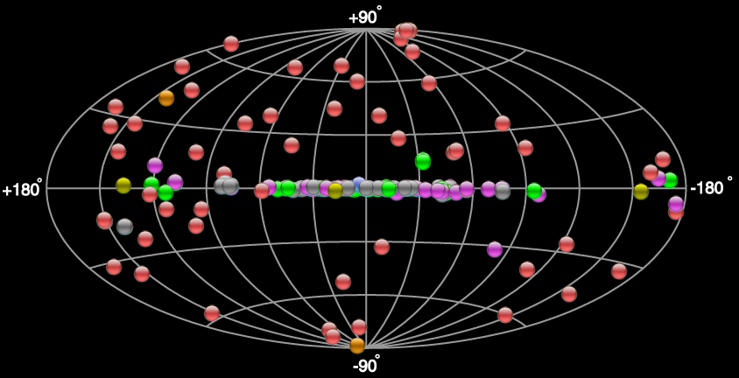
1. Introduction to VHE gamma-ray astronomy
VHE (E> 100GeV) gamma-rays are tracers of non-thermal particle acceleration. A window to probe to astrophysical processes in extreme non-thermal sources.
(1989-now) 143 VHE emitters: Galactic: PWN、SNR、XB，Extra-galactic: AGN、Starburst。

Slide 4
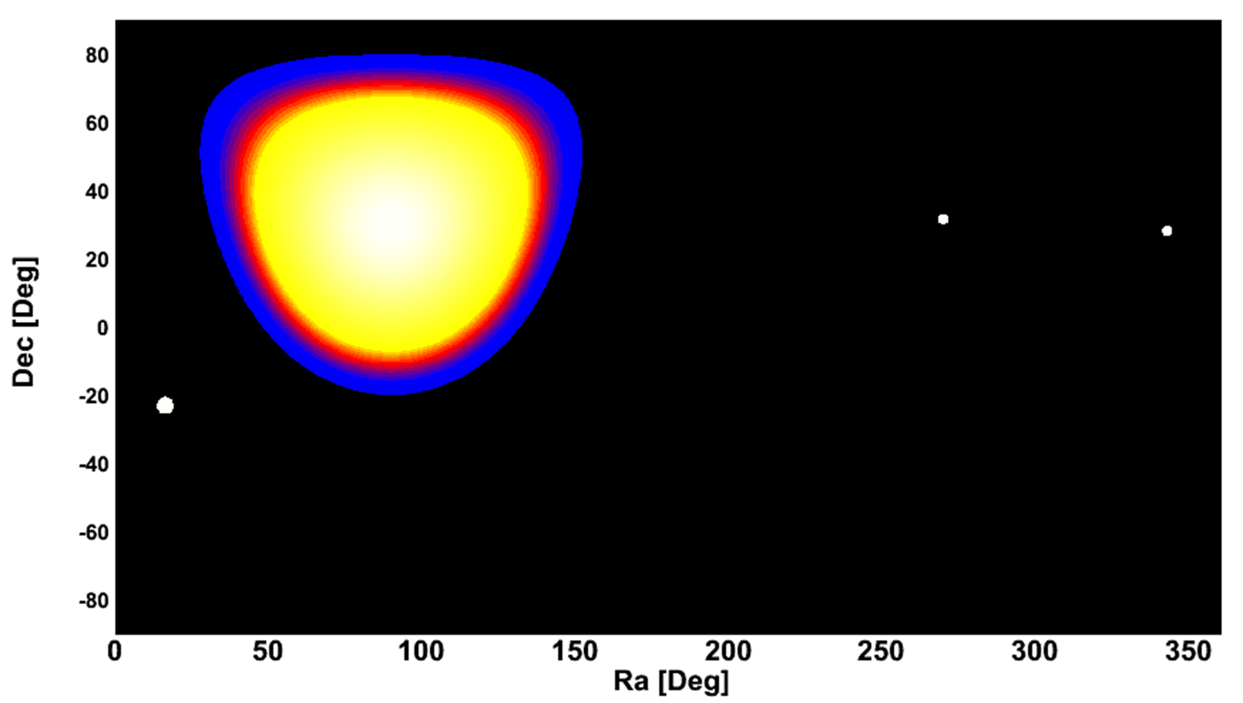
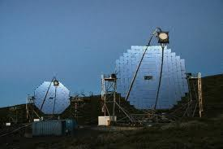
Most are discovered by IACTs, such as H.E.S.S., VERITAS and MAGIC, sensitivity ∼1% I_{Crab}.
With FOV 3~5deg and duty cycle ~10%, IACTs cannot survey the sky, long-term monitor on AGN, measure the GP diffuse gamma-ray, and their observation on extended source are biased.
EAS arrays are essential with FOV ~2sr and >86% duty cycle.
ARGO-YBJ
MAGIC
Moonless night
MAGIC
VERITAS
HESS
FOV

Slide 5
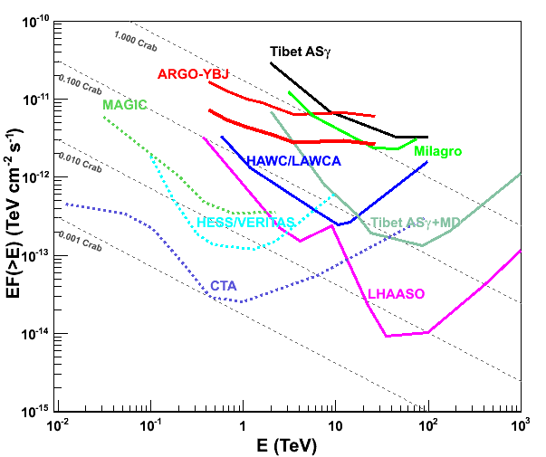
The progress of ground-based EAS arrays
Past EAS arrays (before 2013)
Tibet ASr: 1990-2008
Milagro: 1999-2008
ARGO-YBJ: 2006-2013
50~200% Icrab
Nearly future EAS arrays (~2014)
Tibet ASr+MD,
HAWC
LAWCA
~10% Icrab
Future EAS arrays (~2018?)
LHAASO
~1% Icrab, 0.3~1000 TeV
~100% Icrab
~10% Icrab
~1% Icrab

Slide 6
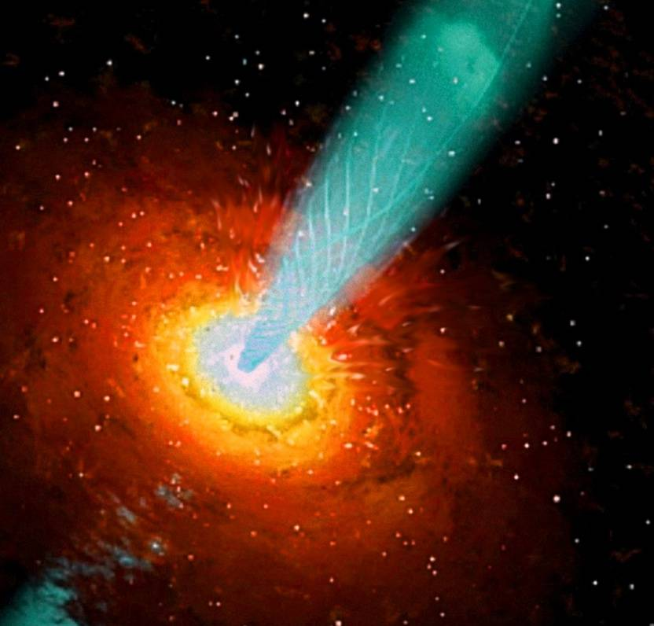
2. AGN
Leptonic SSC, EC? Hadronic?
Acceleration? Location?
？
Different models will predict different correlations between low and high energy components. Thus, long-term continuously multi-wavelength observations, especially at X-ray and TeV band, are crucial to understand the emission mechanisms and underline processes of the outbursts.
Notes:
relativistic jet, black hole, accretion disk

Slide 7
Mrk421
An excellent candidate to study the jets of AGN. With frequent major outbursts about once every two years.
Tibet ASr
ARGO-YBJ
RXTE/2-12keV

Slide 8
Tibet ASr observation
The first observation of long-term correlations between satellite keV X-ray and TeV gamma-ray data based on simultaneous observations during the large flare in 2000-2001.
Amenomori et al. ApJ 598:242 (2003)

Slide 9
ARGO-YBJ observation
A good several years long-term correlation between X-ray and TeV gamma-ray including both active and quiet phases.
Bartoli et al. ApJ 734:110 (2011)

Slide 10
X-ray and TeV gamma-ray correlation
No significant lag longer than 1 day is found. The tight correlation between X-ray and TeV emission indicates their same origin!
Bartoli et al. ApJ 734:110 (2011)

Slide 11
Mrk501
Another excellent candidate to study the jets of AGN.
During the 2011-2012 flare, Mrk501 appeared in day time. Only EAS array can observe it.
RXTE/2-12keV
Swift/15-50keV
1997
2011

Slide 12
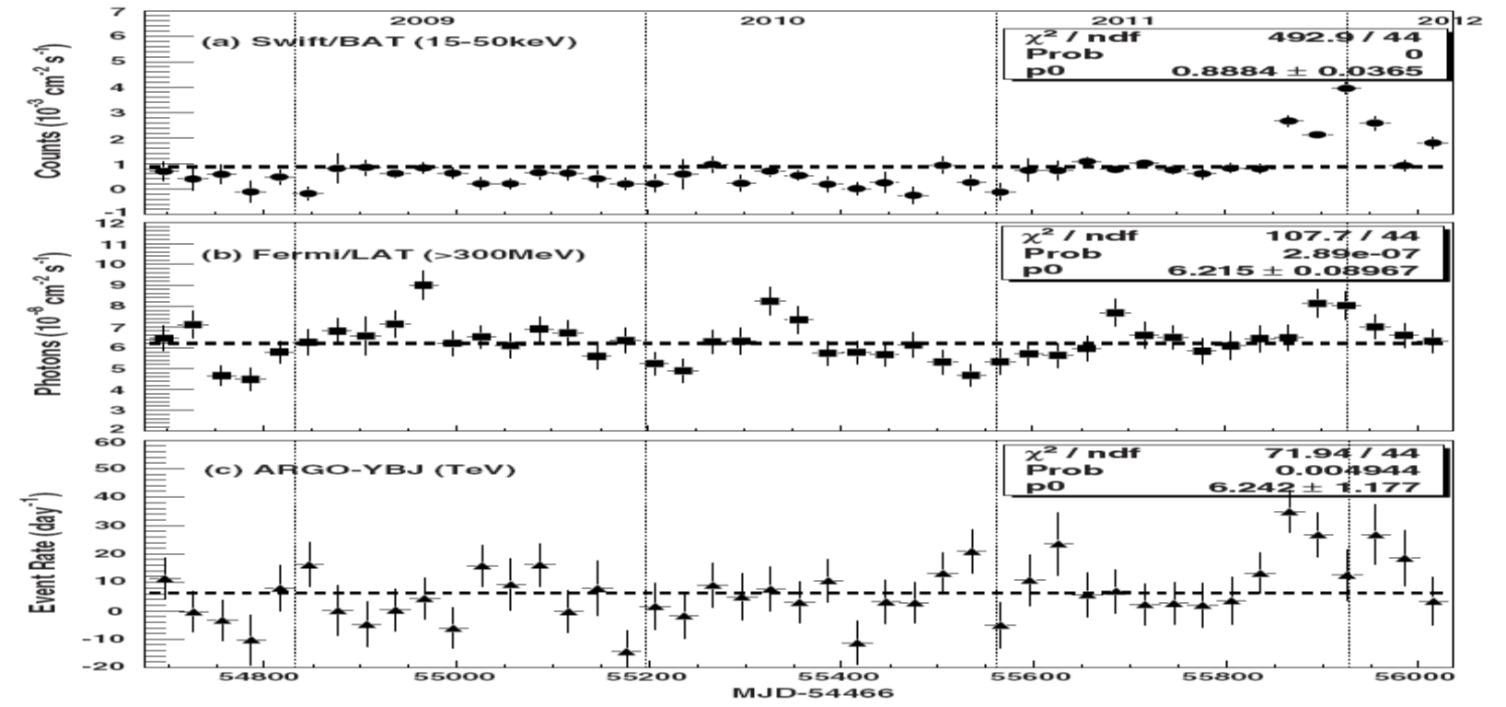
2011-2012 flare
Flares only in X-ray and TeV band.
ARGO-YBJ TeV
Bartoli et al. ApJ 758:2 (2012)

Slide 13
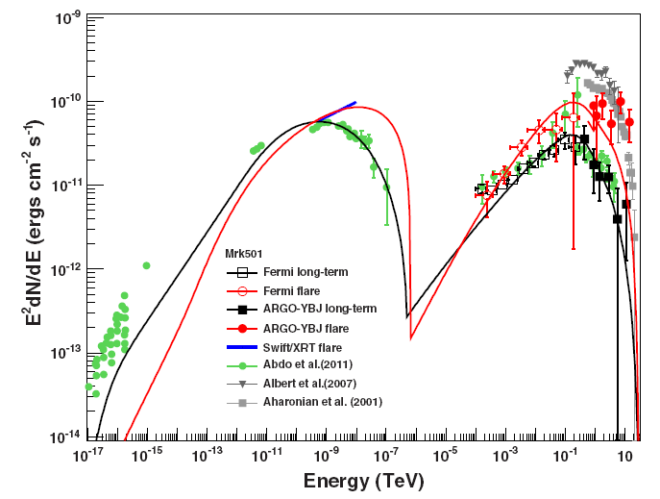
2011-2012 flare
One-zone SSC model can fit steady SED well, but cannot fit flare SED. The radiation mechanism may be different during steady and flare states.
Bartoli et al. ApJ 758:2 (2012)

Slide 14
Probing the intergalactic magnetic fields (IGMFs) with VHE gamma-rays
The GeV-TeV observation could be used to constrain IGMF.
According to Takahashi et al.(arXiv:1303.3069), IGMF B < 10^{−20.5} G can be excluded at ∼ 4σ level using long-term, simultaneous Fermi-LAT and ARGO-YBJ observation on Mrk 421.
weak B
IC CMB
Strong B
Takahashi et al. ApJL 744:L7 (2012)

Slide 15
Prospect for future EAS arrays LHAASO
Even ARGO-YBJ has detected many phenomena from AGN, while its precision is not sufficient to reach a firm conclusion.
LHAASO will boost the sensitivity up to 30 times. A precision measurement will be achieved.
More AGNs are expected. 42 out of 53 VHE AGNs and 271 out of 360 >10 GeV AGNs are inside the FOV of LHAASO.

Slide 16
3. Extended sources
Milagro detect 5 extension sources at 35TeV:
MGRO J2019+37, MGRO J1918+06, MGRO J2031+41
Geminga, MGRO C4
ARGO-YBJ detect 4 extension sources at 1 TeV:
MGRO J1918+06, MGRO J2031+41, HESS J1841-055, HESS J1912+101, no signal from MGRO J2019+37

Slide 17
SED
MGRO J1908+06
EAS arrays are consistent with each other. The fluxes determined by EAS arrays are much higher than IACTs.
Bartoli et al. ApJ760:110 (2012)
MGRO J2031+41
HESS J1841-055
Bartoli et al. ApJL 745,(2012):L22
Bartoli et al. ApJ767:?? (2013)

Slide 18
Remarks
Due to their limited FOV, IACTs might count the extended emission as background, would measure fainter emission than EAS arrays.

Slide 19
MGRO J2019+37
Most bright source in Northern sky except Crab.
A flux variation over several years?
or the spectrum is special? the peak energy is around 10 TeV.
MGRO J2019+37
Bartoli et al. ApJL 745,(2012):L22

Slide 20
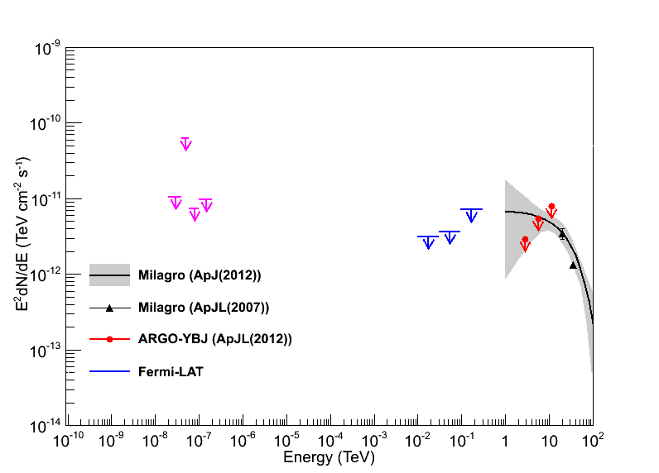
Multi-wave observation status
Single sources or multi-sources?
Hadronic or leptonic origin?
Need deep observation.
LHAASO measurement from 0.1TeV-100TeV will be crucial.

Slide 21
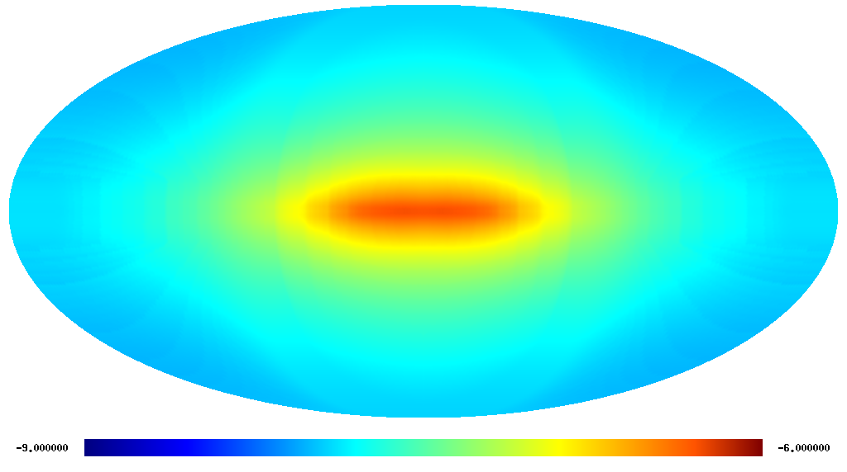
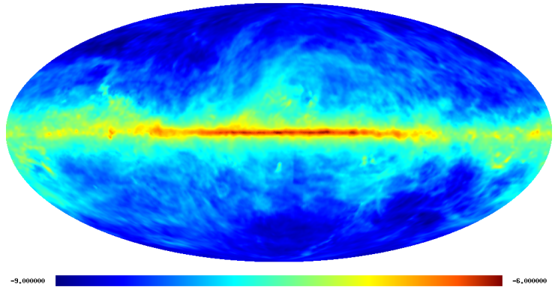
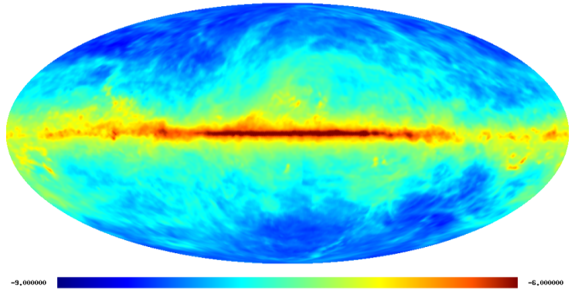
4. Galactic plane diffuse gamma-ray
Inverse Compton π⁰-decay
Bremsstrahlung
From interactions of cosmic rays with the interstellar gas and radiation fields. A tool to study cosmic-ray origin and propagation, and the interstellar medium.
A way to search for Dark Matter Annihilation.

Slide 22
Milagro result
Milagro detect diffuse gamma-ray emission at 15TeV. The flux is higher than conventional cosmic-ray transport model.
Abdo et al. 2008

Slide 23
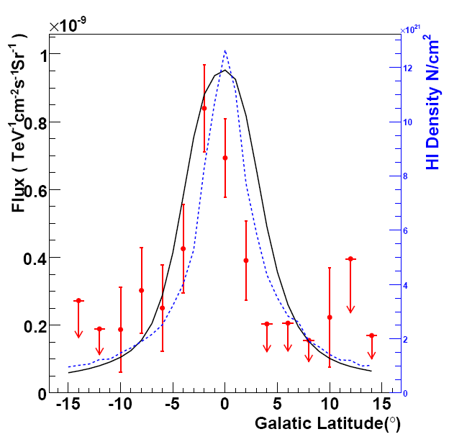
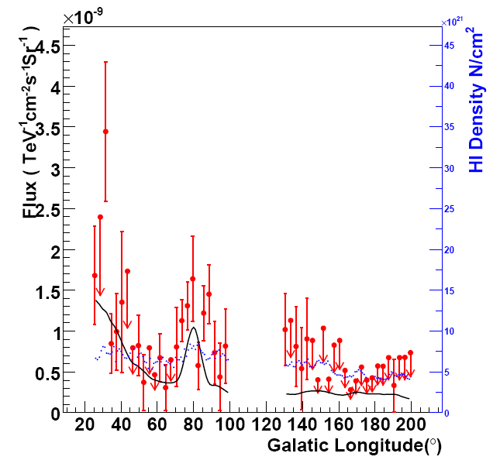
ARGO-YBJ result
ARGO-YBJ detect diffuse gamma-ray emission at 1TeV. region：25º<l<85º
VHE flux is correlation with the HI density.
Consistent with the extension of Fermi result using E^{-2.6}.

Slide 24
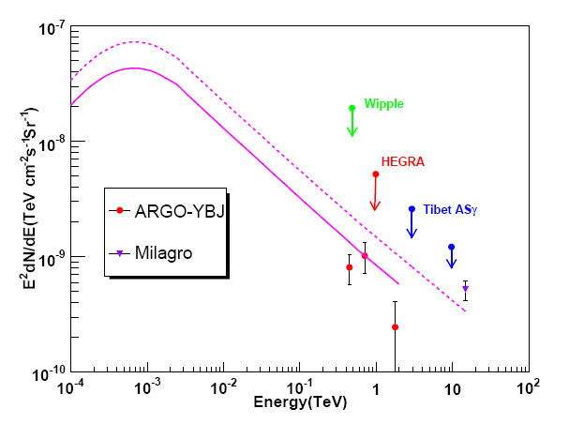
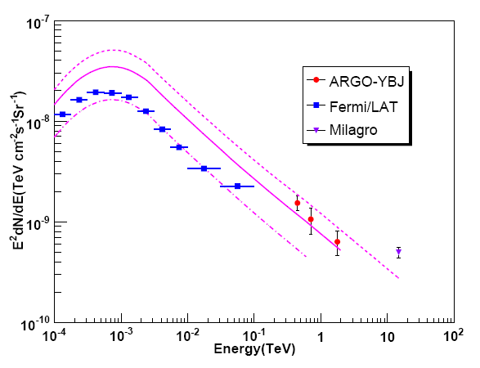
SED of Diffuse gamma-ray
Comparison with the extension of Fermi result.
ARGO-YBJ： 25º<l<65º , |b|<5º
Milagro: 25º<l<65º , |b|<2º
ASγ: 20º<l<55º , |b|<2º
HEGRA: |40-l|<5º , |b|<2º
Whipple: |40-l|<1.5º , |b|<2º
ARGO-YBJ： 65º<l<85º , |b|<5º
Milagro: 65º<l<85º , |b|<2º
Fermi/LAT: 72º<l<88º , |b|<15º

Slide 25
5.Conclusion
In the past decade, the EAS arrays have demonstrated the superiority of their high duty cycle and large field of view. While their limited sensitivity is not sufficient for further look insight into underline physics.
The planning future projects, such as LHAASO, will boost the sensitivity up to 30 times with wide energy band from 0.1 TeV to 1000TeV. These observation data will have a major impact on our knowledge of AGN, extended sources, GP diffuse gamma-ray and related fields.
Thanks!

