Slide 1
Status of LHAASO
Zhen Cao, IHEP, China
One of 16 Megaprojects in 5 yrs
Site and configuration
Facility and its scientific goals
Schedule and prototyping
LAWCA
6th FCPPL Workshop at Nanjing, China, 2013-03

Slide 2

四、“十二五”时期建设重点
“十二五”时期，在我国科技发展急需、具有相对优势和科技突破先兆显现的领域中，综合考虑科学目标、技术基础、科研需求和人才队伍等因素，优先安排16项重大科技基础设施建设。
（七）高海拔宇宙线观测站。宇宙线起源一直是物理学最大的谜团之一。我国在高海拔宇宙线观测研究方面具有长期积累和深厚基础，台址条件具有特殊地理优势，适合建设由多个性能先进的探测系统组成的多参数宇宙线复合观测站。围绕推动国际甚高能伽马天文研究迈入大统计量新时代的科学目标，建设大型高海拔空气簇射宇宙线观测站，主要包括：100万平方米探测阵列，9万平方米伽马射线巡天望远镜，24台广角契伦科夫望远镜，0.5万平方米芯探测器阵列。该设施建成后，将集高灵敏度、大视场、全时段扫描搜索伽马射线源、伽马射线强度空间分布和精确能谱测量等多功能为一体，成为具有国际竞争力的宇宙线研究中心。

Slide 3
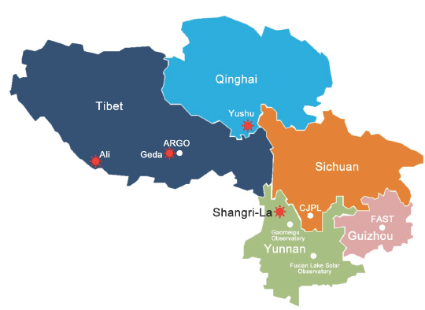
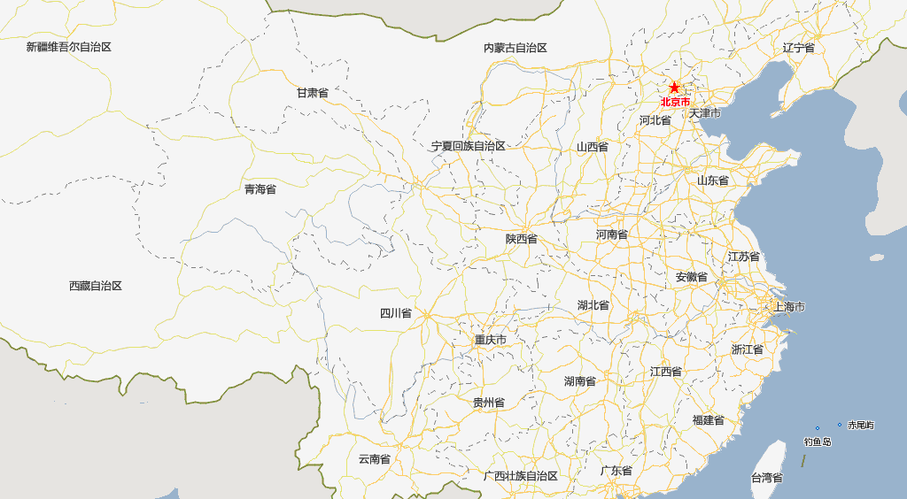
The Best Candidate Sites
ARGO-YBJ
site
LHAASO
site
O-Tele Ф2.4m at ~200km
Solar Tele Ф2m at ~700km
JP Underground Lab at ~400km
FAST-Radio Tele Ф500m

Slide 4
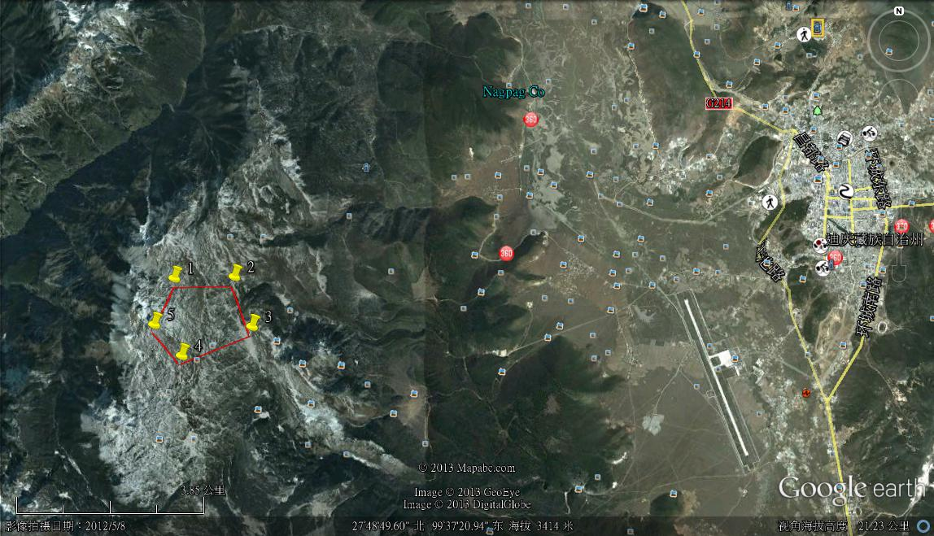
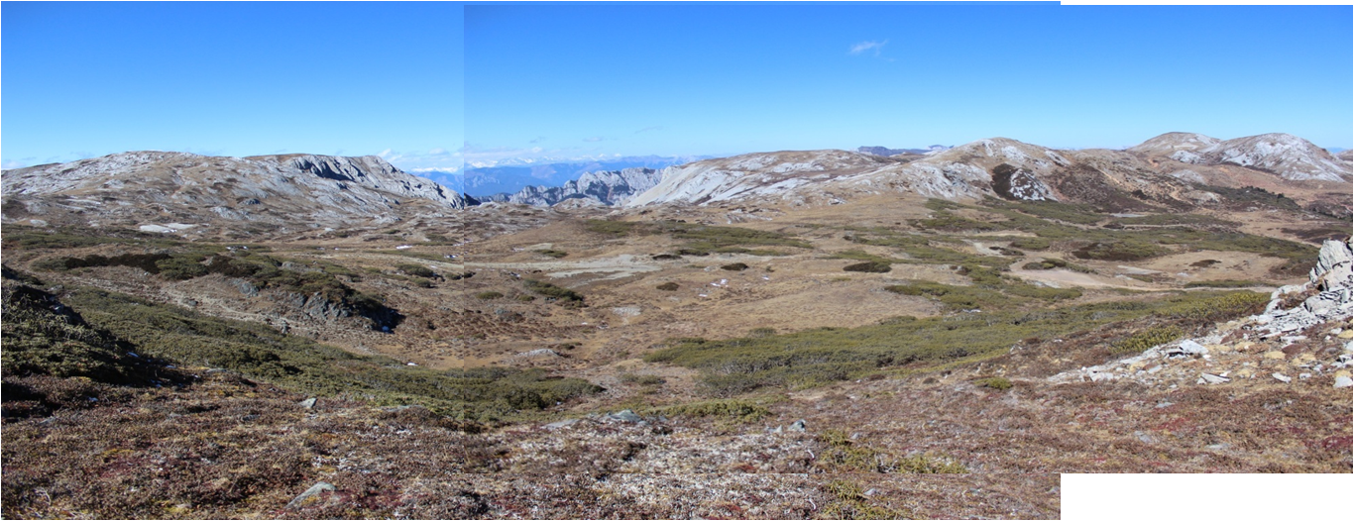
Geo-location of the Shika site
13km
10km
Decided by IHEP and local gov in 2012-12

Slide 5
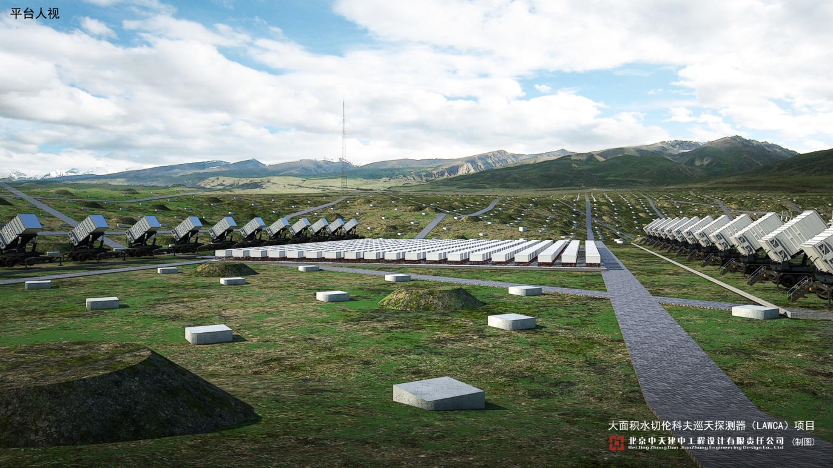
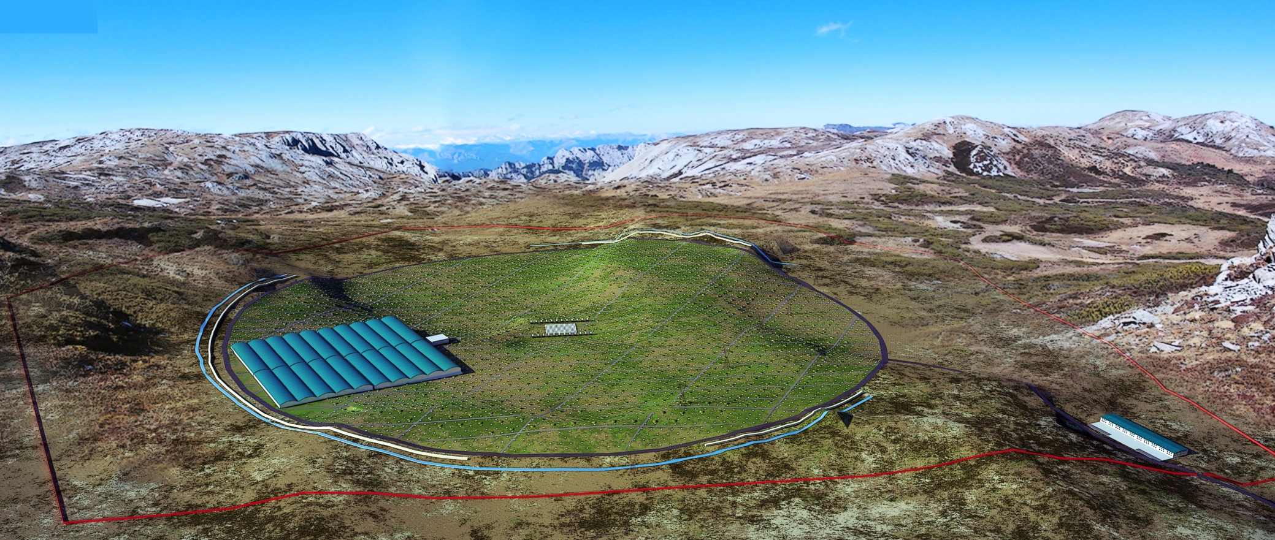
LHAASO layout
Central detector
array for
cosmic rays
90k m² gamma ray survey telescope
1M m² surface EAS detector array

Slide 6
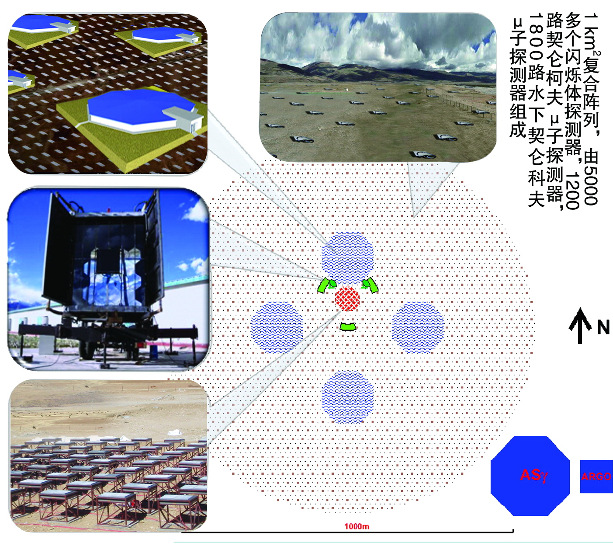
LHAASO——The third generation of survey facility for VHE γray sources
90k square meter
Water Cherenkov
Deter array. Each
one has a size of
HAWC
6100
scintillator
detectors
and 1200
μdetectors
form an
array covering
1 km²
LHAASO Layout in 1 km² at 4300m a.s.l.
24 Wide FOV air
Cherenkov image
Telescopes. For
Air Fluorescence
measurement
above 0.1 EeV also
400 burst detectors
For high energy
Secondary particles
Near the core of air
showers

Slide 7
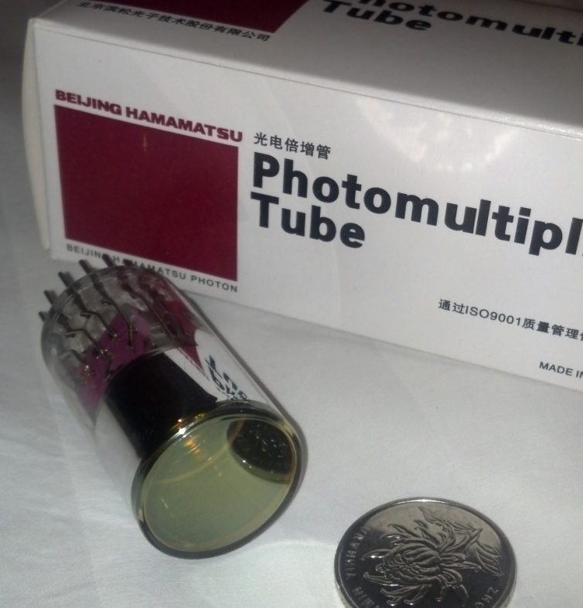
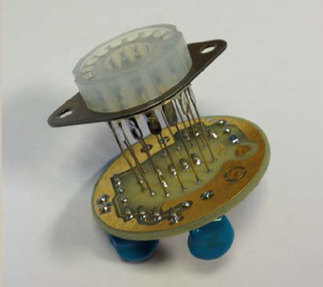
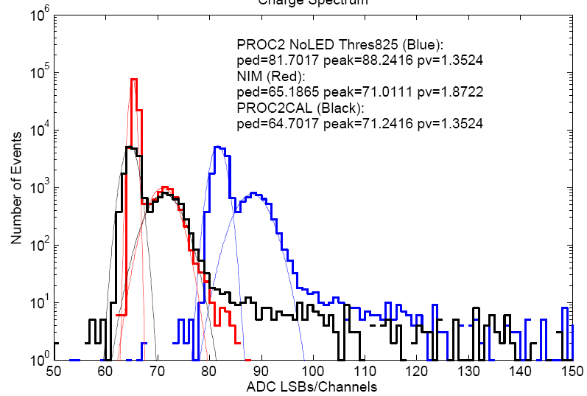
FCPPL: IPNO/LAL/Omega collaboration on ASIC FEE
PARISROC-II based currently
LHAASOROC in future
Simulation for water Cherenkov muon detectors
Simulation for shower measurement using KM2A
ASIC development
PMT base design and tests

Slide 8
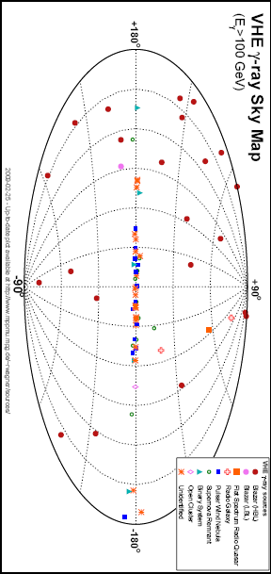
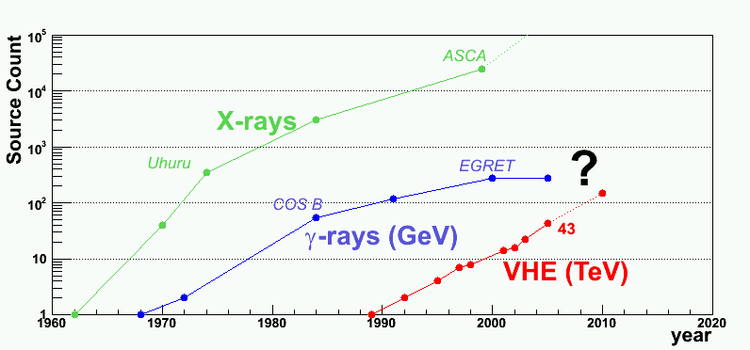
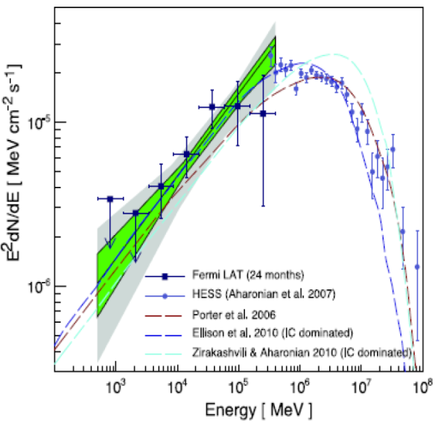
Survey for γ-sources very detailed spectroscopy investigation
( a few hundred extra-galactic sources are expected )
？

Slide 9
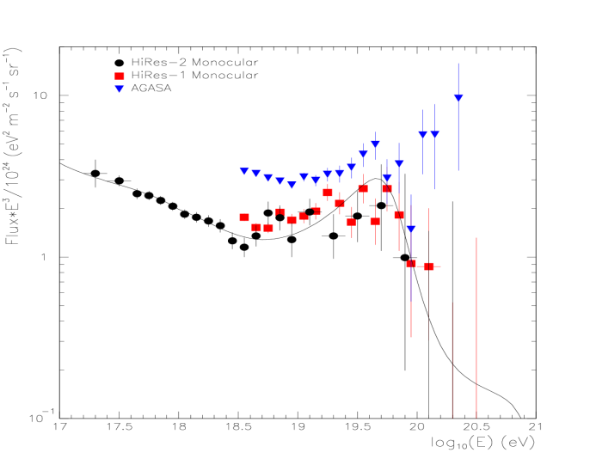
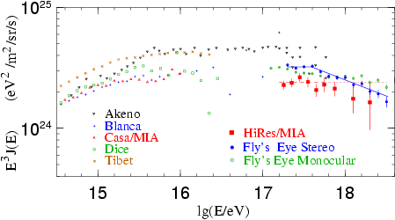
CR spectra of individual spices over two knees with uniform energy scale and direct measured composition in the space
Tower CT: 16
μ : 100x400m²
Side Trigger CT: 2x4
W S
C C
D D
A A
+
W
F
C
T
A
K
M
2
A
+
T
U
N
K
A
K T
M U
2 N
A K
A
+
F
T
A
A
R
G
O
+
W
F
C
T
A
A
R
G
O
Multi-parameter hybrid
observation of showers

Slide 10
Observatory Construction
The proposal is planned to submit to CCDR next month.
It is planned for a construction of 5-6 years
yrs
Detector R/D： 1.5
FEE R/D: 2
FEE Production: 1.5
DAQ & installation: 0.5
Detector deployment: 4
1% array test run: 1
now
6 yrs
2013
2015
2016
2017
All technology that will be used in LHAASO are
tested with engineering arrays at scales of
1%-10% of the full project

Slide 11
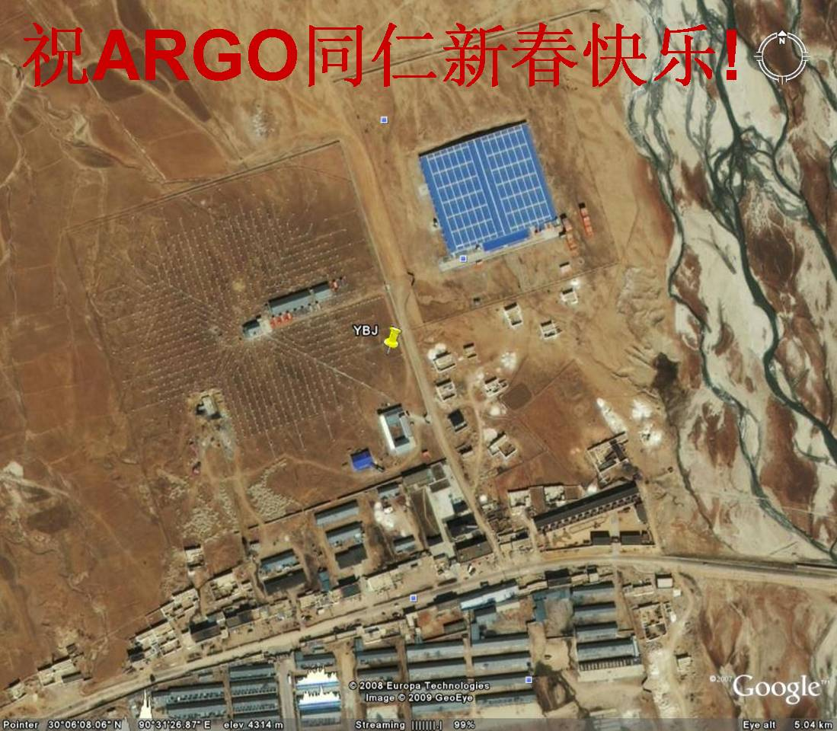
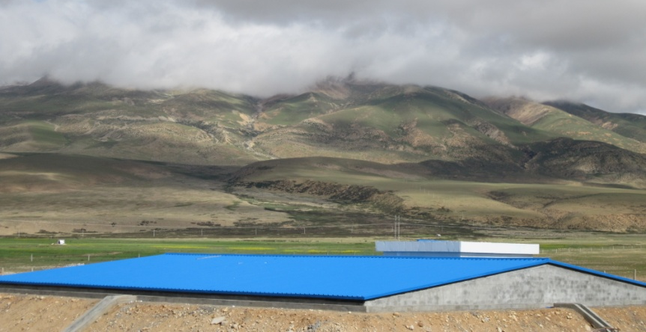
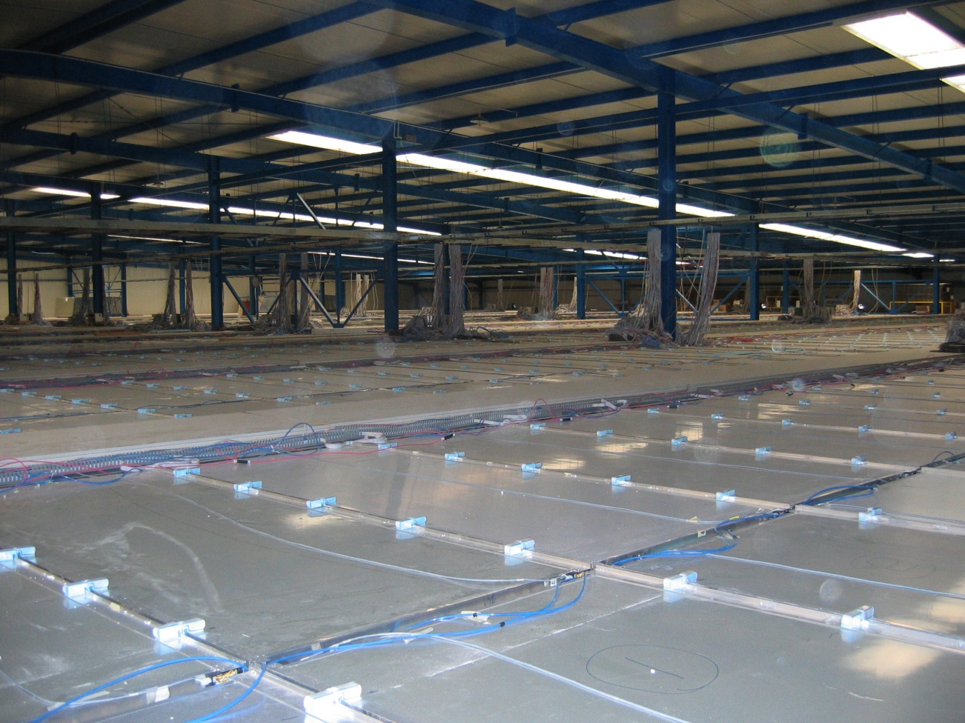




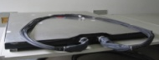


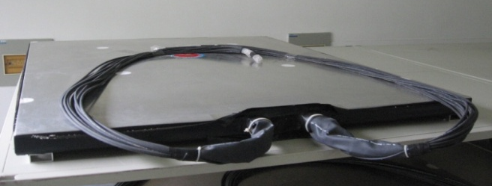
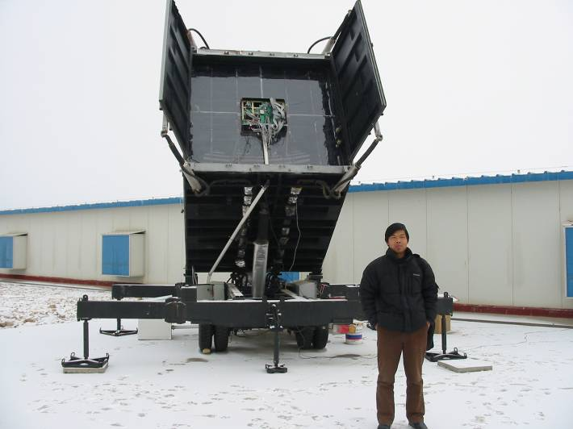
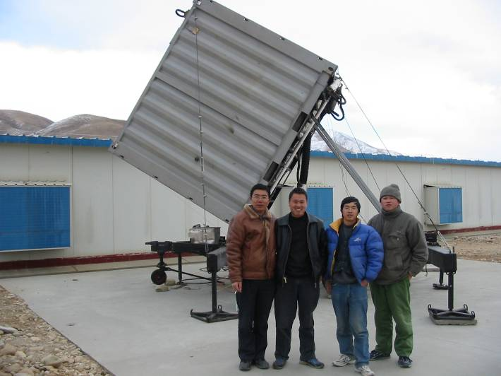
Prototype of LHAASO at Tibet site
1% engineering array near the ARGO detector with a budget of ~1M euro since 2009
μ

Slide 12
Status of LHAASO
All technologies are tested
A couple of steps ahead: environment impact evaluation, feasibility reviewing, TDR reviewing
Selected site has been approved by the local land management. Trade negotiation is under going with province government
Phase-0: Large Area Water Cherenkov Array (LAWCA)

Slide 13
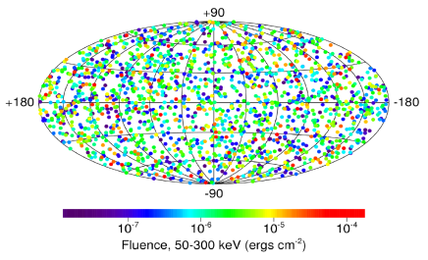
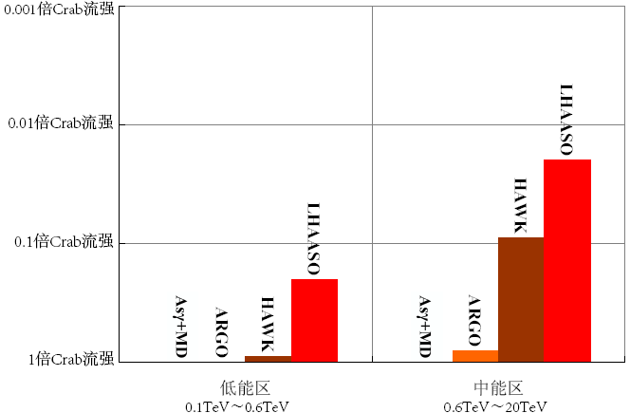
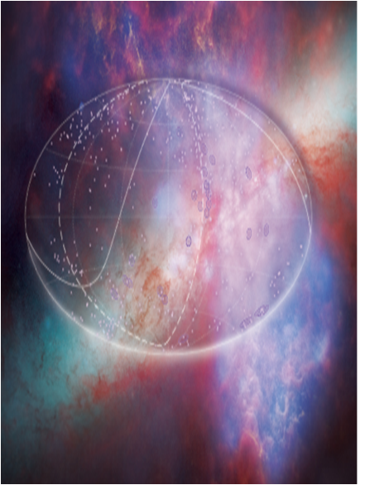
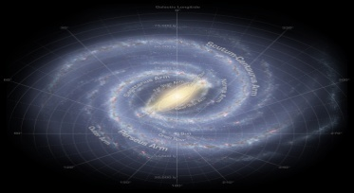
YangBaJing,Tibet
LAWCA+ARGO
superclusters、GRBs
clusters
Milky Way
LAWCA
HAWC
LAWCA
2014年
ARGO+LAWCA
Pushing down threshold for further in the universe
(30k lyr-3b lyr)
HAWC
ARGO
ARGO

Slide 14
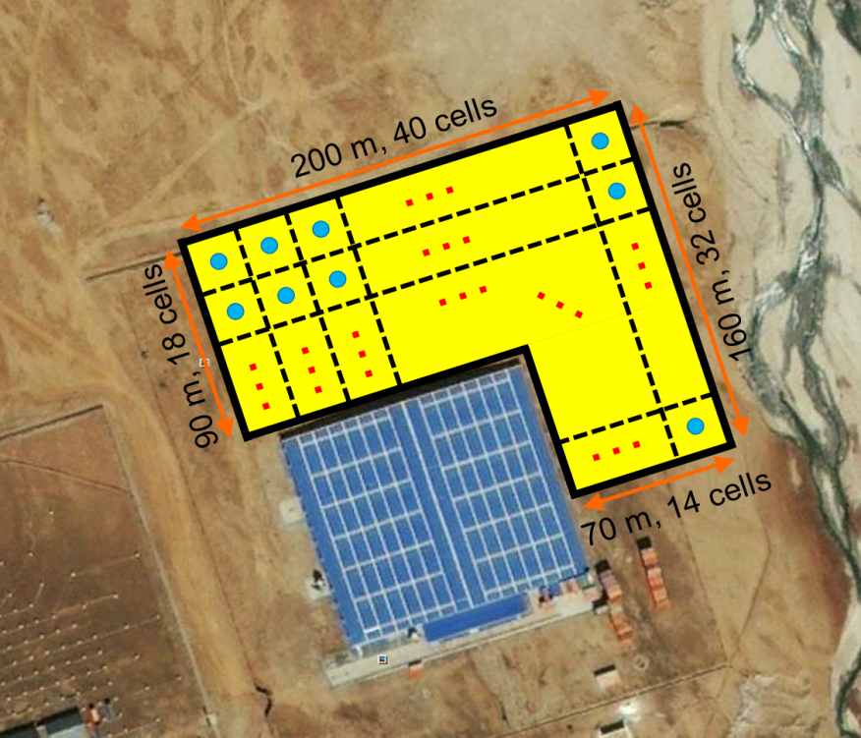
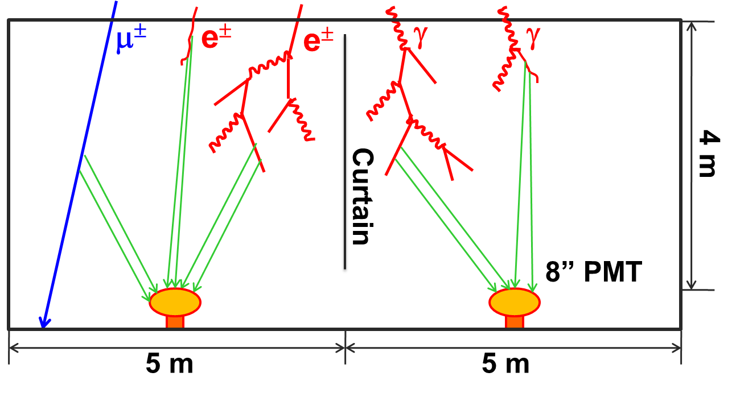
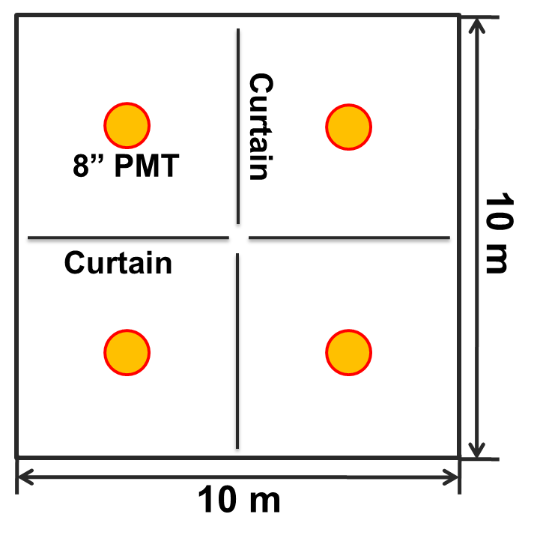
Detector Layout
An L-shaped water pool:
  North-East of ARGO-YBJ hall;
  23,000 m²;
  4.5 m depth;
  900 cells, with an 8” PMT in each cell;
  Cells are partitioned with black curtains.

Slide 15
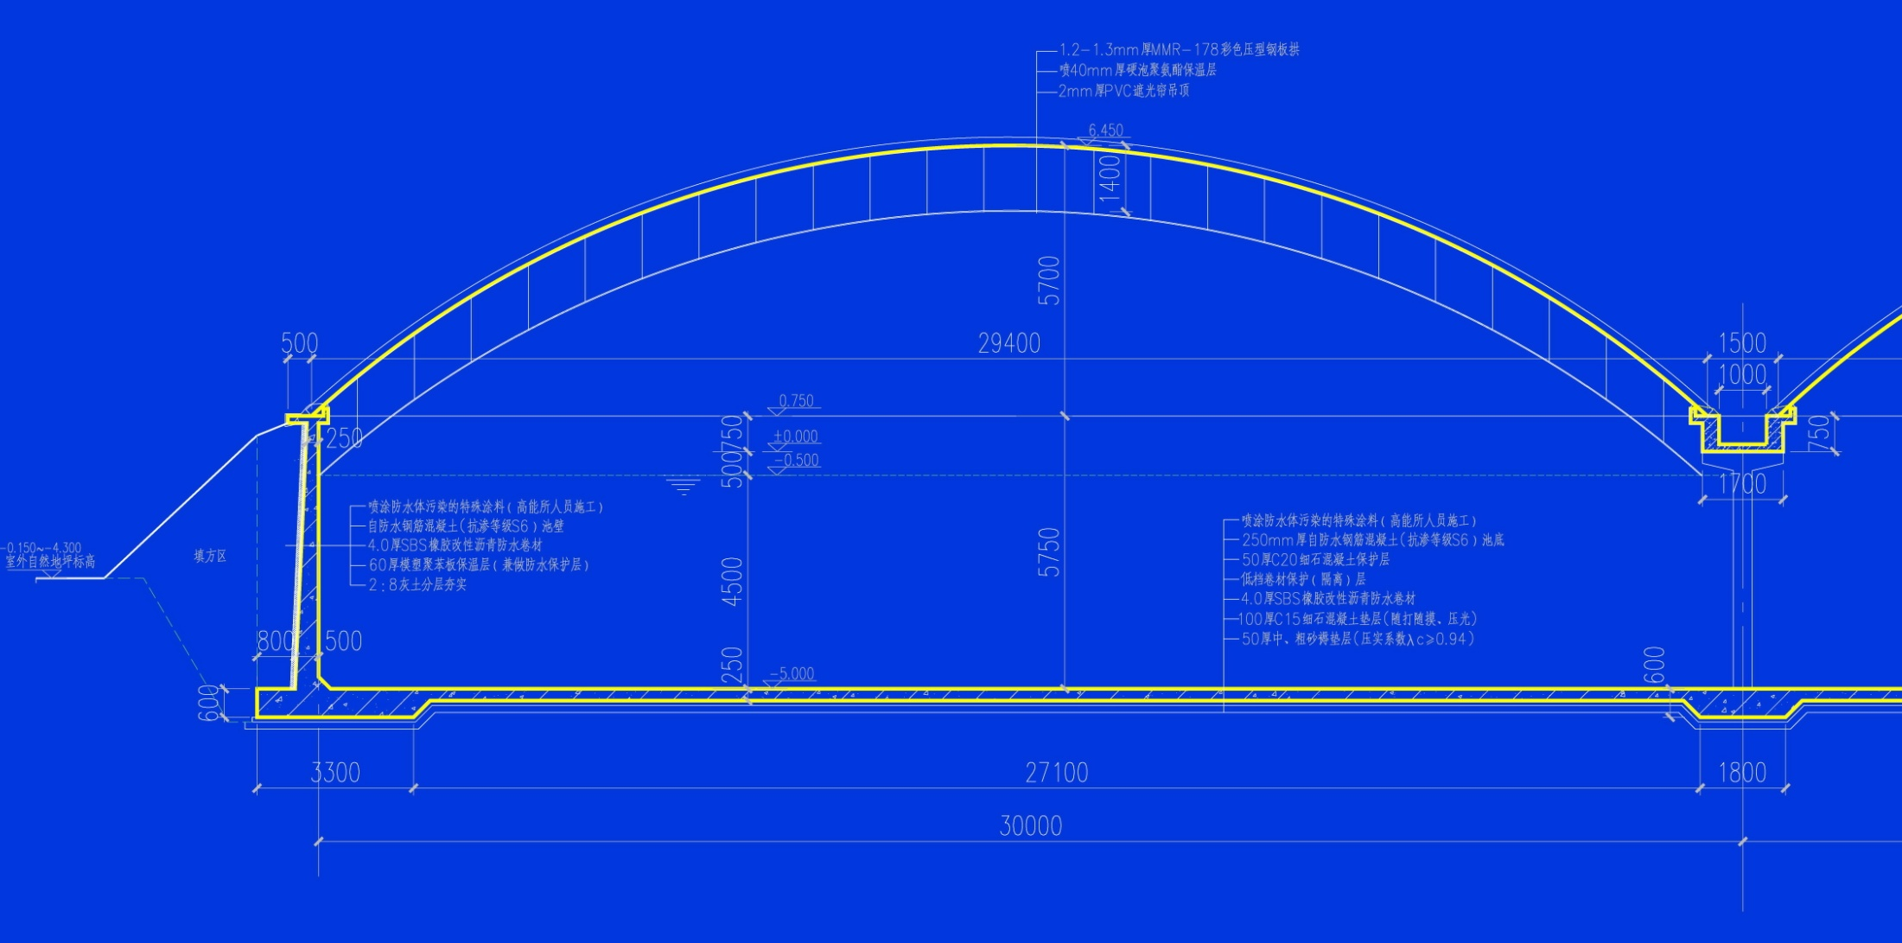
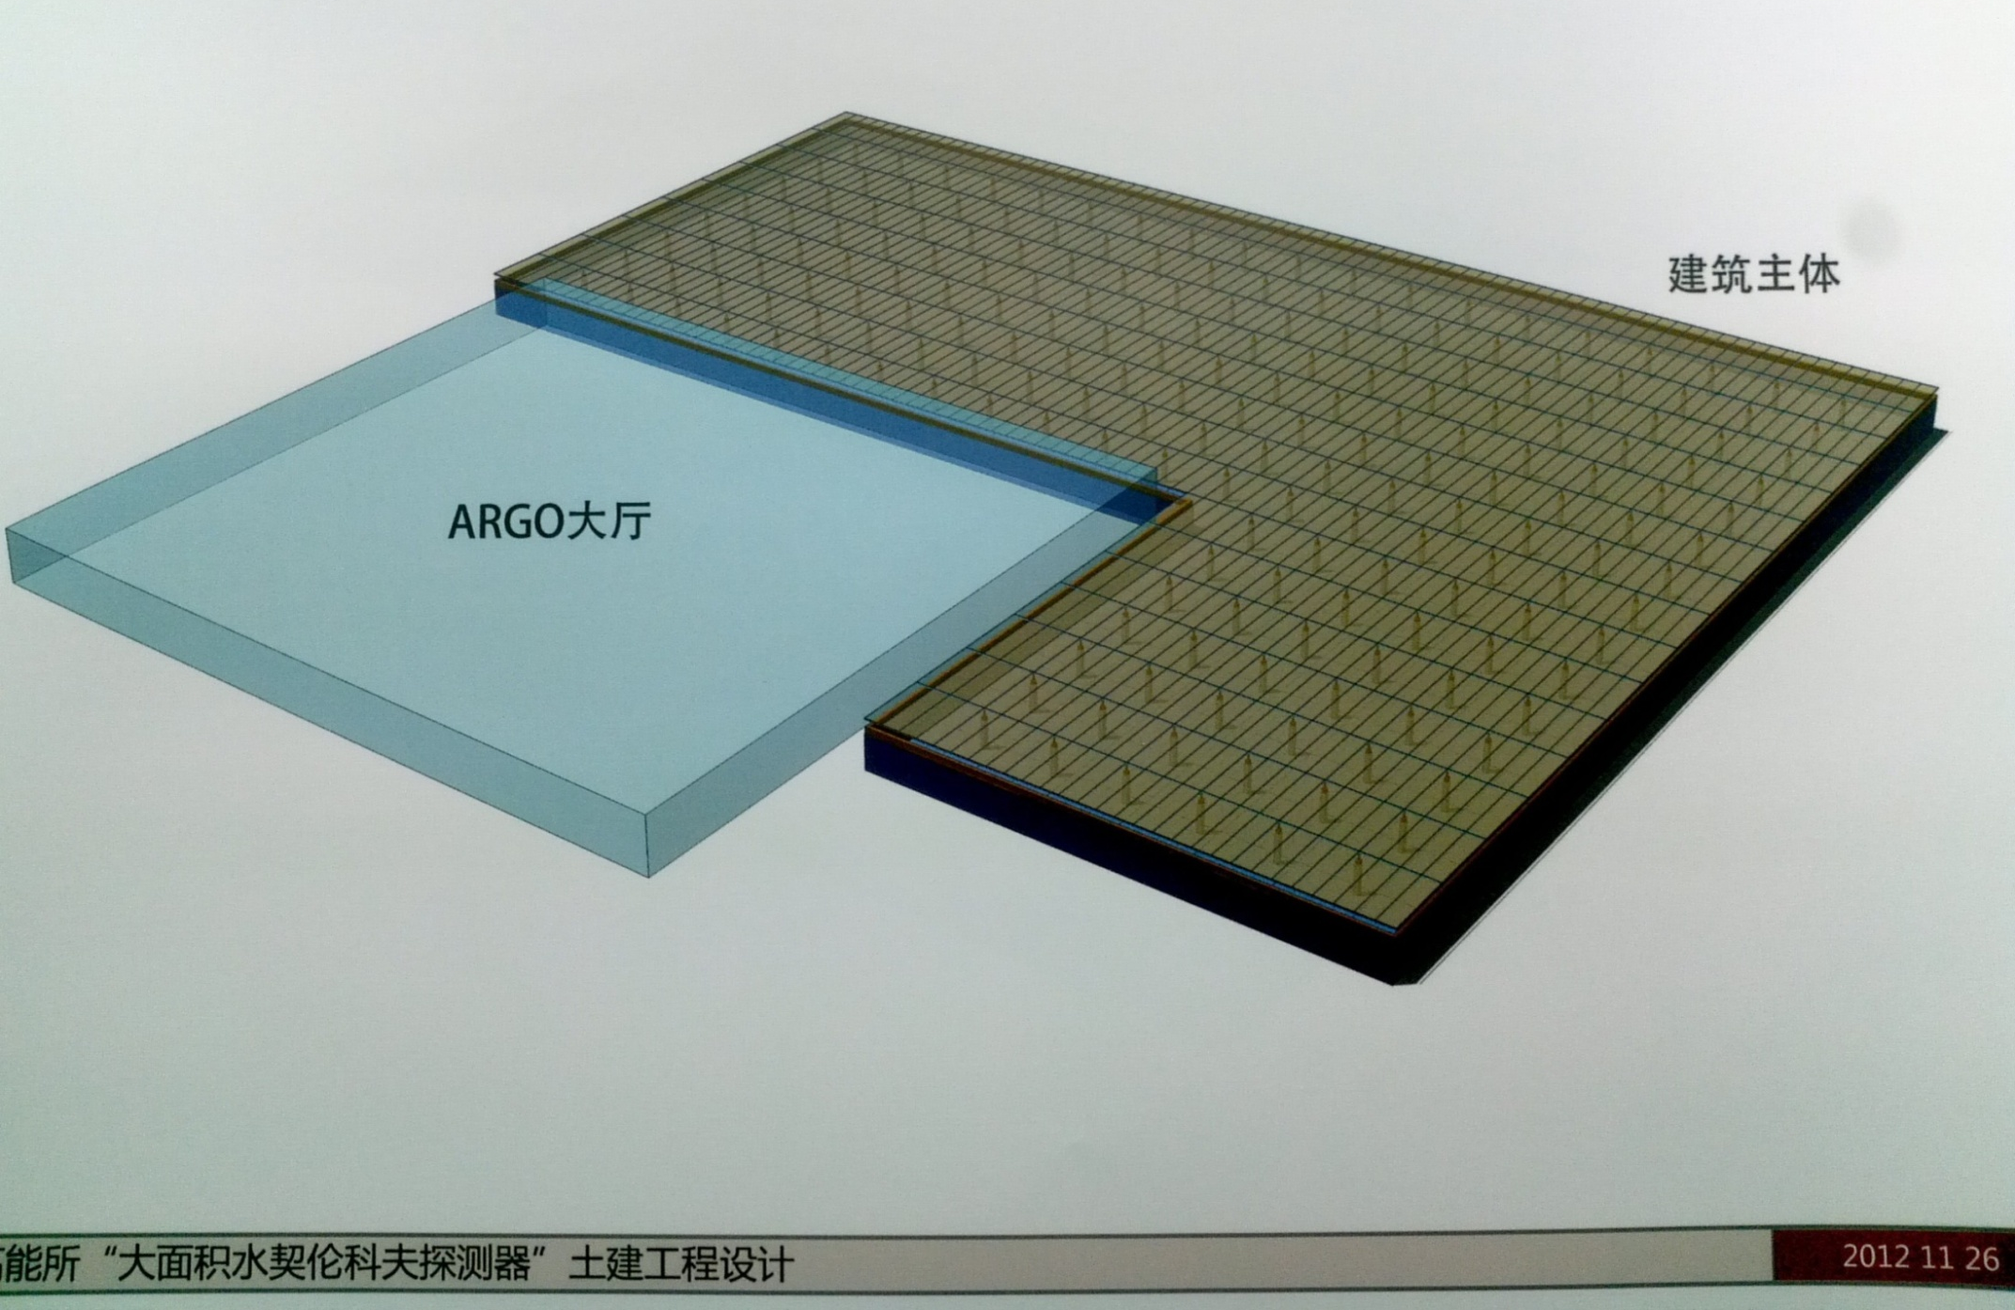
Pool design

Slide 16
LAWCA Schedules
2012 |  |  |  |  | 2013 |  |  |  |  |  |  |  |  |  |  |  | 2014
8 | 9 | 10 | 11 | 12 | 1 | 2 | 3 | 4 | 5 | 6 | 7 | 8 | 9 | 10 | 11 | 12 | 1 | 2 | 3 | 4 | 5 | 6 | 7 | 8 | 9 | 10 | 11 | 12
First
Lights
Start
T1
T2
T3
T4
T5
T6
Run
Land Lease
Field Prep.
Pool construction
Others and
Leak check
(water, light)
Installation of:
PMT (15/day), electronics, calibration,
Slow control,
DAQ
Dry run and debug
Filling and debug
Design
Light & Water-proof
Water recycling group: water recycling system
Operation
group
Detector installation group: detector installation
Slow control group: slow control system
IHEP calibration group: detector calibration
Hamamatsu: PMT production and coating (1/1.5 years)
USTC PMT group: PMT test (16/day)
USTC electronics group: electronics production
IHEP DAQ group: DAQ
IHEP computer center: networking, computing & storage
Software structure, MC and data analysis groups

Slide 17
Conclusion
LHAASO has been selected to be one of 16 megaprojects in 5 yrs
The site is selected at 4300m a.s.l. in Shangri-La, Yunnan province
TeV gamma ray survey and precise measurements of energy spectra of sources will boost the efforts on discovery of cosmic ray origins
LHAASO will play a role in CR measurement over a wide energy range between direct measurement and UHECR, such as AUGER
Before LHAASO construction is fully started in a couple of years, LAWCA will be built near ARGO-YBJ in Tibet to continue the survey and monitor for important transient phenomena

Slide 18
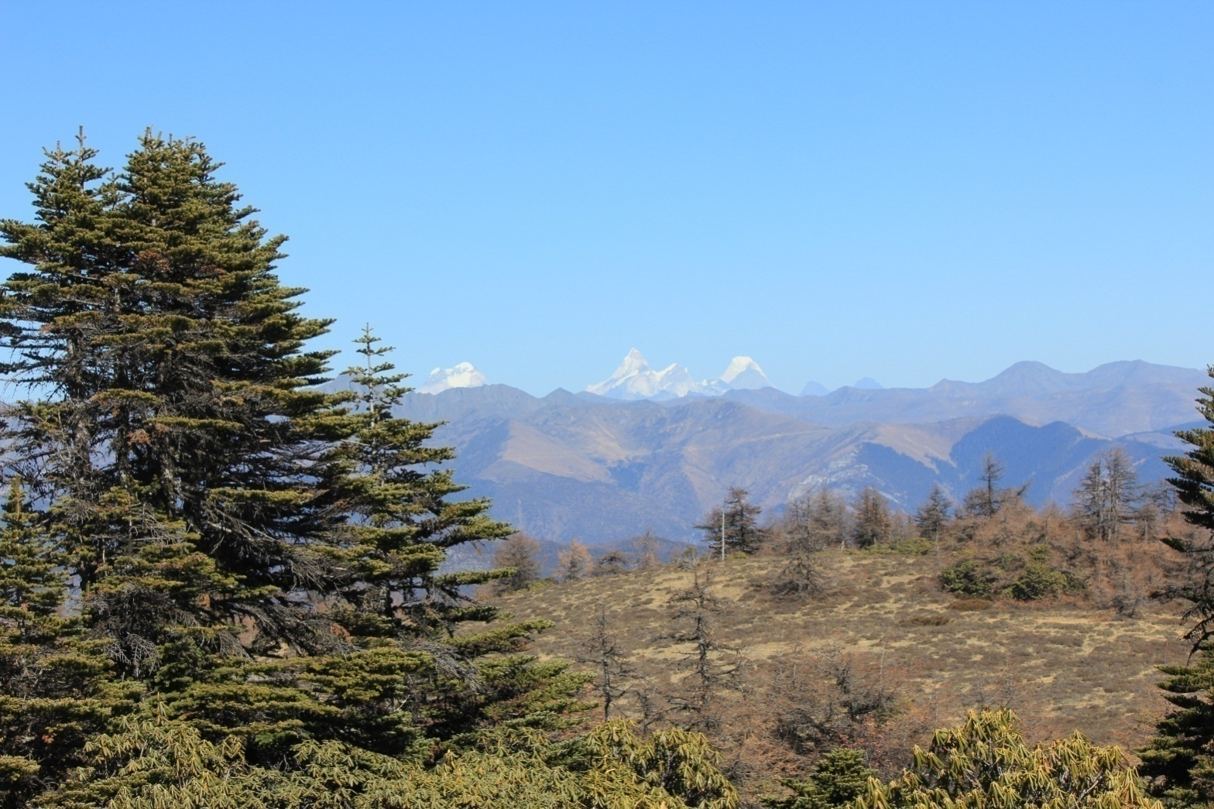
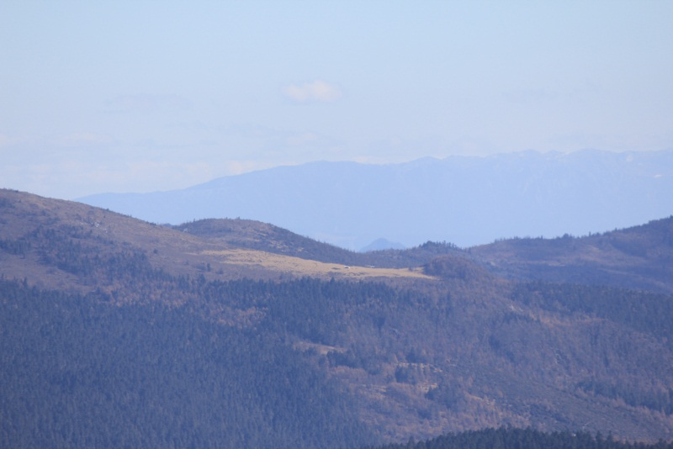
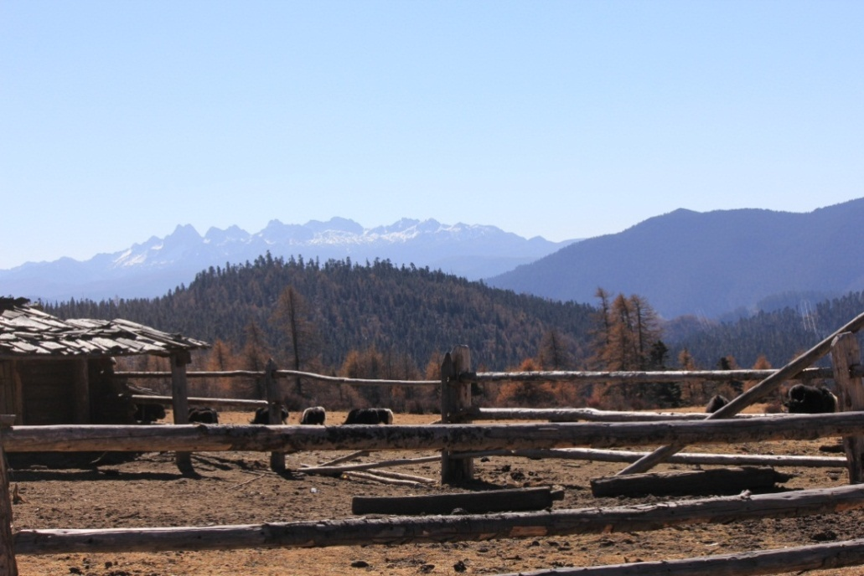
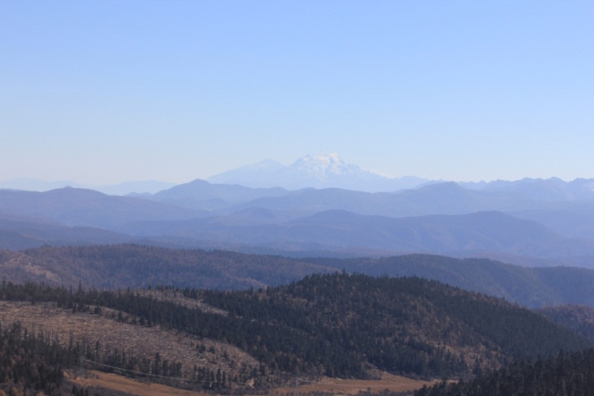
Mt.Gongga, 260km away
Another possible site ,10km away
Mt. Duobao，40km
Mt. Haba，70km

